Slide 1

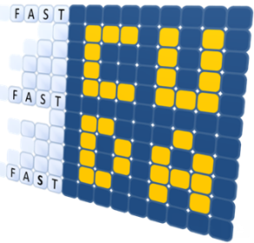


Bringing Hardware Acceleration closer to the programmer
Iakovos Mavroidis
Telecommunication Systems Institute
iakovosmavro@gmail.com
EcoScale-ExaNest joint workshop
Rome, 17 February 2017
ECOSCALE has received funding from the EU Union’s Horizon 2020 research and innovation programme under the grant agreement No 671632

Slide 2
Outline
Introduction : HPC Systems
  Exascale challenges
  Approach: Accelerators (GPUs vs FPGAs)
FPGA in HPC
  Programming Model
  Limitations & Solutions (ECOSCALE)
    UNIMEM/UNILOGIC architecture
    Reconfiguration toolset
    Runtime System
    Execution Environment
Conclusion

Slide 3
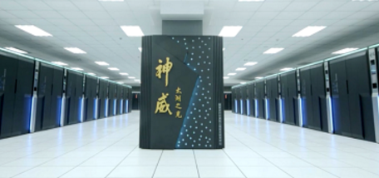
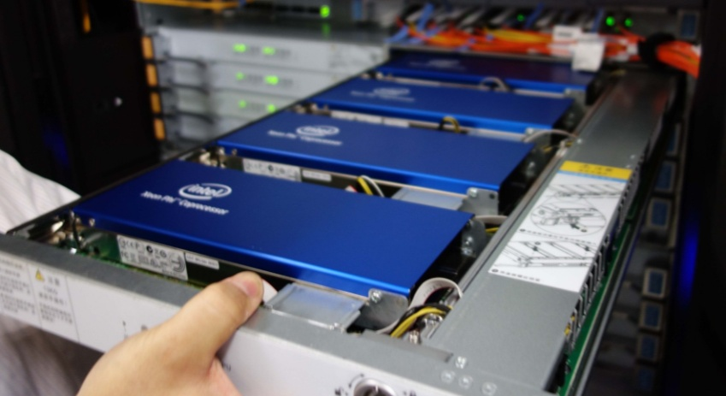
Top HPC Servers Today
SunWay TaihuLight (Chinese)
  10M cores, 93 PFLOPS, 15 MW
    Performance: 10 GFLOPS/core
    Efficiency: 6.6 GFLOPS/W, 1.5 W/core
Tianhe-2 (Xeon E5, Phi)
  3M cores, 33 PFLOPS, 17MW
    Performance: 10 GFLOPS/core
    Efficiency: 1.96 GFLOPS/W, 5.1W/core
Titan (Opteron, NVIDIA K20)
  0.5M cores, 17 PFLOPS, 8 MW
    Performance: 34 GFLOPS/core
    Efficiency: 2.13 GFLOPS/W, 16W/core
SunWay TaihuLight
Tianhe-2

Slide 4
Problem: Just scaling not a viable solution to reach ExaFlop
 Energy Efficiency
  2-6 GFLOPS/W ⇨ 1EFLOPS/0.15-0.5 GW
 Cost & Space
  10-30 GFLOP/ core ⇨ 1 EFLOP / 30-100 Mcores
  10-50x more space and cost
 Resiliency
  projected MTBF less than 1 hour
 Scalability & Management
  Manage 30-100 Mcores

Slide 5
HPC Approach: Improve Technology, Architecture, Software
✓ Technology
  Transistor shrinking
  Bring transistors closer: 3D technology
  ✓ Architecture
  Reduce data movements
  Multi-level memory: scratchpad, cache, Flash
  Increase parallelism
✓ Software
  Programming Languages
  System Software
  Application

Slide 6

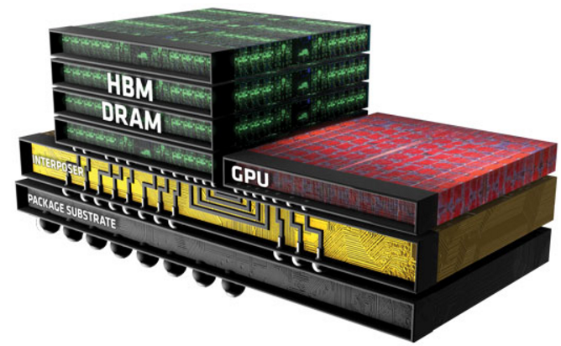
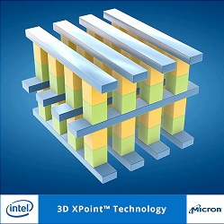
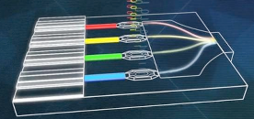
Technology (in short)
optimization
(2016)
10nm
tock
(2011)
tick
(2012)
tock
(2013)
tick
(2014)
tock
(2015)
process
(2017)
architecture
(2018)
Intel Announcement (March 2016): New technology every 3 years instead of 2 years
3D technology
  Interposer
  Stacked
Silicon photonics
Flash memories

Slide 7
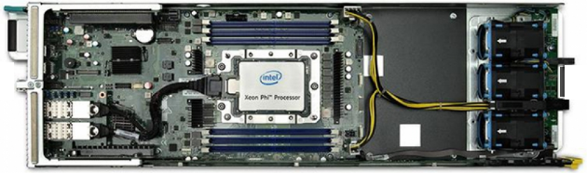
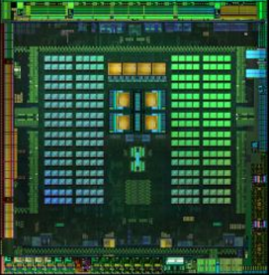
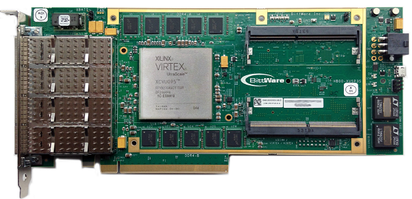
Common Architecture Approach: Use of Accelerators
Accelerators are based on
  ✓ parallel processing
  ✓ synchronized accesses/processing
  ✓ locality
Many-core
  Intel Xeon-Phi
  KALRAY MPPA
GPUs
  NVIDIA
  AMD
  ARM
FPGAs
  Altera
  Xilinx
Xeon-Phi
Tegra X1
Ultrascale Board

Slide 8
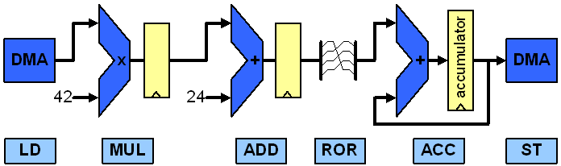
CPUs vs. GPUs vs. FPGAs
Scalar processing
SIMD processing (e.g. GPU)
multiple
Dataflow processing / pipelining (FPGAs)
Notes:
Message: within the next one to two years we will see FPGAs capable to host far beyond 100 fully featured soft-core CPUs!!!

Slide 9
Energy-Efficiency
Indicative numbers from various sources
Type | Device | GFLOPS (SP) | Cost (€) | Power (W) | GFLOPS/€ | GFLOPS/W
Multi-core | Intel E5-2630v3 8x2.4GHz | 600 | 700 | 85 | 0.85 | 7.05
 | Intel E5-2630v3 10x2.3GHz | 740 | 1250 | 105 | 0.59 | 7.04
Many-core | Xeon Phi, knights corner, 16GB | 2416 | 3500 | 270 | 0.69 | 8.94
 | Xeon Phi, knights landing, 16GB | 7000 | 3500 | 300 | 2.00 | 23.3
GPU | Nvidia GeForce Titan X | 7000 | 1000 | 250 | 7.00 | 28
 | Nvidia Tesla K80 | 8740 | 7000 | 300 | 1.24 | 29.13
 | Nvidia Tegra X1 | 512 | 450 | 7 | 19.42 | 73
 | Radeon firepro S9150 | 5070 | 3500 | 235 | 1.44 | 21.5
 | ARM Mali T880 MP16 | 374 | ? | 5? | ? | 74
FPGA | Altera Arria 10 | 1500 | 3000 | 30 | 1.00 | 50
 | Altera Stratix 10 | 10000 | 2000? | 125? | 5.00? | 80
 | Xilinx Ultrascale+ | 4600 | 2000 | 40? | 2.30 | 115
NVIDIA/ARM GPU’s vs Altera/Xilinx FPGA’s
Max Performance per Watt may not be the best metric

Slide 10
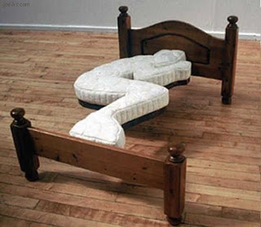
Why are FPGA’s so energy-efficient?
Customized to the needs of the application
  ✓ Instructions are part of the FPGA logic  no IF, ID stages
  ✓ Custom EX stage
  ✓ Optimized data movements
  ✓ Optimized control logic
  ✓ Loop unrolling in HW
  A = B + C
  A = A * D
B
+
C
x
A
D

Slide 11
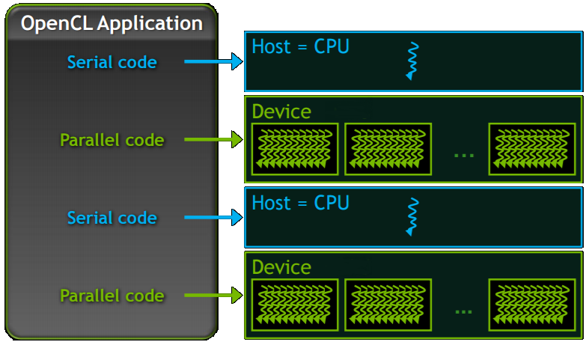
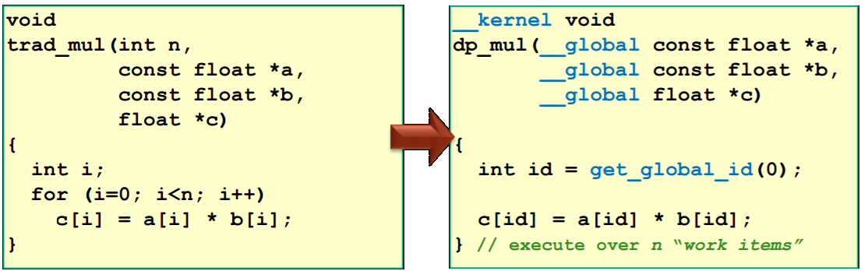
OpenCL in a nutshell: SIMT
Serial code executes in a Host thread
Parallel code executes in Device (GPU/FPGA) threads
Kernel
Work Group
Work
Items

Slide 12
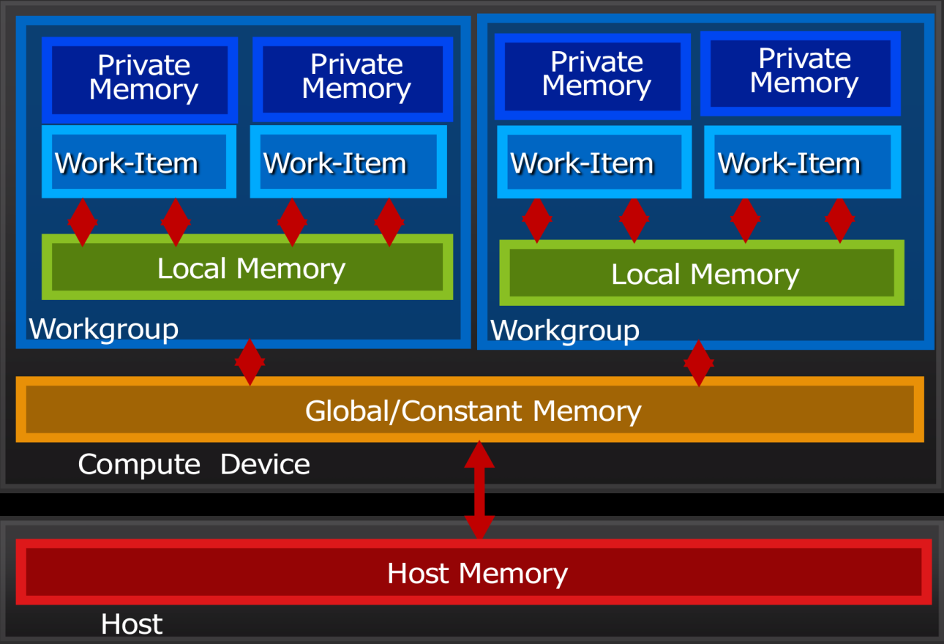
OpenCL in a nutshell: Memory Model
Private Memory
  Per work-item
Local Memory
  Shared within a workgroup
Global/Constant Memory
  Visible to all workgroups
Host Memory
  On the CPU
Explicit Memory Management
move data from host ⇨ global ⇨ local ⇨ private and back

Slide 13
Language: Why OpenCL/CUDA for FPGAs?
✓ Parallelism
  Inside a work group (work items)
  Between work groups
✓ Locality
  Memory Hierarchy: Private, Local, Global memory
✓ Simple and modular
  Explicit Memory Transfers
✓ Many applications already written in OpenCL
 But..
  No Tree-like Hierarchy
  No Communication between work groups

Slide 14
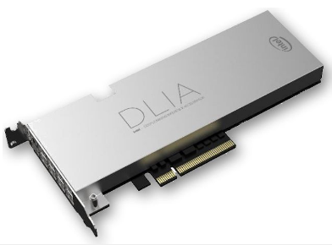






FPGAs in Data Centers
Intel “Two Orders of Magnitude Faster than GPGPU by 2020”:
  Deep Learn. Inference Accel. (DLIA) with Altera Arria 10
  Broadwell Xeon with Arria 10 GX
EC2 F1 instance with Xilinx
  Up to 8xUltraScale+ VU9P per instance
IBM SuperVessel OpenPOWER development cloud using Xilinx SDAccel
Microsoft Bing with Altera Stratix V
FPGA networking for Azure cloud
Xilinx SDAccell on Nimbix cloud
Xilinx OpenStack support
  Libraries: DNN, GEMM, HEVC Decoder & Encoder, etc.

Slide 15
Still FPGA’s are not used extensively - Why?
Programmability
  Huge Design Space  hard to optimize application
    Many FPGAs and choices
    When/Where/What/How to accelerate
  SW and HW skills required
Compile/Synthesis time
  Several hours to synthesize/PnR
  Long time to program
FPGA Size
  FPGA Size directly affects speed and number of accelerated tasks
Data movements (common in most accelerators)
  High-latency links, such as PCIe
  Several memory transfers between host and accelerator
Cost
  2-3K € per FPGA
  Acceleration as a service (Amazon)

Slide 16

What should we do?
Help the programmer!
Improve Programming Language
  Support of OpenCL 2.0
    Shared virtual memory
    Pipes
    Dynamic Parallelism, Atomics, etc.
Improve CAD Tools
  Intel FPGA SDK for OpenCL (supports part of OpenCL 2.0)
  Xilinx Vivado HLS (supports OpenCL 1.1)
Improve Architecture
  Multi-FPGA support
  Multi-user support/shared resources
  OS support (device drivers)
  Runtime System
    Dynamic Scheduling
    Dynamic reconfiguration

Slide 17


Ongoing efforts by ECOSCALE
Improve Programming Language
  Support of OpenCL 2.0
    ✓ Shared virtual memory
    Pipes
    Dynamic Parallelism, Atomics, etc.
Improve CAD Tools
  Intel FPGA SDK for OpenCL (supports part of OpenCL 2.0)
  Xilinx SDSoC, SDAccel (supports OpenCL 1.1)
  OpenCapi
Improve Architecture
  ✓Multi-FPGA support
  ✓Multi-user support/shared resources
  ✓OS support (device drivers)
  ✓Runtime System
    Dynamic Scheduling
    Dynamic reconfiguration

Slide 18
Traditional OpenCL Data Movement
Host
System Memory
Global Memory
PCIe
DMA
Kernel
DMA
Memory Controller
FPGA
DDR
Device Memory
Global Memory of Accelerator is Independent from Host/System Memory
High-Latency PCIe

Slide 19
OpenCL 2.0: Virtual Shared Memory
Host
CCI/MMU
Shared
Memory
Kernel
FPGA
Cache Coherency
  ✓ ARM CCI (Ultrascale+)
  Xilinx CCIX (next generation of Ultrascale+)
  IBM CAPI (Intel QPI/CAPI)
IO MMU
  ARM SMMU (Ultrascale+)
  ☞ Coherent Cache on the FPGA (Ultrascale+)?

Slide 20
UNIMEM: Remote Coherent Accesses
Ultrascale+ MPSOC
Ultrascale+ MPSOC
Host
CCI/MMU
Shared
Memory
Host
CCI/MMU
Shared
Memory
Local Interconnect
Local Interconnect
…
Kernel 0
Kernel 1
FPGA
FPGA
Global Interconnect (UNIMEM)
448GB
PCIe, OCM, QSPI, RPU, etc.
UNIMEM Architecture
  ✓ Global Address Space (PGAS)
  ✓ Direct (load/store) remote accesses
  ✓ Coherent accesses
Address Map

Slide 21
Multiple FPGAs
Node 0 (Coherence Island)
Node 1 (Coherence Island)
Host
CCI/MMU
Shared
Memory
Host
CCI/MMU
Shared
Memory
Local Interconnect
Local Interconnect
…
Kernel 0
Kernel 1
FPGA
FPGA
Global Interconnect (UNIMEM)
Access any FPGA in the System
  ✓ Remote Kernel calls
  ✓ Remote Memory Accesses

Slide 22
Resource sharing
Node 0
Node 1
Node 2
Host
CCI
Memory
Host
CCI
Memory
Host
CCI
Memory
`
Interconnect
Interconnect
Interconnect
Virtualization
Kernel 0
Virtualization
Kernel 1
Virtualization
Kernel 2
Global Interconnect (UNIMEM)
Virtualization Block
  Receives Kernel Execution command from any Node
  Schedules commands and executes them locally

Slide 23
Fine-grain sharing
Node 0
Node 1
Host
CCI
Memory
Host
CCI
Memory
Interconnect
Interconnect
WG0
WG1
WG0
WG1
Virtualization
Virtualization
scheduler
WG2
WG3
WG2
WG3
Global Interconnect (UNIMEM)
SW
HW
Reconfigurable
Accelerator
Virtualization
Parallel execution in HW
WG
done
Kernel Call1
Create WG’s
WG
Exec WG
WG
next
…
WG
Scheduler
Exec WG
WG
next
Kernel Call2
Create WG’s
WG
…
WG
Exec WG
…
WG

Slide 24
Dynamic Reconfiguration: Challenges and Potential Solutions
  Synthesis/PnR too slow
  Bitstream per FPGA per location
  Reconfiguration is slow
  Limited FPGA size
  Limited tool support
  When/what/where to reconfigure
Synthesis at compile time
Improve Placement
Prefetching
GPU/CPU as alternative
Improve Architecture (UNIMEM)
  Standardization/ Improve Tools
Runtime System

Slide 25
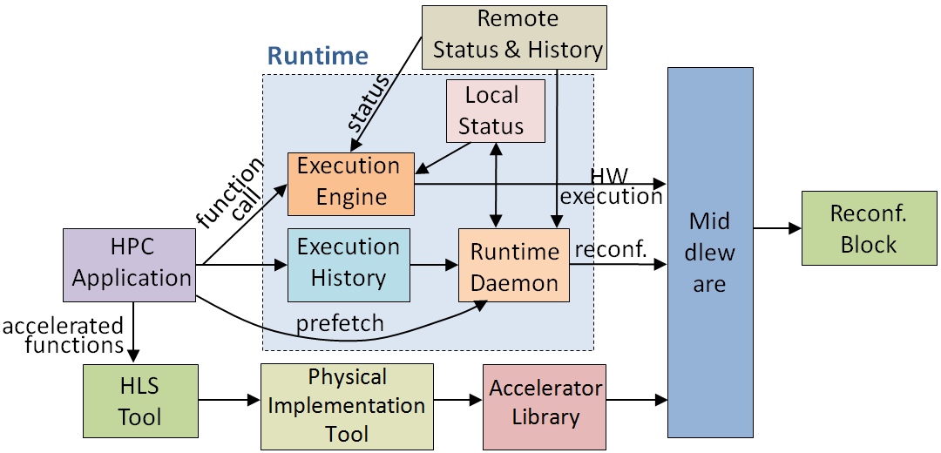
Execution Environment
Reconfiguration at runtime
Task Execution Scheduling
Task Execution Monitoring
Locality Management

Slide 26
Physical Implementation
FPGA
FPGA
HW
WG0
HW Context Switching
HW Context Switching
HW
WG1
Reconfigurable Accelerator
Reconfigurable Accelerator
Slot1
Slot0
Slot2
Slot0
Slot1
HW
WG2
AXI
AXI
Slot2
HW
WG0
HW
WG0
HW
WG1
HW
WG2
HW
WG1
Accelerator Library
Resource-aware Reconfigurable Accelerator Floorplanning and Backend Tool
26

Slide 27
ECOSCALE Recofiguration
Slot 0
Slot 1
Slot 2
HW
WG0
HW
WG0
HW
WG2
HW
WG0
Slot 3
Slot 4
Slot 5
HW
WG1
HW
WG1
HW
WG1
HW
WG2
Slot 6
Slot 7
Slot 8
Accelerator Library
HW
WG2
Acceleration Library
WG’s of different size
Relocation
  Defregmentation
  Move logic closer to data

Slide 28
Runtime System
Compute Node (Ultrascale+ MPSOC’s in UNIMEM)
Host
Worker 1
Worker 2
Worker 3
Memory
Memory
Memory
Memory
exec
exec
Reconf.
Block
Inter
CPU
Reconf.
Block
Inter
CPU
Reconf.
Block
Inter
CPU
Reconf.
Block
Inter
CPU
WG
WG
exec
Global Interconnect
Reconf.
Block
Reconf.
Block
Reconf.
Block
Reconf.
Block
Inter
CPU
WG
Inter
CPU
WG
Inter
CPU
WG
Inter
CPU
exec
exec
Memory
Memory
Memory
Memory
Worker 4
Worker 5
Worker 6
Worker 7
Runtime System
  Reconfigure resources
  Distribute Data and Computation  Locality
  Monitoring

Slide 29
Conclusion
Common HPC Approach
  ☞ Use accelerators: GPUs vs FPGAs
FPGAs main advantage
   Energy Efficiency
FPGAs soon in HPC servers
  But hard to be used by programmers
    Limited FPGA Size  Sharing of resources
    Reconfiguration  Optimize tools/Standardization
    Runtime system which automates/coordinates actions

Slide 30
Runtime
OpenCL PnR
OpenCL exec libraries
Reconf. libraries
Processing System
UNIMEM libraries
memory
Command Packetizer
multiple queues
1 AXI burst per command
Local to global Translation
AXI Interconnect
multiple queues
Command Mailbox
Chip2Chip
commands
Virtualization Block (core)
Reconfigurable
Block
AXI
external link

Slide 31



www.ecoscale.eu
@ecoscale_H2020
Stay Tuned!

