Slide 1
Lab3 Intro Improving Area and Resources

Slide 2
Objectives
After completing this lab, you will be able to:
Manage BRAM and DSP48 resource utilization
Improve memory bandwidth
Balance resource utilization and performance
Distinguish between DATAFLOW directive and Configuration Command functionality

Slide 3
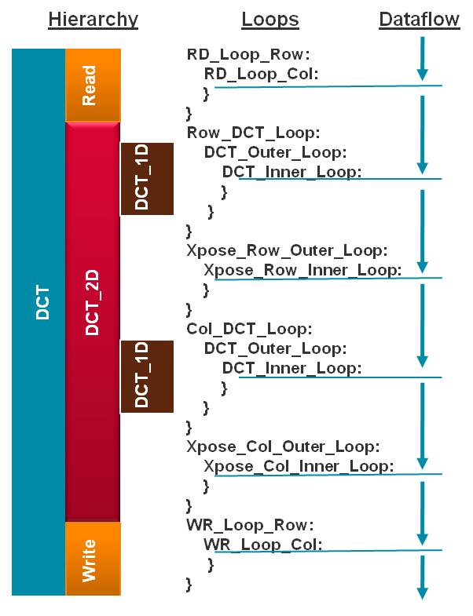
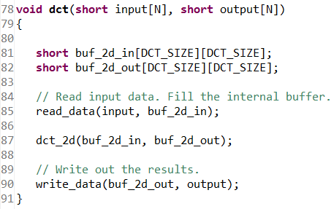
The Design
The design under consideration is a Discrete Cosine Transformation (DCT) function on a 8x8 block of data
The top-level function dct implements 2D DCT algorithm by first processing each row of the input array via a 1D DCT then processing the columns of the resulting array through the same 1D DCT. It calls read_data, dct_2d, and write_data functions.
The read_data function consists of two loops – RD_Loop_Row and RD_Loop_Col.
The write_data function is defined consists of two loops to perform writing the result.

Slide 4
Procedure
Compile the design in command mode and perform C-verification
Open the project in Vivado HLS GUI, synthesize, and review results
Simulate the design
Improve performance using pipeline
Optimize fine-grained parallelism
Improve memory bandwidth
Apply DATAFLOW directive to improve performance
Apply RESHAPE directive and analyze

Slide 5
Summary
In this lab, you learned various techniques to improve the performance and balance resource utilization. PIPELINE directive when applied to outer loop will automatically cause the inner loop to unroll. When a loop is unrolled, resources utilization increases as operations are done concurrently. Partitioning memory may improve performance but will increase BRAM utilization. When INLINE directive is applied to a function, the lower level hierarchy is automatically dissolved. When DATAFLOW directive is applied, the default memory buffers (of ping-pong type) are automatically inserted between the top-level functions and loops. The RESHAPE directive will allow multiple accesses to BRAM, however, care should be taken if a single element requires modification as it will result in read-modify-write operation for the entire word. The Analysis perspective and console logs can provide insight on what is going on.

