Slide 1
Improving Performance

Slide 2
Objectives
After completing this module, you will be able to:
Add directives to your design
List number of ways to improve performance
State directives which are useful to improve latency
Describe how loops may be handled to improve latency
Recognize the dataflow technique that improves throughput of the design
Describe the pipelining technique that improves throughput of the design
Identify some of the bottlenecks that impact design performance

Slide 3
Outline
Adding Directives
Improving Latency
Manipulating Loops
Improving Throughput
Performance Bottleneck
Summary

Slide 4
Improving Performance
Vivado HLS has a number of ways to improve performance
Automatic (and default) optimizations
Latency directives
Pipelining to allow concurrent operations
Vivado HLS support techniques to remove performance bottlenecks
Manipulating loops
Partitioning and reshaping arrays
Optimizations are performed using directives
Let’s look first at how to apply and use directives in Vivado HLS

Slide 5
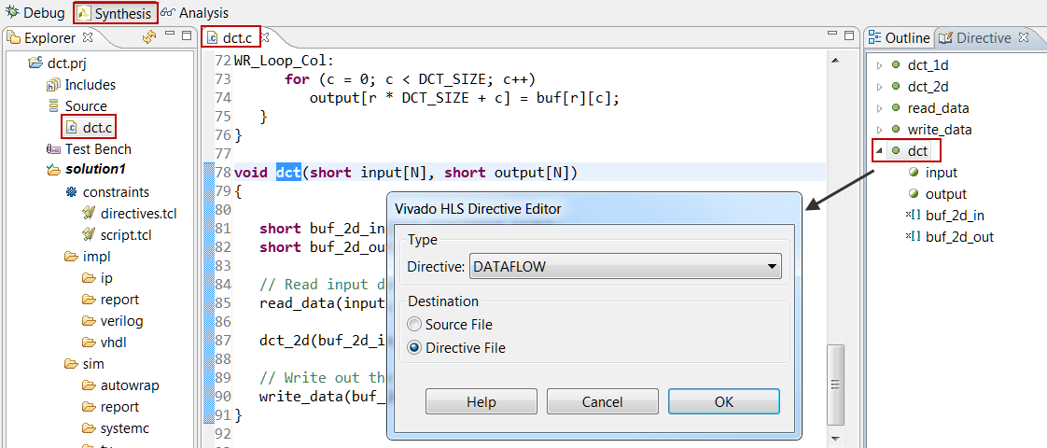
Applying Directives
If the source code is open in the GUI Information pane
The Directive tab in the Auxiliary pane shows all the locations and objects upon which directives can be applied (in the opened C file, not the whole design)
Functions, Loops, Regions, Arrays, Top-level arguments
Select the object in the Directive Tab
“dct” function is selected
Right-click to open the editor dialog box
Select a desired directive from the drop- down menu
“DATAFLOW” is selected
Specify the Destination
Source File
Directive File

Slide 6
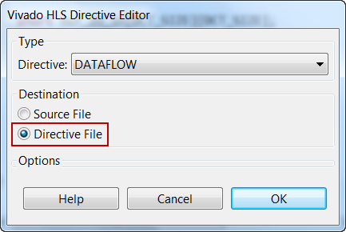
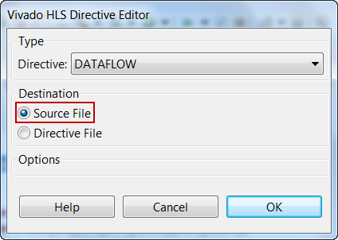
Optimization Directives: Tcl or Pragma
Directives can be placed in the directives file
The Tcl command is written into directives.tcl
There is a directives.tcl file in each solution
Each solution can have different directives
Directives can be place into the C source
Pragmas are added (and will remain) in the C source file
Pragmas (#pragma) will be used by every solution which uses the code
Once applied the directive will be shown in the Directives tab (right-click to modify or delete)

Slide 7
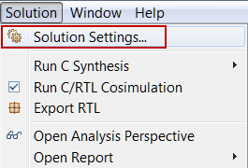
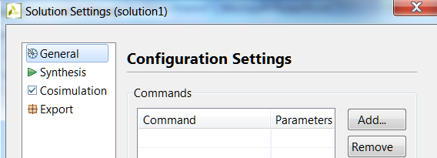
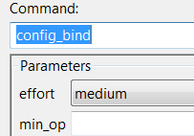
Solution Configurations
Configurations can be set on a solution
Set the default behavior for that solution
Open configurations settings from the menu (Solutions > Solution Settings…)
Choose the configuration from the drop-down menu
Array Partitioning, Binding, Dataflow Memory types, Interface, RTL Settings, Core, Compile, Schedule efforts
“Add” or “Remove” configuration settings
Select “General”

Slide 8
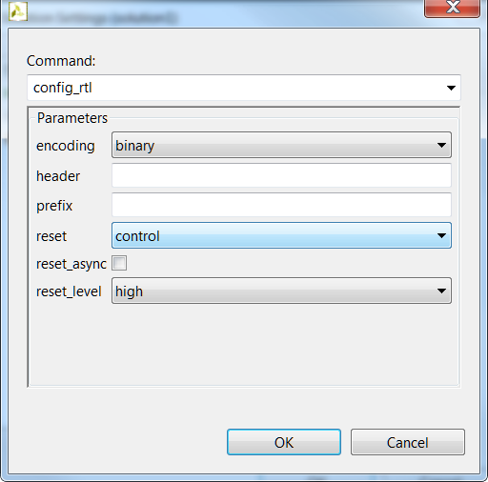
Example: Configuring the RTL Output
Specify the FSM encoding style
By default the FSM is auto
Add a header string to all RTL output files
Example: Copyright Acme Inc.
Add a user specified prefix to all RTL output filenames
The RTL has the same name as the C functions
Allow multiple RTL variants of the same top-level function to be used together without renaming files
Reset all registers
By default only the FSM registers and variables initialized in the code are reset
RAMs are initialized in the RTL and bitstream
Synchronous or Asynchronous reset
The default is synchronous reset
Active high or low reset
The default is active high
The remainder of the configuration commands will be covered throughout the course

Slide 9
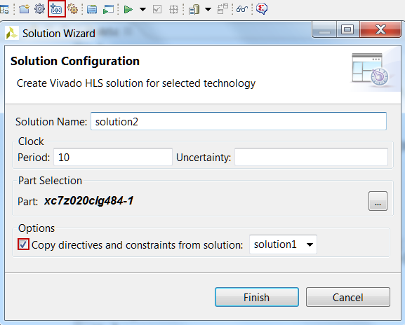
Copying Directives into New Solutions
Click the New Solution Button
Optionally modify any of the settings
Part, Clock Period, Uncertainty
Solution Name
Copy existing directives
By default selected
Uncheck if do not want to copy
No need to copy pragmas, they are in the code

Slide 10
Outline
Adding Directives
Improving Latency
Manipulating Loops
Improving Throughput
Performance Bottleneck
Summary

Slide 11
Latency and Throughput – The Performance Factors
Design Latency
The latency of the design is the number of cycle it takes to output the result
In this example the latency is 10 cycles
Design Throughput
The throughput of the design is the number of cycles between new inputs
By default (no concurrency) this is the same as latency
Next start/read is when this transaction ends

Slide 12
Latency and Throughput
In the absence of any concurrency
Latency is the same as throughput
Pipelining for higher throughput
Vivado HLS can pipeline functions and loops to improve throughput
Latency and throughput are related
We will discuss optimizing for latency first, then throughput

Slide 13
Vivado HLS: Minimize latency
Vivado HLS will by default minimize latency
Throughput is prioritized above latency (no throughput directive is specified here)
In this example
The functions are connected as shown
Assume function B takes longer than any other functions
Vivado HLS will automatically take advantage of the parallelism
It will schedule functions to start as soon as they can
Note it will not do this for loops within a function: by default they are executed in sequence

Slide 14
Reducing Latency
Vivado HLS has the following directives to reduce latency
LATENCY
Allows a minimum and maximum latency constraint to be specified
LOOP_FLATTEN
Allows nested loops to be collapsed into a single loop with improved latency
LOOP_MERGE
Merge consecutive loops to reduce overall latency, increase sharing, and improve logic optimization
UNROLL
Create multiple copies of the loop body, with improved latency but increased resource usage

Slide 15
Default Behavior: Minimizing Latency
Functions
Vivado HLS will seek to minimize latency by allowing functions to operate in parallel
As shown on the previous slide
Loops
Vivado HLS will not schedule loops to operate in parallel by default
Dataflow optimization must be used or the loops must be unrolled
Both techniques are discussed in detail later
Operations
Vivado HLS will seek to minimize latency by allowing the operations to occur in parallel
It does this within functions and within loops
Loop:for(i=1;i<3;i++) {
op_Read;
op_Compute;
op_Write;
}
RD
CMP
WR
Example of Minimizing latency with Parallel Operations
void foo(...) {
op_Read;
op_Compute;
op_Write;
}
Example with Sequential Operations
RD
CMP
RD
WR
WR
RD
CMP
WR
CMP

Slide 16
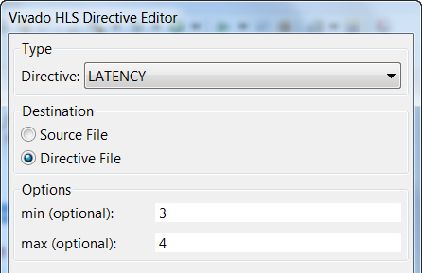
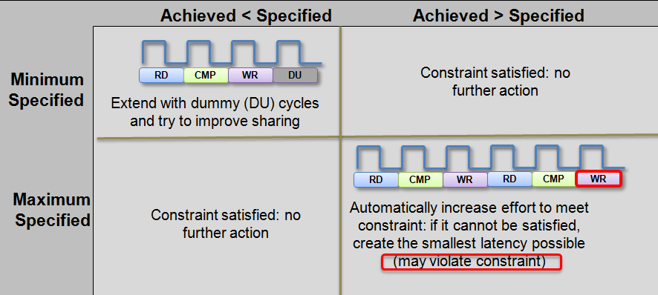
Latency Constraints
Latency constraints can be specified
Can define a minimum and/or maximum latency for the location
This is applied to all objects in the specified scope
No range specification: schedule for minimum
Which is the default
Impact of ranges

Slide 17
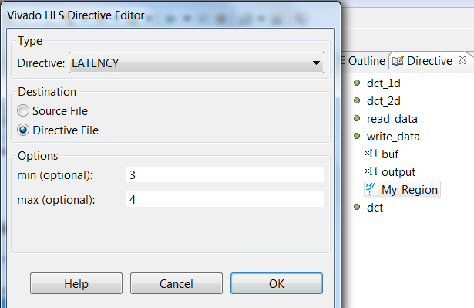
Region Specific Latency Constraint
Latency directives can be applied on functions, loops and regions
Use regions to specify specific locations for latency constraints
A region is any set of labeled braces MY_region: {…a region…}
The region My_Region is shown in this example
This allows the constraint to be applied to a specific range of code
Here, only the else branch has a latency constraint
int write_data (int buf, int output) {
if (x < y) { return (x + y); } else {
My_Region: {
return (y – x) * (y + x);
}
}
Select the region in the Directives tab & right-click to apply latency directive

Slide 18
Outline
Adding Directives
Improving Latency
Manipulating Loops
Improving Throughput
Performance Bottleneck
Summary

Slide 19
Review: Loops
By default, loops are rolled
Each C loop iteration ➔ Implemented in the same state
Each C loop iteration ➔ Implemented with same resources
Loops can be unrolled if their indices are statically determinable at elaboration time
Not when the number of iterations is variable
N
void foo_top (…) {
...
Add: for (i=3;i>=0;i--) {
b = a[i] + b;
...
}
foo_top
Synthesis
+
b
a[N]
Loops require labels if they are to be referenced by Tcl directives
(GUI will auto-add labels)

Slide 20
Rolled Loops Enforce Latency
A rolled loop can only be optimized so much
Given this example, where the delay of the adder is small compared to the clock frequency
This rolled loop with 4 iterations will never take less than 4 cycles
No matter what kind of optimization is tried
This minimum latency is a function of the loop iteration count
void foo_top (…) {
...
Add: for (i=3;i>=0;i--) {
b = a[i] + b;
...
}
Clock
Adder Delay
3
2
1
0

Slide 21
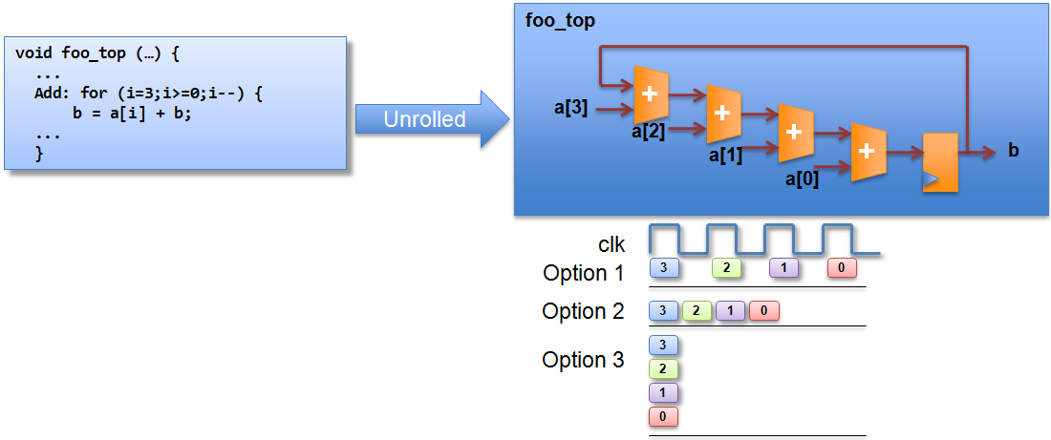
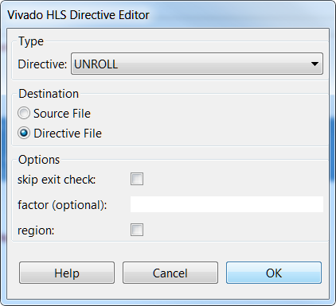
Unrolled Loops can Reduce Latency
Select loop “Add” in the directives pane and right-click
Unrolled loops allow greater option & exploration
Options explained on next slide
Unrolled loops are likely to result in more hardware resources and higher area

Slide 22
Partial Unrolling
Fully unrolling loops can create a lot of hardware
Loops can be partially unrolled
Provides the type of exploration shown in the previous slide
Partial Unrolling
A standard loop of N iterations can be unrolled to by a factor
For example unroll by a factor 2, to have N/2 iterations
Similar to writing new code as shown on the right ➔
The break accounts for the condition when N/2 is not an integer
If the unrolling factor is known to be an integer divider of N
The user can remove the exit check (and associated logic)
Vivado HLS is not always be able to determine if this is true (e.g. if N is an input argument)
User takes responsibility: verify!
Add: for(int i = 0; i < N; i++) {
a[i] = b[i] + c[i];
}
Add: for(int i = 0; i < N; i += 2) {
a[i] = b[i] + c[i];
if (i+1 >= N) break;
a[i+1] = b[i+1] + c[i+1];
}
Effective code after compiler transformation
for(int i = 0; i < N; i += 2) {
a[i] = b[i] + c[i];
a[i+1] = b[i+1] + c[i+1];
}
An extra adder for N/2 cycles trade-off
Notes:
There is an adder for the loop iteration count “i” itself.

Slide 23
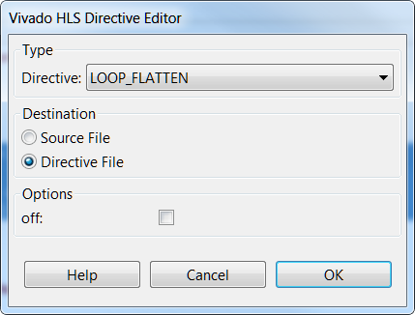
Loop Flattening
Vivado HLS can automatically flatten nested loops
A faster approach than manually changing the code
Flattening should be specified on the inner most loop
It will be flattened into the loop above
The “off” option can prevent loops in the hierarchy from being flattened
void foo_top (…) {
...
L1: for (i=3;i>=0;i--) {
[loop body l1 ]
}
L2: for (i=3;i>=0;i--) {
L3: for (j=3;j>=0;j--) {
[loop body l3 ]
}
}
L4: for (i=3;i>=0;i--) {
[loop body l4 ]
}
void foo_top (…) {
...
L1: for (i=3;i>=0;i--) {
[loop body l1 ]
}
L2: for (k=15,k>=0;k--) {
[loop body l3 ]
}
L4: for (i=3;i>=0;i--) {
[loop body l1 ]
}
1
1
x4
x4
2
x4
2
x16
3
x4
4
4
x4
x4
36 transitions
Loops will be flattened by default: use “off” to disable
28 transitions

Slide 24
Perfect and Semi-Perfect Loops
Only perfect and semi-perfect loops can be flattened
The loop should be labeled or directives cannot be applied
Perfect Loops
Only the inner most loop has body (contents)
There is no logic specified between the loop statements
The loop bounds are constant
Semi-perfect Loops
Only the inner most loop has body (contents)
There is no logic specified between the loop statements
The outer most loop bound can be variable
Other types
Should be converted to perfect or semi-perfect loops
Loop_outer: for (i=3;i>=0;i--) {
Loop_inner: for (j=3;j>=0;j--) {
[loop body]
}
}
Loop_outer: for (i=3;i>N;i--) {
Loop_inner: for (j=3;j>=0;j--) {
[loop body]
}
}
Loop_outer: for (i=3;i>N;i--) {
[loop body]
Loop_inner: for (j=3;j>=M;j--) {
[loop body]
}
}

Slide 25
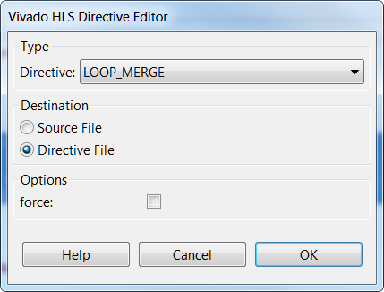
Loop Merging
Vivado HLS can automatically merge loops
A faster approach than manually changing the code
Allows for more efficient architecture explorations
FIFO reads, which must occur in strict order, can prevent loop merging
Can be done with the “force” option : user takes responsibility for correctness
1
void foo_top (…) {
...
L1: for (i=3;i>=0;i--) {
[loop body l1 ]
}
L2: for (i=3;i>=0;i--) {
L3: for (j=3;j>=0;j--) {
[loop body l3 ]
}
}
L4: for (i=3;i>=0;i--) {
[loop body l4 ]
}
x4
void foo_top (…) {
...
L123: for (l=16,l>=0;l--) {
if (cond1)
[loop body l1 ]
[loop body l3 ]
if (cond4)
[loop body l4 ]
}
2
x4
1
3
x4
1
Already flattened
x16
4
x4
36 transitions
18 transitions

Slide 26
Loop Merge Rules
If loop bounds are all variables, they must all have the same value
If loops bounds are constants, the maximum constant value is used as the bound of the merged loop
As in the previous example where the maximum loop bounds become 16 (implied by L3 flattened into L2 before the merge)
Loops with both variable bound and constant bound cannot be merged
The code between loops to be merged cannot have side effects
Multiple execution of this code should generate same results
A=B is OK, A=A+1 is not
Reads from a FIFO or FIFO interface must always be in sequence
A FIFO read in one loop will not be a problem
FIFO reads in multiple loops may be read out of sequence
This prevents loops being merged

Slide 27
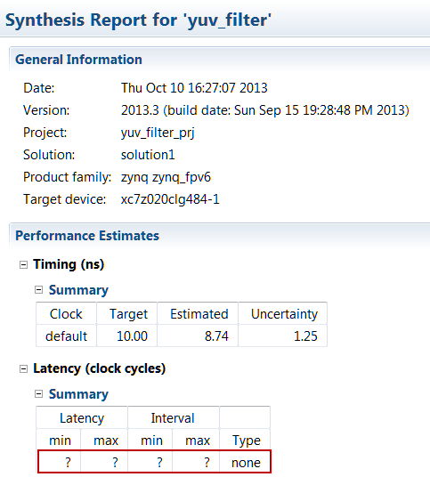
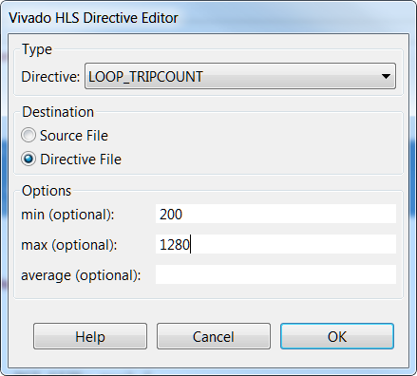
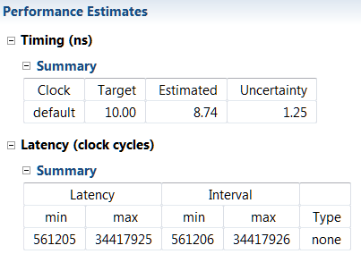
Loop Reports
Vivado HLS reports the latency of loops
Shown in the report file and GUI
Given a variable loop bound, the latency cannot be reported
Vivado HLS does not know the limits of the loop index
This results in latency reports showing unknown values
The loop tripcount (iteration count) can be specified
Apply to the loop in the directives pane
Allows the reports to show an estimated latency
Impacts reporting – not synthesis

Slide 28
Techniques for Minimizing Latency - Summary
Constraints
Vivado HLS accepts constraints for latency
Loop Optimizations
Latency can be improved by minimizing the number of loop boundaries
Rolled loops (default) enforce sharing at the expense of latency
The entry and exits to loops costs clock cycles

Slide 29
Outline
Adding Directives
Improving Latency
Manipulating Loops
Improving Throughput
Performance Bottleneck
Summary

Slide 30
Improving Throughput
Given a design with multiple functions
The code and dataflow are as shown
Vivado HLS will schedule the design
It can also automatically optimize the dataflow for throughput

Slide 31
Dataflow Optimization
Dataflow Optimization
Can be used at the top-level function
Allows blocks of code to operate concurrently
The blocks can be functions or loops
Dataflow allows loops to operate concurrently
It places channels between the blocks to maintain the data rate
For arrays the channels will include memory elements to buffer the samples
For scalars the channel is a register with hand-shakes
Dataflow optimization therefore has an area overhead
Additional memory blocks are added to the design
The timing diagram on the previous page should have a memory access delay between the blocks
Not shown to keep explanation of the principle clear

Slide 32
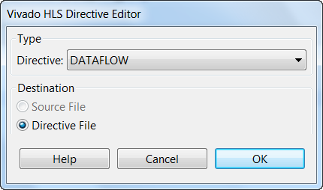
Dataflow Optimization Commands
Dataflow is set using a directive
Vivado HLS will seek to create the highest performance design
Throughput of 1

Slide 33
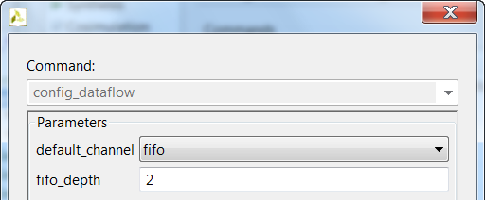
Dataflow Optimization through Configuration Command
Configuring Dataflow Memories
Between functions Vivado HLS uses ping-pong memory buffers by default
The memory size is defined by the maximum number of producer or consumer elements
Between loops Vivado HLS will determine if a FIFO can be used in place of a ping-pong buffer
The memories can be specified to be FIFOs using the Dataflow Configuration
Menu: Solution > Solution Settings > config_dataflow
With FIFOs the user can override the default size of the FIFO
Note: Setting the FIFO too small may result in an RTL verification failure
Individual Memory Control
When the default is ping-pong
Select an array and mark it as Streaming (directive STREAM) to implement the array as a FIFO
When the default is FIFO
Select an array and mark it as Streaming (directive STREAM) with option “off” to implement the array as a ping-pong
To use FIFO’s the access must be sequential. If HLS determines that the access is not sequential then it will halt and issue a message. If HLS can not determine the sequential nature then it will issue warning and continue.

Slide 34
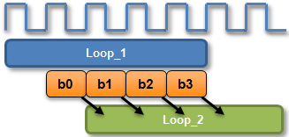
Dataflow : Ideal for streaming arrays & multi-rate functions
Arrays are passed as single entities by default
This example uses loops but the same principle applies to functions
Dataflow pipelining allows loop_2 to start when data is ready
The throughput is improved
Loops will operate in parallel
If dependencies allow
Multi-Rate Functions
Dataflow buffers data when one function or loop consumes or produces data at different rate from others
IO flow support
To take maximum advantage of dataflow in streaming designs, the IO interfaces at both ends of the datapath should be streaming/handshake types (ap_hs or ap_fifo)

Slide 35
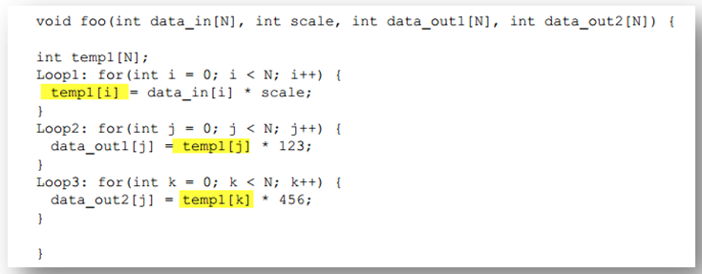
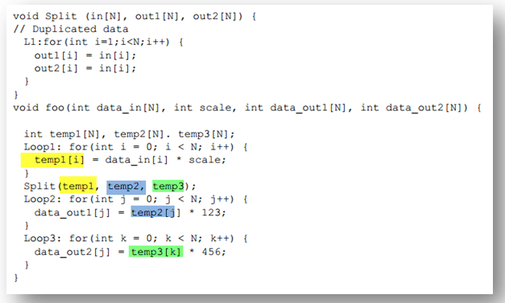
Dataflow Limitations (1)
Must be single producer consumer; the following code violates the rule and dataflow does not work
The Fix
Notes:
For the dataflow optimization to work, the data must flow through the design from one task to the next. The following coding styles prevent the Vivado HLS tool from performing the dataflow optimization:
Single producer consumer violations
Bypassing tasks
Feedback between tasks
Conditional execution of tasks
Loop scopes with variable bounds
Loops with multiple exit conditions

Slide 36
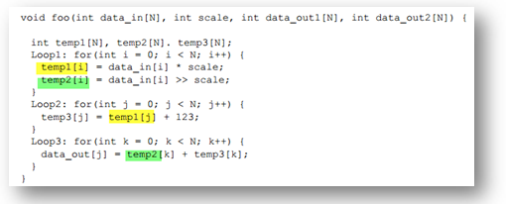
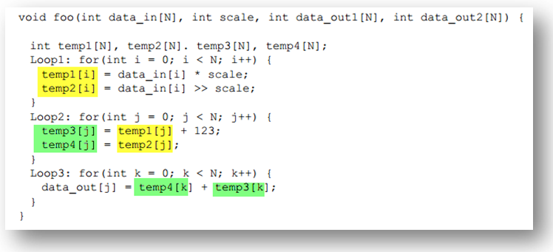
Dataflow Limitations (2)
You cannot bypass a task; the following code violates this rule and dataflow does not work
The fix: make it systolic like datapath

Slide 37
Dataflow vs Pipelining Optimization
Dataflow Optimization
Dataflow optimization is “coarse grain” pipelining at the function and loop level
Increases concurrency between functions and loops
Only works on functions or loops at the top-level of the hierarchy
Cannot be used in sub-functions
Function & Loop Pipelining
“Fine grain” pipelining at the level of the operators (*, +, >>, etc.)
Allows the operations inside the function or loop to operate in parallel
Unrolls all sub-loops inside the function or loop being pipelined
Loops with variable bounds cannot be unrolled: This can prevent pipelining
Unrolling loops increases the number of operations and can increase memory and run time
In OpenCl dataflow optimization can be achieved by using on-chip global memory
Vivado HLS uses BRAM streaming buffers for global arrays between kernels on the same FPGA

Slide 38
Function Pipelining
There are 3 clock cycles before operation RD can occur again
Throughput = 3 cycles
There are 3 cycles before the 1st output is written
Latency = 3 cycles
The latency is the same
The throughput is better
Less cycles, higher throughput
Without Pipelining
With Pipelining
void foo(...) {
op_Read;
op_Compute;
op_Write;
}
RD
CMP
WR
Throughput = 3 cycles
Throughput = 1 cycle
RD
CMP
WR
RD
CMP
WR
RD
CMP
WR
Latency = 3 cycles
RD
CMP
WR
Latency = 3 cycles

Slide 39
Loop Pipelining
Without Pipelining
With Pipelining
There are 3 clock cycles before operation RD can occur again
Throughput = 3 cycles
There are 3 cycles before the 1st output is written
Latency = 3 cycles
For the loop, 6 cycles
Loop:for(i=1;i<3;i++) {
op_Read;
op_Compute;
op_Write;
}
RD
CMP
WR
Throughput = 3 cycles
Throughput = 1 cycle
RD
CMP
WR
RD
CMP
WR
RD
CMP
WR
RD
CMP
WR
Latency = 3 cycles
Latency = 3 cycles
Loop Latency = 6 cycles
Loop Latency = 4 cycles
The latency is the same
The throughput is better
Less cycles, higher throughput
The latency for all iterations, the loop latency, has been improved

Slide 40
Pipelining and Function/Loop Hierarchy
Vivado HLS will attempt to unroll all loops nested below a PIPELINE directive
May not succeed for various reason and/or may lead to unacceptable area
Loops with variable bounds cannot be unrolled
Unrolling Multi-level loop nests may create a lot of hardware
Pipelining the inner-most loop will result in best performance for area
Sometimes it is better to pipeline the next one (or two) out if the inner-most is modest and fixed
e.g. Convolution algorithm, blocked matrix multiplication
Outer loops will keep the inner pipeline fed
void foo(in1[ ][ ], in2[ ][ ], …) {
…
L1:for(i=1;i<N;i++) {
L2:for(j=0;j<M;j++) {
#pragma AP PIPELINE
out[i][j] = in1[i][j] + in2[i][j];
}
}
}
void foo(in1[ ][ ], in2[ ][ ], …) {
…
L1:for(i=1;i<N;i++) {
#pragma AP PIPELINE
L2:for(j=0;j<M;j++) {
out[i][j] = in1[i][j] + in2[i][j];
}
}
}
void foo(in1[ ][ ], in2[ ][ ], …) {
#pragma AP PIPELINE
…
L1:for(i=1;i<N;i++) {
L2:for(j=0;j<M;j++) {
out[i][j] = in1[i][j] + in2[i][j];
}
}
}
1adder, 3 accesses
Unrolls L2
M adders, 3M accesses
Unrolls L1 and L2
N*M adders, 3(N*M) accesses

Slide 41
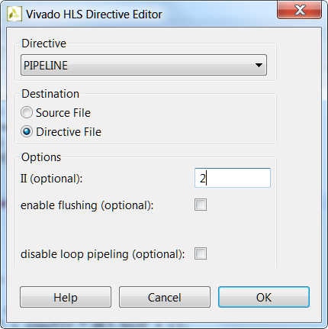
Pipeline Directive
The pipeline directive pipelines functions or loops
This example pipelines the function with an Initiation Interval (II) of 2
The II is the same as the throughput but this term is used exclusively with pipelines
Omit the target II and Vivado HLS will Automatically pipeline for the fastest possible design
Specifying a more accurate maximum may allow more sharing (smaller area)
RD
CMP
WR
RD
CMP
WR
Initiation Interval (or II)

Slide 42
Pipeline Flush
Pipelines can optionally be flushed
Flush: when the input enable goes low (no more data) all existing results are flushed out
The input enable may be from an input interface or from another block in the design
The default is to stall all existing values in the pipeline
With Flush
When no new input reads are performed
Values already in the pipeline are flushed out
Without Flush (default)
With Flush (optional)
Clk
Clk
Data Valid
Data Valid
RD
CMP
WR
out1
RD
CMP
WR
out1
RD
CMP
WR
out2
RD
CMP
WR
out2
RD
CMP
RD
CMP

Slide 43
Pipelining the Top-Level Loop
Loop Pipelining top-level loop may give a “bubble”
A “bubble” here is an interruption to the data stream
Given the following
The function will process a stream of data
The next time the function is called, it still needs to execute the initial (init) operations
These operations are any which occur before the loop starts
These operations may include interface start/stop/done signals
This can result in an unexpected interruption of the data stream

Slide 44
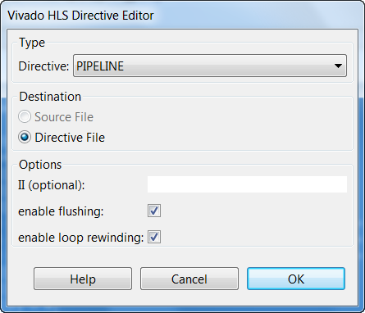
Continuously Pipelining the Top-Level loop
Use the “rewind” option for continuous pipelining
Immediate re-execution of the top-level loop
The operation rewinds to the start of the loop
Ignores any initialization statements before the start of the loop
The rewind portion only effects top-level loops
Ensures the operations before the loop are never re-executed when the function is re-executed

Slide 45
Issues which prevent Pipelining
Pipelining functions unrolls all loops
Loops with variable bounds cannot be unrolled
This will prevent pipelining
Re-code to remove the variables bounds: max bounds with an exit
Feedback prevents/limits pipelines
Feedback within the code will prevent or limit pipelining
The pipeline may be limited to higher initiation interval (more cycles, lower throughput)
Resource Contention may prevent pipelining
Can occur within input and output ports/arguments
This is a classical way in which arrays limit performance

Slide 46
Resource Contention: Unfeasible Initiation Intervals
Sometimes the II specification cannot be met
In this example there are 2 read operations on the same port
An II=1 cannot be implemented
The same port cannot be read at the same time
Similar effect with other resource limitations
For example if functions or multipliers etc. are limited
Vivado HLS will automatically increase the II
Vivado HLS will always try to create a design, even if constraints must be violated

Slide 47
Loop pipelining for OpenCl
Typical way to exploit WI parallelism on FPGAs, because WI loop unrolling is not supported
The loops over WIs are typically pipelined, so they typically (i.e. unless unrolled) execute in order (very useful for debugging)
Note that __attribute__((xcl_pipeline_workitems)) must be applied to each body of each nested loop, not just the top, because:
Each nested loop within a pipelined loop must be unrolled
Loops without a static iteration bound cannot be unrolled

Slide 48
Duplication of work item pipelining attribute
Assume that you want to pipeline WIs in this code:
__kernel foo(__global int *G) {
__local int L[…];
ix = get_local_id(0); // WI index
for (i = …) {
L[ix + i] = G[base + ix + i];
barrier(CLK_LOCAL_MEMORY_FENCE);
… = L[ix + I + 3]; // uses L loaded by another WI

Slide 49
Duplication of work item pipelining attribute
This will pipeline the code only up to the first for loop (and achieve unexpectedly low performance):
__kernel foo(__global int *G) {
__attribute__((xcl_pipeline_workitems)) {
__local int L[…];
ix = get_local_id(0); // WI index
for (i = …) {
L[ix + i] = G[base + ix + i];
barrier(CLK_LOCAL_MEMORY_FENCE);
… = L[ix + I + 3]; // uses L loaded by another WI

Slide 50
Duplication of work item pipelining attribute
On the other hand, this (messy) code will work:
__kernel foo(__global int *G) {
__attribute__((xcl_pipeline_workitems)) {
__local int L[…];
ix = get_local_id(0); // WI index
for (i = …) {
__attribute__((xcl_pipeline_workitems)) {
L[ix + i] = G[base + ix + i];
}
barrier(CLK_LOCAL_MEMORY_FENCE);
__attribute__((xcl_pipeline_workitems)) {
… = L[ix + I + 3]; // uses L loaded by another WI

Slide 51
Outline
Adding Directives
Improving Latency
Manipulating Loops
Improving Throughput
Performance Bottleneck
Summary

Slide 52
Arrays : Performance bottlenecks
Arrays are intuitive and useful software constructs
They allow the C algorithm to be easily captured and understood
Array accesses can often be performance bottlenecks
Arrays are targeted by default to a RAM
May not be the most ideal memory for performance
Cannot pipeline with a throughput of 1
Vivado HLS allows arrays to be partitioned and reshaped
Allows more optimal configuration of the array
Provides better implementation of the memory resource

Slide 53
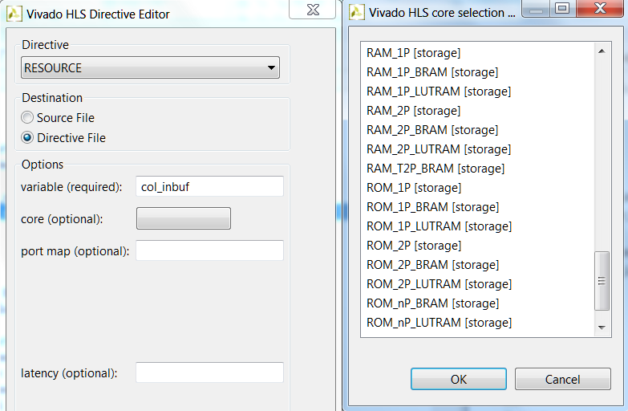
Review: Arrays in HLS
An array in C code is implemented by a memory in the RTL
By default, arrays are implemented as RAMs, optionally a FIFO
The array can be targeted to any memory resource in the library
The ports and sequential operation are defined by the library model
All RAMs are listed in the Vivado HLS Library Guide
List of available Cores

Slide 54
Array and RAM selection
If no RAM resource is selected
Vivado HLS will determine the RAM to use
It will use a Dual-port if it improves throughput
Else it will use a single-port
BRAM and LUTRAM selection
If none is made (e.g. resource RAM_1P used) RTL synthesis will determine if RAM is implemented as BRAM or LUTRAM
If the user specifies the RAM target (e.g. RAM_1P_BRAM or RAM_1P_LUTRAM is selected ) Vivado HLS will obey the target
If LUTRAM is selected, then Vivado HLS reports it as registers, not BRAM
Notes:
Transcript:
memory would give the best performance. So that's why you'll see at the interfaces sometimes you expect a single port being consumed by Vivado HLS and you'll see both ports because the tool currently does not look at the system integration context. It just looks at the performance you want and what your resources are. You can also choose between a block RAM or distributed RAM. And then there's also, if you don't select anything, we'll leave RTL in a way that ISE can then have the freedom of choosing where it wants to map a memory component.
Author's Original Notes:

Slide 55
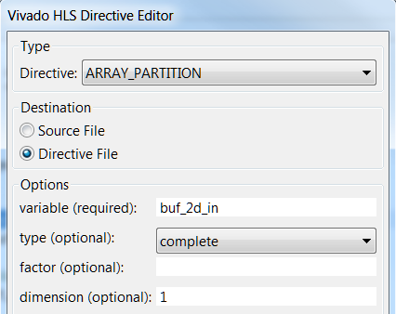
Array Partitioning
Partitioning breaks an array into smaller elements
If the factor is not an integer multiple of the size, the final array has fewer elements
Arrays can be split along any dimension
If none is specified dimension zero is assumed
Dimension zero means all dimensions
All partitions inherit the same resource target
That is, whatever RAM is specified as the resource target
Except of course when partitioning is “complete”, meaning using a register for each element

Slide 56
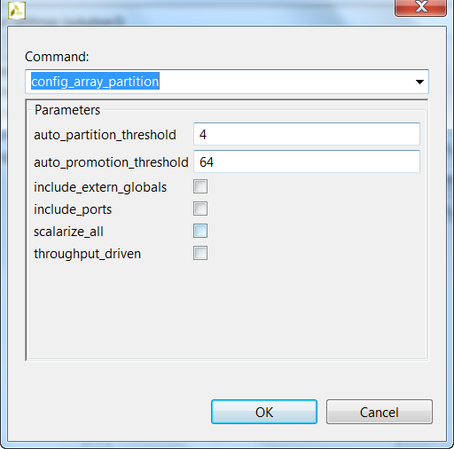
Configuring Array Partitioning
Vivado HLS can automatically partition arrays to improve throughput
This is controlled via the array configuration command
Enable mode throughput_driven
Auto-partition arrays with constant indexing
When the array index is not a variable
Arrays below the threshold are auto-partitioned
Set the threshold using option elem_count_limit
Partition all arrays in the design
Select option scalarize_all
Include all arrays in partitioning
The include_ports option will include any arrays on the IO interface when partitioning is performed
Partitioning these arrays will result in multiple ports and change the interface
This may however improve throughput
Any arrays defined as a global can be included in the partitioning by selecting option include_extern_globals
By default, global arrays are not partitioned

Slide 57
Array Dimensions
The array options can be performed on dimensions of the array
Examples
my_array[10][6][4]
Dimension 1
Dimension 2
Dimension 3
Dimension 0
(All dimensions)
my_array_0[10][6]
my_array_1[10][6]
my_array_2[10][6]
my_array_3[10][6]
my_array[10][6][4] ➔ partition dimension 3 ➔
my_array_0[6][4]
my_array_1[6][4]
my_array_2[6][4]
my_array_3[6][4]
my_array_4[6][4]
my_array_5[6][4]
my_array_6[6][4]
my_array_7[6][4]
my_array_8[6][4]
my_array_9[6][4]
my_array[10][6][4] ➔ partition dimension 1 ➔
my_array[10][6][4] ➔ partition dimension 0 ➔ 10x6x4 = 240 individual registers
Notes:
Transcript:
So this will be dimension one, two, and three. If you say zero, it means everything. So for this 3D array where I'm partitioning on dimension three, it's the same as getting four new arrays that are 10 by six. And that's how the memory's going to look at in the hardware. If you partition it on dimension one, you're going to get 10 different memory that are six by four. And if you partition on zero, you're going to get 240 individual registers. So depending on where you put your partitioning is, yes, your memory bandwidth will go up, but also your resources will also go up. Any questions on this?
Author's Original Notes:

Slide 58
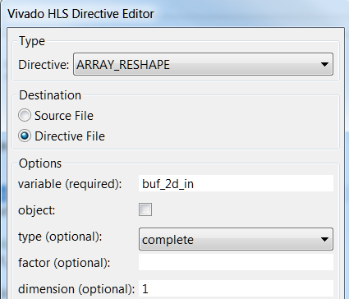
Array Reshaping
Reshaping recombines partitioned arrays back into a single array
Same options as array partition
However, reshape automatically recombines the parts back into a single element
The “new” array has the same name
Same name used for resource targeting

Slide 59
Reshaping vs Partitioning
Both are useful for increasing the memory or data bandwidth
Reshaping
Simply increases the width of the data word
Does not increase the number of memory ports
Partitioning
Increases the memory ports; thus more I/O to deal with
Use it only if you have to use independent addressing
Common error message: cue to use reshaping or partitioning

Slide 60
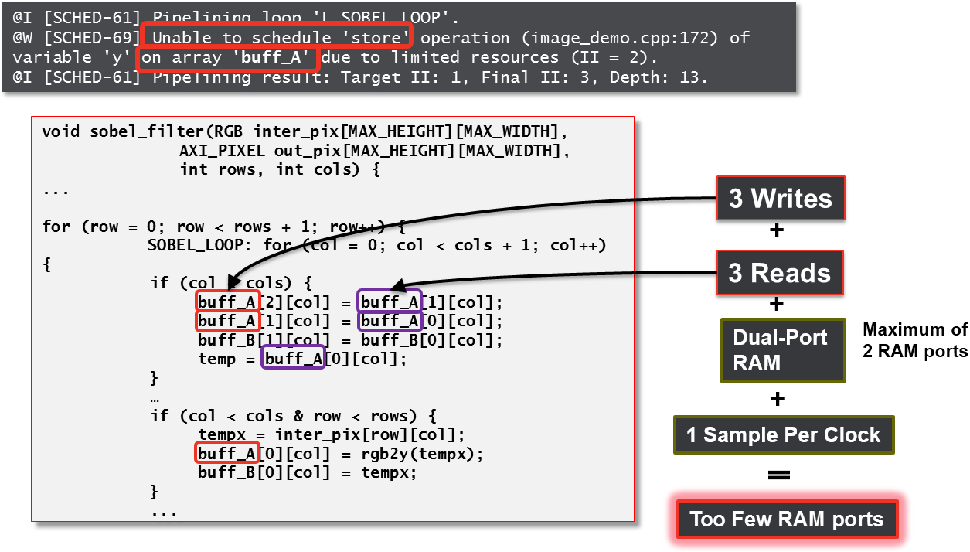
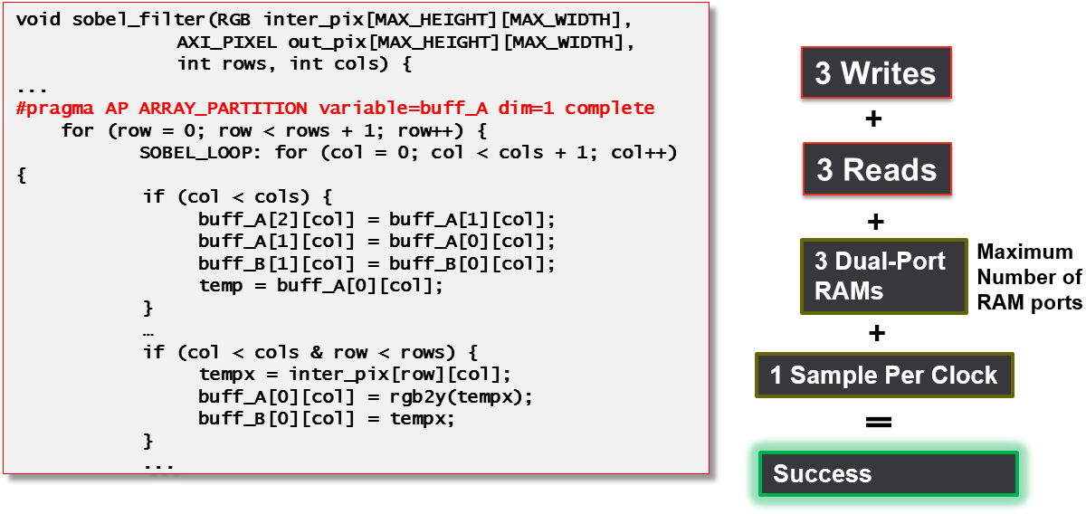
Bottleneck Example
Array accesses (block RAM) can be bottlenecks inside functions or loops
Still prevents an II of 1 despite PIPELINE and DATAFLOW
Prevents processing of one sample per clock
Solution: Use ARRAY_PARTITION directive

Slide 61
Global arrays in OpenCl
Top-level function arguments can be:
Scalar, mapped to registers written by the SW driver and read by the HW
Pointers to global arrays, mapped to BRAM. The pointer register is written by the SW driver and read by the HW
Global memory is accessed via one or more (possibly very wide) AXI master interfaces, connected to the DDR3 controller
Transfers from global to local memory should use bursts, if possible, by calling async_work_group_copy
Using very large data types on the global memory interface leads to the fastest memory transfer
Use tuples of ints, floats, etc.
Best sizes are 256-512 bits

Slide 62
Local arrays in OpenCl
Local variables are mapped to registers (if they are scalar or small arrays) or BRAM (if they are large arrays)
The mapping can be selected by the user with partitioning attributes
Local arrays mapped to BRAM can become the bottleneck if local loops are unrolled (it has 2 ports by default)
Memory partitioning or flattening must match the loop unrolling strategy for best results (very often Vivado HLS cannot automatically achieve this)

Slide 63
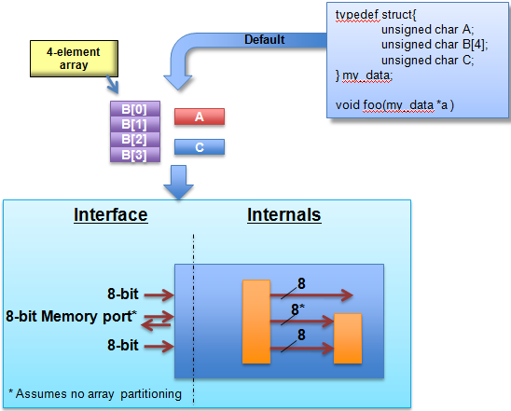
Structs and Arrays: The Default Handling
Structs are a commonly used coding construct
By default, structs are separated into their separate elements
Treated as separate elements
On the Interface
This means separate ports
Internally
Separate buses & wires
Separate control logic, which may be more complex, slower and increase latency
Use the DATA_PACK directive to group them into a single element

Slide 64
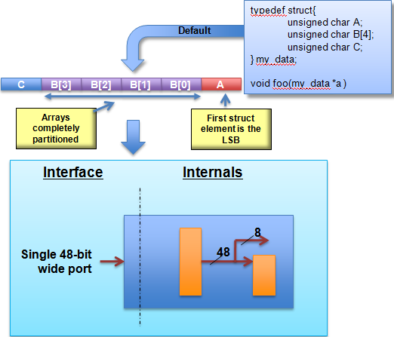
Data Packing
Data packing groups structs internally and at the IO Interface
Creates a single wide bus of all struct elements
Grouped structure
First element in the struct becomes the LSB
Last struct element becomes the MSB
Arrays are partitioning completely
On the Interface
This means a single port
Internally
Single bus
May result in simplified control logic, faster and lower latency designs

Slide 65
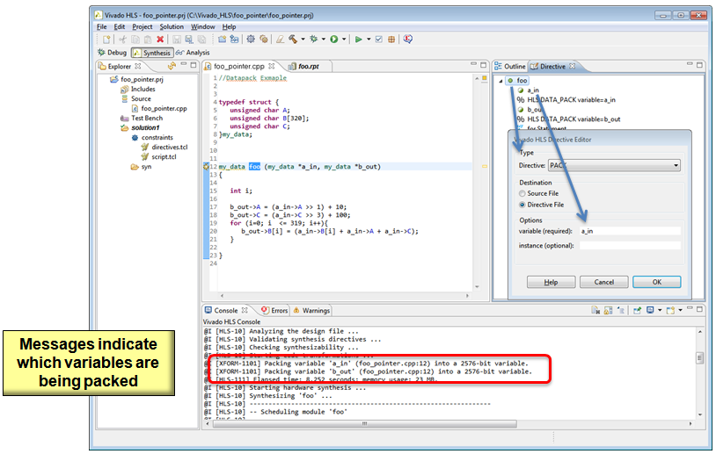
Using Data Pack Directive
Apply the DATA_PACK directive
Select the function and specify the struct variable to pack

Slide 66
Outline
Adding Directives
Improving Latency
Manipulating Loops
Improving Throughput
Performance Bottleneck
Summary

Slide 67
Summary
Directives may be added through GUI
Tcl command is added into script.tcl file
Pragmas are added into the source file
Latency is minimized by default
Constraints can be set
Loops may have impact on the latency
Throughput may be improved by pipelining at
The task, function, and loop level
Arrays may create performance bottleneck if not handled properly

Slide 68
Summary
Optimizing Performance
Latency optimization
Specify latency directives
Unroll loops
Merge and Flatten loops to reduce loop transition overheads
Throughput optimization
Perform Dataflow optimization at the top-level
Pipeline individual functions and/or loops
Pipeline the entire function: beware of lots of operations, lots to schedule and it’s not always possible
Array Optimizations
Focus on bottlenecks often caused by memory and port accesses
Removing bottlenecks improves latency and throughput
Use Array Partitioning and Reshaping directives to achieve throughput

