Slide 1
Introduction to High-Level Synthesis with Vivado HLS

Slide 2
Objectives
After completing this module, you will be able to:
Describe the high level synthesis flow
Understand the control and datapath extraction
Describe scheduling and binding phases of the HLS flow
List the priorities of directives set by Vivado HLS
List comprehensive language support in Vivado HLS
Identify steps involved in validation and verification flows

Slide 3
Outline
Introduction to High-Level Synthesis
High-Level Synthesis with Vivado HLS
Language Support
Validation Flow
Summary

Slide 4
Need for High-Level Synthesis
Algorithmic-based approaches are getting popular due to accelerated design time and time to market (TTM)
Larger designs pose challenges in design and verification of hardware at HDL level
Industry trend is moving towards hardware acceleration to enhance performance and productivity
CPU-intensive tasks can be offloaded to hardware accelerator in FPGA
Hardware accelerators require a lot of time to understand and design
Vivado HLS tool converts algorithmic description written in C-based design flow into hardware description (RTL)
Elevates the abstraction level from RTL to algorithms
High-level synthesis is essential for maintaining design productivity for large designs

Slide 5
High-Level Synthesis: HLS
High-Level Synthesis
Creates an RTL implementation from C, C++, System C, OpenCL API C kernel code
Extracts control and dataflow from the source code
Implements the design based on defaults and user applied directives
Many implementation are possible from the same source description
Smaller designs, faster designs, optimal designs
Enables design exploration

Slide 6
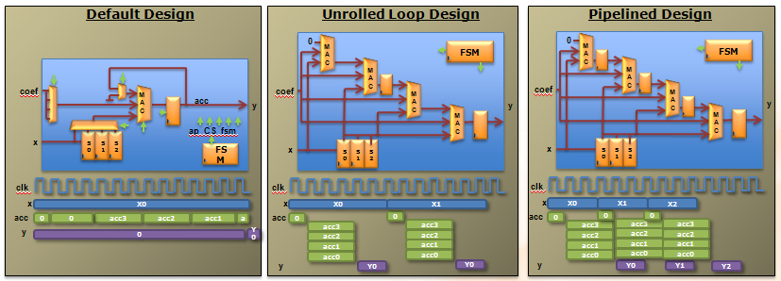
Design Exploration with Directives
…
loop: for (i=3;i>=0;i--) {
if (i==0) {
acc+=x*c[0];
shift_reg[0]=x;
} else {
shift_reg[i]=shift_reg[i-1];
acc+=shift_reg[i]*c[i];
}
}
….
One body of code:
Many hardware outcomes
Before we get into details, let’s look under the hood ….
The same hardware is used for each iteration of the loop:
Small area
Long latency
Low throughput
Different hardware is used for each iteration of the loop:
Higher area
Short latency
Better throughput
Different iterations are executed concurrently:
Higher area
Short latency
Best throughput

Slide 7
Introduction to High-Level Synthesis
How is hardware extracted from C code?
Control and datapath can be extracted from C code at the top level
The same principles used in the example can be applied to sub-functions
At some point in the top-level control flow, control is passed to a sub-function
Sub-function may be implemented to execute concurrently with the top-level and or other sub-functions
How is this control and dataflow turned into a hardware design?
Vivado HLS maps this to hardware through scheduling and binding processes
How is my design created?
How functions, loops, arrays and IO ports are mapped?

Slide 8
HLS: Control Extraction
Code
Control Behavior
void fir (
data_t *y,
coef_t c[4],
data_t x
) {
static data_t shift_reg[4];
acc_t acc;
int i;
acc=0;
loop: for (i=3;i>=0;i--) {
if (i==0) {
acc+=x*c[0];
shift_reg[0]=x;
} else {
shift_reg[i]=shift_reg[i-1];
acc+=shift_reg[i]*c[i];
}
}
*y=acc;
}
Finite State Machine (FSM) states
Function Start
0
For-Loop Start
1
For-Loop End
2
Function End
From any C code example ..
The loops in the C code correlated to states of behavior
This behavior is extracted into a hardware state machine

Slide 9
HLS: Control & Datapath Extraction
Code
Operations
Control Behavior
Control & Datapath Behavior
void fir (
data_t *y,
coef_t c[4],
data_t x
) {
static data_t shift_reg[4];
acc_t acc;
int i;
acc=0;
loop: for (i=3;i>=0;i--) {
if (i==0) {
acc+=x*c[0];
shift_reg[0]=x;
} else {
shift_reg[i]=shift_reg[i-1];
acc+=shift_reg[i]*c[i];
}
}
*y=acc;
}
Finite State Machine (FSM) states
Control Dataflow
RDx
RDc
>=
0
-
RDx
RDc
==
>=
-
==
-
+
1
+
*
*
+
*
+
*
2
WRy
WRy
From any C code example ..
Operations are extracted…
The control is known
A unified control dataflow behavior is created.

Slide 10
High-Level Synthesis: Scheduling & Binding
Scheduling & Binding
Scheduling and Binding are at the heart of HLS
Scheduling determines in which clock cycle an operation will occur
Takes into account the control, dataflow and user directives
The allocation of resources can be constrained
Binding determines which library cell is used for each operation
Takes into account component delays, user directives
Design Source
(C, C++, SystemC)
Technology
Library
Scheduling
Binding
User
Directives
RTL
(Verilog, VHDL, SystemC)

Slide 11
Scheduling
The operations in the control flow graph are mapped into clock cycles
The technology and user constraints impact the schedule
A faster technology (or slower clock) may allow more operations to occur in the same clock cycle
The code also impacts the schedule
Code implications and data dependencies must be obeyed
void foo (
…
t1 = a * b;
t2 = c + t1;
t3 = d * t2;
out = t3 – e;
}
a
b
*
c
+
d
*
e
-
out
Schedule 1
*
+
*
-
Schedule 2
*
+
*
-

Slide 12
Binding
Binding is where operations are mapped to cores from the hardware library
Operators map to cores
Binding Decision: to share
Given this schedule:
Binding must use 2 multipliers, since both are in the same cycle
It can decide to use an adder and subtractor or share one addsub
Binding Decision: or not to share
Given this schedule:
Binding may decide to share the multipliers (each is used in a different cycle)
Or it may decide the cost of sharing (muxing) would impact timing and it may decide not to share them
It may make this same decision in the first example above too
*
+
*
-
*
+
*
-

Slide 13
Outline
Introduction to High-Level Synthesis
High-Level Synthesis with Vivado HLS
Language Support
Validation Flow
Summary

Slide 14
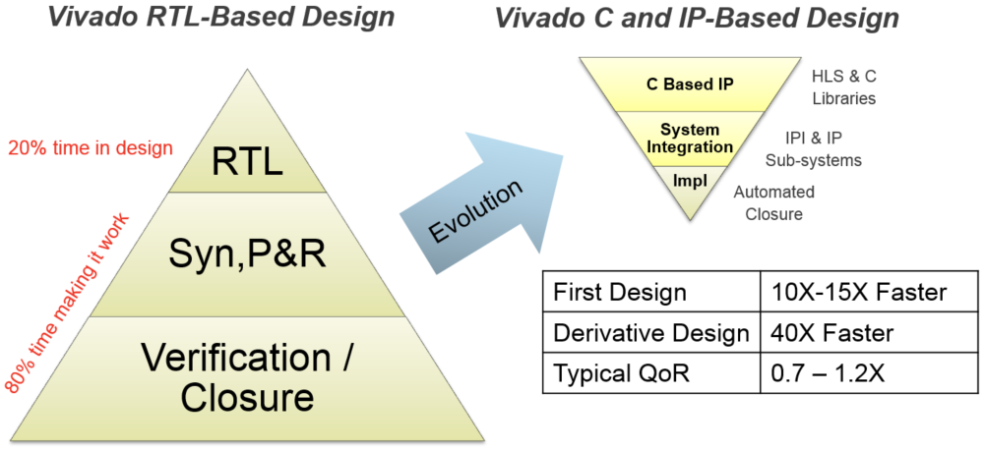
RTL vs High-Level Language
Notes:
RTL design cycles typically consist of verification and design closure iterations for each block, as well as for the entire design. As a consequence of this methodology, the platform connectivity design never stabilizes, as any change in the differentiated logic can cause an I/O interface (e.g. DDR memory, Ethernet, or PCIe® core) to fail timing requirements. Also, RTL verification cycles no longer allow for exhaustive functional tests prior to hardware bring up.
A high-level design methodology turns the development effort on its head, allowing designers to spend more time designing the value-add logic and less time trying to make it work. This flow provides a 15X reduction in design cycle compared to an RTL design flow.
The main attributes of a high-level methodology are:
Separation of platform development and differentiated logic, allowing designers to focus on the company’s high-value functionality.
Rapid configuration, generation and closure of the platform connectivity, using the Vivado® IP Integrator with board awareness, as well as the Vivado IP systems.
C-based simulation for the differentiated logic, decreasing simulation times by orders of magnitude over traditional RTL simulation.
High-level synthesis with the Vivado HLS tool and C/C++ libraries, as well as the Vivado IP integrator for rapid implementation and system integration from C to silicon.

Slide 15
Vivado HLS Benefits
Productivity
Verification
Functional
Architectural
Abstraction
Datatypes
Interface
Classes
Automation
Block level specification AND verification significantly reduced
Video Design Example
Input | C Simulation Time | RTL Simulation Time | Improvement
10 frames 1280x720 | 10s | ~2 days (ModelSim) | ~12000x
RTL (Spec)
RTL (Sim)
C (Spec/Sim)
RTL (Sim)

Slide 16
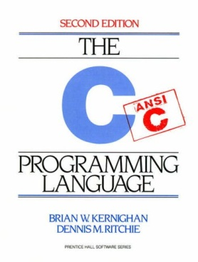
Vivado HLS Benefits
Portability
Processors and FPGAs
Technology migration
Cost reduction
Power reduction
Design and IP reuse
RTL
RTL
RTL
RTL
RTL
RTL

Slide 17
Vivado HLS Benefits
Permutability
Architecture Exploration
Timing
Parallelization
Pipelining
Resources
Sharing
Better QoR
Rapid design exploration delivers QoR rivaling hand-coded RTL
Untimed C
Specification
Area
RTL
Share Resources
RTL
RTL
Insert Pipelines
RTL
Unroll Loops
RTL
Partition Arrays
Timed RTL
Architectures
Performance

Slide 18
Understanding Vivado HLS Synthesis
Vivado HLS
Determines in which cycle operations should occur (scheduling)
Determines which hardware units to use for each operation (binding)
Performs high-level synthesis by :
Obeying built-in defaults
Obeying user directives & constraints to override defaults
Calculating delays and area using the specified technology/device
Priority of directives in Vivado HLS
Meet Performance (clock & throughput)
Vivado HLS will allow a local clock path to fail if this is required to meet throughput
Often possible the timing can be met after logic synthesis
Then minimize latency
Then minimize area

Slide 19
The Key Attributes of C code
Functions: All code is made up of functions which represent the design hierarchy: the same in hardware
void fir (
data_t *y,
coef_t c[4],
data_t x
) {
static data_t shift_reg[4];
acc_t acc;
int i;
acc=0;
loop: for (i=3;i>=0;i--) {
if (i==0) {
acc+=x*c[0];
shift_reg[0]=x;
} else {
shift_reg[i]=shift_reg[i-1];
acc+=shift_reg[i] * c[i];
}
}
*y=acc;
}
Top Level IO : The arguments of the top-level function determine the hardware RTL interface ports
Types: All variables are of a defined type. The type can influence the area and performance
Loops: Functions typically contain loops. How these are handled can have a major impact on area and performance
Arrays: Arrays are used often in C code. They can influence the device IO and become performance bottlenecks
Operators: Operators in the C code may require sharing to control area or specific hardware implementations to meet performance
Let’s examine the default synthesis behavior of these …

Slide 20
Functions & RTL Hierarchy
Each function is translated into an RTL block
Verilog module, VHDL entity
By default, each function is implemented using a common instance
Functions may be inlined to dissolve their hierarchy
Small functions may be automatically inlined
Source Code
RTL hierarchy
void A() { ..body A..}
void B() { ..body B..}
void C() {
B();
}
void D() {
B();
}
void foo_top() {
A(…);
C(…);
D(…)
}
foo_top
C
B
A
D
B
my_code.c
Each function/block can be shared like any other component (add, sub, etc) provided it’s not in use at the same time

Slide 21
Types = Operator Bit-sizes
Code
Operations
Types
void fir (
data_t *y,
coef_t c[4],
data_t x
) {
static data_t shift_reg[4];
acc_t acc;
int i;
acc=0;
loop: for (i=3;i>=0;i--) {
if (i==0) {
acc+=x*c[0];
shift_reg[0]=x;
} else {
shift_reg[i]=shift_reg[i-1];
acc+=shift_reg[i]*c[i];
}
}
*y=acc;
}
Standard C types
RDx
long long (64-bit)
short (16-bit)
unsigned types
RDc
int (32-bit)
char (8-bit)
>=
float (32-bit)
double (64-bit)
-
==
Arbitary Precision types
+
C: ap(u)int types (1-1024)
*
C++: ap_(u)int types (1-1024)
ap_fixed types
+
C++/SystemC: sc_(u)int types (1-1024)
sc_fixed types
*
WRy
Can be used to define any variable to be a specific bit-width (e.g. 17-bit, 47-bit etc).
From any C code example ...
Operations are extracted…
The C types define the size of the hardware used: handled automatically

Slide 22
Loops
By default, loops are rolled
Each C loop iteration ➔ Implemented in the same state
Each C loop iteration ➔ Implemented with same resources
Loops can be unrolled if their indices are statically determinable at elaboration time
Not when the number of iterations is variable
Unrolled loops result in more elements to schedule but greater operator mobility
Let’s look at an example ….
N
void foo_top (…) {
...
Add: for (i=3;i>=0;i--) {
b = a[i] + b;
...
}
foo_top
Synthesis
+
b
a[N]
Loops require labels if they are to be referenced by Tcl directives
(GUI will auto-add labels)

Slide 23
Data Dependencies: Good
Example of good mobility
The read on data port X can occur anywhere from the start to iteration 4
The only constraint on RDx is that it occur before the final multiplication
Vivado HLS has a lot of freedom with this operation
It waits until the read is required, saving a register
There are no advantages to reading any earlier (unless you want it registered)
Input reads can be optionally registered
The final multiplication is very constrained…
Default Schedule
void fir (
…
acc=0;
loop: for (i=3;i>=0;i--) {
if (i==0) {
acc+=x*c[0];
shift_reg[0]=x;
} else {
shift_reg[i]=shift_reg[i-1];
acc+=shift_reg[i]*c[i];
}
}
*y=acc;
}
==
*
>=
==
*
>=
==
*
>=
==
*
>=
WRy
-
-
+
-
-
+
-
-
+
-
+
RDc
RDc
RDc
RDx
RDc
Iteration 1
Iteration 2
Iteration 3
Iteration 4
The read X operation has good mobility

Slide 24
Data Dependencies: Bad
Example of bad mobility
The final addition must occur before the final write and after the last multiplication and the previous addition
It could occur in the same cycle if timing allows
Loops are rolled by default
Each iteration cannot start till the previous iteration completes
The final addition (in iteration 4) must wait for earlier iterations to complete
The structure of the code is forcing a particular schedule
There is little mobility for most operations
Optimizations allow loops to be unrolled giving greater freedom
Default Schedule
void fir (
…
acc=0;
loop: for (i=3;i>=0;i--) {
if (i==0) {
acc+=x*c[0];
shift_reg[0]=x;
} else {
shift_reg[i]=shift_reg[i-1];
acc+=shift_reg[i]*c[i];
}
}
*y=acc;
}
==
*
>=
==
*
>=
==
*
>=
==
*
>=
WRy
-
-
+
-
-
+
-
-
+
-
RDx
+
RDc
RDc
RDc
RDc
Iteration 1
Iteration 2
Iteration 3
Iteration 4
Add is very constrained

Slide 25
Schedule after Loop Optimization
With the loop unrolled (completely)
The dependency on loop iterations is gone
Operations can now occur in parallel
If data dependencies allow
If operator timing allows
Design finished faster but uses more operators
2 multipliers & 2 Adders
Schedule Summary
All the logic associated with the loop counters and index checking are now gone
Two multiplications can occur at the same time
All 4 could, but it’s limited by the number of input reads (2) on coefficient port C
Why 2 reads on port C?
The default behavior for arrays now limits the schedule…
RDc
RDc
RDc
RDc
RDx
*
*
*
*
+
+
+
WRy
void fir (
…
acc=0;
loop: for (i=3;i>=0;i--) {
if (i==0) {
acc+=x*c[0];
shift_reg[0]=x;
} else {
shift_reg[i]=shift_reg[i-1];
acc+=shift_reg[i]*c[i];
}
}
*y=acc;
}

Slide 26
Arrays in HLS
An array in C code is implemented by a memory in the RTL
By default, arrays are implemented as RAMs, optionally a FIFO
The array can be targeted to any memory resource in the library
The ports (Address, CE active high, etc.) and sequential operation (clocks from address to data out) are defined by the library model
All RAMs are listed in the Vivado HLS Library Guide
Arrays can be merged with other arrays and reconfigured
To implement them in the same memory or one of different widths & sizes
Arrays can be partitioned into individual elements
Implemented as smaller RAMs or registers
foo_top
void foo_top(int x, …)
{
int A[N];
L1: for (i = 0; i < N; i++)
A[i+x] = A[i] + i;
}
N-1
A[N]
SPRAMB
N-2
Synthesis
A_in
DIN
DOUT
A_out
…
ADDR
1
CE
0
WE

Slide 27
Top-Level IO Ports
Top-level function arguments
All top-level function arguments have a default hardware port type
When the array is an argument of the top-level function
The array/RAM is “off-chip”
The type of memory resource determines the top-level IO ports
Arrays on the interface can be mapped & partitioned
E.g. partitioned into separate ports for each element in the array
Default RAM resource
Dual port RAM if performance can be improved otherwise Single Port RAM
void foo_top( int A[3*N] , int x)
{
L1: for (i = 0; i < N; i++)
A[i+x] = A[i] + i;
}
DPRAMB
foo_top
DIN0
DOUT0
Synthesis
+
ADDR0
CE0
WE0
Number of ports defined by the RAM resource
DIN1
DOUT1
ADDR1
CE1
WE1

Slide 28
Schedule after an Array Optimization
With the existing code & defaults
Port C is a dual port RAM
Allows 2 reads per clock cycles
IO behavior impacts performance
With the C port partitioned into (4) separate ports
All reads and mults can occur in one cycle
If the timing allows
The additions can also occur in the same cycle
The write can be performed in the same cycles
Optionally the port reads and writes could be registered
loop: for (i=3;i>=0;i--) {
if (i==0) {
acc+=x*c[0];
shift_reg[0]=x;
} else {
shift_reg[i]=shift_reg[i-1];
acc+=shift_reg[i]*c[i];
}
}
*y=acc;
RDc
RDc
RDc
RDc
RDx
*
*
Note: It could have performed 2 reads in the original rolled design but there was no advantage since the rolled loop forced a single read per cycle
*
*
+
+
+
WRy
RDc
RDc
RDc
RDc
RDx
*
*
*
*
+
+
+
WRy

Slide 29
Operators
Operator sizes are defined by the type
The variable type defines the size of the operator
Vivado HLS will try to minimize the number of operators
By default Vivado HLS will seek to minimize area after constraints are satisfied
User can set specific limits & targets for the resources used
Allocation can be controlled
An upper limit can be set on the number of operators or cores allocated for the design: This can be used to force sharing
e.g limit the number of multipliers to 1 will force Vivado HLS to share
Resources can be specified
The cores used to implement each operator can be specified
e.g. Implement each multiplier using a 2 stage pipelined core (hardware)
Use 1 mult, but take 4 cycle even if it could be done in 1 cycle using 4 mults
3
2
1
0
Same 4 mult operations could be done with 2 pipelined mults (with allocation limiting the mults to 2)
3
1
2
0

Slide 30
Outline
Introduction to High-Level Synthesis
High-Level Synthesis with Vivado HLS
Language Support
Validation Flow
Summary

Slide 31
Comprehensive C Support
A Complete C Validation & Verification Environment
Vivado HLS supports complete bit-accurate validation of the C model
Vivado HLS provides a productive C-RTL co-simulation verification solution
Vivado HLS supports C, C++, SystemC and OpenCL API C kernel
Functions can be written in any version of C
Wide support for coding constructs in all three variants of C
Modeling with bit-accuracy
Supports arbitrary precision types for all input languages
Allowing the exact bit-widths to be modeled and synthesized
Floating point support
Support for the use of float and double in the code
Support for OpenCV functions
Enable migration of OpenCV designs into Xilinx FPGA
Libraries target real-time full HD video processing

Slide 32
C, C++ and SystemC Support
The vast majority of C, C++ and SystemC is supported
Provided it is statically defined at compile time
If it’s not defined until run time, it won’ be synthesizable
Any of the three variants of C can be used
If C is used, Vivado HLS expects the file extensions to be .c
For C++ and SystemC it expects file extensions .cpp

Slide 33
OpenCl
OpenCl is essentially C with three main extensions:
An implicit set of 6 loops over:
Work Groups (WGs) in a kernel, over 3 dimensions, whose iterations can be executed in any order
Work Items (Wis) in a WG, over 3 dimensions, whose iterations can be executed in any order except when required by a barrier
An explicit definition of memory hierarchy:
Global data, mapped in slow large external DRAM (typically via pointers or arrays), shared among all WGs
Local data, mapped to fast but limited-port on-chip BRAM, shared among WIs in a WG
Private data, mapped to registers, local to each WI
Image processing-specific data types and functions

Slide 34
OpenCl support
WG size must be chosen at compile time via __attribute__ ((reqd_work_group_size(X_SIZE, Y_SIZE, Z_SIZE)))
The implicit loops over WGs and WIs are supported like on a GPU, with two very significant differences:
The loops over WIs are typically pipelined, so they execute in order (very useful for debugging)
There is no divergence problem: on a GPU threads with different condition values for if-then-else, switch and data-dependent loops are sequentialized, while control on an FPGA does not have this issue
The loop over WIs cannot be unrolled
The best way to improve task parallelism is to instantiate multiple independent WGs

Slide 35
SDAccel versus Vivado HLS
SDAccel manages the host code compilation, driver creation, and simulation of OpenCl applications
Vivado HLS (called automatically by SDAccel) synthesizes individual kernels
SDAccel works pretty much like a compiler (it requires a lot of experience to understand how to optimize code)
The Vivado HLS GUI provides much more information about how to solve performance bottlenecks

Slide 36
SDAccel versus Vivado HLS
SDAccel performs, via a TCL script or Makefiles, the following tasks:
Estimate for each kernel
cost (FPGA resource utilization, i.e. LUTs, FFs, DSPs, BRAMs)
performance (clock cycle counts)
possible only if all loops are bounded,
use a very approximate model of global memory access
Simulate the entire application:
Functionally (“SW emulation”) for debugging via
gdb, which currently does not work if the application contains more than 1 kernel
printf, which is useful because WGs and WIs execute in order on the FPGA
At a cycle-accurate level (“HW emulation”) for precise (slow) performance analysis with data-dependent loops and with the real delays of the global memory interface
Generate the bitstream, by calling Vivado
P&R is time consuming but running on the FPGA is much faster than RTL simulation

Slide 37
SDAccel versus Vivado HLS
Vivado HLS can also directly synthesize OpenCl kernels
Best option when performance bottleneck is unclear
Since 2016.4, optimization directives are supported using both the OpenCl __attribute__ style and the Vivado HLS #pragma style
Note that the Vivado HLS simulator will only call one WG
The full application simulation must still be done in SDAccel
Typical optimization flow:
Use SDAccel SW emulation and printfs to trace global memory accesses
Optimize global-to-local memory burst transfers
Pipeline the WI loop (via __attribute__((xcl_pipeline_workitems)))
If performance is still unsatisfactory, use the Vivado HLS GUI
Go back to SDAccel for final performance analysis

Slide 38
Outline
Introduction to High-Level Synthesis
High-Level Synthesis with Vivado HLS
Language Support
Validation Flow
Summary

Slide 39
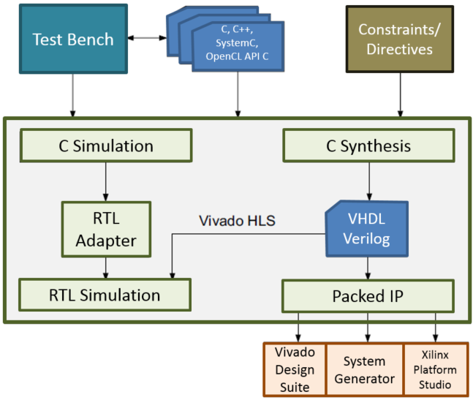
C Validation and RTL Verification
There are two steps to verifying the design
Pre-synthesis: C Validation
Validate the algorithm is correct
Post-synthesis: RTL Verification
Verify the RTL is correct
C validation
A HUGE reason users want to use HLS
Fast, free verification
Validate the algorithm is correct before synthesis
Follow the test bench tips given over
RTL Verification
Vivado HLS can co-simulate the RTL with the original test bench
Validate C
Verify RTL

Slide 40
C Function Test Bench
The test bench is the level above the function
The main() function is above the function to be synthesized
Good Practices
The test bench should compare the results with golden data
Automatically confirms any changes to the C are validated and verifies the RTL is correct
The test bench should return a 0 if the self-checking is correct
Anything but a 0 (zero) will cause RTL verification to issue a FAIL message
Function main() should expect an integer return (non-void)
int main () {
int ret=0;
…
ret = system("diff --brief -w output.dat output.golden.dat");
if (ret != 0) {
printf("Test failed !!!\n");
ret=1;
} else {
printf("Test passed !\n");
}
…
return ret;
}

Slide 41
Determine or Create the Top-level Function
Determine the top-level function for synthesis
If there are Multiple functions, they must be merged
There can only be 1 top-level function for synthesis
Given a case where functions func_A and func_B are to be implemented in FPGA
Re-partition the design to create a new single top-level function inside main()
main.c
main.c
int main () {
...
func_A(a,b,*i1);
func_B(c,*i1,*i2);
func_C(*i2,ret)
return ret;
}
#include func_AB.h
int main (a,b,c,d) {
...
// func_A(a,b,i1);
// func_B(c,i1,i2);
func_AB (a,b,c, *i1, *i2);
func_C(*i2,ret)
return ret;
}
func_A
func_B
func_C
func_AB
func_C
func_AB.c
#include func_AB.h
func_AB(a,b,c, *i1, *i2) {
...
func_A(a,b,*i1);
func_B(c,*i1,*i2);
…
}
Recommendation is to separate test bench and design files
func_A
func_B

Slide 42
Outline
Introduction to High-Level Synthesis
High-Level Synthesis with Vivado HLS
Language Support
Validation Flow
Summary

Slide 43
Summary
In HLS
C becomes RTL
Operations in the code map to hardware resources
Understand how constructs such as functions, loops and arrays are synthesized
HLS design involves
Synthesize the initial design
Analyze to see what limits the performance
User directives to change the default behaviors
Remove bottlenecks
Analyze to see what limits the area
The types used define the size of operators
This can have an impact on what operations can fit in a clock cycle

Slide 44
Summary
Use directives to shape the initial design to meet performance
Increase parallelism to improve performance
Refine bit sizes and sharing to reduce area
Vivado HLS benefits
Productivity
Portability
Permutability

