Slide 1



HEPIX 2017 Budapest
Michele Michelotto

Slide 2
Statistics
First HEPIX meeting @ Budapest
125(!) registered participants
  102 from Europe, 13 from Asia, 9 from North America and 1 from Israel
  Representing 35+ organizations
66 contributed presentations
Special network security workshop by Liviu Valsan (CERN)
  A call to coordinate response to security incidents among HEPIX sites

Slide 3
More Statistics
Presentations by track
  Site Report (18)
  Security & Network (9)
  Storage & Filesystems (8)
  Grid & Clouds (7)
  Computing & Batch (8)
  IT Facilities & Business Continuity (4)
  Basic IT Services (8)
  End-User Services (2)
  Miscellaneous (2)
Some newcomers and not recently seen participants (CSCS, JSI, Aachen, Zurich, KISTI, Tata, Alba, NRC) – encourage continued participation

Slide 4
Site Report
CERN’s Migration away from AFS underway
  Some impact at various sites
  Replacement options (CERN Box, BNL Box, IHEP Box, EOS, CVMFS, etc)
Bologna, DESY, LAL, BNL, RAL, etc reported on the construction of new facilities and activities
  Absorb smaller data centers and consolidate for more efficient operations
  Branch out into newer domains (ie, weather forecasting & atmospheric research, photon sciences, biology, etc)

Slide 5
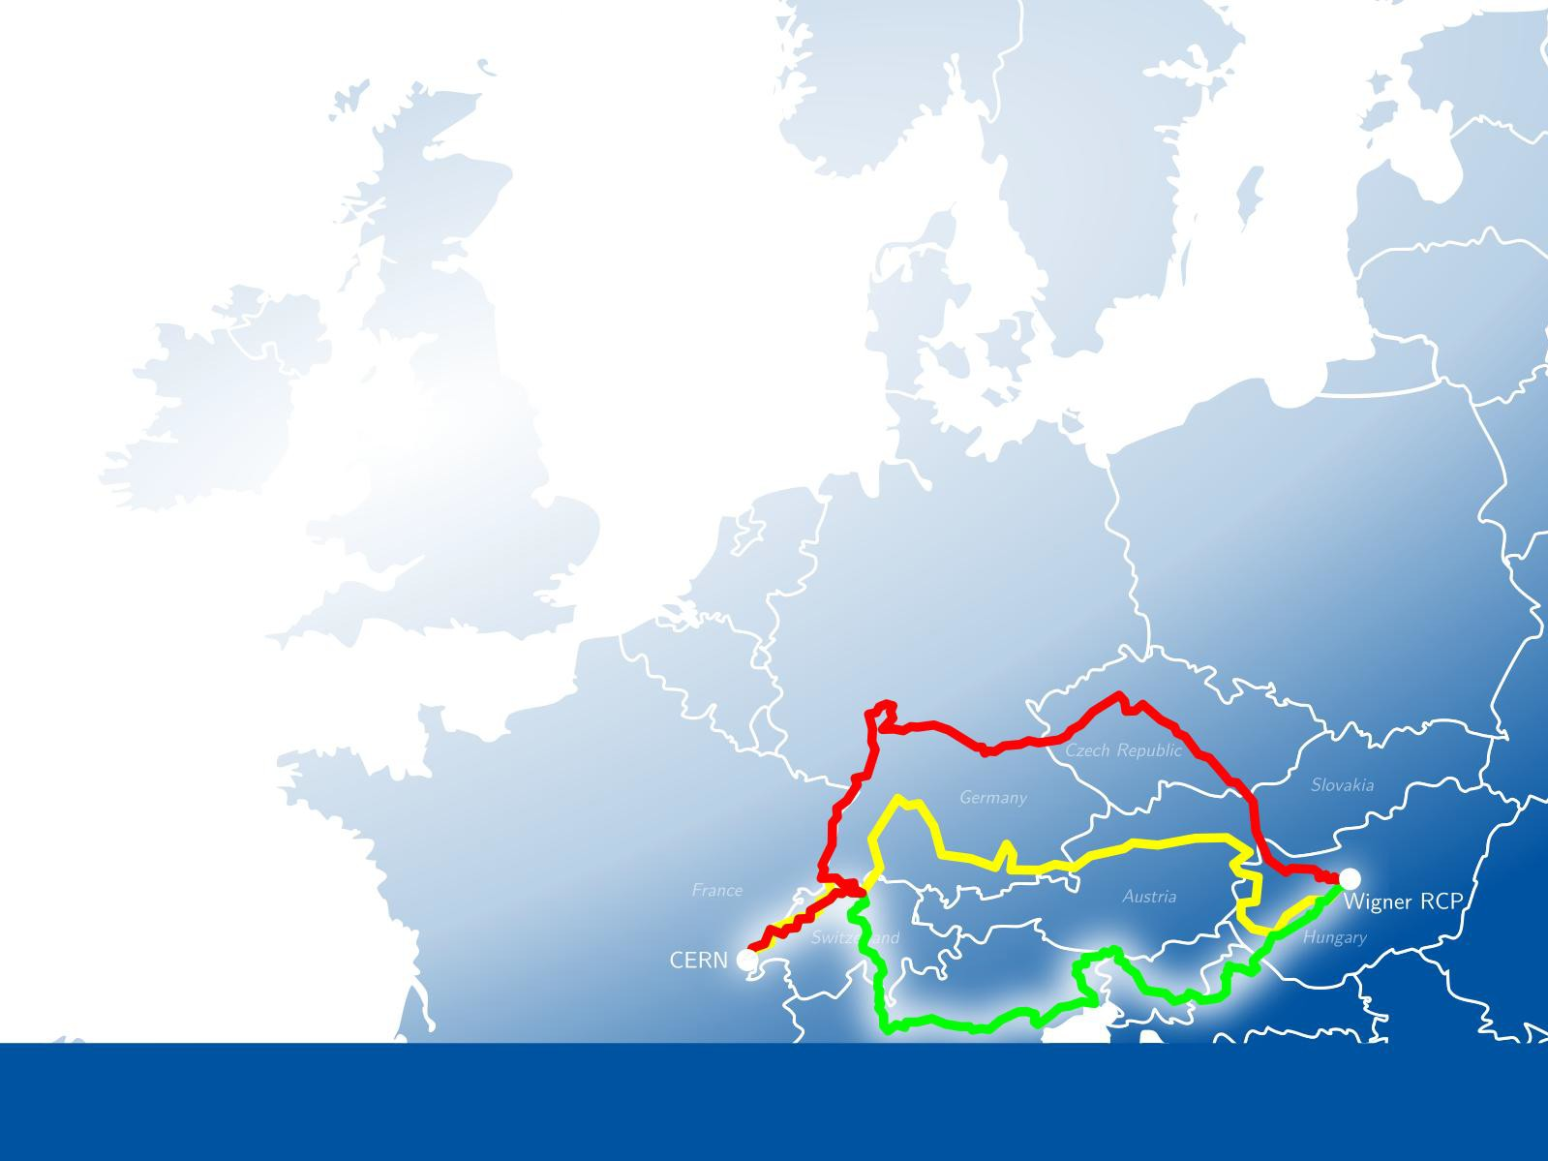

IT Department at CERN
Enabling the laboratory to fulfil its mission
^{❼} Main data centre in Meyrin site
^{❼} Wigner data centre in Budapest, 23 ms away
^{❼} Connected via 3 dedicated 100-Gb/s links
^{❼} Service resources in both sites where possible
(+ disaster recovery)
4

Slide 6
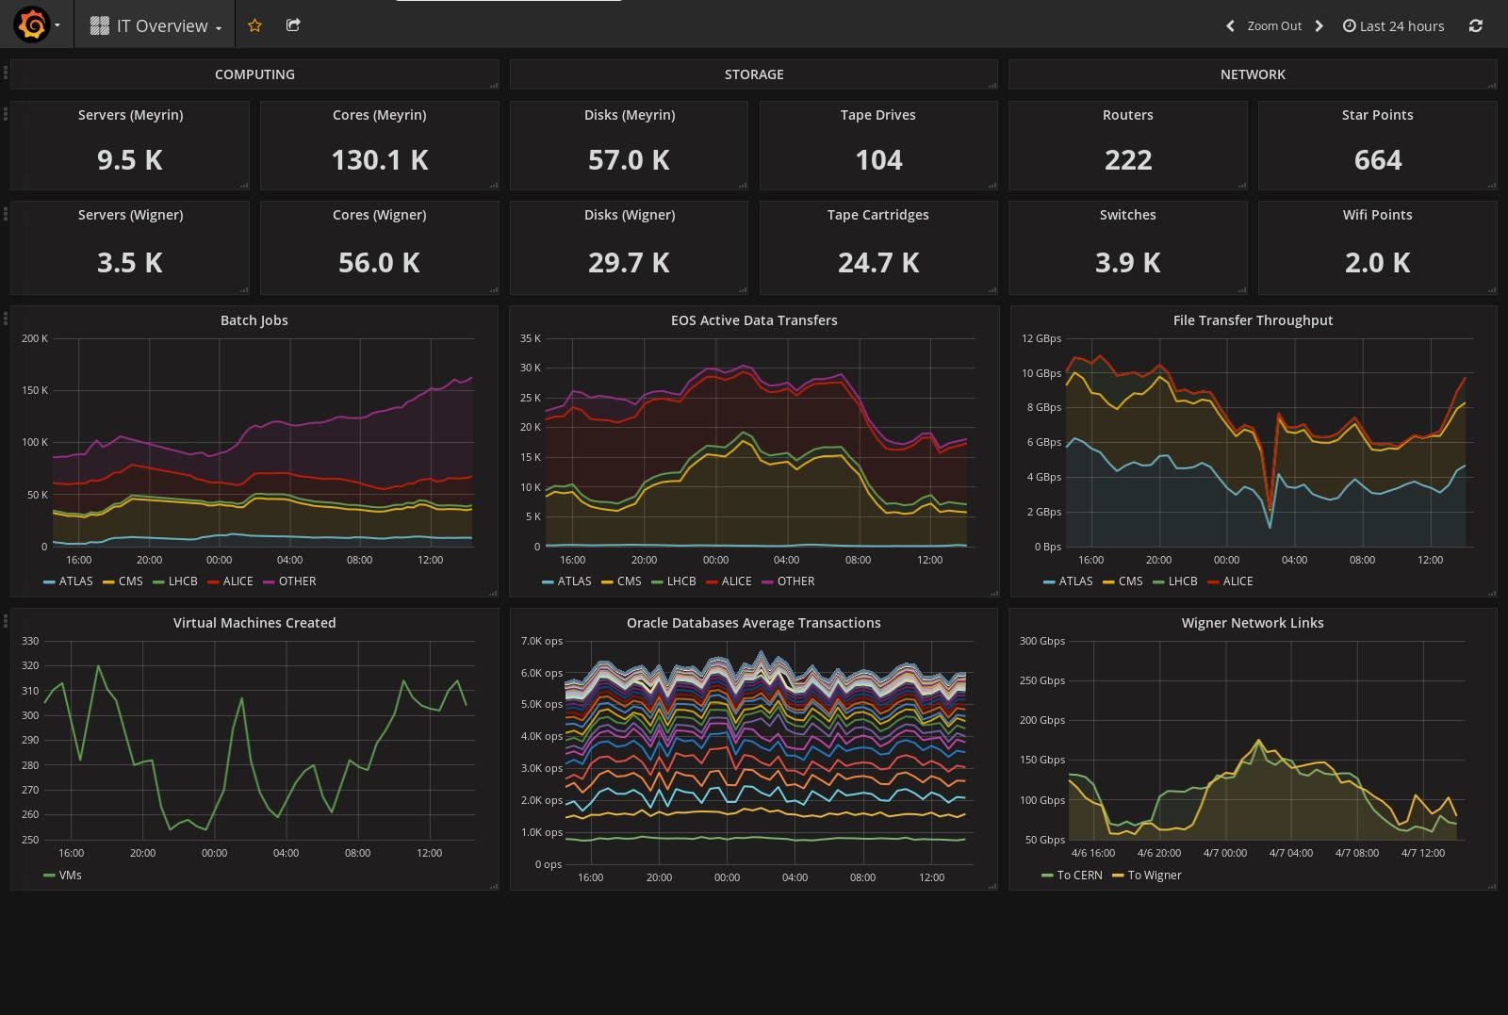

Slide 7
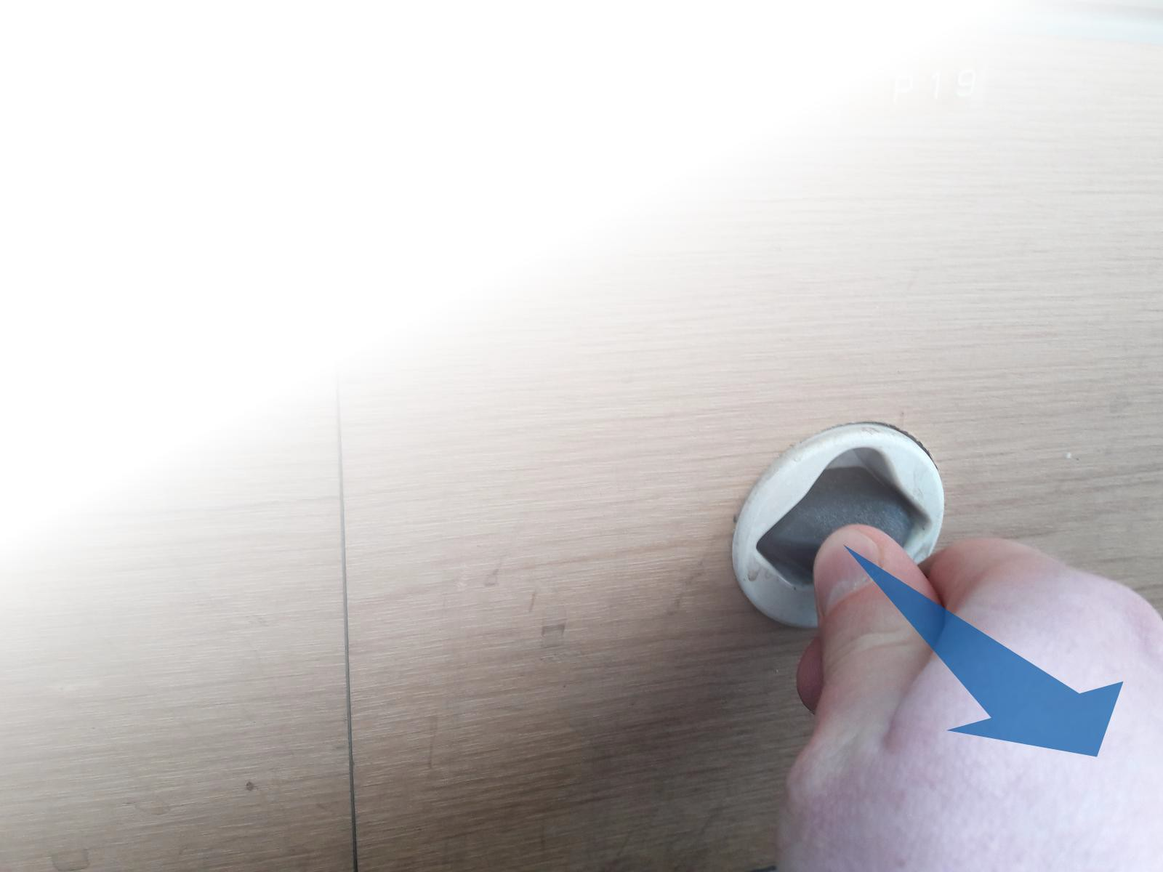
External AFS Disconnection Test
^{❼} In the context of the AFS phaseout
^{❼} Disconnection test: 15 March, 9:00 CET https://twiki.cern.ch/twiki/bin/view/ IT/AfsPhaseoutExtDisco
^{❼} Flush AFS dependencies
^{❼} Few sites affected, little feedback from experiments
^{❼} Will do again, for longer

Slide 8
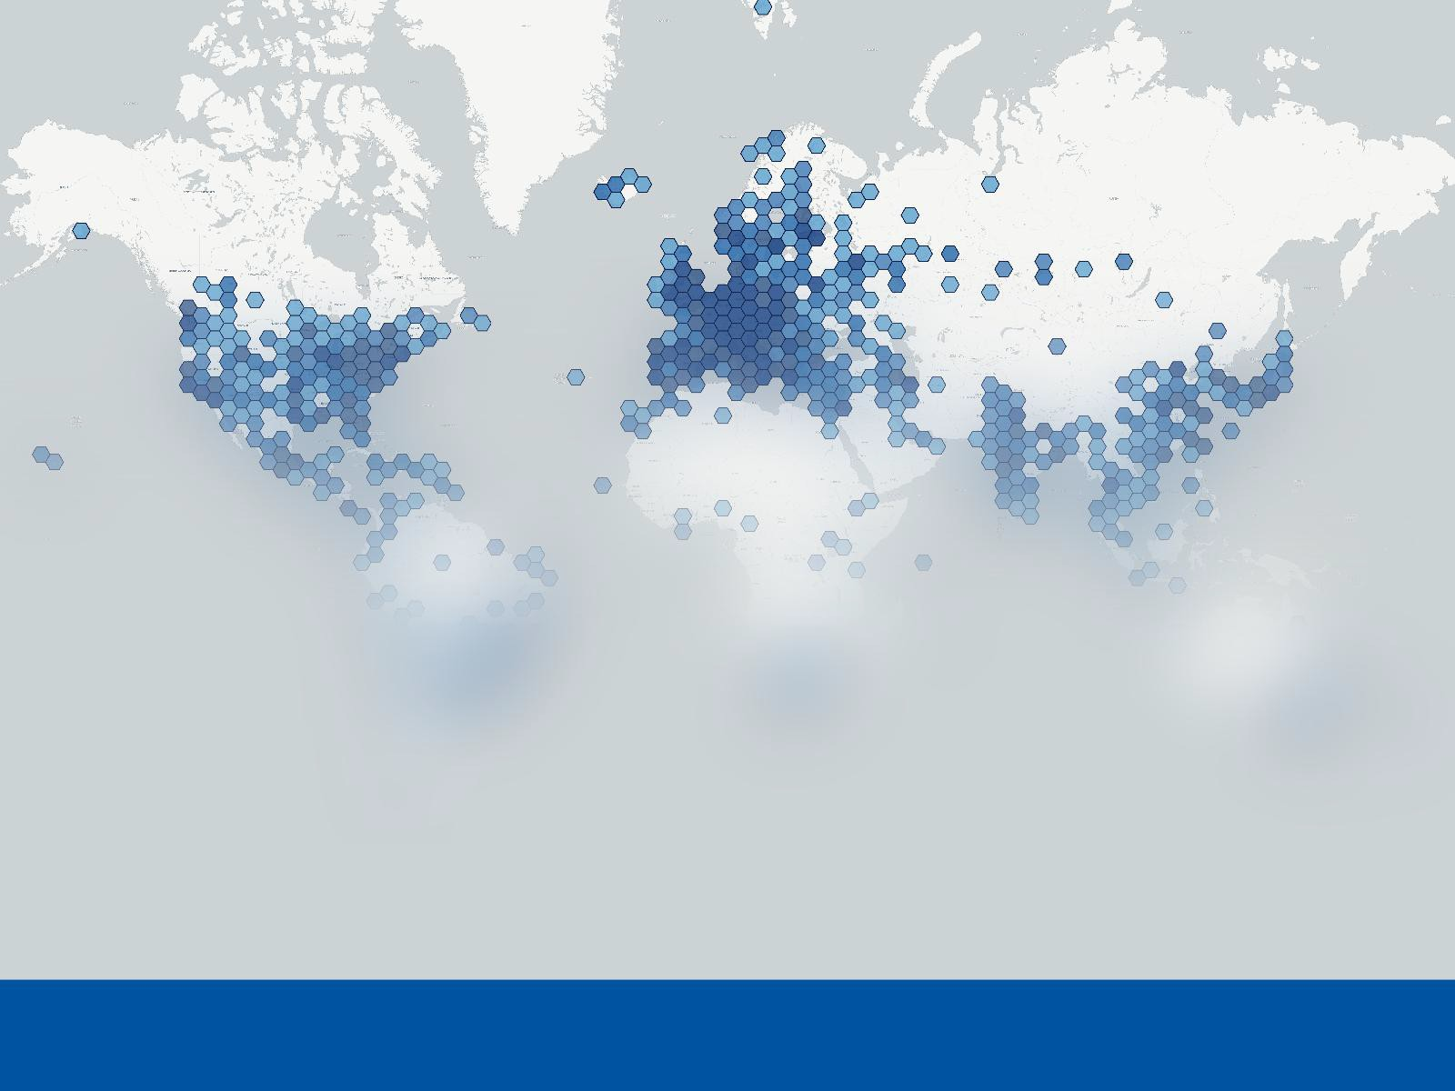

Storage: Disk Operations (I)
Impressive growth of EOS,
CERNBox
^{❼} 170 PB, 1.3 billion files
^{❼} Preparing next delivery of 100 PB
^{❼} 9500 CERNBox users

Slide 9
Batch Services: High-Throughput
^{❼} 130k CPU cores, expecting 200k end of 2017
^{❼} 650k jobs/day
^{❼} 50% LSF, 50% Condor
^{❼} Moving major users and all LHC by Q3 2017
^{❼} Training, staff to help migrate
^{❼} Understanding CPU efficiency
^{❼} Better HW, multicore support, CC7, cgroups
^{❼} Investigating expanding the pool with lower SLA work, by using under-utilised capacity, e.g. disk servers

Slide 10
Security
SSO for trusted organisations:
^{❼} eduGAIN supports 1000s of organisations
^{❼} CERN supports Sirtfi-compliant organisations Future authorisation service:
^{❼} To manage authorisation for apps
^{❼} App-specific roles WhiteHat training:
^{❼} Pen-testing for improving security and resilience
^{❼} Trainings given regularly

Slide 11

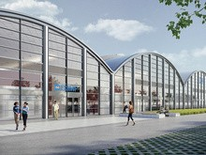


ECMWF moving to Bologna!
Bologna has been chosen to host the new Data Center of the
European Center for Medium-­‐Range Weather Forecasts (ECMWF).
INFN-­‐T1, CINECA and ECMWF all located in Bologna
  CINECA #12 on top 500
  ECMWF #24 on top 500
Bologna to become one of the biggest center for computing in Europe
The new facility would be shared with other users
  An opportunity for INFN-­‐T1 to move to the same location
  May mark the end of “Garage Era” for INFN-­‐T1
24-­‐Apr-­‐2017
Vladimir Sapunenko
4

Slide 12
Extending the farm 2nd phase
We successfully extended our farm to BARI
• 20k HS06
New challenge: use a cluster hosted by CINECA
  Computing nodes from Marconi cluster
    2x 2697v4 CPUs
    128 GB RAM
    2 x 1TB SAS disks
    2x 10GbE links
  Adopted BARI ReCaS approach
  Next year some pledges may come from this cluster
24-­‐Apr-­‐2017
Vladimir Sapunenko

Slide 13
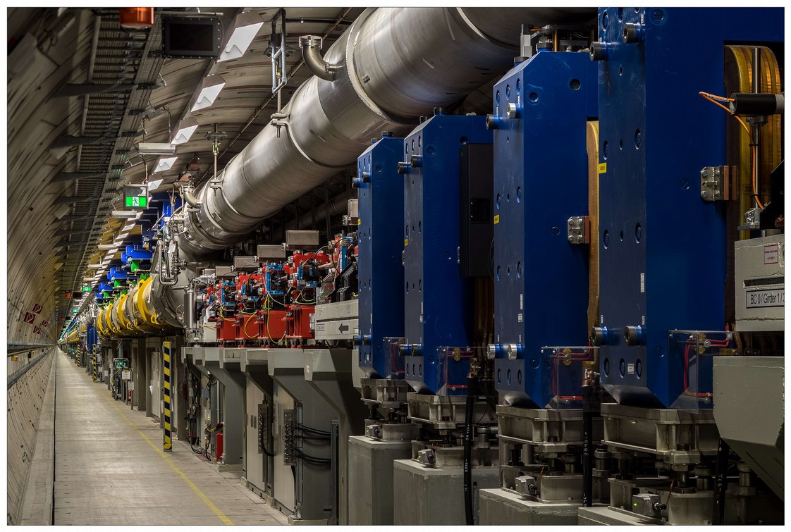
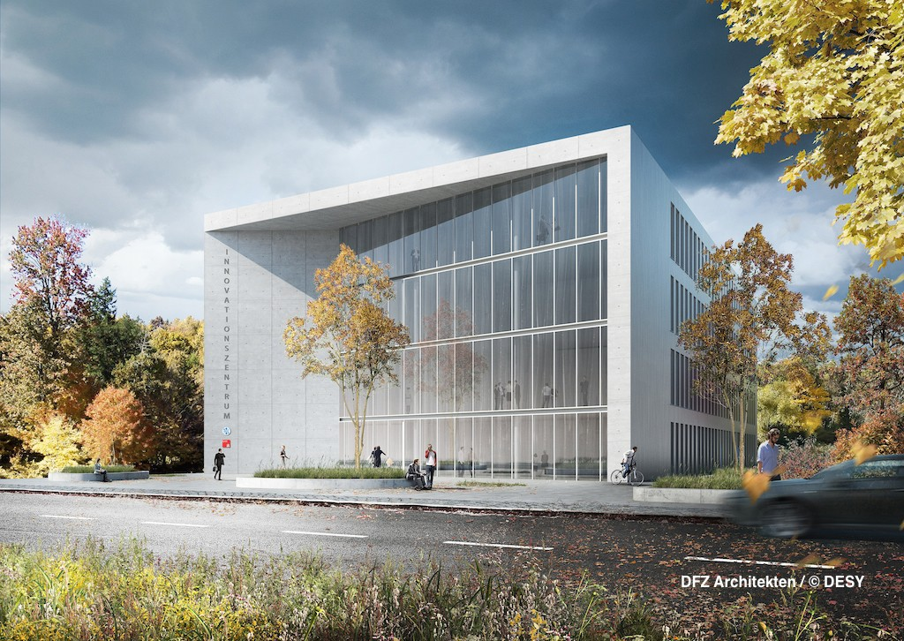
Facilities
> XFEL status
Construction of the superconducting part finished in September last year
Cooling started in December last year
First electrons in the -271°C cooled main accelerator in January
> DESY hosts the XFEL scientific computing and data management centre
Quite a lot of resources on the HPC cluster and XFEL dCache instance
> Starting signal for the Innovation Centre
Joint project by DESY, University of Hamburg & City of Hamburg
Limited company was founded that will run the centre
Construction work will begin this year

Slide 14
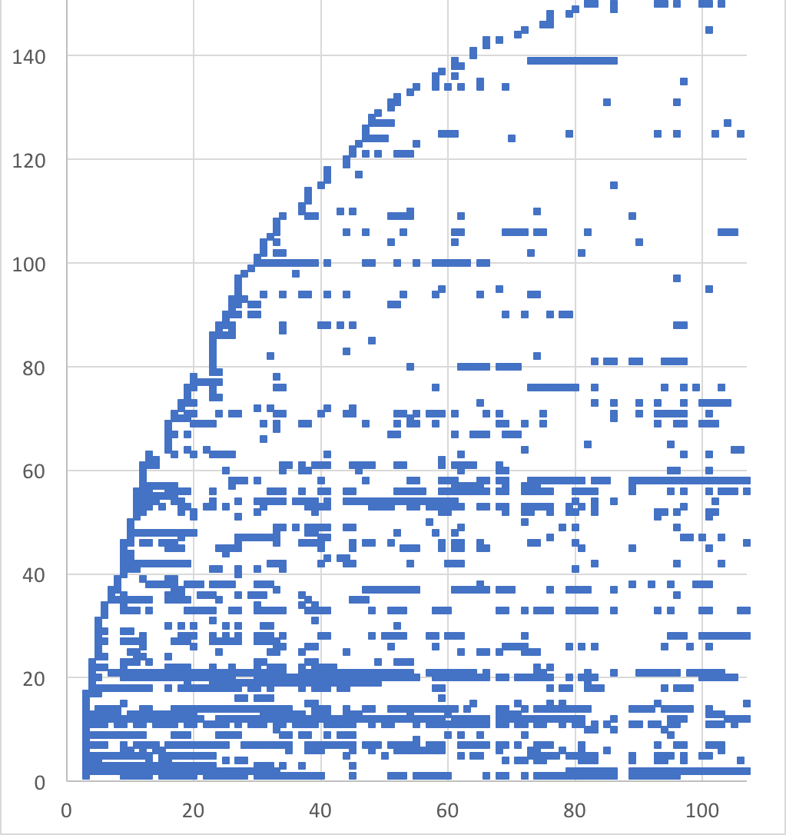
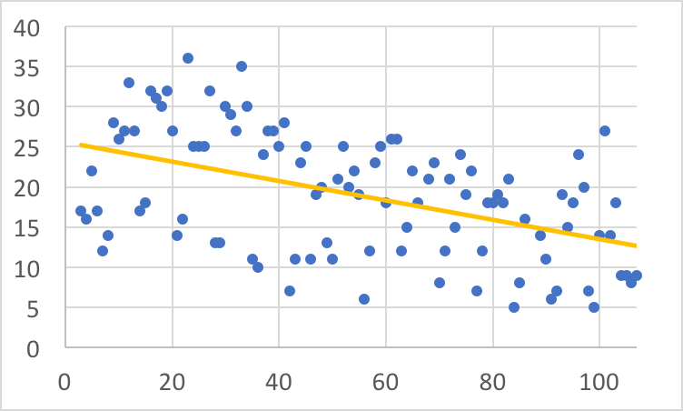
CERN AFS at DESY (HH)
Access of users dot: access, white: no access
> Background:
CERN to decomission its AFS cell
CERN hides AFS on 15.2.2017
DESY largest off-site user of CERN AFS
> Potential impact at DESY
NAF users have access to AFS
Grid-WNs have AFS
> On 3.1.2017, implemented a script
Basically lsof | grep /afs/cern.ch every 5 minutes on all relevant nodes
Plus some mimicry around
> Send one email to each users that has accessed CERN AFS the previous day
Some users ignore the emails
User n
Days since 3.1.2017
#users / day Trend decreasing
Andreas Haupt | DESY Site_{D}R_{a}ep_{y}o_{s}rt |_{si}2_{n}01_{c}7_{e}-04₃-2.4_{1.}| ₂P₀ag₁e₇7

Slide 15
CERN AFS at DESY (HH) cont.
> Access to which destination?
Mostly stuff also in CVMFS
~9% of files in user/work directories
> Grid: Interesting case
For years, DESY Grid WNs did not have AFS
Since ~1 year, they have AFS
ATLAS, CMS and LHCb show activity
CMS mainly user and work areas. How did they do before? No-one complained!
ATLAS: „...will not fix older sw with afs rpaths“
LHCb: Changed things, but not 100% AFS-free
„recommendation is therefore that sites remove the CERN AFS cell from the worker nodes “ ... Sites should not be forced to change their setup because of bad experiment software...
> Future:
„Hiding CERN AFS“ activities are OK
To be effective, they need to be much longer than 24h ... minimum 1 week
/afs/cern.ch/cms/slc6_amd64 | 33,9%
/afs/cern.ch/sw (non-ROOT) 29,5%
/afs/cern.ch/sw (ROOT) 9,4%
/afs/cern.ch/work 7,7%
/afs/cern.ch/cms/share 5,6%
/afs/cern.ch/atlas/project 3,8%
/afs/cern.ch/atlas/software 3,4%
/afs/cern.ch/user 1,8%
/afs/cern.ch/atlas/offline 1,8%
/afs/cern.ch/eng 1,6%
/afs/cern.ch/cms/lumi 1,1%
/afs/cern.ch/atlas/groups 0,3%
> Alternatives?
Tell users about CVMFS
CernBox on DESY shared resources?

Slide 16
Miscellaneous
> New Identity & Access Management System (IAM) went into production
Used to keep track of the 30k+ people registered at DESY
Gears towards delegated administration while maintaining a central life cycle management
> New email quarantine system productive
Shall help in protecting from malware
Ransomware is increasingly evolving into a nasty problem...
> Web-based training infrastructure established for security and safety instructions
for: DESY, EXFEL, CFEL
> Windows 10: Starting pilot phase within next weeks
Plan: Mostly CBB (Current branch for business), some rare LTSB (Long Term Servicing Branch) for machine control systems
Some current investigation: Privacy settings / MS-AppStore / Additional (Cloud-)Storage
> Infrastructure hosted for whole BELLE-II collaboration
Membership Management Services
Collaboration Services

Slide 17
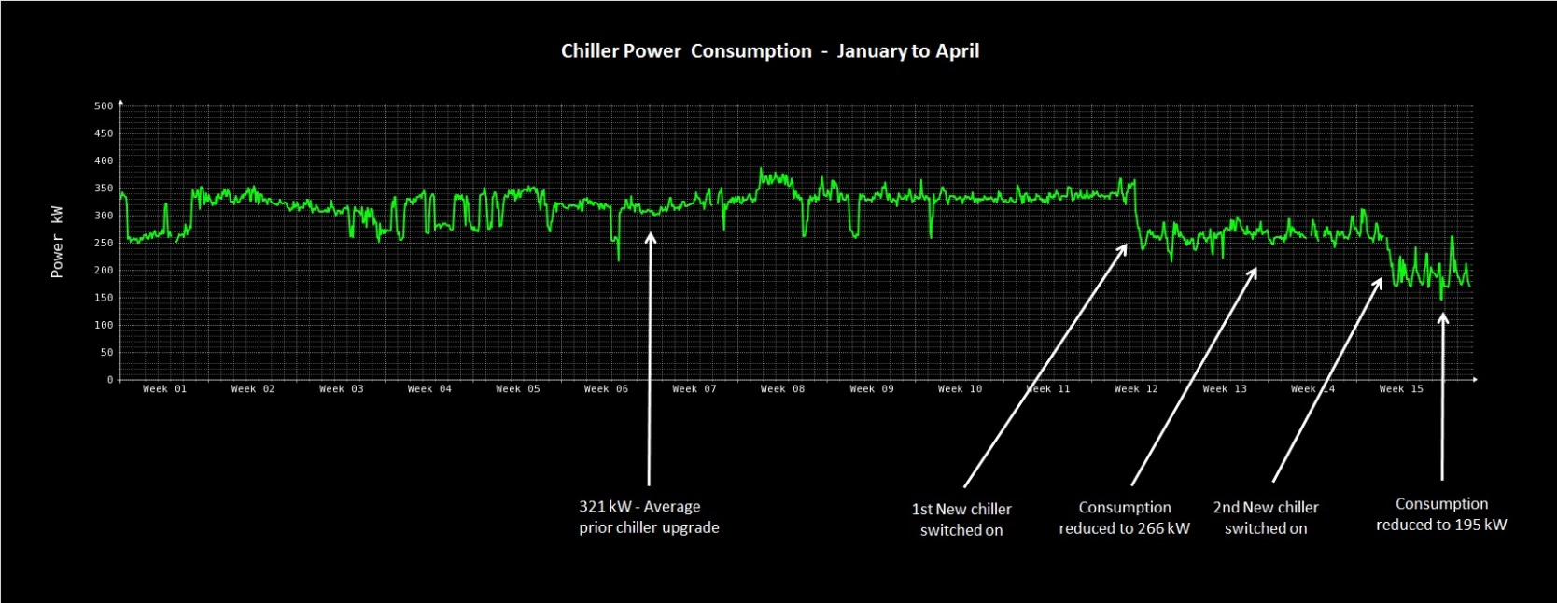
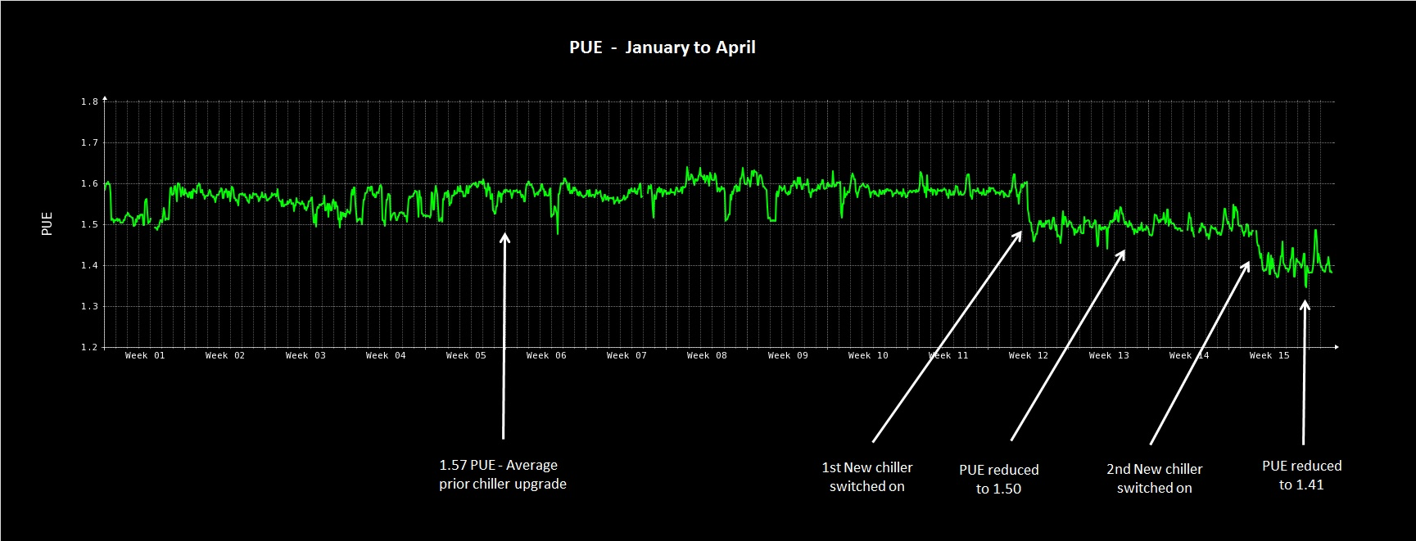
Power / PUE

Slide 18

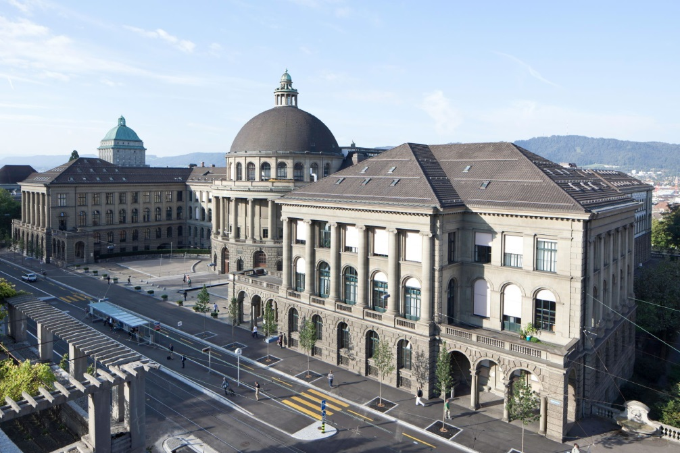
Swiss National Supercomputing Centre
Located in Lugano, Switzerland
Unit of the Swiss Federal Institute of Technology in Zurich (ETH Zurich)
  Flagship machine: Piz Daint
    Hybrid Cray XC50/XC40 system
    Intel E5-2690v3 - NVIDIA Tesla P100 / Intel E5-2695v4
Lugano Lake View
ETH Zürich View

Slide 19
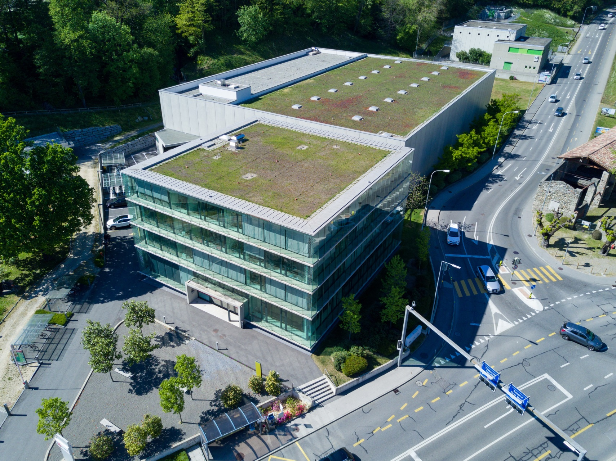
CSCS Facility - Offices and machine room

Slide 20
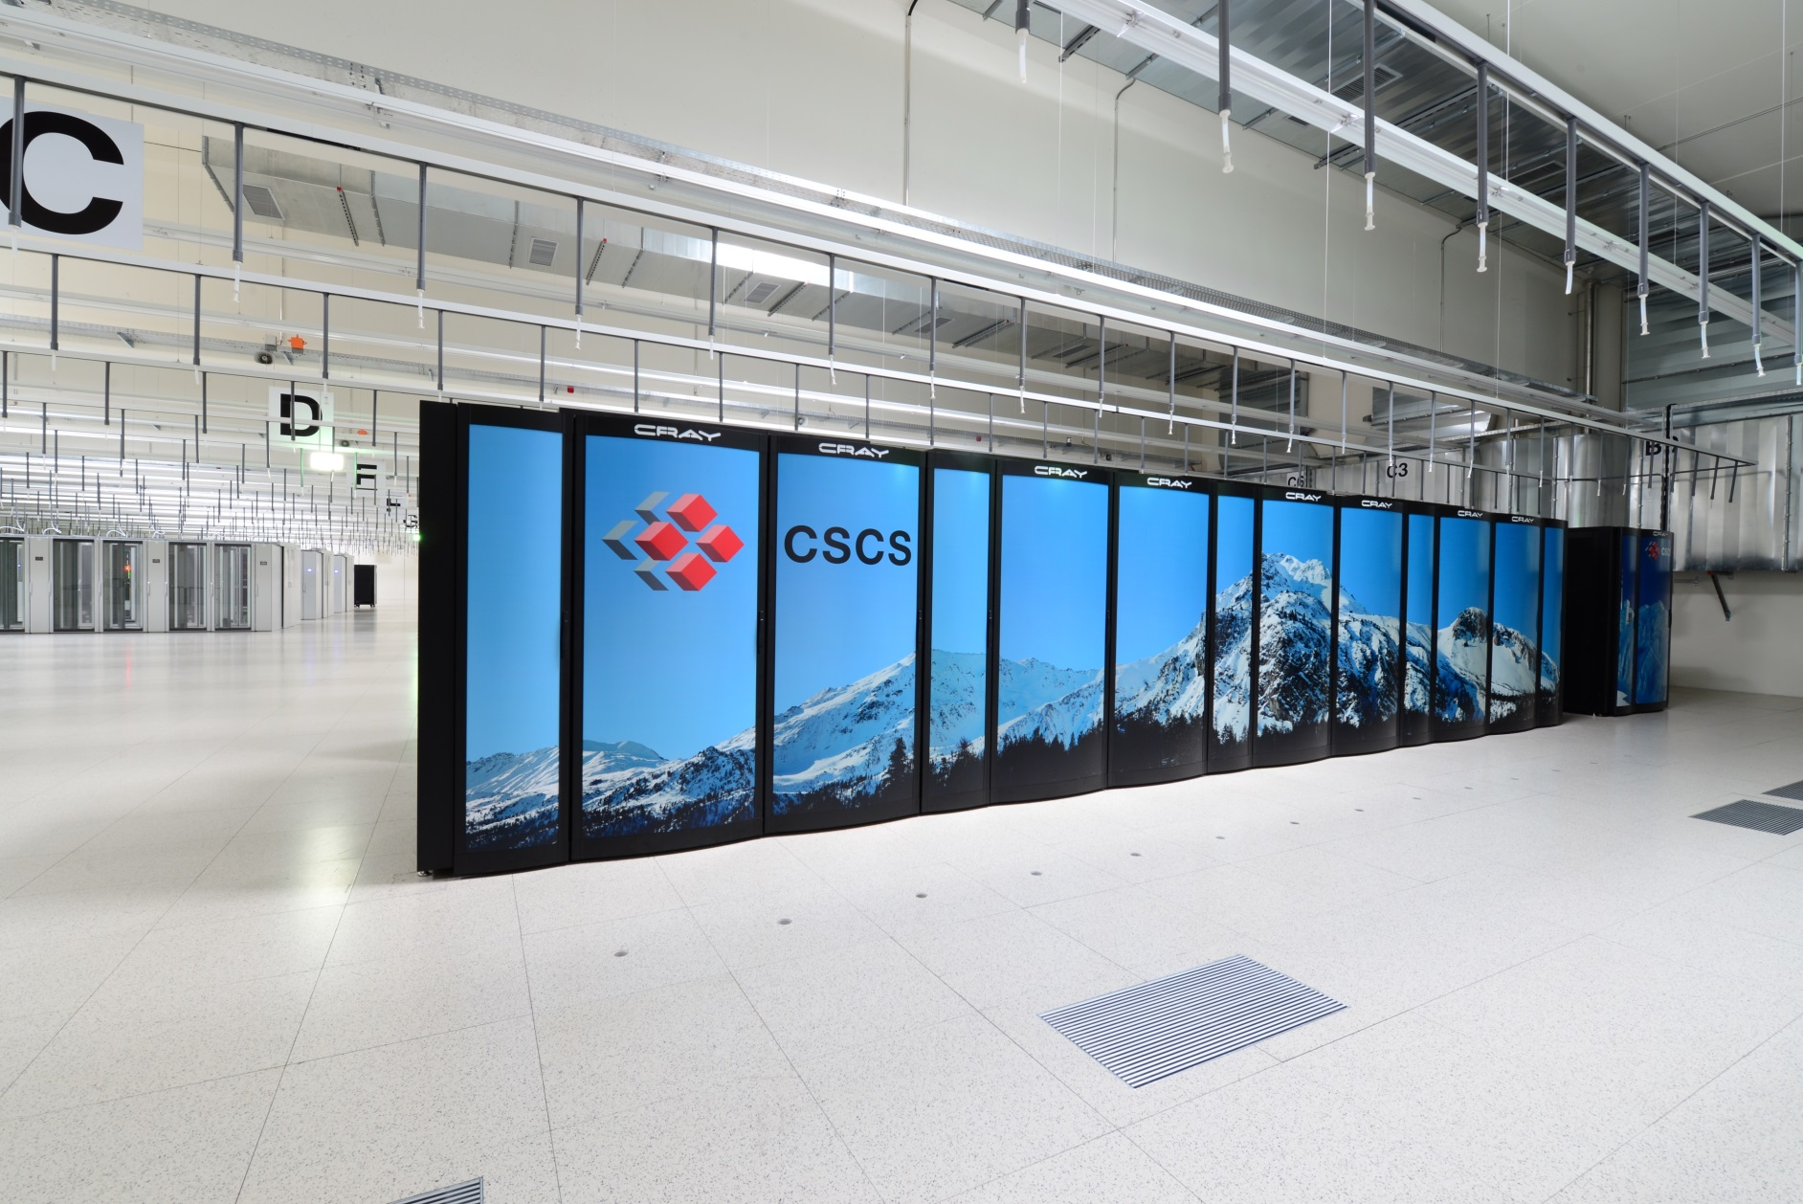
CSCS Facility – Machine room – Piz Daint

Slide 21
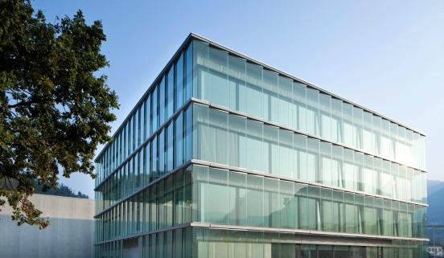
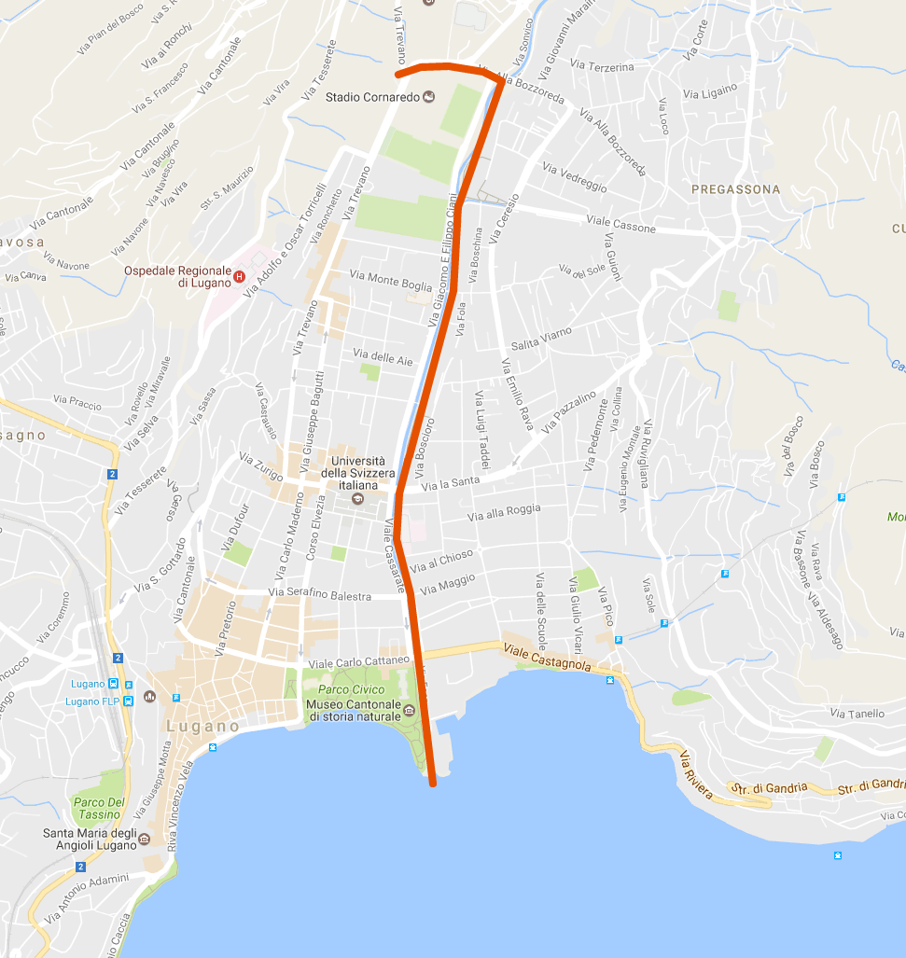
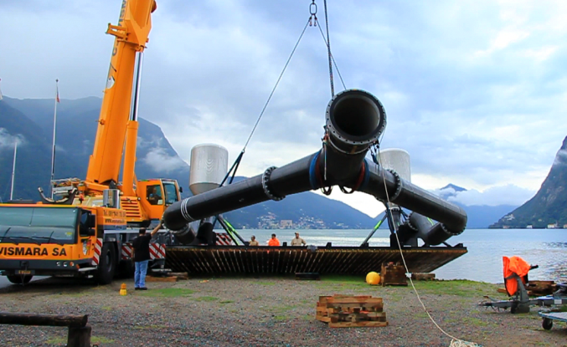
CSCS Facility – Free cooling (lake water)
Pipeline length: 2.8 km
High difference: 30 m
Max. flow rate: 760 l/s
Water taking depth: 45 m
Water temperature: 6 °C

Slide 22
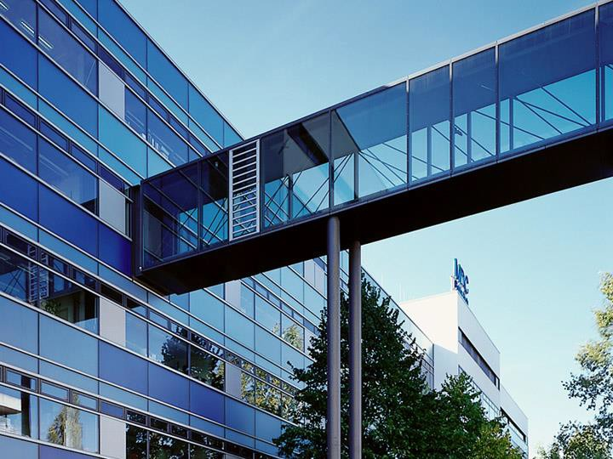





Page 1
Site Report
Dr. Alf Wachsmann
CIO Max Delbrück Center for Molecular Medicine Scientific Computing Berlin Institute of Health
HEPiX, Spring 2017

Slide 23
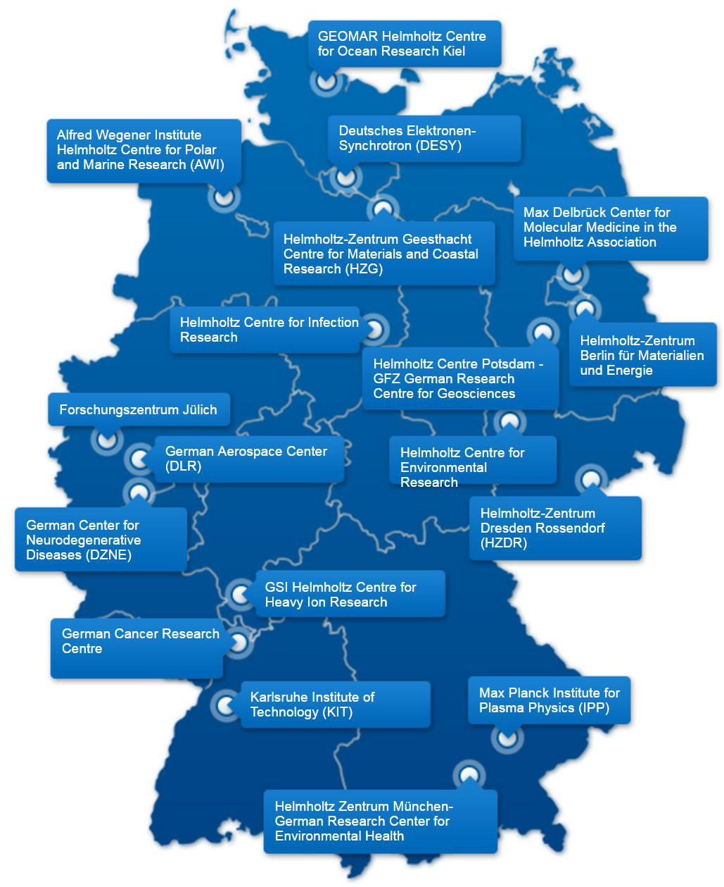
















Helmholtz Association
Largest research organization in Germany
18 national research centers (6 with
focus on Health Research)
More than 38,000 staff
Budget: more than € 4 bn
Max Delbrück Center for Molecular Medicine in the Helmholtz Association (MDC)
Helmholtz Centre for Infection Research (HZI)
Max Delbrück Center for
Molecular Medicine
(HZB)
MDC Core Budget 2014 | € 81 M
Extramural Funding 2014 Shared 2nd place for DFG-funding nationwide | € 23 M
European Research Council (ERC) Grants | 14
Research Groups | 60
Staff (incl. guests), 25% international | 1,653
Postdocs (incl. guests), 50% international | 229
PhD Students (incl. guests), 44% international | 374
Patent families | 95
(UFZ)
German Center for Neurodegenrative Diseases (DZNE)
Basic Facts 2014
German Cancer Research Centre (DKFZ)
Helmholtz Centre Munich – German Research Center for Environmental Health (HMGU)

Slide 24
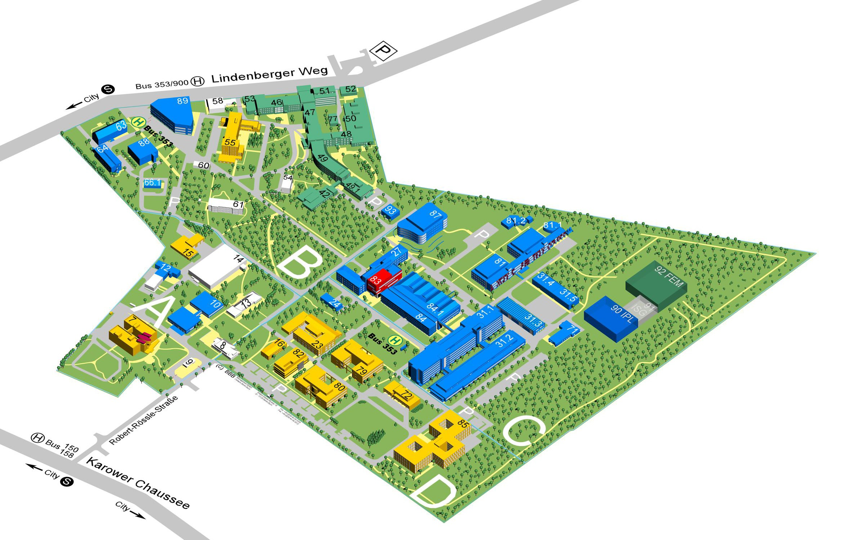



MDC
Leibniz Institute for
Molecular Pharmakology (FMP)
Charité
(Startup) Companies
Common Facilities Research
Clinical Research Companies

Slide 25
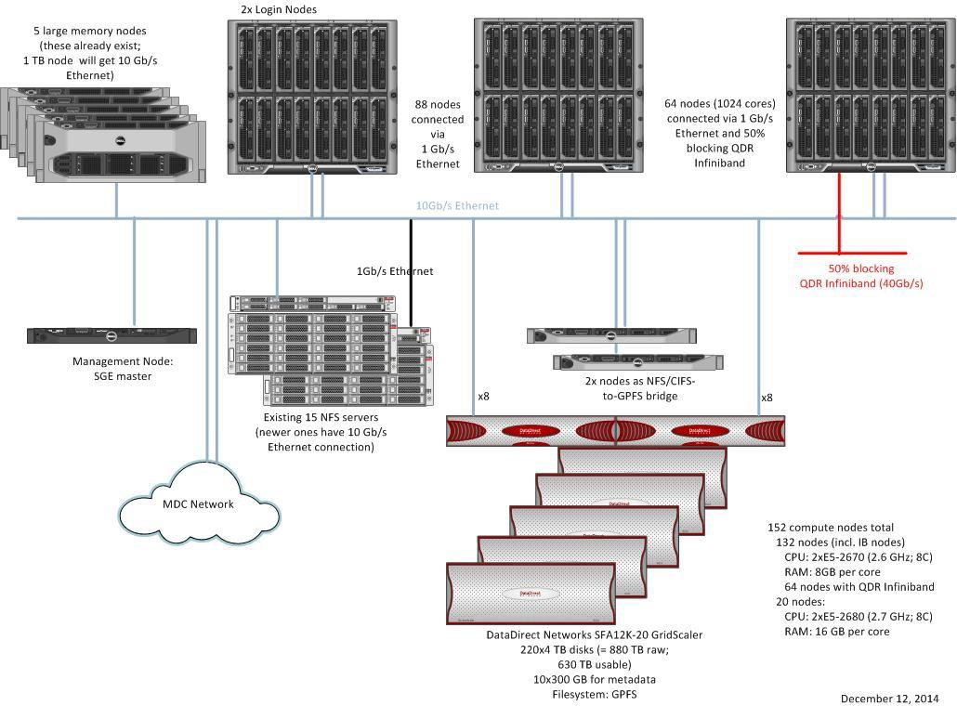
RFP is out for
~70 compute nodes with a 40 Gb/s backbone and 5 Tesla P100 GPUs
HPC
GPFS is now ~830 TB usable
NFS space on
5 Oracle ZFS appliances (HA) and 2 Dell servers.
Total of ~3.4 PB usable space

Slide 26
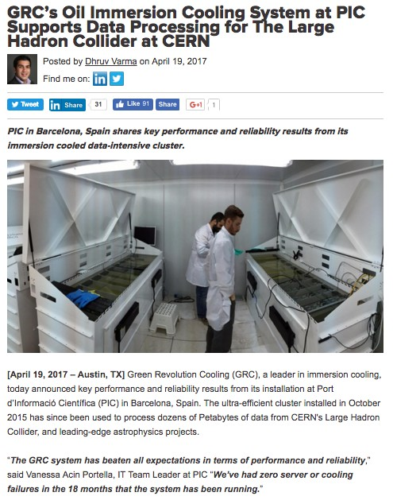
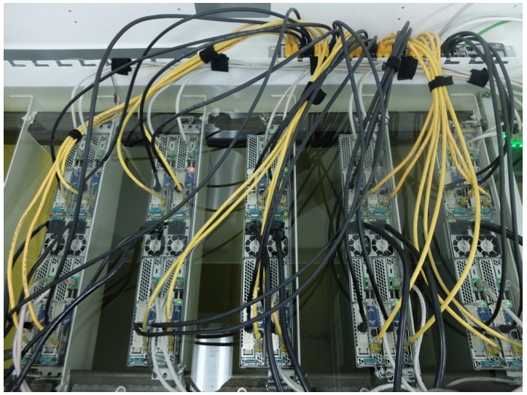
All new CPU is immersed in oil
htp://info.grcooling.com/grc-pic-cern-large-hadron-collider
26

Slide 27
ATLAS AFS Phaseout
ATLAS Tier-1 jobs no longer using AFS
  CVMFS was already providing access to software releases and related files for ATLAS jobs at BNL
  CVMFS Stratum Zero service created to host frequently used job files, including file transfer clients that were hosted in AFS
Remaining AFS functionality being replaced by a multi-tiered solution based around CVMFS — phase out remaining dependencies this year
  New CVMFS repo will cater to US ATLAS facility sites, with read-only access to files customized and collected specifically for US ATLAS job requests
  Current CVMFS Stratum One service will continue to serve OSG and WLCG sites, with the additional functionality of hosting the new BNL repository
  Writeable AFS functionality to be replaced by an ownCloud based, Ceph-backed, distributed storage solution (see Hiro Ito’s BNL Box talk on Wed.)

Slide 28
CEPH Cluster
Major Ceph cluster migration started in March
  Installing new CephFS cluster as a storage backend for BNL Box
    60 x 8 TB SAS HDD JBOD arrays
    Currently 3.8 PB raw/1.3 PB usable; 7.5 PB/2.5 PB by end of 2017
    First Ceph cluster at RACF deployed entirely on new hardware w/o HW RAID
  Repurposing “old” ATLAS Ceph cluster (1.2 PB/0.4 PB) as ATLAS "test" cluster (new OSD nodes, upgraded public network layout)
  Replacing storage backend of ATLAS “new” cluster with newly retired dCache storage — will be 5.7 PB/1.9 PB once the process is finished
Targeting Ceph 11.2.x (Kraken) on RHEL7 for all 3 clusters — currently Ceph 9.2.1 (Infernalis)
Migration will require two reassignments of 'cephgw.usatlas.bnl.gov' alias used by ATLAS Event Service — expected in May.
  Current plan assumes no need to preserve content of 'atlas*' buckets during migration sequence

Slide 29
Nebraska
•
I’m not a hardware person, but a few highlights:
•
Newest purchase has 56 hyperthreads / host and 256GB RAM: specialized CMS jobs can use nearly 5GB RAM / core.
•
Wide majority of worker nodes on 10Gbps. As 40Gbps uplinks are cheap, minimal blocking on top- of-rack switches.
•
This means 200Gbps of filesystem traffic is a non- event.

Slide 30


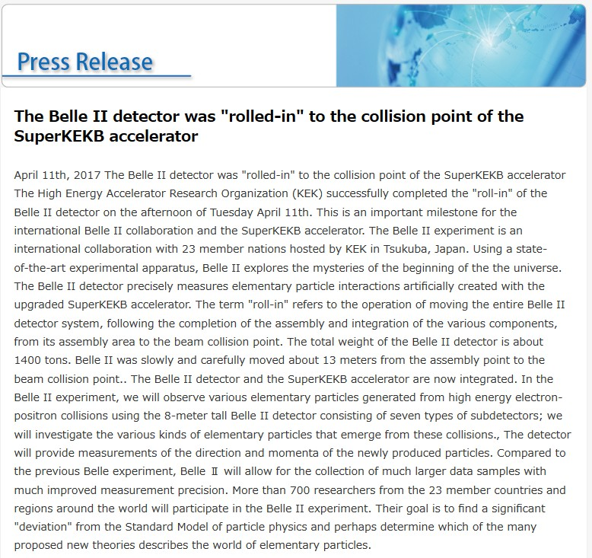
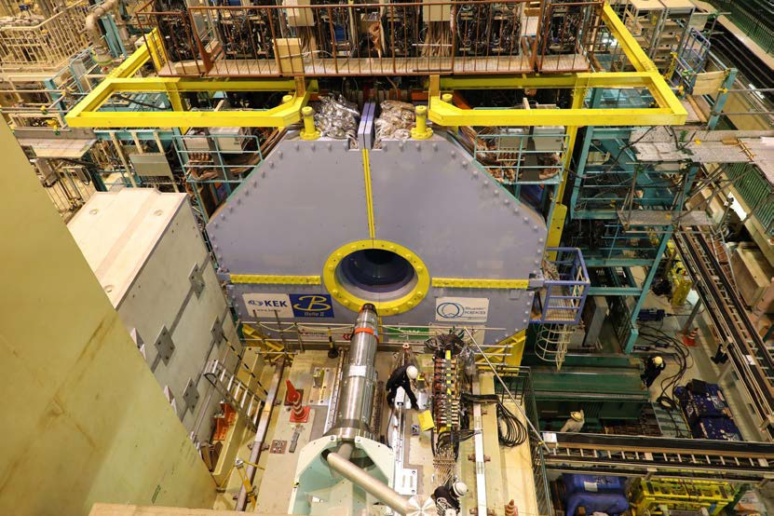
Recent topics from KEK
Mar. 2016: Test operation of SuperKEKB Successful storage of e⁺e⁻ beam
Apr. 2014: Belle II detector was rolled-in
Apr. 11, 2017
http://www.kek.jp/en/NewsRoom/Release/20170411171500/

Slide 31
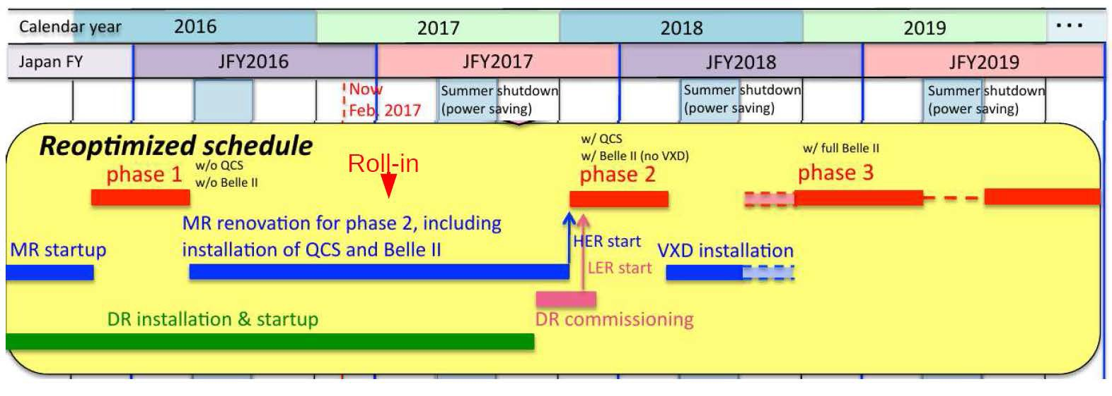
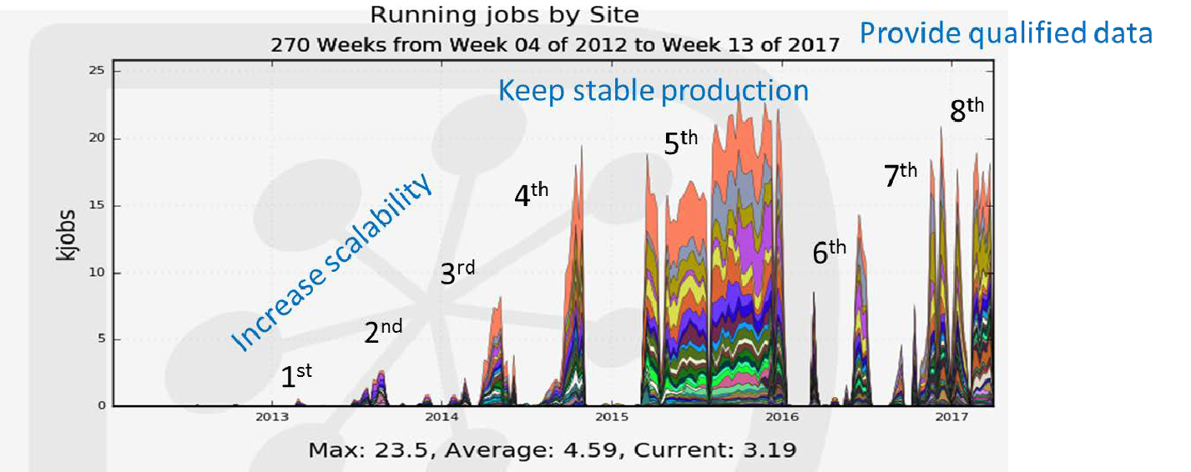
Belle II schedule and distributed computing
K. Akai (B2GM)
R. Ito (JPS meeting)
H. Miyake

Slide 32


Recent update on CE and batch system
Migration of the batch system is ongoing
  Torque/Maui → HTCondor
  In the last year, we deployed a small cluster of ARC- CE+HTCondor combination in production:
CE | Batch system | CPU cores | Job types
CREAM | Torque/Maui | 2304 (96 WNs) | Single-core jobs
 |  | 2304 (96 WNs) | Multi-core jobs
ARC | HTCondor | 1536 (64 WNs) | Single- and Multi-core jobs (dynamic partitioning)
* Dynamic partitioning has been introduced in HTCondor
T.Kishimoto (ICEPP)

Slide 33

Static vs Dynamic partitioning
Number of required CPUs
6000
5000
4000
3000
2000
1000
0
2016-11-14
00:00
2016-11-16
19:12
2016-11-19
14:24
2016-11-22
09:36
2016-11-25
04:48
2016-11-28
00:00

Slide 34


CPU utilization
pbs_server crush
Software maintenance
016
week3,4
 | Nov. week1,2 | 2 |  | Dec. week1,2 | 2016 week3,4 | Jan. 2 week1,2 | 017 week3,4
Torque/Maui (Static partitioning) | 98.8% |  | 93.9% | 88.8% | 94.2% | 95.1% | 75.0%
HTCondor (Dynamic partitioning) | 99.4% |  | 98.0% | 94.8% | 98.5% | 98.4% | 91.1%
*
Test jobs (i.e. ops job) are overcommitted in HTCondor system
Improvement of CPU utilization has been observed thanks to the dynamic partitioning.
HTCondor is stable so far.
- We plan to migrate all CPUs from Torque/Maui to HTCondor in the near future.
T.Kishimoto (ICEPP)

Slide 35

Journal SW&C for Big Science
Online journal, continuous publication, in partnership with Springer
  Christian Caron (Executive Publishing Editor @Springer) associated with the project since its early stage (present at HEPiX in Berlin) and very motivated
  Springer provides all the manuscript handling system to help with an efficient peer-review
  Hybrid business model rather than pure Open Access until potential inclusion into SCOAP³
    Too late for including in phase 2 (2017-2019) but positive preliminary contacts for next phase, even
if not strictly HEP-focused
    In fact, Springer decided to allow free access during the 2 first years… so in fact Open Access for now
Types of articles: topical articles, advanced tutorials, project/technology reviews
  No proceedings: may cause the journal to be excluded from indexing, other places like CHEP
  Do not duplicate what is published somewhere else: would be damage the journal image

Slide 36
Topics: Everything related to SW&Computing
Infrastructures for large-scale, high-throughput computing
Middleware development
Data processing, hosting and sharing
Distributed data analysis
Software development Infrastructures
Software benchmarking and Performance Assessment
Frameworks and software integration
Novel algorithms for efficient data reconstruction and filtering
Deep learning algorithms
Event and object classification
Online/Offline data quality monitoring
Data visualization

Slide 37
VENOM: discovery OF a New Malware
14th of Dec 2016: a site in central Europe reports a root compromise
  Yesterday (13th of Dec), during standard operations activities we revealed a malicious process running on one of our DPM servers <SNIP>. The process seems to provide a backdoor access to the system. It was run under the root user and automatically started upon system boot.
  A more detailed investigation is ongoing right now. We still don't know how the malware got to the box or other details about the intrusion.
  The process in question was running off a program placed
in /var/lib/mkinitramfs, which is a dynamically built ELF executable

Slide 38

VENOM: Malware Analysis
Linux VENOM rootkit, never seen before
Contributions from multiple experts (US, Europe, Asia) The malware has two components:
‣
Userland encrypted backdoor with remote code execution and proxy functionalities
Kernel part featuring additional port-knocking for the backdoor, requiring 3 specific TCP packets:
‣
TCP Source Port + Sequence Number ==
Mysterious P2P traffic on TCP/9090 between compromised hosts
1221
Used for copying source + binaries files between victims?

Slide 39
VENOM: Malware Analysis
‣
Actors behind have excellent opsec:
‣
Binaries are compiled on the victim’s machine in /dev/shm
Paths, including runtime, are changed to always ressemble a legitimate or expected Linux system component
‣
/var/lib/mkinitramfs, /etc/X11/applnk/.window, / usr/share/man/man5/printers_cupsd.conf.5.gz, crond, …
Local log files are erased and filesystem timestamps are manipulated
Persistence across system reboot is relying on a modification of the system init scripts (/etc/rc.d/init.d/ functions)
‣
‣

Slide 40
Email as an infection vector
Easiest way into an organization & most popular infection vector
Generic platforms, more and more dynamic payloads
  From Switzerland, on a Windows 7 machine? Get a banking trojan!
  From US, on a Windows 10 machine? Get some ransomware!
Two main techniques
  Malicious attachements (Microsoft Office, JS, PDF, etc.)
  Malicious URL (random TLDs, but also AWS, Google Drive, Dropbox, compromised Wordpress, etc.)
Difficult to detect and block
Oh, and users will make significant efforts to click!

Slide 41
MAILING CAMPAIGN AT CERN FOR AWARENESS RAISING
‣
Email messages designed by students at the University of Rotterdam
  No inside knowledge of CERN
‣
Click rate in 2016:16.54%*
Click rate in 2017: 18.7%
Percentage of the people that clicked in 2016 and again in 2017: 24.5%

Slide 42
Many reported the phishing emails to us
A total of 938 people out of 19 880 recipients contacted us
The majority reported it as phishing and asked to have it blocked
Some were asking if this is one of our campaigns
And some were asking for what to do after having clicked
‣
‣

Slide 43
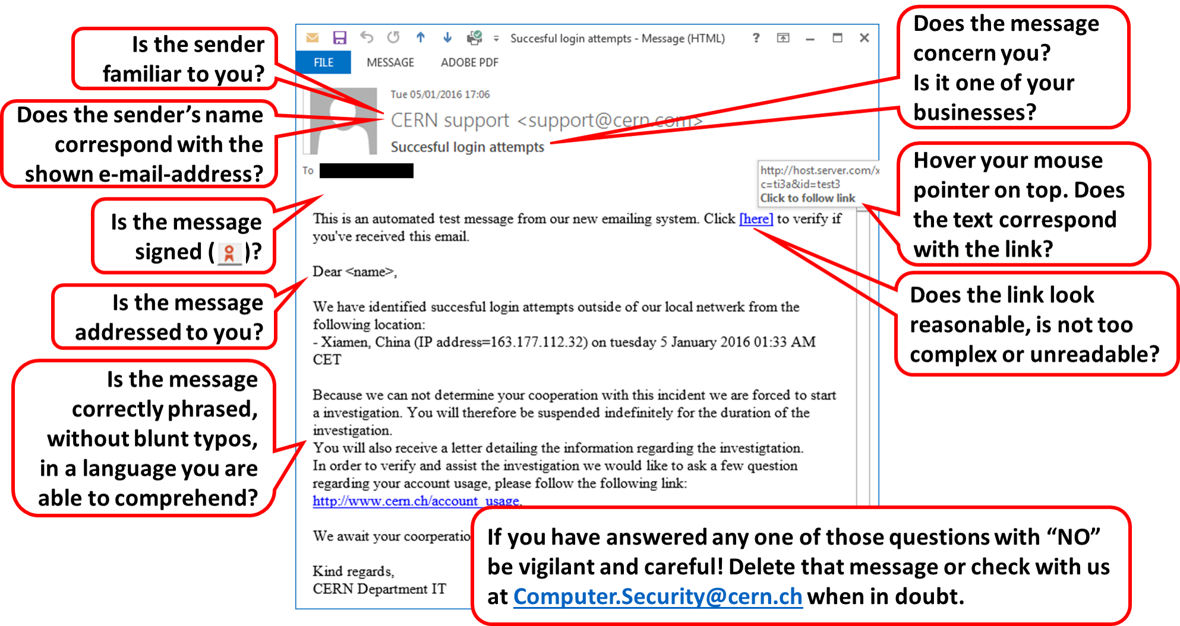
Anyone been to china recently?

Slide 44
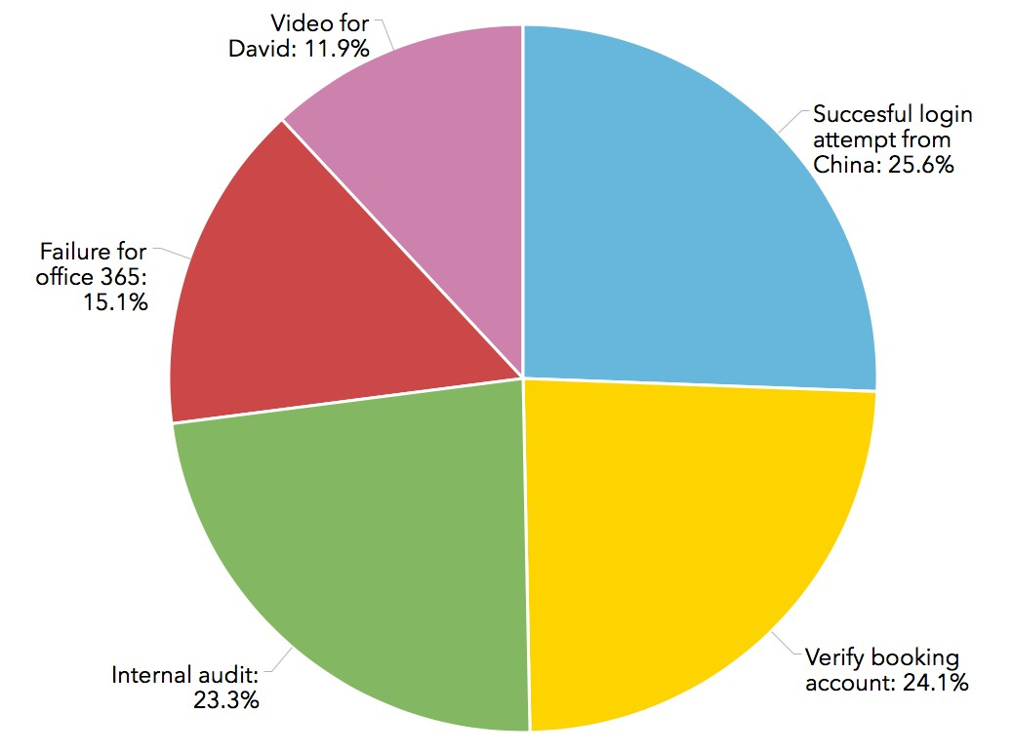
SOME MESSAGES ARE MORE EFFECTIVE THAN OTHERS
Two of the 5 messages used accounted for half of the number of clicks
10

Slide 45
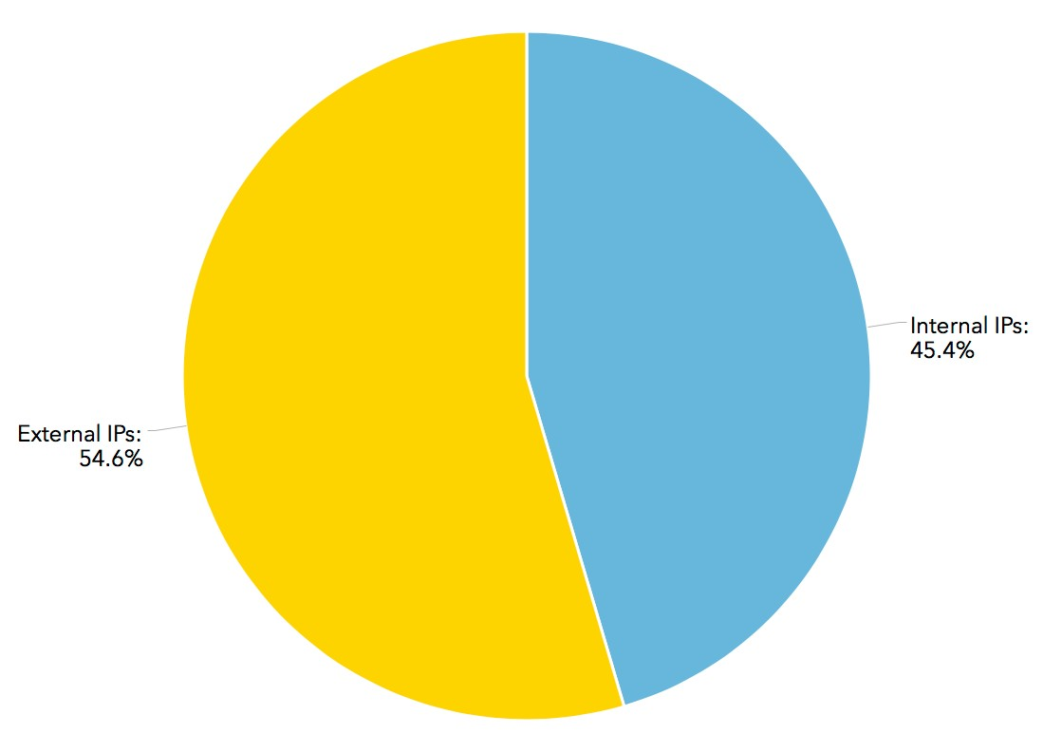
MOST PEOPLE WERE CLICKING FROM OUTSIDE CERN
Blocking malware and phishing domains at the DNS level not 100% efficient
11

Slide 46
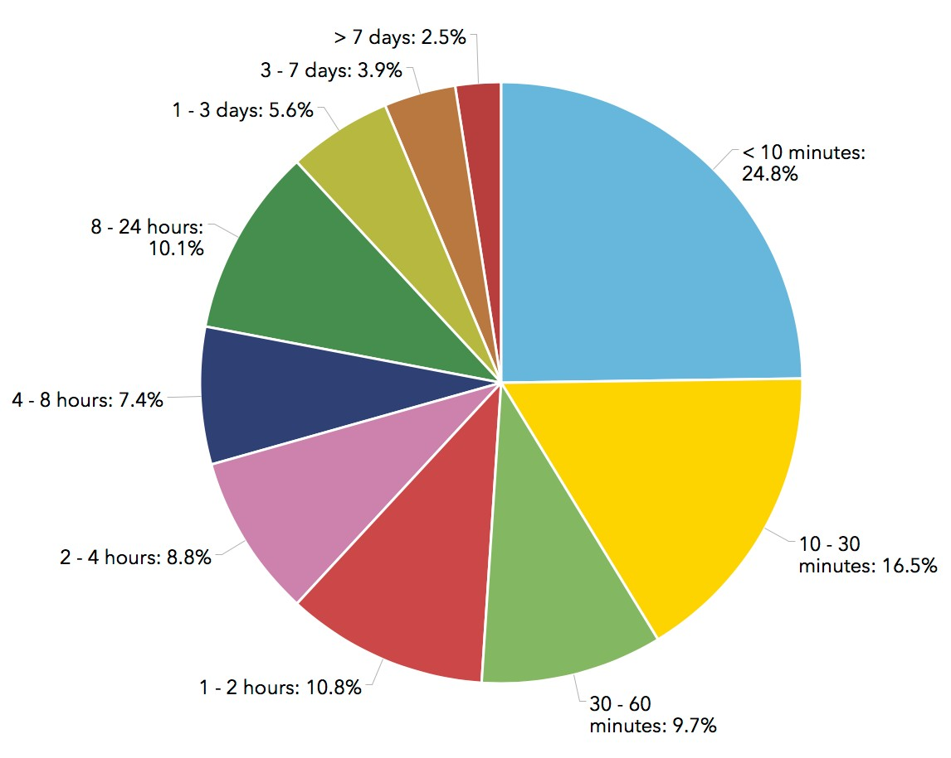
MORE THAN HALF CLICK WITHIN ONE HOUR FROM EMAIL BEING SENT
Ideally blocking should happen before emails start arriving

Slide 47
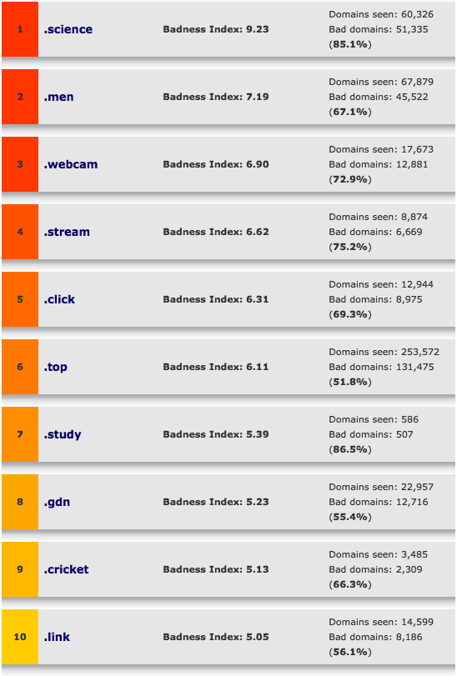
The 10 Most Abused Top Level Domains
Have you seen any legit use for most of these TLDs?
How about blocking access to them at the DNS / proxy level?
Source: https://www.spamhaus.org/statistics/tlds/

Slide 48
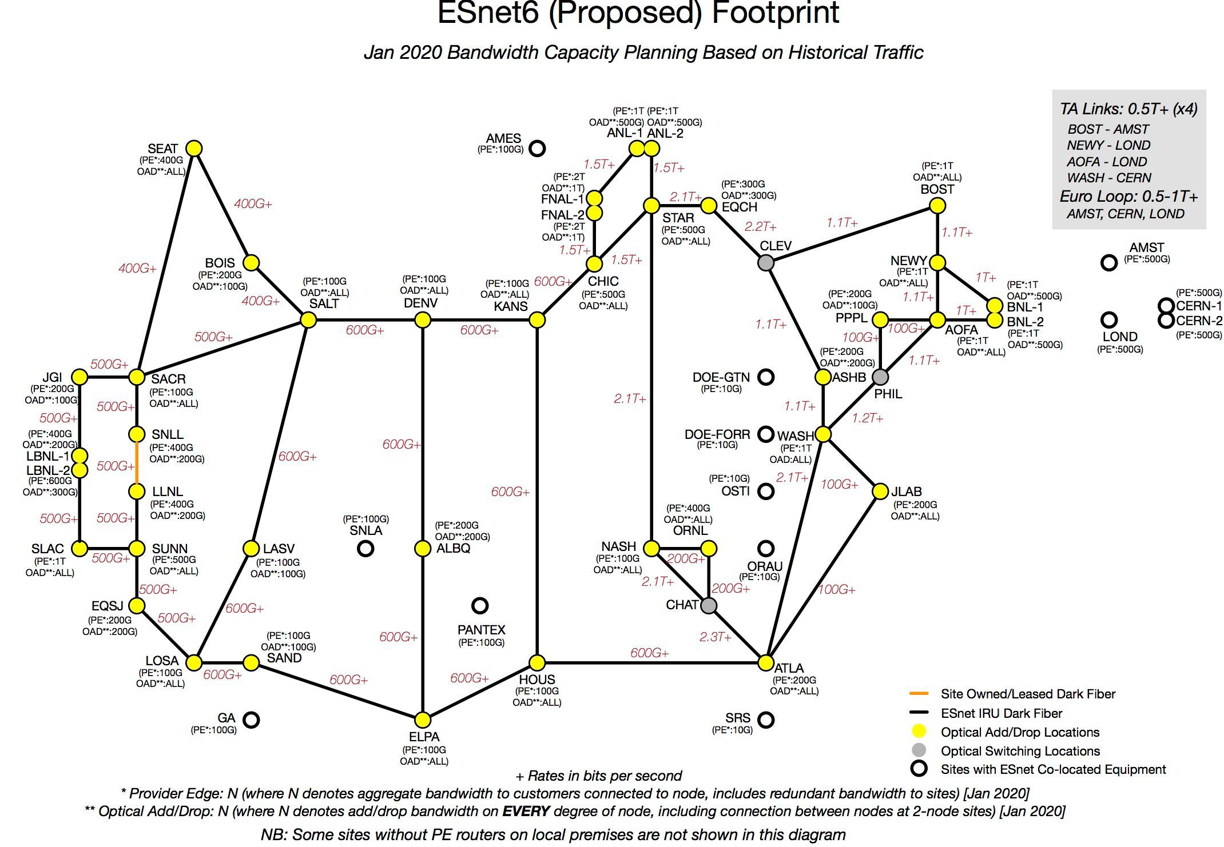
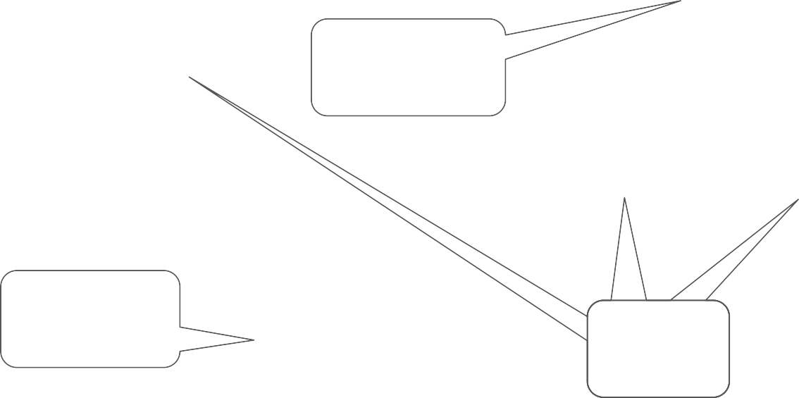
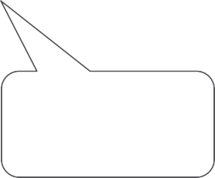
Our first forecast of ESnet 2020 link capacities required to meet demand extrapolated from historic traffic levels and assuming historic services, loads & protection mechanisms
2 Tbps Trans Atlantic
2 Tbps Ring in Eastern US
600 Gbps Rings in Western US
1 Tbps
1 Tbps
LHC
Sites
Sites?

Slide 49
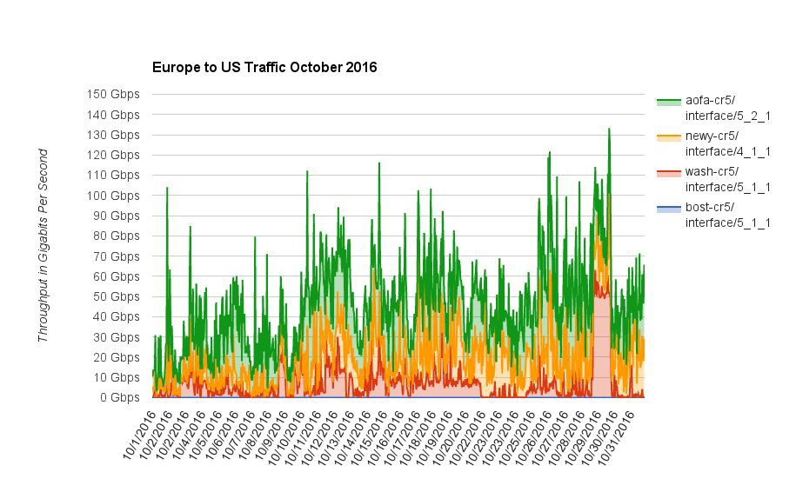
ESnet Europe to US Traffic October 2016 Utilization sorted by Time
(Stacked graph of the 4 different circuits)
11

Slide 50
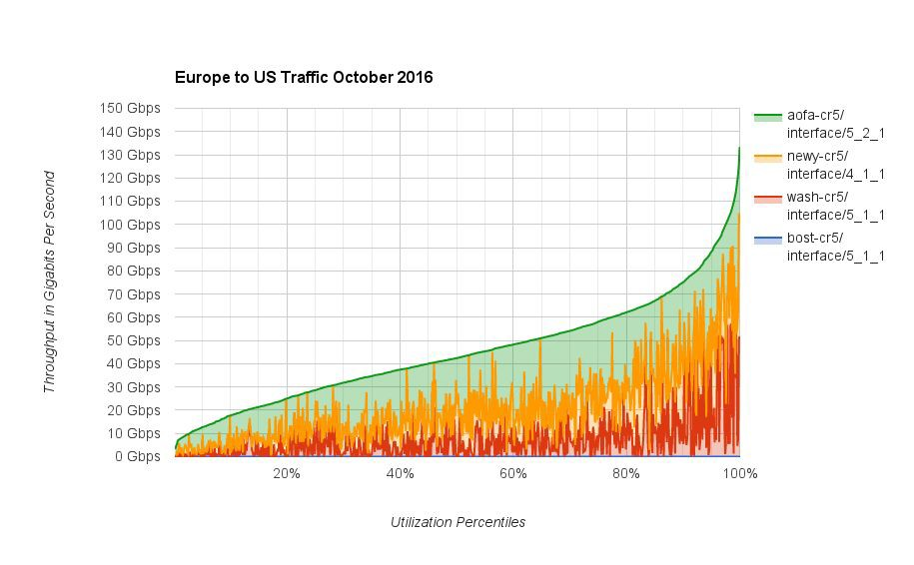
Same data sorted by Utilization instead of Time
Shaded area is used capacity
Unshaded area is unused capacity
12

Slide 51

Same data sorted by Utilization instead of Time
- Shaded area is used capacity
- Unshaded area is unused capacity
13
For this example, a capacity of 90 Gbps was sufficient to meet the needs 95% of the time.

Slide 52
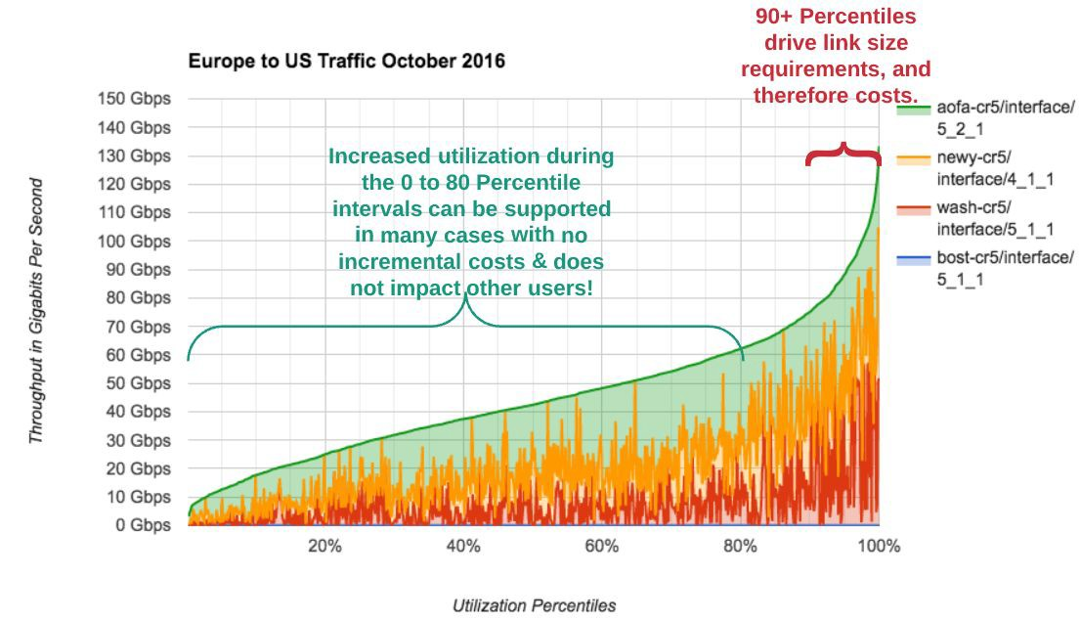
Peak Utilization Drives Network Operations & Planning
14

Slide 53
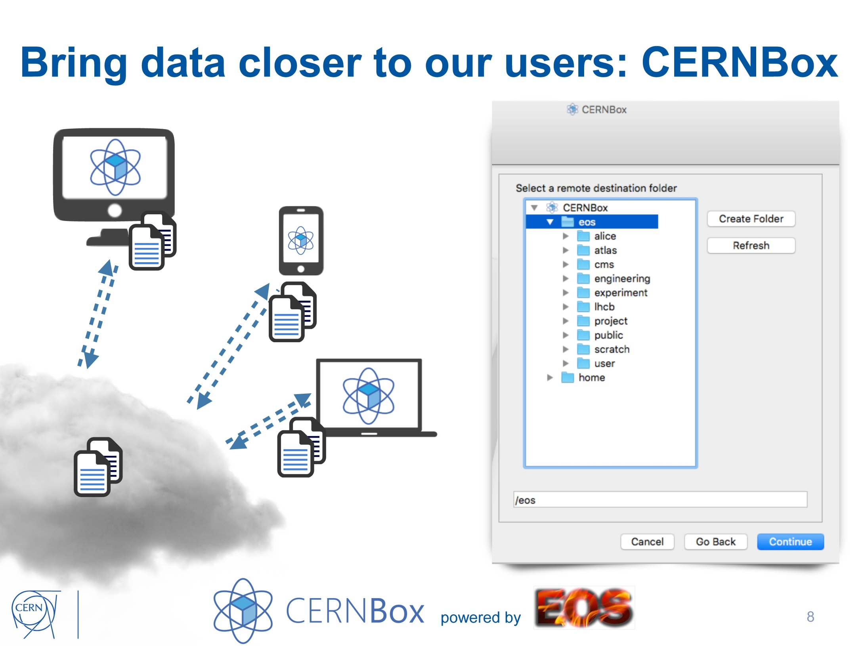

Slide 54
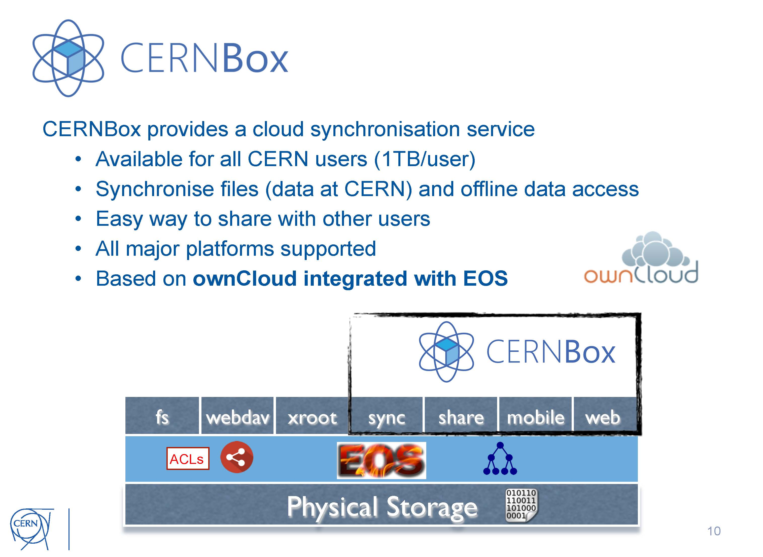

Slide 55
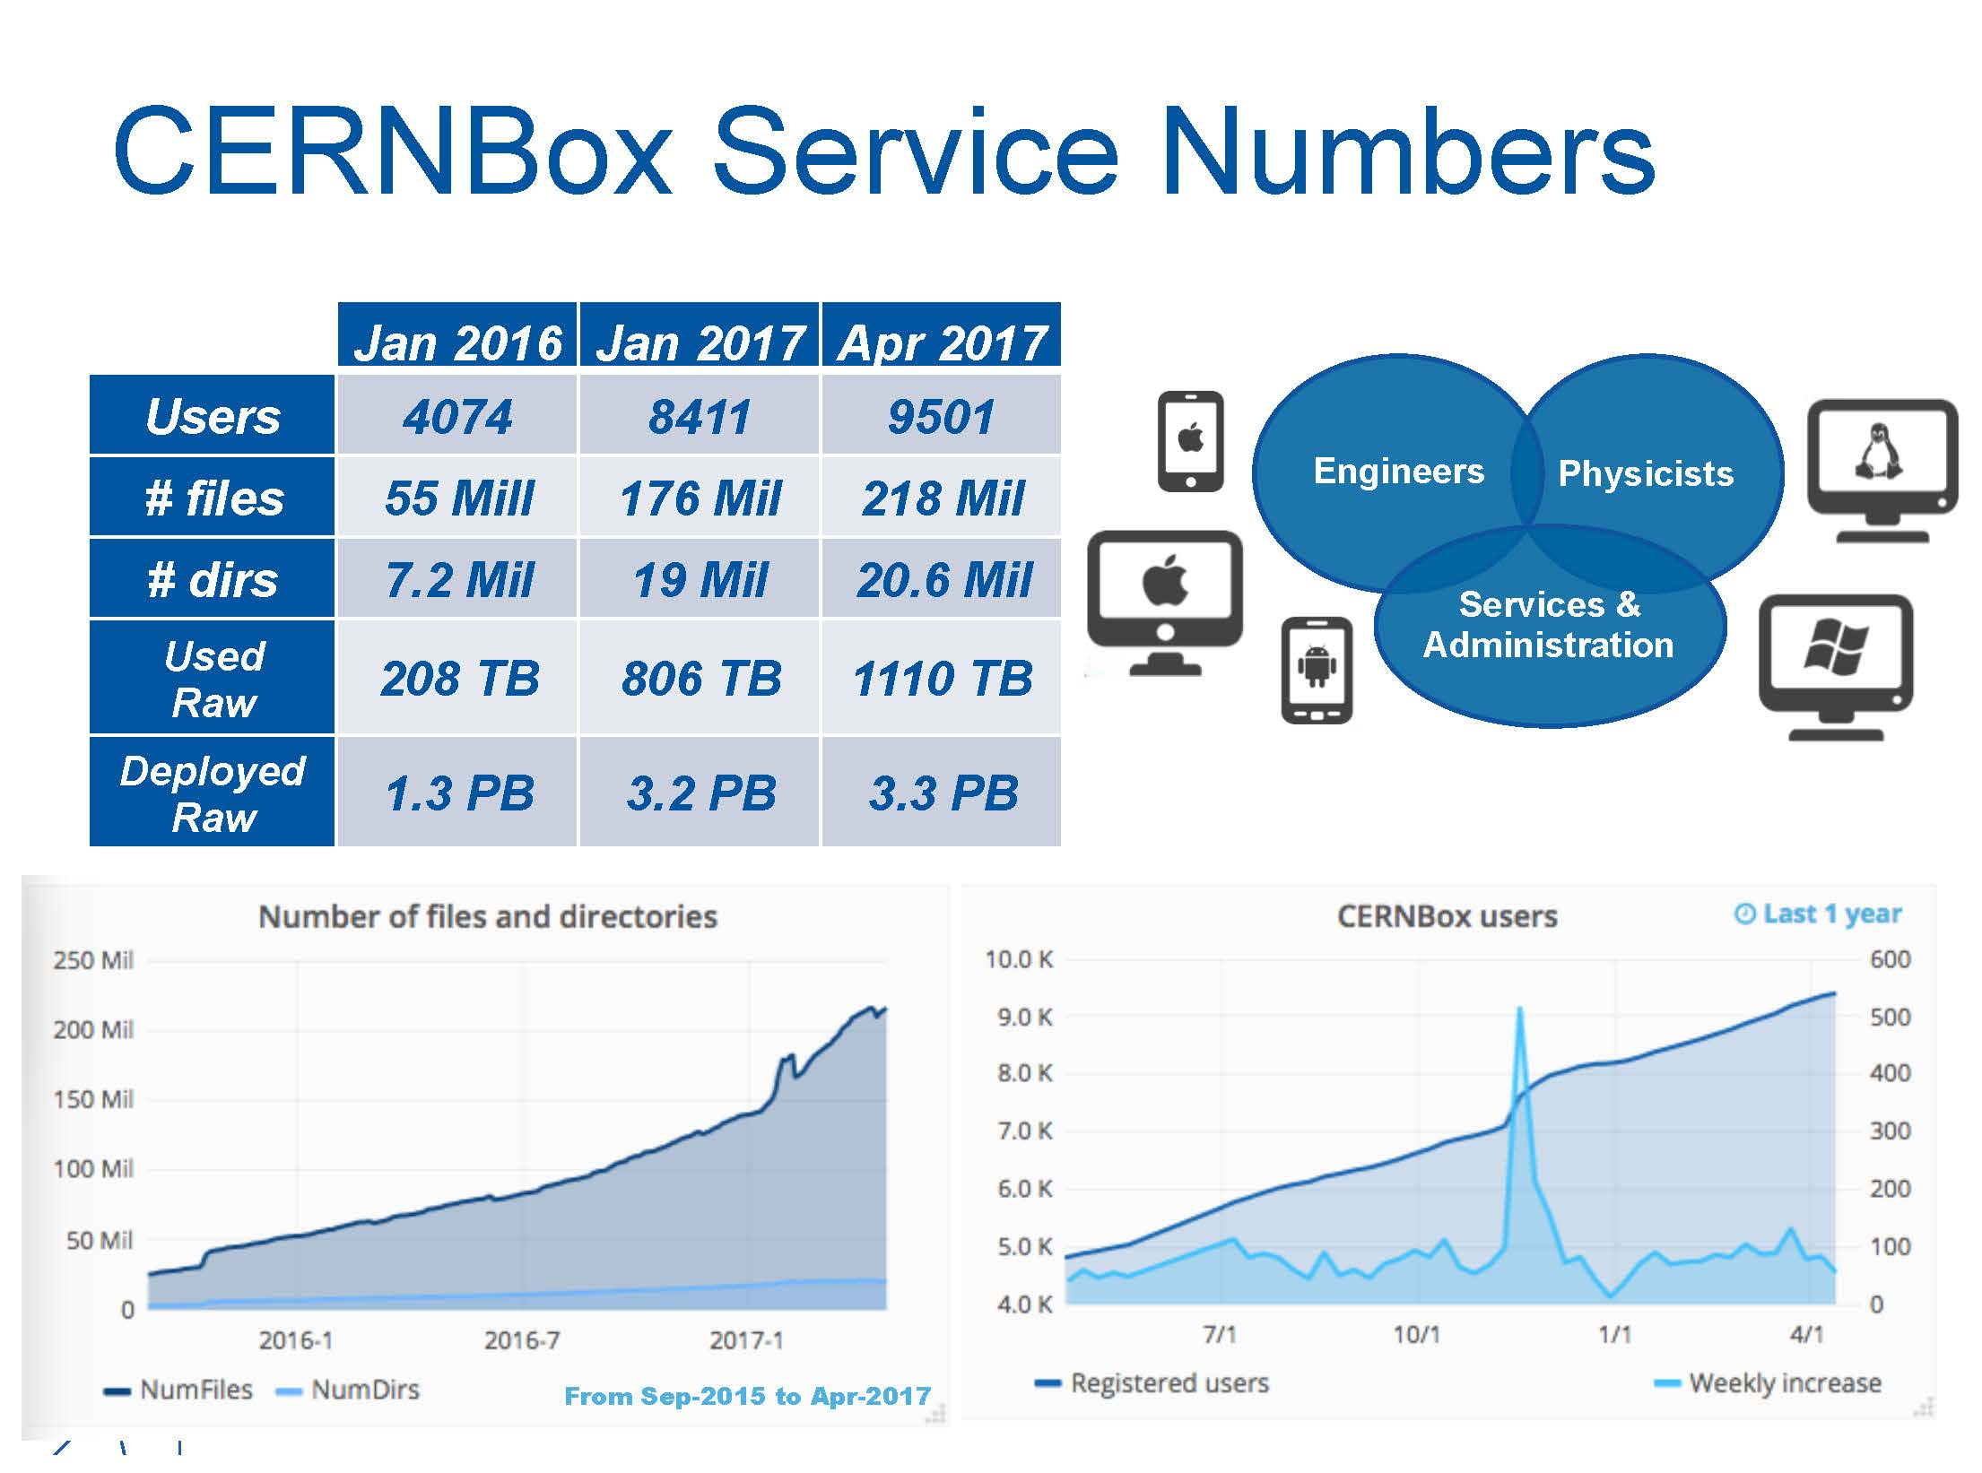

Slide 56
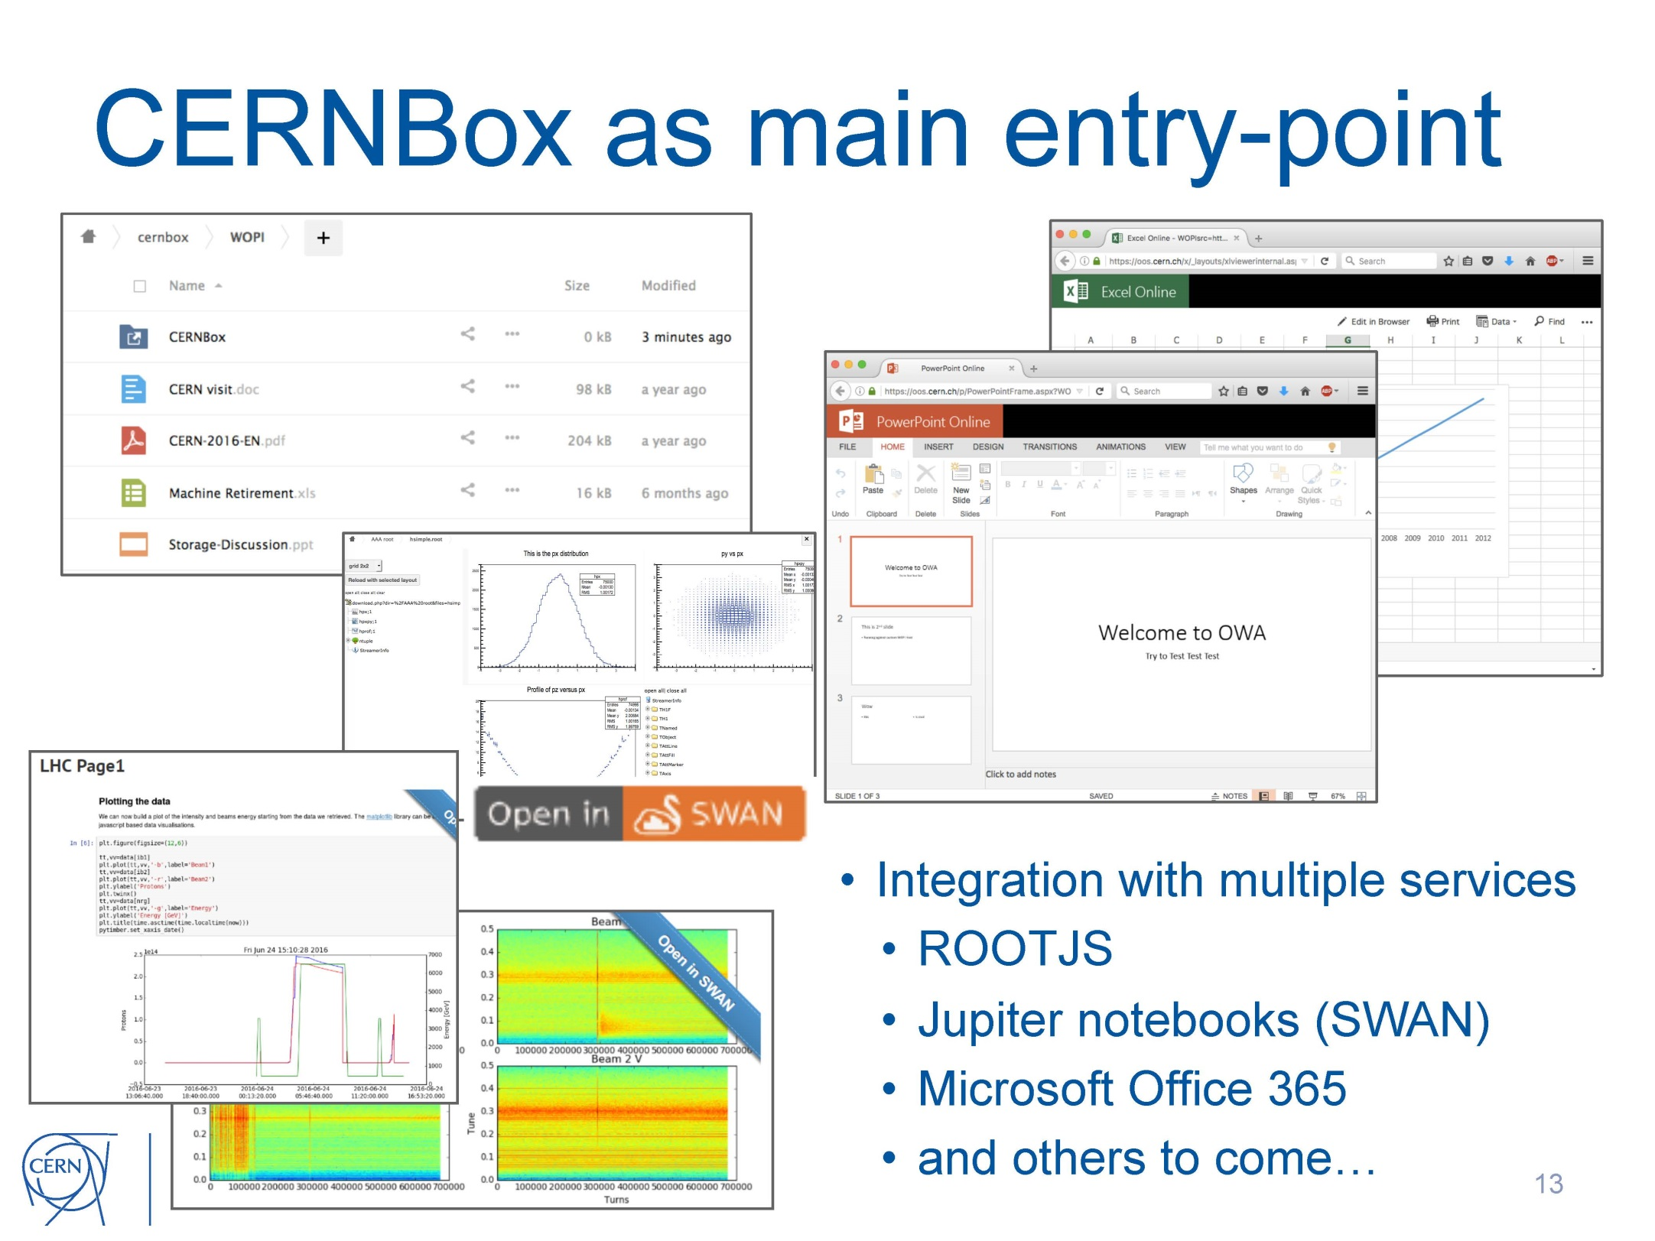

Slide 57
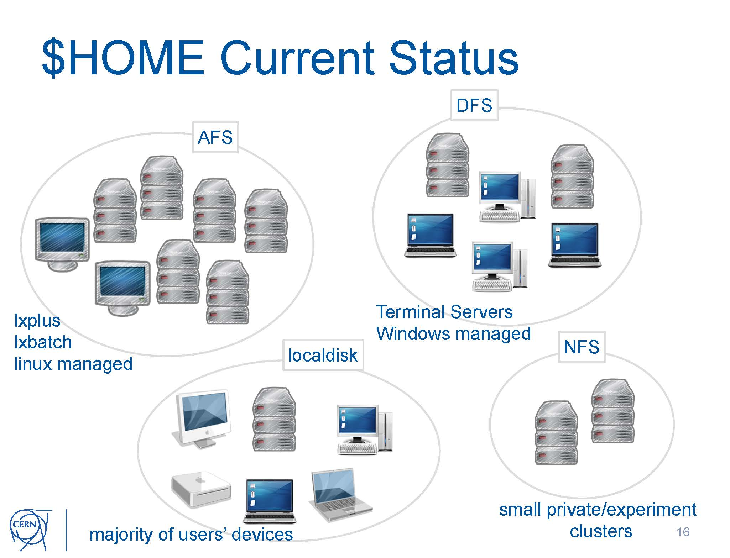

Slide 58
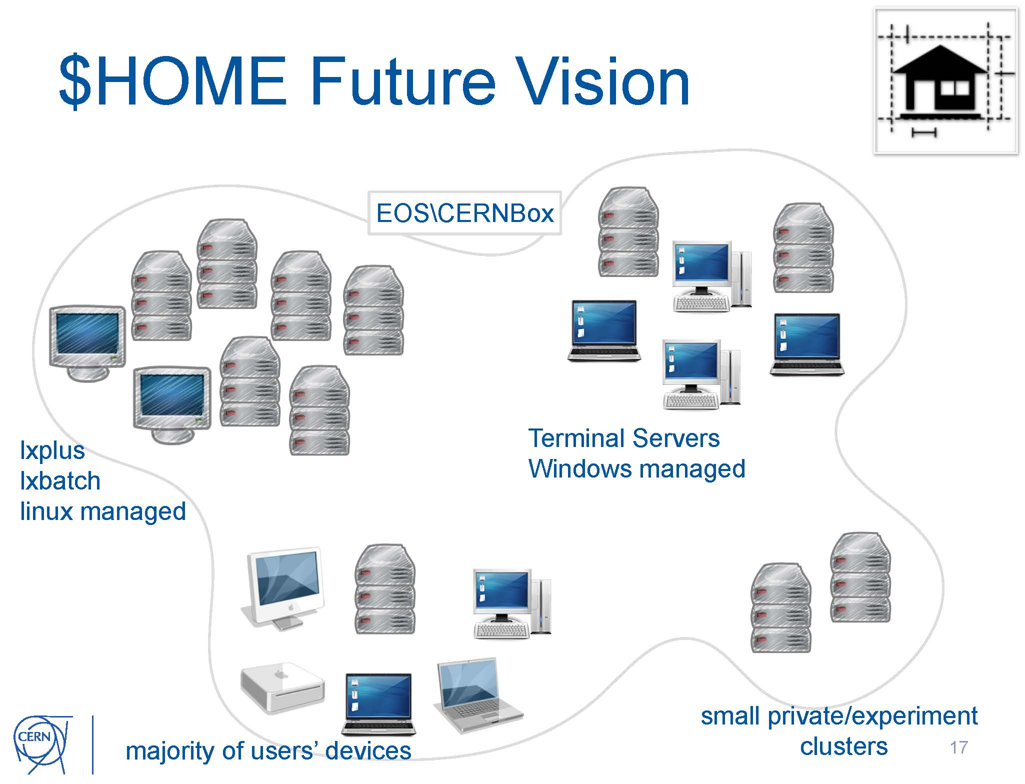

Slide 59
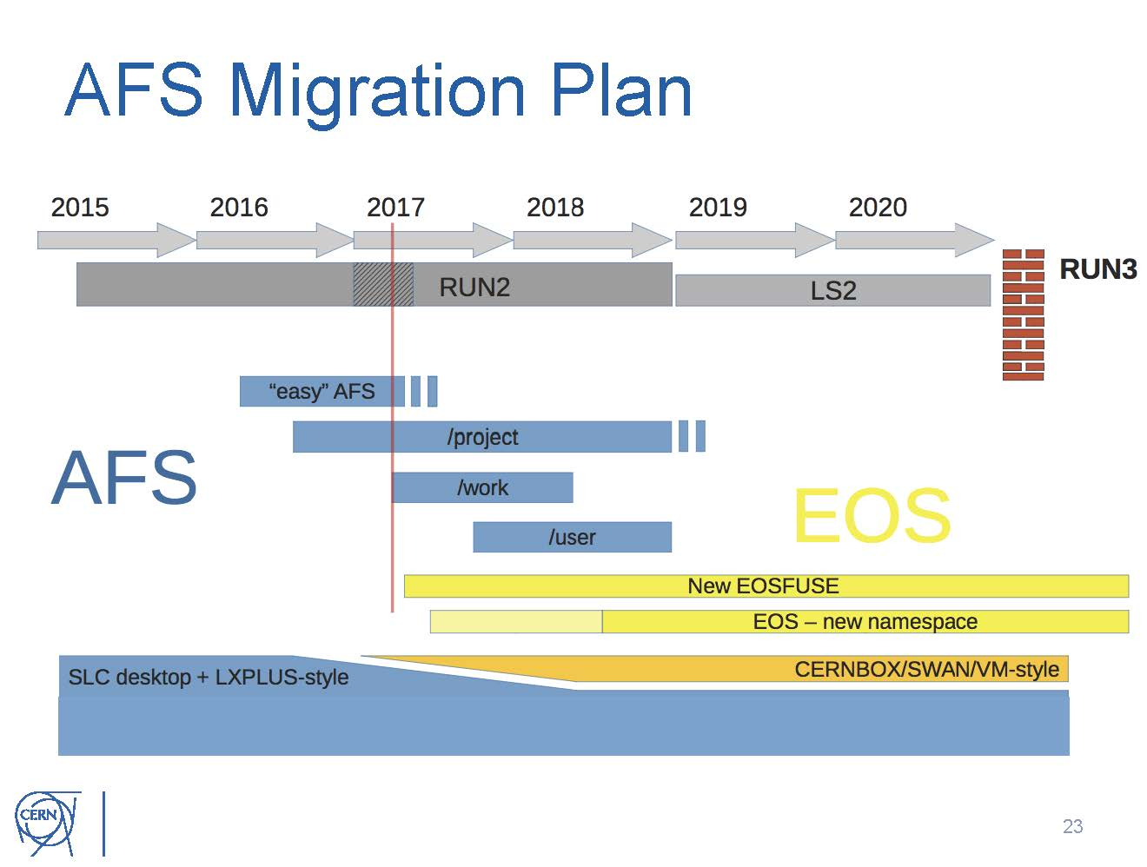

Slide 60
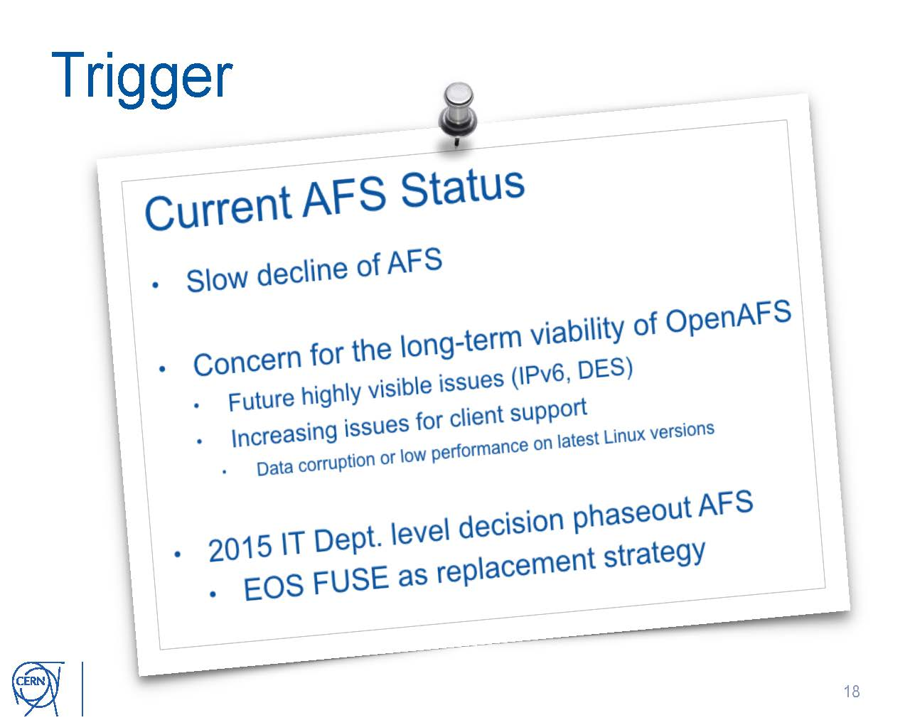

Slide 61
Diagram
Mobile APP
Android / iOS
Laptop / Desktop App
MS Win / Mac / Linux
Worker Nodes
Owncloud
Custom easy-to-use
copy-command
Request to restore the data from archive
Tape Restore Control
Custom XROOTd
Name-to-name
Translation to isolate a user to own data
CephFS
XROOTd
dCache
HPSS Tape Archive

Slide 62
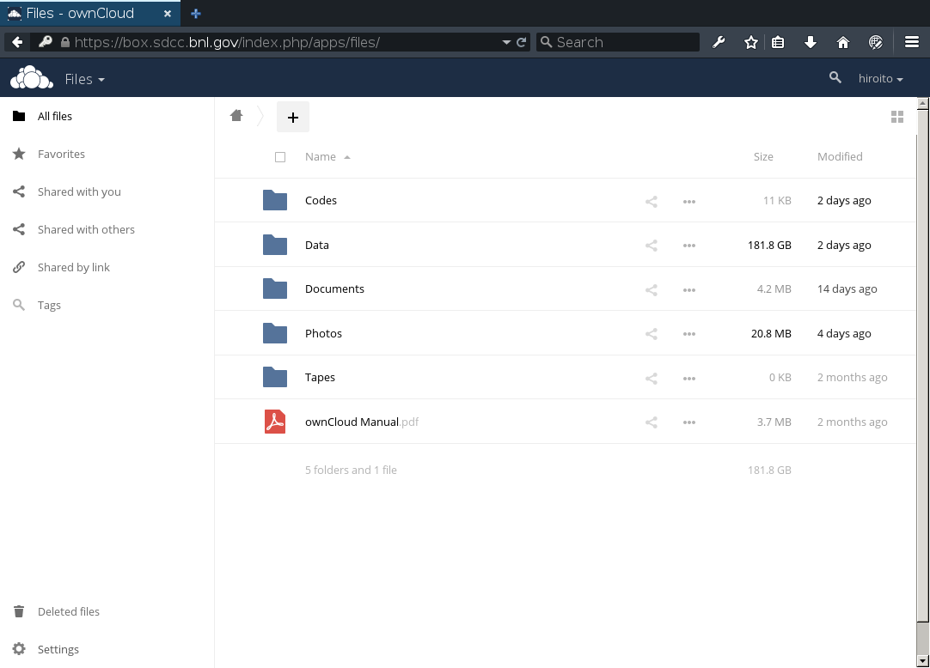
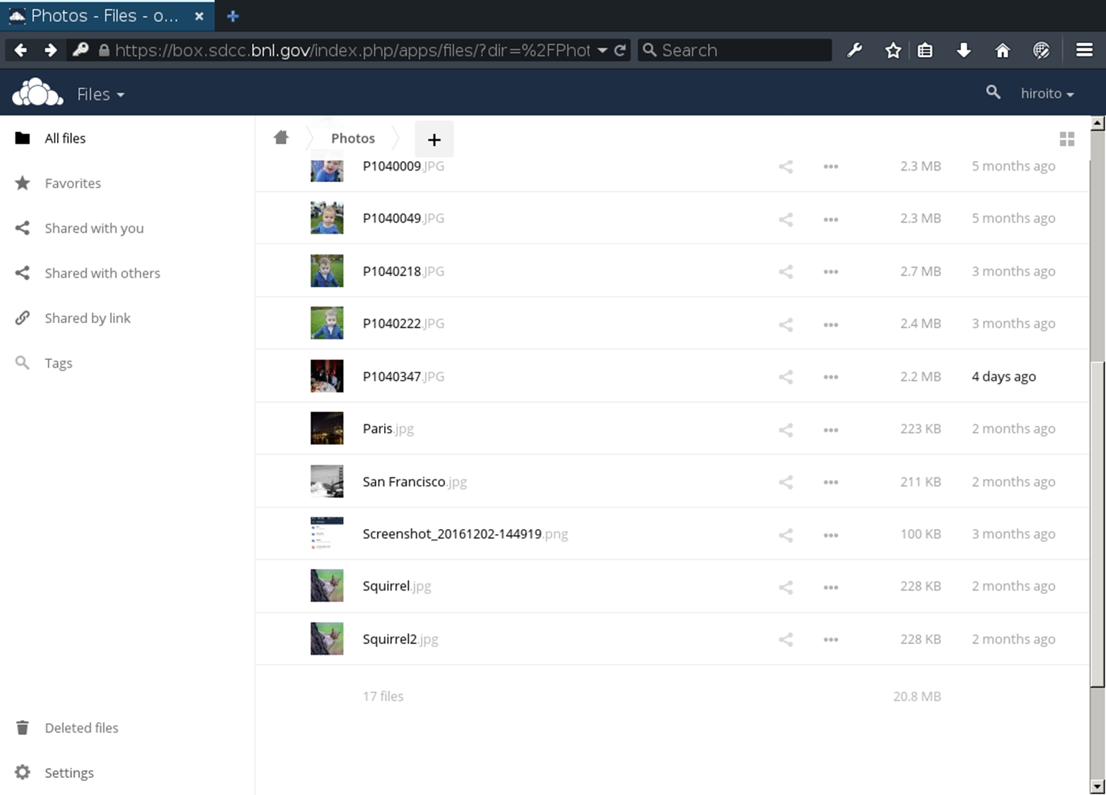
Sample images
Users only see their own directory.

Slide 63
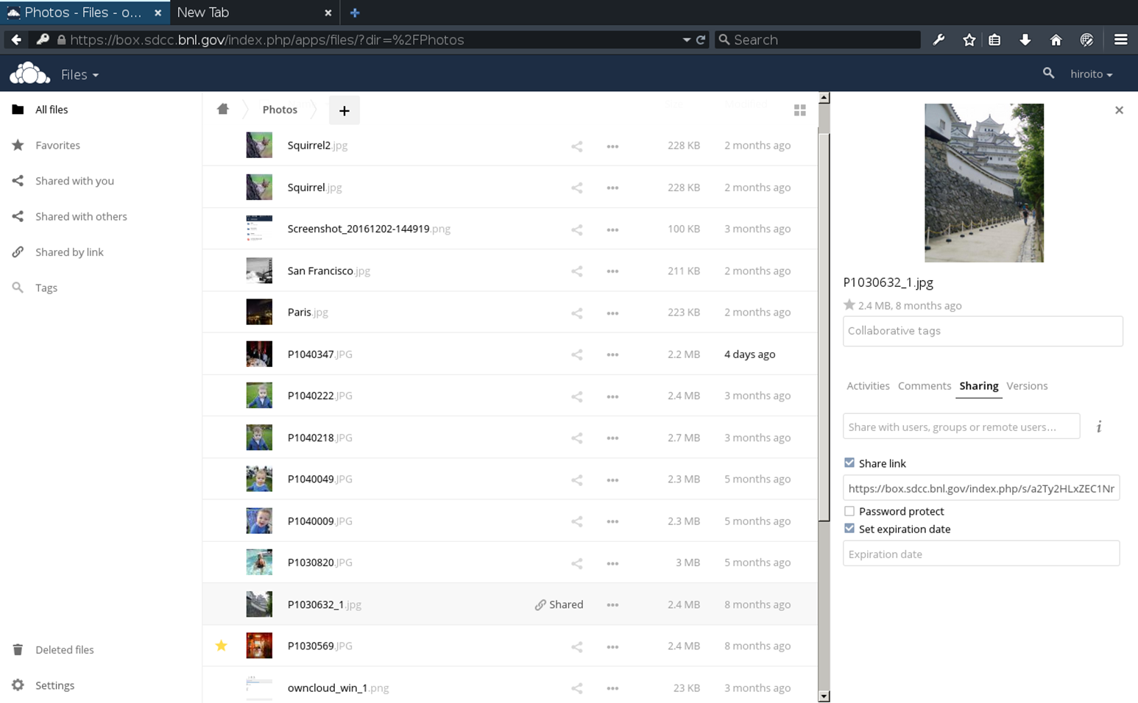
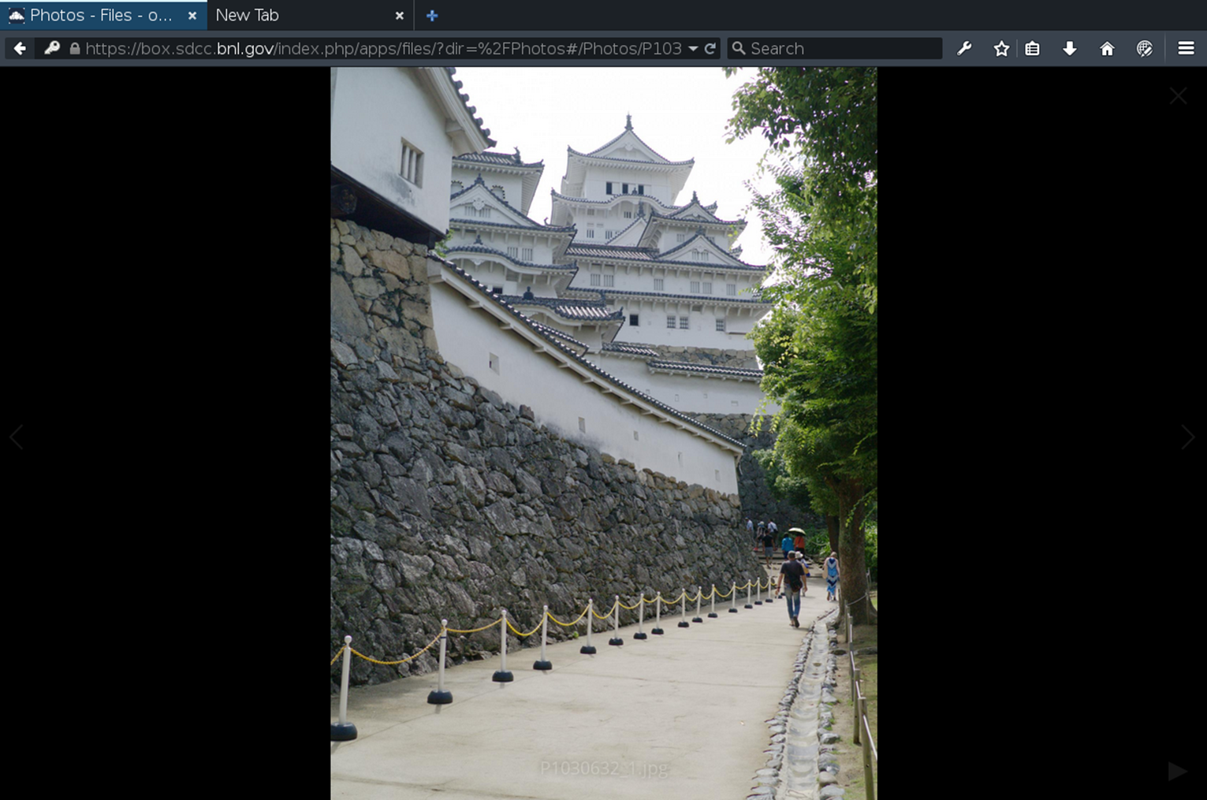
Share data
Users can share their data publicly or privately with password.

Slide 64


Users decide what to sync
Using the provided app, users can decides what to sync automatically.
For an example
Data and Tapes directories are not synchronized.
Codes, Documents, Photos directories are synchronized automatically.
Desktop/Laptop apps are available in MS Win, Mac and Linux.
The performance seems to be limited to the maximum of 100MB/s.

Slide 65
Timeline / Overview
Fall 2016-BNL acquires KNL machine
Winter 16/17-debugging hardware issues
February - March 2017, debugging performance & stability
April 2017-"beta" status, converging on final configuration
142-node KNL cluster deployed in RACF/SDCC data center since 2016Q4:
  Single Intel Xeon Phi CPU 7230: 64 physical / 256 logical cores @ 1.3 GHz
    (1.5 GHz maximum in turbo mode) per node
  Dual Intel Omni-Path PCIe x16 HFI cards (non-blocking 200 Gbps)
  Two level fat-tree single fabric Intel OPA interconnect system built out of 8x spine (core) + 14x leaf (edge) 48-port Intel Omni-Path switches
    Bisection (unidirectional) bandwidth for compute nodes alone is about 14 Tbps = 1.7 TB/s
    All the OPA uplinks are done with passive copper cables (630 uplinks total in 5 racks)

Slide 66
Conclusions
US LQCD group purchasing new cluster this Fall
Considering KNL, GPU (Pascal), or Skylake-based machines Machine is finally reliably producing scientific results
Took more effort than expected to get there
For unoptimized code, Broadwell HS06/$ is 1.5x KNL
Simple auto-vectorization gets to parity

Slide 67
Computing & Batch Services
Report from Benchmarking WG
  Discussion about detailed study of fast benchmark and replacing HS06 for guidance on procurement and site pledge. Various candidates (ATLAS KV, DB12, ROOT Stress test, etc)
  Start requirements to validate successor to HS06
    Must be representative of WLCG job mix
    Must disentangle several effects (HT on/off, bare metal vs. VM, OS versions, etc)
Separate presentation on DB12 to study discrepancy in results between Ivy-Bridge and Haswell
IHEP migration to HTCondor also includes unifying resources and allow for cross-usage→goal is to increase overall utilization
Singularity presentation by Brian (Nebraska)
  Job isolation and traceability within a container
  Alternative to glexec
  Being tested at various sites (as alternative to Docker)

Slide 68
Computing & Batch Services
CosmoHub created to share data among cosmology projects
  Migrating from PostgresQL to Apache Hadoop+Hive to improve scalability and data analysis response time
HammerCloud
  WLCG testbed → essential tests and automation tool
  180k jobs daily
  Data Center commissioning → job submission to resources behind HTCondor-CE
Knights Landing (KNL) clusters
  BNL installed a 144 test cluster
    Many surprises and delays – hope to enter production in May 2017
    ATLAS benchmarked BNL KNL cluster – good performance with optimization
  JLAB cluster a 192 production cluster
    Similar problems
    Currently in production with LQCD community

Slide 69
Mandate of the Working Group
Investigate scaling issues between HS06 and CPU intensive HEP workloads (i.e. EvtGen, Simulation)
Study the next generation of long-running benchmark
(successor of HS06)
Evaluate fast benchmarks; identify their properties; provide recommendations to the community
– To estimate the performance of a job slot (in traditional batch farms) or VM instances (in cloud environments)
HEPiX

Slide 70








DB12 Vs jobs (LHCb and ALICE)
LHCb
  HS06 not a good predictor for MC
    In particular for Intel Haswell CPUs
    Not as bad for LHCb reconstruction jobs though
  DB12 is much better
JobPower vs HS06 (from MJF)
JobPower vs DB12-in-job benchmark
Normalisation sets peak to ~1.0
But lots of structure, with that big shoulder at 50% above the peak.
This isn’t just variations in the load on the system.
Normalisation sets peak to ~1.0
Much better picture across the same set of sites and architectures.
Mean very close to peak. Very little in the 1.5 area and above.
DB12 + LHCb benchmark work - Andrew.McNab@cern.ch - preGDB, CERN, 7 Feb 2017
14
DB12 + LHCb benchmark work - Andrew.McNab@cern.ch - preGDB, CERN, 7 Feb 2017
16
ALICE
  Very good correlation of DB12 Vs MC
  Large discrepancy respect to HS06
NB: the average load of the server (i.e. number of running job slots) plays a major role in those evaluations (see next slides)
HEPiX

Slide 71




CMS Tests
J. Flix
https://indico.cern.ch/event/624813/
Fluctuations and no additional benefit in the HT region
Preliminary comparison of DB12, KV, HS06 Vs CMS jobs
Several dedicated nodes targeted for benchmarking
  Sandy Bridge, Ivy Bridge, Haswell, AMD, ARM
  ttbar simulation
Ongoing activity
  Pilots instrumented to run fast benchmarks and collect results Vs any kind of job
  CPU model reported in the job dashboards
    This will enable also the passive benchmark approach (see next slides)
Normalised at 16 processes: ttbar and HS06 show good agreement!!
HEPiX

Slide 72




The Branch Prediction due to CPython Module
perf studies from M. Guerri have shown that the main contributor to DB12 is
PyEval_EvalFrameEx
Starting from Haswell models, this module benefits from a better branch prediction that boosts the DB12 performance
[see L. Atzori’s talk]
https://indico.cern.ch/event/612774/
HEPiX

Slide 73

LHC cost evolution
Current cost trends suggest a 5x decrease vs a 60x increase in needs
Revolutionary changes are required in the experiment computing
  Faster simulation, faster reconstruction algorithms, …
  More compact data formats, more efficient data management (less copies)
  Aggressively use new architectures and resources (clouds, HPC, etc.)
10% more likely :-(
Moore’s law and gain from increased CPU complexity slowing down

Slide 74
The Impact of Flash
From Smartwatches to cards to arrays – what ‘valuable’ gets stored to HDD eventually
Note: the applications for NAND flash are: Flash Memory Card, USB Flash Drive, MPS/ PMP Player, Mobile Phone, Digital Still Camera, Personal Navigation Device, Digital Video Camcorder, Solid State Drive, Tablet, e-Reader, Smartwatch
* Seagate Market Research MTW 62 Q2CY16 ** Forward Insights NAND Insights Q2'16

Slide 75

How a hard drive works
An INCREDIBLE amount of TECHNOLOGY in a small box
Head is capable of reading and writing sub 100 nanometer tracks at data rates >4 Gb/s
High speed nanometer tracking precision
Sub nanometer smooth media
Sophisticated disk lubricant
Sub 10 nm magnetic grains
Recording head flies on an air bearing only about a nanometer above the surface of the disk
On Board- High performance data channel converts analog signals from the head into user bits. Controlled by over 6 milllion lines of firmware code
Disk spins up to 15000 RPM
Notes:
Fun Facts:
19000 Data tracks fit on a pin head
630 Data tracks fit on a papers edge
Disc lube thickness is ~0.9nm, 1/100000 the thickness of paper
The head flies about 1.5nm off the surface of the disk = less than width of a DNA strand
Each bit on a disk - ~14 switched media grains (8.8nm dia) The stack up of all grains would reach to the top of our atmosphere
Disc surface roughness is ~ 0.1nm = 10x smoother than a high grade optical lens
Active spacing between recording head and lube surface is 1nm, 1/100000 of width of typical human hair or the equivalent of 8 oxygen molecules
Thickness of mag. layer where bits are stored is 15nm = 1/1000 typical Al. foil
Firmware Facts:
Controller FW: 1,999,021 LOC and growing at a rate of 13.5K/month
Self Test: 273,577 LOC growing at a rate of 1.5K/month
Servo Code: 276,526 LOC growing at a rate of 1.7K/month
492 FW developers initiating ~500,000 code builds per month or 6 million code builds per year
ware

Slide 76

Sustained Investment to Areal Density Growth/Reliability
HDMR
(Heat Dot Magnetic Recording)
Multiple heads improve signal-to-noise allowing higher data density
HAMR
(Heat Assisted Magnetic Recording)
Lasers spot-heat disk media when writing, enabling smaller bits
MSMR/TDMR
(Multi-Sensor Magnetic Recording)
multiple read heads can average or cancel noise
Technology Evolution
Helium
Increases drive capacity, low power and weight
SMR
(Singled Magnetic Recording)
Overlaps tracks for up to 20% storage gain
CMR
(Conventional Magnetic Recording/Perpendicular)
Current storage generation
Seagate’s technology investments
Industry’s projection of areal density growth
Notes:
CMR: Conventional Magnetic Recording (Perpendicular)
SMR: Shingled Magnetic Recording
TDMR: Two-Dimensional Magnetic Recording
HAMR: Heat-Assisted Magnetic Recording
HDMR: Heated Dot Magnetic Recording
BPM: Bit-Patterned Media
Seagate is ramping technologies such as SMR and HAMR to continue scaling areal densities (the amount of data per square inch on a disk drive platter).
Helium: Allow for adding disks while maintaining, or improving, power consumption and tracking capability
Shingled: tracks smaller, harder and harder to write data onto the disk, making the write head wider than track density) so we can produce enough field to switch the magnetization write, then overlaying the tracks like shingles on a roof. Gives great improvement in track density, read head is made narrow to read these smaller tracks that were written with these larger heads.
Bridge to HAMR
HAMR: integrated semi-conducter laser onto head..integrated optics also included. Shine laser into gold atenna. The focus laser causes surface plasma and they re-radiate energy throughout disk..the energy from antenna couples with media and heats up media. Why? To be able to writer smaller bits, cannot produce enough field from conventional rec head, so the heat modifies the magnetic disk structure so it is easier to write. Heat it to write and cool it down, smaller bits than what we can write with perpendciular recording are more stable…all within a nano-second.
Enhanced cache- has non-volatile memory so we can cache information in write mode, in enterprise. Improve format efficiency.
TDMR/MSMR (Multi-Sensor Recording)- multiple read heads can average or cancel noise. Can improve head performance.
Seagate is a founding member of ASTC and contributes money annually to fund university research in advanced storage technologies
In addition to funding university research, ASTC also releases an annual roadmap to help educate our customers and our suppliers on future technology trends in our industry
As the nearby chart shows, we have line of site to 10 years of areal density growth. Many challenges remain, but if we can deliver these technologies on these timelines, 100 TB 3.5” drives should be possible in 10 years
This is isn’t just our view it is the HDD industry consensus view

Slide 77

Storage Utilization in the Data Center and Cloud
OLTP
$/IOP driven
Perfect fit for tiered storage
Localized, non-deterministic Transactions
HPC / Analytic
SSD used for high random IOPS
HDD for storing data
Big Data
Metadata to SSD
Blob data streams to HDD
Generic Storage
SSD for performance
HDD low $/TB large data storage.
Warm Archive
SSD tier for hot data
HDD for cold, long term low $/TB storage.
Mix of
SSD + HDD
Content Distribution
HDD for bulk storage ($/GB)
SSD for caching multiple asynchronous streams
Archive
HDD $/TB is the overwhelming choice
Lower spin speed for reduced power footprint

Slide 78
IT Facilities & Business Continuity
Wigner described data center infrastructure
  Upgrade of cooling for better control/regulation —tied to power consumption for higher efficiency
CERN presentation on data center news
  Water leak near electrical transformers—not yet fully resolved
  Planning for new data center going forward
  2nd Network Hub—need for redundancy for critical networking equipment
Orsay data center extension
  Propose PUE < 1.3 with redundant power feed but no UPS—max load of 1.5 MW available to IT equipment
  Cooling from rear-door heat exchanger—no CRAC’s in data center
  Estimated to be ready by Sept. 2018
Managing hardware failure (almost automatically) at IN2P3
  Cuts down time interfacing with vendor support staff
  Use vendor (Dell in this case) API – not applicable to all failure modes
  Very informative figures on historical failure data

Slide 79
Second Network Hub Project
Why?
  To provide a second location for core network equipment to guarantee connectivity across the site and to the rest of the world in the event of a major incident in the CERN Main Data Centre.
What?
  Will have efficient air cooling and be sized for 48 racks in 4 rows with 120kW for IT equipment. Max inlet temperature of 32 degrees.
  All IT load and cooling infrastructure will be on by UPS.
Where?
    Currently being built on the CERN Prévessin site close to an electrical substation.
When?
  Due to be ready in summer 2017.

Slide 81




Slide 82



Slide 83





Slide 84

HEPIX Fall 2017
Next meeting at KEK Oct. 16-20
  First HEPIX in Asia since 2012 meeting in Beijing
  First HEPIX hosted by KEK
  Co-located with HPSS Users Forum (HUF) and LHCOPN-LHCONE meeting
  Local organizers:
    Takashi Sasaki
    Tomoaki Nakamura
  See you in Japan!

