Slide 1
Il calcolo per KM3NeT
Agnese Martini
INFN LNF

Slide 2
The KM3NeT infrastructure (I)
The KM3NeT research infrastructure will comprise a deep-sea neutrino telescope (ARCA) and the neutrino-mass-hierarchy detector ORCA at different sites and nodes for instrumentation for measurements of earth and sea science (ESS) communities.
The cable(s) to shore and the shore infrastructure will be constructed and operated by the KM3NeT collaboration.

Slide 3
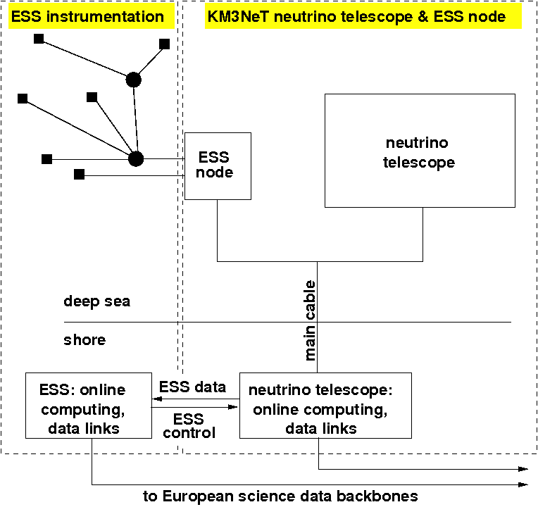
The KM3NeT infrastructure (II)
Both the detection units of ARCA/ORCA and the ESS nodes are connected via a deep-sea cable network to shore.
Note that KM3NeT will be constructed at multiple sites (France (FR), Italy (IT) and Greece (GR)) as a distributed infrastructure. The set-up shown in Figure will be installed at each of the sites.

Slide 4
The detector
The ARCA/ORCA will consist of building blocks (BB) containing 115 detection units (vertical structures supporting 18 optical modules each).
Each optical module holds 31 3-inch photomultipliers together with readout electronics and instrumentation within a glass sphere. One building block thus contains approximately 65,000 photomultipliers.
Each installation site will contain an integer number of building blocks.
The data transmitted from the detector to the shore station include the PMT signals (time-over-threshold and timing), calibration and monitoring data.
Phase | Detector Layout | No. of DUs
Phase 1 | approx. ¼ BB | 31 DUs
Phase 2 | 2 BB ARCA/ 1 BB ORCA | 345 DUs
Final Phase | 6 building blocks | 690 DUs
Reference | 1 building block | 115 DUs

Slide 5
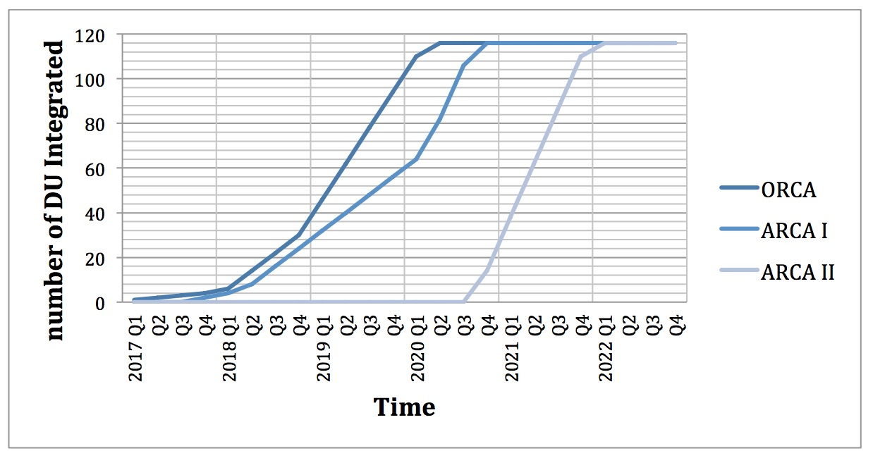
The detector status
Status Italian Seafloor Network: down since 16th of April for power failure. After investigations The network will be powered off until a ROV inspection that we are investigating the possibilities
Status of the French seafloor Network: A repair operation of the cable that connects the infrastructure is currently ongoing. The fault was located in a joint close to the node and the repair should be completed in the next few weeks.
2 DU are being prepared for deployment in France this summer.
DOM/DU integration: The overall integration of DOM’s and DU’s is not affected by any of the network problems and will be pursued without delay.

Slide 6
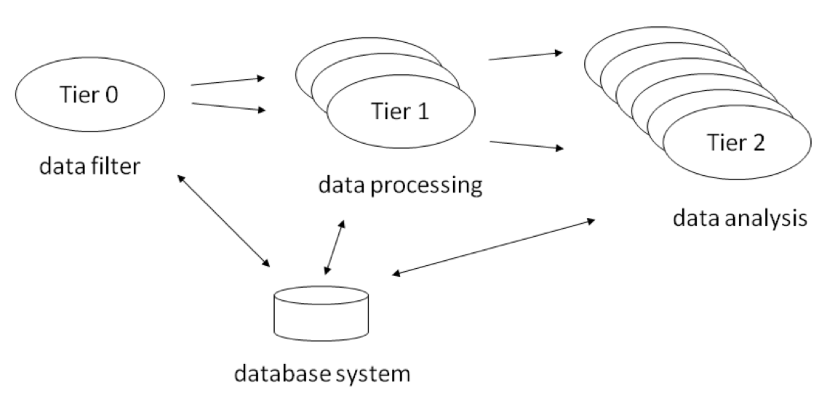
The KM3NeT Computing Model
The KM3NeT computing model (data distribution and data processing system) is based on the LHC computing model. The general concept consists of a hierarchical data processing system, commonly referred to as Tier structure
Notes:
La toglierei sostituita dalla 8

Slide 7
Data processing steps at the different tiers
Tier | Computing Facility | Processing steps | Access
Tier-0 | at detector site | triggering, online-calibration, quasi-online reconstruction | direct access, direct processing
Tier-1 | computing centers | calibration and reconstruction, simulation | direct access, batch processing and/or grid access
Tier-2 | local computing clusters | simulation and analysis | varying
Notes:
Fare il merge con la 7

Slide 8
Computing centres and pools provide resources for the KM3NeT
Tier | Computing Facility | Main Task | Access
Tier-0 | at detector site | online processing | direct access, direct processing
Tier-1 | CC-IN2P3 | general offline processing and central data storage | direct access, batch processing and grid access
 | CNAF | general offline processing and central data storage | grid access
 | ReCaS | general offline processing, interim data storage | grid access
 | HellasGrid | reconstruction of data | grid access
 | HOU computing cluster | simulation processing | direct access, batch processing
Tier-2 | local computing clusters | simulation and analysis | varying
Notes:
TIER-0 uno in Francia a Marsiglia/Tolone? Uno a Catania/Portopalo?
HOU dove si trova?

Slide 9
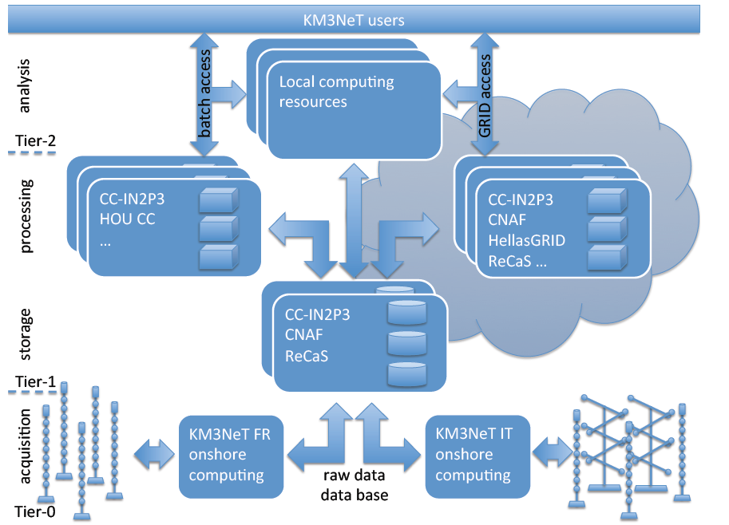
Detailed Computing Model

Slide 10
Data distribution
The raw data must be transferred from Tier0s (detector sites) to Tier1s: CC-IN2P3 and CNAF. The 2 storages must be mirrored.
The data resulting from all the processing tasks have to be transferred to the Tier1s
The main task is to implement an efficient data distribution and mirroring system between these 2 centers that implement different data transfer protocol
iRODS (Integrated Rule-Oriented Data System ) at CC-IN2P3
GridFTP (File Transfer Protocol for grid computing) at CNAF

Slide 11
Detector Deployment (DUs at beginning of the year)
year | Detector Layout | No. of DUs
2018 | 4 Dus ORCA 2 Dus ARCA | 6 DUs
2019 | 0,3 building block ORCA 0,25 building block ARCA | 65DUs
2020 | 1building block ORCA 1/2 building block ARCA | 170 DUs
2021 | 1 building block ORCA 1,3 building block ARCA | 260 DUs
2022 | 1 building block ORCA 2 building block ARCA | 345 DUs
1 Building block = 115 DUs
Notes:
Da ripensare

Slide 12
Overview on computing requirements at T1s per year
per year | size (TB) | computing time (HS06.h) | computing resources (HS06)
One Building Block | 1000 | 350 M | 40 k
2018 | 250 | 25 M | 3 k
2019 | 750 | 350 M | 40 k
2020 | 500 | 150 M | 20 k
2021 | 2000 | 700 M | 80 k
2022 | 3000 | 700 M | 80 k

Slide 13
Detailed expectations of necessary storage and computing time for one building block (per processing and per year)
processing stage | size per proc. (TB) | time per proc. (HS06.h) | Size per period (TB) | time per year (HS06.h) | periodicity ( year)
Raw Data
Raw Filtered Data | 300 | - | 300 | - | 1
Monitoring and Minimum Bias Data | 150 | - | 150 | - | 1
Experimental Data Processing
Calibration (incl. Raw Data) | 750 | 24 M | 1500 | 48 M | 2
Reconstructed Data | 150 | 119 M | 300 | 238 M | 2
DST | 75 | 30 M | 150 | 60 M | 2
Simulation Data Processing
Air showers | 100 | 14 M | 50 | 7 M | 0.5
atm. Myons | 50 | 1 M | 25 | 638 k | 0.5
neutrinos | 2 | 22 k | 20 | 220 k | 10
total: | 827 | 188 M | 995 | 353 M
First building block deployed
in 2 years
Notes:
Cosa significa “per processing” che differenza con per anno?

Slide 14
Networking
phase | connection | average data transfer (MB/s) | peak data transfer (MB/s)
Building Block:
 | Tier-0 to Tier-1 | 25 | 125
 | Tier-1 to Tier-1 | 50 | 500
 | Tier-1 to Tier-2 | 10 | 50
Final Phase:
 | Tier-0 to Tier-1 | 200 | 1000
 | Tier-1 to Tier-1 | 500 | 5000
 | Tier-1 to Tier-2 | 100 | 500
Rough estimate of the required bandwidth.
Note that the connection from Tier-1 to Tier-2 has the largest fluctuation, driven by the analyses of data (i.e. by users)

Slide 15
KM3NeT on the GRID VO Central Services
Service | Site
Authentication/authorization system VOMS | RECAS-NAPOLI
User Interface | RECAS-NAPOLI, HellasGrid-Okeanos, CNAF, Frascati
Logical File Catalog | RECAS-NAPOLI
Job submission and management system (WMS) | HellasGrid-Afroditi
KM3NeT is starting on the GRID
use case: CORSIKA simulation
Notes:
Da rifare inserendo I vari tier-2

Slide 16
GRID sites supporting the VO KM3NeT
Site name | Storage (TB) | CPU (not pledged)
HG-03-AUTH |  | 440
HG-08-Okeanos | - | 120
INFN-BARI |  | 654
INFN-FRASCATI |  | 2016
INFN-T1 | 200 | 25504
RECAS-NAPOLI | 320 | 1500
UNINA-EGEE |  | 64

Slide 17
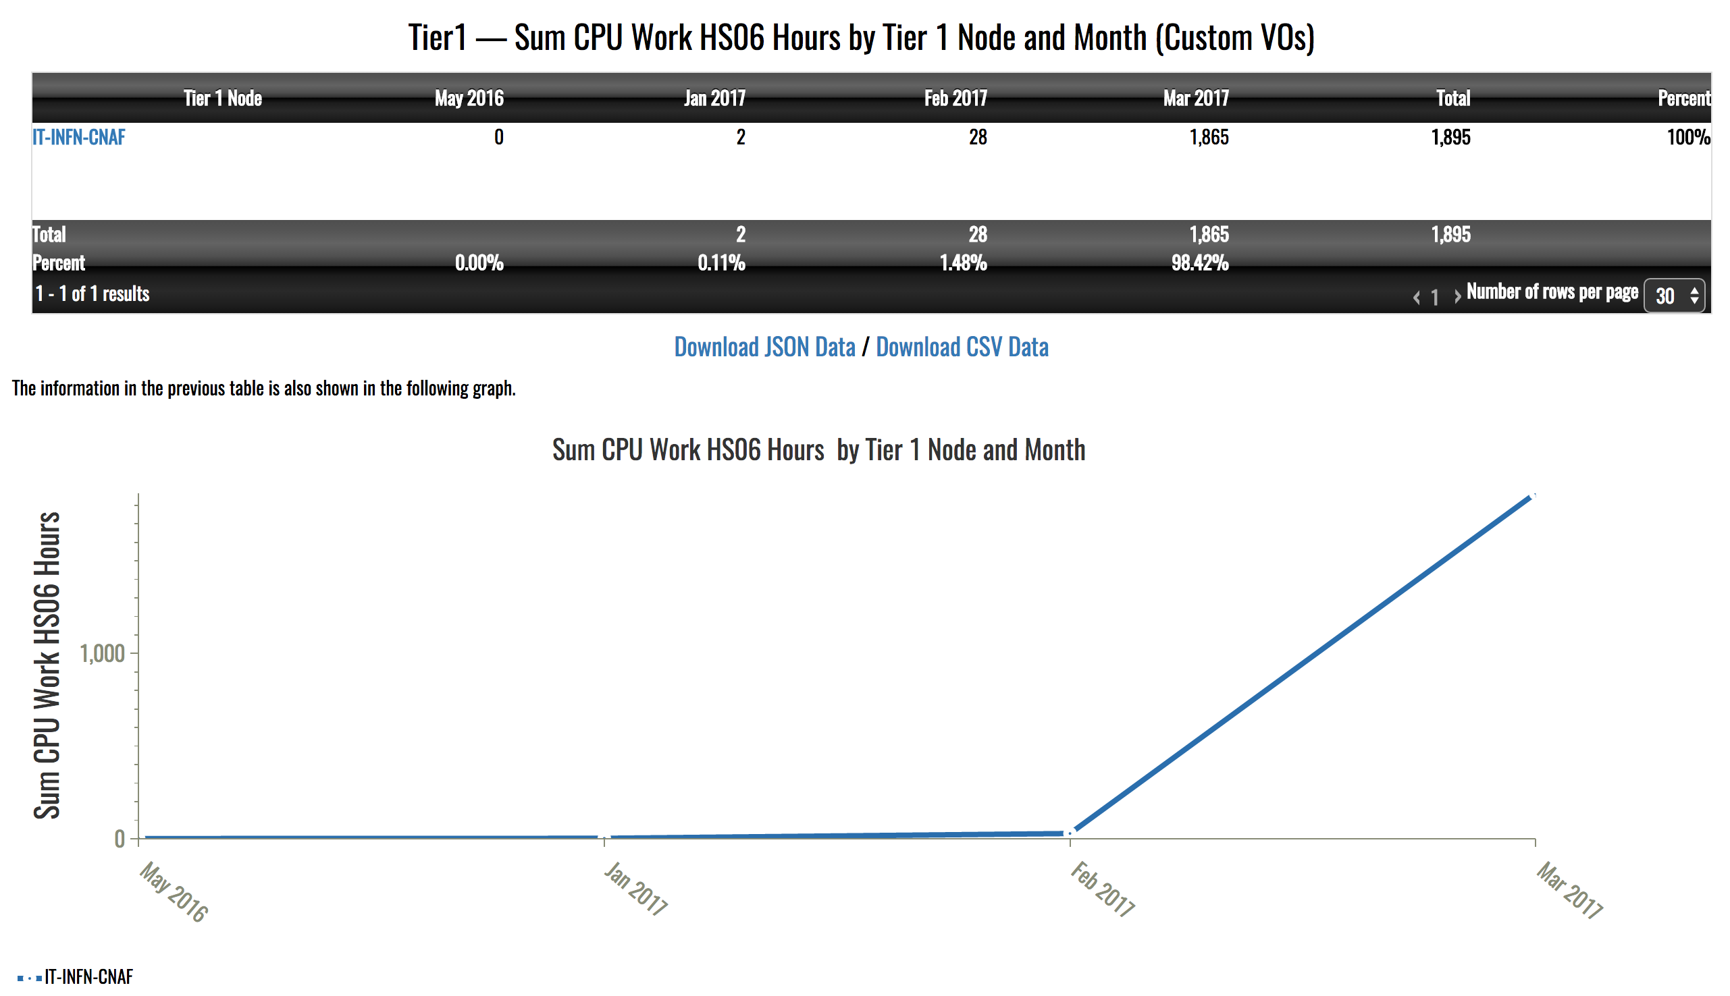
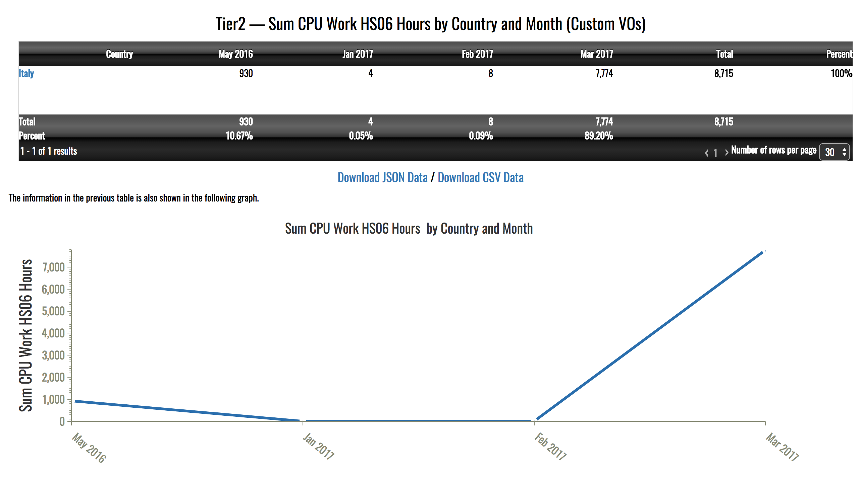
HS06.h the last year
HS06.h at Tier1 CNAF
HS06.h at Tier2s Italy

Slide 18
INFN for OBELICS 3.4
Activities in WP 3.4 (1/3)
CORELib: COsmic Ray Event Library
Background to many experiments
Also a tuning benchmark
Potentially useful to other communities
Currently using CORSIKA as generator
Status of production
Proton-induced showers:
HEMODELS: QGSJET01 with CHARM, QGSJET01 with TAULEP, QGSJET-II with TAULEP, EPOSLHC with TAULEP
LEMODEL: GHEISHA
about 21M Evts per HEMODEL
7 energy bins (2×102GeV-103GeV+equally logarithmically spaced from 1TeV to 109GeV)
power-law spectrum with -2 spectral index
zenith angle from 0 to 89 degrees
Nuclei-induced showers:
HEMODELS: QGSJET01 with CHARM, QGSJET01 with TAULEP, QGSJET-II with TAULEP, EPOS-LHC with TAULEP
LEMODEL: GHEISHA
about 21M Evts per HEMODEL
7 energy bins (A×2×102GeV-A×103GeV+equally logarithmically spaced from A×1TeV to A×109GeV)
power-law spectrum with -2 spectral index
zenith angle from 0 to 89 degrees

Slide 19
INFN for OBELICS 3.4
Activities in WP 3.4 (1/3)
CORELib: COsmic Ray Event Library
Status of production
Energy range (GeV) | Number of events
200-1000 | 10⁷
103-104 | 10⁷
104-105 | 10⁶
105-106 | 10⁵
106-107 | 10⁴
107-108 | 10³
108-109 | 10²
Production done with and without Cherenkov radiation
High energy model | Low energy model | Option
 |  | TAULEP | CHARM
QGSJET01 | GHEISHA |  | X
QGSJET01 | GHEISHA | X
QGSJETII-04 | GHEISHA | X
EPOS LHC | GHEISHA | X

Slide 20
INFN for OBELICS 3.4
Activities in WP 3.4 (2/3)
ROAst: ROot extension for Astronomy
Classes to access astronomical catalogues
Coordinate transformation
Moon position and motion
Generators of primary particles (neutrinos will be implemented, others will be supported only as placeholders)
Status
Catalogue name | Status
UCAC4 | Supported
URAT1 | Supported
GSC-II (Guide Star Catalog) | Supported
Fermi-LAT 3FGL | Supported
TeVCat | Supported
LUNAR MOTION: DONE
Astronomical coordinate system | Geographical coordinate system | Time coordinate
Equatorial | N/A | N/A
Galactic | N/A | N/A
Horizontal | Lat-Long/UTM | Unix time/UTC/Local Sidereal
Eclyptic rectangular | N/A | N/A

Slide 21
Summary
The data distribution model of KM3NeT is based on the LHC computing model. The estimates of the required bandwidths and computing power are well within current standards. A high bandwidth Ethernet link to the shore station is necessary for data archival and remote operation of the infrastructure.
KM3NeT-INFN already addressed requests to CCR
KM3NET is already operative on GRID
We are also active on Big Data future challenges, i.e. Asterics

