Slide 1
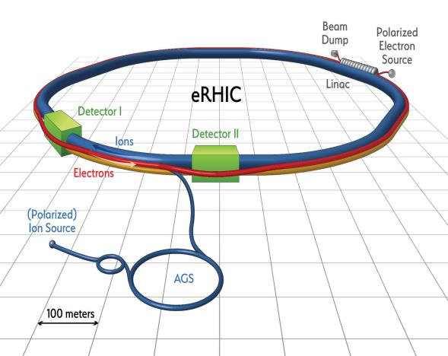
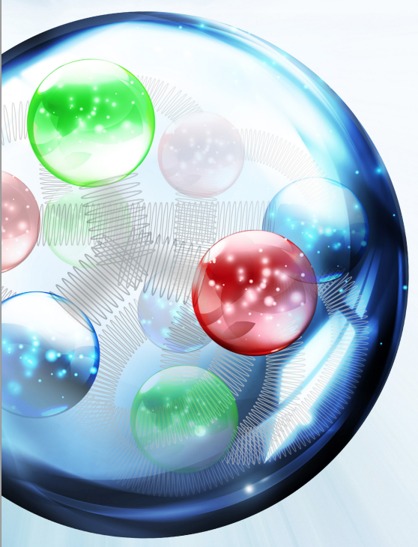
EIC and Workshop Intro Fulvia Pilat, JLAB Ferdinand Willecke

Slide 2
Outline
EIC: an introduction
EIC accelerator challenges and parameters
EIC concepts
EIC R&D
Collaborative frame, US and international
Goals for this workshop

Slide 3
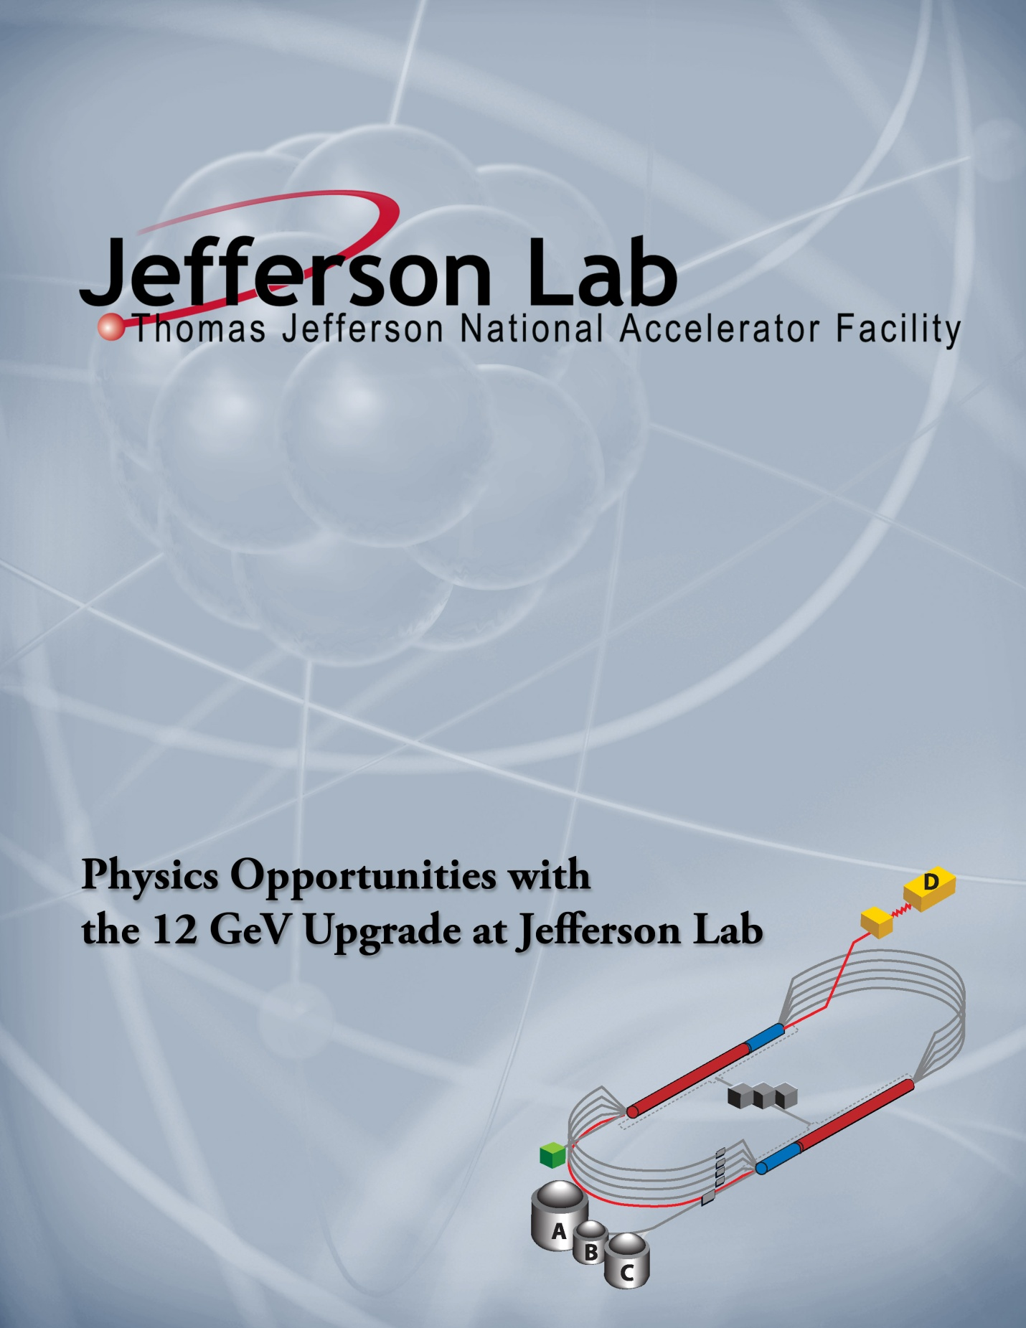
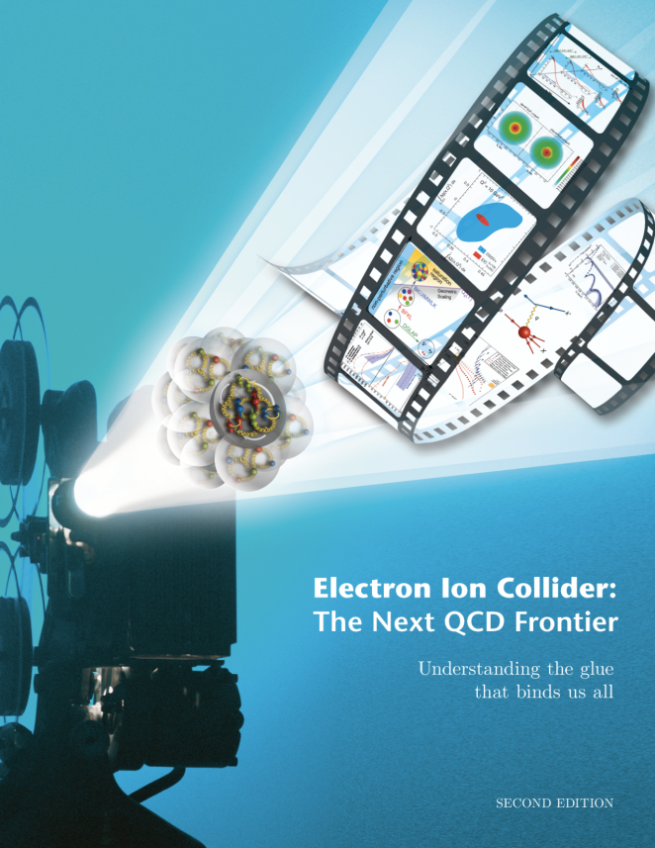
An electron-Ion collider is the highest priority for new construction in Nuclear Physics
Decade of Experiments Approved
First 12 GeV Science
Experiments Complete
Electron Ion Collider
The Next QCD Frontier
Confinement
Hadron Structure
Nuclear Structure and Astrophysics
Fundamental Symmetries
2015 NSAC Long Range Plan
Strong support for JLAB program
Role of Gluons in Nucleon and Nuclear Structure
3

Slide 4
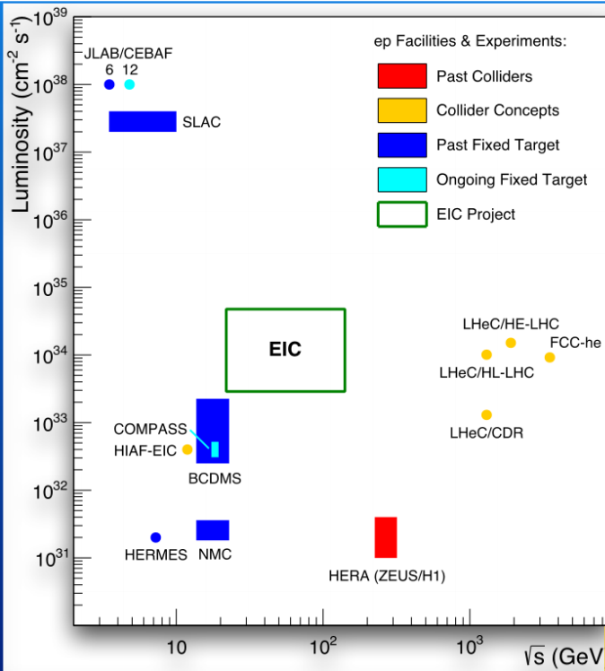
EIC unique characteristics and challenge
High luminosity (50 x Hera)
High polarization: first ever fully polarized collider
Wide range of collision energies and collision energy ratios
Many species ( polarized p, e- and light nuclei, d to heaviest nuclei)
Large detector acceptance: first ever e-p and e-A studies with ~100% reconstruction of nuclei in the final state

Slide 5
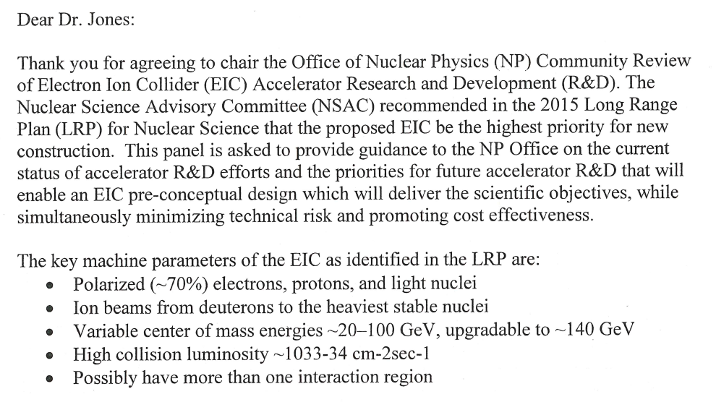
EIC parameters
From the charge letter to the NP Panel Review of EIC design and R&D, December 2016:

Slide 6
EIC Physics

Slide 7
EIC accelerator designs
New e-ring and ion complex
CEBAF full e-energy injector
High initial luminosity
Increase energy reach
New e-ring (or e-ERL)
RHIC ion complex
High initial collision energy
Increase luminosity

Slide 8
EIC detector designs

Slide 9
EIC R&D
Pre-project R&D ongoing since 10+ years
JLEIC R&D overview was presented at the NP EIC Community Review Panel (a.k.a. “Jones Panel”) in November 2017
Final Review Panel Report and R&D Priorities released in March 2017
Identified EIC JLAB-BNL Common R&D at JLEIC April Collaboration Meeting
NP EIC R&D FoA was tabled for FY’2017
NP asked for a plan for Accelerator R&D to be submitted by May 31 2017
Plans submitted by May 31 2017

Slide 10
Project development and collaborations
JLAB and BNL have been developing their designs in close collaboration with other US laboratories and Universities for 10+ years
The Long Range Plan endorsement of the EIC has motivated an increased collaboration in the US and a reach to expand the collaboration internationally
An 800+ member international EIC Users Group has been established, next meeting in Trieste in July 18-22 2017
The EIC accelerator community is encouraging national and international collaboration

Slide 11
EIC Users Group

Slide 12
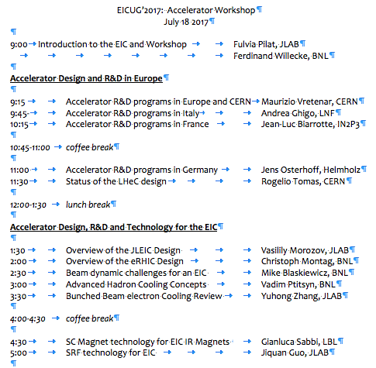
EIC Accelerator outreach
Outreach to EU institutions/funding agencies
EIC event at INFN Genova in January 2017
EIC event at LNF Frascati in March 2017
Presence at EPS high energy physics conference in July 2017
Accelerator workshop at the EICUG in Trieste
Planned outreach in Asia in 2018-19

Slide 13
Goals for this workshop
Learn about Accelerator R&D program in Europe and the LHeC
Review eRHIC and JLAB design
Discuss key EIC R&D and technology
Establish a collaboration framework

Slide 14
Summary
The recognition in the US of the EIC as the highest priority for new construction in nuclear physics has set firm foundations to build this challenging accelerator
We are looking forward to engaging the national and international scientific communities
Contact info for Fulvia and Ferdinand
Fulvia Pilat, JLAB, pilat@jlab.org
Ferdinand Willecke, willecke@bnl.gov

