Slide 1

Institut national de physique nucléaire et de physique des particules
The IN2P3 visions and plans
for nuclear and particle physics
Electron Ion Collider User Group Meeting
Trieste, July 19th, 2017

Slide 2
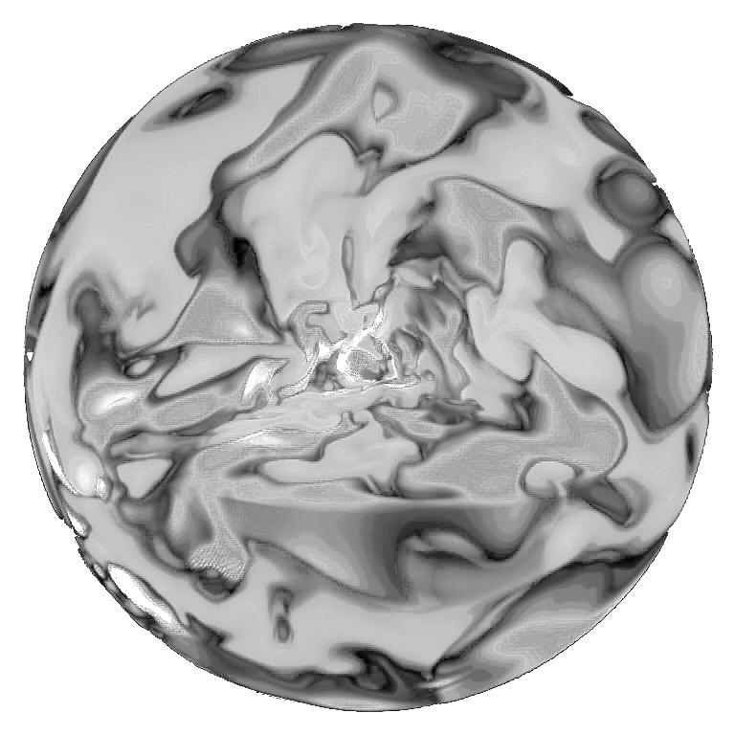
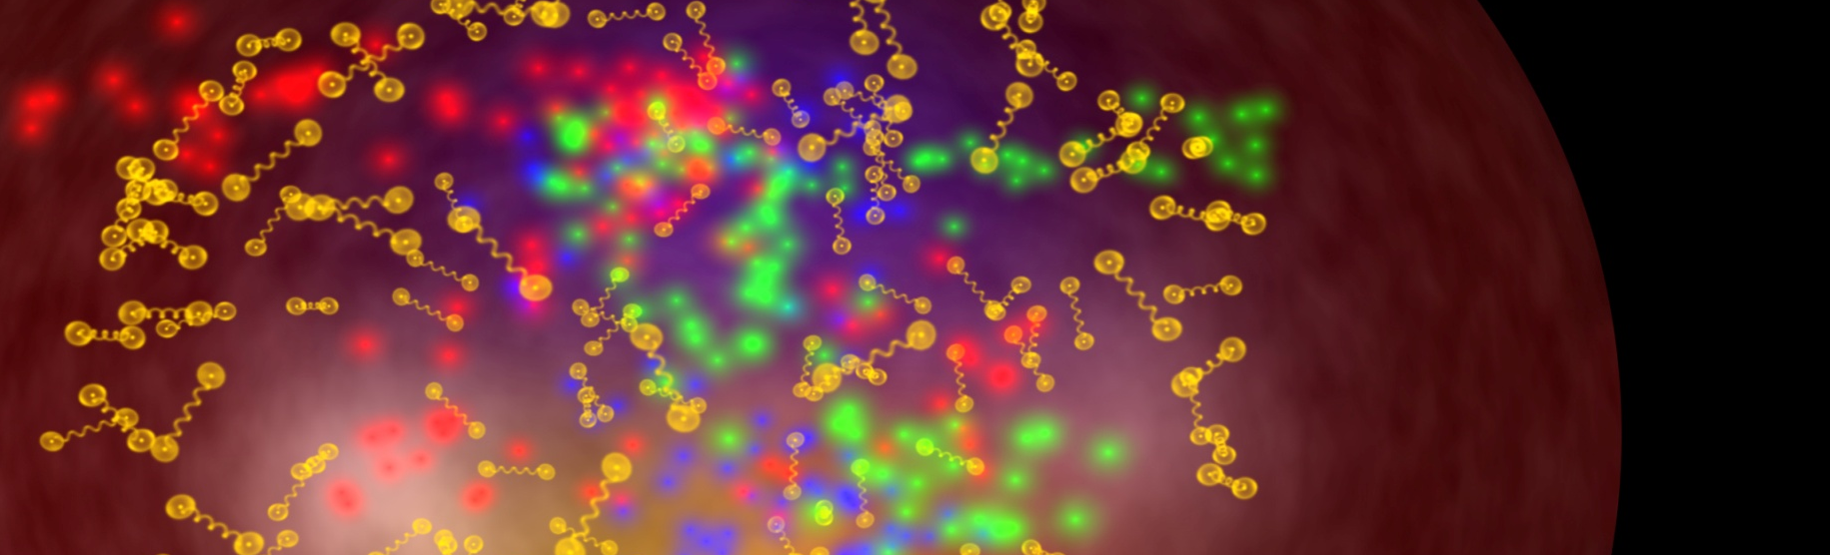
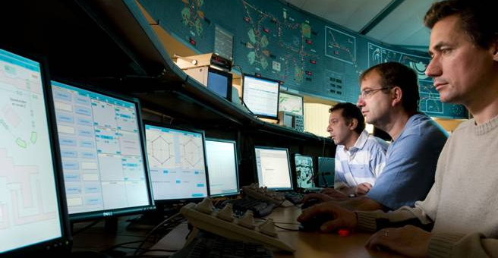
IN2P3 : A National Institute
ANIMATE AND COORDINATE RESEARCH IN THE FIELDS OF SUBATOMIC PHYSICS
PROVIDING
LINKS WITH SOCIETY
Associated technologies, Applications and Interdisciplinary research
Expertise
Teaching Training
COORDINATION
Research Programs on behalf of CNRS, in partnership with CEA and Universities
EXPLORATION
The Physics of the two infinities: from elementary particles to cosmology

Slide 3
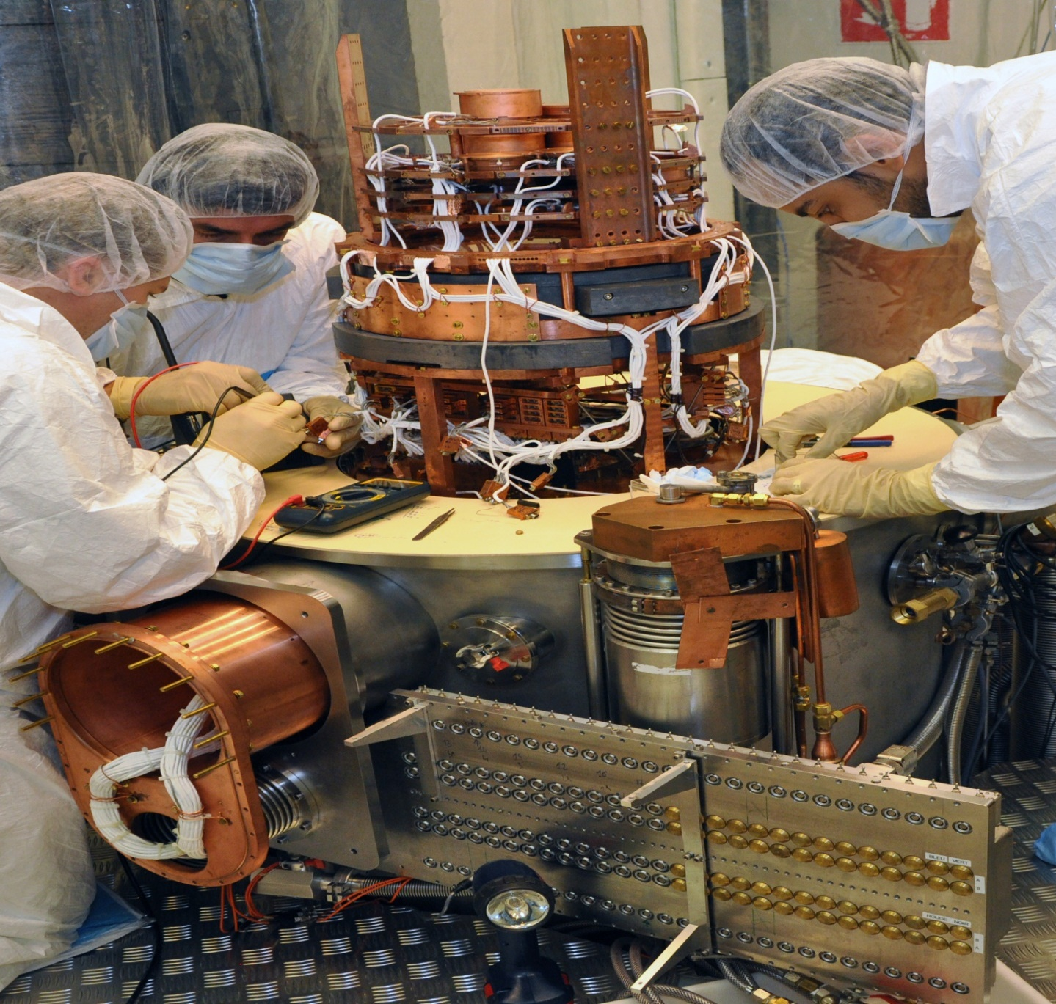
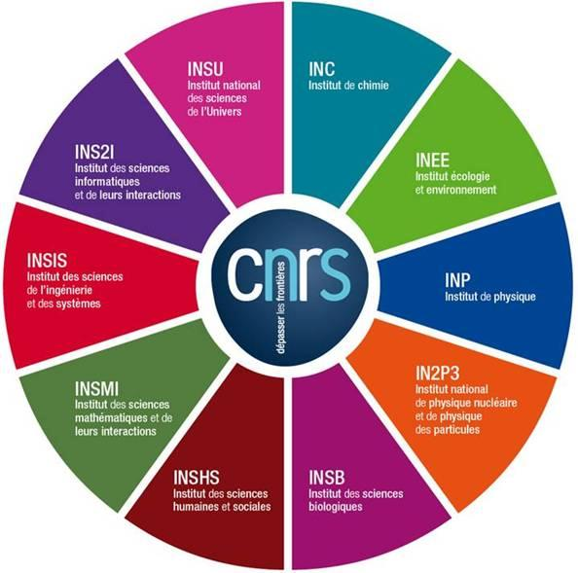
IN2P3, ONE OF 10 CNRS INSTITUTES
CNRS
10 institutes
1 100 laboratories :
95% in partnership with Universities or other research organisations
34 000 researchers,
engineers, technicians
3.3 G€ budget

Slide 4

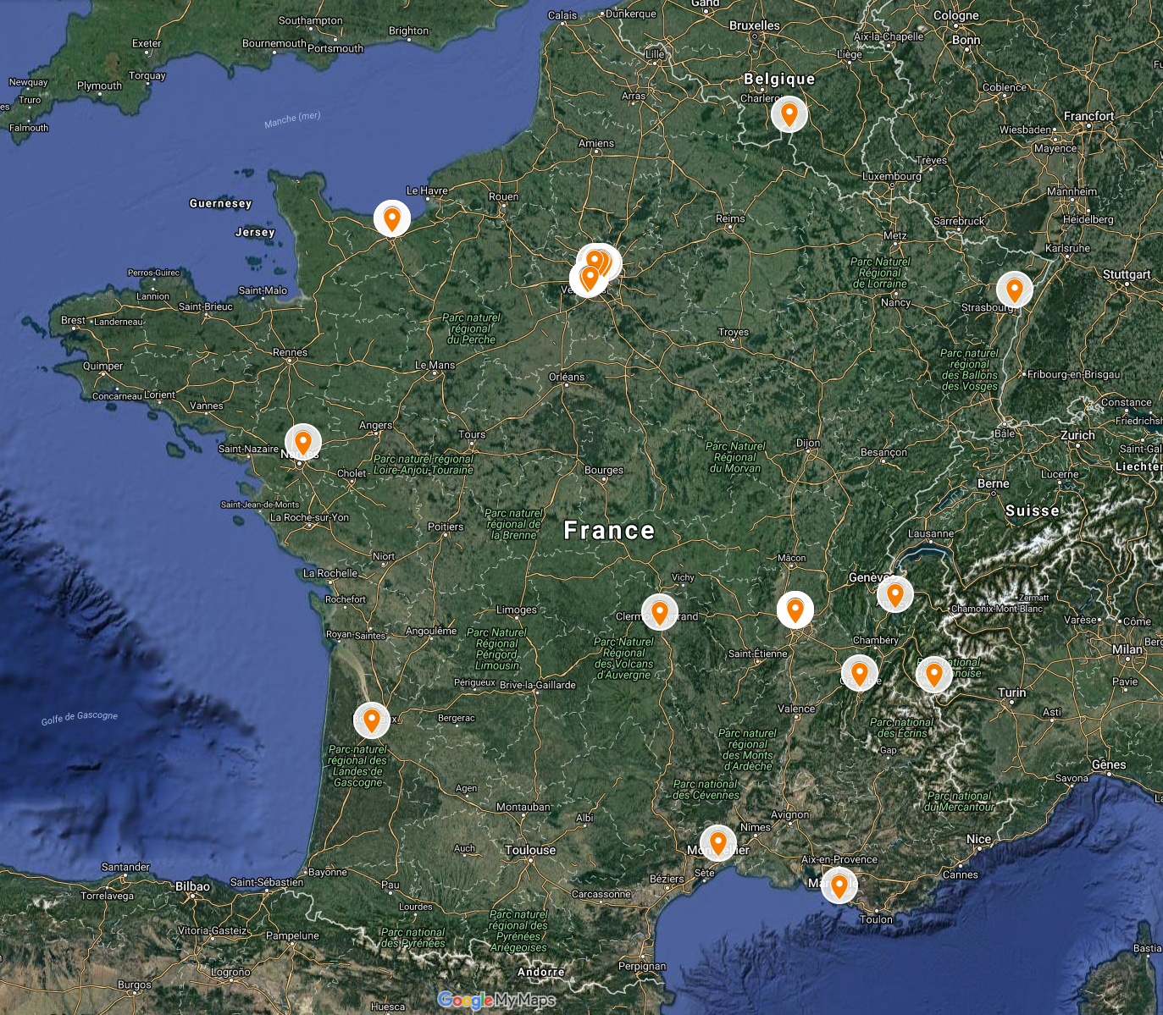
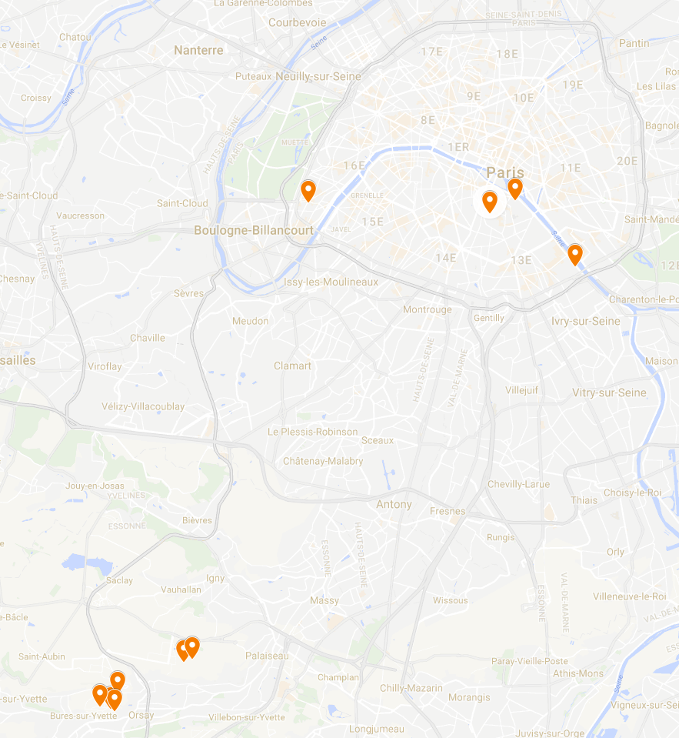
IN2P3 : A “single” distributed laboratory
LNCA
LPC Caen
CNRS/IN2P3
LPNHE
25 labs in France
3100 employees
525 CNRS researchers
360 faculties
1100 engineers
400 technicians/administratives
300 non-permanents
400 PhD students
Musée Curie
APC
IPHC
SUBATECH
LPC
IPNL
LAPP
OMEGA
LMA
LPSC
LSM
IMNC
CCIN2P3
LAL
CENBG
LLR
LAL
IPNO
CSNSM
LUPM
CPPM

Slide 5
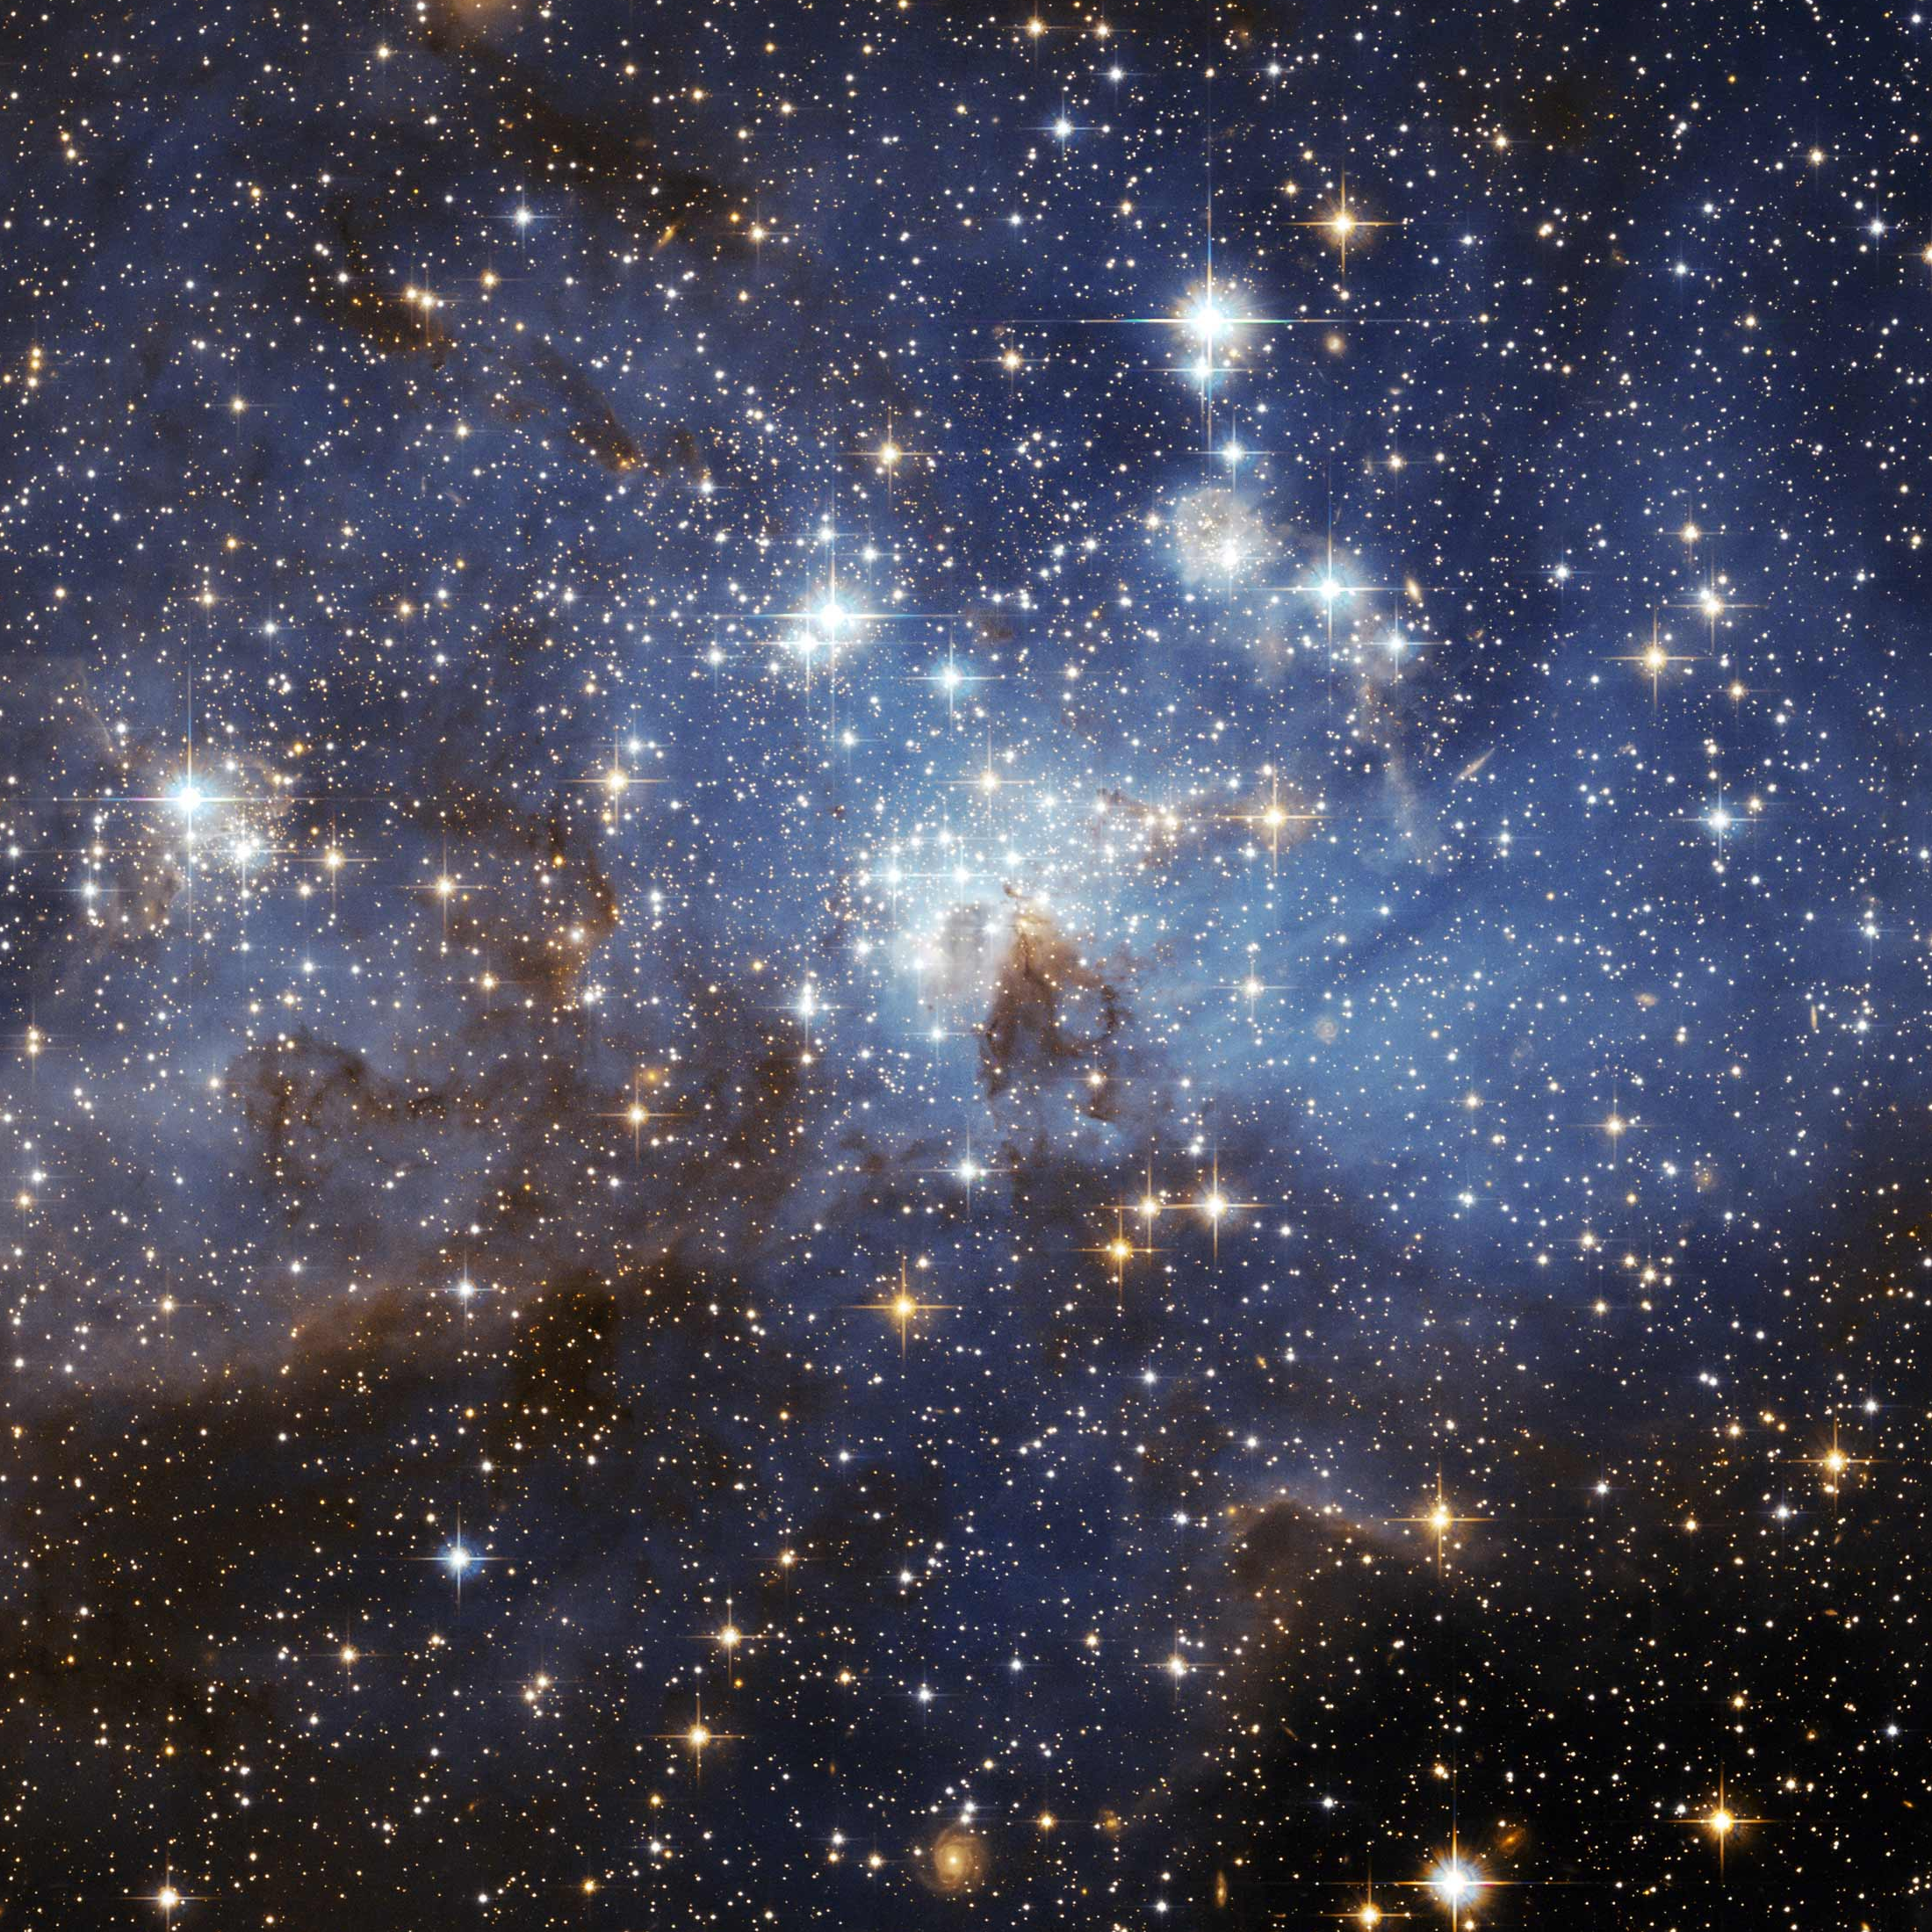

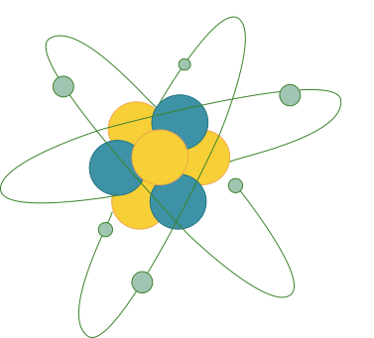
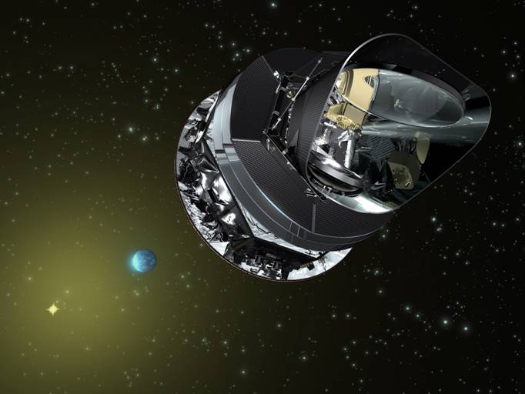
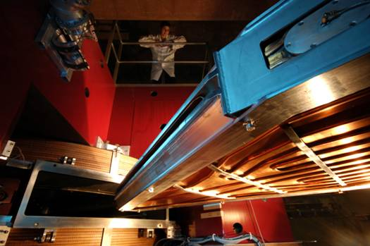
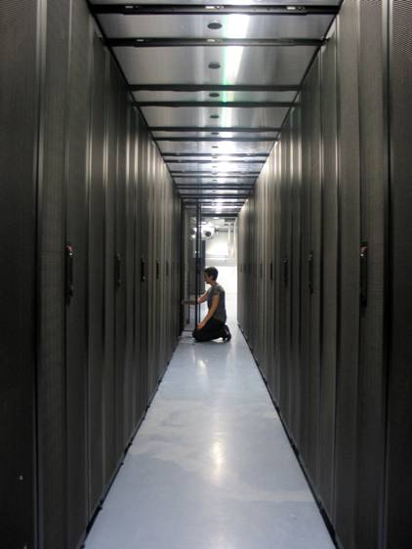
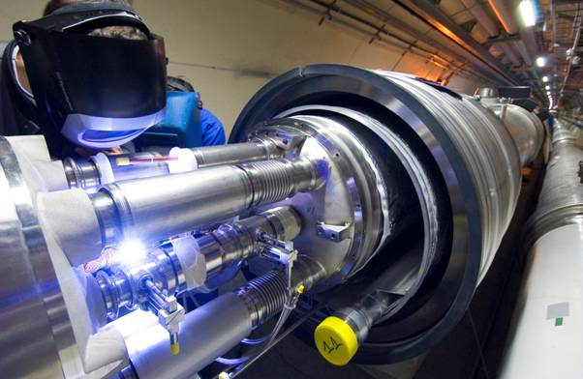
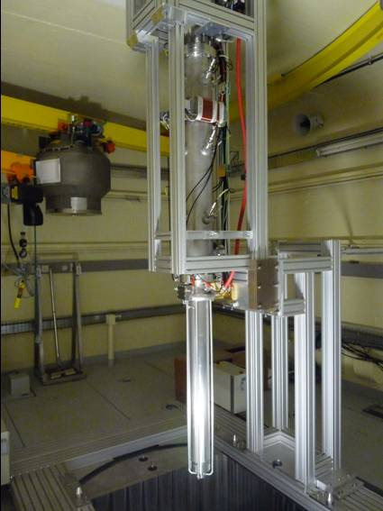
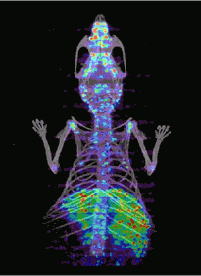
Research Areas
Astroparticle physics and Cosmology
Universe’s composition and behaviour
Particles & hadronic physics
Matter’s most elementary constituents and fundamental interactions
Nuclear physics &
Applications
Structure of nuclear matter, nuclear energy and medical applications
Computing & Data
Data Science and Computing research
Accelerator & Technology
Major R&D domains

Slide 6
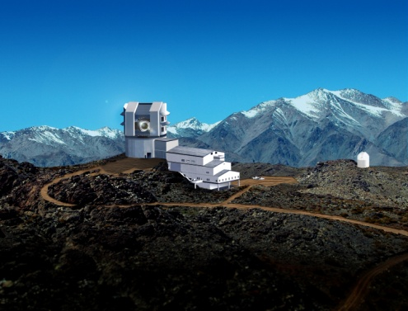
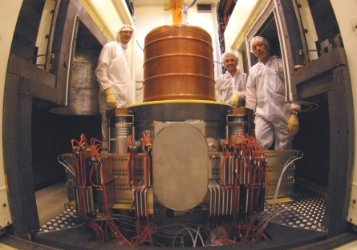
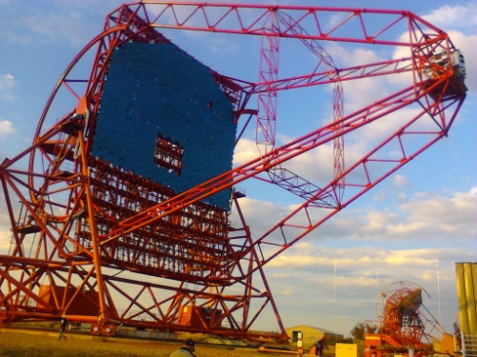
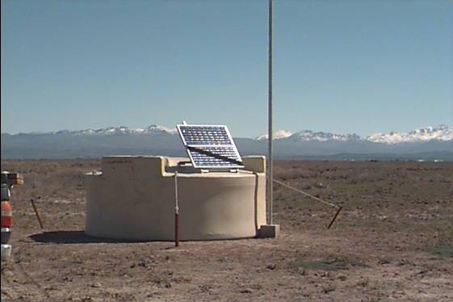
Astroparticle physics and Cosmology
High-energy gamma rays
HESS
Fermi-LAT
CTA
HARPO
SVOM
High-energy cosmic rays
AMS
Auger Prime
EUSO
CREAM
EXTASIS
Gravitational Waves
Virgo
LISA / LISA Pathfinder
Non-accelerator neutrinos
KM3NeT
SUPERNEMO
SuperKamiokande
LUMINEU
Direct dark matter detection
Edelweiss
XENON
R&D DAMIC
DARKSIDE
MIMAC
Inflation and CMB
QUBIC
NIKA
CORE
PLANCK
Dark Energy
LSST
SSP
DESI
SDSS/BOSS/eBOSS
EUCLID
6

Slide 7
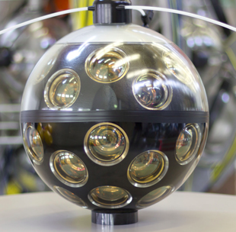
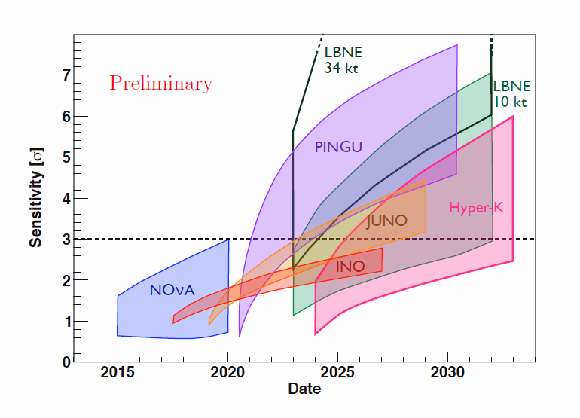
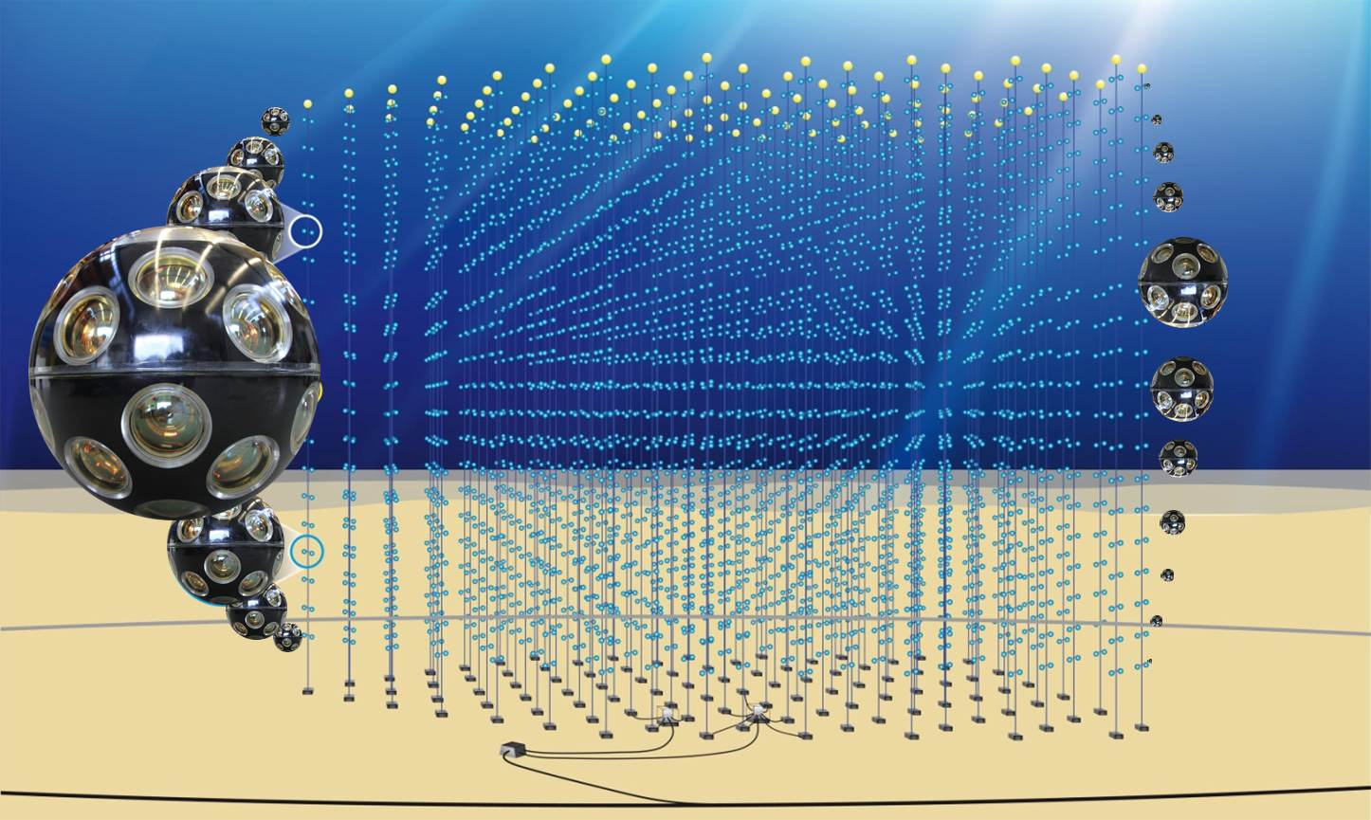
Some Highlights: astroparticles physics
KM3NET: included in the ESFRI-Roadmap with 2 sites
Arca (Italy) : large volume dedicated to neutrino astronomy
Orca (France) : dense array for the measurement of the neutrino mass hierarchy
Deployment of new optical strings has successfully started !
Full array expected by 2019
ORCA
7

Slide 8
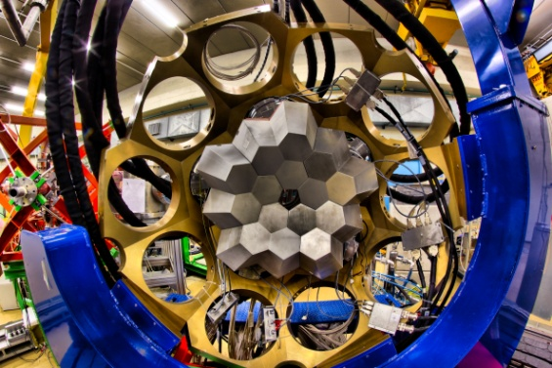
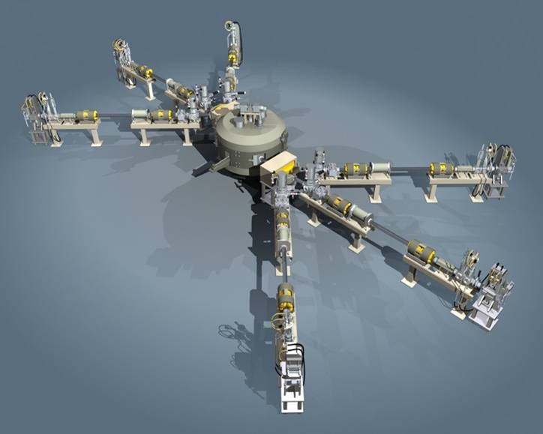
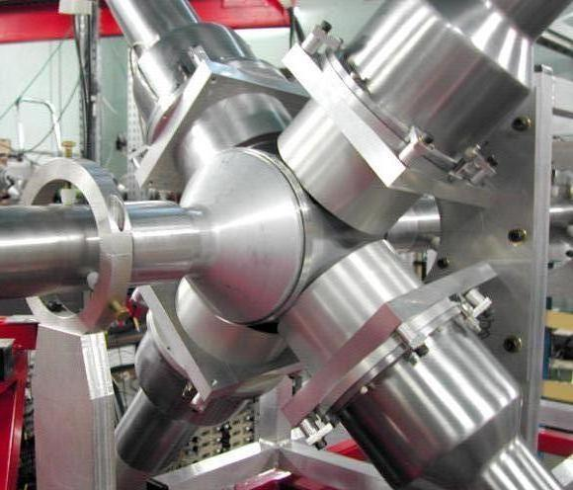
Nuclear physics and its application
Nuclear physics and astrophysics
  Study of exotic nuclei
  Study of the nucleon structure
Reactor based neutrino physics
  Double-Chooz, JUNO
  Sterile neutrinos : STEREO, Solid
Applications for
  Health and life-science
    ( Radiotherapy, radioisotopes, dosimeters, imaging technics, simulations)
  Nuclear Energy
    (ADS transmutation, studies for Thorium-cycle)
  Radiochemistry
  Cosmic ray tomography
8

Slide 9
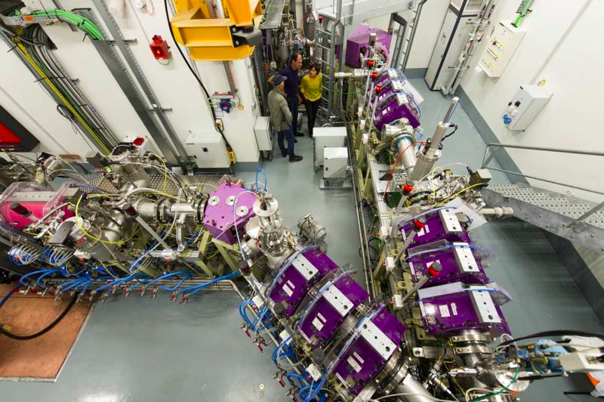
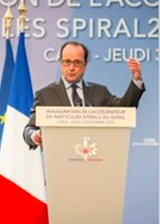
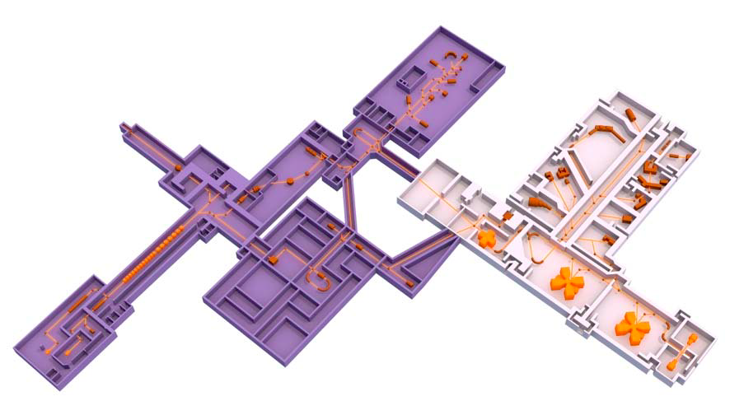


Some Highlights: nuclear physics
Inauguration of Spiral 2 by the President (November 3, 2016)
Aim: study of exotic nuclei, creating new super-heavy elements
December: first proton beam in the new injector
GANIL : national nuclear physics infrastructure
Budget : 30M€/year
250 physicists, engineers and technicians
700 users from 30 countries and 65 laboratories and universities each year
3000 publications since 1983
9

Slide 10
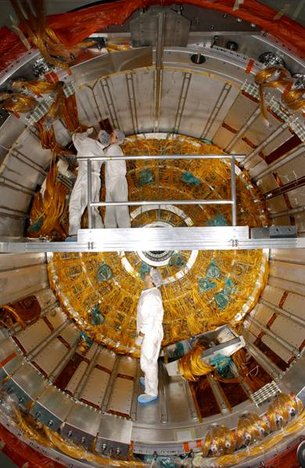
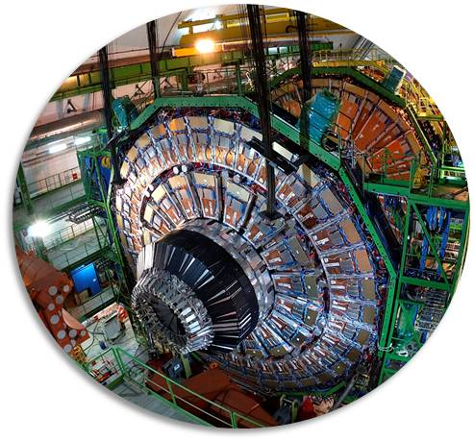
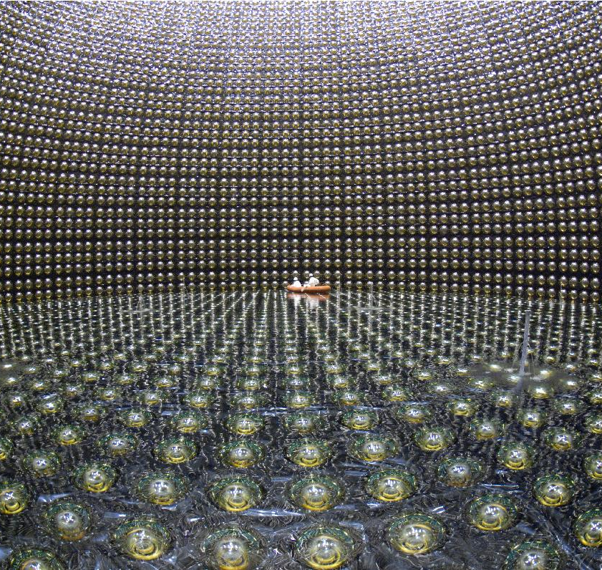
Particle and hadronic physics
Participation in all 4 major LHC experiments :
  Physics of and beyond the standard model
  B-physics and fundamental symmetries
  Heavy-Ion physics
Participation to Belle-II:
  In discussion (July 2017)
Hadronic physics
  J-Lab and Hades/GSI
Participation in precision physics experiments
  nEDM (PSI), GRANIT (ILL),
  Comet (J-Parc), AEgIS & Gbar (CERN)
Accelerator based neutrino physics
  T2K, DUNE (ProtoDUNE-DP, WA105)
Detector R&D for ILC:
  CALICE (SiW and SDHCAL), CMOS technology for micro-vertex
10

Slide 11
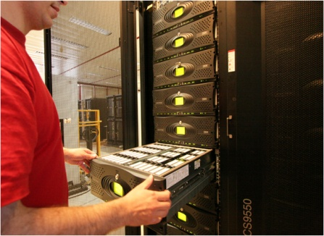
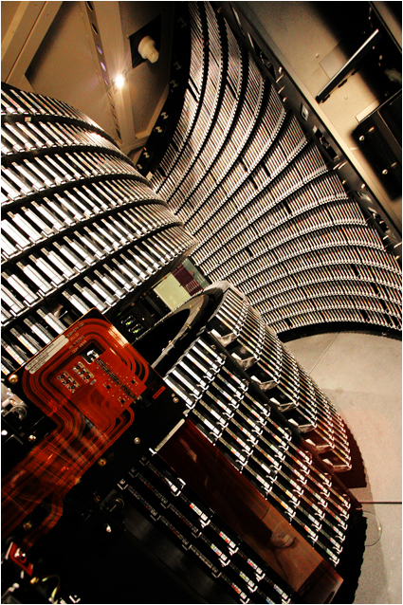
Computing and Data
CC-IN2P3 in Lyon:
National Data-center
Tier 1 for w-LCG, but also computing for 70 other projects
Major challenge to come:
  HL-LHC, LSST, Euclid and CTA
France Grille: distributed grid and cloud computing over 9 regional site
Participation in EOSC and HelixNebula projects
Software developments
11

Slide 12
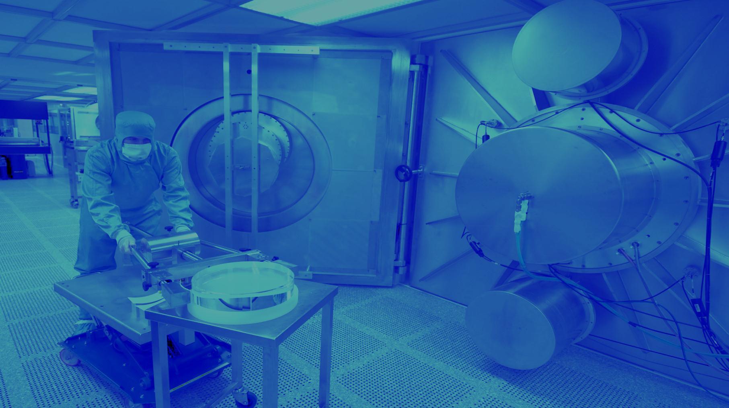
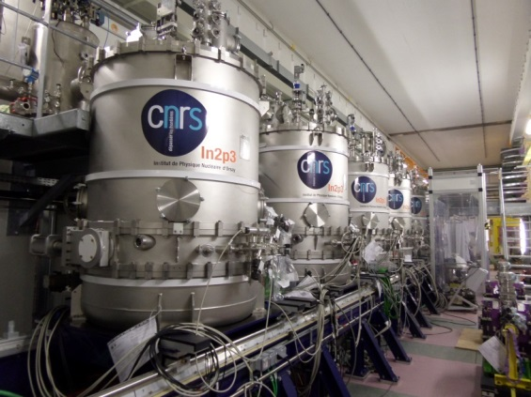

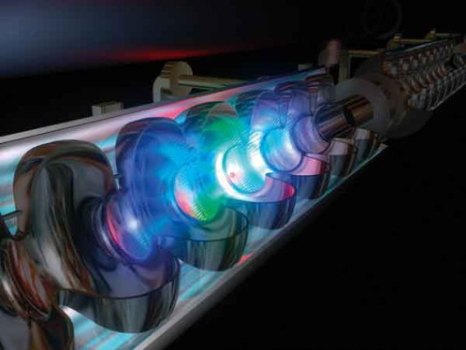
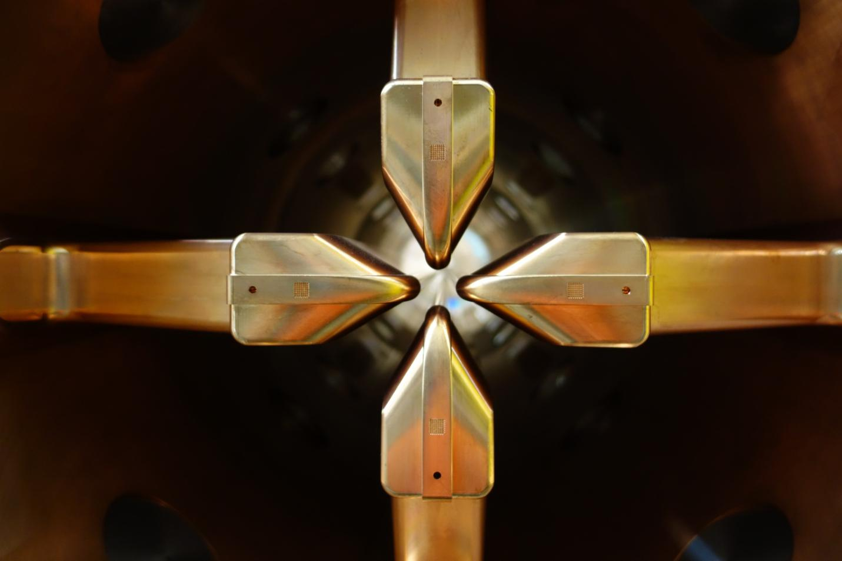
Accelerators R&D at IN2P3
[c.f. Jean-Luc Biarrotte presentation yesterday]
ACCELERATOR R&D
High-field superconducting magnets
Superconducting accelerating cavities and cryotechnology
Sources & injectors
Radioactive beams
Beam dynamics, final focus
Plasma acceleration, laser/beam interactions
Beam instrumentation
Related technologies (RF, vacuum…)
© CSNSM/Jean François Dars, Desy Hamburg, Ganil, CNRS/IN2P3
Conception graphique : Anna Thibeau (IPNL)
INTENSE BEAMS
LASERS
SUPERCONDUCTING
ION SOURCES
PLATFORMS
CRYOTECHNOLOGY
12

Slide 13
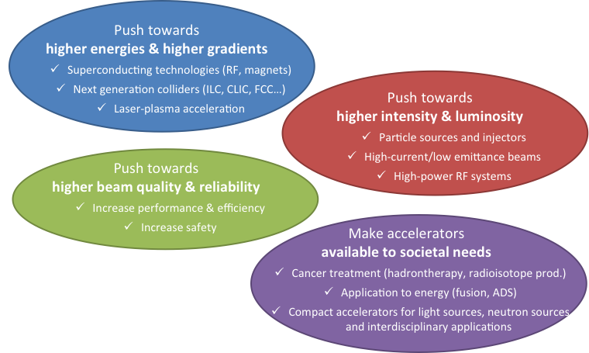

Accelerators R&D at IN2P3
13

Slide 14
Hadronic Physics at IN2P3
Most efforts are currently focused on the heavy ion program at CERN:
ALICE and its ugrades (Muons, ITS, MFT)
CMS Heavy Ions
LHCb Heavy Ions
=> Phase 1 upgrade during LS2 in 2019-2020
Physics program at GSI/FAIR:
Contribution to Hades
Discussion in progress concerning possible contributions to PANDA, CBM and nuclear physics program at FAIR
Contribution to J-Lab
DVCS at CLAS & proton tomography
Polarized Electrons for Polarized Positrons
Heavy Photon Search
Accelerator R&D for EIC: «We would be glad to help on EIC »
Strong scientific interest for EIC physics
14

Slide 15
Thank you !

Slide 16
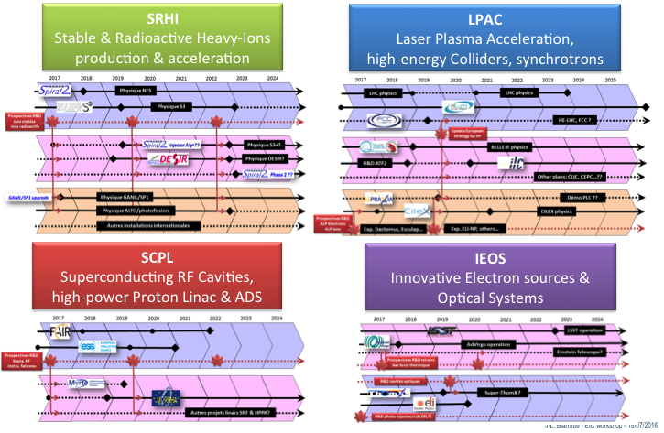
Accelerator roadmap @ CNRS/IN2P3

Slide 17
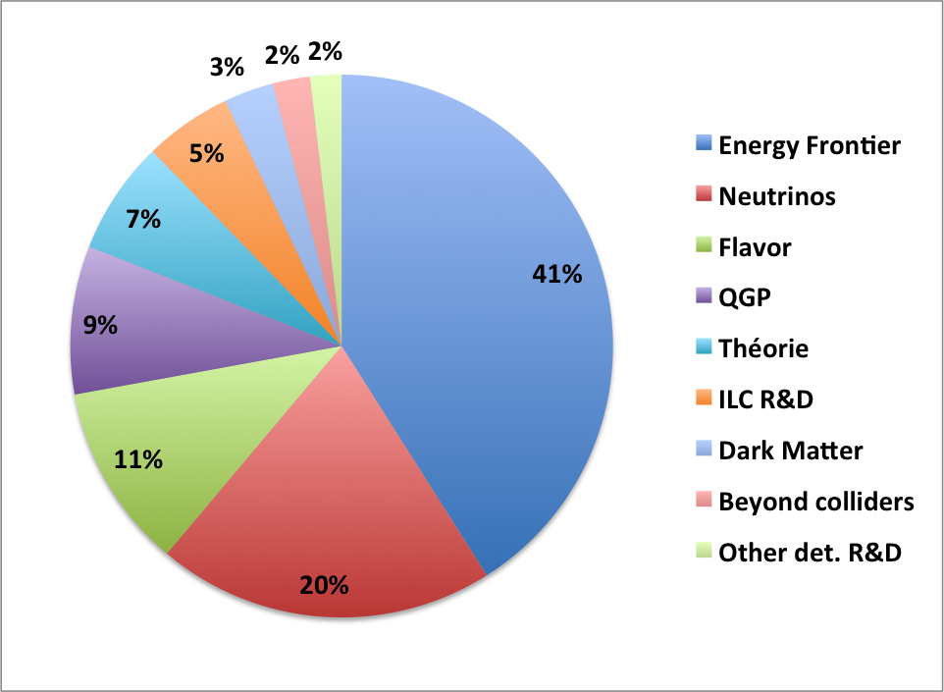
Particle physics at IN2P3
Energy Frontier physic:
  ATLAS, CMS
Flavor physic:
  LHCb, interest for Belle-2
Hadronic physic:
  ALICE, J-Lab
Beyond Colliders:
  nEDM, GRANIT, AEgIS, Gbar,
  COMET-g-2/EDM
Neutrinos:
  T2K/Super-K, DUNE-WA105
  Double-Chooz, JUNO, SOLID, STEREO
  Super-Nemo, Antares/Km3net
Dark Matter:
  Edelweiss, Xenon-1 T, DarkSide, DAMIC R&D
ILC R&D

Slide 18
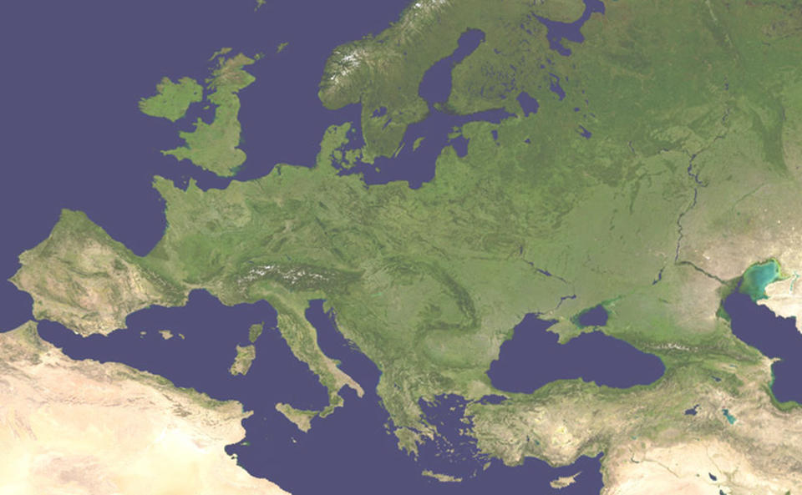
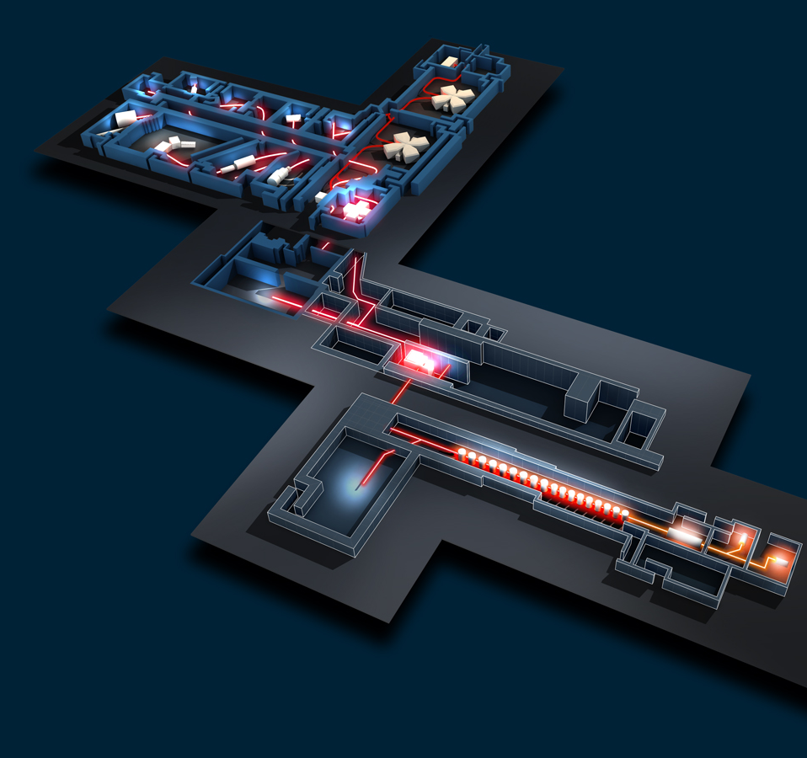
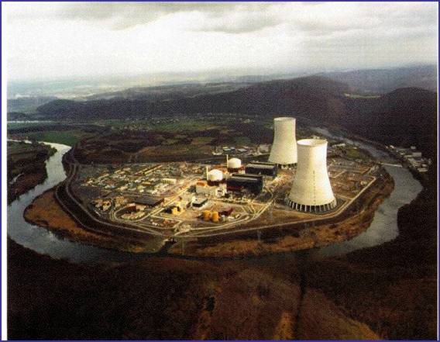

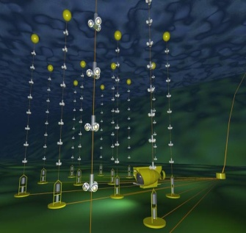
Major Research Infrastructures in France
GANIL /Spiral2
LNCA / DChooz
CC-IN2P3
LSM / Edelweiss, SuperNemo
Antares KM3NET

Slide 19
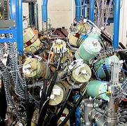
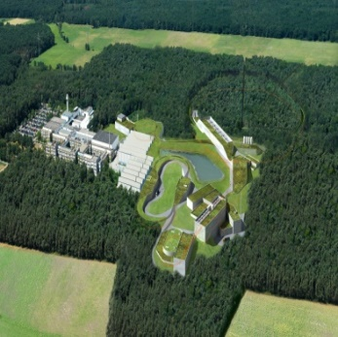
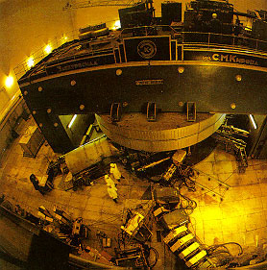
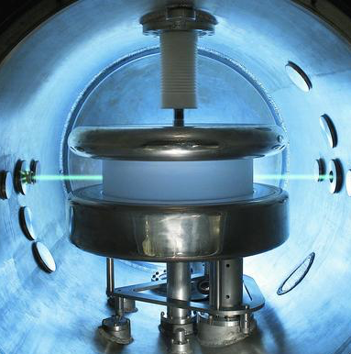
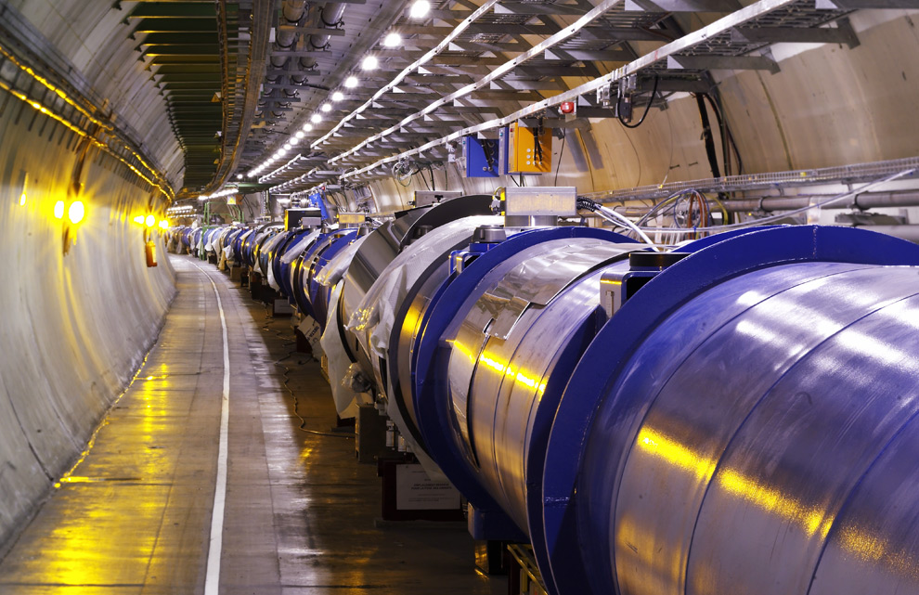
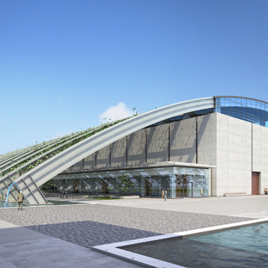

European Collaborations
Jyväskylä
(Finlande)
JINR Dubna
(Russie)
FAIR/GSI (Allemagne)
LHC, Isolde / CERN
nEDM / PSI
(Suisse)
© Cern, Nasa, Opera, GSI, JINR Dubna, Profilmedia
Virgo/EGO
(Italie)
ELI-NP
(Roumanie)
Gran Sasso
(Italie)

Slide 20




International Collaborations
SNOLab
TRIUMF
Fermilab
T2K, Riken (Japon)
LBNL, SLAC
Jlab
JUNO (Chine)
Hess (Namibie)
Planck, AMS, Lisapathfinder, Euclid, … (Space)
LSST (Chili)
Auger (Argentine)

Slide 21

IN2P3: Key Figures
About 1000 CNRS and University researchers,
1500 engineers, technicians and administrative staff
About 700 postdocs and Ph.D students
30 major international
research programs
17 international research networks
© CENBG, LSM – Conception graphique : Anna Thibeau (IPNL)
70 M€
annual budget
(excluding salaries)
TGIR
17 laboratories
8 technical support labs
8 interdisciplinary accelerator based platforms

Slide 22











IN2P3 organization

