Slide 1
(S)RF Technology for Electron Ion Colliders
Presented By:
Jiquan Guo, JLAB
EIC User Group Meeting 2017
Trieste, Italy
July 18-22, 2017

Slide 2
Outline
Introduction to RF systems of both eRHIC and JLEIC
EIC collider ring cavities
JLEIC Circulating Cooler Ring (CCR) cavities and RF kicker
JLEIC ion linac and ion bunch formation RF systems

Slide 3
Outline
Introduction to RF systems of both eRHIC and JLEIC
EIC collider ring cavities
JLEIC Circulating Cooler Ring (CCR) cavities and RF kicker
JLEIC ion linac and ion bunch formation RF systems

Slide 4
Introduction
Both eRHIC (ring-ring design) and JLab EIC (JLEIC) are electron-ion colliders designed to deliver high luminosities up to above 10³⁴/cm²/s for meeting the requirements of the EIC science program
To achieve this luminosity goal, both designs chose ampere level high beam current electron/ion collider rings, with short bunch length, high bunch reprate, and low emittance (hadron cooling needed).
The beam current in the electron ring of both designs is mainly set by the 10MW administrative limit in synchrotron radiation power. The parameters will be similar to the B-factory storage rings (PEP-II and super KEKB), with more challenges from wide electron energy range.
Short bunch length (cm level) is unprecedented in the ion ring and will be a challenge for the RF system. Strong hadron cooling requires high current (Ampere level) low energy (20-140MeV) electron beam.
Crabbing in hadron collider requires a strong crabbing RF voltage and is unproven. Both EIC teams collaborate closely with HiLumi LHC crab cavity development.
Both designs need to inherit some real estates from existing accelerators.
Both designs are still evolving and becoming more self-consistent

Slide 5
eRHIC RF Systems
Ion Ring:
  Use the current RHIC 28.15MHz warm accelerating cavities and 56MHz SRF/197MHz warm cavities for storage
  Use the current ion injector chain
  Will upgrade to higher frequency (harmonics of 112.6MHz) for future high reprate operation
Electron ring:
  Two cell 563MHz SRF cavities under development.
Crab cavity system: 337.8MHz
Electron injector:
  A multi-turn SRF linac with FFAG optics in the baseline
  May adopt RCS design

Slide 6
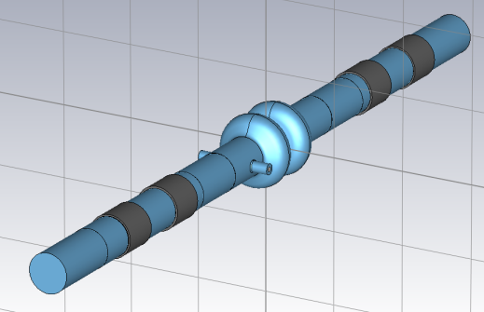
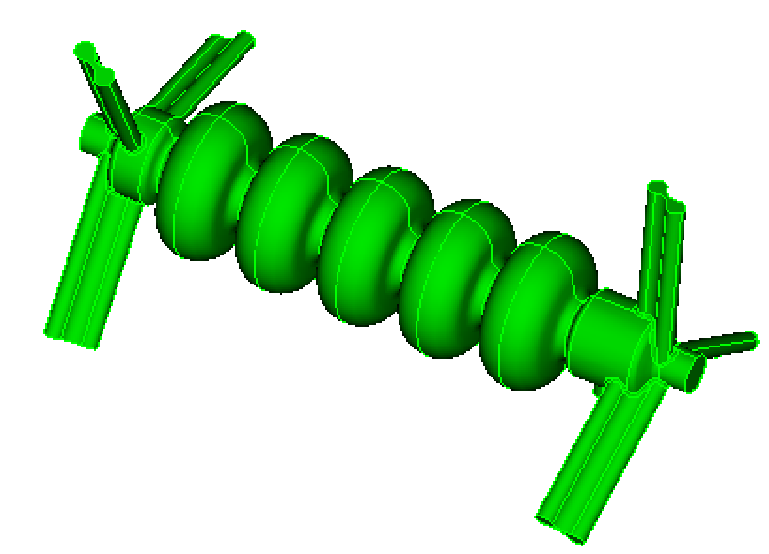
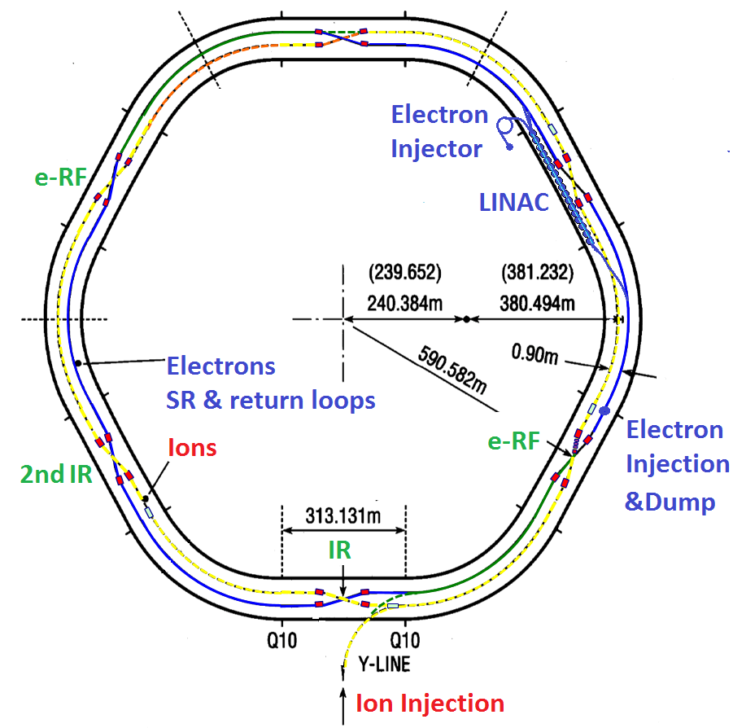
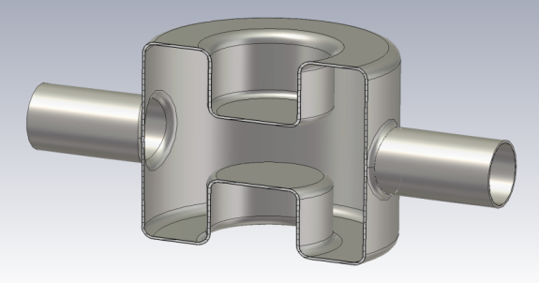
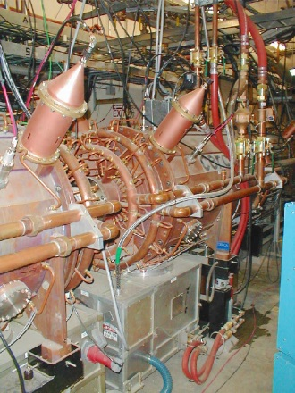
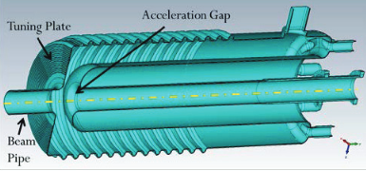
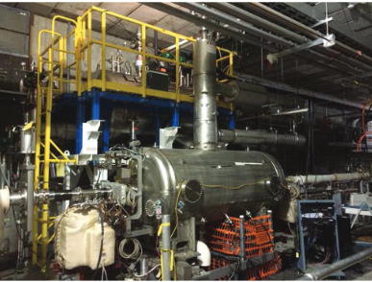
Introduction: eRHIC RF Cavities
5-cell injector linac cavity with ridged waveguide HOM damper
Two-cell 563MHz SRF cavity for e-ring, under development
DQW SRF crab cavity, 337.8MHz, under development
28MHz accelerating cavities
56MHz QWR SRF storage cavity, newly developed

Slide 7

JLEIC RF Systems
Electron ring: PEP-II warm 476MHz RF adopted
  Proven technology with low cost
  Use CEBAF as injector, frequency matched by 1497×7/22=476.3𝑀𝐻𝑧
  Enough cavities and klystrons available as the total beam SR power is similar
  Will upgrade to 952.6MHz SRF cavities for future high reprate operation
Ion ring: new 952.6MHz SRF cavities to provide bunching voltage
  Plus low frequency cavities for capture, acceleration and bunch formation.
Crab cavity system: 952.6MHz
Cooler:
  952.6MHz cavities for source and ERL (20-55MeV)
  Cooler baseline with circulator ring, using RF harmonic kickers
Ion injector chain:
  An SRF linac with warm front end as developed by ANL
  A booster with a series of low frequency for capture, acceleration and bunch split

Slide 8
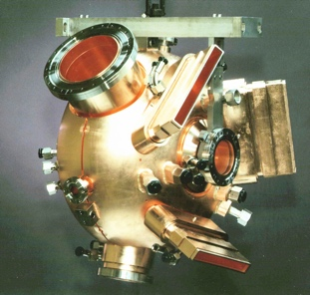
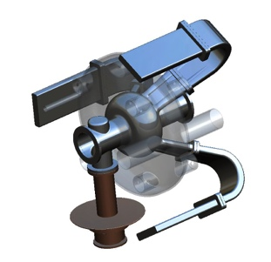
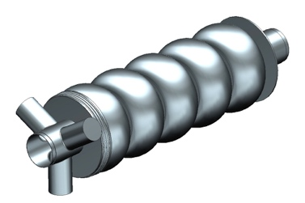
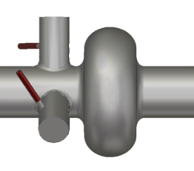
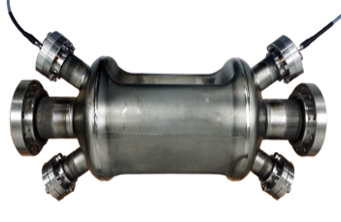
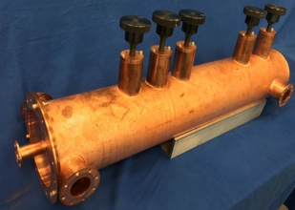
Introduction: RF Cavities for JLEIC
952.6 MHz i-ring
(SCRF)
JLEIC
Collider
Rings
i-SRF +
NCRF
BB cooler
952.6 MHz cooler ERL (SCRF)
Crab
IP
e-RF
476.3 MHz e-ring
(NCRF PEP-II)
Crab
e-RF
Future IP
Booster
952.6 MHz cooler booster (SCRF)
ODU
SRF Linac
Ion Source
952.6 MHz crab
(SCRF)
Electron Injector
Hall D
12 GeV 1497MHz CEBAF
Harmonic Fast kicker for cooling ring
Halls A, B, C
Not including ion acceleration and bunch formation

Slide 9
Introduction: Selected EIC Parameters
 |  | eRHIC ring-ring |  | JLEIC
Parameter | Units | Protons/ions | Electrons | Protons/ions | Electrons
Beam Energy | GeV | 50-275 | 5-18 | 20-100 | 3-10
Circumference | m | ~3834 |  | ~2255
Bunch reprate | MHz | 28.15/112.6 |  | 476.3 (119, 238)/952.6
Storage RF frequency | MHz | 56, 197/TBD | 563 | 952.6 | 476.3/952.6
Beam Current | A | 0.46/0.92 @275GeV | 1.25/2.48 @10GeV | 0.75 | 0.71 (10 GeV) to 3 (3 GeV)
Bunch Length | cm | 7/3.5 @275GeV | 0.3 @10GeV | 1.2 | 1.2-1.6
Main RF technology |  | SRF, NCRF (RHIC) / TBD | SCRF | SCRF | NCRF(PEP-II) /SCRF
Installed cavity voltage | MV | 2/3/TBD | TBD | Up to 45 | Up to 22/TBD
Number of Cavities | ea | 1/5/TBD | TBD | Up to 36 | Up to 34/TBD
Crabbing Angle | mrad | 11 | 11 | 25 | 25
Crab cavity Frequency | MHz | 337.8 | 337.8 | 952.6 | 952.6
Crabbing Voltage per Side of IP at Max Energy | MV | 13 | <4 | 20.82 | ~2.8
Betatron at Crab Cavity | m | 1200 | TBD | 363.44 | ~200
Parameters in red are for future upgrades by replacing the legacy RF systems.
Parameters are still evolving in design iterations.
Some parameters used in the latest RF design may lag the lattice design iteration.

Slide 10
Outline
Introduction to RF systems of both eRHIC and JLEIC
EIC collider ring cavities
  JLEIC electron ring using PEP-II cavities
  JLEIC 952.6MHz SRF cavity family
  Crab cavities
JLEIC Circulating Cooler Ring (CCR) cavities and RF kicker
JLEIC ion linac and ion bunch formation RF systems

Slide 11
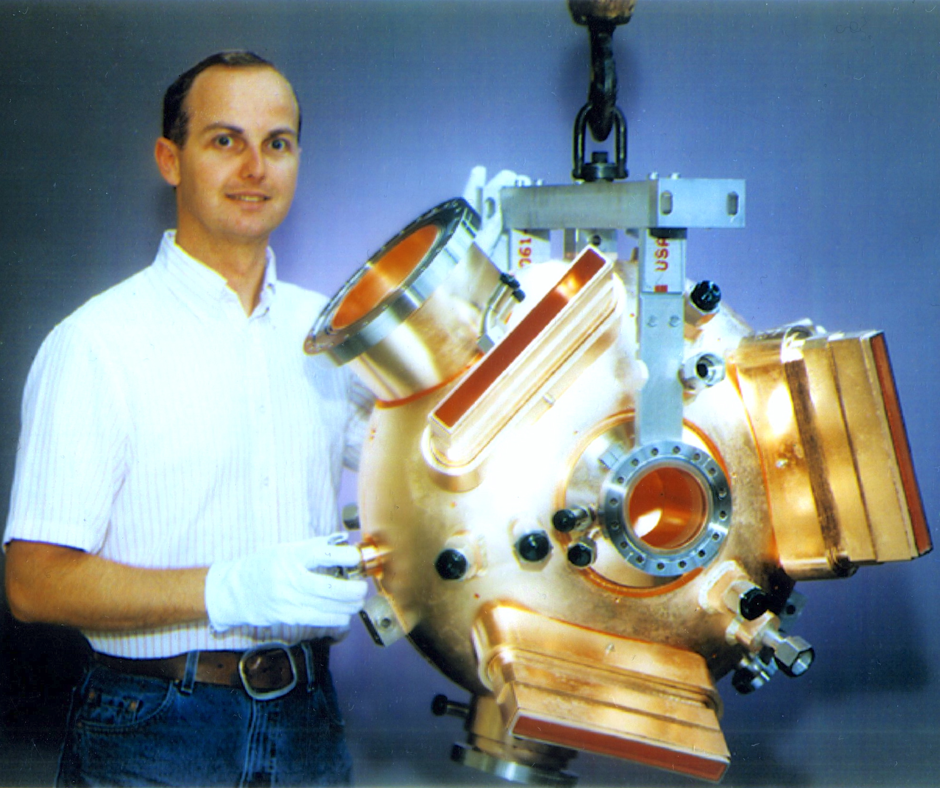
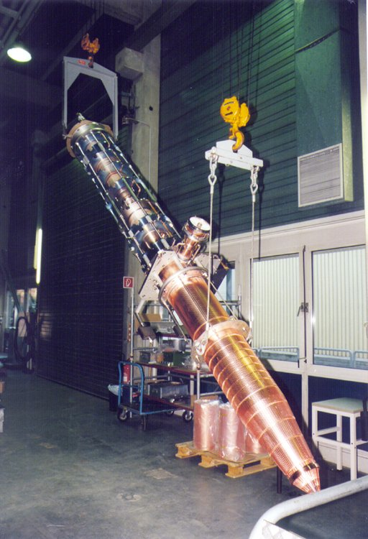
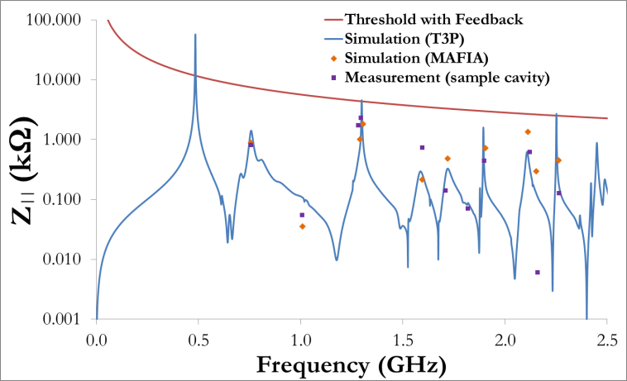
JLEIC Electron Ring with PEP-II Cavities
1-cell cavity with on-cell HOM damper
  34 cavities available
  1.2MW klystron with power supplies, etc
  13 available, each drives 2 or 4 cavs
Using feedback + fewer cavities at low electron energy helps to reduce impedance and increase beam current limited by coupled bunch instability (CBI)
Refurbishment/adjustment may be needed
PEP-II RF cavity
1.2 MW Klystron
PEP-II cavity impedance and CBI threshold
(assuming PEP-II longitudinal feedback amplitude)

Slide 12
JLEIC High Level RF Parameters
Electron Ring NCRF |  |  |  |  |  |  | Proton SRF |  |  | Pb⁸²⁺ SRF
Energy | 3 | 5 | 8 | 10 |  | GeV | 30 | 100 |  | 40 |  | GeV/u
Energy Loss per Turn | 0.114 | 0.883 | 5.785 | 14.124 |  | MeV
SRpower/ring (= power to beam) | 0.34 | 2.65 | 8.17 | 10.00 |  | MW
Beam Average Current | 3.000 | 3.000 | 1.412 | 0.708 |  | A | 0.5 | 0.5 |  | 0.5
Bunch Length | 12.0 | 12.0 | 12.0 | 15.6 |  | mm
Vpeak, Total | 0.76 | 3.59 | 15.38 | 21.69 |  | MV | 11.64 | 44.66 |  | 42.27
Syn. Phase | 8.7 | 14.2 | 22.1 | 40.6 |  | Degree | 0 | 0 |  | 0
Vgap, 1K2C | 0.38 | 0.45 | 0.76 | 0.79 |  | MV | 0.73 | 1.12 |  | 1.06 |  | 1S1C
Vgap, 1K4C |  |  | 0.40 | 0.47 |  | MV
Gradient, 1K2C | 1.21 | 1.43 | 2.42 | 2.51 |  | MV/m | 4.62 | 7.10 |  | 6.72 |  | 1S1C
Gradient, 1K4C |  |  | 1.26 | 1.49 |  | MV/m
Cavity Number, Total | 2 | 8 | 24 | 34 |  |  | 16 | 40 |  | 40
Klystron Number | 1 | 4 | 10 | 13
PowerToBeam per Cavity, 1K2C | 171.61 | 331.03 | 404.89 | 363.90 |  | kW | 0 | 0 |  | 0 |  | 1S1C
PowerToBeam per Cavity, 1K4C |  |  | 210.96 | 215.62 |  | kW
Cavity Wall Loss Power, 1K2C | 20.64 | 28.76 | 83.06 | 89.03 |  | kW | 0.3 | 0.7 |  | 0.7 |  | W
Cavity Wall Loss Power, 1K4C |  |  | 22.55 | 31.26 |  | kW
Reflected Power, 1K2C | 6.29 | 39.97 | 1.25 | 6.83 |  | kW | 24.0 | 56.5 |  | 50.7 |  | 1S1C
Reflected Power, 1K4C |  |  | 12.89 | 2.35 |  | kW
Forward Power Per Cavity, 1K2C | 198.53 | 399.76 | 489.20 | 459.76 |  | kW | 24.0 | 56.5 |  | 50.7 |  | 1S1C
Forward Power Per Cavity, 1K4C |  |  | 246.41 | 249.22 |  | kW
Qext | 4615 | 4615 | 4615 | 4615 |  |  | 52400 | 52400 |  | 52400
Total RF Power | 0.397 | 3.198 | 9.798 | 12.263 |  | MW | 0.38 | 2.26 |  | 2.00
Reflected power is a required overhead for Robinson Instability in both rings
Need R&D for 952.6MHz sources, possibly magnetron and/or solid state amplifiers.

Slide 13
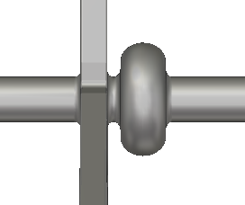

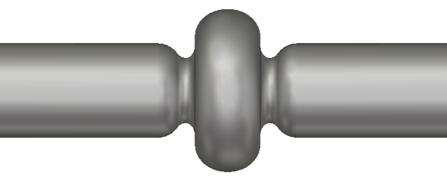
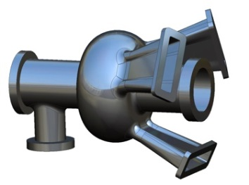
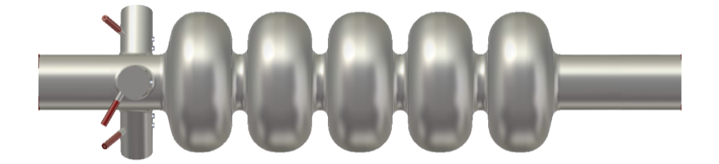
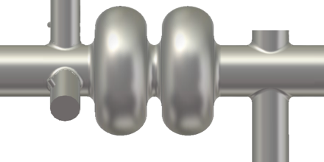
JLEIC 952MHz SRF Cavity Family
New 952.6MHz High-current cavity shape
4 different HOM damping schemes under evaluation
1, 2, 5 cells for different sub-systems
  1-cell, on-cell damper for e-ring 952MHz upgrade and possibly for i-ring and ERL booster
  2-cell possibly for i-ring and ERL booster
  5-cell for ERL linac
Prototype in progress (without end-groups)
1) 3WG. 2) 3 x coax dampers. 3) enlarged beam pipes (ref) 4) on-cell dampers
Cooler needs 5-cells in the ERL, 1 or 2 -cells in the injector.
Ion ring might use 2-cells with TM010 π mode R/Q tuned close to 0

Slide 14
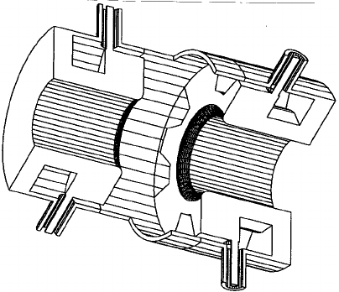
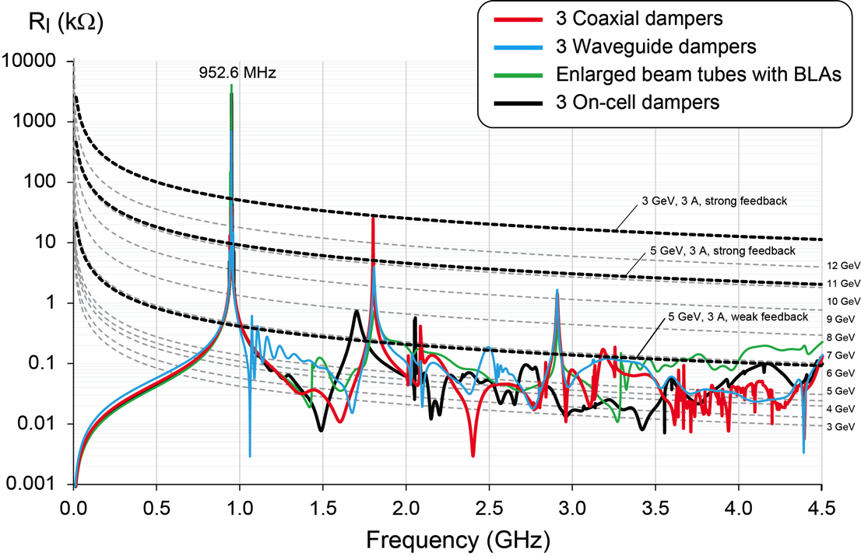
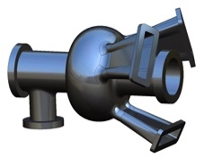
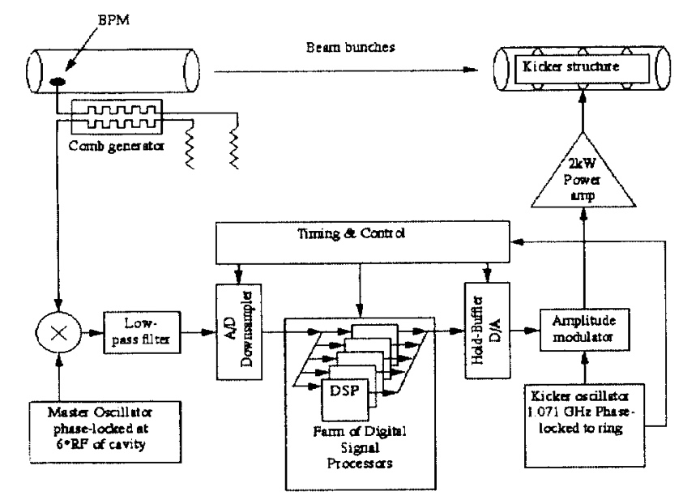
JLEIC Impedance and feedback
Broadband damping of cavity HOMs is essential
PEP-II feedback systems allowed running above threshold. Similar systems are now commercially available
JLEIC needs a high level system design and performance simulation for pre-CDR
Many other ring components need to be considered
Reliable high-power kickers are needed
DAPHNE
type kicker
PEP-II Longitudinal Feedback system concept
F. Marhauser, “Next Generation HOM-damping”, Special Issue on Superconducting RF for Accelerators, to be published

Slide 15
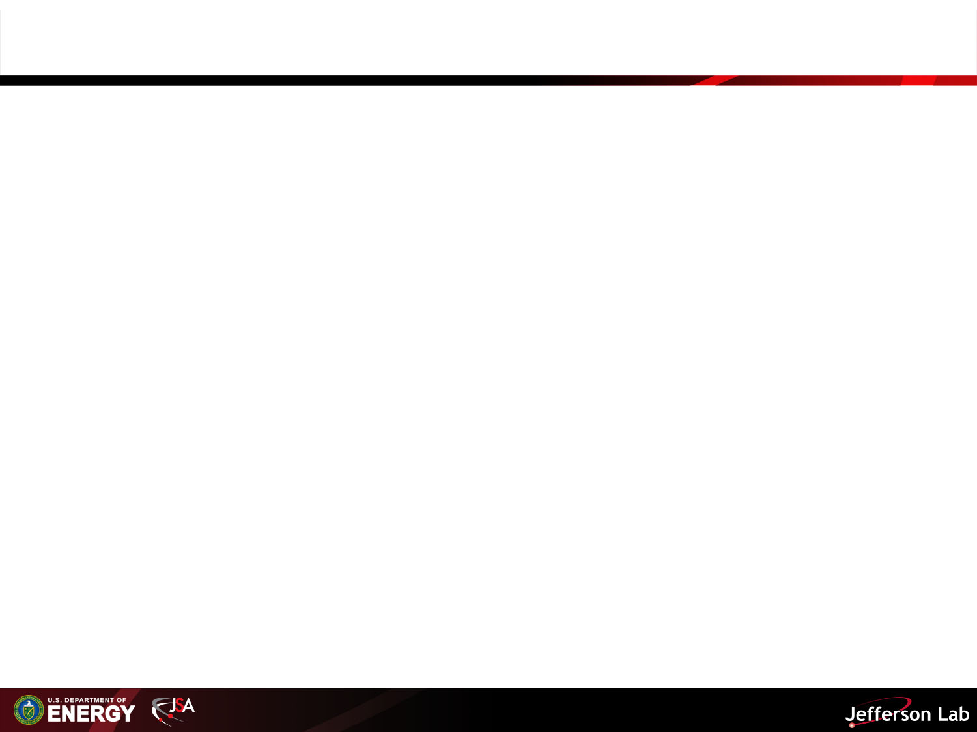
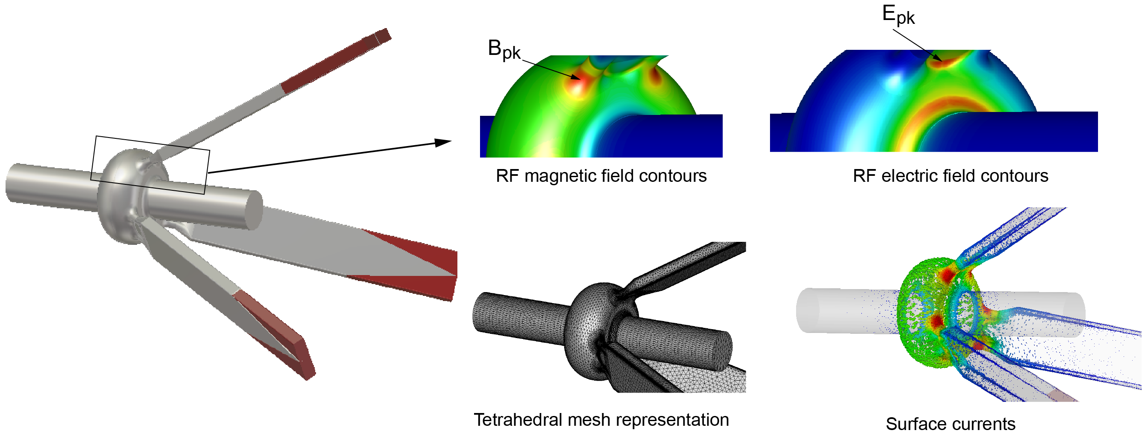
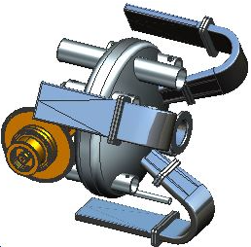
JLEIC Heavily-Damped Collider Ring Cavity
Progress has been made to design of a heavily damped 952.6 SRF single-cell cavity with on-cell waveguide dampers
The effective and broadband HOM damping with a similar arrangement of three waveguide dampers is well proven with normal-conducing cavities (e.g. BESSY 500 MHz cavity and PEP-II 476 MHz cavity)
The magnetic field enhancement at the surface (openings) can be limited to a factor of ~2 compared to standard elliptical cavities, around ~15 MV/m are feasible
F. Marhauser, “Next Generation HOM-damping”, Superconductor Science and Technology, Volume 30, Number 6, Published 15 May 2017.

Slide 16
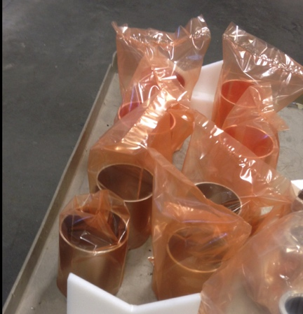
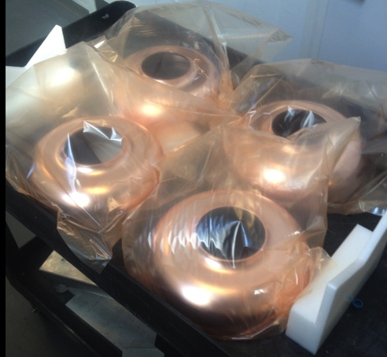
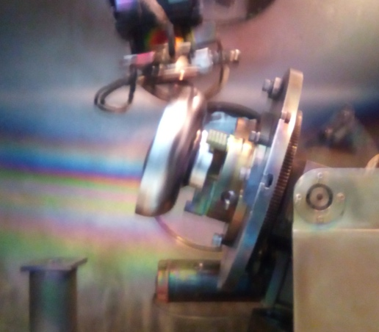
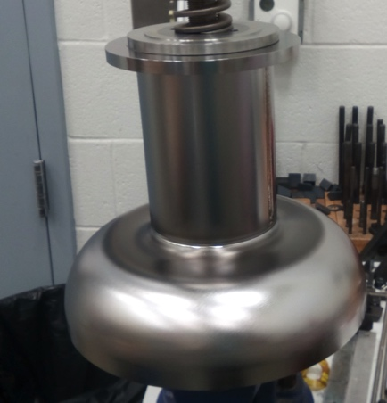
First 952.6 MHz Cavity Fabrication Status
Cavity | Qty. | Material | Nb blanks for half cells | Nb blanks for beam tubes | Half cells deep-drawn | Beam Tubes | Flanges | Endgroups | Cavity
1-cell | 1 | Nb | 2/2 – wire EDM completed | wire EDM completed | 2/2 - completed | Completed/ machined | Completed/ machined (Nb flanges) | 2/2 Welding completed | Waiting for RF trim fixture
1-cell | 2 | Cu | 4/4 – wire EDM completed | wire EDM completed | 4/4 - completed | Rolled/ not machined yet | SS CF flanges - to be ordered | Not yet Started | -
5-cell | 1 | Nb | 10/10 – wire EDM completed | wire EDM completed | 2/10 (new fixture in place to ease release of cells) | Completed/ machined | In stock – not yet used | Not yet started | -
F. Marhauser et. al.
Single-cell Nb cavity endgroups ready, getting close to complete cavity
16

Slide 17
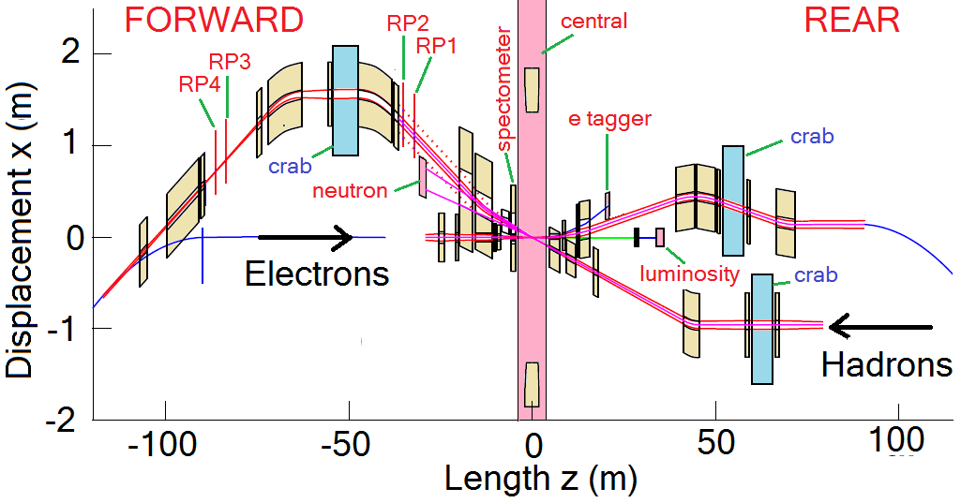
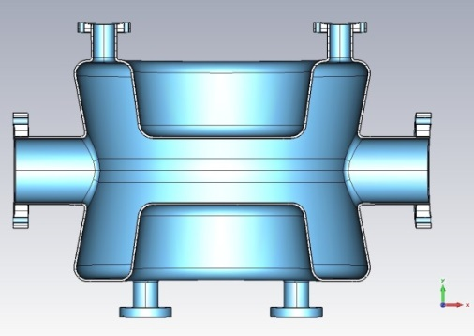
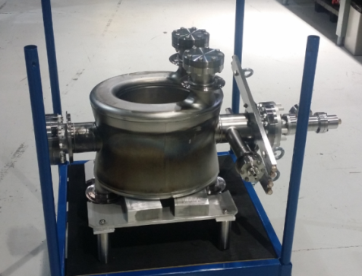
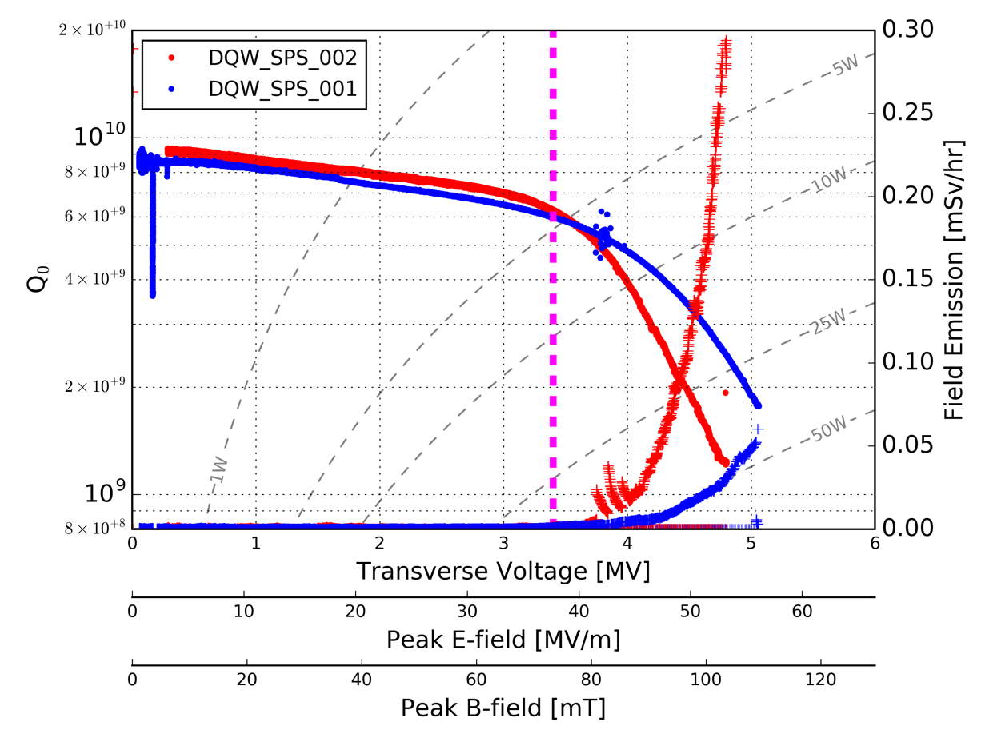

eRHIC Crab Cavities
337.8MHz DQW cavity
similar to LHC 400MHz DQW (BNL design, 3 copies fabricated and tested in collaboration with CERN, Argonne, Niowave, and JLAB)
No LOM
Parameter | Unit | Electron | Proton
Energy | GeV | 18 | 275
Bunch frequency | MHz | 112.6
Crossing angle | mrad | 22
Betatron function @ IP | cm | 62 | 94
Betatron function @ crab cavity | m | TBD | 1200
Integrated kicking voltage per IP side | MV | <4 | 13
Parameters still evolving
eRHIC CC location
400MHz DQWCC for SPS (CERN copy), design, fabrication and testing results
Q₀=6.2×10⁹ @3.4MV
V_{t_max}=5MV
eRHIC DQWCC design
17

Slide 18

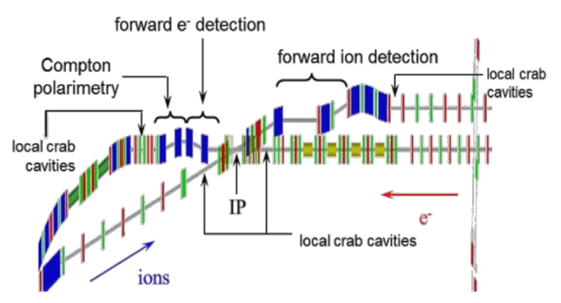
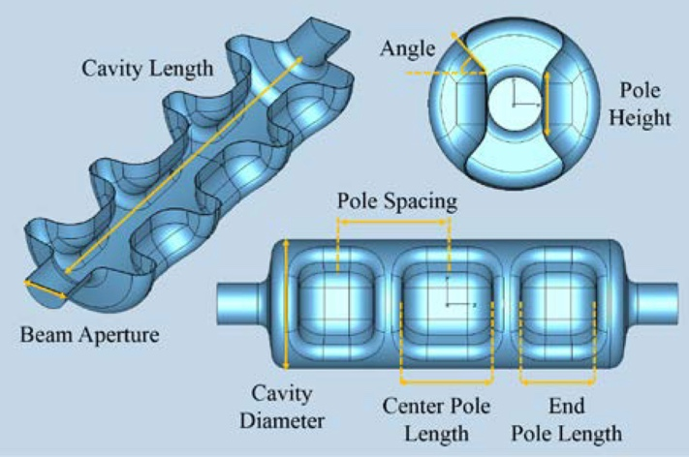
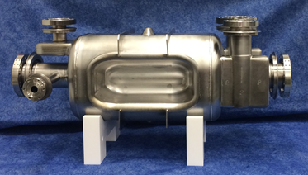
JLEIC Crab cavity
Parameter | Unit | Electron | Proton
Energy | GeV | 10 | 100
Bunch frequency | MHz | 952.6
Crossing angle | mrad | 50
Betatron function @ IP | cm | 10
Betatron function @ crab cavity | m | ~200 | 363.44
Integrated kicking voltage per IP side | MV | ~2.8 | 20.82
Number of cavities per IP side (single cell RFD) |  | 3 | 18
Number of cavities per specie |  | 6 | 36
Design by ODU
952.6 MHz “RF dipole” like LHC
Modest RF system (no beam loading)
Must have good HOM damping
Cryostat may be similar to other cavities
Multi-gap RF dipole would be very desirable
  LOM needs to be damped
Parameters still evolving
Location in IP
LARP/LHC prototype*
Multi-gap concept
EFFECTS OF CRAB CAVITIY MULTIPOLES ON JLEIC ION RING DYNAMIC APERTURE, Salvador Sosa, V. Morozov, S. U. De Silva, J. R. Delayen, WEPIK044 proceedings of IPAC2017, Copenhagen, Denmark
CRAB CAVITY R&D, Jean Delayen, JLEIC Collaboration Meeting Spring 2017
*L. Ristori HL-LHC AUP Director’s Review – June 13 2017
18

Slide 19
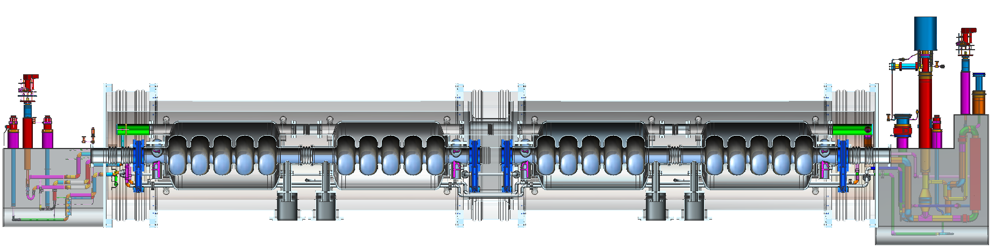
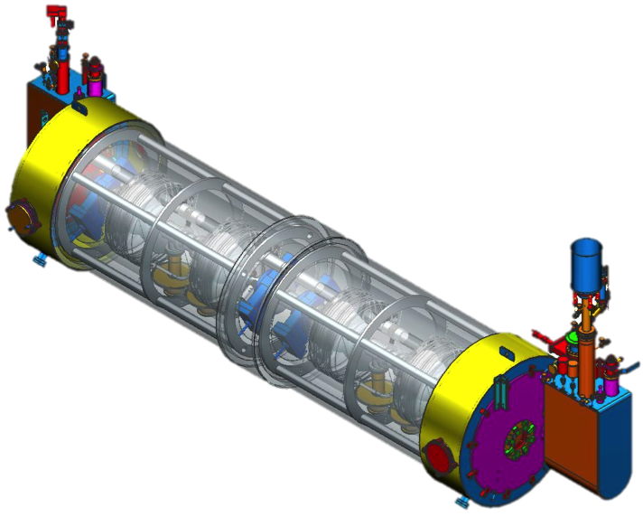
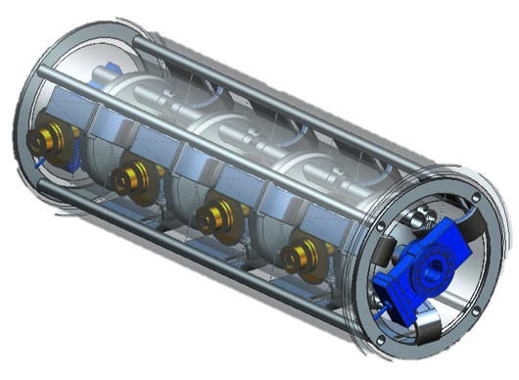
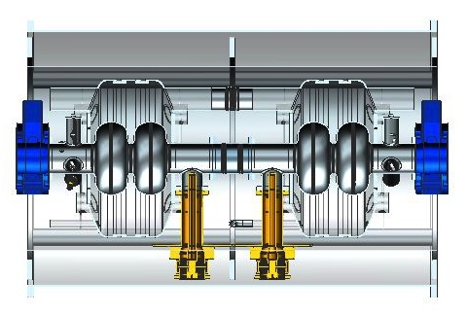
JLEIC Modular Cryostat
Take the best features of previous JLab designs
Modular approach to hold various different cavities
Design suitable for industrial production
Simple concepts, low parts count to reduce costs
8 x 1-cell cavities
4 x 1-cell cavities
On-cell HOMs
4 x 2-cell cavities
2-cell “pair”
19

Slide 20
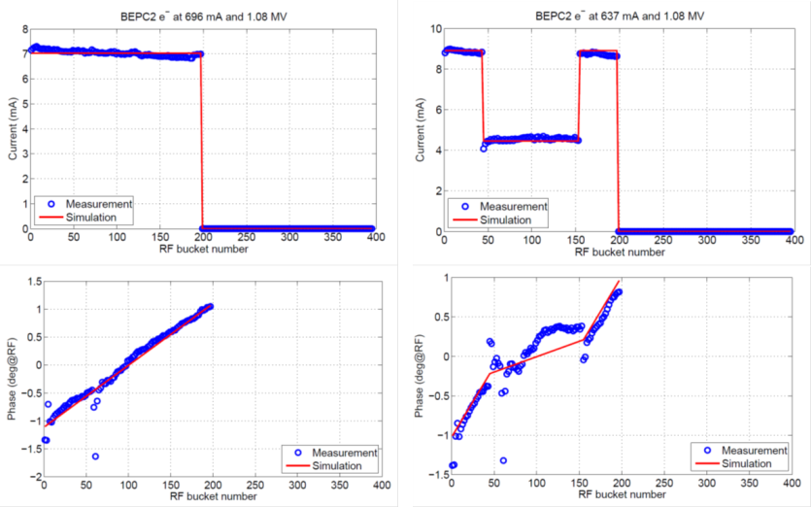
Beam Transients in collider rings
Gaps in high current rings cause strong transients (e.g. KEK-B, PEP-II). Cannot be corrected by RF alone.
Collaboration with LBNL, JLab, IHEP and DimiTel.
*
YES!
ALS data
BEPC-II data
Modulated fill
Even fill
Even fill
Modulated fill
April 7 2017
gap
gap
Phase transient
Phase
transient
reduced
transient
Reduced transient
D. Teytelman, Dimtel, Inc., San Jose, CA, USA.
“Transient beam loading in FCC-ee (Z)”, FCC Week 2017
*
J.Byrd et al.,Phys.Rev. ST Accel. Beams 5, 092001 (2002)

Slide 21
Outline
Introduction to RF systems of both eRHIC and JLEIC
EIC collider ring and cooler cavities
JLEIC Circulating Cooler Ring (CCR) cavities and RF kicker
JLEIC ion linac and ion bunch formation RF systems

Slide 22
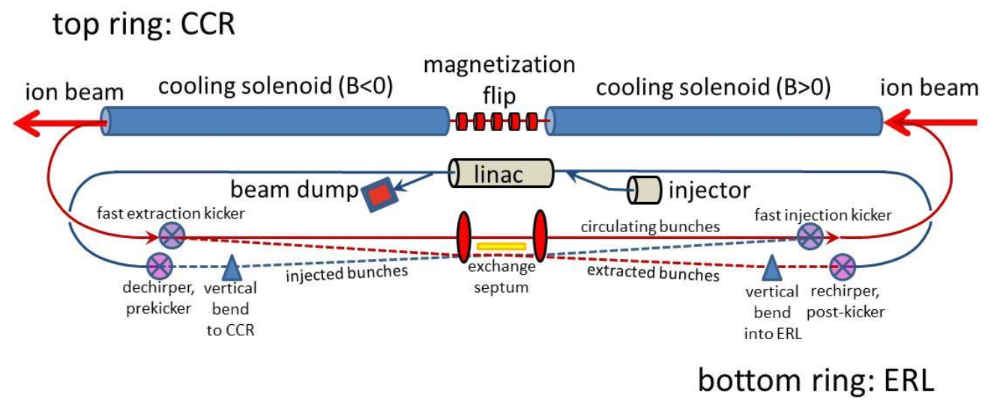
JELIC Circulating Cooler Ring (CCR)
Multi-Turn High Energy Electron Cooler Baseline Design
Bunched cooling is essential for JLEIC luminosity, requiring 20-55MeV 476MHz 1.5A low emittance electron beam. ERL injector energy 5MeV.
CCR reuses the cooling electron beam by 10-30 turns, reducing the bunch reprate and beam current in the ERL gun by a factor of the recirculating turns, with charge per bunch unchanged at ~3.2nC.
A harmonic RF kicker system is the key for CCR, replacing each bunch in the CCR after the required circulations. Kicking voltage is modest, but requires high reprate (10s of MHz) and ns level rise/fall time.
Other RF systems include the injector cavities and the ERL linac cavities.
Impedance and wakefield analyses/control are important for such a high current low energy beam.

Slide 23
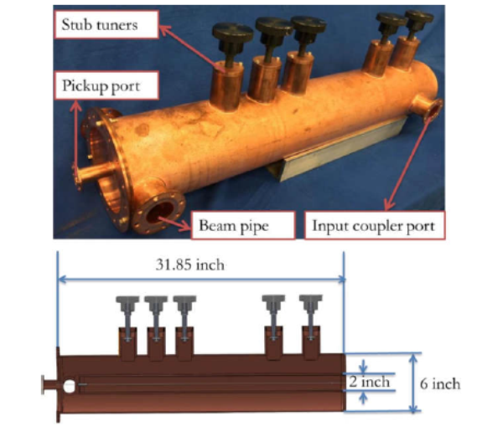
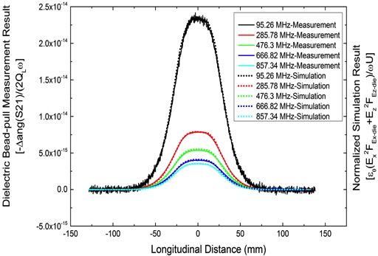
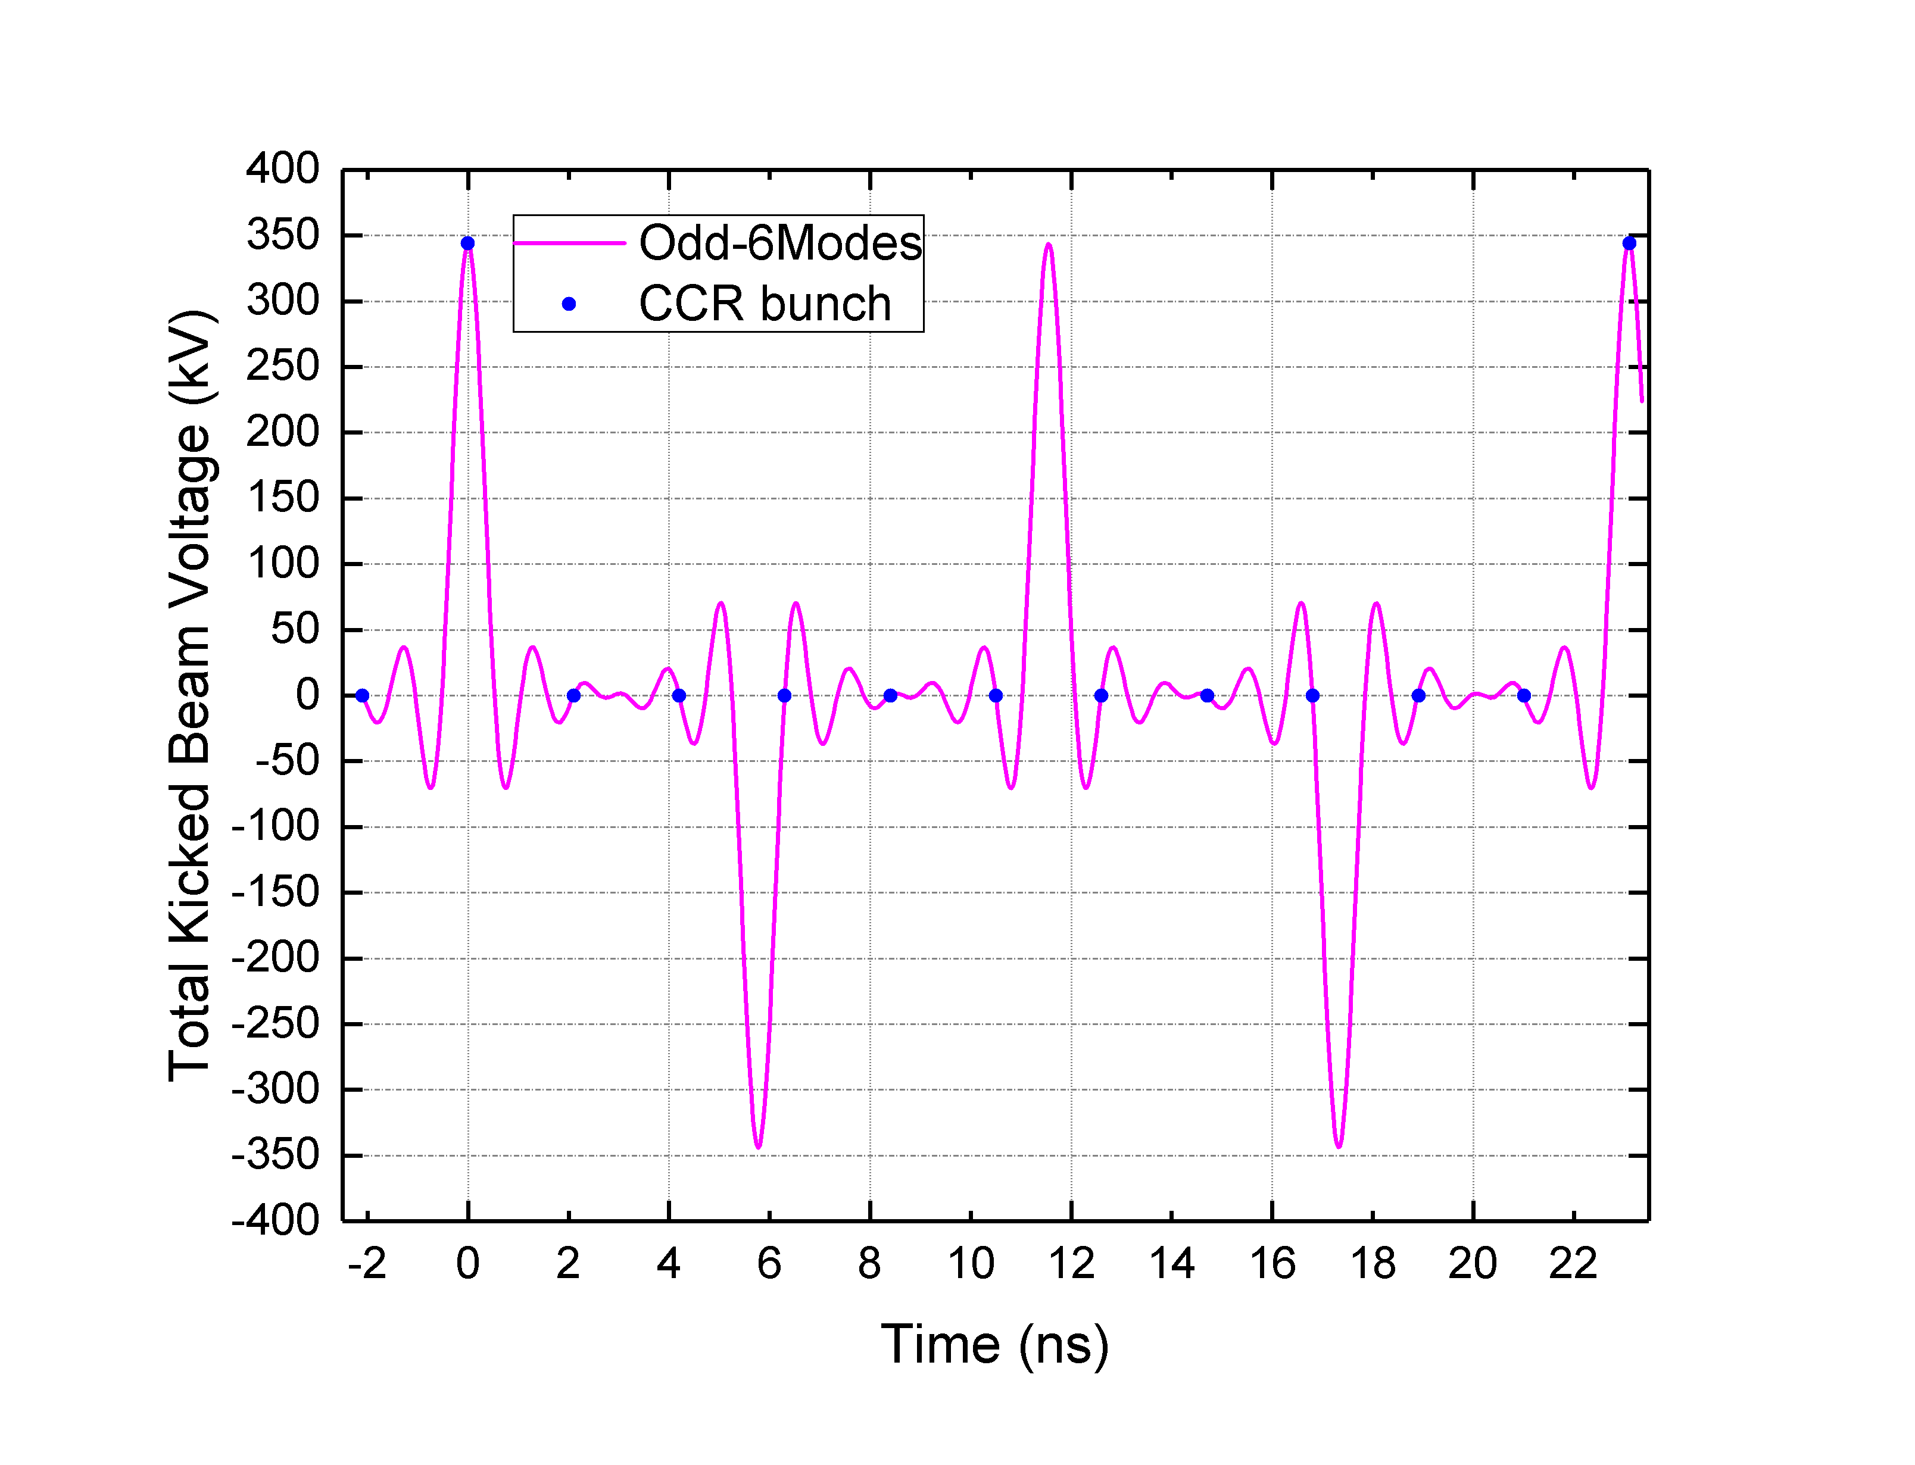

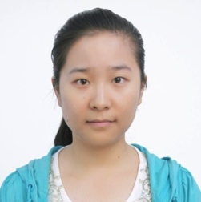
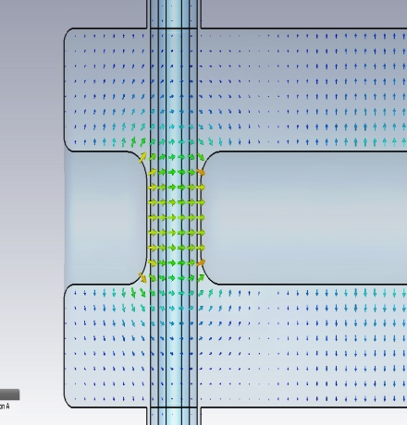


JLEIC CCR Harmonic Fast Kicker R&D
New!
÷11 scheme
(Andrew Hutton/Dotson)
5-harmonics, copper prototype kicker Cavity, Yulu Huang, IMP/JLab PhD Thesis, 2016
138kV kick voltage (2.5mrad@55MeV)
Baseline cavity design:
six odd harmonics of 86.6MHz to 952.6MHz + possible DC, one cavity design for all harmonics, one-pair for CCR
QWR cavity with tapered center conductor
High shunt impedance, ~2kW @138kV per cavity
Asymmetric inner conductor design for the 952.6MHz mode to minimize the beam loading effect
Compatible for 119, 238, 476.3 and 952.6MHz bunch reprate
Compatible for future proposal of beam based tests at UITF/LERF. Gun needs to operate at 136MHz rep rate
preliminary
New!
end stub
Ex & Ez vs z
Vz=0 on beam axis for the 952.6MHz mode
Improved symmetry in gap, Sarah Overstreet summer student project 2017
23

Slide 24



HOM Power in JLEIC ERL Cooler Cavities
Note that the spectral lines are weighted by the nominal 20 mm flattop bunch length, which produces the roll-off at the high frequency end (beyond 10 GHz however there will be a ripples due to the beer-can distribution, i.e. peak currents will raise again to some extent)
The monopole HOM power up to 9.5 GHz is 137 Watts @ 2nC bunch charge.
The HOM power is 350 Watts @ 3.2nC bunch charge
952.6 MHz
Individual HOM power values
are summed up
Or?
F. Marhauser
24

Slide 25
Outline
Introduction to RF systems of both eRHIC and JLEIC
EIC collider ring and cooler cavities
JLEIC Circulating Cooler Ring (CCR) cavities and RF kicker
JLEIC ion linac and ion acceleration/bunch formation RF systems

Slide 26





Ion Injector Linac
A/Q≤7
Pb³⁰⁺
Pb⁶⁷⁺
Possible truncation
100MHz
5MeV/u
(Pb) 40MeV/u
(H) 135MeV
(Pb) 100MeV/u
(H) ~300MeV
RFQ1
MEBT
(Pb) 13.3MeV/u
100MHz,
500keV/u
IH DTL
QWR1
QWR2
HWR1
HWR2
RFQ2
Carbon Stripper
100MHz
β_{g}=0.15
200MHz
β_{g}=0.30
A/Q≤2
WARM
SRF
JLEIC QWR Design
ATLAS 4-vane RFQ
Parameters for JLEIC QWR/HWR
Parameter | QWR | HWR | Units
β_{opt} | 0.15 | 0.30
Frequency | 100 | 200 | MHz
Length (βλ) | 45 | 45 | cm
E_{PEAK}/E_{ACC} | 5.5 | 4.9
B_{PEAK}/E_{ACC} | 8.2 | 6.9 | mT/(MV/m)
R/Q | 475 | 256 | Ω
G | 42 | 84 | Ω
E_{PEAK} in operation | 57.8 | 51.5 | MV/m
B_{PEAK} in operation | 86.1 | 72.5 | mT
E_{ACC} | 10.5 | 10.5 | MV/m
Phase (Pb) | -20 | -30 | deg
Phase (p/H⁻) | -10 | -10 | deg
No. of cavities | 21 | 14+49
HWR Module
JLEIC HWR Design
BNL EBIS Injector 100 MHz IH Structure
Courtesy of J. Alessi
Horizonal orientation of cavities
QWR Module

Slide 27
JLEIC Ion Acceleration and Bunch Formation
~8GeV H⁺
~2GeV Pb⁶⁷⁺
<=100GeV H⁺
<=40GeV Pb⁸²⁺
135/300MeV H⁻
40/100MeV Pb⁶⁷⁺
H⁻ Strip
Pb Strip
Multi-turn injection
Bucket-to-bucket transfer
collider ring with BB cooler
ion sources
SRF Linac
Booster with DC cooler
JLEIC ion bunch acceleration and splitting process in brief
  Multi-turn injection of ions (40-300MeV) from the linac into the booster (282m circumference)
  Capture coasting beam to a h=1 bucket (bunch length ~200m) in the booster
  Accelerate the beam to intermediate energy (2GeV) and perform cooling if necessary. Accelerate to booster extraction energy (~2GeV for Pb67+, 8GeV for H)
  Compress the bunch to ~56m.
  Bucket-to-bucket transfer into the collider ring (2255m circumference, h=28 buckets). Leaving ~80ns gap between bunches for kicker rise time.
  Repeat 1-5 by ~26 cycles, fill the collider ring and leaving 2 abort gaps of ~80m each
  Ramp the beam in the collider ring to ~20GeV (minimum collision energy)
  Perform up to 7 time of binary splitting to form 476.3MHz bunches (h=3584).
    In the case of low energy collision requiring h=3585-3592 for ions, do RF gymnastics by fast phase flip in the abort gap (~0.3µs) to create extra buckets
  Capture the bunch in 952.6MHz RF buckets
  Ramp to collision energy

Slide 28

JLEIC ion acceleration/bunch formation cavities
JPARC cavity (Metglass loaded).
Used as basis for JLEIC low frequency cavities.
Cavity function | β range | Energy (GeV) | Frequency (MHz)
Booster acceleration/bunching | 0.283-0.994 | 0.04-8 | 0.30-1.06
Collider ring acceleration | 0.957-0.999 | 2.3-20 | 3.56-3.72
Collider ring bunch splitting | 0.999 | 20 | 7.44
 |  |  | 14.87
 |  |  | 29.75
 |  |  | 59.49
 |  |  | 118.98
 |  |  | 237.96
Collider ring bunch splitting, bucket manipulation, acceleration | 0.999-1.000 | 20-100 | 475.9-476.4
List of JLEIC ion acceleration/bunch formation cavities
Cavity voltage still under study

Slide 29
Conclusion
For both eRHIC and JLEIC, the design will involve a number of different sub-accelerators with unique requirements for RF systems, some are very challenging.
The electron ring RF systems of both designs could benefit from the B-factory experiences, especially the feedback system.
JLEIC 952.6MHz cavity design and prototype are progressing.
JLEIC ion injector linac design is in good shape. The acceleration/bunch formation cavities in the booster and ion ring still need a lot of R&D.
JLEIC baseline now requires strong cooling with ERL and CCR
  RF harmonic kicker for the CCR is very promising
Both EIC teams collaborate closely with LHC crab cavity project, and the progress is promising.
Modular cryostat design would help to reduce the complexity and cost associated with such a variety of cavities.

Slide 30
Acknowledgements
First I need to thank all the colleagues/collaborators providing contents of these slides
  ANL: B. Mustapha
  BNL: F. Willeke, Q. Wu, W. Xu
  JLAB: S. Benson, J. Henry, F. Marhauser, R. Rimmer, H. Wang, S. Wang
  ODU: J. Delayen, S. Sosa
I would also like to thank all the JLEIC team members contributing to the RF R&D, especially:
  S. Benson, W. Clemens, Z. Conway (ANL), Y. Derbenev, F. Fors, J. Henry, Y. Huang (IMP/JLAB), A. Hutton, S. H. Kim (ANL), R. Li, F. Lin, F. Marhauser, V. Morozov, B. Mustapha (ANL), P. Ostroumov (ANL/MSU), F. Pilat, R. Rimmer, T. Satogata, H. Wang, S. Wang, R. York (MSU), Y. Zhang

Slide 31
Backup

Slide 32

CBI: Damping rate by Longitudinal Feedback System
Improved understanding of LFB damping rate as a function of energy
Feedback kicker voltage = 1.5 kV
Feedback system phase resolution = 8.7 mrad
S. Wang

Slide 33



PEP-II type CB feedback systems
PEP-II feedback systems allowed running above threshold
Similar systems are now commercially available
JLEIC needs a high level system design and performance simulation for CDR
Reliable high-power kickers are needed
Figure 2: Longitudinal Feedback system concept

Slide 34





e-ring stability modeling
H. Wang
Developing models to understand Robinson stability margin at high current
Sensitive to number and type of cavities, feedback gain, delay, power margin and gap transients
Calibrate against other rings (PEP-II, BEPC-II, KEK-B)
Work in progress…
examples
Without feedback
With direct feedback
Impedance with feedback

Slide 35


Both feedback system and fewer cavity number help to increase the beam current at low energy operation in electron ring
e-ring stability modeling SRF
With SRF cavities
Beam current is limited by total available RF power, currently, 10 MW is assumed.
S. Wang

Slide 36




Comparison of Klystrons verses Magnetrons
Why?
Klystron: Space-charge effect in electron bunch forming process in linear motion dominates the efficiency. Spent energy deposits in the collector.
Magnetron
forms bunches in spoke-on-hub process in circular motion. Beam-to-RF cavity interaction in multiple passes. Much less wasted energy.
L3 20-80kW magnetron
L3 13 kW klystron
National 1.2kW oven magnetron
Varian 5kW klystron

Slide 37
Harmonic fast kicker
Few mrad
Few kV
~ns
~10 of ns
CCR scheme required fast bunch swap out every 10-20 turns
Pulsed power supplies, especially with these characteristics are beyond state of the art.
An alternative driving method is summing simple cosine waves at sub-frequencies of the final beam repetition frequency to generate a continuous waveform.
A. Hutton,
Y. Huang,
J. Guo

Slide 38



High-power model
Vacuum model concept in progress
Can test in UITF or LERF
Need to settle on a baseline kicking scheme (angle, frequency) to go to the next step.
New postdoc position hired
Need to study multi-turn effects with magnetized beams
J. Henry, F. Fors

Slide 39

Modular helium vessel
1 to 5 cells, coax, WG or on-cell dampers

