Slide 1
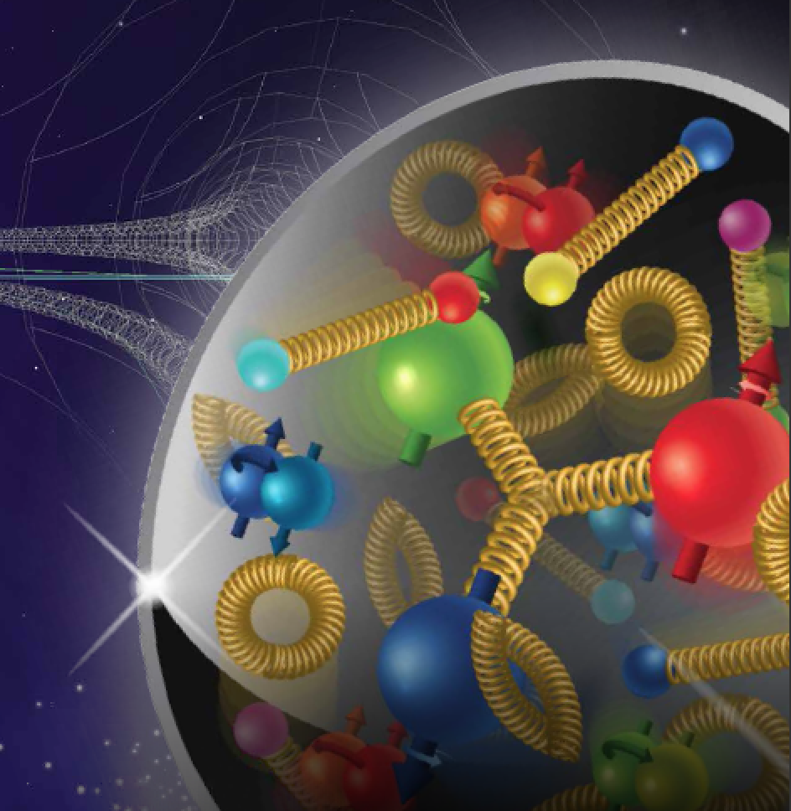


Salvatore Fazio
Brookhaven National Lab
Measuring Nuclear Structure Functions at an EIC
Electron-Ion Collider User Group Meeting
Trieste (Italy) July 18-22, 2017
Notes:
S. Fazio – Brookhaven National Laboratory

Slide 2
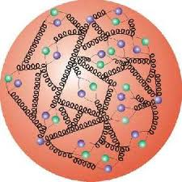
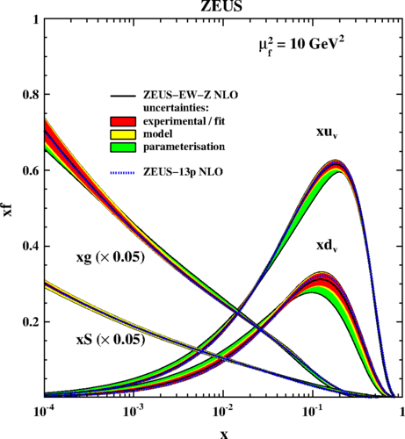
Proton PDFs from HERA
What we Know:
Extensive program carried at HERA
F₂ precisely measured in a large-x range
At low-x gluons dominate
Reduced Cross Section
parton density
Resolution (Q² / GeV²)
Differential cross section:
Reduced cross section:

Slide 3
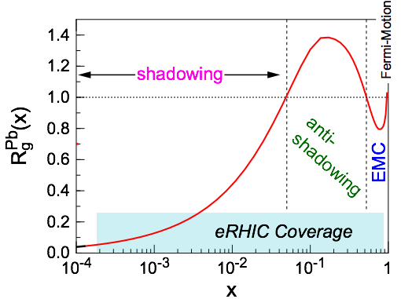
Nuclear Structure Functions
Inclusive DIS on e+A analog to e+p:
quark+anti-quark
gluons
(or tag on F₂-charm)
Theory/models have to be able to describe the structure functions and their evolution
Ratio: F₂(x,Q²)_{Pb}/F₂(x,Q²)_{p}
DGLAP:
predicts Q² but not A-dependence and x-dependence
Saturation models:
predict A-dependence and x-dependence but not Q²
→ Need: large Q² lever-arm for fixed x, A-scan
Aim at extending our knowledge on structure functions into the realm where gluon saturation effects emerge ⇒ different evolution

Slide 4
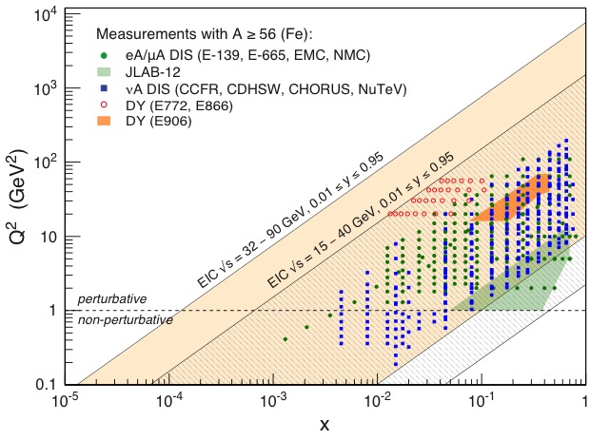
Electron-Ion Collider’s Phase Space
An EIC at its highest extends kinematic coverage for e+A data by a decade in x at a fixed Q² by a decade in Q² at a fixed x

Slide 5
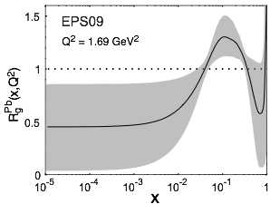
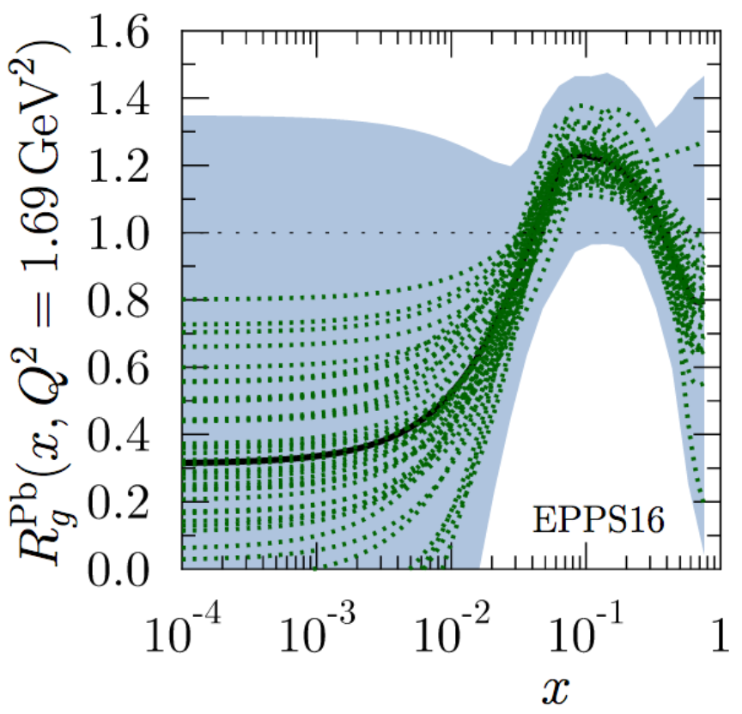
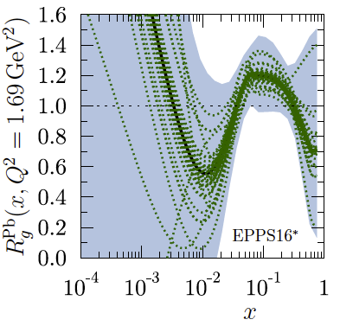
Nuclear Modifications – Present Knowledge
Measure different structure functions in e+A → constrain nPDF
Latest state-of-the-art nPDF is EPPS16
K. J. Eskola, P. Paakkinen, H. Paukkunen, C. A. Salgado [Eur.Phys.J. C77 (2017) no.3, 163]
  Replacing EPS09. Quark flavors are now separated
  includes latest LHC data
  EPPS16*→ functional form with less constraints (for gluons) in extrapolating for x < xdata
  ⇒ critical to study the impact of the high precision EIC data!
  What is the possible impact of an Electron-Ion Collider?
More details on
P. Zurita’s talk
Ratio: g(x,Q²)_{Pb}/g(x,Q²)_{p}
EPS09
EPPS16
EPPS16*

Slide 6
Reduced Cross Section & Structure Functions
Structure functions can be extracted from the reduced cross section
Pseudo-data are generated using PYTHIA and according to EPS09 central values
In order to extract F₂ from the reduced cross section, we adopted the same method used at HERA [e.g. see HERMES paper on arXiv:1103.5704]
F_{L} extracted from the reduced cross section by fitting the slopes in Y⁺ for different √s at fixed x, Q² → requires running at (at least) three different c-o-m energies
Simulation:
e+Au sample simulated using PYTHIA
5(20) GeV electrons X 50 GeV Au [√s = 32(63) GeV] –> L = 2 fb⁻¹/A
5(20) GeV electrons X 75 GeV Au [√s = 39(78) GeV] –> L = 4 fb⁻¹/A
5(20) GeV electrons X 100 GeV Au[√s = 45(89) GeV] –>L = 4 fb⁻¹/A
Total simulated event sample (for each electron energy) L = 10 fb⁻¹/A

Slide 7
Reduced Cross Section & F₂ (e+Au)
  Systematics = 3%
  Stat. and Sys. error summed in quadrature (Sys. dominate!)
  Gluon extraction via scaling violation → dσ(x,Q²)/dlnQ² (requires ~> 1 decade in Q² at a fixed x)
  Comparison of linear with non-linear evolution in x will signal saturation
  ⇒ needs low-x reach
σ
An EIC at its highest energy provides a factor 10 larger reach in Q² and low-x compared to available data
Large expected impact on current theory uncertainty, especially at low-x and low-Q²

Slide 8
Radiated photons
We use Django simulator including O(α) radiative effects
We look at photons radiated from the electron
before or after the interaction
50% events radiate a photon
Radiated photons are
Low energy (most of them < 1 GeV)
uniformly distributed in the azimuthal angle
collinear to the scattered electron (θ_{γ} > 3 rad)
Correction factor:

Slide 9
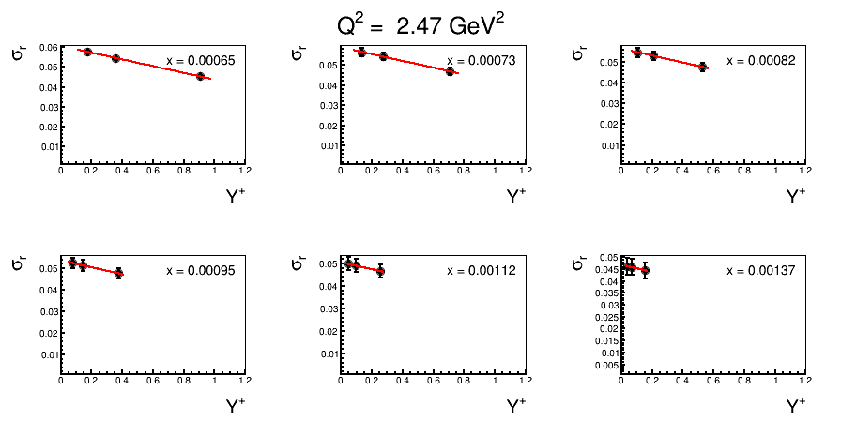
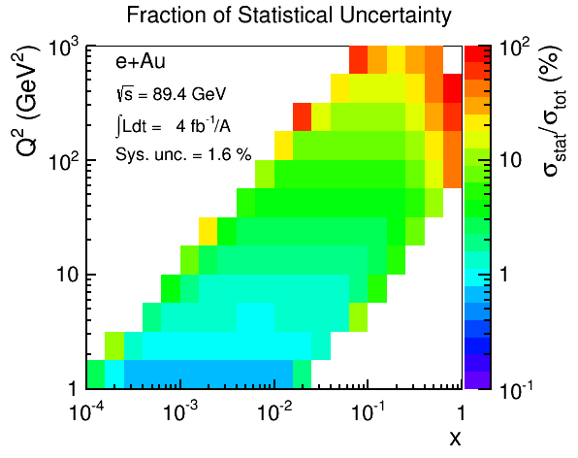
Extracting F_{L} (e+Au)
Higher energy EIC: √s = 63, 78, 89 GeV
Enough Lever Arm required
(three points, Y⁺ > 0.2)
Errors still dominated by systematics
(similarly for larger Q² and lower energies)
Fraction of statistical uncertainty over total uncertainty in measuring σ_{r}
total error = stat. + sys. summed in quadrature
assumed sys. = 3%
Star error dominates only at large-x and very large Q²

Slide 10
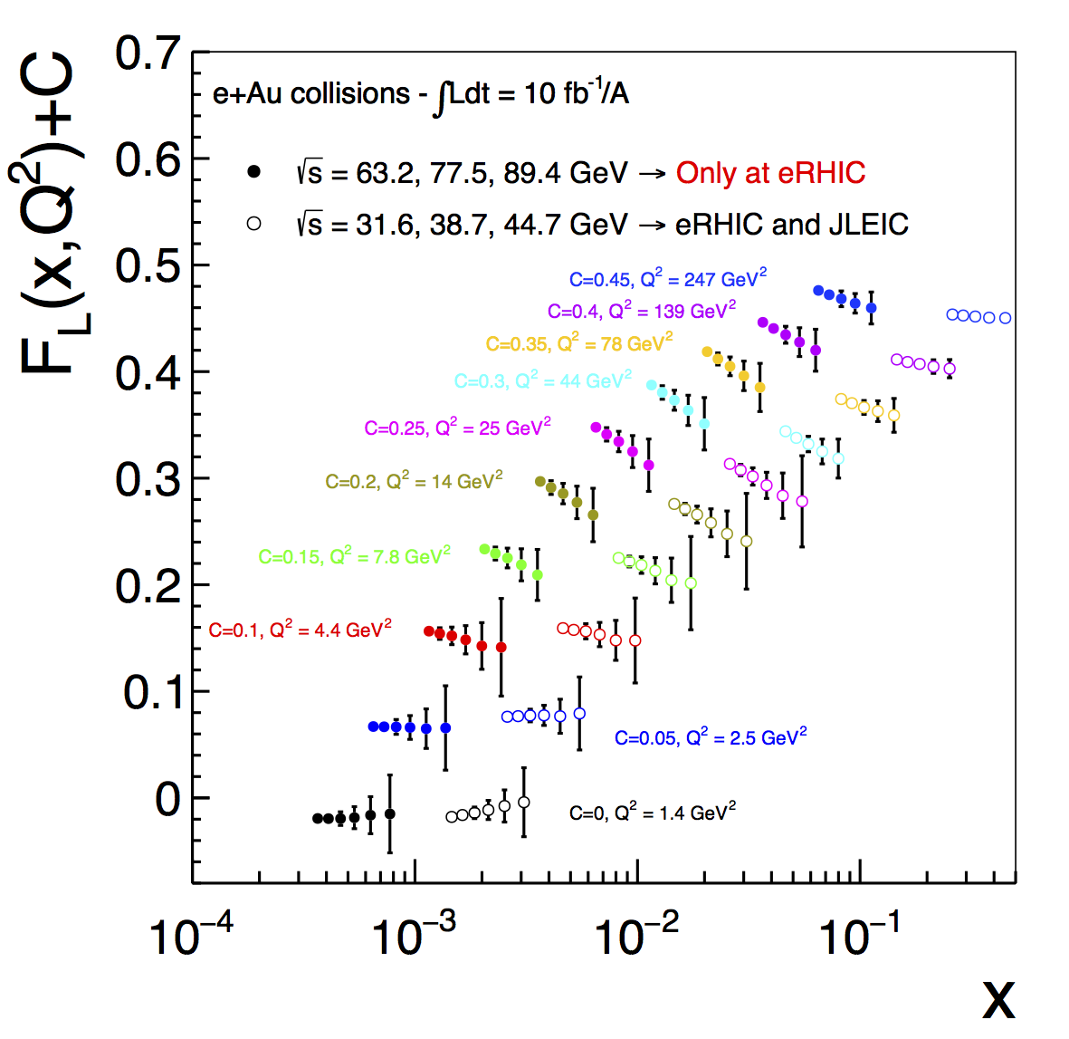
F_{L} (e+Au)
  Errors dominated by the systematics in the cross section measurement
  →Not luminosity hungry!
  Study: 10 fb⁻¹ →100 fb⁻¹
  has negligible impact
  (see backup slide)

Slide 11
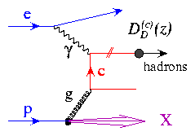
Charm production: a unique tool!
Direct access to gluons at medium to high x by tagging photon-gluon
Helps determining heavy quarks mass scheme
Novel probe!
Selection of charm-production events
We select kaons in the final state of the D meson decay, looking for:
a displaced vertex: 0.01 cm <|Vertex|< 3 cm
Momentum within the acceptance of an EIC model detector (BeAST @ eRHIC)
CENTRAL DETECTOR (-1 < η < 1)
dE/dx -> 0.2 GeV < P < 0.8 GeV
RICH -> 2 GeV < P < 5 GeV
FORWARD (1 < η < 3.5)
RICH -> 2 GeV < P < 40 GeV
REAR (-3.5 < η < -1)
RICH -> 2 GeV < P < 15 GeV

Slide 12
Charm - reduced Cross Section & F₂ (e+Au)
σ
  Systematics = 7%
  Stat. and Sys. error summed in quadrature (Sys. dominate!)
  No world data exist!
Large expected impact on current theory uncertainty, especially at low-x and low-Q²

Slide 13
Charm - F_{L} (e+Au)
Enough Lever Arm required (three points, y+ > 0.2)
  Errors dominated by the systematics in the cross section measurement
  →Not luminosity hungry!
  Study: 10 fb⁻¹ →100 fb⁻¹
  has negligible impact
  (see backup slide)

Slide 14
Charm selection: background & efficiency
Background study
We look at background from DIS events with kaons that pass the whole selection but are not coming from a charm decay.
The fraction of background over signal events is:
(selected bkg events) / (selected Charm Events)
Conclusion:
The B/S fraction is expected in the order of ~1% with a very light energy dependence
Efficiency study
We look at the efficiency of selection charm production events. The efficiency is defined as:
(selected Charm Events) / (charm Events in Acceptance)
Conclusion:
The charm selection efficiency is expected in the order of ~28% with no significant energy dependence

Slide 15
The EIC impact – gluons
low-energy scenario
high-energy scenario
Pia Zurita
will tell you everything and more
  Inclusive DIS alone has a huge effect at low-x
  Charm has a dramatic effect at high-x
Not only for nuclei!
Comparable precision for proton Structure Functions in e+p scattering, to even higher Q² at high x
→ Beyond what HERA achieved: precise measurement of proton F_{L}

Slide 16
Conclusions
e+A physics program at a future Electron-Ion Collider provides an unprecedented opportunity to study quarks and gluons in nuclei
Precise measurements of nuclear structure functions in a large phase-space
Constrain gluon nPDFs at large-x by tagging photon-gluon fusion through precise measurements of charm production
Large impact in constraining gluon nPDFs at low-x
Same or better precision expected for proton SFs too!
Now we are working on a publication
Additional material on the BNL EIC Science Task Force page:
https://wiki.bnl.gov/eic/index.php

Slide 17


Slide 19
Proton F_{L} - HERA

Slide 21
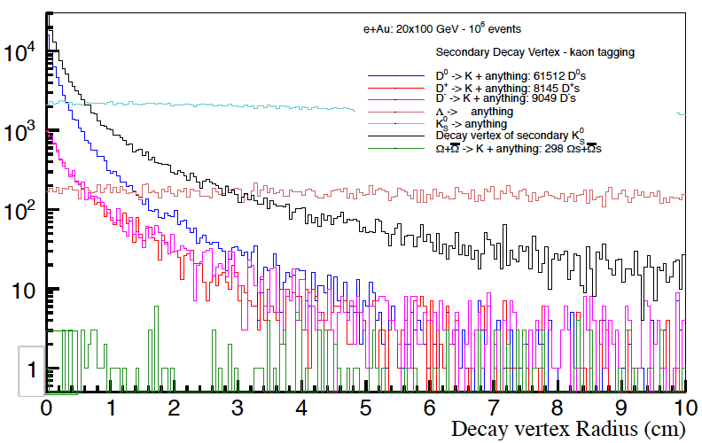
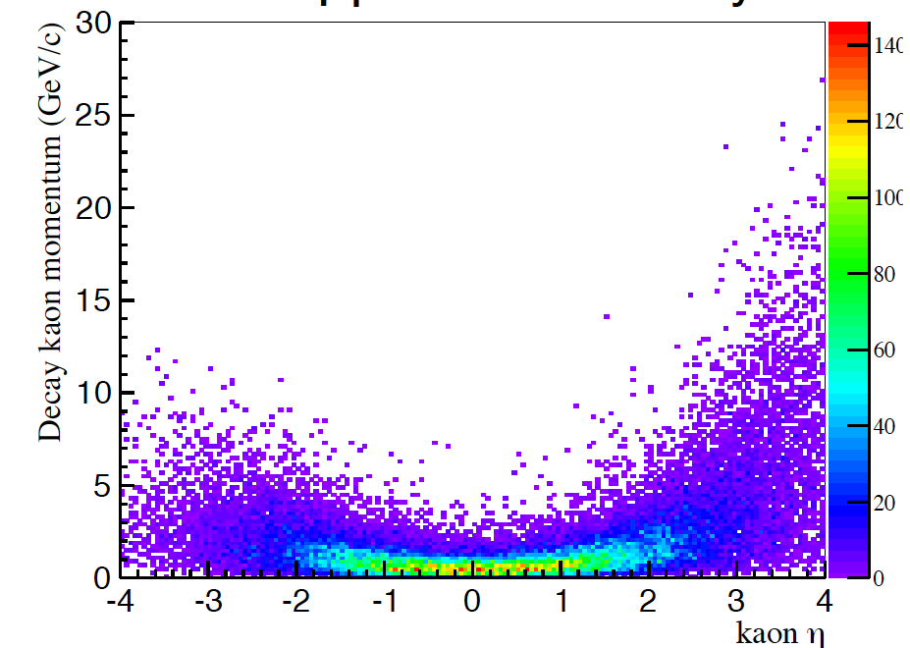
F_{L}^{C}
We tag charm by displaced kaons in the final state
0.01 cm < |VTX| < 3 cm → Cut on the Decay Vertex
Particle ID for Kaons:
CENTRAL DETECTOR (-1 < Eta < 1):
dE/dx -> 0.2 GeV < P < 0.8 GeV
RICH -> 2 GeV < P < 5 GeV
FORWARD (1 < Eta < 3.5):
RICH -> 2 GeV < P < 40 GeV
REAR (-3.5 < Eta < 1):
RICH -> 2 GeV < P < 15 GeV
same sample as for F_{L}
but increased systematic uncertainty 7%

Slide 22
Impact from and on p+A and A+A physics
  nPDFs required as input to physics in A+A
  p+A @ LHC has so far only moderate impact (see arXiv:1612.05741) on constraining nPDFs
LHC/RHIC x coverage at rapidity |y|<1
  Higher energy configurations of an EIC
  constrain nPDFs in an x-range critical for the A+A program at the LHC

Slide 23
The EIC impact – valence quarks
Fits to the EIC simulated data (including charm)
EPPS16* → EPPS16 using a flexible function with a couple of extra free parameters at small x for gluon (not for the quarks)
EIC: √s = 32, 39, 45 GeV
EIC: √s =63, 78, 89 GeV
u
d

Slide 24
The EIC impact – sea quarks
Fits to the EIC simulated data (including charm)
EIC: √s = 32, 39, 45 GeV
low-energy scenario
EIC: √s =63, 78, 89 GeV
high-energy scenario
u-bar
d-bar

Slide 25
The EIC impact – gluons
low-energy scenario
high-energy scenario
  Inclusive DIS alone has a huge effect at low-x
  Charm has a dramatic effect at high-x
Not only for nuclei!
Comparable precision for proton Structure Functions in e+p scattering, to even higher Q² at high x
→ Beyond what HERA achieved: precise measurement of proton F_{L}

