Slide 1

Open Charm Production and
Nuclear Gluon Densities
Charles Hyde
Old Dominion University
Norfolk VA

Slide 2
Nuclear Gluons
JLAB LDRD project fy2016,2017
Ch.Weiss, E. Chudakov, Yu.Furletova, S.Furletov, D.Higinbotham (Jlab)
Zh.Ye (ANL), F. Hauenstein, C.H. (ODU), M. Strikman (Penn State),
M. Stratmann (Tübingen), N. Sato (UConn), D. Nguyen (UVA)
MC Tools:
  HVQDIS MC (HERA),
  PYTHIA/HERWIG for hadronic final states
  Detector: GEMC & GENFIT/EVE
Materials publicly available on Wiki: https://wiki.jlab.org/nuclear_gluons/

Slide 3
A Motivational Goal for the EIC
Understand the Quark-Gluon Structure of
  NN Force,
  NNN Force, and
  Nuclear Binding

Slide 4
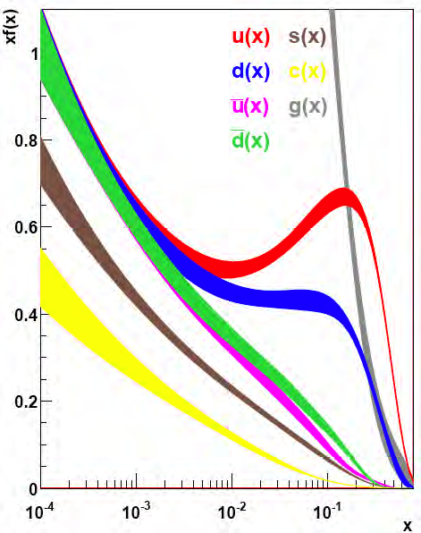
Where are the Gluons?
Everywhere!
  ∼50% of gluon momentum sum-rule is at x > 0.1
  g(x) ≈ d(x) for x ≥ 0.3
  (within errors)
Nuclear Structure
DIS & EMC Effect
Gluons

Slide 5
Nucleon Momentum Distributions in NUCLEI
A = 2, 3, 4, 16, 56, ∞
  C. Ciofi degli Atti & S. Simula,
  PRC 53 (1996) p.1689
Universal high momentum tails from short-distance NN & NNN interaction

Slide 6
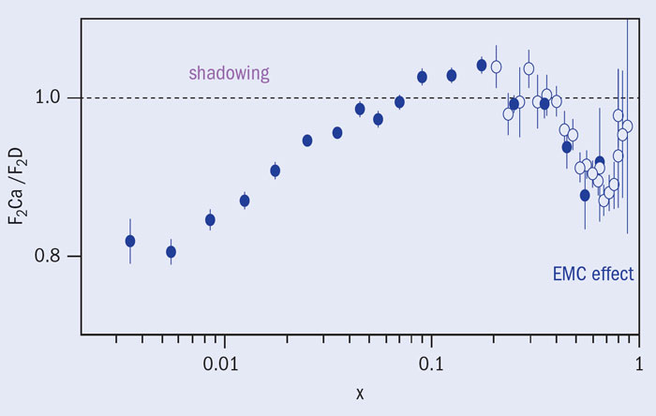
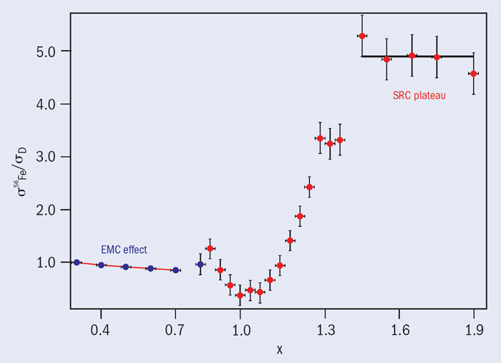
Nuclear DIS Ratio to the Deuteron
CERN Courier
April 2013
Anti-Shadowing
Universal high-momentum tail of nucleon momentum distributions
The Nucleus
is everywhere!
Parameterize EMC effect by slope for
0.3 < x < 0.7
Shadowing

Slide 7
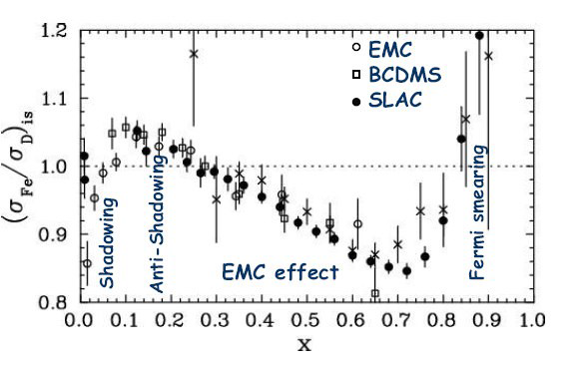
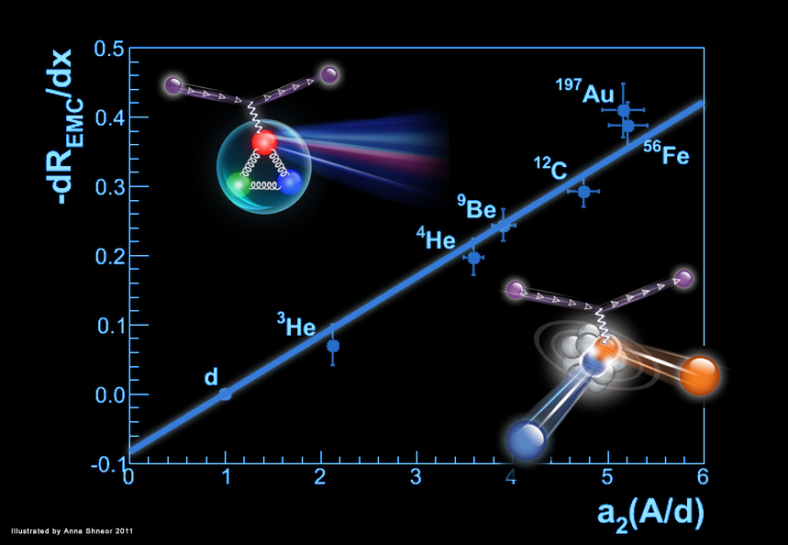
The EMC Effect
Quark-gluon imprint of Nuclear Binding
NN Correlations
hello
N. Fomin, (Jlab Hall C) et al,
CernCourier April 2013
EMC slope
a₂= magnitue of x>1
plateau
= strength of NN
correlations

Slide 8
Gluons in Nuclei
Global fit (EPS09):
  Huge error-bars for gluons
  Strong gluon anti-shadowing for x ≈ 0.1
  No anti-shadowing for sea-quarks

Slide 9
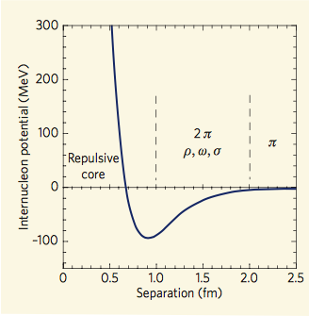
(Possible) Dynamic Origin of
Gluon Anti-shadowing
0.5 fm
0.5 fm
DIS longitudinal coherence length λ ≈ 1/(2xM)
  For x > 0.3, 𝝀 < 0.33 fm
    EMC effect reveals distortion of single nucleon by short-range interactions (previous slides)
  For x < 0.2, 𝝀 > 0.5 fm
    Anti-shadowing results from NN Hard-core ~0.5 fm
    Short-range NN interaction is quark-quark-glue exchange,
    not quark—anti-quark exchange

Slide 10
Open Charm: A Direct probe of Gluons
EIC:
  Nuclei
  CM Energy
  Luminosity
    Count rate reach to “high”-x
    Small branching fractions
  Particle ID, vertexing

Slide 11
Inclusive Charm Production Rates
Inclusive Charm rates are robust
  ~ 1month @ 10³⁴/nucleon
  What is purity and efficiency of charm tagging?
x_{B}
High Q² enhances Charm/DIS ratio!

Slide 12
Methods of Charm Reconstruction

Slide 13
Exclusive D-meson Reconstruction
Decay channels with all charged tracks
  Multiply fragmentation (f) by Branching Ration (BR)
D^{*+}→π⁺(slow) + (K⁻ π⁺)_{D0}
  Used at HERA w/o PID, f∙BR < 1%
EIC: PID + vertex detection
  Include all exclusive channels {D⁰, D⁺, D_{S}⁺, 𝛬_{C}⁺} ➔ Σ_{i} f_{i} ∙BR_{i} ≈10%

Slide 14
Example: D⁰ meson reconstruction
Exclusive decay D⁰ → K⁻ π⁺
Level-2 simulation:
  Combinatorial background
  Realistic momentum-, vertex-resolution
PYTHIA-6, arbitrary statistics,
  Vertex cut ≥ 100 μm
DIS background, realistic PID in progress

Slide 15
Inclusive D-Meson Reconstruction
e + A → e’ + K± + X
Vertex distribution of Kaons from PID
No cut: Use wrong side sample to subtract Δz=0 sample
Charm-tagging efficiency up to 30%

Slide 16

Inclusive Charm Production Rates
Tagged Open-Charm yield
~ 1 year @
  10³⁴/nucleon
  10% Charm tagging efficiency ⊗ purity
High Q² enhances Charm/DIS ratio!

Slide 17
EIC Nuclear Gluon projections
R_{g} = g_{A}(x)/[Ag_{N}(x)
EPS09: green band
EIC: blue band
  Precision measurement of gluon shadowing, anti-shadowing, “EMC-effect”

Slide 18

Shadowing: Coherent interaction of probe with partons from multiple nucleons
x_{Bj} < 0.05
λ = 1/(2xM) > 2 fm

Slide 19
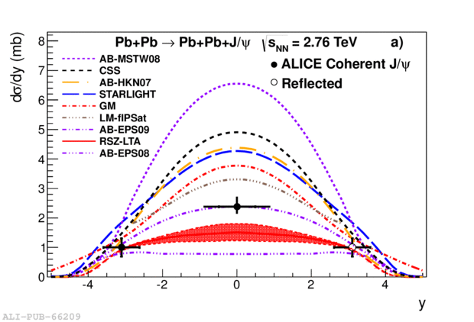

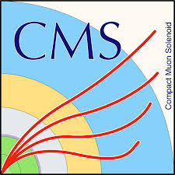
Shadowing from Ultra-Peripheral AA
EPJ C73 (2013) 2017
ALICE, CMS
Talks by
T. Lappi,
E. Scapparone
x ~10⁻²
x ~10⁻³
arXiv: 1605.06966v1

Slide 20
How to study the NNN interaction at the EIC
Diffractive Dissociation:
  Partonic Structure:
  Gluon Structure:

Slide 21
Conclusions
EIC: A precision probe of the gluonic structure of nuclei over a wide range of kinematics
  Nucleon modification in “EMC-Region”
  NN interaction in “Anti-shadowing”
  Long range coherence of gluons in shadowing
  Transition to saturation

Slide 22
A few more slides…

Slide 23
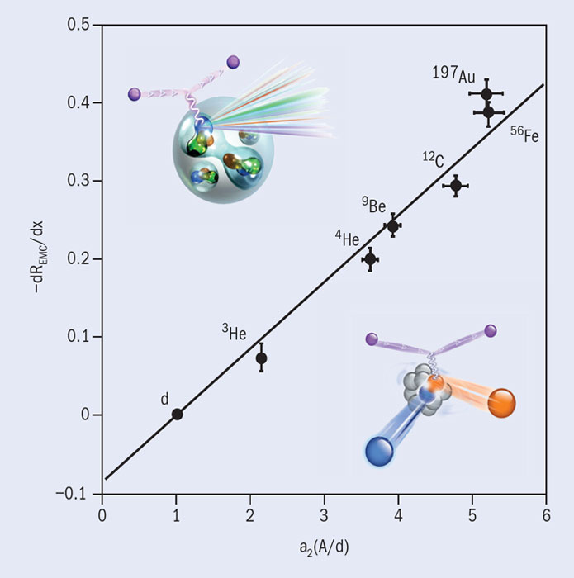
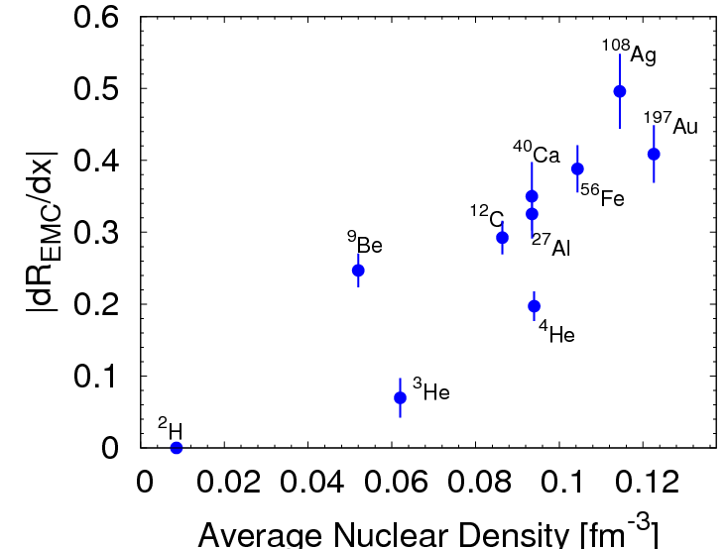
Dynamic Origin of EMC Effect: Correlations!
EMC Strength: proportional to x>1 plateau (NN correlations)
NOT proportional to average density
J. Arrington, et al.,
PRC 86 (2012) 065204

Slide 24
Tracking: VerTEX + Central + Endcaps
GENFIT/EVE Event Display
Yulia Furletova

Slide 25



EMC Effect’: Anti-Shadowing
Anti-shadowing is valence + glue
Anti-shadowing is not anti-quarks!
FermiLab Drell-Yan E722

