Slide 1
H2020 AMICI
Workpackage 4 - Innovation

Slide 2
WP4 Round Table - Agenda
08:30 Introduction 10'
Speaker: Anthony Gleeson (STFC)
08:40 Industry Survey - Accelerator Technologies 40'
Speakers: Anthony Gleeson (STFC)
Dr. Sophie Muller (Thales Communications and Security)
09:20 Industry Survey - Magnets Technologies 40'
Speakers: Dr. Pierre Védrine (CEA)
Dr. Ziad Melhem (Oxford Instruments NanoScience)
10:00 Good practices and barriers 40'
Speakers: David Alesini (LNF)
Dr. Andrea Ceracchi (CECOM)

Slide 3
WP4 Round Table - Aims
The aims of this round table session are to:
1) Understand the scopes and activities of the three tasks 2) Collect the interest of industry in such activities 3) Establish the basis for collaborative work, identify next steps and define timescales

Slide 4
WP4 Innovation – Scene Setting
Identify a European network of commercial organisations, consisting of both large companies and SMEs, that has the potential to innovate in the field of mature Accelerator and Magnet technologies.
Identify domains of societal applications and potential markets beyond Research Infrastructures that can be developed by these innovative commercial organisations.
Identify ways to optimise the effective engagement between Industry and the Technology Infrastructures to support the development of societal applications by industry.

Slide 5
WP4 Innovation – Scene Setting
From the publicity material for this event:
The AMICI H2020 project is charged by the European Commission with the challenging task of building the conditions for consolidating and exploiting such collaboration to strengthen the capabilities of European companies to compete on the global market, not only as qualified suppliers of components for accelerators and big superconductor magnets, but also in the development of innovative applications in advanced sectors such as healthcare and space.
“How can the coordinated Technology Infrastructures of the major European accelerator research labs help industry?”

Slide 6
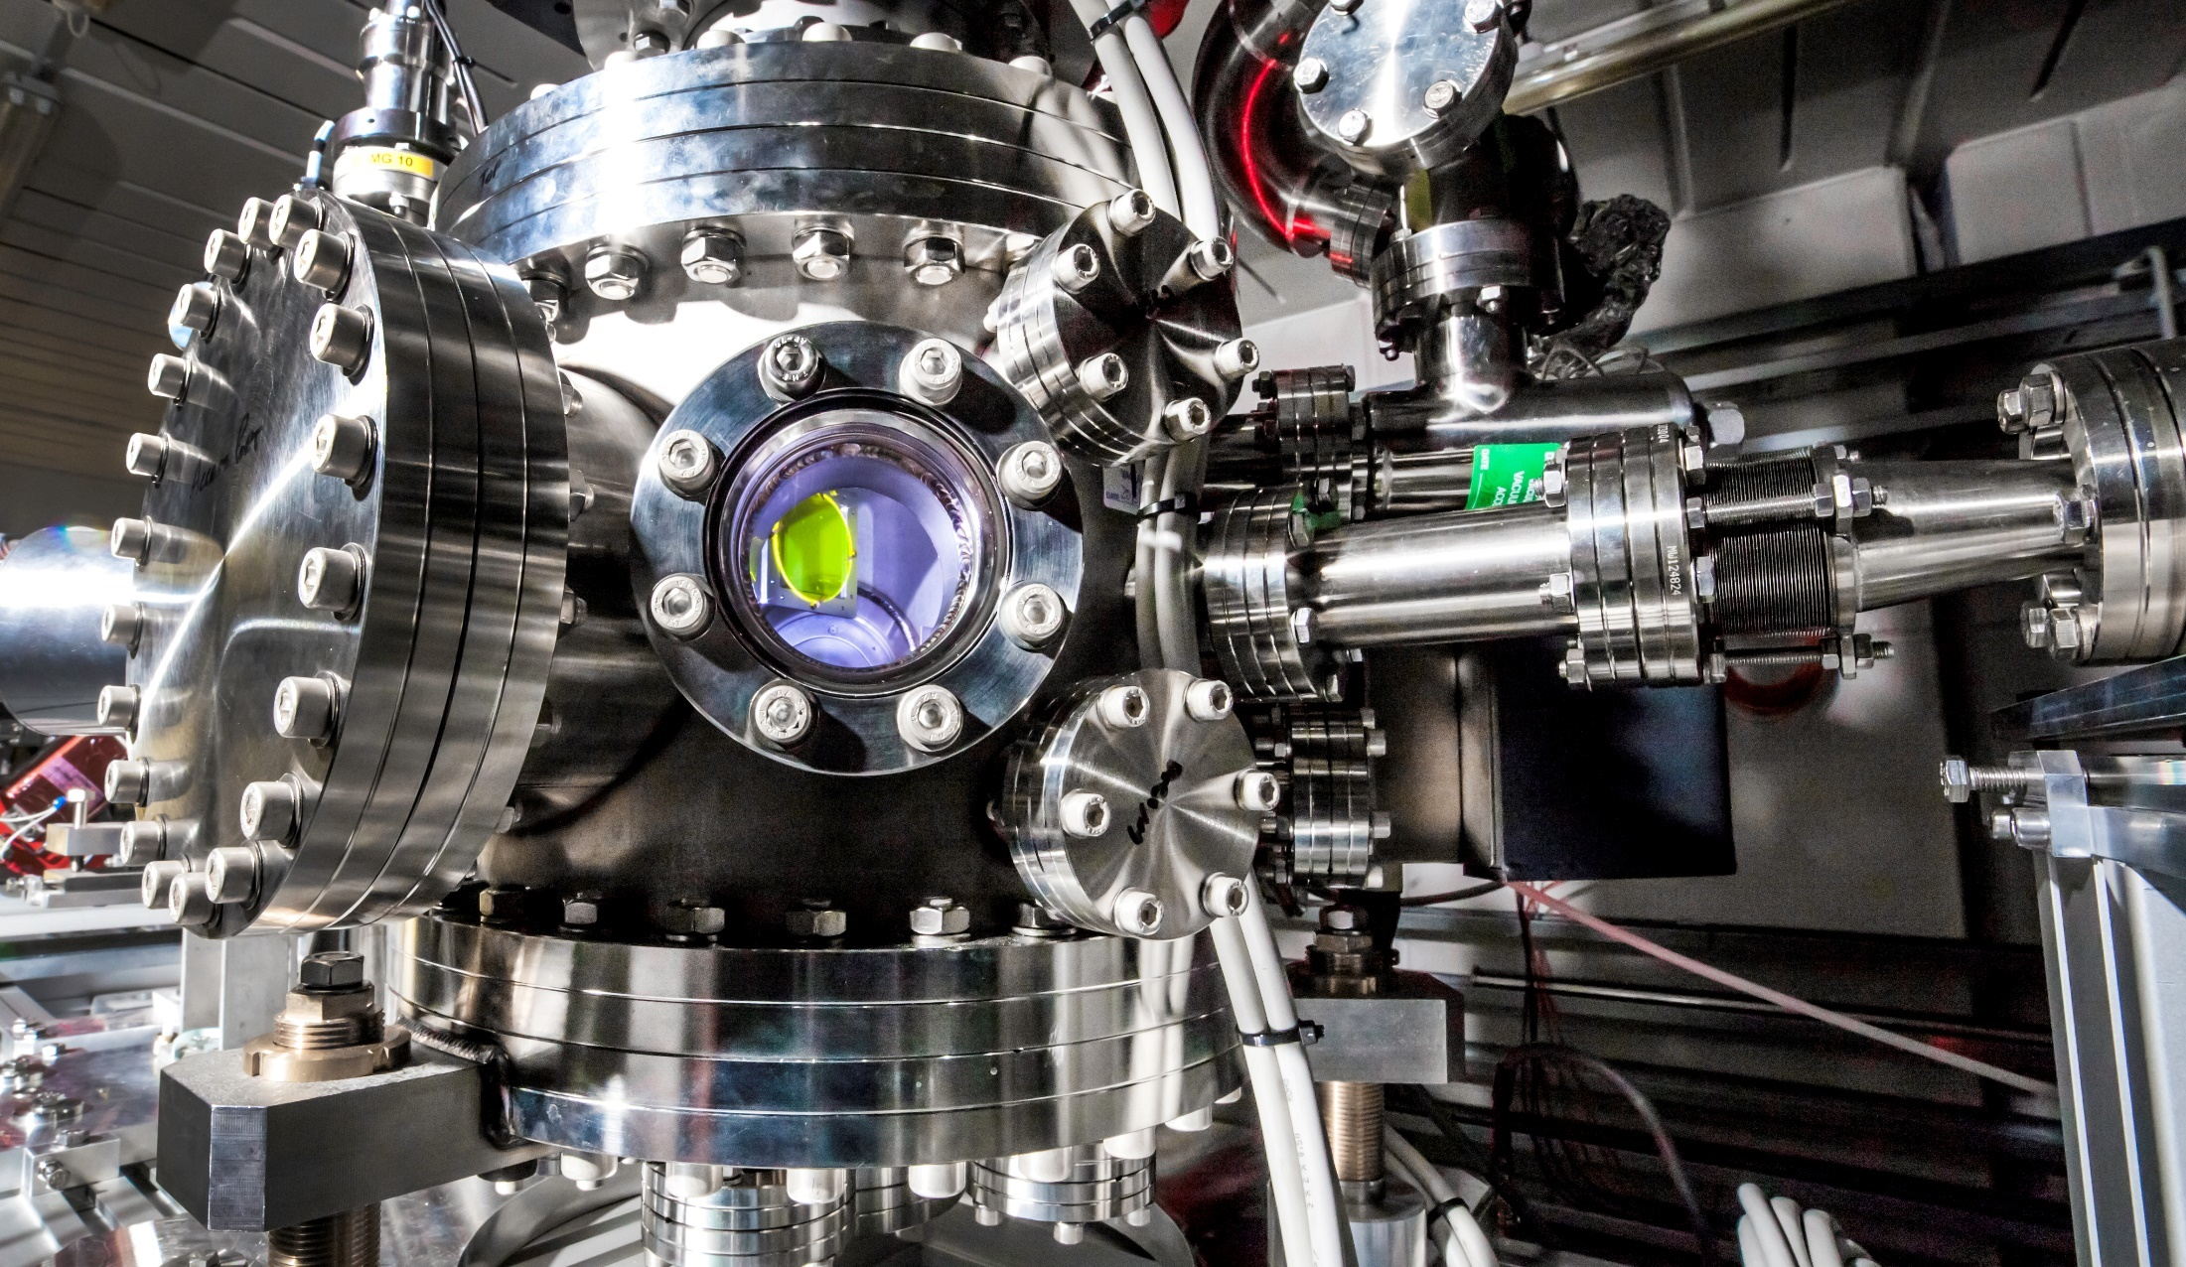
Task 4.1 Innovation – Accelerator Technologies
Anthony Gleeson, STFC Daresbury Laboratory, UK
anthony.gleeson@stfc.ac.uk +44 1925 603911

Slide 7
Task WP4.1
Industry Survey – Accelerator Technologies
“…to assist innovative European commercial organisations in identifying and successfully exploiting broader societal market opportunities for mature Accelerator technologies.”
A survey will assess the technical capabilities of each participating organisation in the identified Accelerator technology areas, looking at their equipment, skills and capacity to deliver, as well as their appetite for commercial innovation based on past history and current attitude to risk.
In addition the survey will provide insight into the domains of societal applications and potential market sizes beyond Research Infrastructures.
Output
A report identifying specific domains of societal applications and European commercial organisations that have the current capability, and future potential, to innovate and develop solutions in the fields of mature Accelerator technologies through the use of Technology Infrastructures will be delivered at the end of the project (month 30).

Slide 8
WP4.1 - Benefits for industry
AMICI will enable easier access to coordinated, cutting edge infrastructure for your industrial product development
Industry partners can identify themselves as proactive participants in developing the coordinated infrastructures
Opportunity for industry to host/integrate their equipment and skills within the technology infrastructures (if required)
Identify and access new high-value markets outside of the national laboratories
“This should be driven by industry’s demands - we need your help to get this right!”

Slide 9
Survey - Outline
Methodology: interview-led rather than via an online questionnaire. Primary source of information will be phone survey.
Anticipated Industry commitment – less than two hours per company.
Where appropriate, short company visits or regional workshops may be arranged to canvas opinion.

Slide 10
Survey - Process
What would help get the best response?
Does it have to be in local language?
Have you done similar surveys for the EU or other parties?
Who in the company is the best contact? Who would you direct this to in your company (e.g. product manager, marketing, technical director)?
One person or group interview?
Would it be helpful to send questions in advance?
Follow up process? Email updates? Follow up phone call?
Can we use contacts to advise of infrastructure opportunities?

Slide 11
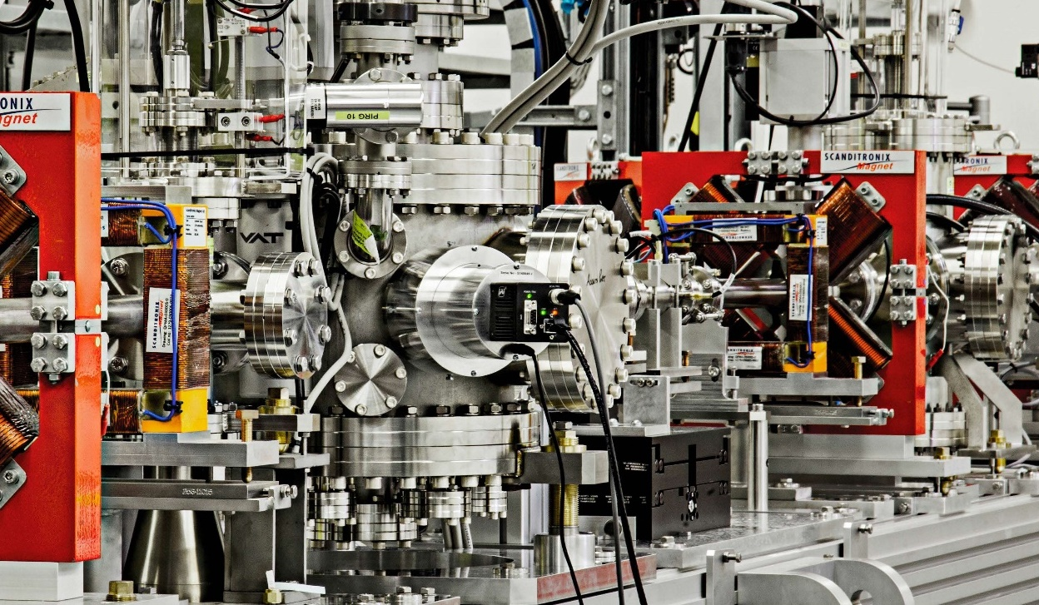
Task 4.1 Innovation – Accelerator Technologies
Dr. Sophie Muller, Thales Communications and Security

Slide 12
What is industry’s expectation?
“How can the coordinated Technology Infrastructures of the major European accelerator research labs help industry?”

Slide 13
Industry’s Expectations
Be in a position (*) to offer products and services in sustainable/growing markets,
get a larger market share in an existing market
have a market share in an emerging market
(*) The dream: Be alone or with a leading position on a sustainable market with a dream product line)
Create added value and differentiators, fill gaps… through access to new assets (scientific and technological, facilities, services ..)
Benefit from know-how and assets of European laboratories at fair conditions

Slide 14
Issues
Competition between industries
« price » to pay with regard to the risk to take to fill the gap between the technological stage (TRL?) and the industrialized and product ready to sell. Risk management.
Return On Investments (ROI) to be as reduced as possible (3 years?...)
Geographical distance between industries and laboratories provided it is generally preferable to establish close links with the technology provider(s) and eventually an end-user.

Slide 15
Paths to reach objectives and solve issues…
Need for market surveys including competitors and end-users (Find outside Europe competitors and do better solely or collectively)
Need for updated market positioning of industries to distribute/organize positions (?)
Agreements between industries to address the same market or different markets (?)
Remain focused on the objective to optimise costs-performance-planning and create relevant references in order to be competitive.

Slide 16
Need for a clear survey of technology providers:
Who are the experienced/Centres of excellence laboratories in each technology?
What are their specificities, differentiators?
What is their offer for industries? (Transfer of Technology, training, personal exchanges? ,facilities for demonstrator building, part of production, assistance in services? …)
Which conditions, financing rules, IPR, exclusivity or not…? Room for bartering?
Possibility to associate several laboratories to add value to a unique solution?

Slide 17
Discussion
Is the scope of the task clear?
Are the benefits for industry convincing?
Are the expectations and commitments of industry well understood?
What are the next steps and timelines?
All feedback welcome

