Slide 1



Nanotechnologies and their applications
Silvia bistarelli, phd.
Muse, general meeting - Infn, frascati national laboratories.

Slide 2
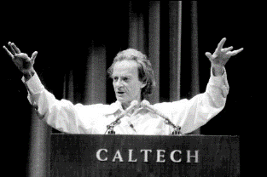
“The Father” of Nanotechnology
Richard Feynman’s talk (Nobel ’65, in Physics), December 29th 1959 at the annual meeting of the American Physical Society at the California Institute of Technology (Caltech) “There’s Plenty of Room at the Bottom”, it was first published in Caltech Engineering and Science, Volume 23:5, February 1960, pp 22-36.
to describe a field, in which little has been done, but in which an enormous amount can be done in principle.
This field is not quite the same as the others in that it will not tell us much of fundamental physics (in the sense of, "What are the strange particles?") but it is more like solid-state physics in the sense that it might tell us much of great interest about the strange phenomena that occur in complex situations.
Furthermore, a point that is most important is that it would have an enormous number of technical applications.”

Slide 3
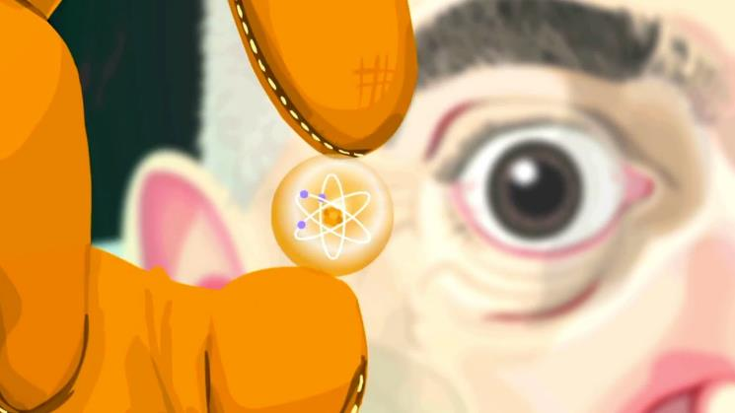
What is nanotechnolgy ?
Nanoscience and nanotechnology are the study and application of extremely small systems and can be used across all other science fields, such as chemistry, biology, physics, materials science, and engineering. Nanotechnology is not just a new field of science and engineering, but a new way of looking at and studying them.
MILESTONES OF NANO-RESEARCH:
1959: R. Feynman described a process in which scientists would be able to manipulate and control individual atoms and molecules
1974: First Molecular Electronic Device patent (IBM)
1981: IBM Invents scanning probe microscope: measure and identify structures at nano-scale. Ability to move individual atoms and molecules on surface
1985: Curl, Kroto, Smalley discovered buckey balls. Stable molecules that contain 50 to 500 carbon atoms in a ball, using laser vaporized carbon.
1986: Atomic Force Microscopy (AFM) Invented at IBM
1989: IBM Almaden Research Center : D.M. Eigler wrote IBM with 35 Xenon atoms.
1991: Discovery of carbon nanotubes by Sumin Iijima at NEC Research Labs
1993: First US research lab devoted entirely to nanoscience. Smalley at Rice University.

Slide 4
The relevance of the nanoscale
The bulk properties of materials often change dramatically when reduced to nanoscale dimensions.
This has to do with two main reasons:
Firstly, nanomaterials have a relatively larger surface area when compared to the same mass of material in bulk form.
This can make materials more chemically reactive (in some cases materials that are inert in their larger form are reactive when produced in their nanoscale form), and affect their strength or electrical properties.
Secondly, quantum effects can begin to dominate the behavior of matter at the nanoscale – particularly at the lower end – affecting the optical, electrical and magnetic behavior of materials.
Materials can be produced that are nanoscale in one dimension (for example, very thin surface coatings), in two dimensions (for example, nanowires and nanotubes) or in all three dimensions (for example, nanoparticles and quantum dots).

Slide 5
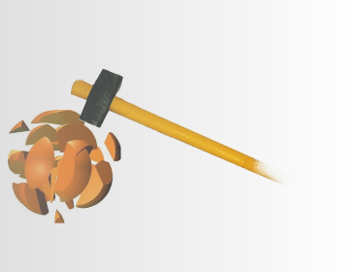
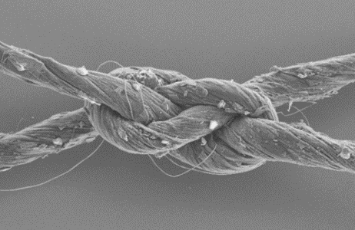
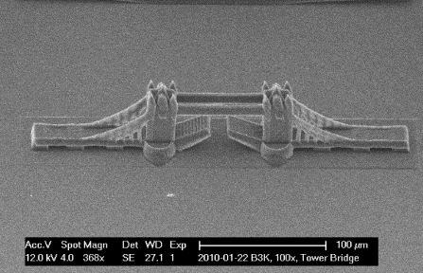
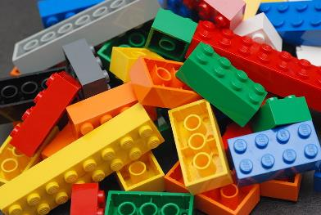
“Top – Down Bottom- Up”
“Top – Down”
“Bottom - Up”

Slide 6
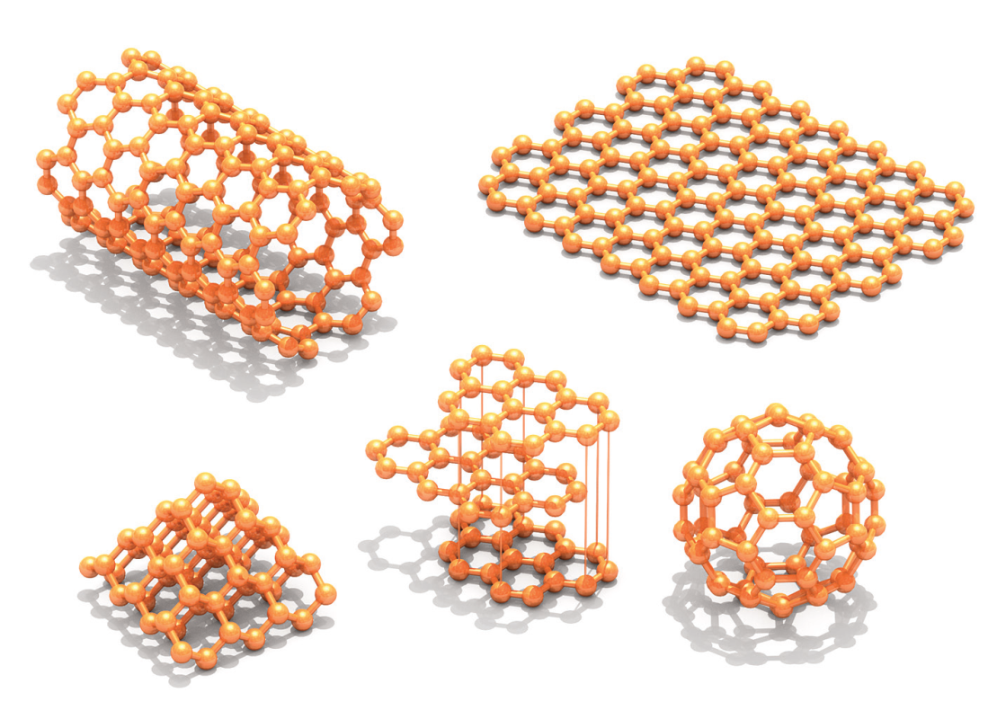
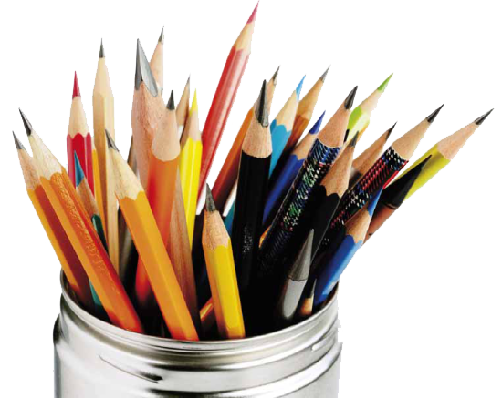
Carbon Family
Graphene
C. Nanotube
C
C
C
C
C
C
Graphite
Fullerene
Diamond

Slide 7
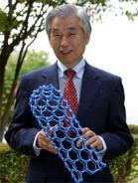
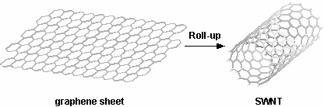
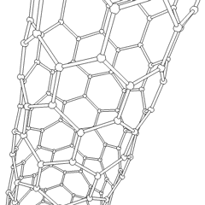

Why Carbon Nanotubes?
High aspect ratio (L/Ф) ⇒1D structure
High current density (
~ 10⁹ A/cm²) more than cupper!
No Joule effect!!!
It is 50000 times smaller than an human hair
High Young ‘s Modulus (around 1 Tpa)
High Tensile Strenght (90 - 150 Gpa).
High thermal conductivity at room temperature (1800-6000W/m*K).

Slide 8
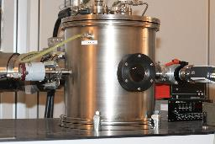
Carbon Nanotubes
Arc Discharge
Chemical Vapour Deposition (CVD)
Hot filament - CVD

Slide 9
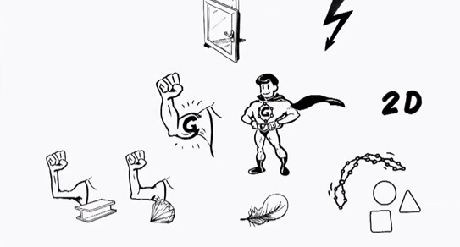

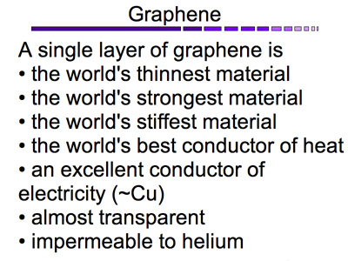
Graphene
Outstanding electrical, thermal and mechanical properties:
 | Cu | CNT | GNR
Max current density [A/cm²] | 10⁷ | > 10⁹ | >10⁸
Thermal conductivity [kW/mK] | 0.38 | 1.7 ÷ 5.8 | 3.0 ÷ 5.0
Mean free path at 20 °C [nm] | 40 | 10³ ÷ 25x10³ | ∼ 10³
Temperature coefficient of the resistance [10⁻³K^{-1]} | 4 | -1.37 ÷ 1.1 | - 1.47
Tensile strength [GPa] | 0.22 | 11 ÷ 63 | ---

Slide 10
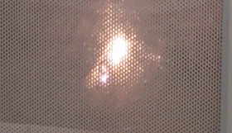
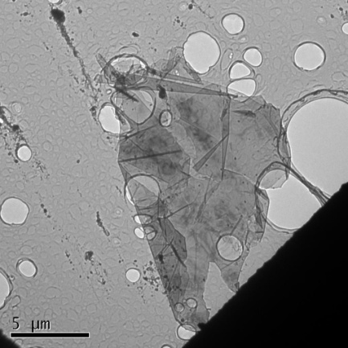
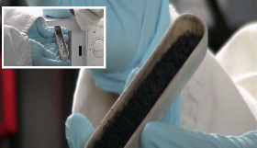
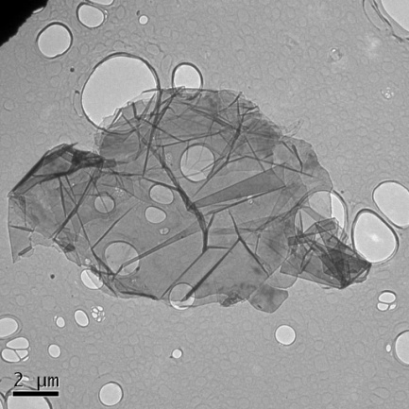
Graphene NanoPlates
Ultrasonic Bath
Notes:
i campioni dopo l’espansione si presentano sotto forma di work-like. Dalle micrografie SEM si nota che la struttura multi layer della grafite intercalata risulta espansa. Con un breve trattamento con ultrasuoni in alcol isopropilico, le GNP si liberano dalla sovrastruttura work like e formano delle particelle aventi larghezza di decine di micrometri e spessori di inferiori ai 5nm (una decina di layer).

Slide 11
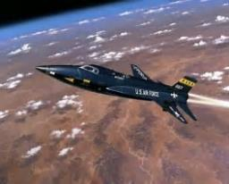
APPLICATIONS
AEROSPACE
ELECTRONICS
ENERGY
MEDICINE AND BIOLOGY

Slide 12
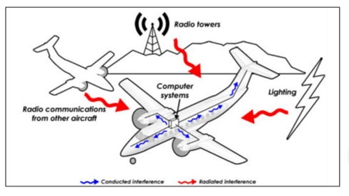
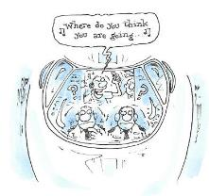
ELECTROMAGNETIC SHIELDING

Slide 13


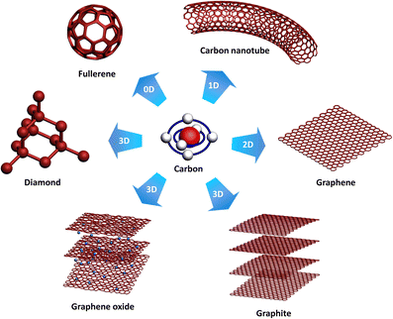
Epoxy Resin
Curing agent
SWCNT
MWCNT
Graphene Nanoplates (GNP)
Thick Graphite (TG)
Exfoliated Graphite (EG)
Carbon
Nanostructures

Slide 14
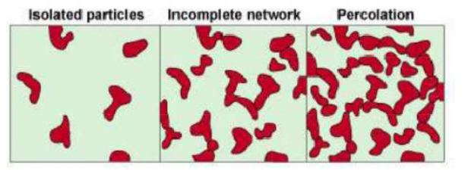
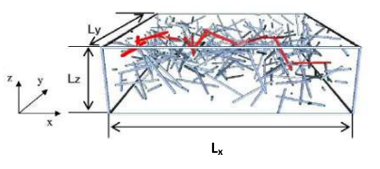
Above percolation threshold:
Network
Conductivity starts to occour

Slide 15
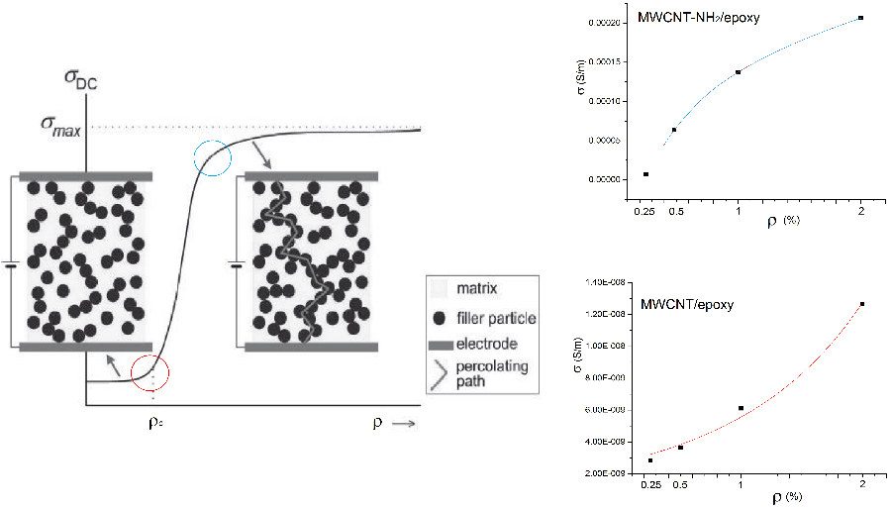

Slide 16
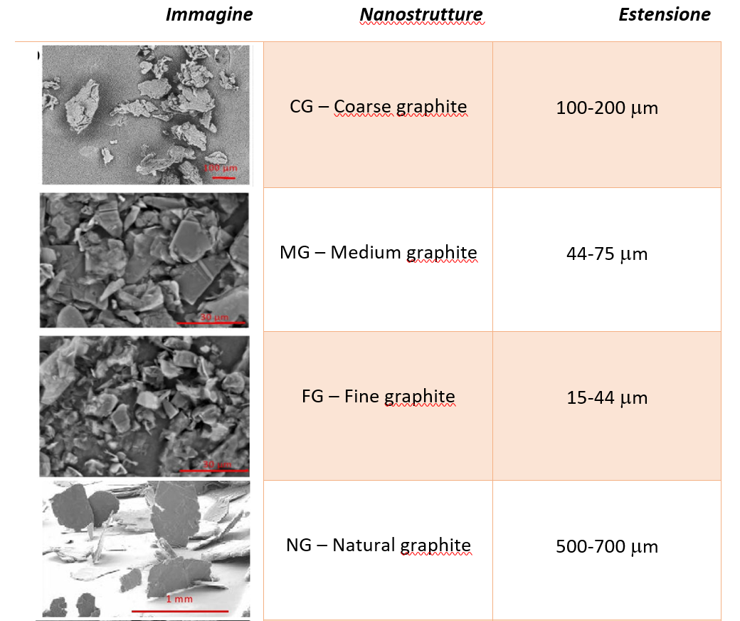
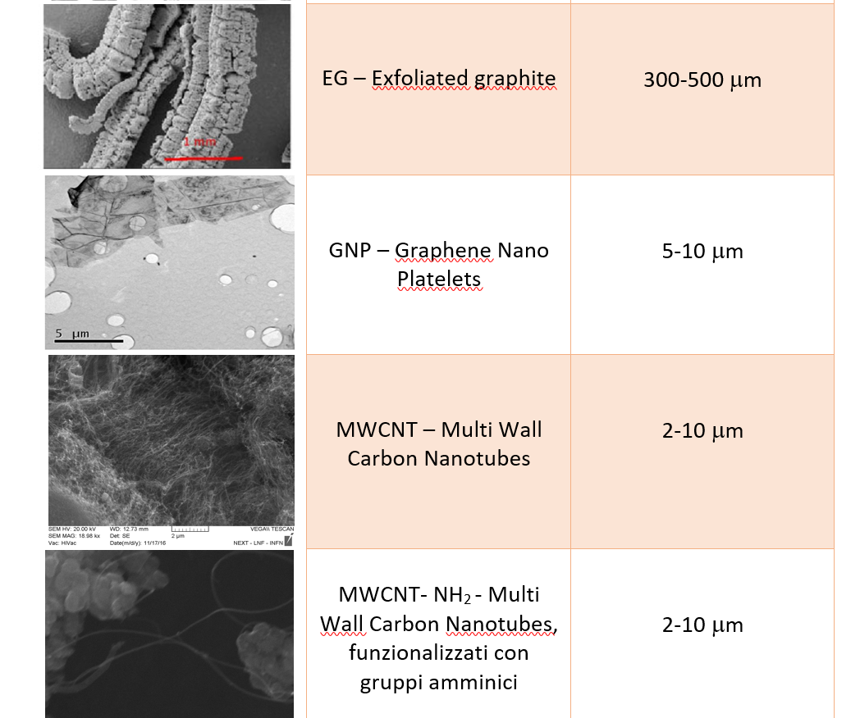
Picture Nanostructures Threshold
Picture Nanostructures Threshold

Slide 17
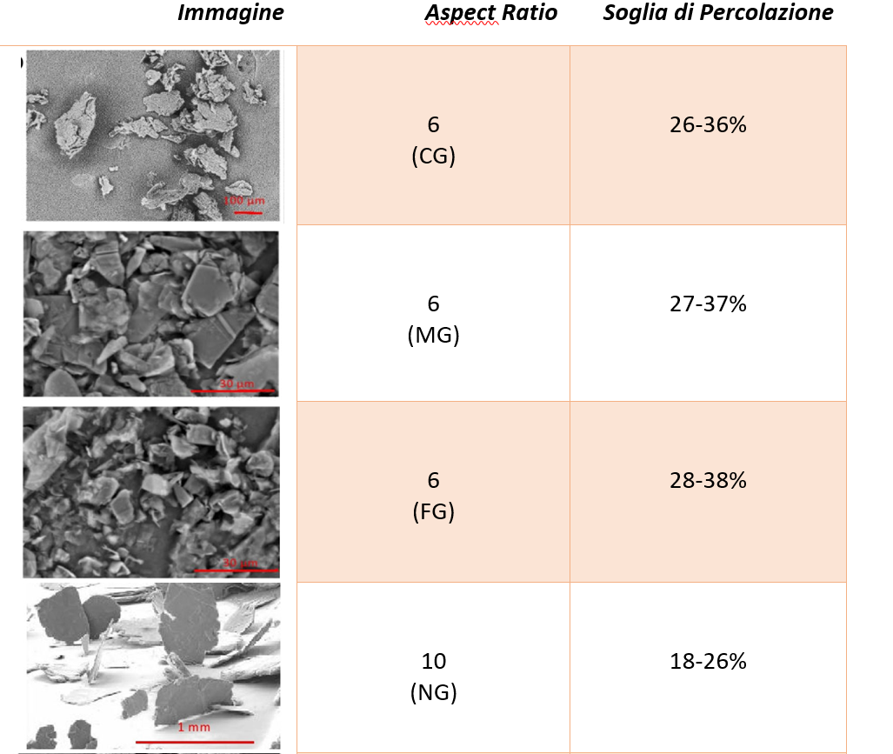
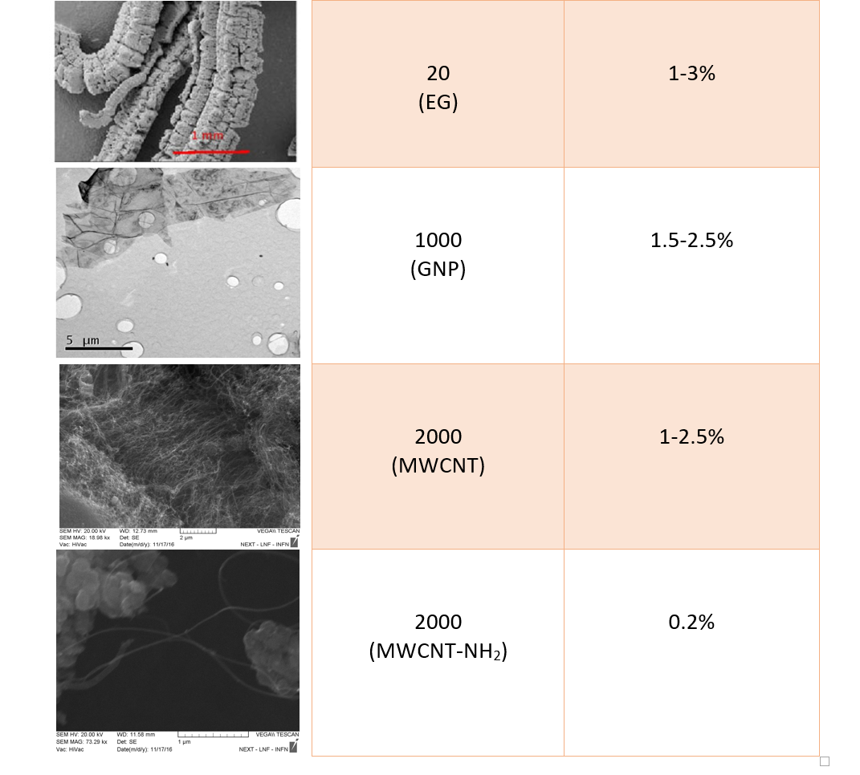
Picture Nanostructures Threshold
Picture Nanostructures Threshold

Slide 18
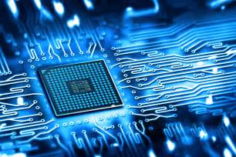
APPLICATIONS
AEROSPACE
ELECTRONICS
ENERGY
MEDICINE AND BIOLOGY

Slide 19
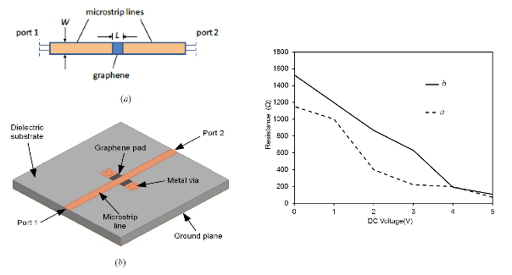
Innovative Tunable Microstrip Attenuators Based on Few-Layer Graphene Flakes
GNP thin film was used for a tunable attenuator device. The GNP patch was deposited in two configuration, first in the gap of a microstrip line and secondly, as a novel enhanced design, two graphene patches located between the main microstrip line and two metal vias. The results show for the first configuration a wide band functionality from DC to 20 GHz, with a tunability of 7 dB and minimum insertion loss of 5 dB, and for the second an operation in a frequency band of DC to 5 GHz, with 14 dB tunability and minimum insertion loss of 0.3 dB

Slide 20
Carbon interconnects with negative temperature coefficient of the resistance
R vs T, DEVICES #1, #2 and Cu
Temperature Coefficient of
the Resistance (TCR)
Device | TCR @ 20 °C [mK⁻¹]
Device 1 | 3.1
Device 2 | 7.2
Copper (measured) | 3.5
Copper (theoretical) | 3.7
Good thermal stability around
20 °C (low TCR values)
Among many outstanding properties of carbon-based interconnects, it is of great interest for nanoelectronics applications, the possibility to have an electrical resistance almost insensitive to the temperature increase. This behavior has been theoretically predicted and experimentally proven for graphene nanoribbons, but only in controlled conditions, and for limited ranges of geometrical dimensions and temperature. We demonstrated the possibility of observing such a desirable behavior in graphene conductors, made by self-assembly of graphene flakes.

Slide 21

APPLICATIONS
AEROSPACE
ELECTRONICS
ENERGY
MEDICINE AND BIOLOGY

Slide 22
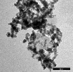
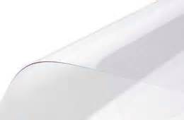
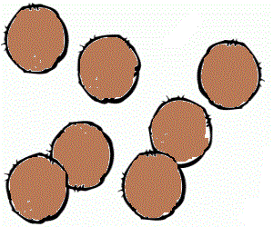
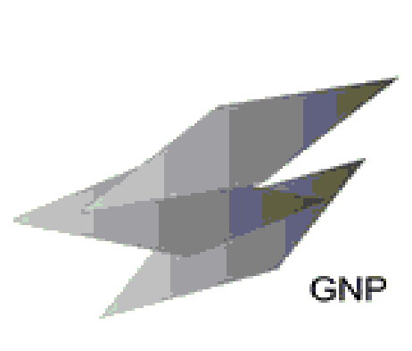
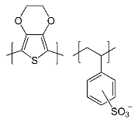
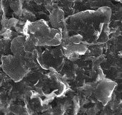
CU nanoparticles
LIGHT AND FLEXIBLE DEVICE
PEDOT:PPS
Graphene NanoPlatelets (GNP)

Slide 23
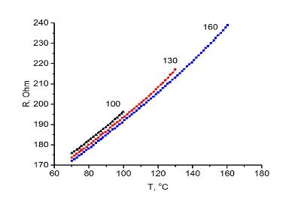
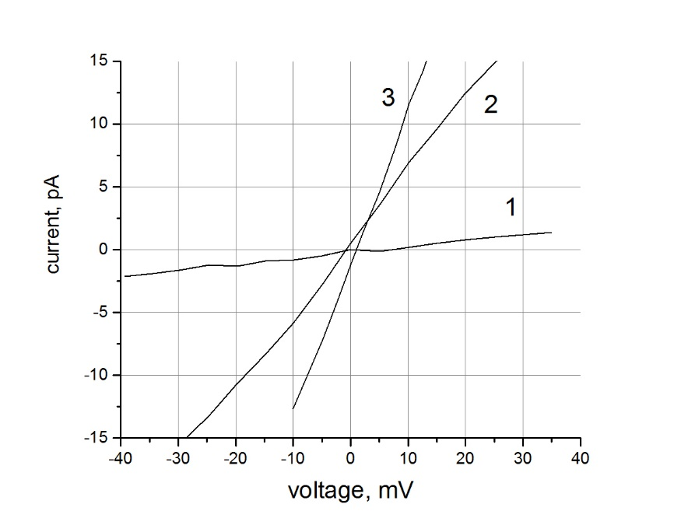
RESULTS
Temperature dependence of the resistance of the graphene film modified with copper NP, measured while cooling the sample in vacuum from different temperatures (with values reported near the corresponding curves).
The film resistance is decreasing with the growth of the initial cooling temperature, owing to the increase of charge carrier mobility caused by the decrease of the adsorbed oxygen concentration.
Current-voltage characteristics of PEDOT:PSS (1) with wt0.05% graphene (2) and wt0.05% graphene+CuNP (3) polymer nanocomposite film deposited on a polycor substrate with 500 µm separated 5 mm long Ni electrodes.
It can be clearly seen that the conductivity is drastically improved by introducing GNP into the polymer and moreover, in the case of the embedding of GNP-CuNP nanofillers.
In GNP-CuNP pedot:pps composite good contacts and adhesion are provided by the interaction with copper NP resulting in the formation of stable and homogeneous film with good and stable electrical conductivity

Slide 24

APPLICATIONS
AEROSPACE
ELECTRONICS
ENERGY
MEDICINE AND BIOLOGY

Slide 25
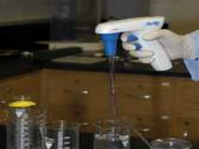
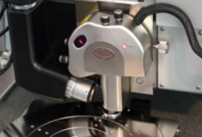
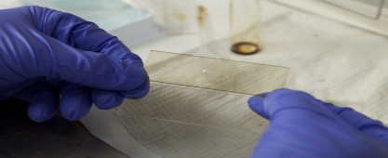
TOXICITY
INCUBATION WITH MWCNT
MWCNT dispertion in H₂O by sonication for 15 minutes.
MWCNT incubation at concentrations of 0.1mg/ml for 72h.
Cells fixed with 4% paraformaldehyde and preserved in PBS solution.
AFM PREPARATION
Dishes washed three times with solution containing 0.1M glucose and NaCl with ratio of 2:1.

Slide 26
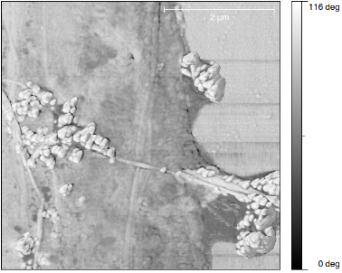
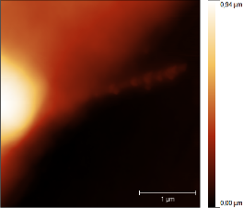
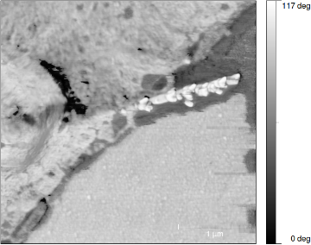
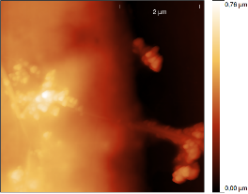
AFM in tapping mode
(A /A ~ 0.86)
MWCNT
0
S
PHASE SHIFT
different interaction tip-sample respect to cellular part.
MWCNT

Slide 27
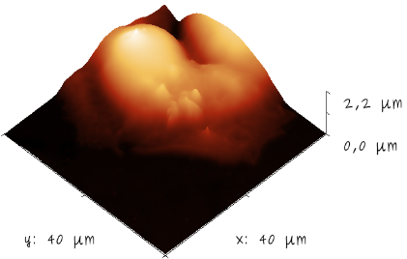
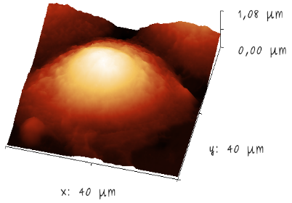
TOXICITY - SURFACE MODIFICATION
Treatment with MWCNT
DECREASE in roughness of 3 times
DECREASE of surface area of 3%
Control
The results are conserved in all frames examinated Global property

Slide 28
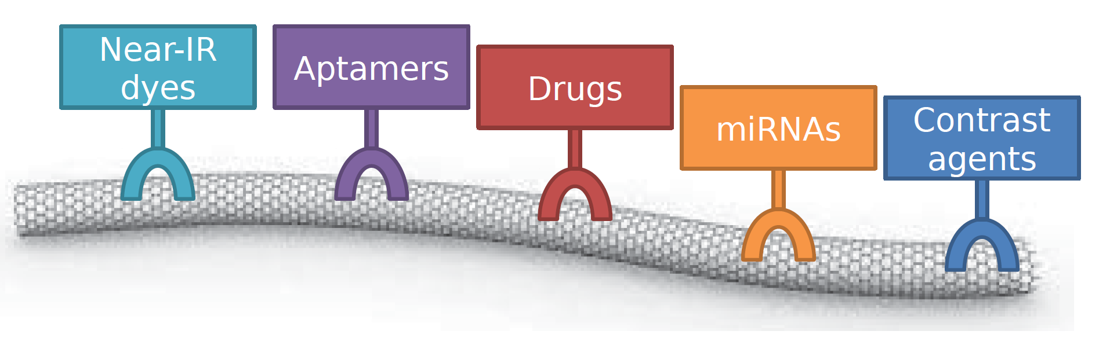
PEDIATRIC PULMONAY HYPERTENSION
Innovative therapeutic and diagnostic tool
MicroRNA
Carbon Nanotubes

Slide 29
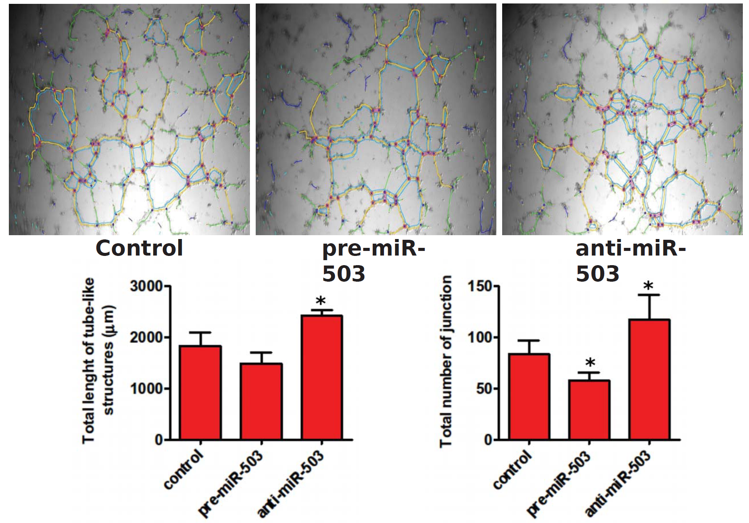

Formation of a vascular network
Intracellular localizzation

Slide 30










Dr. Stefano Bellucci

Slide 31





