Slide 1
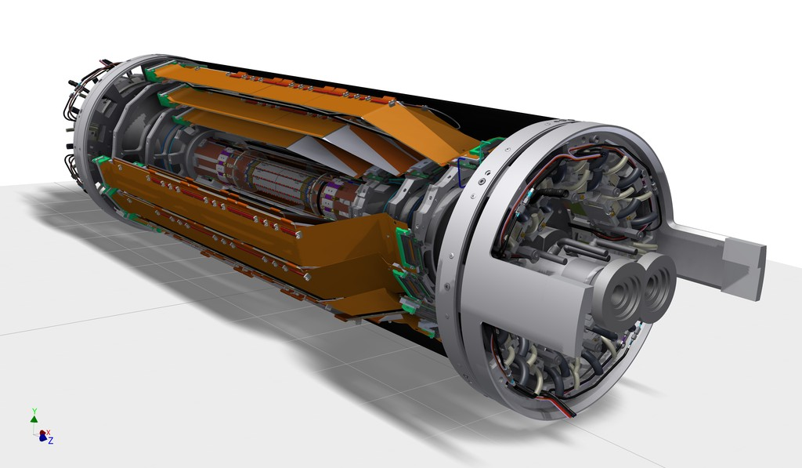
Update on the SVD construction
Carbon fiber
(CF) cone
Outer CF shell
End flange
End rings
Ladders
Beam pipe
PXD
(independent sub-detector inside SVD)
S. Bettarini on behalf of the SVD-Group
7th Belle II Italian Coll. Meeting, 05/05/2017 Trieste

Slide 2
Outline
Layer 4,5,6 Ladder production status
  FW modules: (PF1) peel-off issue
Layer3 cooling improvement
SVD Ladder mount:
  Cooling-pipes mounting
  Fibers insertions (see LL)
A look at the activities in 2018:
  Commissioning; Integration SVD/PXD; Cosmics run

Slide 3
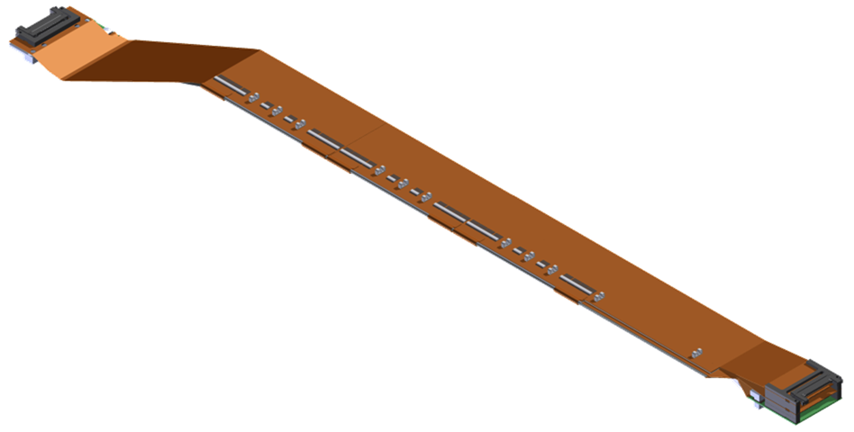
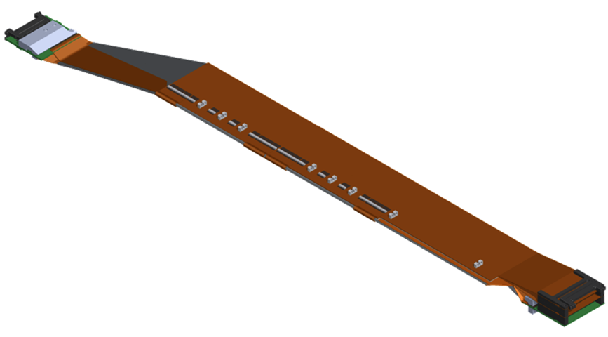
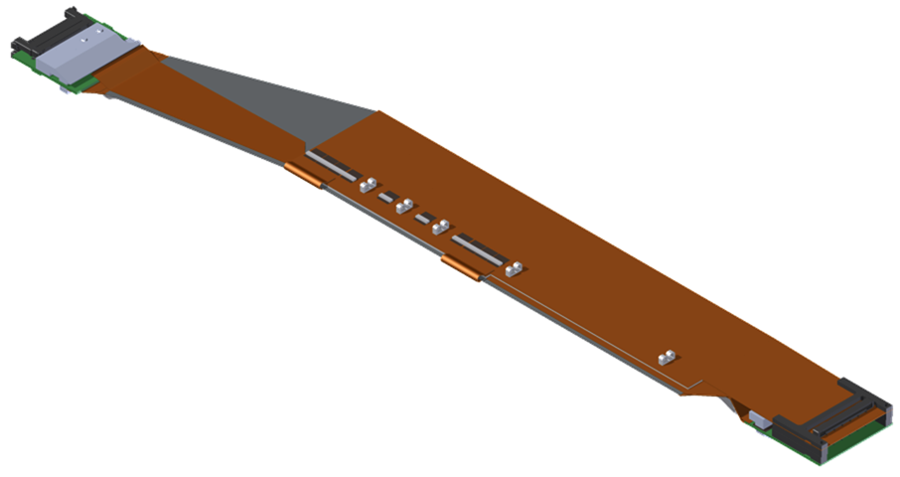
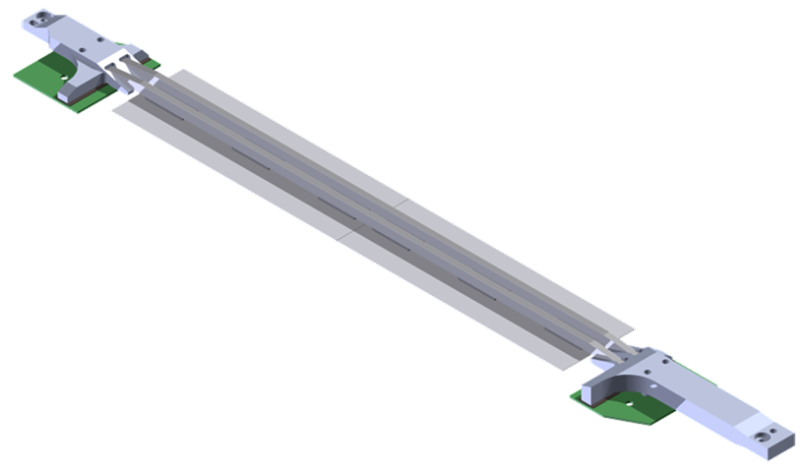
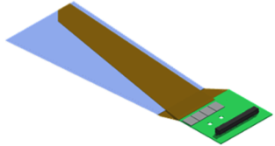
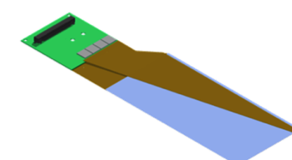
SVD ladders
Layer | Ladders (spares) | DSSDs / ladder
6 | 16 (4) | 5
5 | 12 (3) | 4
4 | 10 (2) | 3
3 | 7 (2) | 2
L6 Ladder
(Kavli IPMU)
FWD module
FWD
Origami +z
47 FWD + 47 BWD
L5 Ladder
(HEPHY)
Origami ce
BWD
Origami -z
L4 Ladder
(TIFR)
BWD module
L3 Ladder
(Melbourne)
Cooling pipe
FWD module
(Pisa)
Cooling pipe
BWD module
(Pisa)
Cooling pipe

Slide 4
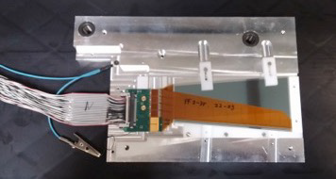
SVD Ladder Construction (I)
In 2016 Pisa completed the production of the needed 47 BW + 47 FW subassemblies. Prod. Line kept active in 2017:
  To feed the ladder assembly sites with the spare
  subassemblies needed for replacement in case of failures
  So far built extra +1 BW and +7 FW (Class B det’s!)
  A production of extra +4 BW needed before July
Origami production issue totally overcome: a sufficient number of tested class A origami circuits is now in our hand for ladder assembly.
Layer 6 assembly is on the critical path in the schedule.
  The L6 team (reinforced by an expert from Pisa) has implemented a shift system to use the assembly line at IPMU most efficiently: 1 ladder/21 days; in this way the global schedule (ladder mount) is matched but with very limited contingency.
FADC readout system
  FADC v3 has performed well at the test-beam in DESY in April 2016
  There are delays in v4 preparation

Slide 5
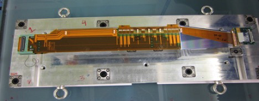
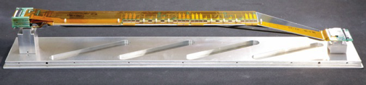

SVD Ladder Construction (II)
Layer-3 : already completed the production with spares
Layer-4 :
Layer-5 :
Layer-6 :

Slide 6
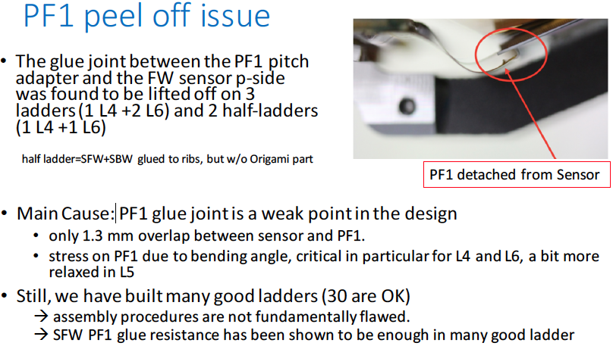
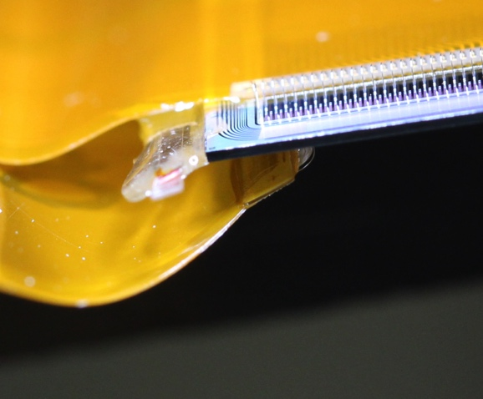
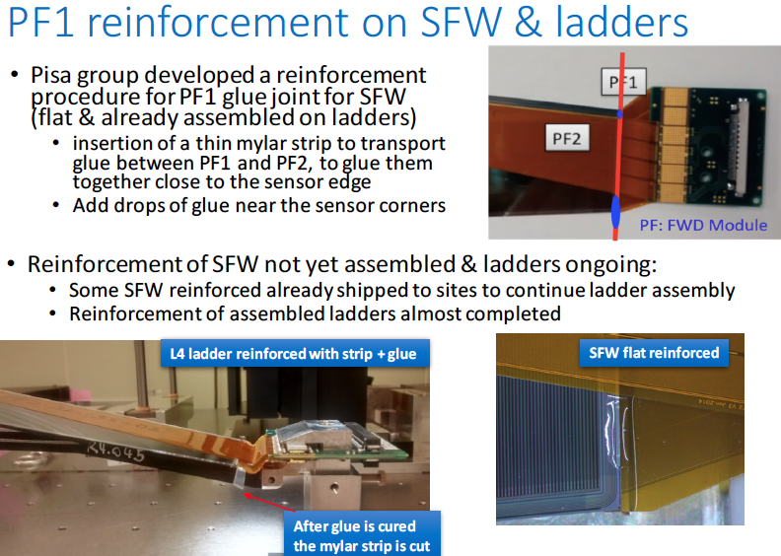
Unexpected failure after reinforcement!
Last week a L4 ladder experienced
a PF1 peel off, developed 6 days
after the half ladder assembly!
The failure mode indicates a glue
adhesion problem, and just adding
more glue is not enough.
Proposed a change in the assembly
procedures: the SFW glued is left on the ribs for about a week before
proceeding with the ladder assembly.
The whole SVD group is at work to find a definitive solution.

Slide 7
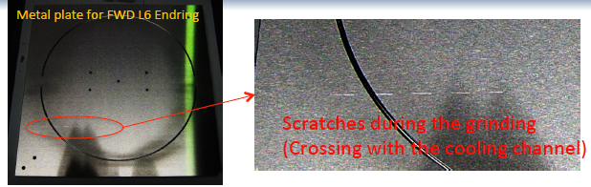
SVD Milestones
Item/Operation | Updated in April 2017
Completion L4 production (10+2) | Oct 2017
Completion L5 production (12+3) | Sep 2017
Completion L6 (enough for the 1st shell) | Dec 2017
Completion L6 production (16+4) | Mar 2018
Ladder mount (1st half shell) | Aug 2017- mid. Dec 2017
Ladder mount (2nd half shell) | mid. Dec 2017 – mid. April 2018
SVD ready for integration with PXD | End of April 2018
The SVD Group produced a detailed Gant Schedule that is monthly updated taking into account the delay caused by the most important issues met along the path…
For instance …
FWD end-ring re-production
(QA failure at the Welcon)
A scratch on the component
(overlooked during the
production) caused a leak in
the cooling circuit.

Slide 8
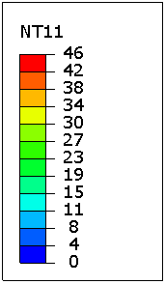
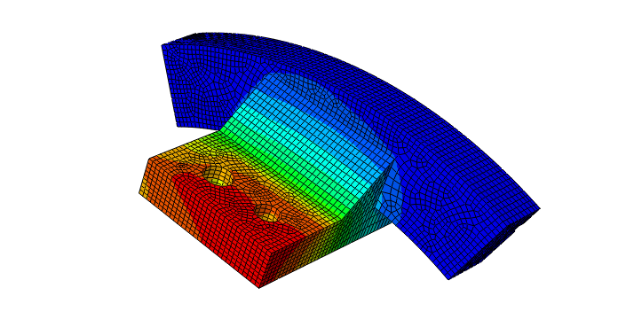
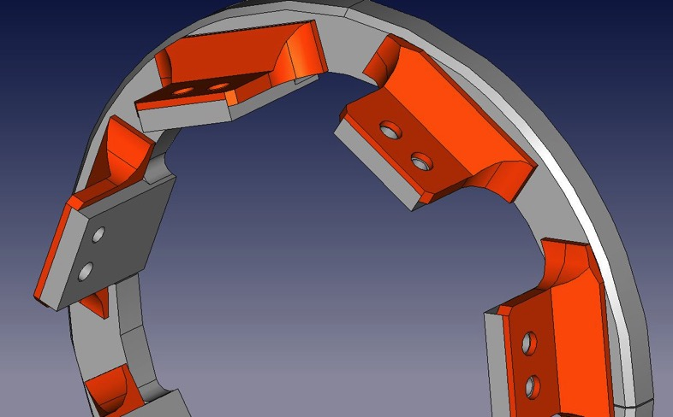
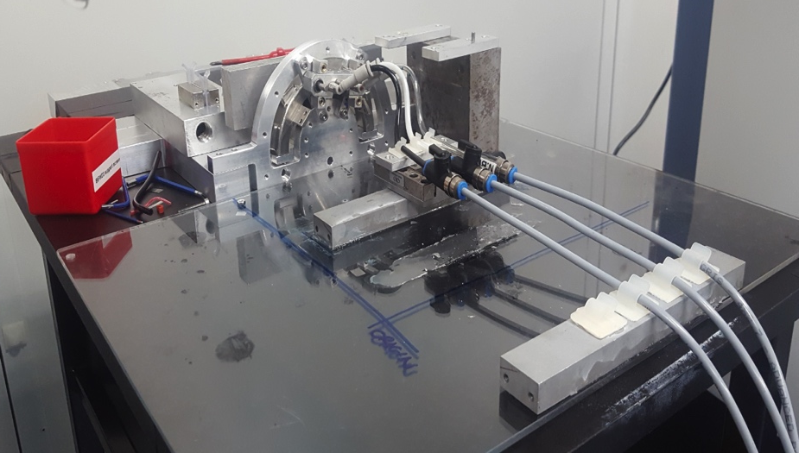
L3 cooling improvement (Melbourne)
Operation of the thermal mockup @ DESY indicated that the cooling of the APV chips on the L3 hybrids is marginal.
p-side APV chips in the FWD are ~70 °C above the coolant temperature, mainly due to the large temperature drop on the stainless steel FWD end-ring finger (45 °C)
L3 cooling is reinforced by adding copper inserts on the L3 fingers both in the FWD and in the BWD (T_{max} decreases by ~30 °C)
Copper Insert
Setup in Melbourne
Endring support
Gluing jig
Gluing support
Vacuum
Stress relief
Gluing station
Stress relief
The gluing of the copper inserts is foreseen before the June B2GM

Slide 9
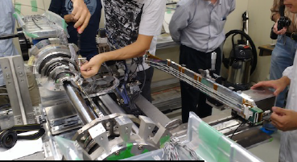
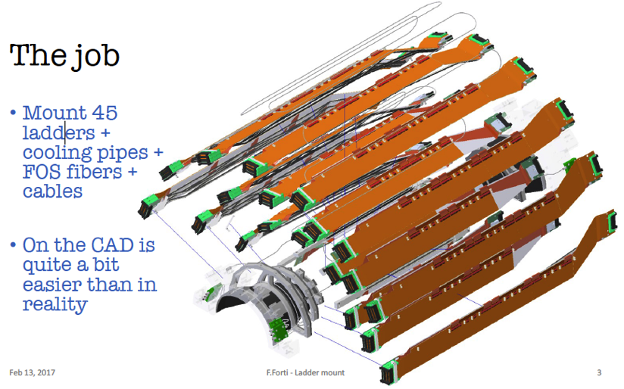
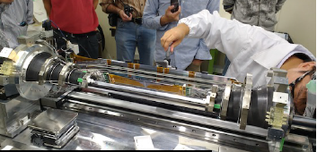
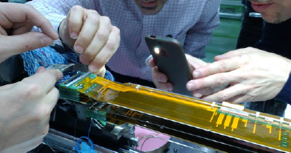
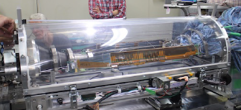
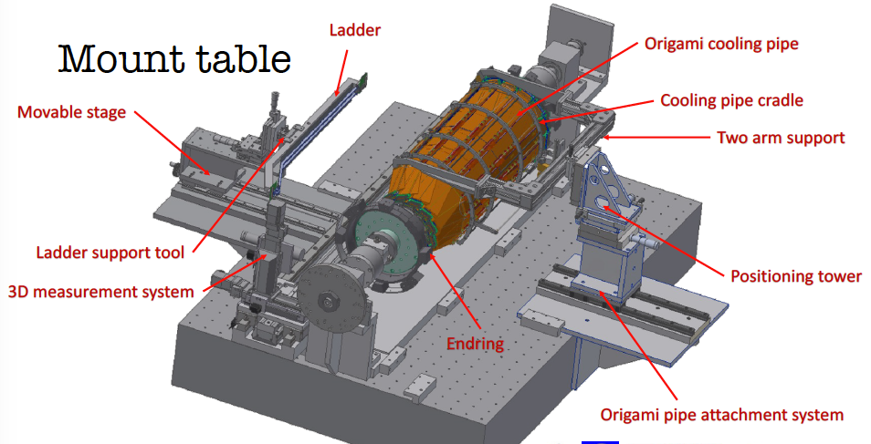
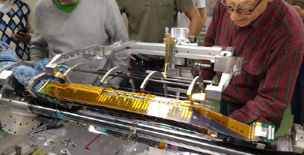
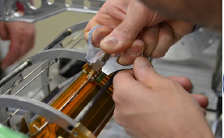
Ladder Mount
Ladder pick-up and mounting
FOS fiber insertion (TS)
Cooling pipe positioning (PI)

Slide 10
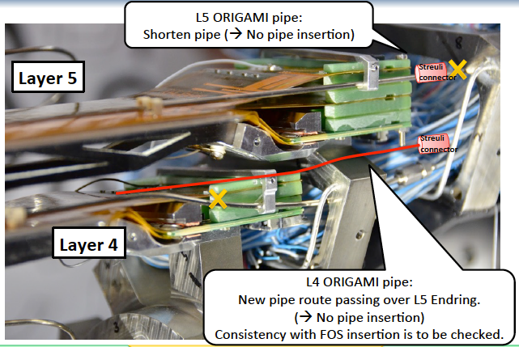
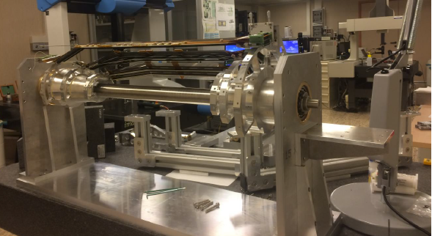
Cooling-pipe mounting
(Pisa responsibility)
In the reharsal of Febr. We decided to modify the L4-pipe routing to allow its easy mounting.
It has been important to have at home a mock-up of the mounting table where to test the mechanical tools and the procedures:
The next step is just the next week when the pipe-mounting for the Layer4-5-6 and the L3-cover will be tested: work to be done with the Trieste group to test also the
fiber insertion.
The last dressed reharsal of the complete ladder mounting procedure scheduled before the June B2GM

Slide 11
Main SVD Activities in 2018
The activities on beast2 (see LL’s talk) are also a useful exercise in preparation for the final SVD commissioning …, including the challenge of the tracking (ROI,...) on the SVD cartridge (Jan 2018)
2nd half SVD Ladder mount (first 4 months)
  SVD Commissioning, not yet completely defined in details, but foreseen:
    SVD standalone Cosmics data
    Integration with PXD
    Combined SVD/PXD Cosmics
    Installation VXD in Belle2
Cosmic Run before the Physics Run
A lot of exciting work @ KEK! Good opportunity for young people (free of teaching constraints) who gained expertise during the SVD module construction ...

