Slide 1
Computing activities in Napoli
Dr. Silvio Pardi (INFN-Napoli)
Seventh Belle II Italian collaboration meeting
4 May 2017 – Trieste - Italy

Slide 2
Activities in Napoli
Grid Services
Network:
Belle II Network Representative
Network Requirements
Network DC
Http/Webdav and Dynamic Federation
Helix Nebula Science Cloud
SCOReS-GARR Project
Vcycle Cloud

Slide 3
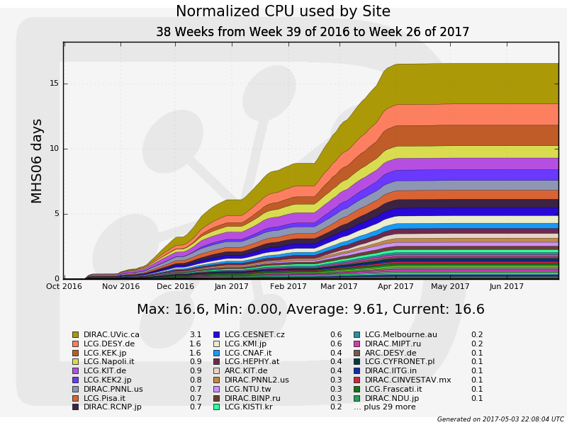
Grid Services: Computing
GRID Cluster updated with the possibility to use opportunistic resource from local project (Prisma, SCOReS)
LCG.Napoli.it has been one of the most used Site in the last 3 Quarters

Slide 4
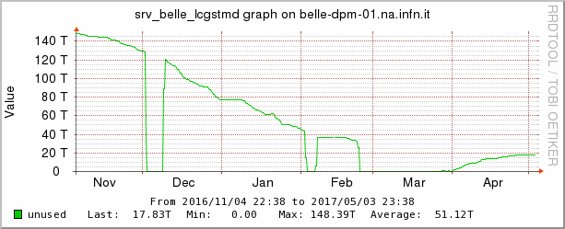
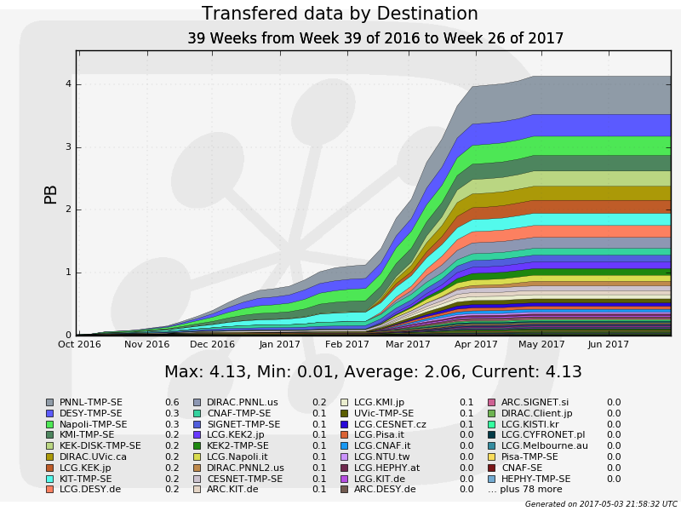
Grid Services: Storage
Storage totally Full
In February up to Mach
Some data
have been deleted in April
NAPOLI-SE has been one of the most used storage in the last 3 Quarters

Slide 5
Network Activity in Napoli
Silvio Pardi and Bruno Hoeft Network Representative for Europe.
Presentation of Belle II Network activity at the LHCONE in Helsinki (sept 2016)
Participation at the WLCG-GDB focus on Network representing Belle II (January 2017)
Network Estimation: updated at the last B2GM
Data Challenge:
New DC activity focus on test HTTP for third-part copy with FTS.
Some preliminary tests already done in Napoli using WebFTS provided by CERN as proof of the concept
New test are ongoing, in collaboration with Vikas and other site managers, using the FTS Server in PNNL

Slide 6
Http/Webdav and Dynamic Federation
# | STORGE DIRAC NAME | HOSTNAME | TYPE
1 | DESY-DE | dcache-belle-webdav.desy.de | DCACHE
2 | GRIDKA-SE | f01-075-140-e.gridka.de | DCACHE
3 | NTU-SE | bgrid3.phys.ntu.edu.tw | DCACHE
4 | SIGNET-SE | dcache.ijs.si | DCACHE
5 | UVic-SE | charon01.westgrid.ca | DCACHE
6 | Adelaide-SE | coepp-dpm-01.ersa.edu.au | DPM
7 | CESNET-SE | dpm1.egee.cesnet.cz | DPM
8 | CYFRONNET-SE | dpm.cyf-kr.edu.pl | DPM
9 | Frascati-SE | atlasse.lnf.infn.it | DPM
10 | HEPHY-SE | hephyse.oeaw.ac.at | DPM
11 | Melbourne-SE | b2se.mel.coepp.org.au | DPM
12 | Napoli-SE | belle-dpm-01.na.infn.it | DPM
13 | ULAKBIM-SE | torik1.ulakbim.gov.tr | DPM
14 | IPHC-SE | sbgse1.in2p3.fr | DPM
15 | CNAF-SE | ds-202-11-01.cr.cnaf.infn.it | STORM
16 | ROMA3-SE | storm-01.roma3.infn.it | STORM
17 | KEK-SE | Kek-se03.cc.kek.jp | STORM
18 | McGill-SE | gridftp02.clumeq.mcgill.ca | STORM
Testing Dynafed server in Napoli updated at the last version 2 weeks ago.
The testbed is expanded
Now included 18 of the 23 SRM in production.
In April a new call for interest has been sent to the mailing list. Other sites plan to join included Torino, Pisa
https://dynafed01.na.infn.it/myfed/

Slide 7
Http/Webdav and Dynamic Federation
Ongoing Activities:
Test S3 storage areas in Dynafed
Test standard WedDav Storage in Dynafed using a local synology
Testing ACL in Dynafed
The Dynafed Server in Napoli is part of the WLCG demonstrator for data federation as representative of the Belle II use-case.
10 May 2017 a new presentation will be done at the WLCG-GDB at CERN

Slide 8
HNSciCloud Goal
The Helix Nebula – The Science Cloud (HNSciCloud) is a Pre-Commercial Procurement support action funded by the EU Framework Programme for Research and Innovation Horizon 2020.
HNSciCloud aims to create a competitive marketplace of innovative cloud services serving scientific users from a wide range of domains. The marketplace builds on a hybrid cloud platform including commercial cloud service providers, publicly funded e-infrastructures and buyers' in-house resources.
INFN Coordinator: Luca dell’Agnello.

Slide 9
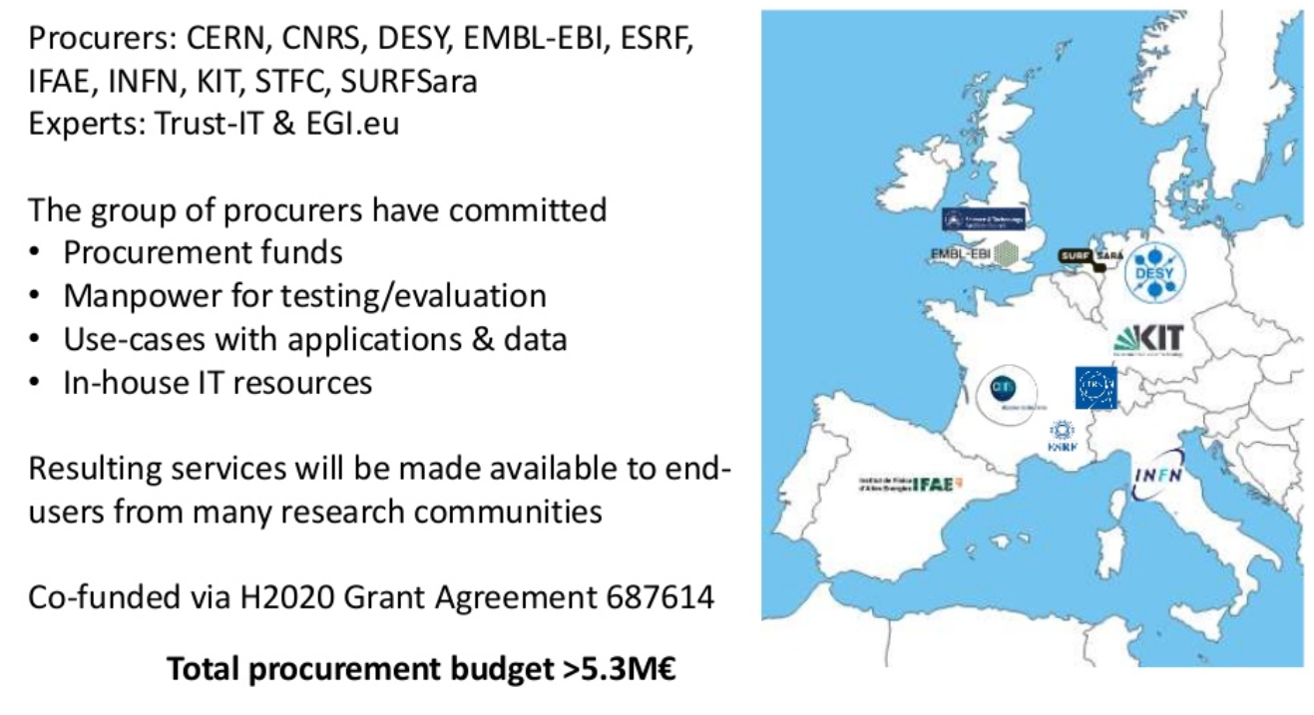
Participants
Ref: HNSciCloud Introduction - Bob Jones - Prototype Phase kickoff meeting

Slide 10
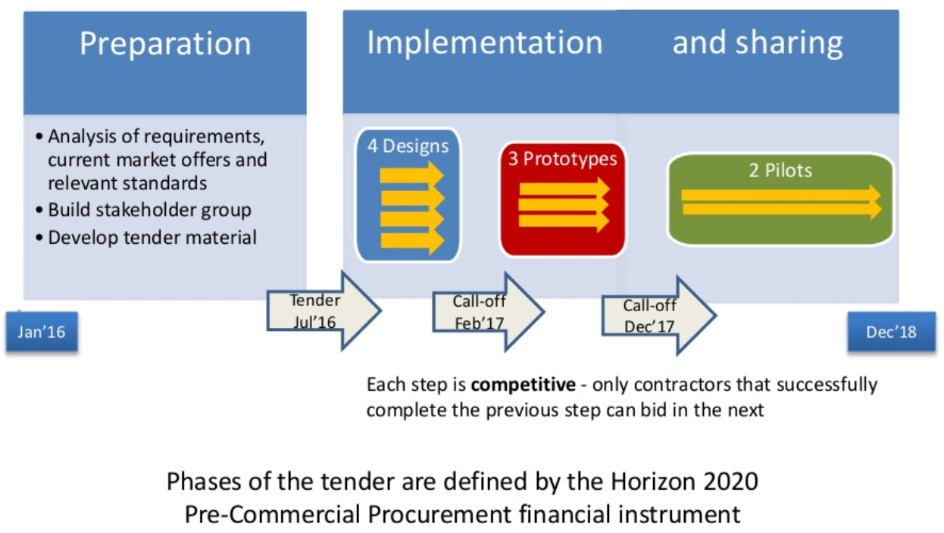
HNSciCloud project phases
Ref: HNSciCloud Introduction - Bob Jones - Prototype Phase kickoff meeting

Slide 11
Challenges
Ref: HNSciCloud Introduction - Bob Jones - Prototype Phase kickoff meeting

Slide 12
HNSciCloud Tender: Winning Bidders of the Design Phase
The 3 April the winners of the bids to build prototypes have been announced at CERN during the “Launching the Helix Nebula Science Cloud Prototype Phase” webcast event.
http://www.hnscicloud.eu/events/launching-the-helix-nebula-science-cloud-prototype-phase-webcast-3-april-2017-cern
Contractor 1: T-Systems, Huawei, Cyfronet, Divia
Contractor 2: IBM
Contractor 3: RHEA Group, T-Systems, exoscale, SixSq

Slide 13
Cloud Prototype for Belle II
Belle II is a use-case supported by INFN because is a VO supported by CNAF (early proponent)
First goal is study how to setup the VMs provided by the contractors in order to be used by Belle II users or for run Montecarlo.
At now we don’t have access to the contractors platforms and we are waiting for see the start of the activities.

Slide 14
SCOReS Project
Italian Acronym for: Study of a Caching system for optimize the usage of Opportunistic Resources and site without pledged storage, for e-Science application (SCOReS).
Project funded by GARR within a National call consisting in a 1+1Year fellowship.
Davide Michelino - project fellowship
Domenico del Prete - Master Thesis student
Silvio Pardi – Project Tutor for INFN-Napoli

Slide 15
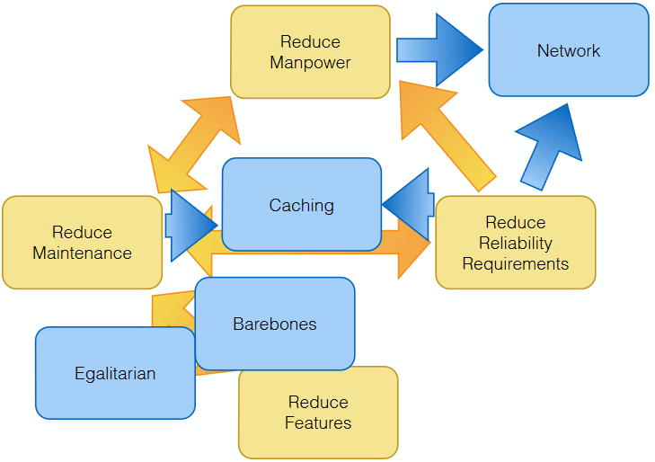
SCOReS Project: Motivation
Working Group WLCG/INFN
“Protocol zoo” Strategy
Discussed at CHEP2016
Reduce maintenance costs and manpower
Help site without pledged storage
Simply usage Cloud resources
Sam Skipsey

Slide 16
SCOReS Project: Technologies
Caching System: Squid, Varnish, Nginx, Apache Traffic Server
Protocol: HTTP/S3/WebDav, Xrootd
Federation: Dynafed
Analysis: Apache Lucene, Log Stash, Elastic Search, Kibana

Slide 17
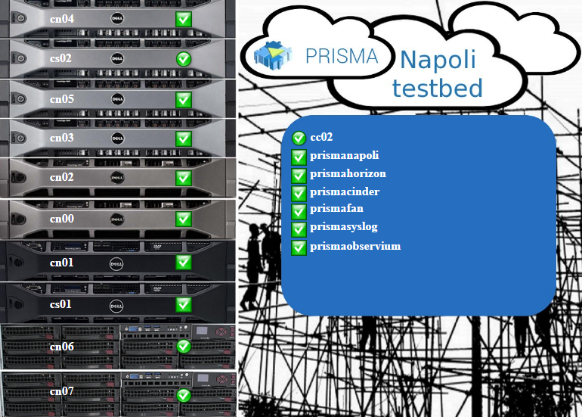
SCOReS Project: Facilities
The project will integrate the caching system in the RECAS-Napoli infrastructure supporting belle II and Atlas experiment. The goal is to create a pilot system and if possible a pre-production services
For the testbed we can take advantage from a local cloud based on Openstack, with the following characteristics
2 Server (tot 80 Cores to store the collective service)
384 cores for computation
88TB Raw Data
10Gbps Network

Slide 18
What is VCYCLE
VCYLCE is VM lifecycle manager developed by GRIDPP, it is designed to create VM on Cloud endpoints offering EC2, Openstack or Azzure interface.
VCYCLE can be easily integrated in DIRAC and the accounting system is compatible with APEL. VCYCLE is currently used in production by LHCb.
https://www.gridpp.ac.uk/vcycle/

Slide 19
How VCYCLE works

Slide 20
VCYCLE for Belle II
Testing activity started during the last B2GM26 suggested by Ueda.
In February I have been at CERN to meet the vcycle developer Andrew McNab for a working session.
We configured a VCYCLE endpoint attached to the PRISMA/SCOReS Cloud and we integrated it in the DIRAC VALIDATION server of PNNL.
The work required an intenste activity of VCYLCE customization for the Belle II use-case.

Slide 21
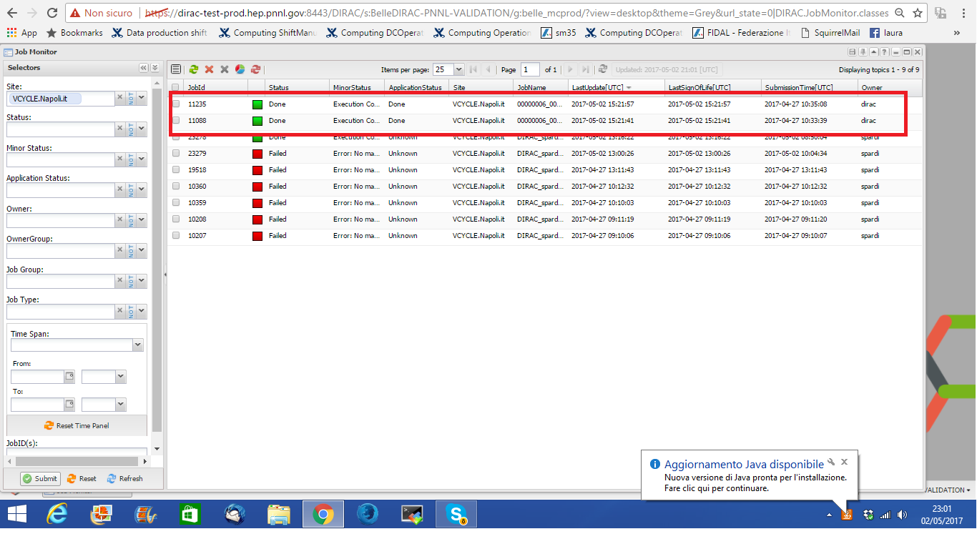
VCYCLE Pilot Jobs via PNNL DIRAC Server

Slide 22
People
Prof. Guido Russo
Dr. Silvio Pardi
Dr. Davide Michelino (GARR fellowship)
Dr. Domenico del Prete (Master Thesis)

