Slide 1


Graphene Nanostructures As Terahertz Photedetectors
Alessandra Di Gaspare
28/03/2017

Slide 2

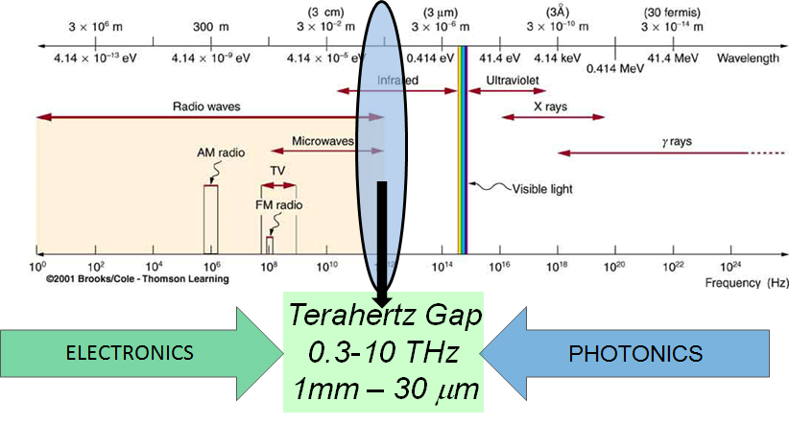
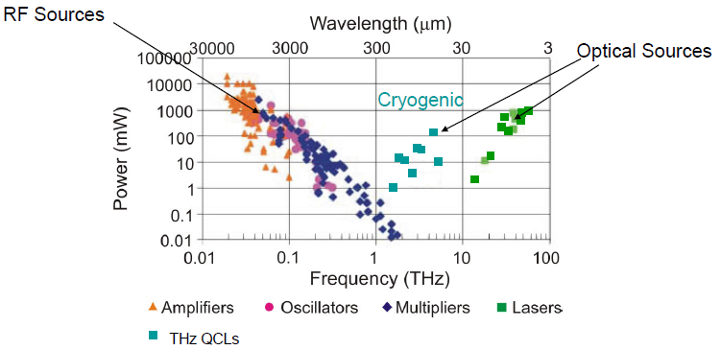
The THz Gap
Limited by parasitic
RC time constant
Limited by band-gap and thermal Energy
(1 THz = 4 meV)
THz Sources
Output Power
LNF, 28/03/2017

Slide 3
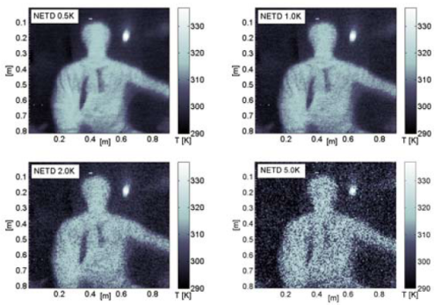
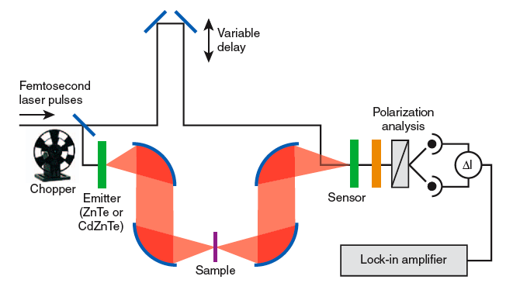

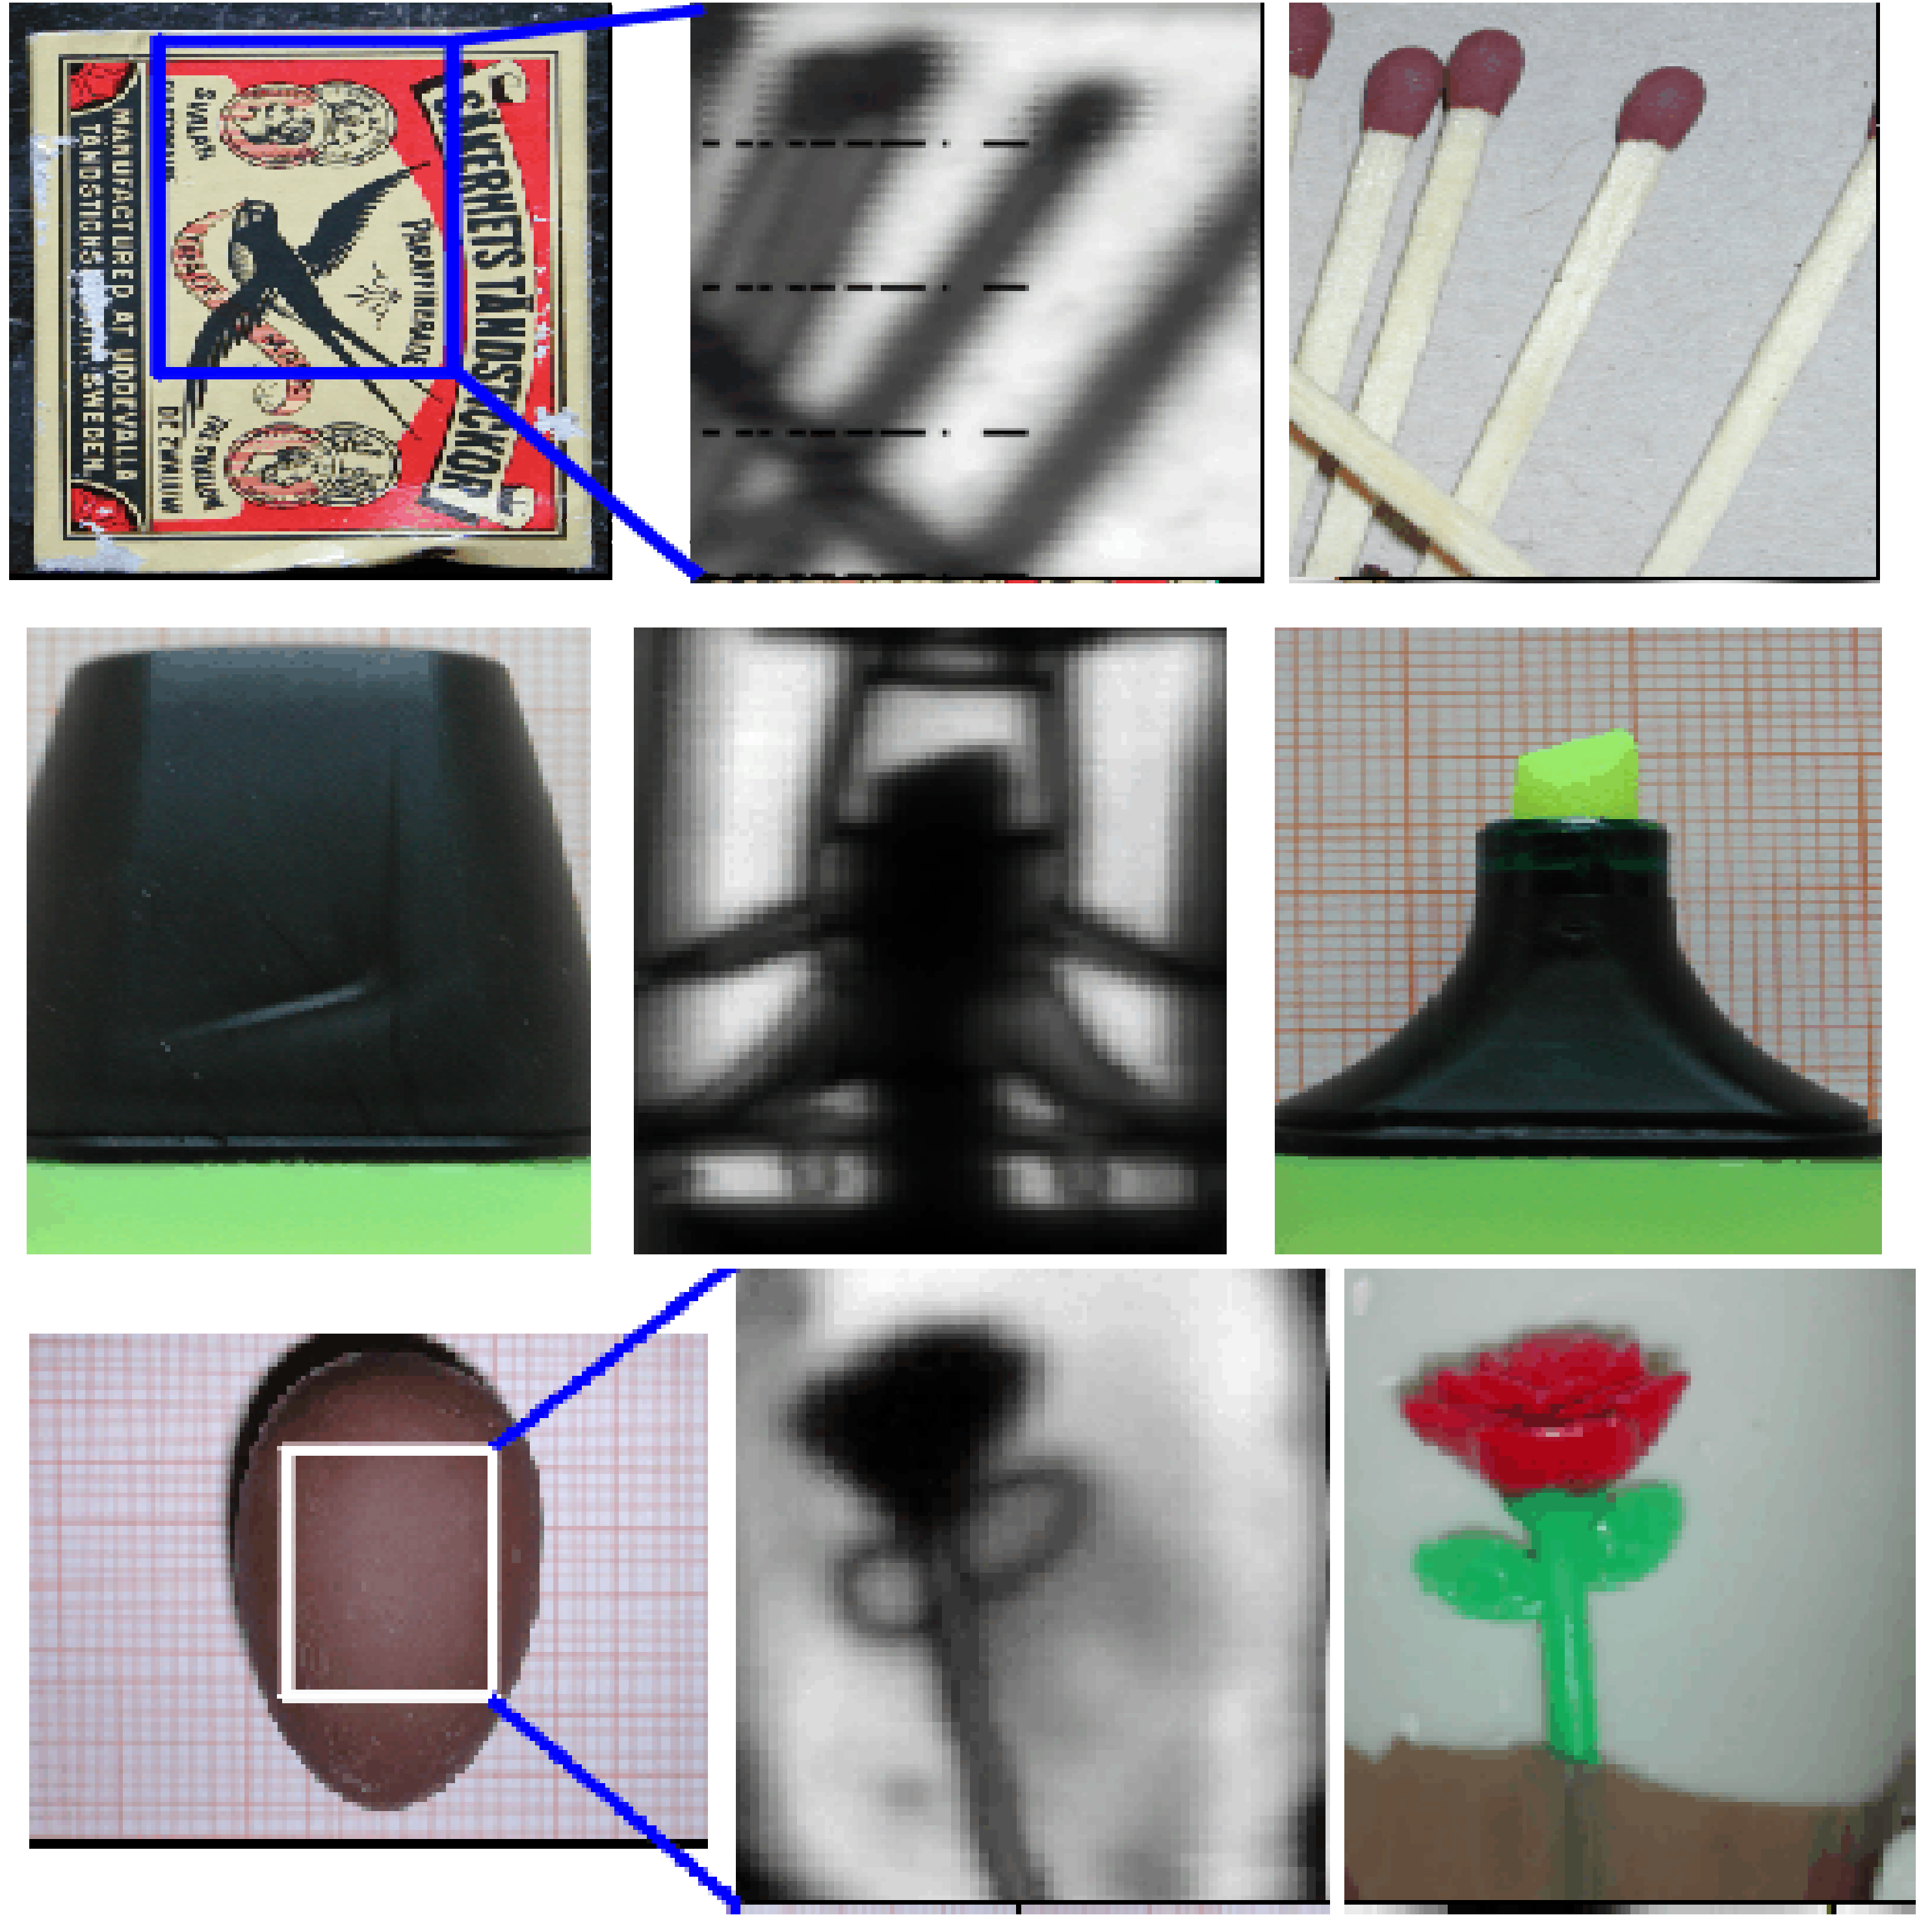
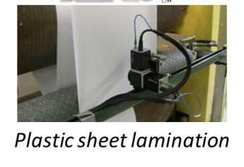
THz radiation applications
THz range offers many opportunities for applications
Security
Fundamental Science
Body scanner to reveal concealed weapons
THz Time Domain Spectroscopy:
dynamics of electrons, holes, phonons
Inspection of Material Devices, …
Industrial Process monitoring, food contamination
Availability of sensitive detectors: main technological bottleneck
In R&D: new approaches and devices based on interaction between THz radiation and technologically important materials
LNF, 28/03/2017

Slide 4
OUTLINE
Semiconductors Nanostructures and Terahertz Radiation
  Systems and State of the Art
  Detection in Field Effect Transistors: theory and some experimental results
Low dimensional semiconductrors nanostrucures as effective active material for THz detection
  Graphene, 1D systems
Reaching the photon-counting level in the THz range
LNF, 28/03/2017

Slide 5
THz Detection: figures of merit
Electrical Output
Input Power
Responsivity (R) [A/W] or [V/W]
Noise Spectral Density
Responsivity
Noise Equivalent Power (NEP) [W/Hz^{-1/2}]
Response Time (t)
[Max. modulation freq.]⁻¹
Portable/Integration On-chip/Scalable/Price
LNF, 28/03/2017

Slide 6
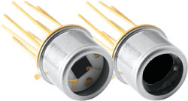
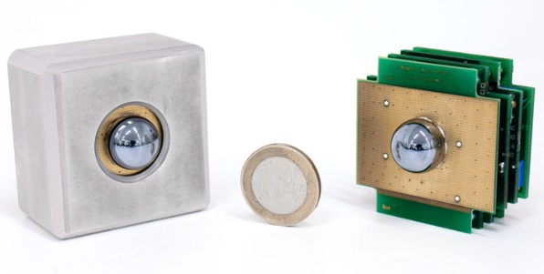
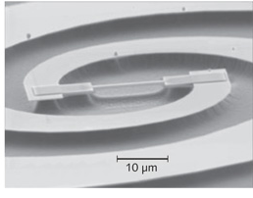
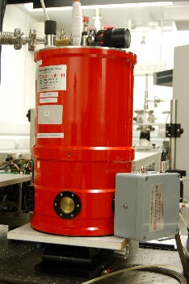
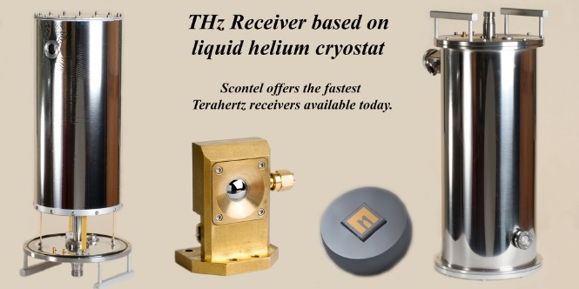
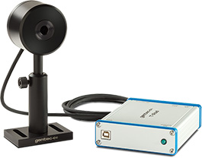
THz Direct Detectors
QWIPs
Pyroelectric
NEP = 3 nWHz^{-½}
Hot Electron Bolometers
NEP = 3 x 10⁻¹⁹ WHz^{-½}
CMOS Multipixel Camera, Schottky Diodes
NEP = 100 pWHz^{-½}
Higher performances, cryo needed
1-Portability
2-In electronic systems, time response very fast
T < 10 K
LNF, 28/03/2017

Slide 7
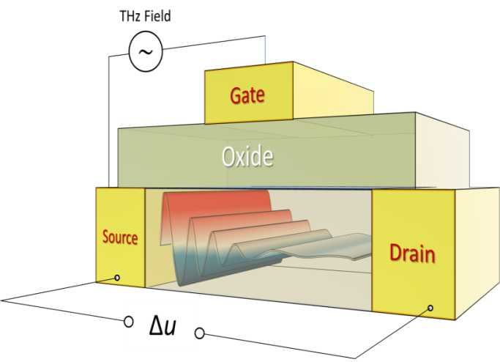
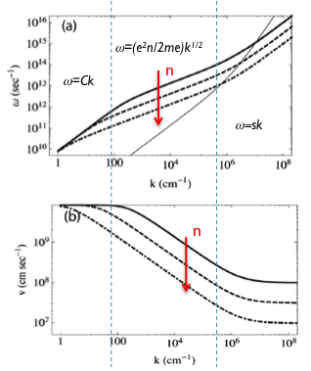
THz Detection in FETs
Rectification of THz plamsa waves in the 2D active channel
(Dyakonov and Shur, PRL 1993)
1-Low-dimesnional systems, 2DEG (Two-dimensional electron gas) gas of electrons free to move in two dimensions, quantum-confinement in the third dimension...
2- 2D plasmons @ THz frequencies can be coupled to radiation provided there is a wave vector defined by geometry (grating or antenna) to compensate for the momentum mismatch
Confinement of THz radiation in subwavelenght cavity
Tunability of the plasma frequency in 2D systems
F. Evangelisti, JAP 2013
LNF, 28/03/2017

Slide 8
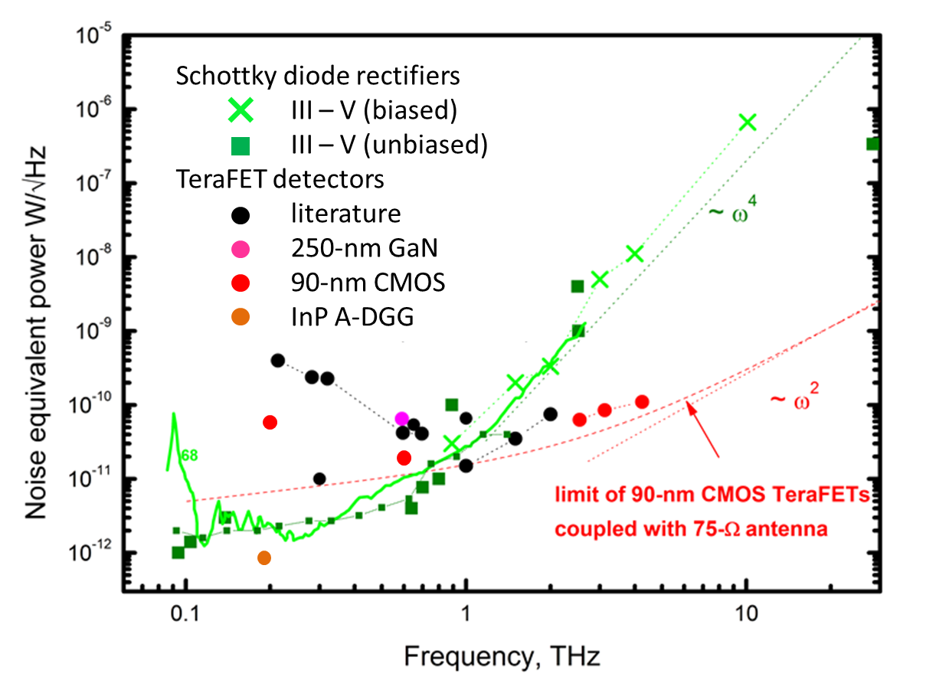
Why FETs for THz detection?
LNF, 28/03/2017

Slide 9
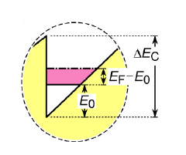
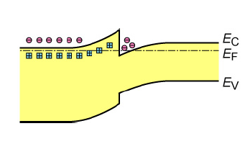
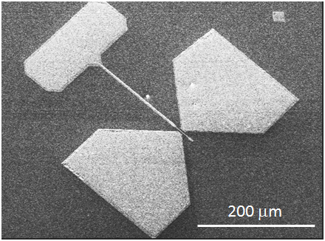
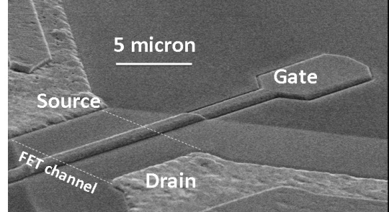
Plasma wave devices
Exeprimental approach: fabrication of field effect transistors whose conducting channel is a 2DEG, integrated with a planar antenna
SOURCE
GATE
DRAIN
n-AlGaAs
GaAs
PLASMON MICROCAVITY
semi-insulating substrate
The 2DEG channel realizes a
plasmonic microcavity
GATE
λ_{photon}/2
DRAIN
SOURCE
λ_{plasmon}/2
Charge modulation in time and space at ω → 2DEG in hydrodynamic regime
LNF, 28/03/2017

Slide 10
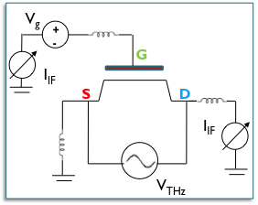
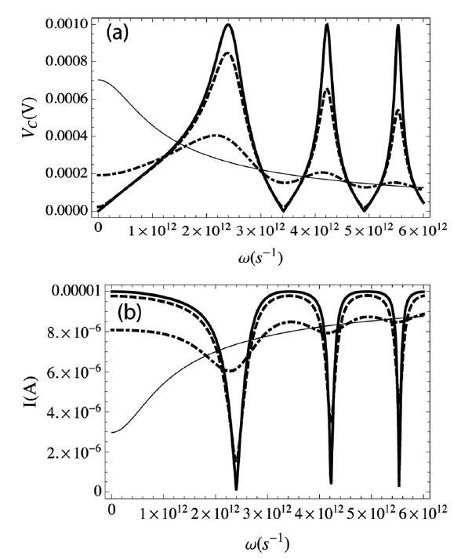


THz-down conversion: DC photocurrent
Self-mixing in FETs (Dyakonov-Shur mechanism) THz modulation of the channel charge density imposed by the gate terminal
Intrinsic nonlinearity in the 2DEG-hydrodynamic response
Heating of the 2DEG
…
Absorption of THz radiation
Damped (broadband) detection
µ
µ
Resonant detection
Inversion symmetry of the E field must be broken (antenna, channel design)
LNF, 28/03/2017

Slide 11
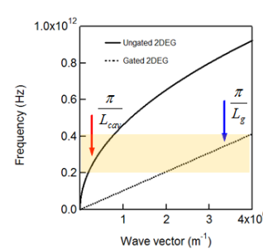
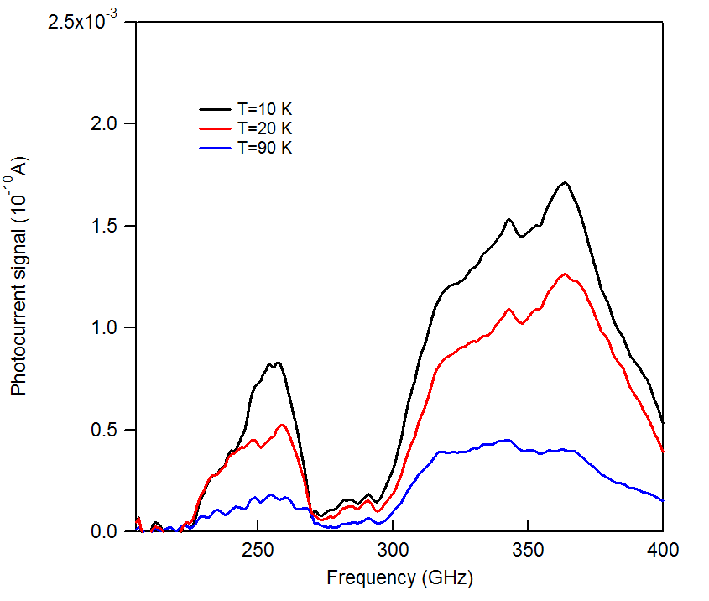
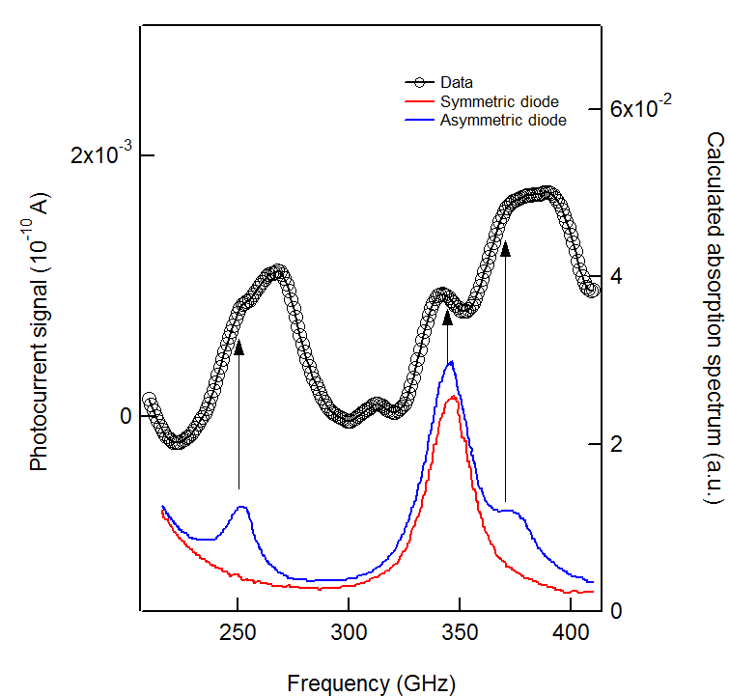
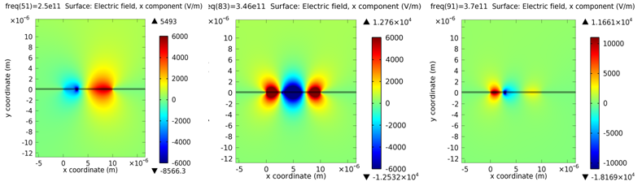
Spectral Response
Two-terminal device with asymmetric design
Hydrodinamic regime of the ungated 2DEG in the investigated spectral range
W
L_{g}
S
undoped GaAs
L_{SD}
substrate
50 mm
D
10 mm
Two perpendicolar linear dipole antenna
Strong indication of plasma waves
Modes assignement:
interaction btewteen 2DEG gated and ungated (hybrid cavity)
Activation of optically inactive mode
50 mm
A. Di Gaspare, APL 2012
A. Di Gaspare, J. Opt 2013
V. Giliberti, PRB 2015
Optical inactive even mode
with asymmetric E distribution
G
hybrid gated cavity
m=2
m=3
m=1
LNF, 28/03/2017

Slide 12
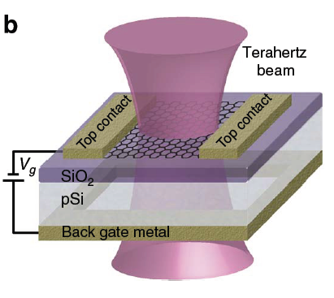
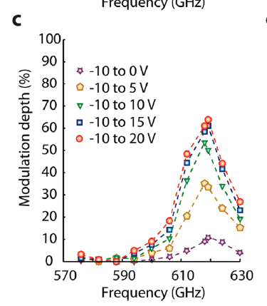
The Terahertz gap & graphene
THz plasmonic devices
THz generation
THz metamaterials
Y. M. Bahk et al, ACS Nano, 2014, 8 (9), pp 9089–9096
A. N. Grigorenko et al,Nature Photon., vol. 6, pp. 749–758 (2012)
THz modulation
50 mm
THz detection
B. Sensale-Rodriguez et al., Nature Commun. 3, 780 (2012)
B. Sensale-Rodriguez et al., Nano Lett. 12, pp. 4518–4522 (2012)
N. Papasimakis et al., Light: Science & Applications (2013) 2, e78
LNF, 28/03/2017

Slide 13
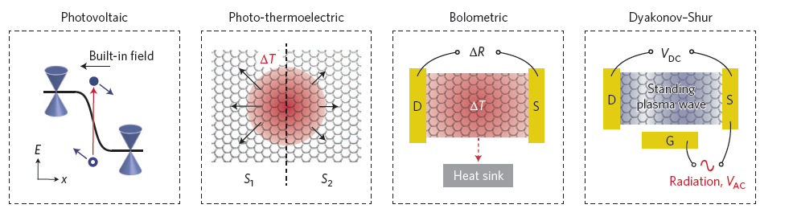
Graphene-based devices as THz detectors
L. Vicarelli et al, Nat. Mater. 11, 865 (2012).
D. Spirito et al, Appl. Phys. Lett. 104, 061111 (2014).
A. Zak et al, Nano Lett. 14, 5834 (2014).
A. V. Muraviev et al, Appl. Phys. Lett. 103, 181114 (2013).
M. Mittendorff et al, Appl. Phys. Lett. 103, 021113 (2013).
X. Cai et al., Nat. Nanotechnol. 9, 814 (2014).
Works only for Graphene in the
THz Range
Electrons
Holes
Koppens et al, Nature Nanotechnology 2014
LNF, 28/03/2017

Slide 14
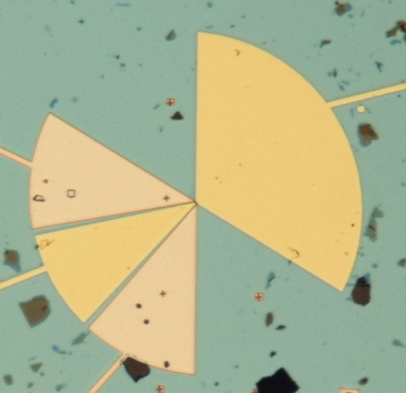
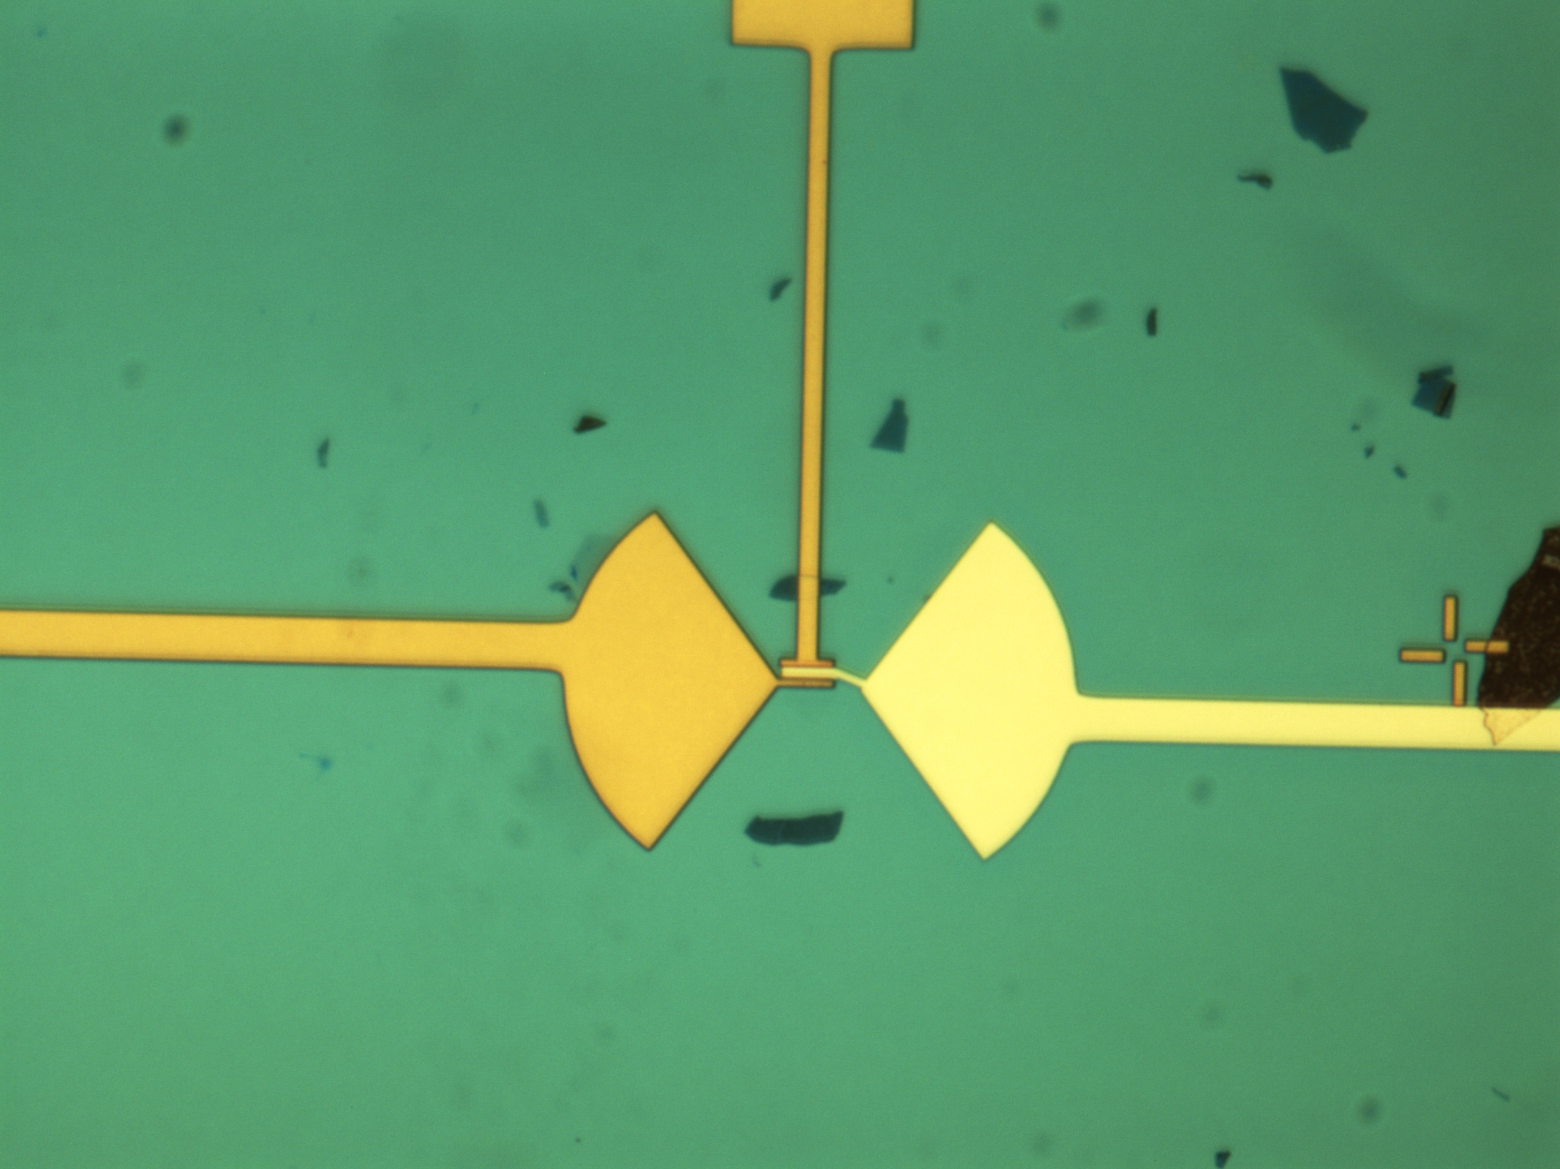

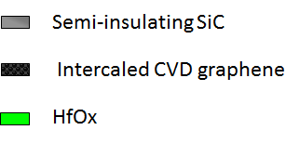
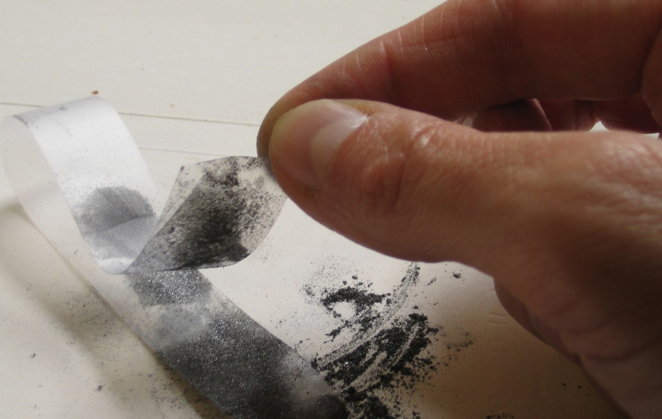
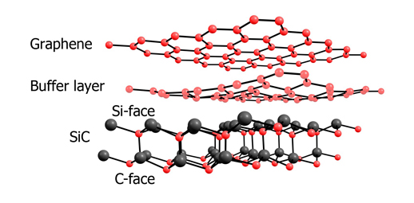
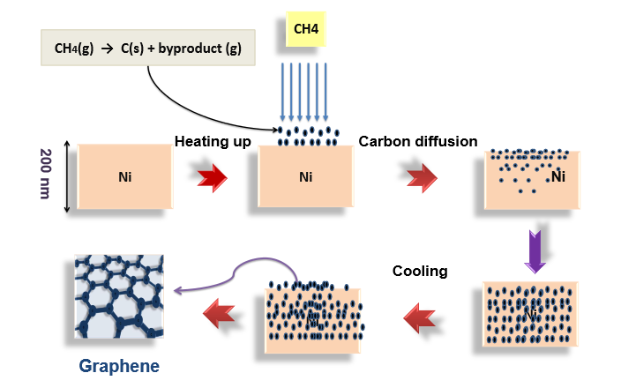
Antenna coupled Graphene-FET
Antenna Integration
D
Device development@NEST
S
G
G
S
Top-gate G-FET
D
D
Substrate
S
G
Graphene
HfOx
Broadband Asymmetric coupling
Exfoliated graphene
Epitaxial and CVD graphene
Epitaxial growth
CVD growth
LNF, 28/03/2017

Slide 15
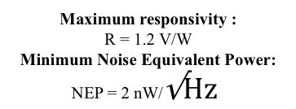

Antenna coupled Graphene-FET
D. Spirito, APL 2014
L.Vicarelli, Nat. Nano 2012
Exfoliated BL Graphene
Exfoliated SL Graphene
Maximum responsivity :
R = 0.05 V/W
Minimum Noise Equivalent Power:
NEP = tens of nW/$\sqrt{Hz}$
0.3 THz
Maximum responsivity :
R = 1.2 V/W
Minimum Noise Equivalent Power:
NEP = 2 nW/$\sqrt{Hz}$
Broadband detection
ΔU=C*σ⁻¹*dσ/dV_{G}
j = e ⟨n(t)·v(t)⟩_{2π/ω}
Photovoltage (a.u.)
C ~ 10⁻⁴ V²
efficiency of the antenna coupling and the FET impedance
CNP
= 1/R_{sd}
source/drain conductance
LNF, 28/03/2017

Slide 16
QCL radiation detection by GFETs
at 3.4 THz
Non-resonant plasma wave rectification
D
S
G
Maximum responsivity :
R = 1 V/W
Minimum Noise Equavalent Power:
NEP = 10 nW/Hz^{-1/2}
Detection speed:
250 kHz
Limit imposed by presently used experimental set up
Expected maximum speed > 1 MHz
LNF, 28/03/2017

Slide 17
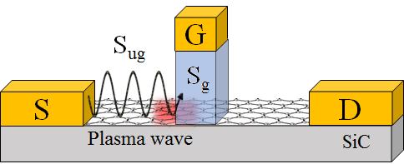
Epitaxial graphene FET
F. Bianco, APL 2015
Max responsivity R = 0.25 V/W
NEP = 80 nW/√Hz
2 Competing detection mechanism
p
ΔT
p/n
S_{ug}
S_{g}
LNF, 28/03/2017

Slide 18
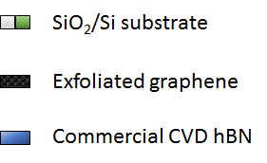

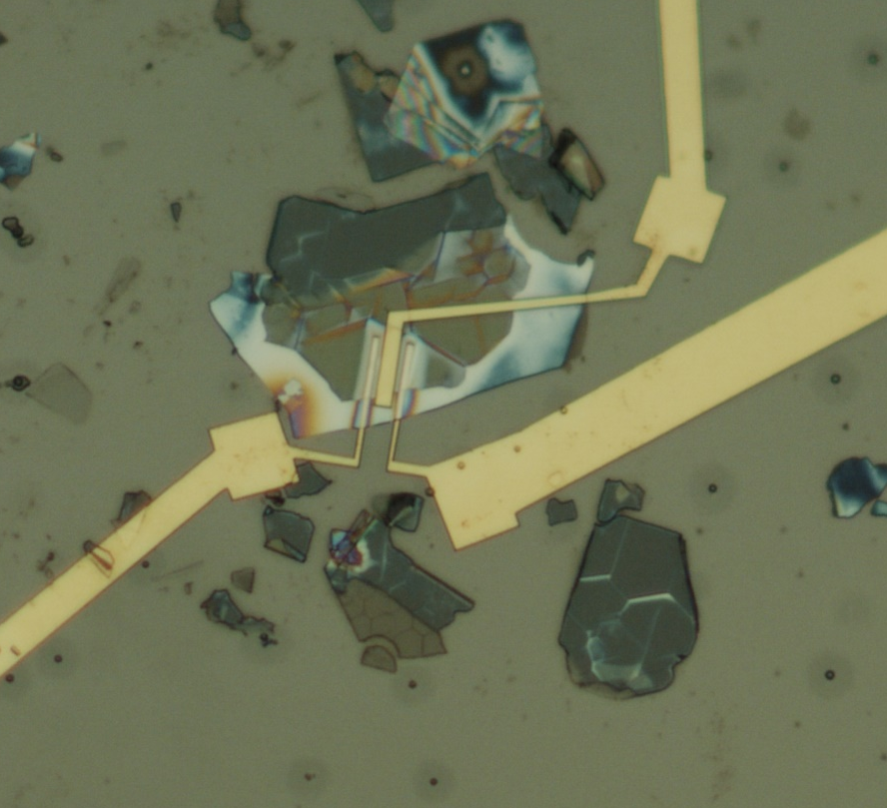
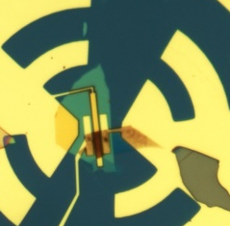
Resonant Detectors (work in progress)
Encapsulated graphene
Large scattering time, High mobility
Cr-seeded CVD grown
single crystal graphene array
Exfoliated hBN
Graphene on hBN
Top hBN
Cr
Graphene
Cu foil
G
45 nm-thick hBN flake
V_{sd} = 1 mV
Graphene
flake
hBN
flake
G
D
S
m = 33000 cm²/Vs
n₀ = 5.7×10¹² cm⁻²
R_{c} = 95 W
V_{d} = 3.7 V
S
D
15 nm-thick hBN flake
LNF, 28/03/2017

Slide 19
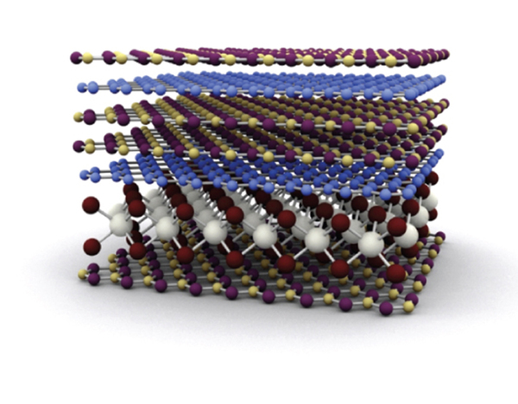
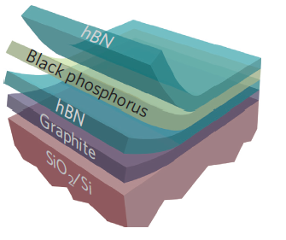
Van Der Waals Heterostructures:
the Flat Land
Improved material properties by
creating the «ideal» environment
BORON NITRIDE is a promising candidate:
Impervious to water and oxygen
High k dielectric
No dangling Bonds
Examples:
hBN/Graphene/hBN samples
hBN/BP/hBN Heterostructure
High Mobility
High Stability
[L.Viti, Adv. Mater. 2016]
µ > 10⁵ cm²/Vs
LNF, 28/03/2017

Slide 20
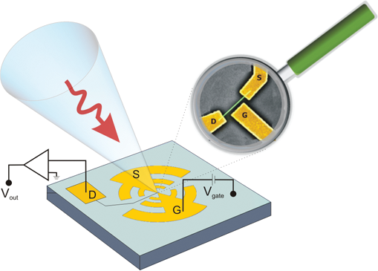
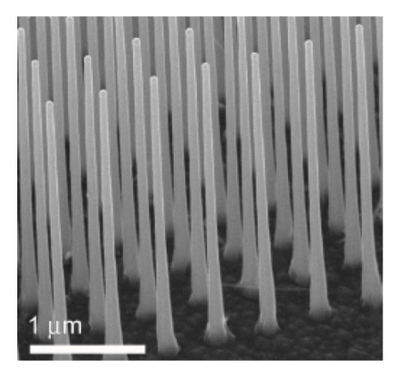
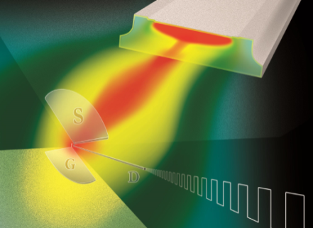
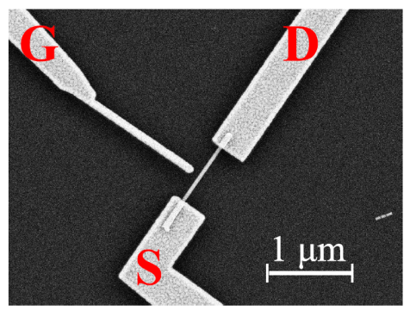
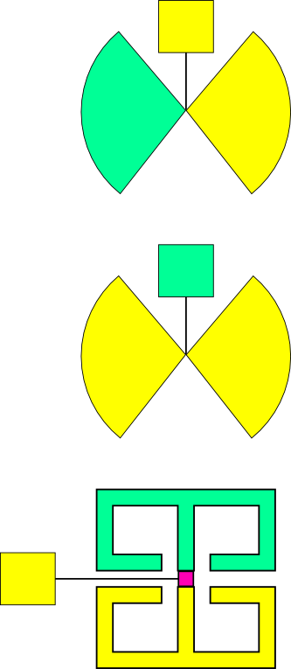
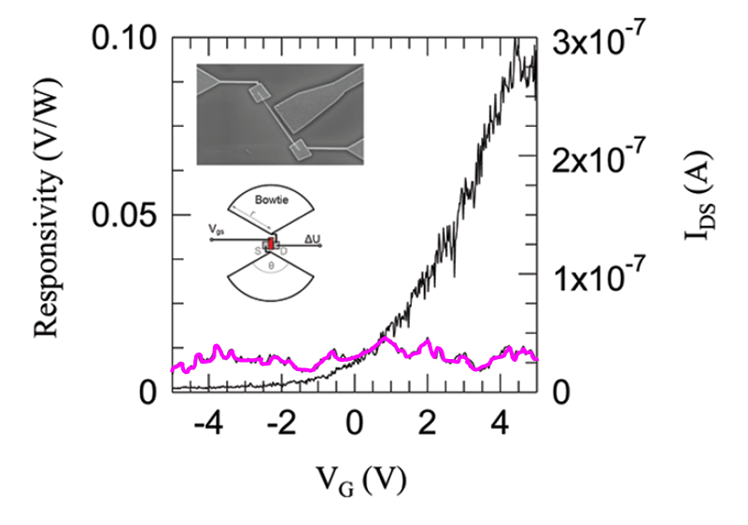
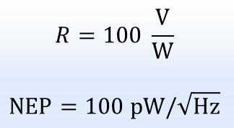
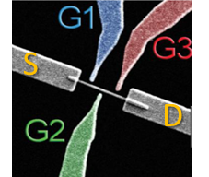
THz Detection in nanostructures: Nanowire-FETs
InAs NanoWires-FETs
V_{out}
Vg
Room temperature
THz detectors
0.3 – 3.5 THz range
Viti et al., Nanoscale Research Letters 7, 159 (2012)
Vitiello et al., Nano Letters 12, 96 (2012)
Optimization: materials, device design, antenna (Vitiello M.S., APL Materials 2015)
Homogeneous and Gradient-doped
tapered
InAs NWs
Asymm. Broad Band
300 GHz
Symm. Broad Band
Asymm. Narrow Band
LNF, 28/03/2017

Slide 21
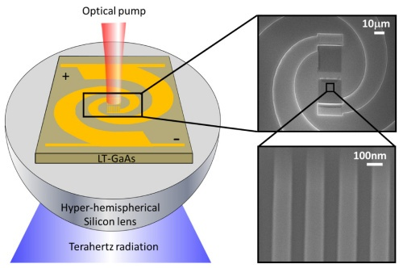
Sensing single photons at THz
Detector Scheme for free-space THz beams: quasi optical approach
Used also Photo-Conductive Antenna generators
THz beam is focused, collected and converted by the antenna
THz field is confined in a sub-wavelength region hosting the sensing element
bolometer phototransistor Schottky diode
for certain applications an ultimately high sensitivity reaching a photon-counting level is required (direct detection of dark matter in a region of the parameters space difficult to reach with different techniques)
in THz range E< 124 meV, λ> 10 µm: the single-photon detection is not trivial
With the available detector technologies, attainable sensitivities are currently far below the level of single-photon detection
LNF, 28/03/2017

Slide 22



Graphene Bolometers
Key points:
strong light-matter interaction and collective effects (plasma waves in the 2DEG)
Transport dominated by Hot-Carrier
Study on the thermal properties indicated the possibility to reach very high sensitivity as both a bolometer and as a calorimeter
T increase:
4 µm² channel, 100mK,
Superconding contatcts, el-phonon coupling very weak
…
General Advantages
Low Noise, Broadband absorption
Challenge: material purity, fabrication; many device contraints
LNF, 28/03/2017

Slide 23

Nanostructured systems for THz Photon Counting
quantum devices based on nanostructured semiconductors have demonstrated single-photon detection capabilities in the THz range
Classical photodetector
Isig=G_{pc}*e*(ηP_{in}/hν), G_{pc}<1 (gain)
R= I_{sig}/P_{in} = 8 A/W
1photon – 1 electron, E=124 meV
Responsivity is limited, some Gain enhancement is needed
LNF, 28/03/2017

Slide 24


Nanostructured systems for THz Photon Counting
quantum devices based on nanostructured semiconductors have demonstrated single-photon detection capabilities in the THz range
DQD Det.
Classical photodetector
1-QD charging by 1-photon abs
2-sensing the 1QD via conductance in QPC or SET
Komiama, IEEE JSTQE 2011,
See also F. Gatti talk
Novel nanostructure-based detector
Robust and reliable metrologies for single-THz photons are still lacking
Why not to implement device concepts on QD+new materials?
P_{in}10⁻¹⁸W
every skip is single photon!
Dark count 10⁻² s⁻¹
LNF, 28/03/2017

Slide 25

Conclusion
Detection demonstrated from 0.2 THz up to 3.4 THz in Semiconductor Nanostructures (2D systems, Graphene, Nanowires)
NW-FETs
Gr-FETs
LNF, 28/03/2017

Slide 26

Conclusion
Detection demonstrated from 0.2 THz up to 3.5 THz in Semiconductor Nanostructures (2D systems, Graphene, Nanowires)
NW-FETs
Gr-FETs
LNF, 28/03/2017

Slide 27
Conclusion
Detection demonstrated from 0.2 THz up to 3.5 THz in Semiconductor Nanostructures (2D systems, Graphene, Nanowires)
Detection signals related to plasma wave effects in the 2D electronic system, but also other contributions
Antenna, device design and material are degrees of freedom for detectors optimization
Present-days performances enabled most of room-T applications
Quantum confinement in nanostrucutured and/or intrinsic low-dimensional materials is a potential playground for photon counters in the terahertz range
LNF, 28/03/2017

Slide 28



Aknowledgments
Prof. Alessandro Tredicucci
Tredicucci’s Group@NEST, Federica Bianco
Miriam Vitiello, Leonardo Viti, THz Group@NEST
Camilla Coletti, Graphene Group@IIT NEST
LNF, 28/03/2017

Slide 29
Conclusion
Detection demonstrated from 0.2 THz up to 3.5 THz in Semiconductor Nanostructures (2D systems, Graphene, Nanowires)
Detection signals related to plasma wave effects in the 2D electronic system, but also other contributions
Antenna, device design and material are degrees of freedom for detectors optimization
Present-days performances enabled most of room-T applications
Quantum confinement in nanostrucutured and/or intrinsic low-dimensional materials is a potential playground for photon counters in the terahertz range
LNF, 28/03/2017

Slide 30

High mobility AlGaAs/GaAs heterostructure
with
Resonant plasmons: reduced electron-phonon scattering suppresses the plasmon-phonon decay channel
Heterostructure provided by CNR-IOM, Trieste, Italy
Notes:
In order to realize the condition for observation of resonant plasmons we used an ultra-high mobility AlGaAs/GaAs heterostructure, whose succession of epilayers is reported in this figure. The ultra high mobuility is needed to reduce phonon-electron scattering and increase the lifetime of the collective excitations. At 10 K the mobility is around 300000 cm2/Vs and for a 10 um plasmon microcavity, around 200 ghz, the decay time of plasma waves is almost 2 times the transit time of the microcavity, hence

Slide 31
Antenna integrated-HFET
S
G
D
(n) Al_{0.33}Ga_{0.67}As
Ohmic contact: evaporation of metal (Ge/Au/Ni multilayer )
and Rapid Thermal Annealing
Electrical isolation of devices: ion implantation
Gate contact: evaporation of Ti/Au
2 DEG
Undoped GaAs
Two perpendicolar linear dipole antenna: one connected to the source and drain terminals, and the other connected to the source and gate terminals.
S
50 μm
D
THz excitation of a “2DEG diode”
Two-terminal device with asymmetric design
Hydrodinamic regime of the ungated 2DEG in the investigated spectral range
50 μm
W
L_{g}
undoped GaAs
L_{SD}
substrate
10 μm
Notes:
The chosen design of the antenna, shown in this scanning electron microscope image, is two perpendicolar linear dipole antenna centered at 300 Ghz: one connected to the source and drain terminals, and the other connected to the source and gate terminals. Here is shown an image of the plasmon microcavity and these are the dimensions. Taking into account the frequency range of our tunable THz source Virginia diodes multipliers, which is 0.15 to 0.4 THz, we have designed a transistor with a distance between source and drain of L=10 um. The dimensions are limited by our technological capability. It is important to note that the gate is shifted towards the source contact and is very short compare to the source and drain lenght. In this way the plasmon dispersion is almost aneffected by the presence of the gate electrode.

Slide 32

Plasma wave devices
Electrodynamics equations for the 2DEG
F. Evangelisti, Journal of Applied Physics 114, 124506 (2013)
Equivalent Circuit:
The 2DEG impedance oscillates as function of frequency
LNF, 28/03/2017

