Slide 1
Josephson far-infrared photon detectors
based on temperature-to-phase-conversion
F. Giazotto
NEST, Istituto Nanoscienze-CNR & Scuola Normale Superiore, Pisa, Italy
Workshop on Axion Physics & Experiments
March 27-28 2017
Laboratori Nazionali di Frascati
Giazotto Research Group

Slide 2
Collaboration
Pauli Virtanen (NANO – CNR, IT)
Alberto Ronzani (LTL - Aalto University, FI)
Paolo Solinas (SPIN – CNR, IT)
Giazotto Research Group
Frascati, 28/03/2017

Slide 3
Outline
Motivations
Principle of photonic sensing based on T-to-ϕ transduction
Model
  JJ behavior
  Read-out weak-link behavior
Amplification: Superconducting Quantum Interference Proximity Transistor (SQUIPT)
T-to-I conversion & noise analysis
Nanocalorimeter operation:
  Thermal model, S/N ratio & resolving power
Nanobolometer operation:
  Thermal model, NEP
Conclusions & perspectives
Giazotto Research Group
Frascati, 28/03/2017

Slide 4
Motivations
Quantum technology: when quantum mechanics & nanotechnology
merge to boost future devices with enhanced capabilities
Quantum radiation detectors: accessing ultra-high sensitivity in
bolometric & calorimetric operation
Paving the avenue to fundamental physics research: quantum
computing, quantum criptography, entanglement, particle &
astroparticle physics, dark matter, cosmology
Giazotto Research Group
Frascati, 28/03/2017

Slide 5
T-to-ϕ transduction: operating principle
Radiation absorption (hν)
T_{e} enhancement in detector JJ
Suppression of circulating J current
Variation of phase drop across the WLs
Modification of DOSs
SQUIPT readout
Assumptions:
Short ( ) SNS JJ junctions:
Drastic reduction of detector volume 
Known analytical solusions for current and DOS
Enhanced response in the readout JJ
Fluxoid quantization
Giazotto Research Group
Frascati, 28/03/2017
P. Virtanen, A. Ronzani, and FG, arXiv:170305284v1, submitted

Slide 6
Model: Josephson junctions behavior (i)
Josephson supercurrent
Josephson supercurrent behavior
T_{e} time evolution
T_{e}-induced suppression of supercurrent (for Φ_{ext} ≠ 0)
Variation finite phase drop across the WLs
Conservation of circulating supercurrent
Fluxoid quantization in the interferometer
Giazotto Research Group
Frascati, 28/03/2017
P. Virtanen, A. Ronzani, and FG, arXiv:170305284v1, submitted

Slide 7
Model: Josephson junctions behavior (ii)
For
phase drop will occur predominantly across readout JJ
For
phase drop will occur predominantly across detector JJ
Giazotto Research Group
Frascati, 28/03/2017
P. Virtanen, A. Ronzani, and FG, arXiv:170305284v1, submitted

Slide 8
Model: readout weak-link behavior
DOSs in the SNS junctions
Phase-tunable minigap
Gapped metal (ϕ = 0)
Gapless metal (ϕ = π)
Sizable T_{e}-induced modulation of the DOS minigap
Giazotto Research Group
Frascati, 28/03/2017
P. Virtanen, A. Ronzani, and FG, arXiv:170305284v1, submitted

Slide 9
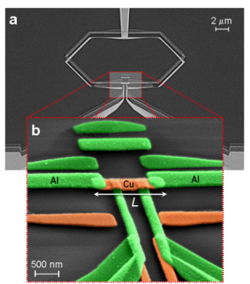
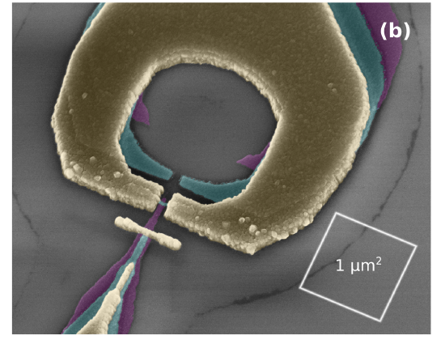
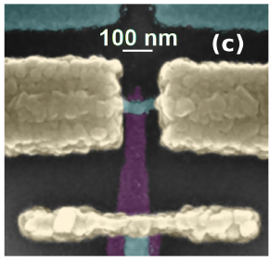
Model: SQUIPT response (i)
Superconducting quantum interference proximity transistor
Nature Phys. (2010)
PRB (2011)
PRB (2011)
PRAppl (2014)
APL (2015)
SQUIPT DOSs
SQUIPT I-V characteristics
Giazotto Research Group
Frascati, 28/03/2017
P. Virtanen, A. Ronzani, and FG, arXiv:170305284v1, submitted

Slide 10
Model: SQUIPT response (ii)
Current through the S tunneling probe
Current response with or without radiation
Absorption of a photon yields a reduction of tunneling current
Current response versus junctions asymmetry
Reduction of α yields a lowering of V₀
Giazotto Research Group
Frascati, 28/03/2017
P. Virtanen, A. Ronzani, and FG, arXiv:170305284v1, submitted

Slide 11
Model: T-to-I conversion & noise analysis (iii)
Temperature noise
Low-frequency current noise
T-to-I conversion and transfer functions
Temperature sensitivity
Giazotto Research Group
s_{T} as low as 10⁻⁸KHz^{-1/2} in the 10mK...1K range tunable with Φ_{ext}
Frascati, 28/03/2017
P. Virtanen, A. Ronzani, and FG, arXiv:170305284v1, submitted

Slide 12

Nanocalorimeter operation: thermal model (i)
After photon absorption
Photon absorption
heat equation
heat equation
E-ph heat
Electronic entropy in N
E-ph relax half-time
Giazotto Research Group
Electronic entropy in S
Frascati, 28/03/2017
P. Virtanen, A. Ronzani, and FG, arXiv:170305284v1, submitted
P. Virtanen, A. Ronzani, and FG, arXiv:170305284v1, submitted

Slide 13
Nanocalorimeter operation: S/N ratio & resolving power (ii)
S/N ratio
Resolving power
E-ph relaxation half-time
S/N ratio & resolving power behavior
S/N ratio ∼100 or above below 100mK
Resolving power > 100 for above 100GHz @ 10mK
Giazotto Research Group
Suited for microwave and FIR single-photon detection
Frascati, 28/03/2017

Slide 14
Nanobolometer operation: NEP
Steady-state thermal balance equation
E-ph heat exchange
NEP TFN
Thermal conductance
Giazotto Research Group
NEP below 10⁻²²WHz^{-1/2} @ 50mK
Frascati, 28/03/2017

Slide 15
Conclusions
T-to-ϕ conversion due to kinetic inductance changes & SQUIPT spectroscopy
Thermal sensitivity amplified by small thermal capacity (superconductivity & small
volume)
As electron thermometer: sensitivity up to tens of nK/Hz^{1/2} tunable with Φ in the
10mK…1K temperature range
Calorimetric mode: resolving power hν/δE > 10² for 50GHz…10THz photons
Bolometric mode: NEP ∼ 10⁻²² W/Hz^{1/2} below 50 mK
Attractive as MW and FIR radiation detector for open problems in
astrophysics & quantum electronic circuits
Giazotto Research Group
Frascati, 28/03/2017

Slide 16

Acknowledgements
FP7 ERC Consolidator grant agreement no. 615187 - COMANCHE
MIUR-FIRB2013–Project CoCa (grant no. RBFR1379UX)
FP7/2007-2013/REA grant agreement no. 630925 – COHEAT
Marie Curie Initial Training Action (ITN) Q-NET 264034
Giazotto Research Group
Frascati, 28/03/2017

Slide 17
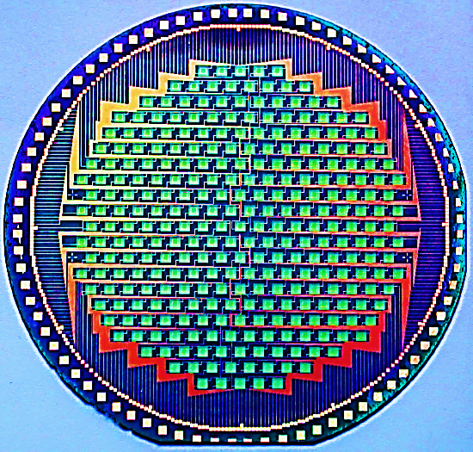
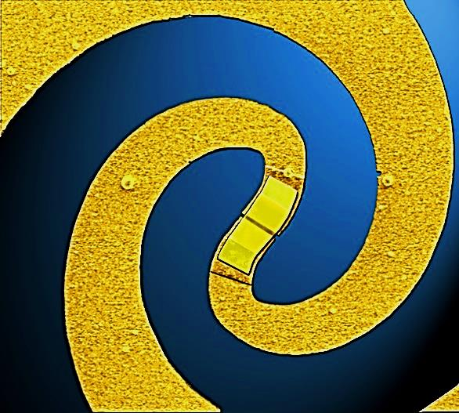
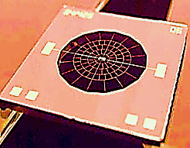
Towards detection of DM: STAX
THz Bolometer technology
APEX Camera LABOCA
Advanced HEB TU Delft
NASA/JPL-Caltech
Applications:
Human science
Archeology
Architectural heritage preservation
Pattern recognition
Safety
National security
Chemical safety
Natural disasters prevention
Natural disasters rescue
Air, water & earth pollution monitoring
Giazotto Research Group
Frascati, 28/03/2017

Slide 18
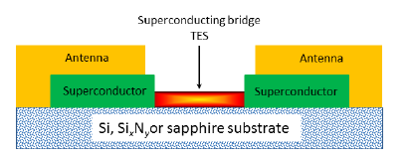

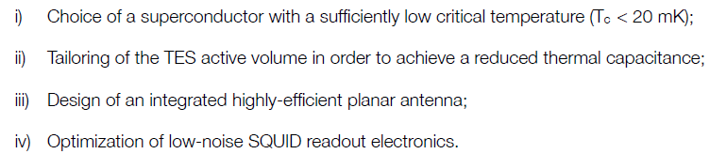
Sub-THz & mw single-photon detection in STAX
STAX: TES operating in the 30 GHz-150 GHz range
∝ T ^{3/2}Volume^{1/2}
TES energy resolution
Requirements:
Giazotto Research Group
Frascati, 28/03/2017

Slide 19
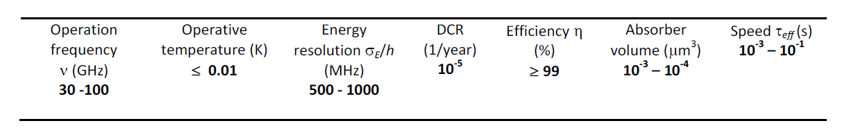
Sub-THz & mw single-photon detection in STAX
i) Choice of a superconducing bridge with low Tc (≤ 20mK)
(α-W, TiN_{X}, Ti/Cu, Ti/Au, or Al/Cu bilayers)
ii) Reduced TES active volume (down to 10⁻³-10⁻⁴μm³)
iii) EBL to downsize TES lateral dimensions to a few tens of nm
iv) Highly-efficient log-period spiral antennas (NbTi, Nb, or V)
v) ultra-low noise dc SQUID amplifiers (n_{I}∼10 fAHz^{-1/2} @100mK)
STAX TES calorimeters expected performance:
Giazotto Research Group
Frascati, 28/03/2017

