Slide 1
& OLD
New ideas for resonant cavities
David Alesini
(INFN-LNF, Frascati)
With the contribution of all QUAX collaboration

Slide 2
OUTLINE
1) Design guidelines of high frequency (15-30 GHz) passive RF cavities in high magnetic fields (QUAX-type, ADMX-like cavities):
-Modes of operation
-coupling, tuning
-quality factor
-….
2) Superconducting, normal conducting and mixed cavities
3) Cavities with dielectrics
4) Few considerations on
active cavities (with power)
from Particle Accelerator world…

Slide 3
Design requirements for passive cavities in high magnetic fields: the dream cavity
High frequency means small volumes, if we increase the volume of the cavity we have to work with higher order modes and the comb of resonant modes became very dense
a) Resonant cavities in the range 10-30 GHz
b) Quality factor of the order of 10⁶
c) Wide tunability range of the order of 1 GHz (to explore different axion masses)
d) Working in high magnetic field (5-10 T)
e) The magnetic field has to penetrate inside the volume of the cavity
f) With critical coupling
g) Uniformity of the magnetic field along the axis (QUAX)
h) Single mode cavity
i) Large resonating volumes (up to a 1 dm³)
Strong
magnet
High Q
cavity
AXION
search
Low noise Amplifier
Large
volume
cavity
Image: Ohjoon Kwon

Slide 4
Design requirements for passive cavities in high magnetic fields: the dream cavity
High quality factors require, in principle, SC cavities that do not couple with high magnetic field and, moreover, the magnetic field is expelled from the cavity in the transition between the NC state and the SC state (with differences between zero field cooling ZFC and field cooling FC…)
a) Resonant cavities in the range 10-30 GHz
b) Quality factor of the order of 10⁶
c) Wide tunability range of the order of 1 GHz (to explore different axion masses)
d) Working in high magnetic field (5-10 T)
e) The magnetic field has to penetrate inside the volume of the cavity
f) With critical coupling
g) Uniformity of the magnetic field along the axis (QUAX)
h) Single mode cavity
i) Large resonating volumes (up to a 1 dm³)
Strong
magnet
High Q
cavity
AXION
search
Low noise Amplifier
Large
volume
cavity
Image: Ohjoon Kwon

Slide 5
Design requirements for passive cavities in high magnetic fields: the dream cavity
This require the insertion of metallic plungers and/or dielectrics rods but avoiding perturbation of the field uniformity that is important for the QUAX experiment (uniformity on the region where magnetic materials are inserted)
a) Resonant cavities in the range 10-30 GHz
b) Quality factor of the order of 10⁶
c) Wide tunability range of the order of 1 GHz (to explore different axion masses)
d) Working in high magnetic field (5-10 T)
e) The magnetic field has to penetrate inside the volume of the cavity
f) With critical coupling
g) Uniformity of the magnetic field along the axis (QUAX)
h) Single mode cavity
i) Large resonating volumes (up to a 1 dm³)
Strong
magnet
High Q
cavity
AXION
search
Low noise Amplifier
Large
volume
cavity
Image: Ohjoon Kwon

Slide 6
Design requirements for passive cavities in high magnetic fields: the dream cavity
If we work with SC cavities the quality factor depend on the temperature, frequency and applied magnetic field. In this case one has to have the possibility to tune the coupling in order to be always in critical one.
a) Resonant cavities in the range 10-30 GHz
b) Quality factor of the order of 10⁶
c) Wide tunability range of the order of 1 GHz (to explore different axion masses)
d) Working in high magnetic field (5-10 T)
e) The magnetic field has to penetrate inside the volume of the cavity
f) With critical coupling
g) Uniformity of the magnetic field along the axis (QUAX)
h) Single mode cavity
i) Large resonating volumes (up to a 1 dm³)
Strong
magnet
High Q
cavity
AXION
search
Low noise Amplifier
Large
volume
cavity
Image: Ohjoon Kwon

Slide 7
Basic Geometry: Cylindrical cavity working on TM_{xx0} mode
⇒Simple design
⇒RF field uniform along the longitudinal coordinate (0 ⇒no variation on z)
⇒Resonant frequency fixed by the radius of the cell (a)
⇒cylindrical symmetry of the structure (⇒ cylindrical symmetry of DC induced currents in the SC)
x
ϕ
r
z
RF B_{cav}
B_{ext}
DC B_{ext}
RF E_{cav}
a
DC B_{ext}
y
TM₁₁₀
(QUAX)
TM₀₁₀
(ADMX-like)
L
H
H
E
E

Slide 8
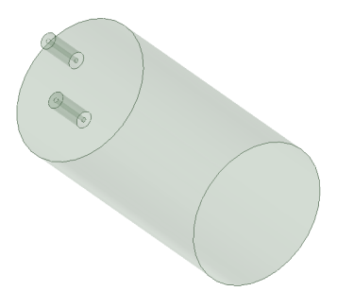
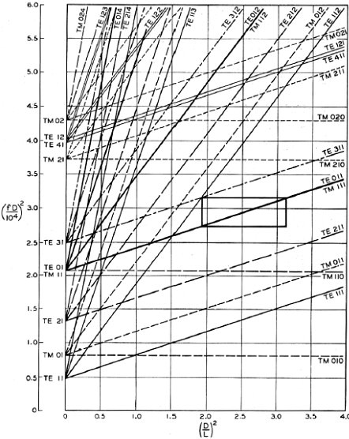
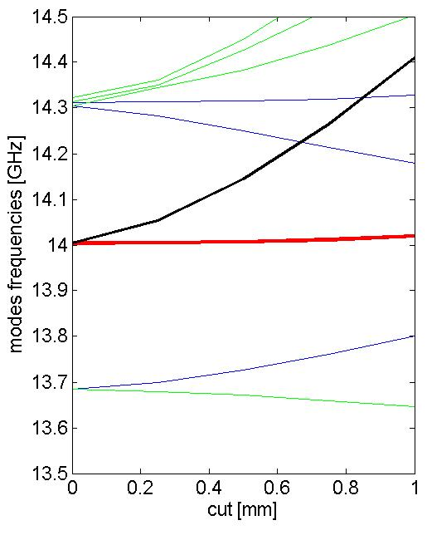
Cylindrical cavities working on TM₁₁₀ mode:
NEAREST MODES AND MODE DEGENERATION REMOVAL
L=50.3 mm
⇒To increase the volume of the cavity (for YIG or other material insertion) we have to increase the cavity length.
This increase the number of nearest modes (hybridization can couple different modes?)
D=26.1 mm
f_{res}=14 GHz
⇒There are, in principle, infinite TM₁₁₀ dipole modes that can be excited with different tilted polarities.
⇒It is necessary and useful to remove this degeneration for several reasons.
⇒this can be done by cutting the structure
Working mode
Other polarity
Working mode
Separation with other modes
(D/L)²≅0.26 in our case
Mode frequencies in GHz
1 7.368 (D)
2 8.802 (TM₀₁₀)
3 8.996 (D)
4 9.293
5 10.630
6 11.196 (D)
7 11.568 (D)
8 12.547
9 12.668 (D)
10 13.693 (D)
11 14.025 (TM₁₁₀)
14.314 (D)
cut

Slide 9
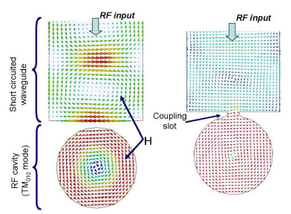
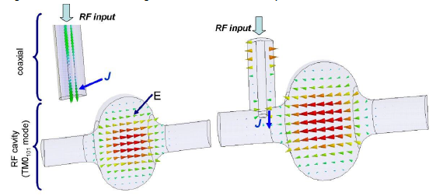
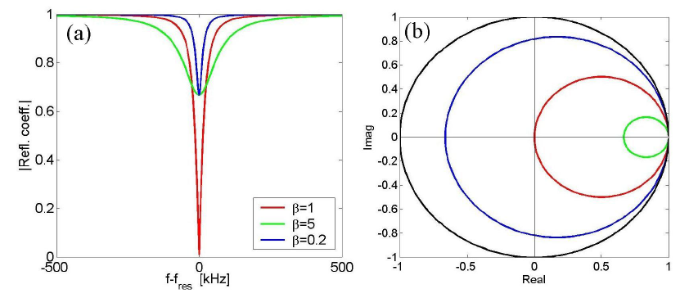
COUPLING TO CAVITIES
Magnetic coupling
Electric coupling
Reflection coefficient for different β
Coupling coefficient

Slide 10
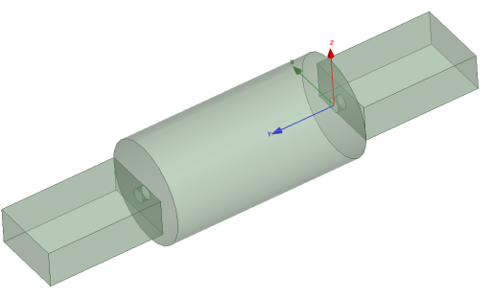
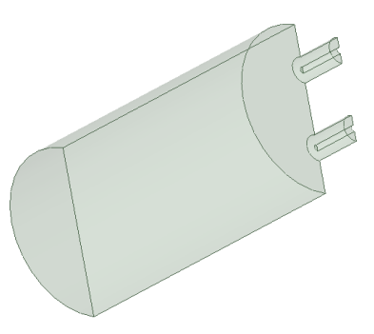
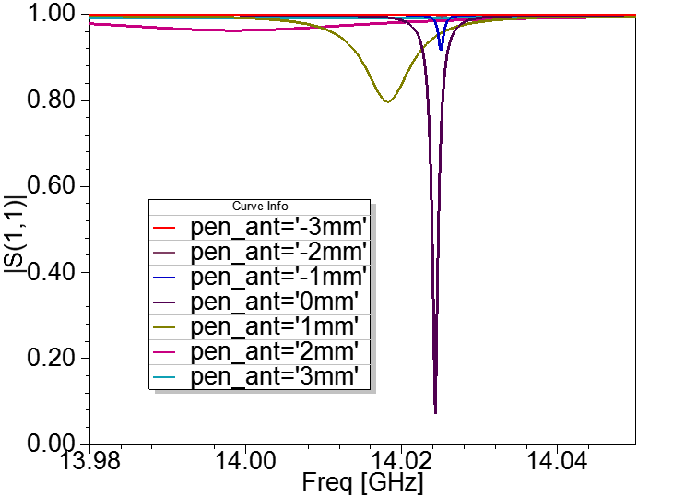
Cylindrical cavities working on TM₁₁₀ mode:
COUPLING
⇒We can couple to the mode in several ways
The coupling can be varied in a wide range changing the penetration of the antenna into the structure
Magnetic coupling
Antenna penetration
Electric coupling
One of the two probe (or waveguides) is critically coupled while the other one is undercoupled and allow measuring the mode properties in transmission
NB not all nearest modes are coupled with the probe or waveguide but hybridization can introduce mode mixing if the modes are not sufficiently separated in frequency (?)

Slide 11
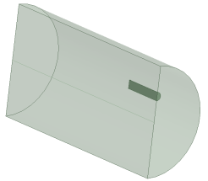
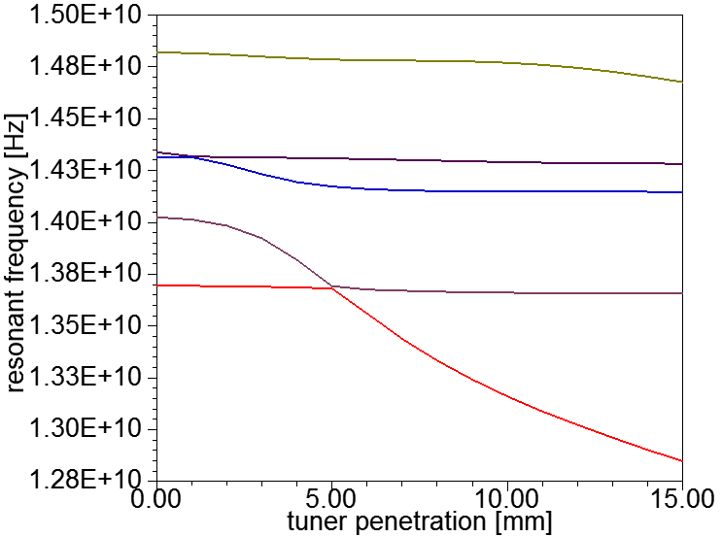
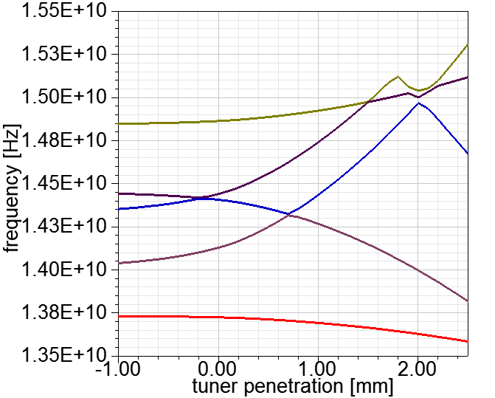
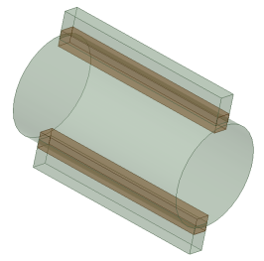
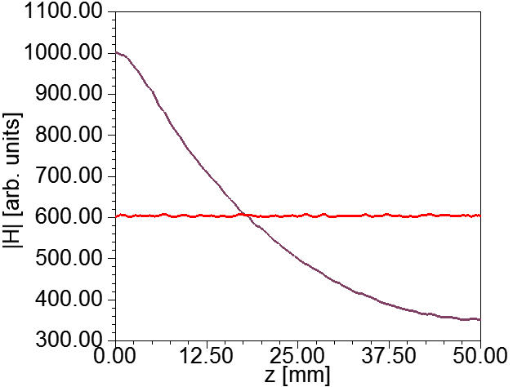
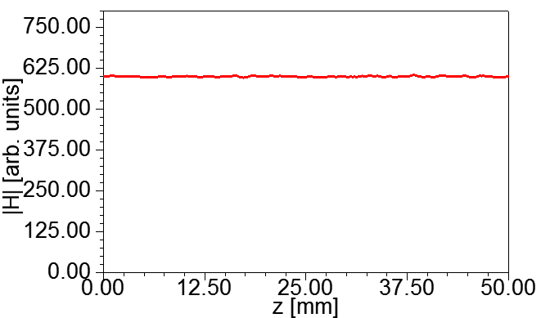
Cylindrical cavities working on TM₁₁₀ mode: RESONANT FREQUENCY TUNING
There are different possibilities to change the resonant frequency of the mode but the uniformity of the field has to be preserved
Sapphire Rod
Metallic tuner on the outer volume
Working mode
Working mode

Slide 12
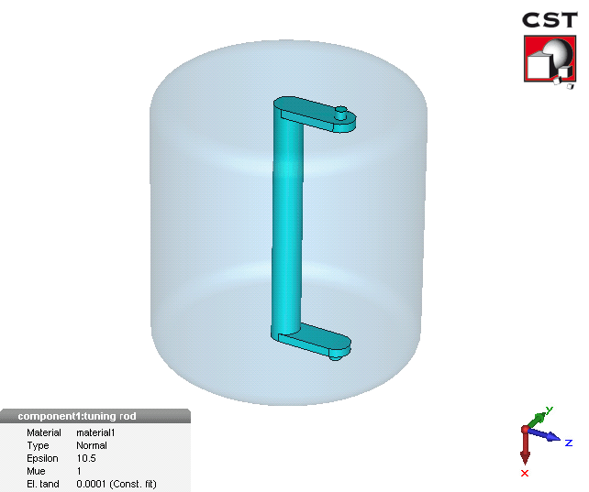
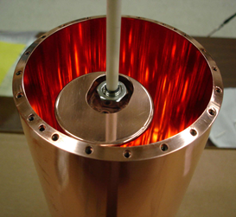
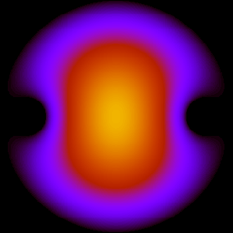
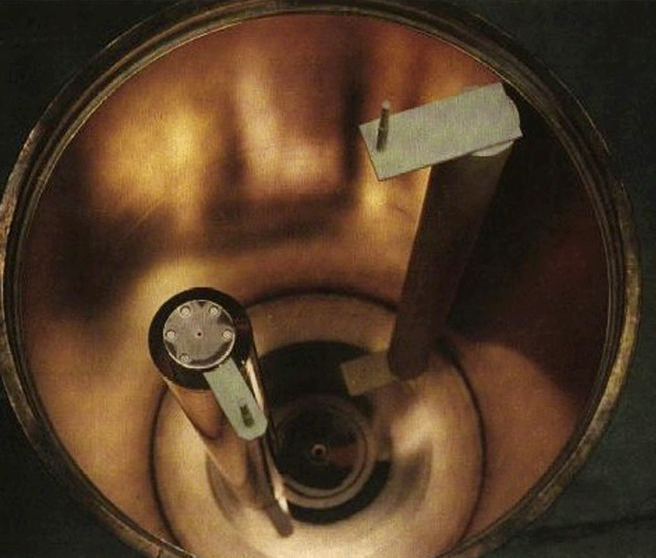
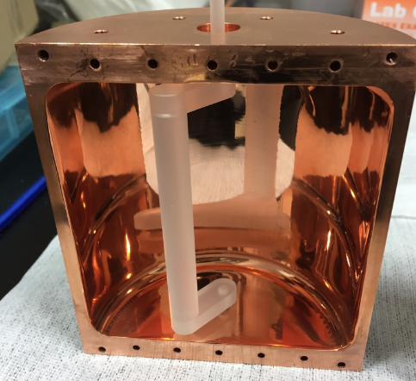
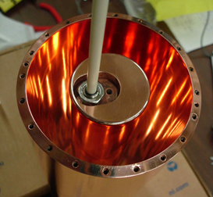
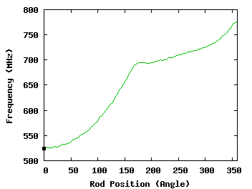
Cylindrical cavities: RESONANT FREQUENCY TUNING WORLDWIDE
Dielectric rod: sapphire
Metallic rod
Ohjoon Kwon, et al. KAIST, Korea
ADMX experiment
Images taken from: http://depts.washington.edu/admx/cavity.shtml#
Ben Brubaker
Yale University 5.7 GHz
Tuning range: 2.1-2.5GHz

Slide 13
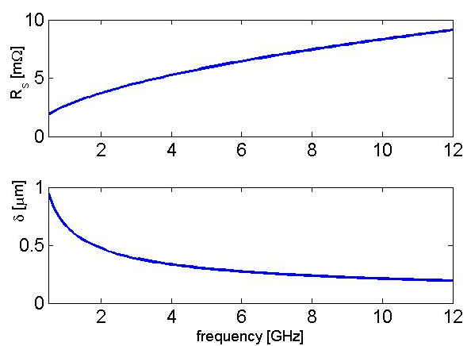
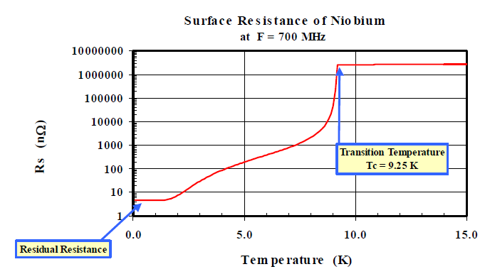
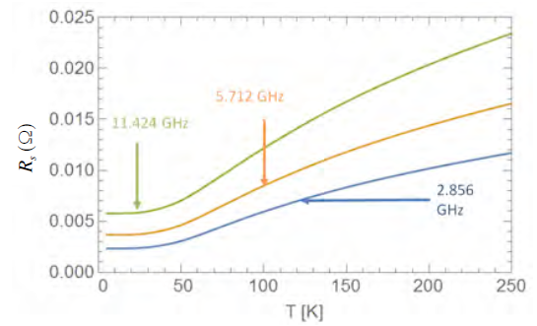
MATERIALS FOR CAVITY FABRICATION
Normal conducting materials
SUPER conducting materials
Model valid for T<T_{c}/2 and below few GHz
The microwave surface resistance of a normal metals is expressed by:
For copper: σ=5.8x10⁷ S/m⇒R_{s}(@1 GHz)≅3mΩ, δ<1 μm
At cryogenics temperatures and high frequency, the “anomalous skin depth effect” limits the quality factor.
Courtesy H. Safa,
Model not valid if the SC is inserted into high magnetic field!
Which is the correct model of the surface resistance for SC exposed to H field and RF field at 15-30 GHz? (R. Vaglio/S. Calatroni model to be implemented and properties of material such as Nb Ti or Nb3Sn to be measured)
Courtesy J. Rosenzweig

Slide 14
CHOICE OF MATERIAL FOR cavities working IN HIGH MAGNETIC FIELD
NC: Copper
SC: Nb Ti
PROS
CONS
PROS
CONS
⇒arbitrary H fields can be applied
⇒H field (DC) can penetrate inside the cavity volume
⇒Low cost, simple fabrication (brazing, welding,…)
⇒Low quality factor even at cryogenic temperatures (6-8x10⁴ because of the anomalous skin depth effect)
⇒High quality factor ∼10⁶ (to be measured at 15 GHz)
⇒H fields below H_{c2} can be applied. Q-factor deterioration when H field are applied (between H_{c1} and H_{c2}) (no model for R_{s}, measurements to be done, preliminary results on Nb).
⇒external H field can, in principle, penetrate inside the cavity volume but measurements of the field penetration and uniformity have to be done (different regimes ZFC and FC can be explored).
POSSIBLE SOLUTIONS
Cut on the cavity wall to interrupt surface DC currents that obstacle the penetration of the H field into the cavity (measurements to be done)
Two copper plates to allow penetration of the H field
B_{ext}
B_{ext}

Slide 15
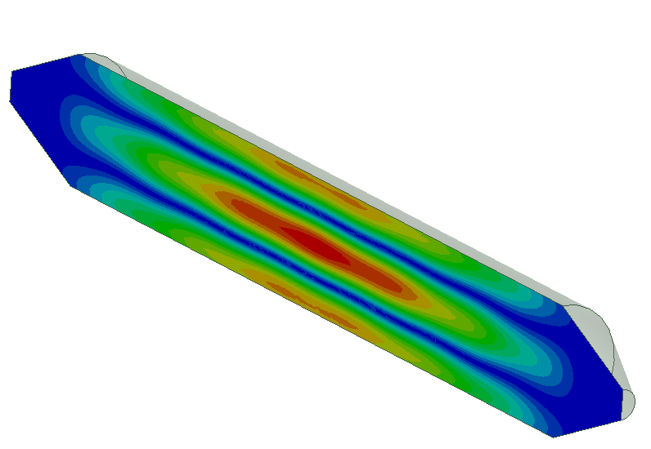
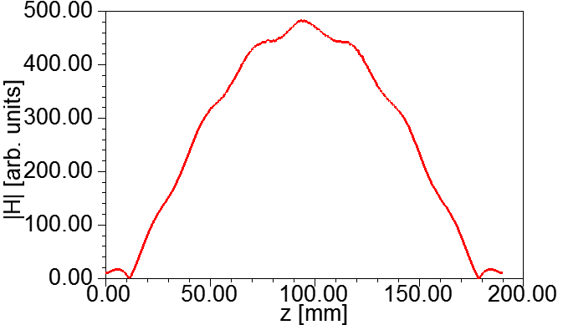
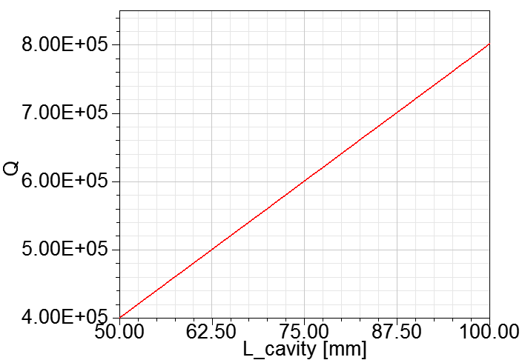
Cylindrical cavities working on TM₁₁₀ mode: CUT AND COPPER CUP TO ALLOW PENETRATION OF THE EXTERNAL H FIELD
SC
Cut works for the RF field
Cu
No surface currents
Dissipation
J_{surf}
To minimize the copper dissipation it is possible to increase the cavity length to increase the ratio W/P_{diss} and/or introduce cones in which the field is below cutoff thus reducing the losses on Cu
50 mm
10% variation
13.69 GHz
14.02 GHz
14.31 GHz
13.76 GHz
14.02 GHz
14.10 GHz
Q_{Cu_plates}=4x10⁷

Slide 16
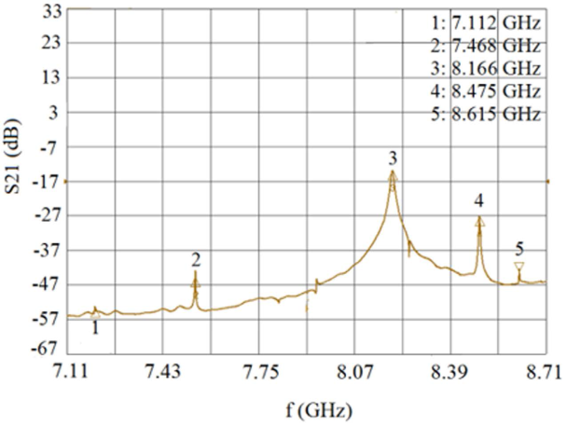
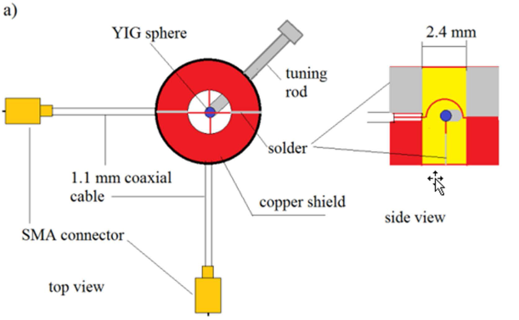
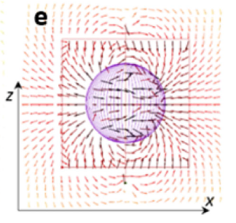
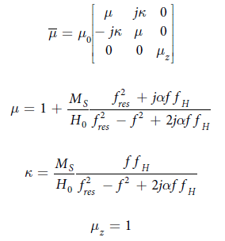
OPEN QUESTION: HOW TO CORRECTLY MODEL YIG MATERIAL AND THE FINAL FIELD CONFIGURATION OF HYBRID MODES?
These type of materials are used for tunable microwave filters and the modeling of the e.m. field into the material is not trivial but would be very useful to understand the real configuration of the field into the cavity and sphere in case of hybridization.
If a uniform static magnetic field is applied along the z-axis of a cylindrical or Cartesian coordinate system, then the permeability tensor for this material takes the following form:

Slide 17
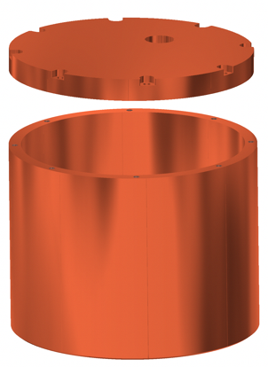
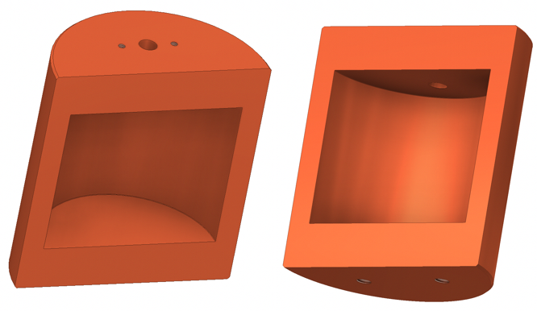
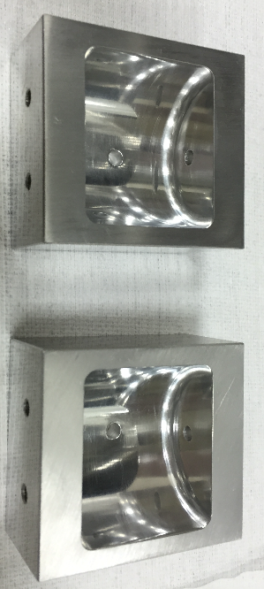
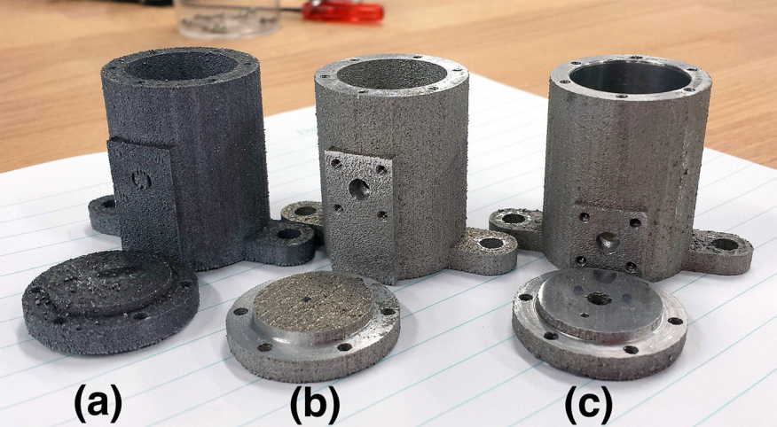
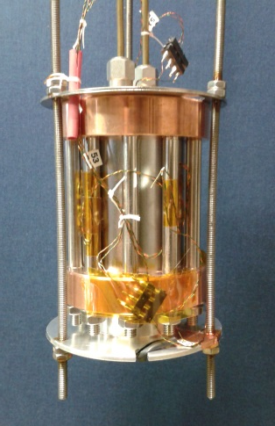
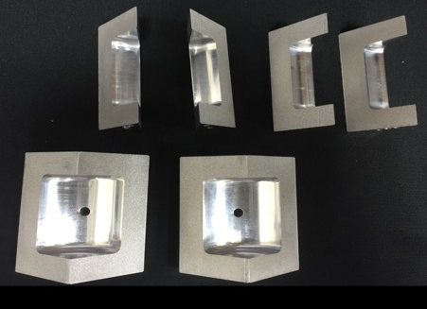
Cylindrical cavities: REALIZATION ISSUES
1) Clamping
4) 3D printing
Ohjoon Kwon, et al., KAIST, Korea
QUAX
2) Electron Beam Welding
5) Thin Coating on Cu or other substrates
Ian Stern, Hybrid cavities for ADMX
3) Brazing (?)
It can help in high magnetic field regime?

Slide 18
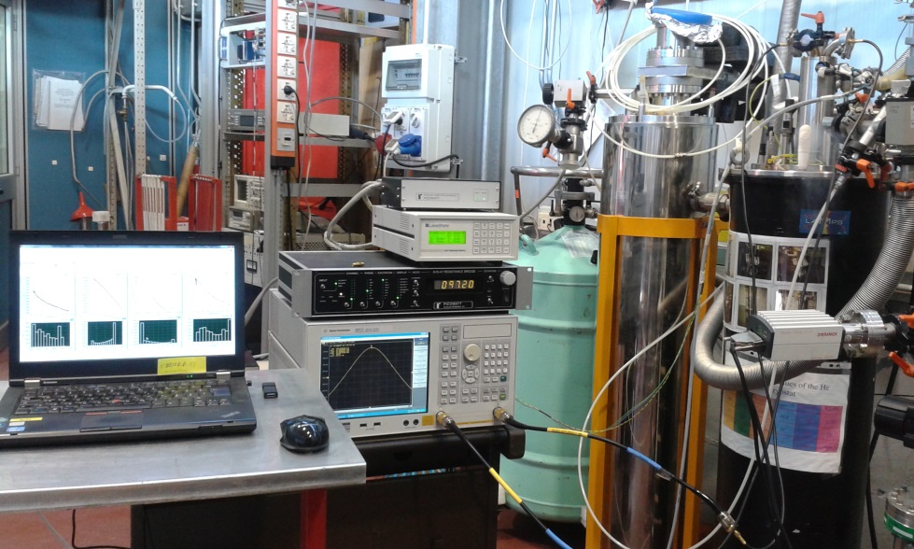
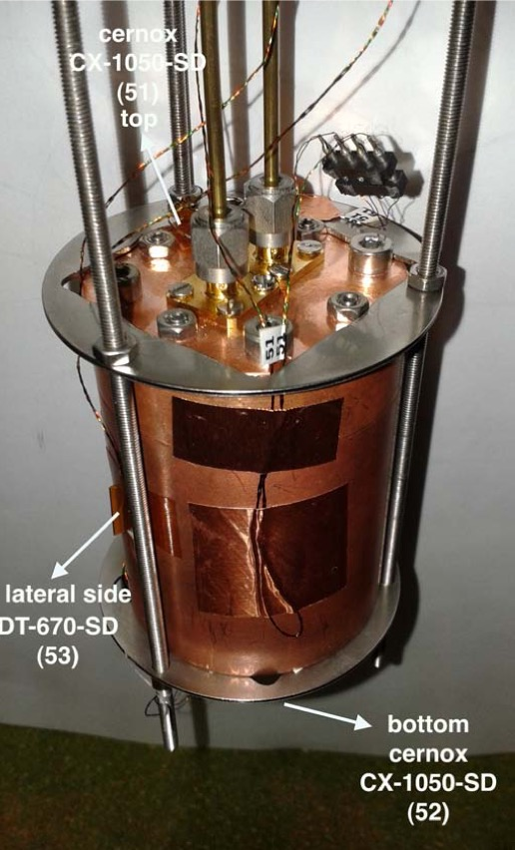
EXPERIMENTAL ACTIVITIES ON SC CAVITIES IN HIGH MAGNETIC FIELD AT LNF (QUAX)
QUAX Experiment
LNF Activities: measurements of NC and SC properties (at cryogenics temperatures) under magnetic field (work in progress).
Nb
Cu
Cavities fabricated and pre-tested at LNL
D. Di Gioacchino

Slide 19
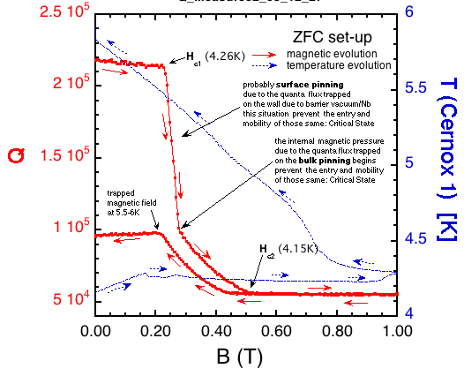
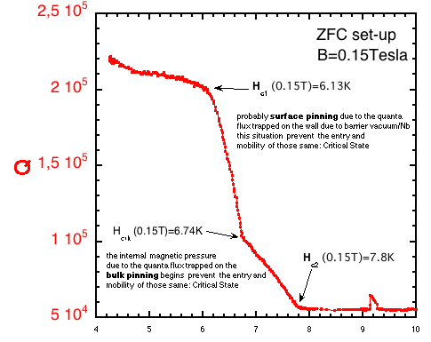
FEW EXPERIMENTAL RESULTS
Cu @ ∼6 K
Q/10⁴
H [T]
Effect of DC magnetic field on anomalous skin depth effect
t [s]
WORKPLAN
⇒B field measurements inside the Nb cavity (without closing cups) with and without the surface cut to avoid surface currents: meas. Of H field penetration and uniformity
⇒Q map Nb cavity (FC and ZFC) with Cu cups and with cut
H_{c2}
Nb ZFC
H
H_{crit}
H_{c1}
T_{c}
T

Slide 20
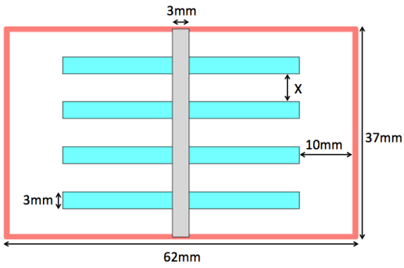
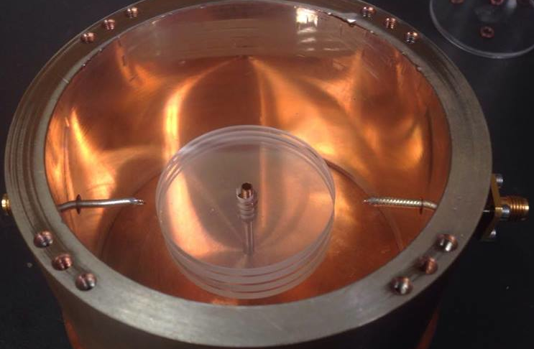
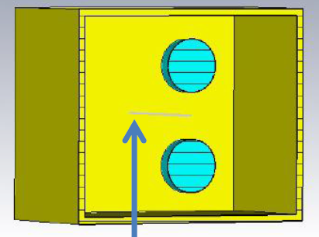
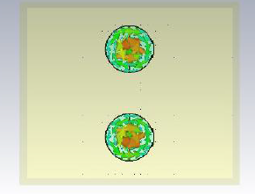
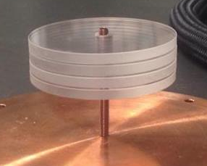
Cylindrical cavities working on TM₀₁₀ mode:
ADMX-like cavities
RF E_{cav}
DC B_{ext}
⇒The field uniformity is less stringent (frequency tuning with rods deforming the field configuration is possible).
⇒All other considerations on Q factor, field penetration still works
⇒cavities with dielectrics can be used (no needed space for magnetic material insertion): dielectrics with high ε_{r} allow concentrating the RF field into the dielectrics thus reducing the dissipation on the magnetic walls.
sapphire disks
For QUAX experiment does not work properly.
High Q factors
Field concentrated in the dielectrics
Q₀=10⁶
S. Gallo/G. Ruoso

Slide 21
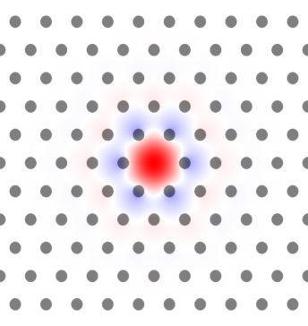
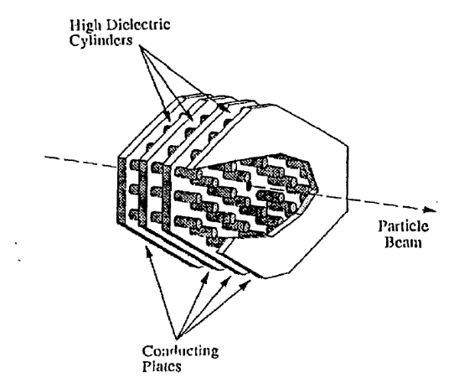
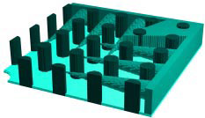
OTHER MORE “EXOTIC” CAVITIES:PBG
Photonic bandgap cavities PBG (Nathan Woollett, LLNL)
⇒Dielectrics Periodic structures can produce bandgaps in photon propagation like electrons in an atomic lattice.
⇒Defects in the structure can be used to create waveguides, resonant cavities and other features.
⇒With suitable choice of material Q’s similar to those of superconducting cavities can be achieved.
⇒application of magnetic fields relatively straight forward.
⇒Multiple cavities can be linked to create larger resonating structures (?).
⇒Coupling into the structures and tuning the structure is non-trivial.
⇒Small volume of the cavities.
Considered for particle accelerators because the HOM can propagate and wakefields are reduced

Slide 22
ACTIVE CAVITIES WORKING ON TM MODES…FROM PARTICLE ACCELERATOR WORLD (SW CASE)
Multi-cell cavities are used in particle accelerator to accelerate (TM₀₁-like modes) or to deflect (TM₁₁-like modes)
Structures can be Standing Wave (SW) or Travelling Wave (TW).
N cell Multi-cell SW cavities have N Modes distributed in frequency on the dispersion curve of the “iris loaded waveguide”. The maximum number of cells is typically limited to 10-15 because of mode overlap.
Average dissipated power that can be easily managed are of the order of few kW/m.
Maximum electric field for copper cavities that can be reasonably sustained are of the order of 50-100 MV/m with ten of MW/structure in pulsed regime (klystron).
P _{RF in}
E_{z}
z
f_{res}
Δf_{res_π}
0 mode
π mode
E_{z}
E_{z}
z
z
0 mode
π/2 mode
π mode

Slide 23
ACTIVE CAVITIES WORKING ON TM MODES…FROM PARTICLE ACCELERATOR WORLD (TW CASE)
P _{RF in}
P _{RF out}
TW structures can be of hundred cells (meters)
The dispersion curve has limited bandwidth
The phase velocity of the field can be also equal to c (differently from uniform waveguides)
Average dissipated power and maximum electric field are similar to SW structures
P _{RF TW}
E_{z}
z
ω
ω_{RF}
k*
π/D
k

Slide 24
CONCLUSIONS
Main guidelines for design of high frequency cavities, working on magnetic field have been investigated: modes, frequency and coupling tuning, mode degeneration removal, dissipation,… problems and possible solutions in using SC cavities have been also addressed
Measurements of Q factors of SC cavities in high magnetic field (Nb, NbTi, cut on surface, Cu cups,…) started and are still in progress
Measurements of penetration of H field inside the material have to be done to guide the final electromagnetic design of the cavity
Dielectrics can be used for ADMX-like experiment but not for experiments that require field uniformity and space for insertion of magnetic material (like QUAX)
Main features of cavities from accelerator world for powered cavities have been illustrated

Slide 25
ACKNOWLEDGEMENTS
All QUAX colleagues and in particular:
C. Gatti, D. Di Gioacchino, C. Ligi, M. Iannarelli, G. Lamanna (LNF)
G. Carugno, C. Braggio, C. S. Gallo (Padova)
A. Ortolan, N. Crescini, G. Ruoso (LNL)
U. Gambardella (Napoli)
THANK YOU FOR YOUR ATTENTION!

