Slide 1





ITS Upgrade Activity at Frascati
Federico Ronchetti
INFN-Laboratori Nazionali di Frascati
ALICE Meeting 21/02/2017

Slide 2
Activity Status
Additional vacuum pump and inverted: ongoing, to be checked
General conditioning system: present compressor 11 kW (broken), requested 20 kW: submitted to Technical Division
Common vestibule furniture: to do
Drier and air filter for secondary compressor: ongoing, to be checked
Half Stave welding station: see next slide
ALICE local computing cluster: ongoing, submitted to Computing Service, meeting today 14:30
Transport to Torino: all items identified, except “red Alcaplus jig”
  Scheduled for beginning of March (Mauro Rossi)
EcoBond glue: to be picked up at CERN

Slide 3
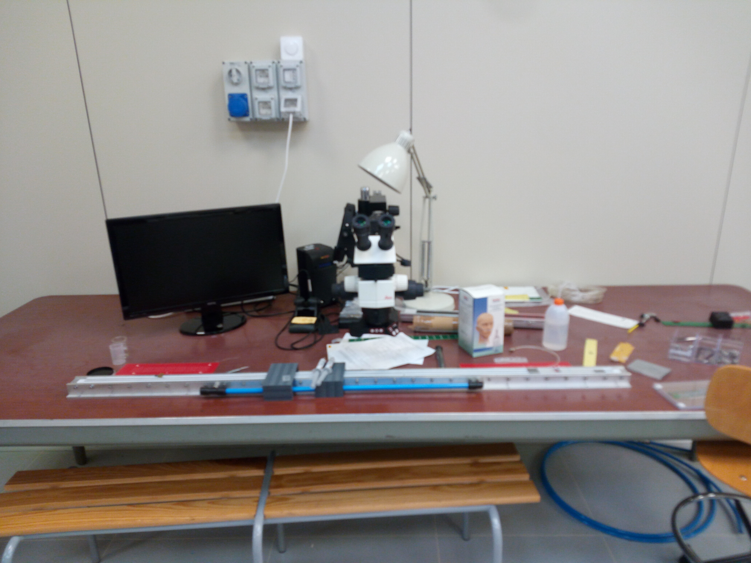
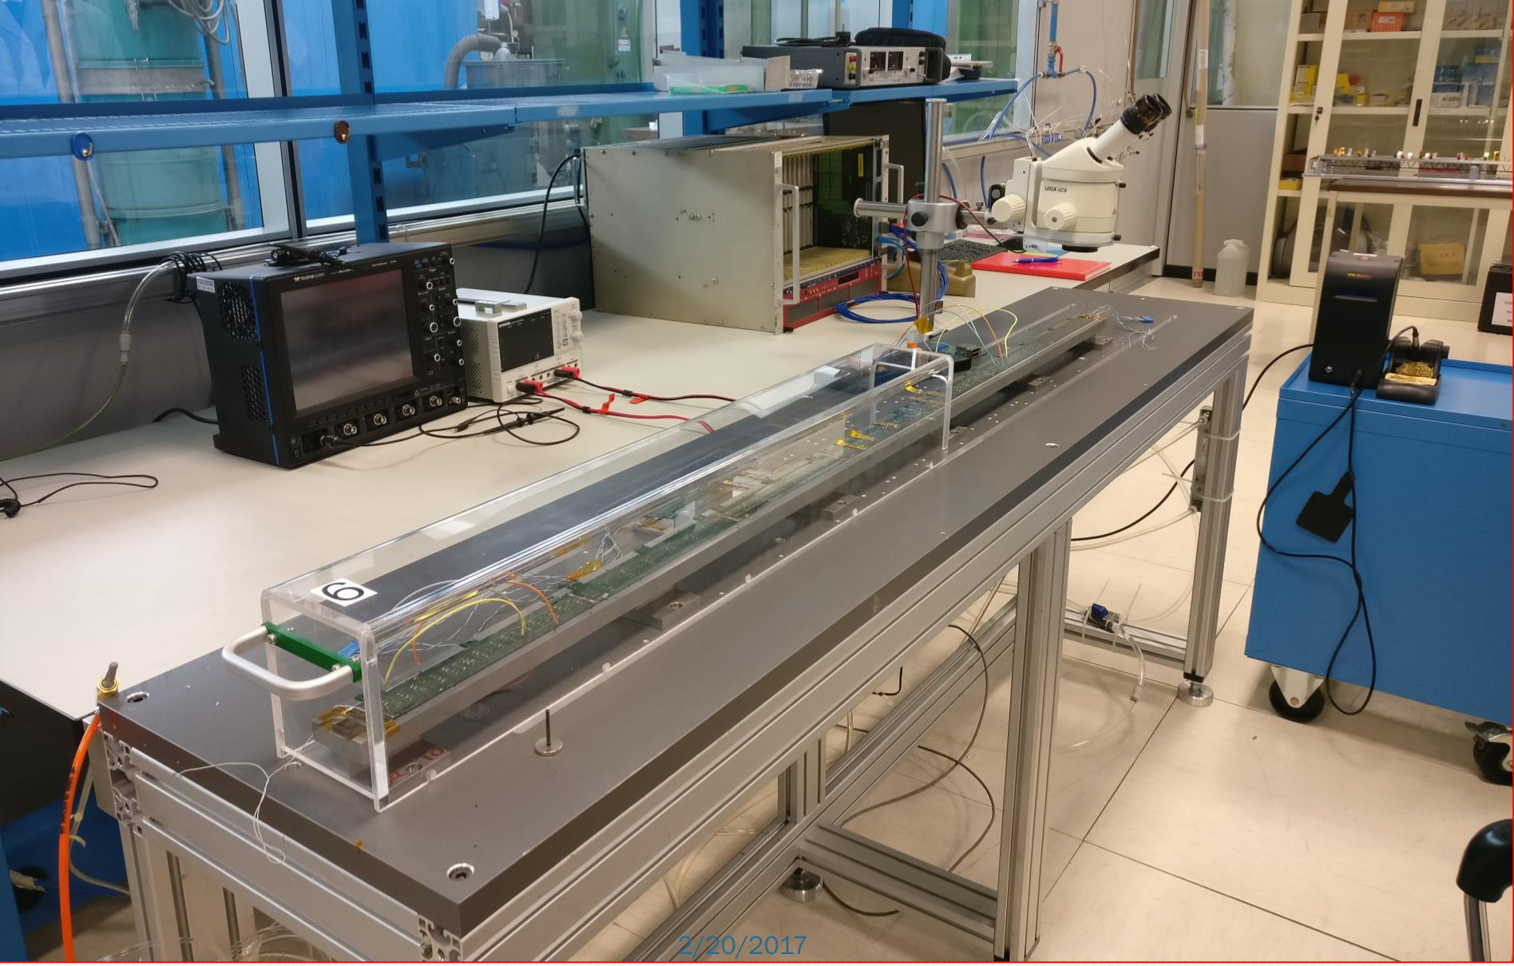
Infrastructure
LNF
Fixed welding point
Fixed microscope
Torino
Fixed HS bar
Moving welding point
Moving microscope
Potential issue with the LNF setup:
Mosaic readout needs to be performed at some point (to be clarified)
If each HIC needs to be readout after the interconnections are welded there will be
cables attached on the HS bar and sliding it will be problematic

Slide 4
Mechanical Stave
Good results for the dummy modules alignment: 20/30 um
Nominal is <20 um
We have data only for the Upper CP
Need to measure (again) the marker positions for the Lower CP
Decide when to present results
  Stave development meeting
  ITS plenary
  Both

Slide 5
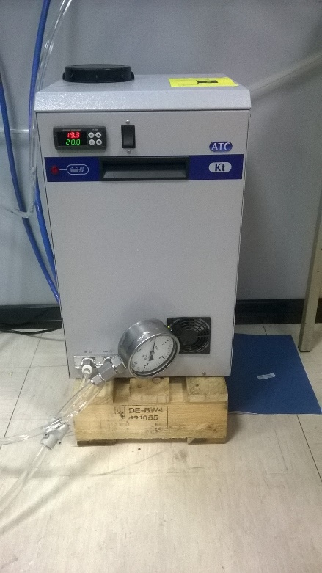
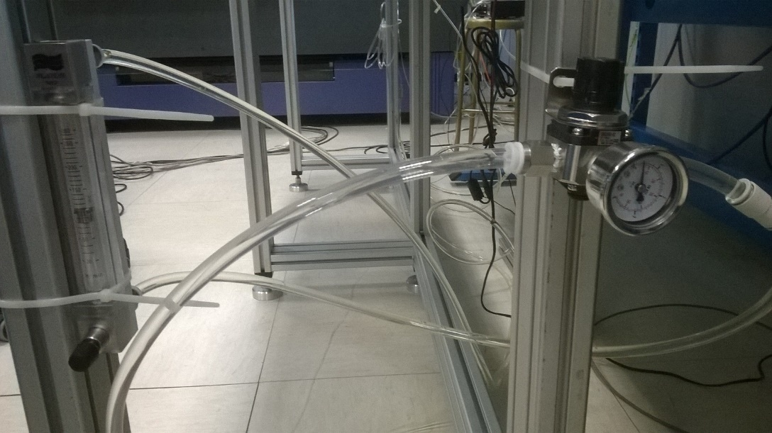
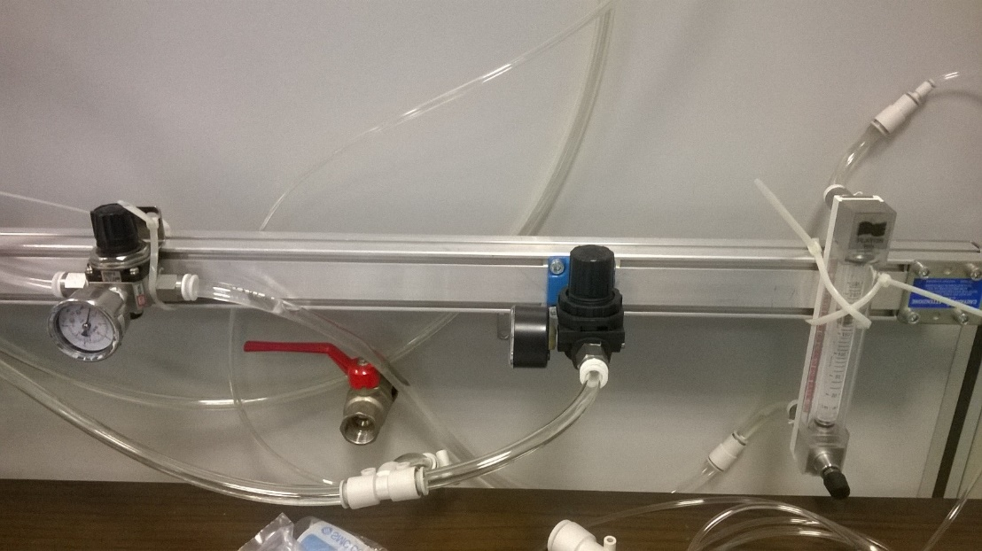
HS/STAVE COOLING CIRCUIT
PANELS for flow meters and pressure regulators in production
DEIONISER still not in line (next step)
CHILLER
HALF STAVE,
Water flow= 0,1 lit/min
Inlet P =1,4 bar (absolute)
STAVE,
Water flow= 0,2 lit/min (or 0,1+0,1 lit/min)
Inlet P= 1,4 bar (absolute)

Slide 6
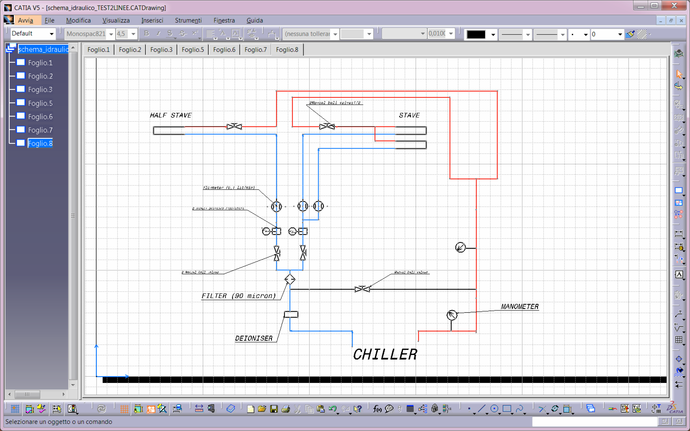
COOLING CIRCUIT IN TURIN
RETURN TUBES
INLET TUBES

Slide 7
ALPIDE
Alpide4 single chip carrier board at LNF
Connected to the MOSAIC redoubt chain yesterday
  Overcurrent problem solved (pwell and substrate to ground)
  System operational
  Marco/Pavel/Paula working to setup a trigger
This week: finalize setup
possibility for test beam at the BTF on Friday

Slide 8
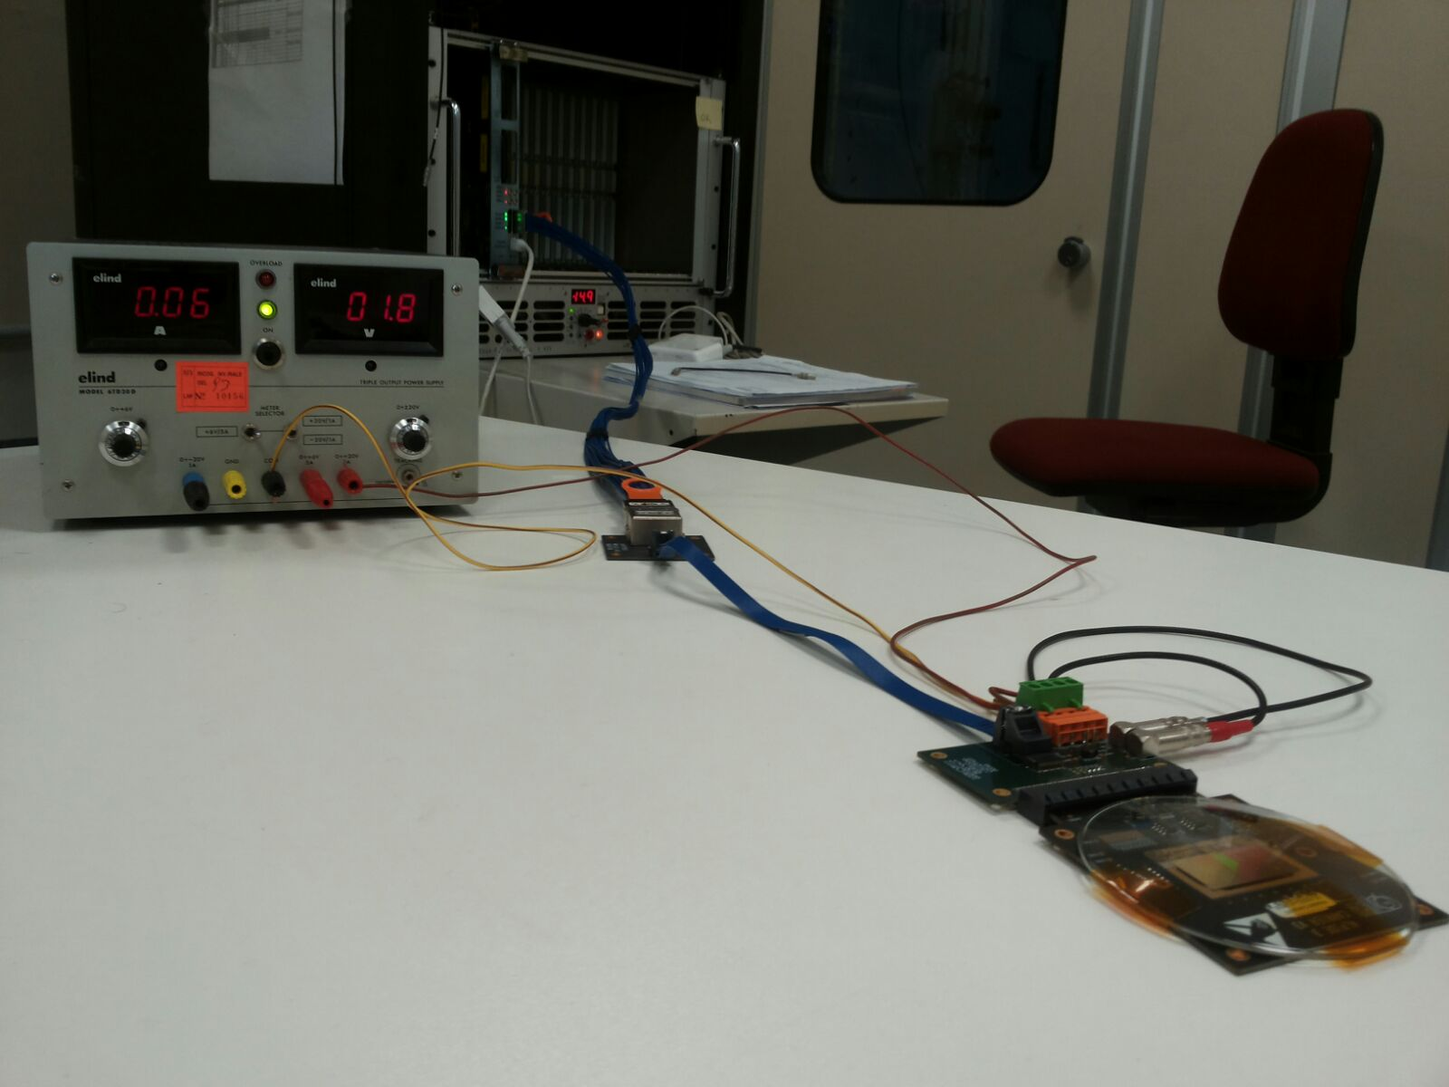
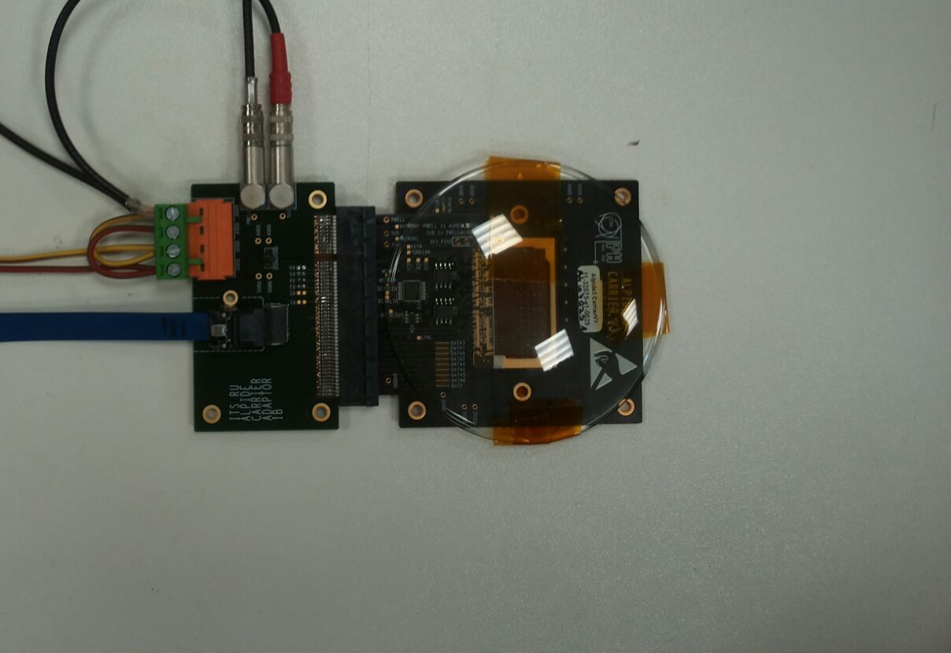
ALPIDE

Slide 9
Meetings
Stave development: February 23
ITS plenary: February 27-28
ALICE week: March 6-10

Slide 10

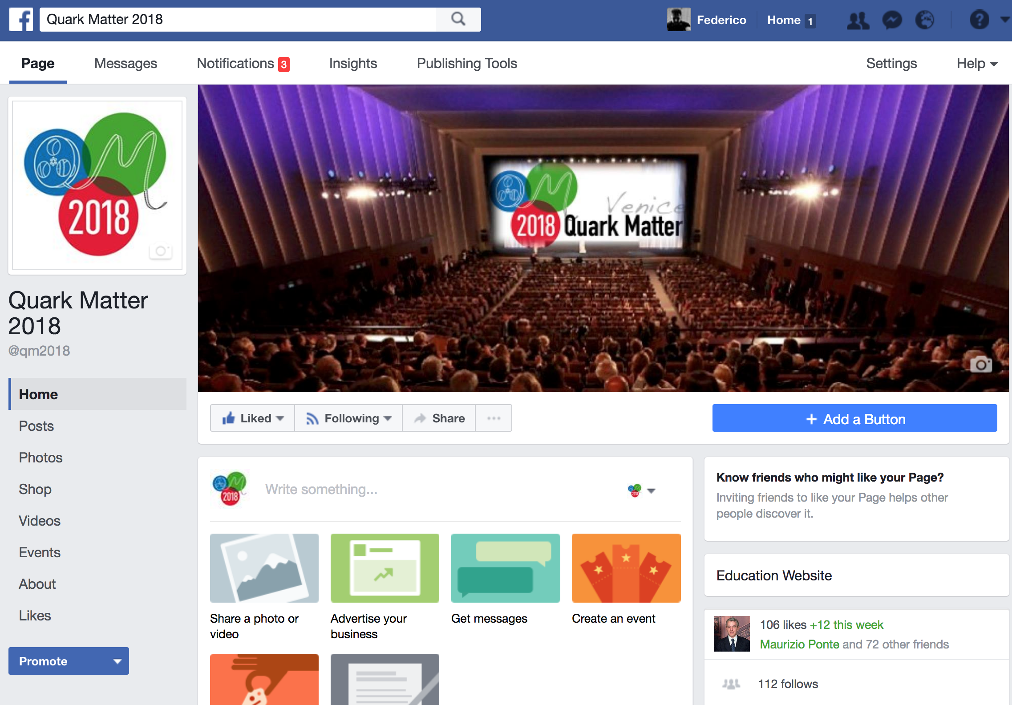
QM2018
OC: Federico (Social Media), Alessandra (Booklet)

Slide 11
Backup

