Slide 1



Aspects of Pairing in Nuclei
Augusto O. Macchiavelli
Nuclear Science Division Lawrence Berkeley National Laboratory
aom@lbl.gov
Work supported under contract number DE-AC02-05CH11231.

Slide 2
Lecture III
Pairing and temperature
Where does pairing come from ?
Transfer reactions
Neutron-proton pairing
The Giant Pairing Vibration (GPV)
Weak binding effects

Slide 3
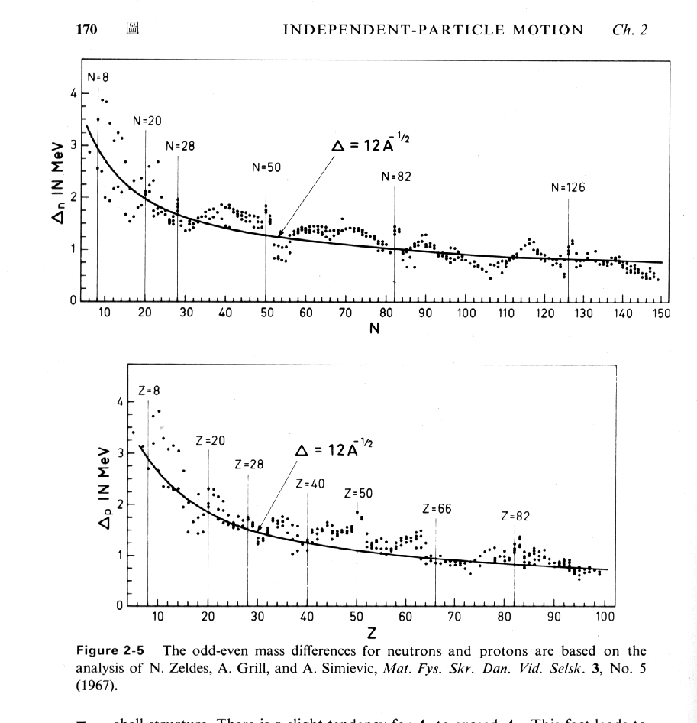
Pair gaps from mass differences
BM Vol 1 page 170

Slide 4
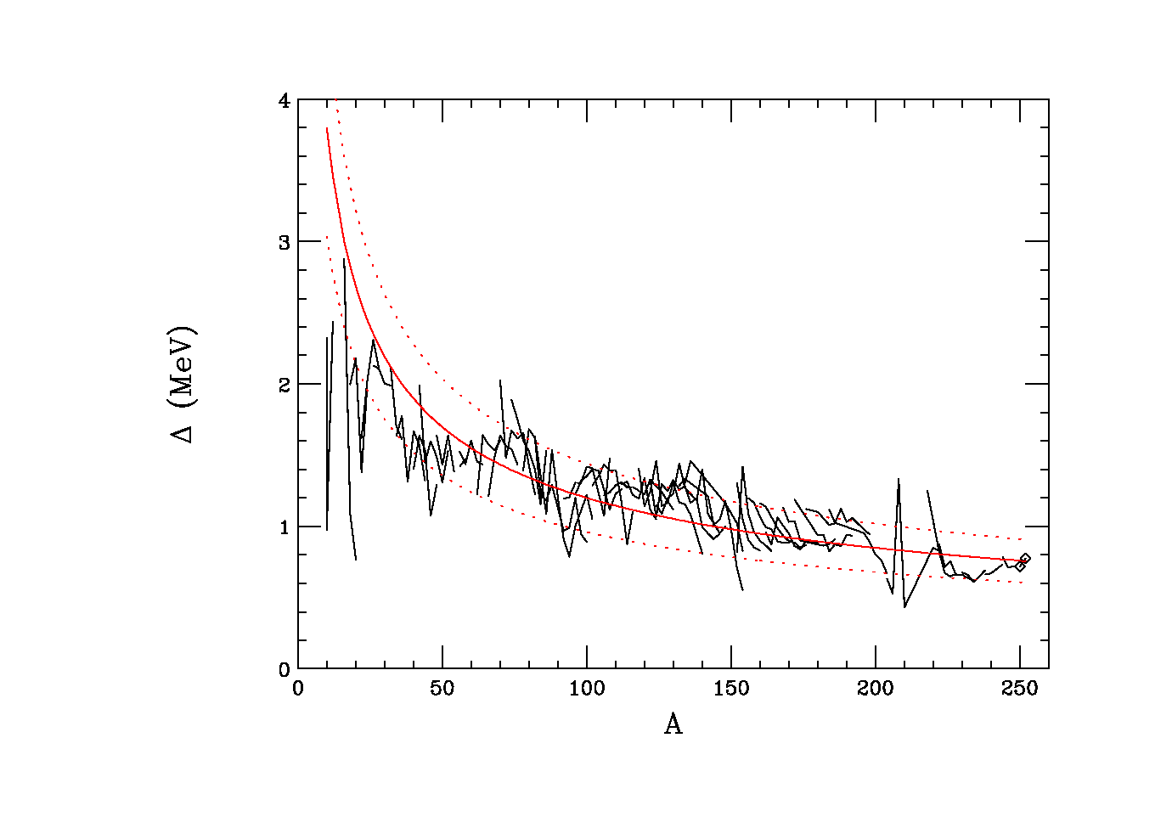
Pair gaps from rotational properties
12 A^{-1/2}

Slide 5
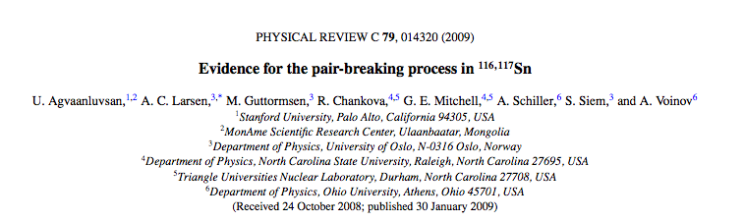
Thermal Properties of Pairing Correlations
Breaking of Cooper pairs with temperature. Phase transition.
Measurement of level densities with excitation energy.
Oslo group
R. Chankova et al. Phys. Rev. C73 034311 (2006)
(³He,α) (³He,³He’) reactions in Mo -isotopes

Slide 6
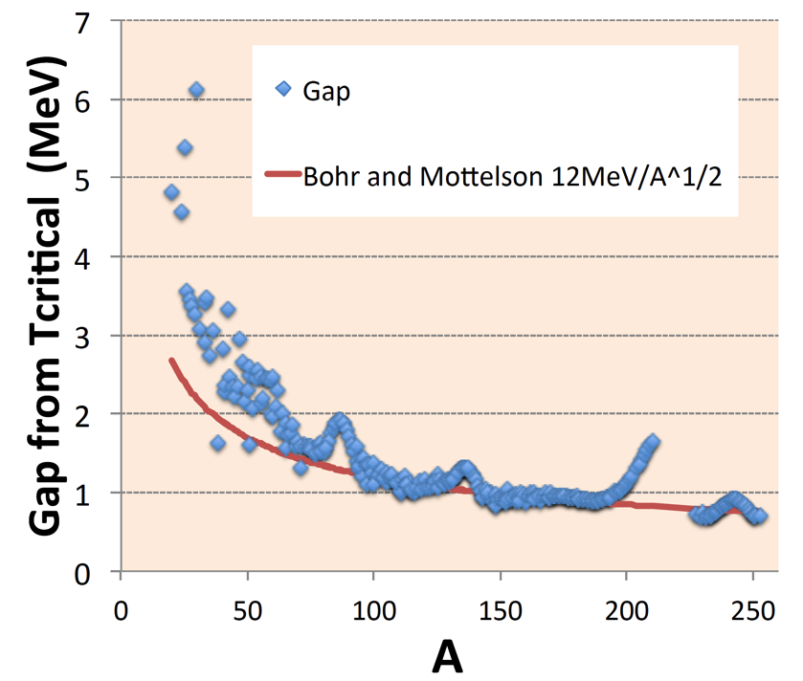
Thermal Properties of Pairing Correlations
Breaking of Cooper pairs with temperature. Phase transition.
Measurement of level densities with excitation energy.

Slide 7
Where does pairing come from?
D. Brink, R.A. Broglia, Superfluidity in nuclei

Slide 8
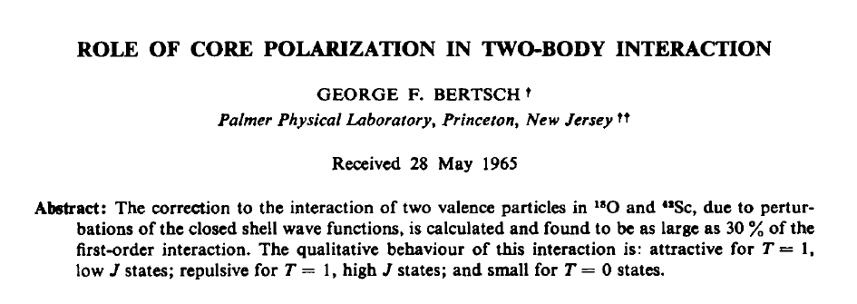
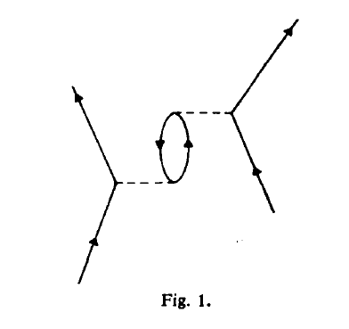

Slide 9
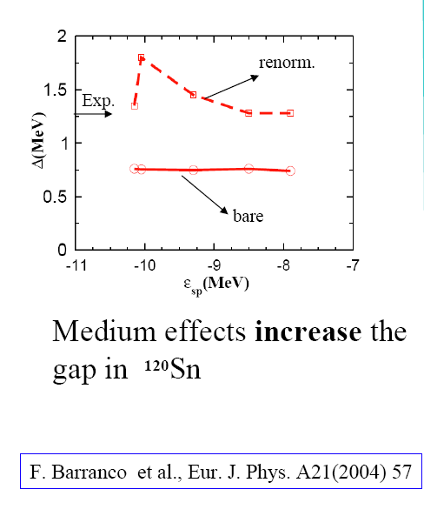

Slide 10
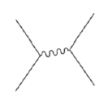
The halo neutrons of ¹¹Li are bound only because of the extra pairing interaction mediated by the exchange of low-frequency surface vibrational modes.
F.Barranco, et al. Eur.Phys.J A 11 385 (2001)
NN
Essentially no role
Low lying phonons
Monopole, dipole and quadrupole
Mechanism analogous to the lattice phonon exchange responsible for the binding of electron Cooper pairs in a superconductor
⇨¹¹Li halo, an isolated Cooper pair?

Slide 11
~ 1.7 MeV
2+
0+
⁶He
⁴He
RMS radius=1.6fm
→ We need to correct for Volume size !!!!
RMS radius=2.5fm

Slide 12
Transfer reactions continue to play major role in our understanding of the nuclear elementary modes of excitation, particularly in the characterization of the single particle degrees of freedom and their correlations.

Slide 13
Transfer reactions continue to play major role in our understanding of the nuclear elementary modes of excitation, particularly in the characterization of the single particle degrees of freedom and their correlations.
(d,p) vacancies
(p,d) particles

Slide 14

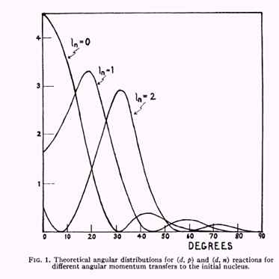

Ideal tool to study the single-particle degree of freedom.
Angular distribution of the outgoing particles reflect the transferred angular momentum  l-value
Spectroscopic factors.
Overlap between initial and final state Test wave functions

Slide 15
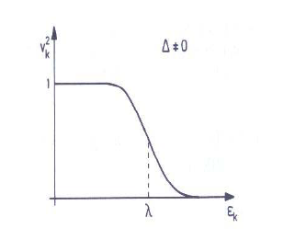

McFarlane and French Sum Rules
(p,d) particles
U²
(d,p)
vacancies

Slide 16
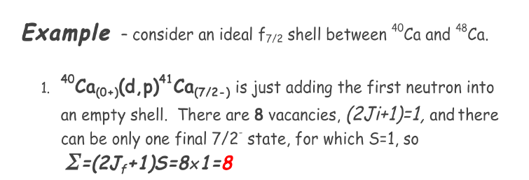
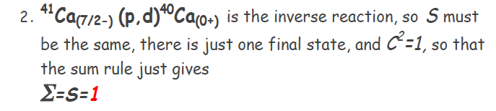
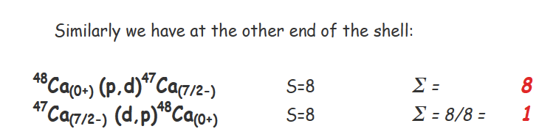
U² = 8/(2j+1)=1, V²=0
V² = 8/(2j+1)=1, U²=0

Slide 17
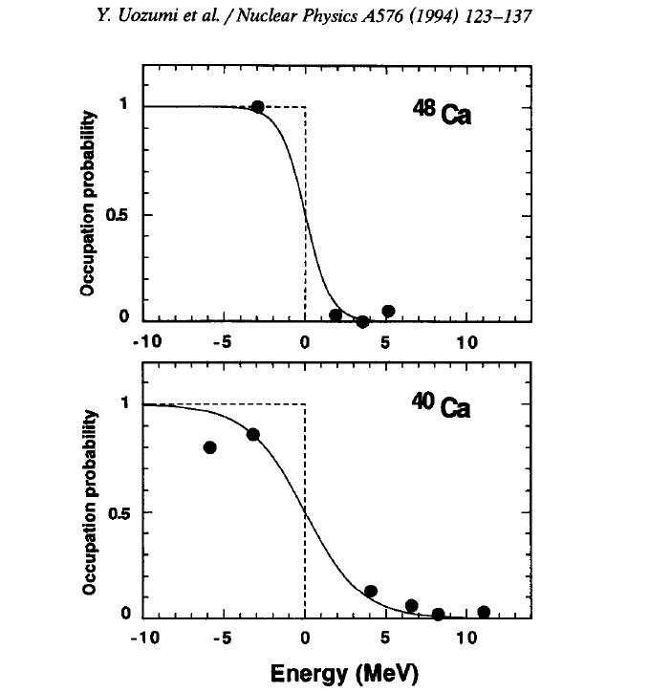
V² = 8/(2j+1)=1, U²=0
N=28
F7/2
N=20
U² = 8/(2j+1)=1, V²=0

Slide 18
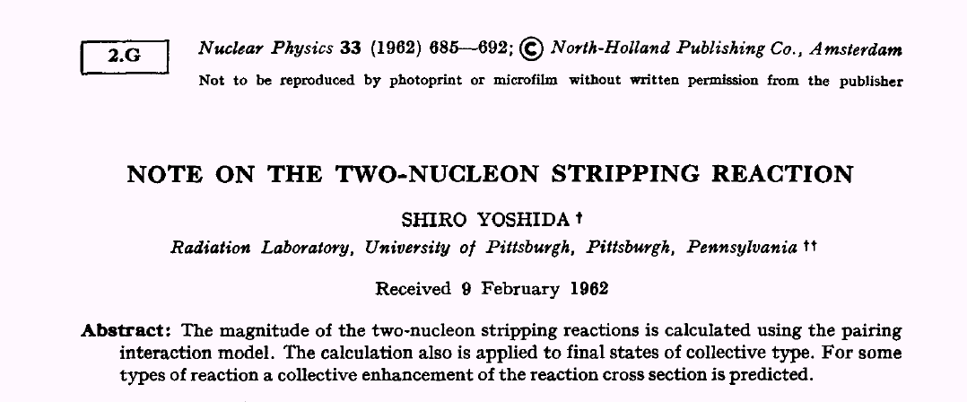
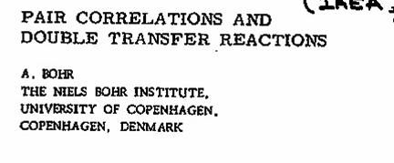
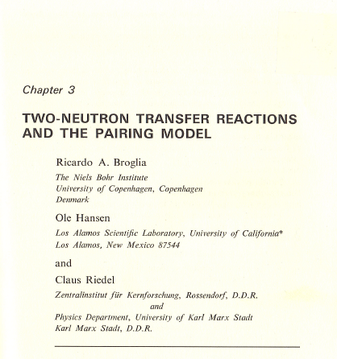
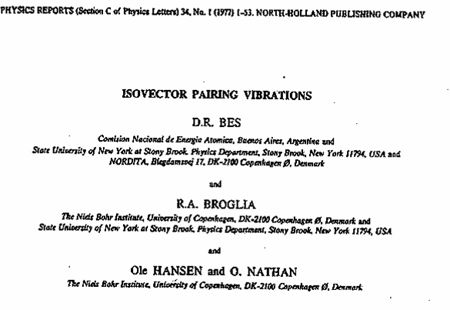
Proc. Int. Symp. On Nuclear Structure, IAEA – Vienna, 1968, Pag. 179
Adv. Nucl. Phys. 6 , 287 (1973)

Slide 19
Two particle transfer reactions like (t,p) or (p,t), where 2 neutrons are deposited or picked up at the same point in space provide an specific tool to probe the amplitude of this collective motion.
The transition operators <f|a⁺a⁺|i>, <f|aa|i> are the analogous to the transition probabilities BE2’s on the quadrupole case.
Process amplitude proportional to :
Pair correlations result in a constructive interference of reaction amplitudes giving a enhanced two-nucleon transfer.

Slide 20


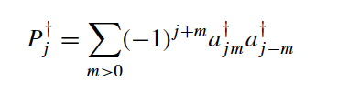


Slide 21

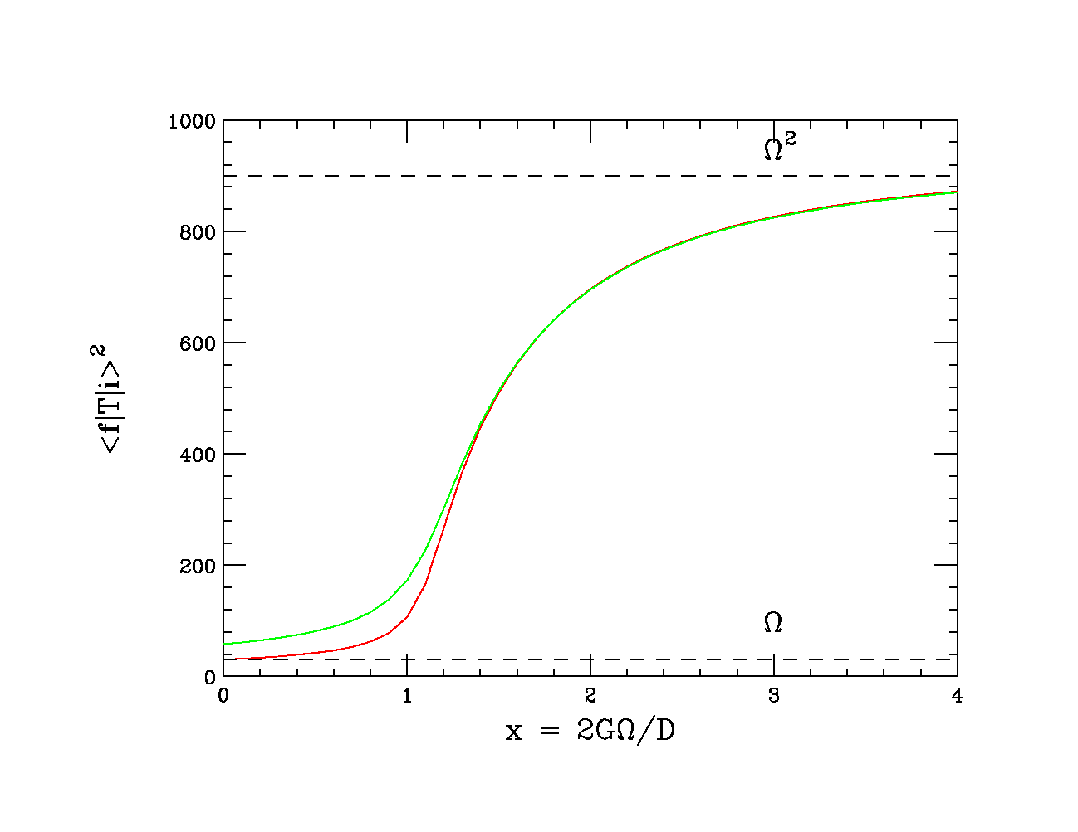
Superfluid
Vibrations

Slide 22
σ ( Α_{gs}→ Α+2_{gs})
Superfluids
∼ (Δ/G)²
∼ Ω²
Vibrations
~ (n +1 )
∼ Ω
Single
Particle
A_{o}
Closed shell
Closed shell
Systematic relative measurements and within a given nucleus.

Slide 23
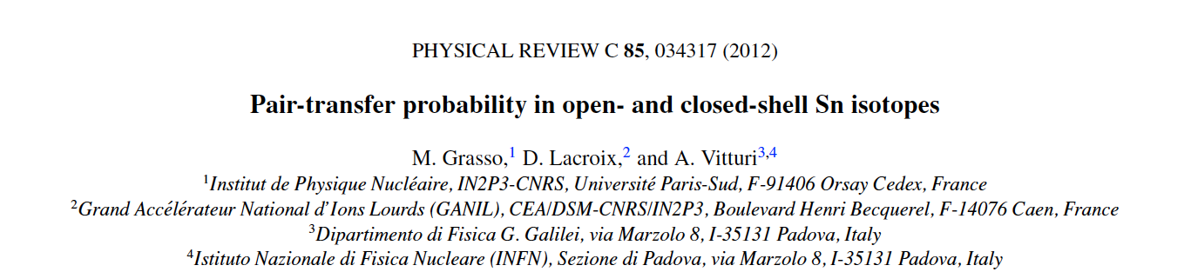
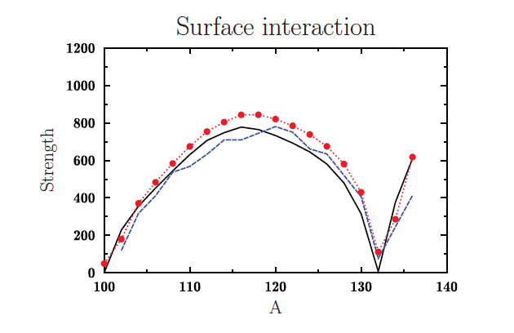

Slide 24
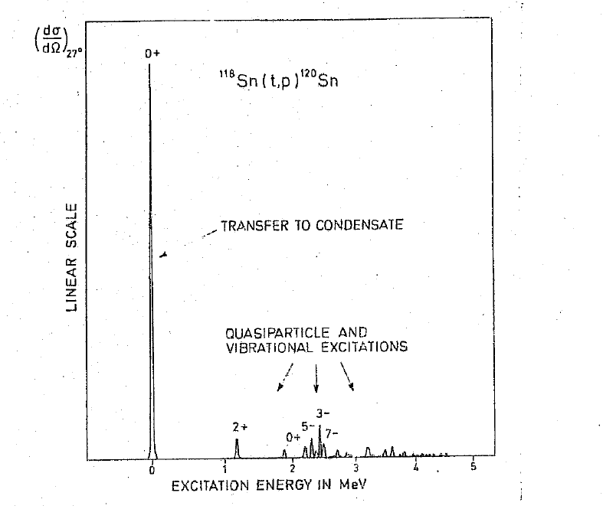
An example of a “superfluid” nucleus (pairing rotations)
DWBA Analysis
Direct One-step
Two-neutron in relative 0S state
Zero-range approximation
Common normalization factor
Relative cross-sections
J.H.Bjerregaard et al. NPA 110 1 (1968)

Slide 25
Neutrinoless Double-Beta Decay
Neutrinos are the only neutral elementary fermions and could be their own antiparticle.
If neutrinoless DBBD indicates this MAJORANA property.
A measured decay rate could provide the first determination of the absolute neutrino mass if the nuclear matrix elements known.
Initial and final wave functions critical.
Courtesy of Sean Freeman

Slide 26
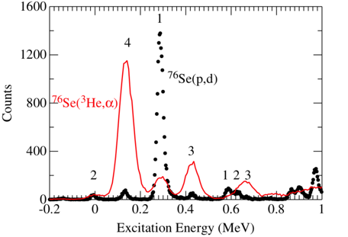
Single-particle occupancies are a measurable characteristic of a gs wave function that might help test input to DBBD matrix elements.
Neutron-transfer reactions done at Yale near 10 MeV/A:
^{74,76}Ge/^{76,78}Se (d,p) and (p,d)
^{74,76}Ge/^{76,78}Se (α,³He) and (³He,α)
J. P. Schiffer et al. PRL 100 112501 (2008)
Reactions with different Q values to ensure observation across all L-transfers.
Neutron-adding AND neutron-removing reactions: mid-shell nuclei with partial occupancy of fpg orbitals.
Measurements of occupancy and vacancy in removing and adding reactions should add up to (2j+1).
Courtesy of Sean Freeman

Slide 27
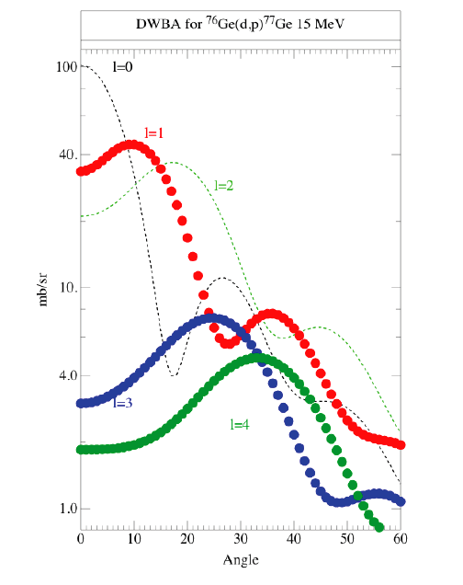

Slide 28
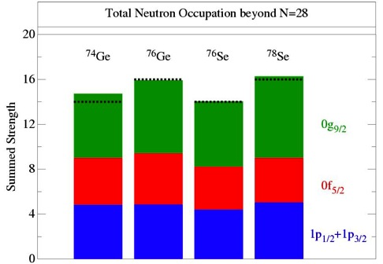
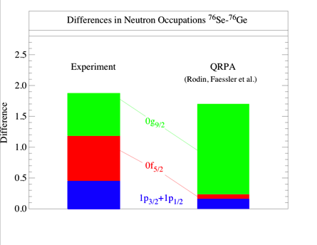
Fermi surface seems considerably more diffuse than QRPA.
Neutrons from three to four orbits are changing substantially between ⁷⁶Ge and ⁷⁶Se, while in QRPA the change is almost entirely in the 0g_{9/2.}
Consequences on the calculated matrix for 0ν2β remain to be explored: it is obvious, however, that there are deficiencies in the approach or the method.
Courtesy of Sean Freeman
J. P. Schiffer et al. PRL 100 112501 (2008)

Slide 29
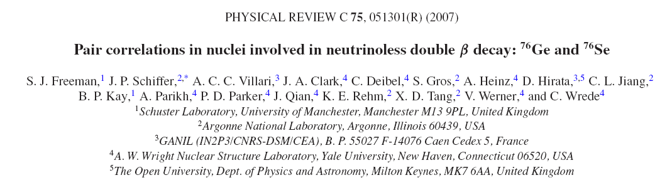
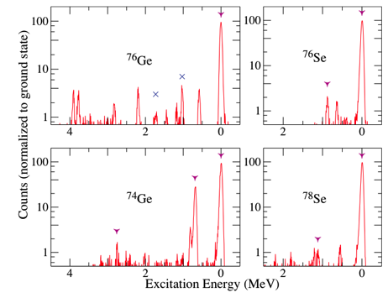
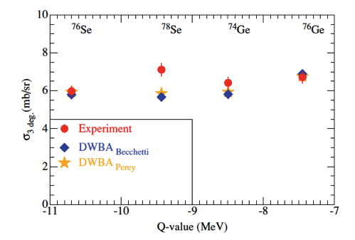
Spectra from (p,t) reactions:
20MeV protons Yale Tandem. Split-pole spectrograph.
For ⁷⁶Ge and ⁷⁶Se (p,t) strength is predominately to the ground states, indicating they can be described as simple BCS paired states with quantitatively similar pair correlations.

Slide 30
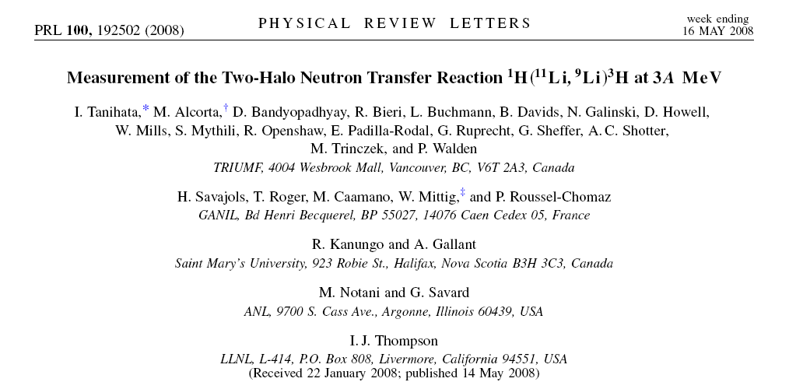
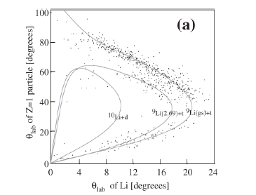
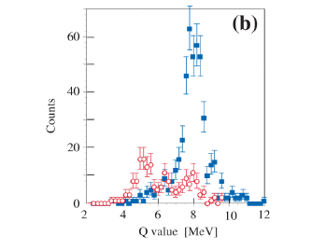
37MeV ¹¹Li from ISAC2 plus MAYA active target detector system

Slide 31
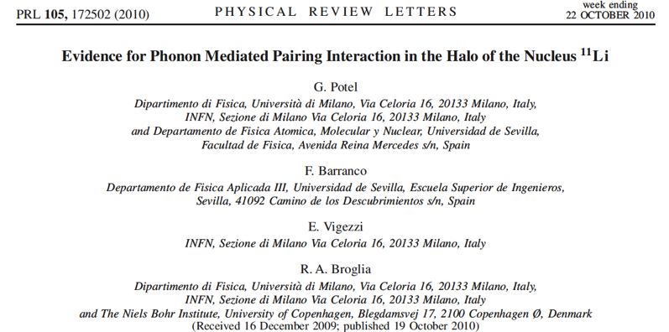
Two particle transfer in second order DWBA
Simultaneous and successive transfer
Absolute normalization !!!

Slide 32

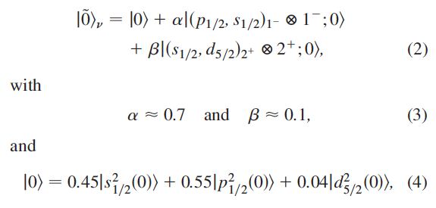

Slide 33
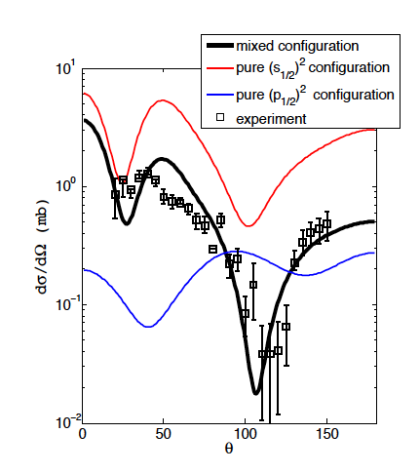
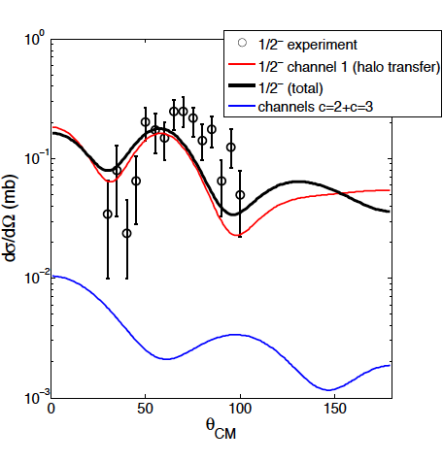
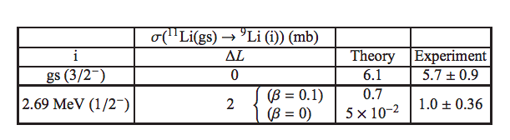

Slide 34
Neutron-Proton Pairing
T=1, S=0
T=0, S=1
T_{z}=0

Slide 35
Neutron-Proton Pairing
Protons are Red
Neutrons are Blue
T=0 pairing is fascinating …
… but we still don’t have a clue !
T=1, S=0
T=0, S=1
T_{z}=0

Slide 36



T=1, S=0
Elusive
quasi-deuteron phase ??
T=0, S=1

Slide 37
N=Z nuclei, unique systems to study np correlations
As you move out of N=Z, T=1 nn and pp pairs
will start to dominate. T=0 excited states.
Role of isoscalar (T=0) and isovector (T=1) pairing
Large spatial overlap of n and p
Pairing vibrations (normal system )
Pairing rotations (superfluid system)
Does isoscalar pairing give rise to collective modes?
Possible signals
Binding energy differences
Low-lying states of odd-odd self-conjugate nuclei
Rotational properties: moments of inertia, alignments
Alpha decay, Beta decay, Gamow-Teller
Radii, Electromagnetic properties
Direct reactions
S. Frauendorf and A.O.Macchiavelli
Progress in Particle and Nuclear Physics, 78 (2014) 24-90.

Slide 38
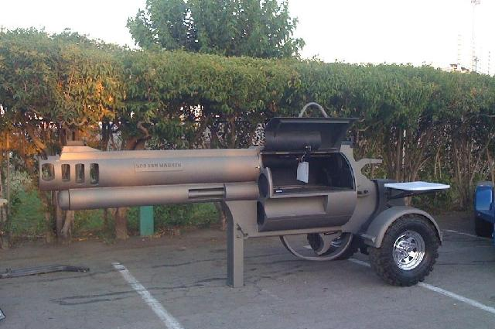
Transfer Reactions
Marlene Assie
The smoking gun ?

Slide 39
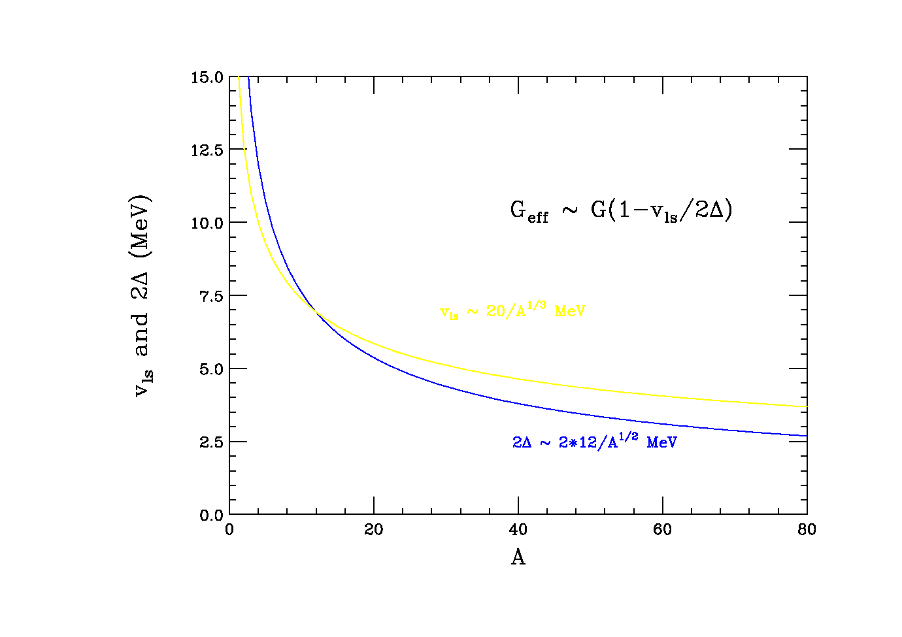
Spin-Orbit Splitting
l-s
l+s
V_{ls}

Slide 40
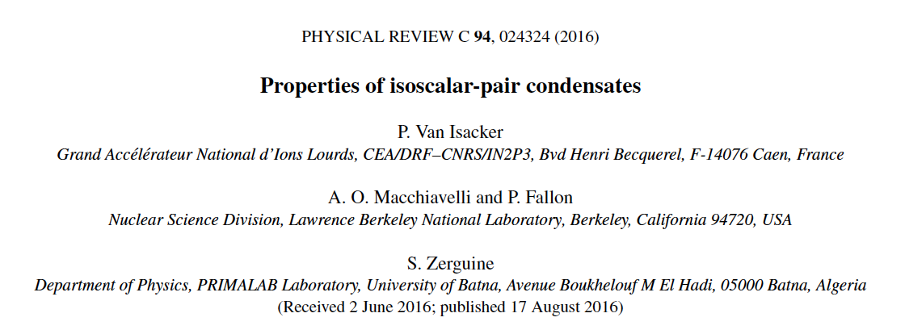
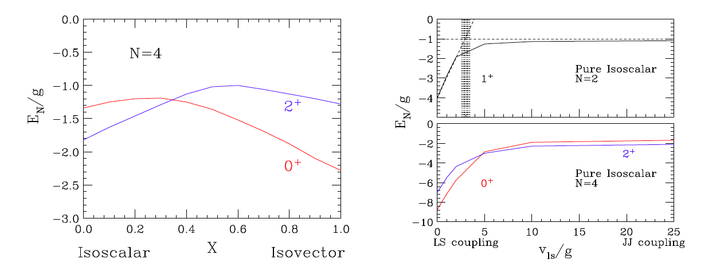

Slide 41
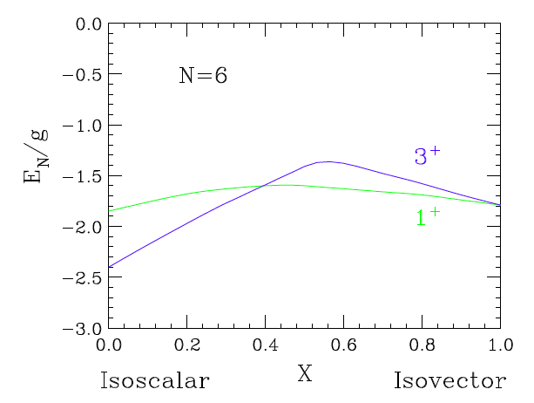
Aligned configuration of n=N/2 quasi-deuteron pairs → I=n⁺

Slide 42
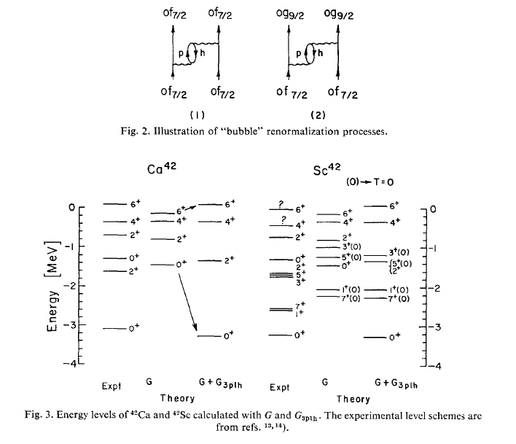
Kuo and Brown, Nucl.Phys. A114, (1968),241-279

Slide 43
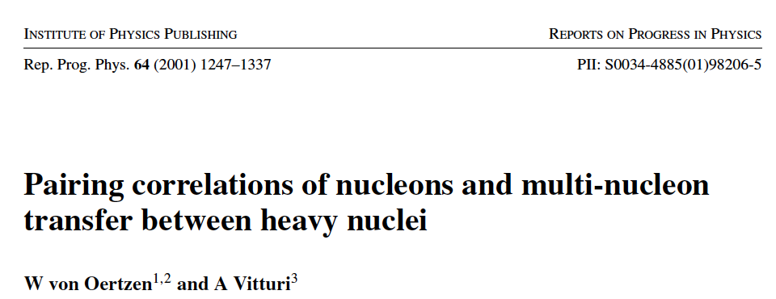
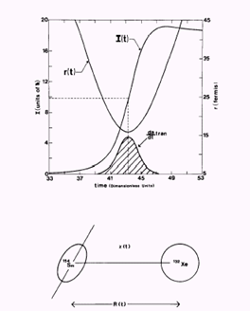
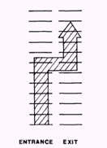
ΔM/M, ΔL/L and ΔE/E << 1
Sommerfeld parameter η>>1
allows for a semi-classical description.
 Classical trajectory and tunneling
Josephson Effect
Enhancement of pair transfer
~ (Δ₁/G)² (Δ₂/G)²

Slide 44
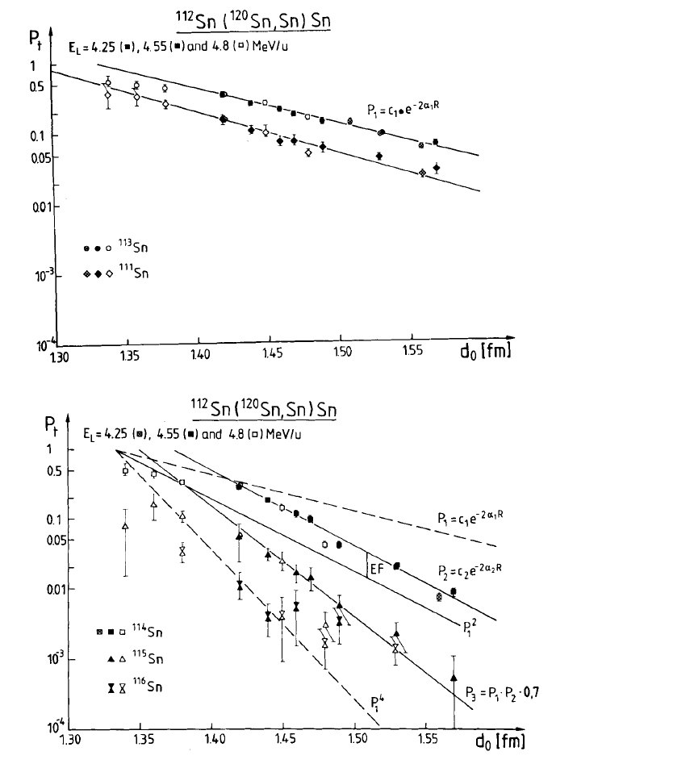
Compare
P_{1n}² with P_{2n}

Slide 45

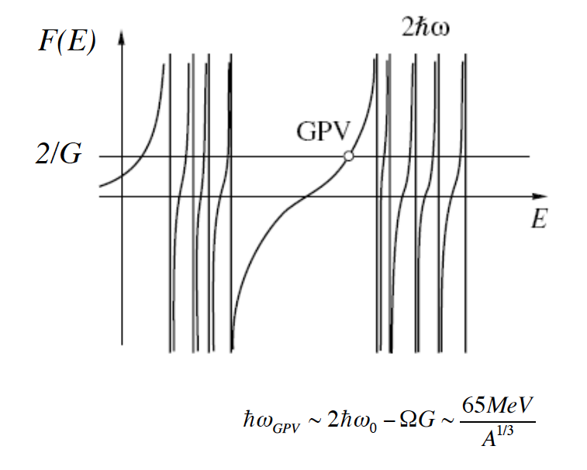
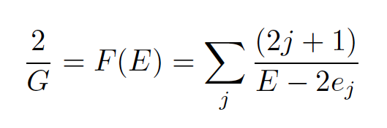
The Giant Pairing Vibration (GPV)
Fundamental excitation mode of the nucleus predicted long ago
(R. A. Broglia and D. R. Bès, Phys. Lett. B69 (1977) 129)
The GPV is a coherent superposition of pp excitations analogous to the more
familiar Giant Shape Vibrations based on ph excitations.

Slide 46



Slide 47
Our data show the clearest signal compatible with the long searched GPV so far.
The resonances at Ex=16.9±0.1MeV in ¹⁴C and at Ex=13.7±0.1 MeV in ¹⁵C show properties consistent with those defining the GPV mode.

Slide 48

Why has the GPV never been observed in (t,p) and (p,t) reactions?
L. Fortunato et al., ( Eur. Phys. J. A14 (2002) 37) suggest that beams, such as t or ¹⁴C, do not favor excitation of high-energy collective pairing modes due to a large energy mismatch ~ exp(- c(Q-Q_{opt})²)
Q-values in a stripping reaction involving weakly bound ⁶He are much
closer to the optimum.

Slide 49




Slide 50



Slide 51

Experimental Considerations
⁶He beams with E_{BEAM} ~ 6 MeV/A at intensities of I≥10⁵ particles/sec.
Sketch of the experimental set-up :
IRIS IC
IRIS Detector Setup
ΔE-E
⁶He
α
¹¹⁶Sn and ²⁰⁸Pb targets
L=0 transfer to forward scattering angles
S1642

Slide 52

GPV ??
S1642

Slide 53


Slide 54



Pairing in weakly bound systems
Matsuo PRC 73 (2006)044309
N. Pillet et al. PRC 76 (2007)024310
Separation
Correlation Length
Skin Di-neutrons
Effects on Two-neutron transfer reactions
Do we expect an enhancement of the cross-section ?

Slide 55

I hope I did succeed in conveying to you the exciting physics of pairing phenomena in nuclei, and I trust you had as much fun as I did in preparing the lectures.

Slide 56


“Prediction is very difficult, especially about the future.”
Niels Bohr
“The future isn’t what it used to be.”
Arthur C. Clarke

Slide 57
Augusto's Forecast
Sunny & Warm

