Slide 1



Aspects of Pairing in Nuclei
Augusto O. Macchiavelli
Nuclear Science Division Lawrence Berkeley National Laboratory
aom@lbl.gov
Work supported under contract number DE-AC02-05CH11231.

Slide 2
Aspects of Pairing in Nuclei
Augusto O. Macchiavelli
Augusto O’ MacChiavelli
Nuclear Science Division Lawrence Berkeley National Laboratory
aom@lbl.gov
Work supported under contract number DE-AC02-05CH11231.

Slide 3
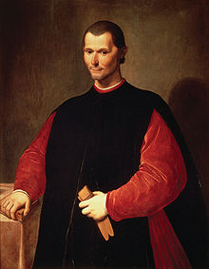



Slide 4
Lecture I
Short introduction
Shell Model and residual interactions
Pairing coupling scheme
A two-level model
BCS
Pairing plus Quadrupole 101
Shape and pairing phase transitions

Slide 5
Atomic nuclei constitute unique many body systems of strongly interacting fermions. Their properties and structure, are of paramount importance to many aspects of physics.
Many of the phenomena encountered in nuclei share common basic physics ingredients with other mesoscopic systems, thus making nuclear structure research relevant to other areas of contemporary research, for example in condensed matter and atomic physics.
These are exciting times in the field of physics of nuclei:
Existing and planned accelerator facilities worldwide, and new detector systems with increased sensitivity and resolving power not only will allow us to answer some important questions we have today, but most likely will open up a window to new and unexpected phenomena.
New developments in theory and computer power are shaping a path to a predictive theory of nuclei and reactions.

Slide 6

Intellectual Drivers
• How did visible matter come into being, and how does it evolve?
• How does subatomic matter organize themselves, and what
phenomena emerge?
• Are the fundamental interactions that are basic to the structure of
matter fully understood?
• How can the knowledge and technological progress provided by
nuclear physics best be used to benefit society?
http://www.nap.edu/catalog/13438/nuclear-physics-exploring-the-heart-of-matter

Slide 7
The Physics of Nuclei: Science Drivers
The Physics of Nuclei: Science Drivers
Facilities (stable and radioactive beams)
State of the art instrumentation
Theory

Slide 8
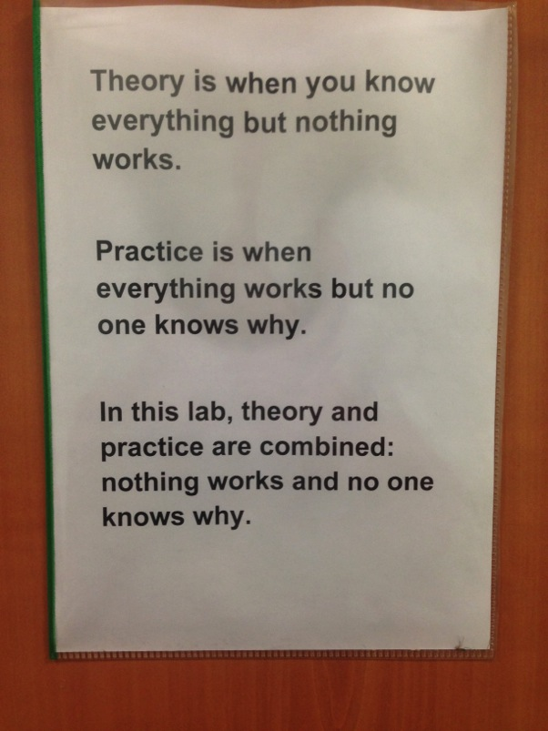
THE SYNERGY between THEORY and EXPERIMENT

Slide 9
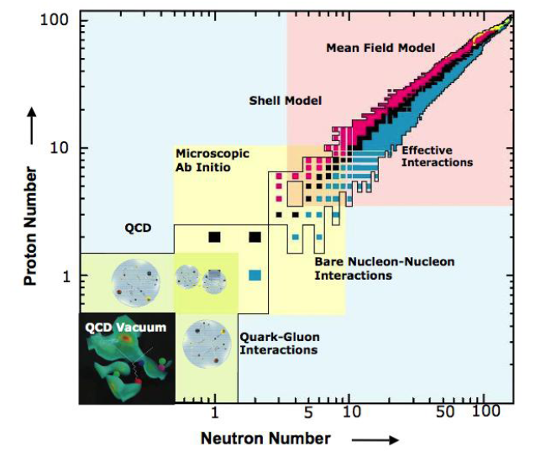
The Ultimate Goal
A comprehensive and quantified model of atomic nuclei does not yet exist
In recent years, enormous progress has been made with measurements of properties of rare isotopes and developments in nuclear theory and computation
Access to key regions of the nuclear chart constrains models and identifies missing physics
Theory identifies key nuclei and properties to be studied

Slide 10
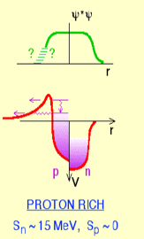
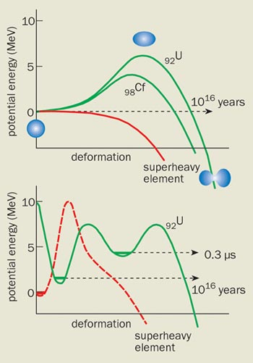
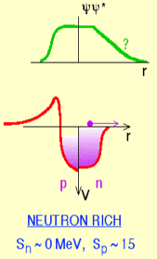
The Nuclear Landscape
The Nuclear Landscape
Proton drip-line
Mirror symmetry
p and 2p tunneling
Spin triplet superconductivity (T=0 pairing)
rp-process
Novae, X-ray bursts
Heavy Elements
Shell stability
Island of SHE
Neutron drip-line
Halos, Skins
Pairing at low density
New shell structure
New collective modes
r-process
Stars, Supernovae

Slide 11
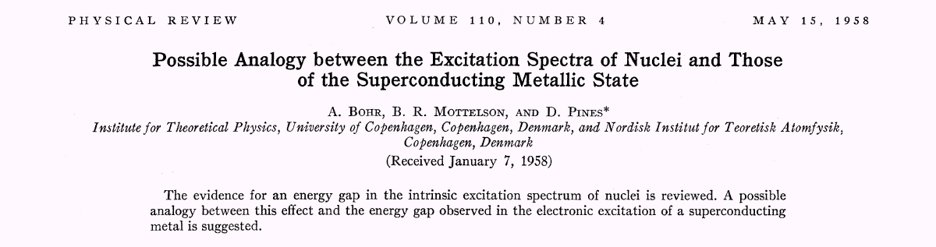
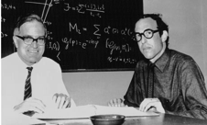


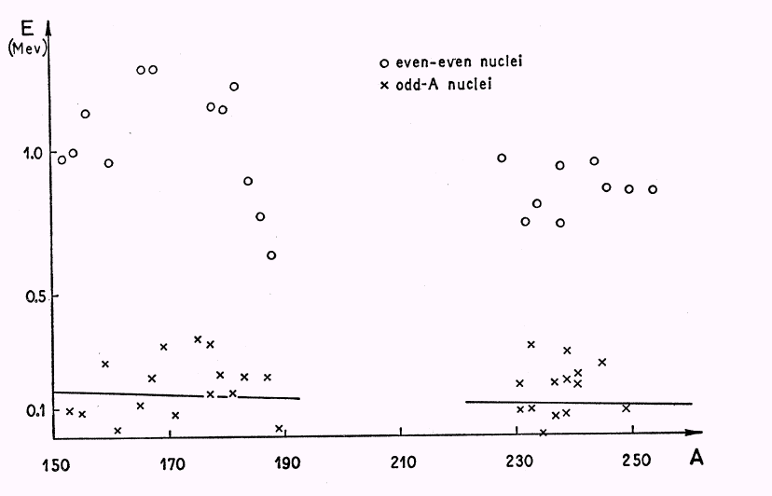
Where it all started
1975

Slide 12
BUT Guys
Danielle, Andrea, and Edoardo
Me
Nuclear Pairing

Slide 13
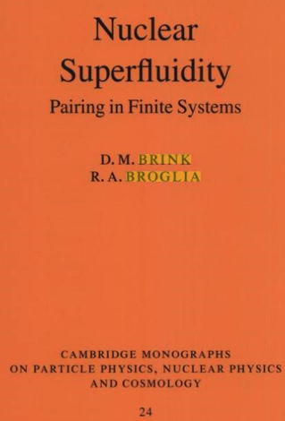

B. R. Mottelson,
Proceedings of the International School of Physics "Enrico Fermi, “ Course 15,
edited by G. Racah (Academic, New York,1962).

Slide 14
More reading:
- Nuclear Theory, A. M. Lane
- The Practitioner’s Shell Model, G. Bertsch
- Nuclear Structure from a Simple Perspective, Richard F. Casten
- The Nuclear Shell Model and Concepts in Nuclear Physics, K. Heyde
- From Nucleons to Nucleus: Concepts of Microscopic Nuclear Theory, Jouni Suhonen
- Fundamentals of Nuclear Models, D.J. Rowe and J.L.Wood
- Nuclear Structure, Volumes I and II, A. Bohr and B. Mottelson
- Nuclear Shell Theory, A. de Shalit and I. Talmi
- Simple Models of Complex Nuclei, I. Talmi
- The Nuclear Many Body Problem, P. Ring and P. Schuck
S. T. Belyaev, K. Dan. Vid. Selsk. Mat. -Fys. Medd. 31,No. 11 (1959).
D.R.Bes and R.A.Sorensen, Adv. Nucl. Phys. 2,129 (1969)
R.A. Broglia, O. Hansen, C. Riedel, Adv. Nucl. Phys. 6 , 287 (1973)
D.J.Dean and M.Hjorth-Jensen, Rev. Mod. Physics 75, 607 (2003)

Slide 15

Nuclear Shell Structure
Me
Prof. Liotta

Slide 16
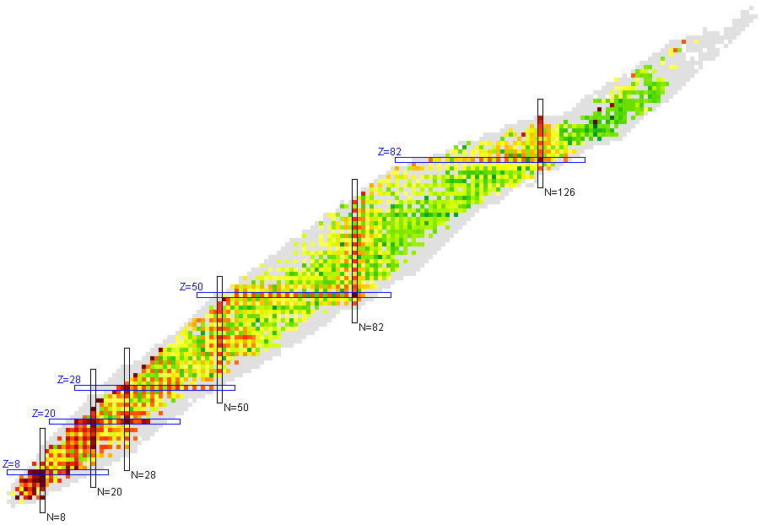
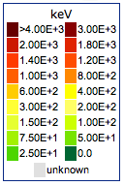
Nuclear Shell Structure
Energy of First Excited State
Z
N

Slide 17
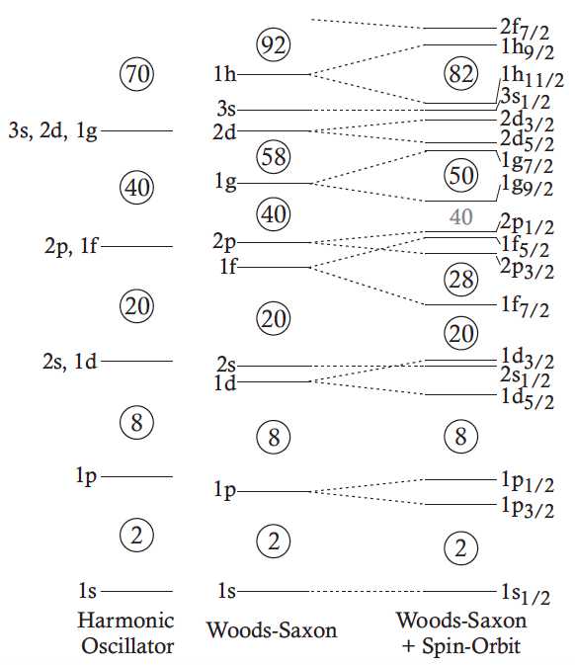
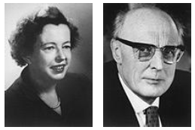
Nuclear Shell Model
Maria Goeppert-Mayer & Hans D. Jensen
1963
Maria Goeppert-Mayer, Phys. Rev. 75, 1969 (1949).
O. Haxel, Phys. Rev. 75, 1766 (1949).

Slide 18

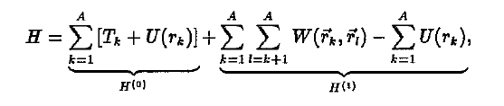
Nuclear shell model
In principle if the form of the bare nucleon-nucleon interaction is known, then the properties and structures of a given nucleus can be calculated ab-initio:
+ 3-body + …
In the shell model we make the following approximation to the problem:
Mean Field
Residual Interaction, V(1,2)

Slide 19
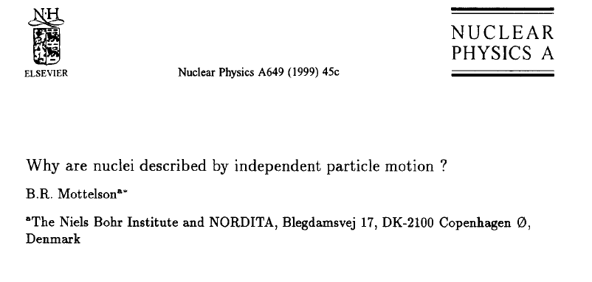
The applicability of the shell model has actually a profound meaning

Slide 20
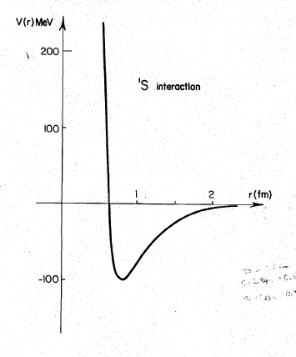
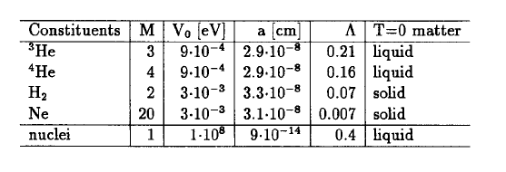
“Quantality Parameter”
Fermi Liquid, quasiparticles

Slide 21
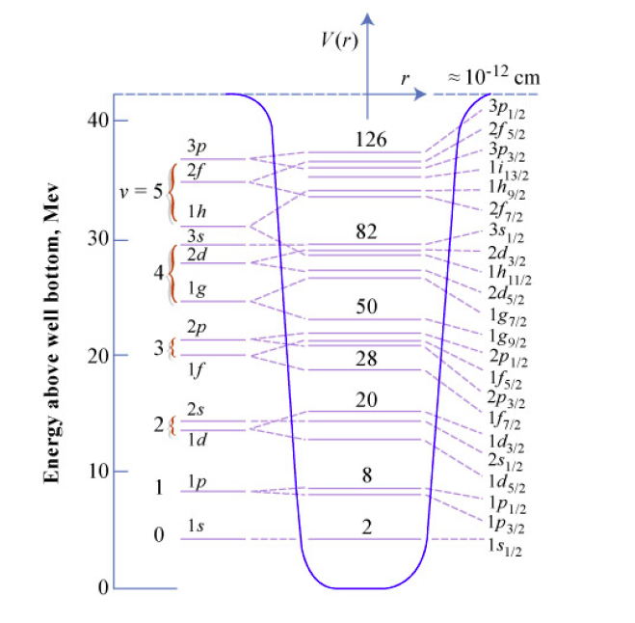
The Mean Field

Slide 22
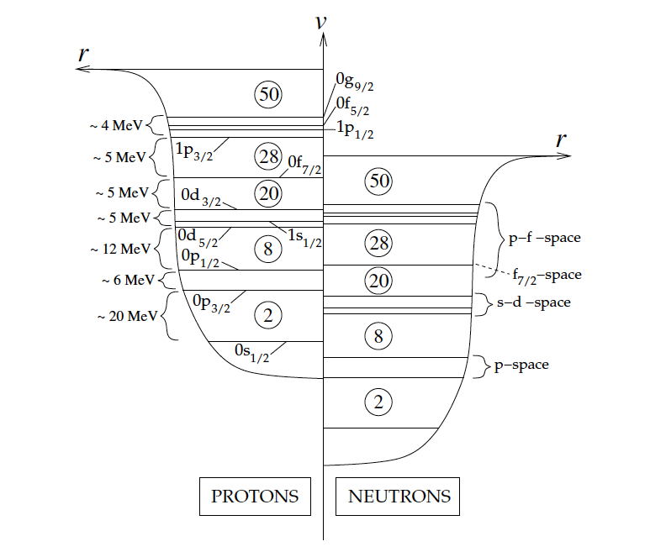
The Mean Field

Slide 23
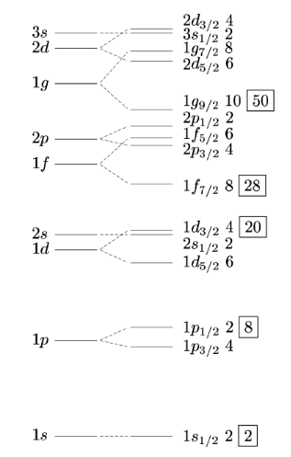

Slide 24
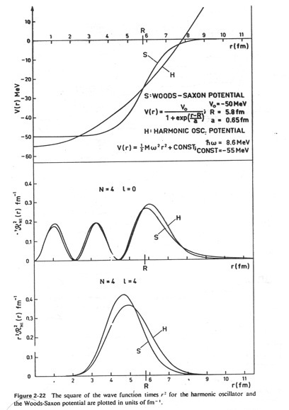

Slide 25
The average potential U(r_{k}) , experienced by all the k particles approximates the combined effects of all the two-body interactions.
We now consider the motion of the valence nucleons
( i.e. neutrons or protons that are in excess of the last,
completely filled shell) in the mean field and the effect of a
residual interaction, V(r_{1,} r₂) , only among them.

Slide 26
This is not completely so as valence particles will tend to polarize the core.
However, this require excitations with energy of
Which is large compared to an average residual interaction
and thus can be treated perturbatively.
Note that <V>/ΔE decreases as A^{2/3}.

Slide 27
The residual interaction
  Derive from the nn interaction with in-medium effects
  Determine the residual interaction from experimental data.
  Use a schematic model with a simple spatial form that captures the main ingredients of the force.

Slide 28

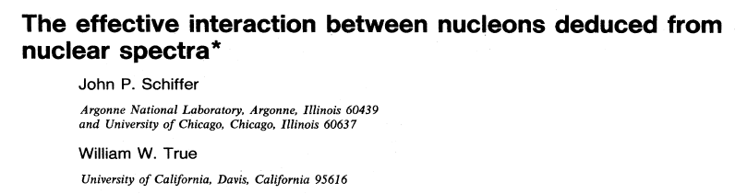
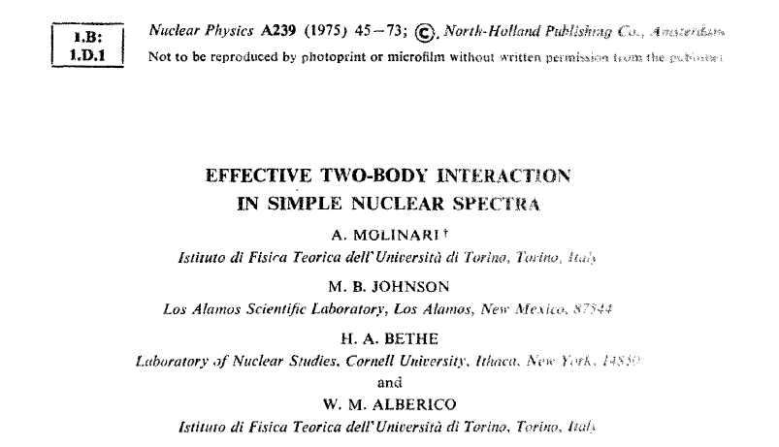

Slide 29
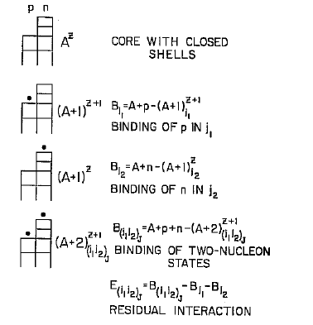

Slide 30
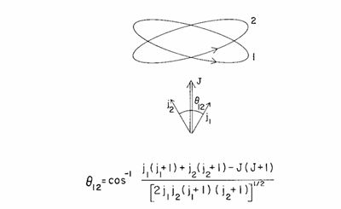
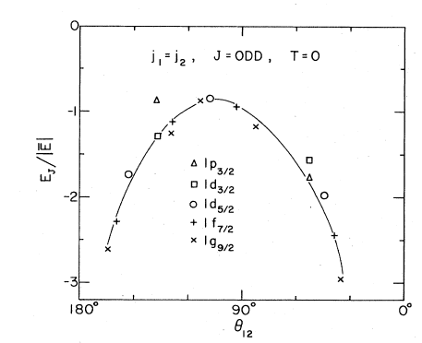
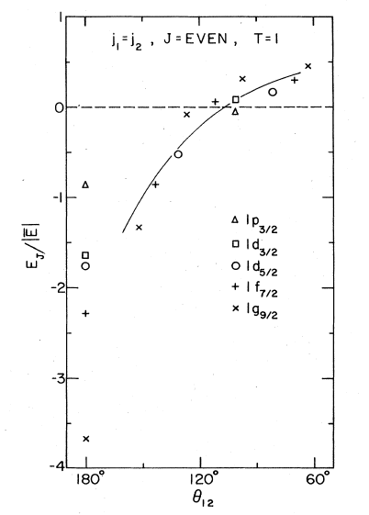
Short-range (Pairing ) + long-range (Quadrupole)

Slide 31
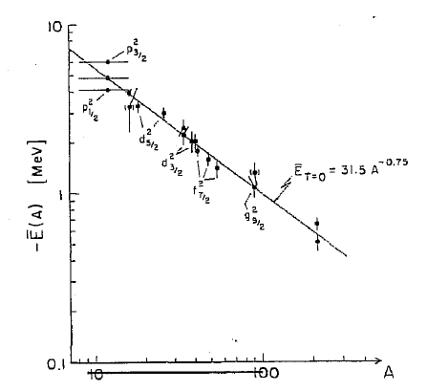
Problem #1
W.W.Daehnick Physics Reports 96 (1983) 317

Slide 32
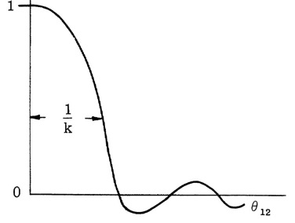
The pairing coupling scheme
s
Short range force favors 0⁺ pairs
j
l
Wave function is
Correlations within a distance
r ≤ R/l
1/l
j
I
For I ≠ 0 the distance is ≈ IR/l

Slide 33
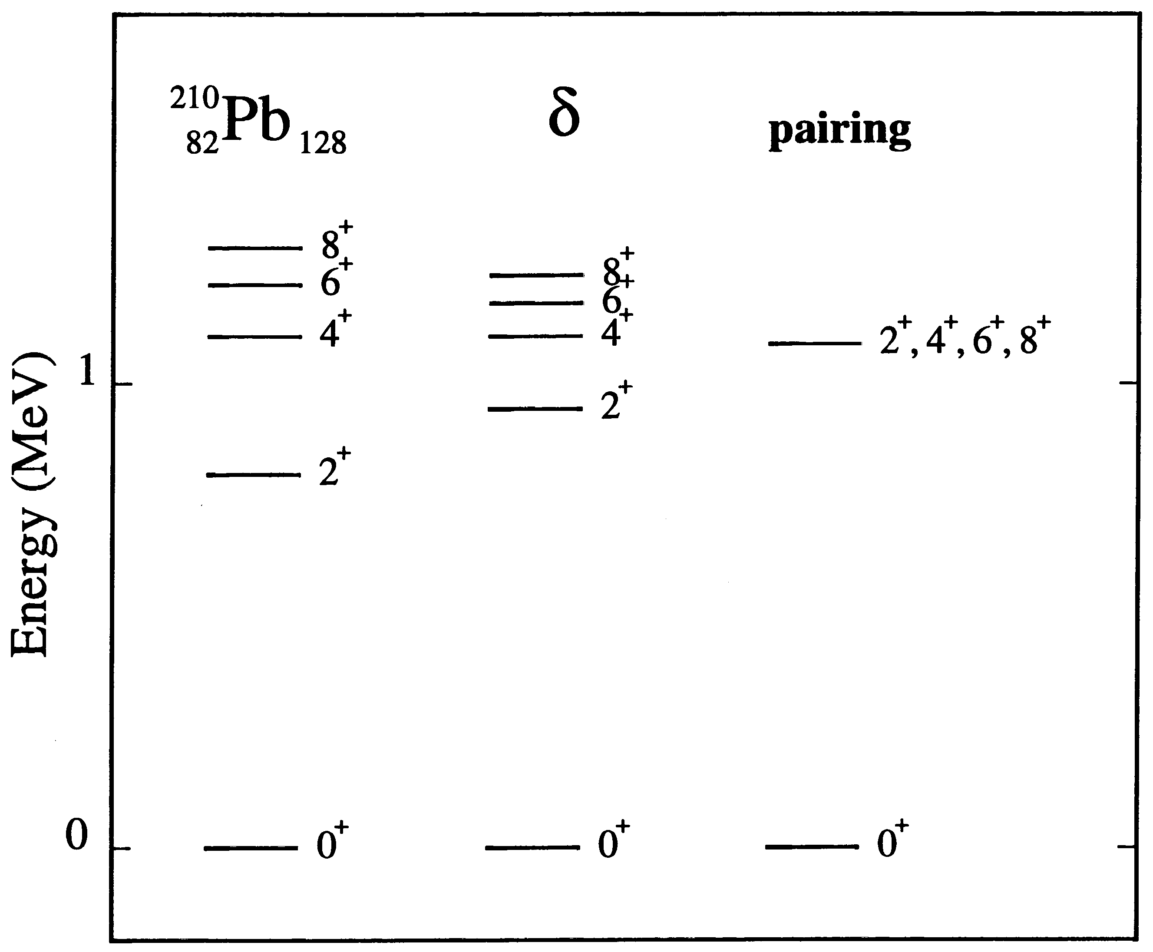
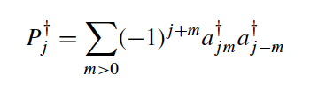

Slide 34
2Δ
Even-even gap
Δ
Odd-Even mass difference
2Δ
Odd-odd to Even-even mass difference
^{A}Z_{N}
^{A+1}Z_{N+1}
^{A+2}Z_{N+2}
^{A+2}(Z+1)_{N+1}

Slide 35
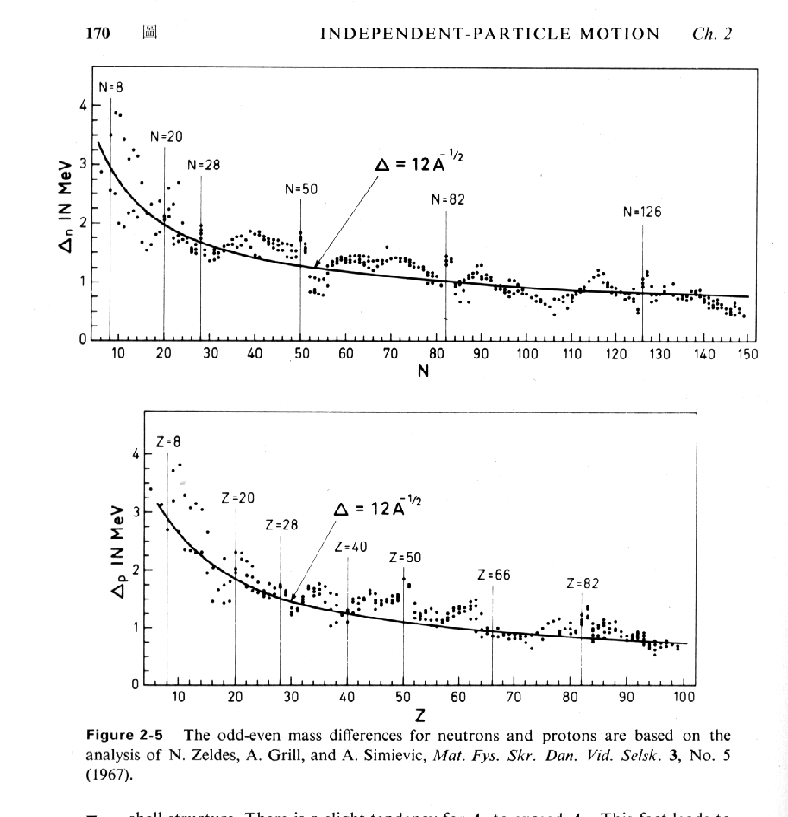
Pair gaps from mass differences
BM Vol 1 page 170

Slide 36
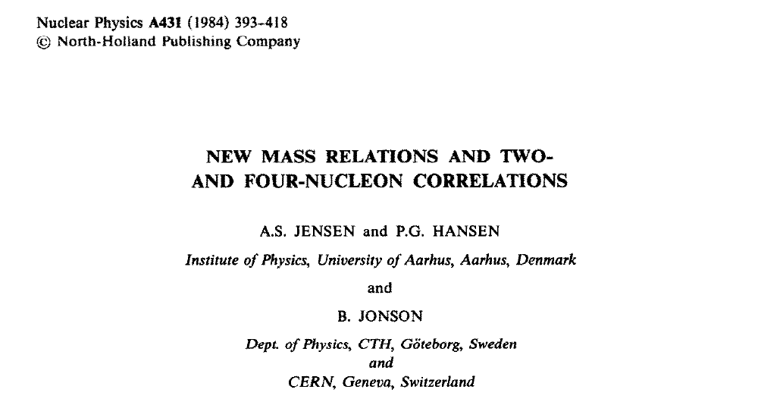



Slide 37
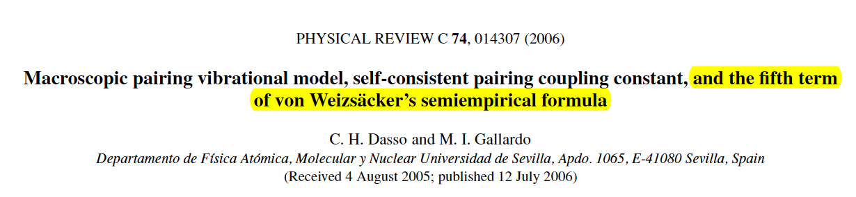
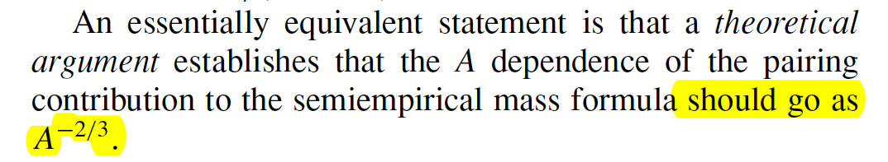

Slide 38


A simple microscopic model: Two j-shells
“Control parameter”

Slide 39


Slide 40
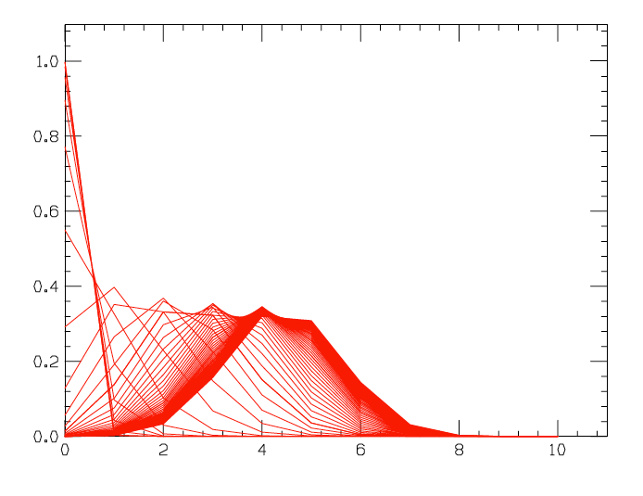
Small X - Pairing Vibrations
X ~ 1
Large X – Pairing Rotations

Slide 41

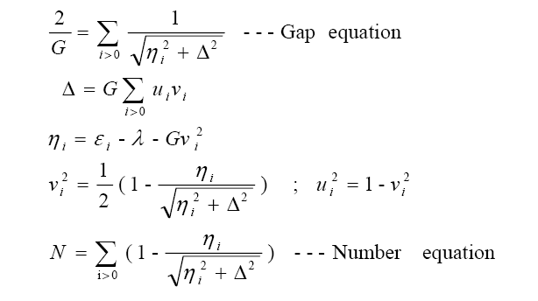
To treat more realistic situations the j^{n} model has to be generalized
BCS wave function does not have definite number of particles
⇨ minimize with a constrain that fixes the average number of particles to N

Slide 42
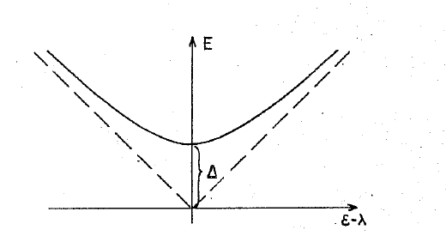
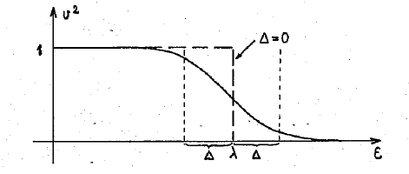
Quasi-particles

Slide 43
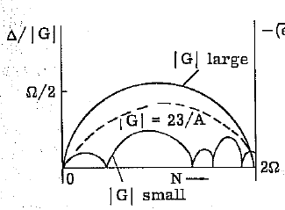
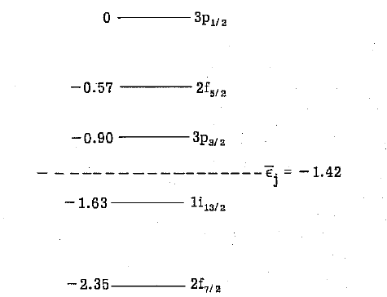
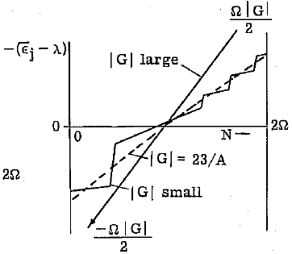
D

Slide 44
