Slide 1





ITS Upgrade Activity at Frascati
Federico Ronchetti
INFN-Laboratori Nazionali di Frascati
ALICE Meeting 14/02/2017

Slide 2
Outline
Stave assembly status
Welding procedure and stations
Shifts
ALPIDE

Slide 3
Stave Assembly Status
Data analysis ongoing (Marco + Pavel)
Transport of parts back to Torino being organized
  1 piastra metallica 2000x1000m
  1 barra di carbonio 1500mm
  1 tastatore piezioeletrico a 5 punte
  1 placca di alluminio
  1 barra di acciaio 1500mm
  1 rotolo di tappeto anti-statico
  10 cavi spiralato
  10 bracialetti
  5 punto messa a terra.
Ecobond glue arrived in Torino today

Slide 4
Infrastructure
Additional vacuum pump: ongoing this week
General conditioning system: to be checked
New table the white and grey area: done
New common vestibule between the CL1000 and CL10000 rooms: ongoing: done
Drier and air filter for secondary compressor: investigation of cost ongoing, no news, to be checked
Base for Half Stave welding:
  Back to LNF design
  Fixed welding position, microscope and fume absorber
Computing Cluster: no news

Slide 5
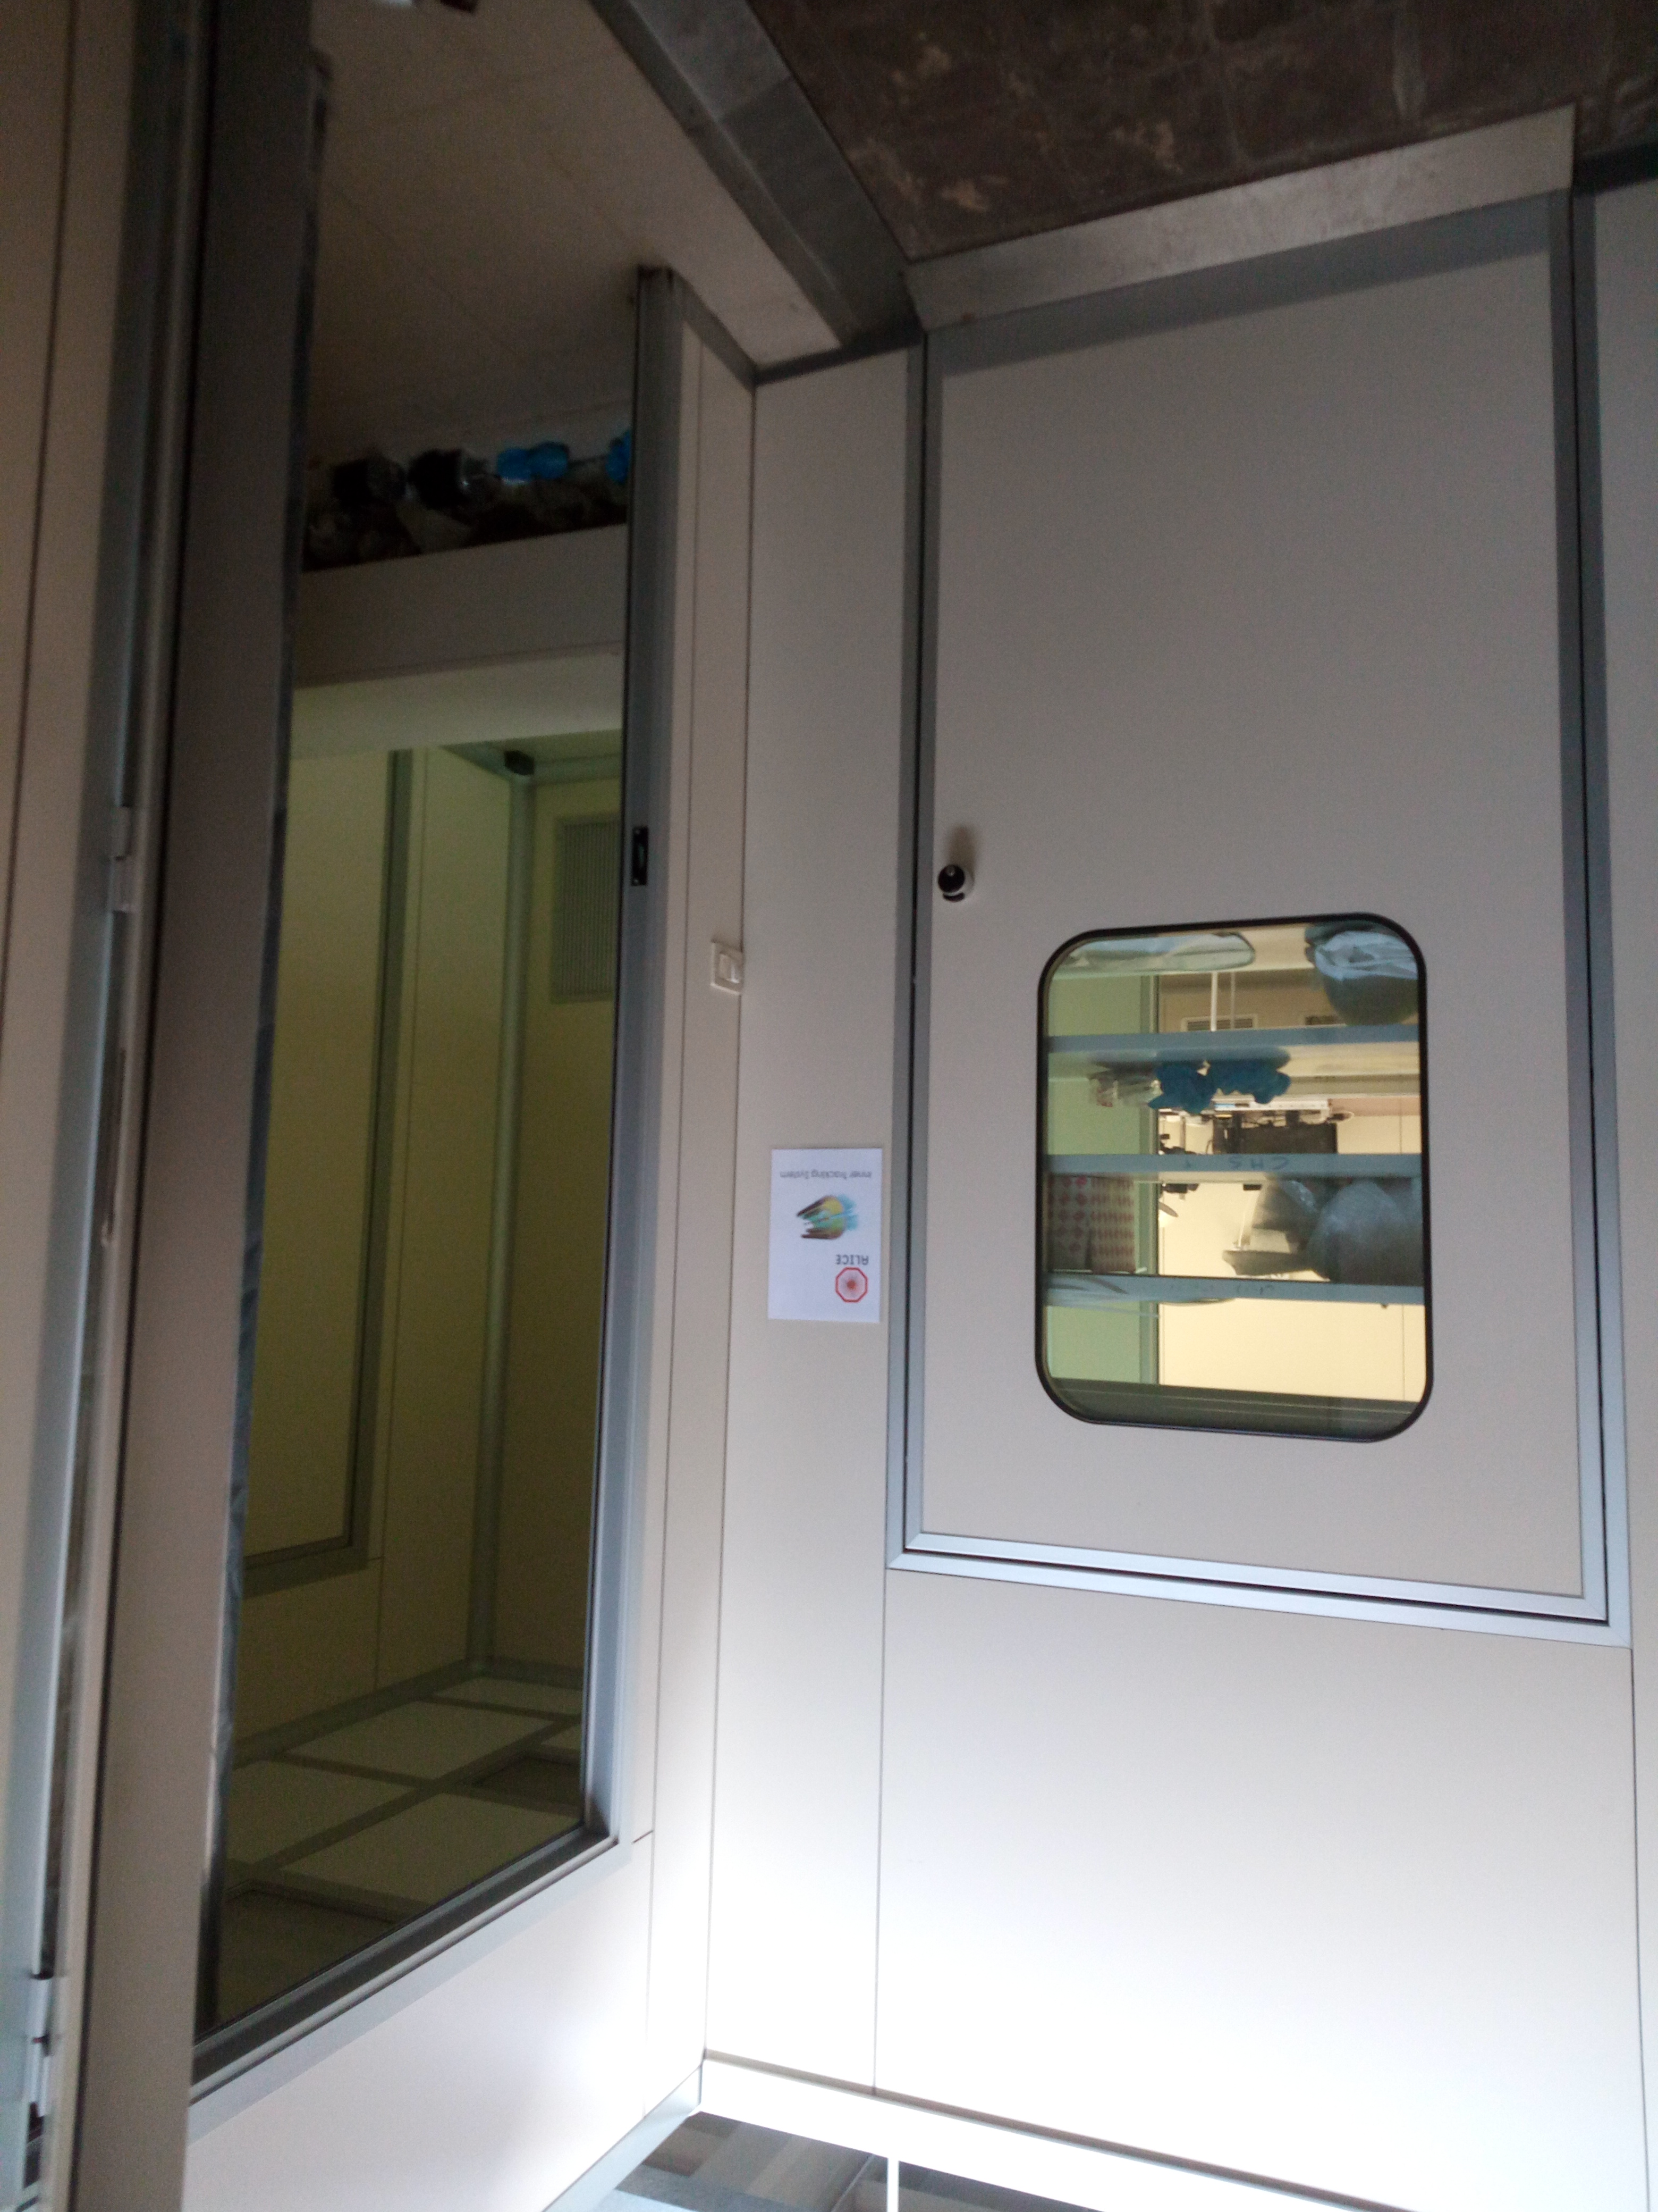
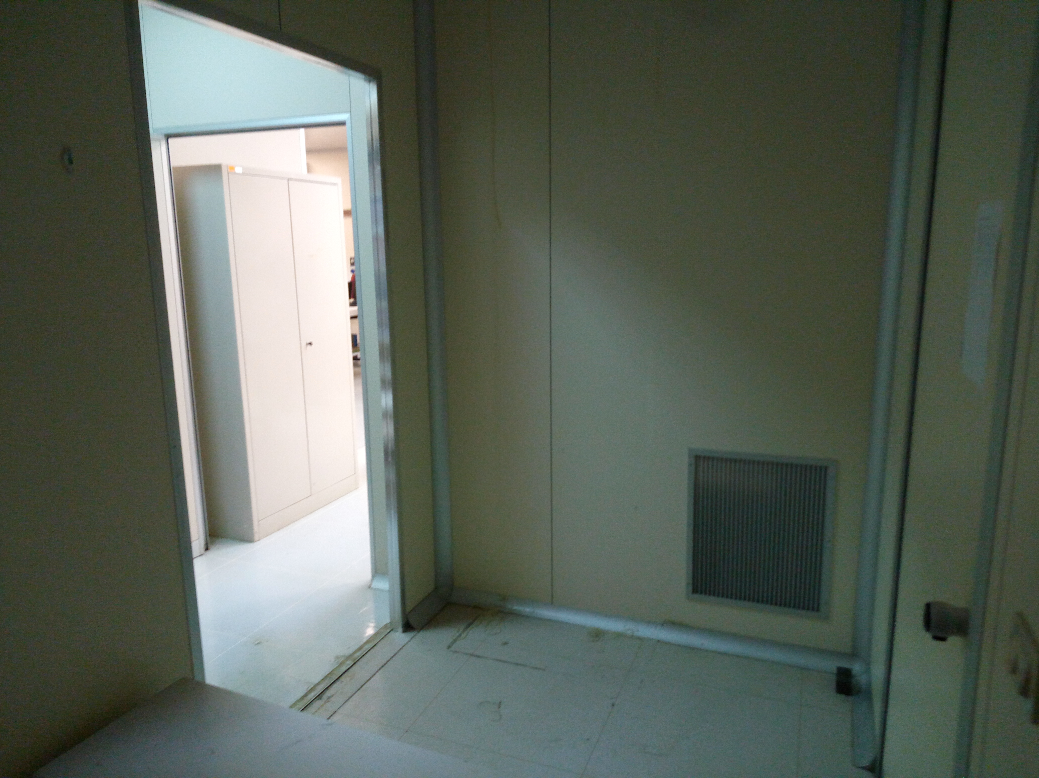
Infrastructure

Slide 6
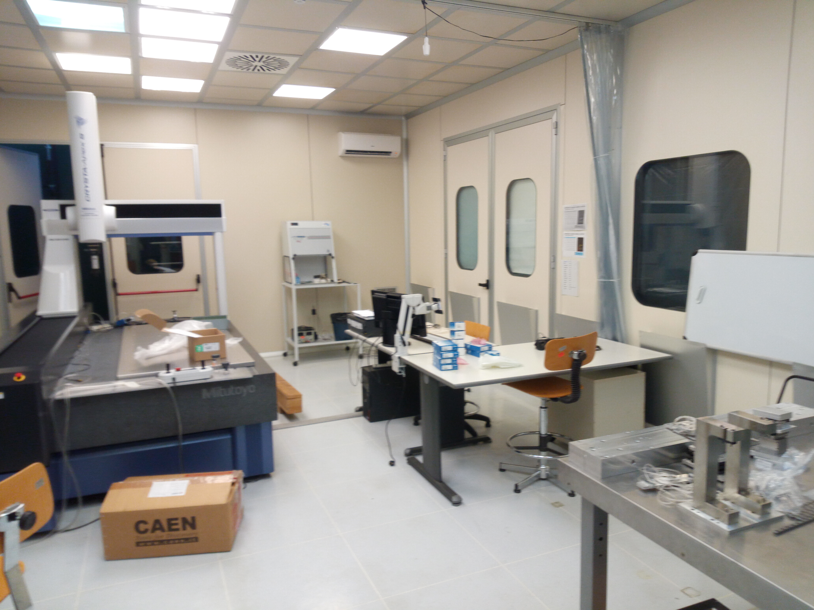
Infrastructure

Slide 7
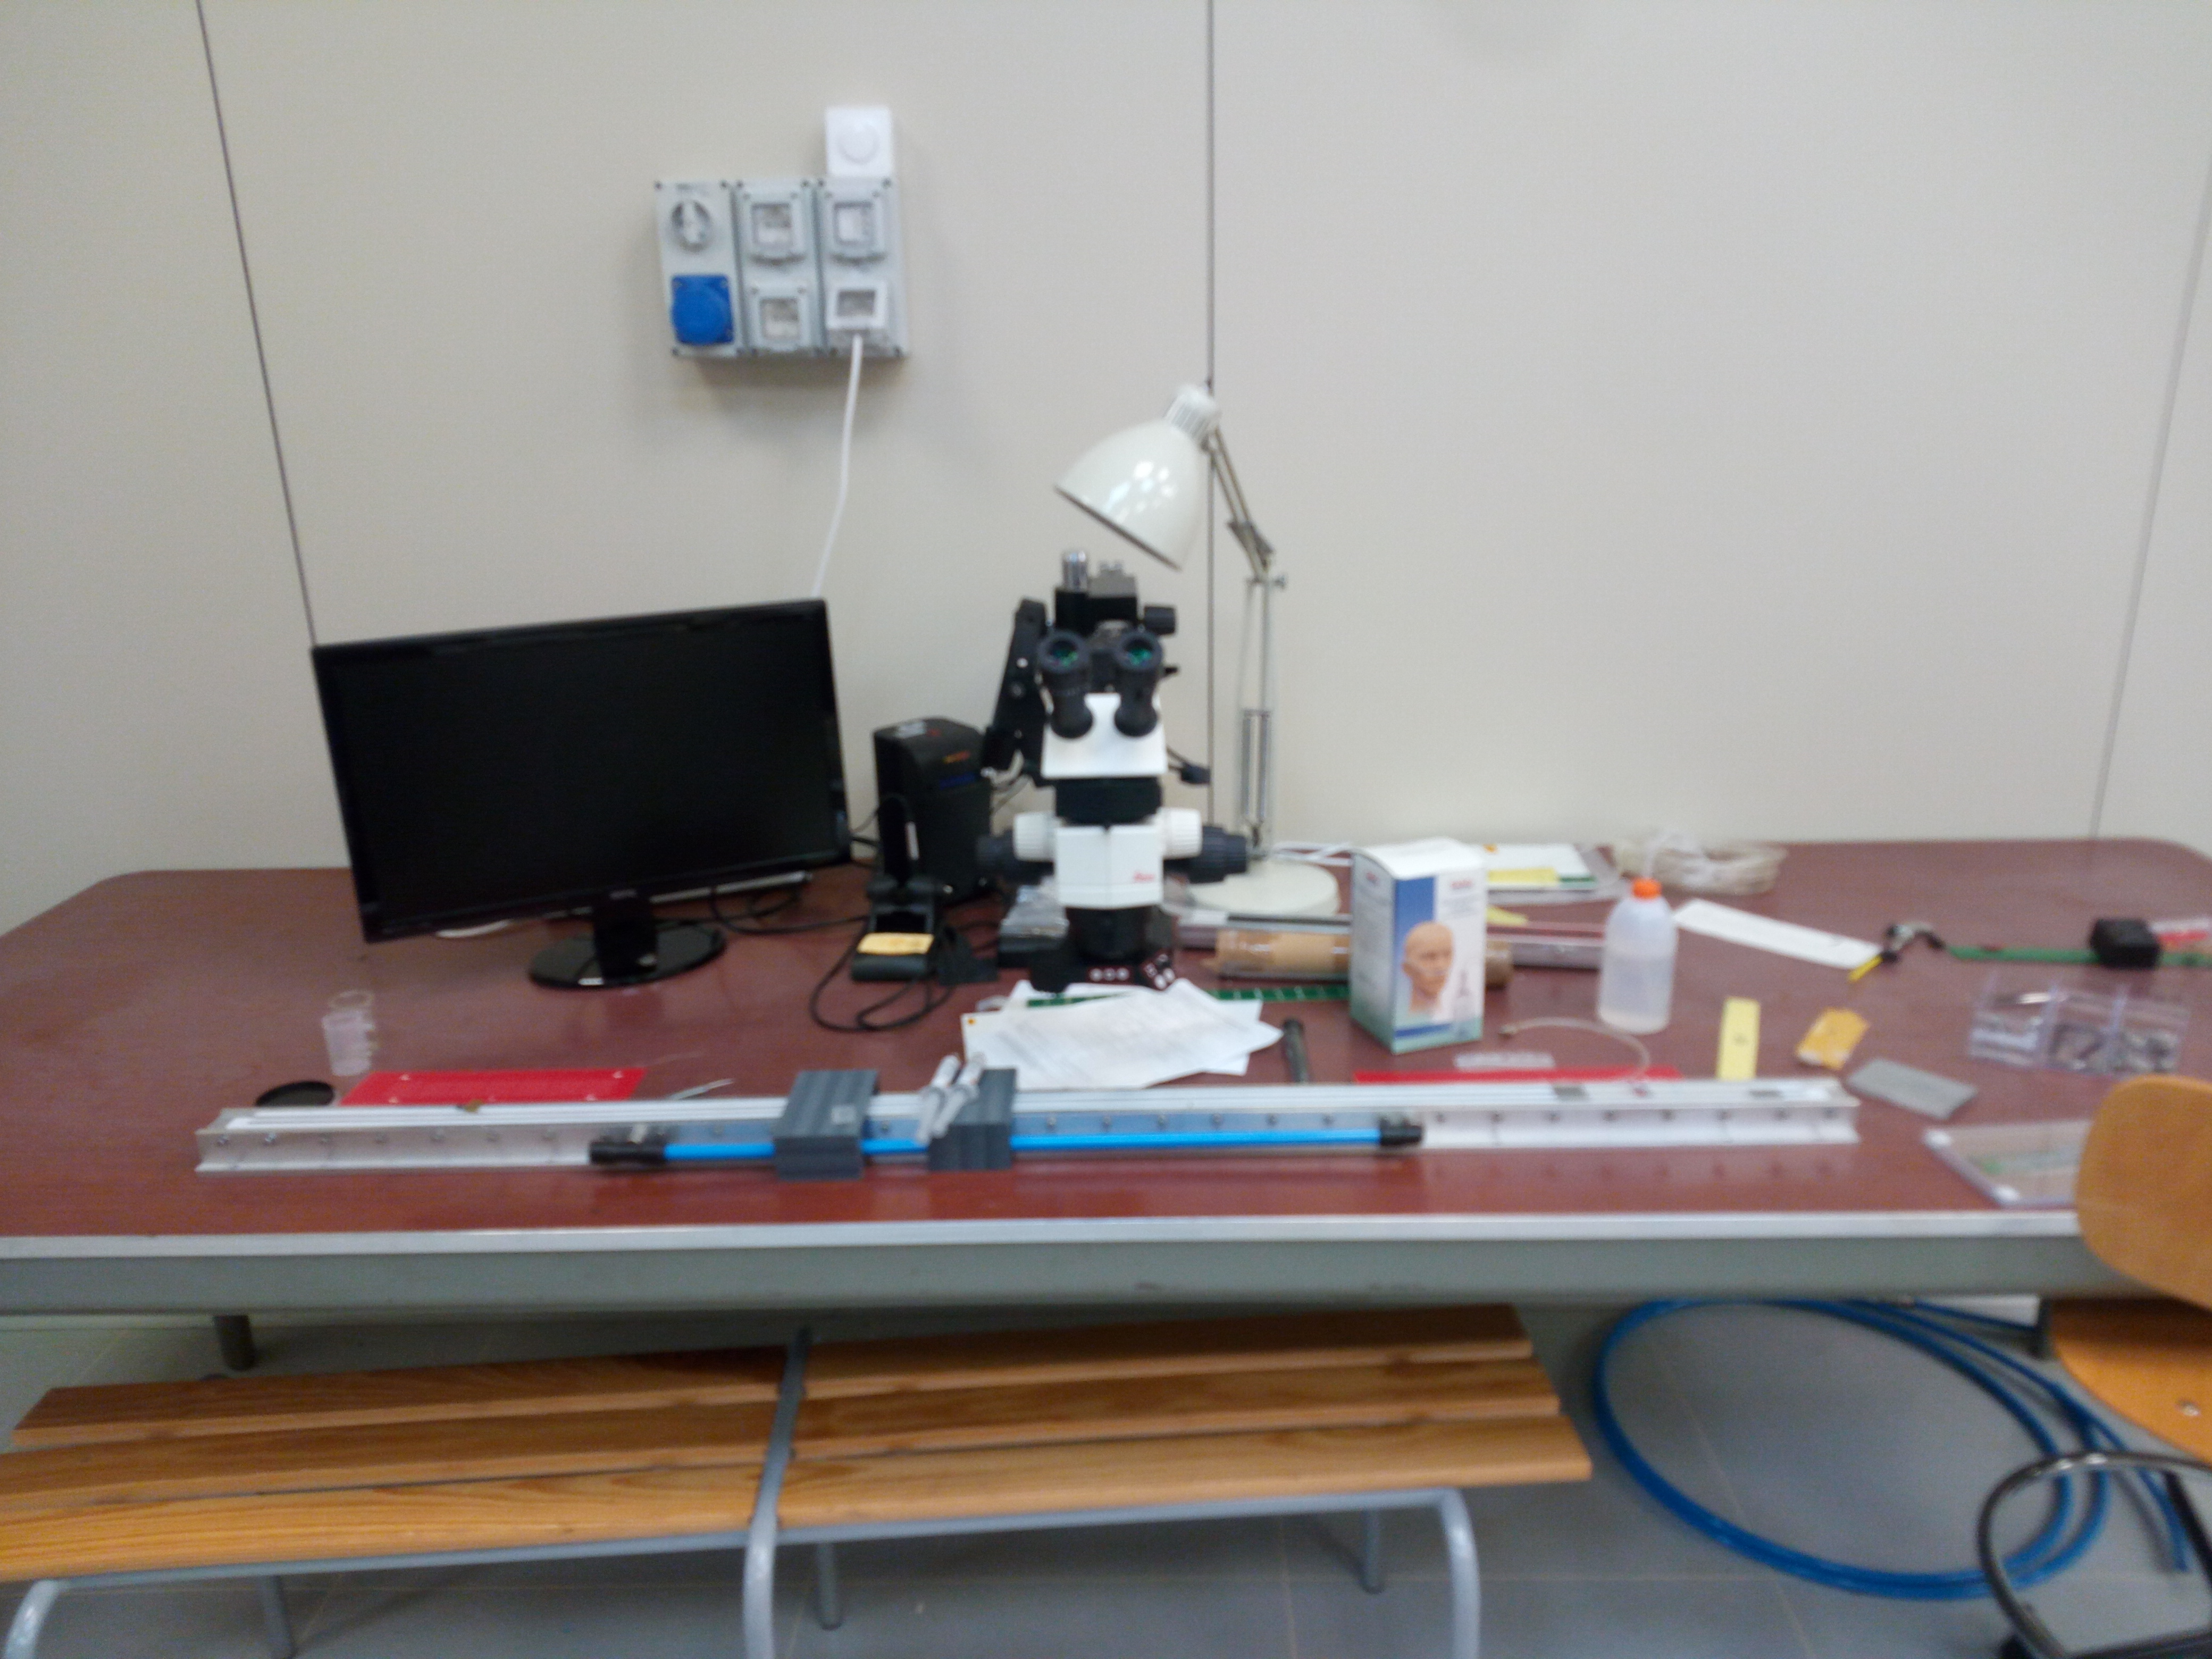
Infrastructure
Welding table
ToDo list
Al Base
Rails + carriages
Hands supports
Fume absorber

Slide 8
Welding Infrastructure
EDSYN (Sn62Pb36Ag2 ø=0.35 mm T= 183˚C) wire for FPC-FPC interconnections was bought at CERN by Daniele
Resume soldering tests this week using the old bridge-FPC structures.
Jig for the Power Bus welding and stave test
gray area
chiller setup: checked with Torino
  Internal pump is enough
  Design of hydraulic joints ongoing (Silvia C.)

Slide 9
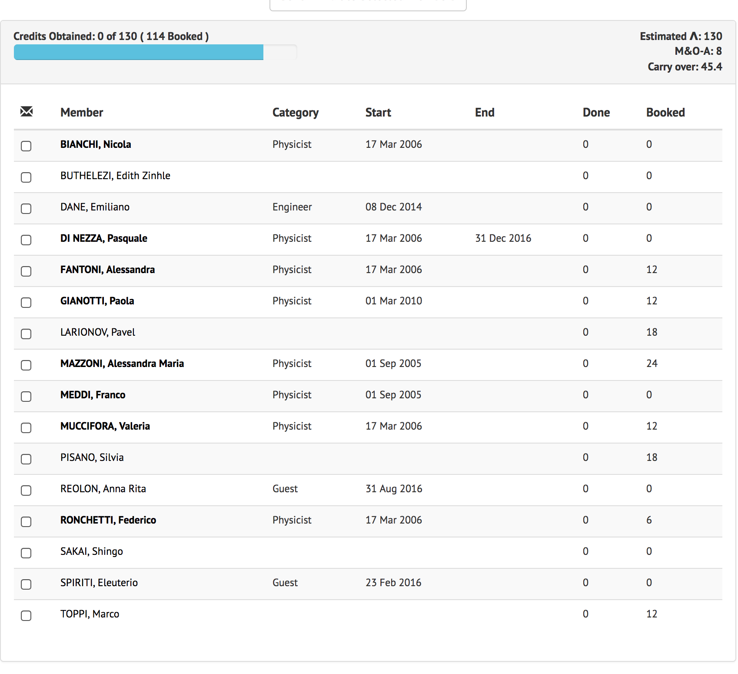
SHIFTS: https://alicesams.web.cern.ch
88% of the due

Slide 10
ALPIDE
Alpide Single Chip board and adaptor at LNF (thanks Daniele)
This week: try to plug the Chip board into the MOSAIC chain
Next week: finalize setup, possibility for test beam at the BTF

Slide 11
Backup

