Slide 1





ITS Upgrade Activity at Frascati
Federico Ronchetti
INFN-Laboratori Nazionali di Frascati
ALICE Meeting 07/02/2017

Slide 2
Outline
Stave assembly status
Welding procedure and stations
ALICE cluster status at LNF
Shifts
Alpide Production

Slide 3
Stave Assembly Status
Stave assembled with fake-FPC dummy modules
Data analysis ongoing (Marco + Pavel)
Transport of parts back to Torino being organized
  Jig ( need to find appropriate transport box)
  SS base bar (for teflon cleaning),
  old Handling Bar
  touch probe
To Do
  Stave metrology

Slide 4
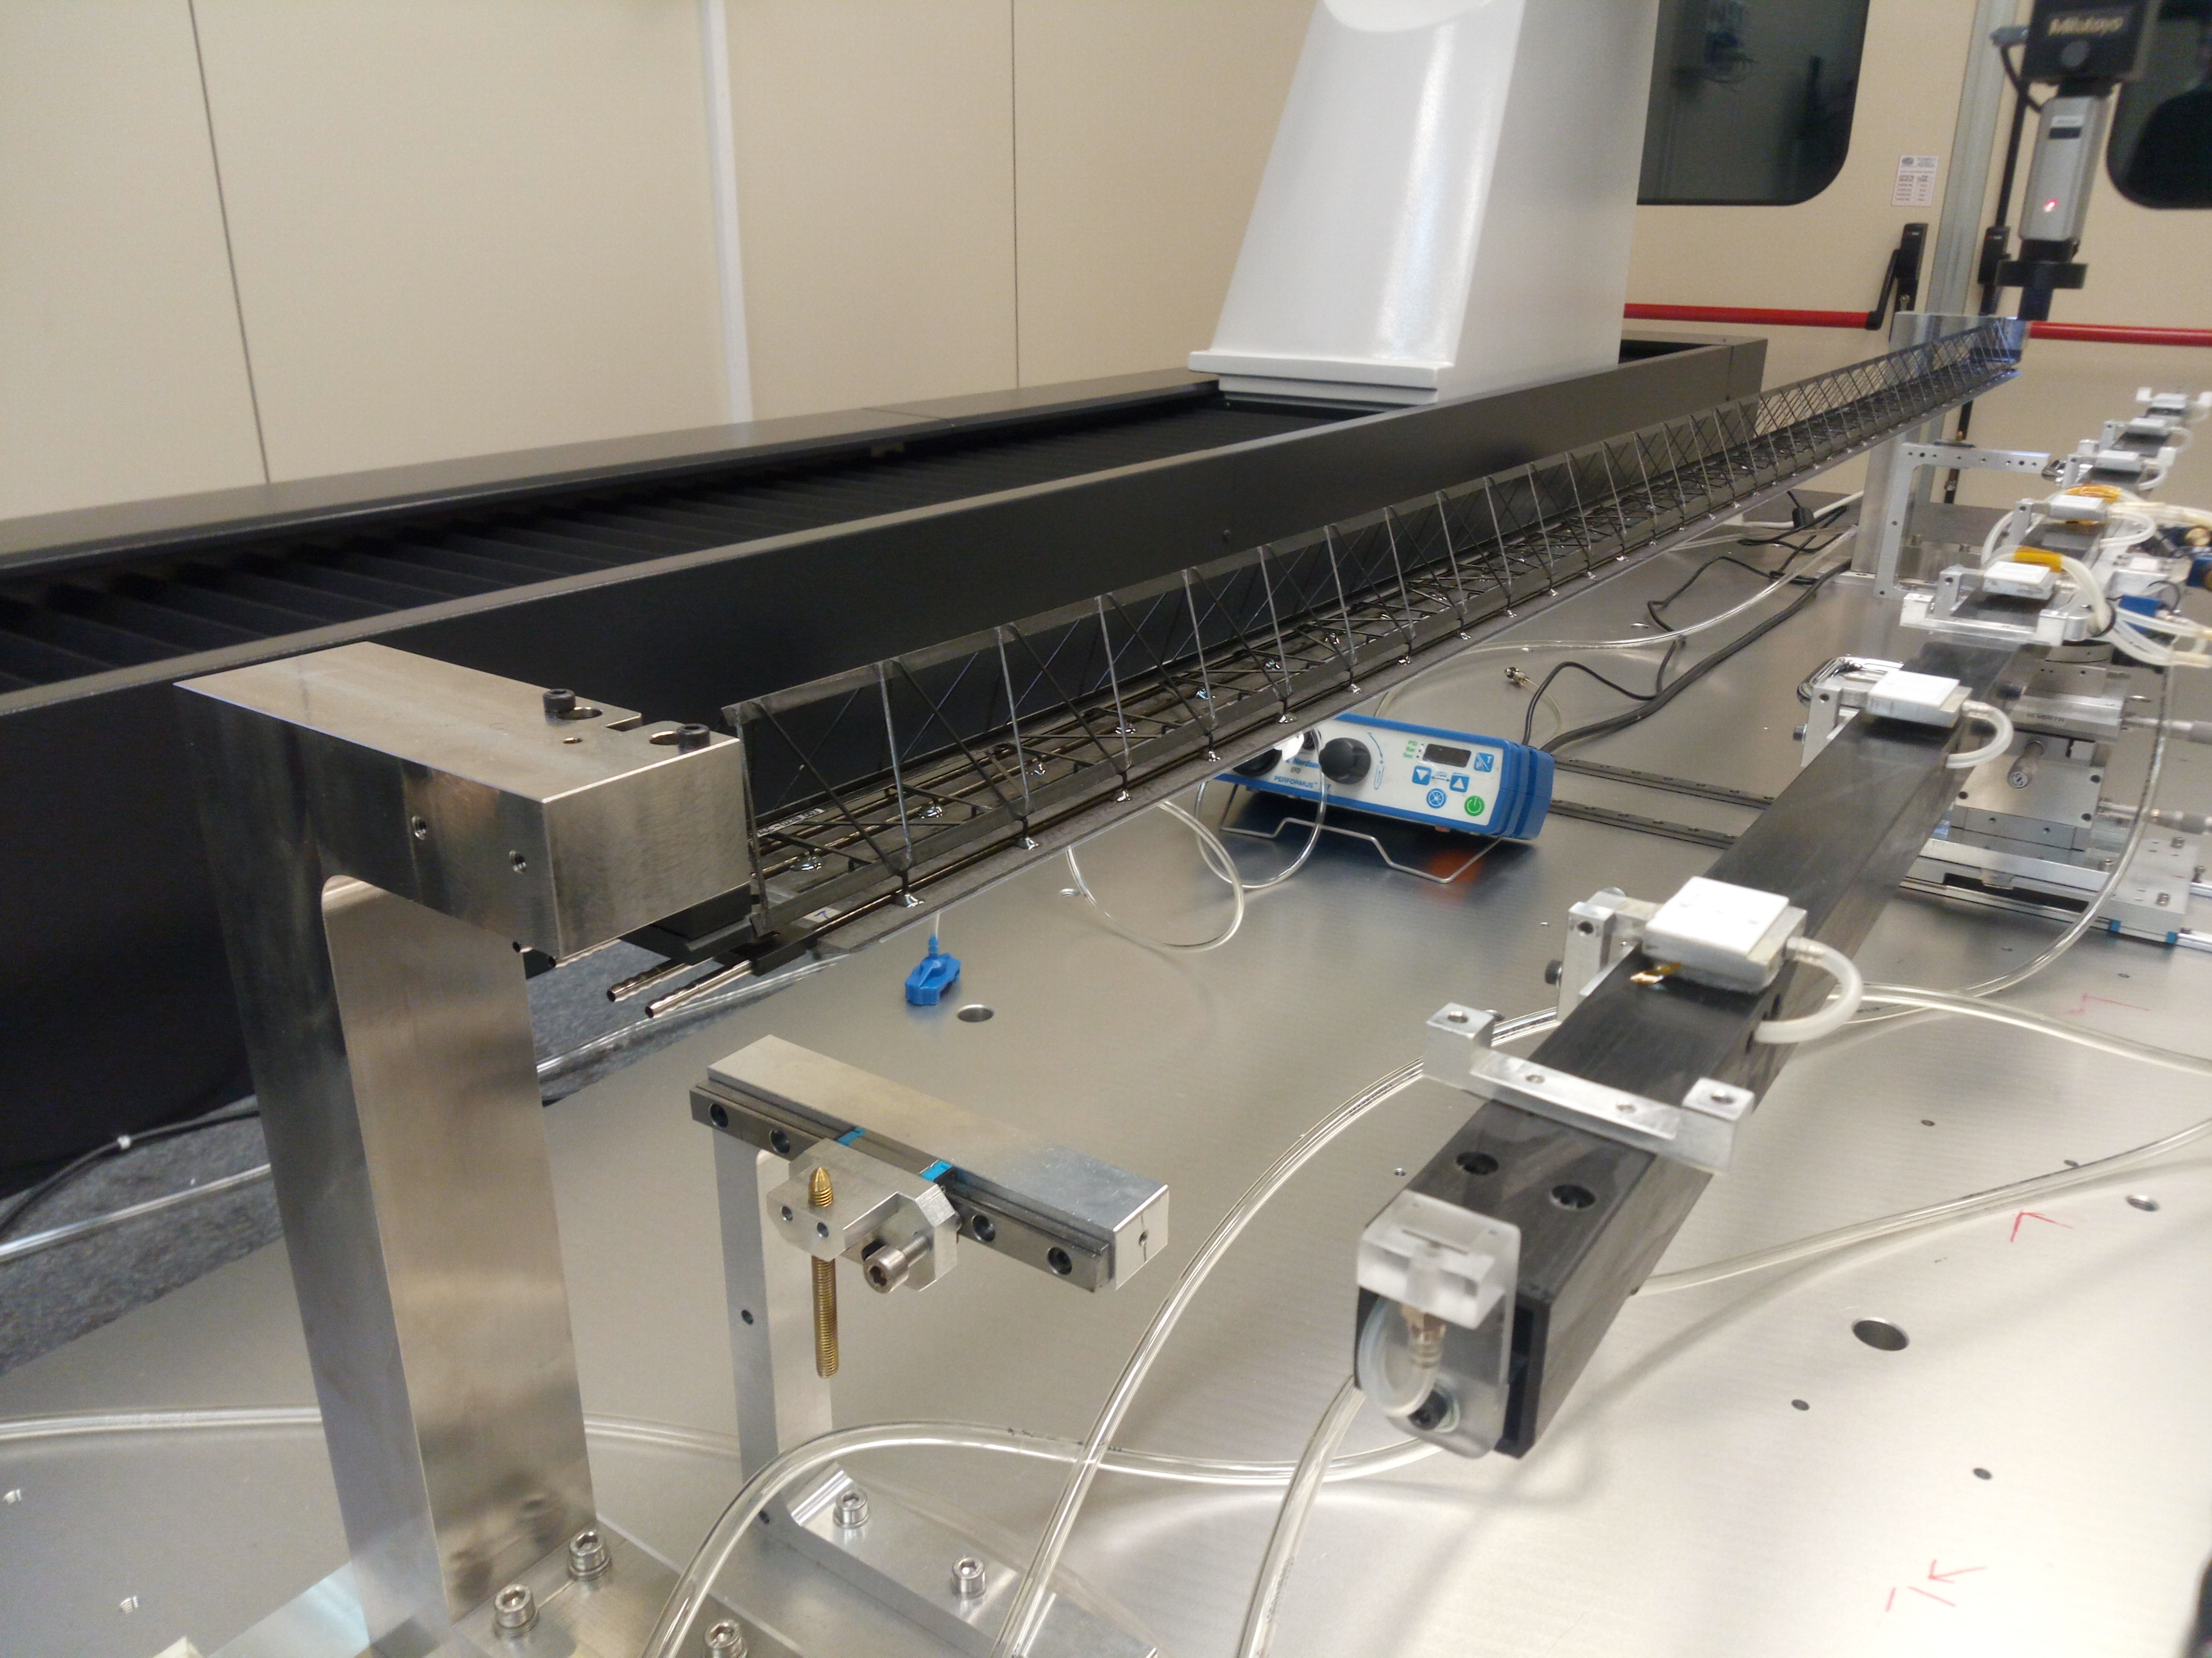
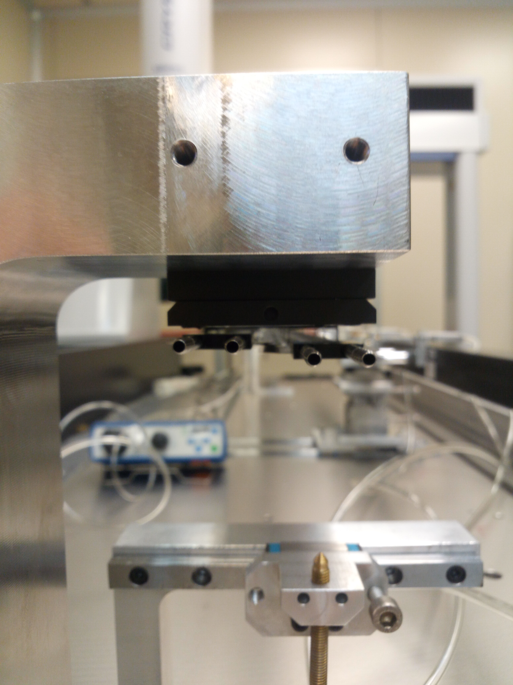
Stave Assembly Status

Slide 5
Infrastructure
Additional vacuum pump: ongoing (to be checked)
General conditioning system: to be checked
New table, chairs and PC for the clean room: ongoing, reminder sent
New common vestibule between the CL1000 and CL10000 rooms: ongoing, company allowed to work
Drier and air filter for secondary compressor: investigation of cost ongoing, no news, to be checked
Base for Half Stave welding
  drawings from Torino available
  Need validation and request to LNF workshop
  Welding air

Slide 6
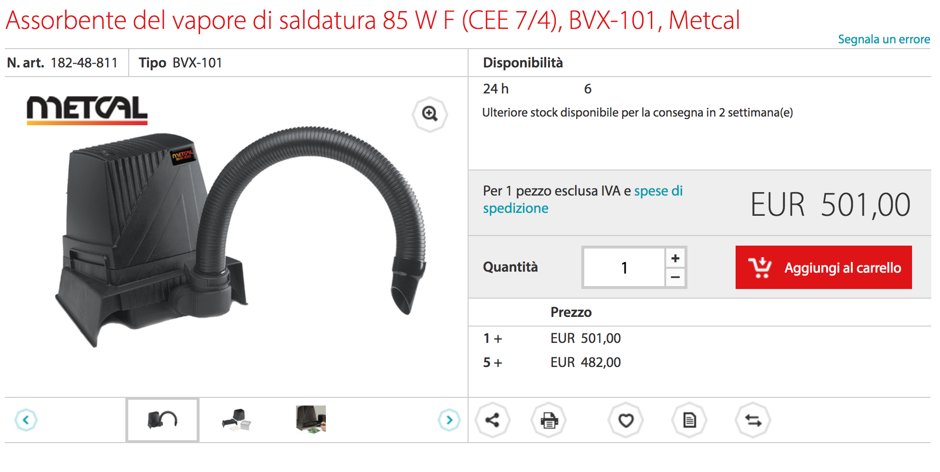
Welding
Optimal welding for FPC-FPC interconnections is obtained using solder wire:
EDSYN (Sn62Pb36Ag2 ø=0.35 mm T= 183˚C)
Welding reels being purchased at CERN (Daniele and Alessandro)
Need for fume absorber(s)

Slide 7
Welding Infrastructure
Jig for the Power Bus welding and stave test
gray area
test for the chiller and chiller setup
still to be checked with Torino

Slide 8
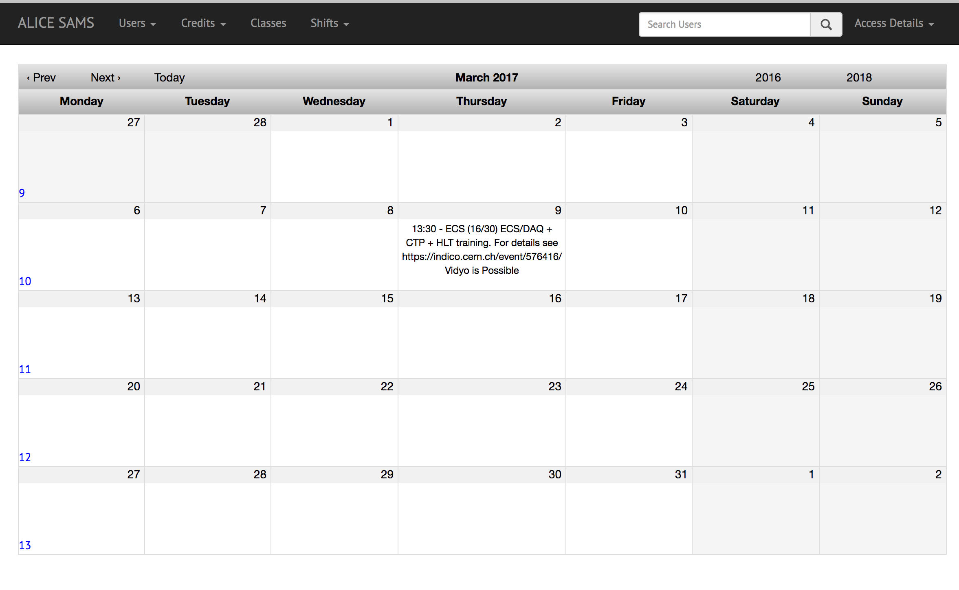
SHIFTS: https://alicesams.web.cern.ch
You need to sign up to a class
(ECS, DCS, DQM, SL) to be able to book.
Keep an eye on the SAMS calendar

Slide 9
Local ALICE Cluster
Proposed breakdown of tasks to revive ALICE computing at LNF
Recreate the login node with AFS services (LNF)
Install CENT OS 7 (LNF/ALICE)
Install ALICE libraries (ALICE)
Maybe fix the local queuing system (LNF)
Agreement with Paola – need to be communicated to Computing Service

Slide 10
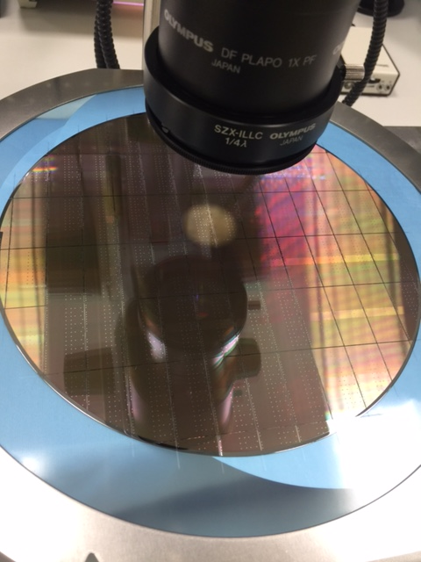
Chip Production
Alpide production
Production of Polyimide protection layer for the chip: ongoing
25 wafers delivered end February/ beginning of march
Legal issues being solved
Dicing
Problem: filaments, due to dicing technique?

Slide 11
Chip Production
Residues of tape glue (filaments) on chip edges
Present on almost all chips, mostly away from round pads, close though to small pads
Cannot be removed with N2 blowing

Slide 12
Backup

