Slide 1
The response of EBT3 films ¹H, ¹²C, ⁴He, ¹²O, e⁻, γ clinical beams
in the dose range of 0.4 – 20 Gy
@ CNAO (Pavia), HSR (Milano), CPT (Trento), HIT (Heidelberg)

Slide 2
Measurements in 2015
CNAO - Pavia (July and November)
Dose response of EBT3 films:
Proton Beams 63, 150 and 230 MeV
Carbon Ion Beams 115 MeV/u and 400 MeV/u;
Depth Dose in water with proton beam of 150 MeV and carbon ion beam of 400 MeV/u:
Markus chamber
EBT3 films;
HSR - Milano (September)
Dose response of EBT3 films:
Radiotherapy accelerator
Photon beams 6 MV and 18 MV
Electron beams 6 MeV and 12 MeV;
3. HIT - Heidelberg (October)
Dose response of EBT3 films:
Proton Beam 150 MeV
Carbon Ion Beam 150 MeV/u;
4. CPT - Trento (September)
Dose response of EBT3 films:
Proton beams 90 MeV and 180 MeV

Slide 3
EBT3 Dose Response Curves

Slide 4
Depth Dose Curve (150 MeV protons)

Slide 5
Depth Dose Curve (400 MeV/u ¹²C ions)

Slide 6
Misure dE/dx al Tandem Napoli (2016)
Acceleratore in manutenzione fino ad Aprile
Misure di de/dx in acqua liquida previste Maggio-Giugno
STATO: ACCELERATORE MAI RIMESSO IN FUNZIONE E TUTTORA FERMO

Slide 7
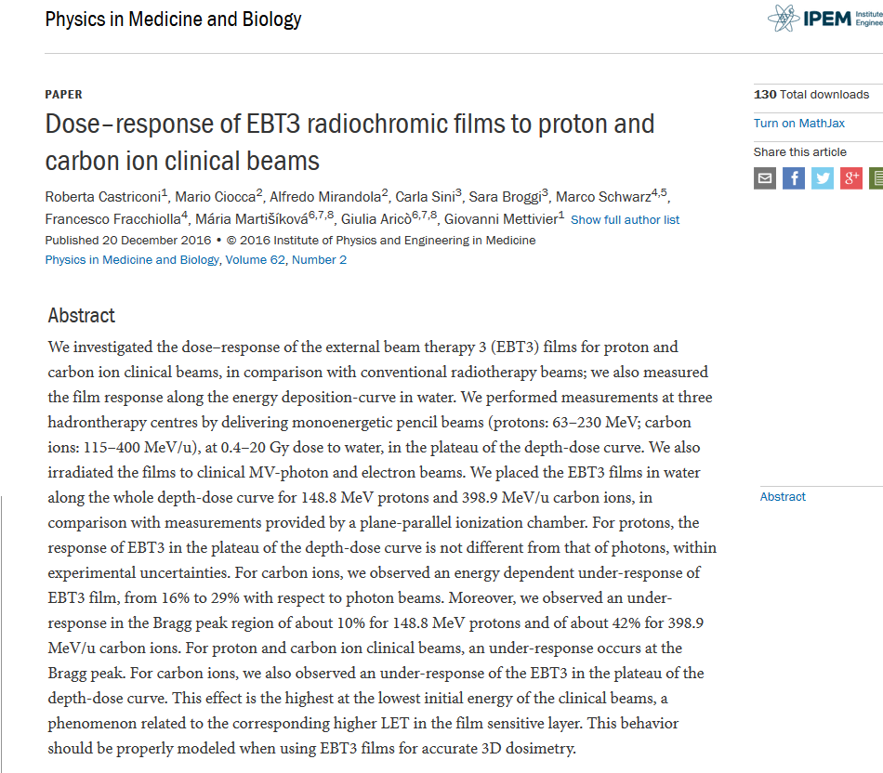
Misure 2016 ad HIT – ¹²C, ¹H

Slide 8
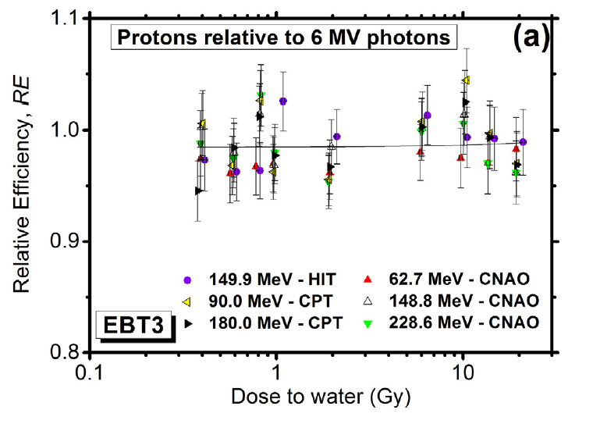
Misure 2016 ad HIT – ¹H

Slide 9
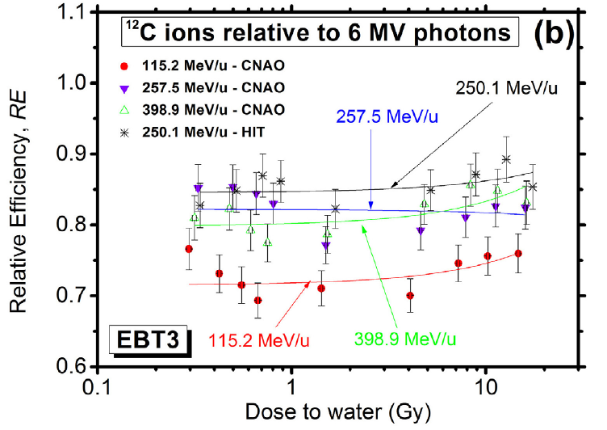
Misure 2016 ad HIT – ¹²C

Slide 10
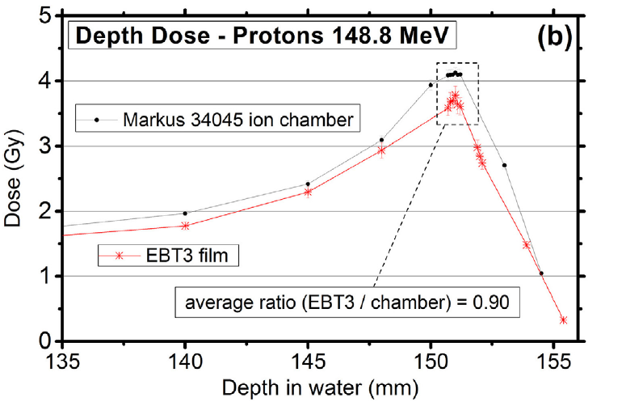
Misure 2016 ad HIT – ¹²C

Slide 11
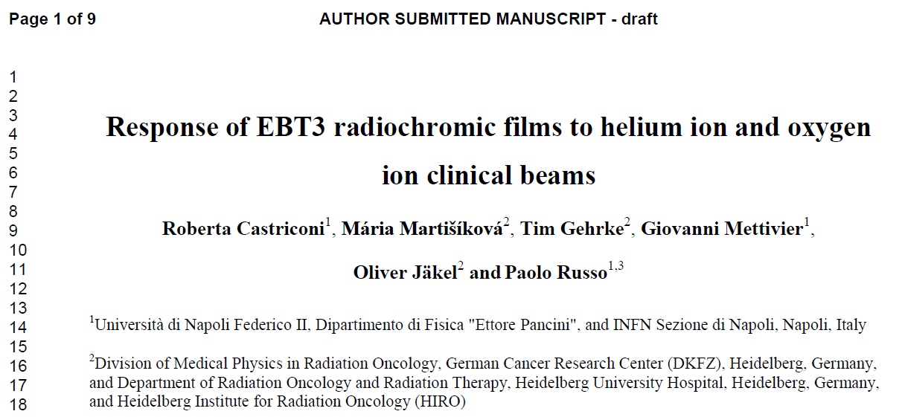
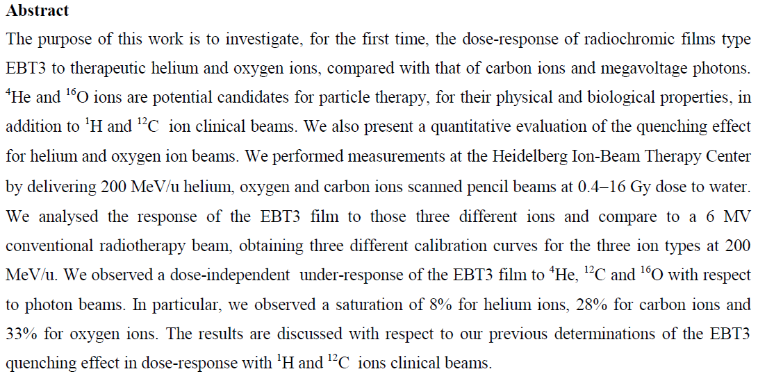

Slide 12
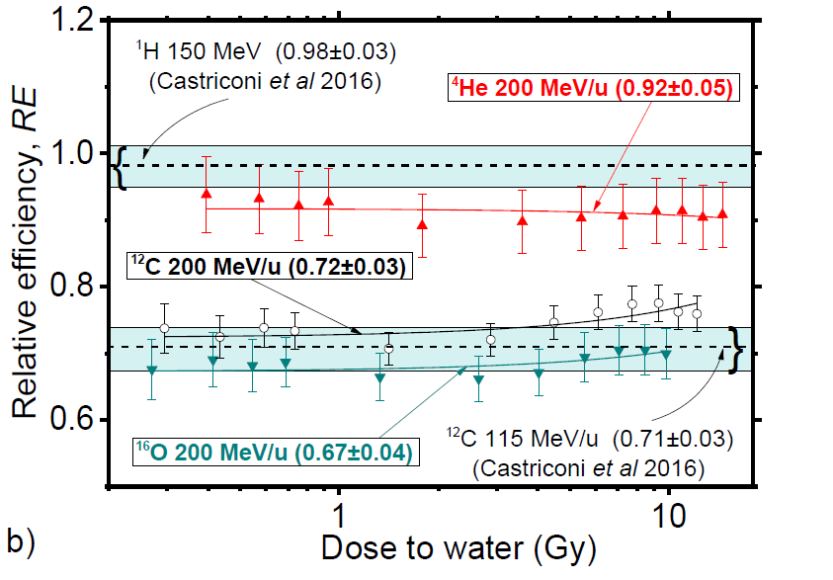
Misure 2016 ad HIT – ⁴He, ¹⁶O

Slide 13
Misure 2017
Interconfronto di dose tra HIT, CNAO, CPT,

