Slide 1
Measurements Planning 2017-2018

Slide 2
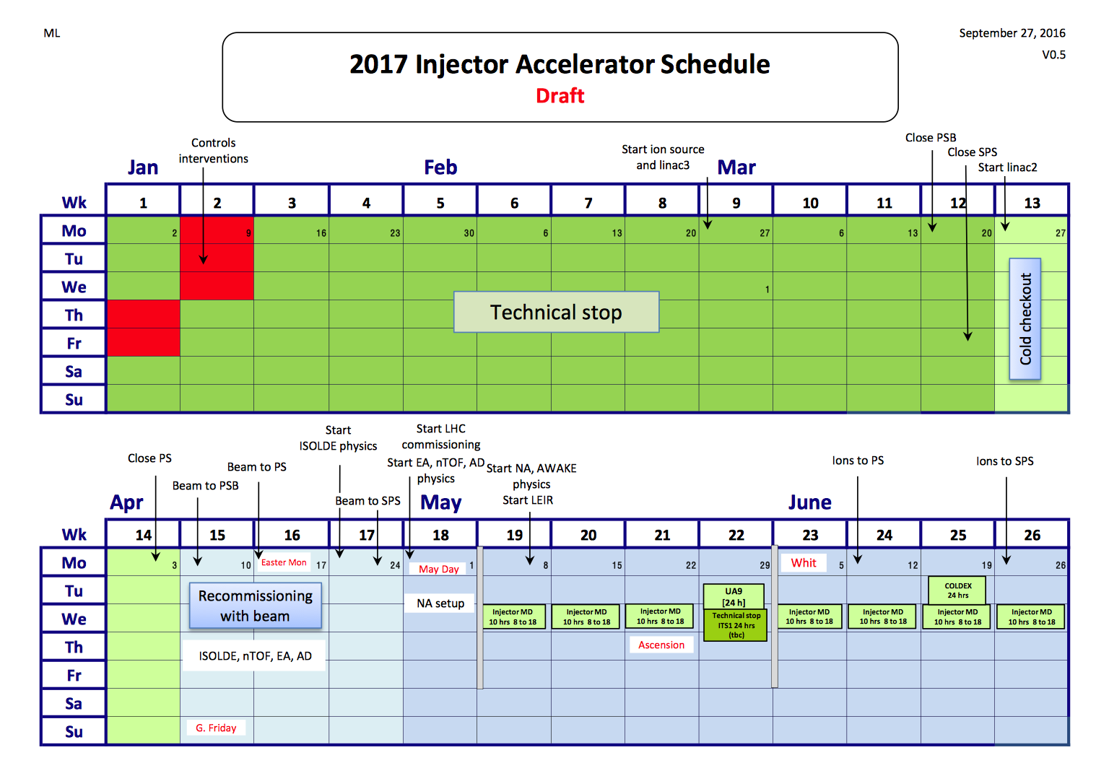
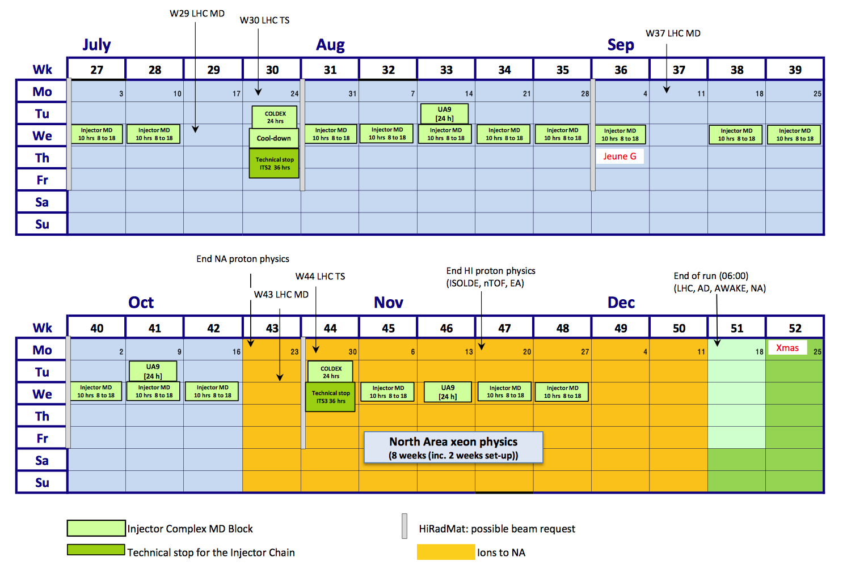
2017 Injector (draft) schedule
n_TOF Physics Run 2017
29 weeks from May 1st to November 20th
(2 weeks shorter than 2016 and 2018)
N.B. The ISOLDE class A will not be in operation
between the 9th January 2017 until the 30th March 2017
(modification ventilation system)

Slide 3
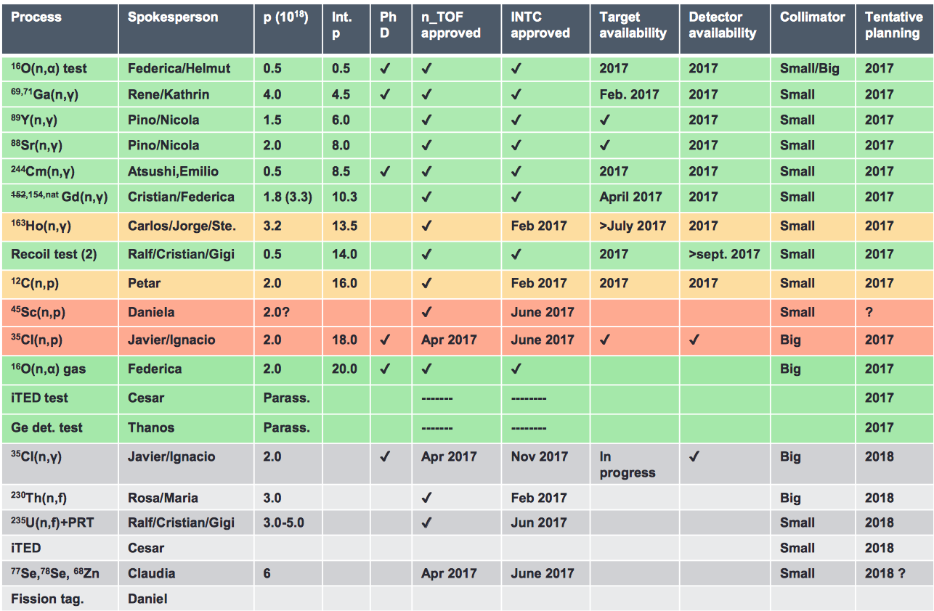
EAR1 (1.8x10¹⁹ p.o.t. in 2017, 1.9x10¹⁹ p.o.t. in 2018)

Slide 4
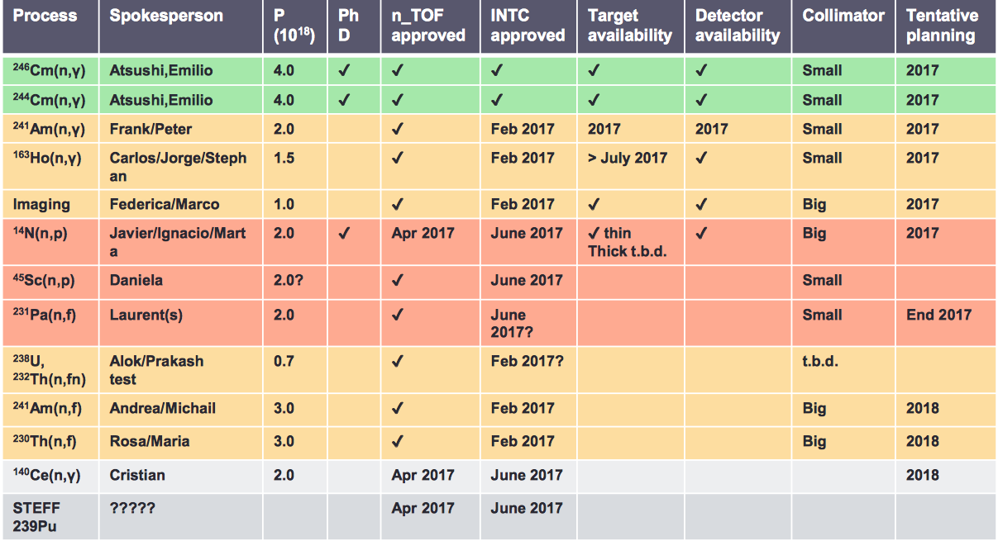
EAR2 (1.8x10¹⁹ p.o.t. in 2017, 1.9x10¹⁹ p.o.t. in 2018)

