Slide 1
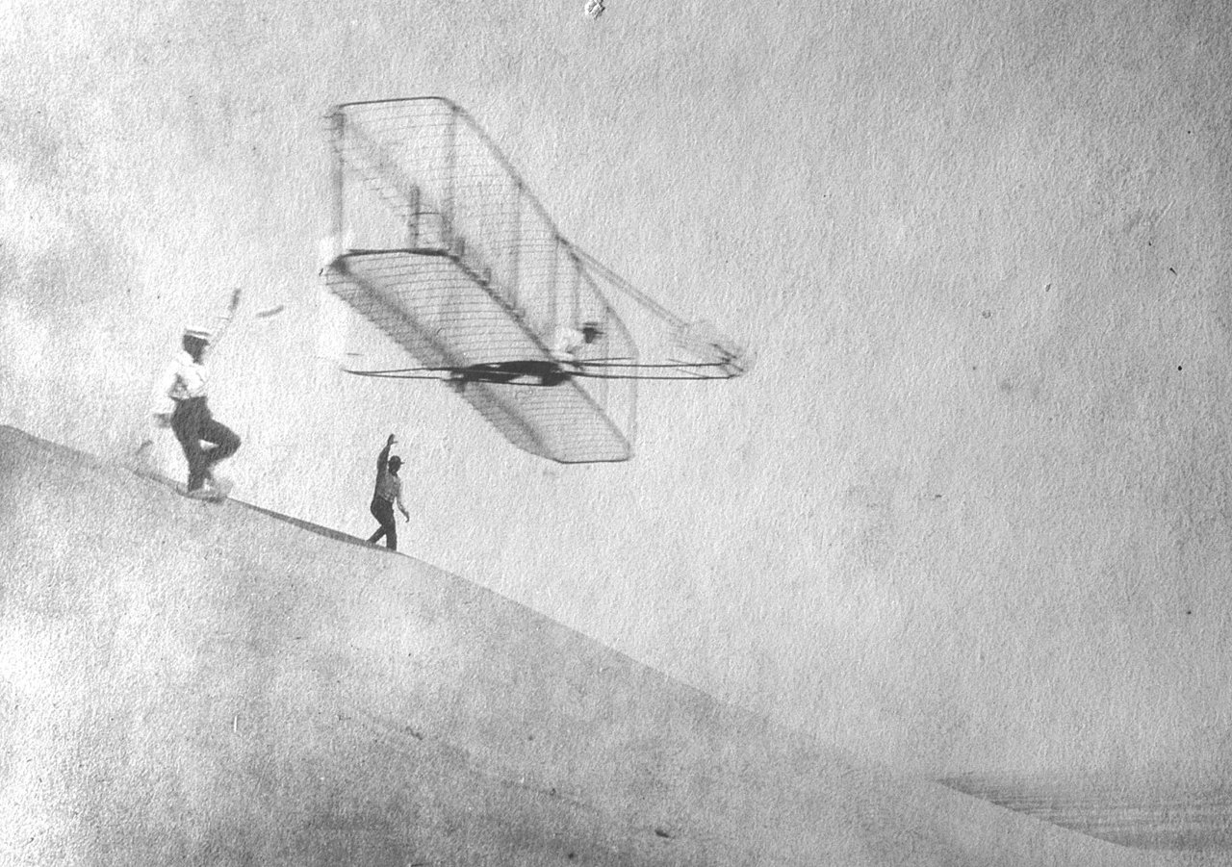
The Doctor’s leap
Transferrable skills and the value of a PhD outside Academia
Eva Ratti, C2T Consortium fot Technology Transfer
Project manager Find your Doctor
Gran Sasso Science Institute, 25 Gen. 2017, L’Aquila
Notes:
I’m here to discuss with you the crucial role of discontinuity in career paths starting from academia and to introduce a practical tool – which we call Find Your Doctor - to manage such discontinuity while unveiling its intrinsic educational content.

Slide 2
Part one:
On the employability of a PhD today
“
The real voyage of discovery consists not in seeking new landscapes, but in looking with new eyes.
Paraphrased from Marcel Proust
Free PowerPoint Templates
Notes:
Or, are we all doomed?

Slide 3
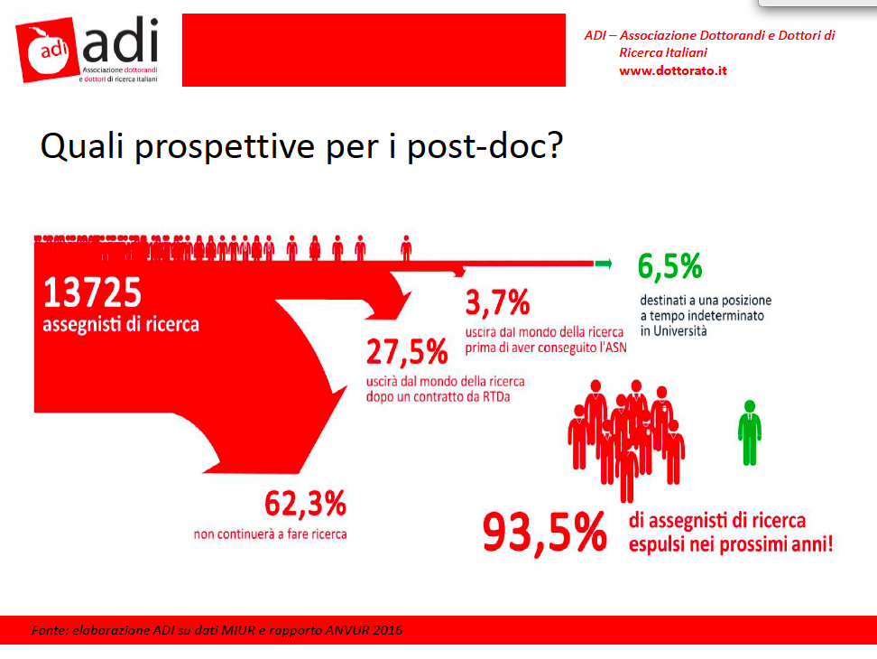
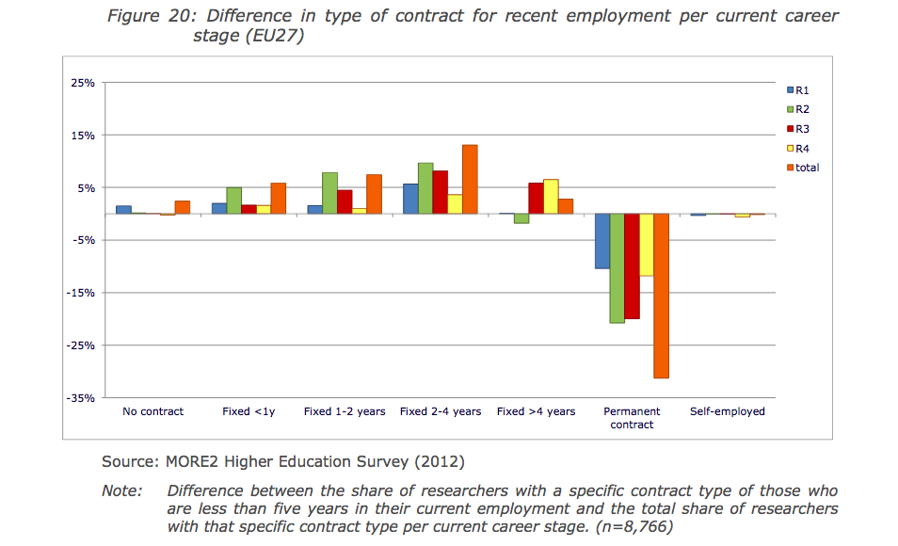
Little perspectives in the Academia
PhD as first step to Academic/research career, but:
Few per cent of PhDs expected to reach permanent positions in Academia, across western states
Notes:
Even systems with a strong tradition of hiring researchers on a tenured or tenure-track position, or with permanent civil service hiring arrangements similar to tenure, are moving toward more fixed-term appointments. Several countries (in Western Europe) have formally abolished tenure, and have replaced it with term contracts which are renewed as a matter of course44.
Nota: The R3 researchers are in the majority (32%), followed by R4 (29%), R2 (21%) and R1 (18%). Notare però che questa è gente che lavora in uni o governativa, sono dati del MORE2

Slide 4
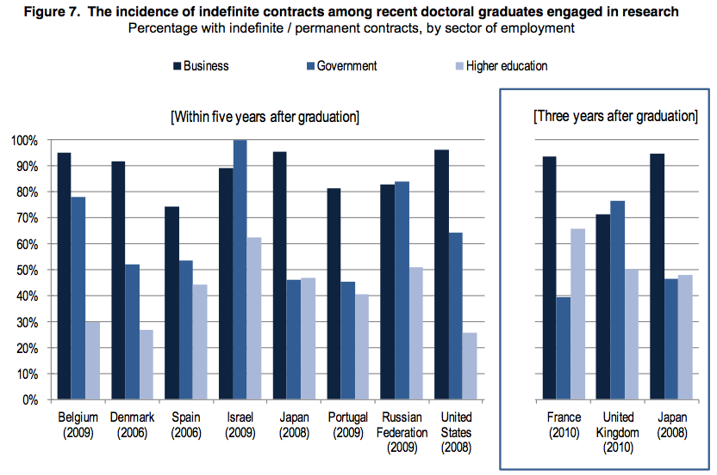
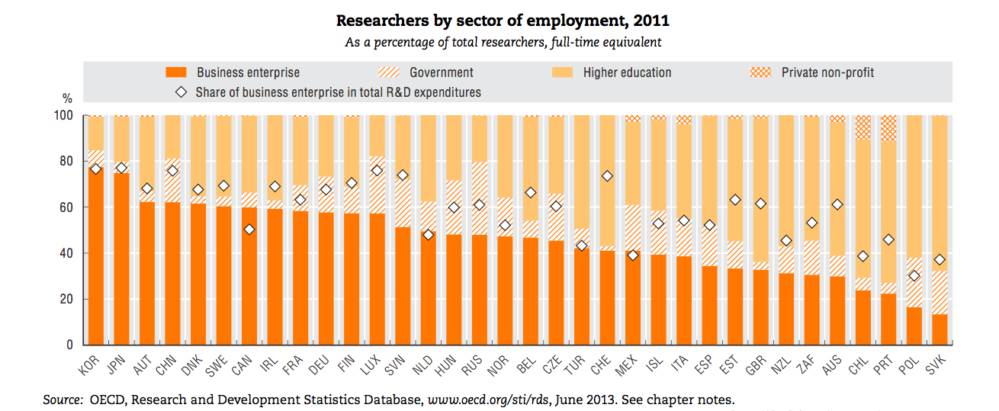
Long term perspectives in business
Including all types of contract, around 50% of PhDs across Europe is in business
More indefinite contracts in business
Notes:
Qui abbiamo I ricercatori per settore di impiego, mappati da survey sulla forza lavoro riportata in OECD science&tech scoreboard.

Slide 5
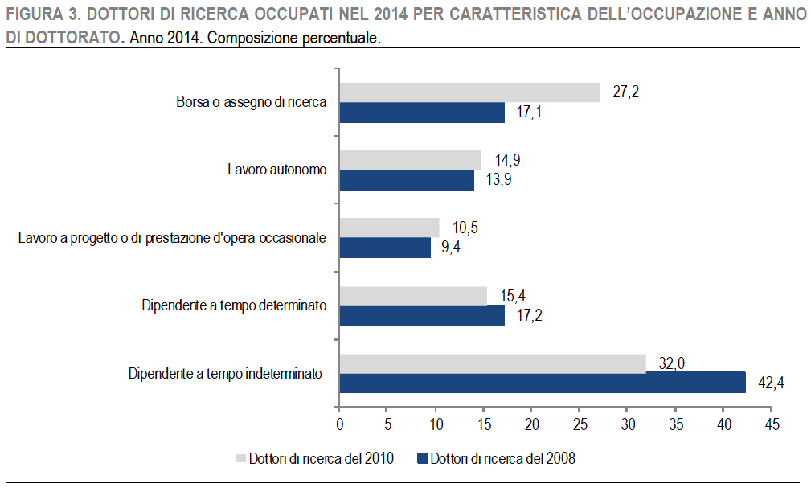
Long term perspectives in business (IT)
Italy: contracts in business seem around 40%-50%
Not Academics
Partly Academics
Notes:
Qui abbiamo I ricercatori per settore di impiego, mappati da survey sulla forza lavoro riportata in OECD science&tech scoreboard.

Slide 6
Should we make the PhD more business-oriented?
“
If I have to go into business anyway, does a PhD training make sense?
Free PowerPoint Templates
Free PowerPoint Templates

Slide 7
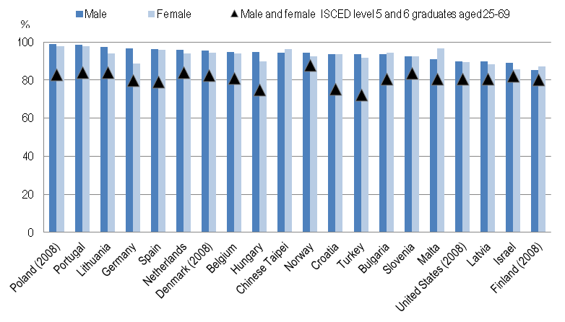
Employment rates
Employment rate for doctorate holders by gender, 2009
PhD’s employment rates higher than for other graduates, internationally and in Italy

Slide 8
Employment rates (IT)
[ISTAT report 2015]
“Occupation is high in all disciplines, especially among Doctors in Mathematics, Informatics, Industrial and information engineering”
“… the competitive advantage of the PhD title is maintained”

Slide 9
>1800 € for PhDs in medicine, physics, information and industrial engineering, economics and statistics, law; >1400 € in the humanities
Median monthly salaries
(IT)
Highest wages for (company) employees and self-employed men
Notes:
Mostro solo Italia perché sappiamo che non è tra i migliori, anche se dalla stessa indagine non sembra grande la differenza rispetto alla media degli altri stati.
La media non male. Se mi focalizzo sui contratti da dipendente che sono tipici dell’impresa, anche meglio
Sarebbe bello avere una comparazione con i redditi medi a sei anni dalla laurea

Slide 10
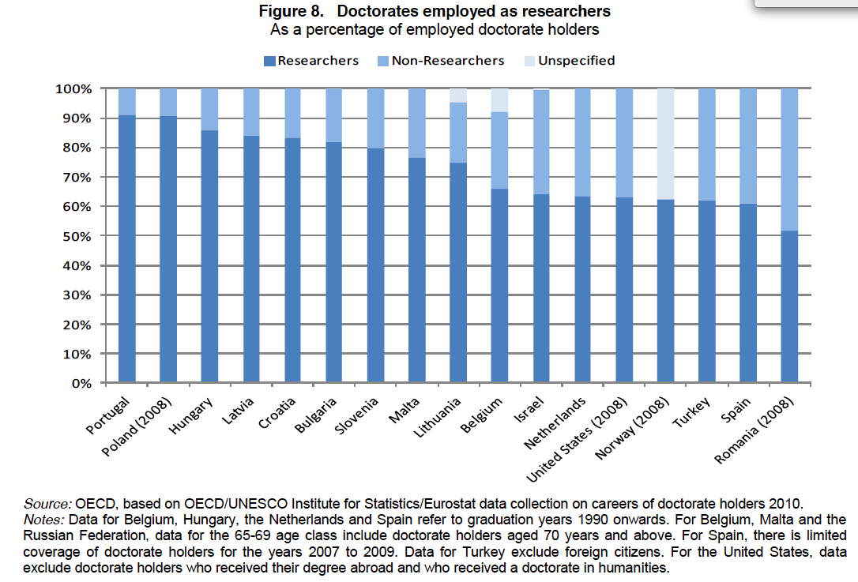
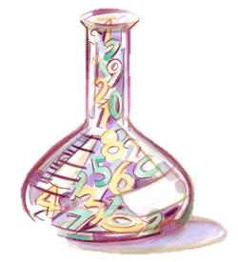
Tasks
Natural scientists and engineers are more likely to be engaged in research, while social scientists find more opportunities in non-research occupations that are nevertheless related to their degree.
Tasks for PhDs outside Academia in ITALY:
~ 40% declare to be engaged in research
~ 50%-75% declare job is adequate for their level of instruction
Rough estimate from ISTAT, assuming 40% PhD in business
Notes:
La stima viene da quanto riportato dall’ISTAT: tra 80 e 90 percento PhD a seconda della disciplina dichiarano di afre lavoro adeguato, a 4 anni dal PhD. Tre su quattro dichiarano di fare ricerca.
In italia l’ISTAT rileva un lieve calo tra l’indagine condotta nel 2014 e quella del 2009, dell’ordine del 3%: vista la crisi, non stravolgente e comunque meglio che i livelli di occupazione ordinari. Sarebbe bello avere una comparazione con i redditi medi a sei anni dalla laurea
La quote è da uno studio europeo
What does it mean “related to their degree?”

Slide 11
Part two:
Research background outside the Academia
“
What is related to a PhD other than pure research?
Is a PhD training wasted when you leave “the lab”?
“
Free PowerPoint Templates
Free PowerPoint Templates
Notes:
A cook can’t cook if there is nothing to prepare. A doctor can’t cure if there is no illess. But a researcher, is a researcher everywhere.
If you stop doing research, is your training wasted? I will answer not from the point of view of your personal goals, but from that of society

Slide 12
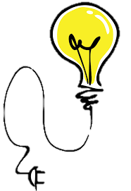
Researchers as knowledge workers
“
Researchers are defined as professionals engaged in the conception and creation of new knowledge, products, processes, methods and systems and are directly involved in the management of projects.
“
Well trained, creative and dynamic researchers are indispensable for building and sustain a competitive knowledge-based economy. […] Europe still has a long way to go before it matches the US, Japan and China in the ratio of business-to-public sector researchers.

Slide 13
Europe wants more
“
The proportion of researchers employed in the business sector is insufficient to sustain Europe’s position as a global economic leader.
An additional one million researchers may be needed in Europe by 2020 to meet an R&D intensity target of 3% GDP.
Europe must invest in generating sufficient large pool of skilled human resources for research and innovation
Notes:
Why? What is it that is so valuable? For same may be hard knowledge. But they make no distinction here on the discipline of study. I use to study black holes, most study things that do not directly apply. Do they need to know what an accreting X-ray binary is? I doubt it...

Slide 14

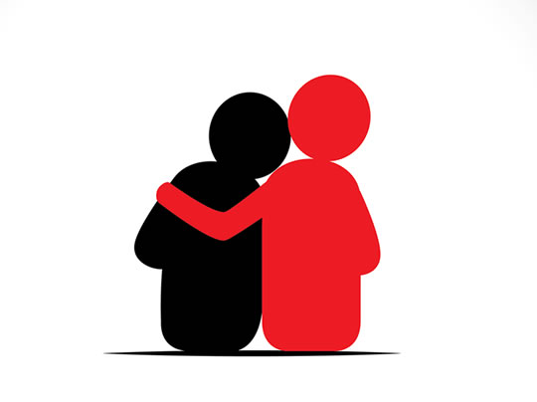

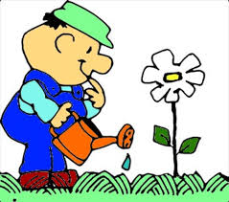

Tacit knowledge
“
A knowledge that is not coded, not written in texts or manuals, nor communicated in a structured way, but that exists in the head of individuals, developed through experience and – as such – connected to intuitions and sensations that can hardly be understood by those who do not share the same experience
Notes:
Know how is way more difficult to learn than know what.
(Questi due termini furono coniati dal filosofo del linguaggio Gilbert Ryle nel testo “the concept of mind” del 1949)
La definizione viene da Wiki, ma è stata validata da Andrea.
“una conoscenza non codificata, non contenuta in testi o manuali, non gestita attraverso flussi comunicativi strutturati; ma una conoscenza che esiste nella testa degli individui, che nasce dall'esperienza lavorativa e che - come tale - si collega alla capacità di comprensione dei contesti di azione, intuizioni, sensazioni che difficilmente possono essere comprese da chi non condivide tale esperienza”

Slide 15
A bit of PhD’s know-how
Information management
Analyse the context, collect data/info
Organise information from different sources
Browse scientific/technical literature
Understand the reliability of sources
Assembly data/info
Communicate/share info
Make deductions (find solutions)
Project management
State-of-the art analysis
Define goals/schedule
Locate resources
Time management/organise work
Team working (international/remote)
Write proposals, reports, documents
Communicate results
…
& a cutting edge “Know what”
Notes:
Could you do it after your Mastr’s degree? No one gave you a manual to do that. You learned it on the field.

Slide 16











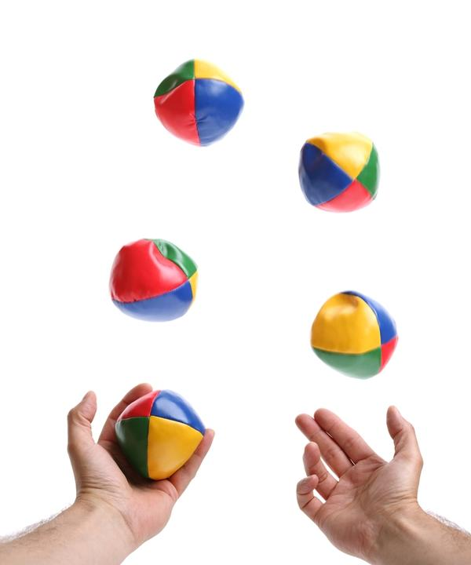

Let’s do this!
Set reasonable goals
Publish
Is it good?
Is it new?
What’s been done already?
Write a plan/proposal to obtain resources
Go to conferences
Talk to the collaborators, learn or get the tools…
What instruments/methods/tech do I need?
Hard work
Who do I need?
Be cited, find new ideas, partners, job..
(+ increase knowledge)
What resources: money, time, data…?
Research project:
Notes:
Start with an idea, yours or your supervisor’s, Check literature for what has been done, Figure the tools and methods you need (software, instrumentation…), Write a project plan, obtain resources (financial or data), Identify cohautors, if needed, coordinate the work, face trouble, pray, produce your result, advertise your result, collect citations and find the next job.

Slide 17
Set reasonable goals
Have your product ready
Let’s do this!
Publish
Is it good?
Is it new?
What’s been done already?
Write a plan/proposal to obtain resources
Marketing
Talk to the collaborators, learn or get the tools…
What instruments/methods/tech do I need?
Hard work
Who do I need?
Sell product and keep company running
What resources: money, time, data…?
Business project:
Notes:
Underlying logic is the same!
Ovviamente certi aspetti si fanno in modo diverso: es, pianificazione pervede budgeting e piani economici → vanno imparati.

Slide 18
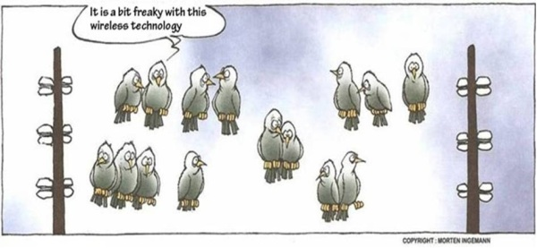
New field, new rules
You must acquire the “know-what” of the new context in order to transfer your “know-how”
“
Although the nature of PhD training is diversifying and the majority of PhD graduates embark on careers outside of academia […] early stage researchers are often inadequately informed about career paths outside of academia and have insufficient experience in industry and other relevant employment sectors. Only one in ten early-stage researchers reported receiving training in entrepreneurship or intellectual property rights during their PhD.
Notes:
Universities are working to include teachings about some of those qinformation that will help you in the new context.

Slide 19
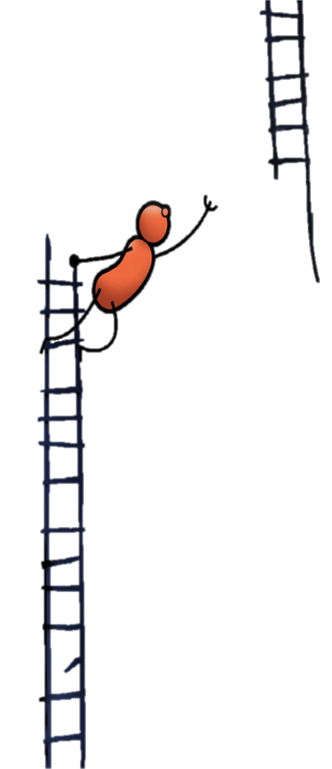
Difficulties in the transition
Most companies in Italy (and Europe) are small and do not do proper R&D
Most companies (especially small ones) are not aware of the content of a PhD training
Big companies with R&D or consultancy firms not suited for everyone (work-life balance)
There is little support for the placement of PhD holders
Overall, different languages and prejudices on both sides
Notes:
However, the need is reale, the value is already granted to the tacit and explicit knowledge provided by the PhD path. The seeds are there, the ground is fertile, we just need to brake the hard crust of the soil, plow and seed. A stronger collaboration between academia and industry is possibile. I we work, the passage will become easier in the coming years. Bu a question arise..

Slide 20
Is transitioning to business a failure?
The third mission of the University:
Engagement between University and Society.
The Third Mission complements the mission of teaching and the mission of research.
PhD graduates that leave Academia are science’s “bridge” towards society!

Slide 21
“
Even when it stops to be a job title, being a researcher stays a remarkably sticky state of mind
...which is needed.
Free PowerPoint Templates
Free PowerPoint Templates
Notes:
And that state of mind is needed in this walls as well as outside.

Slide 22
Part three:
The Find your Doctor project
“
Those who give up are more than those who fail
Attributed to Henry Ford
Free PowerPoint Templates
Free PowerPoint Templates
Notes:
How can we increase PhDs’ employability, companies innovative capacity and help University accomplice its “third mission”?

Slide 23


The proper intermediation
Knowledge workers, innovative, international....
Researchers
Enterprise
Stability, geographically spread, “concrete” challenges ...

Slide 24
The proper intermediation
Researchers
Network with those who share same goal
Enterprise
Insert “bilingual translator” here
Create cooperation on something real, even if small
Not (only) information, but education
Bottom-up approach

Slide 25

Find your Doctor
A project of the non-profit C2T consortium for Technology Transfer
(Soon to be) “innovative start up with social purpose”
Job-matching as a mean to:
Increase awareness on PhD value
Favour innovation in enterprises
Favour the penetration of scientific culture in society
Increase professional options for PhDs
Bilingual
Researcher’s talent for the business world
Free PowerPoint Templates
Free PowerPoint Templates
Notes:
Promoted by a no-profit Consortium of enterprises.
Soon will be Start-up with social purpose, bound at constitution to reinvest revenues in the project
Rooted in entreprise, leaded by an entrepreneur and two PhDs (astrophysics and adult education)
“Bilingual” team
Operates on both sides
Private and small, flexible

Slide 26
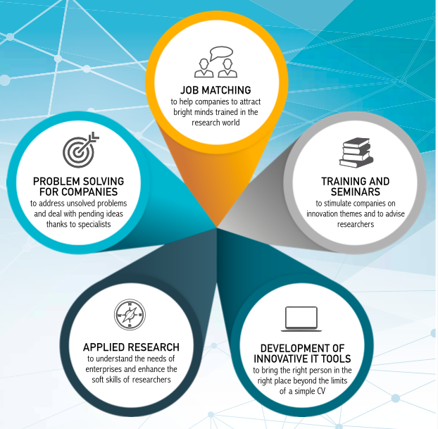
What we do
Free PowerPoint Templates
Free PowerPoint Templates
Notes:
Promoted by a no-profit Consortium of enterprises.
Soon will be Start-up with social purpose, bound at constitution to reinvest revenues in the project
Rooted in entreprise, leaded by an entrepreneur and two PhDs (astrophysics and adult education)
“Bilingual” team
Operates on both sides
Private and small, flexible
Research on skills and education runs parallel with activity with companies
Immediate application/testing/emproving of ideas and services
Concrete outcome

Slide 27
Doc Desk
Easy first-contact tool for PhD and company
Proves PhDs skills on something concrete
Very positive feedbacks on both sides
Create cooperation on something real, even if small
Free PowerPoint Templates
Free PowerPoint Templates
Notes:
Promoted by a no-profit Consortium of enterprises.
Soon will be Start-up with social purpose, bound at constitution to reinvest revenues in the project
Rooted in entreprise, leaded by an entrepreneur and two PhDs (astrophysics and adult education)
“Bilingual” team
Operates on both sides
Private and small, flexible
Research on skills and education runs parallel with activity with companies
Immediate application/testing/emproving of ideas and services
Concrete outcome

Slide 28
Research
Constantly testing our services, adapting to the request, understanding the critical points and find solutions
Research on competences and “transferrable skills”
Bottom-up approach
Free PowerPoint Templates
Free PowerPoint Templates
Notes:
Promoted by a no-profit Consortium of enterprises.
Soon will be Start-up with social purpose, bound at constitution to reinvest revenues in the project
Rooted in entreprise, leaded by an entrepreneur and two PhDs (astrophysics and adult education)
“Bilingual” team
Operates on both sides
Private and small, flexible
Research on skills and education runs parallel with activity with companies
Immediate application/testing/emproving of ideas and services
Concrete outcome

Slide 29
Education
Almost al services are conceived with an educational content
Unearth tacit knowledge through self-reflection (biographic narratives) and experience (more later)
Not (only) information, but education
Free PowerPoint Templates
Free PowerPoint Templates

Slide 30
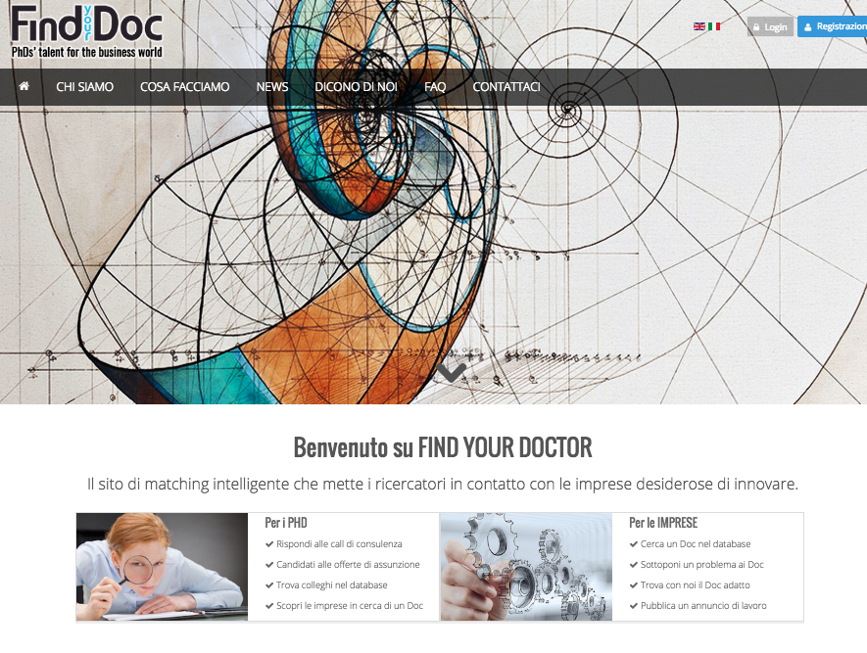
How does it work?
Website to reach and involve researchers
Offline work of the Find your Doctor team on the enterprises side
Intermediation in job matching and Doc Desk consultancies, to overcome cultural barriers
English version under construction (sorry ☹)

Slide 31
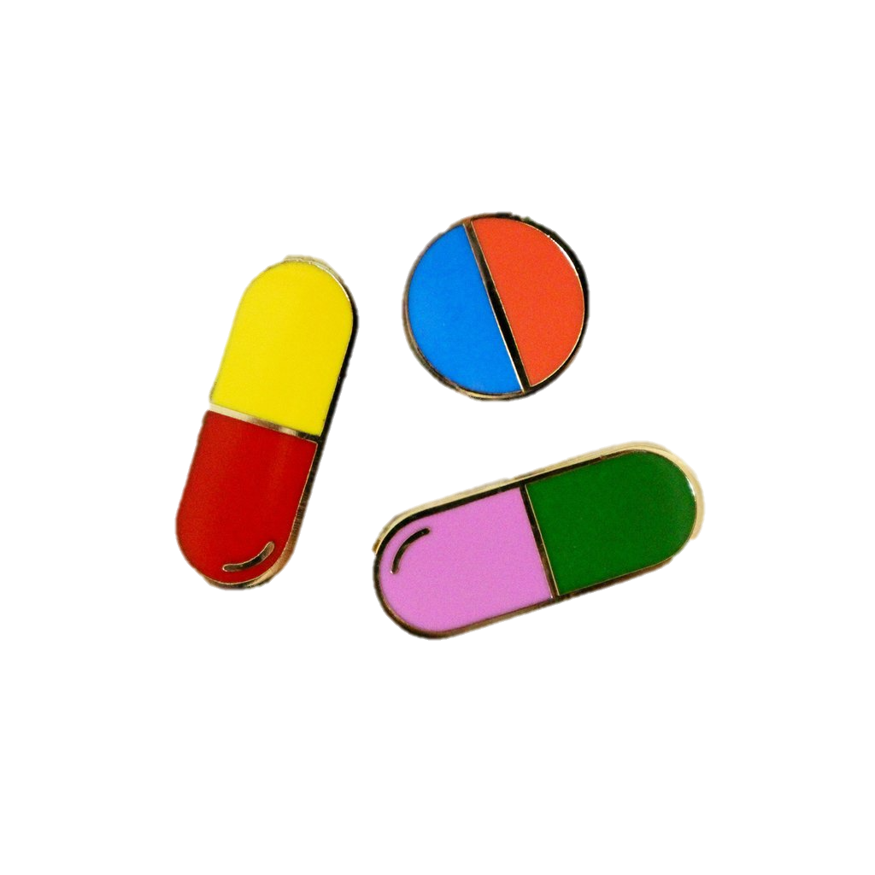

Your profile (profiling what?)
Aim to overcome the limits of a CV
TODAY
TOMORROW
Take your pills! Attention on values and approach; stimulate self-reflection while profiling yourself
Group your info in a handy way
Based on hard skills, we will call you for consultancies
Based on your Pills and interview, we will choose you for job-matching
More narrative tools to tell your story
Job-orientation while profiling yourself
Upload video and other material
Search engine including “soft” skills, values, approach
University of Milan
Notes:
Immagine del profilo. Attenzione sulla sezione pillole. Zoom nella prossima slide

Slide 32
Education and orientation
“Doc desk” as a learning experience
Learning workshops within PhD courses: tranferrable skills and self-orientation
Learning workshops for subscribers (across university, regions, career stage)
Workshops and tools to stimulate the learning potential intrinsic to the transition outside academia
Collect experiences as a tool for understanding and an example for others

Slide 33
Those working with us
SUPPORTERS AND PARTNERS IN THE ACADEMIA
PARTNERS FROM/CLOSE TO ENTERPRISE WORLD
University of Milan - IT department
(research partner)
University of Milan - Bicocca (research partner; spreads job opportunities)
University of Turin - (spreads job opportunities; joint seminars)
Politecnico di Milano (spreads job opportunities)
International Physicists Network association (partners, shared project in fieri)
API – Italian Association of small and medium industries (partners in ApiTech, start-up for innovation)
COREFAB - Coworking (partner; shared seminars and services)
C2T CONSORTIUM for technology transfer
(founder and promoter)
+ contacts and collaborations with other Technology Transfer operators
Free PowerPoint Templates
Free PowerPoint Templates

Slide 34
How can we work together
PhD students, graduates and researchers are – by construction – Find your Doctor’s main partners
Subscribe (for free) to www.findyourdoc.org
Take the “pills” on your profile
Follow us on FB, linkedin or twitter
Participate to the “Doc Desk”
Participate to initiatives organised with your institute
Be aware of what you are learning, and be proud of what you are doing!
Free PowerPoint Templates
Free PowerPoint Templates

Slide 35
“
Tradition is the preservation of fire, not the worship of ashes
Gustav Mahler
Free PowerPoint Templates
Free PowerPoint Templates
Notes:
True for companies, stop doing what they always did. True do research: stop consider researchers only as academics. PhD has to change, but it can change without loosing itself. Growing requires changing as well.

Slide 36



Find Your Doctor | Via Uberto Visconti di Modrone, 30 | Milano
Contacts:
CALL US
WEBSITES
MAIL or CHAT
02 37904343
www.findyourdoc.org
www.consorzioc2t.it
www.api-tech.it
info@consorzioc2t.it
hr_c2t (Skype)
Data sources:
Report Istat 2014 – L’inserimento professionale dei dottori di ricerca
VI indagine ADI - 2016
OECD Science, Technology and Industry Scoreboard 2013 - OECD Publishing http://dx.doi.org/10.1787/sti_scoreboard-2013-en
MORE2 Idea consulting
Researcher’s report 2013 e 2014 - Deloitte consulting for EU commission
OECD-knowinno project on the careers of doctorate holders
Free PowerPoint Templates
Free PowerPoint Templates

