Slide 1
Proton acceleration studies with ultrashort PW pulses at DRACO
DRACO: a 150 TW / 1 PW dual beam laser facility
Status of proton acceleration at DRACO
Highly efficient proton beam transport with pulsed solenoid coils
Spectral and spatial beam shaping for in-vivo radiobiology studies

Slide 2




A lot of work, a lot of people…
F.-E. Brack, L. Gaus, A. Jahn, S. Kraft, F. Kroll, J. Metzkes, L. Obst, M. Rehwald, H.-P. Schlenvoigt, K. Zeil, T. Ziegler, U. Schramm, T. Cowan
S. Bock, C. Eisenmann, R. Gebhardt, U. Helbig, D. Möller
E. Beyreuther, L. Karsch, M. Schürer, J. Pawelke
T. Herrmannsdörfer, S. Zherlitsyn
S. Goede, M. Gauthier, W. Shoemaker, S. Glenzer
P. Poole, G. Cochran, D. Schumacher

Slide 3
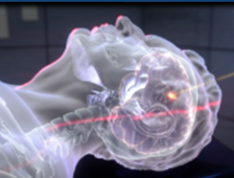
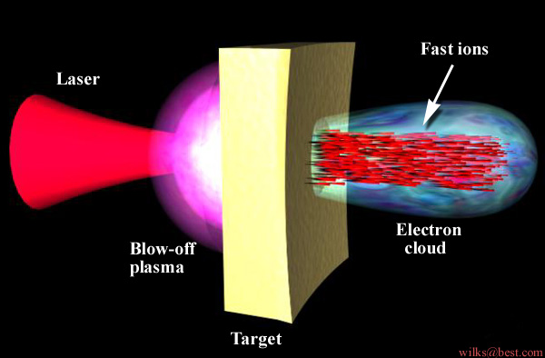

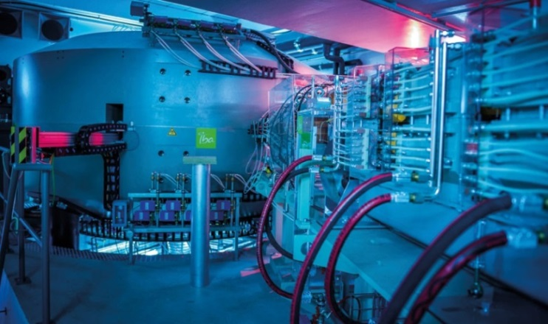
Compact ion accelerator for radiation therapy
Proton therapy related research
energy gain:
MeV/µm
field strength: TV/m instead of ~ 10 MV/m
Alternative: Compact, laser-driven ion sources?
Proton Therapy Center Dresden
D
D
Mean dose rate
t
t
Investigation of the pulse time structure on biological systems

Slide 4
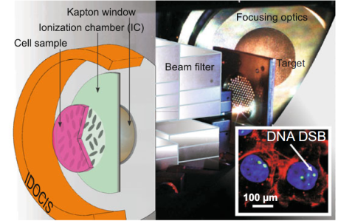

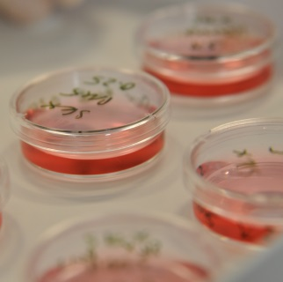
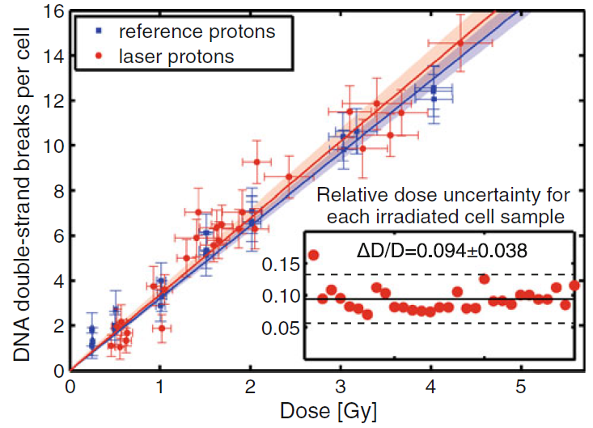
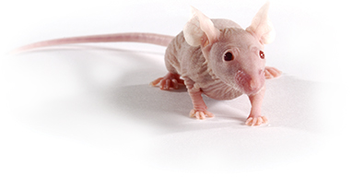
Compact ion accelerator for radiation therapy
In vitro cell irradiation with laser-accelerated protons
→ relative dose uncertainty of below 10 %
In vivo cell irradiation
criver.com
[1] Zeil et al. Appl. Phys B 110, 437(2013)
[2] Kraft et al. NJP 12, 045015 (2010)

Slide 5
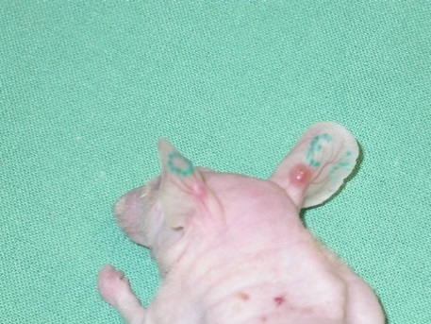
Requirements for in vivo experiments
Suitable tumor model for current capabilities of laser driven proton sources
LN229 glioblastoma on ear of nude mice
End point = radiation-induced tumor growth delay
High take rate, low secondary tumor rate
3-day irradiation window, but long follow up
[3] Beyreuther et al, PLOS one 0177428 (2017)
tumor
Irradiation requirements of this adapted tumor model
Small lateral irradiation field: 5 mm diameter
Short depth range: 5 mm, hence proton energy of 25 – 40 MeV
Dose rates in the order of Gy/min
Precise dose application
High degree of reproducibility

Slide 6
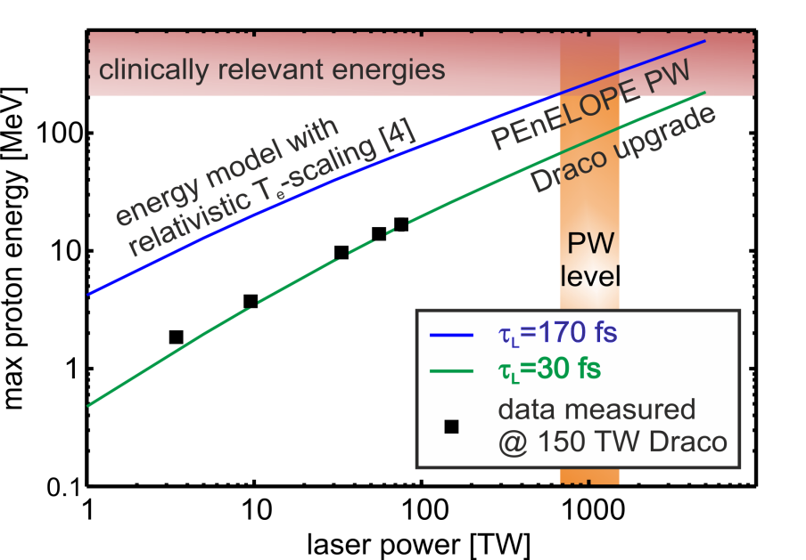
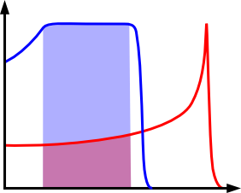
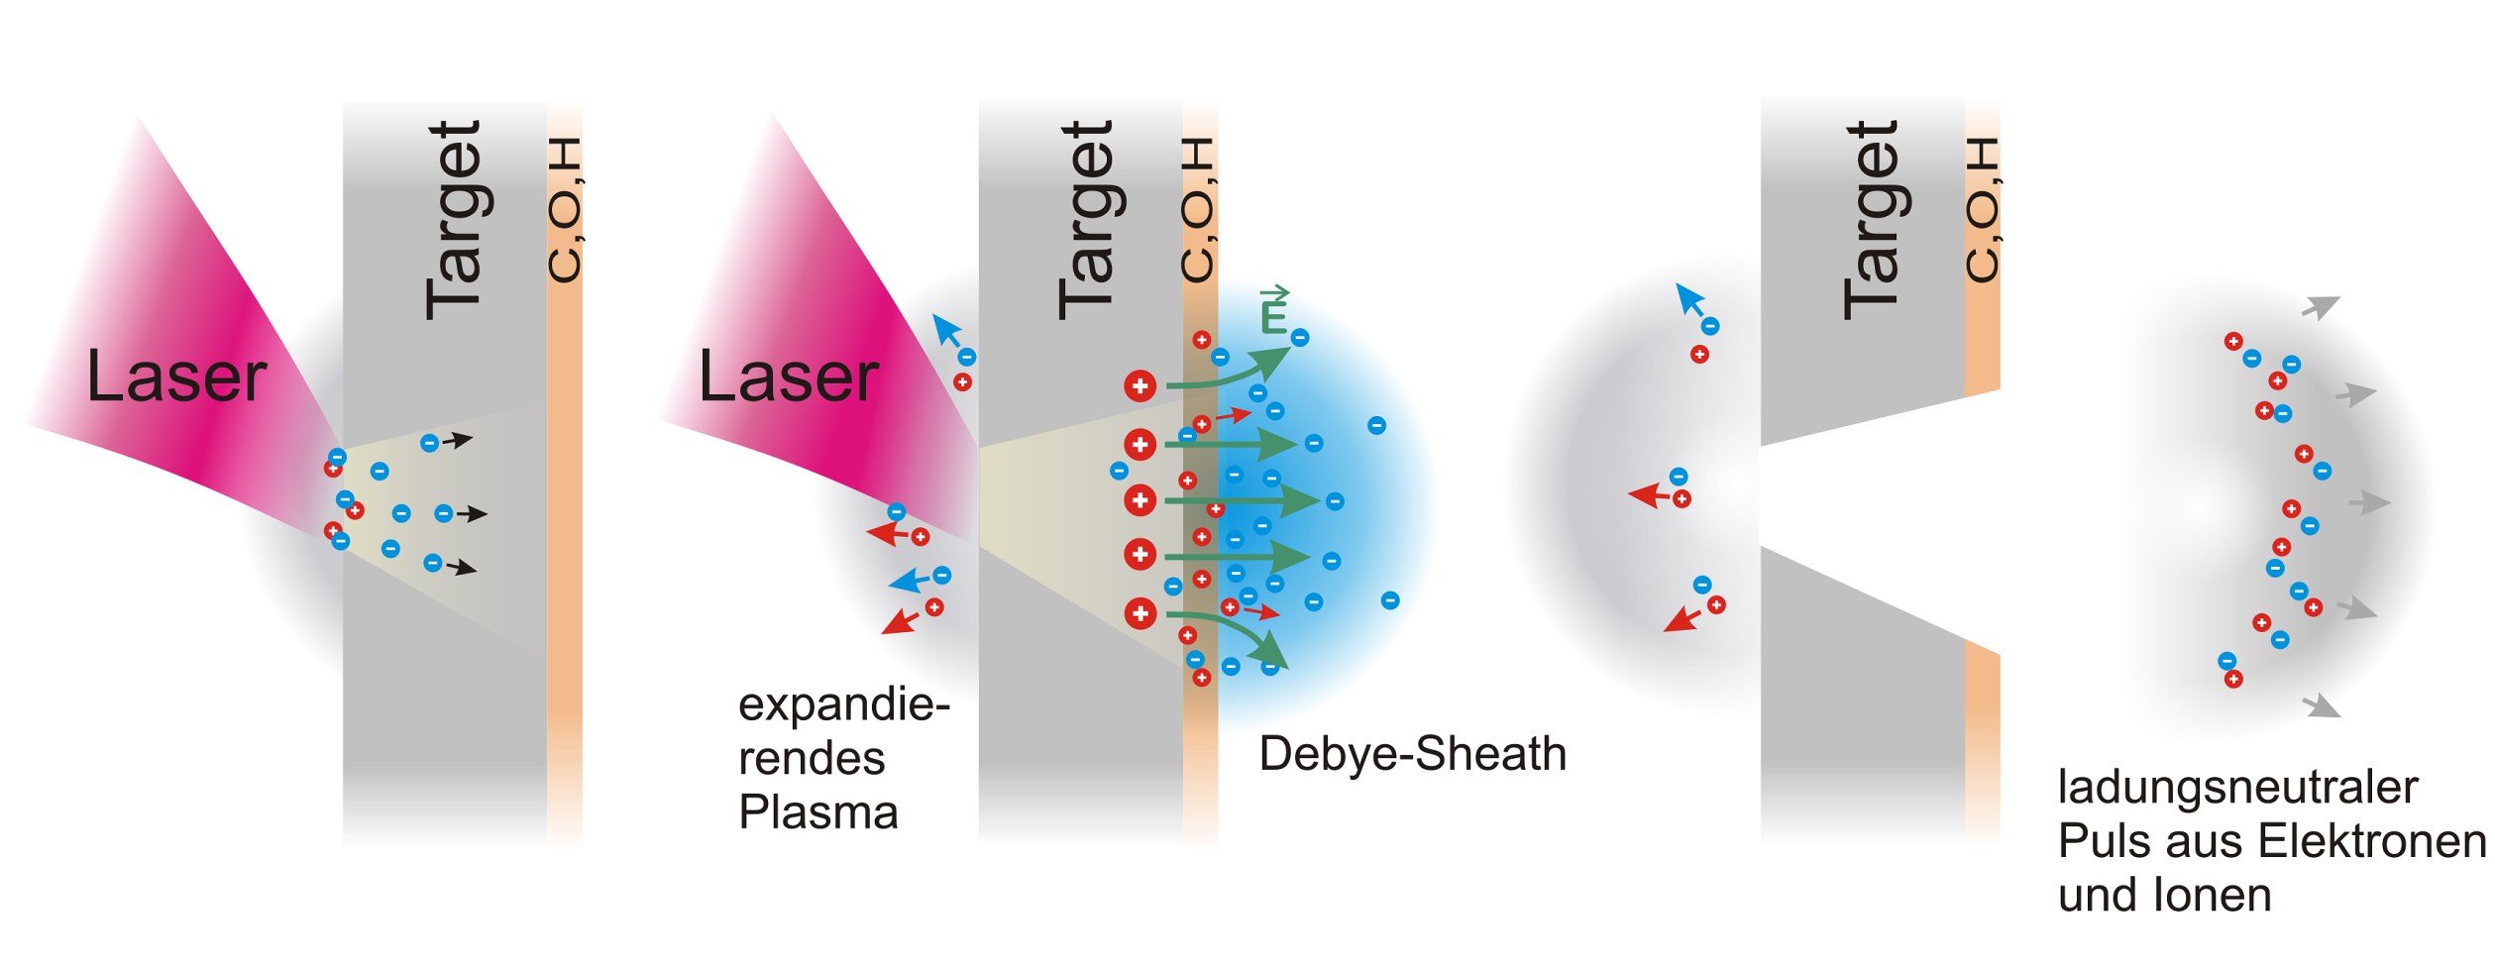

Animal irradiation requirements
Route to sufficient proton energies
25 MeV
40 MeV
*
dose
SOBP
Plateau
depth
[*] Kluge et al. PRL 107, 205003 (2011)
Beam transport and precise dose application
??

Slide 7
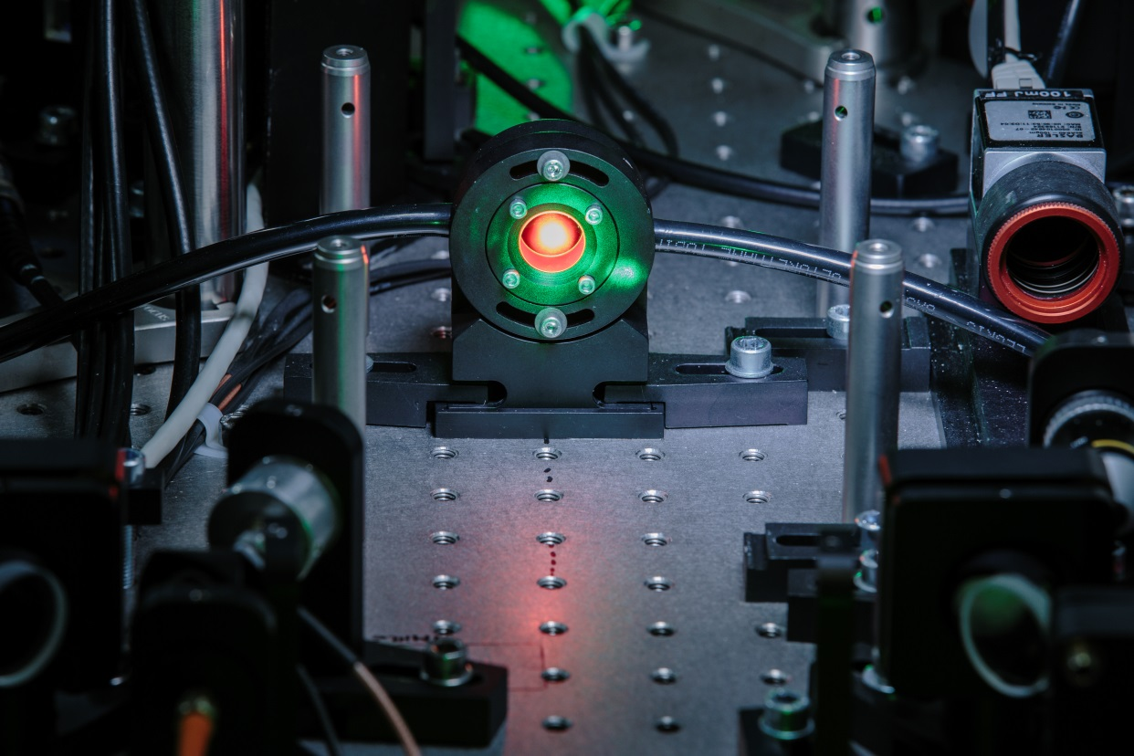
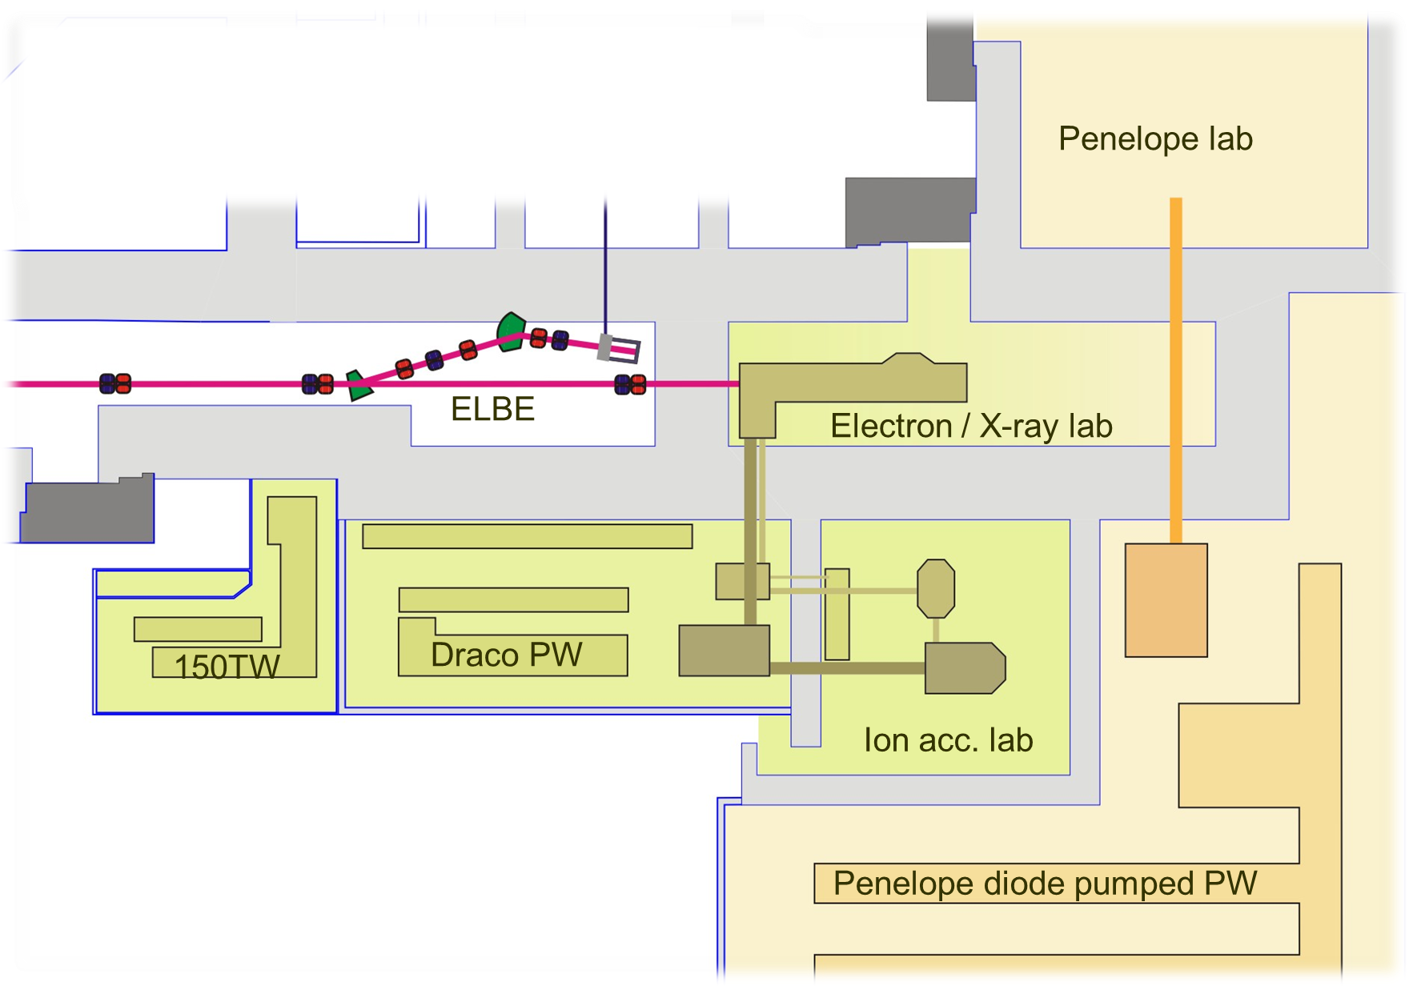
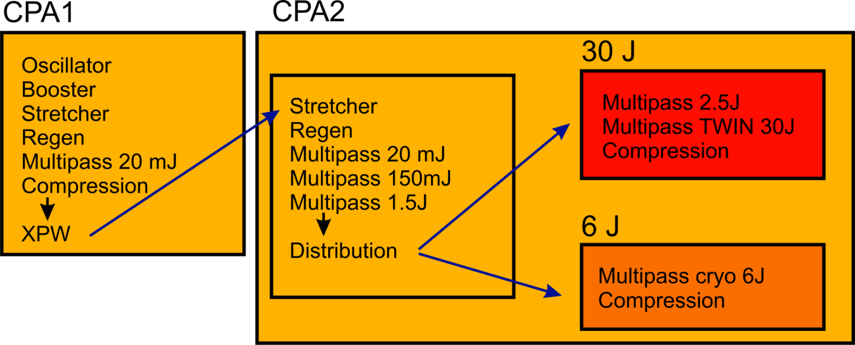
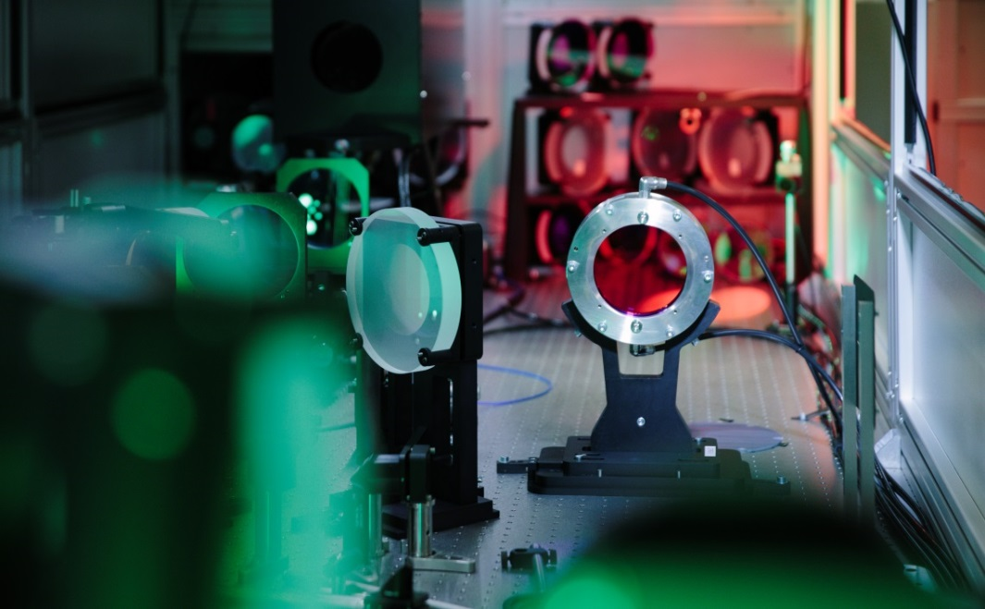


DRACO: Dresden laser particle acceleration source

Slide 8
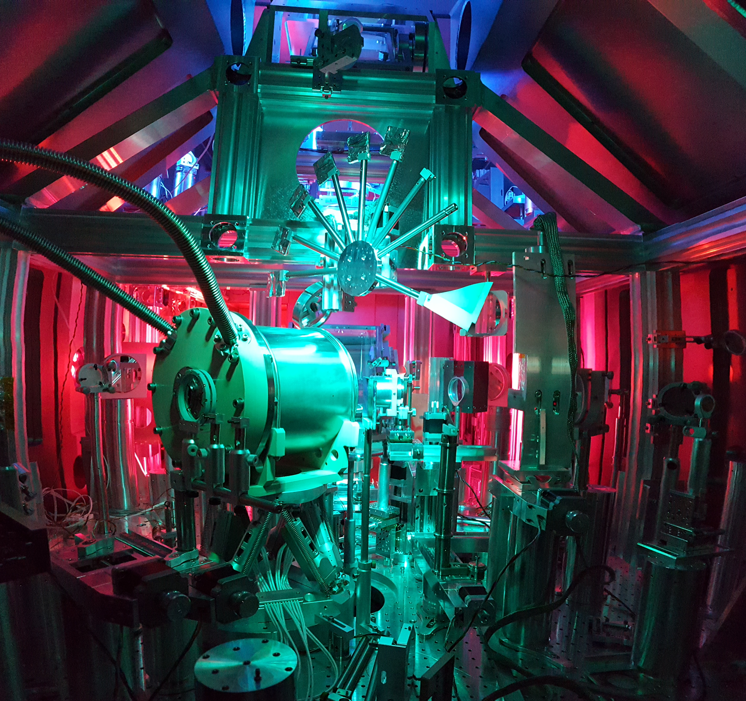
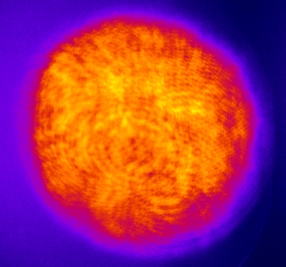
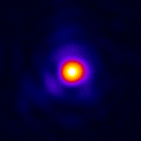
Ion acceleration lab - technical capabilities
6 J beam line
6 J uncompressed, up to 10 Hz possible
4 J compressed to 30 fs
single-pass plasma mirror: 3 J
F/2.5 focussing: 3 µm FWHM, Strehl 0.85
I_{peak} ≈ 1×10²¹W/cm², a₀ ≈ 24
30 J beam line
30 J uncompressed, up to 1 Hz possible
20 J compressed to 30 fs
single-pass plasma mirror: 14 J
F/2.5 focussing: 2.7 µm FWHM, Strehl 0.85
I_{peak} ≈ 8×10²¹W/cm², a₀ ≈ 60
30 J
24 cm
10 µm

Slide 9
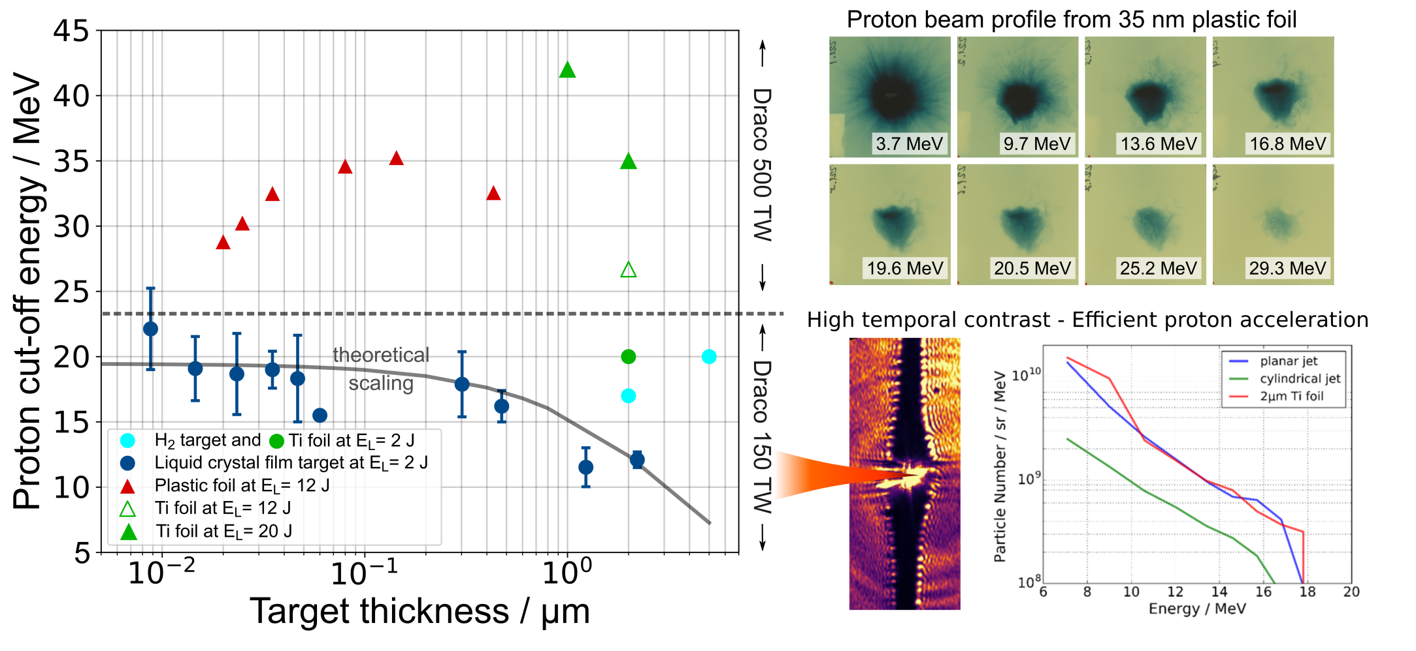


Ion acceleration status
For hydrogen jet, see talk by L. Obst, 19:15
[4] Schramm et al., IPAC Proceedings 2017
[5] Obst et al. Sci. Rep. 7, 10248 (2017)
[6] Gauthier et al. APL 111, 114102 (2017)
[7] Poole et al. , under review

Slide 10
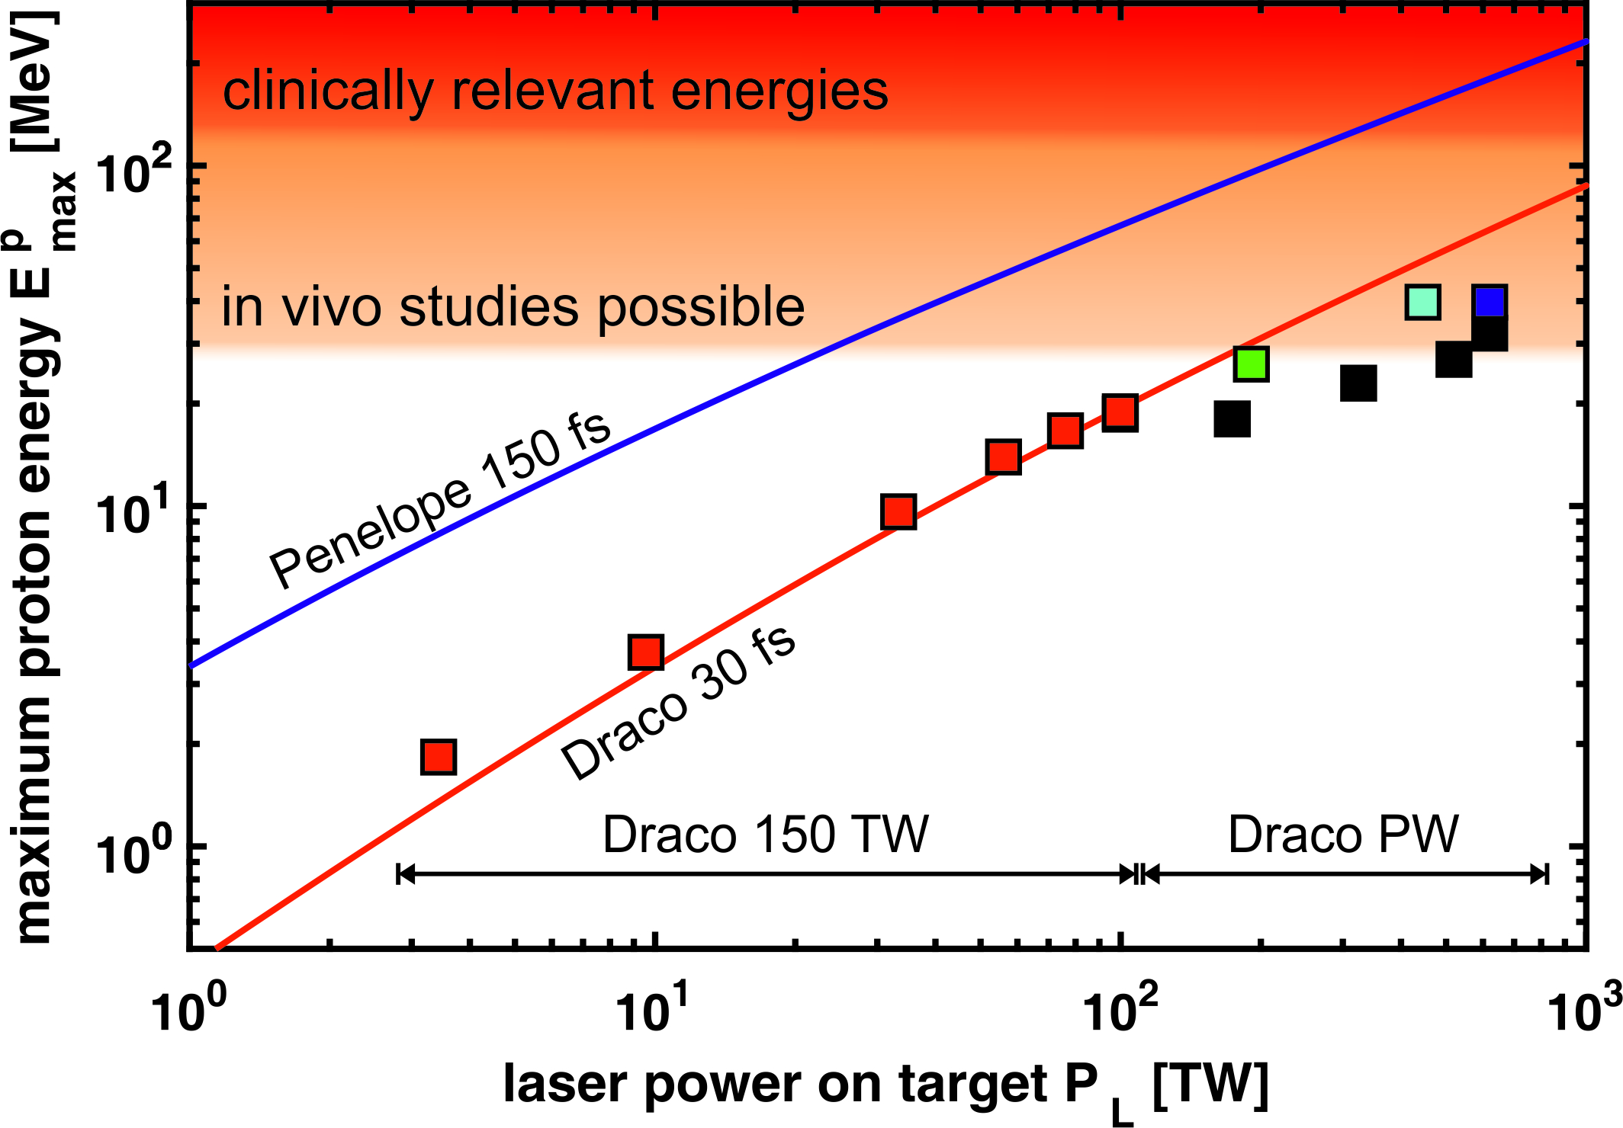
Animal irradiation requirements
Route to sufficient proton energies
25 MeV
40 MeV
dose
SOBP
Plateau
*
depth
Precise dose application
Solenoid
[*] Kluge et al. PRL 107, 205003 (2011)

Slide 11
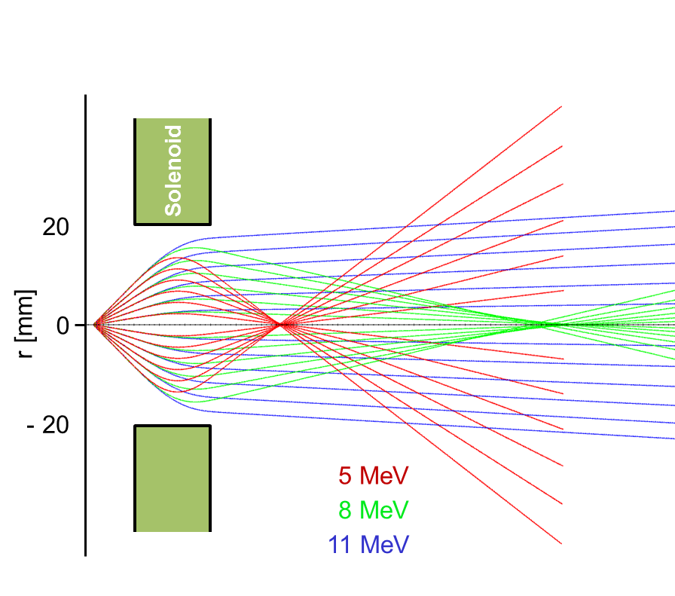
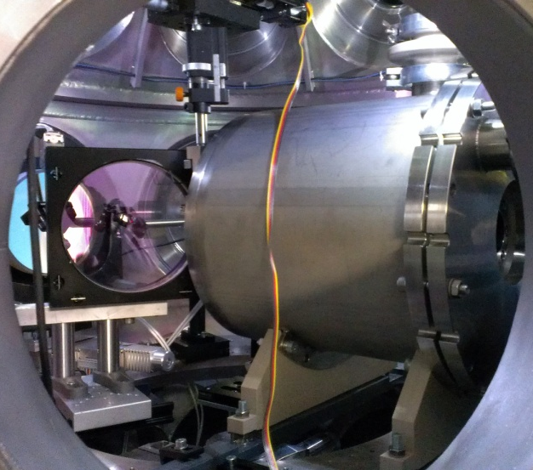

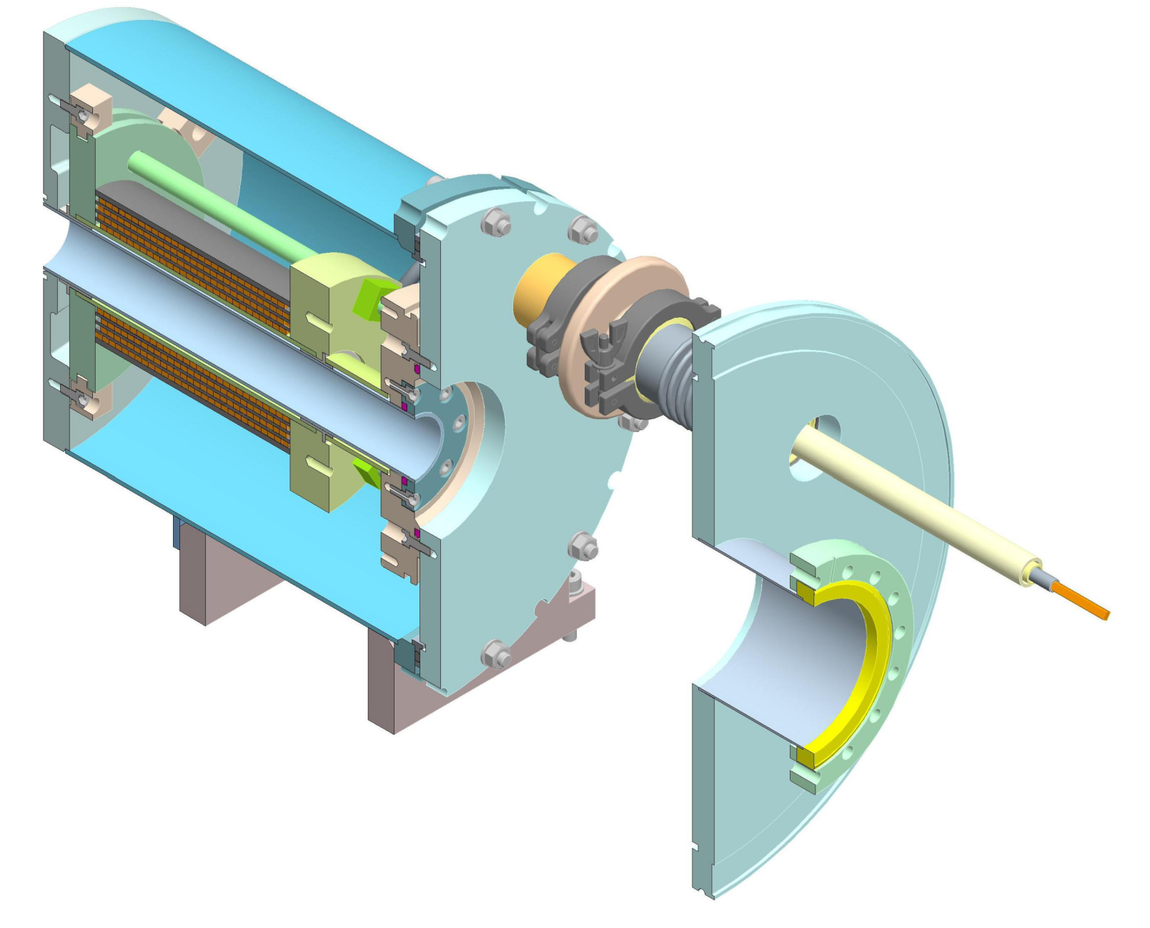


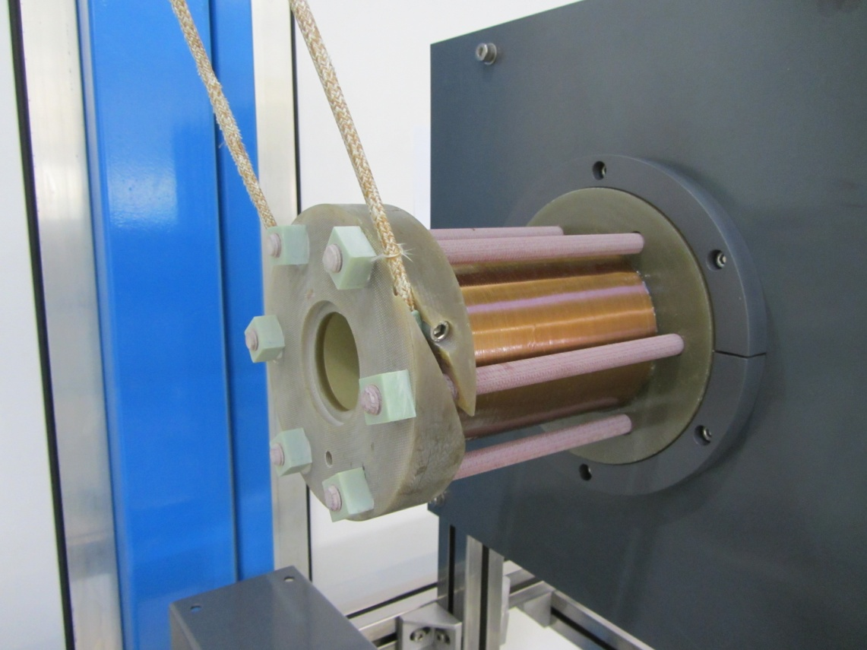

Solenoid-based proton beamline
  Chromatic focusing
B_{max} = 20 T (I_{max} = 24 kA)
Collimation of 70 MeV from 5 cm distance
40 mm open aperture
few years operation (1000s of pulses)
in-vacuum tank at atmospheric pressure
Steel housing
LASER
Coil
Incoming
Ion Beam
Vacuum tube
Air cavity
Current feed
Transported beam

Slide 12
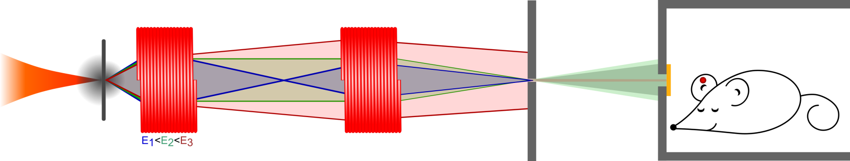
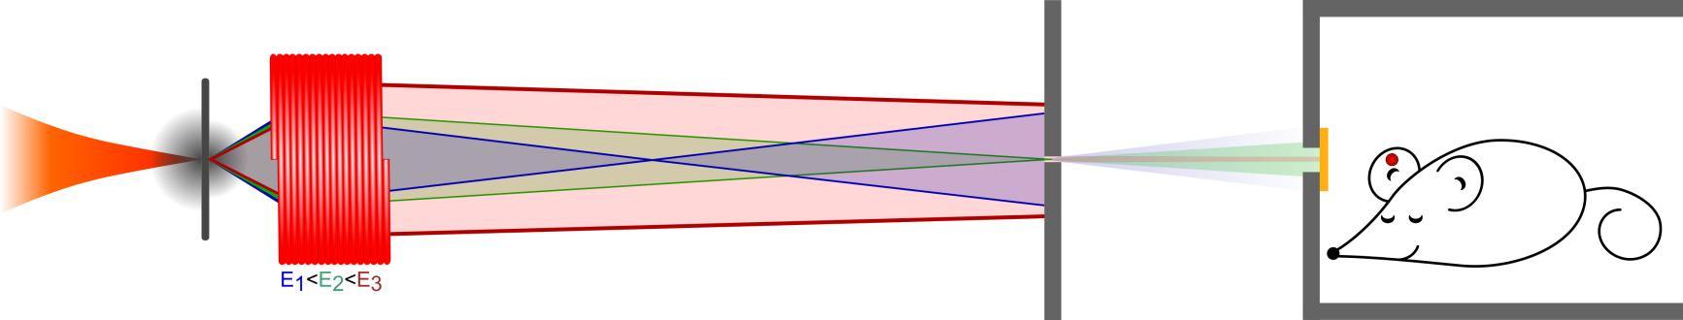
Proton beamline explained
1 solenoid coil setup
Desired proton energy is focused through aperture, thereby energy-selection
Beam homogenization by divergence, optional scatter foil
Optional Ridge filter for SOBP formation
2 solenoid coil setup
Desired proton energy first collimated, then focused for energy-selection
Second, lower energy passes as well; can be separated by “misalignment”
Beam homogenization etc. as above, but second energy has similar divergence
Higher transmission and bandwidth, reduced coil stress, quicker homogenization

Slide 13
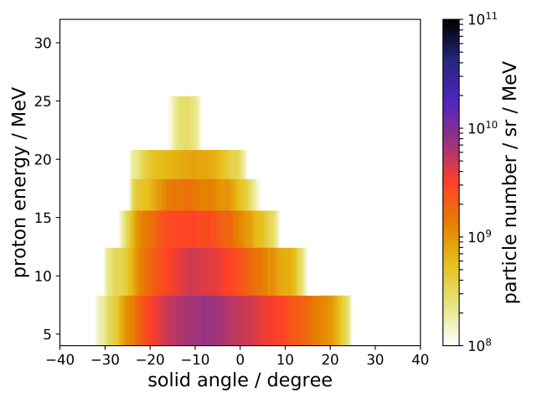
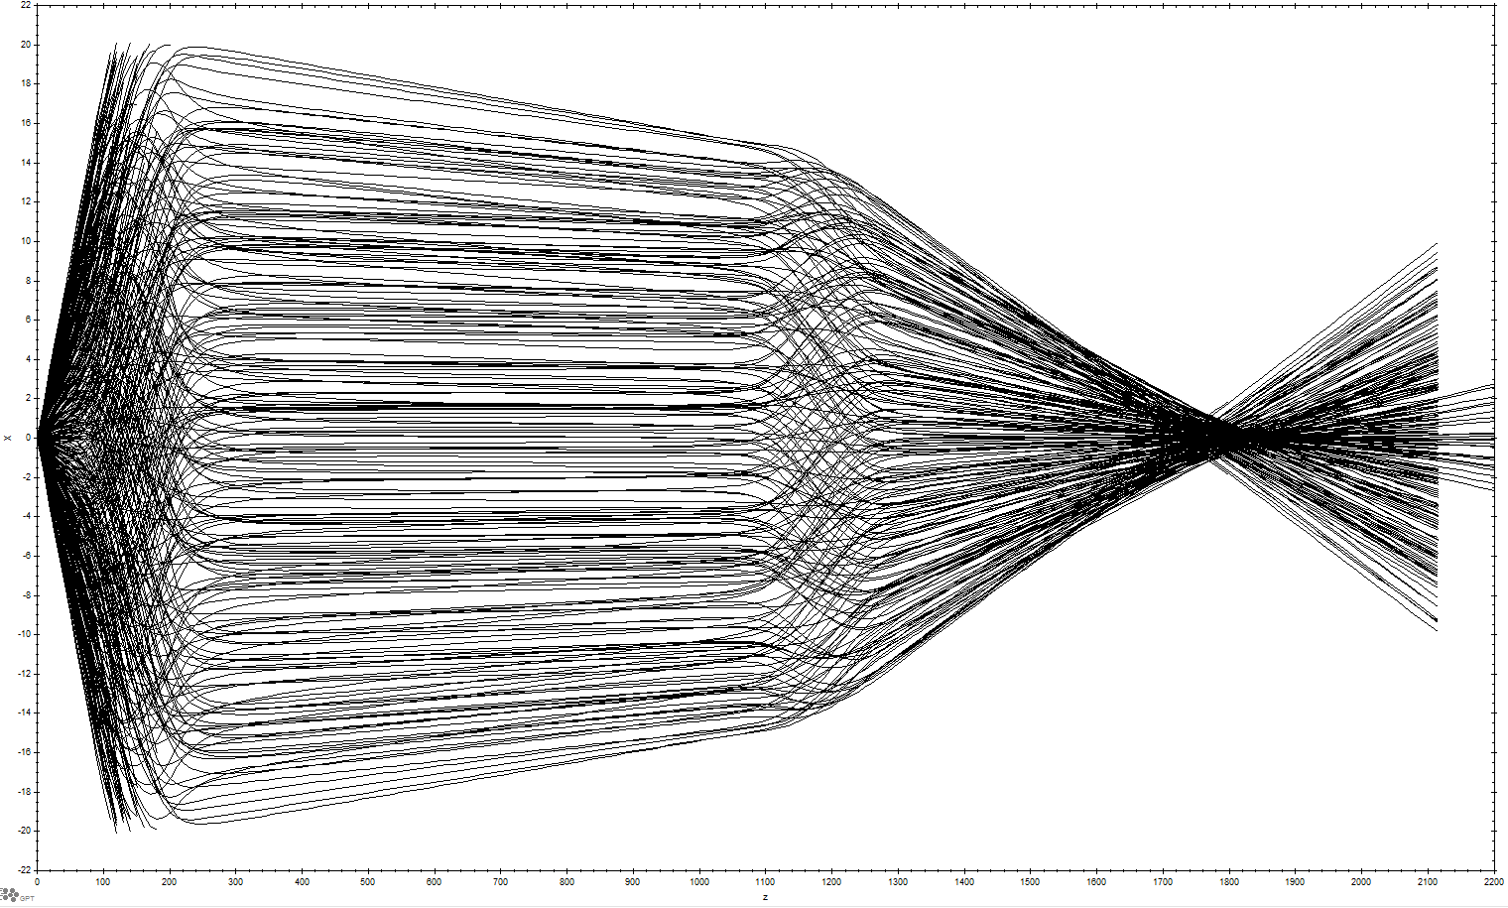
GPT simulations
Idealized windings / field structure
Measured exponential proton spectrum (T ≈ 6 MeV)
Measured energy-dependent proton source divergence
Simulation currents mapped to real world currents
Only ballistic transport
Transport efficiency from source to any surface
Beam envelope → design of thick apertures
Rough idea of afocal beam sizes

Slide 14
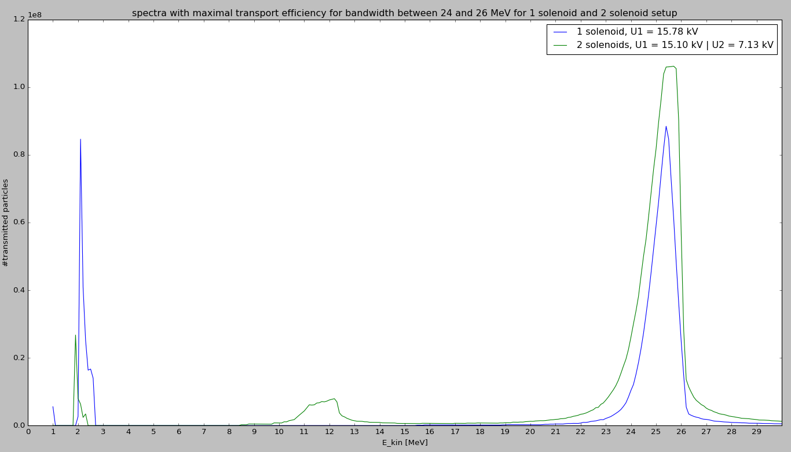
GPT simulation example
For given aperture positions, optimize coil currents and aperture sizes before experiment
Trade-off between aperture size and currents
High transmission to mouse position is likely to small beam spot, hence rather inhomogeneous field

Slide 15
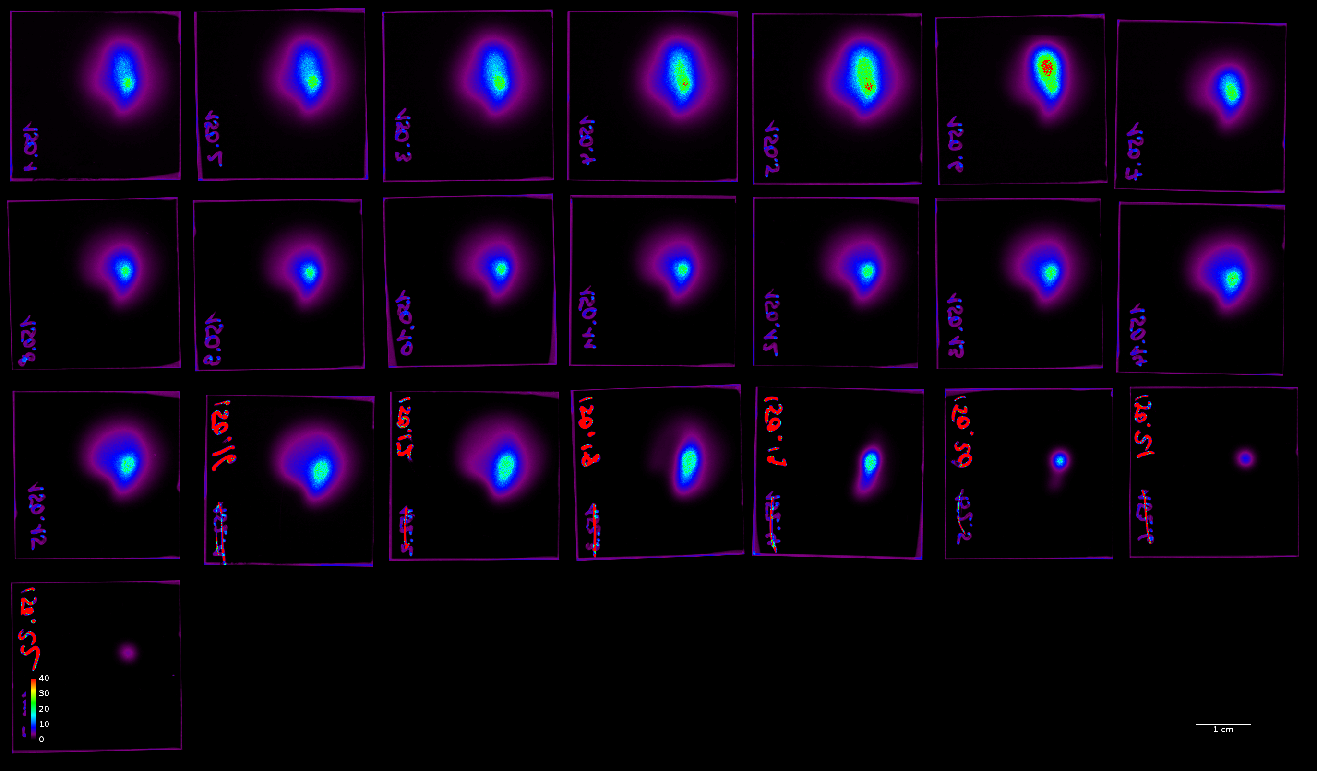
Dose profiles vs. depth, w/o scatter foil
Gy, 5 shots integrated

Slide 16
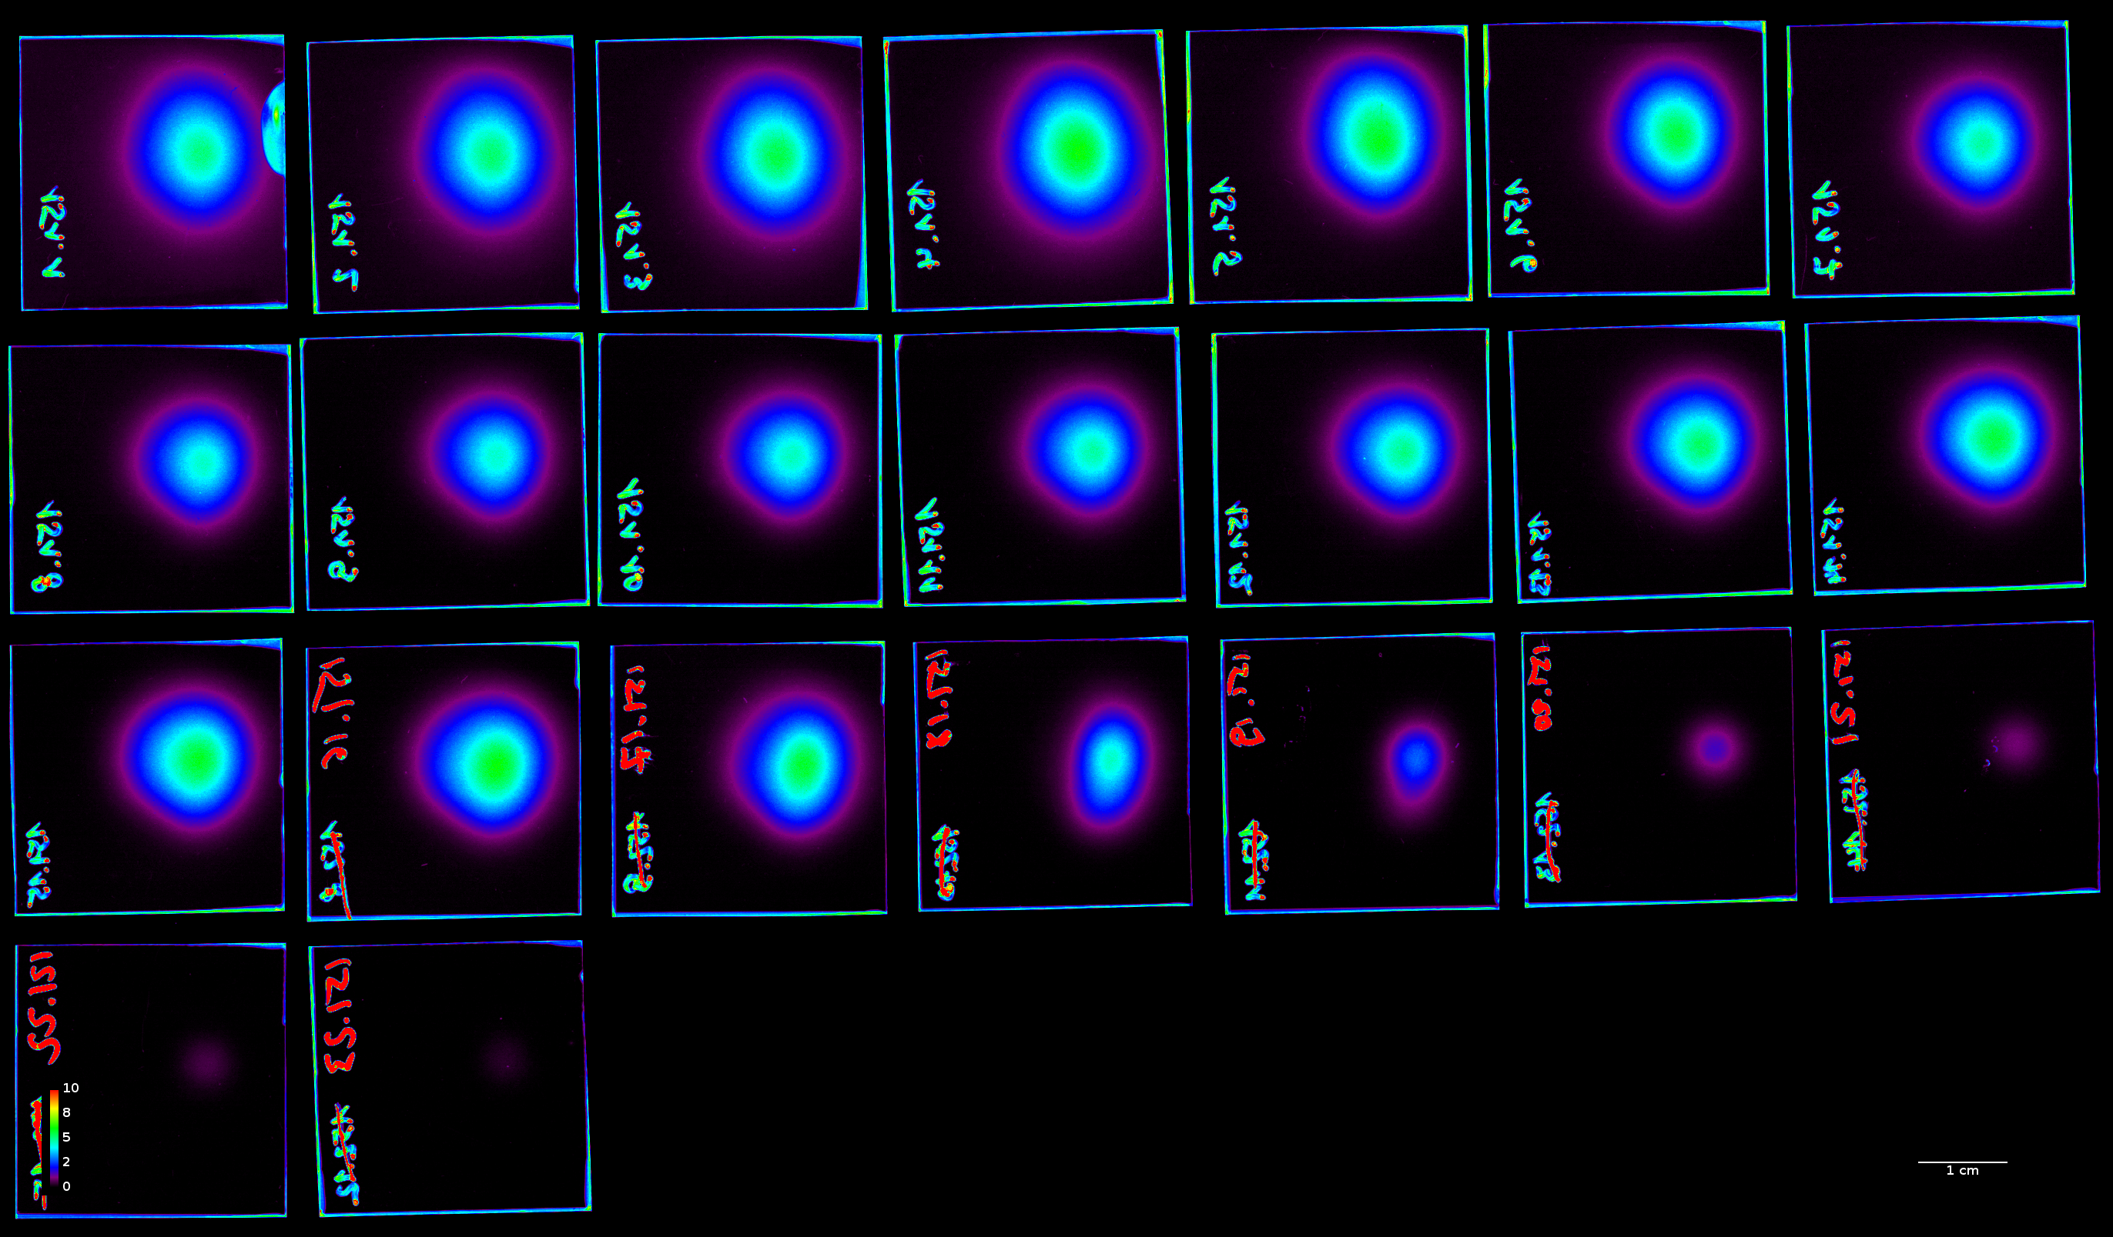
Dose profiles vs. depth, w/ 25µm brass
Gy, 5 shots integrated

Slide 17
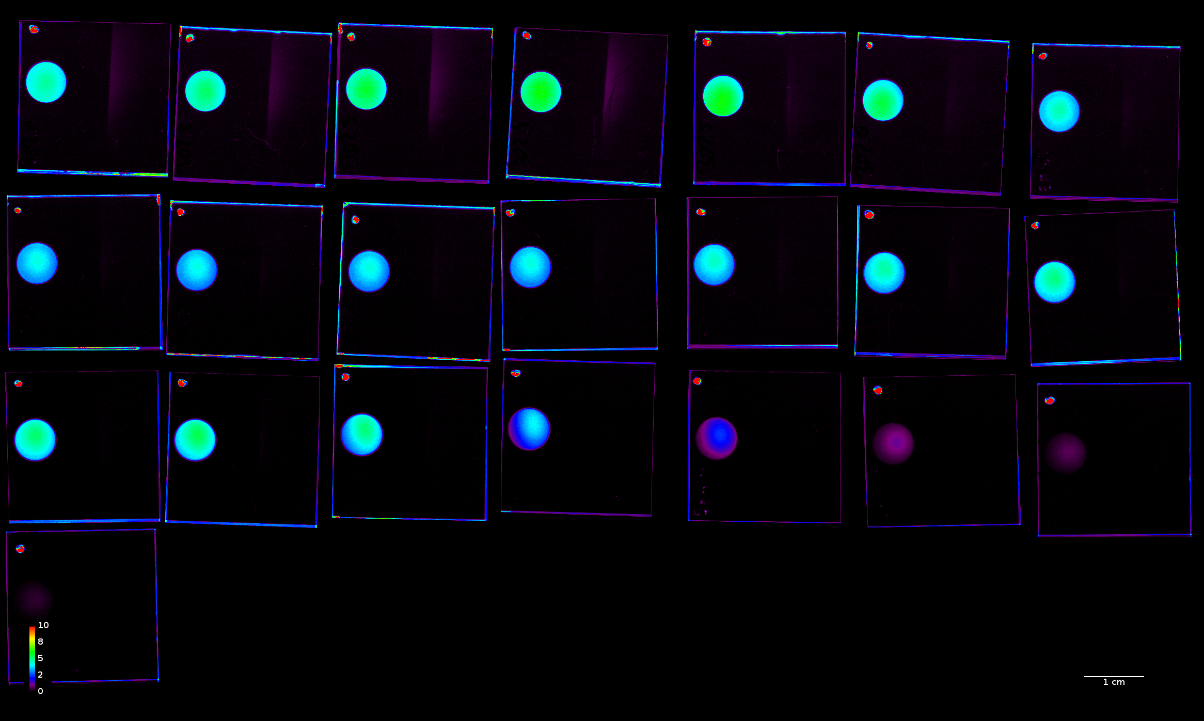
Dose profiles vs. depth, w/ 25µm brass and aperture
Gy, 5 shots integrated

Slide 18
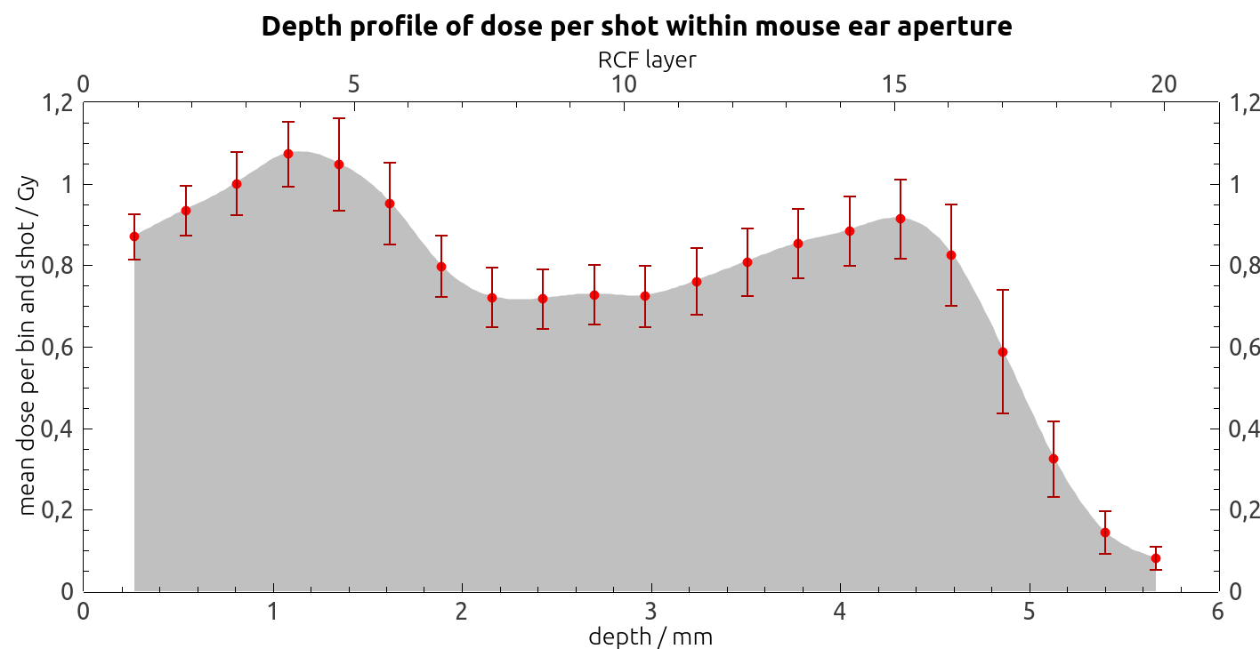
Summary
Proton beam transport and shaping
5 mm penetration depth with ± 20% dose variation
5 mm field diameter with 10-20% dose variation
0.9 Gy/shot at 2 m distance from source
30 sec rep-rate
PW laser-driven proton source
35-40 MeV cut-off from 100-200 nm CH with 12 J on target (400 TW, a₀ ≈ 45)

Slide 19
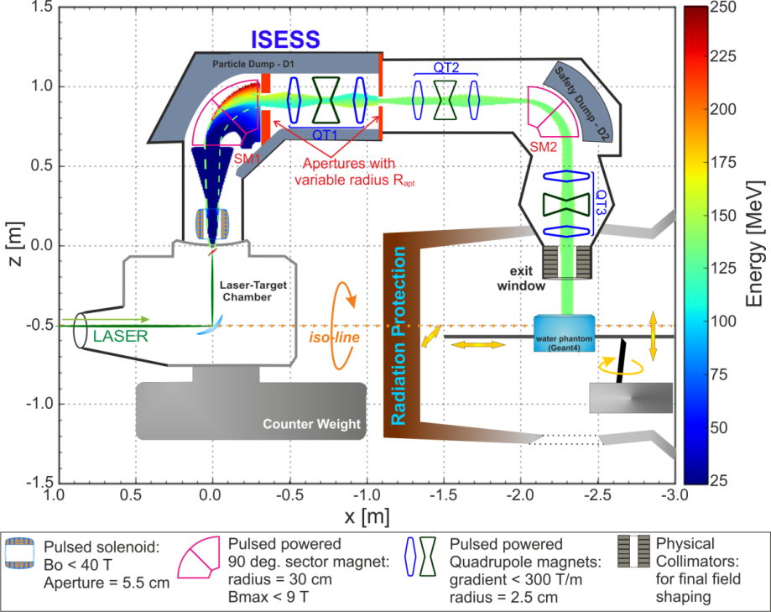
Outlook
Proton irradiation setup for radiobiological studies
First irradiation experiments with radiobiological samples already done
Ongoing campaign in October
Hydrogen jet (see talk by L. Obst!)
Renewable, debris-free, high-rep-rate target
Single ion species
Capable for heavier light ions
PEnELOPE PW laser development
10 J amplification shown
Fully diode-pumped, 150 J / 150 fs, 1 Hz
Compact pulsed-magnet particle beam gantry
Test experiments of individual parts
[8] U. Masood et. al. Applied Physics B (2014)

