Slide 1
Laser driven plasma acceleration at PEARL laser system: progress and prospects
A. Soloviev, K. Burdonov, S. N. Chen, A. Eremeev, S. Pikuz, G.V. Pokrovskiy, T.A. Pikuz, G. Revet, A. Sladkov, V. Ginzburg, E. Khazanov, A. Kuzmin, D.Kumar, S. Mironov, R. Osmanov, I. Shaykin, A. Shaykin, I. Yakovlev, M. Starodubtsev, and J. Fuchs

Slide 2
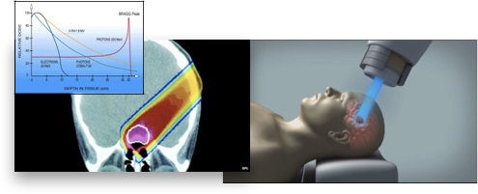
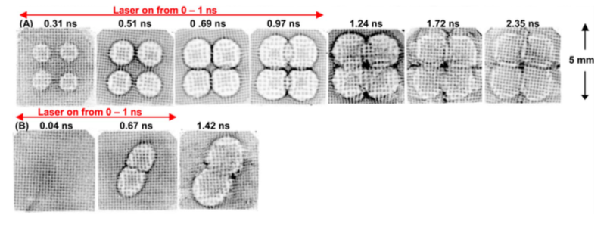
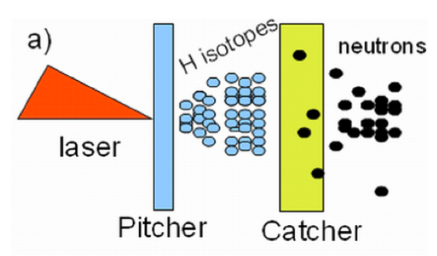
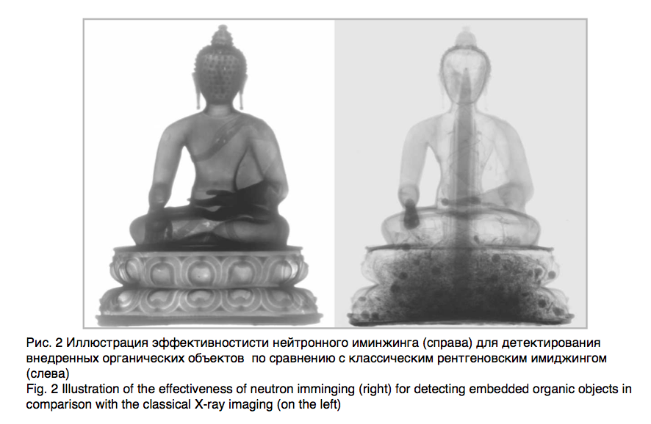
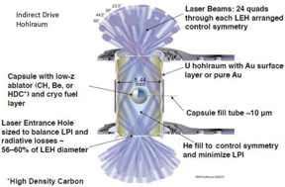
Cancer treatment
Proton radiography (deflectometry)
C.K.Li et al. PRL 99, 055001 (2007)
Proton driven sources:
of neutrons:
ICF diagnostics, Fast ignition
of isotopes for PAT e.t.c.

Slide 3
Outline
Ion acceleration: the objectives and applications
The experimental setup
Discussion
The prospects

Slide 4
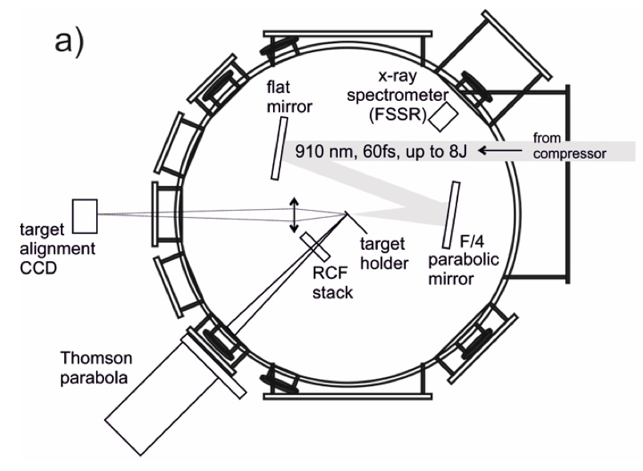
Experimental setup
Basic laser parameters:
λ0 ≈ 910 nm,τ ≈ 60 fs, E ≈ 10 J, P ≈ 160 ТW D ≈ 100 mm, F/4.2, I ≈ 3 × 10^20 W/сm2 С ≈ 2 × 10^8 (1 ns)
1 Shot/20min
List of diagnostic equipment:
Thomson parabola
RCF stack
FSSR X-ray spectrometer

Slide 5
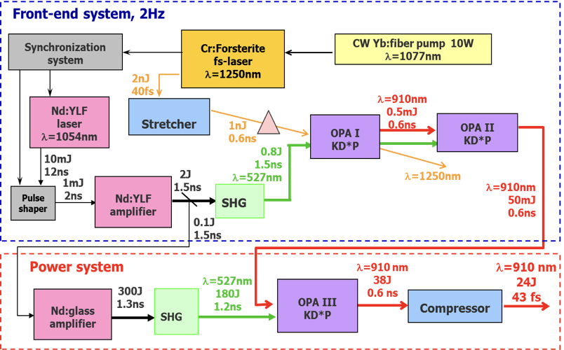
Laser principle scheme

Slide 6
Experimental setup
Basic laser parameters:
λ0 ≈ 910 nm,τ ≈ 60 fs, E ≈ 10 J, P ≈ 160 ТW D ≈ 100 mm, F/4.2, I ≈ 3 × 10^20 W/сm2 С ≈ 2 × 10^8 (1 ns)
1 Shot/20min
List of diagnostic equipment:
Thomson parabola
RCF stack
FSSR X-ray spectrometer

Slide 7
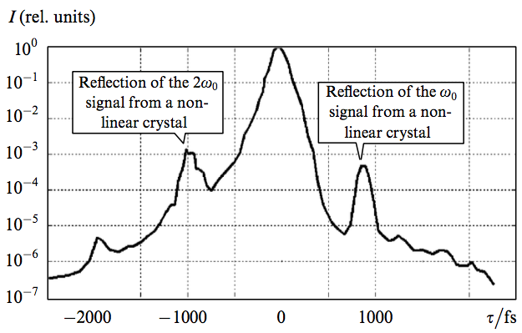
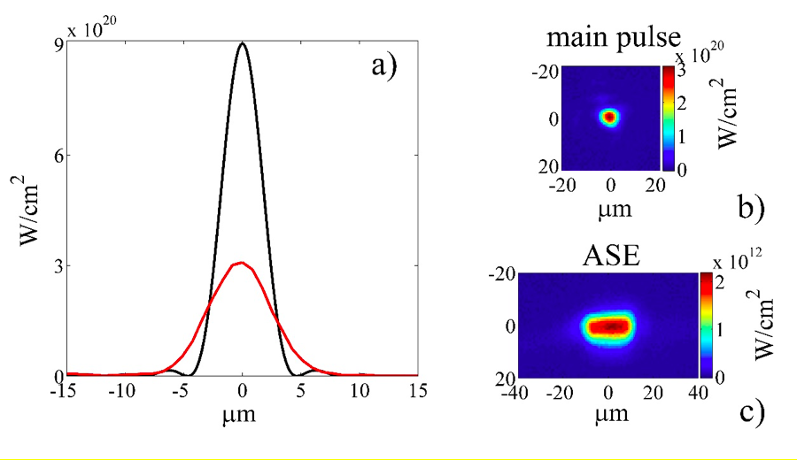
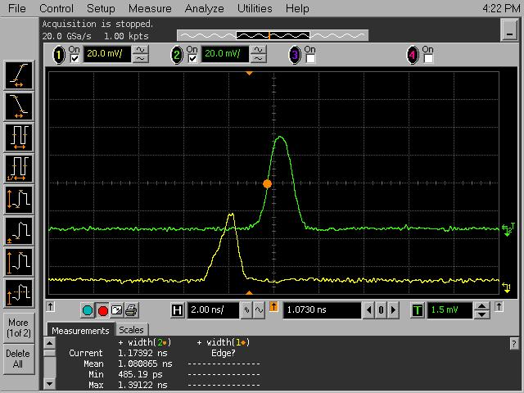
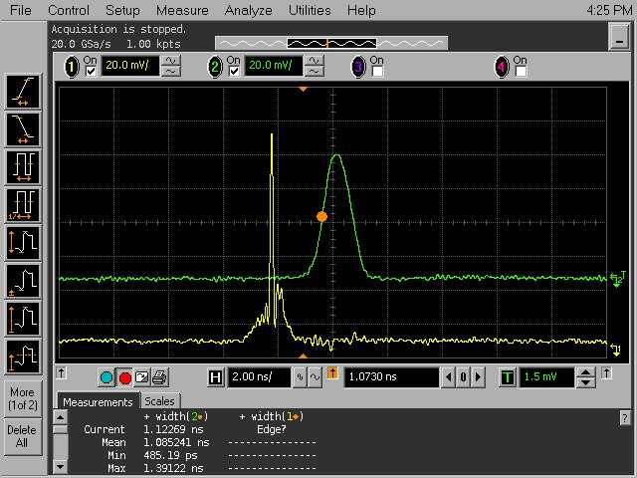
Focusing & contrast of the laser pulse
Pic. Power contrast Mironov
Pic. Focal spot
Direct parametric luminescence measurement gives 2*10^8

Slide 8
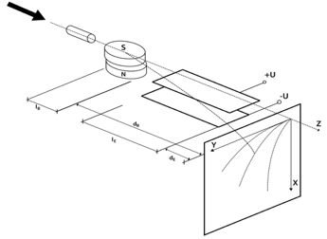
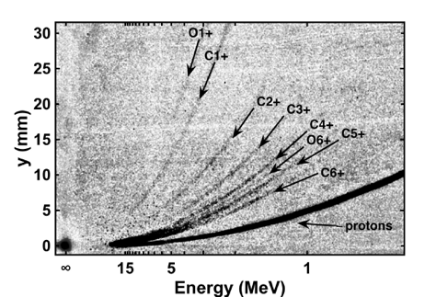
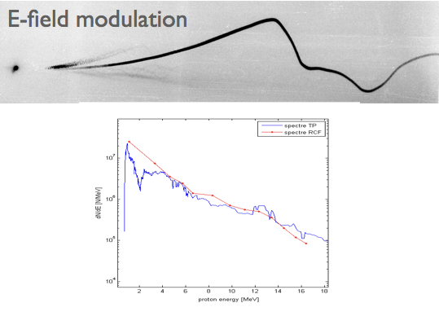
TP scheme
Thomson parabola data:

Slide 9
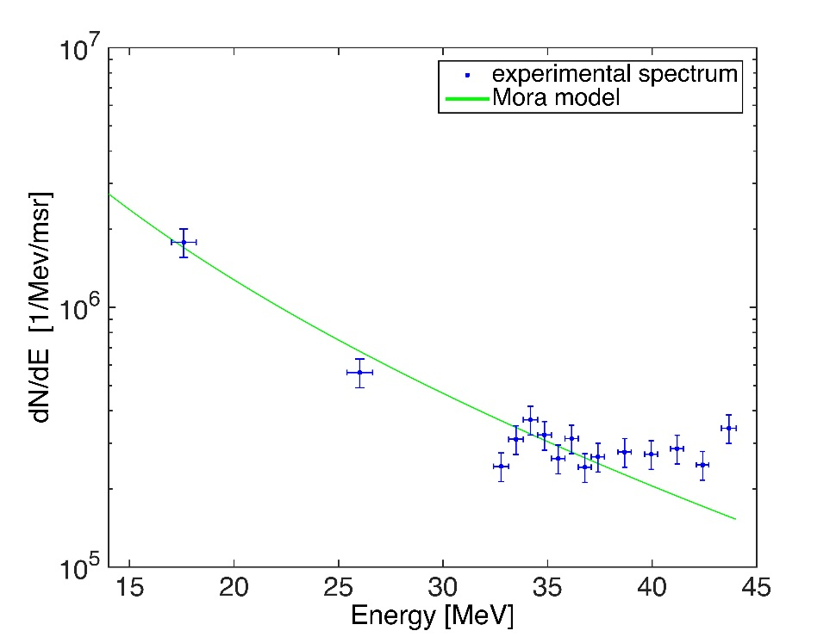
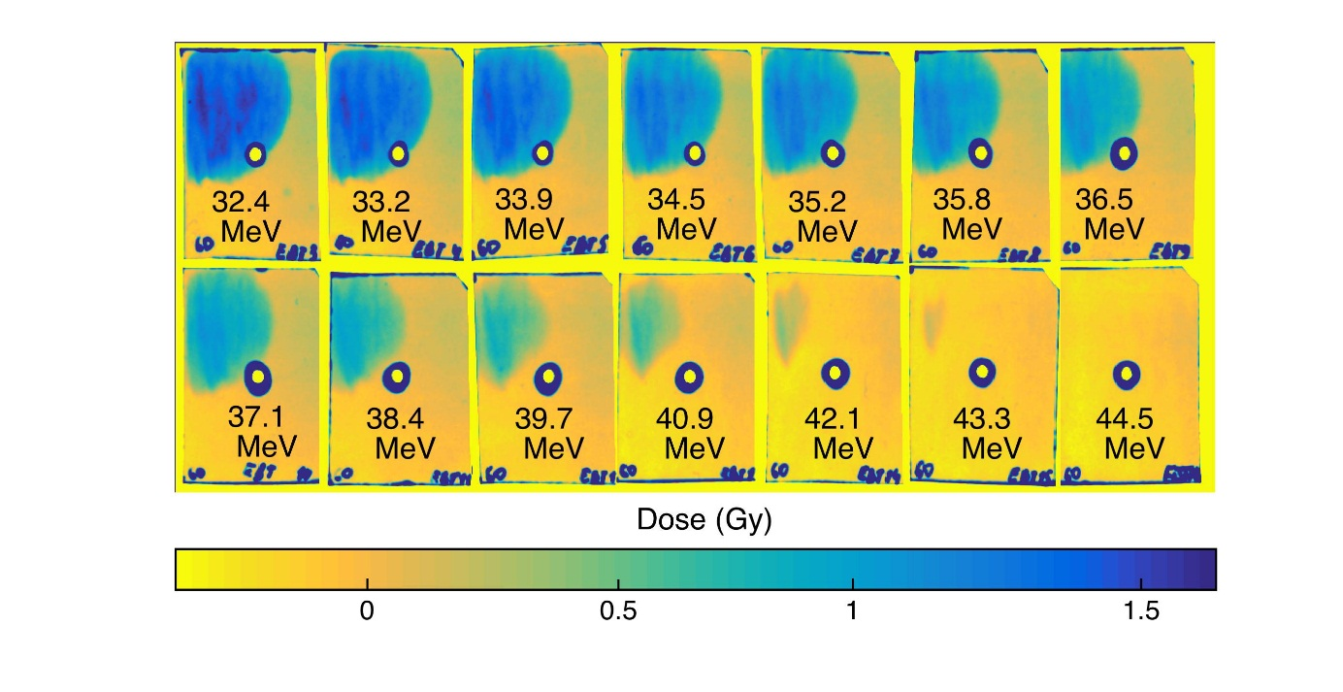
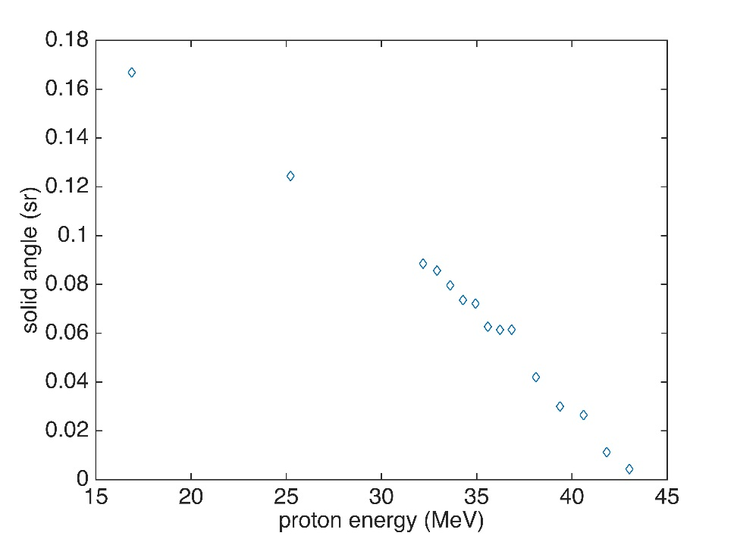
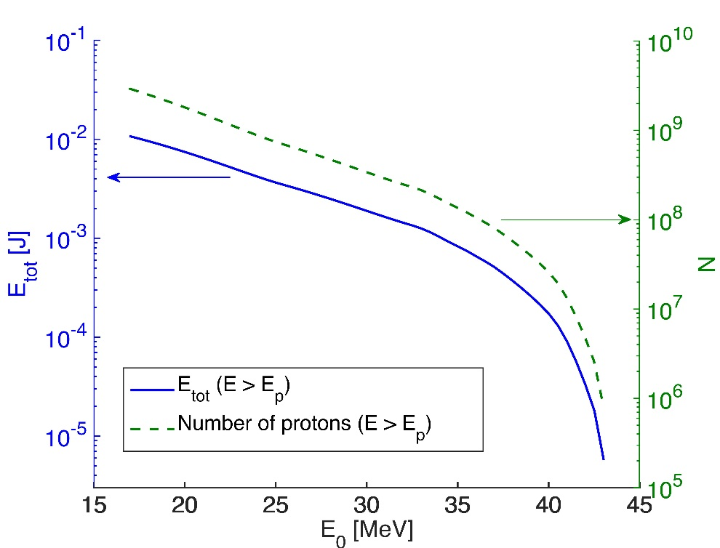
Proton data: RCF
RCF1
T_{h}= 3.1±0.3 MeV
$$\frac{dN}{dE}=\frac{n_{e0}c_{s}t_{acc}S_{sheath}}{{\left({2ET}_{h}\right)}^{\frac{1}{2}}}×\exp\left(−{\sqrt{\frac{2E}{T_{h}}}}^{}\right)$$
P. Mora model:

Slide 10
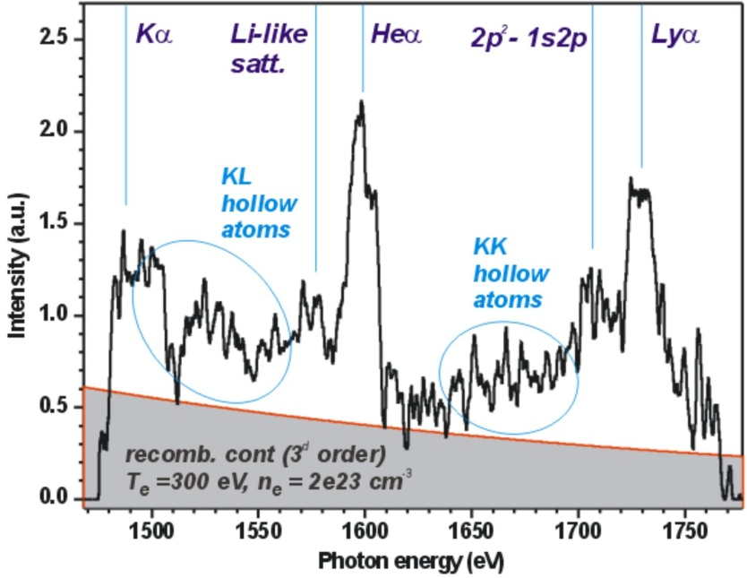
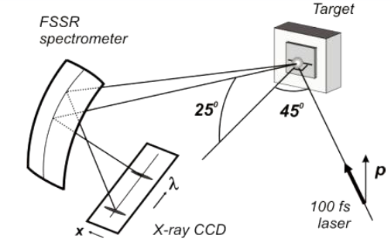
X-ray diagnostics
IP

Slide 11
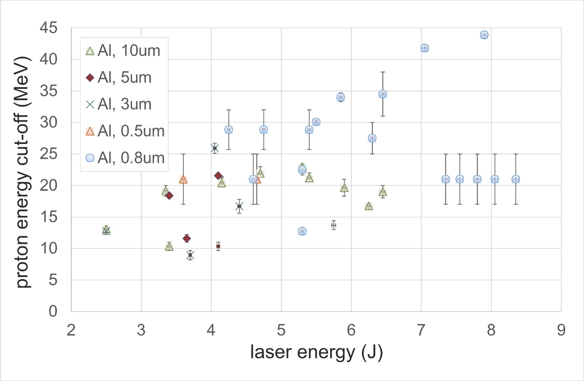
Statistics of the shots

Slide 12
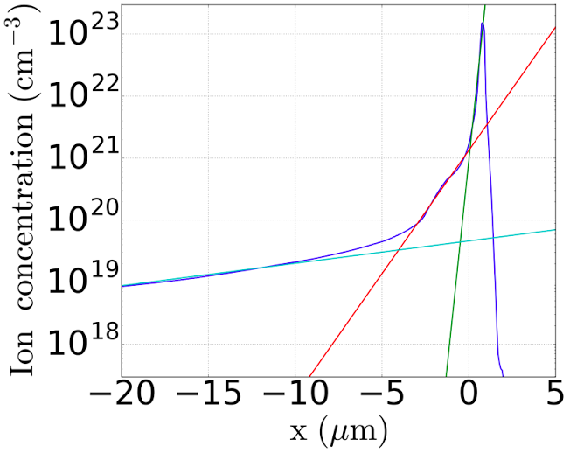
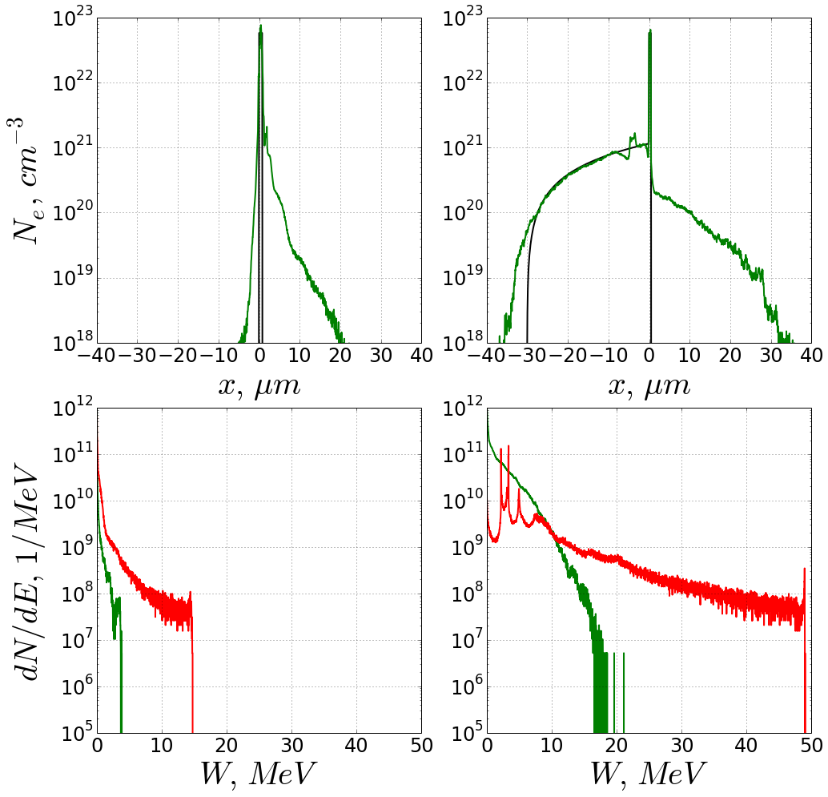
Numerical simulations
Ion concentration of the target (blue line) at the moment of the main pulse arrival, fitted with
green by exp(x/L) with L = 0.16 µm for the overdense part;
red by exp(x/L) with L = 1.1 µm for the dense part; and
cyan by exp(x/L) with L = 12 µm for the low-dense part

Slide 13
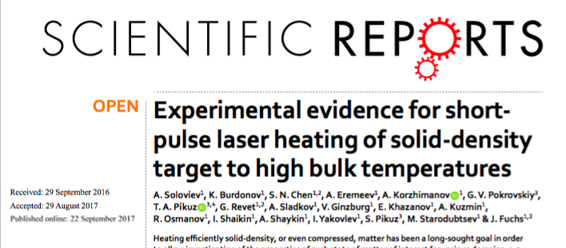
Conclusions:
The initial OPCPA contrast is appropriate for a high effective energy deposition into the target
Confirmed by:
- the TNSA protons of the cut-off above the 43.3MeV (retrieved from RCF stack)
- the presence of different charge states of C+ and O+ been accelerated (retrieved from the TP) is in a good agreement with RCF data
- the T_{h} =3.1MeV,-extracted from the proton spectra
- the fitting of the continuum as well as the ration between He_{a} and Ly_{a} resonance lines correspond
to the 300eV temperature under the concentration of about~ 2*10²³ cm⁻³
- the traces of the hollow atoms presence on X-ray spectra
From MHD modeling:
- the plasma distribution at the moment of the main pulse arrival is combined of three plasma scale-lengths
-the 300 eV temperature for the cold fraction of the electrons is in a good consistence with the both 1D and 2D MHD-modeling performed
The paper published few days ago:

Slide 14
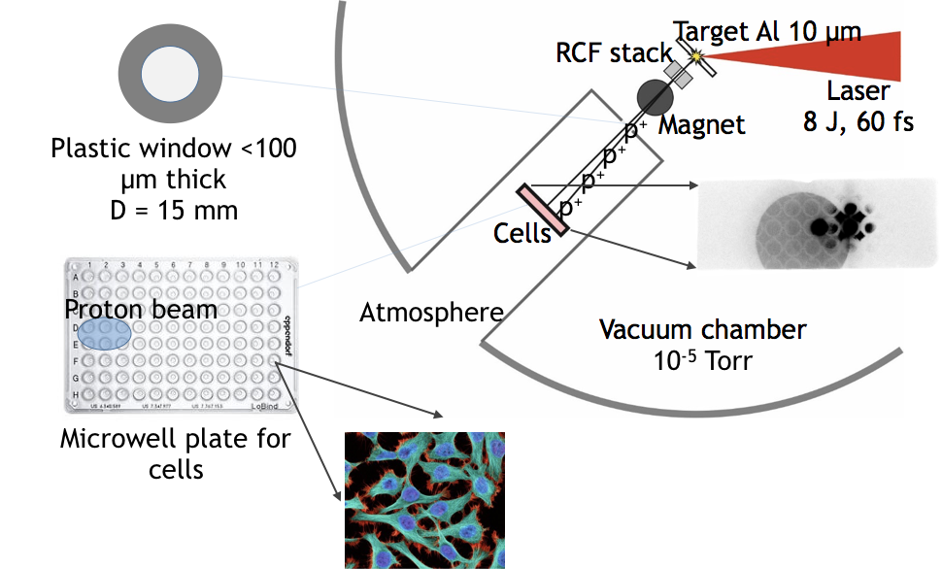
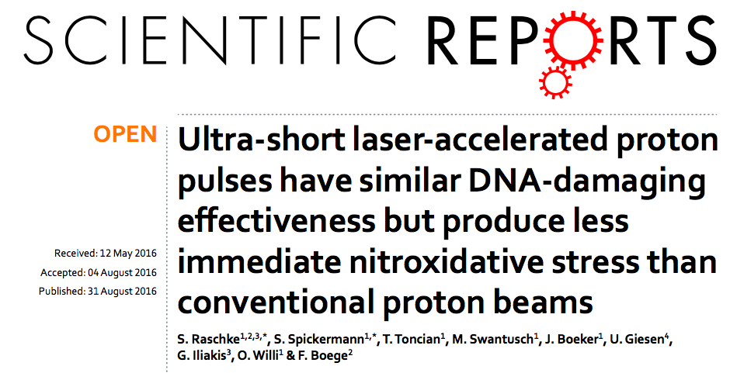
Experiments on bio-objects

Slide 15
Laser ions driven secondary sources
Neutrons
Isotopes

Slide 16
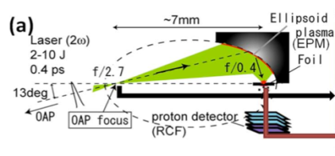
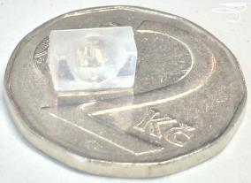
Tight focusing experiments
Tight focusing experiments:
low-cost production
efforts under way ➔
Raw print
Tight focusing for increased intensity has demonstrated higher TNSA energy
However, open questions remain on role of magnetic fields
Technology has not been tried for sub 100fs lasers.

Slide 17
Tanks for your time!

