Slide 1


Design Concept for THz- driven Electron Streaking Technique
Mozhgan Hayati
Bern University
3rd European Advanced Accelerator Concepts Workshop
24-30 September 2017, La Biodola, Isola d'Elba

Slide 2
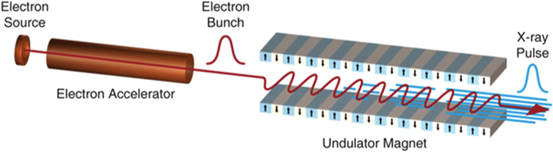
Motivation
Ultrafast electron diffraction
e- rescatering in atoms
XFEL
C. Pellegrini et al.; Review of Modern Physics 88, 015006 (2016)
Goal: Few femto- second time resolution measurement for electron pulses (10-100 Kev) as well as electrons in a few MeV energy range.

Slide 3
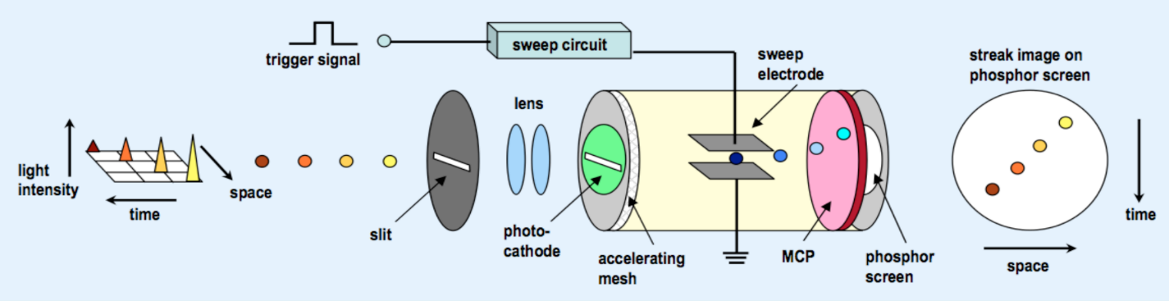
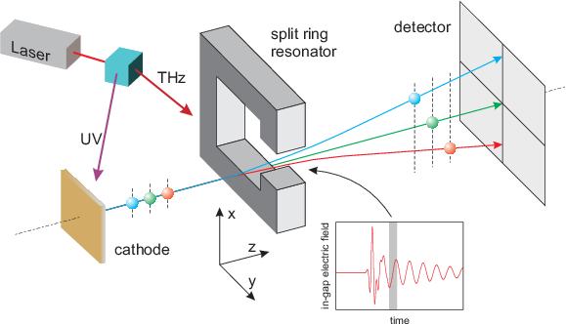
What is the idea?
Hamamatsu Photonics K.K. 2008
J. Fabianska, G Kassier & T. Feurer, Scientific Reports 4, 5645 ,2014

Slide 4
Principles of the SRR Streaking structure
J. Fabianska, G Kassier & T. Feurer, Scientific Reports 4, 5645 ,2014

Slide 5
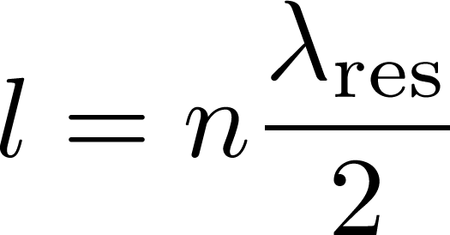
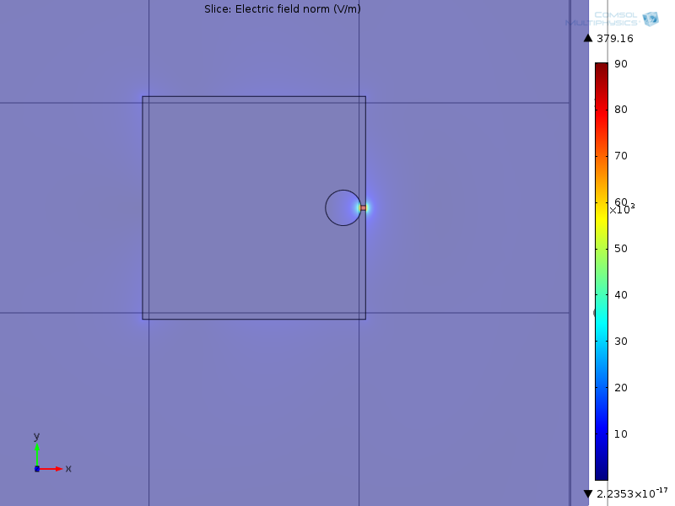
THz Field Enhancement in a SRR

Slide 6
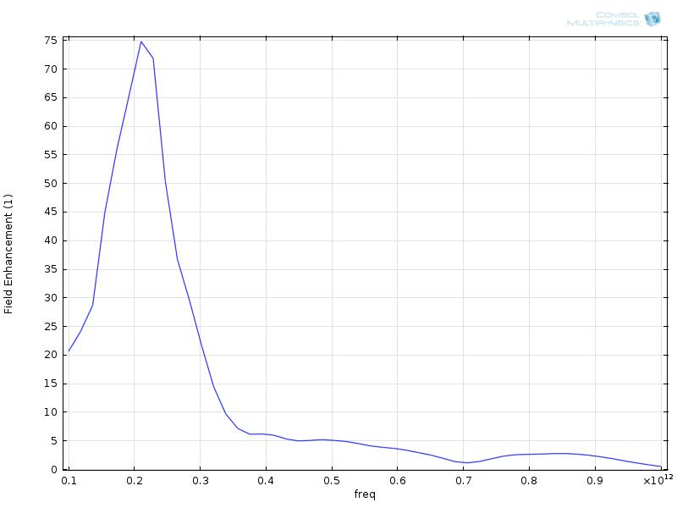
A simulated electric field distribution using COMSOL
Parameter | Value
Resonance Frequency | 0.22 THz
Peak incident electric field | 5 MV/m
Width | 24 um
Deflector gap | 20 um
Kick | 40keV/c
Field Enhancement in the gap | 74
1- Incident THz Electric Field
2-THz electric field amplitude in the gap
Notes:
Two distinguished electric field !

Slide 7
Definitions
Electron beam source
Area | 4 x 4 μm²
Transverse emittance | 0
Energy | 30 keV & 1 MeV
Energy spread | 0.1 % & 1 %
Initial bunch length | 0 – 100 fs
rms angular spread
streak velocity =
time
rms angular spread [mrad]
1000 individual electrons without space charge forces
Aerial space charge density of 10⁷ electrons/mm² including space charge effects and the detector
was located 10 cm and 50 cm farther along the beam line

Slide 8
Single electron trajectory simulations
0 fs
50 fs
0.3 THz
0.6 THz
0.9 THz
E_{Gap}= 100 MV/m
J. Fabianska et al.; Scientific Reports 4, 5645 (2014)

Slide 9
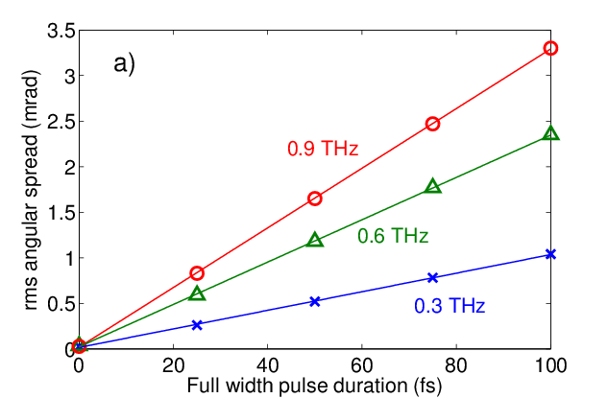
Constant Angular Streak Velocity
Temporal resolution $∆t=\frac{σ_{0}}{V_{θ,s}}=0.9 fs @ 0.9 THz \& EGap=100 MV/m$
J. Fabianska, G Kassier & T. Feurer, Scientific Reports 4, 5645 ,2014

Slide 10
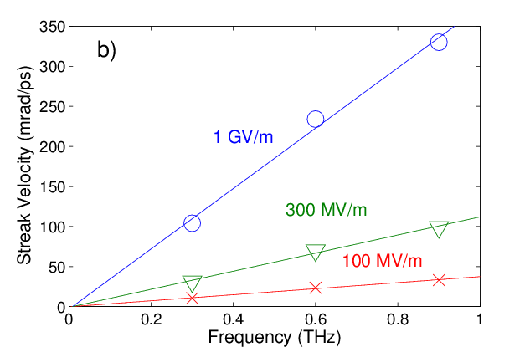
Streak Velocity @ resonance frequency
Temporal resolution $∆t=\frac{σ_{0}}{V_{θ,s}}=1.5 fs @ 0.9 THz \& Egap=1 GV/m$
J. Fabianska, G Kassier & T. Feurer, Scientific Reports 4, 5645 ,2014

Slide 11
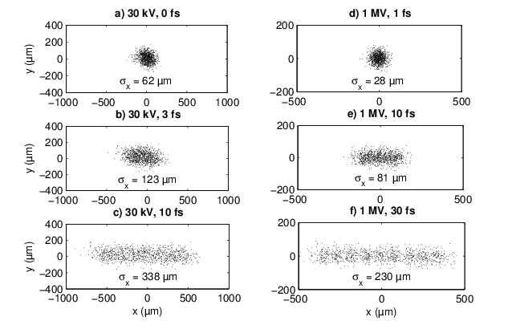
Including space charge effects
0.9 THz
1GV/m
J. Fabianska, G Kassier & T. Feurer, Scientific Reports 4, 5645 ,2014

Slide 12
Summary of results (Realistic Electrons)
 |  | Temporal resolution ( fs )
Resonance frequency (THz) | Total streaking window ( fs) | 100 MV/m | 300 MV/m | 1 GV/m
0.3 | 717 | 48 | 16 | 4.8
0.6 | 358 | 21 | 7.1 | 2.1
0.9 | 239 | 15 | 5.1 | 1.5
Notes:
The total streaking window and the rms time resolution for different split ring resonator frequencies and field strengths. A bunch centre electron of 30 KeV and an rms angular spread of 0.5 mrad imminently prior to streaking are assumed

Slide 13
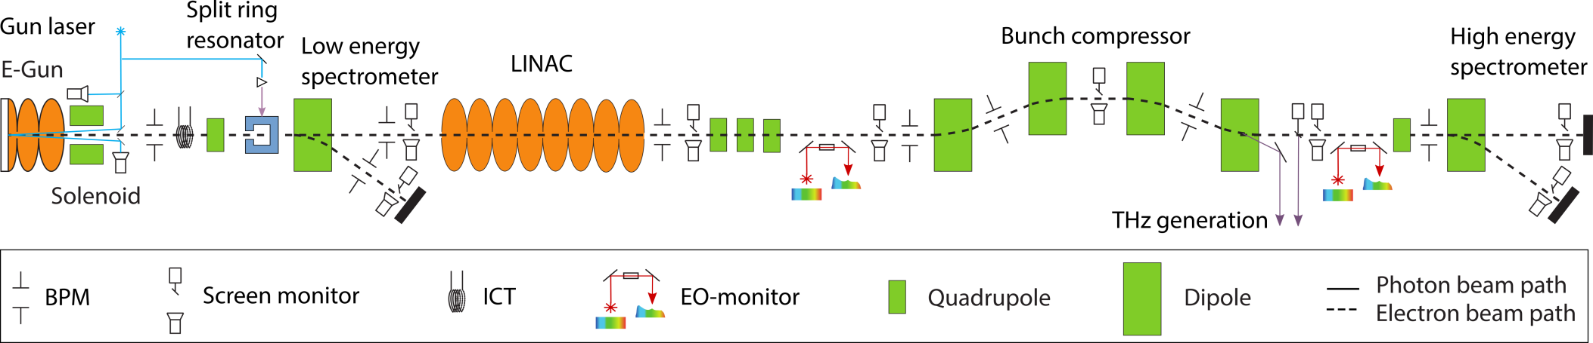
Ferninfrarot Linac und Test Experiment
Proof of principle SRR experiment
Parameter | Value
Electron energy | 7.7 MeV
Electron bunch charge | Wide range, 10 fC ~ 3 nC
Laser wavelength (fundamental) | 800 nm
THz pulse wavelength | 150 μm
Notes:
A proof of principle experiment will be performing at the FLUTE accelerator test facility at KIT ,Germany

Slide 14
Schematic of THz pulse source
Optical rectification
Efficient THz pulse generation
Tilted pulse front excitation

Slide 15
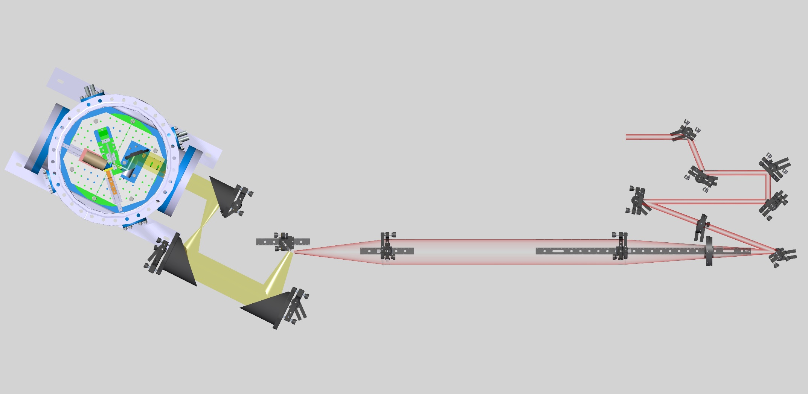
3D layout of THz pulse source & SRR experiment
SRR chamber
Diffraction grating
LiNbO₃
4F imaging system
THz Imaging system

Slide 16
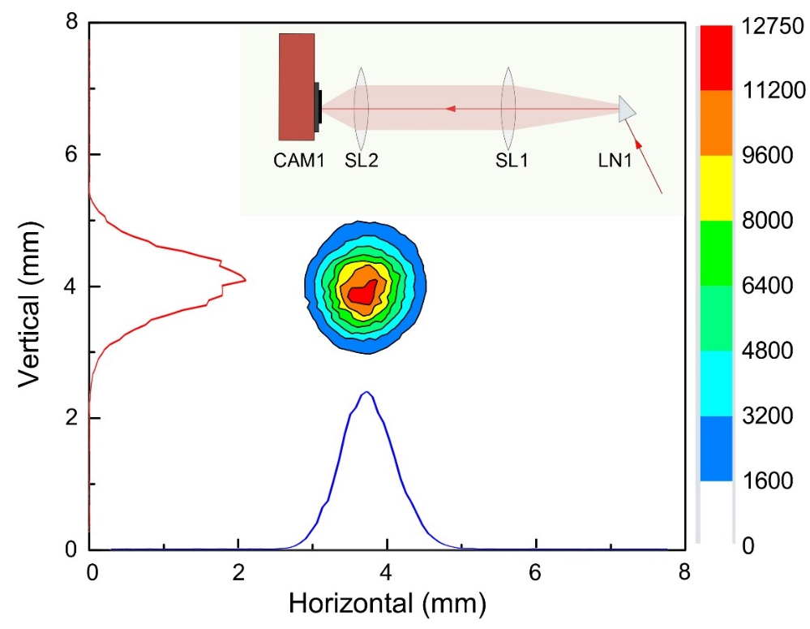

Experimental results
THz pulse generation
THz pulse imaging
$${Electric field}_{THz}=14.6\frac{MV}{m}$$
Notes:
The THz spot dimensions (full with at half maximum) are 0.92 mm in horizontal direction and 1.15 mm in vertical direction. The maximum THz pulse energy was 0.8 μJ
Camera image of the THz beam at the image plane of a 4f THz imaging system. A schematic of the 4f imaging system is seen in the inset.

Slide 17
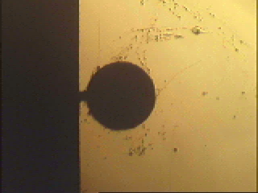
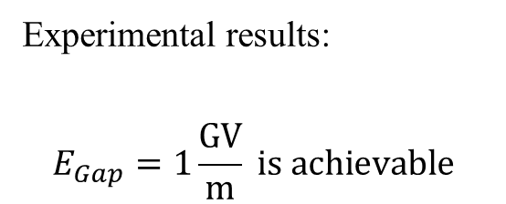
SRR prototype and near-field measurement of electric field in the gap
Experimental results:
$$E_{Gap}=1\frac{GV}{m} is achievable$$

Slide 18
Summery :
The proposed streak camera is expected to be capable of few femtosecond resolution for the measurement of the realistic electron bunches in Kev and Mev range
The split ring resonator is an ideal tool for electron bunch measurement in UED experiments
For FEL application an array or these structures, and higher resonance frequency can be used to maintain high resolution.
with different SRR design larger field enhancement is possible
for SRR array more “kick”
Planned proof-of-principle experiments:
SPARC, Frascati, Italy, 2018
UED, LBNL, California , US, 2018
Korea Atomic Energy Research Institute (KAERI), South Korea

Slide 19



Many thanks to the collaborators!
University of Bern, Switzerland
Thomas Feurer, Roxana Tarkeshian, Zoltan Ollman,
Paul Scherre Institute, Villigen, Switzerland
Micha Dehler, Volker Schlott, Rasmus Ischebeck,
Karlsruhe Institute of Technology, Karlsruhe, Germany
Minjie Yan, Erik Bründermann, Robert Ruprecht , Michael Nasse, Anke Susanne Müller,
Enrica Chiadroni, Massimo Ferrario, Spark , Frascati, Italy
Daniele Filippetto, Wim Leemans, UED, LBNL, US,
James Rosenzweig, UCLA, US

Slide 20

THANK YOU FOR YOUR Kind ATTENTION!

