Slide 1
Beam loading at a nanocoulomb-class laser wakefield accelerator
Jurjen P. Couperus^{1,2}
R. Pausch^{1,2}, A. Köhler^{1,2}, O. Zarini^{1,2}, J.M. Krämer^{1,2,},T. Kurz^{1,2}, M. Garten^{1,2}, A. Huebl^{1,2}, R. Gebhardt¹, U. Helbig¹, S. Bock¹, K. Zeil¹, A. Debus¹, M. Bussmann¹, U. Schramm^{1,2} & A. Irman¹
¹Institute of Radiation Physics, Helmholtz-Zentrum Dresden - Rossendorf, Germany
² Technische Universität Dresden, Germany
EAAC, 24-30 September 2017, Elba, Italy

Slide 2
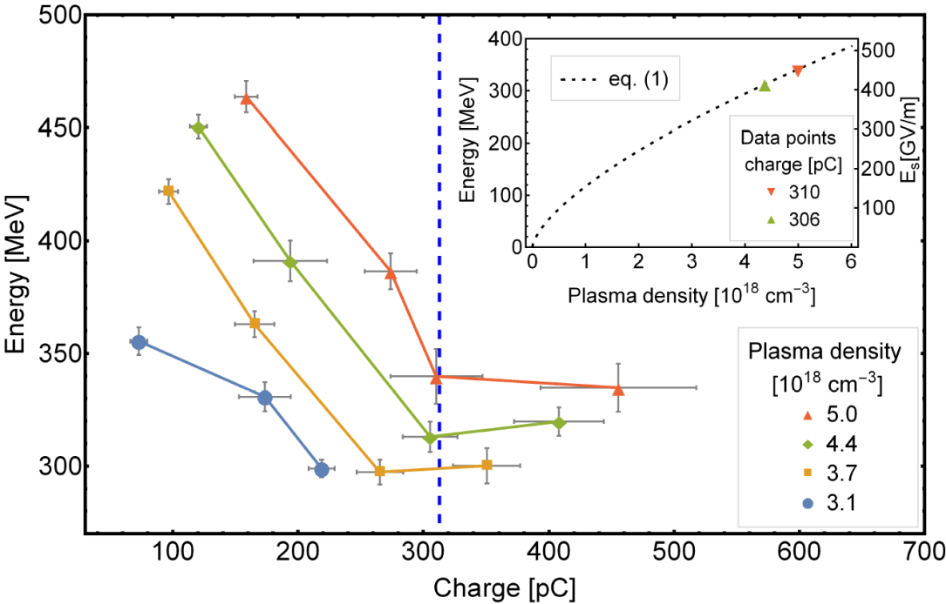
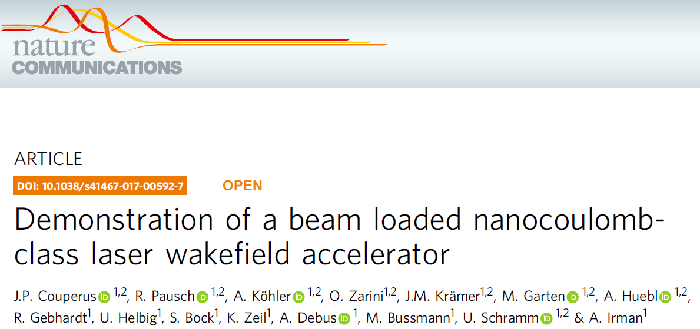
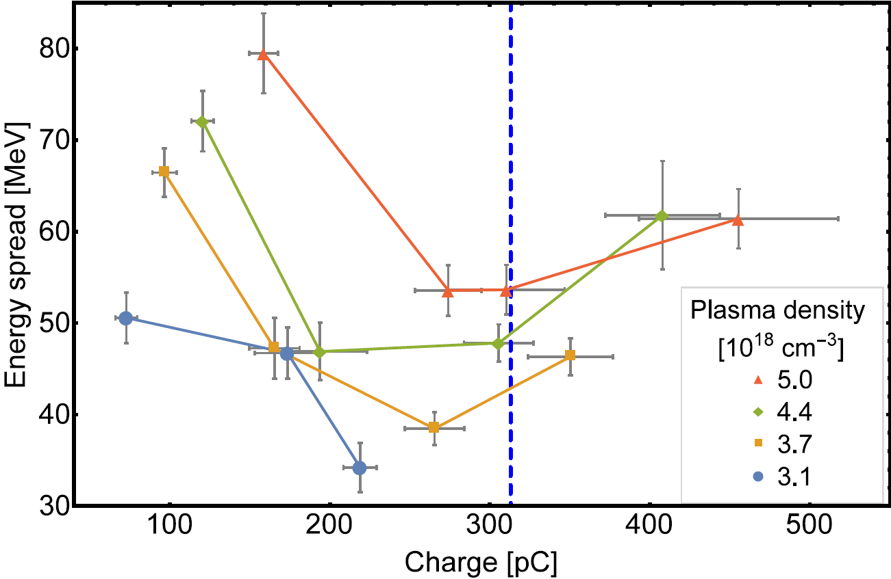
Reduce energy spread by beam loading
0.2%
0.5%
1%
1.5%
Beam loading
Injection of quasi mono-energetic bunches up to 0.5 nC charge
Increasing charge
→ energy decrease
→ energy spread decrease

Slide 3
Title
Outline
Optimal beam loading: how does it happen?
Setup & systematic studies
Beam loading experiments at the HZDR
Operation and tailoring the Self-Truncated Ionization Injection regime
Controlling the charge injection
Reaching the optimal loading condition
Conclusion

Slide 4
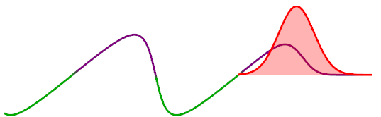
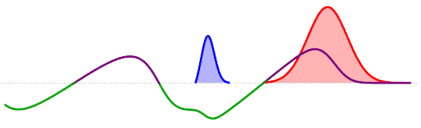
High charge induced beam loading
Self-fields of bunch superimpose the wakefield
Laser driven acc. field
+
e⁻ beam self field
=
Beam loading
Beam loading effects
Reshaping plasma accelerating structure
Reduction of effective acceleration gradient
Degradation of the final beam quality:
maximum energy, energy spread, emittance
Rechatin et al., PRL 103, (2009)
Guillaume et al., PRSTAB 18 (2015)
Vafaei-Najafabadi et al., PRL, 112, (2014)

Slide 5
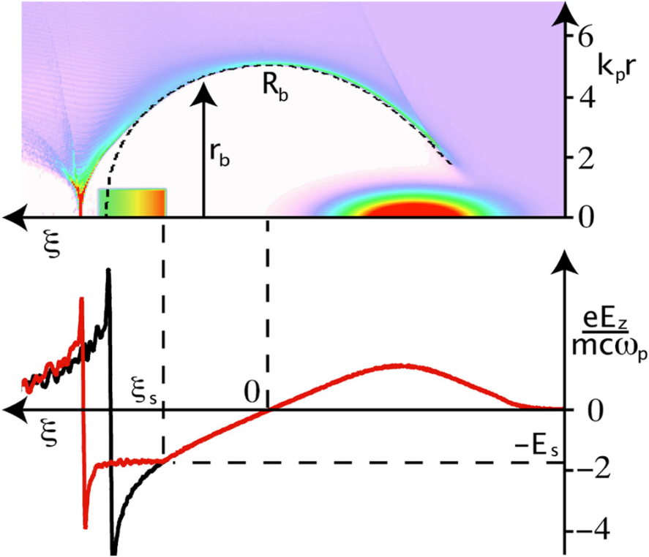
High charge induced beam loading
BUT, one can optimize it :
Injection of an optimum bunch shape in the nonlinear bubble regime with a specific charge Q_{s}
Charge scaling at the optimum loading condition
Requires ~0.3 nC of injected charge at 65 TW laser power
Tzoufras et al.,
Phys. Rev. Lett. 101, 145002 (2008)
Optimum beam loading
Beam loading affects:
Energy and energy spread
Longitudinal beam distribution
Beam emittance & transverse dynamics
Accelerating gradient constant along the bunch
No extra addition of energy spread
Katsouleas et al., Part. Acc. 22 (1987)

Slide 6
Title
Outline
Optimal beam loading: how does it happen?
Setup & systematic studies
Beam loading experiments at the HZDR
Operation and tailoring the Self-Truncated Ionization Injection regime
Controlling the charge injection
Reaching the optimal loading condition
Conclusion

Slide 7
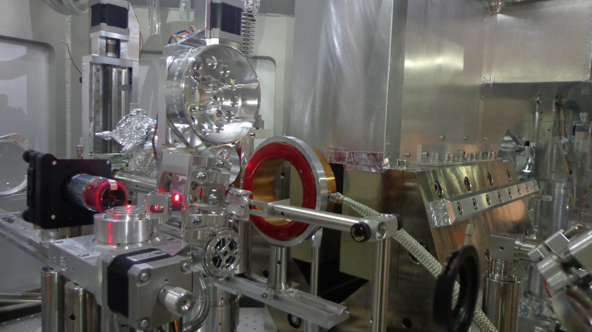
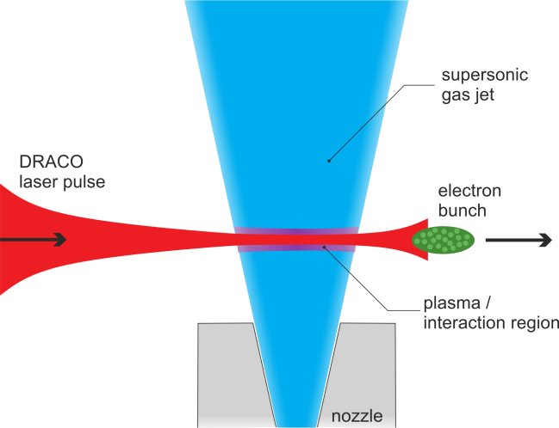
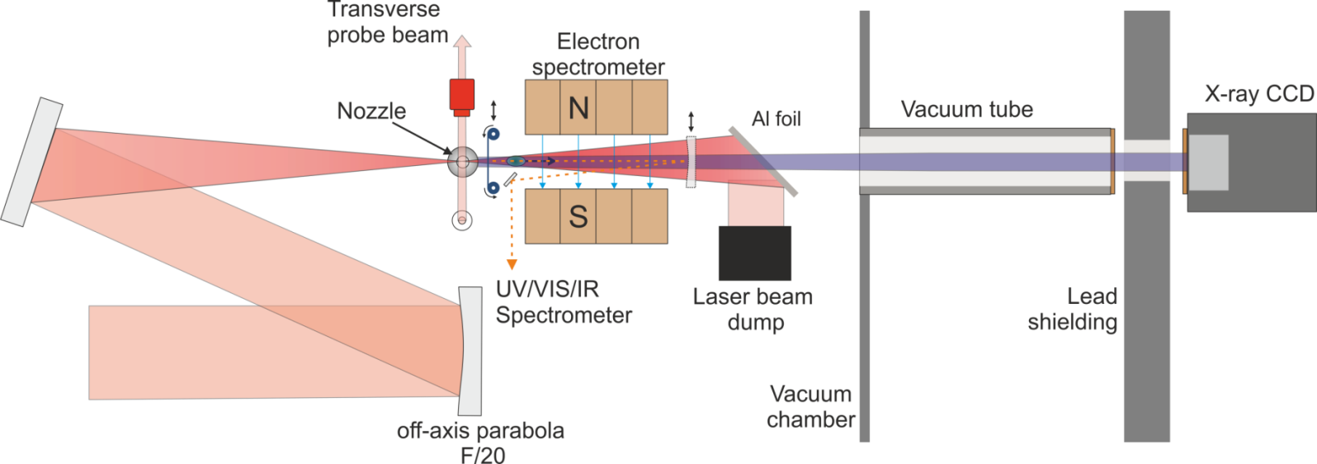
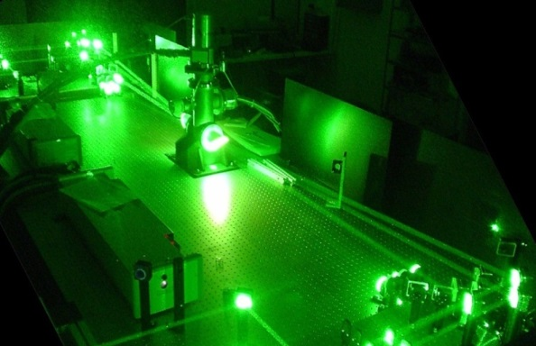
Setup
Tape drive
Charge calibrated-electron spectrometer
DRACO
laser
gas jet
Ti:Sa Laser DRACO
λ₀ = 800 nm
up to 4 J on target
27 fs pulse width (FWHM)
Strehl-ratio > 0.9
20 μm FWHM

Slide 8
Systematic study of:
Bunch measurements using OTR
Bunch length measurements using CTR. O. Zarini (Monday)
Transverse bunch diagnostics by OTR
R. Zgadzaj / M. Laberge, Uni. of Texas at Austin/HZDR (Tuesday, 16:20, WG 5)
Beam loading (this talk)
Betatron analysis & Transverse beam dynamics
A. Köhler
(Thursday 18:30, WG 4)
Ti:Sa Laser DRACO
λ₀ = 800 nm
up to 4 J on target
27 fs pulse width (FWHM)
Strehl-ratio > 0.9
20 μm FWHM
Inverse Thomson scattering with a plasma mirror
M. Downer / A. Hannasch, Univ. of Texas at Austin/HZDR (Tuesday 16:00 WG 1)

Slide 9
Title
Outline
Optimal beam loading: how does it happen?
Setup & systematic studies
Beam loading experiments at the HZDR
Operation and tailoring the Self-Truncated Ionization Injection regime
Controlling the charge injection
Reaching the optimal loading condition
Conclusion

Slide 10
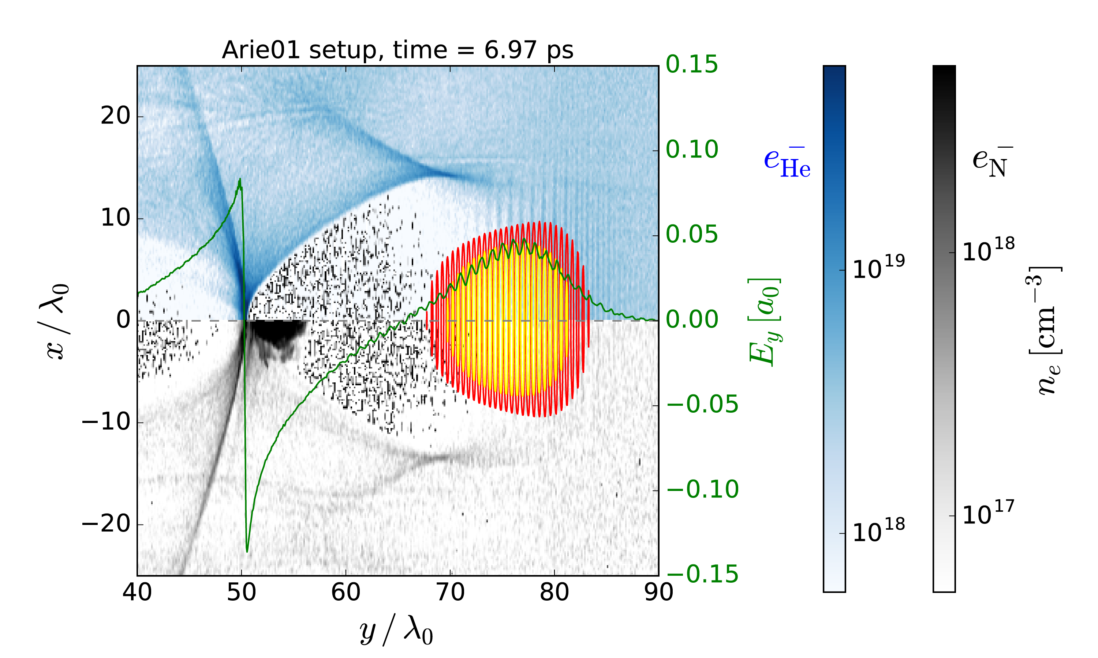
Ionization Injection
The accelerating medium is doped by a high-Z gas
Choosing the gas and laser energy such that inner shell electrons only ionize at the peak of the laser
Species | Ionisation energy (eV)
He¹⁺ | 24.6
He²⁺ | 54.4
N¹⁺ | 14.5
N²⁺ | 29.6
N³⁺ | 47.4
N⁴⁺ | 77.5
N⁵⁺ | 97.9
N⁶⁺ | 552
N⁷⁺ | 667
Ionized only near the
laser peak intensity

Slide 11
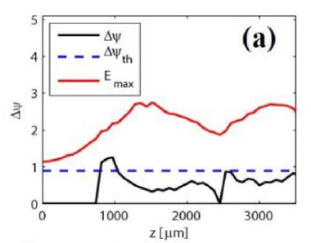
Self-Truncated Ionization Injection (STII)
Injection can be limited by using an unmatched laser spot, focussed at the gas-jet onset
Laser modulation influences the wake, thus changing the wake pseudo-potential difference
Injection only when:
Laser max energy is high enough for ionization
pseudo-potential difference allows trapping
Zeng et al. Phys. Plasmas 21, 030701 (2014)
Mirzaie et al. Sci. Rep. 5, 14659 (2015)

Slide 12
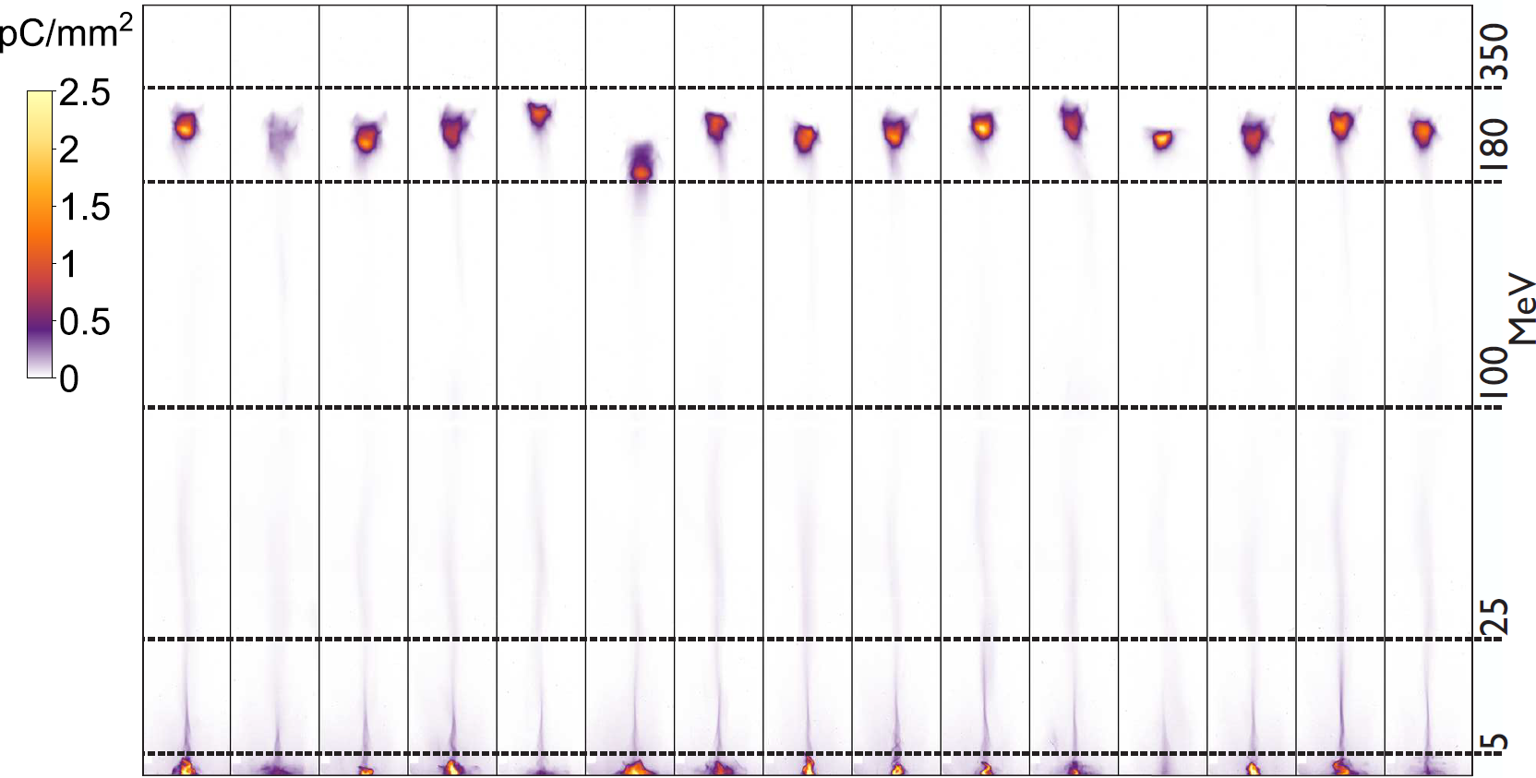
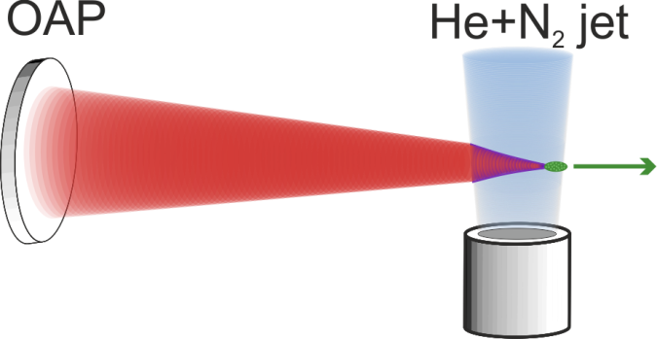
Stable operation with high charge
consecutive shots
Parameters | Mean ± Shot-to-shot jitter
Mean peak energy | 250 MeV ± 22.5 MeV
Charge in fwhm | 220 pC ± 40 pC
Abs. energy width | 36 MeV ± 11 MeV
Divergence | 7 mrad ± 1 mrad
2.5 J, 30 fs, plasma density 3.1x10¹⁸ cm⁻³ , mixed He + 1% N₂ , 3 mm gas jet

Slide 13
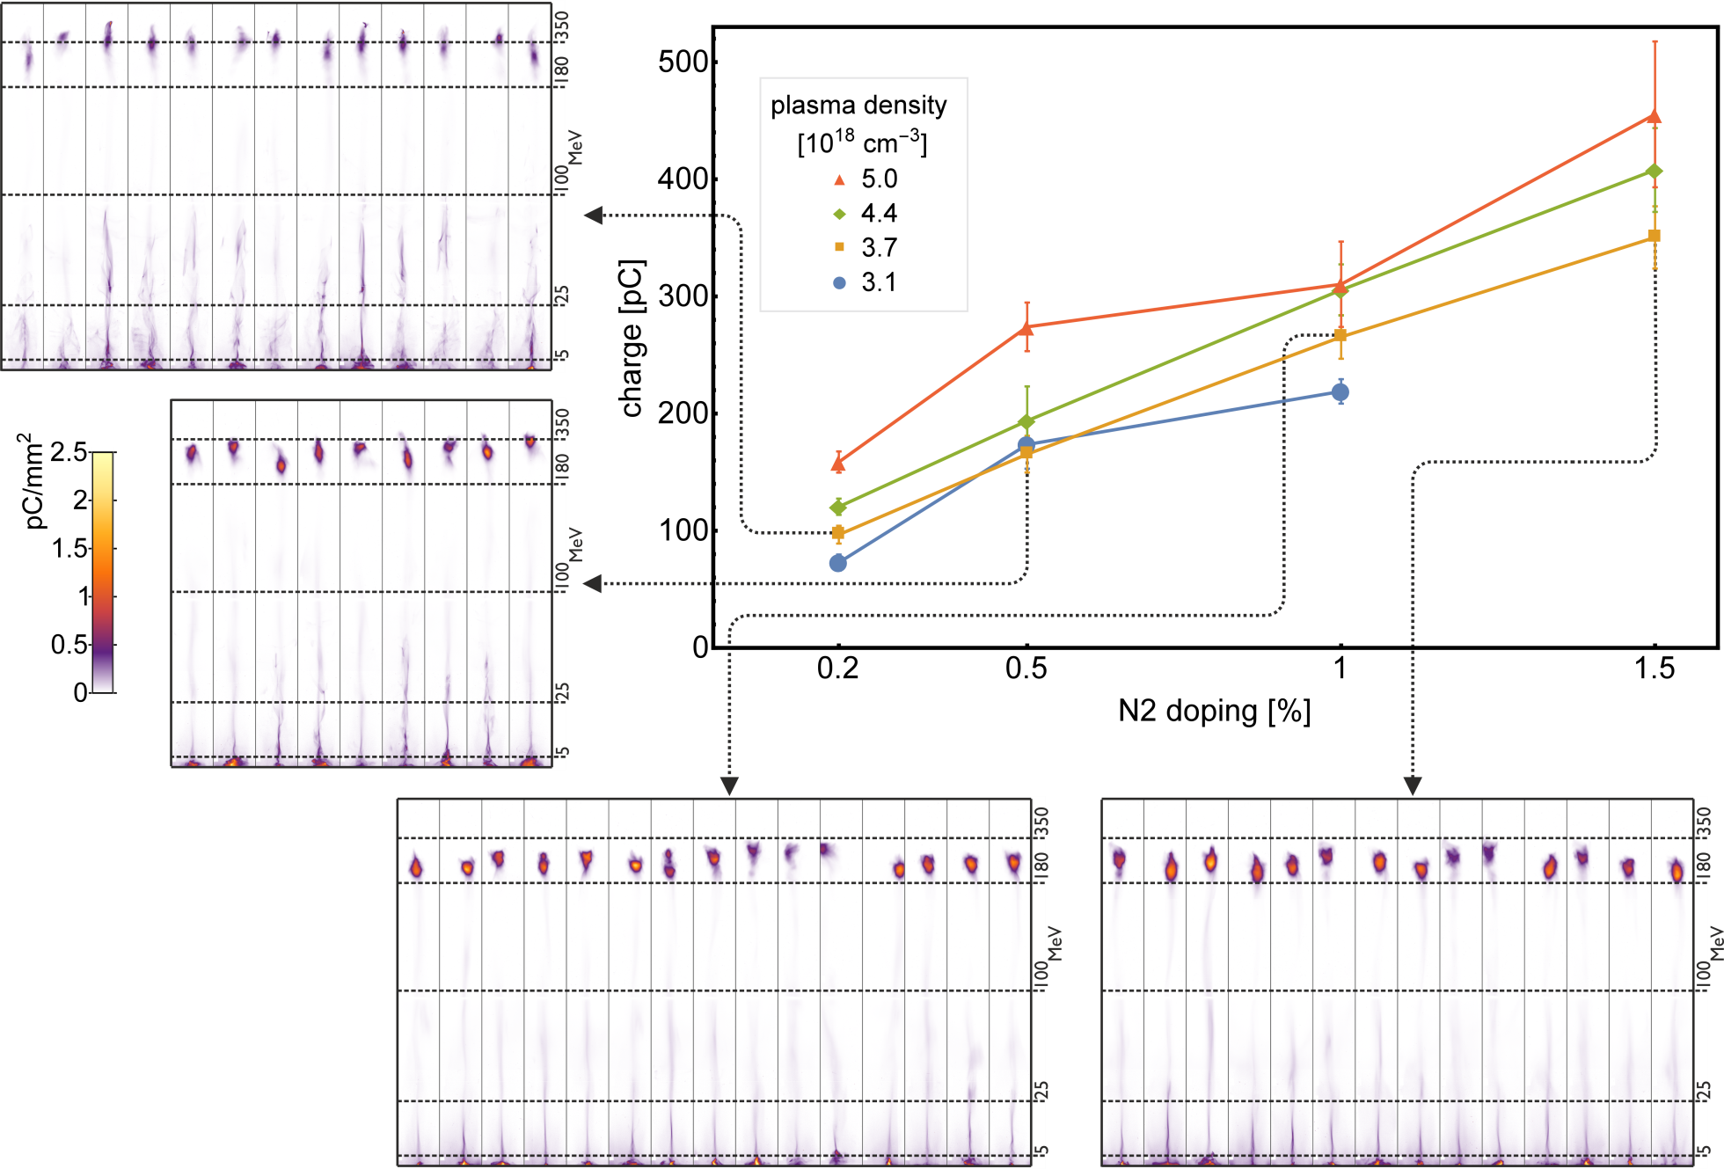
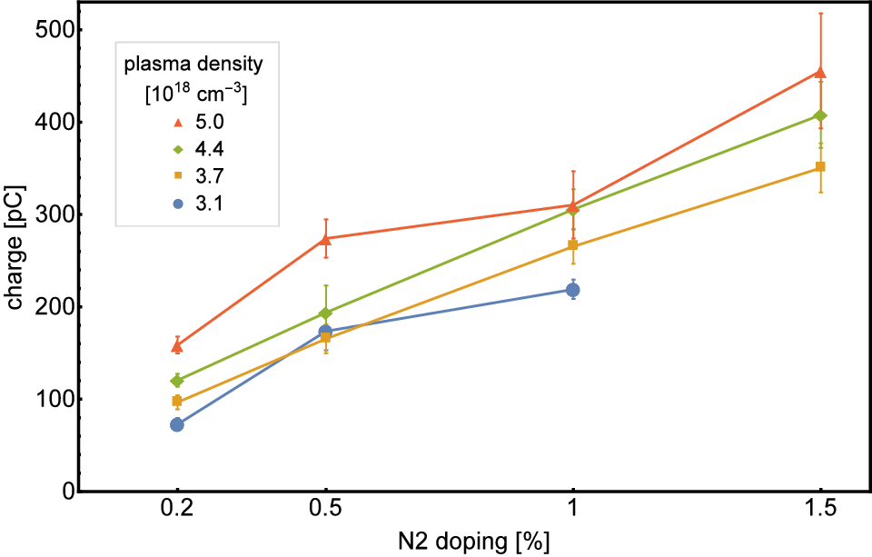
Controlled over injected charge
In order to systematically study beam loading effects, we tune the injected charge at equal plasma dynamics
Charge is increased by increasing nitrogen doping
Keep laser parameters constant
→ Injection volume phase- space constant
Very good shot-to-shot stability
systematic study: each data point is acquired by averaging up to 20 shots

Slide 14
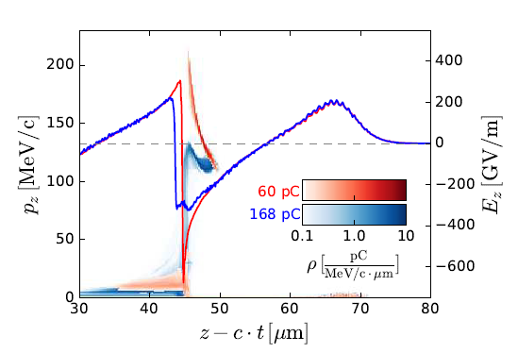
Beam loading effects at a LPA
0.2%
0.2%
0.5%
0.5%
1%
1%
1.5%
1.5%
Tzoufras et al., Phys. Rev. Lett. 101,145002(2008)
prediction Tzoufras
Beam loading
Increasing charge
→ energy decrease
→ energy spread decrease
Optimum loading:
→ minimum energy spread
@ 300 pC, ~ 15 fs → up to 20 kA
Couperus et al. Nat. Commun. 8, 487 (2017)

Slide 15
Conclusion
Operation of a nano-coulomb class laser plasma accelerator
A tailored STII scheme:
→ very robust, good shot-to-shot stability
→ control of the injected charge
Optimization of beam loading:
Verifying predicted optimal loading condition by Tzoufras et al.
Minimizing energy spread
→ generation of peak current up to 20 kA with 15% relative energy spread

Slide 16
J.P. Couperus, A. Köhler, O. Zarini, J.M. Krämer, T. Kurz, A. Irman
R. Pausch, A. Debus, M. Garten, A. Huebl, M. Bussmann
S. Bock, U. Helbig, R. Gebhardt, K. Zeil & U. Schramm
Thank you for your attention!
Further talks:
CTR bunch length and substructures investigations
O. Zarini
Inverse Thomson scattering with a plasma mirror
M. Downer / A. Hannasch (Univ. of Texas at Austin/HZDR): Tuesday 16:00 WG 1
Beam investigation by OTR
R. Zgadzaj / M. Laberge (Univ. of Texas at Austin/HZDR): Tuesday 16:20, WG5
Shedding light on LWFA plasma dynamics
R. Pausch: Wednesday 19:10, WG 6
Betatron and Transverse beam dynamics
A. Köhler: Thursday 18:30 WG 4
A laser-to-beam-driven plasma wakefield accelerator
Talk by A. Martinez de la Ossa (DESY): Thursday 18:36, WG 1
Sachsen Zeitung

Slide 17
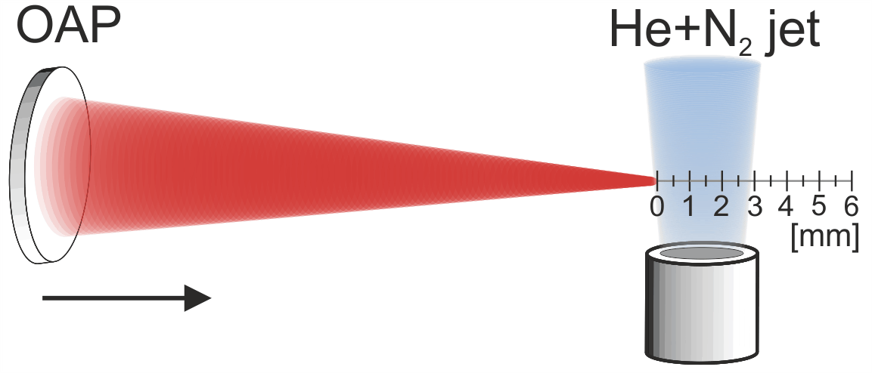
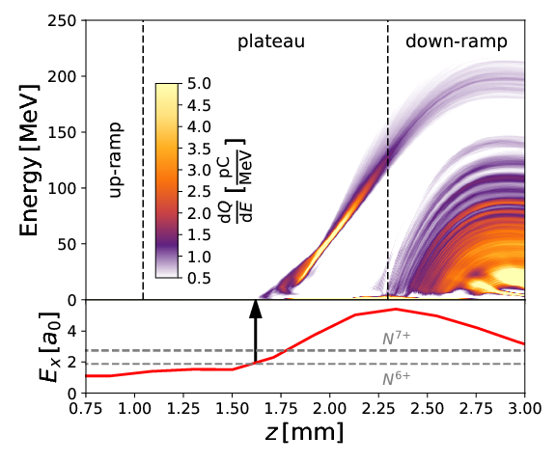
A tailored scheme of STII
250 pC in FWHM
Vacuum focus is positioned behind the gas jet
Geometric focusing is enhanced by relativistic self-focusing to reach injection threshold and to fullfill the unmatched spot size condition
Injection distance and time limited by STII effect
Shedding light on LWFA plasma dynamics
How to improve the matching of simulation to experiment using radiation diagnostics:
Talk by R. Pausch Wednesday 19:10 WG 6
Couperus, Pausch et al. Nat. Commun. 8, 487 (2017)

