Slide 1
Multi-proton bunch driven hollow plasma wakefield acceleration in the nonlinear regime
Y. Li^{1,*}, G. Xia¹, K. Lotov², A. Sosedkin,² K. Hanahoe¹, O. Mete-Apsion¹
¹The University of Manchester/Cockcroft Institute
²Budker Institute of Nuclear Physics/Novosibirsk State University
*yangmei.li@manchester.ac.uk

Slide 2
Outline
PD-PWFA
PD-HPWFA
Multiple PD-HPWFA in the nonlinear regime
Summary & Outlook
Proton Driven Plasma Wakefield Acceleration
Proton Driven Hollow Plasma Wakefield Acceleration

Slide 3
Why PD-PWFA?
Limited energy content in e- bunches/lasers
Technically challenging multi-stage acc
PWFA
Transformer ratio
Single stage
SLAC (50 GeV, 2e10 e/bunch) ~ 0.16 kJ
ILC (250 GeV, 2e10 e/bunch) ~ 0.8 kJ
SPS (400 GeV, 3e11 p/bunch) ~ 20 kJ
LHC (7 TeV, 1.15e11 p/bunch) ~ 130 kJ
LWFA
A PW laser proposed for wakefield acceleration is about 40 J.
Despite rapid growth, lasers have not brought a proportionally impressive progress in particle energy. (3D effect)
Tight synchronization and alignment requirements of the drive and witness bunches and of each accelerator module

Slide 4
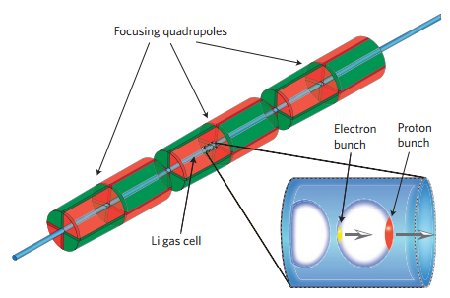
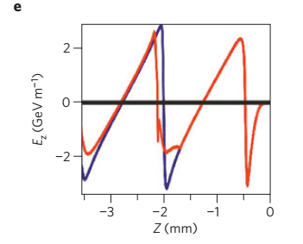
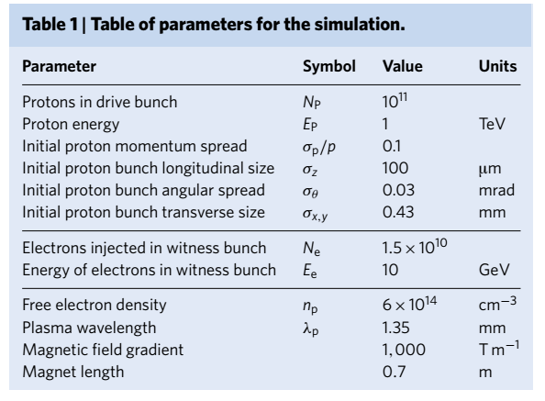
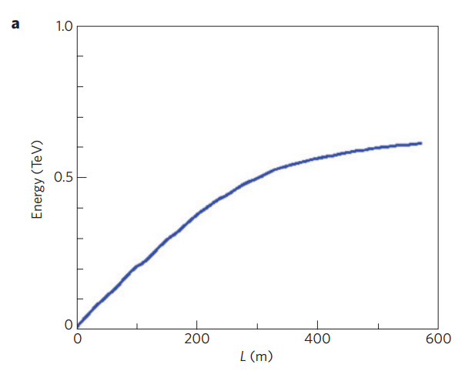
PD-PWFA
Proton driven plasma wakefield acceleration
0.62 TeV e⁻ beam
Energy Frontier!
Caldwell, A. et al., Nature Phys. 5, 363 (2009).

Slide 5
Outline
PD-PWFA
PD-HPWFA
Multiple PD-HPWFA in the nonlinear regime
Summary & Outlook
Proton Driven Plasma Wakefield Acceleration
Proton Driven Hollow Plasma Wakefield Acceleration

Slide 6
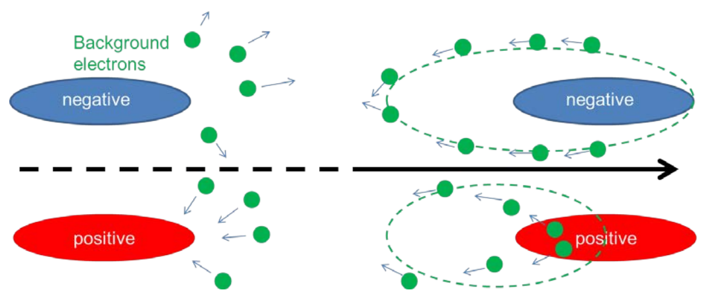
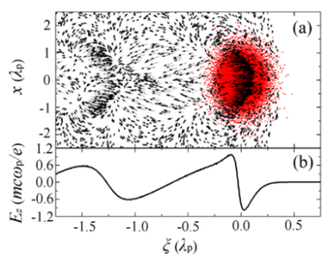
Different Wakefield Mechanisms
Qualitatively different plasma wakefield acc schemes between negatively and positively charged drivers
proton driver
expel
attract
Electron driven: plasma electrons oscillating in the same phase
strong and radially linear focusing
Proton driven: “phase mixing”
Strong, radially- and time- varying focusing forces--->degrade the quality of the witness beam

Slide 7
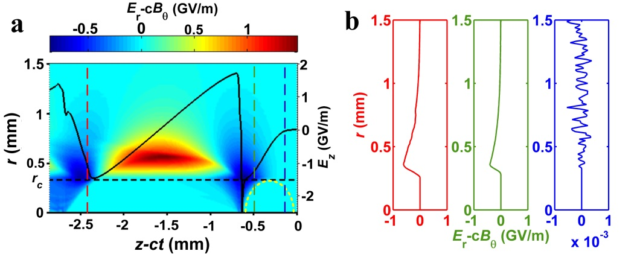
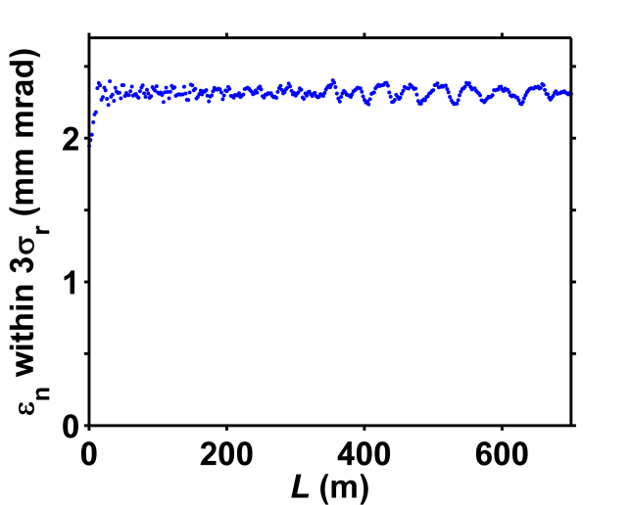
PD-HPWFA
Create a regime completely without radial plasma wakefields so that the emittance of the accelerated beam can be conserved.
Electron bunch
Proton bunch
hollow radius r_{c}
Y. Li, et al. arXiv preprint arXiv:1610.08734 (2016).

Slide 8
Outline
PD-PWFA
PD-HPWFA
Multiple PD-HPWFA in the nonlinear regime
Summary & Outlook
Proton Driven Plasma Wakefield Acceleration
Proton Driven Hollow Plasma Wakefield Acceleration

Slide 9
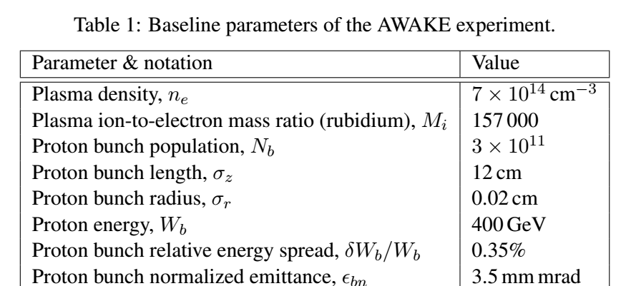
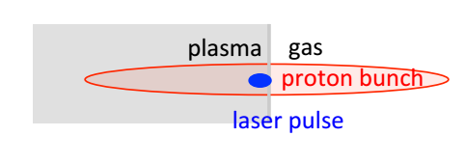
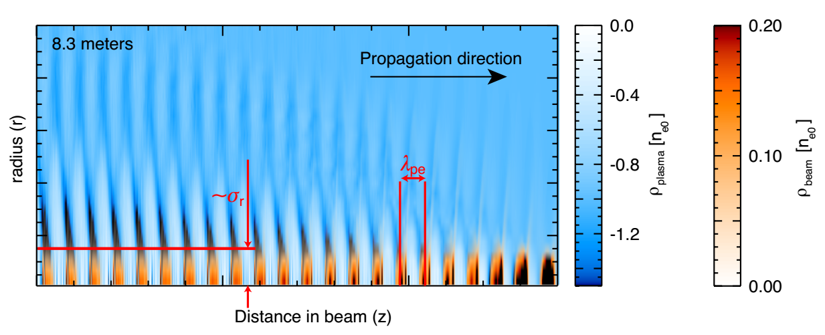
AWAKE at CERN
Compression of currently available proton bunches to plasma wavelength by a factor of several orders of magnitude is technically challenging.
SMI enables multi-microbunch driven plasma wakefield acceleration.
Caldwell, A., et al. AWAKE design report: a proton-driven plasma wakefield acceleration experiment at CERN. No. CERN-SPSC-2013-013. 2013.

Slide 10
Multiple PD-HPWFA in the nonlinear regime
SMI of the long proton bunch in the uniform plasma limits the beam-plasma interaction to the linear or weakly nonlinear regimes.
The wave period elongates as nonlinear effects comes into play.
Most of the bunch defocuses during the growth of the SMI in the blowout regime.
The plasma focusing in the linear regime nonlinearly varies both across and along the witness bunch.
The accelerating field inevitably varies radially instead of being constant.
Notes:
the wave period elongates as nonlinear effects comes into play, and the wave eventually falls out of resonance with the bunch train
The plasma focusing in the linear regime depends on the witness density and, for a high witness charge, nonlinearly varies both across and along the witness bunch38. The accelerating field also inevitably varies radially instead of being constant, which is detrimental to the witness quality

Slide 11
Multiple PD-HPWFA in the nonlinear regime
Simulation Parameters
Parameters | Values | Units
Initial proton beam:
Population of a single bunch, N_{b} | 1.15×10¹⁰
Energy, W_{d0} | 1 | TeV
Energy spread | 10%
Single bunch length, σ_{z} | 63 | μm
Beam radius, σ_{r} | 71 | μm
Bunch train period | 631 | μm
Initial witness electron beam:
Population | 2×10⁹
Energy, W | 10 | GeV
Energy spread, δW/W | 1%
Normalized emittance, ε_{n} | 2 | mm mrad
Unperturbed hollow plasma:
Plasma density, n_{p} | 6×10¹⁵ | cm⁻³
Hollow channel radius, r_{c} | 200 | μm
External quadrupole magnets:
Magnetic field gradient, S | 0.5 | T/mm
Quadrupole period, Lq | 0.9 | m
Y. Li, et al. arXiv preprint arXiv:1707.03193 (2017).

Slide 12
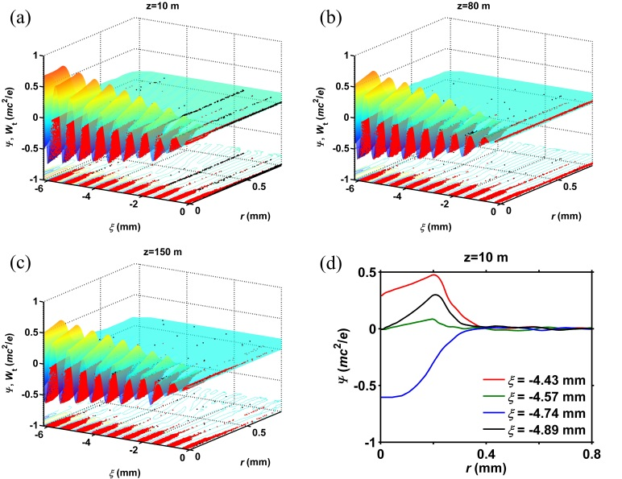
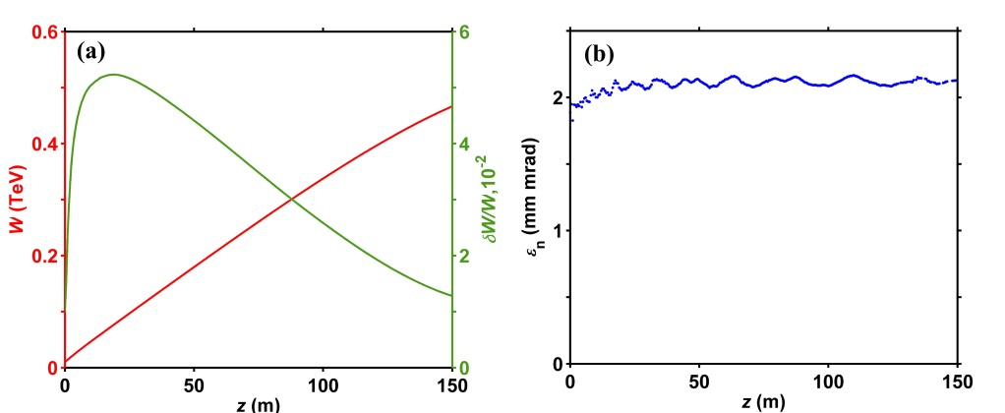
Characteristics of DB and WB
0.5 TeV
1.2%
(a) Energy and correlated energy spread; (b) normalized emittance of the witness bunch.
Spatial distributions (a, b, c) of wakefield potential and driver protons (red dots for trapped and black for untrapped ones). (d) Radial dependencies of the potential at different $ξ$-positions.
Basin-like radial profile of the wakefield potential in the channel.
Survival rates for the whole proton driver and the first driving bunch, respectively.

Slide 13
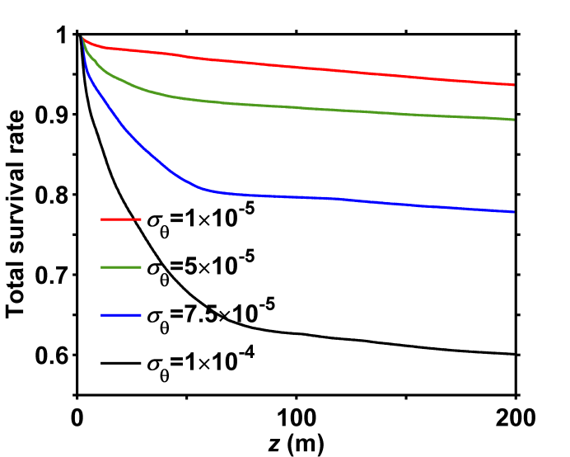
Dependence of the proton survival rate on the proton bunch parameters
$$W_{t}=p_{r}^{2}/(2γ_{b})+Δψ(r,ξ)$$
$p_{r}^{2}/(2γ_{b})$ denotes the transverse kinetic energy of a proton, and $Δψ(r,ξ)$ represents the potential energy difference between the value at the proton position and the maximum value along the radius (at the basin edge).
Self-modulation results in large radial momenta of the protons.
Other methods to generate bunches (longitudinal modulation?)

Slide 14
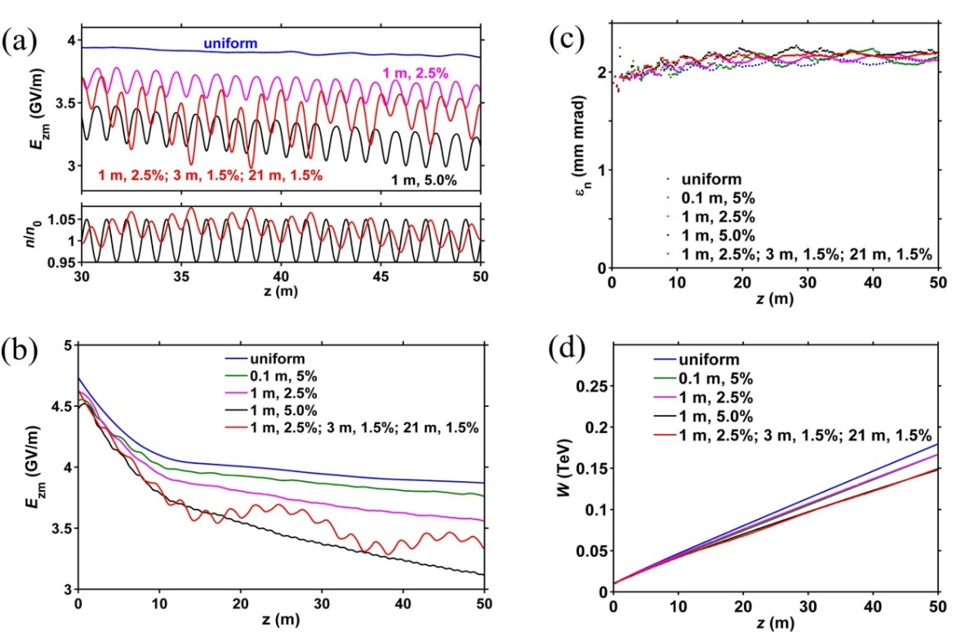
Effect of channel inhomogeneity
Regular plasma density non-unifomity
Irregular plasma density non-unifomity
Reducing the periods below the proton oscillation period can significantly boost the average wakefield amplitudes
The limitation on tolerable density perturbations comes from decreasing the acceleration rate, rather than degrading the witness quality as in the case of uniform plasmas.

Slide 15
Summary
The hollow plasma enables the operation of multiple PD-PWFA in the blowout regime;
It eliminates the defocusing from background ions within the channel and broadens the region where the protons can stay;
The majority of protons survive after a long distance;
The witness bunch is accelerated with well-preserved beam quality;
This scheme can sustain relatively large eigenfrequency fluctuations (at the level of 5%).

Slide 16
Outlook
Owing to high energy contents, proton bunches become very promising candidates in the near future, which are capable of bringing witness particles to the energy frontier in a single plasma stage.
The hollow channels would open the path to emittance-preserving accelerating structures for future high-energy physics facilities, even though experimental implementation of such channels is still in its infancy.
A possible option is the channel could be sectionalized into multiple plasma cells with almost no decrease of the longitudinal fields, provided that the gap between cells is shorter than the betatron period of driver particles.

Slide 17
Thank you for your attention!

