Slide 1


Warp-X: a new exascale computing platform for Beam-Plasma Simulations
Jean-Luc Vay - Lawrence Berkeley National Laboratory
with A. Almgren¹, J. Bell¹, G. Blaclard^{5,1}, L. Ge³, B. Godfrey^{4,1}, D. Grote², M. Kirchen⁶, O. Kononenko³, M. Hogan³, R. Lehe¹, M. Lobet⁵, A. Myers¹, C. Ng³, J. Park¹, R. Ryne¹, O. Shapoval¹, M. Thevenet¹, H. Vincenti^{5,1}, W. Zhang¹
¹Lawrence Berkeley National Laboratory
²Lawrence Livermore National Laboratory
³SLAC Accelerator National Laboratory
⁴U. Maryland
⁵CEA Saclay, France
⁶U. Hamburg, Germany

Slide 2
Outline
Context & overview of the project
Code structure, libraries & optimization on Intel KNL
Advanced algorithms
Progress
Next steps

Slide 3
U.S. DOE Exascale Computing Project (ECP)
As part of the National Strategic Computing initiative, ECP was established to accelerate delivery of a capable exascale computing system that integrates hardware and software capability to deliver approximately 50 times more performance than today’s 20-petaflops machines on mission critical applications.
ECP’s work encompasses
  applications,
  system software,
  hardware technologies and architectures, and
  workforce development to meet scientific and national security mission needs.

Slide 4



DOE Exascale Computing Project Applications (1ST ROUND)
Title | Team
Computing the Sky at Extreme Scales | Salman Habib (ANL)+LANL,LBNL
Exascale Deep Learning and Simulation Enabled Precision Medicine for Cancer | Rick Stevens (ANL)+LANL, LLNL, ORNL, NIH/NCI
Exascale Lattice Gauge Theory Opportunities and Requirements for Nuclear and High Energy Physics | Paul Mackenzie (FNAL)+BNL,TJNAF,Boston U.,Columbia U., U. of Utah,Indiana U., UIUC,Stony Brook,College of William & Mary
Molecular Dynamics at the Exascale: Spanning the Accuracy, Length and Time Scales for Critical Problems in Materials Science | Arthur Voter (LANL)+SNL, U. of Tennessee
Exascale Modeling of Advanced Particle Accelerators | Jean-Luc Vay (LBNL)+LLNL, SLAC
An Exascale Subsurface Simulator of Coupled Flow,Transport,Reactions and Mechanics | Carl Steefel (LBNL)+LLNL, NETL
Exascale Predictive Wind Plant Flow Physics Modeling | Steve Hammond (NREL)+SNL,ORNL, U. of Texas Austin
QMCPACK: A Framework for Predictive and Systematically Improvable Quantum‐Mechanics Based Simulations of Materials | Paul Kent (ORNL)+ANL,LLNL,SNL,Stone Ridge Technology, Intel, Nvidia
Coupled Monte Carlo Neutronics and Fluid Flow Simulation of Small Modular Reactors | Thomas Evans (ORNL,PI)+ANL, INL, MIT
Transforming Additive Manufacturing through Exascale Simulation (TrAMEx) | John Turner (ORNL)+LLNL, LANL, NIST
NWChemEx: Tackling Chemical,Materials and Biomolecular Challenges in the Exascale Era | T. H. Dunning,Jr. (PNNL),+Ames, ANL, BNL, LBNL, ORNL, PNNL, Virginia Tech
High-Fidelity Whole Device Modeling of Magnetically Confined Fusion Plasma | Amitava Bhattacharjee (PPPL)+ANL,ORNL, LLNL, Rutgers, UCLA, U. of Colorado
Data Analytics at the Exascale for Free Electron Lasers | Amedeo Perazzo (SLAC)+LANL, LBNL, Stanford
Transforming Combustion Science and Technology+Exascale Simulations | Jackie Chen (SNL)+LBNL, NREL, ORNL, U. of Connecticut
Cloud-Resolving Climate Modeling of the Earth’s Water Cycle | Mark Taylor (SNL)+ANL, LANL, LLNL, ORNL, PNNL, UCI, CSU

Slide 5
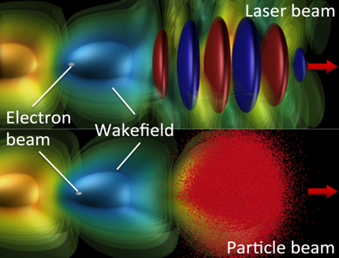
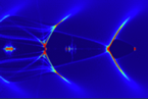
Plasma accelerators are challenging to model
Short driver/wake propagates through long plasma
➔ Many time steps.
For a 10 GeV LPA scale stage:
~1μm wavelength laser propagates into ~1m plasma
➔ millions of time steps needed
Non-linear regime:
very small features
➔ small grid cells

Slide 6
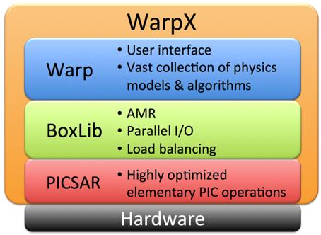
ECP Project WarpX: Exascale Modeling of Advanced Particle Accelerators
Goal (4 years): Convergence study in 3-D of 10 consecutive multi-GeV stages in linear and bubble regime, for laser- & beam-driven plasma accelerators.
How: ➔ Combination of most advanced algorithms
      Coupling of Warp+BoxLib/AMReX+PICSAR
      ➔ Port to emerging architectures (Xeon Phi, GPU)
Illustration
Team: LBNL ATAP (accelerators) + LBNL CRD (computing science) + SLAC + LLNL
Ultimate goal: enable modeling of 100 stages by 2025 for 1 TeV collider design!

Slide 7
Outline
Context & overview of the project
Code structure, libraries & optimization on Intel KNL
Advanced algorithms
Progress
Next steps

Slide 8
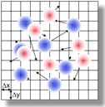
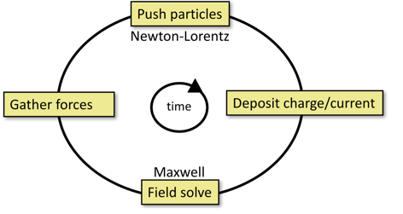
UML Diagram of WarpX details code structure
PIC loop
Smoothing
BoxLib/AMReX
WarpX: loop control, data structure, …
PICSAR: low-level optimized PIC loop
AMReX: AMR & parallelism
Warp: problem setup, extra physics, …

Slide 9
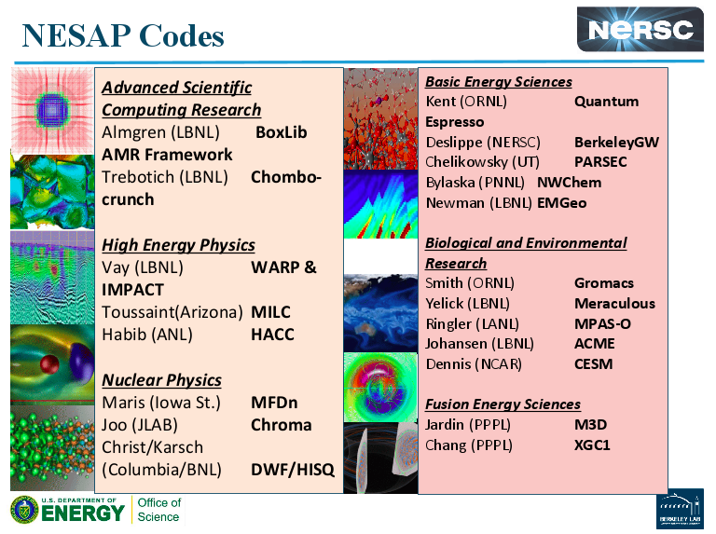
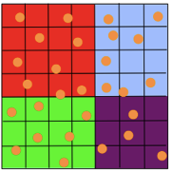
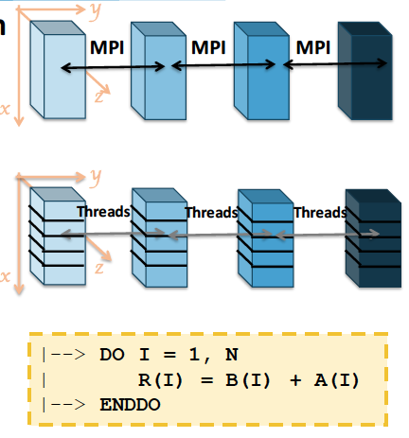

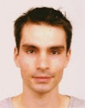

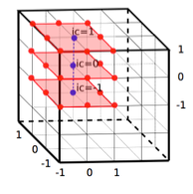
PICSAR created as part of
NERSC Exascale Applications Program (NESAP)
Warp EM-PIC kernel extracted ➔
Particle-In-Cell Scalable Architecture Resources (PICSAR)
Optimized with new vectorization algo.* + tiling/sorting + OpenMP + MPI
Collaboration with
Mathieu Lobet
Henri Vincenti
Ex-NESAP postdoc
(now at CEA, Saclay, France)
Marie Curie
postdoc fellowship
(now at CEA, Saclay, France)
*H. Vincenti, R. Lehe, R. Sasanka and J.-L. Vay, Comp. Phys. Comm. , 210, 145-154 (2017).
PICSAR website: https://picsar.net - to be open source access soon.

Slide 10
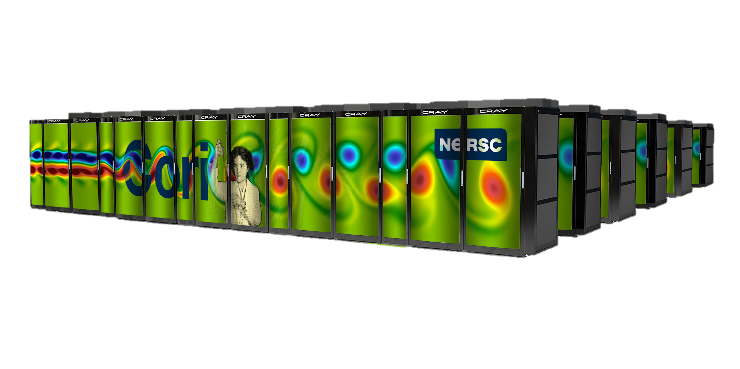
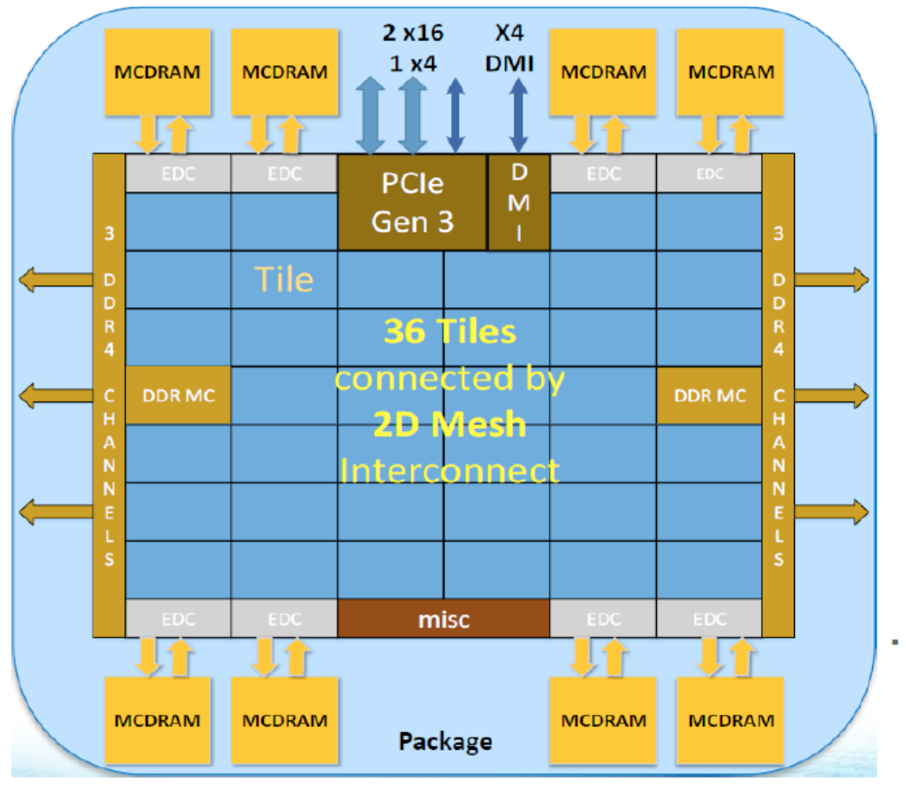
Newest NERSC supercomputer based on Intel KNL
Cori*:
9,688 Intel KNL nodes (658,784 cores)
29.1 PFlops total (theoretical peak)
# 6 on top500 list
Berkeley, USA
Intel KNL
Peak performance: 3 TFlops per socket:
68 cores at 1.4-1.6 Ghz for energy performance
4 threads/core
2 VPU AVX-512 vector register per core (up to 16 DP floats)
34 Mb L2 cache per node but no L3
KNL does not forgive optimization laziness anymore
Frequency divided by 2 per core
No low latency L3 cache
Courtesy J. Deslippe, M. Lobet
[1] www.nersc.gov

Slide 11
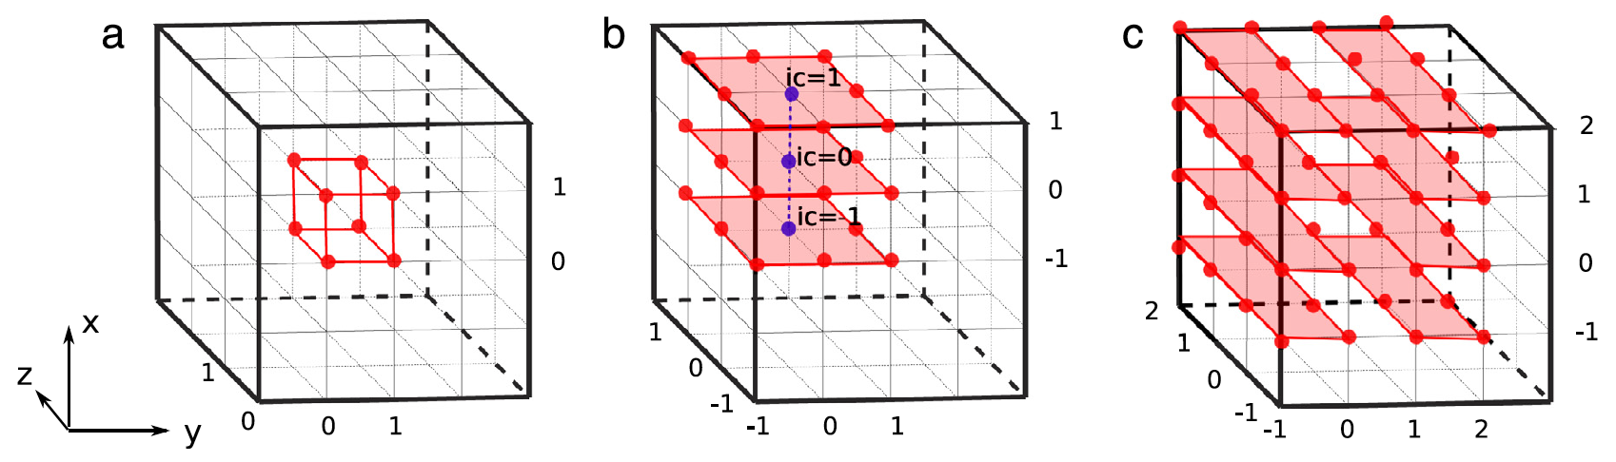
Revised data structure enables vectorization*
And contiguous data in memory
Order of deposition
Original Rho structure:
Rho(Nx*Ny*Nz)
1 = CIC
2 = TSC
3 = QSP
7
8
5
6
3
4
1
2
New Rhocell structure:
Rhocell(8,Nx*Ny*Nz)
New dimension in the current and charge array to access vertices of a cell in a contiguous way
Enable vectorization of the deposition with no memory races, no gather/scatter
Reduction at the end in the original structure: Non-efficient vectorization but in O(Ncells) with Ncells << Nparticles
1
New dimension for 8 contiguous elements at icell
8
*H. Vincenti, R. Lehe, R. Sasanka and J.-L. Vay, Comp. Phys. Comm. , 210, 145-154 (2017).
11

Slide 12
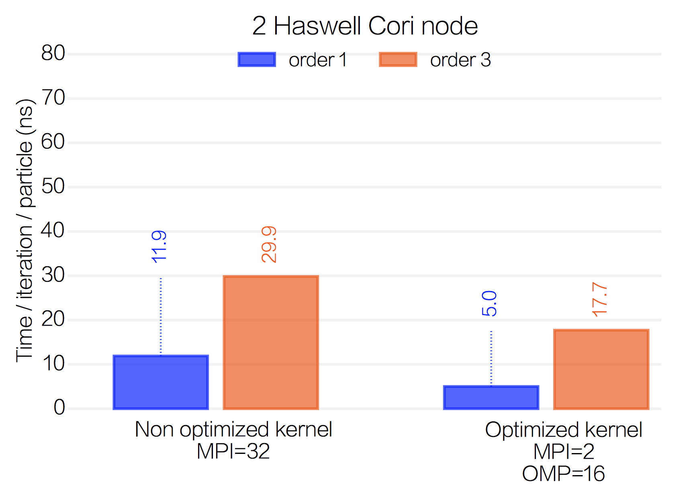
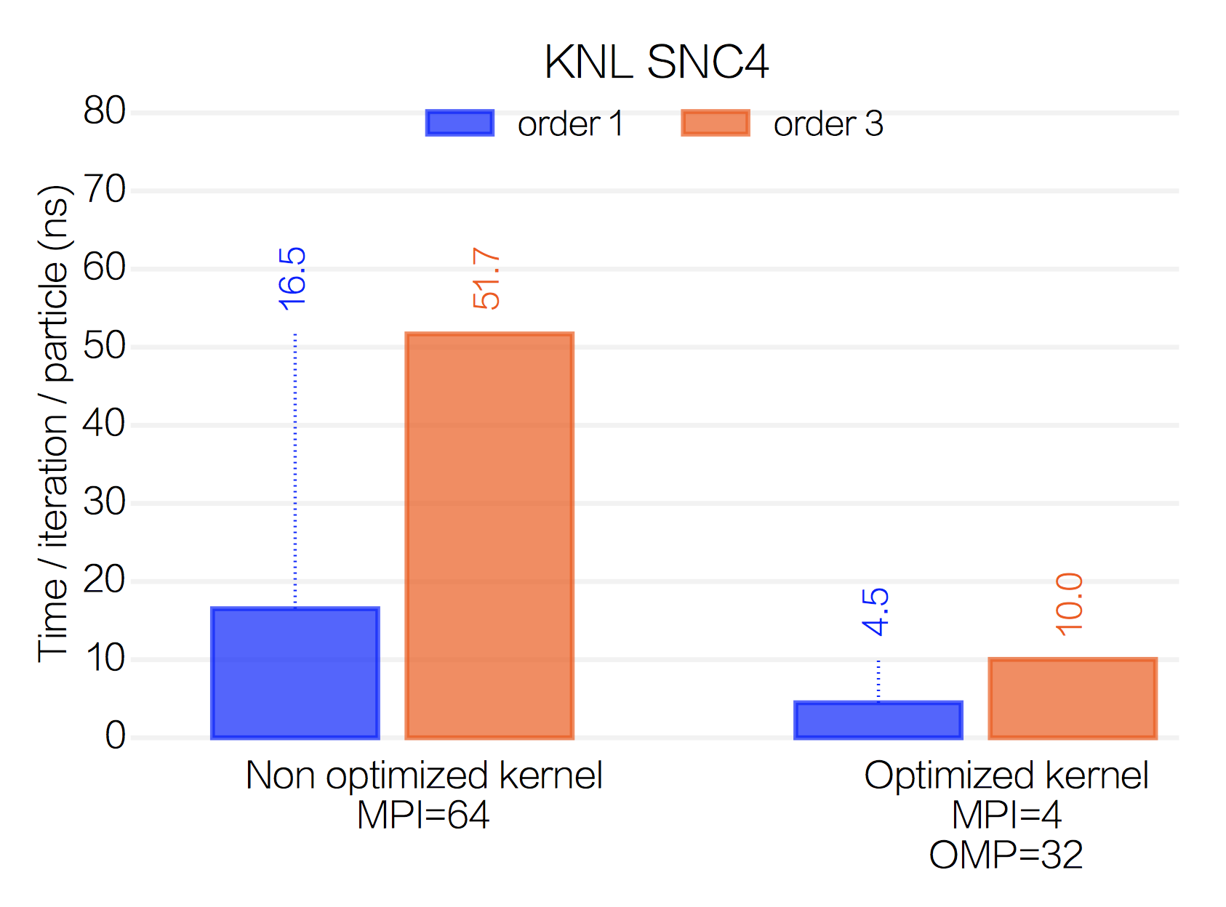
Latest optimization led to good single-node performance on Haswell and KNL
Speed-up of 2 on Haswell node
Speed-up of 5 on KNL node
With optimizations, KNL is 1.8 times faster than Haswell node at order 3
Mathieu Lobet - 12

Slide 13
Outline
Context & overview of the project
Code structure, libraries & optimization on Intel KNL
Advanced algorithms
Progress
Next steps

Slide 14
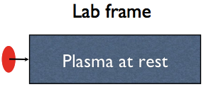
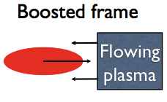
We are combining advanced algorithms
Lower # time steps:
optimal Lorentz boosted frame
Lorentz
Transform
λ
L
γ
λ’=λγ(1+β)
L’=L/γ
# time steps α L/λ
# time steps α L’/λ’
➔ Speedup = (L’/λ’)/(L/ λ) = γ²(1+β)

Slide 15
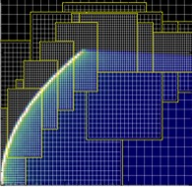
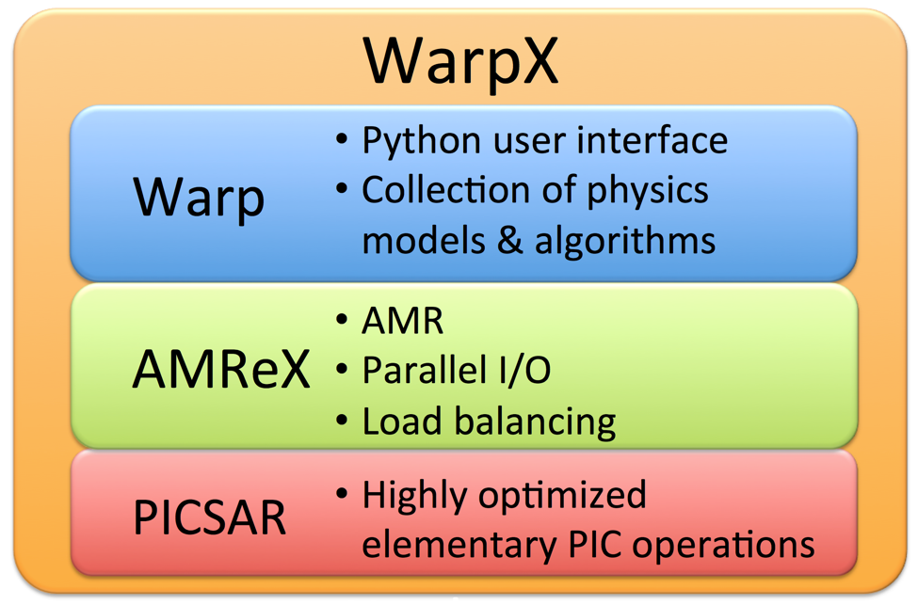
We are combining advanced algorithms
Lower # time steps:
optimal Lorentz boosted frame
Higher accuracy:
AMR provided by BoxLib/AMReX library
Lorentz
Transform
Illustration
15

Slide 16
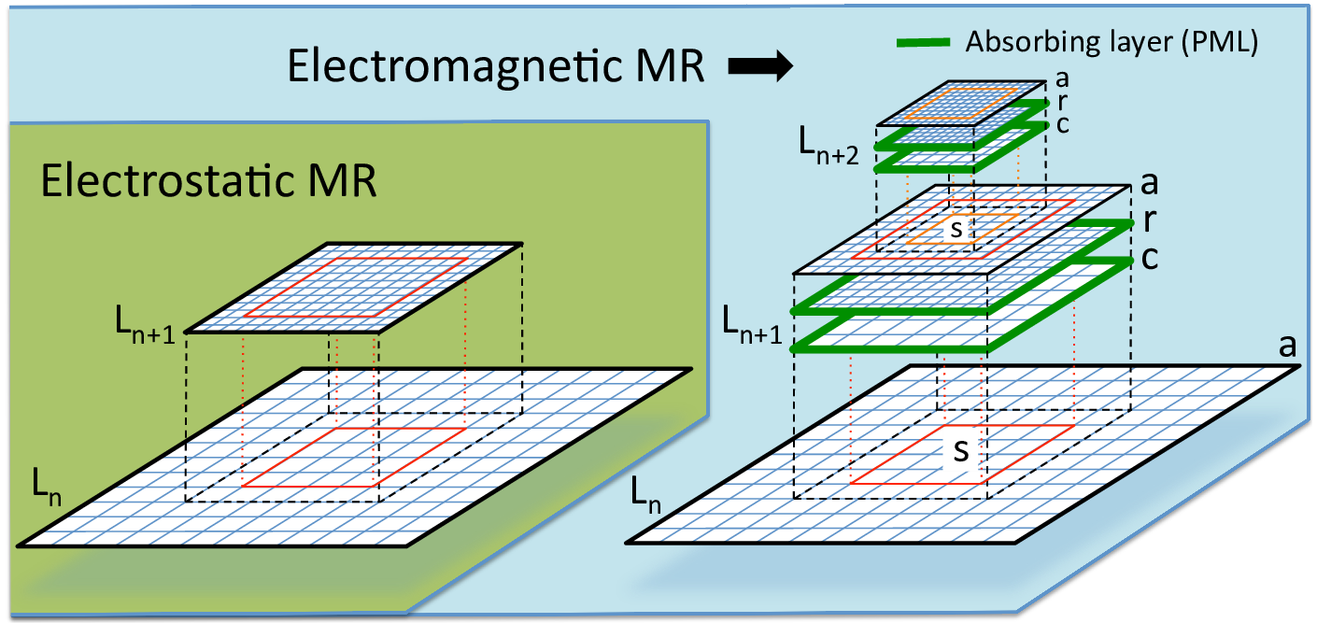
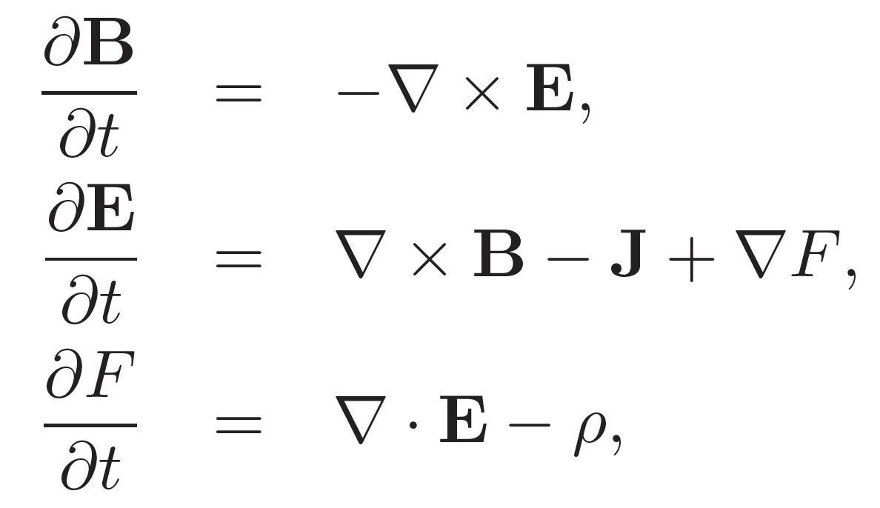
Implementation of mesh refinement based on Warp algorithm
Need to avoid spurious:
  self-forces
  wave reflections
  `ghost stuck’ particles
➔
  buffer regions
  PMLs around patches
  Extended Maxwell with divergence cleaning
Substitution:
F^{n+1}(a) = I[F^{n}(a)-F^{n+1}(c)]+F^{n+1}(r)
J.-L. Vay, P Colella, P Mccorquodale, B Van Straalen, A Friedman, and D. P. Grote. Laser & Particle Beams 20, 569–575, (2002).
J.-L. Vay, J.-C. Adam, A. Héron, Computer Physics Comm. 164, 171-177 (2004).
J.-L. Vay, D. P. Grote, R. H. Cohen, & A. Friedman, Computational Science & Discovery 5, 014019 (2012).

Slide 17
We are combining advanced algorithms
Lower # time steps:
optimal Lorentz boosted frame
Higher accuracy:
AMR
Arbitrary order & pseudo-spectral Analytical Maxwell solvers
Lorentz
Transform
17

Slide 18
Arbitrary-order Maxwell solver offers flexibility in accuracy
(on centered or staggered grids)
Finite-difference
Higher order
N→∞ = Pseudo-spectral (FFT)
cΔt/Δx~0.45
Kronecker δ pulse
Smaller time steps
cΔt/Δx~0.045
Accurate but Expensive
(with leapfrog integrator)

Slide 19
Analytical integration in Fourier space offers infinite order
Pseudo-Spectral Analytical Time-Domain¹ (PSATD)
F⁻¹
F
F⁻¹
F
F⁻¹
F
with
PSATD cΔt/Δx=50
1 time step
Easy to implement arbitrary-order n with PSATD (k=k⚯ → k^{n}).
Both arbitrary order FDTD and PSATD to be implemented in WarpX.
¹I. Haber,R. Lee,H. Klein & J. Boris,Proc. Sixth Conf. on Num. Sim. Plasma, Berkeley, CA, 46-48 (1973)
19

Slide 20
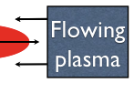
We are combining advanced algorithms
Lower # time steps:
optimal Lorentz boosted frame
Higher accuracy:
AMR
Pseudo-spectral Analytical Maxwell solvers
Higher stability
Galilean T. to suppress Numerical Cherenkov Instability
Lorentz
Transform
See talk by M. Kirchen in WG6 earlier today.
20

Slide 21
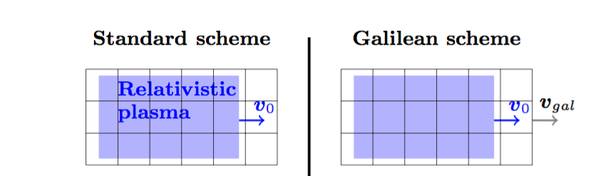
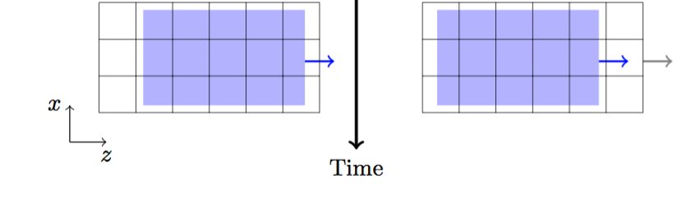

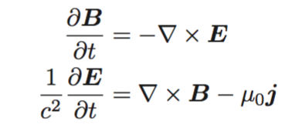
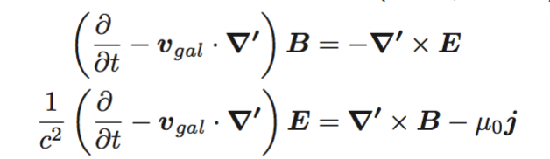



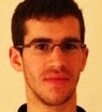
PSATD also enables integration in Galilean frame
Use Galilean coordinates that follow the relativistic plasma.
Standard PSATD PIC
Galilean PSATD PIC
+ integrate analytically, assuming
is constant over one timestep.
Original idea by Manuel Kirchen (PhD student at U. Hamburg)
Concept and applications: Kirchen et al., Phys. Plasmas 23, 100704 (2016)
Derivation of the algorithm: Lehe et al., Phys. Rev. E 94, 053305 (2016)

Slide 22
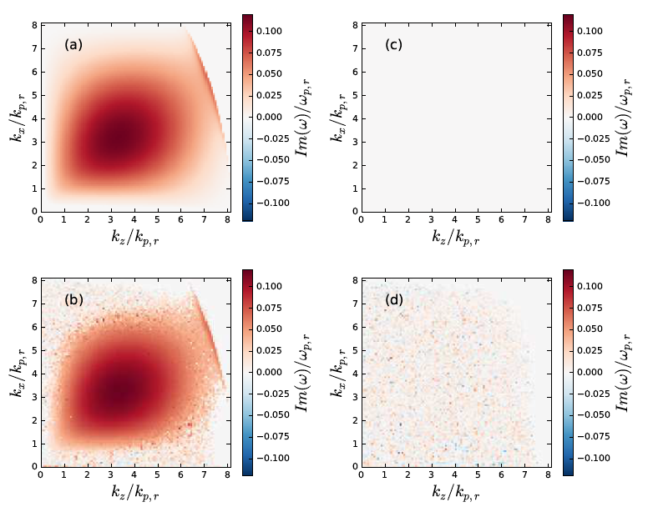
Galilean PSATD is stable for uniform relativistic flow
Uniform plasma streaming in 2D periodic box
  Instability growth rate
Standard PSATD
Galilean PSATD
  Analysis
  Simulation
Lehe et al., Phys. Rev. E 94, 053305 (2016)

Slide 23
We are combining advanced algorithms
Lower # time steps:
optimal Lorentz boosted frame
Higher accuracy:
AMR
Pseudo-spectral Analytical Maxwell solvers
Higher stability
Galilean T. to suppress Numerical Cherenkov Instability
Higher scalability
FFT Maxwell solvers on local domains + domain decomposition
Lorentz
Transform
23

Slide 24
Spectral solvers involve global operations ➔ harder to scale to large # of cores
    Spectral Finite Difference (FDTD)
    global “costly” local “cheap”
    communications communications
    vs
    Harder to scale Easier to scale
○ | ○ | ○ | ○ | ○
○ | ○ | ○ | ○ | ○
○ | ○ | ○ | ○ | ○
○ | ○ | ○ | ○ | ○
○ | ○ | ○ | ○ | ○
○ | ○ | ○ | ○ | ○
○ | ○ | ○ | ○ | ○
○ | ○ | ○ | ○ | ○
○ | ○ | ○ | ○ | ○
○ | ○ | ○ | ○ | ○
Finite speed of light ➔ local FFTs ➔ spectral accuracy+FDTD scaling!
Local FFT
J.-L. Vay, I. Haber, B. Godfrey, J. Comput. Phys. 243, 260 (2013)
H. Vincenti, J.-L. Vay, Comput. Phys. Comm. 200, 147 (2016)
24

Slide 25
Finite-order stencil offers scalable ultra-high order solver
Truncation error analysis ➔ ultra-high order possible with much improved stability
Enabled demonstration of novel spectral solver with local FFTs scaling to ~1M cores
Strong (Cori-Intel KNL)
1024☓1024☓3056
512☓512☓110952
Strong (MIRA-IBM)
1024☓1024☓27648
Truncation error
order (p) requires << # guard cells than spectral (p=inf).
Global FFT
FFTW
Local FFTs
8 cores/FFT
Stencil order = 100
NB guard cells = 8
# cores
# cores
H. Vincenti et al., Comput. Phys. Comm. 200, 147 (2016).
H. Vincenti, J.-L. Vay, “Ultrahigh-order Maxwell solver with extreme scalability for electromagnetic PIC simulations of plasmas.”, http://arxiv.org/abs/1707.08500.
Applied successfully to modeling of LPAs at DESY¹ and plasma mirrors at CEA Saclay^{2,3}
in cases where standard second-order FDTD solvers fail.
[1] S. Jalas, I. Dornmair, R. Lehe, H. Vincenti, J.-L. Vay, M. Kirchen, A. R. Maier, Phys. Plasmas 24, 033115 (2017).
[2] G. Blaclard, H. Vincenti, R. Lehe, J. L. Vay, Phys. Rev. E 96, 033305 (2017)
[3] A. Leblanc, S. Monchoce, H. Vincenti,S. Kahaly, J-L. Vay, F.Quere, Phys. Rev. Lett. (in press)
See also next talk by S. Jalas

Slide 26
Outline
Context & overview of the project
Code structure, libraries & optimization on Intel KNL
Advanced algorithms
Progress
Next steps

Slide 27
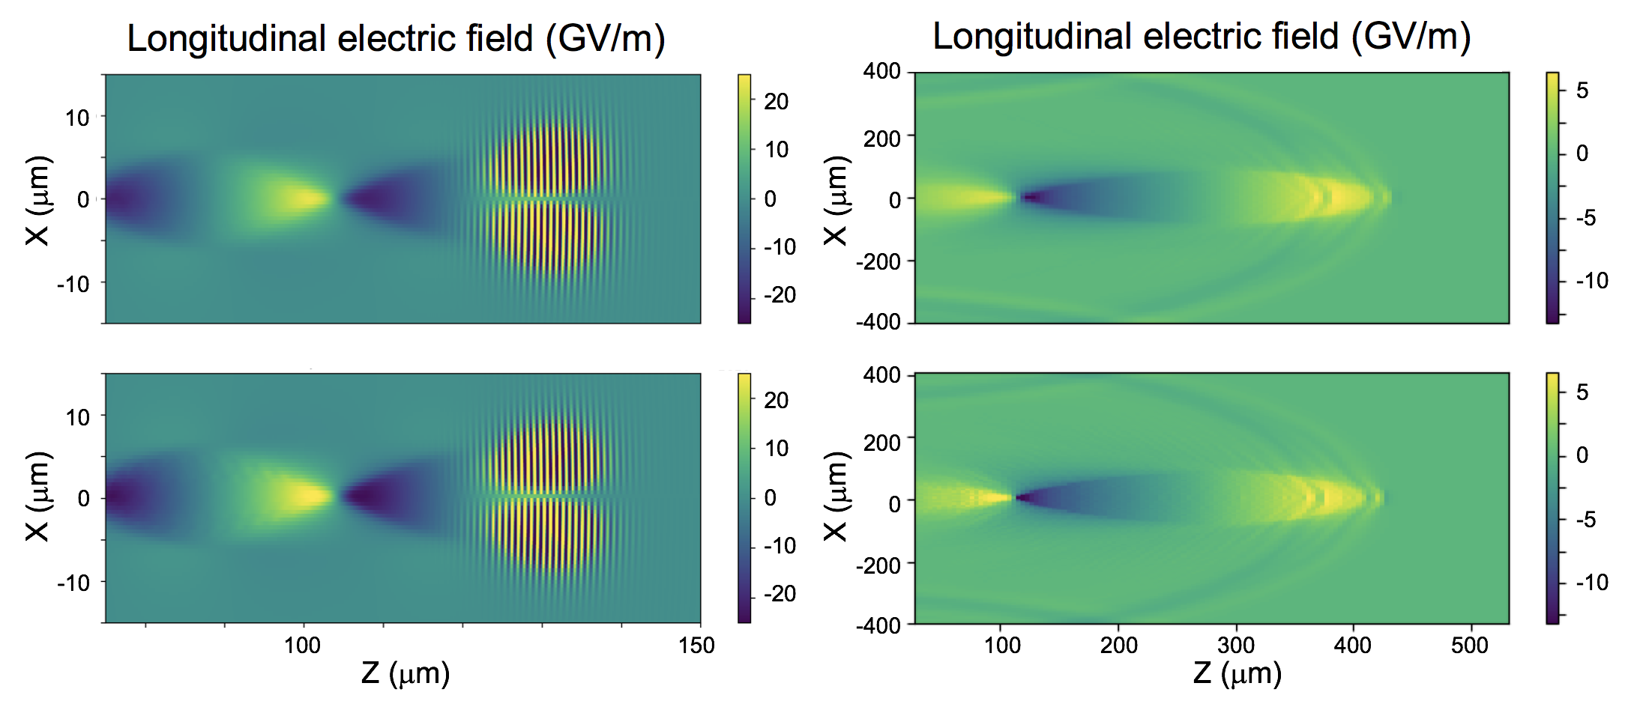
First simulations of plasma-based accelerators with WarpX (03/17)
Laser driven
Particle beam driven
WarpX
Warp
WarpX successfully benchmarked against Warp.

Slide 28
Electromagnetic MR was implemented and tested (06/17)
Single particle orbiting around an external magnetic field, emitting synchrotron radiation
Energy
(64x64)
(128x128)
MR improves result with negligible spurious effects (self-force, waves reflection, ghost particles).
Time
(64x64)+MR
(64x64)+MR
Note: buffer region not implemented yet; expected to improve results once implemented.

Slide 29
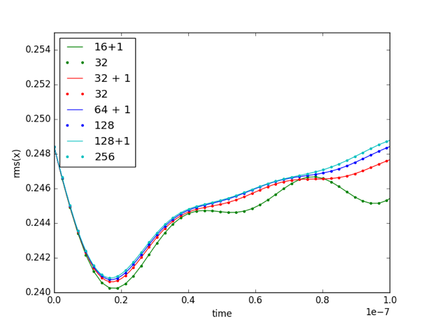
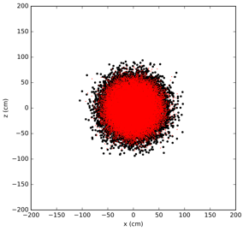
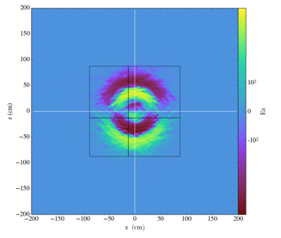
Validation on many particles `beam breathing’ test
Electron Gaussian distribution with inward initial radial velocity on top of static proton dist.
Electron beam contraction/expansion depends on resolution.
MR enables higher accuracy, covering fraction of box.

Slide 30
Laser injection with mesh refinement was validated
Laser generated with antenna.

Slide 31
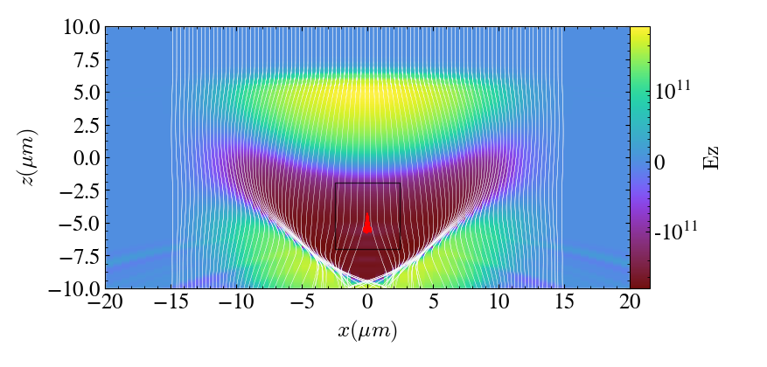
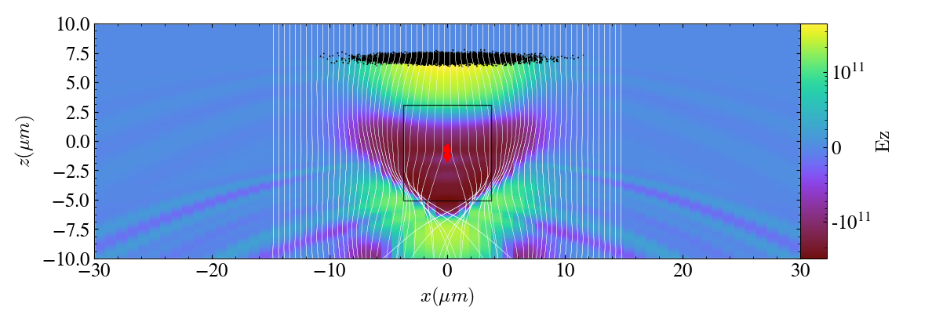
First simulations of plasma accelerators with MR patch (09/17)
Laser driven
2-D
Particle beam driven
Simulations with small MR patch recover results using finer grid over the entire box.

Slide 32
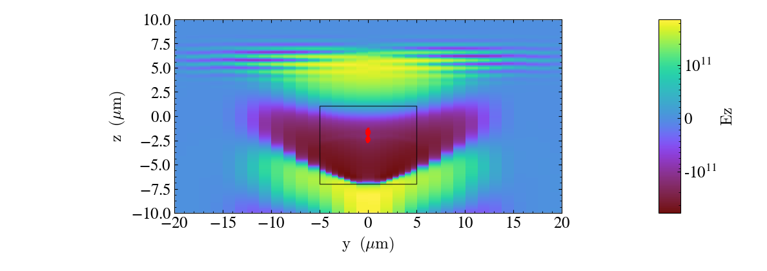
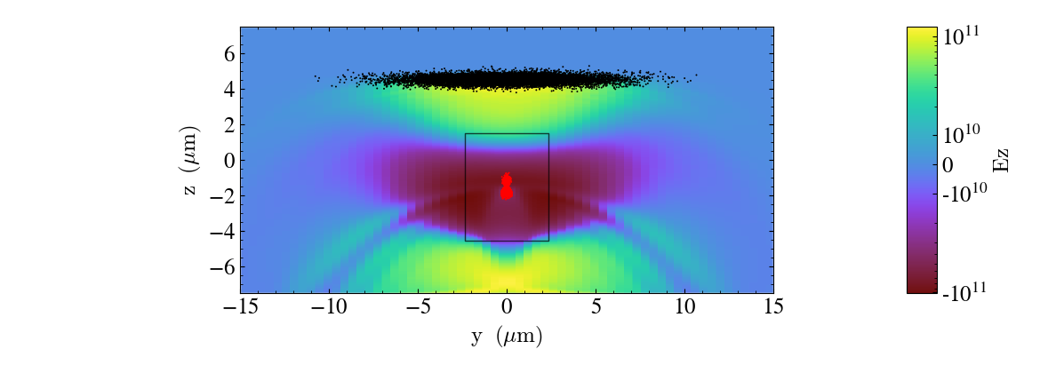
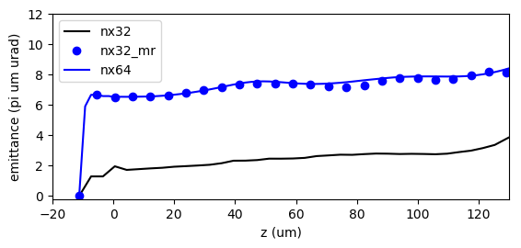
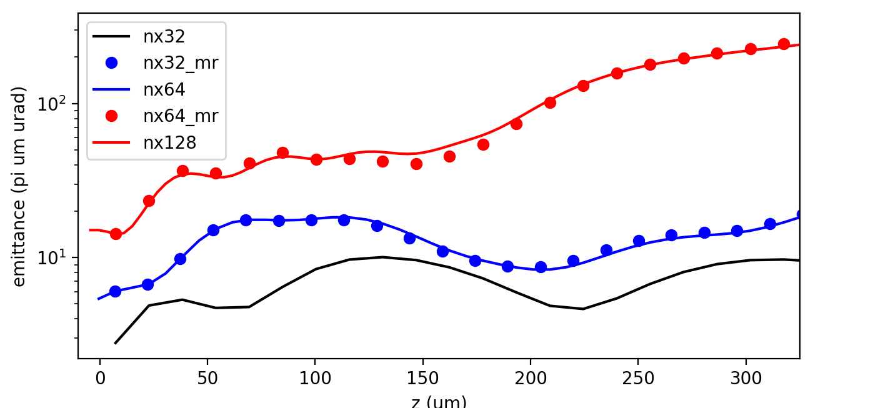
First simulations of plasma accelerators with MR patch (09/17)
Laser driven
3-D
Particle beam driven
Simulations with small MR patch recover results using finer grid over the entire box.

Slide 33
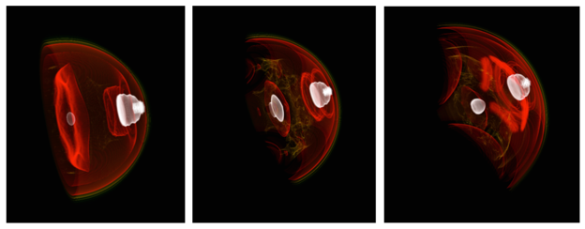
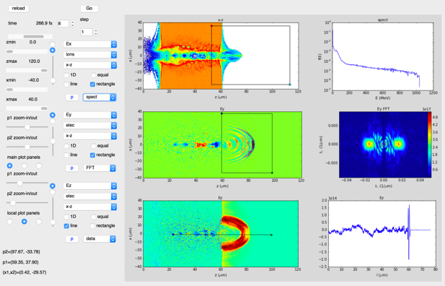
WarpX visualization tools are being developed
3D rendering of WarpX plasma accelerator simulation with yt
Prototype WarpX data analysis GUI
2D/3D visualization with matplotlib, yt, VisIt
  Supports AMReX & OpenPMD data structures
Interface using Python, Jupyter notebooks or GUI.

Slide 34
Outline
Context & overview of the project
Code structure, libraries & optimization on Intel KNL
Advanced algorithms
Progress
Next steps

Slide 35

7-year plan for Exascale project WarpX
From initial code coupling to ensemble of 100 GeV-scale stages
Modeling of ensembles of 100 consecutive GeV-scale plasma accelerator stages
2023
Modeling of 100 consecutive GeV-scale plasma accelerator stages
2022
Modeling of 30 consecutive GeV-scale plasma accelerator stages
2021
End current ECP project
Modeling of 10 consecutive GeV-scale plasma accelerator stages
2020
Mi. FYQ4
Mi. FY19Q4
2019
Modeling of 3 consecutive GeV-scale plasma accelerator stages
Code to be released open source to community.
2018
Modeling a single GeV-scale plasma accelerator stage
Mi. FY18Q4
2017
Modeling of single plasma accelerator stage with static mesh refinement
Mi. FY17Q4
Now
2016
Initial coupling of Warp+Boxlib+PICSAR
Mi. FY17Q1

Slide 36
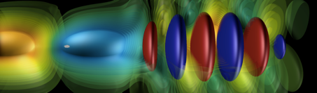
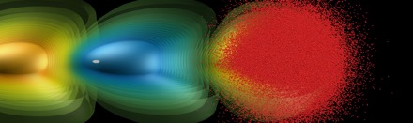
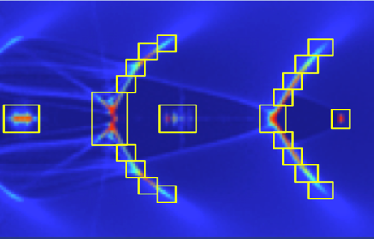
Thank you!
Questions?

