Slide 1


Warp-X: a new exascale computing platform for Beam-Plasma Simulations
Jean-Luc Vay - Lawrence Berkeley National Laboratory
with A. Almgren¹, J. Bell¹, L. Ge³, D. Grote², O. Kononenko³, M. Hogan³, R. Lehe¹, A. Myers¹, C. Ng³, J. Park¹, R. Ryne¹, O. Shapoval¹, M. Thevenet¹, W. Zhang¹
¹Lawrence Berkeley National Laboratory
²Lawrence Livermore National Laboratory
³SLAC Accelerator National Laboratory

Slide 2
U.S. DOE Exascale Computing Project (ECP)
As part of the National Strategic Computing initiative, ECP was established to accelerate delivery of a capable exascale computing system that integrates hardware and software capability to deliver approximately 50 times more performance than today’s 20-petaflops machines on mission critical applications.
ECP’s work encompasses
  applications,
  system software,
  hardware technologies and architectures, and
  workforce development to meet scientific and national security mission needs.

Slide 3



DOE Exascale Computing Project Applications (1ST ROUND)
Title | Team
Computing the Sky at Extreme Scales | Salman Habib (ANL)+LANL,LBNL
Exascale Deep Learning and Simulation Enabled Precision Medicine for Cancer | Rick Stevens (ANL)+LANL, LLNL, ORNL, NIH/NCI
Exascale Lattice Gauge Theory Opportunities and Requirements for Nuclear and High Energy Physics | Paul Mackenzie (FNAL)+BNL,TJNAF,Boston U.,Columbia U., U. of Utah,Indiana U., UIUC,Stony Brook,College of William & Mary
Molecular Dynamics at the Exascale: Spanning the Accuracy, Length and Time Scales for Critical Problems in Materials Science | Arthur Voter (LANL)+SNL, U. of Tennessee
Exascale Modeling of Advanced Particle Accelerators | Jean-Luc Vay (LBNL)+LLNL, SLAC
An Exascale Subsurface Simulator of Coupled Flow,Transport,Reactions and Mechanics | Carl Steefel (LBNL)+LLNL, NETL
Exascale Predictive Wind Plant Flow Physics Modeling | Steve Hammond (NREL)+SNL,ORNL, U. of Texas Austin
QMCPACK: A Framework for Predictive and Systematically Improvable Quantum‐Mechanics Based Simulations of Materials | Paul Kent (ORNL)+ANL,LLNL,SNL,Stone Ridge Technology, Intel, Nvidia
Coupled Monte Carlo Neutronics and Fluid Flow Simulation of Small Modular Reactors | Thomas Evans (ORNL,PI)+ANL, INL, MIT
Transforming Additive Manufacturing through Exascale Simulation (TrAMEx) | John Turner (ORNL)+LLNL, LANL, NIST
NWChemEx: Tackling Chemical,Materials and Biomolecular Challenges in the Exascale Era | T. H. Dunning,Jr. (PNNL),+Ames, ANL, BNL, LBNL, ORNL, PNNL, Virginia Tech
High-Fidelity Whole Device Modeling of Magnetically Confined Fusion Plasma | Amitava Bhattacharjee (PPPL)+ANL,ORNL, LLNL, Rutgers, UCLA, U. of Colorado
Data Analytics at the Exascale for Free Electron Lasers | Amedeo Perazzo (SLAC)+LANL, LBNL, Stanford
Transforming Combustion Science and Technology+Exascale Simulations | Jackie Chen (SNL)+LBNL, NREL, ORNL, U. of Connecticut
Cloud-Resolving Climate Modeling of the Earth’s Water Cycle | Mark Taylor (SNL)+ANL, LANL, LLNL, ORNL, PNNL, UCI, CSU

Slide 4
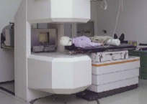
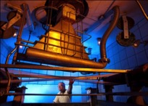
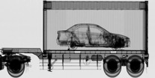
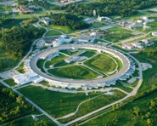
Particle accelerators are essential tools in modern life
Medicine
Industry
National Security
Discovery Science
~9000 medical accelerators in operation worldwide
10’s of millions of patients treated/yr
50 medical isotopes, routinely produced with accelerators
~20,000 industrial accelerators in use
  Semiconductor manufacturing
  cross-linking/ polymerization
  Sterilization/ irradiation
  Welding/cutting
Annual value of all products that use accel. Tech.: $500B
Cargo scanning
Active interrogation
Stockpile stewardship: materials characterization, radiography, support of non-proliferation
~30% of Nobel Prizes in Physics since 1939 enabled by accelerators
4 of last 14 Nobel Prizes in Chemistry for research utilizing accelerator facilities
Opportunity for much bigger impact by reducing size and cost.

Slide 5
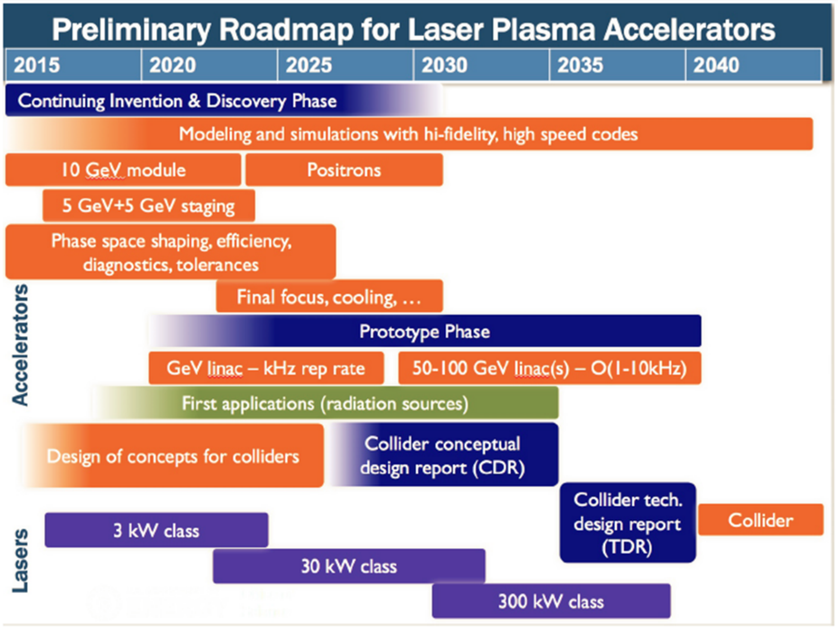
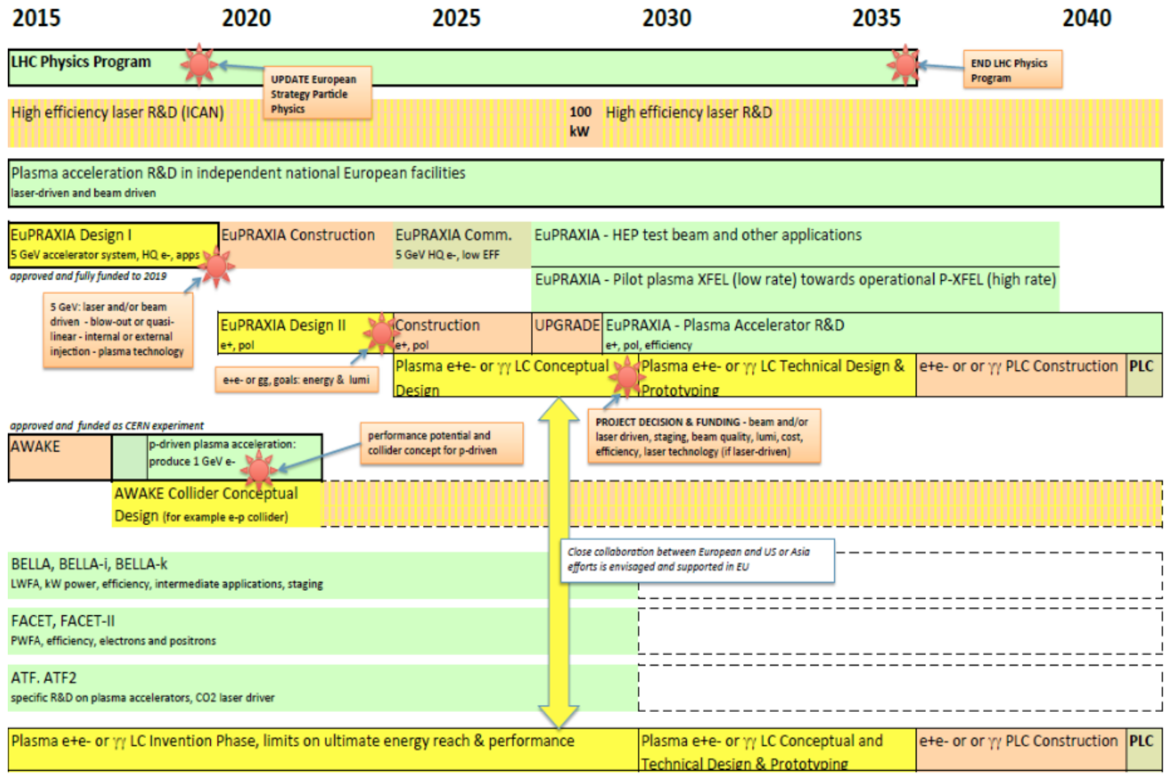
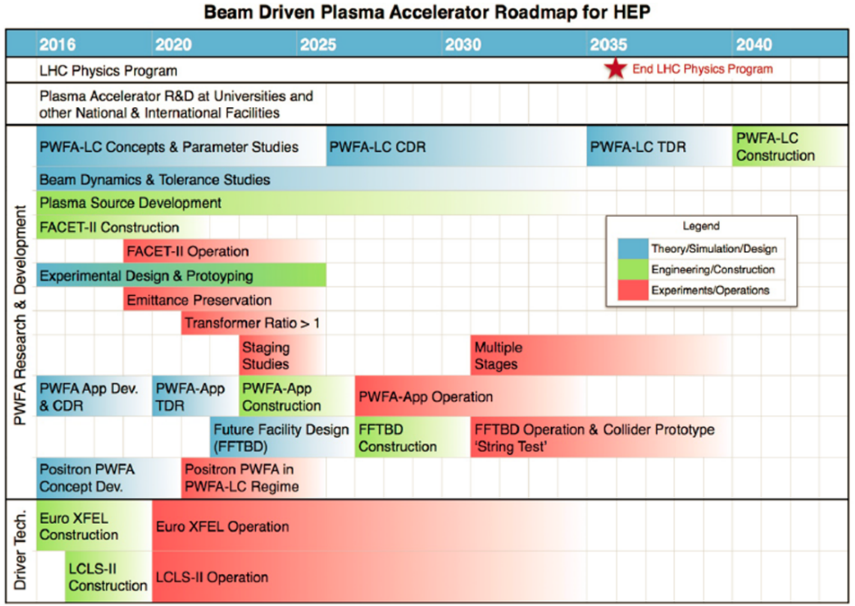
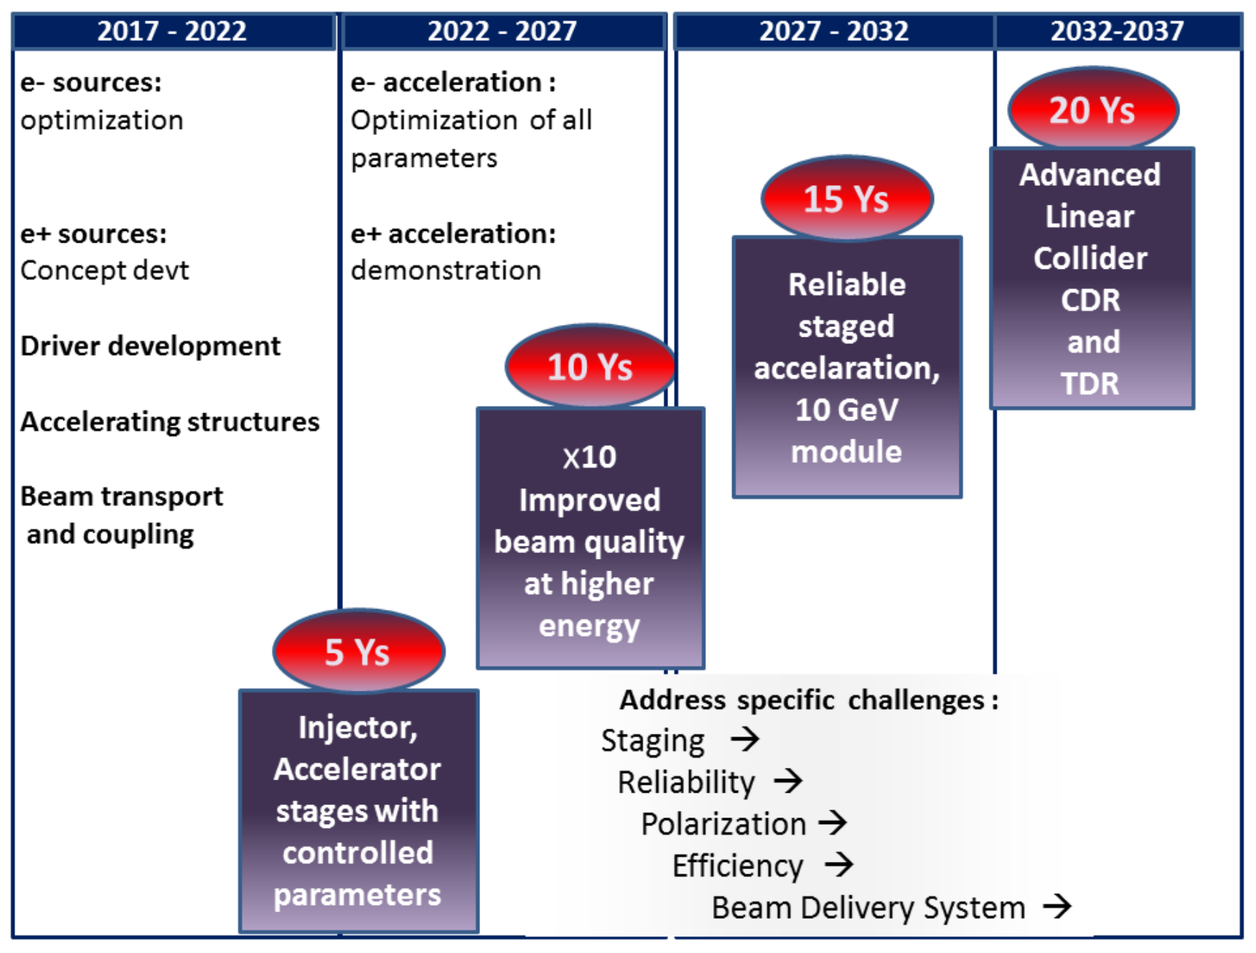
Recent reports from US/Europe present roadmaps for plasma-based collider with design by 2035-2040

Slide 6
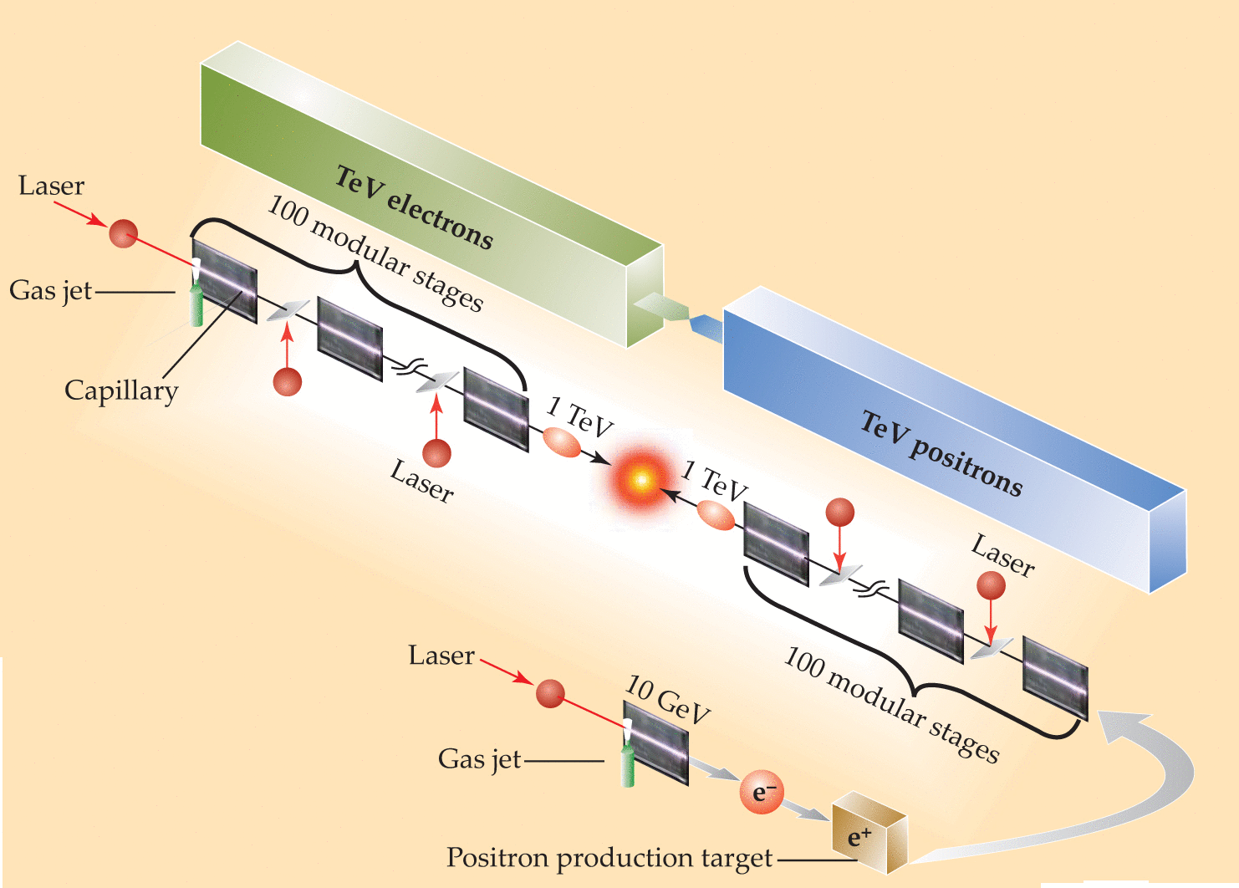
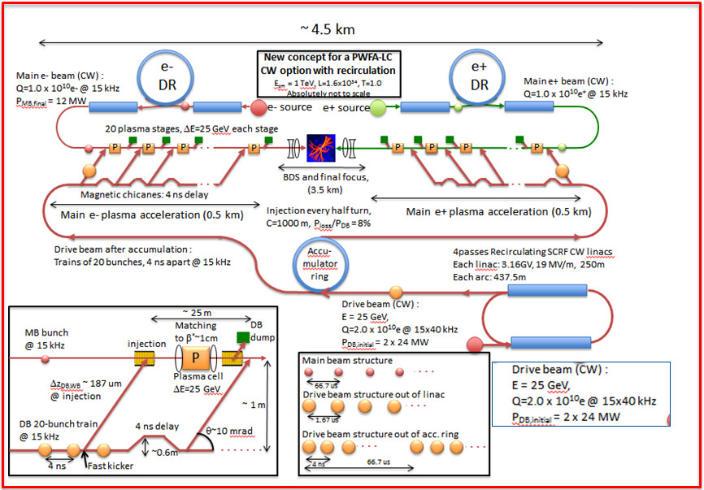
20-100 stages need to be lined up for e⁻e⁺ linear collider
LWFA
PWFA
Leemans & Esarey,
Phys. Today (2009)
E. Adli et al. arXiv:1308.1145,2013
Simulations can currently take days for 1 stage (sometimes in RZ).
Need for ×100 stages ×100 ensemble ×1000 3D!

Slide 7
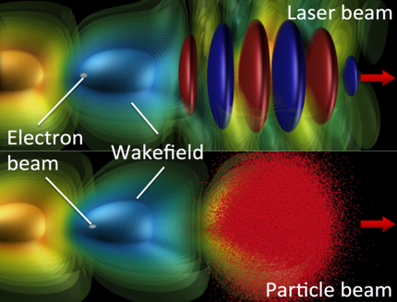
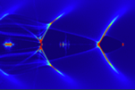
Plasma accelerators are challenging to model
Short driver/wake propagates through long plasma
➔ Many time steps.
For a 10 GeV LPA scale stage:
~1μm wavelength laser propagates into ~1m plasma
➔ millions of time steps needed
Non-linear regime:
very small features
➔ small grid cells

Slide 8
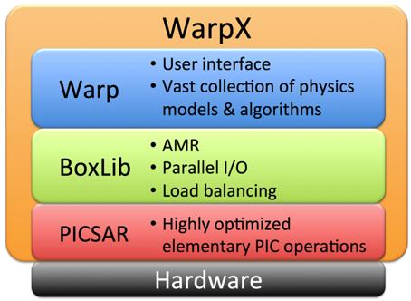
ECP Project WarpX: Exascale Modeling of Advanced Particle Accelerators
Goal (4 years): Convergence study in 3-D of 10 consecutive multi-GeV stages in linear and bubble regime, for laser- & beam-driven plasma accelerators.
How: ➔ Combination of most advanced algorithms
      Coupling of Warp+BoxLib/AMReX+PICSAR
      ➔ Port to emerging architectures (Xeon Phi, GPU)
Illustration
Team: LBNL ATAP (accelerators) + LBNL CRD (computing science) + SLAC + LLNL
Ultimate goal: enable modeling of 100 stages by 2025 for 1 TeV collider design!

Slide 9










Team roster
Jean-Luc Vay (PI)
Rémi
Lehe
Jaehong
Park
Robert Ryne
Olga Shapoval
Maxence Thevenet
Management Algorithms
Optimization
Visualization & I/O
LWFA
LBNL ATAP
Ann
Almgren (coPI)
John
Bell
Andrew
Myers
Weiqun
Zhang
LBNL CRD
AMR
MPI, OpenMP
Visualization & I/O
Marc
Hogan (coPI)
Lixin
Ge
Cho
Ng
Oleksiy
Kononenko
Optimization
Visualization
PWFA
SLAC
David
Grote (coPI)
LLNL
Python interface

Slide 10
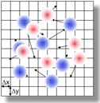
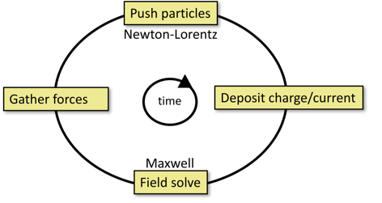
UML Diagram of WarpX details code structure
PIC loop
WarpX
Smoothing
Warp
AMReX
PICSAR
BoxLib/AMReX
WarpX: loop control, data structure, …
Warp: problem setup, extra physics, …
AMReX: AMR & parallelism
PICSAR: low-level optimized PIC loop
PICSAR currently in use with WarpX, Warp and SMILEI.
PICSAR website: https://picsar.net - to be open source access soon.

Slide 11
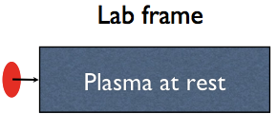
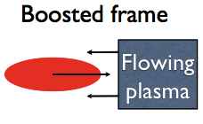
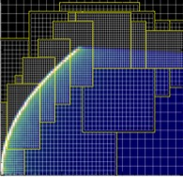
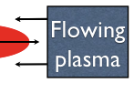
We are combining advanced algorithms
Lower # time steps:
optimal Lorentz boosted frame
Higher accuracy:
AMR
Arbitrary order & pseudo-spectral Analytical Maxwell solvers
Higher stability
Galilean T. to suppress Numerical Cherenkov Instability
Higher scalability
FFT Maxwell solvers on local domains + domain decomposition
Lorentz
Transform
11

Slide 12

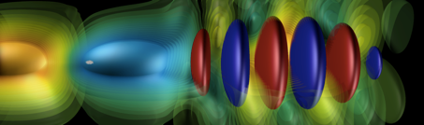

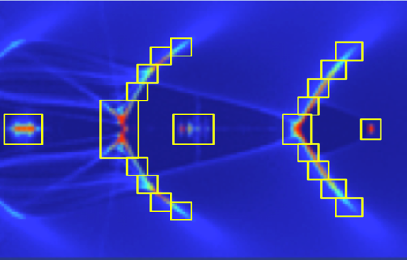
Progress

Slide 13
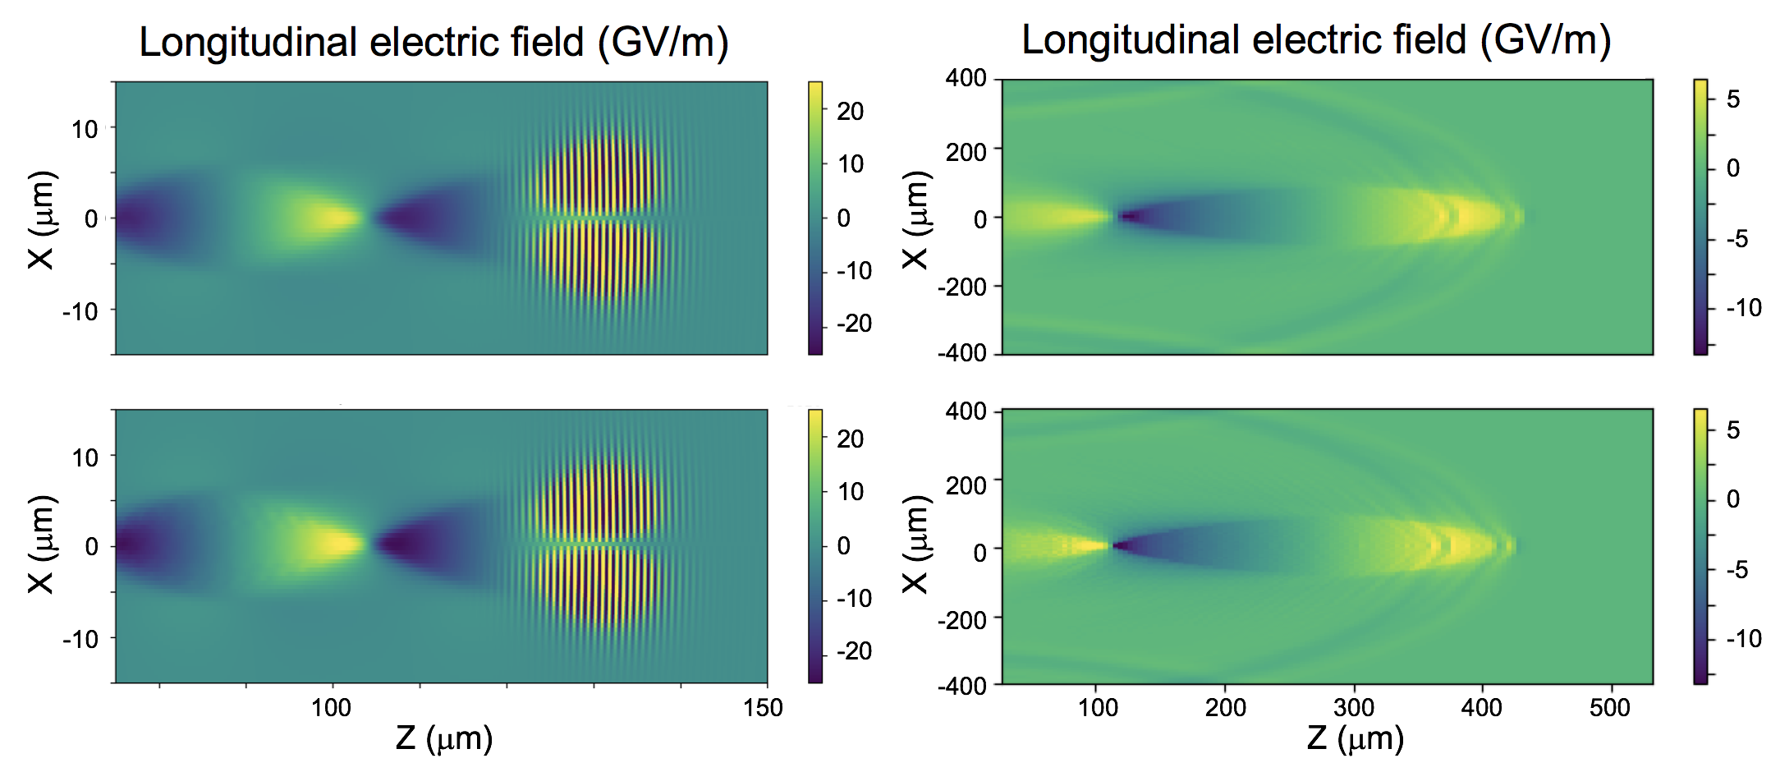
First simulations of plasma-based accelerators with WarpX (03/17)
Laser driven
Particle beam driven
WarpX
Warp
WarpX successfully benchmarked against Warp.

Slide 14
Electromagnetic MR was implemented and tested (06/17)
Single particle orbiting around an external magnetic field, emitting synchrotron radiation
Energy
(64x64)
(128x128)
MR improves result with negligible spurious effects (self-force, waves reflection, ghost particles).
Time
(64x64)+MR
(64x64)+MR
Note: buffer region not implemented yet; expected to improve results once implemented.

Slide 15
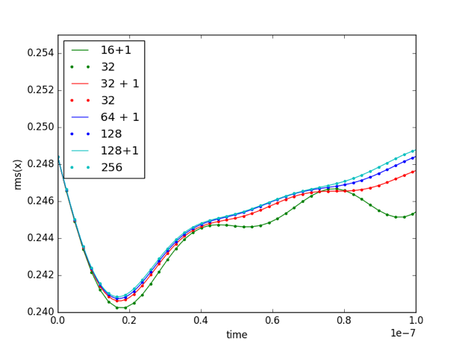
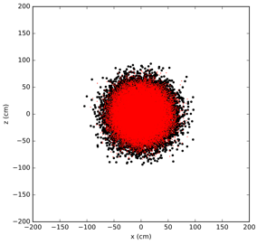
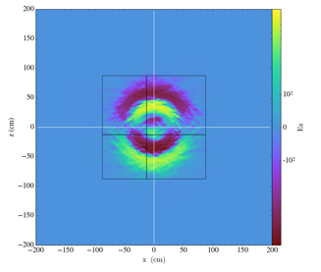
Validation on many particles `beam breathing’ test
Electron Gaussian distribution with inward initial radial velocity on top of static proton dist.
Electron beam contraction/expansion depends on resolution.
MR enables higher accuracy, covering fraction of box.

Slide 16
Laser injection with mesh refinement was validated
Laser generated with antenna.

Slide 17
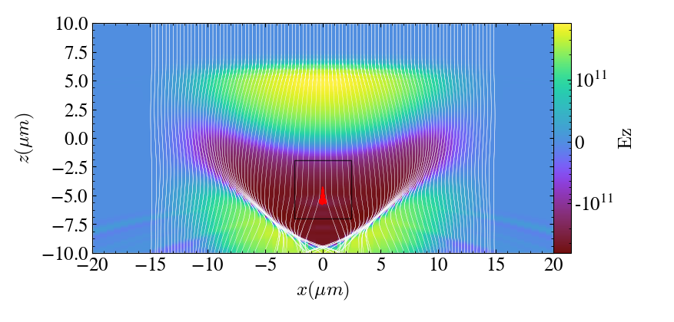
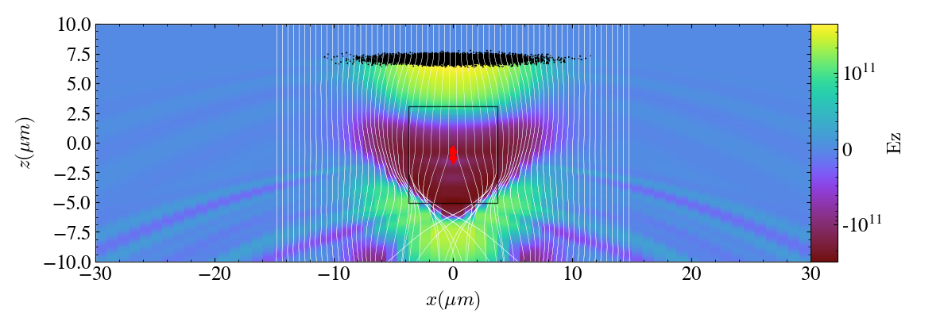
First simulations of plasma accelerators with MR patch (09/17)
Laser driven
2-D
Particle beam driven
Simulations with small MR patch recover results using finer grid over the entire box.

Slide 18
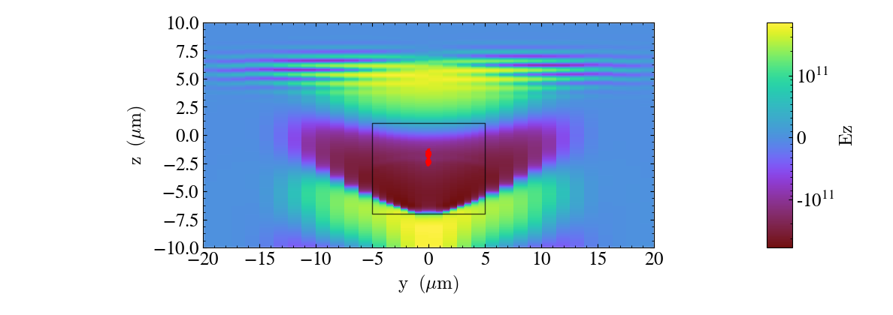
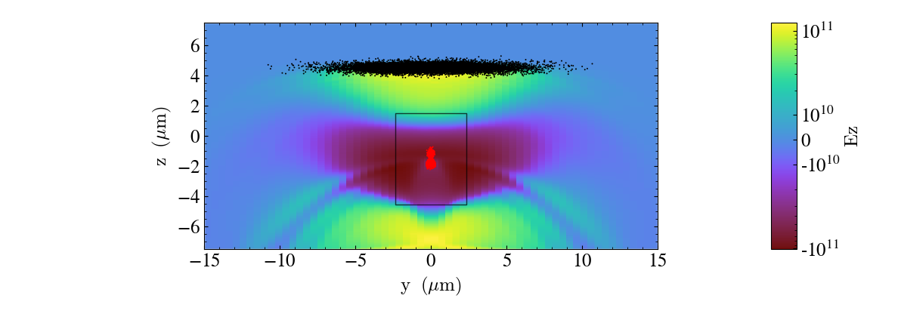
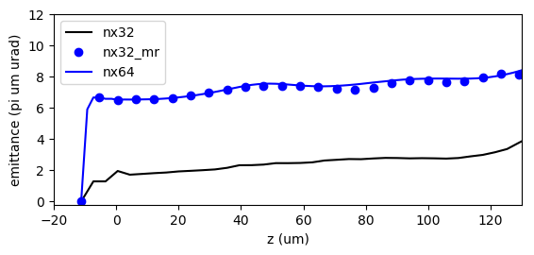
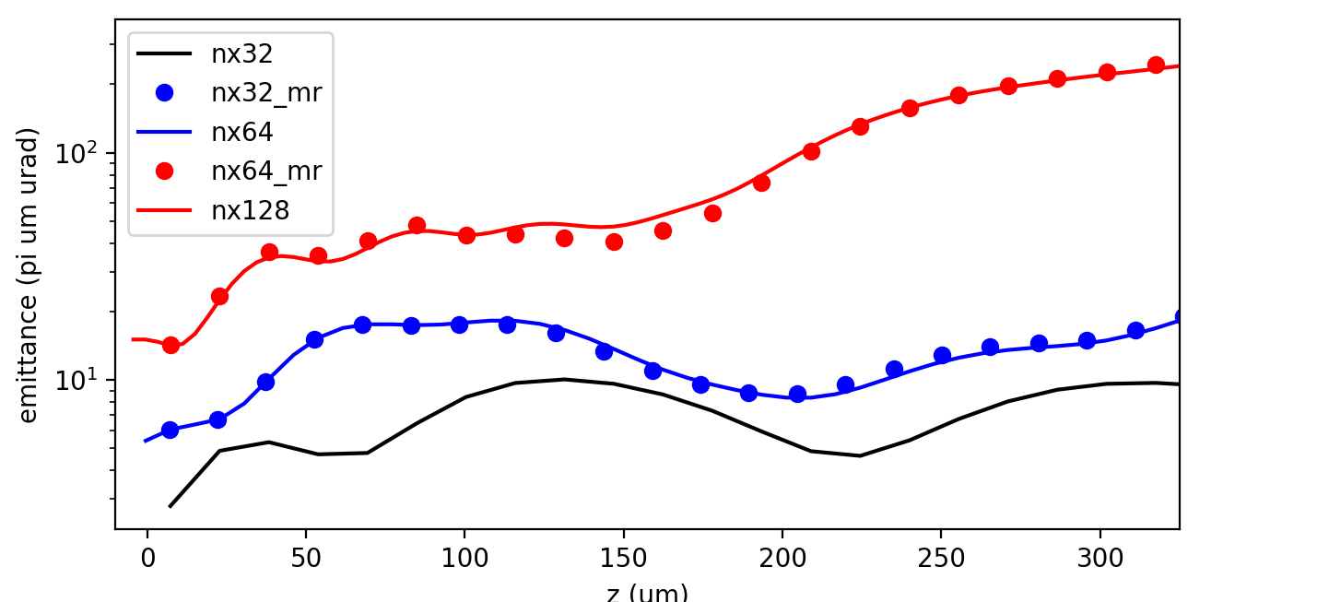
First simulations of plasma accelerators with MR patch (09/17)
Laser driven
3-D
Particle beam driven
Simulations with small MR patch recover results using finer grid over the entire box.

Slide 19
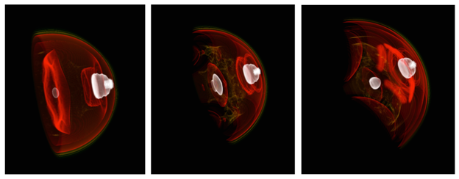
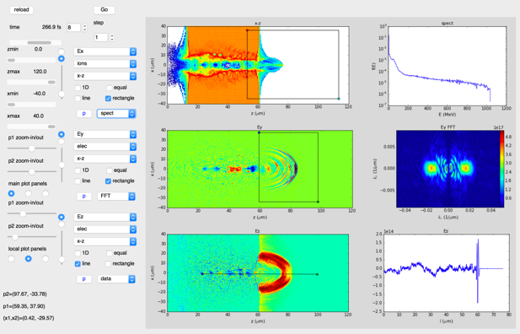
WarpX visualization tools are being developed
3D rendering of WarpX plasma accelerator simulation with yt
Prototype WarpX data analysis GUI
2D/3D visualization with matplotlib, yt, VisIt, …
  Supports AMReX & OpenPMD data structures
Interface using Python, Jupyter notebooks or GUI.

Slide 20
Plans

Slide 21
7-year plan for Exascale project WarpX
From initial code coupling to ensemble of 100 GeV-scale stages
Modeling of ensembles of 100 consecutive GeV-scale plasma accelerator stages
2023
Modeling of 100 consecutive GeV-scale plasma accelerator stages
2022
Modeling of 30 consecutive GeV-scale plasma accelerator stages
2021
End current ECP project
Modeling of 10 consecutive GeV-scale plasma accelerator stages
2020
Mi. FYQ4
Mi. FY19Q4
2019
Modeling of 3 consecutive GeV-scale plasma accelerator stages
Code to be released open source to community.
2018
Modeling a single GeV-scale plasma accelerator stage
Mi. FY18Q4
2017
Modeling of single plasma accelerator stage with static mesh refinement
Mi. FY17Q4
Now
2016
Initial coupling of Warp+Boxlib+PICSAR
Mi. FY17Q1

Slide 22
Thank you!
For those who are interested in technical details, come to my talk tomorrow in WG6.
Questions?

