Slide 1

Overview of laser-driven
positron sources
Gianluca Sarri
School of Mathematics and Physics, Queen’s University Belfast, UK
g.sarri@qub.ac.uk
EAAC 2017, Isola d’Elba, Italy 29/09/2017

Slide 2


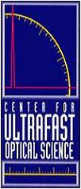







Main Collaborators
A. Alejo, D. J. Corvan,
D. Doria, G. Samarin,
J. Warwick, T. Dzelzainis
A.G.R. Thomas,
W. Schumaker,
K. Krushelnick
L. Gizzi,
G. Grittani
D. Symes
and ASTRA-GEMINI
technical staff
A. Di Piazza,
Ch. Keitel
S. Kuschel
J. Cole, S. P. D. Mangles,
K. Poder, Z. Najmudin,
J. Vieira, N. Shukla,
L. Silva
L. Romagnani
Gianluca Sarri
Slide 1/25

Slide 3

Talk Outline
INTRODUCTION:
ELECTRON-POSITRON BEAMS:
ELECTRON-POSITRON BEAM DYNAMICS:
CONCLUSIONS AND OUTLOOK:
Electron-positron beams in astrophysics
Positron beams in conventional accelerators
Alternative schemes towards neutral electron-positron plasmas
Optical set-up
Pure positron beams
Neutral electron-positron beams
Beam filamentation
Magnetic field generation
Experimental evidence
Ongoing experiments
Gianluca Sarri
Slide 2/25

Slide 4
Introduction
Electron beam dynamics in ultra-intense laser fields
Gianluca Sarri

Slide 5
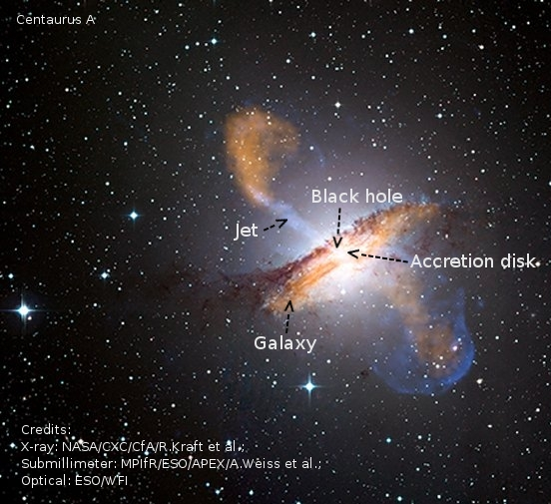
Astrophysical jets
Highly-collimated electron-positron jets are observed being emitted by massive and powerful objects, such as quasars, pulsars, and active galactic nuclei
Associated with strong emission of gamma-rays
Optically thin
Power-law spectrum:
Some predominantly leptonic
Relativistic
Strong interaction with the intergalactic medium
Largest single events observed in the Universe
Equipartition: 10⁻¹ – 10⁻⁵
The generation of gamma rays requires strong and long-lived magnetic fields:
Intergalactic magnetic field (~ nT) too small
MHD shock-compression, equipartion of 10⁻¹¹
Fields from the central engine, equipartition of 10⁻⁷
Weibel-generated fields, too short-lived
Electron-positron
beam filamentation?
Gianluca Sarri
Slide 3/25

Slide 6
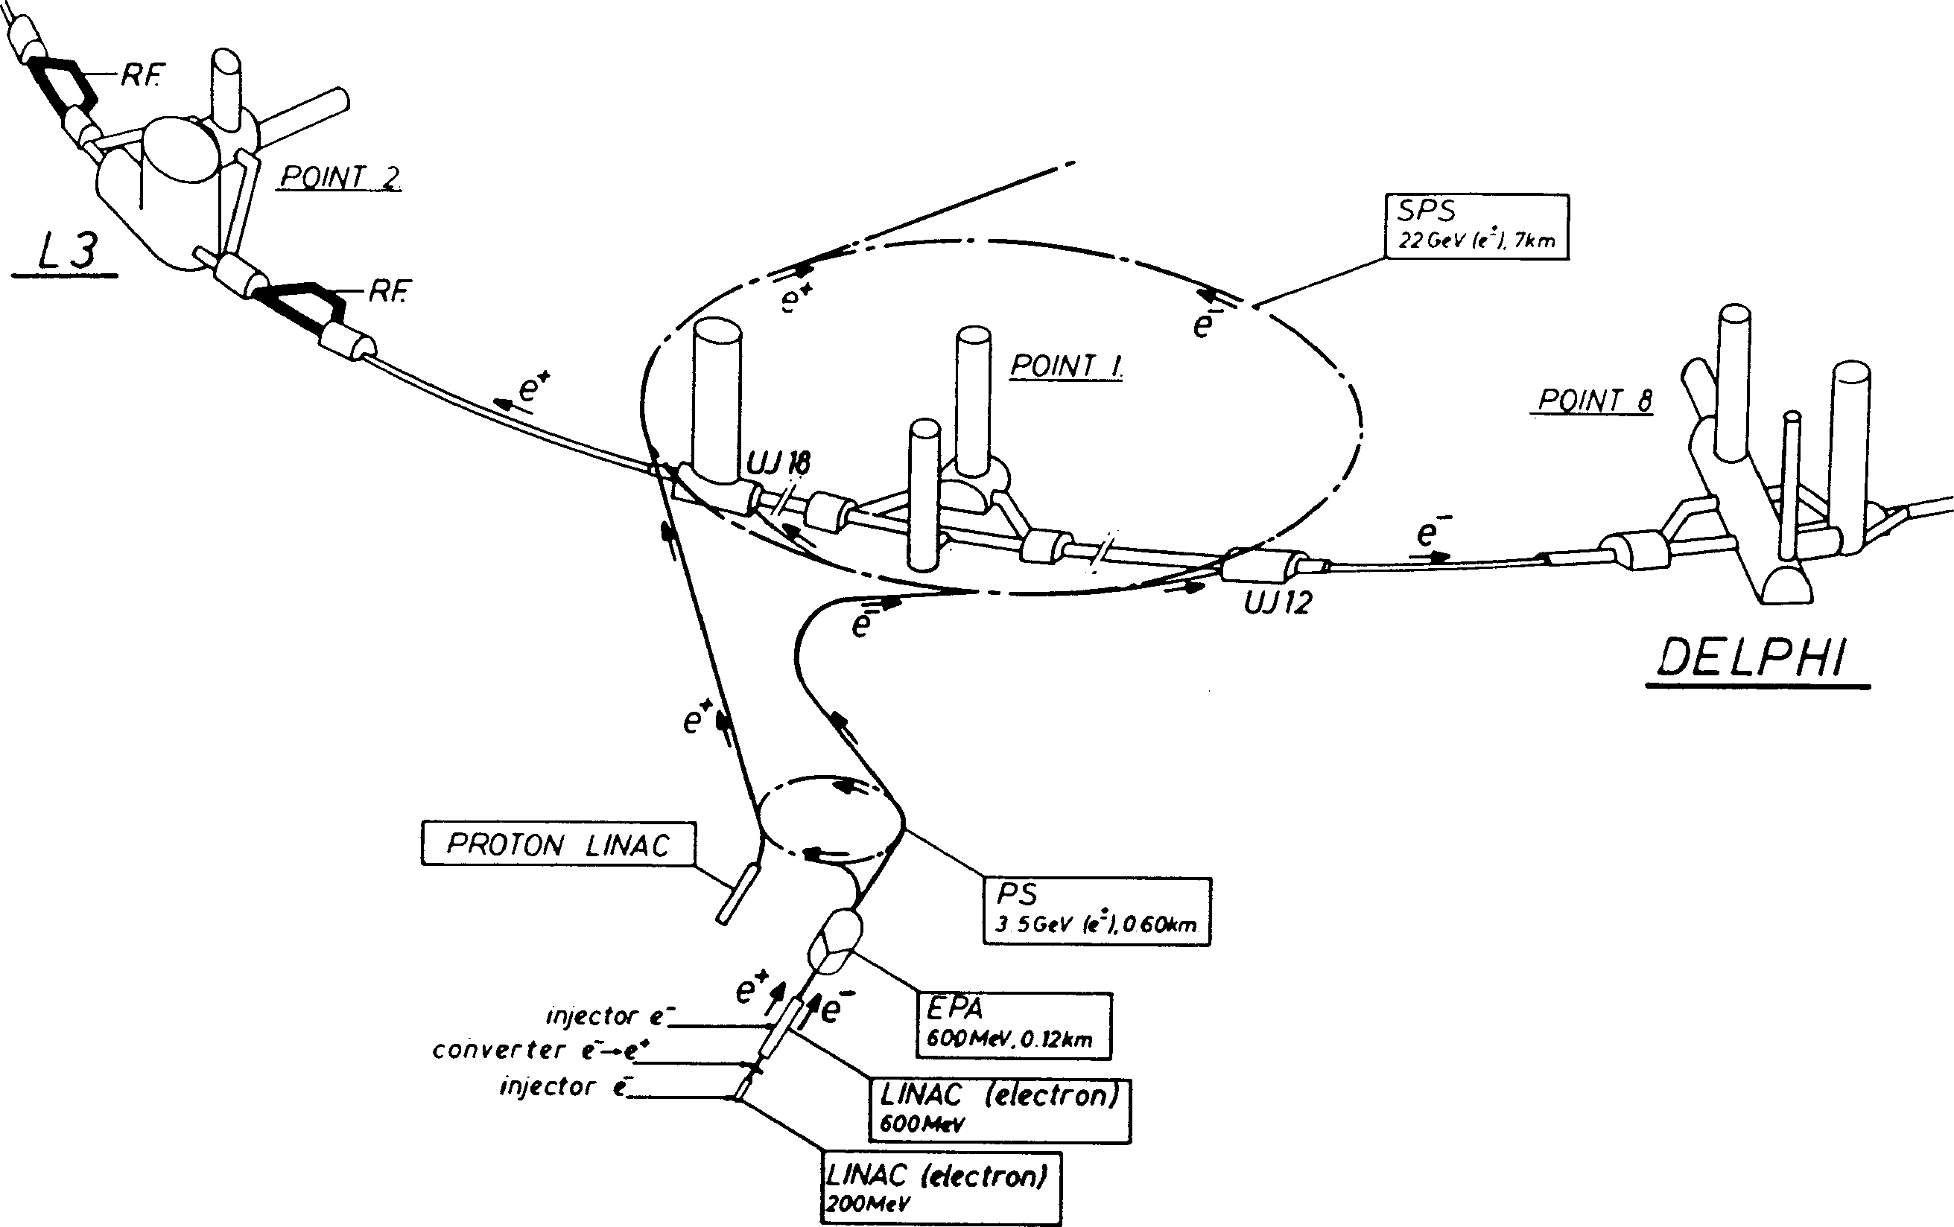
Positrons in accelerators
The largest electron-positron collider ever built was the LEP
Storaged and cooled before being injected
in a 27-km diameter synchrotron
Twin electron beam also generated, with
maximum energy of 209 GeV
Typical parameters
Maximum Energy: 209 GeV
Positrons: ~10¹¹
Luminosity ~10³¹ cm⁻² s⁻¹
New collider proposal: International Linear Collider
Positrons initially generated during the interaction of
a 200 MeV electron beam with a solid target
Typical emittance at injection: 60π mm mrad
≈ 100m
Difficult to generate a neutral electron-positron beam!
Gianluca Sarri
Slide 4/25

Slide 7
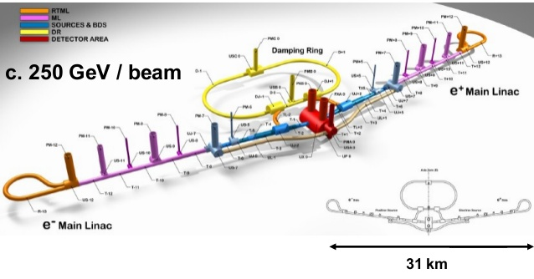
International Linear Collider
Interesting physics still to be unveiled with 1-10 GeV electron-positron colliders!
Gianluca Sarri
Slide 5/25

Slide 8
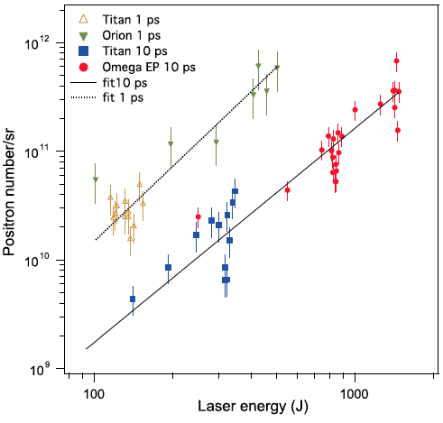
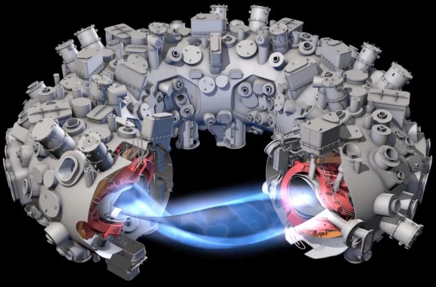
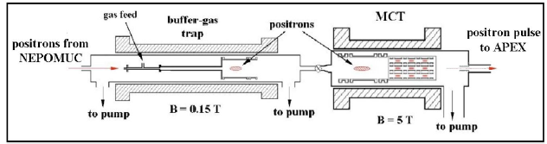
Alternative schemes
Large-scale, high-energy laser systems
- Direct laser irradiation on solid targets
- hot electrons propagating through the target
- Pair production in the nuclear field
Positron injection in a stellarator
- Creation of a steady electron plasma
- Injection of positrons
- Short temporal confinement
- Non-relativistic plasma
- Long duration
- Broad divergence
- Non-neutral!
H. Chen et al., Phys. Rev. Lett. 114, 215001 (2015)
E. Liang et al. Sci. Rep. 5,13968 (2015).
T. S. Pedersen et al., New J. Phys. 14, 035010 (2012)
Gianluca Sarri
Slide 6/25

Slide 9
Wakefield based
positron generator
Electron beam dynamics in ultra-intense laser fields
Gianluca Sarri

Slide 10
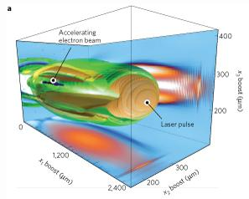
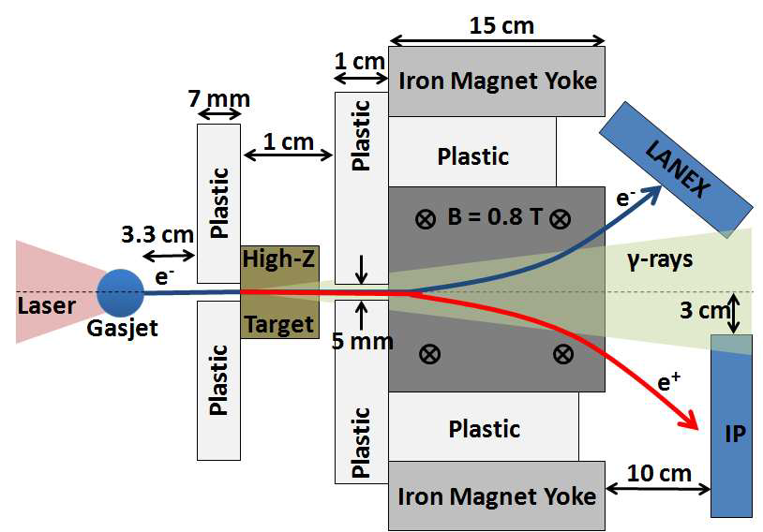
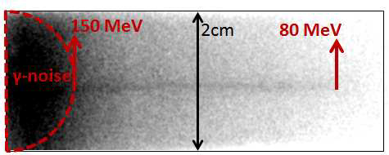
General setup
Laser-wakefield electrons to trigger the cascade in a solid
Divergence: 1-5 mrad (from solid: ~ 20 degrees)
Duration: ~ 10 fs (from solid: 1 – 10 ps)
Energy: 100s of MeV (from solid: 10s of MeV)
Laser energy: ~1-10J (from solid: ~kJ)
Possibility of generating neutral e⁻/e⁺ beams in situ!
(b)
G. Sarri et al., Phys. Rev. Lett. 110, 255002 (2013)
Gianluca Sarri
Slide 7/25

Slide 11
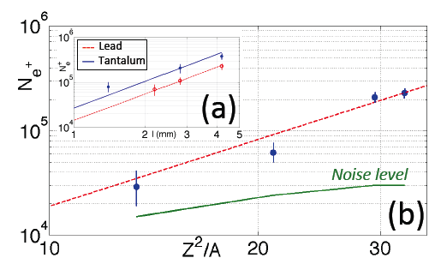
First results: low energy
First results with a 0.8J table-top laser system
5.3 mm Cu
6.4 mm Sn
2.8 mm Ta
Overall positron yield: 3x10⁷
Overall lepton yield: 3x10⁸
Positron density: 2x10¹⁴ cm⁻³
Lepton density: 2x10¹⁵ cm⁻³
Normalised emittance: 30 π mm mrad
Divergence: 3 mrad
4.2 mm Pb
G. Sarri et al., Phys. Rev. Lett. 110, 255002 (2013)
Gianluca Sarri
Slide 8/25

Slide 12
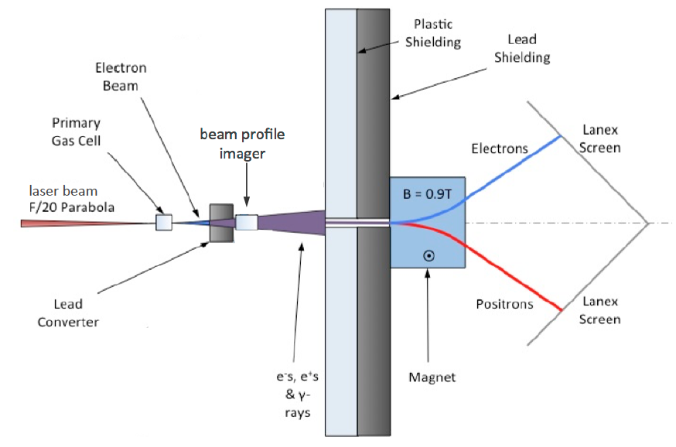
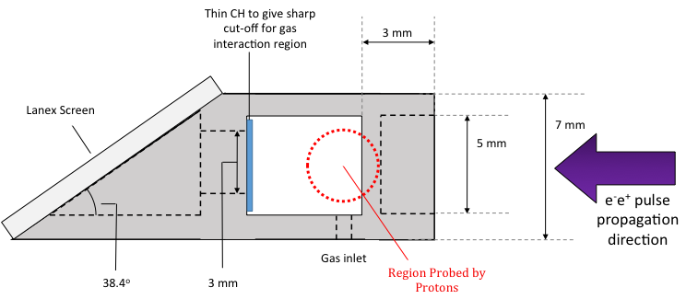
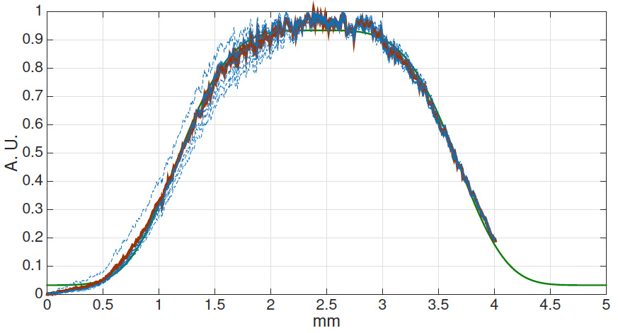
First results: spatial quality
Smooth profile after subtraction
of γ-ray signal.
Super-gaussian FWHM: 2.4mm
(@ 1 cm, spectrally integrated)
Stable and reproducible
Consistent with γ_{AV} ~ 17
G. Sarri et al., Plasma Phys. Contr. F. (2017)
Gianluca Sarri
Slide 9/25

Slide 13
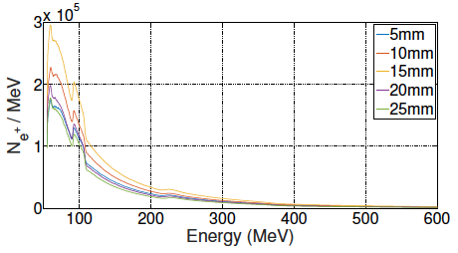
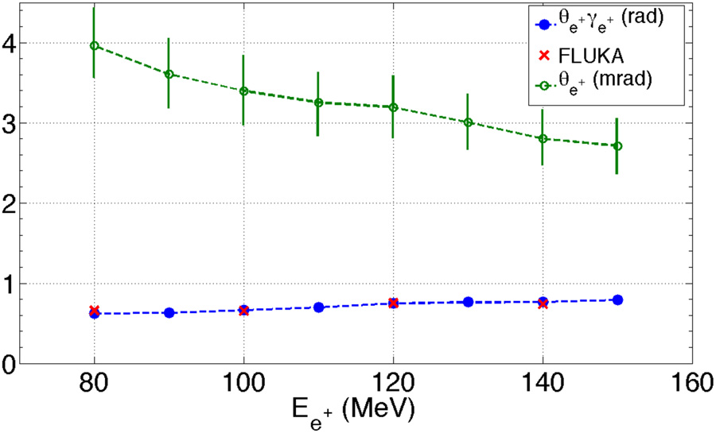

First results: luminosity
Broad spectrum (γ_{AV} ~ 10s)
Maxwell-Juttner distribution
Energy-dependent divergence (Θ∼1/γ)
Source size ~ 200 - 300 microns
Number of relativistic positrons ~ 10⁹ - 10¹⁰
Duration ~ 10s of fs
Peak current: ~ kA
ε at 90 MeV: (3.0±0.5) π mm mrad
ε at 500 MeV: (0.6±0.1) π mm mrad
@ 1 Hz, 10J: L ~ 10²¹ cm⁻² s⁻¹
@ 10 kHz, 10 PW: L ~ 10²⁸ cm⁻² s⁻¹
LEP: L ~ 10³¹ cm⁻² s⁻¹
Luminosity:
G. Sarri et al., Plasma Phys. Contr. F. (2013)
G. Sarri et al., Plasma Phys. Contr. F. (2017)
Gianluca Sarri
Slide 13/25

Slide 14
Neutral electron-positron
beams
Electron beam dynamics in ultra-intense laser fields
Gianluca Sarri

Slide 15
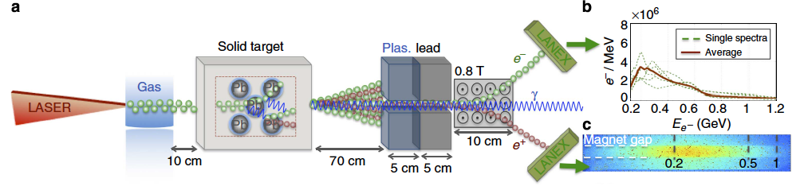
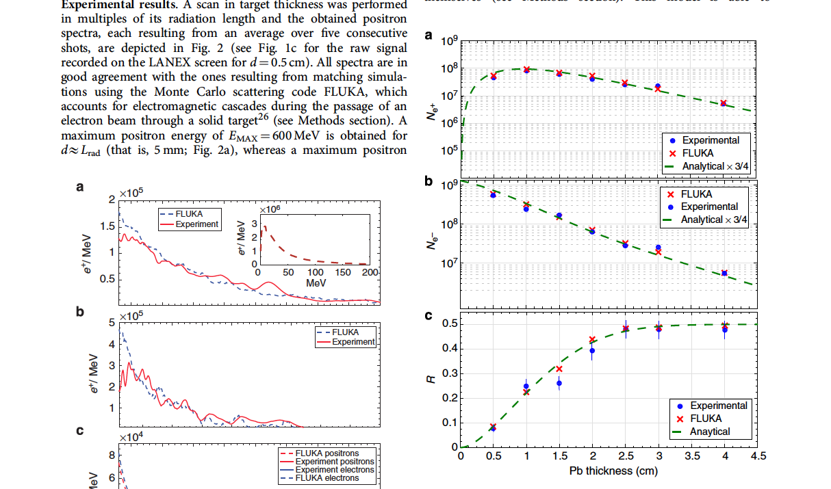
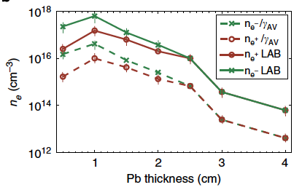
A neutral pair beam
Max.
Neutrality
Maximum positron yield at ~2 L_{RAD}
~48% of positrons at ~ 5 L_{RAD}
Beam duration: ~ tens of fs
Beam diameter: ~ 1.2 c/w_{p}
Beam divergence: ~ tens of mrad
G. Sarri et al.,
Nature Communications
6, 6747 (2015)
Gianluca Sarri
Slide 15/25

Slide 16
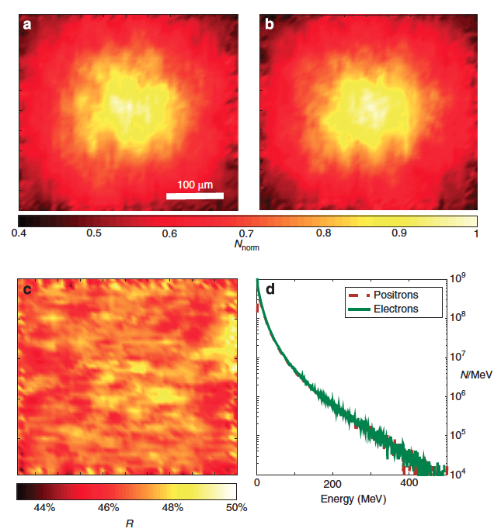
A neutral pair beam
electrons
positrons
FLUKA simulations
similar spatial distribution
beam radius: ~ 150 microns
positron percentage 46 – 50 %
spectral symmetry
departure from neutrality
only at low energies (< 5 MeV)
positron percentage
G. Sarri et al., Nature Communications 6, 6747 (2015)
Gianluca Sarri
Slide 16/25

Slide 17
Beam filamentation
PIC simulations
Electron beam dynamics in ultra-intense laser fields
Gianluca Sarri

Slide 18
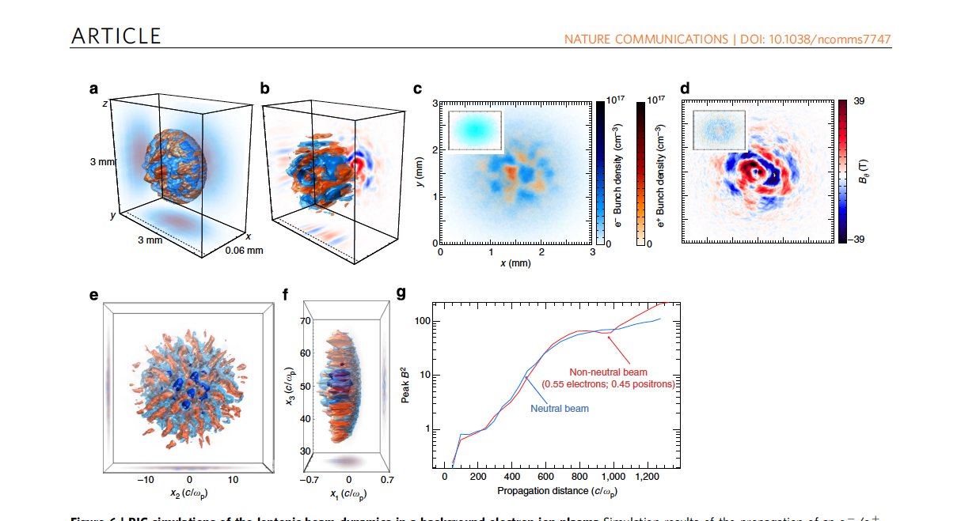
Beam filamentation: ideal
Strong filamentation only for neutral beam (>40%)
Saturation reached at ~800 c/w_{p}
Generation of strong B fields
Equipartition of the order of 10⁻² – 10⁻⁴
Long-lived fields
G. Sarri et al., Nature Communications 6, 6747 (2015)
Gianluca Sarri
Slide 17/25

Slide 19
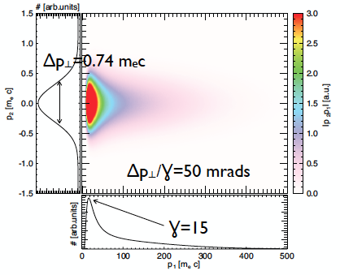
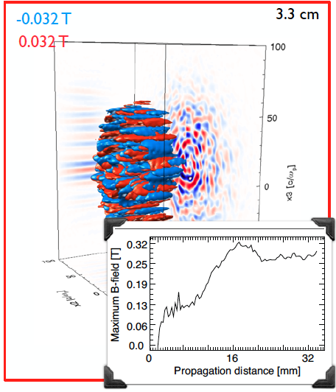
Beam filamentation: real
Laser-driven electron-positron beams have, however, a broad spectrum (Maxwell-Juttner distribution and a wide divergence
Filamentation still a strong process
Generation of strong fields on a scale of the order of the beam collisionless skin depth
N. Shukla et al., submitted (2017)
Gianluca Sarri
Slide 18/25

Slide 20
Beam profile
Electrons (blue) and positrons (red) produce beam-lets with a characteristic diameter of
the order of the relativistic skin depth of the beam
The beam-lets tend to distribute by filling each others density gaps
The beam preserves a smooth density distribution
Total particle symmetry
Undistinguishable by scintillator screen or any other
detector insensitive to the sign of the charge!
Gianluca Sarri
Slide 19/25

Slide 21
Beam filamentation:
experimental evidence
Electron beam dynamics in ultra-intense laser fields
Gianluca Sarri

Slide 22
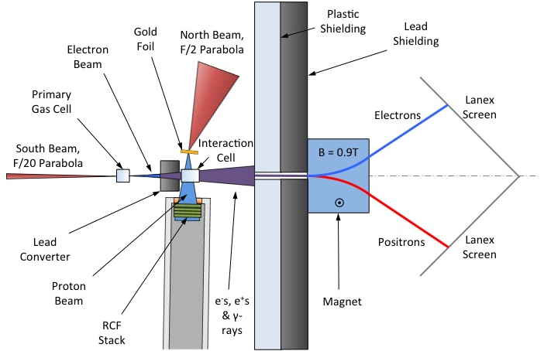
Filamentation: experiment
Gianluca Sarri
Slide 20/25

Slide 23
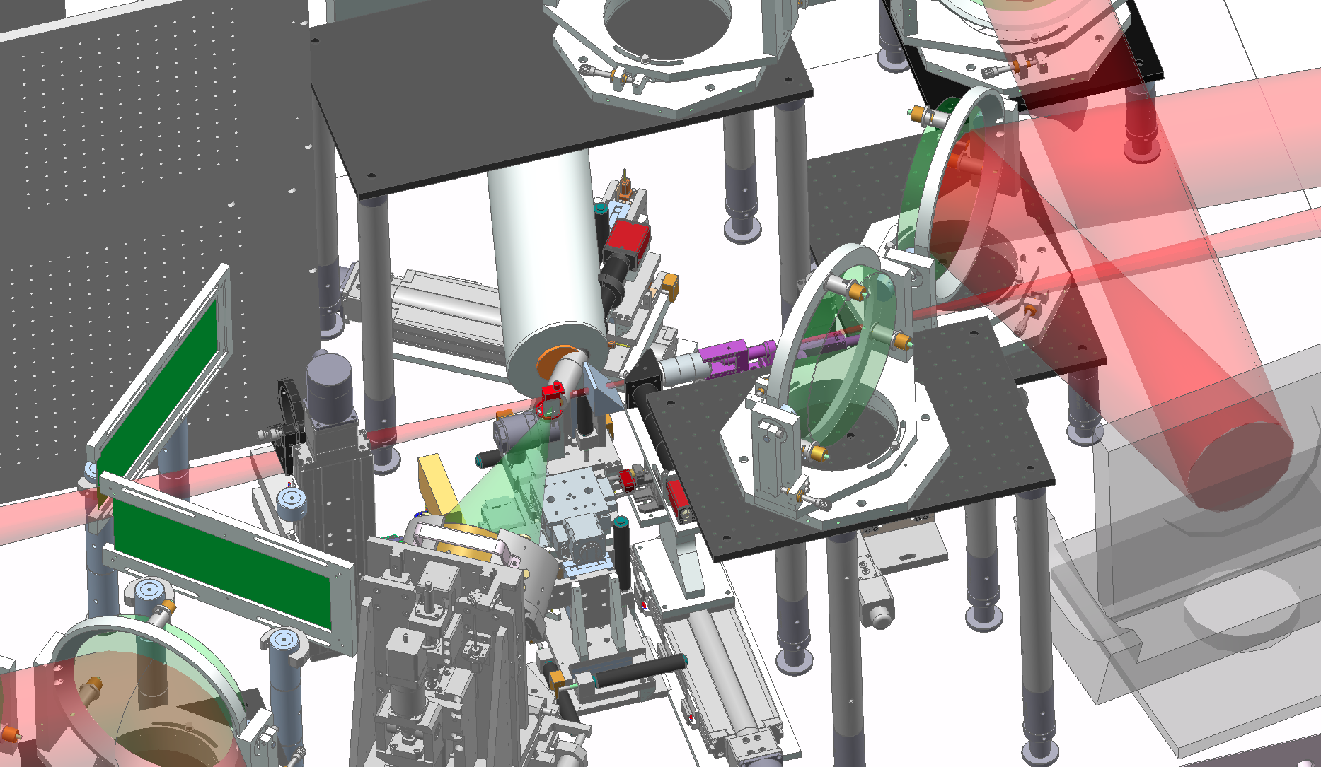
Filamentation: experiment
Gianluca Sarri
Slide 20/25

Slide 24
Expected filamentation
Background plasma
n_{P} = 10¹⁷ cm⁻³
T_{P} ~ 10 eV (from Hydro simulations)
w_{P} = 2x10¹³ Hz
r_{P} ~ 30 μm
Electron-positron beam
n_{B} = 3x10¹⁴ cm⁻³
γ_{AV} ~ 15
w_{B} = 10¹² Hz ➔ t_{P} ~ ps
c/w_{B} ~ 80μm ➔ (relativistic) c/w_{B} ~ 320μm
Beam-plasma linear instability theory predicts a growth rate and a wavelength:
The instability should then grow within tens of microns, producing 1-2 filaments!
The background plasma gyroradius is smaller than the filament wavelength, suggesting that the plasma can get magnetised
M. V. Medvedev et al.,
Astro.phys. J. 526, 697 (1999)
Gianluca Sarri
Slide 21/25

Slide 25
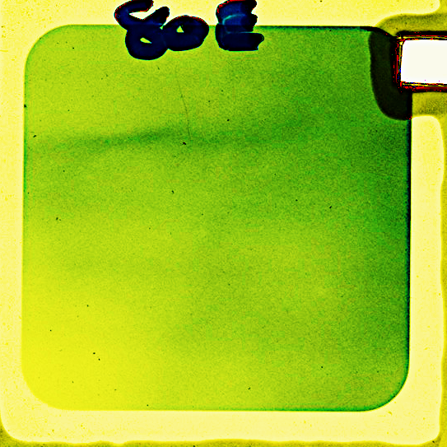
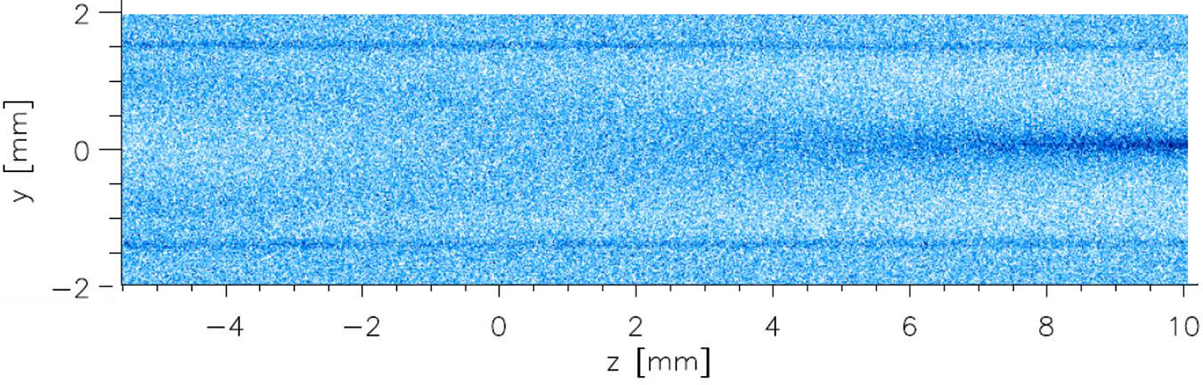
Proton radiography
Can proton radiography see these fields?
RCF
defocussing
focussing
gas
e⁻ beam
B
(10 fs)
return
current
proton beam
Azimuthal magnetic fields left in the background plasma persist for longer than the duration of the beam (proton radiography resolution ~ ps)
The divergent nature of the proton beam
implies that azimuthal magnetic fields induce
focussing/defocussing of the protons
A. Smyth et al. Phys. Plasmas 23, 063121 (2016)
Gianluca Sarri
Slide 22/25

Slide 26
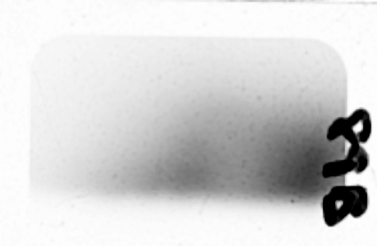
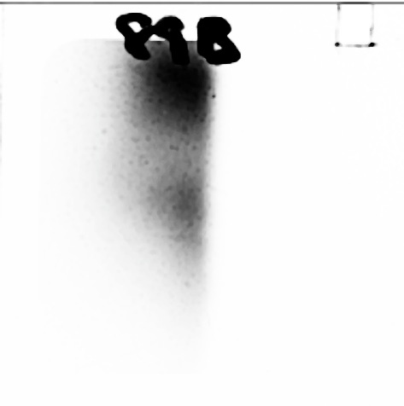
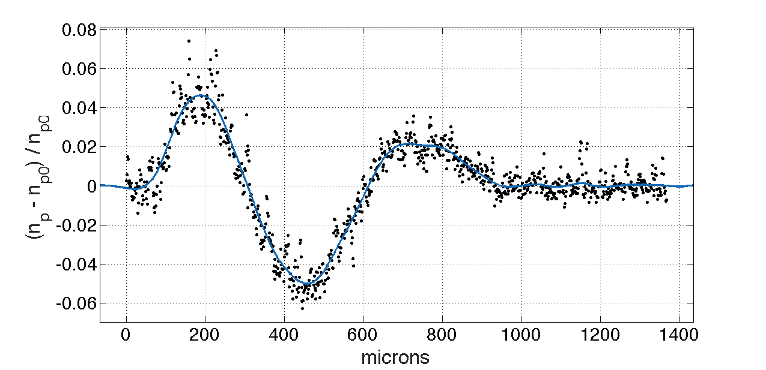
Proton radiography: results
Proton radiographs of the background gas, show clear proton modulation only for quasi-neutral electron-positron beams:
Proton accumulation
~ 1 T field generated
persistent ~1000 w_{p}⁻¹
No modulation in the proton beam
J. Warwick et al., submitted ArXiv: 1705.08162 (2017).
Gianluca Sarri
Slide 23/25

Slide 27
Proton radiography: results
Main features:
Instability observed only for neutral beams
Strong magnetic field generation: (1.2±0.5) T
Consistent with full filamentation of the beam
Equipartition parameter: ε_{B} ~ 10⁻³
Long persistence: > 1000 ω_{p}⁻¹
J. Warwick et al., submitted ArXiv: 1705.08162 (2017).
Gianluca Sarri
Slide 24/25

Slide 28
Thanks for your attention!
Gianluca Sarri
g.sarri@qub.ac.uk

