Slide 1


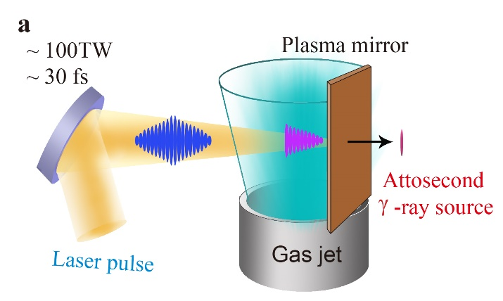
Ultra-brilliance isolated attosecond gamma-ray light source from nonlinear Compton scattering
Peking University: Jinqing Yu, Ronghao Hu, Haiyang Lu & Xueqing Yan
Imperial College London: Z. Najmudin
University of California, Irvine: T. Tajima
3rd European Advanced Accelerator Concepts Workshop

Slide 2
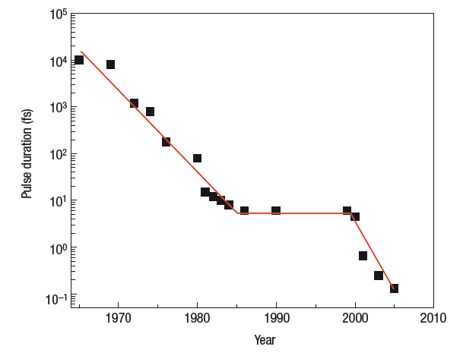
Shorter duration
Attosecond physics started in 21 century!
Attosecond
region
P. B. Corkum, Nature Physics (2007)

Slide 3
Applications of Attosecond light source
Temporal resolution in fs/as scale
Molecular dynamics
Well-controlled pump-probe experiments
Coherent Diffractive Imaging
Holographic Imaging
Zoneplate Imaging
Inner-shell probe, never reached before

Slide 4
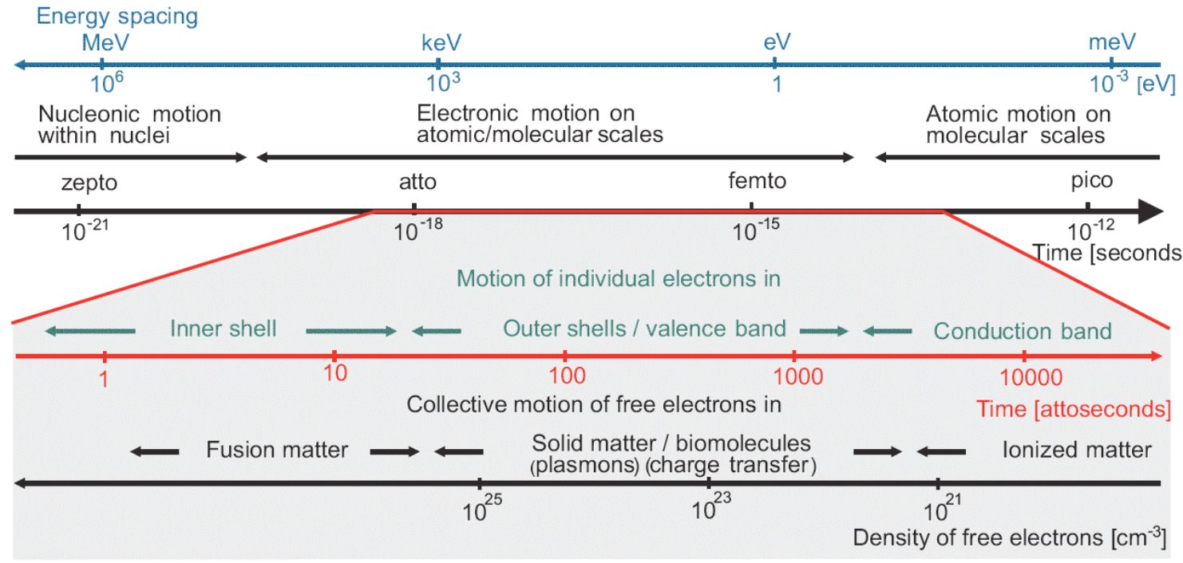
Outer/inner shell dynamics, never reached before
Blank area
F. Krausz, M. Ivanov
Review of Modern Physics 81, 163 (2009)

Slide 5
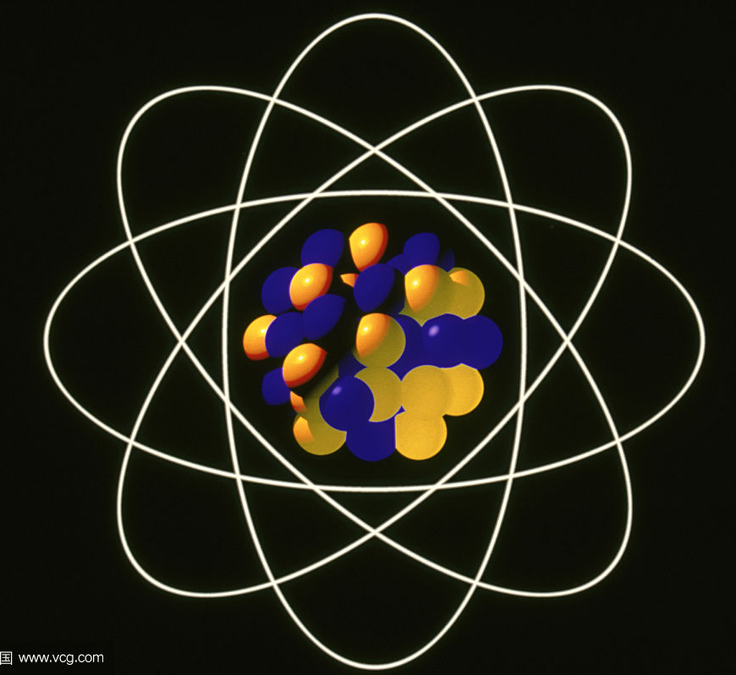
The γ-ray for Outer/inner shell dynamics
High energy photons
2. Ultra-short
attosecond
3. Isolated
4. High brilliance
5. Ultra-smaller source size
γ-ray

Slide 6
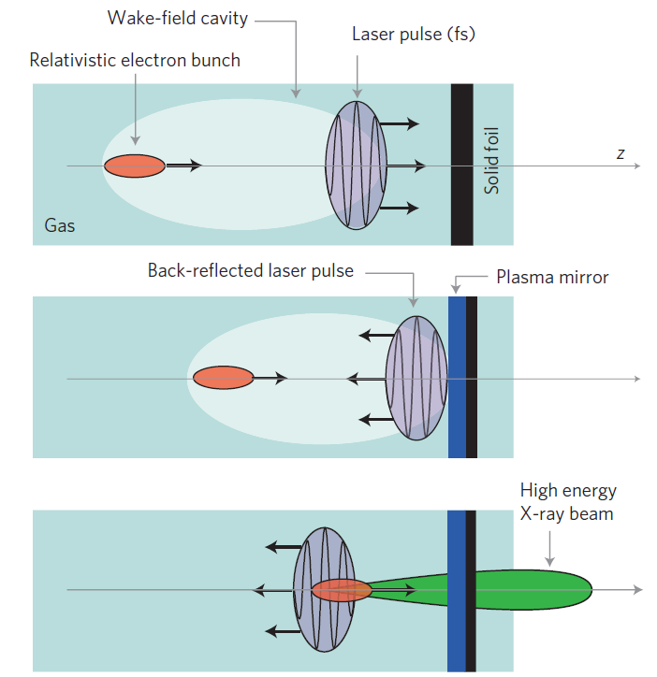
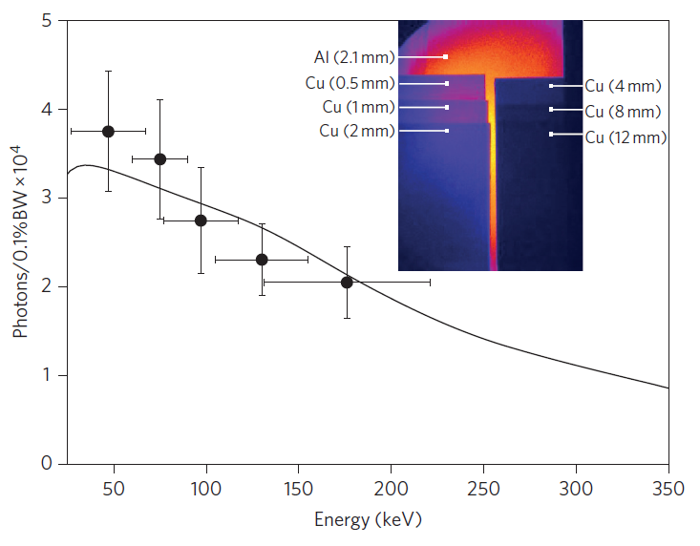
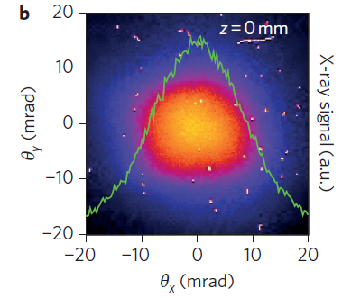
γ-ray generation experiment
K. Ta Phuoc, Nature Photonics 2012

Slide 7
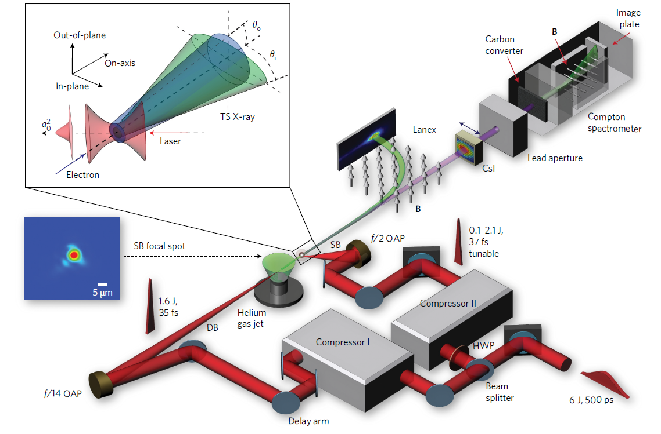
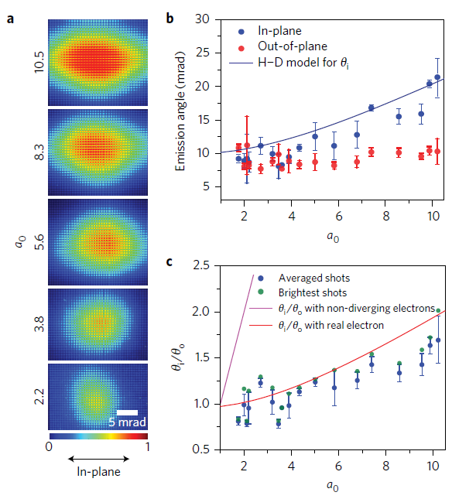
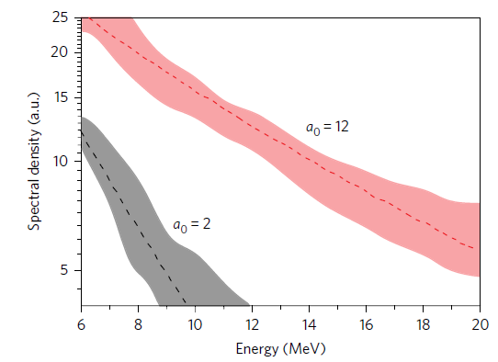
γ-ray generation experiment
W. C. Yan, Nature Photonics 2017

Slide 8
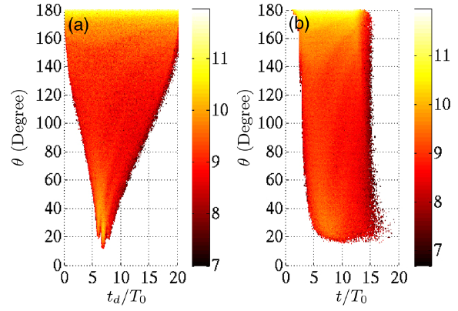
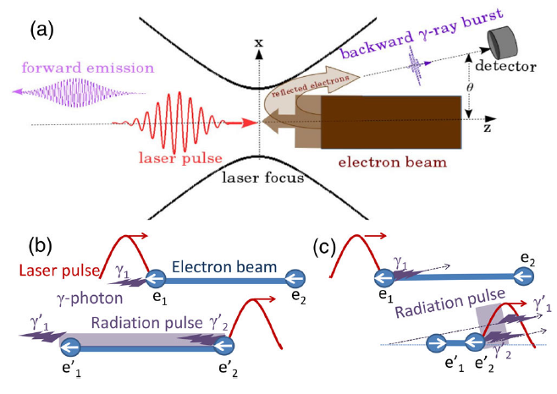
The first attosecond γ-ray method
~4.9×10²³ W/cm²
The gamma source duration was 830 as;
The brilliance was ~3×10²⁰ Photons s⁻¹ mrad⁻² mm⁻² 0.1%BW.
10PW lasers are still under construction!
Jianxing Li, PRL (2015)

Slide 9
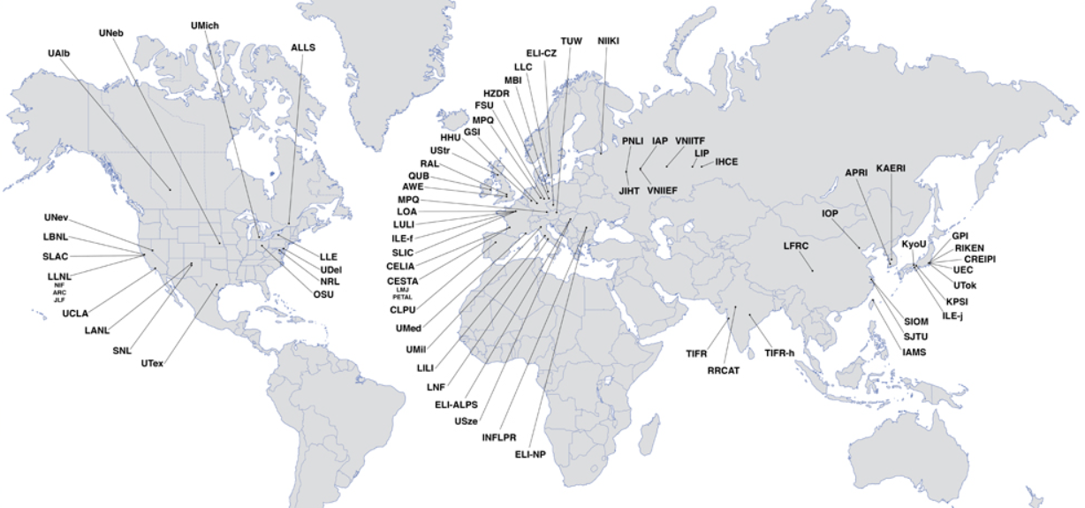
Ultrahigh intensity laser facilities
ICUIL 2011

Slide 10
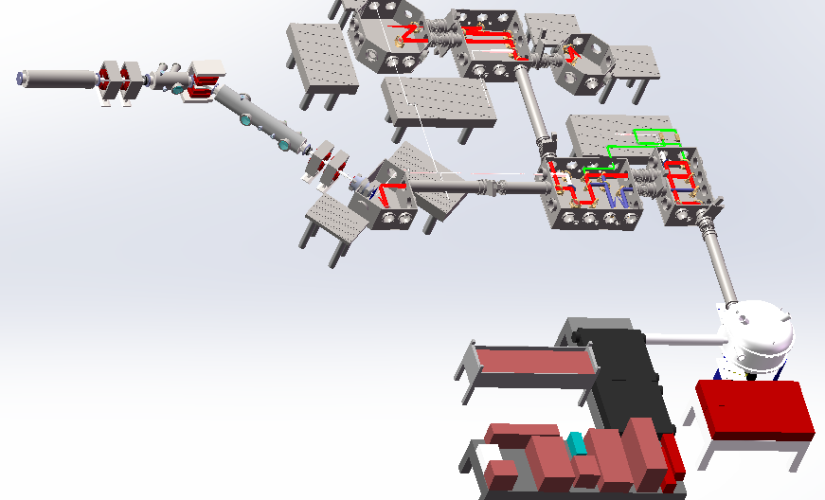
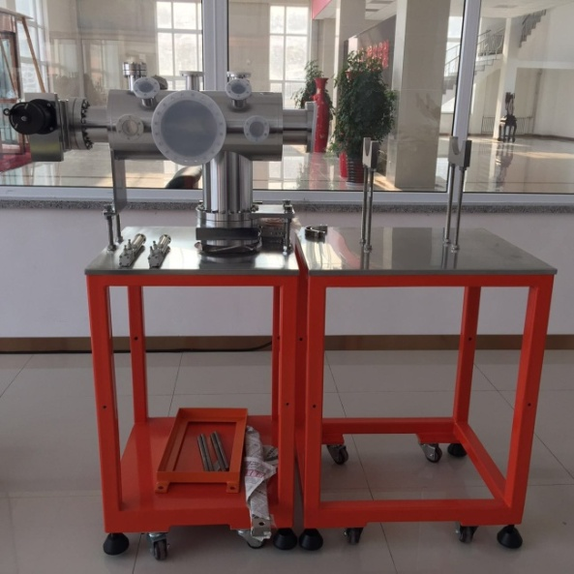
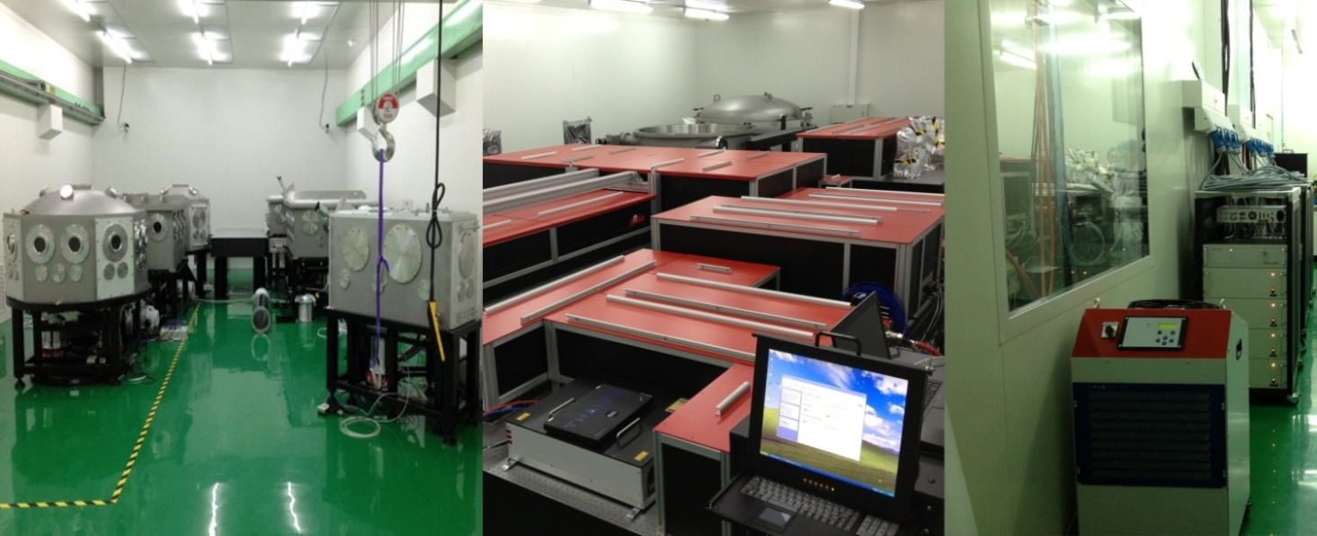
Compact LAser Plasma Accelerator @Peking Uni.
2) FEL beam line
3)Cluster-target Chamber
CLAPA Laser Parameters
Pulse Energy: | 5 J
Pulse Duration: | < 25 fs /5Hz
Wavelength: | 800 nm
Contrast Ratio: | 10¹⁰:1 @ 100 ps 10⁹:1 @ 20 ps
 | 10⁶:1 @ 5 ps
 | 10³:1 @ 1 ps
1)Proton Irradiation
Platform for Animals
Proton Beam Line
Laser
Notes:
Ok, At the beginning of my talk, I want give some words to our new lab.
This is our new laser lab, just finished last year. It’s a 200 TW laser system.
On in this laser, we are studying ion acceleration, electron acceleration and high quality gamma-ray generation.

Slide 11

Attosecond γ-ray pulse generation
How to produce attosecond γ-ray pulse with current 100TW class lasers ???
Notes:
As we can see from the reported studies, almost all the angle is larger than 30 degree.
So is there any reported method to reduce the divergence angle of the γ-ray source? The answer is yes.

Slide 12
Gamma pulse duration in Compton mechanism
The radiation duration is dominated by electron bunch duration or laser pulse duration;
It is possible to generate attosecond radiation by the interaction between attosecond electron bunch and short laser pulse.

Slide 13
Gamma pulse duration in Compton mechanism
Two key points need to be overcame!
How to generate isolated attosecond electron bunch?
How to control the collision point?

Slide 14
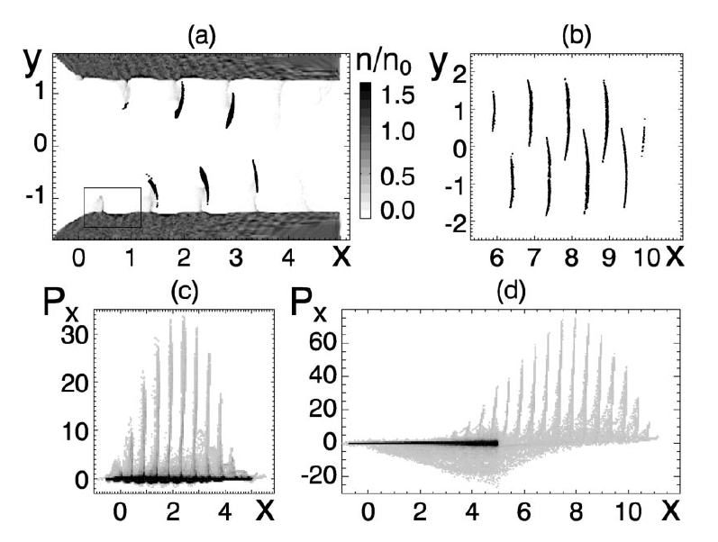
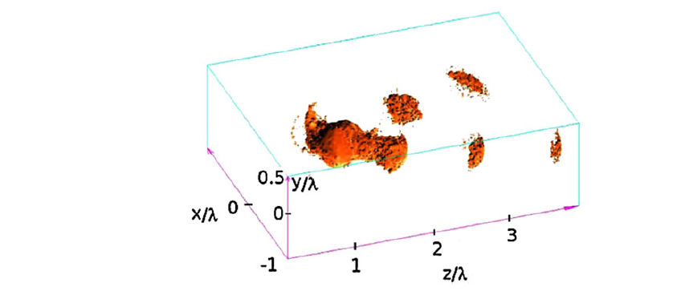
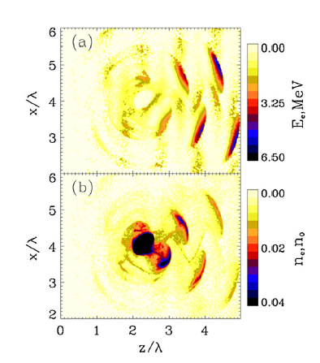
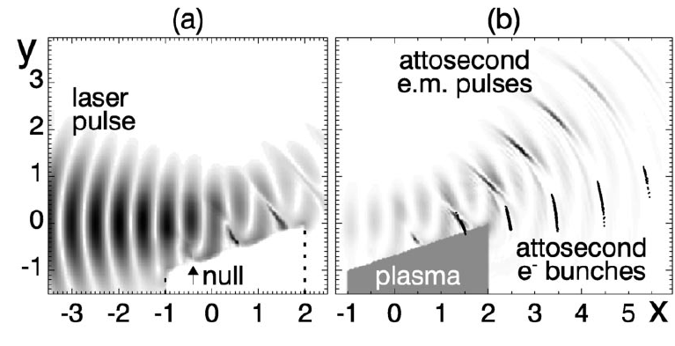
How to generate isolated attosecond electron bunch?
N. Naumova, Attosecond Electron Bunches, PRL, 2004
T.V. Liseykina, PRL, 2010

Slide 15
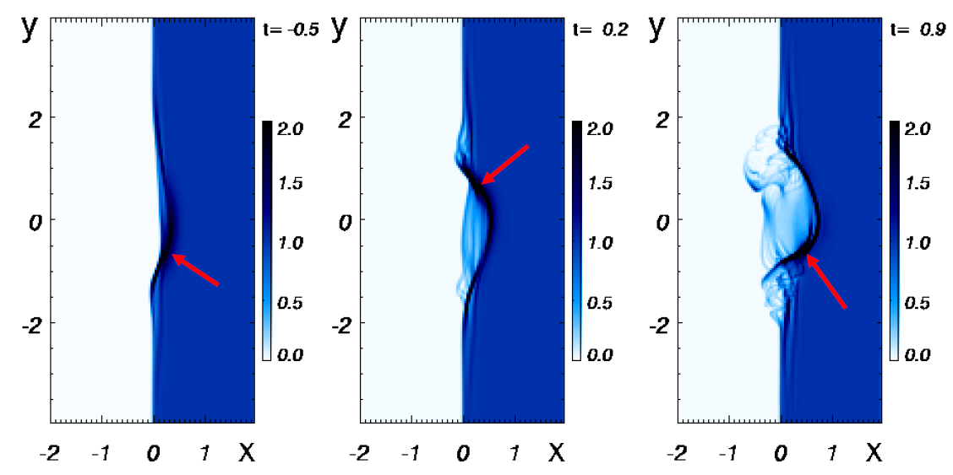
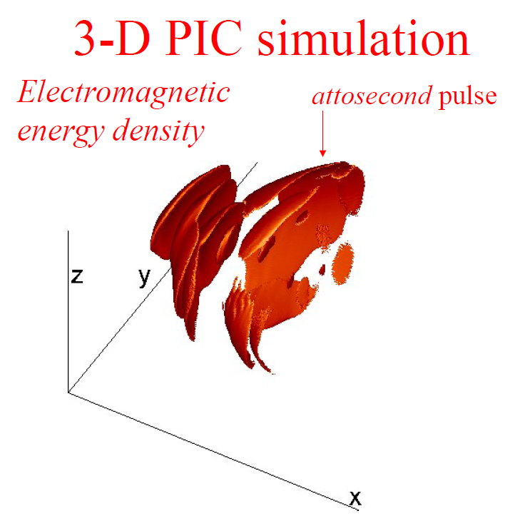
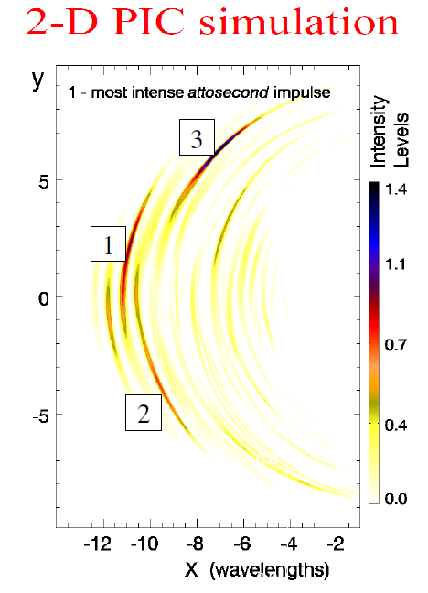
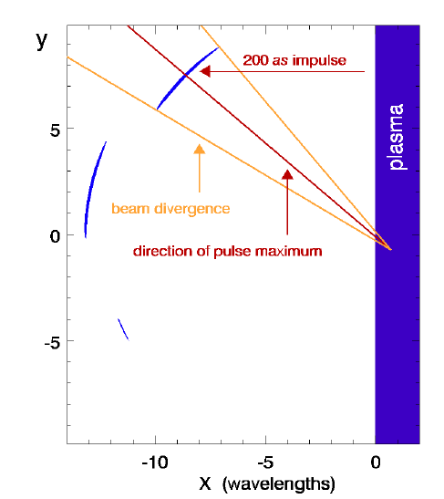
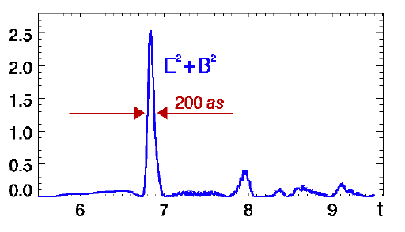
How to generate isolated attosecond electron bunch?
5 fs laser !

Slide 16
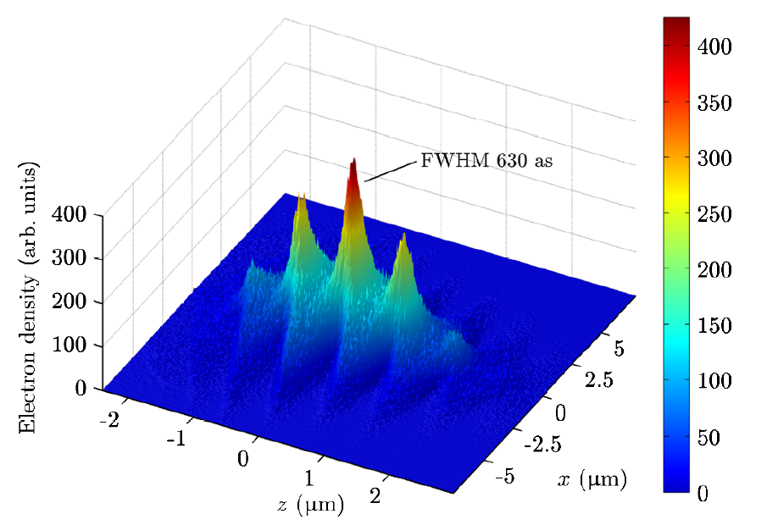
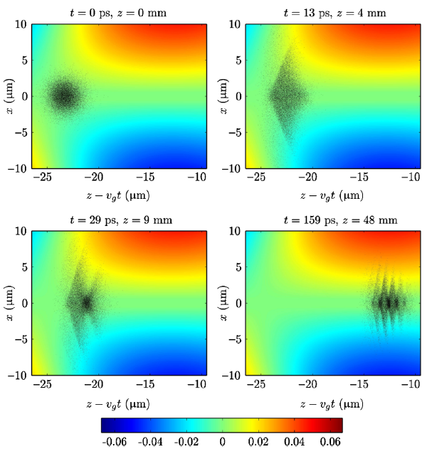
How to generate isolated attosecond electron bunch?
M. J. H. Luttikhof, PRL, 2010

Slide 17
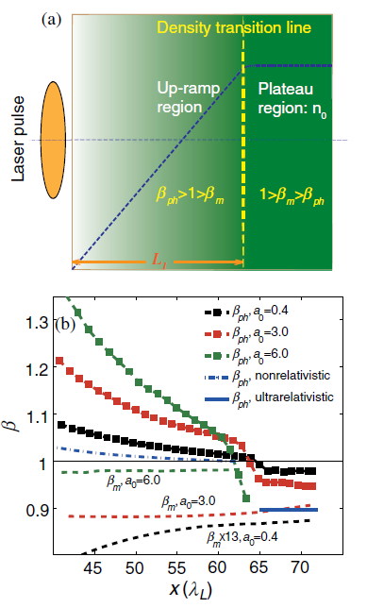
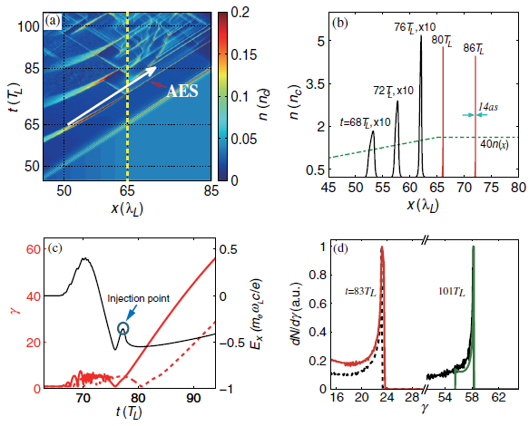
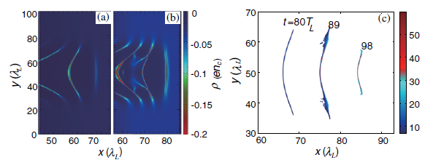
How to generate isolated attosecond electron bunch?
F.Y. Li & Z. M. Sheng, PRL, 2014

Slide 18
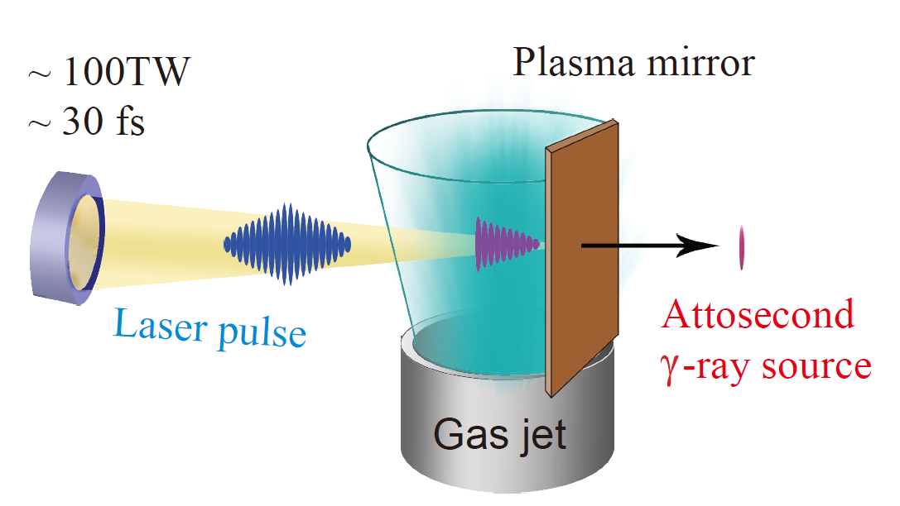
How to control the collision point ？
Change gas jet size and gas pressure to control the injection and collision point.

Slide 19

The PIC code epoch
T. D. Arber, et al., 2015

Slide 20
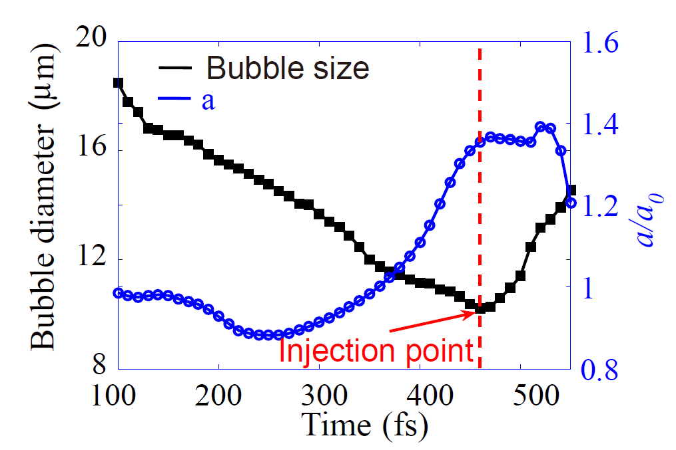
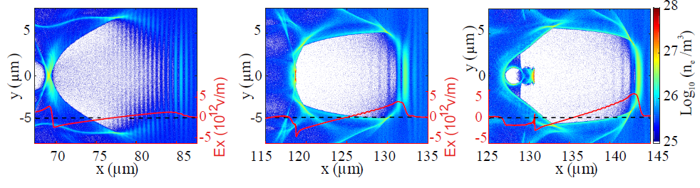
Spot size and a VS. time
Self-balance injection
Jinqing Yu, et al. Submitted 2016

Slide 21
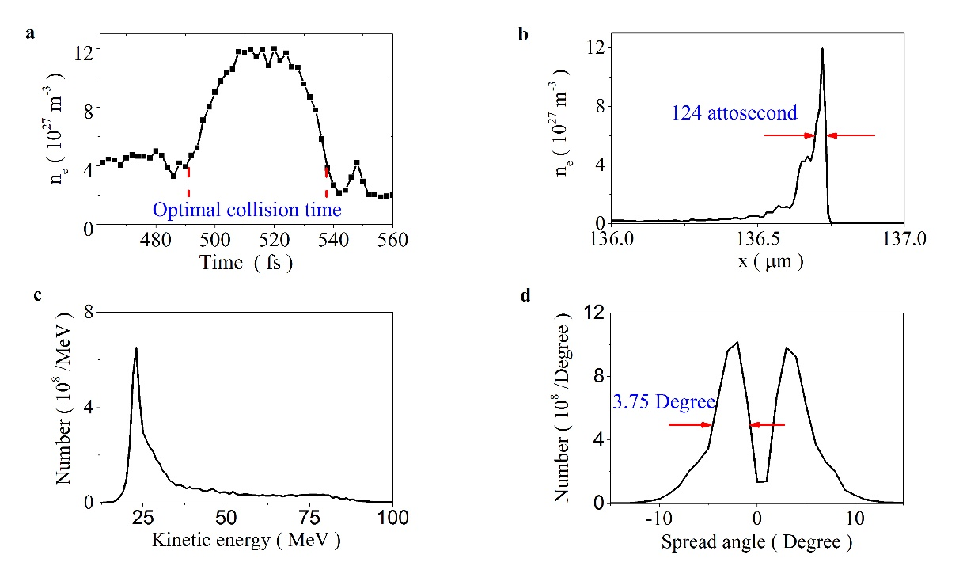
Generation of as electron bunch
Jinqing Yu, et al. Submitted 2016

Slide 22
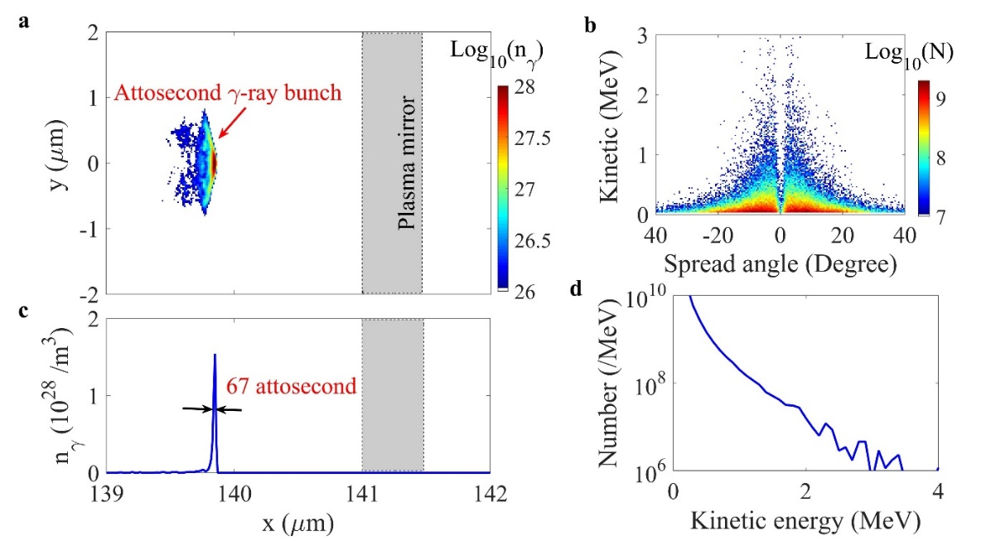
Generation of as photon bunch
Photon number 2.4e10
Jinqing Yu, et al. Submitted 2016

Slide 23
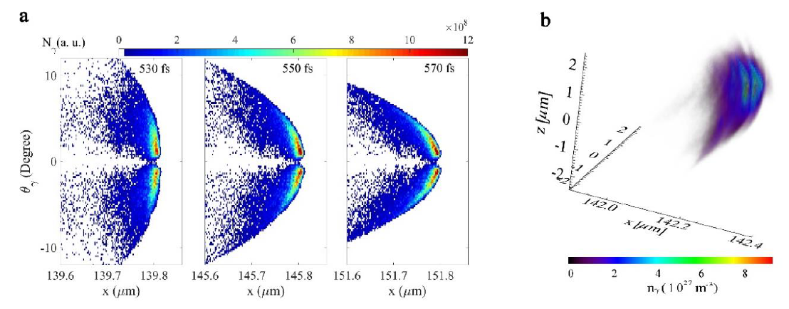
Generation of as gamma(>100KeV) bunch
Gamma location vs. spread angle at different time, Ngamma> 3.6e9
The gamma-ray brilliance is > 1.0e24 /(sec * mrad² * mm² * 0.1%BW)
Jinqing Yu, et al. Submitted 2016

Slide 24
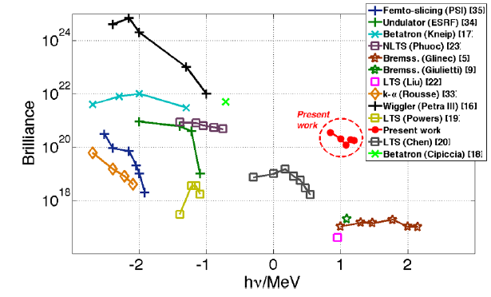
Brilliance
Our work
Sarri
Jinqing Yu, et al. Submitted 2016
G. Sarri, et al. PRL 2014

Slide 25
Conclusion
We propose a method to generated <100 attosecond Gamma-ray pulse driven by ~100 TW laser;
The brilliance of the Gamma-ray is >1.0e24 /(sec * mrad2 * mm2 * 0.1%BW) ;
The brilliance is two orders of magnitude higher than the record result;
Would open the window to study nuclear dynamics.
Jinqing Yu, et al. Submitted 2017

Slide 26
Welcome comments
Notes:
Thanks, Comments please.

