Slide 1
Review of Laser-Plasma Accelerator Scaling in Quasi-Linear and Blowout Regimes
European Advanced Accelerator Concepts Workshop, La Biodola, Isola d’Elba, 24-30 September 2017
D. Gordon, D. Kaganovich, B. Hafizi, M. Helle, Y-H. Chen, A. Ting, R. Hubbard
Plasma Physics Division, Naval Research Laboratory

Slide 2

References on LWFA Scaling
R.F. Hubbard et al., Phys. Rev. E 63, 036502 (2001)
  Scalings for linear channel guided LWFA
S. Gordienko and A. Pukhov, Phys. Plasmas 12, 043109 (2005)
  General scaling law for strong blowout, similarity parameter
W. Lu et al., Phys. Rev. ST/AB 10, 061301 (2007)
  Phenomenological theory for blowout LWFA
C.B. Schroeder et al., Phys. Rev. ST/AB 13, 101301 (2010)
  Quasi-linear scalings relevant to a vision of a LWFA based collider
I.V. Pogorelsky et al., Phys. Rev. ST/AB 19, 091001 (2016)
  Roles for alternative (long) wavelength drivers
Chronological order. Not exhaustive.

Slide 3
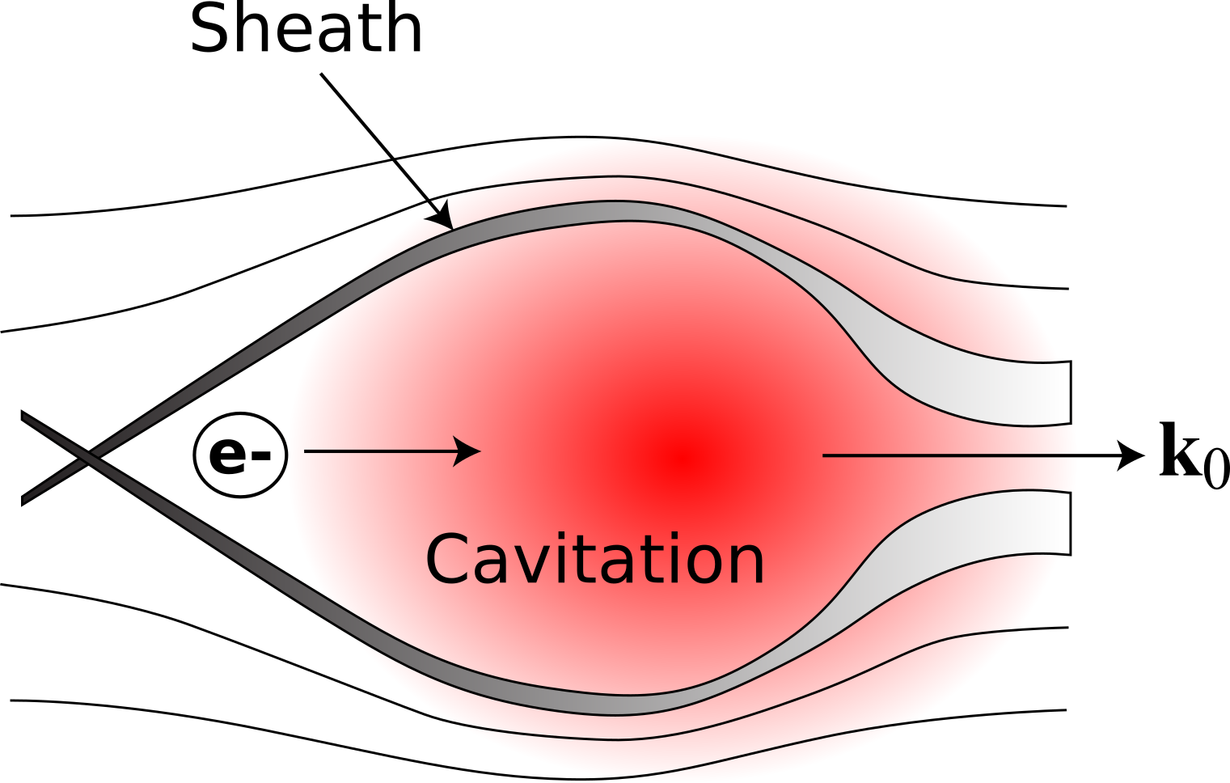


Linear vs. Blowout Regime of LWFA
Quasi-Linear: wakes given by linear theory, no self-trapping, no self-guiding, pump energy barely perturbed in a dephasing length
Blowout: wakes highly nonlinear, electrons self-trapped and self-injected, laser self-guided, efficient pump depletion
+
+
+
Laser Pulse
Accelerated
Electrons
Structure to impose guiding
Self-guided
This talk will not consider self-modulated or multi-pulse schemes

Slide 4
Limiting Processes in Laser Plasma Accelerators
Energy Limitation
  Depletion of laser pulse
  Dephasing in plasma wave
  Diffraction of laser pulse
Charge Limitation
  Beamloading of plasma waves
Emittance Limitation
  Injection mechanism (initial emittance)
  Growth due to Coulomb scattering
Energy Spread Limitation
  Bunch length too long (spatio-temporal phase loading)
  Space Charge (can be beneficial)
There are further issues for collider application
  Spin polarization, positrons, final focus issues

Slide 5
Limiting Processes in Laser Plasma Accelerators
Energy Limitation
  Depletion of laser pulse
  Dephasing in plasma wave
  Diffraction of laser pulse
Charge Limitation
  Beamloading of plasma waves
Emittance Limitation
  Injection mechanism (initial emittance)
  Growth due to Coulomb scattering
Energy Spread Limitation
  Bunch length too long (spatio-temporal phase loading)
  Space Charge (can be beneficial)
There are further issues for collider application
  Spin polarization, positrons, final focus issues
We cannot hope to examine all of this physics, nor the many clever schemes to harness it. We will review only depletion and dephasing.

Slide 6
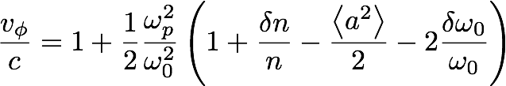


Depletion & Dephasing in the Quasi-linear Regime*
δn and a² terms cancel in front
δn
a²
e-
z - ct
Phase velocity progressively smaller moving toward back of pulse : photon deceleration and red-shifting
Roll downhill, but defocus when δn>0

Slide 7

Pump depletion in blowout regime*
Front etches away due to diffraction and photon deceleration
Back is in cavitation region, so is not strongly perturbed
(Quasistatic susceptibility)
a²
Things can get messy
back here
χ
z - ct
Susceptibility is nearly that of vacuum toward back of pulse
Increasing susceptibility in time red-shifts photons
* Following W. Lu et al. , 2007

Slide 8

Examples of Pump Depletion from PIC Simulations*
1.1
Quasi-Linear (a₀=2)
0.7
1.1
Non-Linear (a₀=3)
Numerical Method:
Quasi-3D OSIRIS
0.7
1.1
Blowout (a₀=4.44)
Pulse is etched backward.
This affects dephasing.
0.7
* A. Davidson, Ph.D. Dissertation (2016)

Slide 9
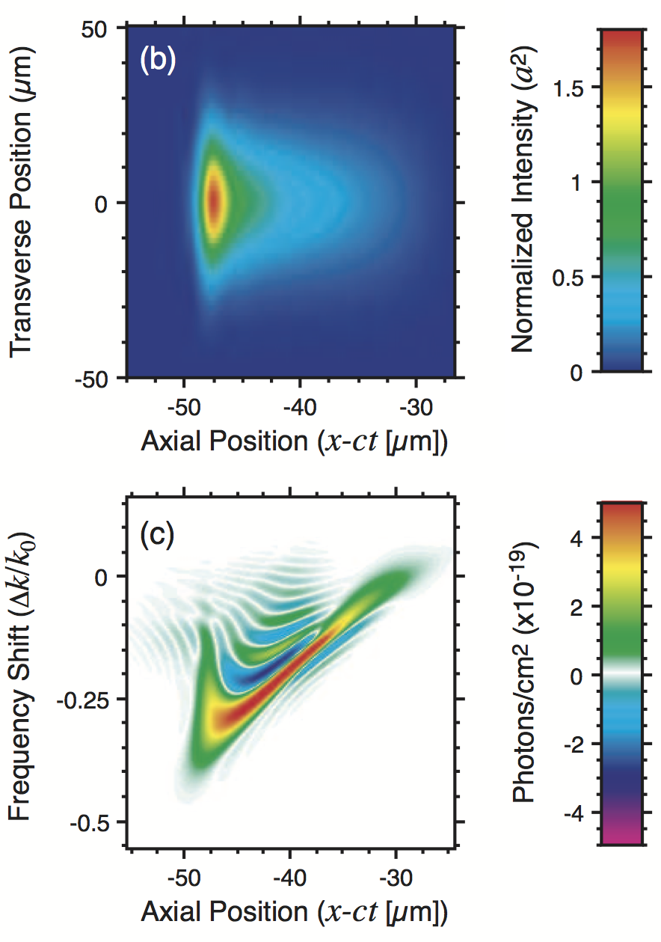
Deep Pump Depletion in Quasi-Linear Regime*
Can only be observed with channel guiding over distance of ~10 cm.
Ponderomotive potential builds in the pulse tail due to photon deceleration and GVD.
This affects dephasing.
Front of the pulse is essentially non-evolving, while middle and rear of pulse are red shifted.
Numerical method:
TurboWAVE PGC Fluid
* D.F. Gordon et al., Phys. Rev. Lett. 90, 215001 (2003)

Slide 10


List of Symbols
We will be displaying many simple equations. Symbols:
R = blowout radius
r₀ = laser spot size
n = electron density
n_{c} = critical density
r_{e} = classical electron radius
ΔE = LPA energy gain
N = electrons in a bunch
= normalized vector potential
= laser pulse length
= laser energy
= beam energy

Slide 11





Phenomenological Blowout Scalings*
Useful for moderate values of a₀ compared with similarity theory
Fundamental relation is the guiding condition:
Much follows from this; yet it is not rigorously derived!
Suppose
>
Pump depletion
Dephasing
Note dephasing length estimate uses spherical bubble picture (a₀>4).
Then,
(good absolute accuracy)
(only for relative comparisons)
* W. Lu et al., Phys. Rev. ST/AB 10, 061301 (2007)

Slide 12


Implications of blowout scalings for efficiency
Appears we want a₀ large, but be careful:
Beam energy
Laser energy
Guiding condition
Controls etching length and self-modulation
Efficiency goes as
(for applications may be worse due to energy in marginal particles)

Slide 13
Current Status of LWFA Electron Bunch Properties
Adapted from Mike Downer, U. Texas, “Overview of LWFA Science”, presented at ANAR 2017
Property | State of Art | Reference Full refs in backups | Remarks
Energy | 2 GeV (±5%, 0.1 nC) 3 GeV (±15%, ~.05 nC) 4 GeV (±5%, 0.006 nC) | Wang (2013) – Texas Kim (2013) – GIST Leemans (2014) - LBNL | Accelerates from E ~ 0
Energy Spread | 1% (0.01 nC, 0.2 GeV) 5-10% | Rechatin (2009a) – LOA More typical (many) | 0.1% desirable for collider/FEL
Normalized Transverse Emittance | ~0.1 π mm-mrad | Geddes (2008) – LBNL Brunetti (2010) –Strathclyde Plateau (2012) - LBNL | Measurements at resolution limit
Bunch Duration | ~few fs | Kaluza (2010) – Jena (Faraday) Lundh (2011) – LOA; Heigoldt (2015) – MPQ/Oxford (OTR) Zhang (2016) - Tsinghua | Measurements at resolution limit
Charge | 0.02 nC @ 0.19 GeV ±5% 0.5 nC @ 0.25 GeV ±14% | Rechatin (2009b) – LOA Couperus (2017) - HZDR | Beam-loading achieved. FOM: Q/ΔE?
Rep-Rate & Repeatability | ~1 Hz @ > 1 GeV 1 kHz @ ~ 1 MeV | Leemans (2014) – LBNL He (2015) - UMich; Salehi (2017) – Umd; Guenot (2017) - LOA | Limited by lasers and gas targets
No one achieves all of these simultaneously

Slide 14
Issues with Experiments in Blowout Regime
If a plasma channel is used, predictions difficult.
  We are missing a theory of blowout wakefields in a channel
Experimental laser pulses are not fundamental Gaussians
Low density gives high energy. Low density gives large matched spot size. Therefore high energy electrons need high laser power.
  Power scaling is weak, ΔE ~ P^{1/3}
Let us examine two famous petawatt experiments:
1. Texas Petawatt 2 GeV Result
2. BELLA 4 GeV Result

Slide 15
Texas Petawatt 2 GeV Experiment
Initial laser parameters: Spot size ~ 275 um, a₀ ~ 0.6, P₀ ~ 0.65 PW
Note that a self guided mode is only expected for a₀ > 2.
Measured laser profile and WAKE simulation* from Wang et al., Nat. Comm. 2013.
Due to spot size mismatch, acceleration does not develop until end of plasma. X-rays confirm.
Let us use a₀~8 based on WAKE simulation. This gives
L_{etch} ~ 9 cm, L_{dephase} ~ 6 cm, and results in:
Comments:
Laser mode is far from fundamental Gaussian.
Mismatch: matched laser parameters are R ~ 40 um, PL ~ 4.5 PW.
Useful region of plasma is shorter than min(L_{etch},L_{dephase})
theory: 5.5 GeV, 2.6 nC
actual: 2 GeV, 0.1 nC
* WAKE is a reduced model. Note that 3D PIC would be exceedingly demanding for this experiment.

Slide 16
BELLA 4 GeV Experiment
Initial laser parameters: Spot size ~ 52 um, a₀ ~ 1.6, P₀ ~ 0.3 PW
No self guiding initially, but there is a channel.
Measured laser profile and INF&RNO simulation from Leemans et al., PRL 2014.
Initial parameters between quasi-linear and blowout, but evolves into blowout wakefield.
Matched spot size for external guiding ~ 70 um
0.4 mm
Let us use a₀~5 based on INF&RNO simulation. This gives
L_{etch} ~ 3 cm, L_{dephase} ~ 5 cm, and results in:
Comments:
Laser mode is more top-hat than Gaussian. PIC uses actual profile and gives 4.3 GeV, .05 nC.
Mismatch: Matched laser parameters are R ~ 30 um, P₀ ~ 1.4 PW.
Plasma source is fairly well matched to min(L_{etch},L_{dephase})
theory: 2.7 GeV, 1.1 nC
actual: 4.2 GeV, 0.006 nC

Slide 17
Issues in simulation of blowout regime
Scale separation : optical vs. plasma
Strong transverse gradients impact cell aspect ratio requirements
Strong nonlinearity and pump depletion stress envelope approximations
Overlap of accelerated beam with laser radiation stresses validity of relativistic ponderomotive force (even for PGC)
Solutions*:
Exploit near axisymmetry and expand in a small number of azimuthal modes.
Transform to a boosted frame.
Exploit underdense and/or quasistatic approximations – but approximations may be dubious.
*A.F. Lifschitz et al., J. Comp. Phys. 228 1803 (2009); V.-L. Vay, Phys. Rev. Lett. 98, 130405 (2007); P. Mora and T.M. Antonsen, Phys. Rev. E 53, 2068 (1996)

Slide 18
Example of Quasi-3D Blowout Simulations*
Azimuthal mode decomposition has been put into OSIRIS.
This enables full scale modeling of many cases of blowout LPA.
Otherwise, a 10 GeV run would consume 20-30 million hours.
Petawatt laser is predicted to reach 10 GeV.
Simulated charge is much greater than anyone gets in experiment.
Analytical scaling reasonably tracks PIC simulation energy.
* A. Davidson, Ph.D. Dissertation (2016)

Slide 19



Quasi-linear regime and channel guiding
Defining Quasi-linearity
  Perturbation expansion in a₀ leads to condition a₀²<<4
  Spot size is such that power is below self-focusing threshold
Without guiding structure weakly nonlinear interaction is limited to
This diffraction length is typically shorter than the dephasing length.
The diffraction limitation is overcome using plasma channels:
Parabolic density guides the fundamental Gaussian laser beam mode

Slide 20


Compact High Energy Single Stage
In an early paper, Hubbard et al. considered a set of performance criteria not tied to applications requiring high charge.
Optimization of single-stage channel guided LWFA
Performance criteria
Acceleration Length, L_{d}
Final Energy, ΔE
Accounting for
Off-resonance effects (pulse duration)
Mode dispersion (spot size correction)
Inputs:
Laser Power, P₀
Laser Wavelength, λ
Resonance Ratio,
Channel Parameters,

Slide 21




Compact High Energy Single Stage Performance
The accelerating gradient is
Semi-empirical factor
Dephasing length:
Spot size correction
Dephasing limited energy gain is:

Slide 22
Performance Results Reproduced from Hubbard et al.
Pulse width affects length more strongly than energy
GeV possible (in principle) with modest laser power

Slide 23

Electron-Positron Collider Considerations
Studied by Schroeder et al. (PRSTAB 2010 & 2012)
  Assuming quasi-linear regime with channel guiding
Two major issues are added
  We need high luminosity
  We need positrons
The overwhelming issue with achieving suitable luminosity is the lack of suitable laser technology. Schroeder et al. 2012 conclude:
Wall Power > 100 MW
Total efficiency ~ 6%
COM energy = 1 TeV
Luminosity = 2x10³⁴ s⁻¹cm⁻²
These conclusions may be strongly affected by details of the configuration of final focus and guiding structure.

Slide 24



Collider Stage Scalings
Quasi-linear regime essentially fixes the following:
Weak to moderate nonlinearity
Resonance condition
Simultaneously suppress blowout and SF
Fixing these leads to scaling for laser energy and bunch charge
Increasing charge means increasing laser energy

Slide 25


Quasi-Linear Energy Gain Scaling
Schroeder et al. consider pump depletion to be the limiting factor.
The following scaling is given for energy per stage:
For fixed density (and therefore scale length) high frequency preferred.
Alternatively, insert quasi-linear fixed parameters into Hubbard et al.:
(there is no inconsistency)
In this view, energy gain and charge are trade-off parameters.
High frequency optimizes energy, low frequency optimizes charge.

Slide 26
Issues with experiments in Quasi-linear regime
Requires external source of ultra-short bunches
Requires long, stable, plasma channel with closely prescribed longitudinal density profile (uniform or tapered)
Lack of diagnostics (what goes on inside channel?)
Main problem: No results yet!

Slide 27
Issues in simulation of quasi-linear regime
Extreme scale separation between length of plasma and laser wavelength
Weak nonlinearity allows laser field to be enveloped
  Ponderomotive guiding center
  Quasi-static treatment
Deep pump depletion stresses enveloped models for laser fields
Reduced geometry
  Axisymmetry may be assumed if envelope model is used for laser fields
  Near-axisymmetry (m=-1,0,1) may be assumed for fully explicit fields
Lorentz boosted frame may reduce computational load at expense of numerical stability issues

Slide 28
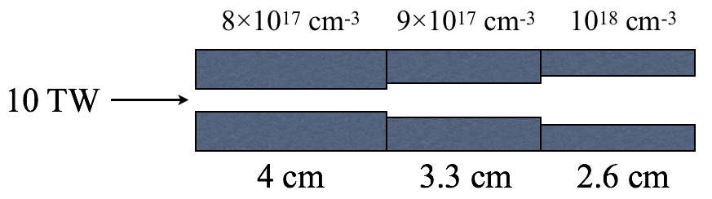
Simulated GeV Acceleration With Modest Laser*
Numerical method: turboWAVE ponderomotive guiding center, axisymmetric
Externally inject electrons into 5th bucket of quasi-linear wake.
Scaling suggests 20 TW is needed to achieve 1 GeV.
The density taper is a way to “beat the scaling.”
* D.F. Gordon et al., Proc. SPIE 8079, 8079OJ (2011)

Slide 29
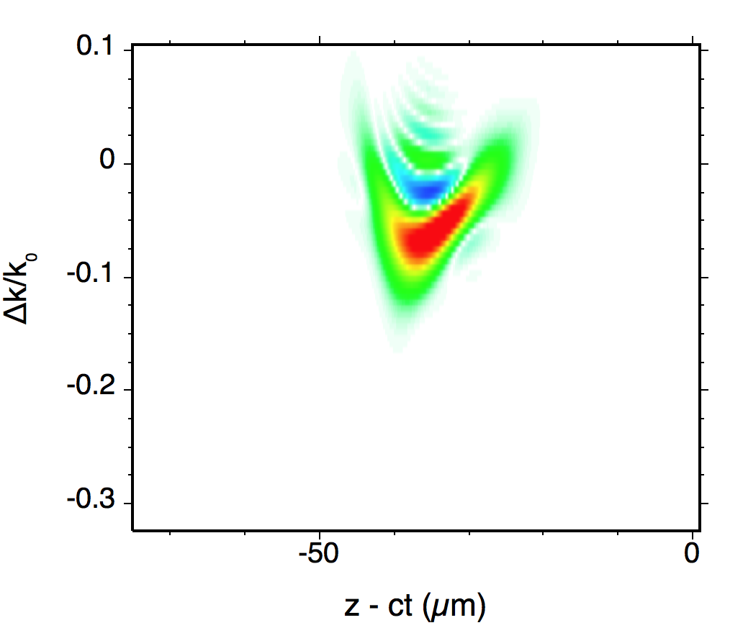
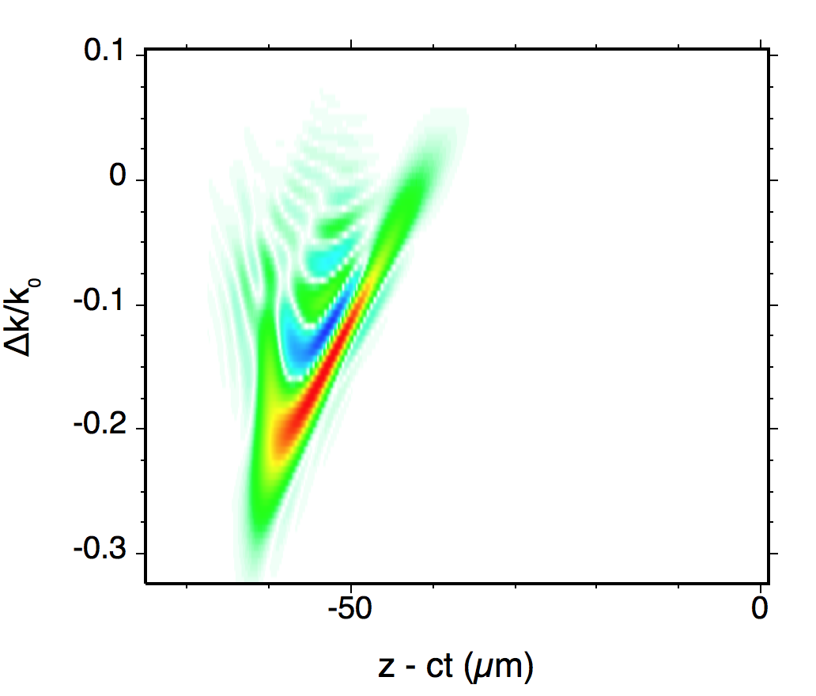
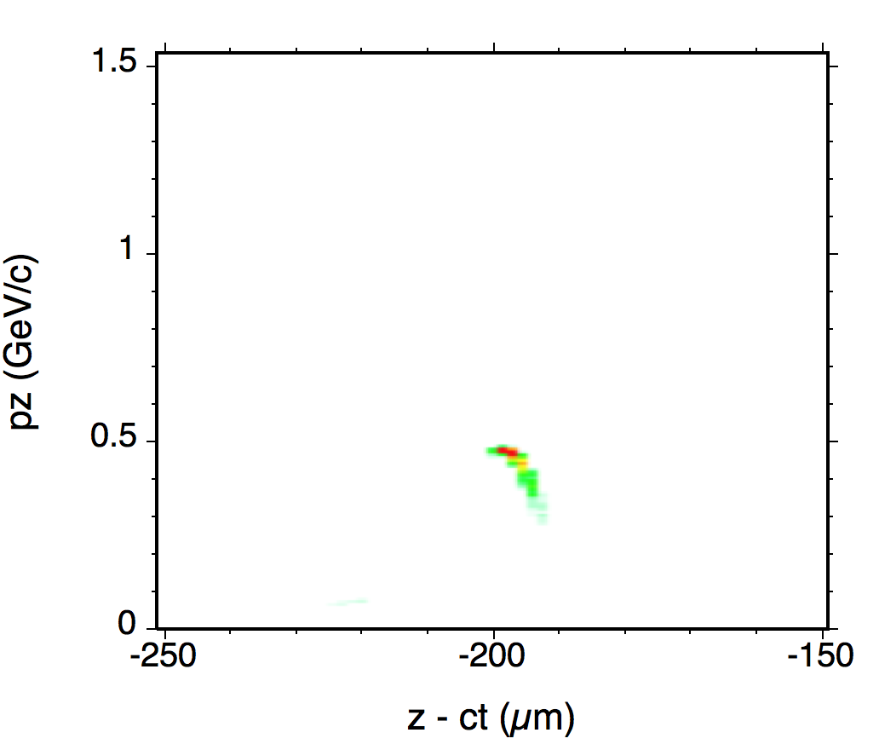
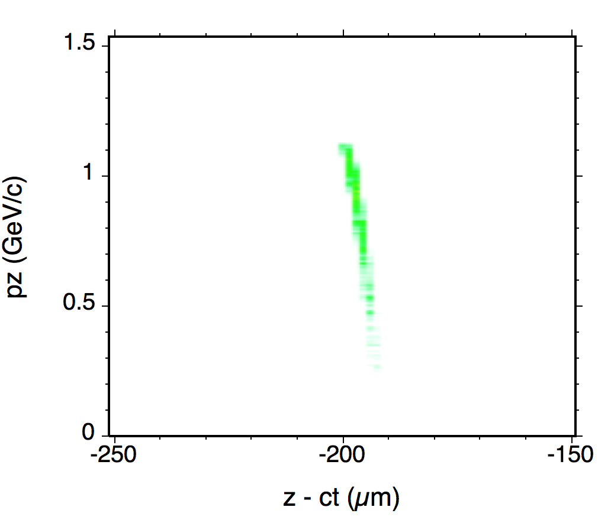
Simulated GeV Acceleration With Modest Laser (2)
Numerical method: turboWAVE ponderomotive guiding center, axisymmetric
First stage
Third stage
Photon
Phase
Space
Electron
Phase
Space
* D.F. Gordon et al., Proc. SPIE 8079, 8079OJ (2011)

Slide 30
Conclusions
Trade-off spaces are challenging for both blowout and quasi-linear laser plasma acceleration schemes
  Incompatibility of high energy, high charge, low emittance, and low energy spread is seen in both scalings and experimental results
Difficult in realistic experiments to achieve ideal parameters for propagation of self-guided fundamental mode
Missing some key scalings
  Blowout wakefields in a plasma channel
  Accurate estimate of charge in high energy peak, esp. with real lasers
Electron-positron collider faces major challenges
  Laser technology
  Beam quality
Many opportunities remain for outstanding contributions.

Slide 31
BACKUP VIEWGRAPHS
D.F. Gordon et al., EAAC 2017

Slide 32






Similarity Theory for Blowout LPA*
Any unbounded collisionless plasma, with given initial conditions, induces a family of systems parametrized by an arbitrary frequency ω. The following are constant for any system in the family:
For an ultra-relativistic laser excited plasma, there is an additional parameter characterizing families of intial conditions:
Where a₀ is the peak normalized vector potential of the driving laser pulse, and ω₀ is the laser frequency. One can show for S<<1:
Unclear if this regime has yet been seen experimentally.
*S. Gordienko and A. Pukhov, Phys. Plasmas 12, 043109 (2005)

Slide 33



Implications of blowout scalings for emittance
External injection (broad sense) appears to be needed for high quality beams

Slide 34
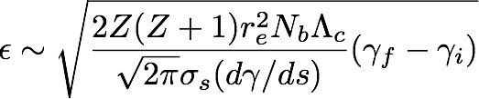
Final Focus Considerations (Emittance)*
In Quasi-linear regime, external injection is required, so that suitably high quality beam may be assumed as an initial condition
Therefore the issue is emittance growth in the LPA stages
Beam density is constrained to n_{b}<n₀
Therefore spot size is constained to some minimum (bad for emittance).
Density is buried in accelerating rate. Puts pressure in direction of high density if a gentle parabolic channel is assumed.
* Following Lebedev&Nagaitsev, PRSTAB 16, 108001 (2013)

Slide 35
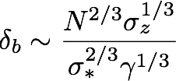
Final Focus Considerations (Beamstrahlung)*
Beamstrahlung energy loss scaling
Demoninator cannot be changed or we lose luminosity and COM energy.
Hence need less bunch charge with proportionately higher rep rate, and/or reduction in bunch length.
Creates pressure in direction of higher plasma density and higher laser frequency.
* Following Schroeder et al., PRSTAB 2012

Slide 36


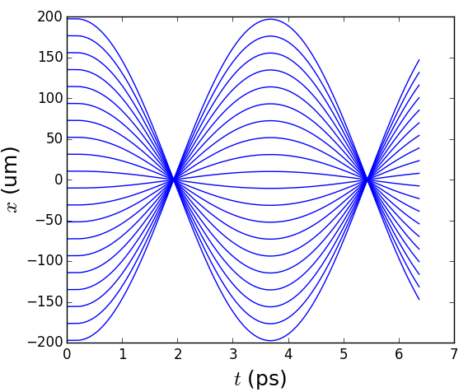
Characteristics of mismatched plasma channel
Eikonal treatment gives ray evolution as
Mismatch leads to perfectly periodic focusing in time (but not in space).
Wave theory required near caustics.
However, paraxial theory spuriously distorts temporal structure.

