Slide 1
Performance of the prototype THz-driven electron gun for the AXSIS project.
Grygorii Vashchenko
R. Assmann, U. Dorda, M. Fakhari, A. Fallahi, K. Galaydych, F. Kaertner, B. Marchetti,
N. Matlis,T. Vinatier, W. Qiao, C. Zhou,
special thanks to A. Fallahi, U. Dorda and whole AXSIS team
The research leading to these results has received funding from the European Research Council under the European Unions Seventh Framework Programme (FP/2007-2013) / ERC Grant Agreement N. 609920.

Slide 2
Contents
Introduction to AXSIS
Horn gun
Experimental results
Understanding of the gun performance in simulations:
  Frequency domain
  Transmission properties
  Acceleration properties
Conclusions and outlook

Slide 3
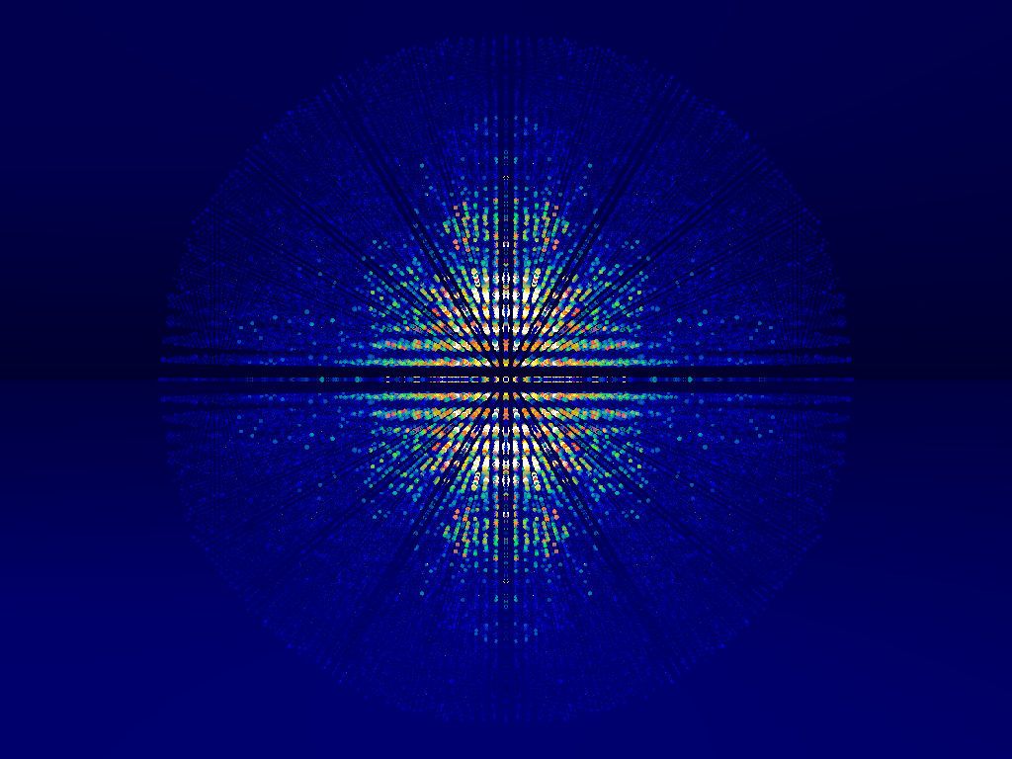
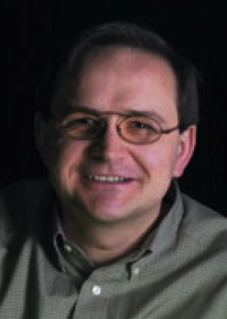


Frontiers in Attosecond X-ray Science:
Imaging and Spectroscopy
AXSIS
Franz Kärtner
University of Hamburg
Ralph Assmann
DESY, Hamburg
Henry Chapman
University of Hamburg
Petra Fromme
Arizona State University
(call to University of Hamburg)
And Associated Scientists from Mid-Sweden University, DESY, and MIT

Slide 4
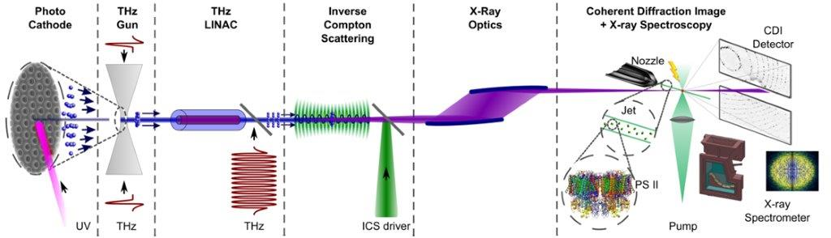
AXSIS = Attosecond X-ray Science: Imaging and Spectroscopy
Photo-cathode, THz driven electron gun
Dielectric loaded, THz driven electron linac
Inverse Compton scattering
Optics
Experiment

Slide 5
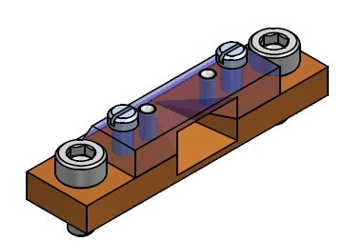
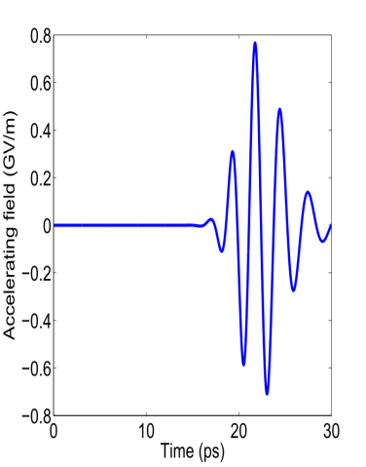
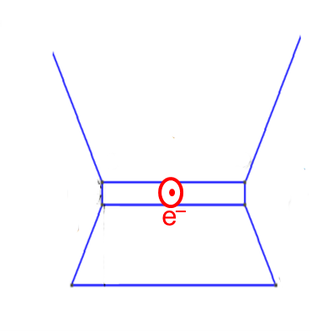
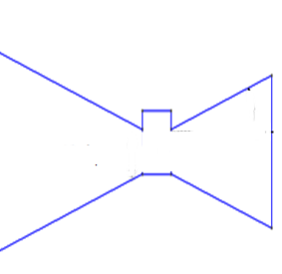
Horn gun: design case
THz pulse:
Gaussian temporal and transverse distributions
Frequency (central): 450 GHz
Peak electric field: 56 MV/m (17 uJ)
Electrons
UV laser
THz pulse
UV laser pulse:
Gaussian temporal and transverse distributions
Wavelength: around 260 nm
Pulse duration: around 40 fs
RMS laser spot size: around 20 µm
zoom
THz
90° rot.
THz
Electron bunch at gun exit:
Energy: up to 25 keV
Charge: up to 80 fC
RMS transverse size: around 10 µm
Emittance: around 15 nm
UV
e–
50 um
Top view
Front view

Slide 6
Horn gun lessons from first prototype
Small dimensions cause tight production tolerances, learning process for perfect production/commissioning is required
No wall at the small horn – misunderstanding between engineers and physicists, at the end gave some profit as movable wall was designed and implemented
Slit length: +400% as compared to design – technically was really hard to manufacture the slit with 50 um height, increase in the height was considered as not harmful, big horn length: +25% as compared to design
Laser energy: -75% of designed – laser design/construction is very challenging, now we have much more laser power
Laser spot size: +100% as compared to design – hard to focus the UV beam into 50 micron wide slit
Frequency: 300 GHz and 390 GHz during first commissioning as compared to 450 GHz in design case – current technologies provide the possibility to operate at 300 GHz at room temperature and 390 GHz at cryogenic temperature of the LiNb crystal.

Slide 7
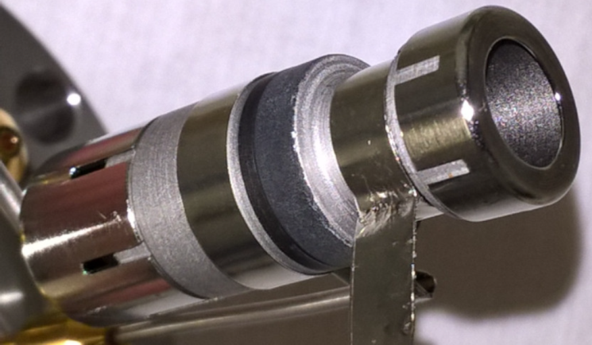
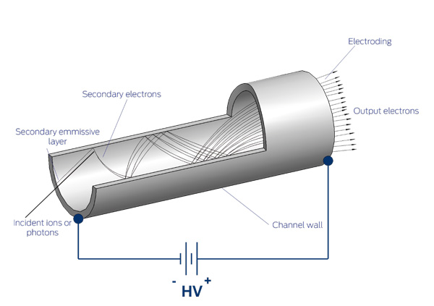
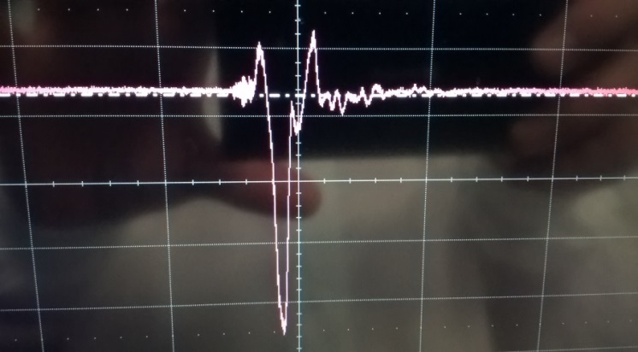
First experimental results: charge detector
Continuous channel electron multiplier, single electron sensitivity
Electron signal is observed:
Voltage, mV scale
Time, ns scale

Slide 8
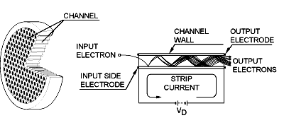
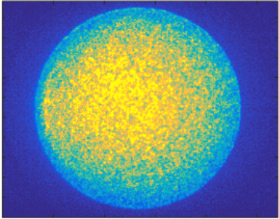
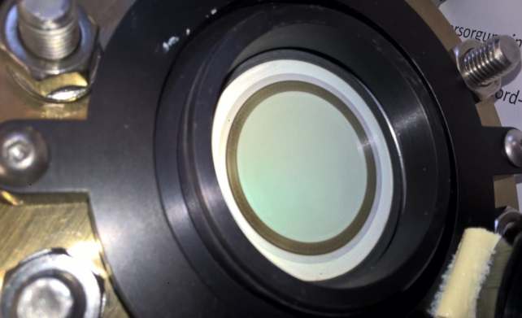
First experimental results: profile detector
Microchannel plate detector
Transverse profile is recorded:
Fast phosphor screen coupled to MCP via fiber optics
Y, a.u.
X, a.u.

Slide 9
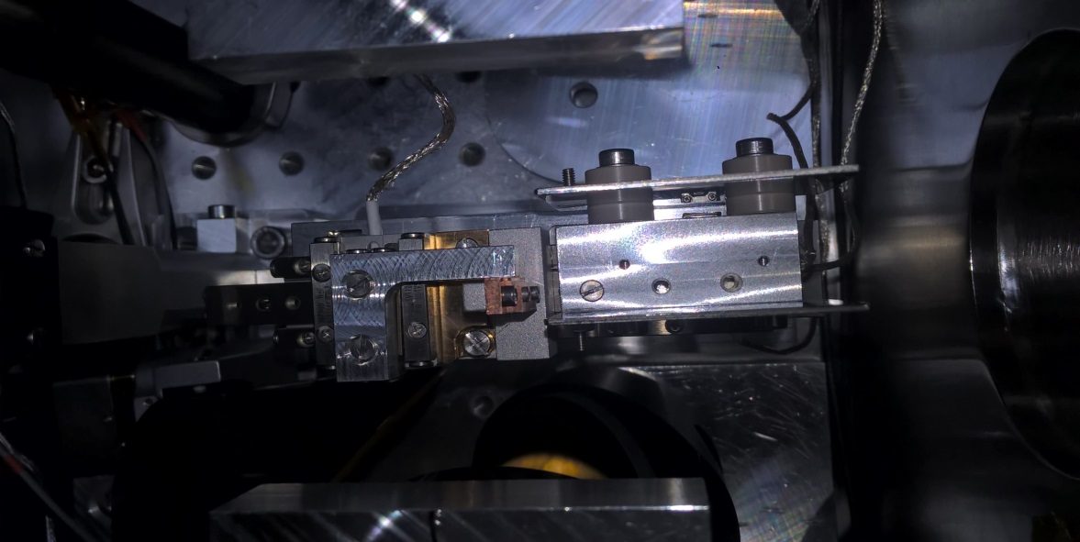
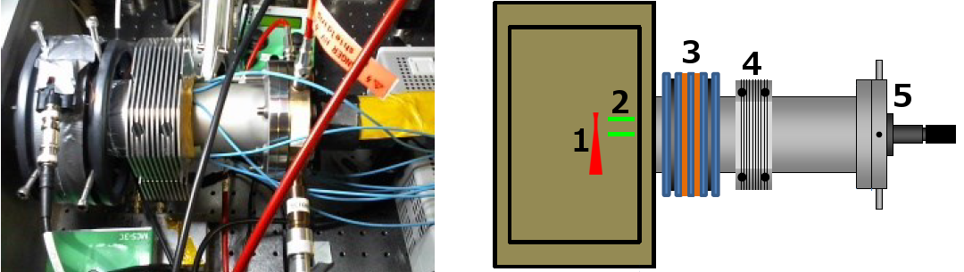
Experimental setup
GUN
Electrostatic plates
Air coil
Steerer
Screen+camera

Slide 10
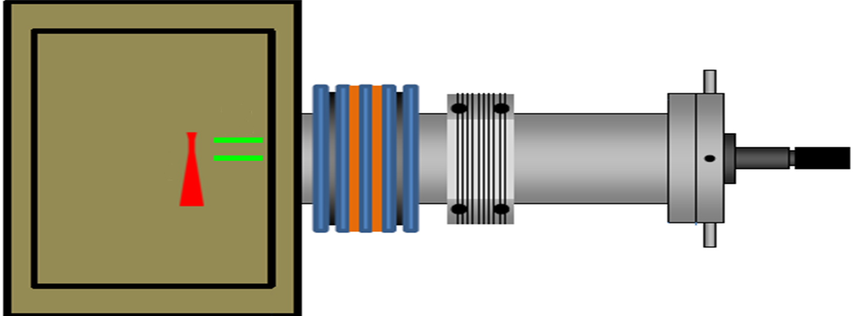
Experimental setup upgrade for energy measurement
~0.4m
Deflector
Screen with camera
Gun
Air coil
Steerer
Courtesy of N. Matlis

Slide 11
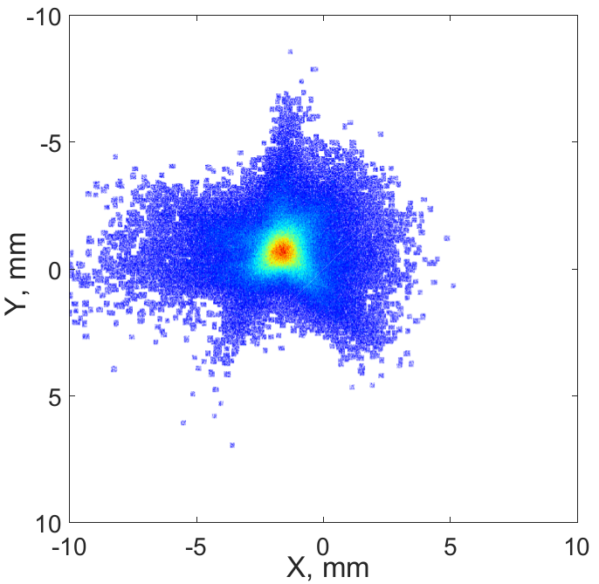
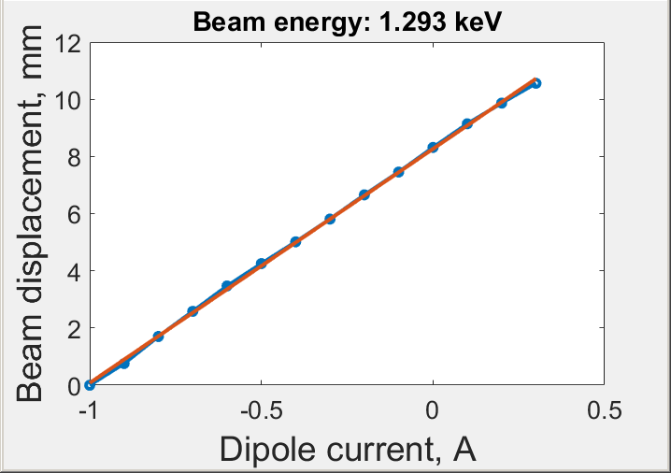
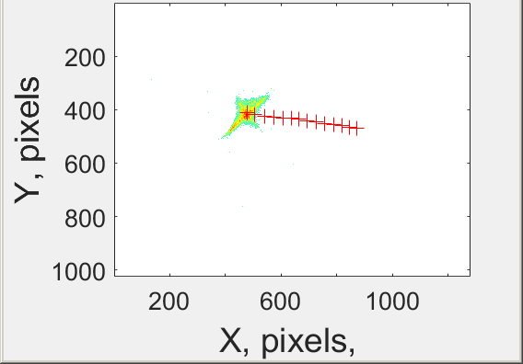
Transverse beam profile and energy measurement
Electron beam focused on the screen
Beam energy measurement

Slide 12
Understanding of the gun performance in simulations
Frequency domain
Transmission properties
Acceleration properties
LEIST code developed by A. Fallahi: three-dimensional hybrid technique based
on discontinuous Galerkin time domain and particle in cell methods
THz Parameter | Value
Frequency, GHz | 390
Rms beam size at waist, mm | 2
Rms beam length, ps | 2.5
Energy, µJ | 5
UV laser Parameter | Value
Wavelength, nm | 250
Rms beam size at waist, um | 10
Rms beam length, fs | 200
Energy, nJ | 75

Slide 13
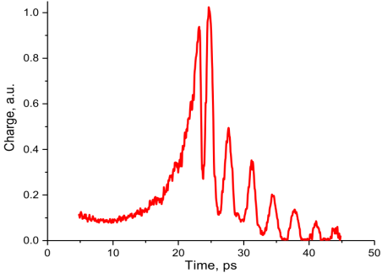
Simulation: results for parameters close to the experimental ones
Experiment

Slide 14
Simulation: results for parameters close to the experimental ones

Slide 15
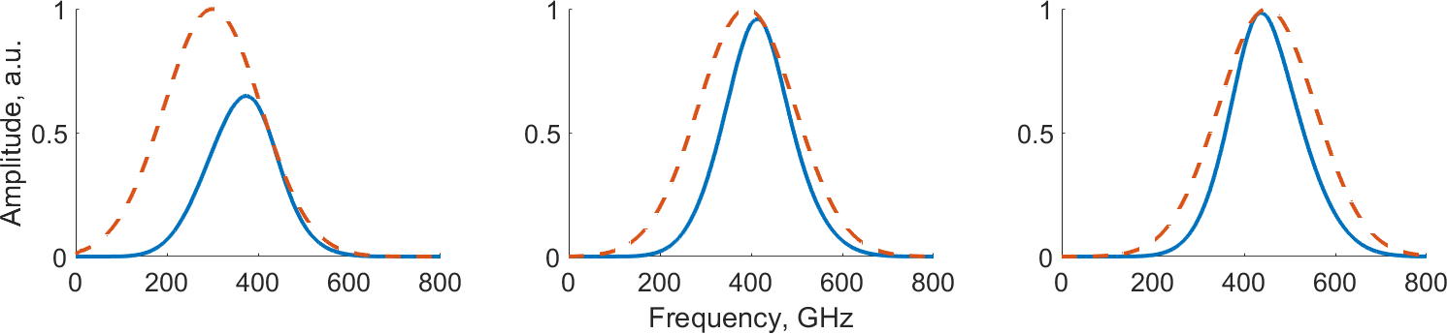
Simulation: Frequency domain
Longitudinal (accelerating) component of the electric field
300 GHz
390 GHz
450 GHz
Blue – pulse at the cathode
Orange – initial pulse
300 GHz – major losses as pulse is partially below the cut-off frequency
390 GHz – much better, some signal loss is observed for higher frequencies
450 GHz – almost ideal, still some losses at high and low frequencies. Low frequencies - cut- off frequency losses. High frequencies – field leakage to the slit.

Slide 16
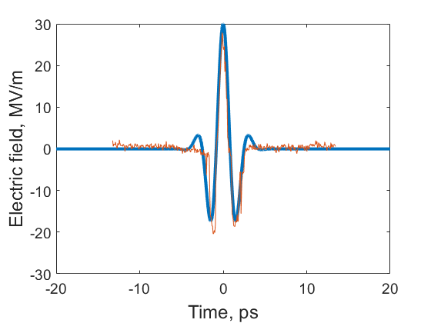
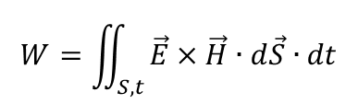
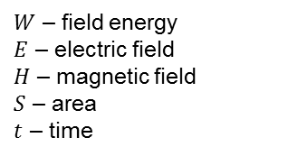
Simulation: Transmission properties
Experimentally measured (red) and analytically calculated (blue) field for σ_{t}= 2.5 ps
THz
e⁻
incoming
THz
reflected
THz
THz
(unwanted)
Parameter | Experiment |  | Design
Frequency, GHz | 300 | 390 | 450
Rms beam size at waist, mm | 2 |  | 1
Rms beam length, ps | 2.5 |  | 2.5
THz energy, µJ | 5 |  | 17
$$W=\iint_{S,t}{\vec{E}×\vec{H}∙d\vec{S}∙dt}$$
$W$ – field energy
$E$ – electric field
$H$ – magnetic field
$S$ – area
$t$ – time

Slide 17
Simulation: Transmission properties, 300 GHz
Energy leakage into slit
Attenuation in accelerating channel
0.09 uJ
Energy transmitted through the plane
4.5 uJ
0.5 uJ
7.7 %
97.4%
43.8%
24.9%
0.5 uJ
1.1 uJ

Slide 18
Simulation: Transmission properties, 450 GHz
Higher energy leakage into slit
Almost no attenuation in accelerating channel
0.52 uJ
Energy transmitted through the plane
4.8 uJ
1.1 uJ
29.4 %
98.9%
64.7%
35.1%
1.1 uJ
1.7 uJ

Slide 19
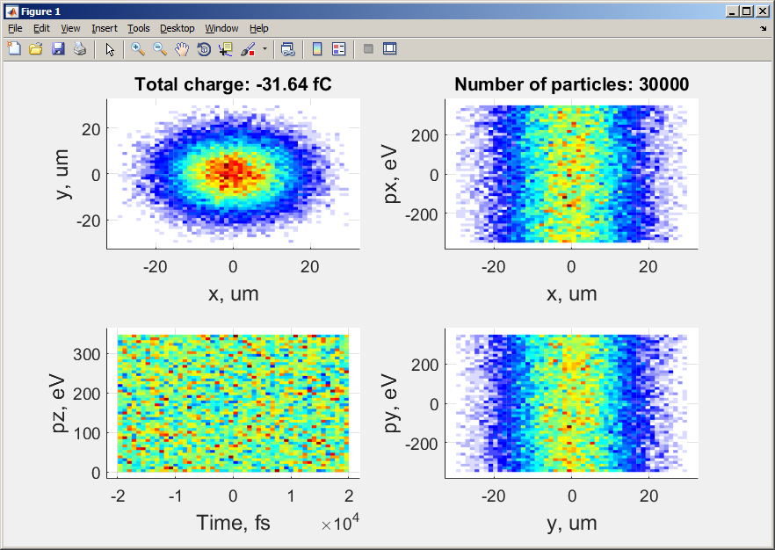
Simulation: Acceleration properties, single particle
Sequence of particles uniformly distributed over time
No space-charge – single particle dynamics

Slide 20
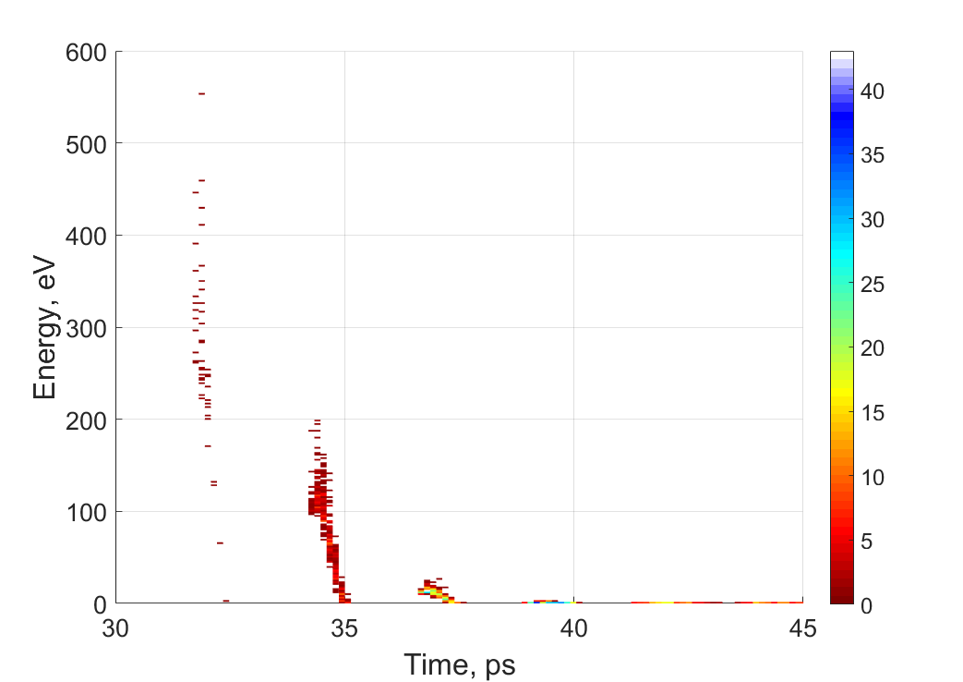
Simulation: Acceleration properties
Particle energy dependence on the time of injection for certain gradient:
No space-charge – looking which maximum energy single particle can gain
Determine proper time of UV pulse injection
Amount of particles

Slide 21
Simulation: Acceleration properties, 300 GHz
No difference in energy gain for low THz energies with and w/o copper plate for THz reflection
Jump around 10 uJ of THz energy
Dependence on the particle statistics
Very low energy gain for THz energies below ~10 uJ

Slide 22
Simulation: New gun design
e–
THz
THz

Slide 23
Acceleration properties, 390 GHz
No difference in energy gain for low THz energies with and w/o reflector
Efficient acceleration threshold lower than for 300 GHz, difference in energy gain with and w/o “magic mirror” increases for high THz energies
Simulation at THz energy corresponding to the experimental one shows about the same electron energy as measured.

Slide 24
Acceleration properties, 450 GHz
Efficient acceleration threshold lowers further, difference in energy gain with and w/o reflector increases stronger

Slide 25
Conclusions and outlook
THz gun was successfully put into operation and characterized
Various diagnostic devices were developed and put into operation
Electrons were accelerated up to 1.6 keV kinetic energy (limited by available THz power)
Detailed simulations of the gun were performed and are in good agreement with experiment
Experimentally observed gun performance is well understood in simulations
Next gun will accelerate electrons up to about 40 keV according to simulations, first run is planned for Nov 2017

Slide 26
Simulation: Transmission properties, 300 GHz
Energy leakage into slit
Attenuation in acc. channel
0.09 uJ
4.54 uJ
0.48 uJ
0.5 uJ
1.13 uJ
Energy transmitted from plane to plane:
24.9%
+
10.8%
+
+
10.6%
43.8%
+
1.9%
7.7%
+
42.7%
97.4%

Slide 27
Simulation: Transmission properties, 300 GHz
Energy leakage into slit
Attenuation in acc. channel
0.09 uJ
4.54 uJ
0.48 uJ
0.5 uJ
1.13 uJ
Energy transmitted from plane to plane:
24.9%
+
10.8%
+
+
10.6%
43.8%
+
1.9%
7.7%
+
42.7%
97.4%

Slide 28
Simulation: Transmission properties, 450 GHz
Higher energy leakage into slit
Almost no attenuation in accelerating channel
0.52 uJ
4.8 uJ
1.1 uJ
1.1 uJ
1.7 uJ
35.1%
+
22.47%
+
+
22.46%
64.7%
+
10.68%
29.4 %
+
64.17%
98.9%

