Slide 1
Session 5: Instability Modeling, Observations and Cures
Chairman: Mikhail Zobov, Scientific Secretary: Eleonora Belli
Session 5.1
Mitigation of collective effects by optics optimization (H. Bartosik, CERN)
Simulation of longitudinal intensity effects with control loops (BLonD) (H.Timko, CERN)
Observation and active damping of longitudinal coupled bunch instabilities (H.Damerau, CERN)
Challenges in impedance and instabilities computation for new generation light sources (S.Persichelli, LBNL)
Session 5.2
Vlasov solvers and macroparticle simulations (N.Mounet, EPFL)
Codes benchmarking for single-bunch instabilities in electron storage rings (H.Xu, IHEP)
Transverse feedback systems for multibunch beam diagnostics and instabilities supression (A.Drago, LNF INFN)
Wide-band feedback systems to diagnose and suppress intra-bunch motion in accelerators (J.Fox, SLAC)
Session 5.3
Damping of transverse instabilities (V.Kornilov, GSI)
Concept and simulations of unconventional damping devices: wideband damper and RFQ (K.Li, CERN)
A study of longitudinal effects on transverse Landau damping (I.Hofmann, GSI)
Beam Transfer Function (BTF) measurements and transvrse stability in presence of beam-beam (C.Tambasco, EPHL)

Slide 2
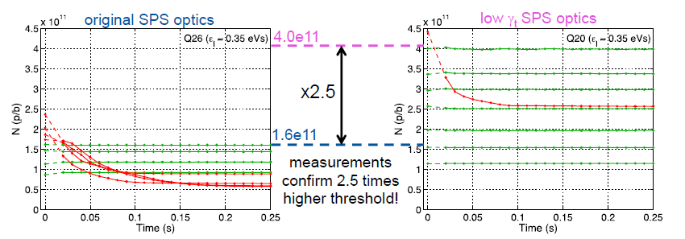
H.Bartosik – Mitigation of Collective Effects by Optics Optimization

Slide 3
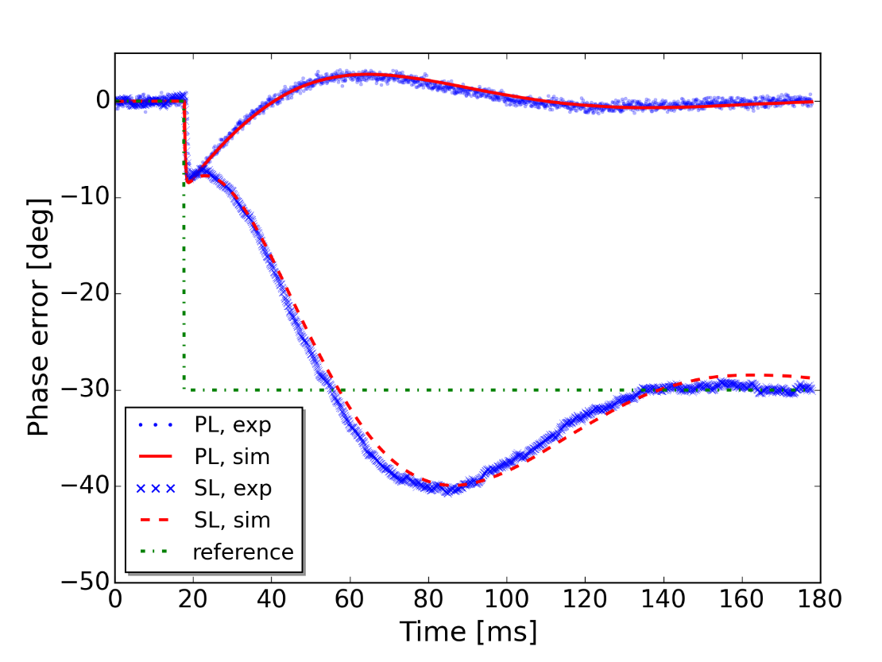
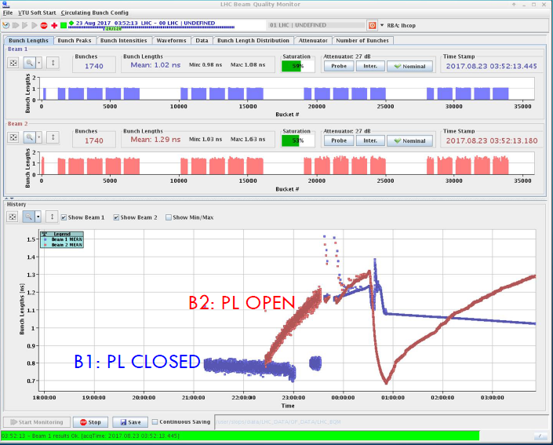
LHC Operational Experience
BLonD Code Benchmarking
Accurate calculations require modelling intensity effects with beam- and cavity-based feedbacks
The BLonD code has precise models of the CERN machines
Benchmarks and optimizations are required to obtain reliable and fast simulations
H.Timko – Simulation of Longitudinal Intensity Effects with Control Loops

Slide 4
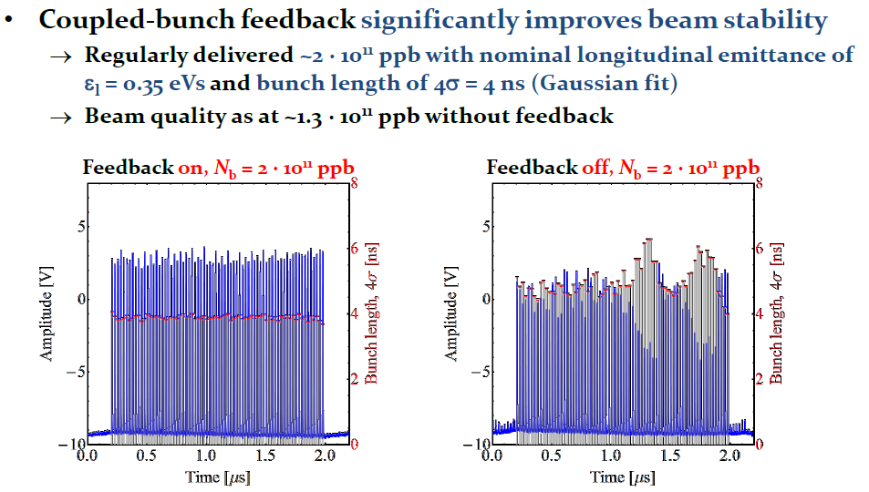
H.Damerau – Observation and (active) damping of longitudinal coupled bunch instabilities

Slide 5
H.Damerau – Observation and (active) damping of longitudinal coupled bunch instabilities

Slide 6
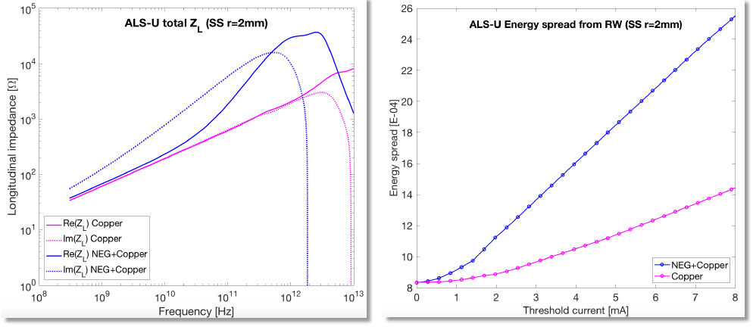
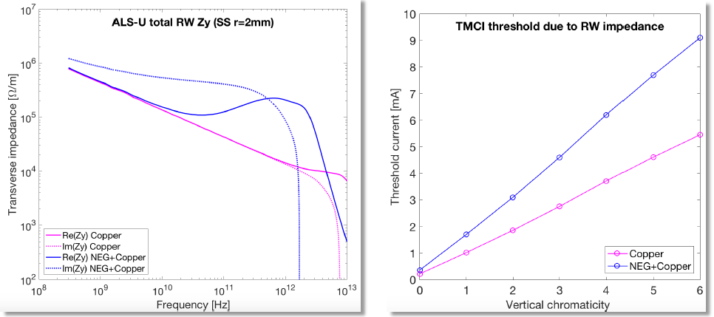
Ultra-low tramsverse emittance (50 pm)
High multibunch current (500 mA)
Short bunch length
Very narrow vacuum chambers
High Coupling Impedance
IBS requires harmonic cavity
Fast ions?
Quadrupolar tune shifts?
RW+NEG Longitudinal
RW+NEG Transverse
S.Persichelli – Challenges in impedance and instabilities computations ..(ALS-U example)

Slide 7
N.Mounet – Vlasov Solvers and Particle Simulations

Slide 8
N.Mounet – Vlasov Solvers and Particle Simulations

Slide 9
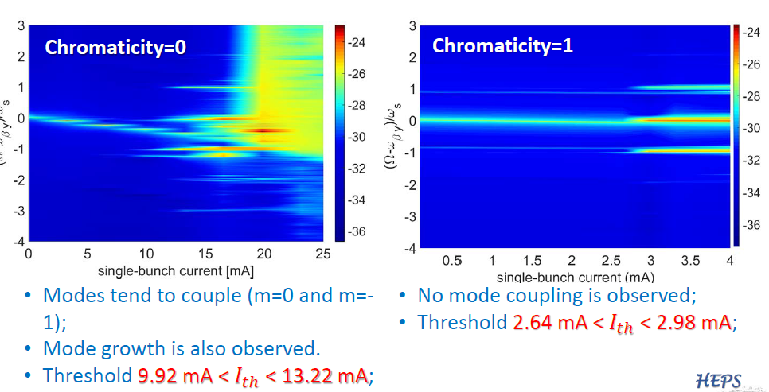
H.Xu – Code benchmarking and simulation studies of single-bunch instabilities in electron storage rings

Slide 10
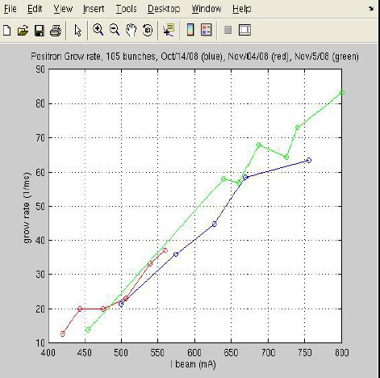
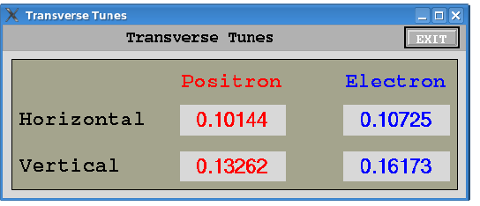
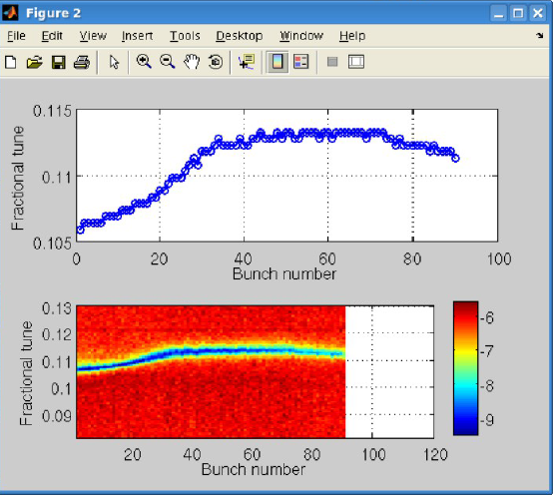
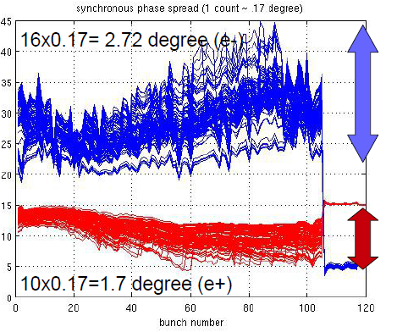
Instability growth rate
Real time tune measurements
Synchronous phase along train
Transverse tunes bunch-by-bunch
A.Drago – Transverse feedbacks for multibunch beam diagnostics and instabilities suppression

Slide 11
J.D.Fox – Wide-band Feedback Systems to Diagnose and Suppress Intra-bunch Motion in Accelerators

Slide 12
J.D.Fox – Wide-band Feedback Systems to Diagnose and Suppress Intra-bunch Motion in Accelerators

Slide 14
K.Li – Concept and Simulations of Unconventional Damping Devices: Wideband damper and RFQ

Slide 15
K.Li – Concept and Simulations of Unconventional Damping Devices: Wideband damper and RFQ

Slide 16
I.Hofmann – Longitudinal effects in Landau damping due to space charge nonlinearity

Slide 17
I.Hofmann – Longitudinal effects in Landau damping due to space charge nonlinearity

Slide 18
C.Tambasco – Beam transfer function measurements and transverse stability in presence of beam-beam

Slide 19
C.Tambasco – Beam transfer function measurements and transverse stability in presence of beam-beam

