Slide 1
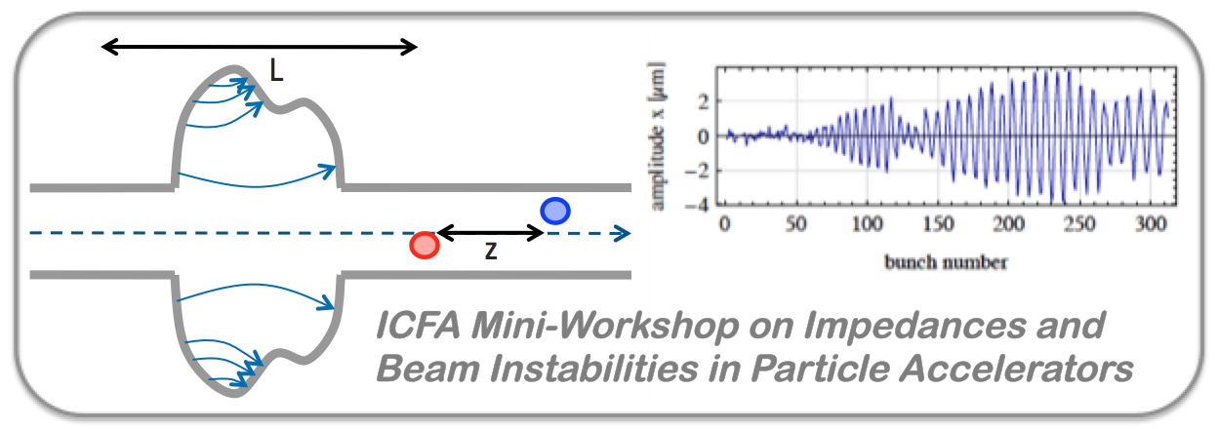
Closing remarks
G. Rumolo (CERN),
M.R. Masullo (INFN Napoli), S. Petracca (Università del Sannio)
ICFA Mini-Workshop on Impedances and Beam Instabilities in Particle Accelerators
http://prewww.unisannio.it/workshopwakefields2017/
https://agenda.infn.it/conferenceDisplay.py?confId=12603

Slide 2
The workshop
Main goal → Review relevant material in the field of impedances and beam instabilities while possibly addressing recent advancements and breakthroughs
Provide enough background to make it possible for everyone to follow
Highlight also what is new and challenging
Some important aspects
Keep an educational perspective (more than a half of the participants are young accelerator physicists at the beginning of their careers)
Bring in new material for discussion (but also old …)
Get people in contact, exchange information, foster collaborations
Very challenging for the speakers, especially due to the strict time constraints, but worth pursuing!

Slide 3
The program
 | Morning | Afternoon
Tuesday 19 September | Introductory talks Chair: Giovanni Rumolo | Impedance theory and modeling Chair: Ursula Van Rienen
Wednesday 20 September | Impedance modeling, measurements and control Chair: Iaia Masullo
Thursday 21 September | Instability theory and modeling Chair: Ingo Hofmann | Instability modeling, observations and cures Chair: Mikhail Zobov Poster session
Friday 22 September | Overview on machines Chair: Chris Prior | Closing remarks Chair: Stefania Petracca
Notes:
Challenging to cover both impedances and instabilities in three days and required a packed program of talks

Slide 4
The social program
 | Morning | Afternoon
Monday 18 September |  | Registration + welcome cocktail with guided visit to the Hortus Conclusus
Tuesday 19 September | Introductory talks | Impedance theory and modeling Historical + award to Vittorio Welcome dinner at Hotel Villa Traiano
Wednesday 20 September | Impedance modeling, measurements and control Light lunch | Excursion to Pompeii Dinner at Il Principe
Thursday 21 September | Instability theory and modeling | Instability modeling, observations and cures Poster session Concert + dinner at Dionisio
Friday 22 September | Overview on machines Farewell lunch at San Vittorino | Closing remarks
Notes:
Challenging to cover both impedances and instabilities in three days and required a packed program of talks

Slide 5
Thanks to …
Thanks to the session chairs and scientific secretaries for leading their sessions and discussions efficiently and professionally – and obviously for the excellent closing speeches, basis for future thought and future work
Thanks to the speakers for contributing with their interesting talks to a smooth execution of the program
‘Demanding’ guidelines were mostly respected
Very high quality of the talks – always educational but also covering advanced concepts, challenges and open questions
Thanks to our younger colleagues who presented their posters with motivation and enthusiasm
Thanks to our supporting staff for diligently carrying out their tasks, promptly responding to all requests and assisting us in every step of the workshop execution – not easy with the dense program of activities every day and all the questions arising …
Thanks to all the participants for the lively discussions

Slide 6
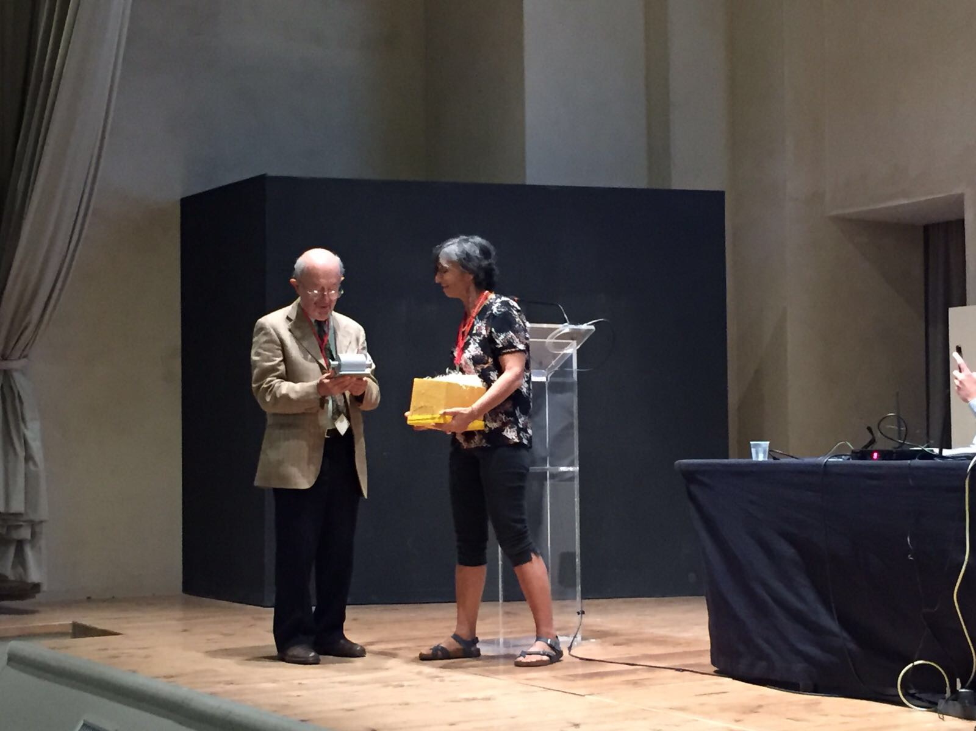
Thanks again to Vittorio
A very nice tale on the historical path leading to
Impedance
Stability charts (by the way, they were introduced in 1969, we can celebrate the 50 years in two years ☺)

Slide 7
Thanks again to Vittorio
A very nice tale on the historical path leading to
Impedance
Stability charts (by the way, they were introduced in 1969, we can celebrate the 50 years in two years ☺)
We are looking forward to many more novel ideas and concepts that you can still feed into our daily work!

Slide 8
Few words on the program and discussions
The subjects of beam coupling impedance and instabilities are 50 years old but always amazingly fashionable
Old concepts need to be adapted and extended to new types of accelerators (e.g. FELs, plasma wakefield accelerators)
New observations in running machines or new regimes to be explored for future machines require original approaches and studies
Modeling and understanding of the phenomena are still making a steady progress
Open questions are still being studied/debated

Slide 9
Impedance theory, modeling, measurements and control
When designing new devices (for old or new accelerators)
Important to use at least two methods (between analytical, numerical, bench measurement) to qualify their beam coupling impedance
Challenges for all methods arise from
More and more complicated devices requiring accurate description
Increasingly demanding performance requirements of accelerators (new and upgraded), which require special attention to the impedance budget
New regimes being explored (e.g. frequencies beyond 100 GHz and small structures
Importance of including impedance considerations in the loop at the stage of the design of an object to its performance specifications has been emphasised more than once (possibly also including all considerations coming from multi-physics simulations)
Importance of beam based measurements to understand and pinpoint the limitations of running machines
Identification of missing impedances
Identification of non-conformities or aging equipment
Identification of main contributors and mitigation techniques

Slide 10
Beam instabilities
Beam instabilities not only driven by beam coupling impedance, but in a variety of situations
Space charge: mainly a friend?
Models seem to suggest so, but some of the machine measurements still need to be understood (e.g. the SPS TMCI thresholds)
Ambiguous actors: Beam-beam, electron cloud, ions – all together (16L2)?
Suppressing instabilities:
Optimise optics at design stage to reduce sensitivity to coherent motion
More (octupoles) or less (RFQ, e-lens) conventional passive damping methods
Feedback systems to damp intra-bunch modes for shortbunches or to be tweaked to damp longitudinal quadrupolar instabilities
Techniques of modeling
Improvements of two-particle models, circulant matrix including different effects
Vlasov solvers
Easily reveal slow growing modes
Usually based on approximations/simplifications that need to be kept in mind
Macroparticle simulations
Relatively simple to implement and extend to include several effects
Need accurate choice of the numerical parameters and convergence studies
Limited by computational times (memory, CPU time), limited observation window
Notes:
Beam coupling calculations wouldn’t make much sense if we didn’t then use them to study component heating and beam instabilities

Slide 11
One last word
We hope that this series of topical workshops devoted to beam coupling impedances and instabilities will be continued
Meanwhile please do not forget the proceedings of this workshop
Please upload your papers on the Indico page by 31 December 2017!
JACoW template (LaTeX preferred)
Yellow Report will be published collecting all the papers submitted by the deadline

Slide 12
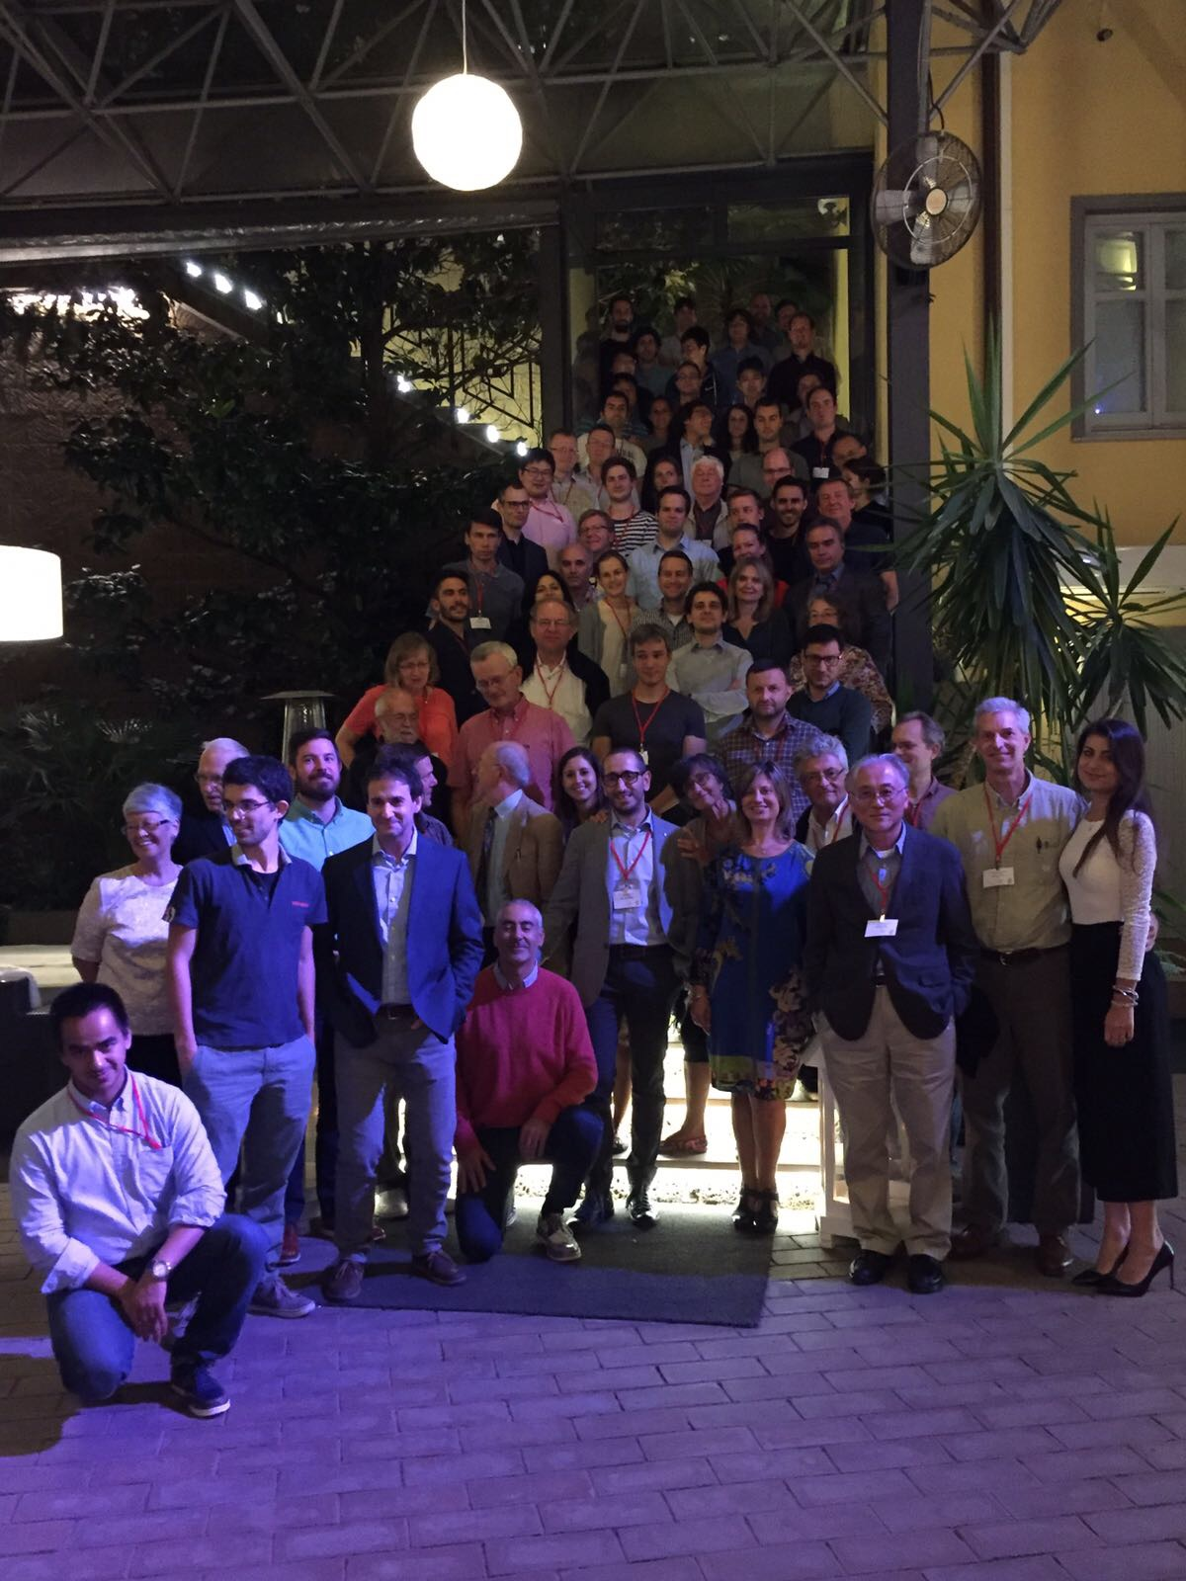
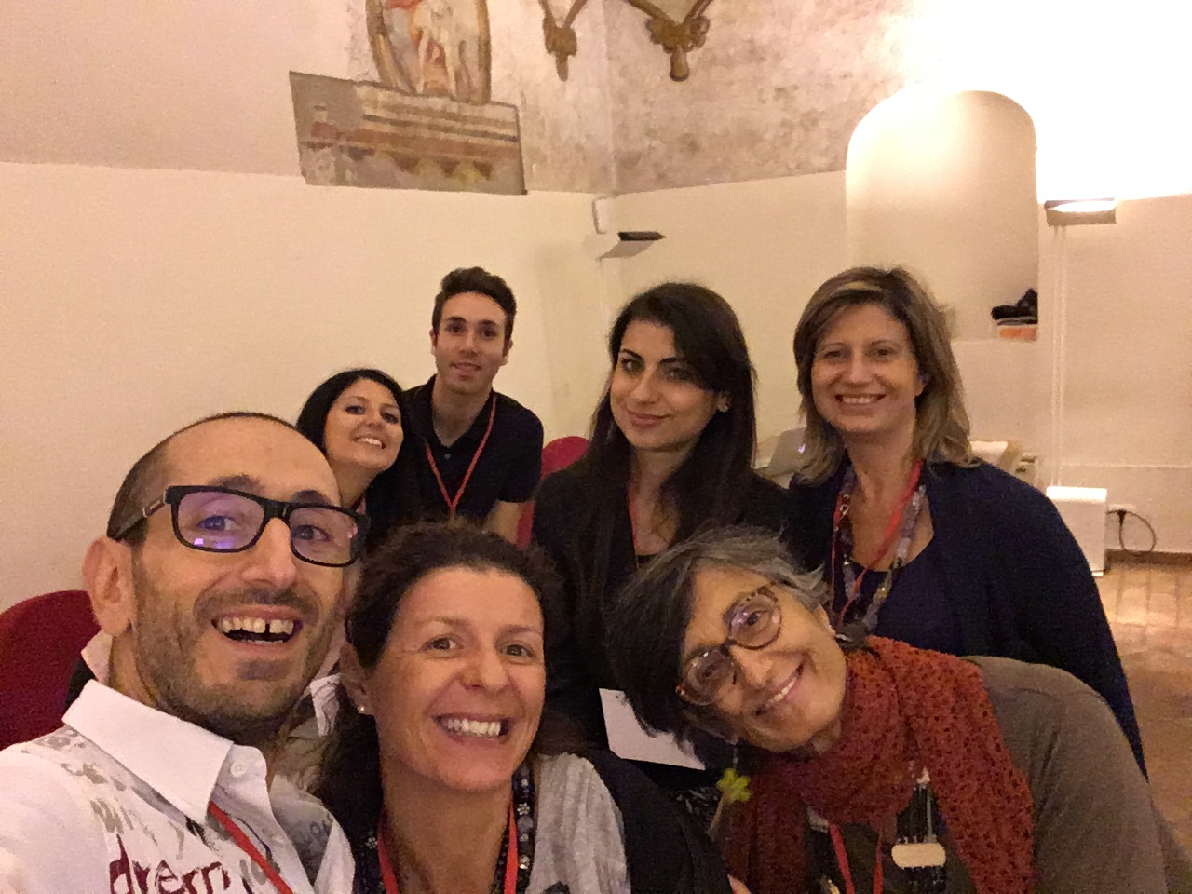
One last word
We hope that this series of topical workshops devoted to beam coupling impedances and instabilities will be continued
Meanwhile do not forget the proceedings
Please upload your papers on the Indico page by 31 December 2017!
JACoW template (LaTeX preferred)
Yellow Report will be published collecting all the papers submitted by the deadline
We hope you have enjoyed this workshop and
see you for the next one in (where, when?)

