Slide 1

The Birth and the Childhood of the Coupling Impedance
and
the Stability Maps
Vittorio G. Vaccaro
UNIVERSITÀ DEGLI STUDI DI NAPOLI FEDERICO II and INFN- SEZ. DI NAPOLI

Slide 2
Outline
Historical Foreword
The birth of the Coupling Impedance
The Universal Maps of Stability
The best production

Slide 3
The first breakthrough: the Phase Stability
At beginning of 40’s Proton accelerators seem to be worn out.
The basic principles of synchrotron design (phase stability) were proposed independently by Veksler in the Soviet Union (1944) and McMillan in the United States (1945). According to this principle, it is possible to accelerate bunches of charged particles of finite dimensions.
Based on this principle, a proton synchrotron was built at BNL, named Cosmotron which reached its full energy in 1953 (3.3 GeV) at BNL.

Slide 4
The second Breakthrough: the Alternating Gradient
Since when Brookhaven's Cosmotron went into operation in the early 1950's, scientists knew that achieving the higher energies was going to be a difficult problem.
The strong focusing principle independently discovered by Christofilos (1949) and Courant (1952) allowed the complete separation of the accelerator into the guiding magnets and focusing magnets. The application of this principle allowed to reduce the transverse dimensions of higher energy beams.

Slide 5
The second Breakthrough: the Alternating Gradient
Without strong focusing, a machine as powerful as the Alternating Gradient Synchrotron (AGS) would have needed apertures (the gaps between the magnet poles) between 0,5 m and 1.5 m instead of apertures of less than 0,1 m.
Strong Focusing -> PS in 1959 (28 GeV) at CERN and AGS in 1960 (33 GeV) at BNL.

Slide 6
The Collider Age Approaches
Even before the successful achievements of PS and AGS, the scientific community was aware of another step needed to improve the energetic efficiency of the accelerator techniques. Indeed, the impact of particles against fixed targets is very inefficient from the point of view of the energy actually available for new experiments: much more efficient could be the head on collisions between high-energy particles.

Slide 7
The Collider Age
With increasing energy, the energy available in the Inertial Frame (IF) with fixed targets is incomparably smaller than in the head-on collision (HC), as Wideroe thought some decades before. If we want the same energy in the IF, using fixed targets one should build gigantic accelerators. In the fixed target case, according to relativistic dynamics, an HC-equivalent beam should have the following energy:
The colliders were very demanding
in terms of intensity and collimation.
Beginning 60‘s: the conceptual design of a large Intersecting proton Storage Ring (ISR) started ay Cern. ISR was supposed to accumulate at 31GeV the largest current ever reached.

Slide 8
Intermezzo in Hamburg 1
Touschek was born and attended school in Vienna. After Anschluss, because of racial reasons, he was not allowed to finish his high school. However, he could continue is studies in a precarious way when he moved to Hamburg. There he met Rolf Wideroe with whom he started cooperating in building a betatron and discussing on Wideroe’s visionary thoughts. Among others Wideroe exposed his ideas about colliding beams. Then Touschek was arrested by the Gestapo in 1945. Wideroe visited him in prison and, during these meetings they continued to talk about accelerators.

Slide 9
Intermezzo in Hamburg 2
Incidentally, in that context Touschek conceived the idea of radiation damping for electrons. When the Allied army reached, Hamburg Wideroe, suspected of collaboration, was arrested. The situation was reversed: now Touschek started to pay visit to Wideroe. Sometime after, he was found not guilty and released. After the war, Touscheck roamed about Europe. Finally, in 1952 he decided to stay in Rome permanently, receiving the position of researcher at the National laboratories of the Istituto Nazionale di Fisica Nucleare in Frascati, near Rome.

Slide 10
Collider Contest: Frascati vs Princeton
At the beginning of 60’s, a contest between Princeton and the Frascati Laboratories started on a feasibility demonstration of beam colliders. Princeton chose a eight-shaped structure: two circular rings in which electrons and positron were circulating with the same orientation, meeting at the collision point. Frascati team was even more audacious: they used a single ring with "counter-rotating" beams of electrons and positrons.
The enterprise began on March 7, 1960.

Slide 11
Collider Contest: Frascati vs Princeton
When Bruno Touschek held a seminar at Frascati Laboratories by which he was proposing to build an electron-positron storage ring, according to Wideroe’s visionary ideas concerning storage rings and colliders. On March 14, a preliminary study demonstrated the feasibility of the proposal. The storage ring was called ADA ( Anello Di Accumulazione = Storage Ring).
The total cost of the project was around 4.000 €.
AdA was brought to operation in February 1961. AdA then moved at LAL-Orsay, Paris, where a more powerful injector; here, on February ‘64 the first electron-positron collisions were detected. The success was enecuraging for boost for the ISR designers.

Slide 12
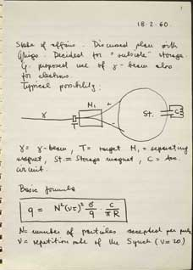
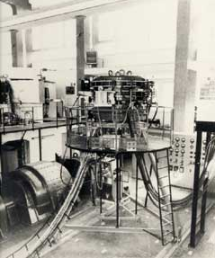
Collider Contest: Frascati vs Princeton
A page from Touschek’s notebook
ADA
Notes:
The project consists in accumulating a beam of electrons and positrons of 250 MeV each, counter-rotating in a magnetic field along almost the same orbit, colliding at four points. The experiment, done in just one year, in which Touschek played a major role, was a huge success: it proved that it was possible the accumulation of the beams in the rings, and the collision between particles. There is no doubt that Ada was the long line progenitor of electron-positron collider -pbuilt in various physics laboratories around the world. Isr p-p. Yhe e most famous descendent of Ada was LEP (Large Electron-Positron Collider) at CERN in Geneva that started in 1989, which worked for 12 years with important scientific results.

Slide 13
The Collider Age: clouds on the horizon
Early ’60s: MURA 50 MeV accumulator (as well as other accelerators) exhibited instabilities consisting in a coherent self bunching and vertical coherent oscillation during particle storing. The phenomenon seemed to be related to the amount of current stored. The accumulated current could not go beyond a certain limit. Above this threshold there was evidence of coherent instabilities, which were interpreted as due to the presence of electrodes.

Slide 14
Somebody leads the way
Sessler et alii tackled this problem resorting to Vlasov equation. They showed that the beam could undergo to modulational instabilities if the finite conductivity of the pipe is taken into account.
The approach to the problem was the usual one adopted for modulational instability, which arise from the coupling between the equation of the particle dynamics and the electromagnetic interaction of a small perturbation superimposed on a coasting particle beam with the surrounding pipe of a circular accelerator.

Slide 15
Beam-equipment e-m interaction and
Dynamics: the Flow Chart (circular accelerators)
BEAM DYNAMICS EQUATIONS
FIRST BRANCH
EM fields
ρ, J
MAXWELL EQUATIONS + BOUNDARY CONDITIONS
EM NOISE and RF
SECOND BRANCH

Slide 16
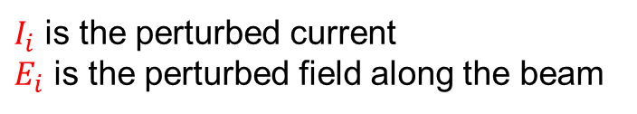
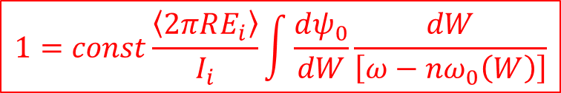
Somebody leads the way
A stabilization mechanism was preconized (Landau Damping) due to the energy spread in the beam.
A criterion of stability was established which seemingly does not depend on the finite conductivity. The authors preconized that it could depend on certain geometrical properties of the accelerator.
These studies, even though the authors cautiously claim to be possibly related to the observed phenomena, represent an epochal breakthrough in coherent instabilities understanding.
$$1=const\frac{\left\langle 2πRE_{i}\right\rangle }{I_{i}}\int{\frac{dψ_{0}}{dW}\frac{dW}{\left[ω−nω_{0}\left(W\right)\right]}}$$
$I_{i}$ is the perturbed current
$E_{i}$ is the perturbed field along the beam

Slide 17
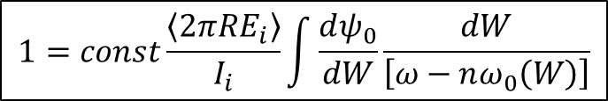
Concern
$$1=const\frac{\left\langle 2πRE_{i}\right\rangle }{I_{i}}\int{\frac{dψ_{0}}{dW}\frac{dW}{\left[ω−nω_{0}\left(W\right)\right]}}$$
This evidence produced in the scientific community the belief that the interaction with the surrounding equipment should not be neglected in the beam dynamics (e.m. field produced by boundary conditions).
On 1966 the design of a large Intersecting proton Storage Ring (ISR, 31GeV) was in a rather advanced stage. This is the equivalent of a 2000 GeV beam hitting a stationary target.
Among other, it was foreseen a large number of clearing electrodes, pick-ups and variety of lumped components. There was very much concern about the stability of the stored beams.

Slide 18

Concern and Call for Help
$$1=const\frac{\left\langle 2πRE_{i}\right\rangle }{I_{i}}\int{\frac{dψ_{0}}{dW}\frac{dW}{\left[ω−nω_{0}\left(W\right)\right]}}$$
Inside the designers community there was very much concern about the successful achievement of the design.
On August 1966, on leave of absence from Berkeley, Andy Sessler (2013 Fermi award) joined CERN for one year.
Pellegrini (2014 Fermi award), Amman (director of Laboratori di Frascati and ADA project), Courant (1986 Fermi award), Krinskii, Dikanski, John Lawson, Auslander were paying visits at CERN for discussions on ISR design.

Slide 19
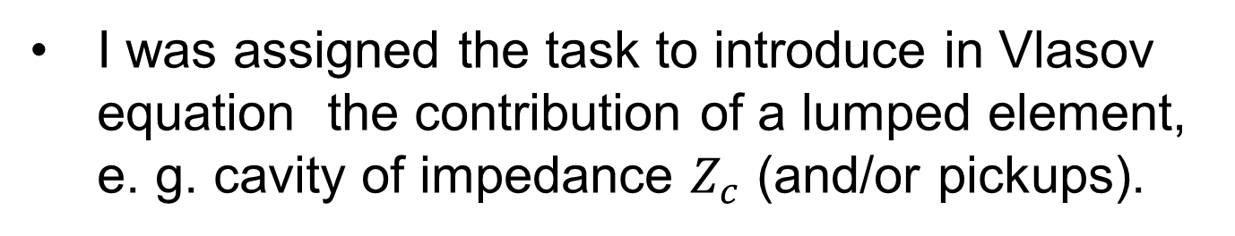
The Fluke of my Life
On June 1966 I was hired from CERN with a three year contract.
On August, when Andy came, I was committed to him. I discovered new horizons.
I was already acquainted with his papers.
An Impedance is in the Air
I was assigned the task to introduce in Vlasov equation the contribution of a lumped element, e. g. cavity of impedance $Z_{c}$ (and/or pickups).

Slide 20

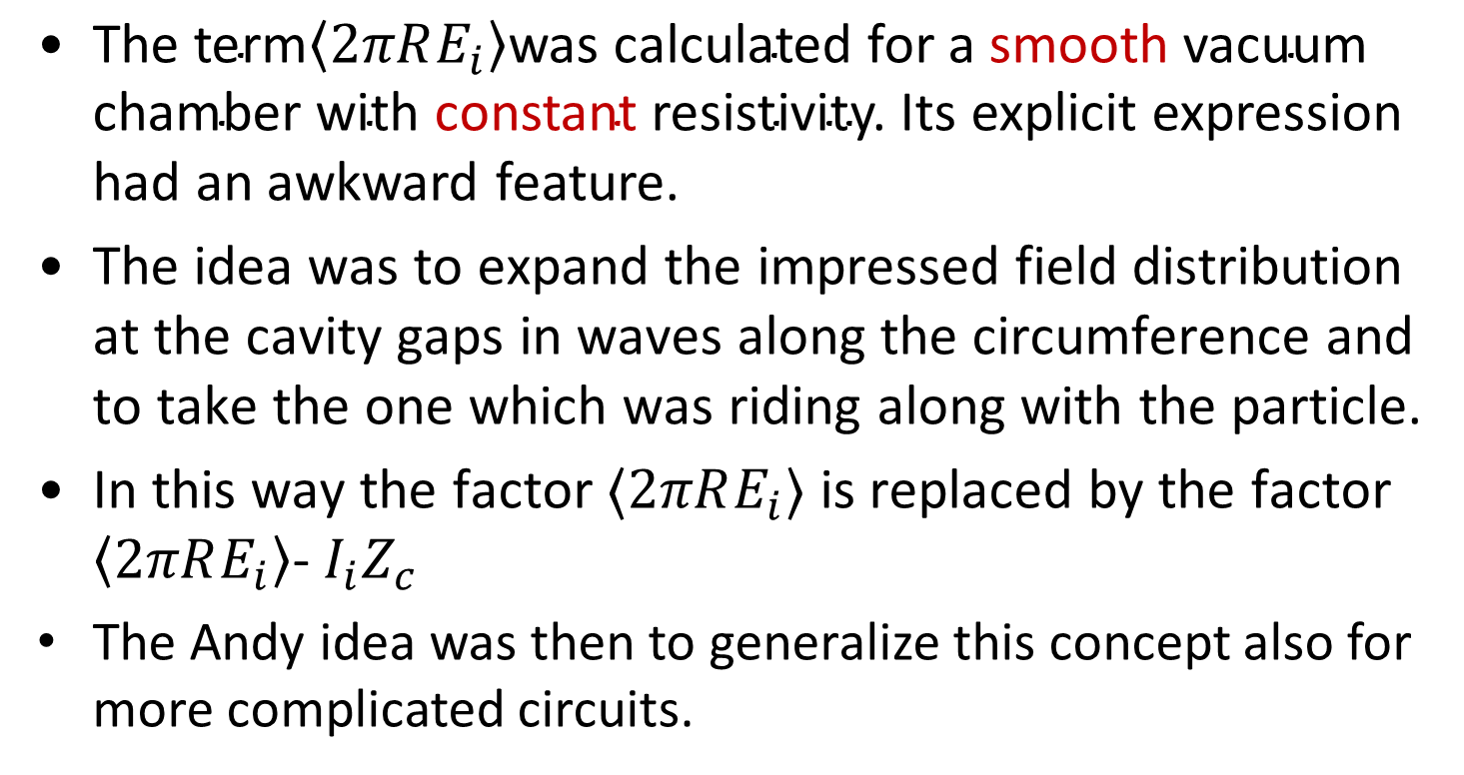
An Impedance is in the Air
The Banality of Invention
$$1=const\frac{\left\langle 2πRE_{i}\right\rangle }{I_{i}}\int{\frac{dψ_{0}}{dW}\frac{dW}{\left[ω−nω_{0}\left(W\right)\right]}}$$
$\text{The} \text{term}\left\langle 2πRE_{i}\right\rangle \text{was} \text{calculated} \text{for} \text{a} \text{smooth} \text{vacuum} \text{chamber} \text{with} \text{constant} \text{resistivity}\text{.}$ Its explicit expression had an awkward feature.
The idea was to expand the impressed field distribution at the cavity gaps in waves along the circumference and to take the one which was riding along with the particle.
In this way the factor ⟨$2πRE_{i}$⟩ is replaced by the factor $\left\langle 2πRE_{i}\right\rangle$- $I_{i}Z_{c}$
The Andy idea was then to generalize this concept also for more complicated circuits.

Slide 21
An Impedance is in the Air
The Banality of Invention
$$1=const\frac{\left\langle 2πRE_{i}\right\rangle }{I_{i}}\int{\frac{dψ_{0}}{dW}\frac{dW}{\left[ω−nω_{0}\left(W\right)\right]}}$$
“It was emphasized that Z described the impedance of the wall elements and was, thus, amenable to computation--or measurement--by means of all the standard techniques employed in electrical engineering. This "engineering technique" was applied to a number of problems - such as helical insert - and allowed complicated structures to be readily analysed, such as pickup electrodes.” Sessler PAC71

Slide 22
An Impedance is in the Air
The Banality of Invention
$$1=const\frac{\left\langle 2πRE_{i}\right\rangle }{I_{i}}\int{\frac{dψ_{0}}{dW}\frac{dW}{\left[ω−nω_{0}\left(W\right)\right]}}$$
Nowadays, I have the impression that the coupling impedance was a concept which was just waiting to be introduced:
I was at the right moment in the right place with the right people.

Slide 23
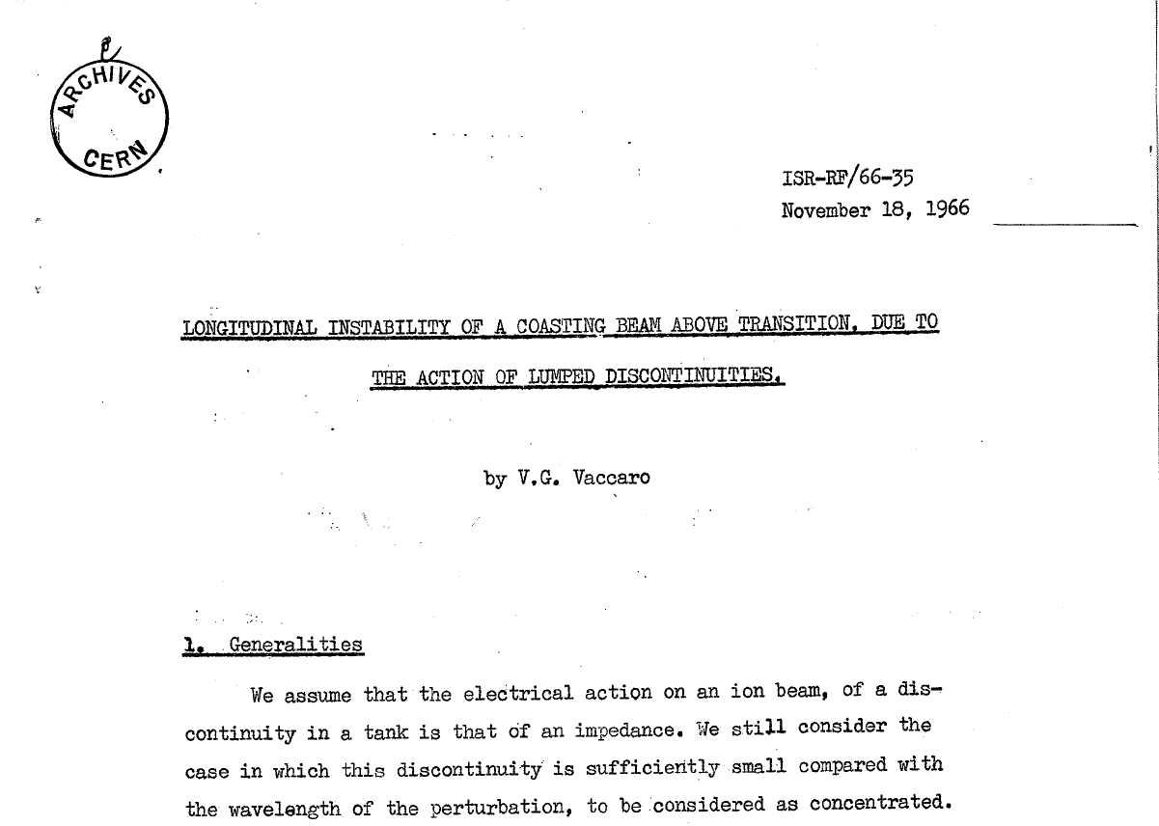

An Impedance is in the Air
The Banality of Invention
$$1=const\frac{\left\langle 2πRE_{i}\right\rangle }{I_{i}}\int{\frac{dψ_{0}}{dW}\frac{dW}{\left[ω−nω_{0}\left(W\right)\right]}}$$
Andy Sessler explicitly said that he did not want his name on the following report.

Slide 24
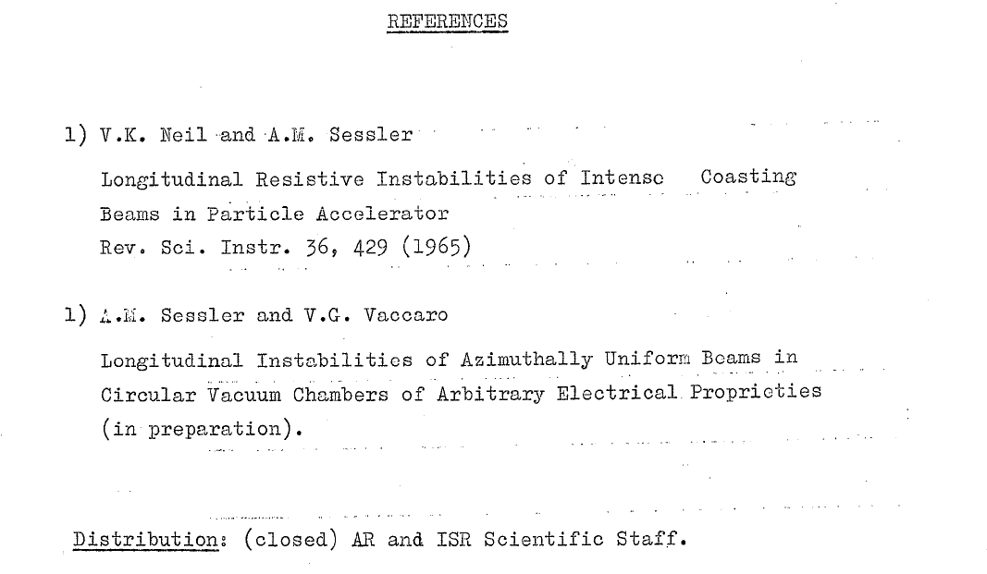
An Impedance is in the Air
The Banality of Invention
$$1=const\frac{\left\langle 2πRE_{i}\right\rangle }{I_{i}}\int{\frac{dψ_{0}}{dW}\frac{dW}{\left[ω−nω_{0}\left(W\right)\right]}}$$

Slide 25
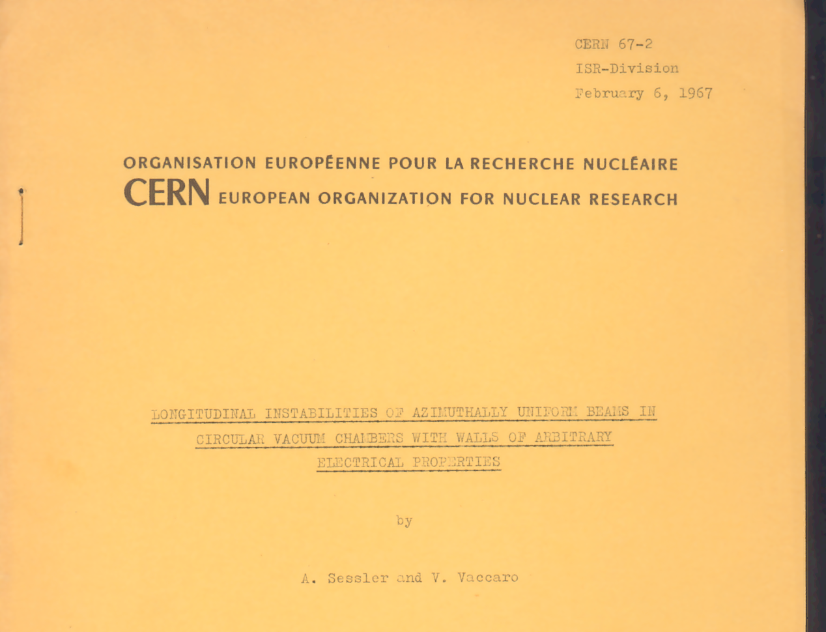
…and that we had to produce a more general paper.

Slide 26
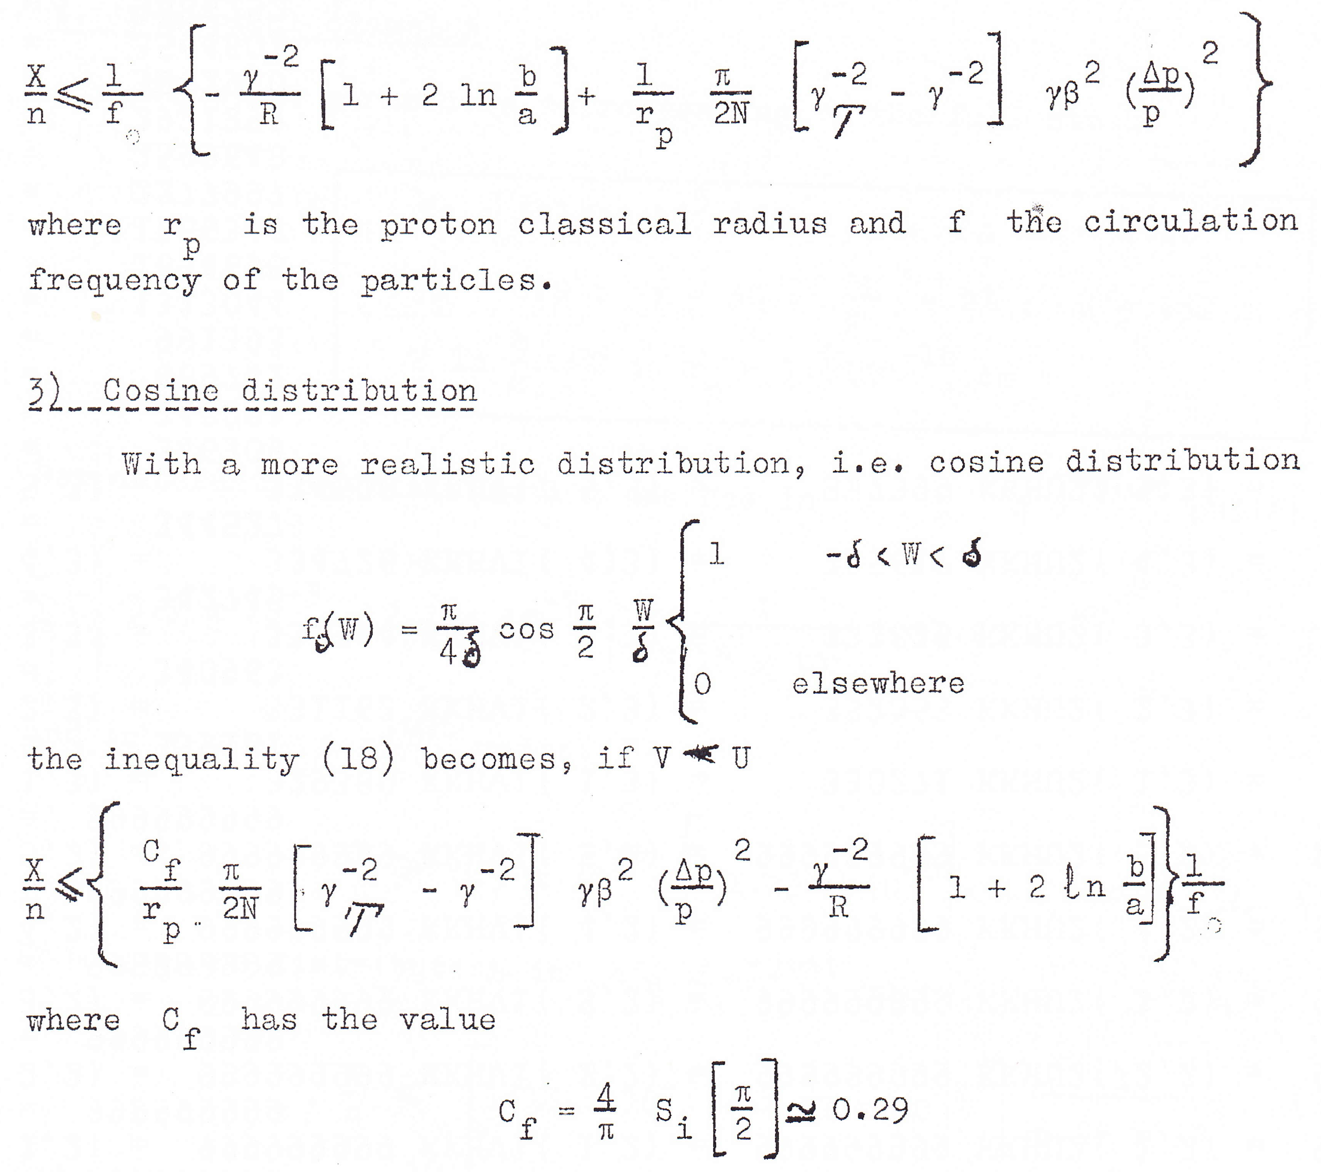
An Impedance is in the Air
The Banality of Invention
$$1=const\frac{\left\langle 2πRE_{i}\right\rangle }{I_{i}}\int{\frac{dψ_{0}}{dW}\frac{dW}{\left[ω−nω_{0}\left(W\right)\right]}}$$
Lorenzian distribution function
Truncated cosine distribution function

Slide 27
The universal stability charts
It is likely that the introduction of coupling impedance concept would lose most of its importance without the introduction of the universal stability charts. One could be meaningless without the other.
When I showed to Andy Sessler that the stability region was drastically reduced by a factor 0.3 with respect to Lorenzian function allowing for a more is realistic distribution function. He commented that he had the impression that this figure was too small. However, he said that it was worth while to have an enquire. He was right! There was a factor 2 missing! Fortunate mistake.
Notes:
It is impossible to make a synthesis of fifty years of work.

Slide 28
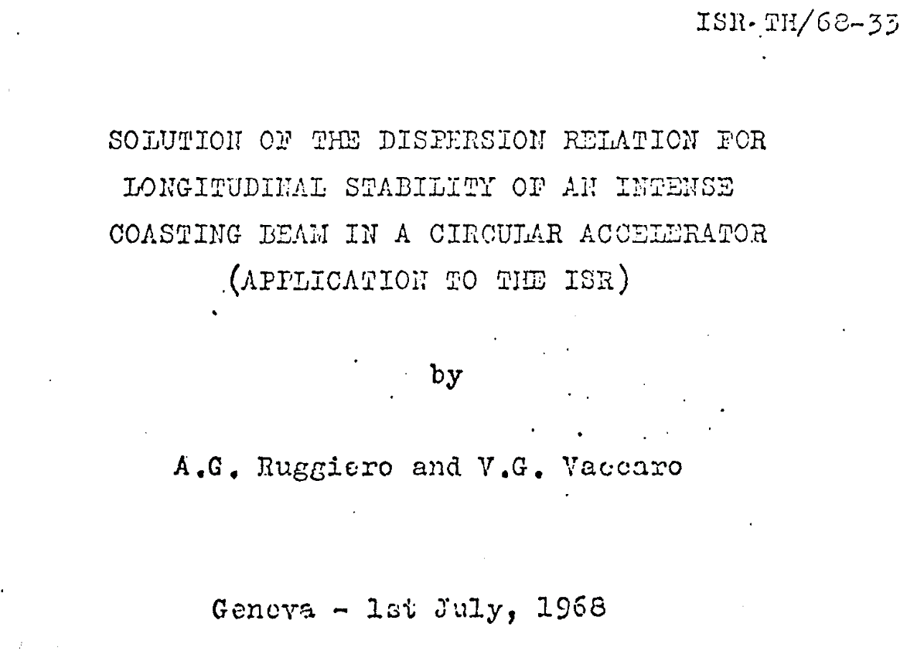
My preferred child:
The Universal Maps of Stability
For one and half year I was engaged in other activities.
Finally, when I was told that my contract would not be renewed, a collaboration started with Sandro Ruggiero. The outcome was a systematic enquire about the stability charts where the parameters were normalized in order to be of universal interpretation.

Slide 29
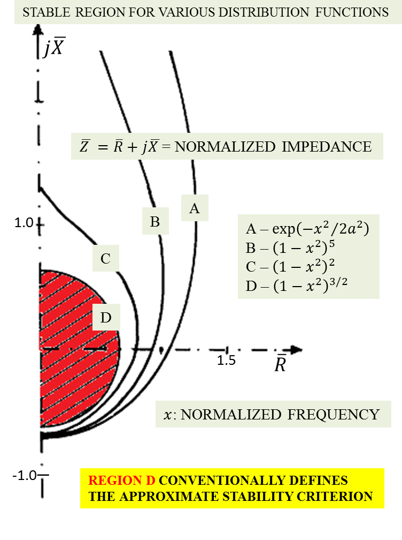
The Banality of Invention
The universal maps
WORKING POINT ABOVE TRANSITION ENERGY
The picture yields the results of the mapping relevant to the stability boundaries for different distribution functions .
The domain in red represents the most conservative approximation of the calculations from realistic distribution functions.
IMPEDANCE BUDGET

Slide 30
Pursuance and Consequences
Afterwards many interesting development.
Hereward gave the definition of transverse coupling impedance.
Sacharer studied coupled beam instabilities and gave criterions for this case.
Sacharer and Nassibian made coupling impedance measurements of a kicker by means of the stretched wire method (Sand and Rees). From there on the youth and maturity age started.

Slide 31
"Que otros se jacten de las páginas que han escrito; a mi me enorgullecen las que he leído"
Jorge Luis Borges
“Let others pride themselves about how many pages they have written; I'd rather boast about the ones I've read.”

Slide 32
“Let others pride themselves about how many papers they have written; I'd rather boast about the pupils I've grown.”

Slide 33
My best scientific production
Luigi Palumbo (U. Rome)
Godehard Wuestefeld (Bessy)
Caterina Biscari (Alba)
Eliana Gianfelice (Fermilab)
M. Rosaria Masullo (INFN)
Augusto Lombardi (INFN)
Antonio Palmieri (INFN)
Roberto Losito (CERN)
Giovanni Rumolo (CERN)
Alessandro D’Elia (ESRF)
Marco Panniello (INFN)
Claudio Serpico (Elettra)
Carlo Zannini (Adam)
Giovanni De Michele (Adam)
Serena Persichelli (LBNL)
Mauro Migliorati (Roma)
Andrea Passarelli (CERN)
Renato Prisco (Lund)
Nicolò Biancacci (CERN)

Slide 34
Thank you and keep up the good work!

Slide 36
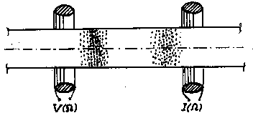
Instabilities for pedestrians
The gedanken experiment.
An ideal device, fed by a voltage ΔV(Ω), produces a small longitudinal density perturbations in the current I at a frequency Ω
Suppose that there is no interaction with surrounding medium and measure the perturbation by means of a reciprocal device which may define the perturbed current ΔI(Ω)
where the BEAM ADMITTANCE Y_{B}(Ω) depends on the beam properties: charge/mass, focusing properties etc. Of course the perturbed current is proportional to the d.c. current I₀

Slide 38
Instabilities for pedestrians
Taking into account the e.m. interaction on one turn of the beam with the environment, this interaction will produce e.m. forces having the same space and time distribution as the perturbation. These forces can be represented by an equivalent voltage ΔV₁’(Ω) which can be meant as produced by the current ΔI(Ω), loading an IMPEDANCE. This impedance, Z_{M}(Ω), represents the overall interaction with surrounding equipment.
This voltage now acts back again on the beam, producing an additional perturbation, and so on. After m turns we have:

Slide 39
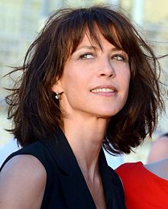
Sophie Marceau
La Boom - The Party – Il tempo delle mele (1980)
Shortly she will be fifty, but she does not look it

Slide 40
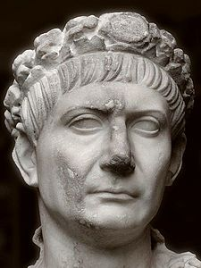
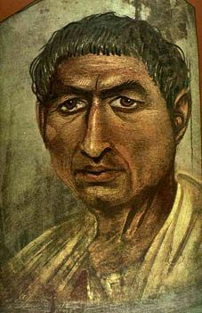
Marco Ulpio Nerva Traiano
L’8 agosto di 1900 anni fa moriva l’imperatore Traiano. Una grande mostra lo celebrerà presso i Mercati di Traino dal 29 novembre 2017

Slide 41
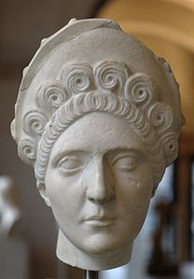
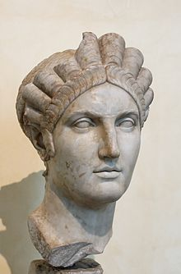
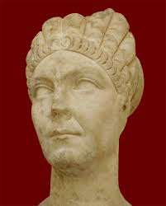

Slide 42


Slide 43

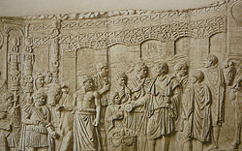
Trajan's Bridge
The structure was 1,135 m (3,724 ft) long (the Danube is now 800 m (2,600 ft) wide in that area), 15 m (49 ft) wide, and 19 m (62 ft) high, measured from the surface of the river.
The bridge's engineer, Apollodorus of Damascus, used wooden arches, each spanning 38 m (125 ft), set on twenty masonry pillars made of bricks, mortar, and pozzolana cement

Slide 44
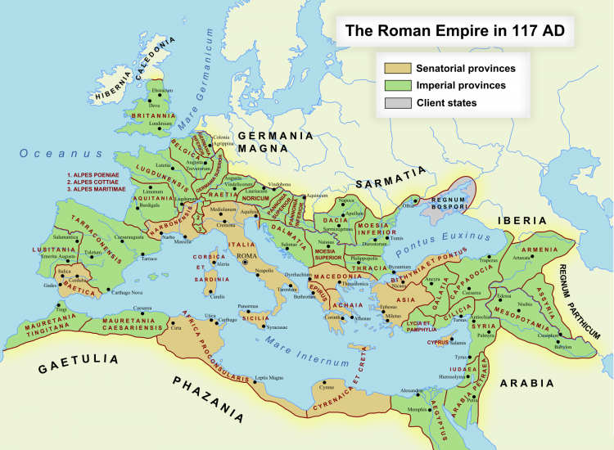

Slide 45
“Just when the gods had ceased to be, and the Christ had not yet come, there was a unique moment in history, between Cicero and Marcus Aurelius, when man stood alone.”, Gustave Flaubert, The letters.

Slide 46
Mode Matching Method: a benchmarking Tool
Representation of a circular cross section subdivided in subsets.
Expansion of e.m. field in the waveguides by means of orthogonal wave modes
radial
waveguide
waveguide
cavity
waveguide
radial
waveguide
Expansion of e.m. field in the cavity by means of an orthonormal set of eigenmodes
Expansion of e.m. field in the radial waveguide by means of radial wave modes

Slide 47
ode Matching Method for Beam Coupling Impedance Computation
Mode Matching Method for Beam Coupling Impedance Computation
Cavity Eigenvector properties
The Eigenvectors are always associated to boundary conditions Dirichlet, Neumann or mixed:
Divergenceless Eigenvectors (dynamic modes):
Irrotational Eigenvectors (static modes):
The boundary condition are relevant to the tangential component of the Electric field.
In a more compact form the static modes may be considered as dynamic modes with k_{n}=0.

Slide 48
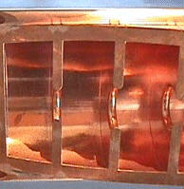
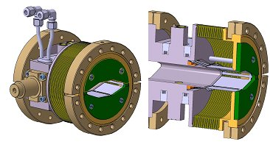
Insertions
The variation of the cross section in accelerators cannot be avoided.
example: the accelerating cavities and bellows.
Notes:
48
The first one is by definition an essential device for carrying out the function itself of the accelerator. The second one is strictly necessary to absorb the thermal stresses and mechanical fabrication tolerances. All the inserts are in general connected to pipes.

Slide 49
A
B
O
V
E
P
I
P
E
C
U
T
O
F
F
INSERTION with
LOSSY WALLS
BEAM
INSERTION ROOM
BEAM
POWER
X %
(100-X)%
≈0%
(100-X)%
PIPE
INSERTION SURFACE
LOSSES
PIPE
Negligible losses in the insertion :
Most of power flows toward infinite in the pipes.
Broad Band Impedance insensitive to cavity conductivity
49
49

Slide 50
B
E
L
O
W
P
I
P
E
C
U
T
O
F
F
INSERTION with
LOSSY WALLS
BEAM
INSERTION ROOM
BEAM
POWER
(100-X )%
forbidden
X %
forbidden
PIPE
INSERTION SURFACE
LOSSES
PIPE
In general (X% very small) very high Q resonances
sensitive to the wall conductivity.
The coupling resistance can be different from zero.
Lossless case (X% = 0) the resistance is null
Notes:
A key parameter of the connecting pipes is the minimum frequency of the waves that which can propagate in the pipe. Allowing for cylindrical pipes, this is connected to the radius of the pipe. Therefore, all the wave numbers will be normalized to this value.

Slide 51
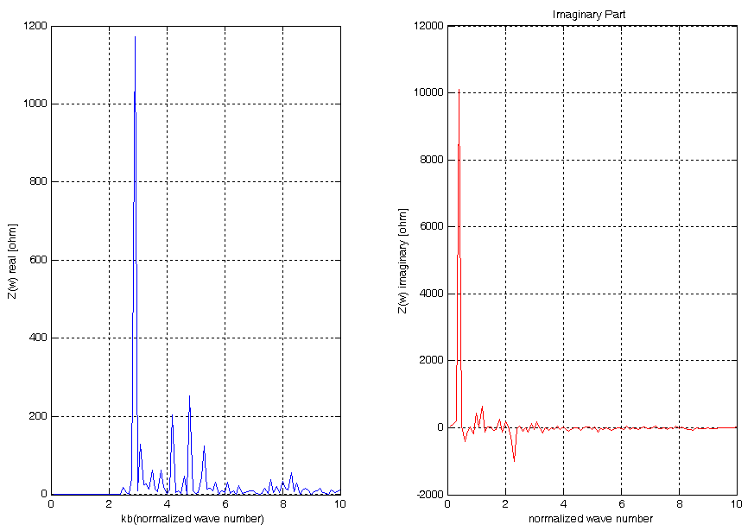
Analysis of a PEC Pillbox
Waveguide radius = 10 mm
Cavity radius = 60 mm
Cavity width = 80 mm
βγ= 10
PEC
40 GHz
Cut-off
Notes:
The real part is null below the waveguide cutoff frequency. By converse, the imaginary part has resonances corresponding to the cavity resonant frequencies, below the cut-off. This means that there is a exchange of energy between the beam and the cavity without losses.
Vanishing of the Real part of the Coupling Impedance for frequencies below the cut-off is essential for the Energy Conservation Principle:
If the real part impedance were not vanishing (namely the particles lose energy) , this would imply that there is an increasing amount of energy stored in the cavity (below cut-off no power can flow in the waveguides!), this would violate the assumption of stationary field configuration. ALL the energy delivered to the cavity is given back to the beam, this implies non zero imaginary part of the Coupling Impedance.

Slide 52
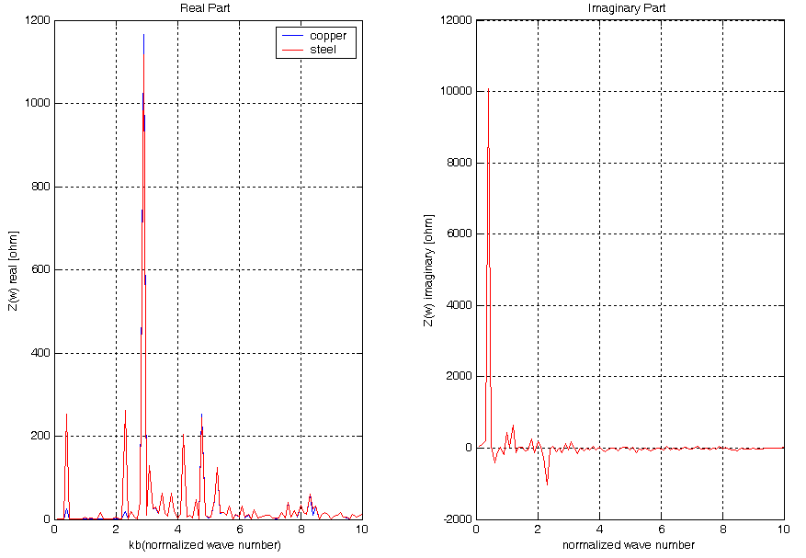
Analysis of a Lossy Pillbox
Waveguide radius = 10 mm
Cavity radius = 60 mm
Cavity length = 80 mm
βγ = 10
Copper: σ =5.98•10⁷ S/m
Steel: σ =6.00•10 ⁵ S/m
40 GHz
Notes:
We can see a new peak in real part in the cutoff region, depending on the conductivity. This peak appears at the same frequency of primary peaks in imaginary part graphic.
In case of finite losses, a certain amount of energy is dissipated in the cavity and, because of the Energy Conservation Principle, peaks of real part will appear below cut-off, corresponding to the relevant cavity resonant frequencies. Comparing steel and copper we see a very little influence of CONDUCTIVITY in the behavior above cut-off.
Below cutoff there are aspects which cannot be appreciated in such a wide frequency range: therefore, it is worthwhile to magnify them in a narrow frequency bandwidth, around the first resonance at 3.2GHz.

Slide 53
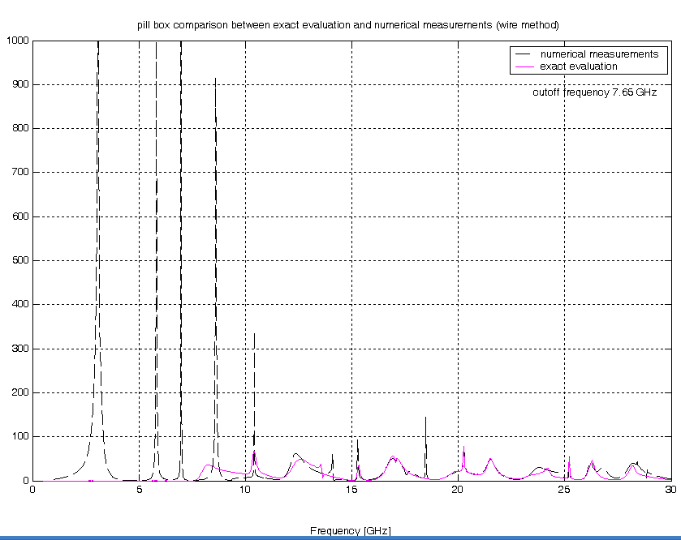
Wire Method vs Exact Evaluation
Cut-off
Notes:
Good agreement above the cutoff frequency and bad agreement below the cutoff frequency. Enormous discrepancy between the two results below the cutoff frequency. The presence of the wire shifts the cutoff frequency to zero (the TEM mode are allowed to propagate because coaxial cables support them). This implies a loss of energy from the resonant cavity which appears as a non existing coupling impedance below cut-off. 30% above cut-off it is striking the agreement between the exact evaluation and measurements. By means of this cross check this proves the goodness of the wire method and M.M. evaluation.

Slide 54
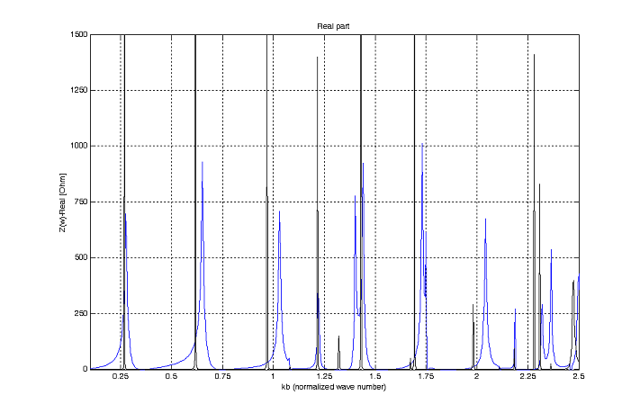
Virtual measurement with stretched wire vs MMT exact evaluation
Pipe radius = 4mm; Pillbox radius = 36mm;
Pillbox length = 12mm

Slide 55
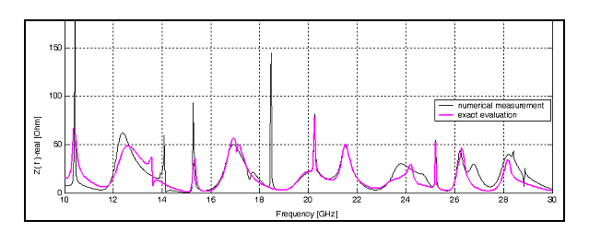
Virtual measurement with stretched wire vs MMT exact evaluation
Pipe radius = 10mm; Pillbox radius = 60mm;
Pillbox length = 80mm

Slide 56
Tables of some results

Slide 57
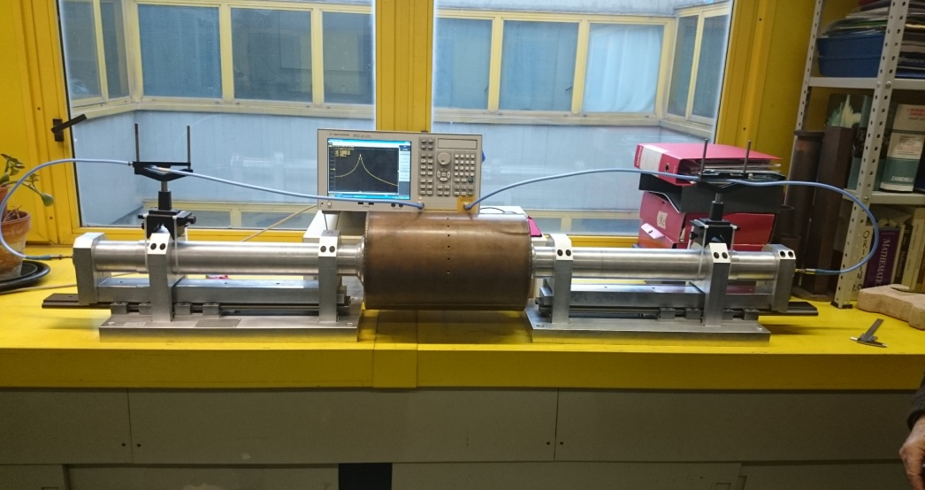
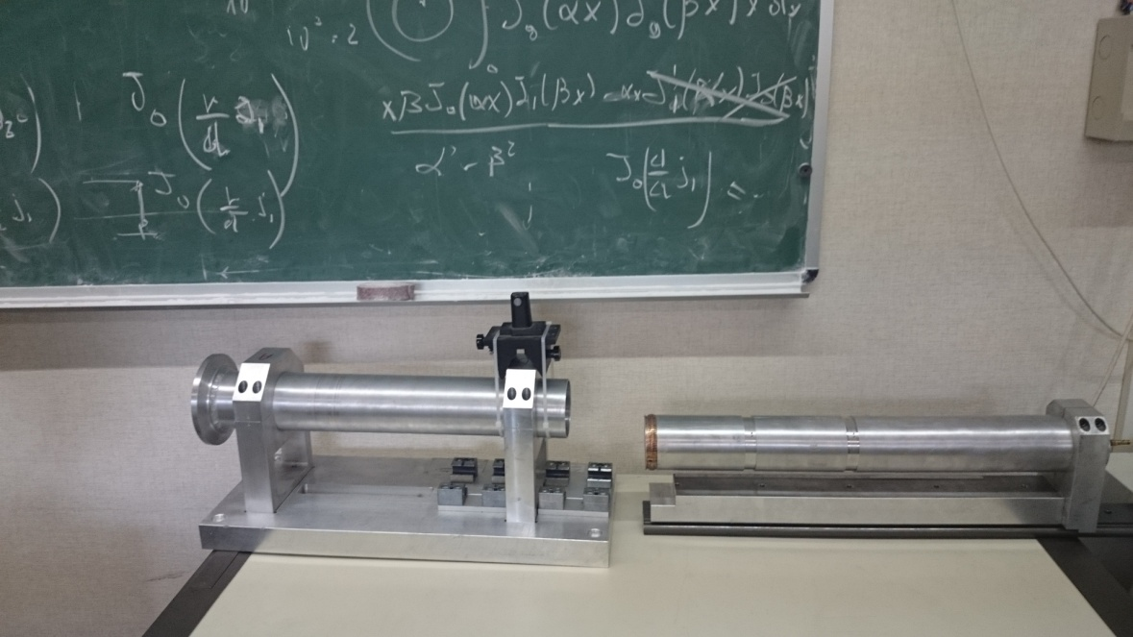
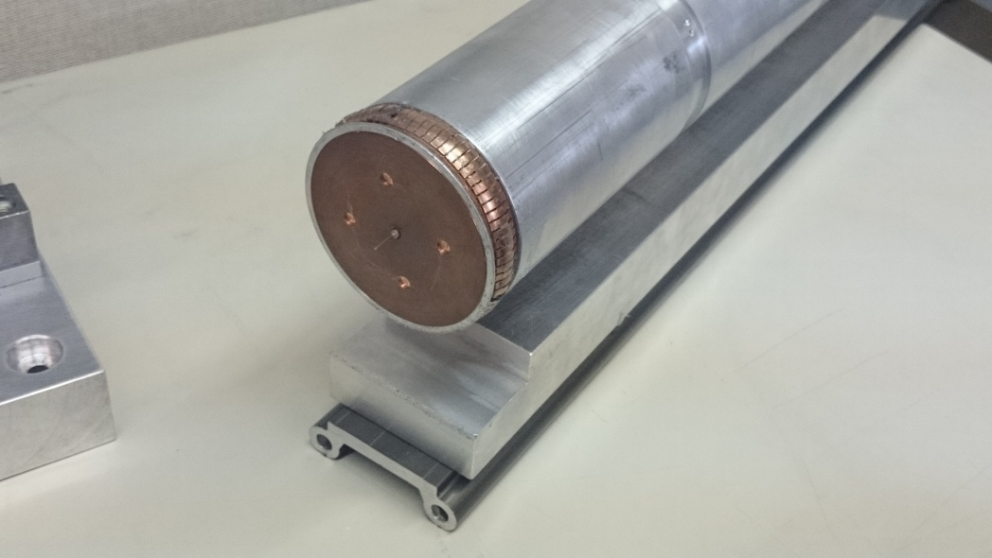
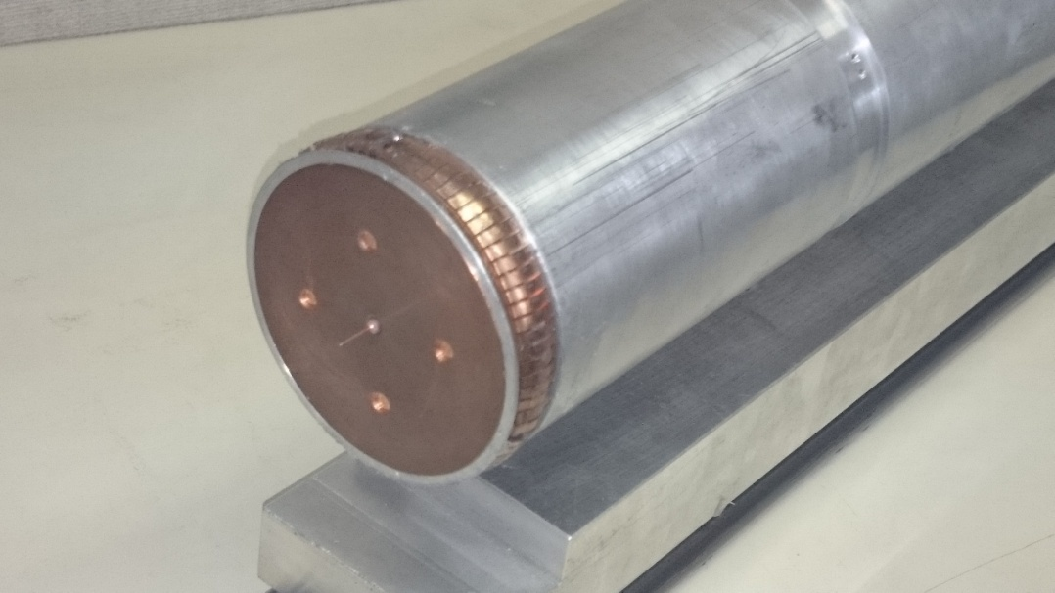
The new telescopic set-up

Slide 58
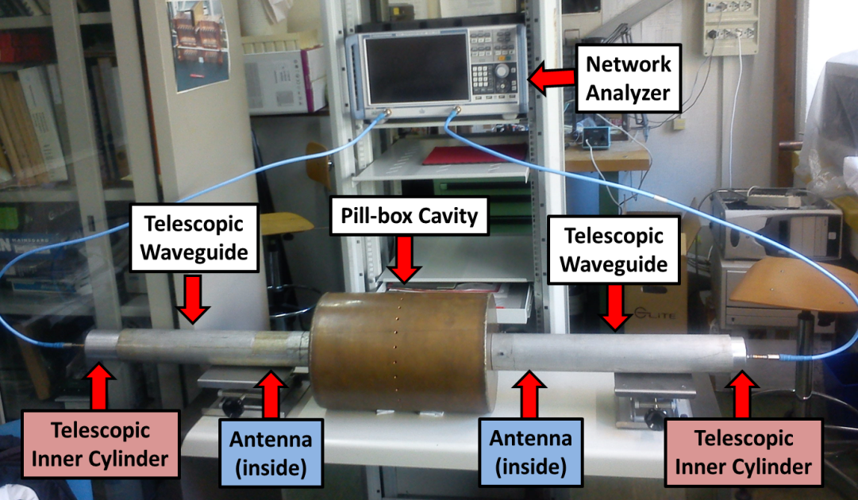
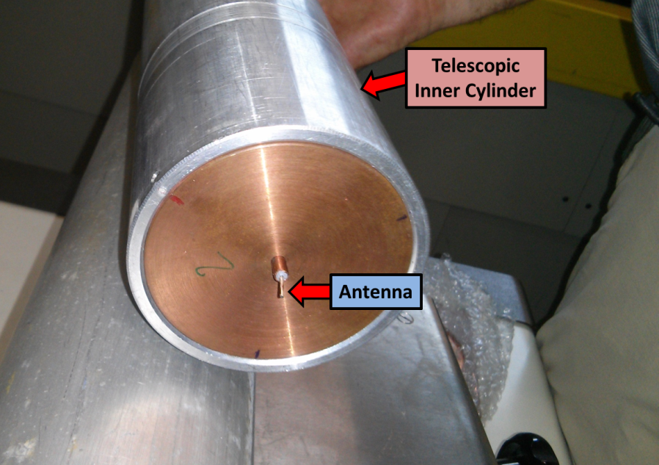
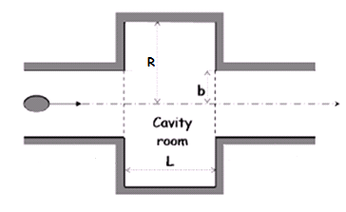
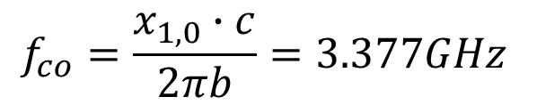
The telescopic measurement device
Parameter | Description
R | 125mm
b | 34mm
L | 375mm
Conductivity | 5.96 e7 S/m
$$f_{co}=\frac{x_{1,0}∙c}{2πb}=3.377GHz$$

Slide 59
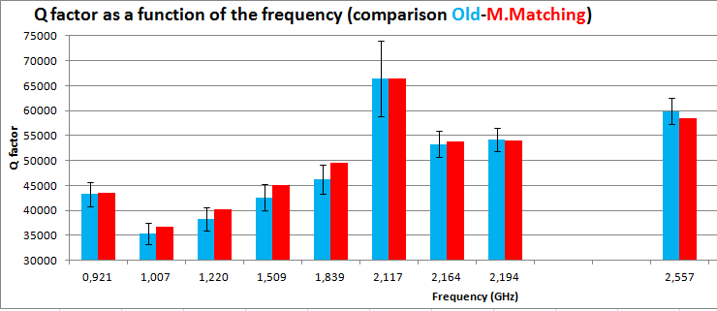
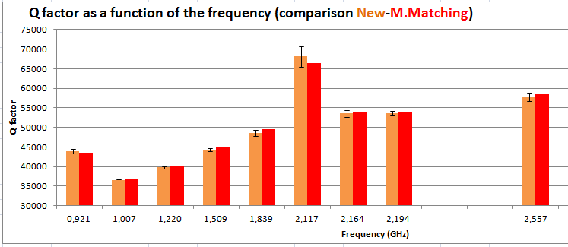
Compare Mode Matching and measures

Slide 60
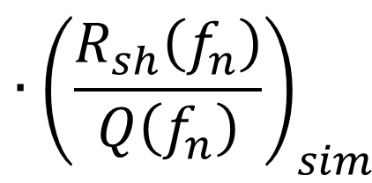
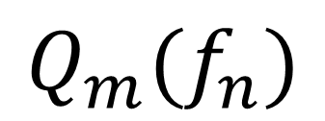

Hybrid (Numerical-experimental) method
The method with antennas does not still allow to measure the value of the coupling impedance below the cut-off frequency. The idea is to combine the Q-factor measured with antenna method and the R_{sh}/Q simulated using CST eigenmode solver in order to evaluate the shunt resistance Rsh for each resonant mode with following formula:
Is interesting to notice that the value of Q_{m} depends even on the EM properties of the material inside the structure (roughness, etc.). On the other hand the ratio (R_{sh}/Q)_{sim} depends only on structure geometry

Slide 61
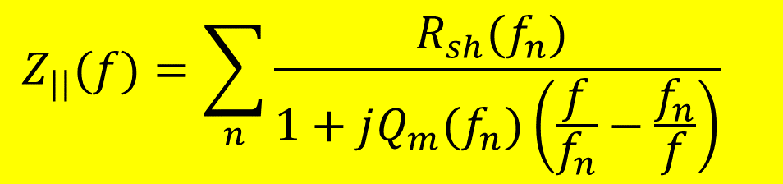
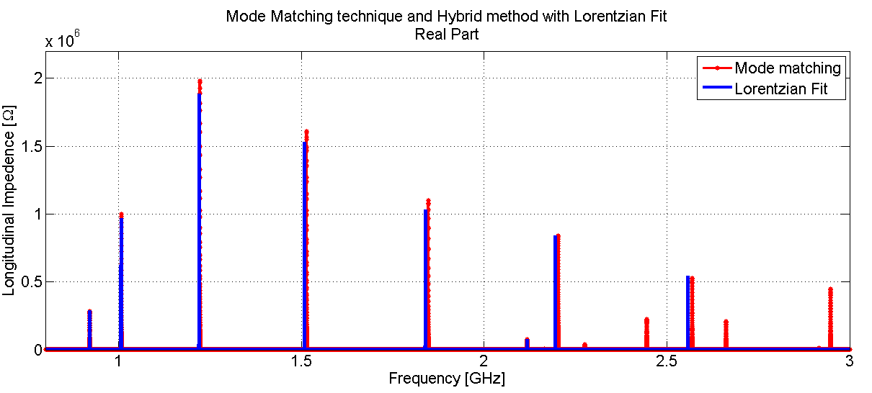
Hybrid (Numerical-experimental) method
A Lorentzian fit has been used to connect the values of resonance frequency, Q-factor and shunt resistance to the coupling impedance value, using the formula:
Lorentzian fit:

Slide 62
Giordano Bruno: epilogue
After seven years of jail. The Inquisition found him guilty of heresy, found guilty of heresy and condemned to be burned on the stake. The verdict was executed on April, 17, 1600.
He never abjured

Slide 63
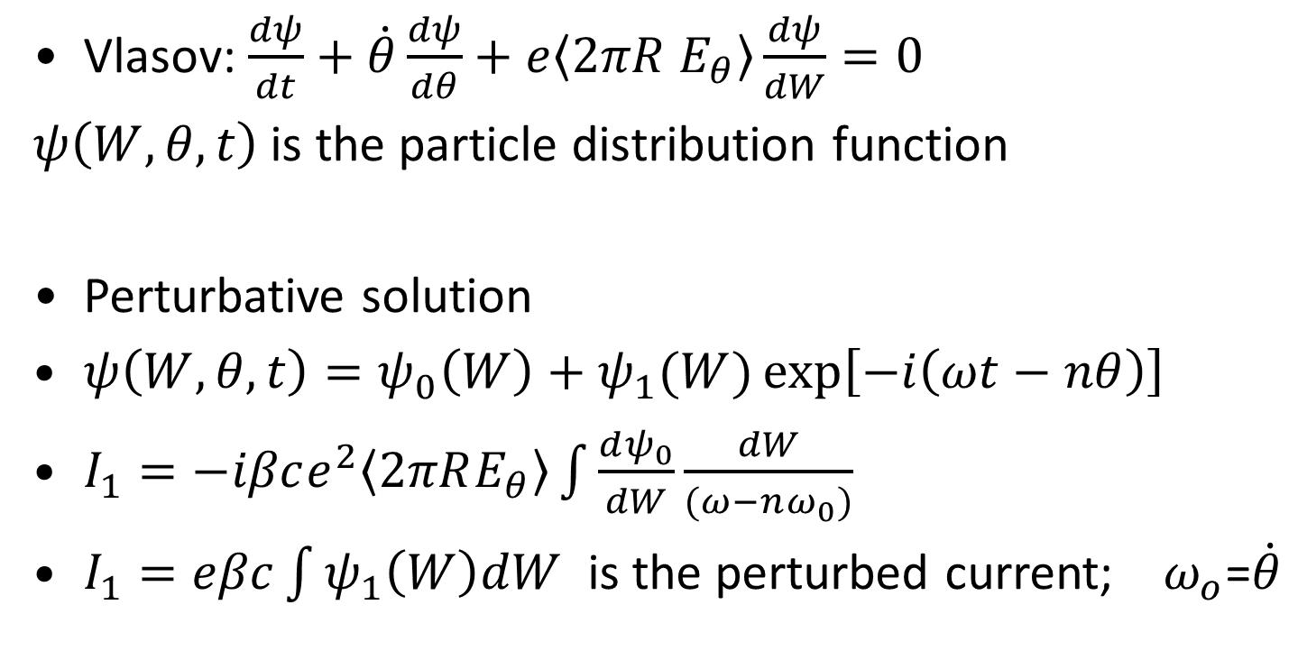
An Impedance is in the Air
The Banality of Invention
Vlasov: $\frac{dψ}{dt}+\dot{θ}\frac{dψ}{dθ}+e\left\langle 2πR E_{θ}\right\rangle \frac{dψ}{dW}=0$
$ψ\left(W,θ,t\right)$ is the particle distribution function
Perturbative solution
$ψ\left(W,θ,t\right)=ψ_{0}\left(W\right)+ψ_{1}(W)\exp\left[−i\left(ωt−nθ\right)\right]$
$I_{1}=−iβce^{2}\left\langle 2πRE_{θ}\right\rangle \int{\frac{dψ_{0}}{dW}\frac{dW}{(ω−nω_{0})}}$
$I_{1}=eβc\int{ψ_{1}\left(W\right)dW}$ is the perturbed current; $ω_{o}$=$\dot{θ}$
Notes:
I was reluctant to use the formulas where the expressions in cgs system

Slide 64

An Impedance is in the Air
The Banality of Invention
I felt uneasy, as an engineer, to tackle a problem expounded in that unfamiliar feature: the imaginary unit $i$was quite misleading.
free space impedance $4π/c$. NO!!!.

Slide 65
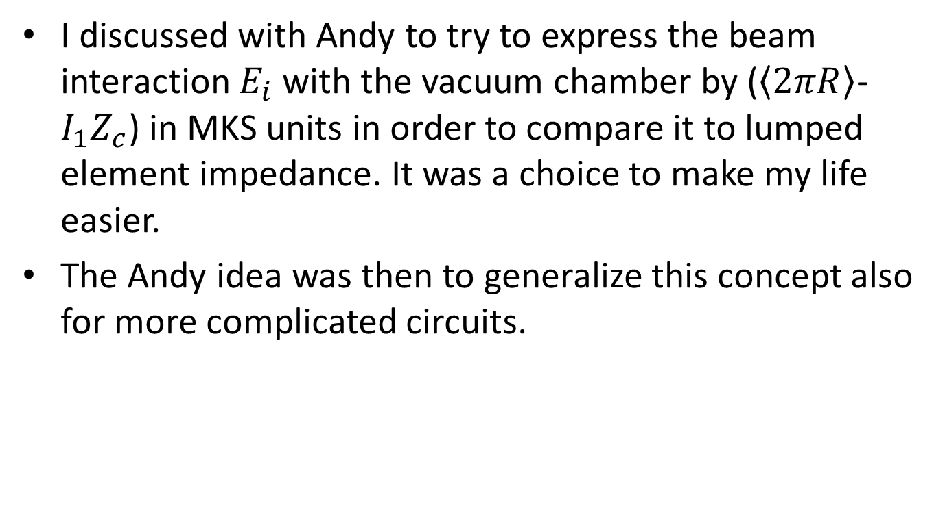
An Impedance is in the Air
The Banality of Invention
I discussed with Andy to try to express the beam interaction $E_{i}$ with the vacuum chamber by ($\left\langle 2πR\right\rangle$- $I_{1}Z_{c}$) in MKS units in order to compare it to lumped element impedance. It was a choice to make my life easier.
The Andy idea was then to generalize this concept also for more complicated circuits.

Slide 66
Further developments
A collaboration starts with Sandro Ruggiero and, later on, with Kurt Huebner, which last for almost two years.
More than twenty paper written on coupling Impedance an Dispersion Relation.
Notes:
It is impossible to make a synthesis of fifty years of work.

Slide 67
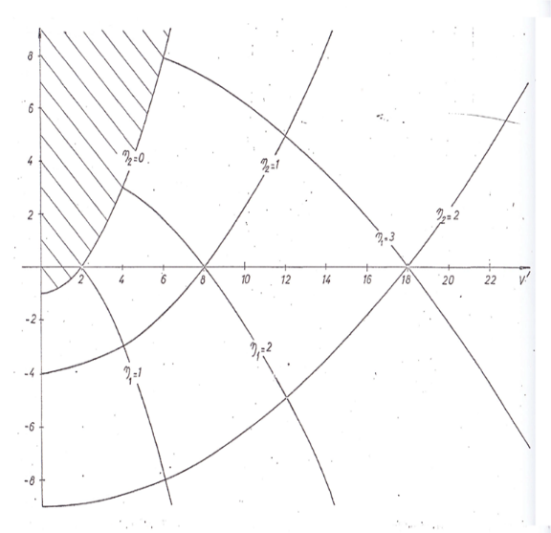
Longitudinal stability chart for Lorenzian distribution function

Slide 68
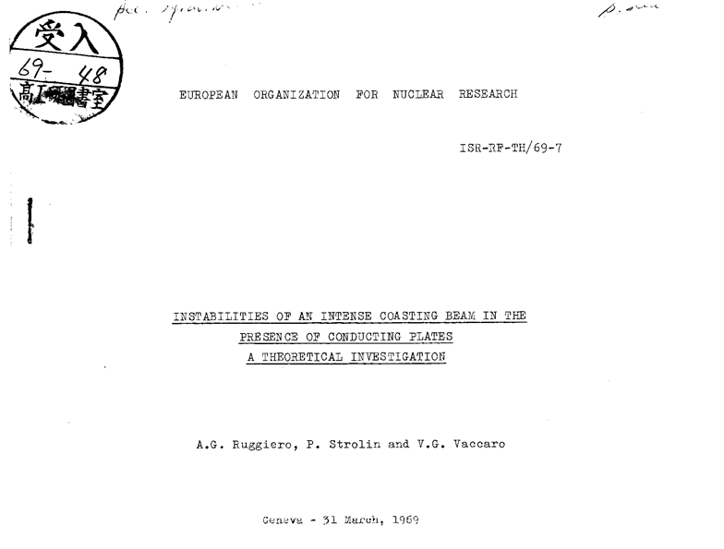

Slide 69
My preferred child:
The Universal Maps of Stability
Given a certain value of coupling impedance it was (at that time) almost impossible to solve the dispersion relation.
We (Sandro and I) thought that it could be interesting to draw maps of stability, better to say ”maps of instability”.

Slide 70
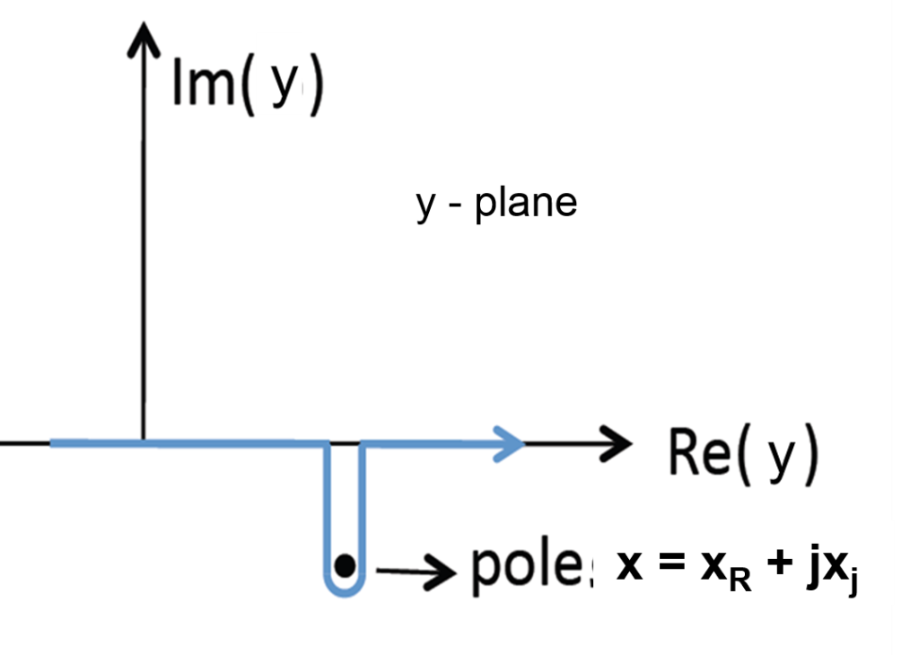
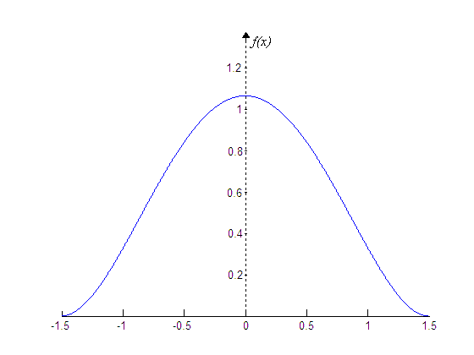
The Universal Map of stability
The variables in the dispersion relation (DR) can be modified in order to let them be dimensionless.
Assuming x as a complex variable,
DR is a conformal transformation from x-plane to y-plane.

Slide 71


The universal maps
Let us consider
This explicit form allow us to calculate the value of $Z(x)$for any given value of $x.$ The procedure consists in assign a value of $x,$ the imaginary part of which is negative (a diverging instability). In order to calculate the integral, the integration path may be supposed to approach the real y-axis from lower half plane. This integral is then equal to the principal values plus the residual in the pole.
GO TO THE NEXT SLIDE.

Slide 72


The universal maps
The picture on the right tells us that the
mapping of lower half $y−plane$ into the
$Z−plane$ covers this plane almost entirely.
Only a small portion (dashed) is left. It is
worth of note that this domain is not covered by an analogous mapping of lower half plane. This domain is interpreted as a region of stability.
If the accelerator has an impedance which is for any frequency inside this domain, the beam is longitudinally stable

