Slide 1




Impedance Issues in the Design, Measurements, and Commissioning of a Narrow Gap Stripline Kicker For On-Axis Injection
S. De Santis
ICFA mini-Workshop On Impedances and Beam Instabilities in Particle Accelerators
Benevento, September 19th, 2017

Slide 2
Outline
Introduction: ALS-U Project and Swap-Out Injection.
Stripline Design and Impedances.
ALS-U Test Kicker at the ALS.
Test Kicker Assembly and Bench Measurements.
Test Kicker Operation With ALS Beam.

Slide 3
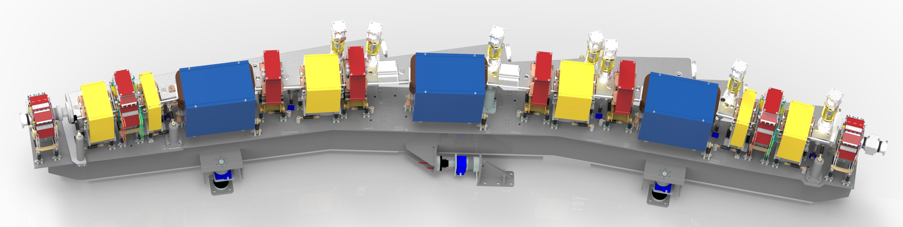
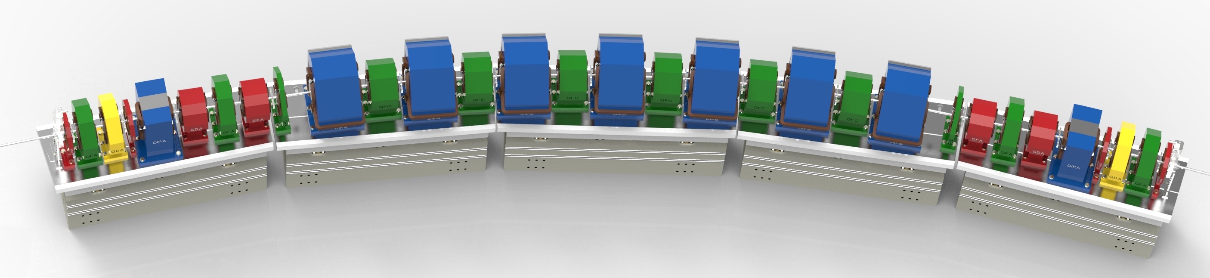
ALS and ALS-U in numbers
Parameter | Units | ALS | ALS-U
Electron energy | GeV | 1.9 | 2.0
Horiz. emittance | pm | 2000 | <70 (stretch goal 50)
Vert. emittance | pm | 30 | <70 (stretch goal 50)
Beamsize @ ID center (σ_{x}/σ_{y}) | μm | 251 / 9 | <13 / <13
Beamsize @ bend (σ_{x}/σ_{y}) | μm | 40 / 7 | <5 / <7
bunch length (FWHM) | ps | 60-70 (harmonic cavity) | 100-200 (harmonic cavity)
RF frequency | MHz | 500 | 500
Circumference | m | 196.8 | ~196.5

Slide 4
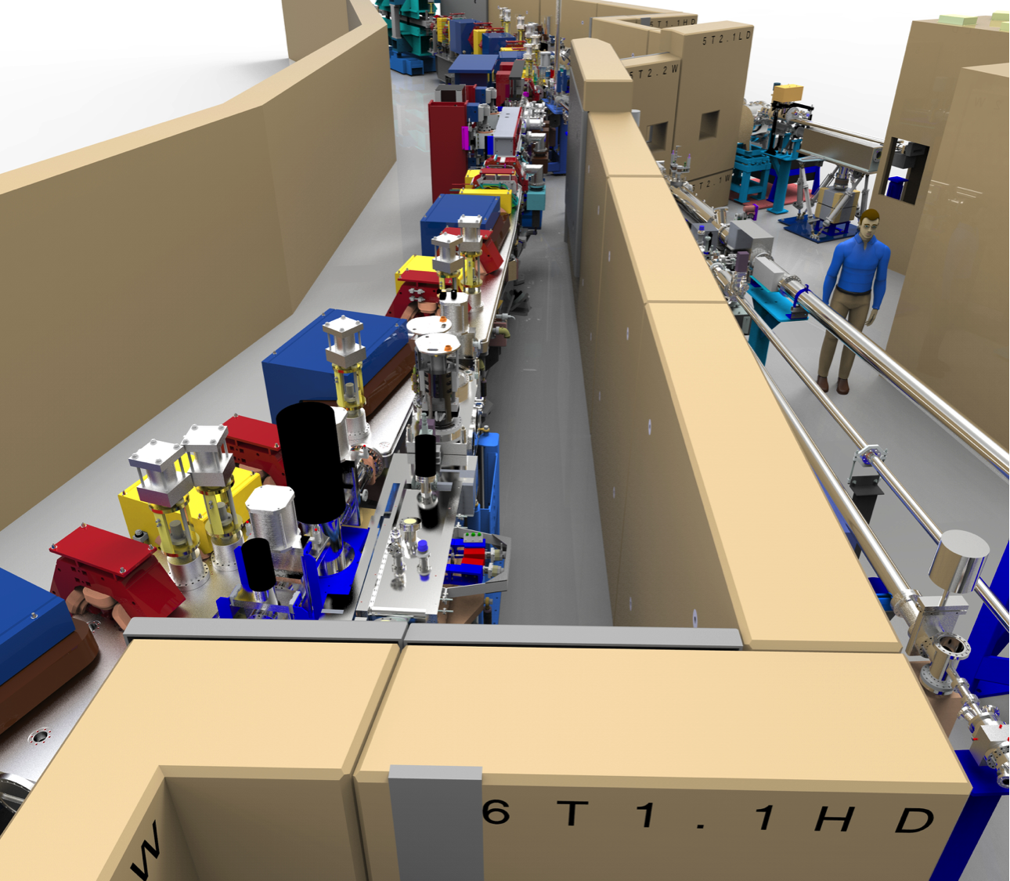
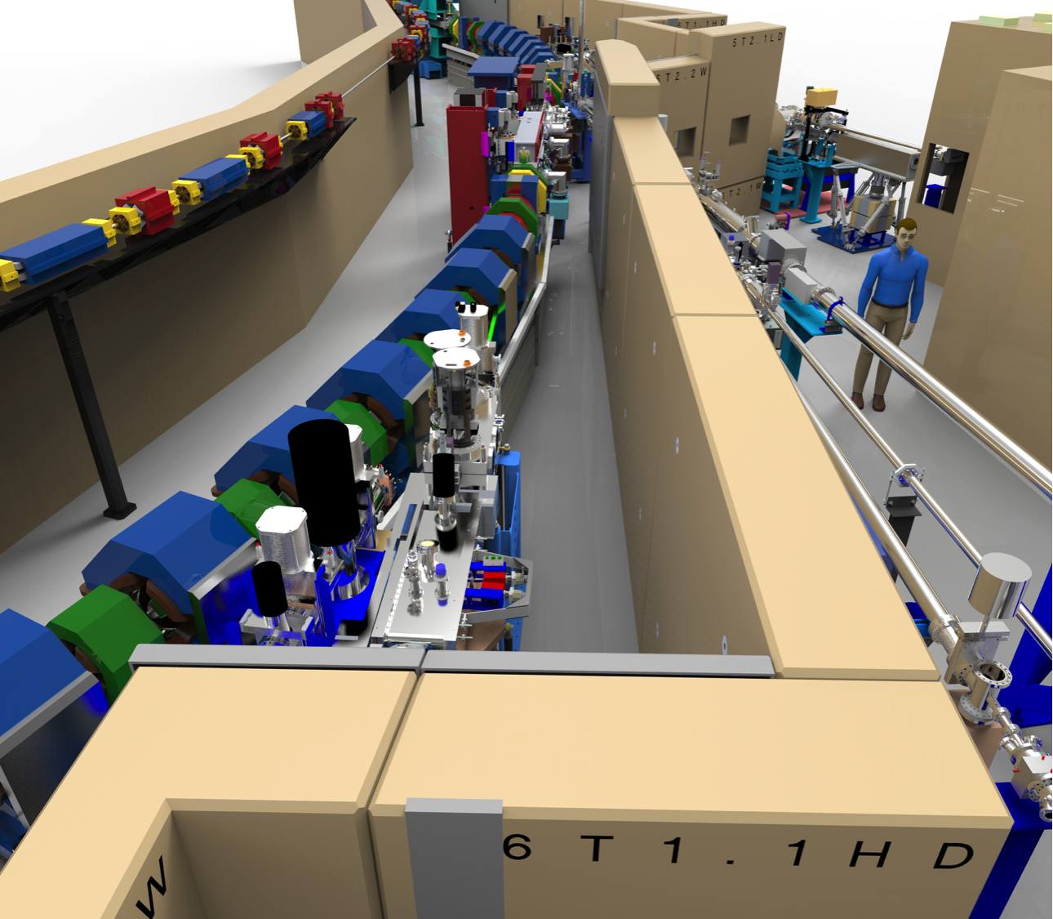
Scope of ALS Upgrade (ALS-U)
Replacement of the existing triple-bend achromat storage ring with a new, high-performance storage ring based on a multi-bend achromat.
Addition of a low-emittance, full-energy accumulator ring in the existing storage-ring tunnel to enable on-axis, swap-out injection using fast magnets.
Upgrade of the optics on existing beamlines and realignment or relocation of beamlines where necessary.
Addition of three new undulator beamlines that are optimized for novel science made possible by the beam’s high coherent flux.
Existing ALS ring
New ALS-U ring
New accumulator ring
Single bunch top-off injection
Swap-out injection

Slide 5
Swap-out Injection
Traditional off-axis injection
On-axis swap-out injection
(initially proposed by M. Borland)
Stored Beam
Stored Beam
Fast Kicker
requires larger
apertures
can use smaller
apertures
Injected Beam
  Swap-out enables:
  Stronger-focusing MBA lattices with smaller dynamic apertures
  Round beams - more useful shape and reduced emittance growth
  Vacuum chambers with small round apertures → Improved undulator performance
  Swap-out with full energy accumulator enables:
  Bunch train swap-out and recovery of the stored beam current
      Lower demand on the injector
      Very small (~nm) injected emittance
      More flexibility in fill patterns
Injected Beam
Only ALS-U and APS-U plan to include swap-out

Slide 6
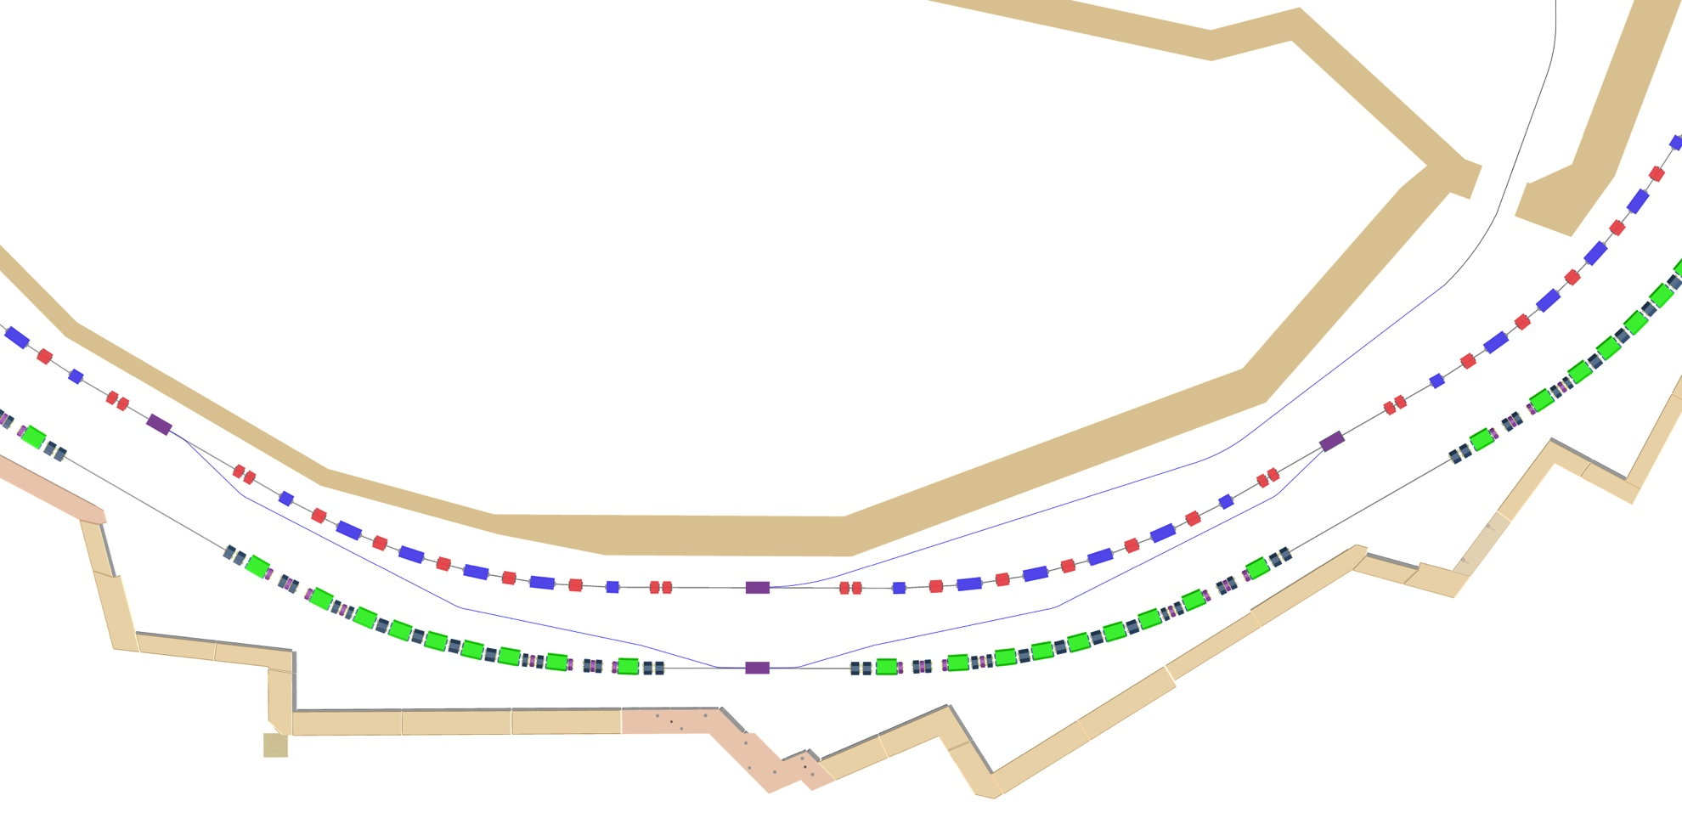
ALS-U Swap-out Injection Scheme
storage ring bunches transferred to accumulator
Fast kicker magnets
New ALS storage ring
New accumulator ring
Extraction pulse 50 ns
2 ns
26 bunches swapped out
500 MHz RF
10 ns
6

Slide 7
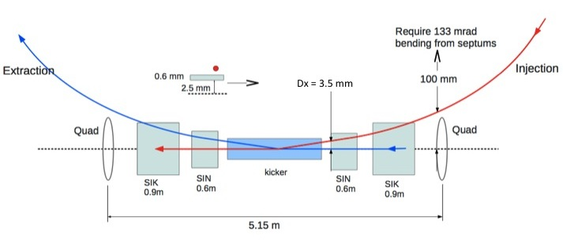
ALS-U Kicker Requirements
accumulator ring
2 m
storage ring
pending lattice finalization
ALS-U Beam: 11 trains of 25/26 bunches. Gap Length: 10 ns
Bend Angle: 3.5 mrad
Total Kicker Length: 2 m
No. of Modules: 4
Pulse Voltage: 5.3 kV
Rise/Fall Time: ≤ 10 ns
Max. Pulse Length: 50 ns
Repetition Rate: ≈ 30 s
Striplines gap: 6 mm
8

Slide 8
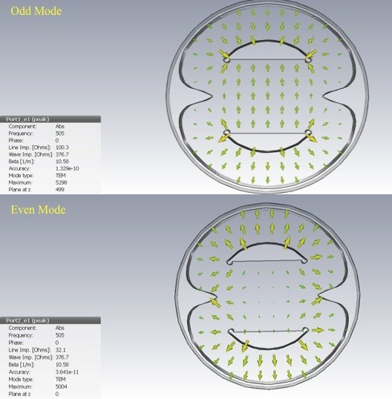
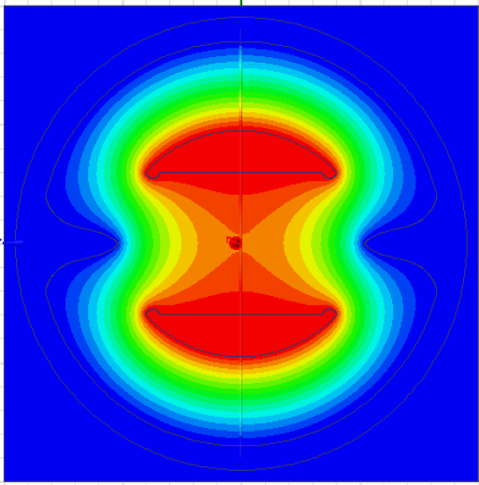
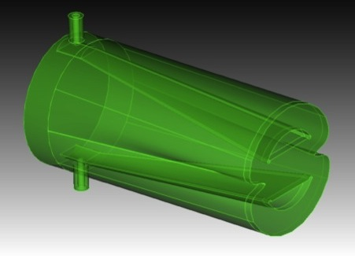
Kicker Design
Transverse plane fenders, to lower the even mode characteristic impedance from 77 to 64 Ω (A. Krasnykh)
50 Ω
8 mm
Peak field
12 MV/m
64 Ω
6 mm
7 mm
Longitudinal tapers to reduce beam coupling impedance at high frequency and improve the feedthrough-to-stripline 50 Ω matching
(D. Alesini, F. Marcellini)
3.8 cm long
11

Slide 9
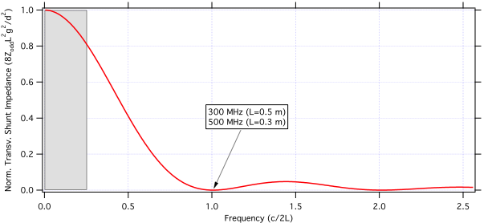
Kicker Design: Length
> 6 ns
0.24 ns
τ_{G}
τ_{b}
maximum stripline length ≈ 50 cm
τ_{R}
V_{pulser}
Transverse shunt impedance
Pulser bandwidth not an issue, but required pulser power scales as

Slide 10
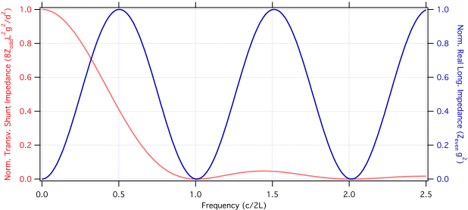
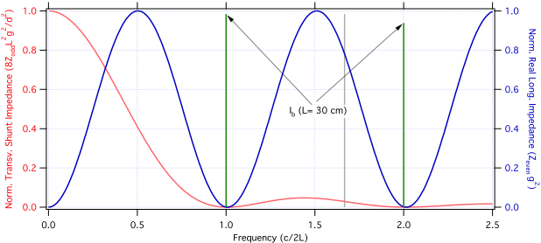
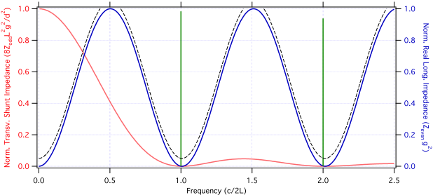
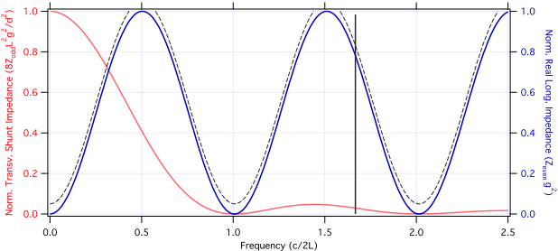
Kicker Design: Length (cont.)
(all RF buckets filled)
Dissipation along the stripline and characteristic impedance mismatch make it impossible to eliminate losses and those residual losses are what we are mostly concerned about: power dissipation on a 500 μm thick copper strip in vacuum !
Idealized beam spectrum (500 MHz f_{RF}) on a 50 cm long stripline
Stripline length can be chosen to minimize power loss

Slide 11
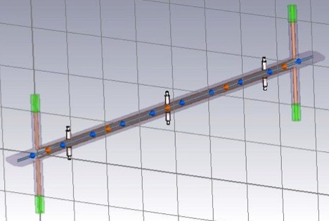
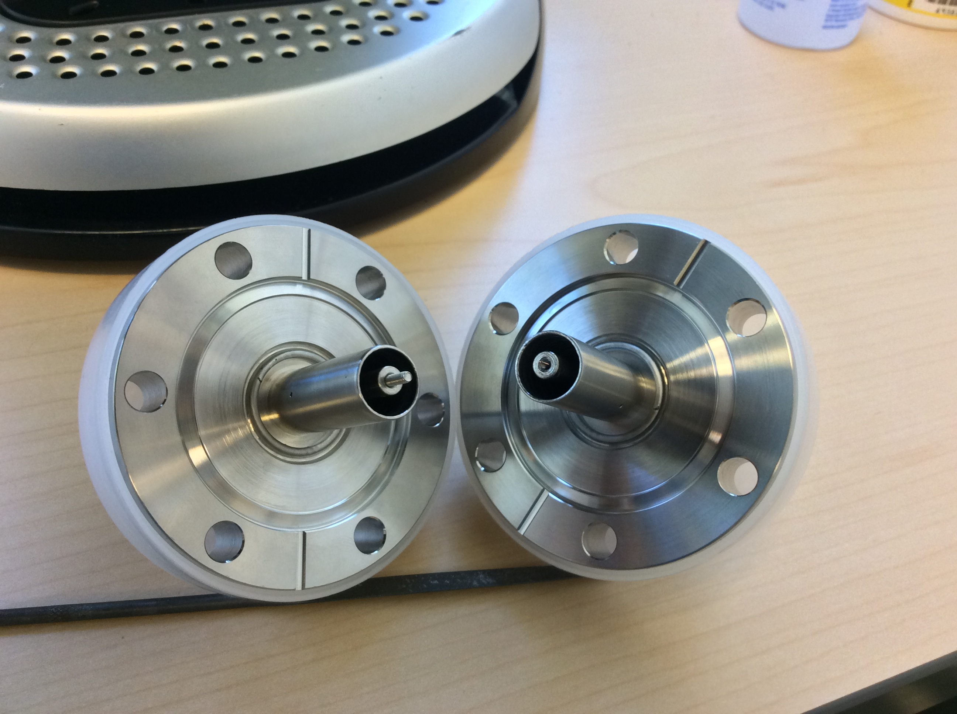
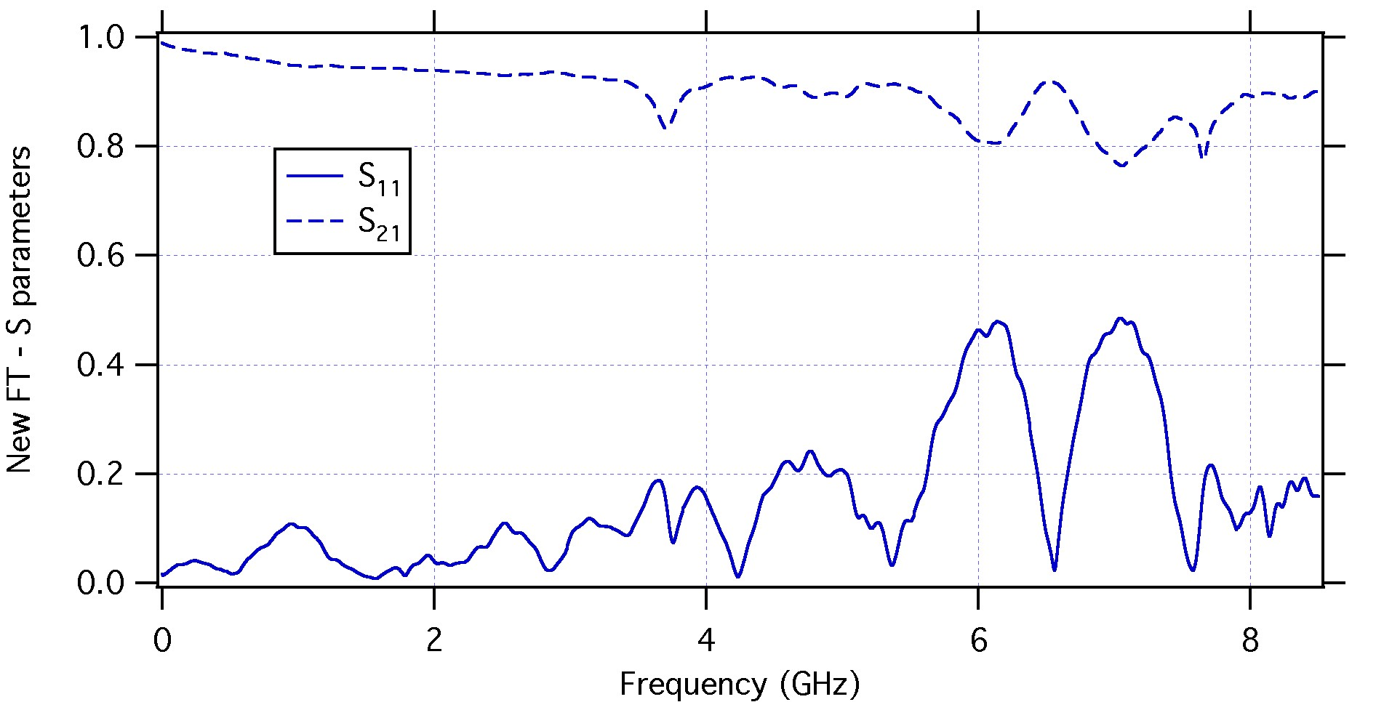
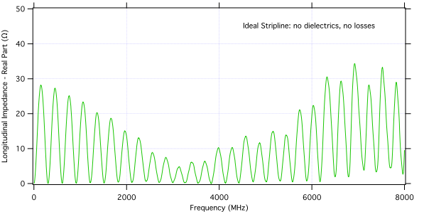
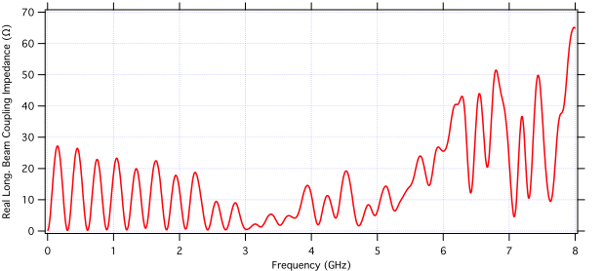
Real Striplines Are More Complex…
ALS Test Kicker
Dielectric supports
Feedthroughs bench meas.
Feedthroughs modelling extremely complex. They can cause a stripline
to deviate considerably from its theoretical behavior.

Slide 12
The ALS-U Test Kicker at the ALS
Successful implementation of the swap-out kicker is a key element for the success of the ALS upgrade.
Its design presents several challenges:
  Electrodes in close proximity of the circulating beam (≤ 3 mm).
  Small transverse dimensions amplify the effect of mechanical misalignments.
  Rise/fall time in pulser output < 7 ns in order to fit in the 10 ns gap (due to propagation time in the kicker). Flat-top stability within ±1% at 5.3 kV.
  Characteristic impedance matching in the kicker structure has to preserve pulser performance.
We were able to take advantage of the similarities between ALS and ALS-U and test a technology demonstrator of the kicker with the ALS beam.

Slide 13
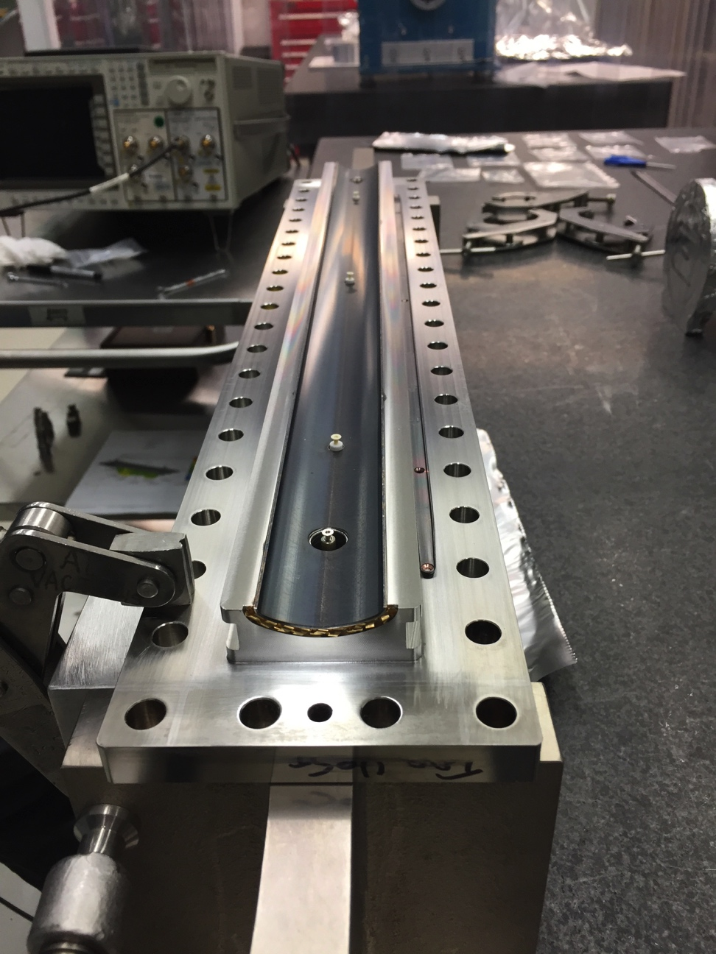
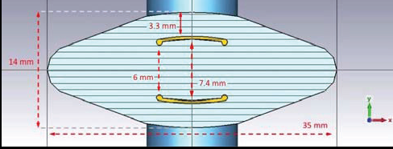
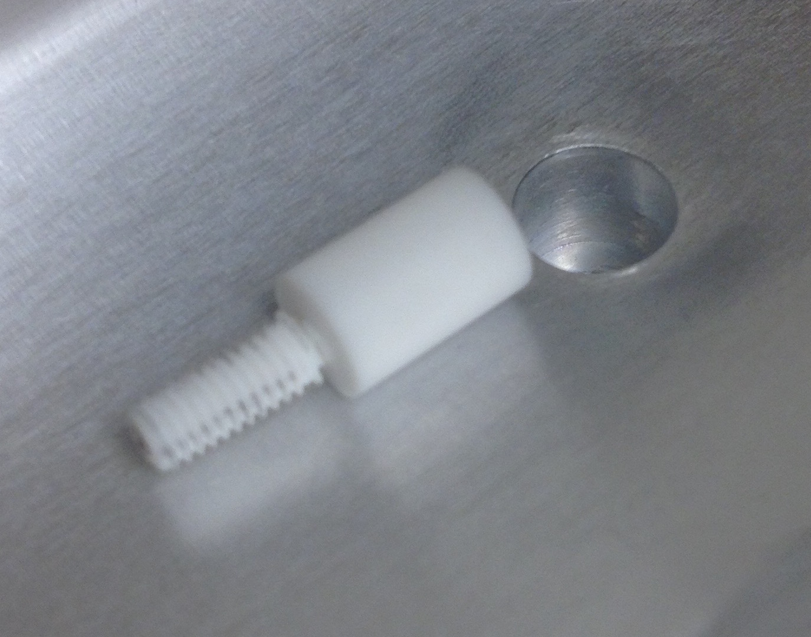
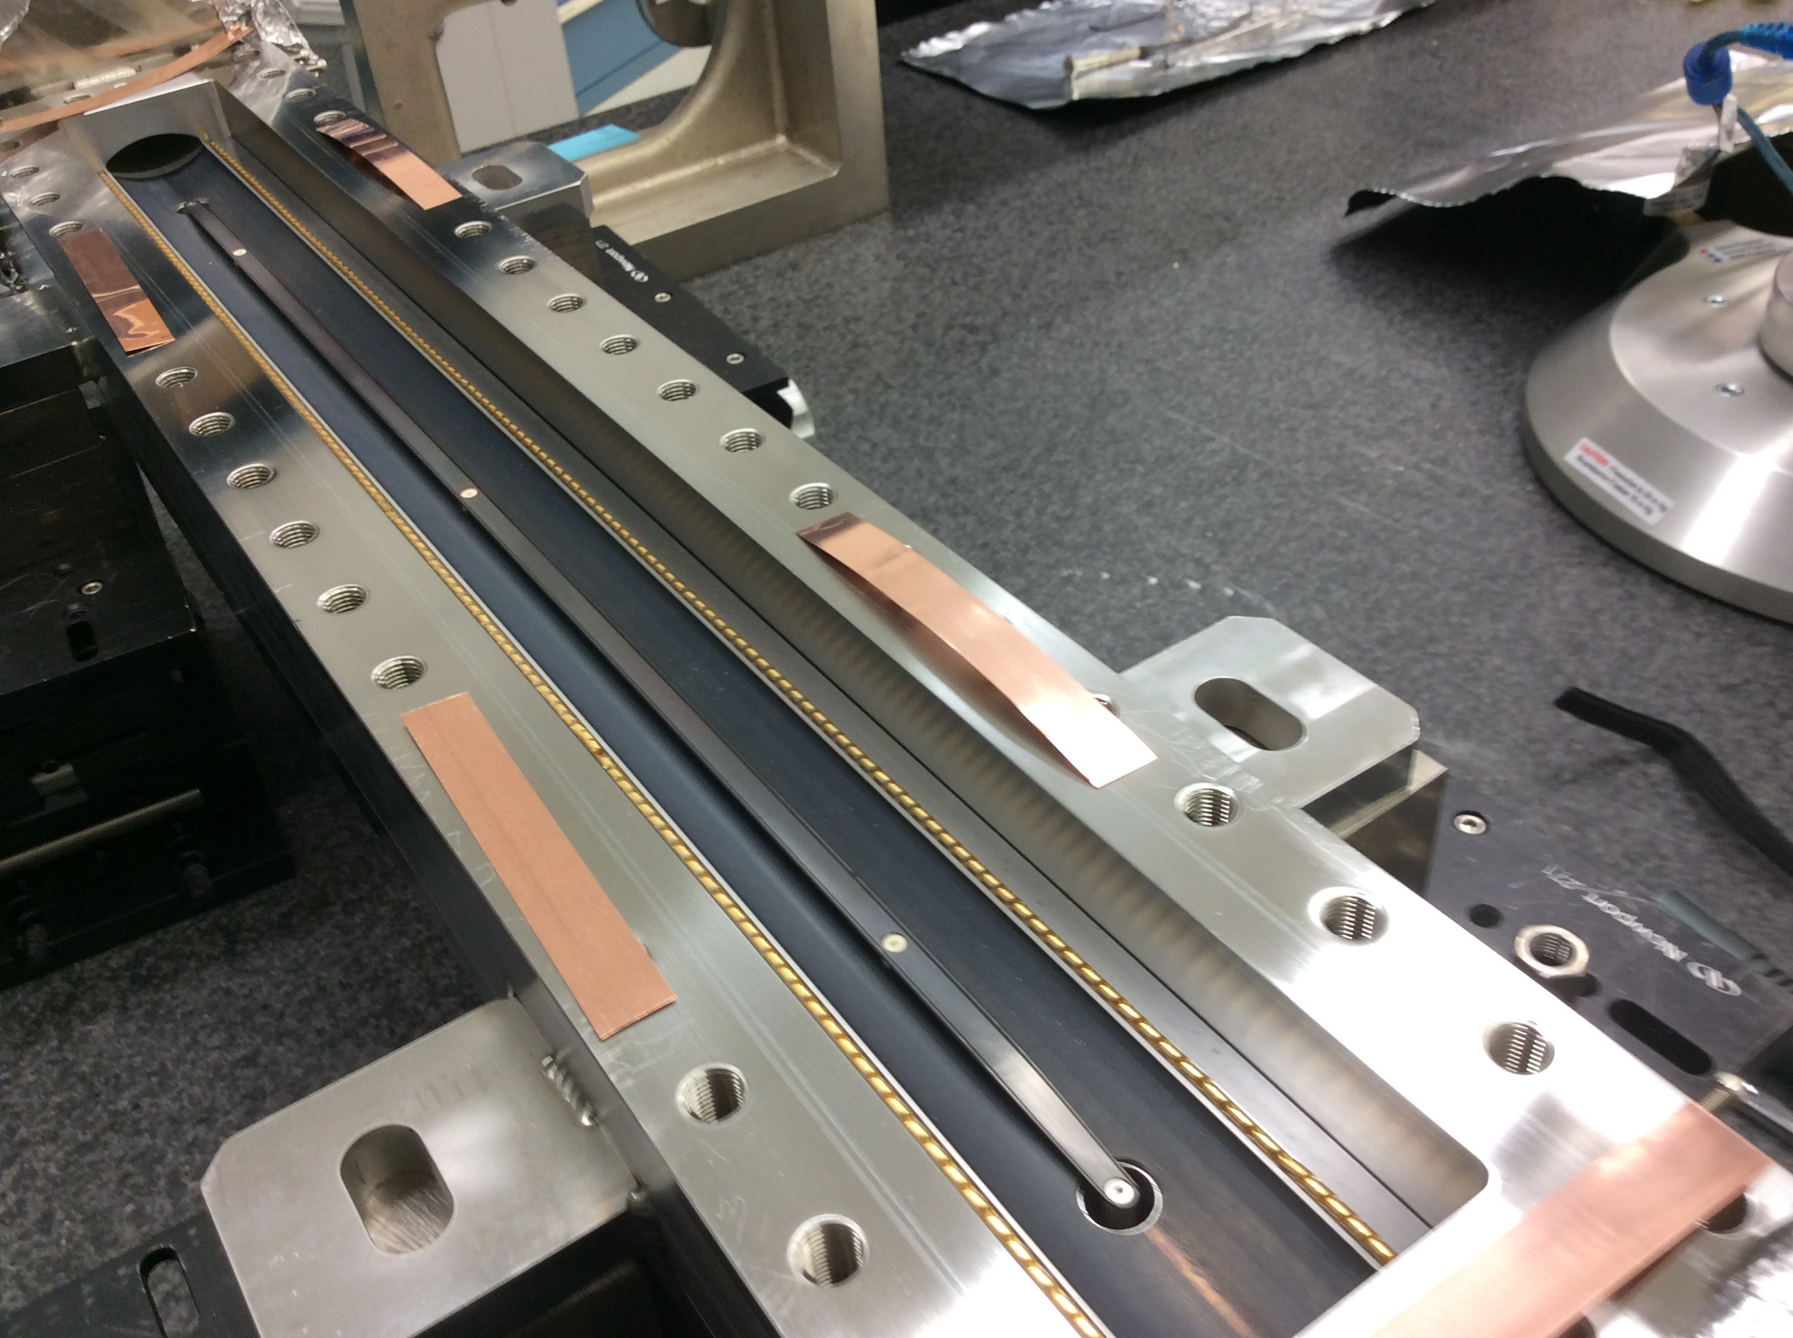
ALS-U Test Kicker
top
2.8 mm
14 mm
6 mm
7.2 mm
Macor supports
35 mm
bottom
0.5 m long stripline kicker, with same aperture as ALS-U modules and the inductive adder pulser prototype were installed in a ALS straight.
Horizontal dimensions have to be much larger, which why fenders are not used.
Cold test model also built.
Sliding joints
Cupric oxide deposition to increase thermal emissivity

Slide 14
Various aspects of the design have been investigated with modeling and hardware tests
2D modeling
  Stripline impedances
  Peak electric fields (HV breakdown)
  Electromagnetic fields (kick amplitude)
3D modeling
  Feedthrough impedance
  Tapered end effects
  Effects of ceramic supports on impedance and losses
  Simulated beam interaction, absorbed beam power
Cold model testing
  TDR measurements for detailed impedance analysis of actual hardware which includes real feedthroughs and fabrication tolerances
System testing in ALS storage ring
  High voltage operation
  Thermal cycling
  Vacuum performance
  Deflection of beam
  Power coupled from beam
  Effects of cables and terminations
  Diagnostics

Slide 15
TDR Measurements As Kicker Diagnostics
Good impedance matching is essential for proper kicker operation:
  Deviations from the nominal 50 Ω odd mode characteristic impedance causes reflections of the deflecting pulse slowing its rise/fall time.
  Changes of the 73 Ω even mode impedance along the kicker may increase its beam coupling impedance and therefore the amount of the deposited beam power to be dissipated.
Due to the small transverse dimension impedance values are very sensitive to the electrodes position in the vacuum chamber.
  Kicker chamber halves open: TDR measurements used to guide in proper positioning of each stripline electrode.
  Kicker fully assembled: TDR measurements used to verify electrodes state at various stages (after assembly, baking, operations with beam)

Slide 16
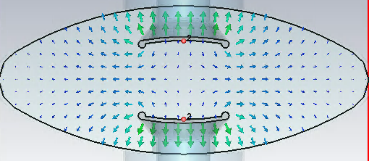
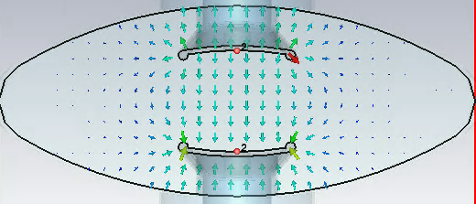
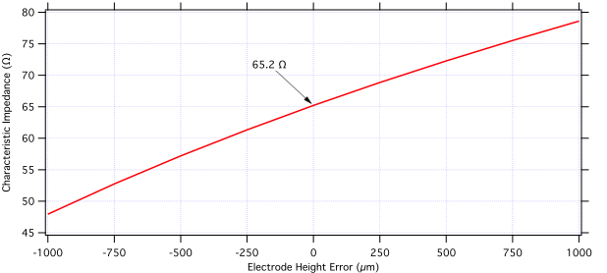
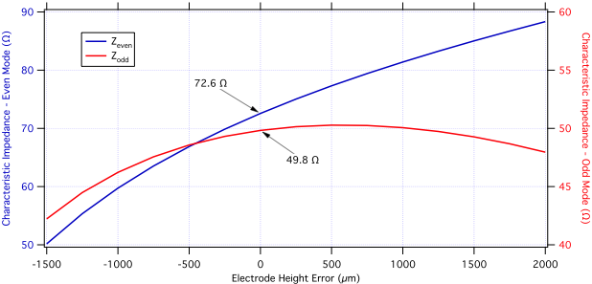
Characteristic Impedance Values For Half and Fully Assembled Kicker
even
odd
CST Microwave Studio
ANSYS Maxwell
Full Kicker
Half Kicker
Characteristic impedance highly sensitive of electrode position

Slide 17
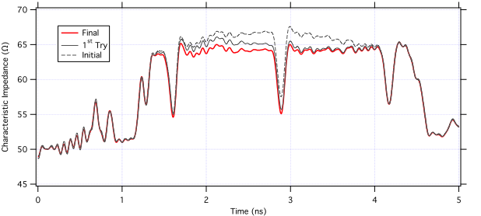
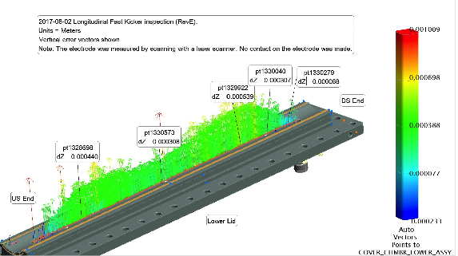
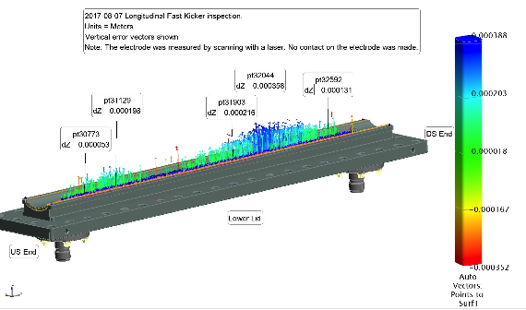
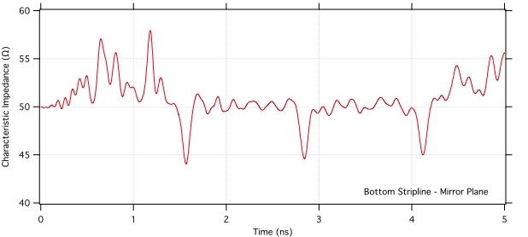
TDR Measurements (Kicker Halves)
Stripline height can more easily be corrected in an open half kicker. TDR measurements (left), supplemented by laser scans (below), are used to reach the desired alignment.

Slide 18
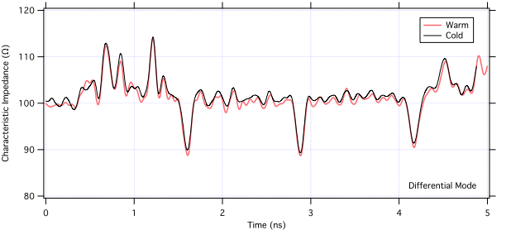
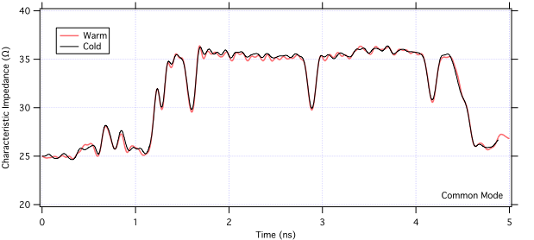
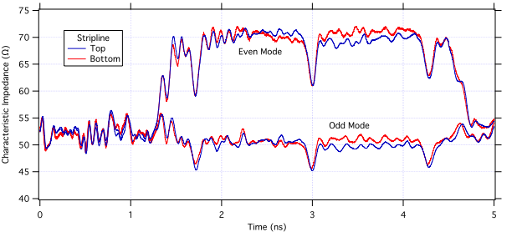
TDR Measurements (Full Assembly)
After the kicker is fully assembled, we can measure even and odd mode impedances along the striplines (left). Measurements below show measurements of differential and common mode impedances after final assembly and during initial baking at 70 °C. Z_{diff} and Z_{comm} can be measured directly with a 2-channel TDR and are linked to the impedance of the individual striplines by:

Slide 19
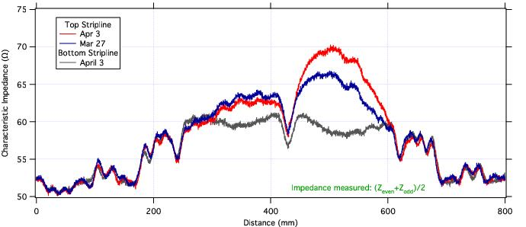
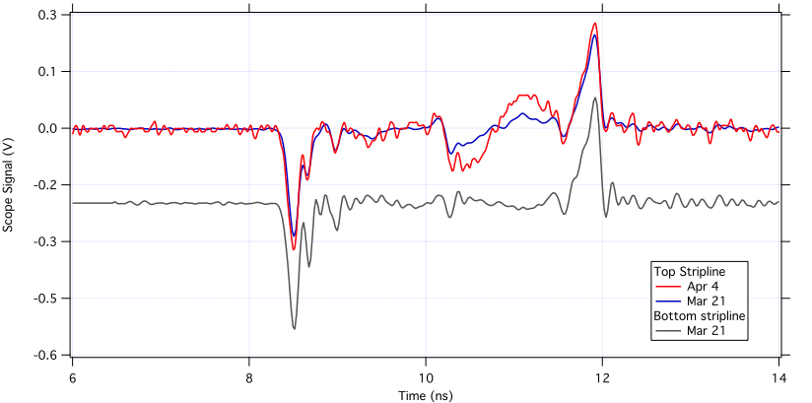
Diagnostics based on beam signals and TDR measurements during operational intervals (original stripline: Mar-Apr ‘17)
after 4x beam power accident
dielectric spacers
On-line diagnostic: 8 GHz bandwidth scope analyzes beam-induced signals. Response in the top stripline shows increasing impedance mismatch due to electrode deformation right of the center spacer.
Off-line diagnostic: Requires ring access; not possible during beam operations. TDR measurement of stripline characteristic impedance. From this data a more quantitative assessment of the electrode displacement is possible.
Even this kicker operated within specs until a mishap caused excessive beam power to be absorbed (HHC cavities detuned at full current).

Slide 20
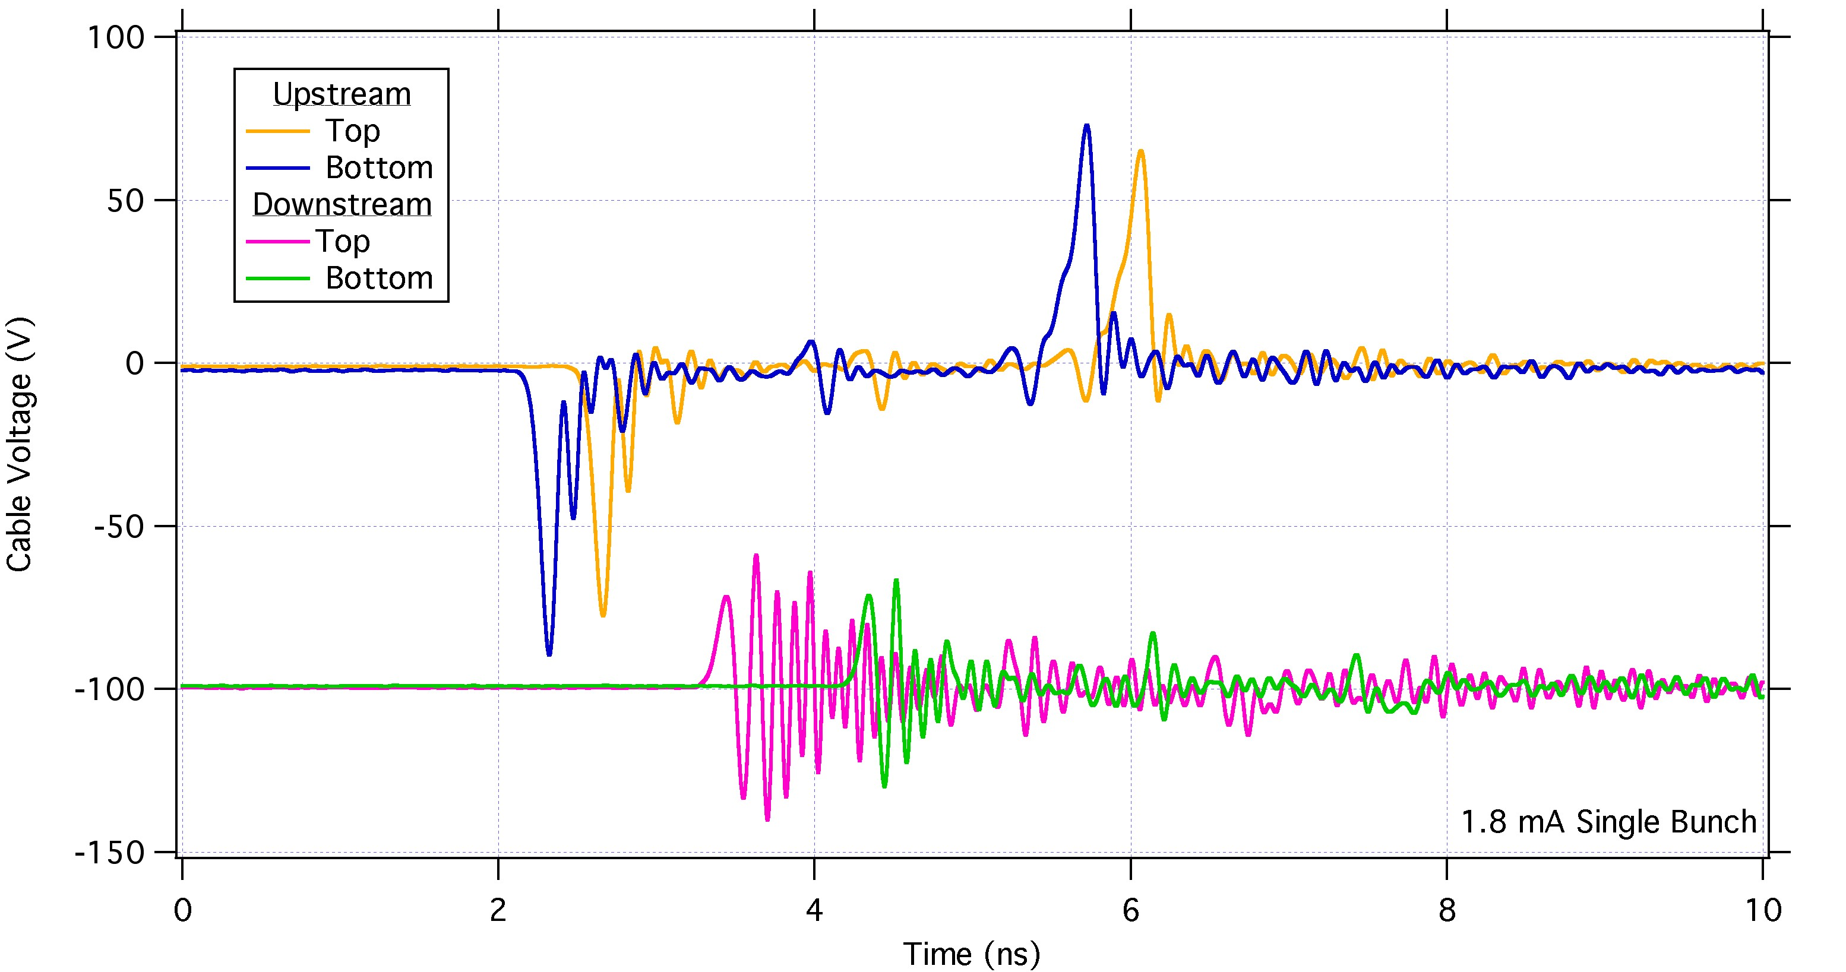
Re-installation and ALS operations: new stripline Sep ‘17
New stripline:
Improved assembly process
Larger sliding joints
Pulser test
Kicker successfully installed. Temperature sensors show minimal heating from full ALS beam.
Beam based tests of the deflecting field prove excellent integration with pulser, essentially satisfying ALS-U requirements.

Slide 21
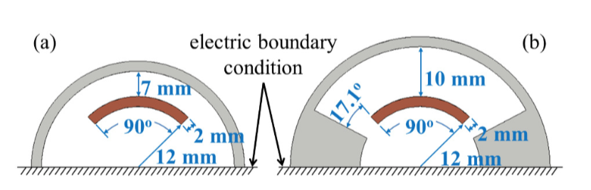
Conclusions
ALS-U
Studies for the SIRIUS feedback kicker
Kicker and BPM striplines are very well understood components.
There is a wealth of theoretical methods, simulation codes, bench measurement techniques available for their design.
In extreme conditions they can still be challenging projects: ALS Test Kicker is the smallest aperture stripline ever installed on a storage ring.

Slide 22
Extra Slides

Slide 23
The ALS-U Test Kicker Timeline
Jan/Feb: kicker with original stripline version assembled and installed on the ALS.
Mar: kicker tested with increasing beam current during the ALS restart, up to 500 mA, in passive mode.
Mar: kicker and pulser tested with ALS beam.
Mar 28th: due to operational mishap, full beam injected with harmonic cavities detuned. Shorter bunches and higher peak current briefly increased electrodes temperature before beam dump. Beam lifetime reduction observed and following measurement of reduced beam aperture and changes in beam induced signal in kicker, removal follows.
Apr: TDR measurements and visual survey after kicker chamber can be opened evidenced sag in downstream half of top stripline, up to 2 mm away from nominal position.
Aug: kicker with new stripline assembled and installed on the ALS.
Sept: measurements with beam.

Slide 24
The original design of the stripline kicker electrodes has been improved to accommodate a higher temperature rise
TDR and beam-induced signal measurements confirmed that the kicker electrode design was acceptable for normal ALS beam conditions where there is beam lengthening with a harmonic cavity
When the harmonic cavity was detuned and the bunches were short, excessive power coupled to a kicker electrode and it deformed by ~2mm
Modifications to reduce the impact of beam heating
  Robust electrodes and improved processing
  Expansion joints with larger range (from 0.22mm to 0.6mm)
  Added diagnostics and interlocks
Beam power loss (500mA) – into electrodes, chamber, cables, feedthroughs, and terminations estimated by CST simulations
  ALS without bunch lengthening: 243W (5mm RMS bunch length) – detailed model from CAD
  ALS with bunch lengthening: 84W (9mm RMS bunch length) – detailed model from CAD
  ALS-U with bunch lengthening: 28W (9mm RMS bunch length) – much simpler model, likely to be low

Slide 25
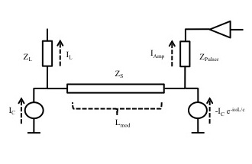
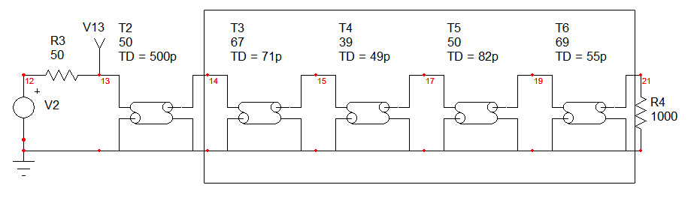
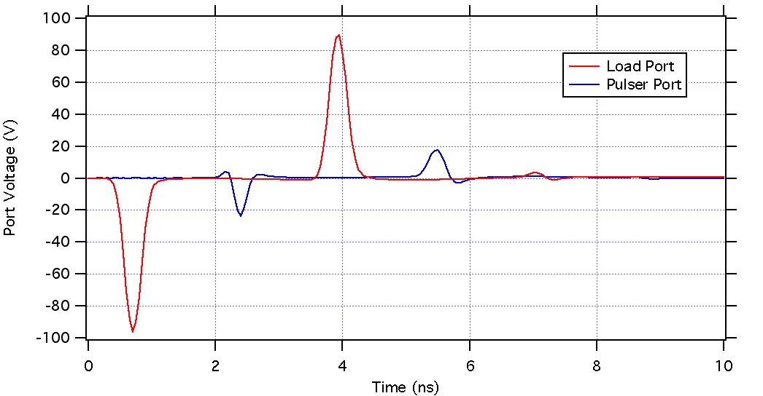
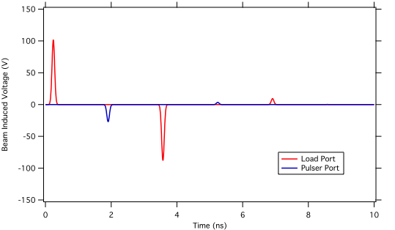
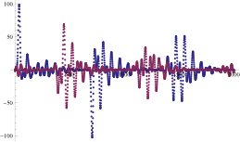
Non-Ideal Loads/Feedthroughs
Stripline excited by the beam (even mode) is mismatched. This causes beam signals to be induced in the pulser port and to bounce back and forth
analytical model
Loads and feedthroughs are not 50 Ω all over the beam spectrum
High-frequency feedthrough model based on TDR measurements
CST simulation
Ideal, purely resistive, load
15

Slide 26
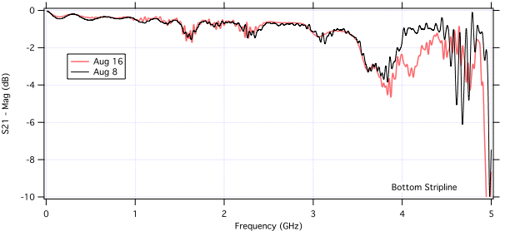
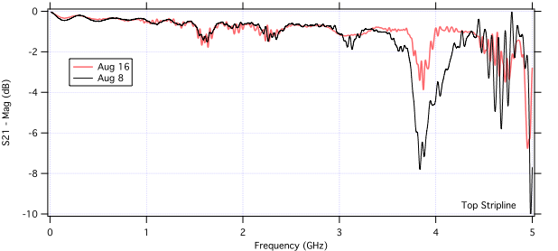
NWA Measurements (Full Assembly)
Network analizer measurements are also performed on the assembled kicker to identify possible defects with a high frequency response.
Beampipe cutoff is around 5 GHz.
The peak just below 4 GHz corresponds to an absorption peak in the Ceramaseal feedthroughs ( see my LER 2016 presentation).
The origin of the differences between the two sets of measurements is unclear. However, the kicker had been assembled on August 8th with a large offset due to a failing TDR module and one of the cables used in the measurements was found to be defective a few days later.

