Slide 1
Multiphysics simulations of impedance effects in accelerators
C. Zannini

Slide 2
Overview
Multiphysics simulations
Application to impedance effects
  Design loop
    EM field calculations
    Power loss calculations
    Thermal calculations
    Structural calculations
  Examples
  Component design flow process

Slide 3
Overview
Multiphysics simulations
Application to impedance effects
  Design loop
    EM field calculations
    Power loss calculations
    Thermal calculations
    Structural calculations
  Examples
  Component design flow process

Slide 4
Multiphysics simulations
Multiphysics treats simulations that involve multiple physical model
Electromagnetic simulations
Impedance
Effect on Beam
Electromagnetic simulations
Impedance
Induced effects
Multiphysics design loop for electromagnetic components
EM fields
Thermal
Structural
Commercial FEM simulation codes allow performing the multiphysics design loop

Slide 5
Overview
Multiphysics simulations
Application to impedance effects
  Design loop
    EM field calculations
    Power loss calculations
    Thermal calculations
    Structural calculations
  Examples
  Component design flow process

Slide 6
Application to impedance effects
Flow in the same physical model
Multiphysics design loop for beam coupling impedance
Outputs
Change of physical model
Wakefields
Beam Induced
EM fields
Power loss density map
Thermal
Thermal map
Stress map
Deformed mesh
Structural
CST allows performing the multiphysics design loop for beam coupling impedance

Slide 7
Application to impedance effects
Multiphysics design loop for beam coupling impedance
Wakefields
Beam Induced
EM fields
Power loss density map
Thermal
Thermal map
Stress map
Deformed mesh
Structural

Slide 8
EM field calculations
Multiphysics design loop for beam coupling impedance
Wakefields
Beam Induced
EM fields
Power loss density map
Thermal
Thermal map
Stress map
Deformed mesh
Structural
Eigenmode, Frequency domain, Time domain (Transient solver, Wakefield solver)

Slide 9
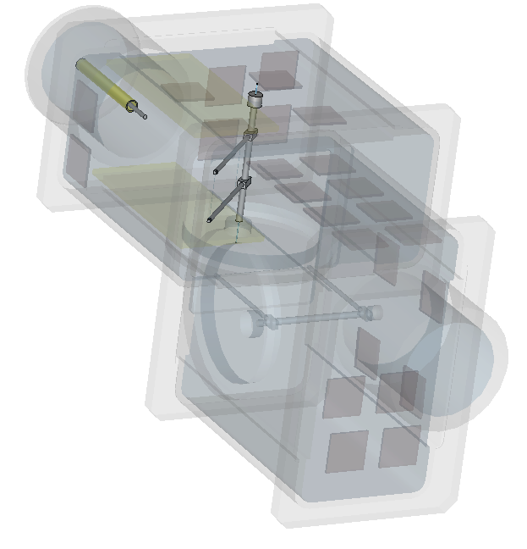
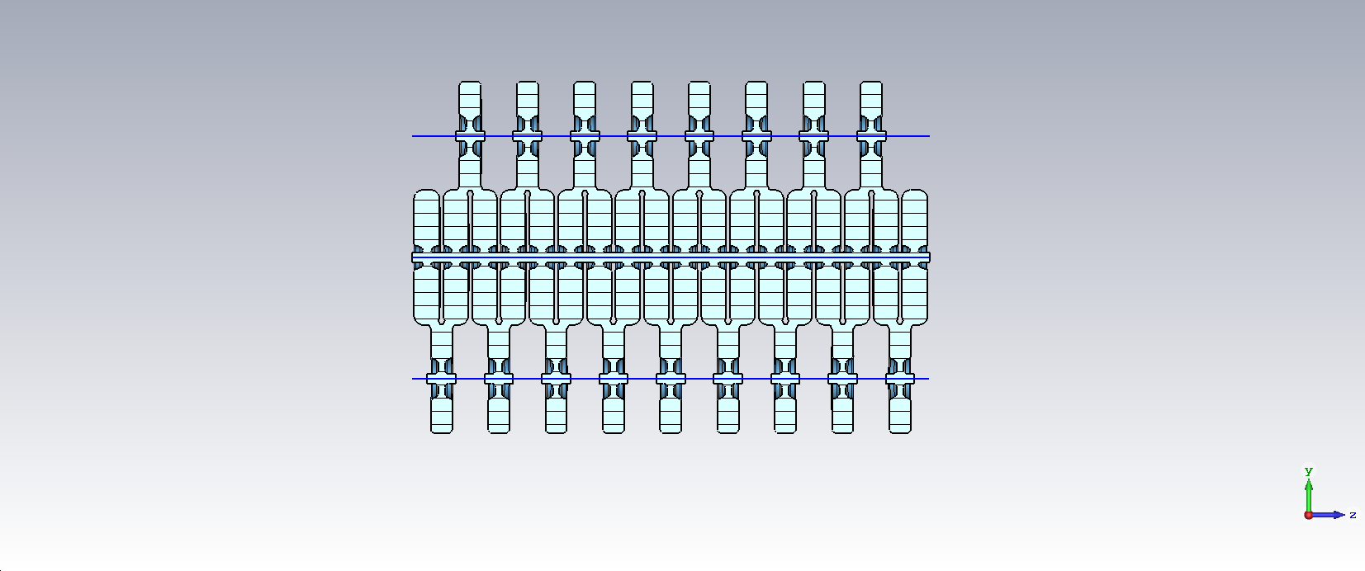
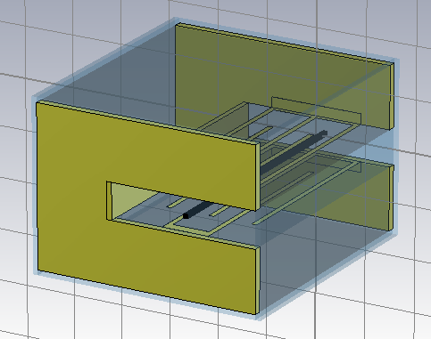
EM field calculations
Frequency Domain
Time Domain
Eigenmode
Transient Solver
Wakefield Solver

Slide 10
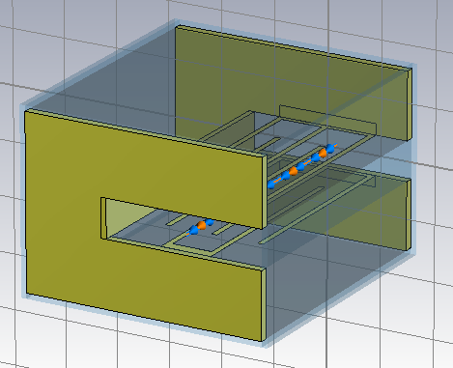
EM field calculations
Frequency Domain
Time Domain
Eigenmode
Transient Solver
Wakefield Solver

Slide 11
EM field calculations
Multiphysics design loop for beam coupling impedance
Wakefields
Beam Induced
EM fields
Power loss density map
Thermal
Thermal map
Stress map
Deformed mesh
Structural
Eigenmode, Frequency domain, Time domain (Transient solver, Wakefield solver)
Fields map

Slide 12
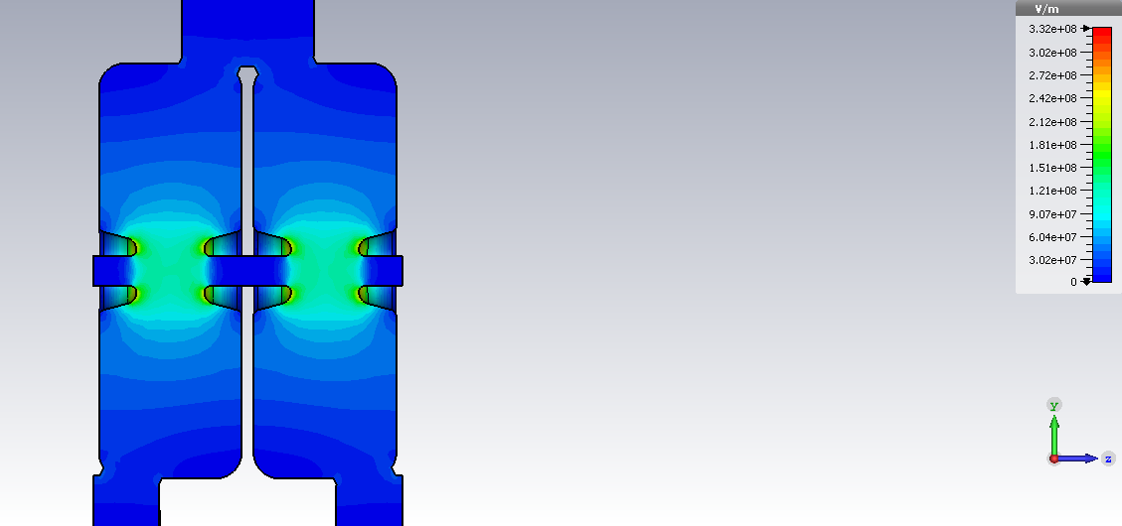
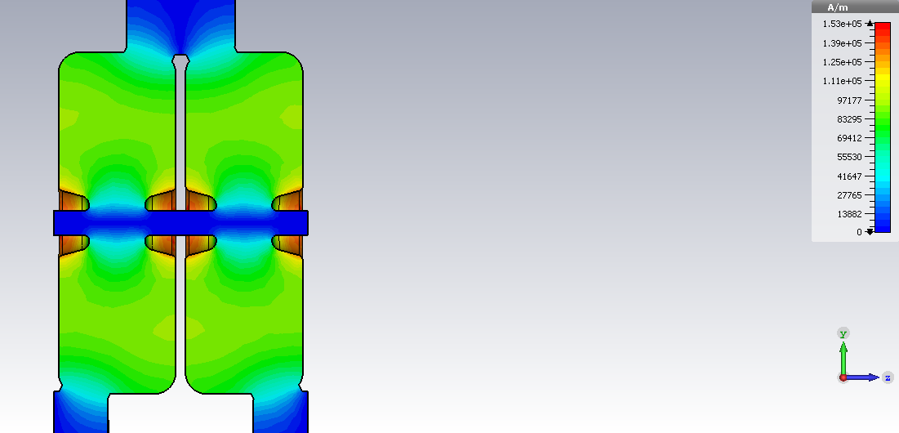
EM field calculations
E-field
H-field

Slide 13
EM field calculations
Multiphysics design loop for beam coupling impedance
Wakefields
Beam Induced
EM fields
Power loss density map
Thermal
Thermal map
Stress map
Deformed mesh
Structural
Post processing of Eigenmode, Frequency domain, Transient solver or Wakefield solver calculation.

Slide 14
EM field calculations
Frequency Domain
Time Domain
Eigenmode
Transient Solver
Wakefield Solver
E (f)
Z (f)
S₂₁ (f)
Z (f)
S₂₁ (f)
Z (f)

Slide 15
EM field calculations
Frequency Domain
Time Domain
Eigenmode
Transient Solver
Wakefield Solver
E (f)
Z (f)
S₂₁ (f)
Z (f)

Slide 16
EM field calculations
Multiphysics design loop for beam coupling impedance
Wakefields
Beam Induced
EM fields
Power loss density map
Thermal
Thermal map
Stress map
Deformed mesh
Structural
Power loss
Eigenmode, Frequency domain, Time domain (Transient solver, Wakefield solver)
Fields map
Power loss density map

Slide 17
EM field calculations
Multiphysics design loop for beam coupling impedance
Wakefields
Beam Induced
EM fields
Power loss density map
Thermal
Thermal map
Stress map
Normalization to the beam induced power loss
Deformed mesh
Structural
Power loss
Eigenmode, Frequency domain, Time domain (Transient solver, Wakefield solver)
Fields map
Power loss density map

Slide 18

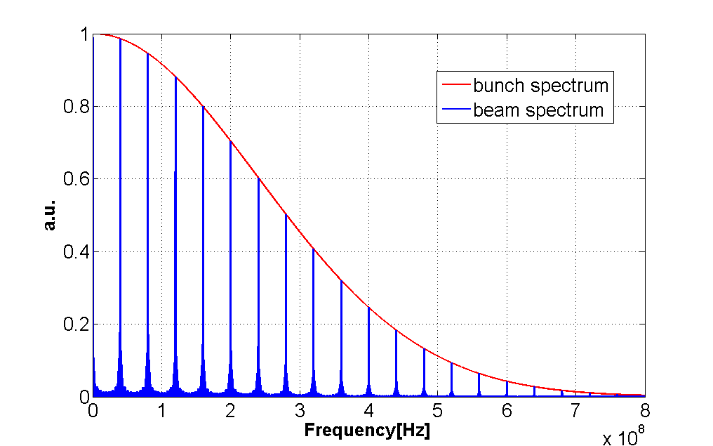
Power loss calculations
Normalized beam spectrum
72
8
72
8
72
8
72
612
25 ns beam
Normalization to the beam induced power loss

Slide 19
Thermal calculations
Multiphysics design loop for beam coupling impedance
Wakefields
Beam Induced
EM fields
Power loss density map
Thermal
Thermal map
Stress map
Deformed mesh
Structural
Define material properties and boundary conditions
Run thermal simulation

Slide 20
Thermal calculations
Multiphysics design loop for beam coupling impedance
Wakefields
Beam Induced
EM fields
Power loss density map
Thermal
Thermal map
Stress map
Deformed mesh
Structural
Identify hot spots and drive design modifications and cooling efficiency optimization

Slide 21
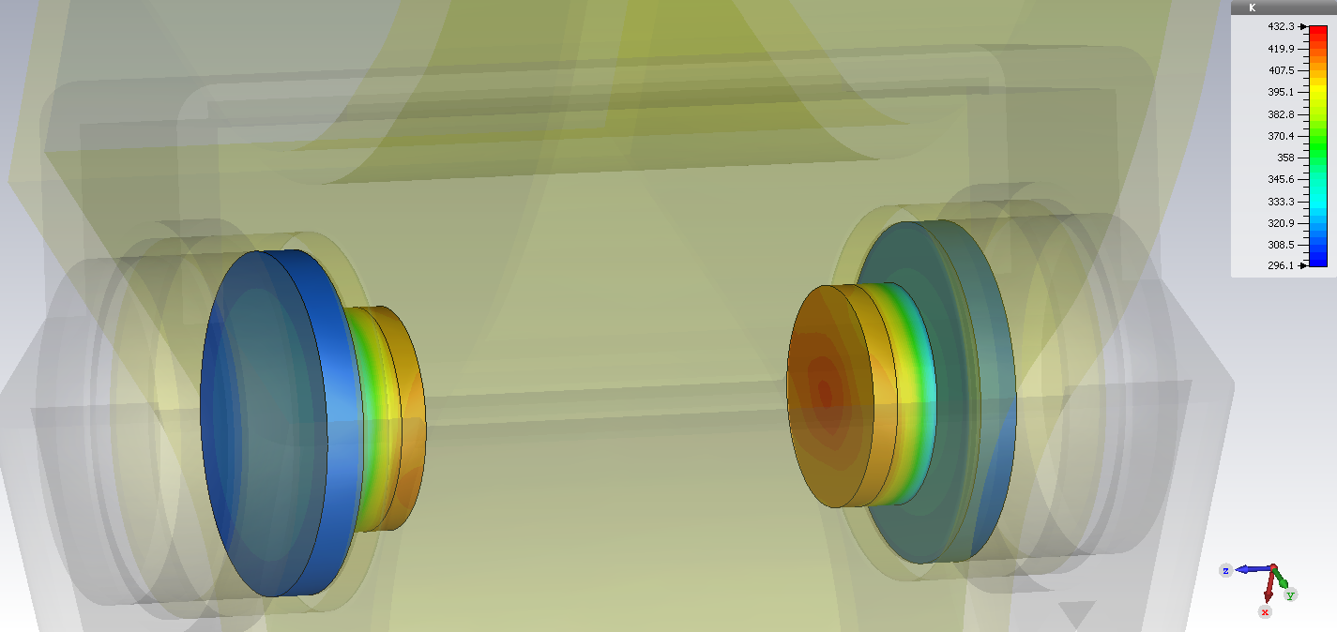
Thermal calculations
Ferrite is heated to 160 °C (Curie temperature is 200 °C)

Slide 22
Structural calculations
Multiphysics design loop for beam coupling impedance
Wakefields
Beam Induced
EM fields
Power loss density map
Thermal
Thermal map
Stress map
Deformed mesh
Structural
Define material properties and boundary conditions
Run mechanical simulation

Slide 23
Structural calculations
Multiphysics design loop for beam coupling impedance
Wakefields
Beam Induced
EM fields
Power loss density map
Thermal
Thermal map
Stress map
Deformed mesh
Structural
Identify critical points, possible breaking points and modify design accordingly

Slide 24
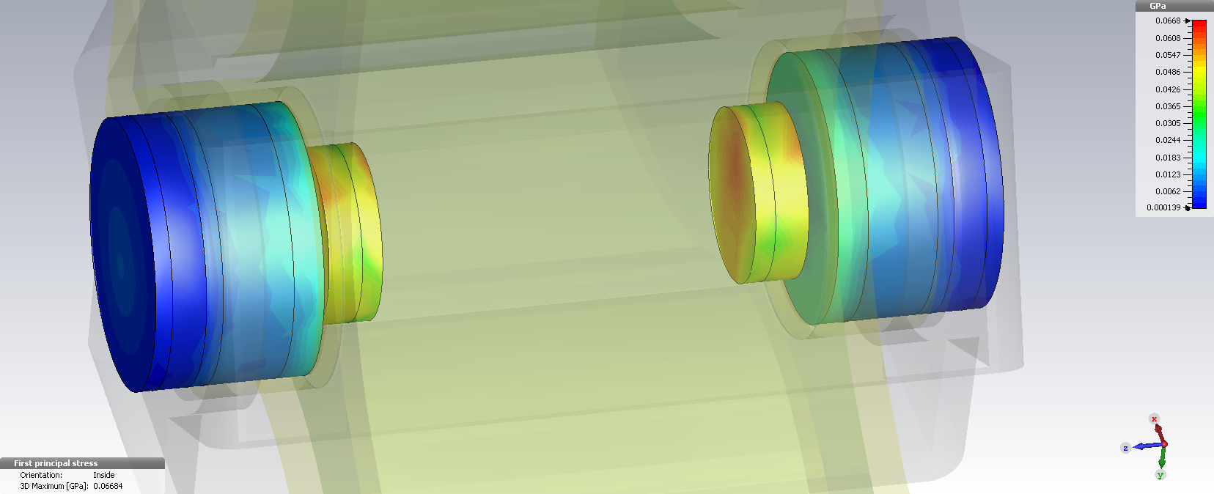
Structural calculations
Maximum stress below 100 MPa. The component could survive without cooling.

Slide 25
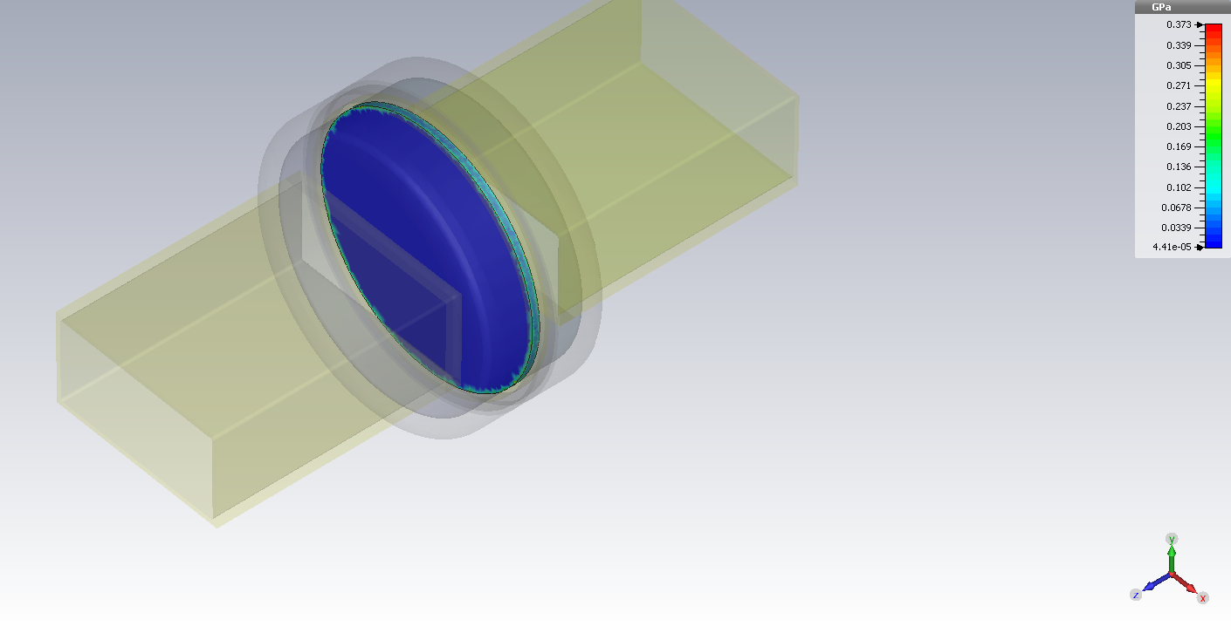
Structural calculations
Maximum stress is around 400 MPa. Probably too high for Alumina plates
Maximum heating is expected on the window (ΔT ≈ 6 °C)

Slide 26
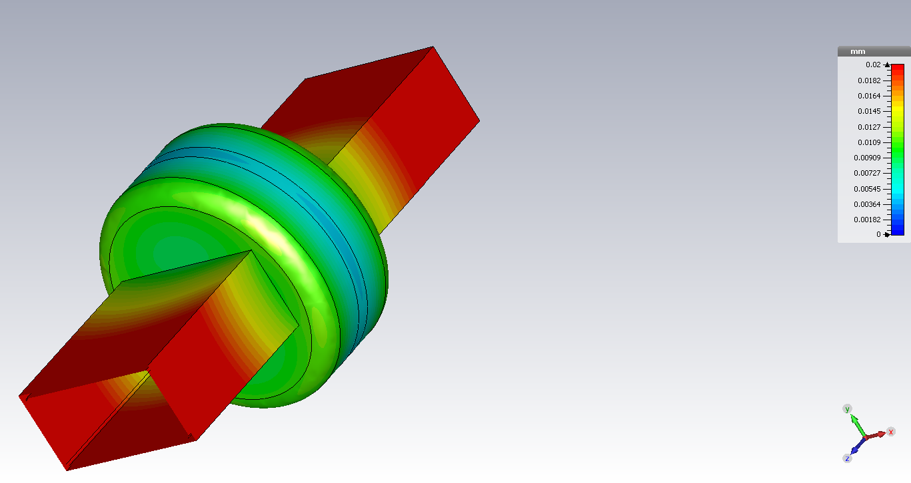
Structural calculations

Slide 27
Structural calculations
Multiphysics design loop for beam coupling impedance
Wakefields
Beam Induced
EM fields
Power loss density map
Thermal
Thermal map
Stress map
Deformed mesh
Structural
Export deformed mesh and use that mesh as input of a new beam induced field simulation

Slide 28
Structural calculations
Wakefields
Beam Induced
EM fields
Power loss density map
Thermal
Thermal map
Stress map
Deformed mesh
Structural
Export deformed mesh and use that mesh as input of a new beam induced field simulation
Impedance variation due to deformation

Slide 29
Overview
Multiphysics simulations
Application to impedance effects
  Design loop
    EM field calculations
    Power loss calculations
    Thermal calculations
    Structural calculations
  Examples
  Component design flow process

Slide 30
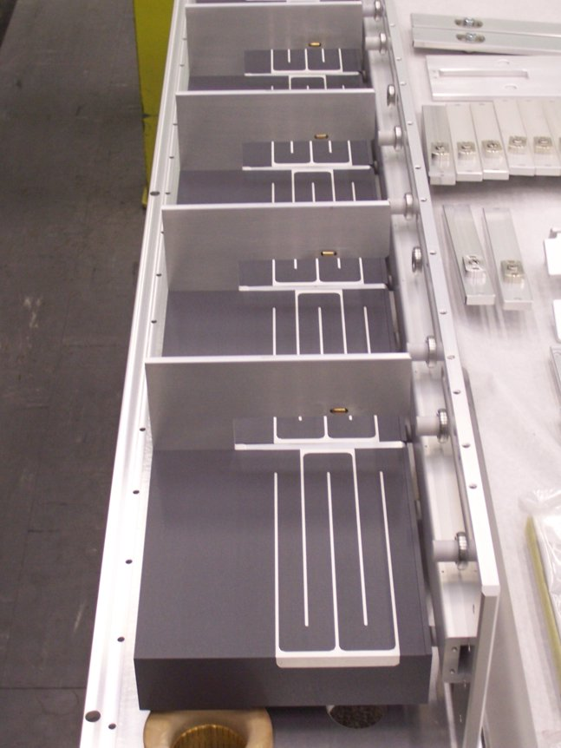
Example: CERN-SPS extraction kicker
Serigraphy

Slide 31
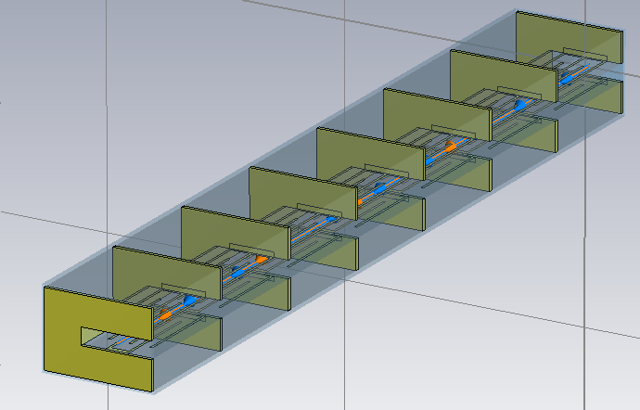
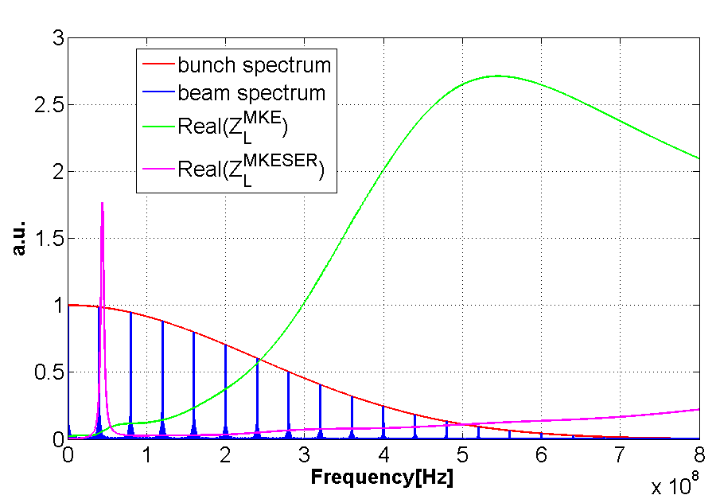
Example: CERN-SPS extraction kicker
  Beam induced heating model
λ/4 resonance on the serigraphy finger length
C. Zannini, Electromagnetic simulations of CERN accelerator components and experimental applications. PhD thesis, Lausanne, EPFL, 2013. CERN-THESIS-2013-076.
Finger length optimization to minimize beam induced power loss
  The impedance model of the SPS extraction kicker with and without serigraphy can explain the beam induced heating observed in the SPS machine
Minimization of ferrite beam induced heating

Slide 32
Example: wire scanner
  Beam induced heating model
C. Zannini, Electromagnetic simulations of CERN accelerator components and experimental applications. PhD thesis, Lausanne, EPFL, 2013. CERN-THESIS-2013-076.
  The impedance model of the SPS extraction kicker with and without serigraphy can explain the beam induced heating observed in the SPS machine
Could wire breaking be related to beam induced heating?

Slide 33
Overview
Multiphysics simulations
Application to impedance effects
  Design loop
    EM field calculations
    Power loss calculations
    Thermal calculations
    Structural calculations
  Examples
  Component design flow process

Slide 34
Component design flow process
Impedance perspective
New devices
(BI, RF, Magnets etc.)
Impedance compliant
In design
Modification needed
Impedance check
Modification needed
Functional design
Impedance check
(All impedance induced effects)
Detailed design

Slide 35
http://www.advancedoncotherapy.com/
Thank you very much for your attention

Slide 36
http://www.advancedoncotherapy.com/
Acknowledgments: G. De Michele, E. Mètral, G. Rumolo, B. Salvant, V.G. Vaccaro
Thank you very much for your attention

