Slide 1
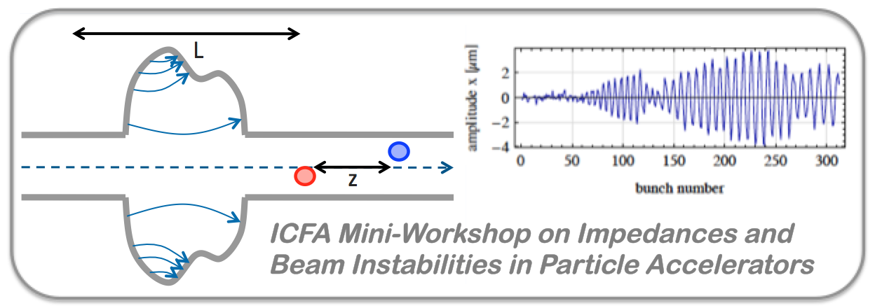


Welcome and General Introduction
S. Petracca (University of Sannio),
M.R. Masullo (INFN Naples), G. Rumolo (CERN)
http://prewww.unisannio.it/workshopwakefields2017/
https://agenda.infn.it/conferenceDisplay.py?confId=12603
ICFA mini-Workshop on Impedances and Beam Instabilities in Particle Accelerators
Benevento, September 19-22, 2017

Slide 2
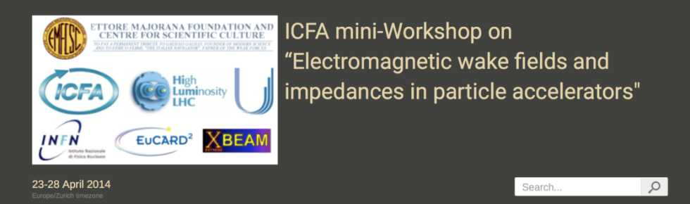

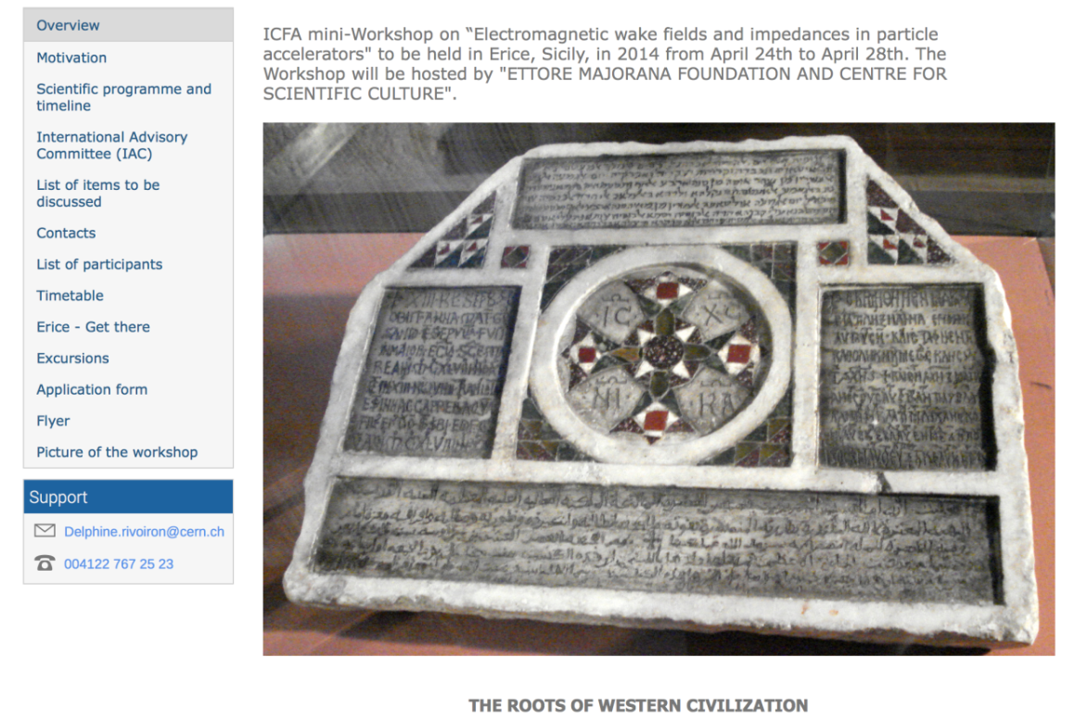
The First Workshop on Impedances
First Workshop on Impedances was held in Erice, Sicily (April 2014)
  Very successful event!
  Lots of participants and
  exciting discussions!
https://indico.cern.ch/event/287930/
ICFA mini-Workshop on Impedances and Beam Instabilities in Particle Accelerators
Benevento, September 19-22, 2017

Slide 3
This Workshop
At the end of 2016, we proposed to organize a 2nd workshop, extending the original scope of the 2014 workshop to include also beam instabilities,
and related issues:
  Beam coupling impedance/wake calculations
  Beam coupling impedance measurements
  Beam energy loss and RF heating
  Modeling of beam instabilities (analytical and numerical)
  Observation and mitigation of beam instabilities
ICFA mini-Workshop on Impedances and Beam Instabilities in Particle Accelerators
Benevento, September 19-22, 2017

Slide 4
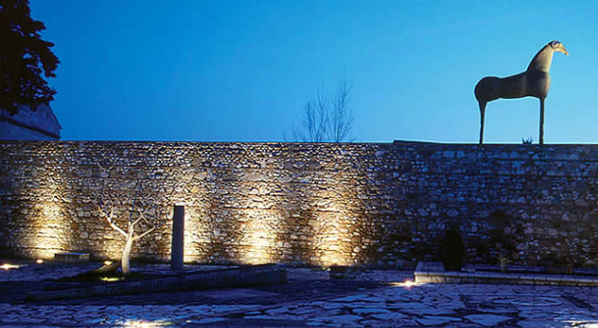

ICFA mini-WORKSHOP ON
IMPEDANCES AND BEAM INSTABILITIES
IN PARTICLE ACCELERATORS
September 19-22 2017, Benevento (Italy)
http://www.unisannio.it/workshopwakefields2017
Topics
- Beam coupling impedance/wake calculation
- Beam coupling impedance measurements
- Beam energy loss and RF heating
- Modeling of beam instabilities (analytical and numerical)
- Observations and mitigation of beam instabilities
Local Organizing Committee
Stefania Petracca (University of Sannio)
Maria Rosaria Masullo (INFN Naples)
ICFA mini-Workshop on Impedances and Beam Instabilities in Particle Accelerators
Benevento, September 19-22, 2017

Slide 5
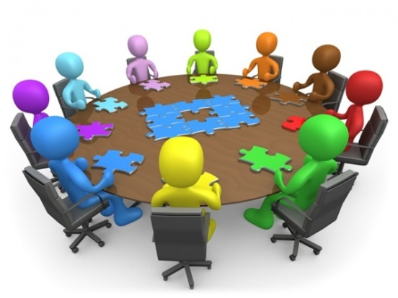
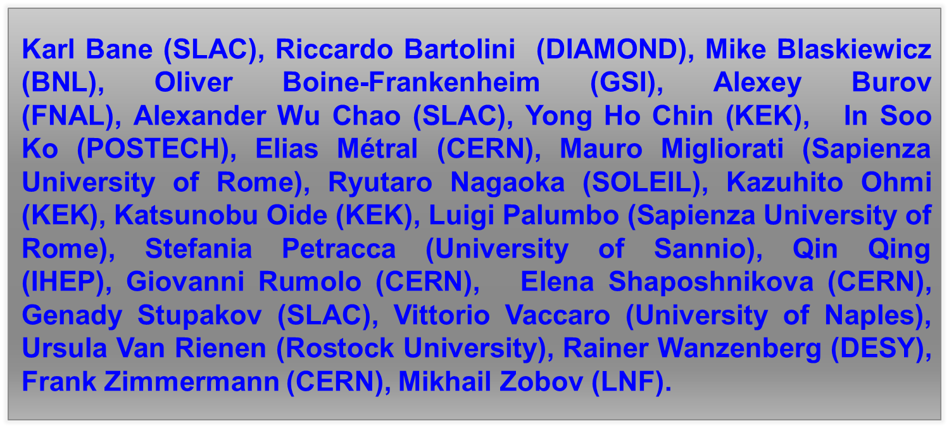
… Achieved Thanks to
the Help and support of our
International Advisory Committee
ICFA mini-Workshop on Impedances and Beam Instabilities in Particle Accelerators
Benevento, September 19-22, 2017

Slide 6
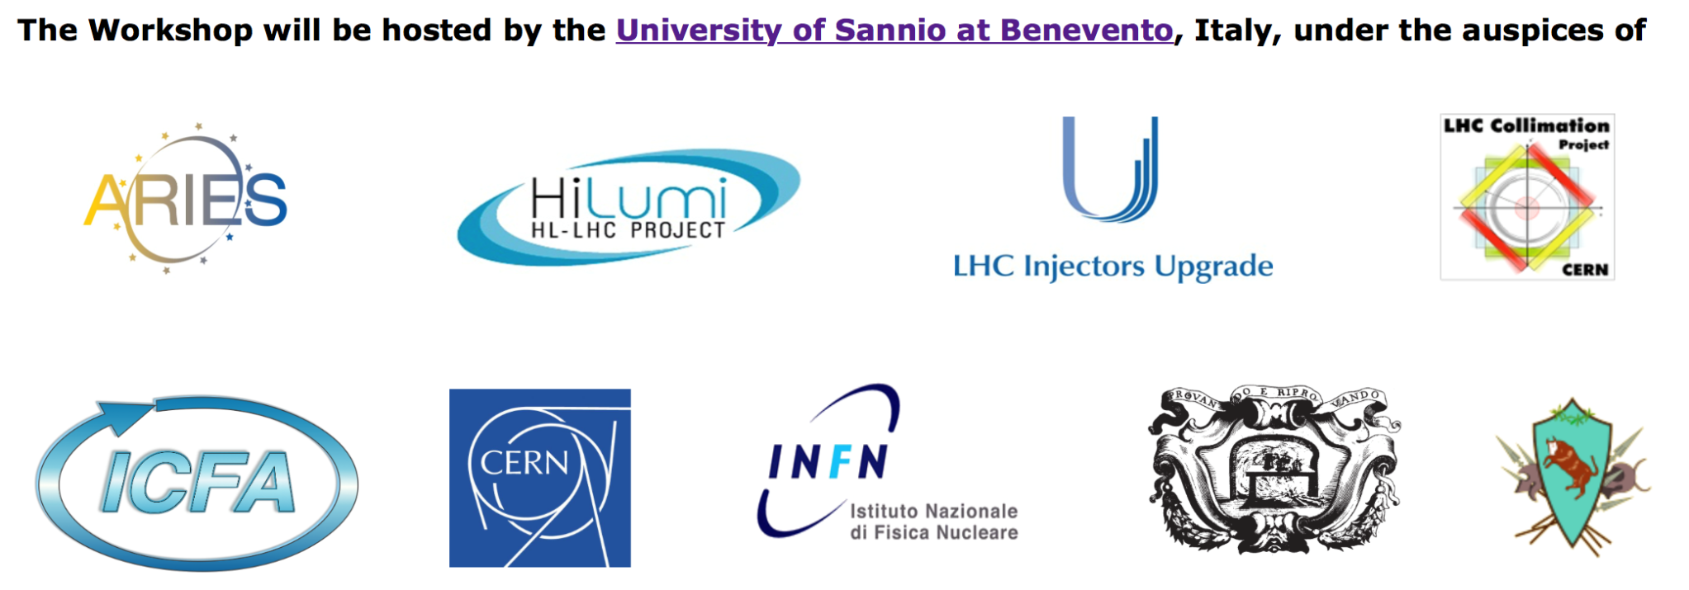

… and to the Generous Support/Endorsement by
… and the University of Sannio at Benevento, hosting the Workshop
ICFA mini-Workshop on Impedances and Beam Instabilities in Particle Accelerators
Benevento, September 19-22, 2017

Slide 7
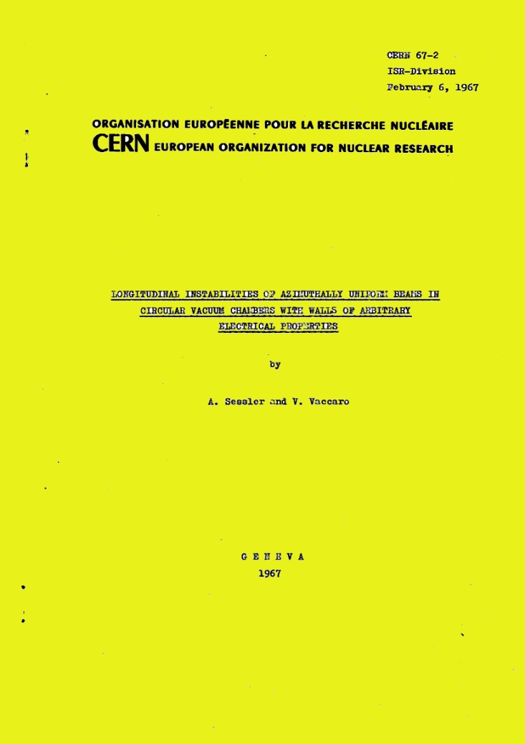
An Anniversary : 50 Years
The timing is ideal to celebrate the 50 years of the very concept of beam coupling impedance …
Many thanks Vittorio
on behalf
of this Community !!!
February 6, 1967
ICFA mini-Workshop on Impedances and Beam Instabilities in Particle Accelerators
Benevento, September 19-22, 2017

Slide 8
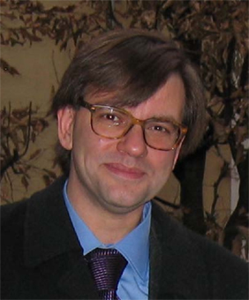
Another Anniversary : a Decennial
The timing is also appropriate to remember fondly, and honor a Colleague and friend who passed away 10 years ago, after giving an impressive, seminal contribution to the field of impedance and beam dynamics in the
presence of collective interactions
”Beauty is truth, truth beauty,
that is all Ye know on earth,
and all Ye need to know”
[John Keats, 1795-1821]
Francesco Ruggiero (1957 – 2007)
ICFA mini-Workshop on Impedances and Beam Instabilities in Particle Accelerators
Benevento, September 19-22, 2017
Notes:
…Francesco was born in Piano di Sorrento , not far (130 Km) from here…

Slide 9
Francesco’s Legacy
Francesco Ruggiero gave important contributions in a number of critical
issues related to beam coupling impedance and beam instabilities.
  Localised impedance sources and impedance database: a framework
The Coupling Impedance of each device must be computed
in at least two ways including :
      theoretical estimation;
      numerical simulation;
      bench measurements.
Need of an impedance patrol collaborating with designers
of accelerator devices!
Need to create an impedance database (Z-base) to provide input for beam dynamics sim- ulations/estimations
Impedance-aware design of devices for a machine (e.g. LHC)
ICFA mini-Workshop on Impedances and Beam Instabilities in Particle Accelerators
Benevento, September 19-22, 2017

Slide 10
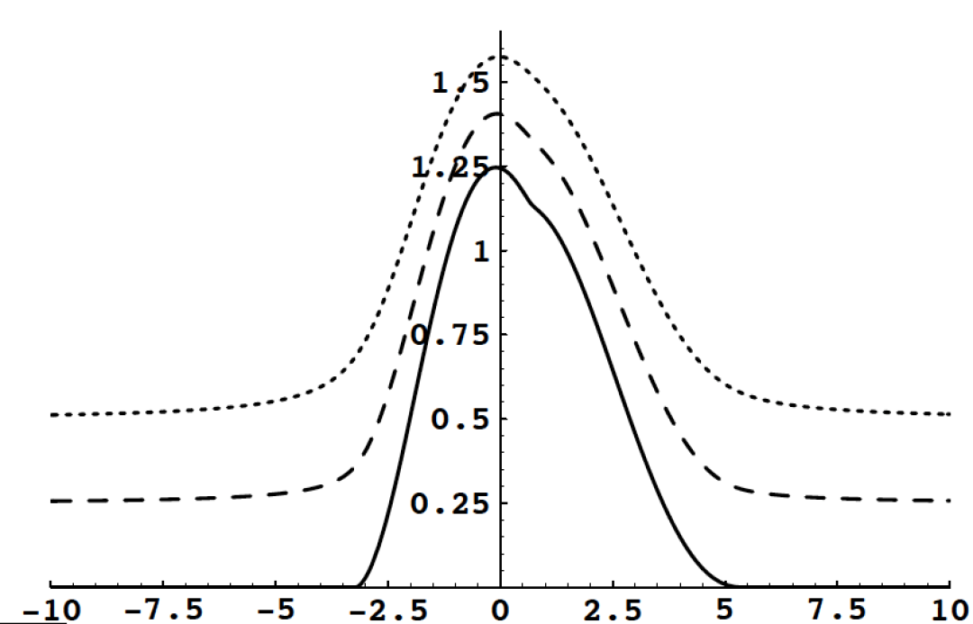
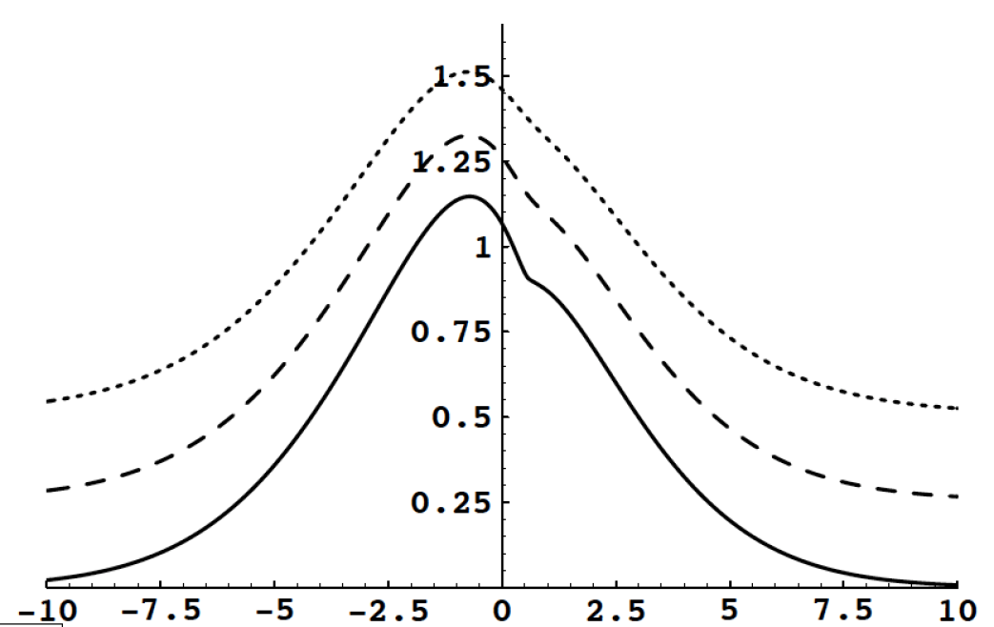
Francesco’s Legacy
Francesco Ruggiero gave important contributions in a number of critical
issus related to beam coupling impedance and beam instabilities
  Localised impedance sources and impedance database: a framework
  Landau damping in 2D from amplitude tune spread and in the presence
  of truncated tails
Stability diagram for Gaussian distribution with truncated tails
Stability diagram for Gaussian distribution
Beam stability in LHC strongly relies nowadays on amplitude detuning from octupoles!
Some of the observed instab-ilities might be ascribed to tail scraping on collimators
ICFA mini-Workshop on Impedances and Beam Instabilities in Particle Accelerators
Benevento, September 19-22, 2017

Slide 11
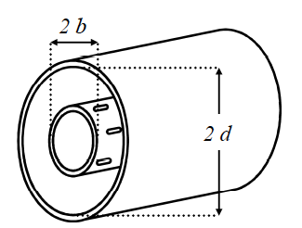


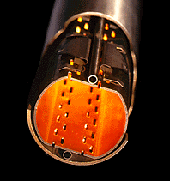
Francesco’s Legacy
Francesco Ruggiero gave important contributions in a number of critical
issues related to beam coupling impedance and beam instabilities
  Localised impedance sources and impedance database: a framework
  Landau damping in 2D from amplitude tune spread and in presence
  of truncated tails
  Impedance of the LHC beam screen (realistic model: rounded corners,
  Cu coating on StSt, pumping holes, welds, saw-tooth, etc.)
Ohmic losses in the coax region
ICFA mini-Workshop on Impedances and Beam Instabilities in Particle Accelerators
Benevento, September 19-22, 2017

Slide 12
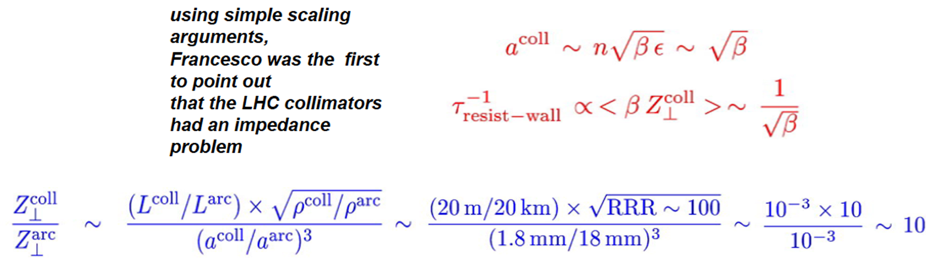
Francesco’s Legacy
Francesco Ruggiero gave important contributions in a number of critical
issues related to beam coupling impedance and beam instabilities
  Localised impedance sources and impedance database: a framework
  Landau damping in 2D from amplitude tune spread and in presence
  of truncated tails
  Impedance of the LHC beam screen (realistic model: rounded corners,
  Cu coating on StSt, pumping holes, welds, saw-tooth, etc.)
  Resistive wall impedance of the LHC collimators
ICFA mini-Workshop on Impedances and Beam Instabilities in Particle Accelerators
Benevento, September 19-22, 2017

Slide 13
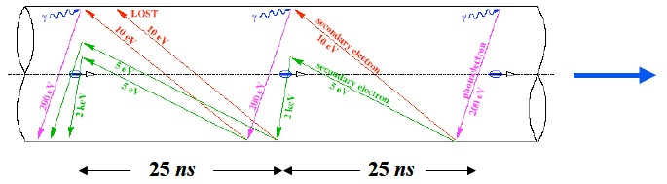
Francesco’s Legacy
Francesco Ruggiero gave important contributions in a number of critical
issues related to beam coupling impedance and beam instabilities
  Localised impedance sources and impedance database: a framework
  Landau damping in 2D from amplitude tune spread and in presence
  of truncated tails
  Impedance of the LHC beam screen (realistic model: rounded corners,
  Cu coating on StSt, pumping holes, welds, saw-tooth, etc.)
  Resistive wall impedance of the LHC collimators
  The electron cloud crash study program
Francesco was so farsighted as to predict that electron cloud would eventually limit LHC both in terms of heat load in the cold regions and beam stability!
Electron cloud R&D program worldwide were inspired by his thought and steady leadership in the field for many years
Many Thanks for all, Francesco !!!
LHC cloud buildup cartoon
by Francesco
ICFA mini-Workshop on Impedances and Beam Instabilities in Particle Accelerators
Benevento, September 19-22, 2017

Slide 14
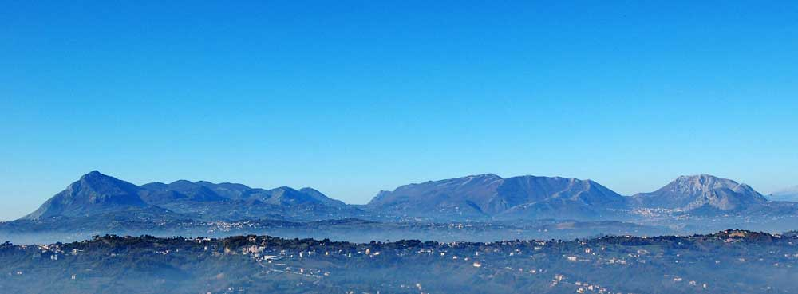
Welcome to Benevento!
The town of Benevento is located between two rivers: Sabato and Calore,
and surrounded by the mountains of the Appennino Campano, including
Mt. Taburno, known as ”the sleeping lady” for its shape.
ICFA mini-Workshop on Impedances and Beam Instabilities in Particle Accelerators
Benevento, September 19-22, 2017

Slide 15
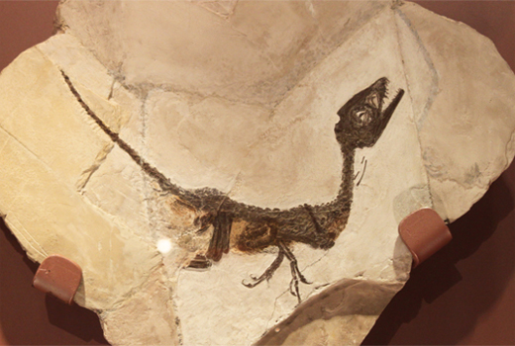
Benevento: The Mesozoic Period
The Benevento area is a rich fossil area: the most famous finding (1981) coming from Pietraroja is a baby dinosaur (Scipionyx Samniticus) 113 Million years old, nicknamed Ciro (on display at Benevento’s «Museo Archeologico»)
Ciro was a carnivor, perhaps
the only one of this kind in
Italy. The exceptional feature
of this fossil is the preserva-
tion of the soft parts of its
body.
According to British traveler Edward Hutton (1875 – 1969), Benevento could have been the most ancient (XV century b.C. ?) stable human settle-ment in Italy.
ICFA mini-Workshop on Impedances and Beam Instabilities in Particle Accelerators
Benevento, September 19-22, 2017

Slide 16
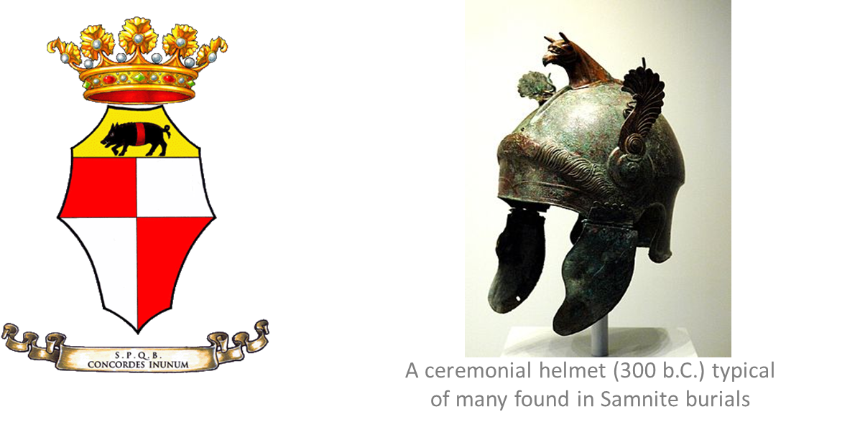
Benevento: an Old, Noble Town
Legend ascribes its foundation to the greek hero Diomedes, after chasing the Calydonian Boar (still shown in the City banner). Another legend reports it was founded by Auson, the
son of Ulysses and Circe.
The Samnites, the local tribes, where brave and fierce warriors. It took three wars, and a
bitter defeat (whence the original name of the city, Maleventum) for the Romans to eventually conquer the city in 290 b.C.
ICFA mini-Workshop on Impedances and Beam Instabilities in Particle Accelerators
Benevento, September 19-22, 2017

Slide 17
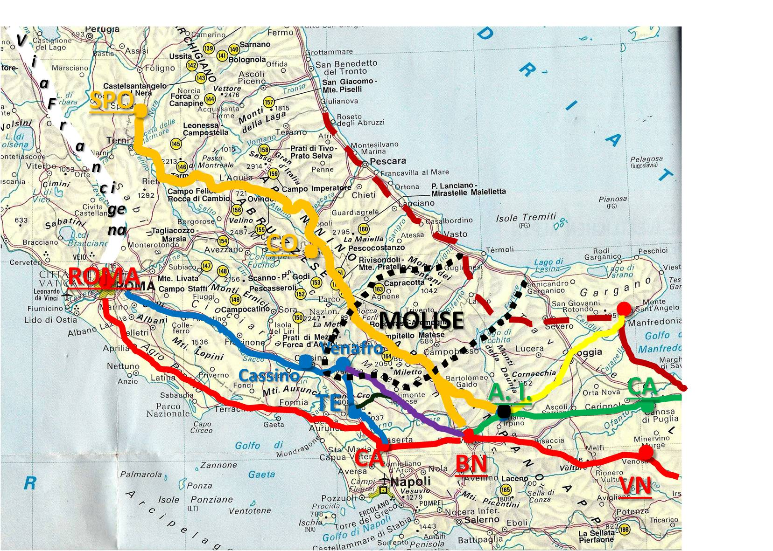
Benevento: the Roman Period (III B.C.- V A.C.)
After the victory in the Forche Caudine battle (321 B.C.), the Samnites were subdued by the Romans and the town name, Maleventum, was changed
into Beneventum.
Beneventum experienced the
political, military and cultural
Roman domination.
The town was a milestone of
the Via Appia, leading from
Roma to Apulia.
(see exibition in San Vittorino)
Benevento became a strategic
center, the Romans embellish-
ed the town with important
buildings.
ICFA mini-Workshop on Impedances and Beam Instabilities in Particle Accelerators
Benevento, September 19-22, 2017

Slide 18
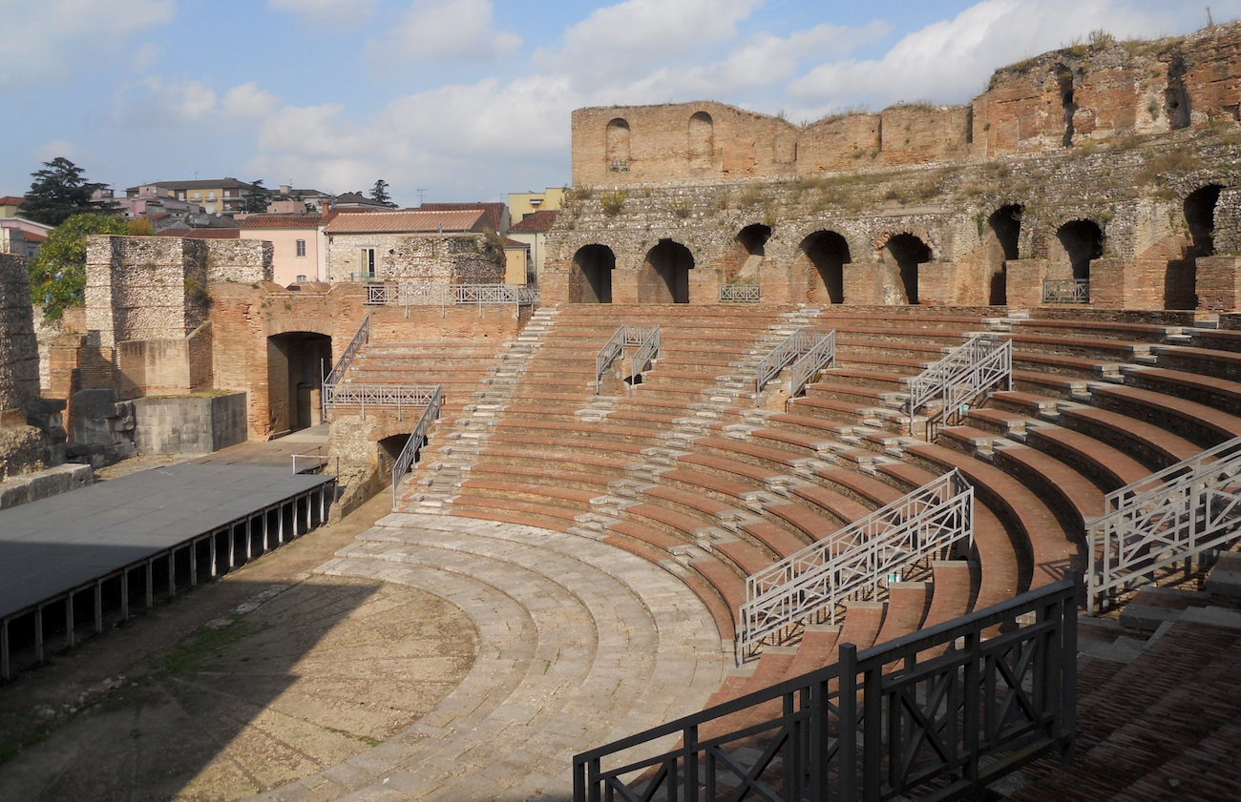
Benevento: the Roman Heritage (III b.C.- V a.C.)
Benevento’s Roman Theater has a diameter of 90m, making it one of the largest
Roman Theaters worldwide, built under the Emperor Hadrian (117-138 a.C.).
ICFA mini-Workshop on Impedances and Beam Instabilities in Particle Accelerators
Benevento, September 19-22, 2017

Slide 19
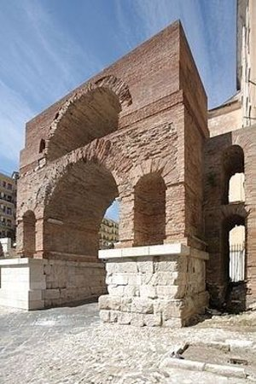
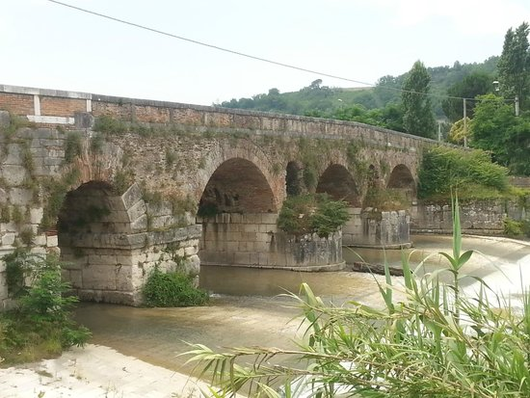
Benevento: the Roman Heritage (III b.C.- V a.C.)
Leproso Bridge
Arch of Sacramento
ICFA mini-Workshop on Impedances and Beam Instabilities in Particle Accelerators
Benevento, September 19-22, 2017

Slide 20
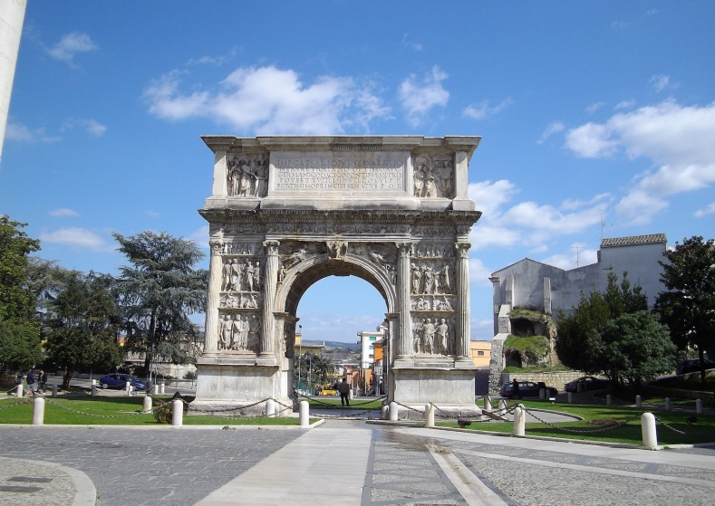
Benevento: the Roman Heritage (III b.C.- V a.C.)
The Traian Arch is Benevento’s icon. Built in 114 a.C. to celebrate the opening of
Via Traiana, a variant of Via Appia, providing a shorter path from Benevento to Brindisi.
ICFA mini-Workshop on Impedances and Beam Instabilities in Particle Accelerators
Benevento, September 19-22, 2017

Slide 21
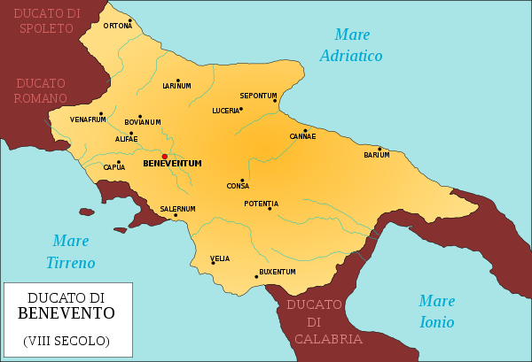
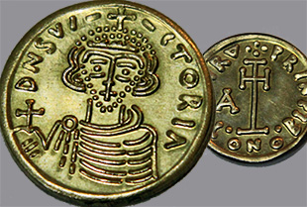

Benevento: the Longobard Period (VI-XI sec.)
Benevento was ruled by the Longobards
from 576 to 849 a.C. as a Duchy.
The Longobard Duques restored the use
of coin money, introduced a new script
style (“scrittura beneventana”) and an
original liturgical chant (“canto bene-
ventano”) …
…pictured in the logo of our University, together with a sample of “scrittura beneven-tana” …
Tremisse of Arechi II (774-787)
ICFA mini-Workshop on Impedances and Beam Instabilities in Particle Accelerators
Benevento, September 19-22, 2017

Slide 22
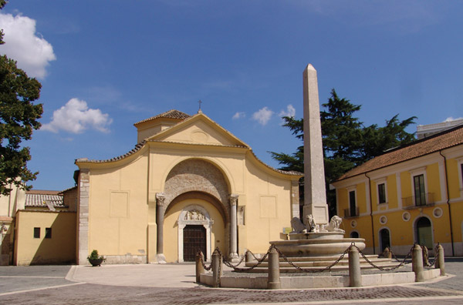
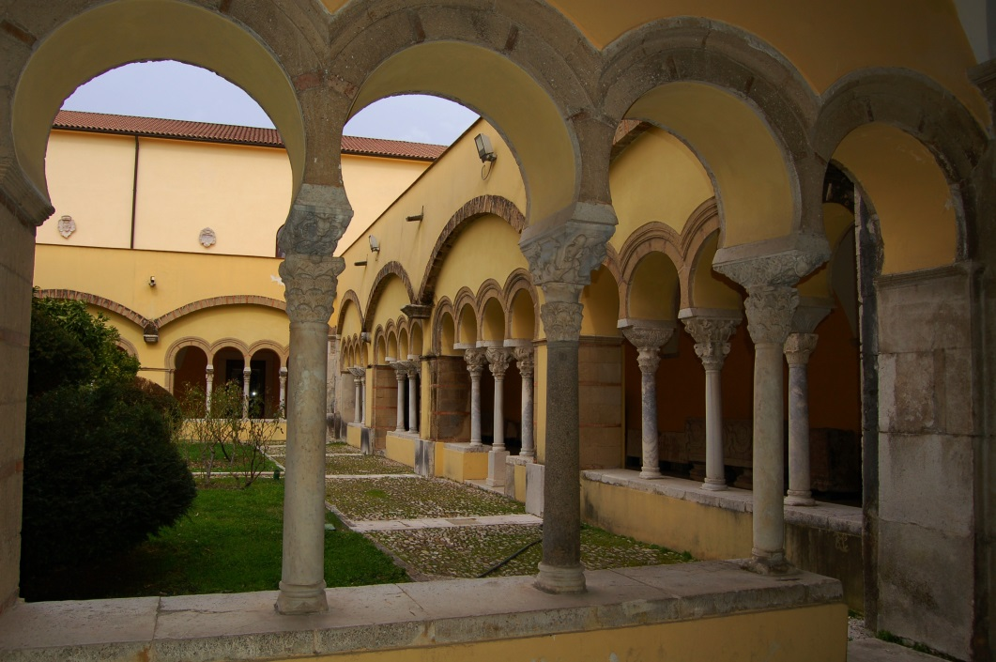
Benevento: the Longobard Heritage (VI-XI sec.)
Santa Sofia’s Church
A Middle Age Masterpiece
(World Heritage Site, 2011)
and Cloister (XII Century),
part of Museo del Sannio
ICFA mini-Workshop on Impedances and Beam Instabilities in Particle Accelerators
Benevento, September 19-22, 2017

Slide 23
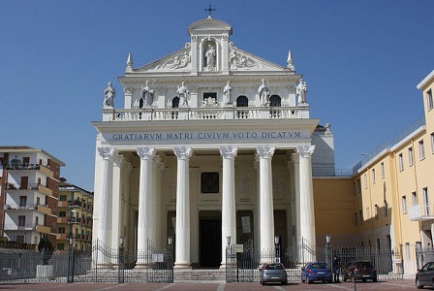
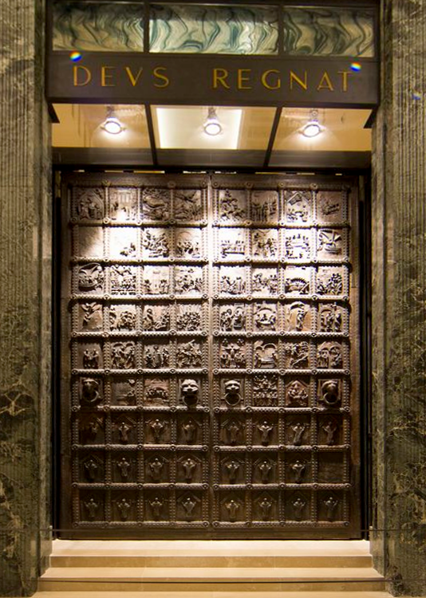
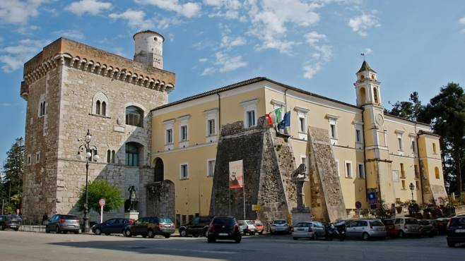
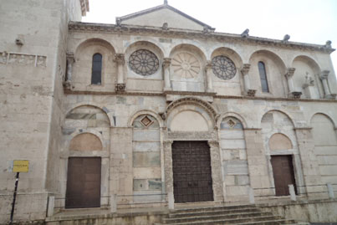
Benevento: the Papal Suzerainty
(1081-1806 ; 1815-1860)
Benevento became part of the Papal States in 1081. The Pope administered it through his rectors until the unifica-tion of the Italian Kingdom (1860), ex-cept for the short period of Napoleon’s conquer (1806-1815), when it was ruled by Charles M. de Talleyrand.
Madonna delle Grazie’s Church
Rocca dei Rettori
The Cathedral
Janua Maior
ICFA mini-Workshop on Impedances and Beam Instabilities in Particle Accelerators
Benevento, September 19-22, 2017

Slide 24
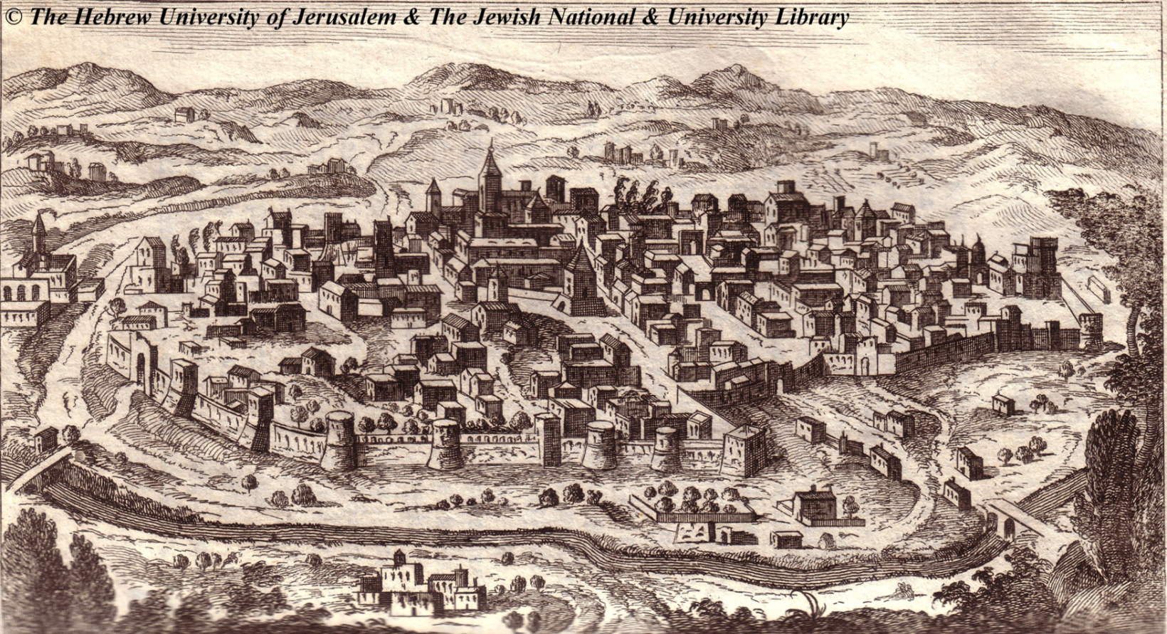
Benevento’s Jewish Community
A Jewish community existed in Benevento since the V-th century. In XII-th Century
it consisted of more than 200 families. While under the Papal Rule, the Jewish com-
munity of Benevento was living in peace, until 1569 when it was expelled with false
allegations.
ICFA mini-Workshop on Impedances and Beam Instabilities in Particle Accelerators
Benevento, September 19-22, 2017

Slide 25
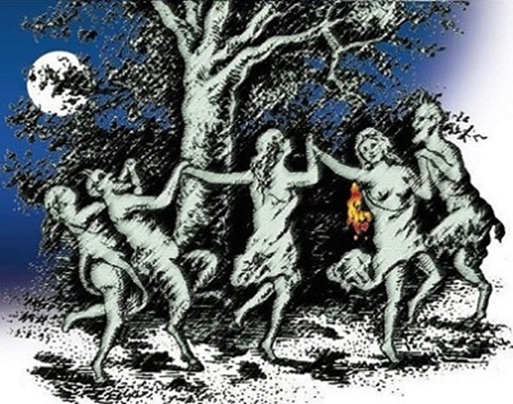

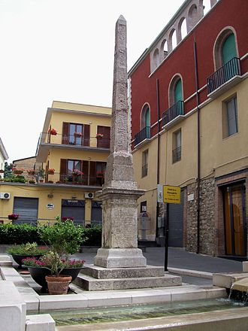




Benevento Folklore: Town of Witches
Benevento earns the lasting fame of being the ”city of the
witches”. Survivals of pagan cults (Isis, Hecate and Diana),
rituals of the Longobards (warriors
rushing on horseback around a tree
striking a hanging goat-hide with their
spears, to tear-off and eat shreds), the
narrations from alleged witches given
under torture in dark ages created this scaring legend…
… What remains today of the Streghe (or
Janare, in the local dialect) is a famous
liqueur made with herbs, whose produc-
tion started in 1860, and related sweets …
Benevento Isis Obelisk
… watch for some complementary samples in your conference bag …

Slide 26
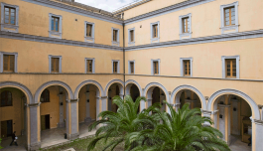
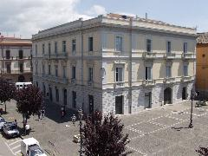
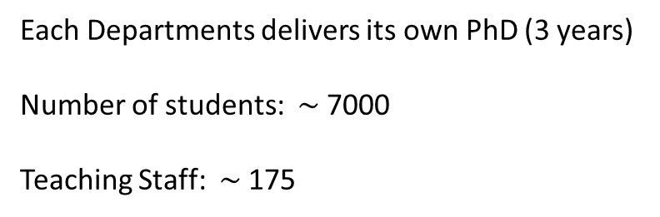
The University of Sannio
Born (1990) as part of the University of Salerno; established as an independent University Jan 1st 1998.
Departments
Law, Economy, Management (DEMM)
Engineering (DING)
Science & Technology (DST)
Palazzo San Domenico
(Rectorate Building)
Degrees (BA, 180ECTS + MA 120 ECTS):
Jurisprudence, Actuarial Science, Economics, Management & Organisation;
Information Engineering, Electrical Eng., Civil Eng., Power Eng.;
Biology, Geology, Biotechnology/Genetic Science.
Each Departments delivers its own PhD (3 years)
Number of students: $\sim$7000
Teaching Staff: $\sim$ 175
Palazzo Bosco-dell’Aquila
(Engineering Building)

Slide 27
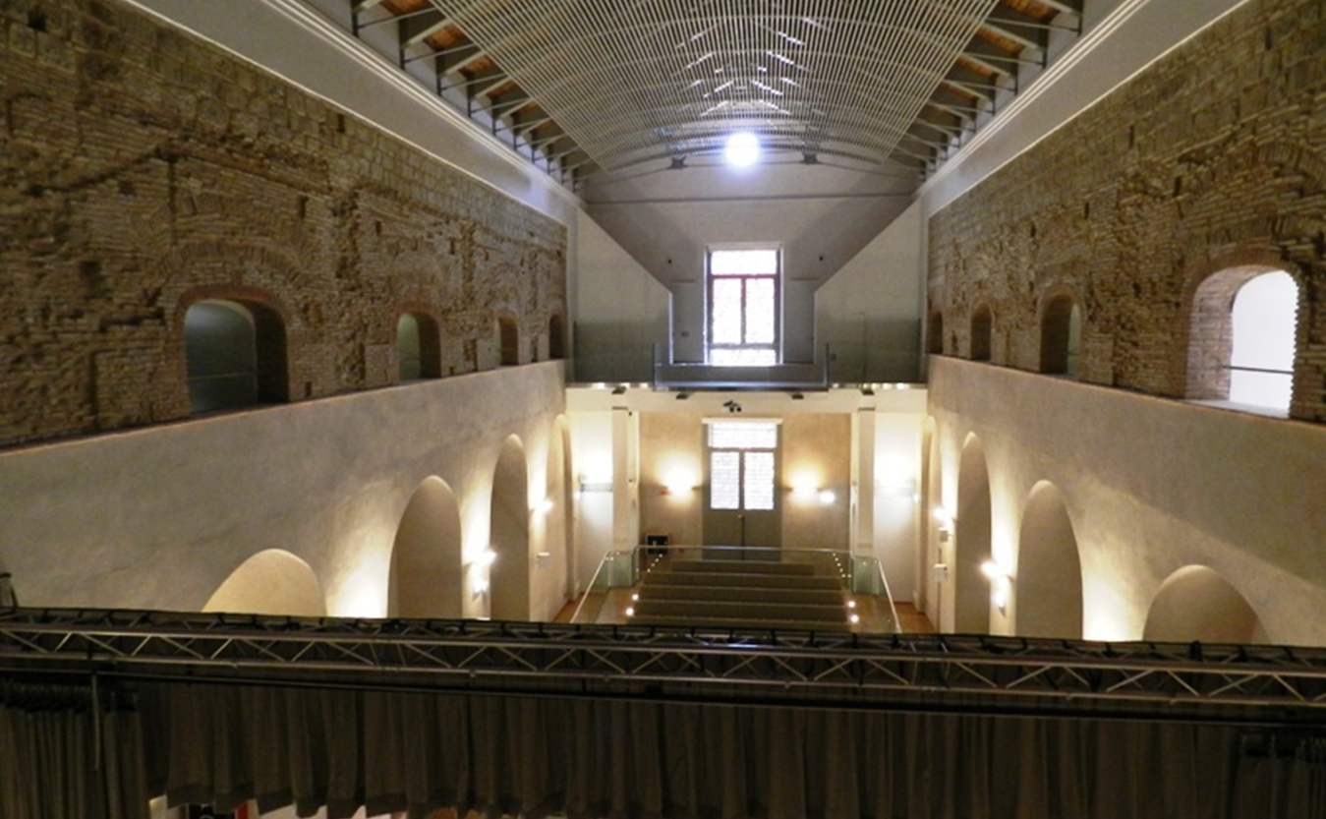
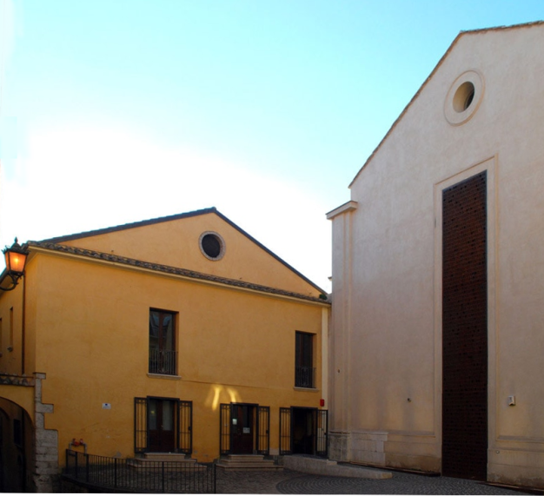
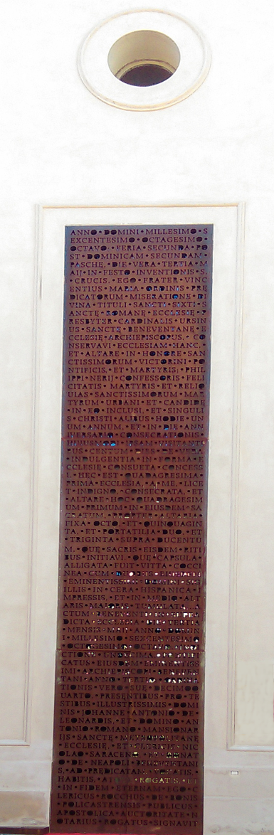

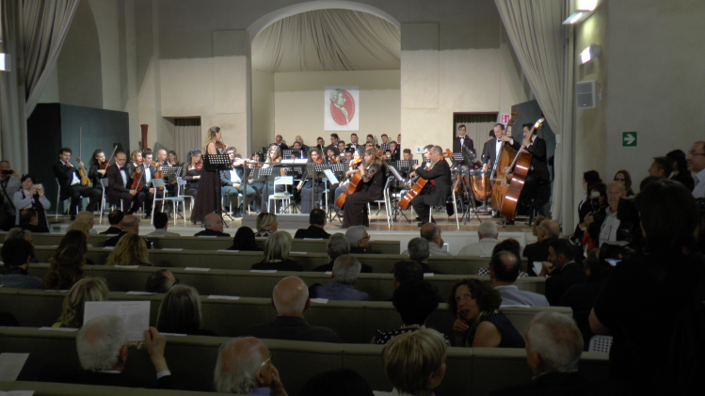

The Venue: The San Vittorino Complex
Built in the Xth Century as a
Monastery of noons, since
1168 was administered by
the Pope. In XVIIth century
the San Vittorino Complex
was flourishing. The mona-
stery was suppressed under
the French in 1806. It was
an Orphanage until 1950,
and was then abandoned.
Restoration is still in progress. The San Vittorino Complex
is now managed by Benevento’s Music Conservatory .
ICFA mini-Workshop on Impedances and Beam Instabilities in Particle Accelerators
Benevento, September 19-22, 2017

Slide 28
The Program
 | Morning | Afternoon
Tuesday 19 September | Introductory talks Chair: Giovanni Rumolo | Impedance theory and modeling Chair: Ursula Van Rienen
Wednesday 20 September | Impedance modeling, measurements and control Chair: Iaia Masullo | Excursion to Pompeii
Thursday 21 September | Instability theory and modeling Chair: Ingo Hofmann | Instability modeling, observations and cures Chair: Mikhail Zobov
Friday 22 September | Instability modeling and cures + Overview on machines Chair: Chris Prior | Closing remarks Chair: Stefania Petracca
ICFA mini-Workshop on Impedances and Beam Instabilities in Particle Accelerators
Benevento, September 19-22, 2017

Slide 29
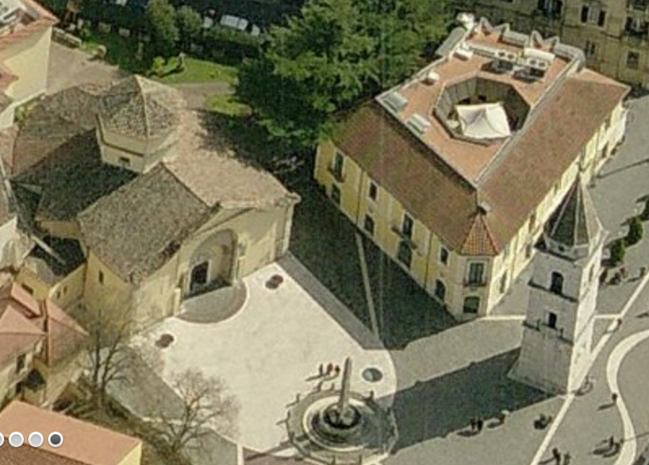
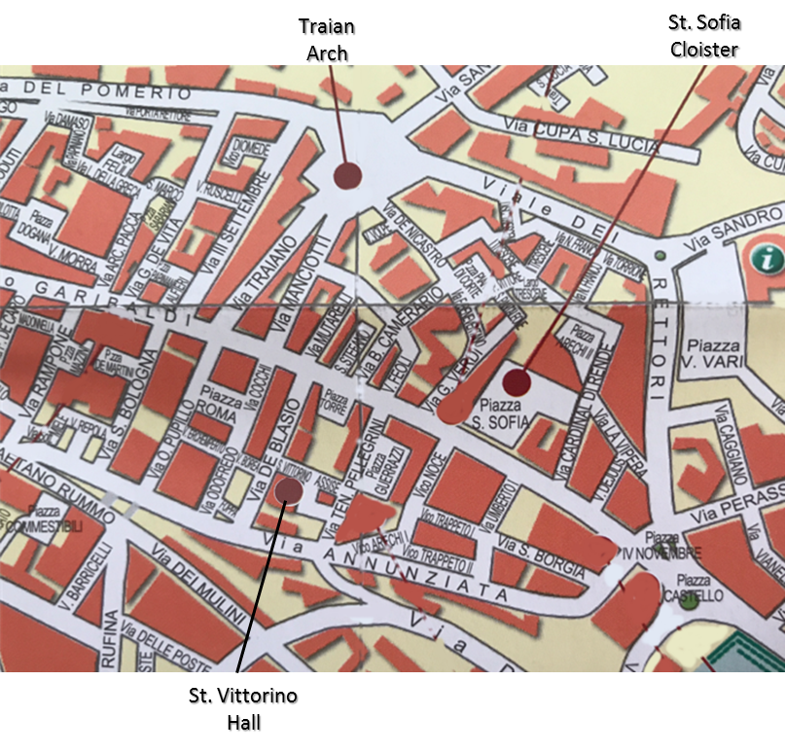
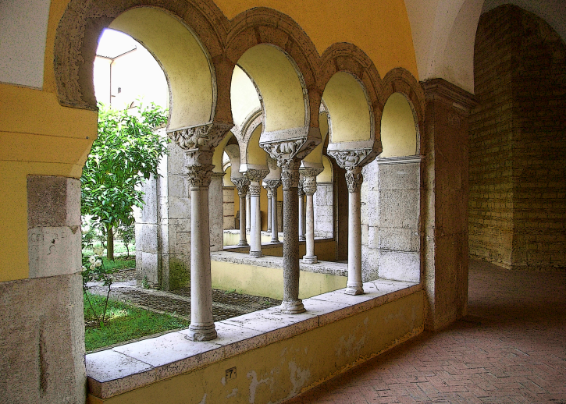
Poster Session at the Santa Sofia Cloister
(courtesy of the Provincia di Benevento)
Entrance to cloister
through Museo del Sannio
The cloister
ICFA mini-Workshop on Impedances and Beam Instabilities in Particle Accelerators
Benevento, September 19-22, 2017

Slide 30

Social Program
Monday September 18, 5 p.m. registration opening at Palazzo San Domenico
7 p.m. welcome cocktail in the Hortus Conclusus
(courtesy of the Municipality of Benevento).
Tuesday September 19, 9:00 a.m. registration at Palazzo San Domenico
10:00 a.m. guided city tour for accompanying persons;
8:00 p.m. welcome party at Hotel Villa Traiano.
Wednesday September 20th, 1:00 p.m. light lunch at San Vittorino;
2:00 p.m. departure by bus to Pompeii;
8:00 p.m. social dinner in Pompeii at ”Il Principe”.
Thursday September 21st, 7:30 p.m. concert at Museo del Sannio;
9:30 p.m. dinner at Dionisio Restaurant.
Friday September 22nd, 1:00 p.m. buffet - lunch at San Vittorino;
3:45 p.m. bus to Naples airport
ICFA mini-Workshop on Impedances and Beam Instabilities in Particle Accelerators
Benevento, September 19-22, 2017

Slide 31
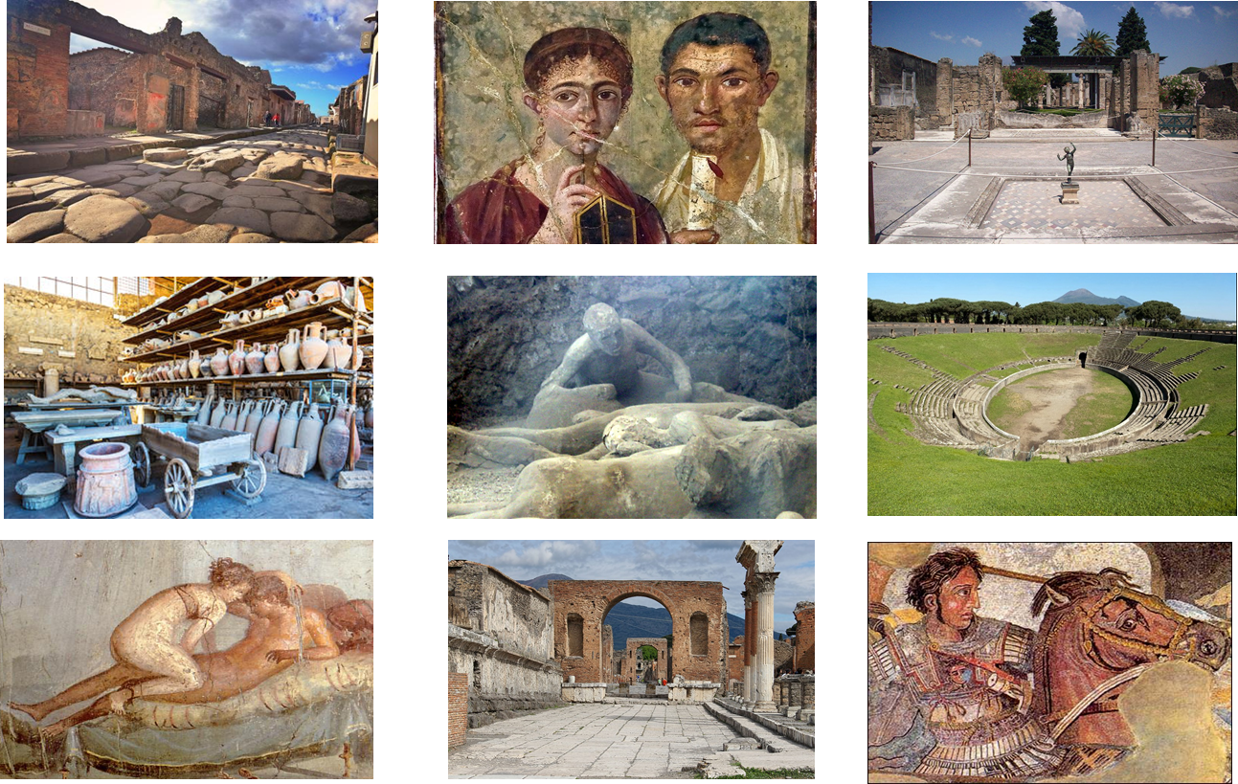
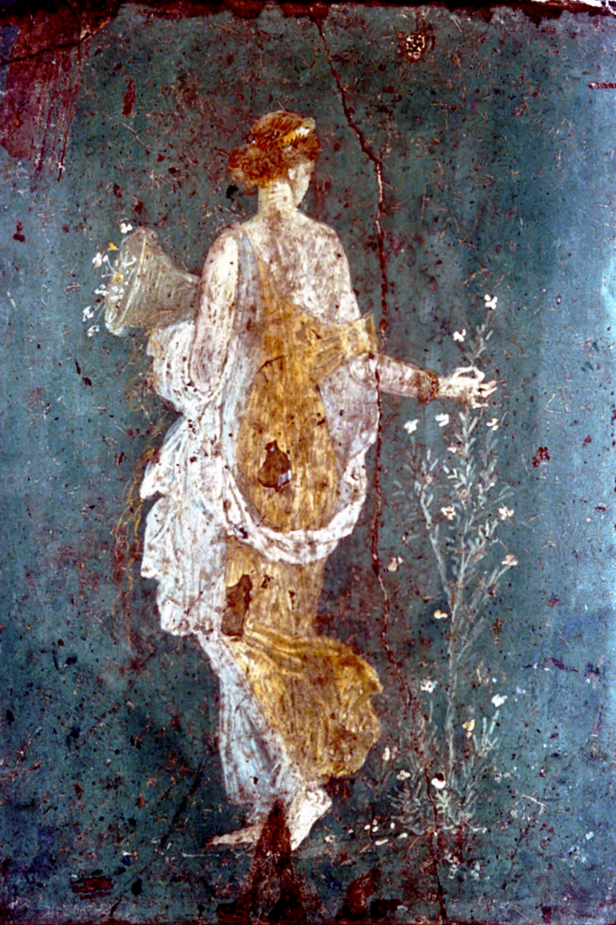
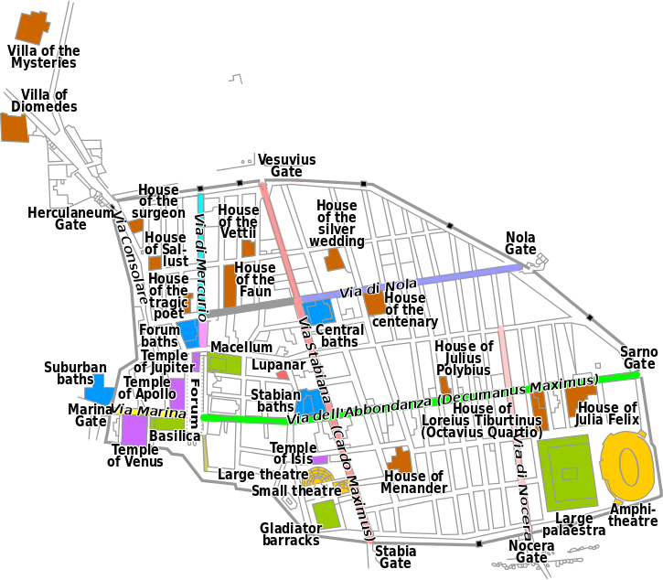
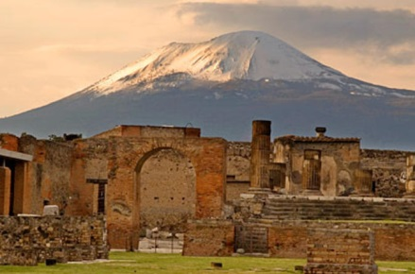
Tour of the Archelogical Site of Pompeii
(109 Km from Benevento, 1h20)
ICFA mini-Workshop on Impedances and Beam Instabilities in Particle Accelerators
Benevento, September 19-22, 2017

Slide 32




Infor
Informations
Coffee and buffet lunches are served on the 2nd floor
  The help desk is on the 2nd floor
  The WI-FI room is on the 2nd floor
  Announcements will be given at the end of every session.
  Watch the whiteboards @ the help desk for updates
  For any question, please ask the organisers!
ICFA mini-Workshop on Impedances and Beam Instabilities in Particle Accelerators
Benevento, September 19-22, 2017

Slide 33
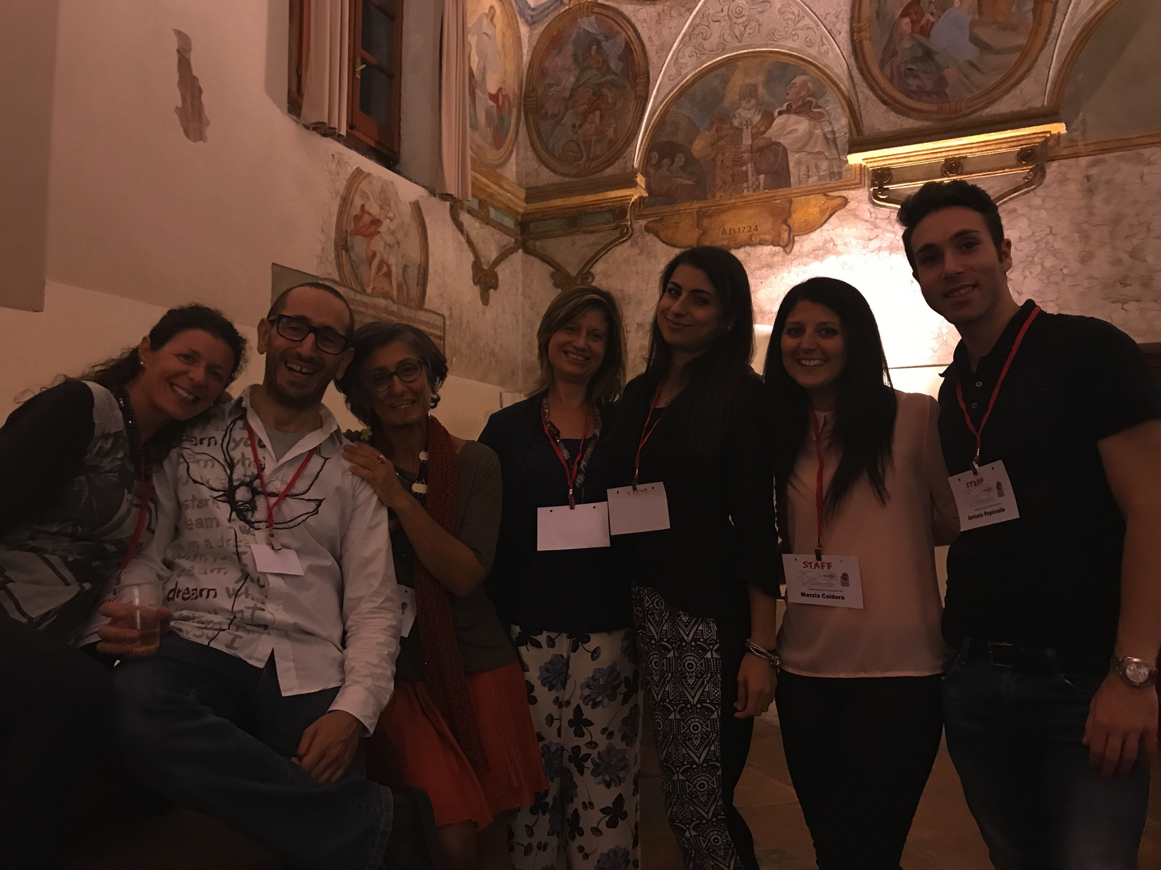
Staff
Add photo
Have a great day at work !
ICFA mini-Workshop on Impedances and Beam Instabilities in Particle Accelerators
Benevento, September 19-22, 2017

Slide 34
BACKUP STUFF
ICFA mini-Workshop on Impedances and Beam Instabilities in Particle Accelerators
Benevento, September 19-22, 2017

Slide 35


