Slide 1
Needs and Solutions for Machine Impedance Reduction
Aaron Farricker, Thomas Kaltenbacher,
Patrick Kramer, Nasrin Nasresfahani,
Branko Popovic, Joël Repond, Christine Vollinger
20-Sept-17

Slide 2
Motivation for Impedance Reduction
Highest possible beam intensities are requested today from most accelerators.
These intensities can be reached only if the interaction of the particle beams with the surrounding structure is sufficiently low, and the contribution is known, at least approximatively.
Consequently, a good description of the machine elements by means of impedances in the frequency domain or wake fields in the time domain is required to avoid performance limitations due to instabilities or other collective effects.
Once the individual impedance contribution of a machine element is known, an optimization (geometrical or by means of mitigation) w.r.t. the contribution to beam impedance can be targeted.

Slide 3
Impedance Sources
Usual approach is to calculate the contribution of separate machine elements, although in some cases this is insufficient, due to interaction/ coupling of the different elements.
Generally to be distinguished between machine elements with potentially large individual impedance contribution as cavities, kickers, etc., and
Other components with smaller individual contribution, but which exist in large quantities, as valves, flanges, pumping ports, general beam pipe transitions.

Slide 4
What this talk is about?
Will not speak about instabilities and beam dynamic simulations, instead
our work is to find RF-solutions to mitigate existing beam impedances, and
to provide input for macroparticle codes by means of impedance calculation so that beam dynamics simulation can be carried out to predict, e.g., intensity thresholds, etc.
Regular request for guidelines, thus a number of examples with possible mitigation strategies will be presented here.

Slide 5
Modeling of Machine Elements
Geometry of the machine element has to be modeled such that its EM-behaviour is reproduced.
Geometries that appear to be simple can be electromagnetically complex
→ example:
SPS vacuum flange shielding.
It can easily come to “oversimplification”
→ two examples:
PS gate valve, and
PS KFA45 kicker.

Slide 6
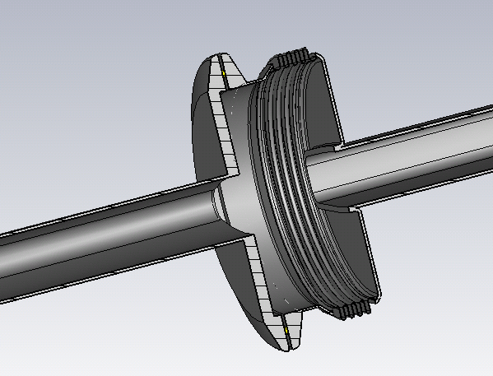
Example: SPS Vacuum Pipe Flanges
VFs of the SPS were not impedance optimized;
For the connection of different beam pipe shapes, a circular VF with bellows was selected at the time;
Some VFs additionally carry an enamel insulation on one side for DC-insulation.
Electromagnetically, this VF shapes a simple pill-box cavity with corrugated walls:
Enamel
MBA beam pipe
(about rectangular)
Unshielded VF
Goal is to find a smooth transition
for the different beam pipe shapes that shields this “pill-box cavity”.
QF beam pipe
(elliptical)

Slide 7
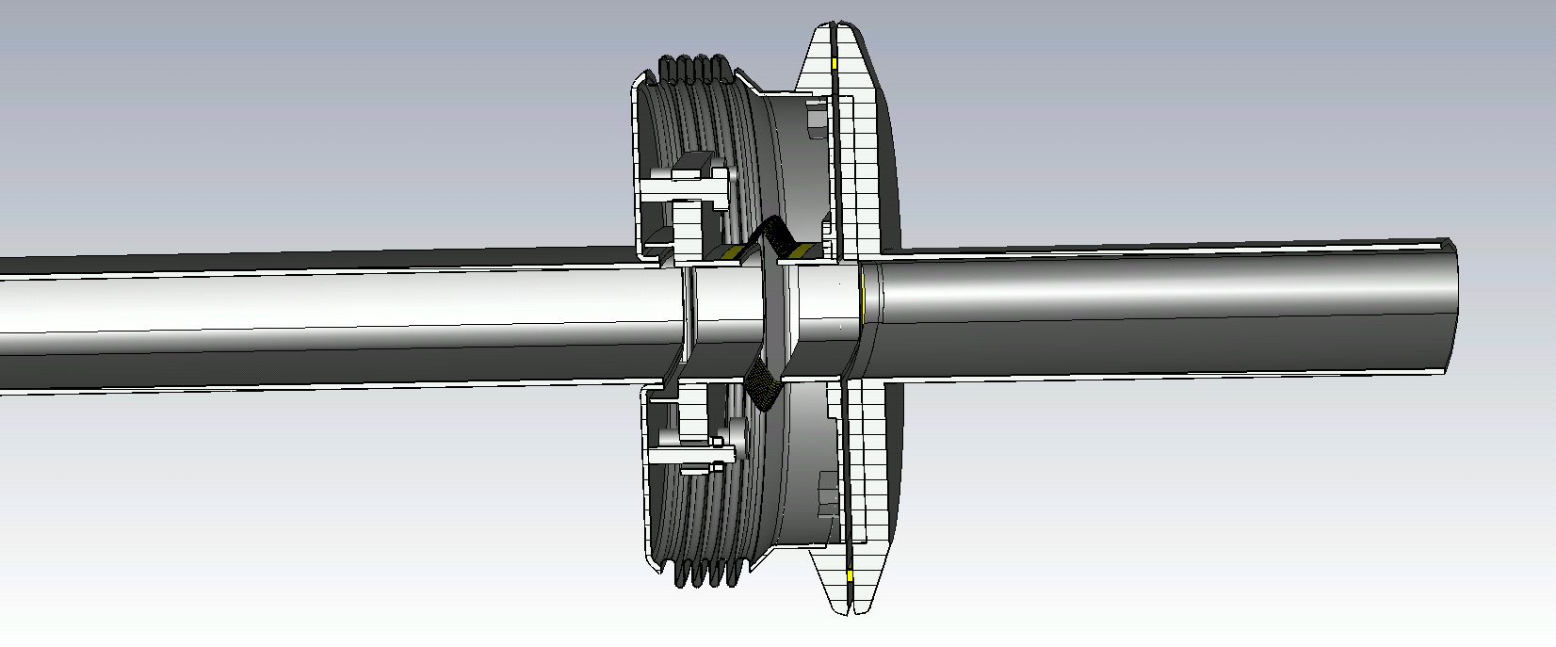
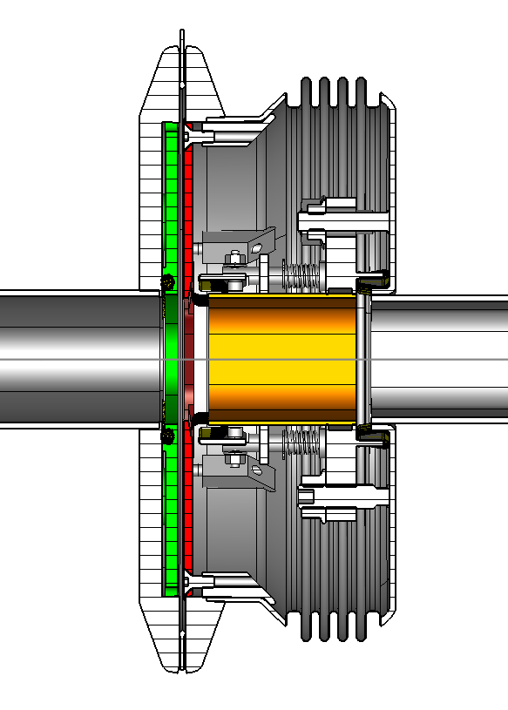
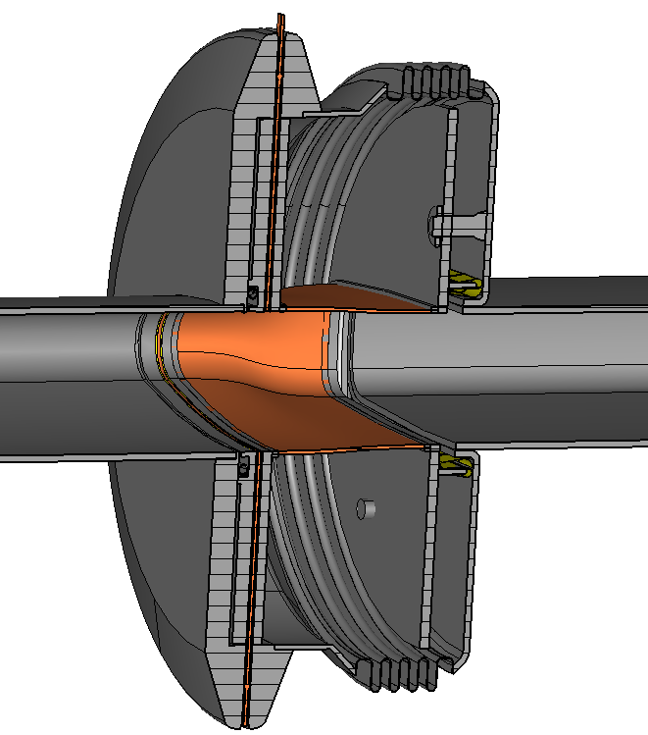
Example: SPS Vacuum Pipe Flanges
Unshielded VF
Shielding this “simple pill-box cavity” is non-trivial!
Even with shields in place, a gap at the gasket position remains.
Double-tube shield
Braided shield
Spring-driven shield
Fixed
RF fingers
gasket
gasket
gasket
gap filler
gap filler
gap filler
Support with fixed
RF contact
Support with fixed
RF contact
Support with fixed
RF contact
Spring-driven moveable RF contact
MBA
beam pipe
Shield made of stainless steel braid
MBA
beam pipe
support plate
support plate
support plate

Slide 8
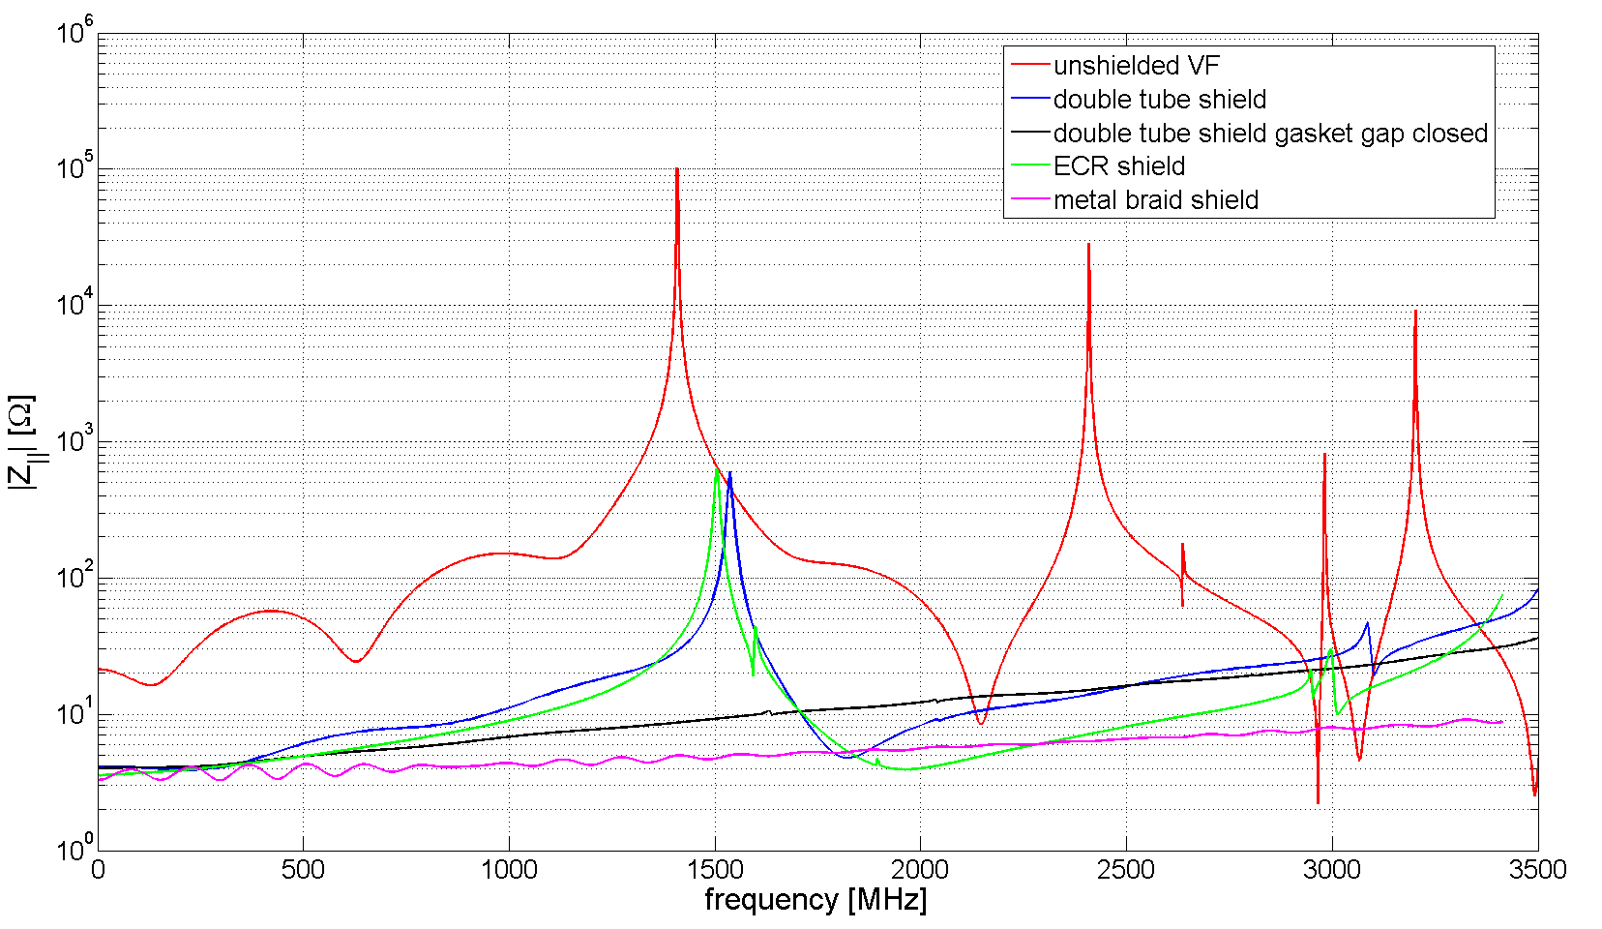
Example: SPS Vacuum Pipe Flanges
Simulated longitudinal impedance
Spring-drivenhield
retro-fit from PP shield
gasket gap closed
Without gasket gap filler, the resonance at about 1.4 GHz is not fully suppressed;
Otherwise, performance of the different shield designs is very similar!

Slide 9
Example: SPS Vacuum Pipe Flanges
Unshielded VF
[N. Ogiwara et al., IPAC’13, Shanghai, THPFI014]
“state-of-the-art” nowadays are shields made of braids, where different materials and mesh structures are available from suppliers.
Braids of this type are also suggested for flexible connections in other locations.

Slide 10
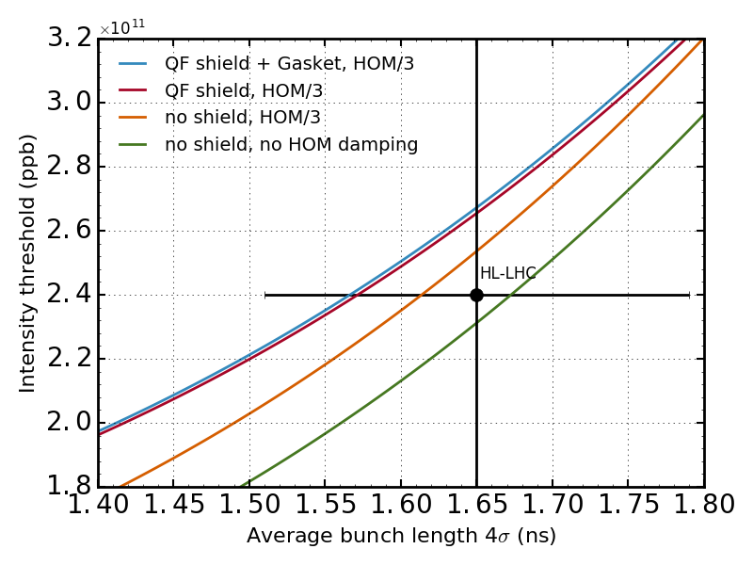
Example: SPS Vacuum Pipe Flanges
VF shielding is required, but is visible in beam dynamics simulations only, if other measures are applied at the same time (here: HOM damping of the 200 MHz TWC);
The improvement obtained from VF shielding thus depends on the level of HOM reduction (e.g. factor 2 or 3) that can be
reached;
Currently, we are targeting a HOM reduction for the 200 MHz TWC by a factor of 3.
(see poster presentation of P. Kramer et.al. on Thursday!)
10%
15%

Slide 11
Modeling of Machine Elements
Geometry of the machine element has to be modeled such that its main features are displayed.
Geometries that appear to be simple can be electromagnetically complex
→ two examples:
SPS vacuum flange shielding, and
SPS gate valves.
It can easily come to “oversimplification”
→ two examples:
PS gate valve, and
PS KFA45 kicker.

Slide 12
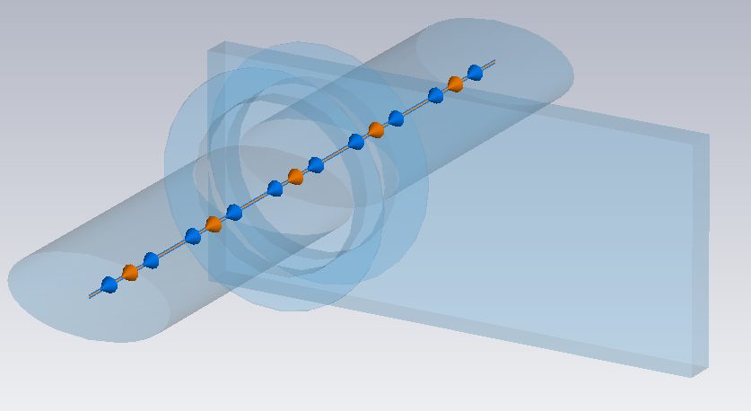
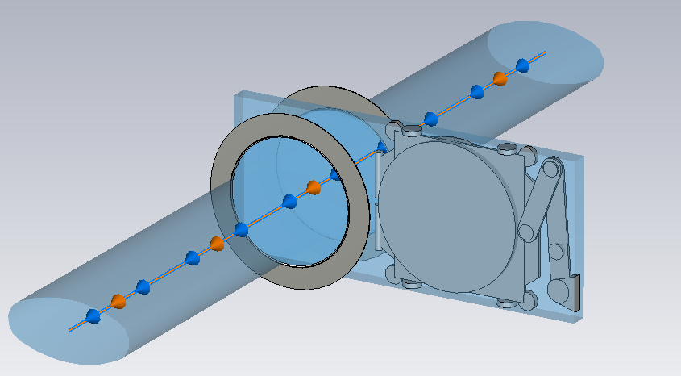
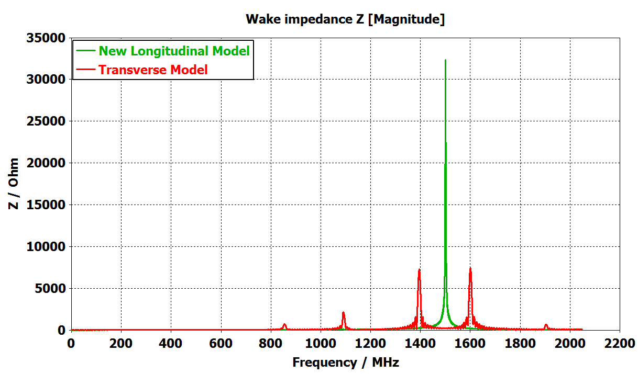
Example: PS Gate Valve Models
Previous Impedance Model
New (Longitudinal) Impedance Model
No geometrical model of the inner parts of the valve exist;
Leaving these parts out will result in an entirely different impedance contribution;
Due to lack of geometry knowledge, measurements have to verify the correctness of the geometry.

Slide 13
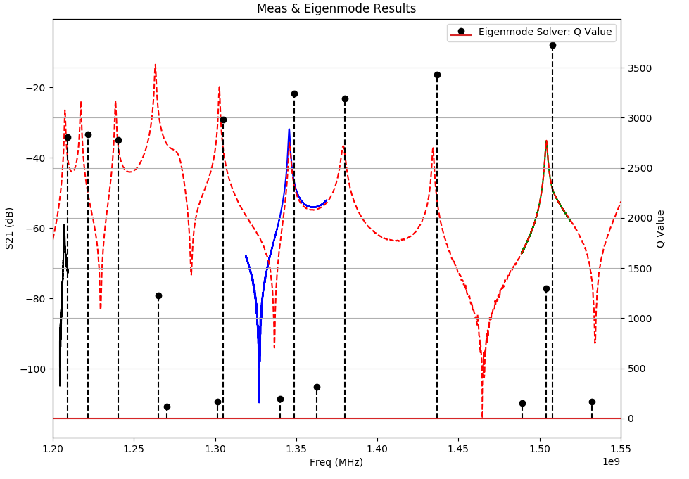
Example: PS Gate Valve Models
Comparing Measured & Simulation Results
TE₁₁₉
TE₁₁₈
TE₁₁₁
TE₁₁₆
TE₁₁₇
TE₁₁₂
TE₁₁₅
TE₁₁₃
Cavity Mode
TM₀₁₀
1504.18
Q: 1184
TE₁₁₄
TE₁₁₅
1345.67 MHz
Q: 1442
TE₁₁₁
1207.04 MHz
Q: 2352

Slide 14
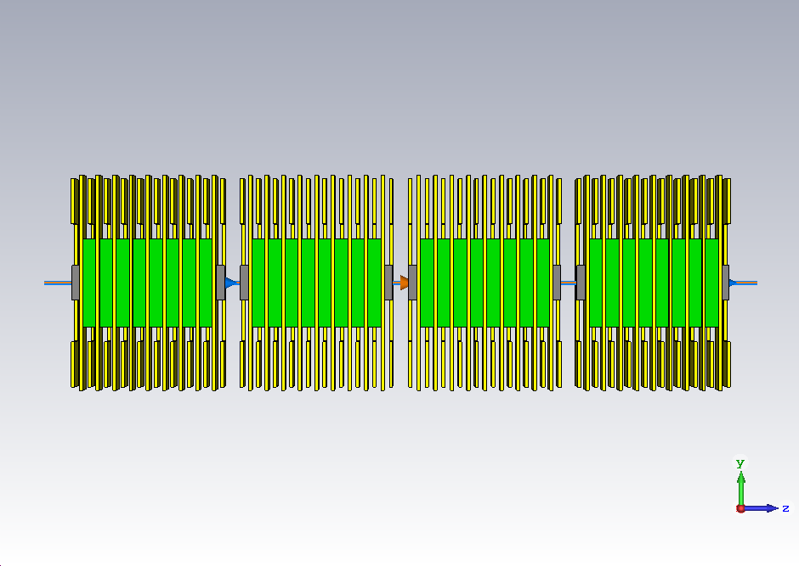
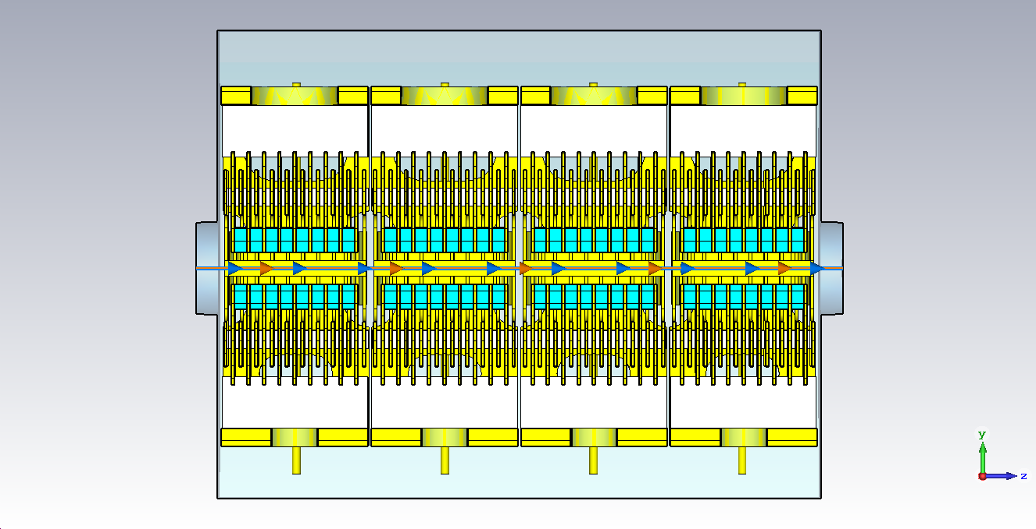
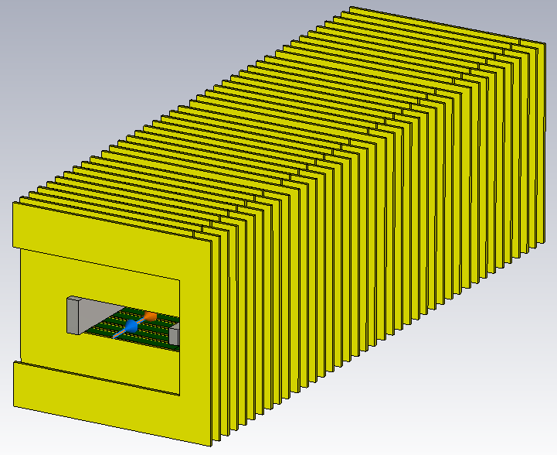
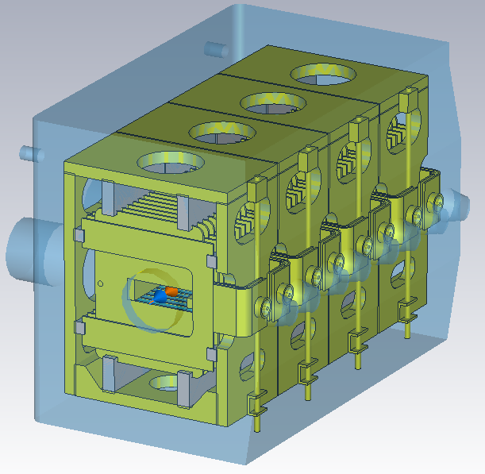
Example: PS Kicker KFA45
Previous Impedance Model
New (Longitudinal) Impedance Model

Slide 15
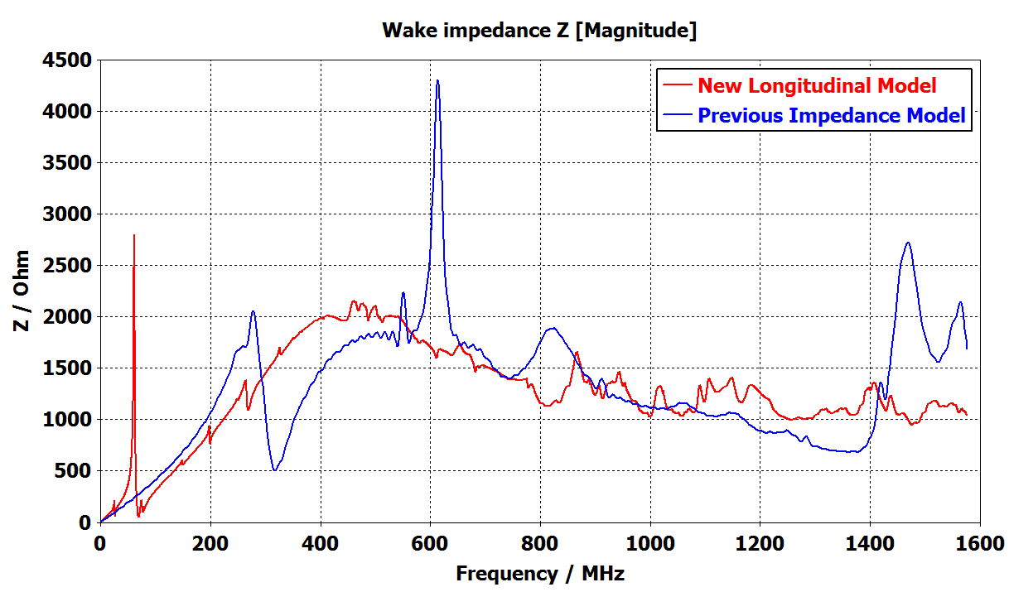
Example: PS Kicker KFA45
Comparing Wakefield Simulation Results for Different Modeling
Also here: correctness of the modeling has to be verified by measurement !

Slide 16
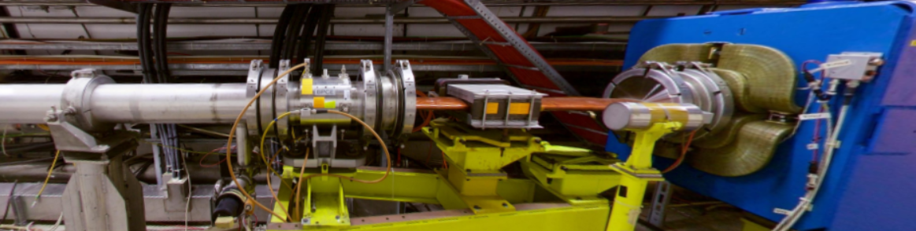
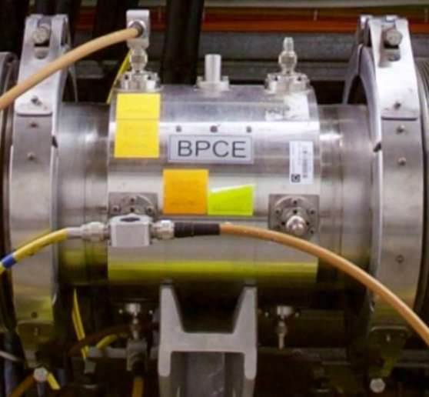
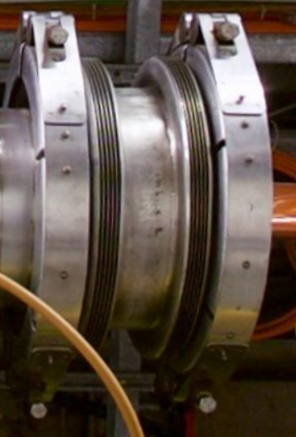
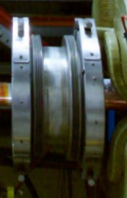
Example: Re-working a Machine “Section” in SPS
Request:
Insertion of an additional machine element in round beam pipe (left side).
New machine element has a beam pipe with race-track cross-section:

Slide 17
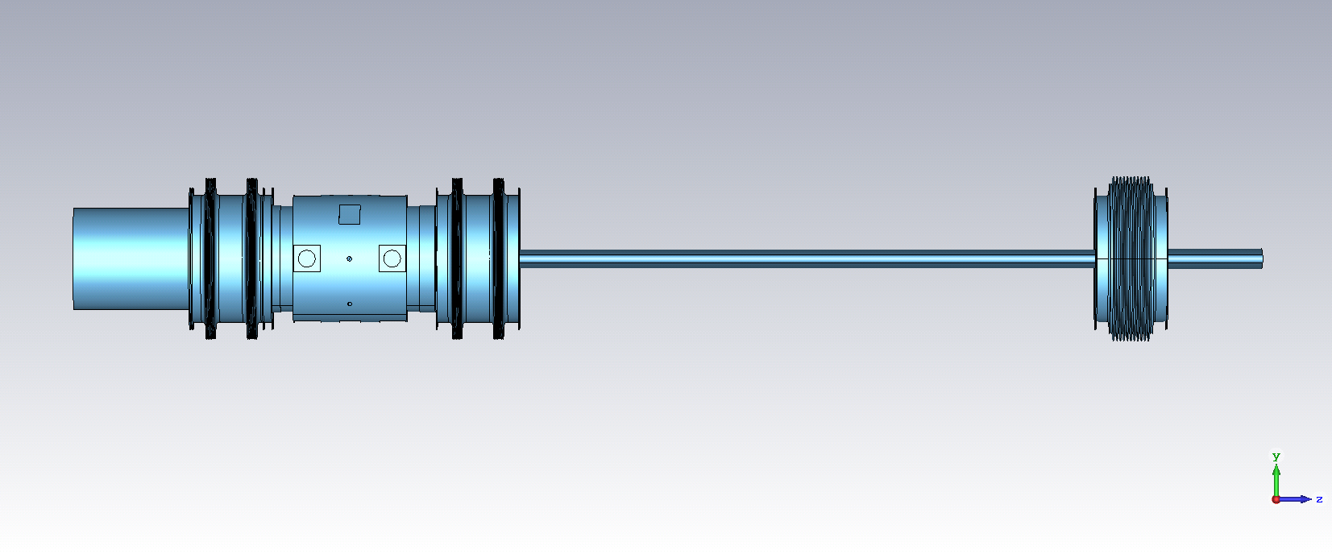
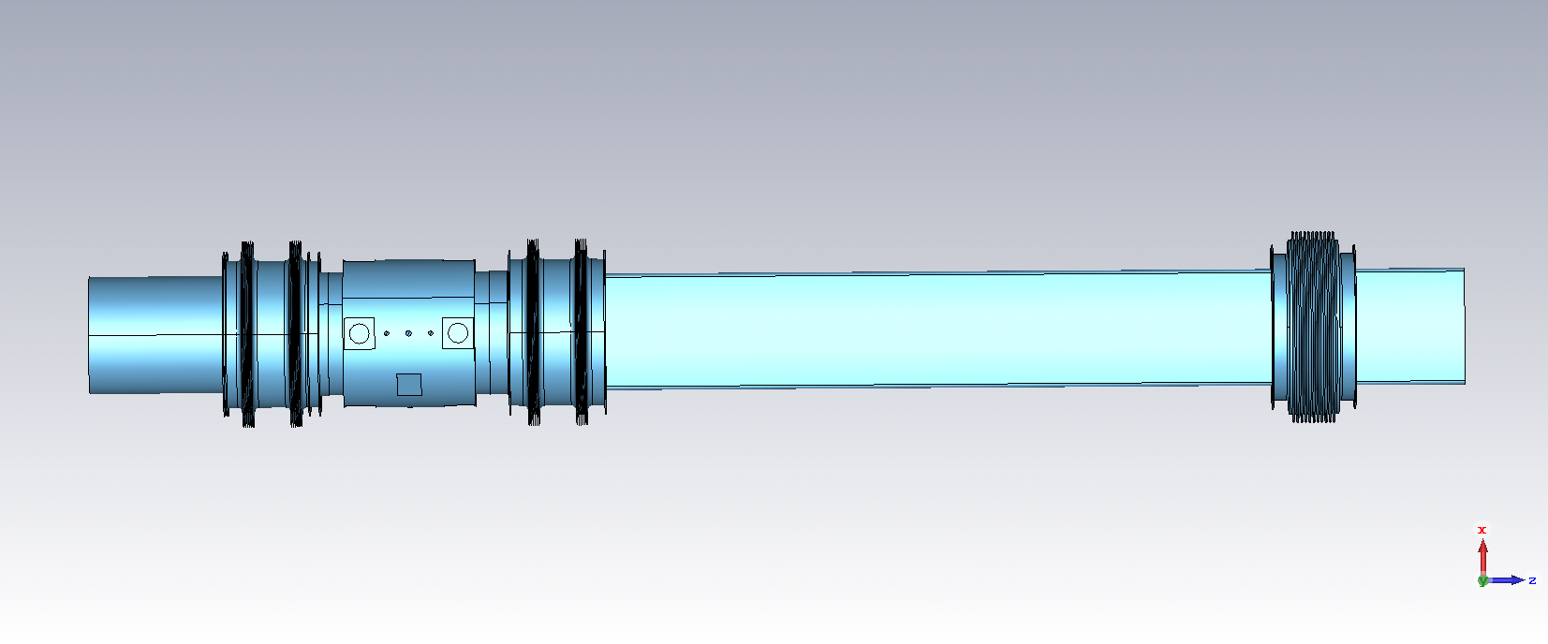
Example: Re-working a Machine “Section” in SPS
+
side view
new machine
element
+
top view

Slide 18
Example: Re-working a Machine “Section” in SPS
Example for bellows:
Identical bellows with entirely different EM-behavior due to connecting vacuum chambers.
Left: bellows resonates with circular part (BPCE & large, round beam-pipe)
Right: bellows resonates but does not interact with adjacent machine elements due to cut-off frequency of flat, elliptical beam-pipe.

Slide 19
Example: Re-working a Machine “Section” in SPS
new machine
element
vacuum chamber
standard
bellows
BPCE
special bellows
vacuum chamber
special bellows
vacuum chamber
Option 1:
Original layout with one special bellows replaced by one elliptical bellows.
elliptical
bellows

Slide 20
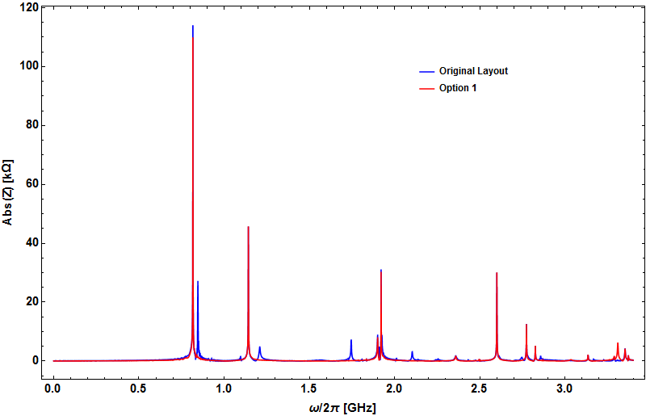
Example: Re-working a Machine “Section” in SPS
new machine
element
vacuum chamber
standard
bellows
BPCE
special bellows
vacuum chamber
special bellows
vacuum chamber
Option 1:
Original layout with one special bellows replaced by one elliptical bellows.
Gives a good indication for 850 MHz resonance source !
elliptical
bellows

Slide 21
Example: Re-working a Machine “Section” in SPS
new machine
element
vacuum chamber
standard
bellows
BPCE
special bellows
vacuum chamber
special bellows
vacuum chamber
Option 2:
Original layout with special bellows replaced by elliptical bellows
AND swap BPCE with new machine element.
elliptical
bellows

Slide 22
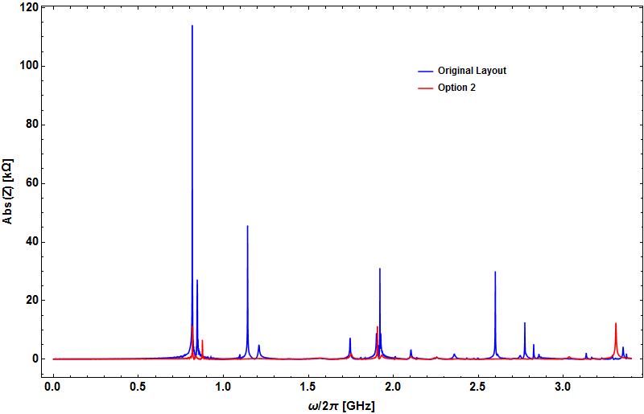
Example: Re-working a Machine “Section” in SPS
new machine
element
vacuum chamber
standard
bellows
BPCE
special bellows
vacuum chamber
special bellows
vacuum chamber
Option 2:
Original layout with special bellows replaced by elliptical bellows
AND swap BPCE with new machine element, use a smooth taper after new element.
elliptical
bellows
elliptical
bellows

Slide 23
Example: Re-working a Machine “Section” in SPS
new machine
element
vacuum chamber
standard
bellows
BPCE
special bellows
vacuum chamber
special bellows
vacuum chamber
Option 3:
Bring BPCE with its two bellows close to the QF-magnet,
use a smooth taper and an elliptical bellows to connect new machine element.

Slide 24
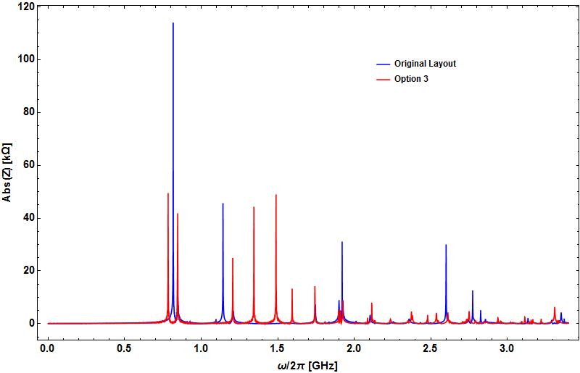
Example: Re-working a Machine “Section” in SPS
new machine
element
elliptical
bellows
smooth taper
vacuum chamber
standard
bellows
BPCE
special bellows
vacuum chamber
Option 3:
Although the cross-sectional changes appear to be reduced,
AND a smooth taper is used, plus elliptical bellows, new resonances show up unexpectedly around 800 MHz and above 1 GHz.
Conclusion: For beam impedance, Option 2 is by far the best re-arrangement !
+ MDH

Slide 25
Conclusion
Powerful tools for impedance calculation exist today,
but a careful geometrical modeling is absolutely required;
Benchmarking of the geometry shall be done by EM-measurements, whenever possible;
1st goal should be to geometrically suppress the impedance source;
If this is not possible, the remaining resonances/HOMs have to be taken out of the machine element (see e.g. poster of P. Kramer et.al. on Thursday);
Guidelines are difficult to draw in a general manner (see three options for re-worked SPS machine section);

Slide 26
Thank you for your attention!

