Slide 1

Modeling of fast beam-ion instabilities
L. Mether, G. Rumolo
Acknowledgements:
E. Belli, X. Buffat, G. Iadarola, A. Lechner, E. Metral, A. Romano
ICFA Mini-Workshop on Impedances and Beam Instabilities in Particle Accelerators
Benevento, 18-22 September 2017

Slide 2
Introduction
Gas molecules ionized by beam
Ions oscillate in beam field
Ions act back on beam
Positive ions attracted by beam field
Instability, tune shift,
ε growth
Ion instability mechanism in electron machines
In synchrotrons without clearing gap, ion density builds up over several turns
  Conventional ion instability
For bunch train followed by gap, ions build up only during one train passage
  Fast beam-ion instability
  Instability builds up over several turns

Slide 3
Fast beam-ion instability
Two-stream instability like electron cloud → similarities and differences:
Ion density increases with every bunch – effect stronger at tail of trains
Ions hardly move during a bunch passage → different dynamics
  “Build-up” depends on ion trapping around beam
  Ions transfer information on bunch centroid position to the trailing bunch(es)
  → coupled bunch instability

Slide 4
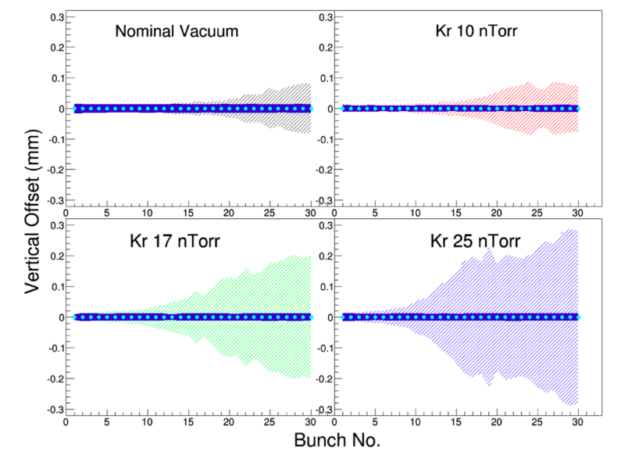
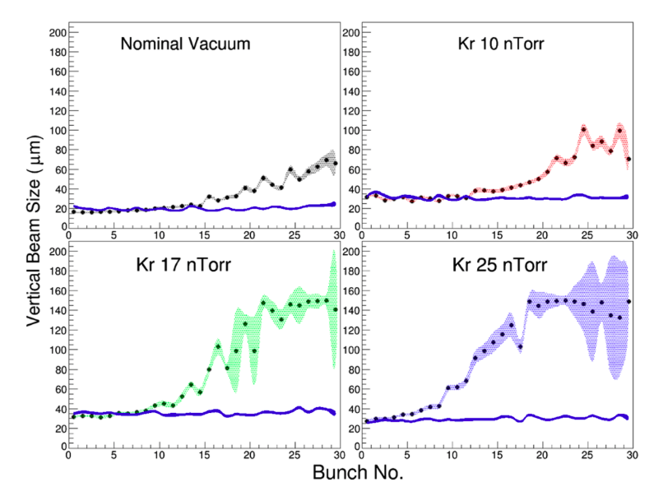
Machine observations
The instability can be observed in most electron machines with vacuum degradation
Can often be mitigated with transverse feedback
Constraints from the instability define vacuum specifications for future machines
e.g. CLIC accelerator chain, FCC-ee, future light sources and low-emittance upgrades
Measurements at Cesr-TA with injected Kr gas (Apr 2014)
Feedback on
Feedback on
A. Chatterjee et al., Phys. Rev. ST Accel. Beams 18 (2015) 6, 064402

Slide 5

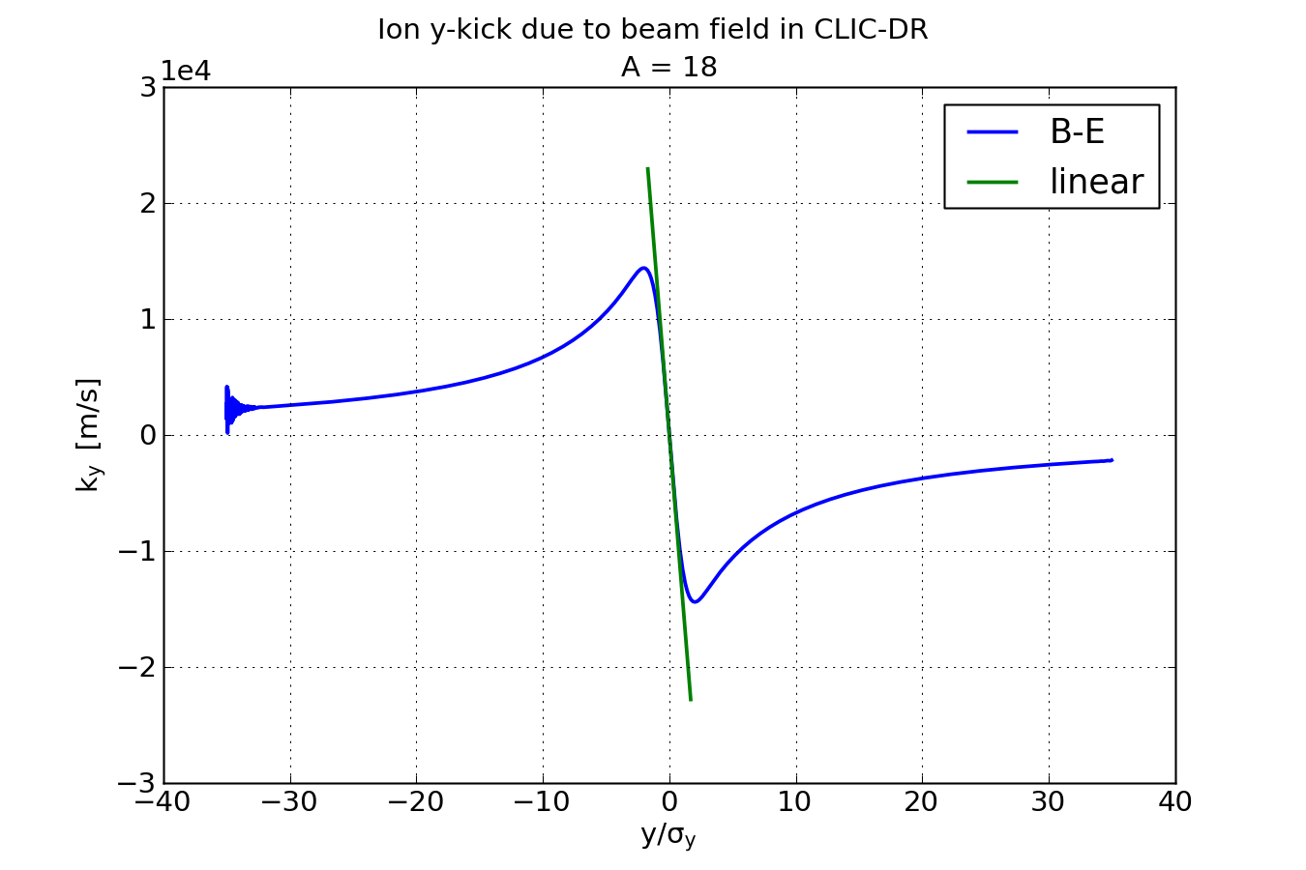
Analytical model
An analytical treatment of the instability can be derived using the linear approximation of the Bassetti-Erskine formula for a Gaussian beam field
An ion with mass number A, receives a velocity kick by the beam
  N_{b} = bunch intensity, r_{p} = classical proton radius, σ_{x,y} = transverse beam size

Slide 6

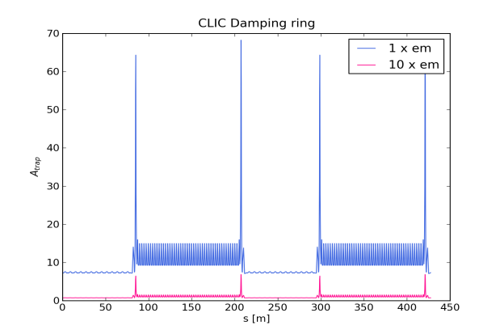
Ion trapping
During the time T_{b} between bunch passages, the ions drift with constant velocity
Using the stability condition of a linear beam trajectory: |Tr(M)| < 2
  The ion motion is stable if |2 – k_{x,y}T_{b}| < 2, or k_{x,y} × T_{b} < 4
  Trapping condition for the ion mass number:
CO, N₂
H₂O
H₂

Slide 7
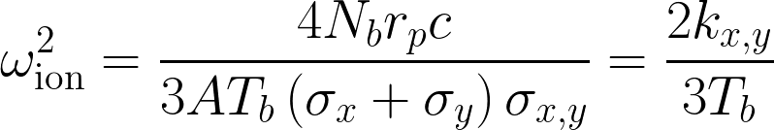
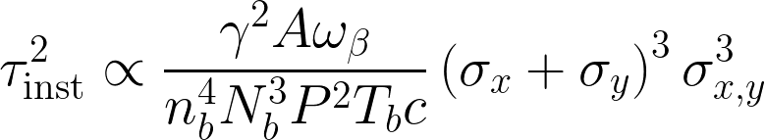
Ion trapping
During the time T_{b} between bunch passages, the ions drift with constant velocity
Using the stability condition of a linear beam trajectory: |Tr(M)| < 2
  The ion motion is stable if |2 – k_{x,y}T_{b}| < 2, or k_{x,y} × T_{b} < 4
  Trapping condition for the ion mass number:
  Ions oscillate in the beam field
  with the frequency:
  Estimated instability rise time:
    n_{b} = nr of bunches, P = pressure, ω_{β} = betatron frequency
Raubenheimer et al., Phys. Rev. E 52, 5, 5487,
Stupakov et al., Phys. Rev. E 52, 5, 5499

Slide 8
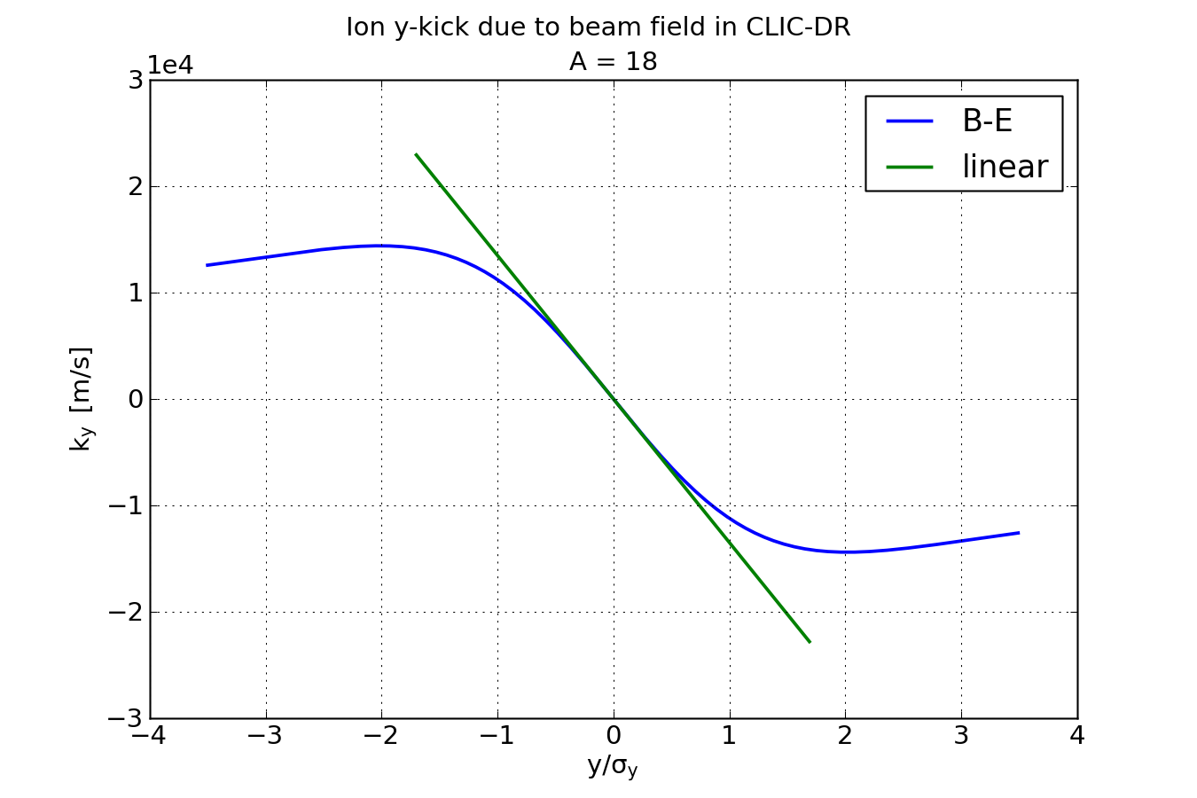
Beyond linear approximation
Linear approximation good only in small region around centre of beam
x,y ≈ 0.5 σ_{x,y}

Slide 9
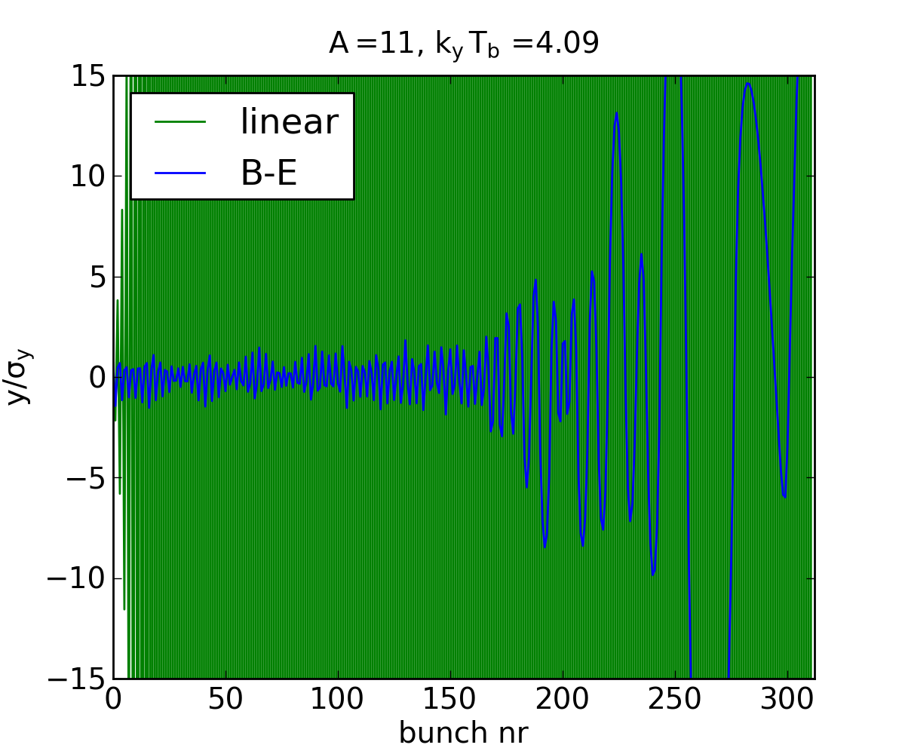
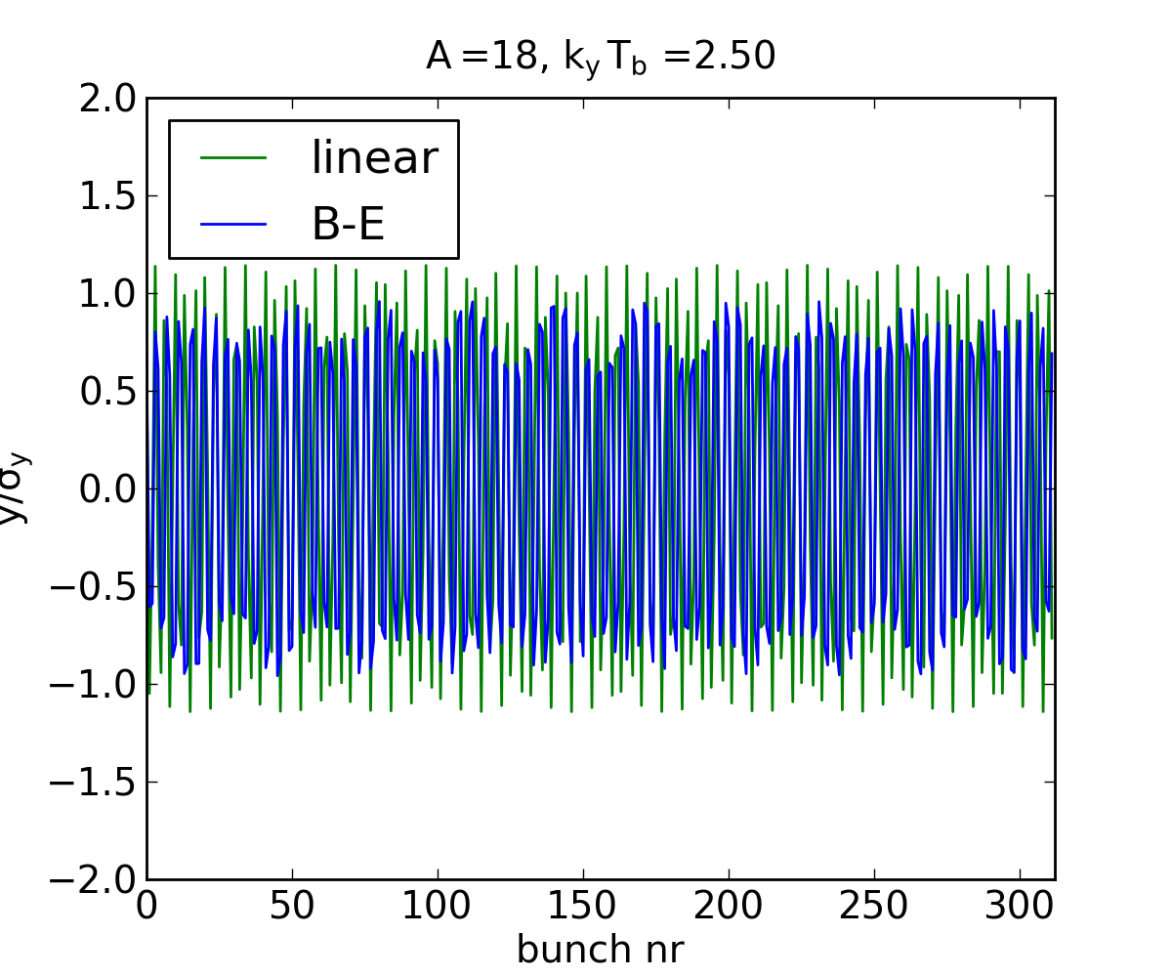
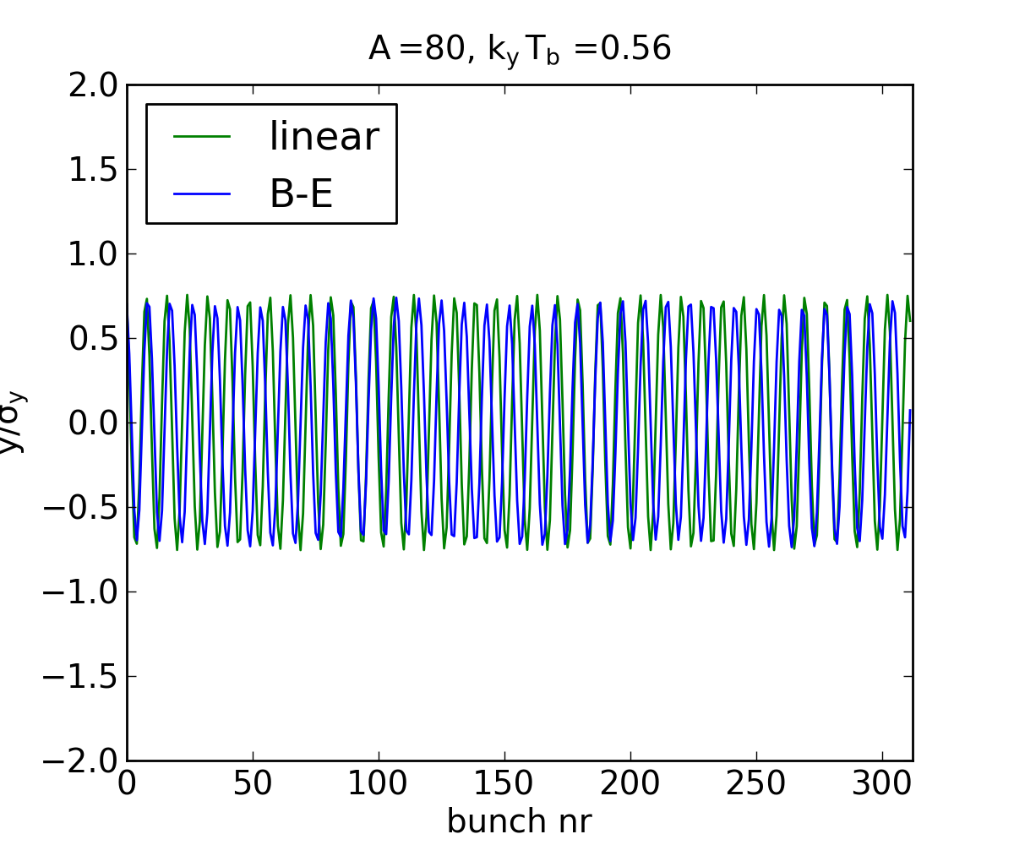
Beyond linear approximation
Effect on stability condition and ion trapping
Trajectories for ion of mass A during the passage of a CLIC bunch train
  x₀ = 0.7 σ_{x}, y₀ = 0.7 σ_{y}
Non-trapping, k_{y}T_{b} > 4
Weak trapping, k_{y}T_{b} = 2.5
Strong trapping, k_{y}T_{b} = 0.56

Slide 10
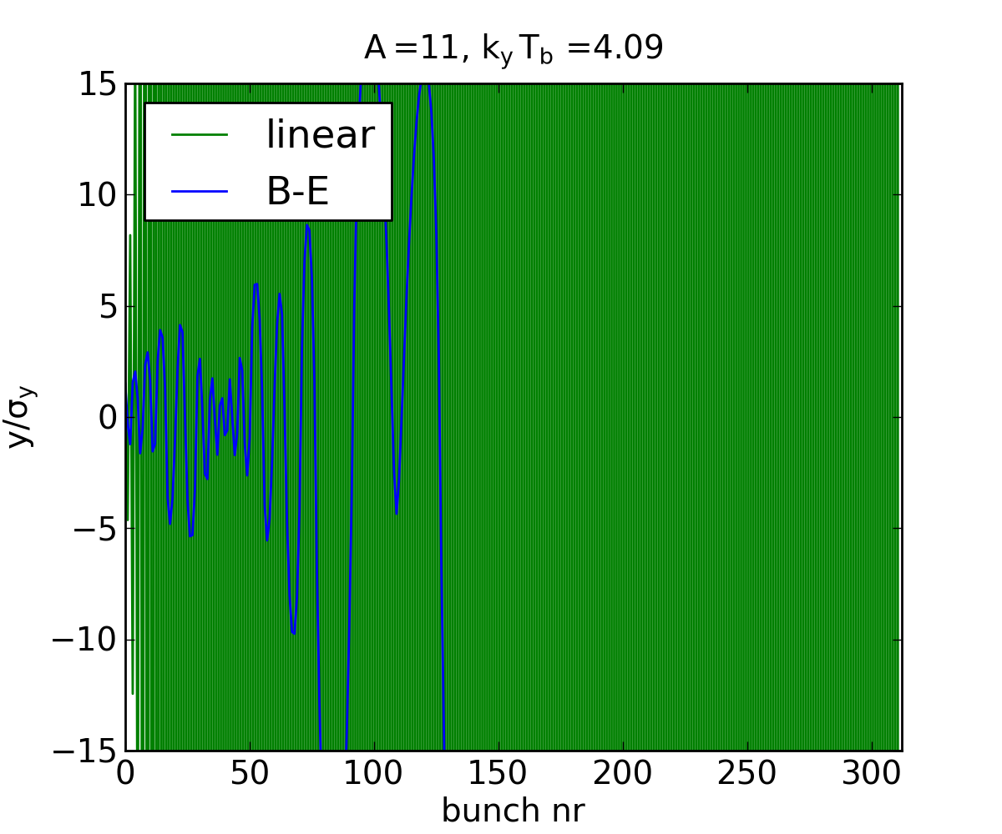
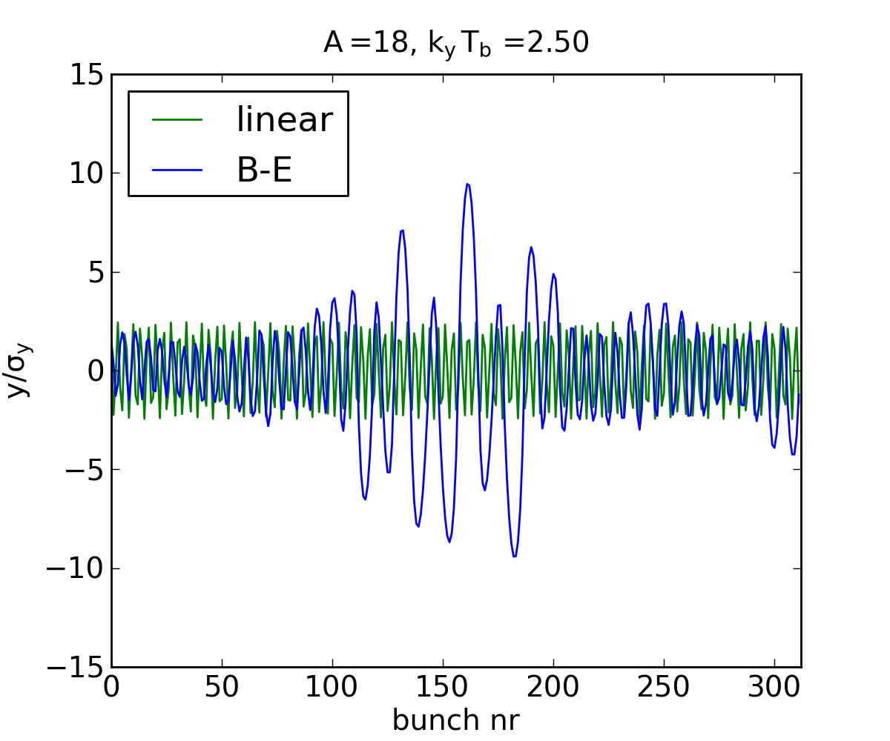
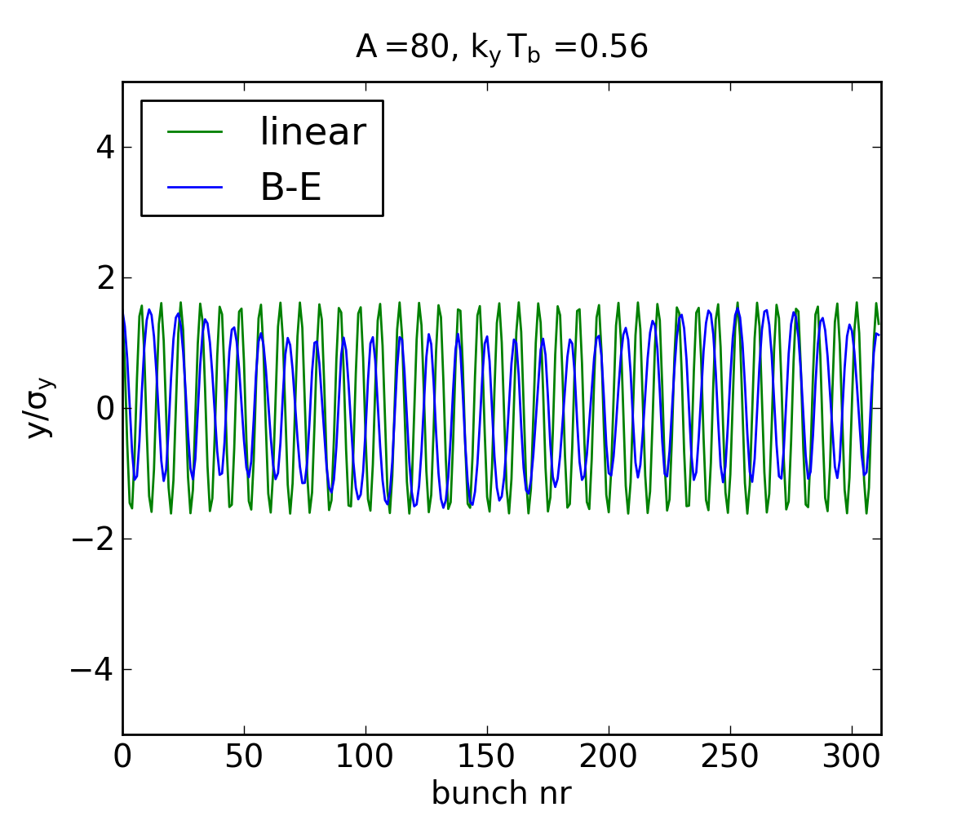
Beyond linear approximation
Effect on stability condition and ion trapping
Trajectories for ion of mass A during the passage of a CLIC bunch train
  x₀ = 1.5 σ_{x}, y₀ = 1.5 σ_{y}
Non-trapping, k_{y}T_{b} > 4
Weak trapping, k_{y}T_{b} = 2.5
Strong trapping, k_{y}T_{b} = 0.56

Slide 11
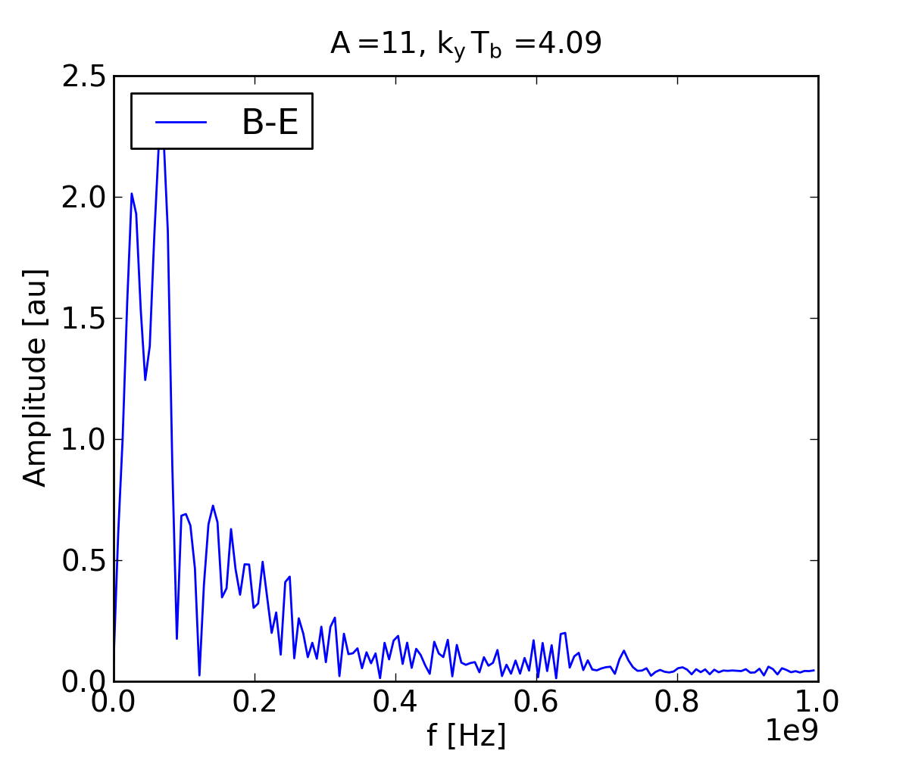
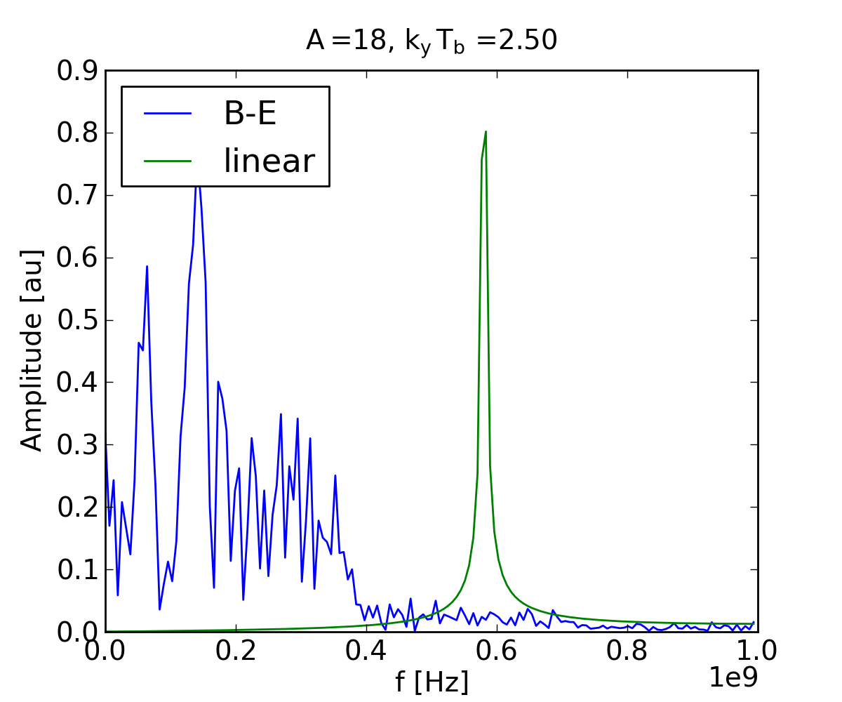
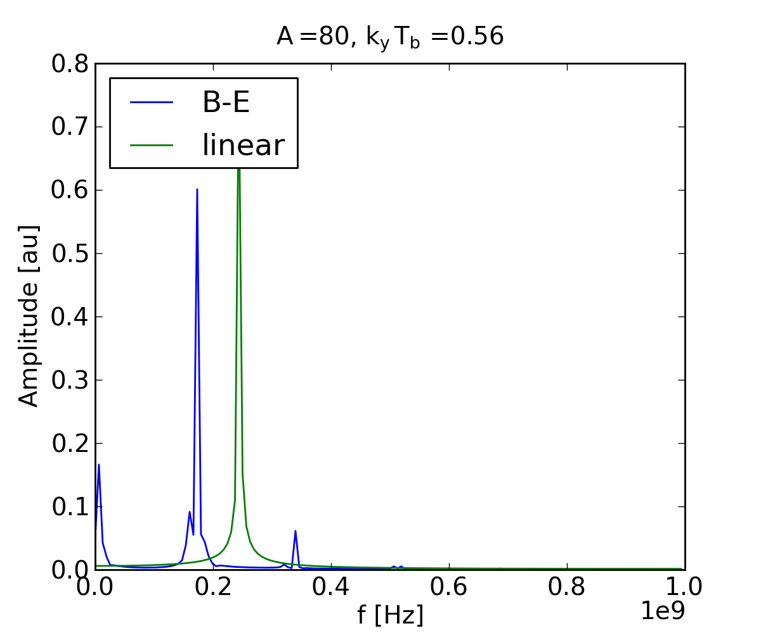
Beyond linear approximation
Effect on stability condition and ion trapping
Oscillation frequencies for ion of mass A during the passage of a CLIC bunch train
  x₀ = 1.5 σ_{x}, y₀ = 1.5 σ_{y}
Non-trapping, k_{y}T_{b} > 4
Weak trapping, k_{y}T_{b} = 2.5
Strong trapping, k_{y}T_{b} = 0.56

Slide 12
Numerical modeling
A comprehensive understanding of the instability can be obtained through macro-particle simulations
Weak-strong simulations can estimate centroid motion
Strong-strong simulations provide full picture including emittance growth
The simulations steps for the fast ion instability are very similar to e-cloud simulations
However, unlike for e-cloud, the “build-up” and the beam dynamics of fast ion instabilities must be simulated together
The ions must be generated dynamically according to each bunch at each passage, since the small differences in bunch position provide the seed for the instability

Slide 13
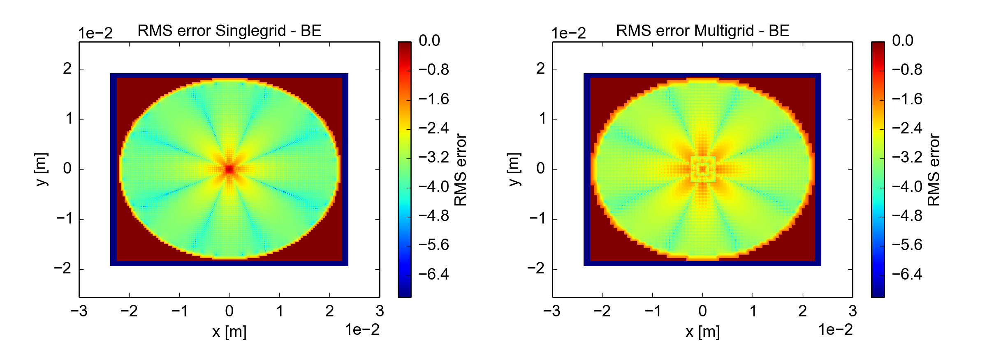
Numerical modeling
Also the associated challenges are very similar to those of e-cloud simulations
The small beam must be resolved very well, while at the same time the ions can oscillate with large amplitudes → benefit from multi-grid solvers
Although the time steps can be longer since ions are slower than electrons, the full bunch train must be simulated and the simulations quickly become time-consuming → benefit from parallelization
For CERN studies the same simulation tools are now used for both cases^{(*)}
G. Iadarola et al
^{(*)}L. Mether at al., “Numerical modeling of fast beam ion instabilities”, HB2016
G. Iadarola et al., “Evolution of python tools for the simulation of electron cloud effects”, IPAC17

Slide 14
Could a fast ion instability occur in a proton machine?
Ions are repelled by the p⁺ beam and cannot be trapped like in e⁻ machines, could they nevertheless cause an instability?

Slide 15
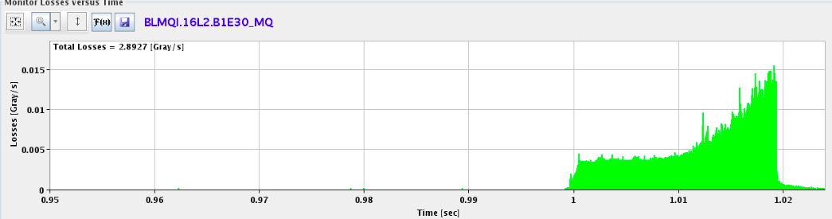
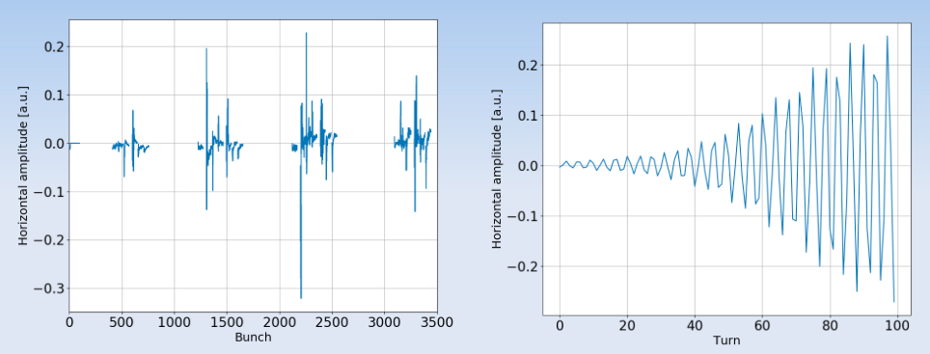
Motivation
More than 50 dumps in the LHC in 2017
connected to losses in fixed location (16L2)
Typical signature
  Quickly developing plateau of high losses
  Consistent with gas density of 10²⁰-10²² over 10 cm distance
  Coherent motion on head of trains
  Sometimes coupled bunch motion
Very fast rise times:
10-100 turns
typically
X. Buffat et al

Slide 16
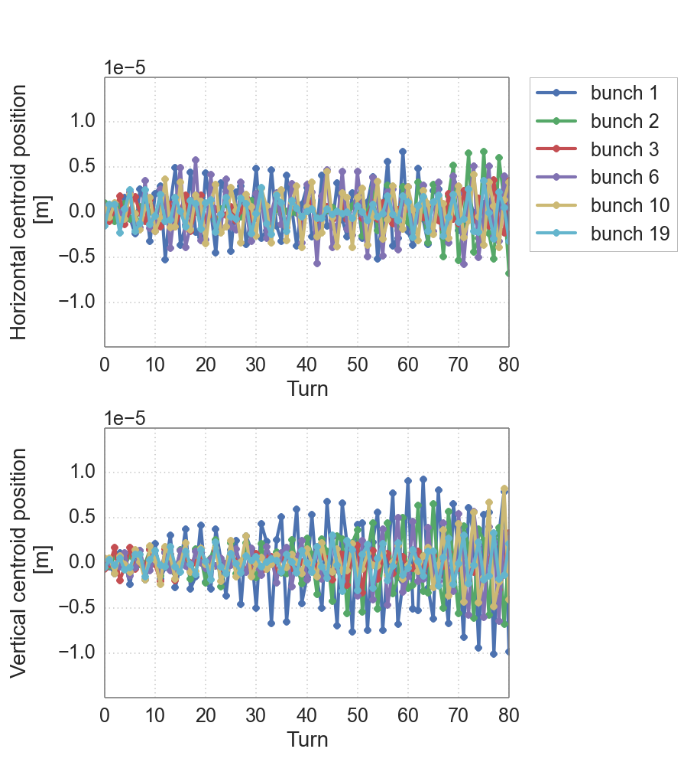
Ions
Preliminary fast ion simulation studies indicate that ions can cause an instability if the gas density is high: at least 10²² m⁻³ (ionization cross-section 2 MBarn)
As soon as they are created, ions start moving out of the beam
At such high densities, the ion space charge has a strong effect on the dynamics
From a neutral gas, an equal amount of electrons would be generated
How do they effect the beam and the ion motion?
Nitrogen gas over 4 m

Slide 17
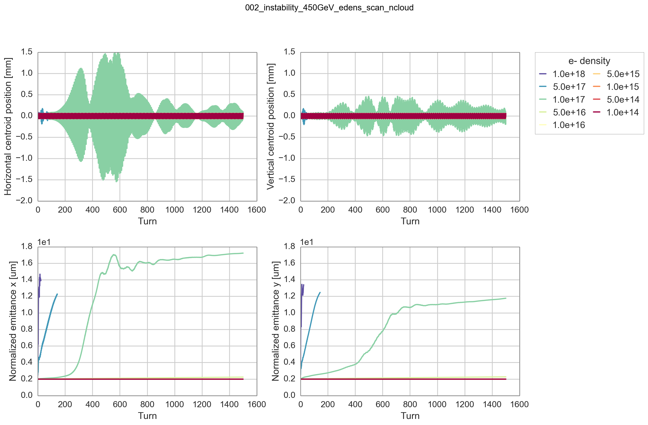
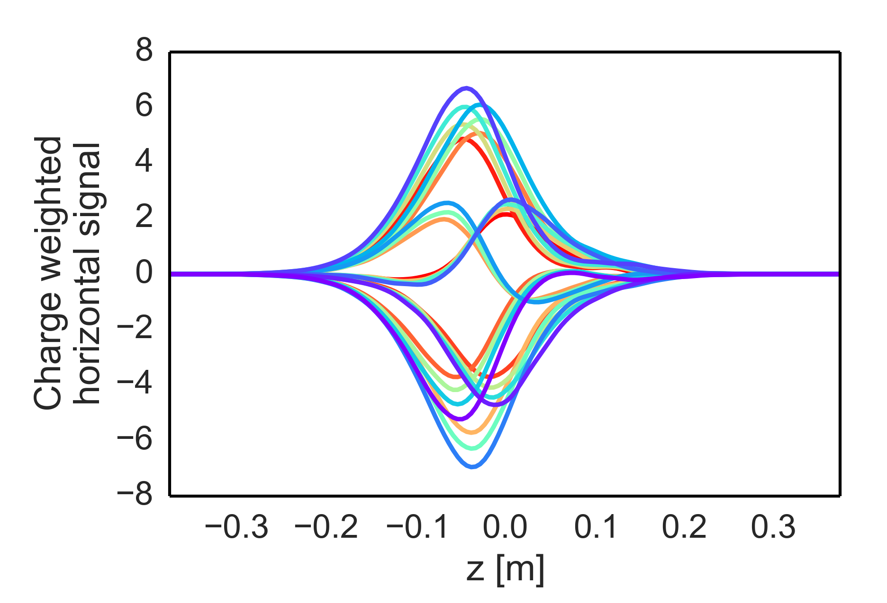
Electrons
Simplified simulations indicate that a high electron density localized in the machine can cause a fast single bunch instability
Required e⁻ densities several orders of magnitude higher than in a typical e-cloud:
10¹⁷ e⁻/m³ over a 10 cm distance
Simulation results fit well with observations: large positive tune shift, intra-bunch modes
1.0e+17

Slide 18
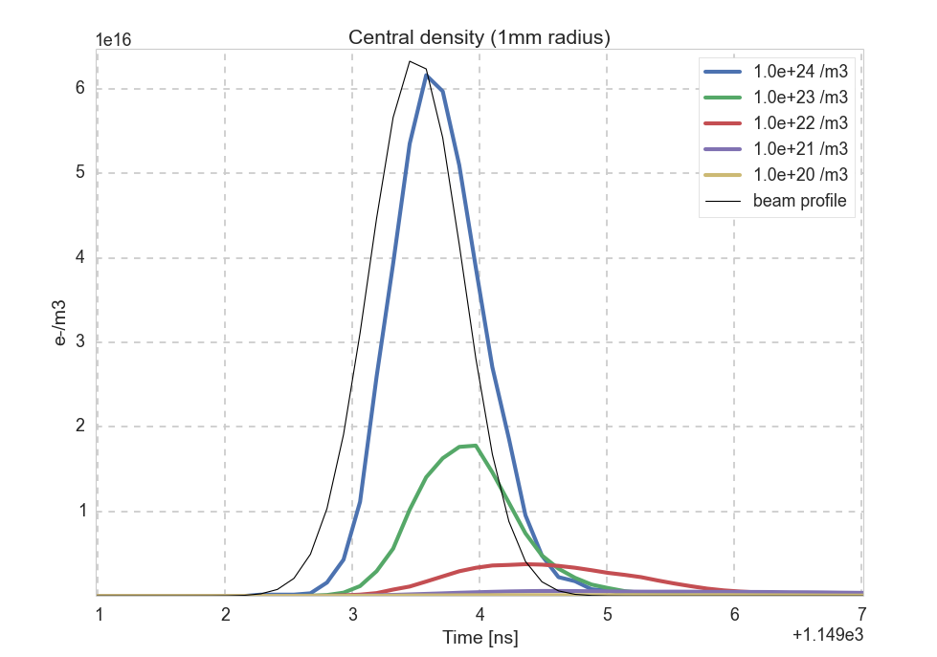
Electrons
E-cloud build up with gas ionization indicate that e⁻ densities within beam can reach very high during a bunch passage
Average electron densities of 10¹⁷ m⁻³ require gas densities > 10²⁴ m⁻³
Dynamics dominated by electron space charge → effect of ion space charge?
We seem to be faced with a three-stream instability mechanism!
Work is underway to modify simulation tools to model it…
1.0e+17

Slide 19
Summary
Fast ion instabilities affect electron machines
Rarely a problem in running machines, can be mitigated with feedback
Should be taken into account when making vacuum specifications for future machines
Linear approximation can be used for first estimates, macroparticle simulations provide detailed model
Possible three-stream instability ion-electron-beam instability observed in the LHC in the presence of (suspected) severe vacuum degradation
Studying the instability can help understand the mechanism
Simulation tools being developed to tackle simulations

Slide 20
Thank you

Slide 21
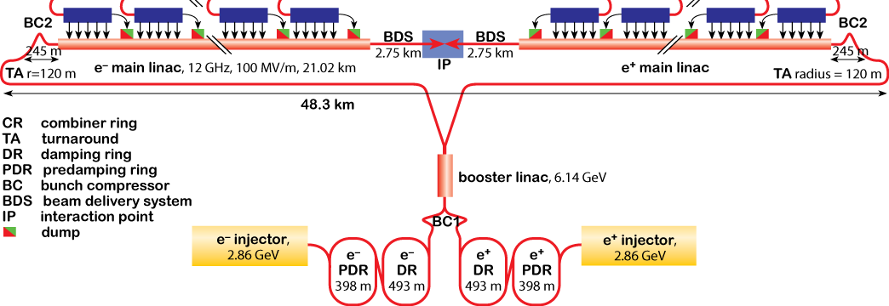

CLIC accelerator complex
Parameters | Value
Bunch population | 4 x 10⁹
Bunches per train | 312
Bunch spacing [ns] | 0.5
Bunch length (rms) [mm] | 1.6
Injected
(ε_{x}, ε_{y}) = (63 μm, 1.5 μm)
Extracted
(ε_{x}, ε_{y}) = (500 nm, 5 nm)

Slide 22
Ion instability simulations
Simulation studies with PyECLOUD-PyHEADTAIL
  Extended to cover ion instability studies last year
Beam parameters:
  Energy = 6.5 TeV
  Emittance = 2.e-6
  Bunch intensity = 1.1 x 10¹¹
Pressure bump
  Length = 2.66 m (1e-4 * LHC circumference)
  Assuming T = 300 K
  Ionization cross-section = 2 MBarn
  Seeded with x,y-kick (defined in beam sigmas)
Looking for coherent motion
Offsets of a few microns
Rise time 10 - 80 turns

Slide 23
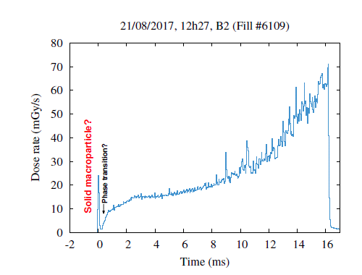
Current picture
Some event, or sequence of events, triggers a vacuum run-away
  Beam particles scatter with the gas → losses
  The beam ionizes the gas → ion-induced coherent motion
  Dump!
Working hypothesis:
Frozen air in beam pipe
Proposed mechanism: (A. Lechner, LMC)
Frozen N₂ macroparticles enter the beam
  Beam particles ionize and possibly heat up the macroparticle
  Under certain circumstances: heating-up → vaporisation/sublimation
  If this does not happen → typical UFO
A. Lechner

