Slide 1
How e-cloud in dipoles and quadrupoles can be source of transverse instability?
A. Romano, K. Li, G. Iadarola, G. Rumolo
Many thanks to: G. Arduini, E. Belli, L. Carver, D. Cesini, L. Mether, E. Mètral and the INFN-CNAF institute in Bologna

Slide 2
Electron cloud build-up
Primary (seed) electrons are generated inside beam chamber (gas ionization, photoemission)
Secondaries are produced when seeds, accelerated by the beam, hit the chamber wall
If the Secondary Electron Yield (SEY) of the surface is large enough, it can drive an avalanche electron production → multipacting regime
A. Romano et al.

Slide 3
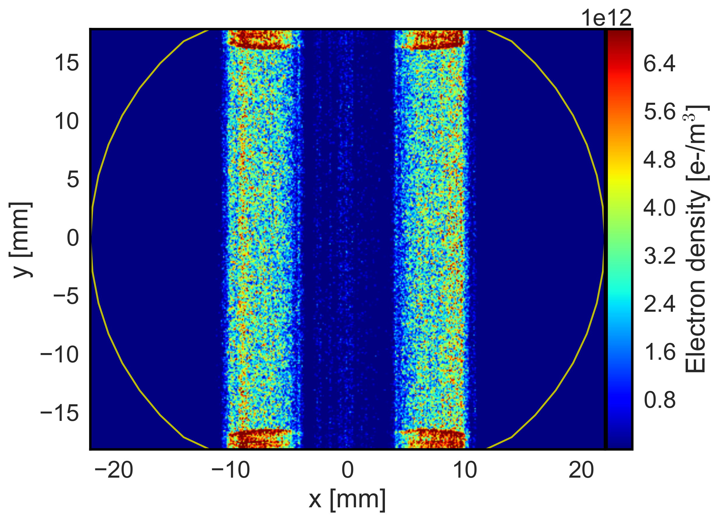
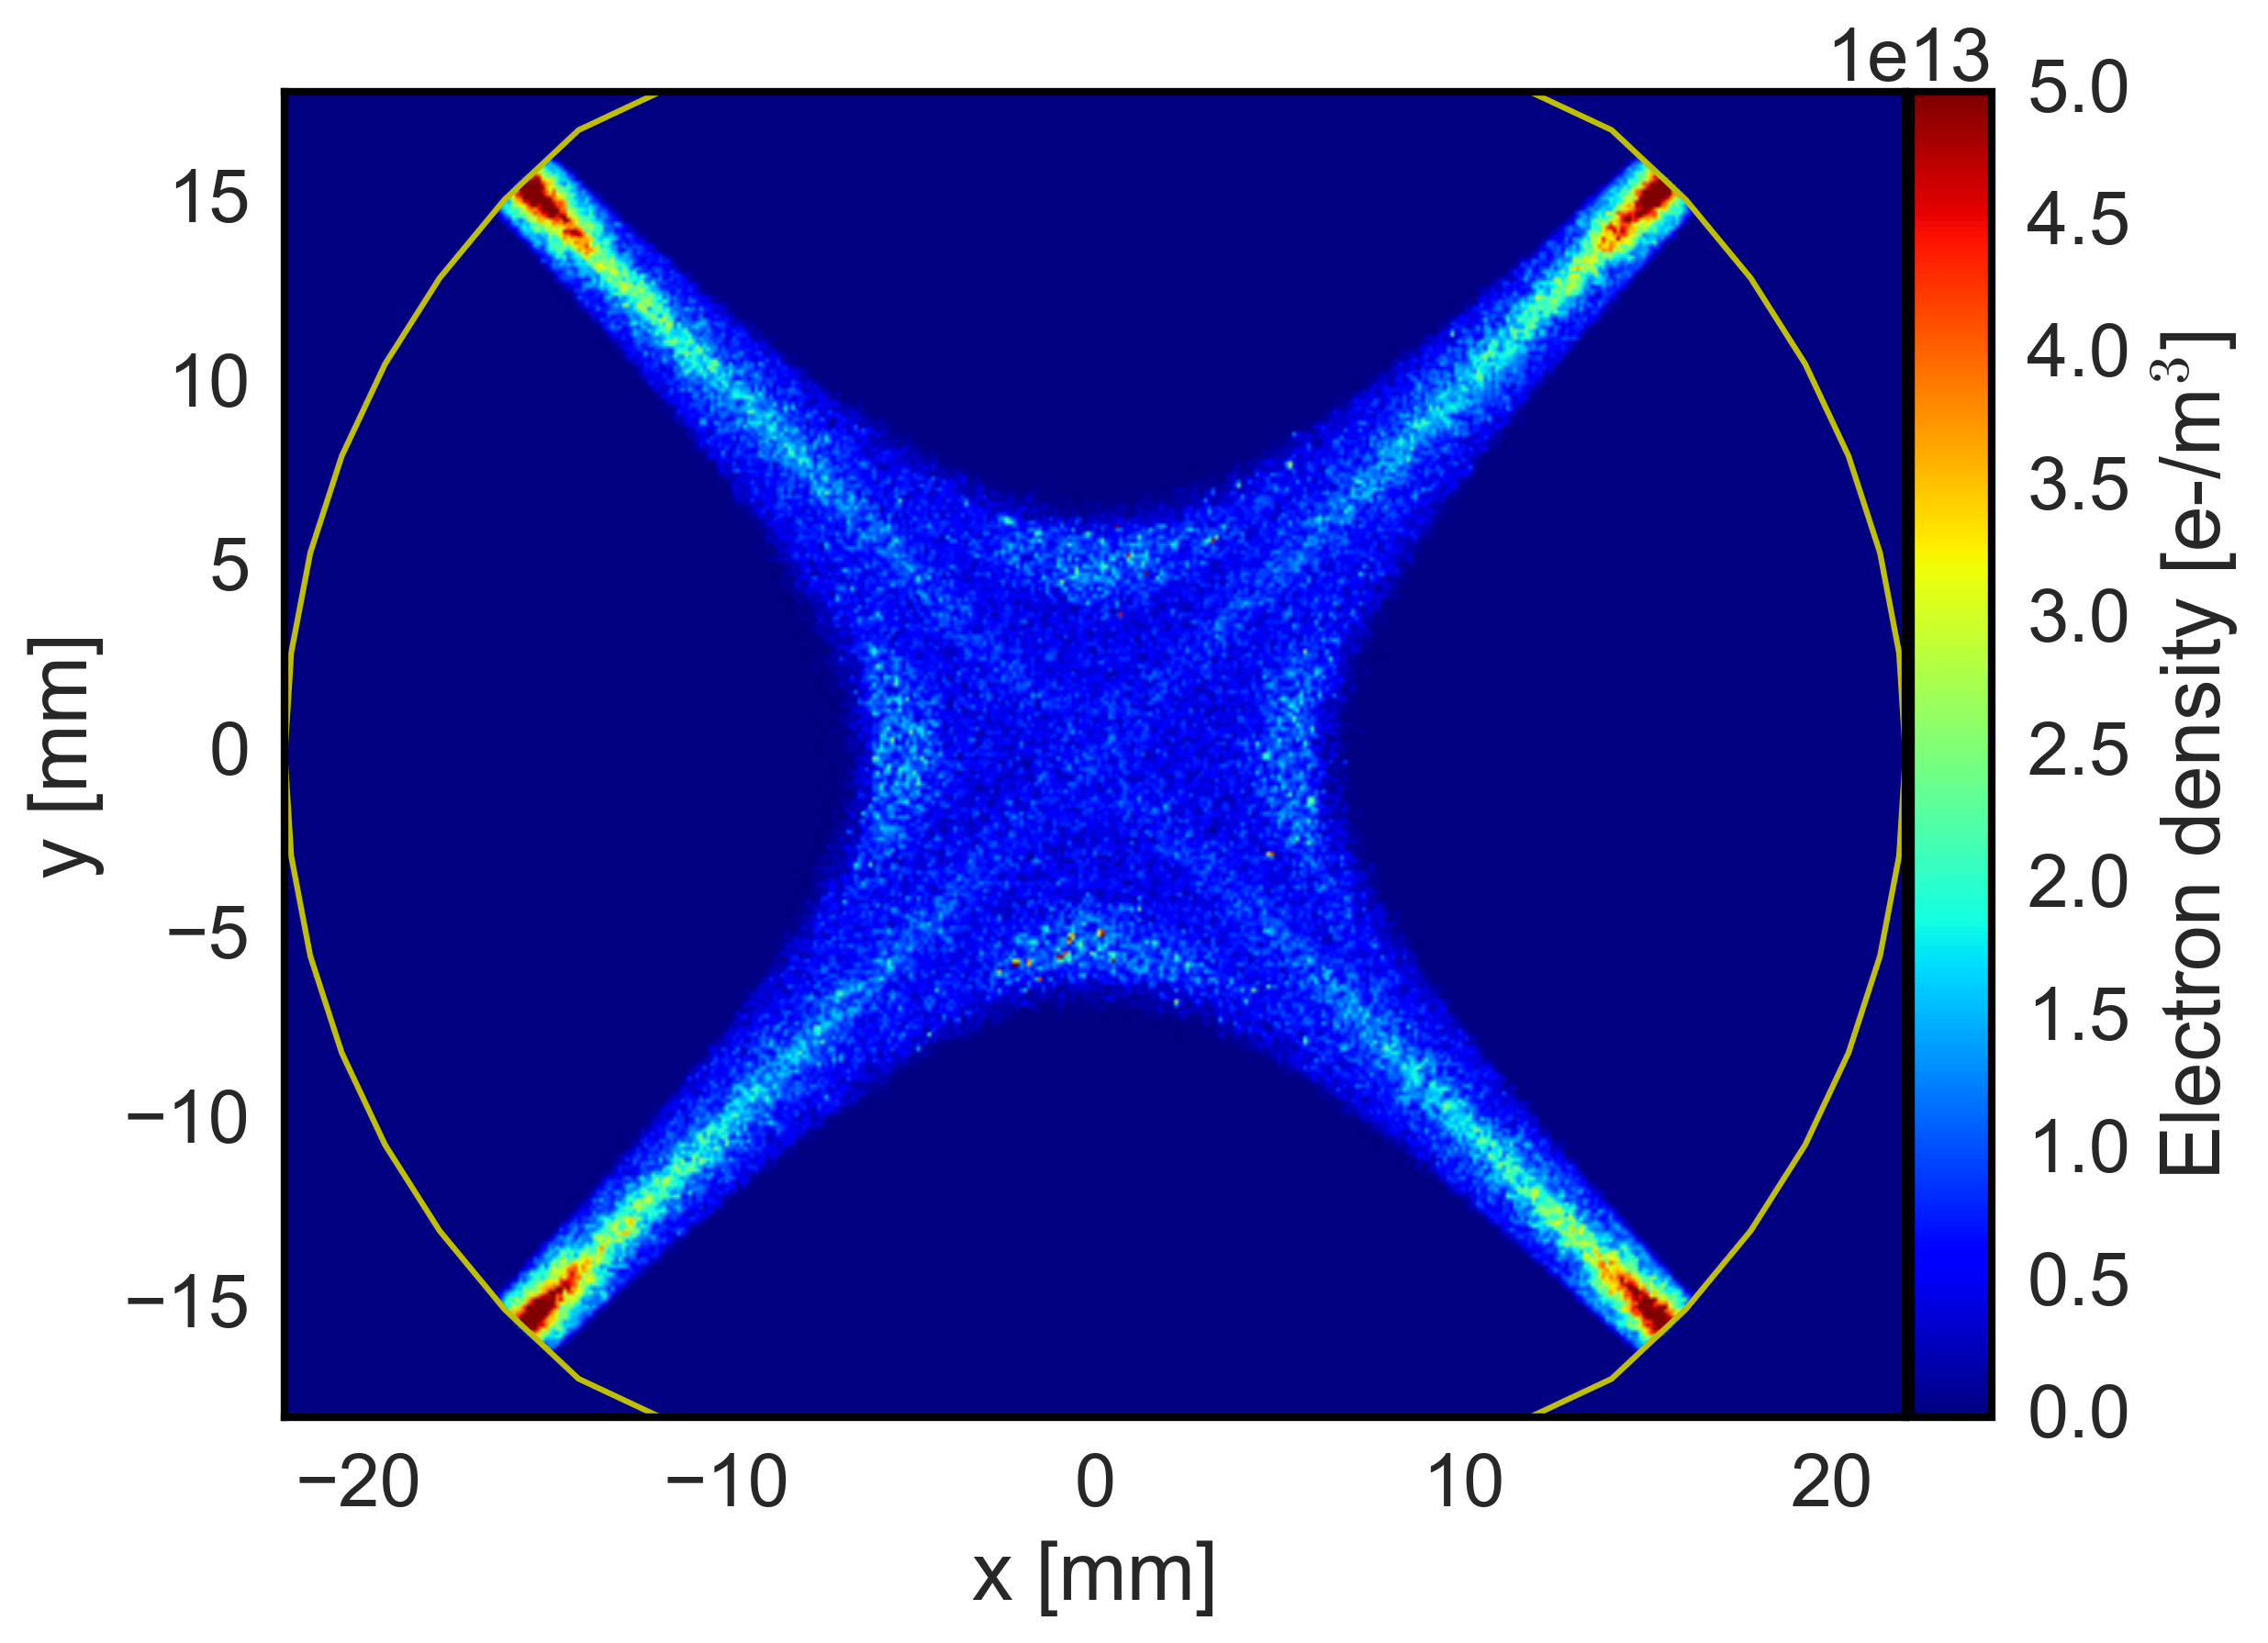
Electron cloud build-up
Primary (seed) electrons are generated inside beam chamber (gas ionization, photoemission)
Secondaries are produced when seeds, accelerated by the beam, hit the chamber wall
If the Secondary Electron Yield (SEY) of the surface is large enough, it can drive an avalanche electron production → multipacting regime
The electron distribution within the beam chamber is strongly influenced by the magnetic field → non-relativistic electrons spin around field lines
LHC Dipole
LHC Quadrupole
A. Romano et al.
Notes:
the interaction between electrons becomes important and the electron cloud itself repels the electrons coming from the wall
→ Ballance between impacting electrons and secondaries is reached!

Slide 4
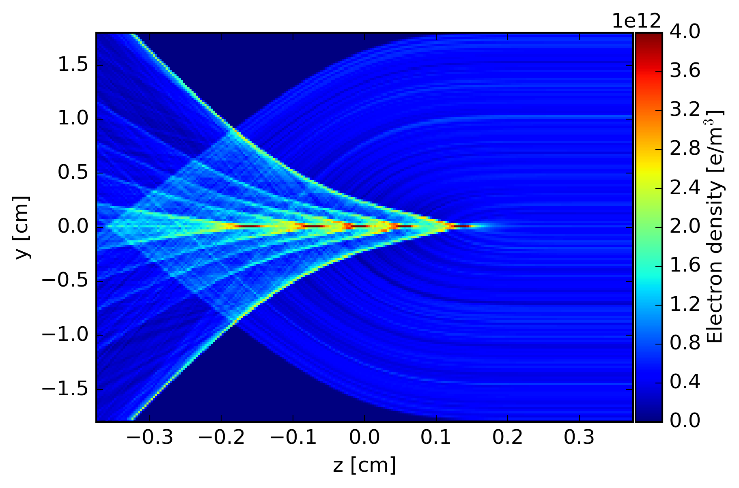
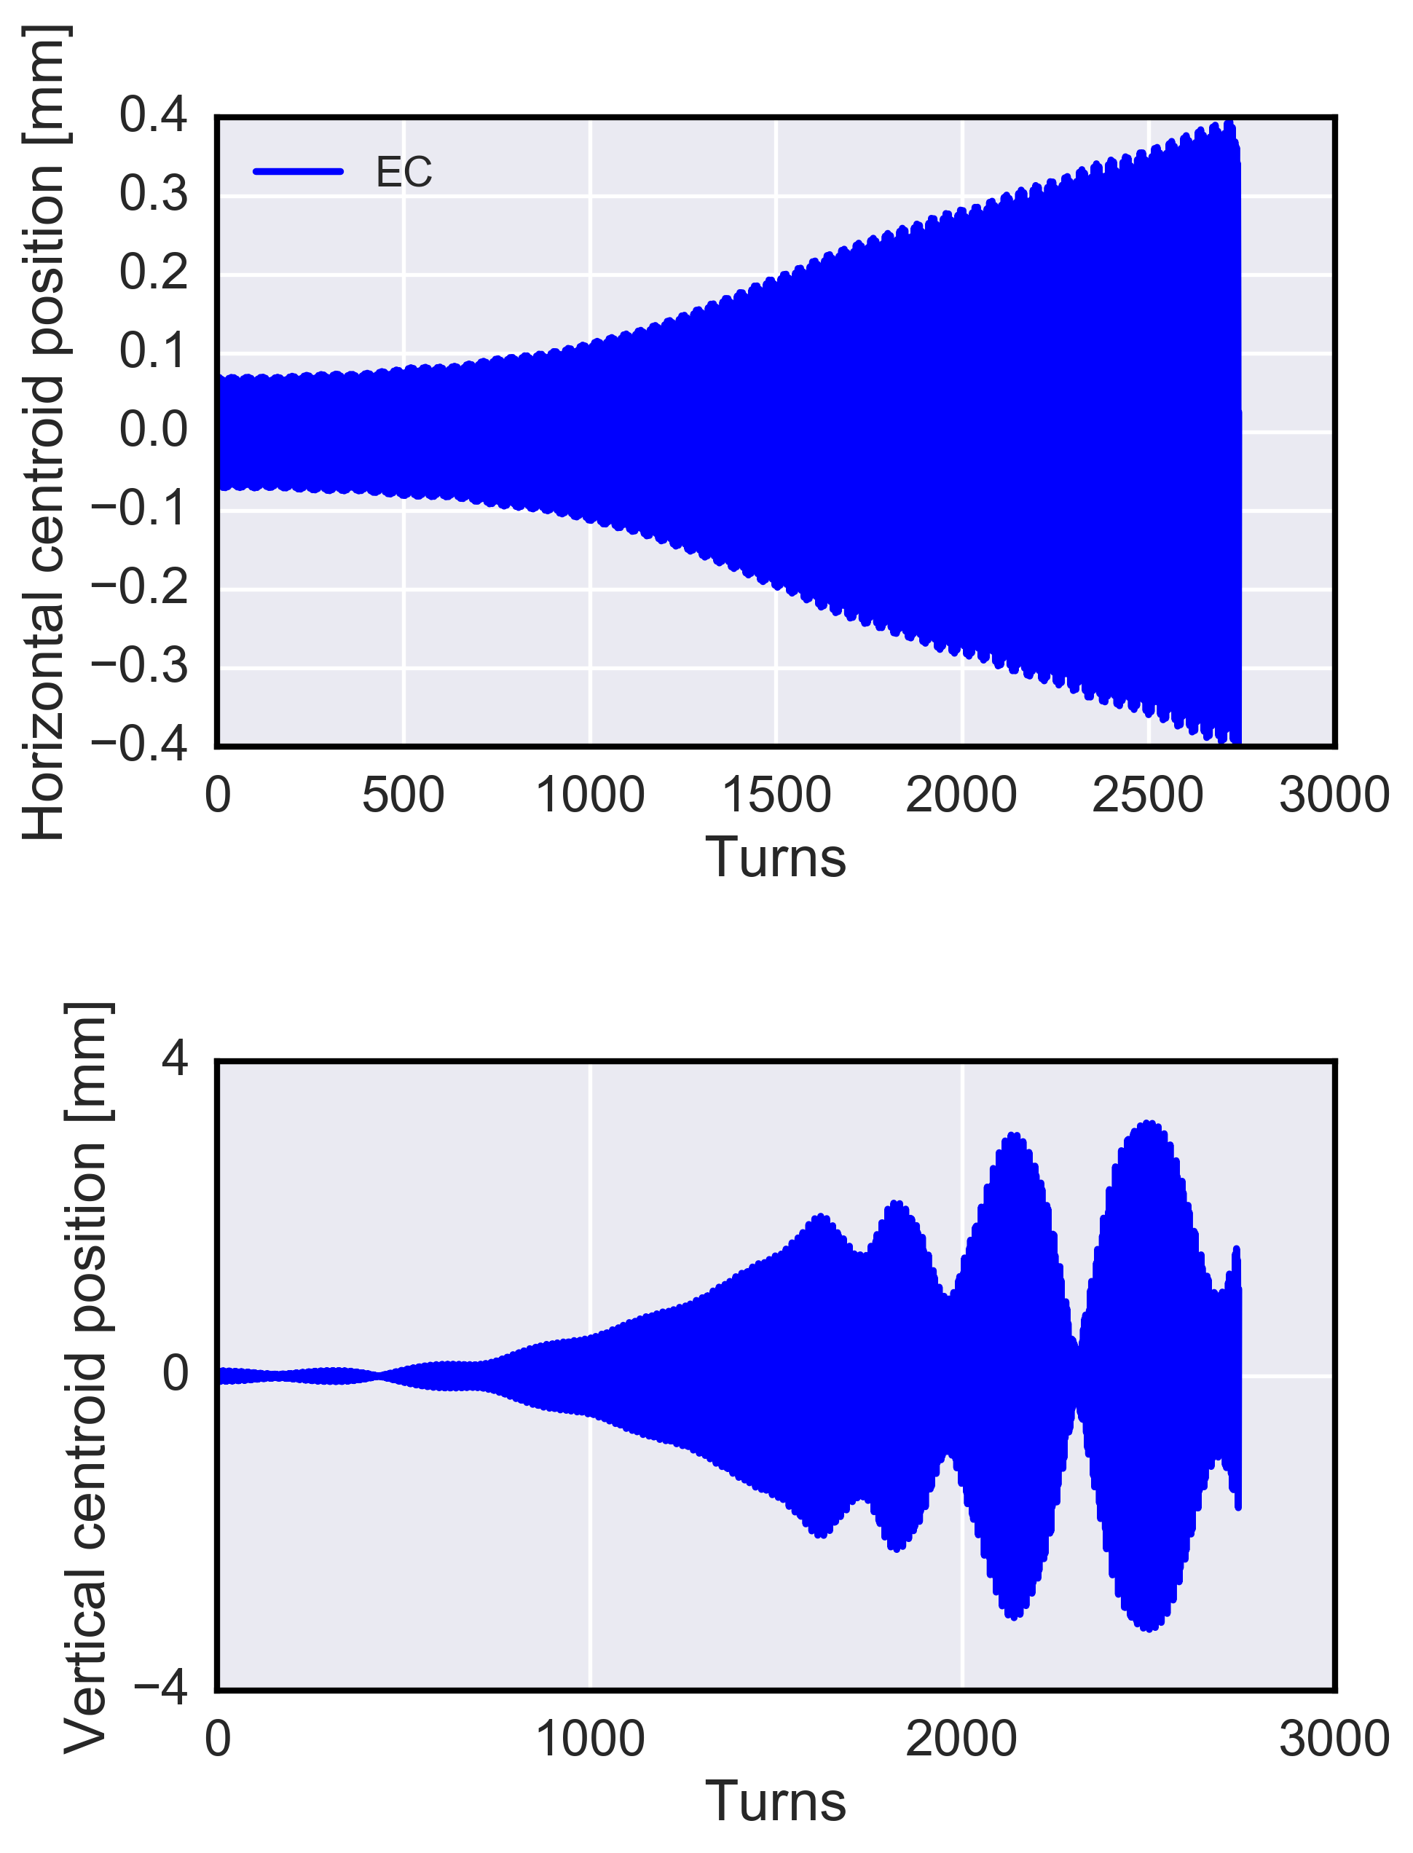
Electron cloud induced instability
The distortion of the cloud induced by the bunch passing through (pinch effect) can give rise to coherent instabilities and emittance growth
  If e.g. the head of the bunch is slightly displaced, an asymmetric pinch will take place which will kick the following bunch particles toward the higher density region
  After several turns, the motion of the head is transferred to the tail
  After a sufficient number of turns, the unstable coherent motion has propagated to the whole bunch
Electron density during a bunch passage
e-cloud driven instability
From Simulations
From Simulations
Bunch tail
Bunch head
A. Romano et al.
Notes:
Due to the interaction with the beam a sudden deformation of the e-cloud distribution takes place. Ad the bunch passes through the electron are attracted towards the center of the beam causing a pinch of the e-cloud itselfs. Assuming that the instant when the bunch enters the ec is here, it is evident that several pinches ara forming around the center of the bunch and then moving towards the end.

Slide 5
Electron cloud induced instability
The distortion of the cloud induced by the bunch passing through (pinch effect) can give rise to coherent instabilities and emittance growth
  If e.g. the head of the bunch is slightly displaced, an asymmetric pinch will take place which will kick the following bunch particles toward the higher density region
  After several turns, the motion of the head is transferred to the tail
  After a sufficient number of turns, the unstable coherent motion has propagated to the whole bunch
  Understanding of beam observables heavily relies on numerical simulations
  At CERN this is done using the PyECLOUD-PyHEADTAIL simulation setup
  Simulations are very demanding in terms of time and computational resources → typical study requires hundreds of CPUs (8 CPUs per job) and 3-4 week to simulate 10⁴ turns (INFN-CNAF clusters used for this purpose)
  Recent work has been focused on increasing the performance of the simulation tools
Electron density during a bunch passage
e-cloud driven instability
From Simulations
From Simulations
Bunch tail
Bunch head
A. Romano et al.
Notes:
Due to the interaction with the beam a sudden deformation of the e-cloud distribution takes place. Ad the bunch passes through the electron are attracted towards the center of the beam causing a pinch of the e-cloud itselfs. Assuming that the instant when the bunch enters the ec is here, it is evident that several pinches ara forming around the center of the bunch and then moving towards the end.

Slide 6
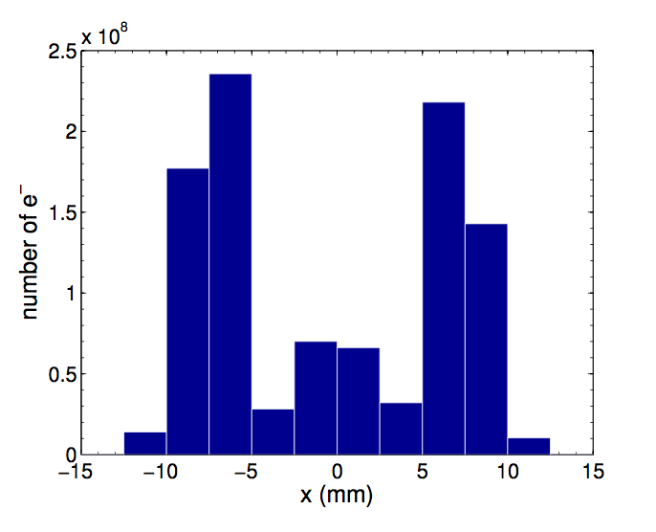
Electron cloud induced instability: dipoles magnets
Which part of the EC distribution is responsible for driving the beam unstable?
EC distribution from
PyECLOUD simulations
Histogram of the horizontal
e- distribution
A. Romano et al.
Notes:
To a chieve a reasonable computational burdern

Slide 7
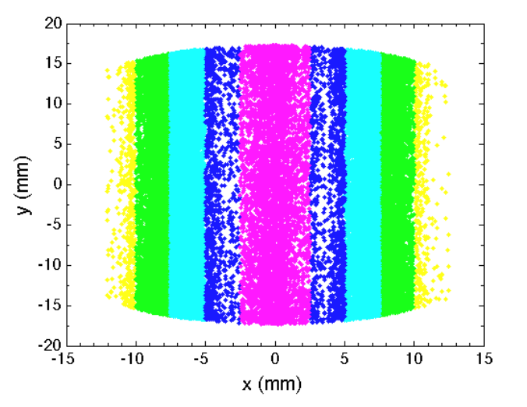
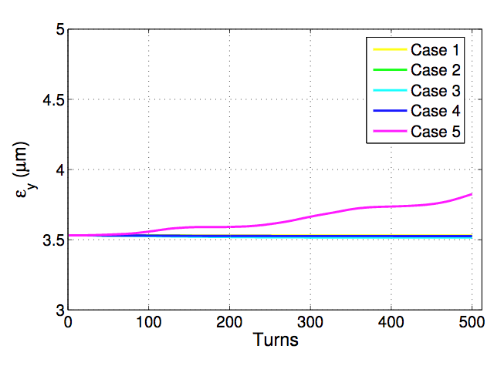
Electron cloud induced instability: dipoles magnets
Which part of the EC distribution is responsible for driving the beam unstable?
Histogram of the horizontal e- distribution from PyECLOUD
MP distribution within the chamber (in the transverse plane) is divided in 5 regions corresponding to the bin of the histogram
Study the contribution from each region to the vertical instability → only the central part is able to drive the beam unstable
H. Bartosik et al., “BENCHMARKING HEADTAIL WITH ELECTRON CLOUD INSTABILITIES OBSERVED IN THE LHC”, ECLOUD12
A. Romano et al.

Slide 8
Electron cloud induced instability: dipoles magnets
Which part of the EC distribution is responsible for driving the beam unstable?
Histogram of the horizontal e- distribution from PyECLOUD
MP distribution within the chamber (in the transverse plane) is divided in 5 regions corresponding to the bin of the histogram
Study the contribution from each region to the vertical instability → only the central part is able to drive the beam unstable
  The instability onset depends strongly on the central electron density seen by the beam. In order to estimate the instability threshold, we can initialize instability simulations with a uniform electron distribution and scan its density
H. Bartosik et al., “BENCHMARKING HEADTAIL WITH ELECTRON CLOUD INSTABILITIES OBSERVED IN THE LHC”, ECLOUD12
A. Romano et al.

Slide 9
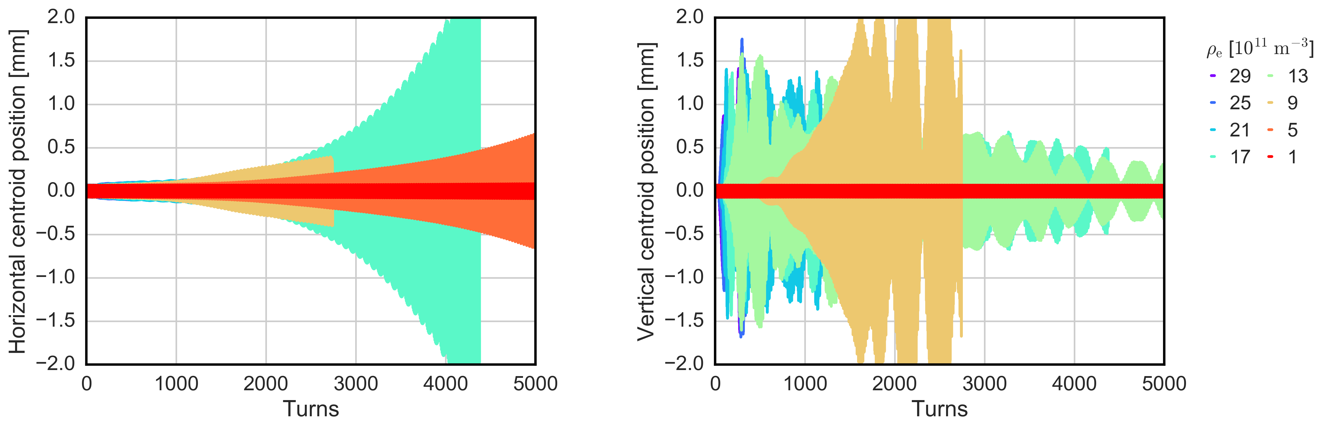
Estimating the instability threshold: LHC dipoles
EC distribution initialized uniform within the dipole chamber → electron density scan
Nominal beam parameter of an LHC bunch at injection energy (450GeV)
  Instabilities appear in both planes → different behaviour
    lower threshold in the horizontal plane
    faster rise-time (but larger threshold) in the vertical plane
    At 6.5 TeV (flat-top energy), due to the increased beam rigidity the instability development is much slower and predominately vertical
A. Romano et al.

Slide 10
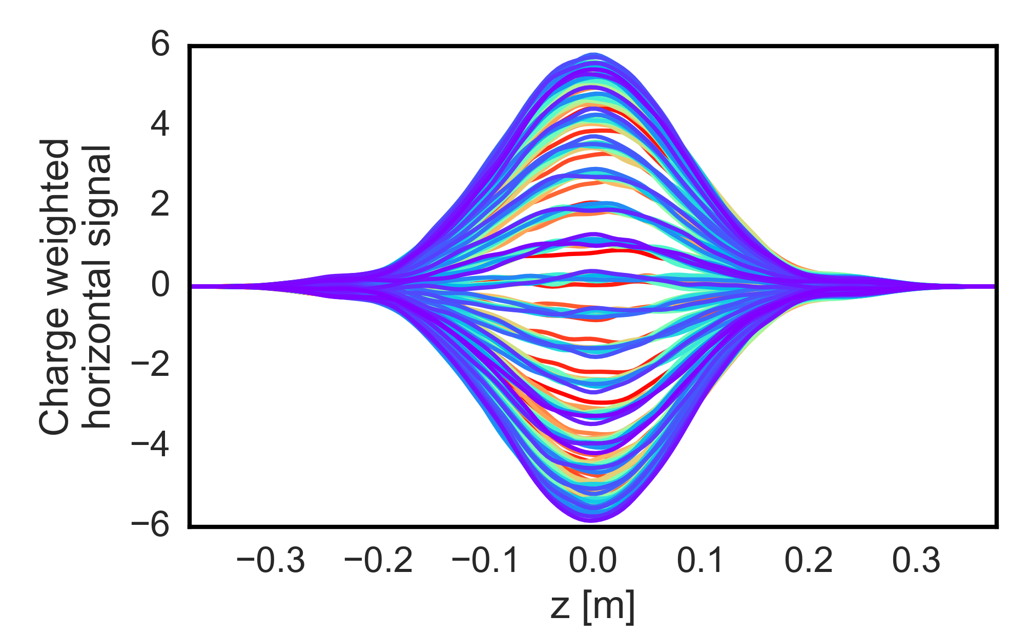
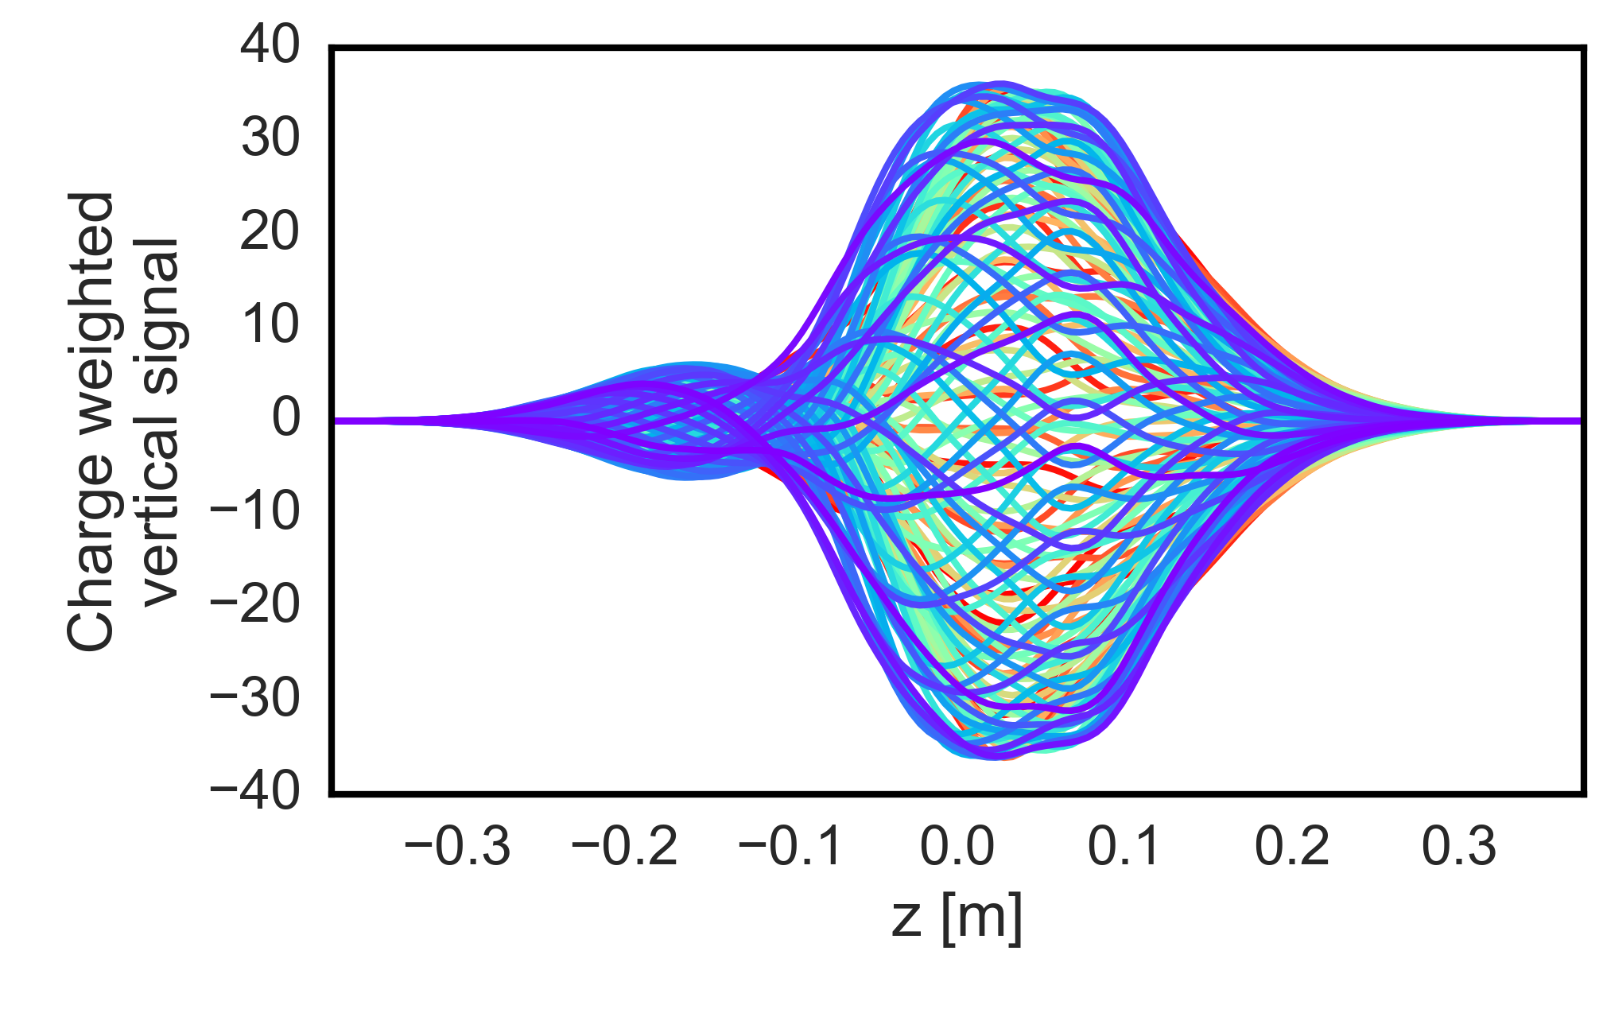
Intra-bunch modes: LHC dipoles
  Intra bunch motion has been studied for an EC density in dipoles of 9x10¹¹ e-/m³
  Different intra-bunch modes excited
    Mode 0-like in the horizontal plane
    Higher order modes in the vertical plane
  Further studies showed that an ideal bunch-by-bunch transverse feedback system (50 turns of damping time) can detect and fully suppress only mode 0 like oscillations
Turns: 1650-1800
Turns: 1650-1800
  (450 GeV, colour code corresponds to different turns after instability developing)
A. Romano et al.
Notes:
For us: look also at beginning of the instability

Slide 11
Intra-bunch modes: LHC dipoles
  Intra bunch motion has been studied for an EC density in dipoles of 9x10¹¹ e-/m³
  Different intra-bunch modes excited
    Mode 0-like in the horizontal plane
    Higher order modes in the vertical plane
  Further studies showed that an ideal bunch-by-bunch transverse feedback system (50 turns of damping time) can detect and fully suppress only mode 0 like oscillations
  Comparing the instability threshold with the electron density at beam location estimated from build up simulations, EC in dipoles is not expected to trigger instabilities →estimated e- density is below the threshold. Is this true for all beam conditions? (see next slides)
Turns: 1650-1800
Turns: 1650-1800
  (450 GeV, colour code corresponds to different turns after instability developing)
A. Romano et al.
Notes:
For us: look also at beginning of the instability

Slide 12
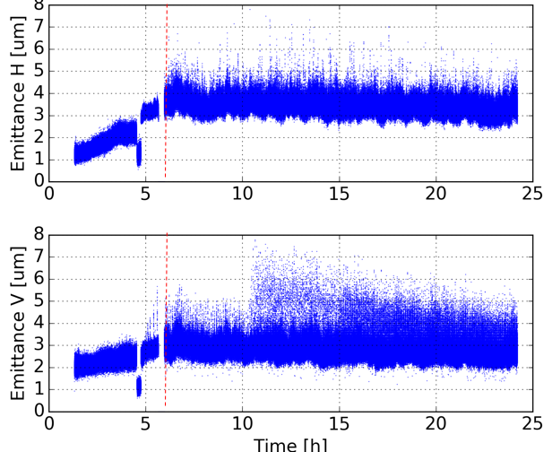
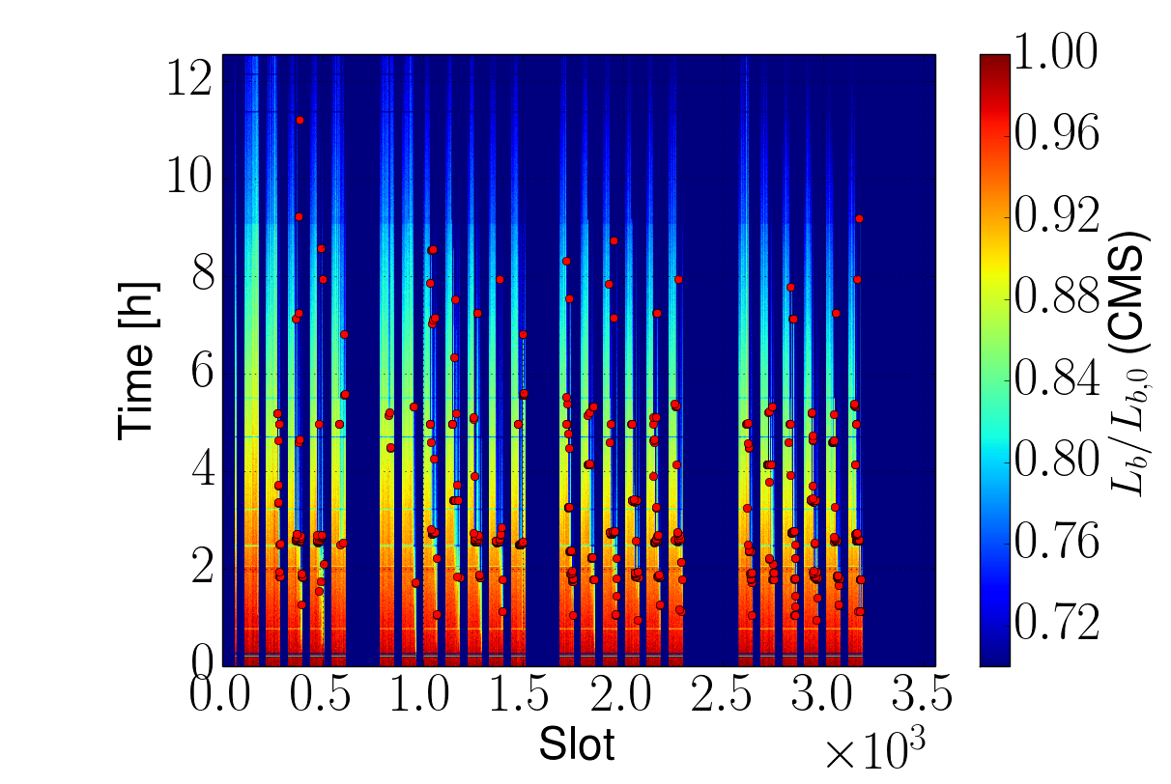
EC observations vs simulations: LHC dipoles
In mid-May 2016, instabilities were observed when the beams were kept stably in collision at 6.5TeV in most of trains with trains of 72b, in spite of a significantly increased beam rigidity and large chromaticity and octupoles
Several bunches blew-up in the vertical plane few hours after the beginning of collisions
  Affecting the tail of the trains → EC in dipoles?
  For bunch intensity between 0.7e11 and 1.1e11 p/bunch
Beginning
of collisions
X. Buffat
A. Romano et al.
Notes:
Beam Synchrotron Radiation Telescope

Slide 13
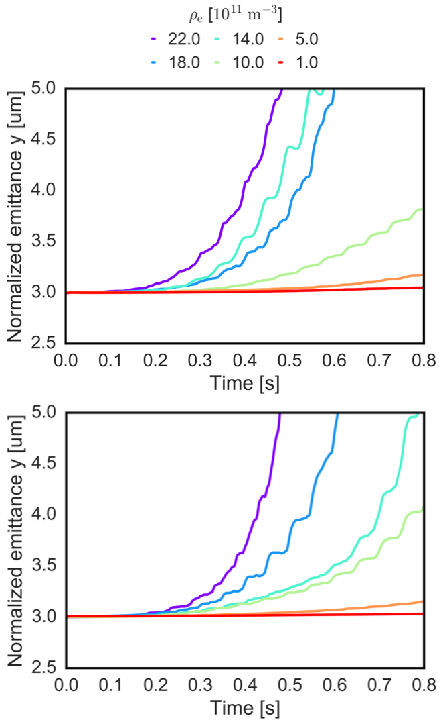
EC observations vs simulations: LHC dipoles
Simulations performed using realistic machine settings and nominal beam parameters → long simulation runs were performed to approach the timescale of the observed instabilities (~2.5 s)
Studied effect of the beam intensity on the instability threshold for various e- densities in the dipoles
    Instability threshold basically unchanged
    an electron density of 5x10¹¹ e-/m³ in the central region of the dipoles is sufficient to drive a vertical instability in both cases
1.1e11 p/bunch
0.7e11 p/bunch
A. Romano et al.

Slide 14
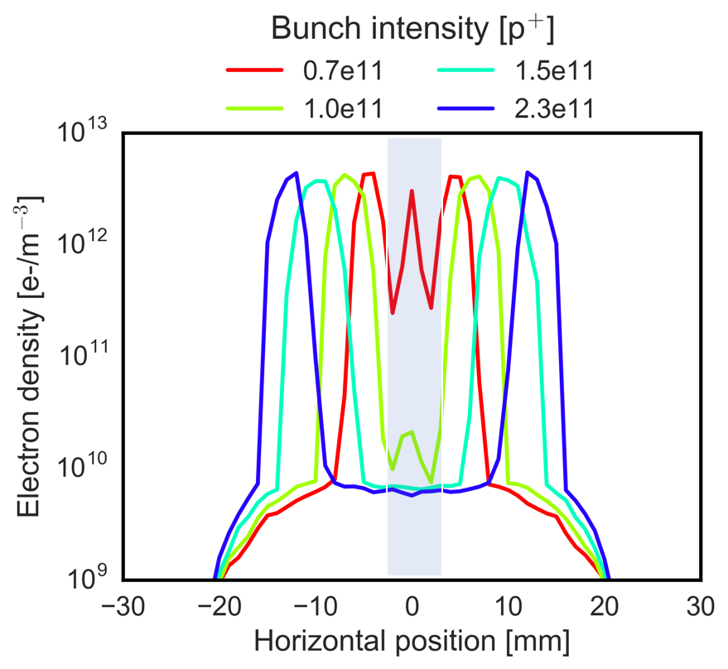
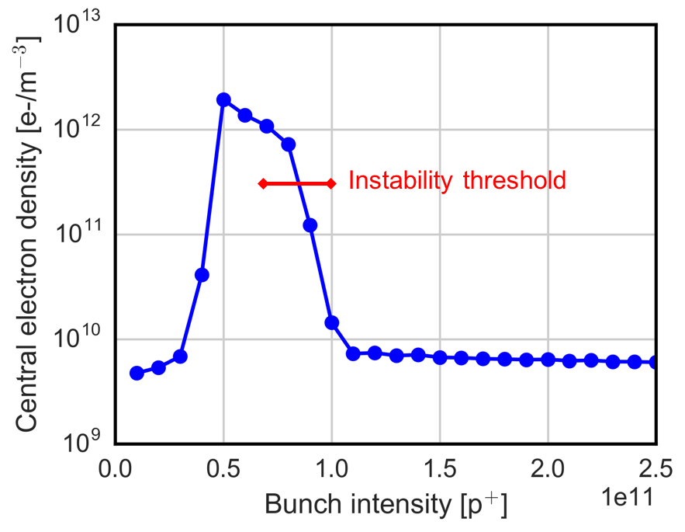
Estimating EC density from PyECLOUD: LHC dipoles
From PyECLOUD simulations we can estimate the electron density profile in the dipoles for different beam intensities
  When the bunch intensity decreases, the central density increases significantly
For bunch intensities below than 1.1e11 ppb, the central density increases rapidly crossing the instability threshold
0.7e11
1.1e11
A. Romano et al.

Slide 15
Estimating EC density from PyECLOUD: LHC dipoles
From PyECLOUD simulations we can estimate the electron density profile in the dipoles for different beam intensities
  When the bunch intensity decreases, the central density increases significantly
For bunch intensities below than 1.1e11 ppb, the central density increases rapidly crossing the instability threshold
  In the present conditioning state of the LHC, the EC in dipoles is not expected to cause coherent instabilities.
  However the situation changes significantly when the bunch intensity decreases w.r.t. the nominal parameters (due to the luminosity burn-off).
  In this case the electron density in the centre can be large enough to drive the beam unstable even at 6.5 TeV, in spite of the increased beam rigidity
0.7e11
1.1e11
A. Romano et al.

Slide 16
Electron cloud induced instability: quadrupole magnets
Due to electron trapping from magnetic field gradients EC density at the beam location can be very high
The EC pinch dynamics in the quadrupoles can be very sensitive to the initial phase space distribution again due to the trapping effects
  Unlike dipoles, in order to assess the threshold for the coherent instability, a realistic initial distribution of electron in the quadrupoles should be taken into account → self-consistent simulations
G. Iadarola et al., “EFFECT OF ELECTRON CLOUD IN QUADRUPOLES ON BEAM INSTABILITY”, IPAC15
A. Romano et al.

Slide 17
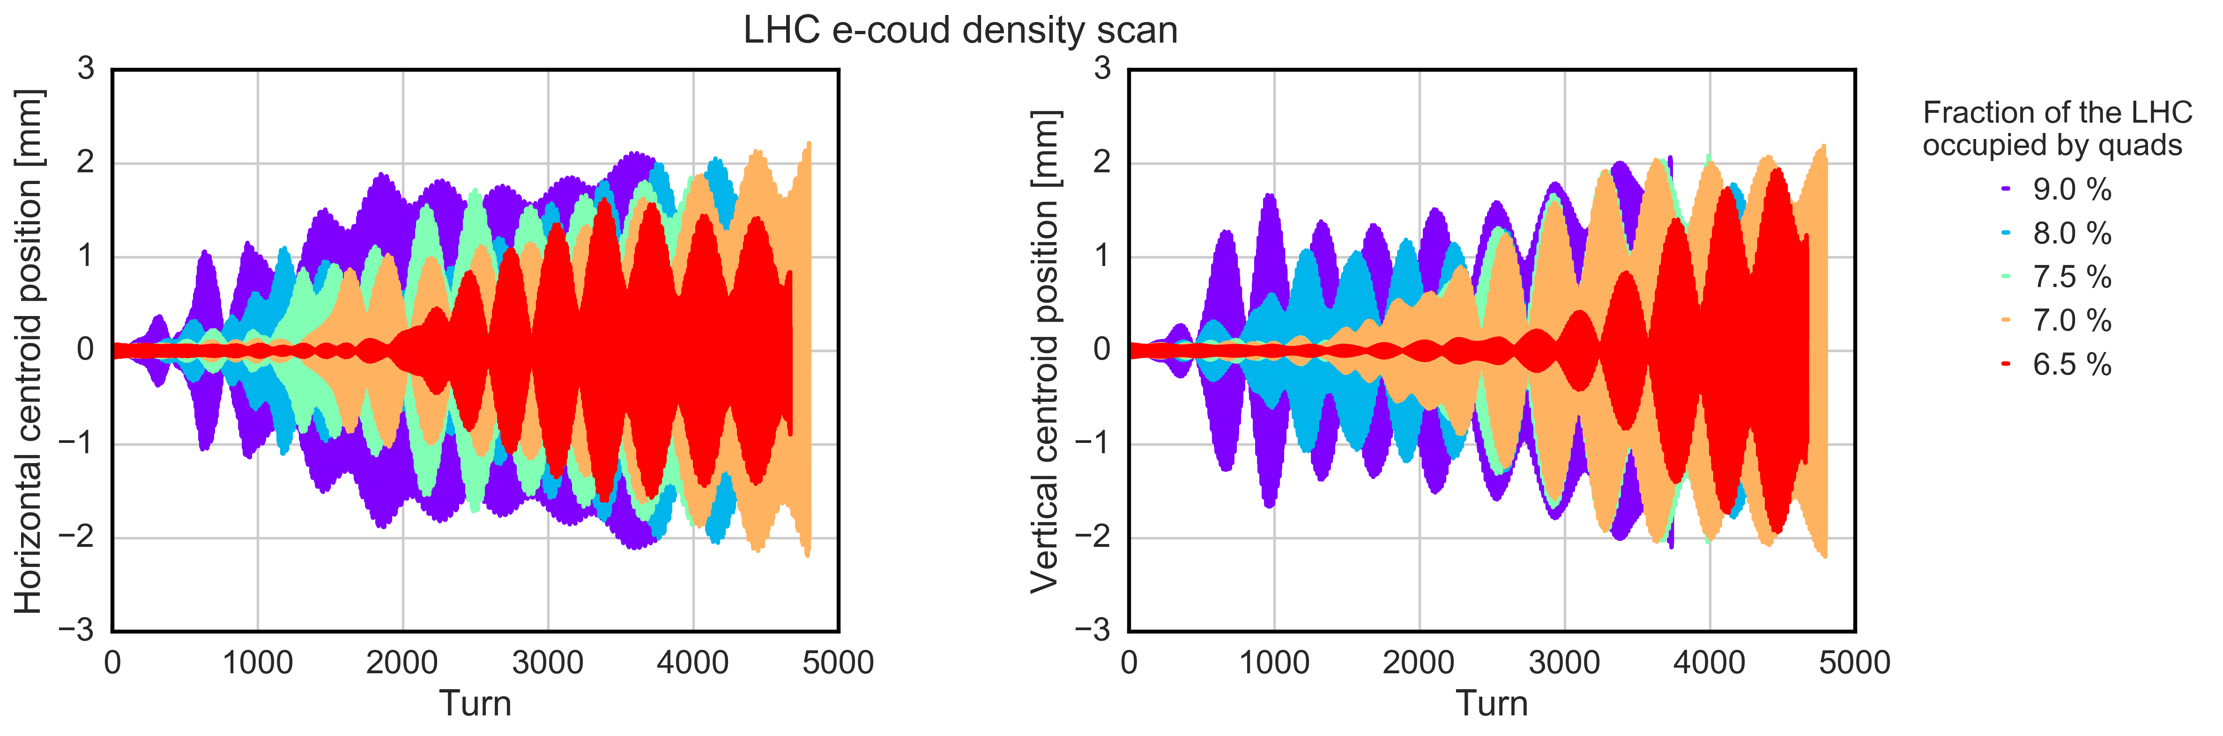
Estimating the instability threshold: LHC quadrupoles
EC distribution taken from PyECLOUD buildup simulation for an SEY=1.3
Nominal beam parameter of an LHC bunch at injection energy (450GeV)
  Instability observed consistently with the symmetry of the EC dynamics
A. Romano et al.

Slide 18
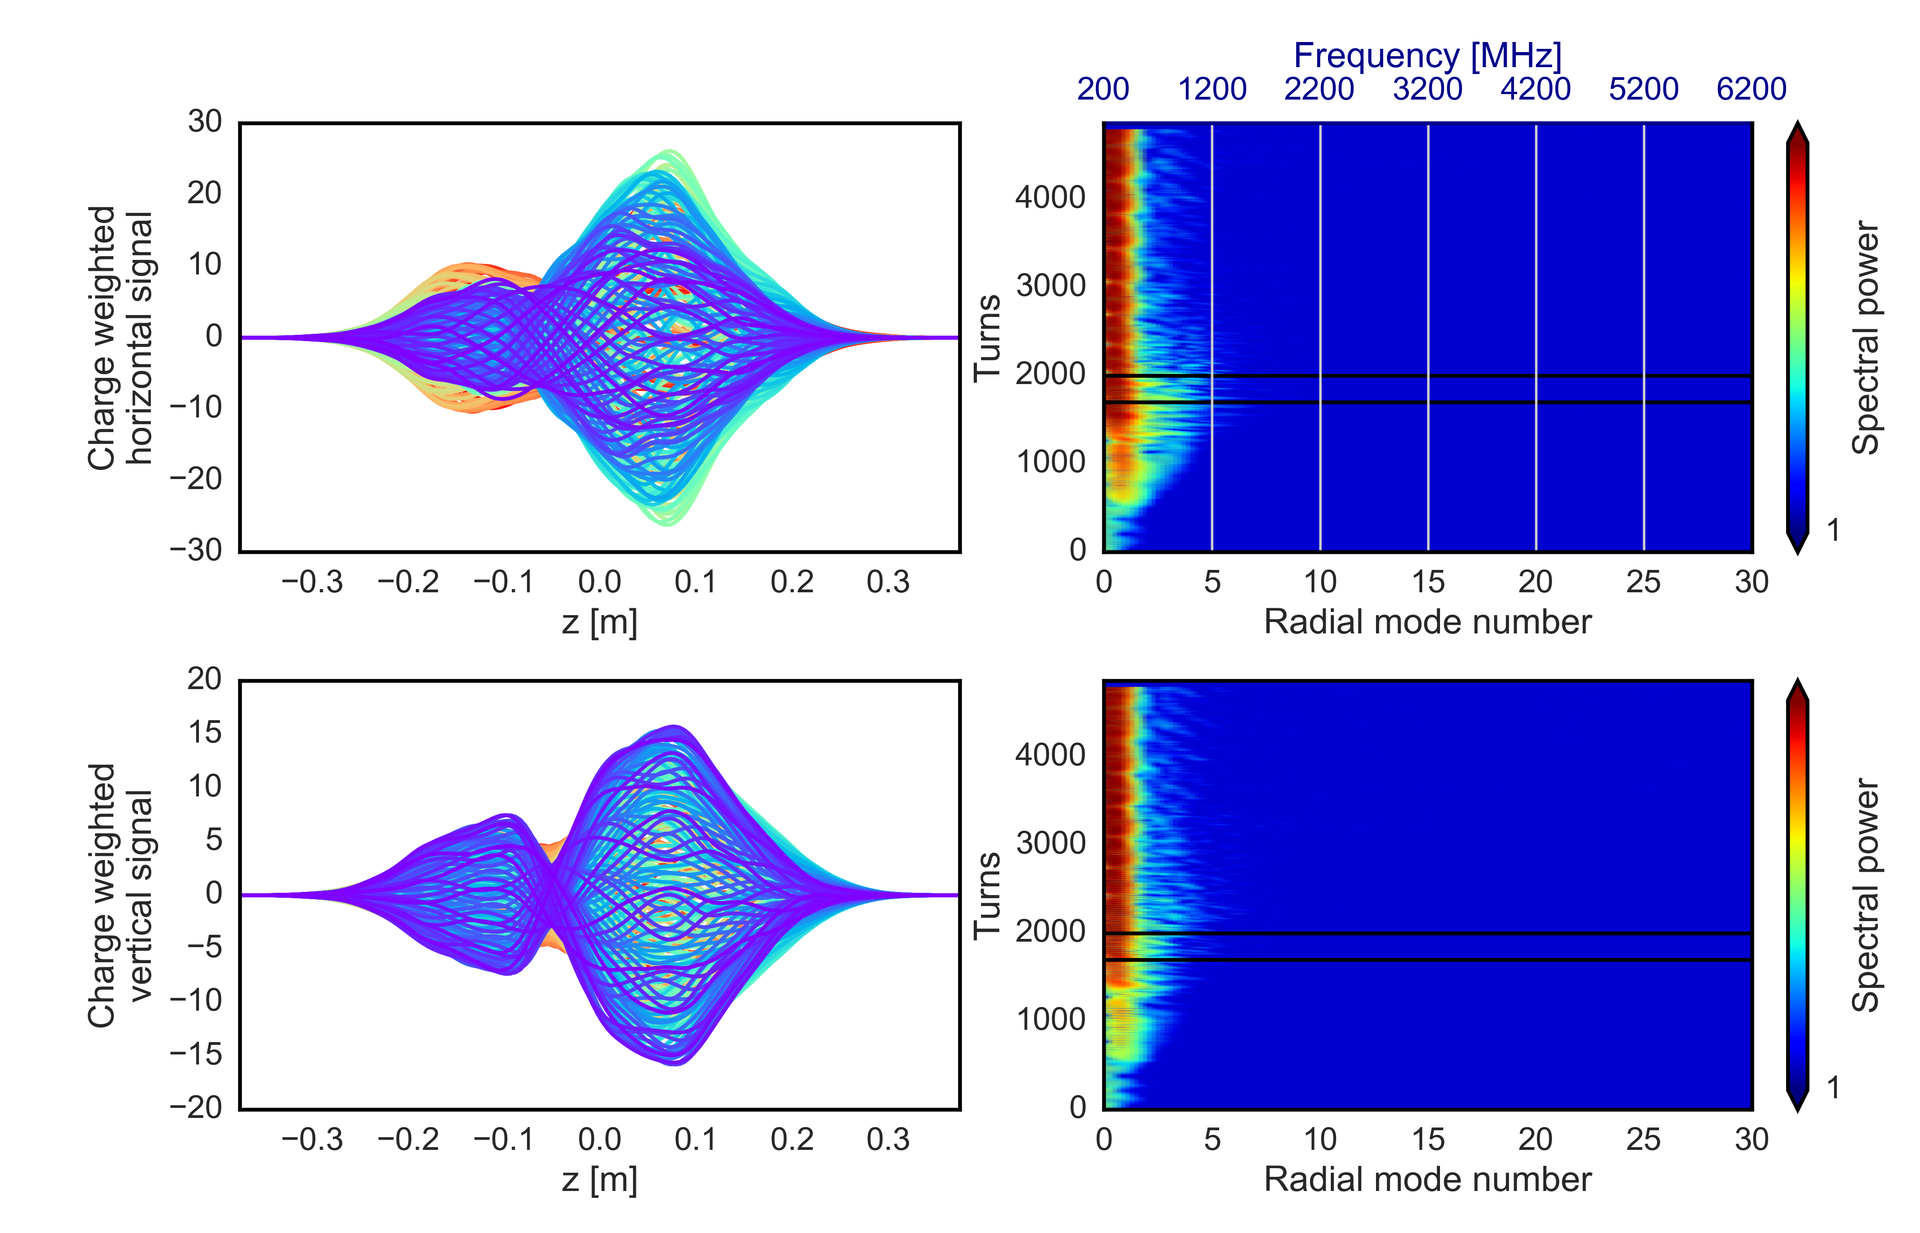
Estimating the instability threshold: LHC quadrupoles
EC distribution taken from PyECLOUD buildup simulation for an SEY=1.3
Nominal beam parameter of an LHC bunch at injection energy (450GeV)
  Instability observed consistently with the symmetry of the EC dynamics
    High order modes excited → cannot be damped by the transverse feedback
A. Romano et al.

Slide 19
Estimating the instability threshold: LHC quadrupoles
EC distribution taken from PyECLOUD buildup simulation for an SEY=1.3
Nominal beam parameter of an LHC bunch at injection energy (450GeV)
  Instability observed consistently with the symmetry of the EC dynamics
    High order modes excited → cannot be damped by the transverse feedback
Even if the quadrupoles cover only the 7% of the total LHC ring (dipoles ~65%), EC in quadrupoles alone could drive the bunch unstable at injection → threshold below the realistic total length
Instability fully suppressed when increasing the beam energy up to 6.5 TeV
A. Romano et al.

Slide 20
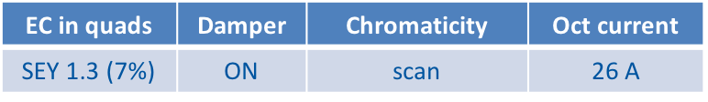
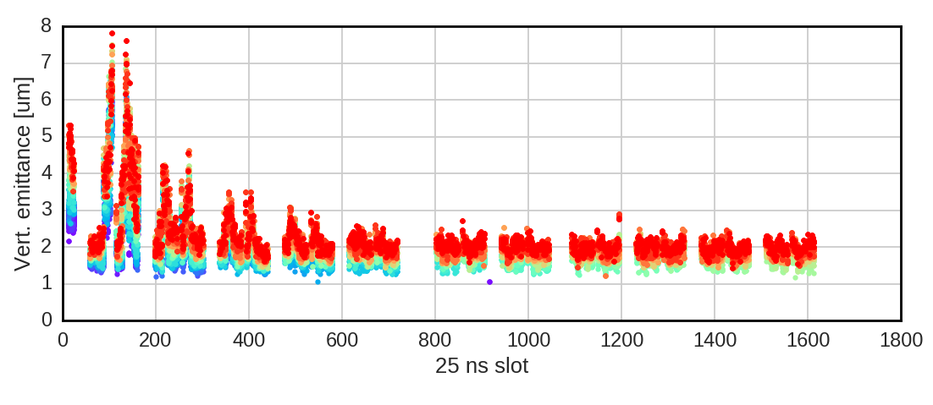
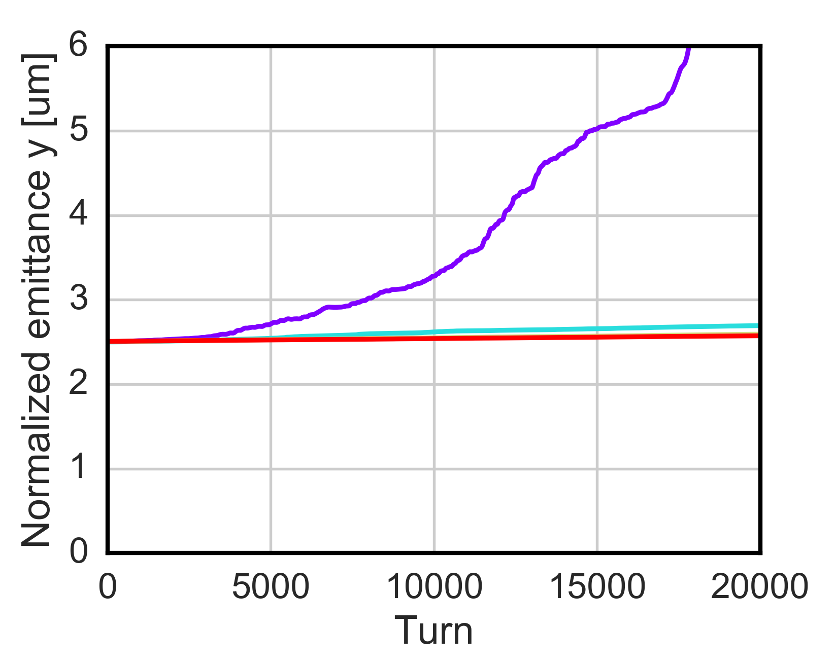
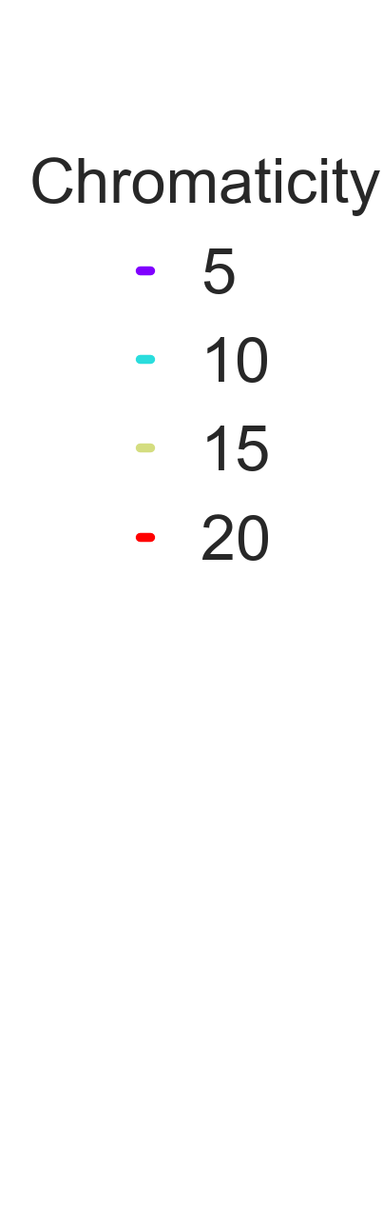
EC observations vs simulations : LHC quadrupoles
The LHC operation with 25 beams can be very challenging → strong EC regime
  Strong instability development, leading to an emittance blow-up observed both in the horizontal and vertical plane at injection energy
    Large chromaticity values, relatively high octupoles current and a fully functional feedback system were needed to reach a satisfactory emittance preservation
Bunch-by bunch emittance measurements
Simulation studies
Oct [A]
Chromaticity
6.5
5/5
13
5/5
13
10/10
13
15/15
26
15/15
52
15/15
52
10/15
52
20/15
(Similar behavior in the horizontal plane )
  Who brings in this instability?
A. Romano et al.

Slide 21
EC observations vs simulations : LHC quadrupoles
The LHC operation with 25 beams can be very challenging → strong EC regime
  Strong instability development, leading to an emittance blow-up observed both in the horizontal and vertical plane at injection energy
    Large chromaticity values, relatively high octupoles current and a fully functional feedback system were needed to reach a satisfactory emittance preservation
  In absence (or low) chromaticity and octupoles settings, the quadrupoles alone are able to drive instabilities at injection
Bunch-by bunch emittance measurements
Simulation studies
Oct [A]
Chromaticity
6.5
5/5
13
5/5
13
10/10
13
15/15
26
15/15
52
15/15
52
10/15
52
20/15
(Similar behavior in the horizontal plane )
  Who brings in this instability?
A. Romano et al.

Slide 22
Conclusion
Electron cloud build-up in particle accelerators could pose important challenges to the machine operation → coherent instabilities, emittance growth, beam losses
EC induced instability in the dipoles
  Simulations can be initialised with a uniform initial electron density at the beam location → good approximation
  At LHC, the EC in dipoles is not expected to trigger vertical instability both at injection and flattop energy → estimated density below the instability threshold
    The situation changes significantly for low bunch intensity (observations of instabilities in collisions consistent with our simulation studies ☺)
EC induced instability in the quadrupoles
  Higher densities due to electron trapping
  Need to run self-consistent simulations → realistic e- distribution from build-up
  Key driver of instabilities at the LHC injection energy → strong stabilizing effect of the beam rigidity at 6.5 TeV
A. Romano et al.

Slide 23
Thanks for your attention!
A. Romano et al.

Slide 24
PyECLOUD-PyHEADTAIL simulations
The beam dynamics is modeled using PyHEADTAIL⁽²⁾
  The ring is split into a set of segments (IPs)
  Linear periodic maps is used for transverse tracking from one IP to the next
  Synchrotron motion is applied once per turn
  At each IP the bunch/e-cloud interaction takes place
IPs
more than 10⁴ simulated turns are needed ….
Segment with
linear transport
K.Li et al.,“Code Development for Collective Effects”, HB16, Malmo, Sweden, paper WEAM3X01, 2016
A. Romano et al.

Slide 25
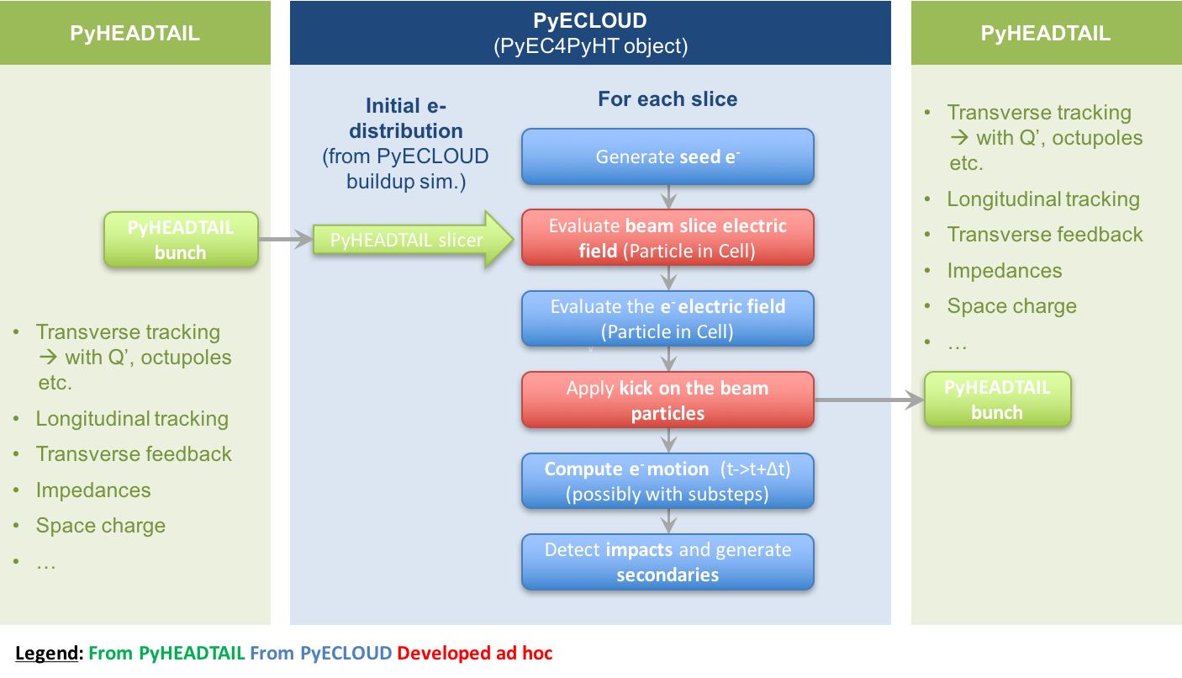
PyECLOUD-PyHEADTAIL simulations
The beam dynamics is modeled using PyHEADTAIL⁽²⁾
  The ring is split into a set of segments (IPs)
  Linear periodic maps is used for transverse tracking from one IP to the next
  Synchrotron motion is applied once per turn
  At each IP the bunch/e-cloud interaction takes place New approach: PyECLOUD⁽³⁾ used in combination with PyHEADTAIL by means of an ad-hoc developed interface
K.Li et al.,“Code Development for Collective Effects”, HB16), Malmo, Sweden, paper WEAM3X01, 2016
G.Iadarola, "Electron cloud studies for CERN particle accelerators and simulation code development", CERN-THESIS 2014-047
A. Romano et al.

Slide 26
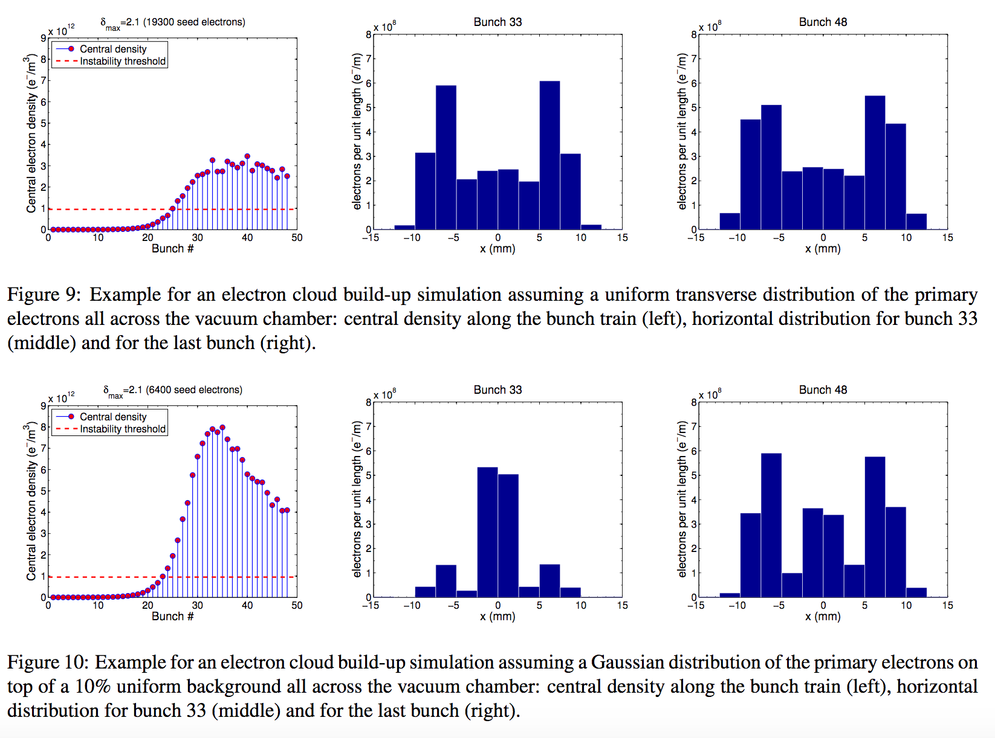
Dependence on primary electrons distribution
H. Bartosik et al., “BENCHMARKING HEADTAIL WITH ELECTRON CLOUD INSTABILITIES OBSERVED IN THE LHC”, ECLOUD12
A. Romano et al.

Slide 27
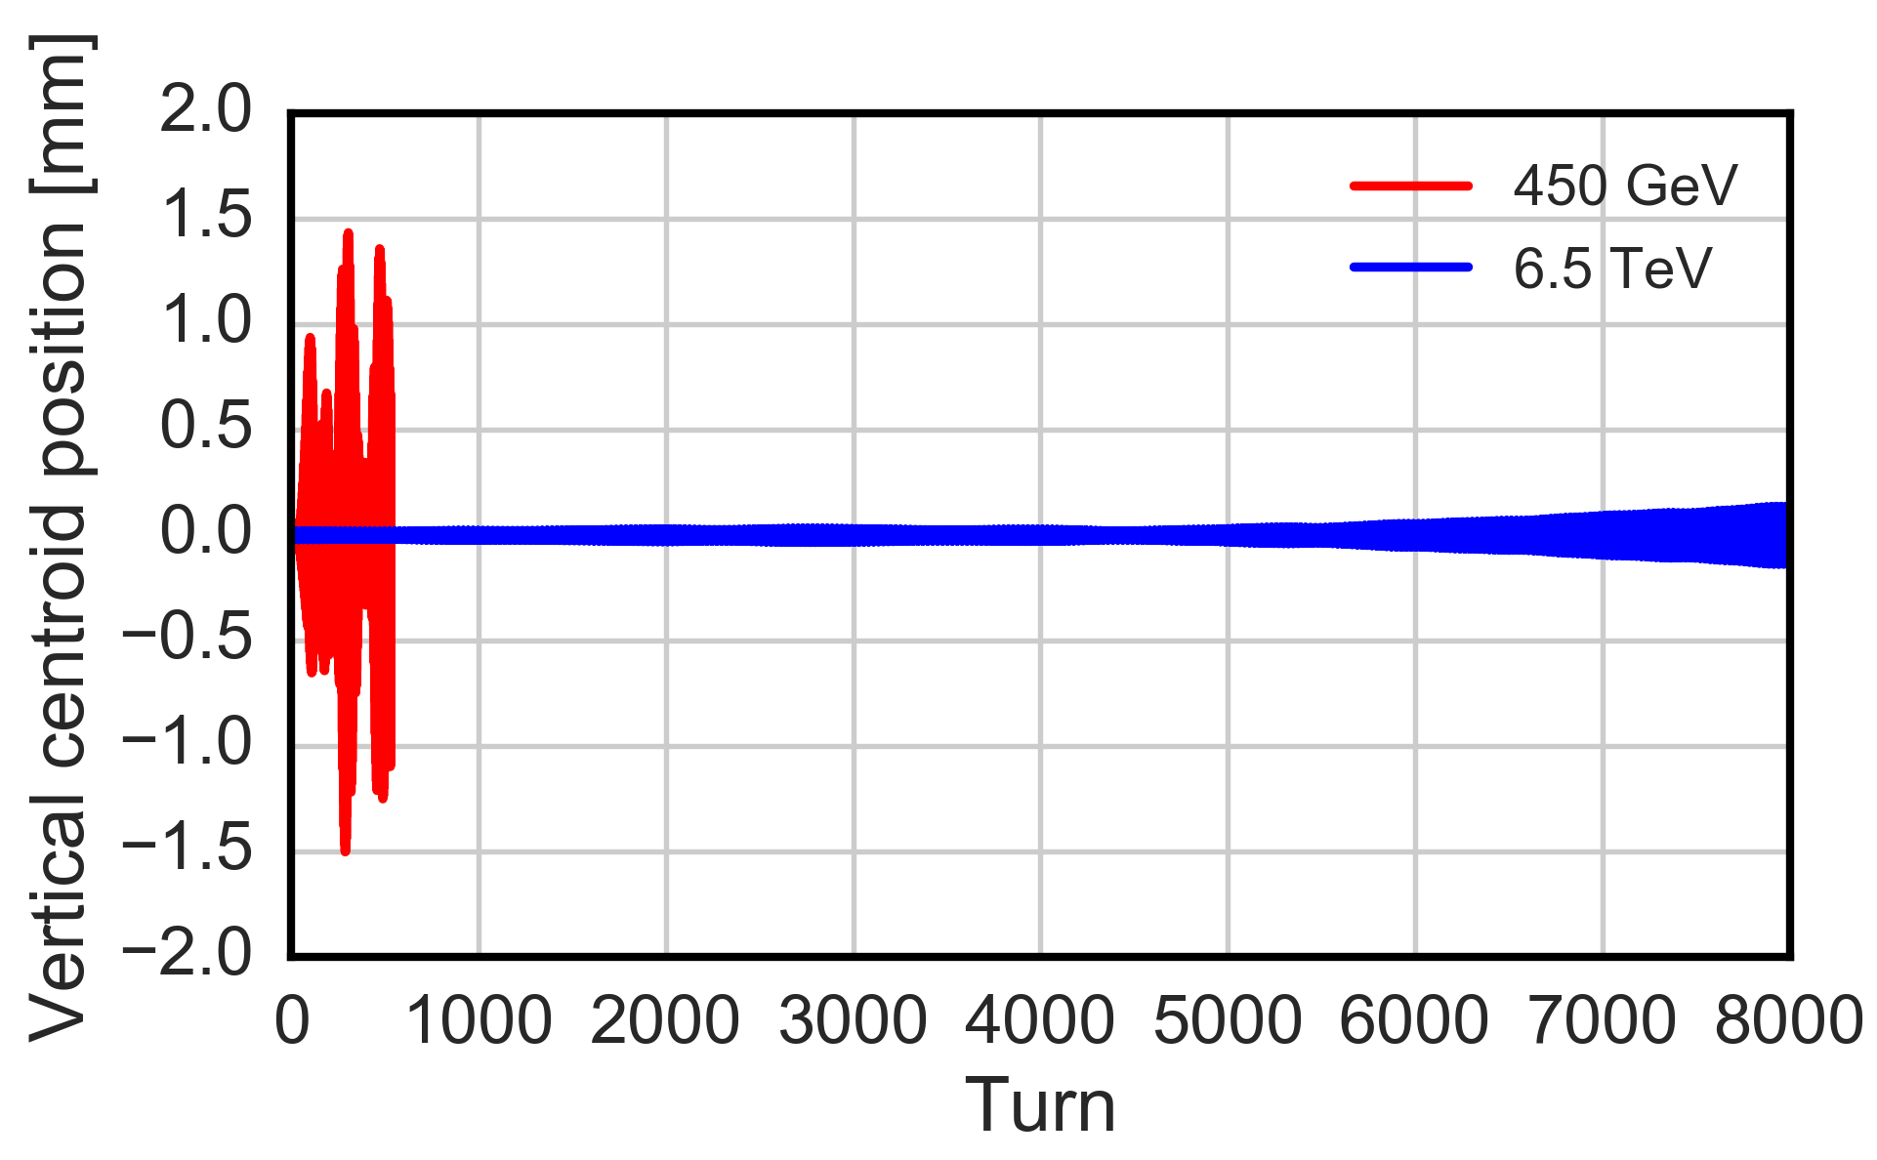
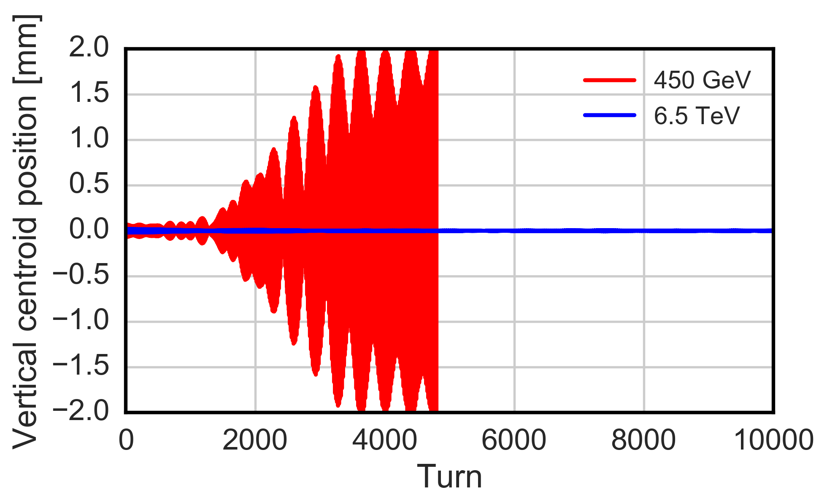
Effect of the beam rigidity on instability
  An increase of the particles energy leads to an increase of the beam rigidity
ARC DIPOLES
  slower instability rise-time
  larger instability threshold (estimated over the same number of turns)
ARC QUADRUPOLES
  no clear instability observed over 10k turns → unlike the injection case, EC instabilities are not expected at 6.5TeV
𝜌_{e, dip} = 26 x 10¹¹ e-/m³
Realistic total length of quadrupoles
A. Romano et al.

Slide 28
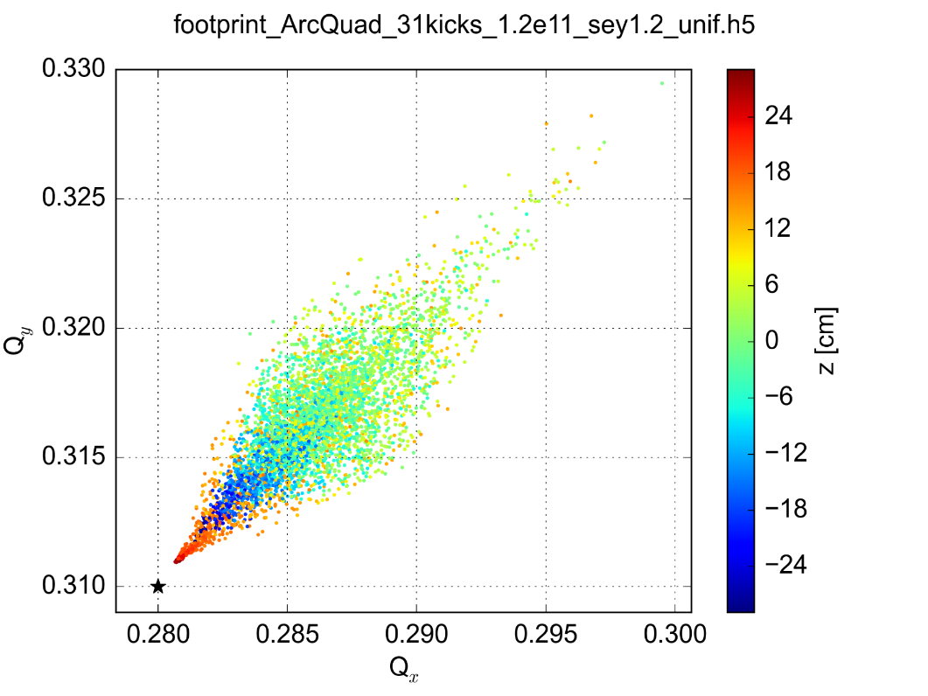
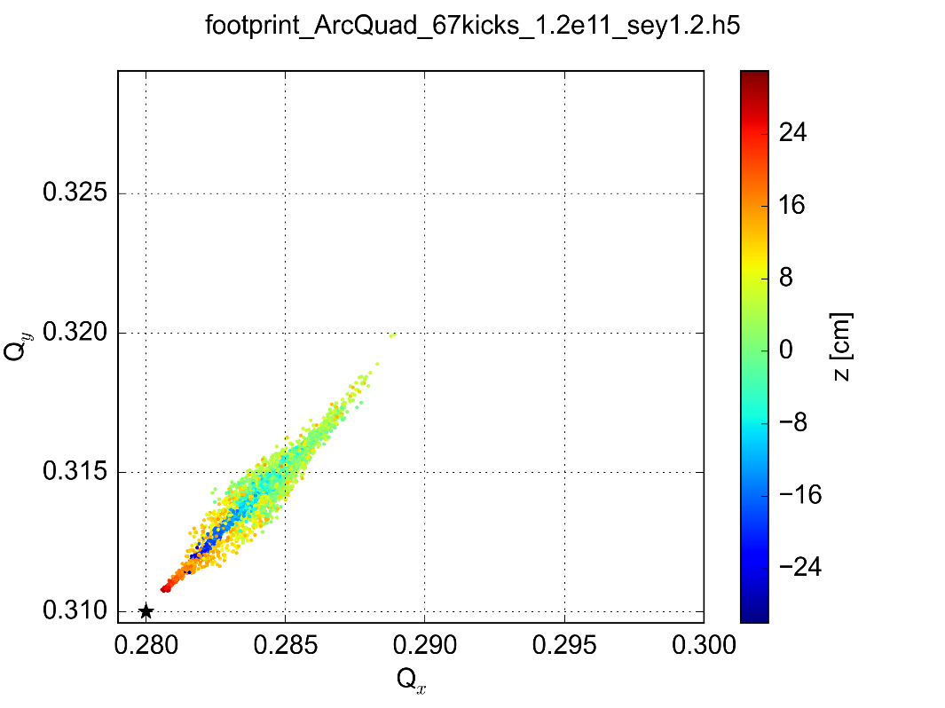
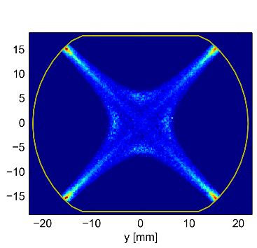
Electron cloud induced instability: quadrupole magnets
The EC pinch dynamics in the quadrupoles can be very sensitive to the initial phase space distribution due to the trapping effects from the magnetic field gradient.
For this reason, the beam tune footprint (very fast simulations compared to the instability ones!) has been evaluated starting from different EC initial distribution
    Significant impact on the footprint extension
    Electrons trapped along the magnetic lines → pinch is attenuated
Tune footprint
(uniform initial distribution)
Tune footprint
(distribution from buildup sim.)
G. Iadarola et al., “EFFECT OF ELECTRON CLOUD IN QUADRUPOLES ON BEAM INSTABILITY”, IPAC15
A. Romano et al.

Slide 29
Intra-bunch modes: arc quadrupoles
  The intra-bunch motion for the realistic total quadrupole length (7%) has been studied
High order intra-bunch modes excited in both planes
  this type of instability cannot be damped by the transverse bunch-by-bunch feedback but only delayed
  alternative mitigation strategies should be investigated
Turns: 1400-1700
Turns: 1400-1700
  (colour code corresponds to different turns after instability developing)
A. Romano et al.
Notes:
For us: look also at beginning of the instability

Slide 30
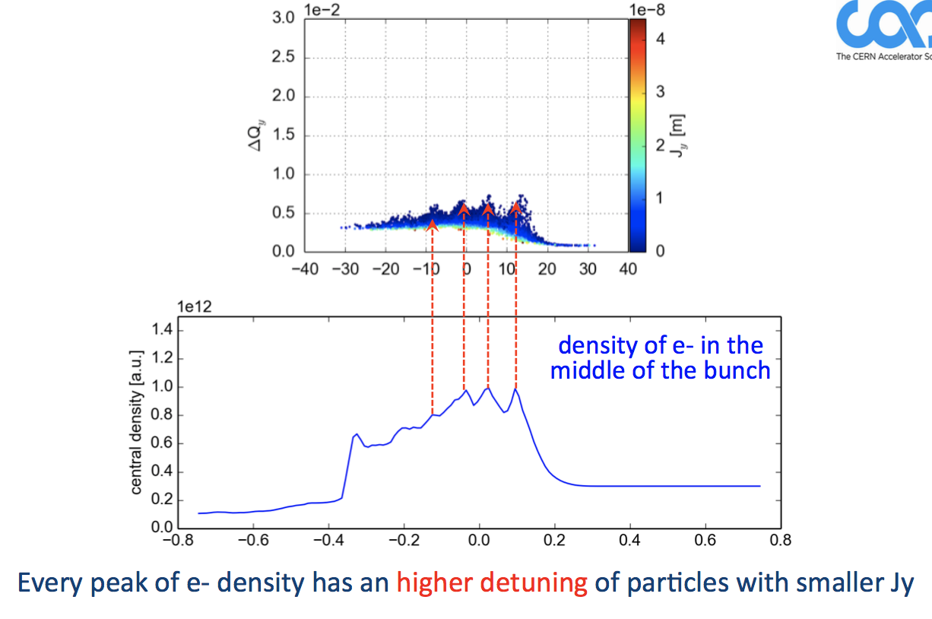
Dipoles: EC induced detuning
A. Romano et al.

Slide 31
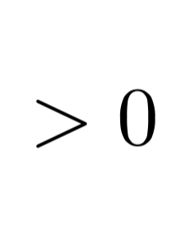
Dipoles: horizontal instability possible mechanism
Transverse wake function (dipolar)
Stability criterion for mode-0
assuming constant wake
Sign of the wake
Stability condition
(above transition)
W_{x}<0, i.e. tail gets kicked in phase
w.r.t. the head displacement
Positive chromaticity
W_{x}>0, i.e. tail gets kicked in counter-phase w.r.t. the head displacement
Negative chromaticity
A. Romano et al.
Notes:
Giovanni R slide 31 USPAS

Slide 32
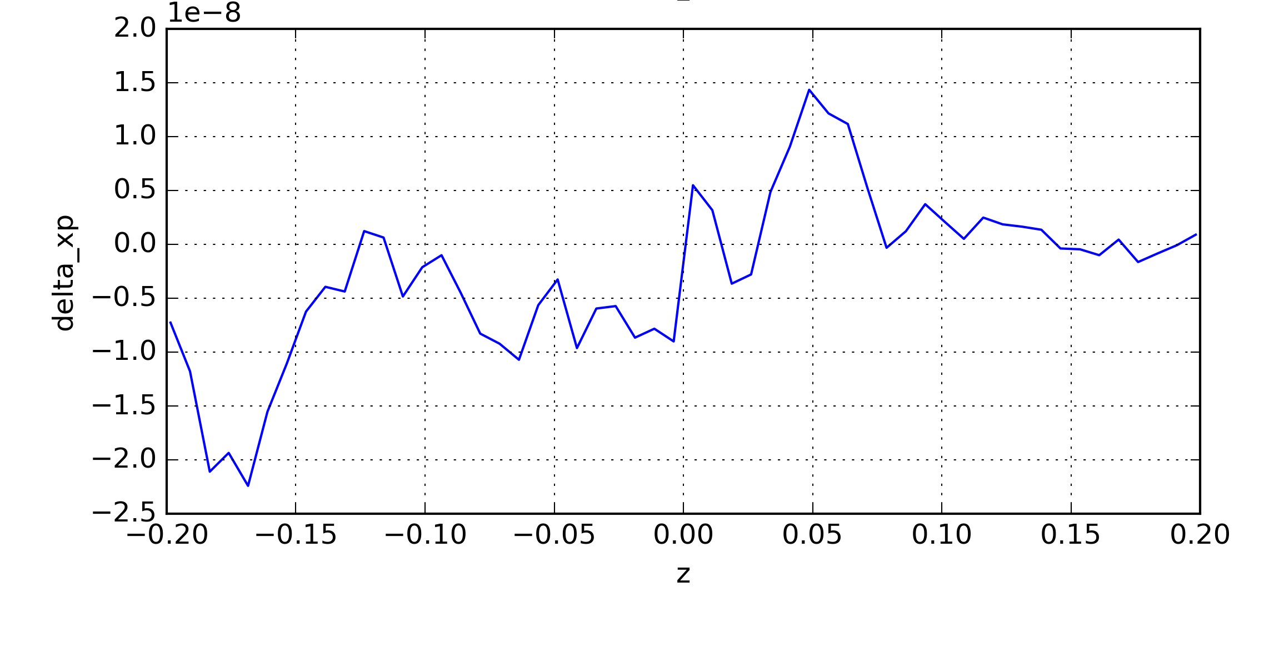
Dipoles: horizontal instability possible mechanism
Bunch head
Bunch tail
Δx α σ _{x}
(positive head displacement)
Δx’ <0
Tail gets kicked in counter - phase with the head displacement
  negative chromaticities can stabilize the bunch oscillation
A. Romano et al.

