Slide 1
Outline of Nuclear Astrophysics lecture
- Introduction
principles of stellar structure and evolution
general features of thermonuclear reactions
- Reaction rates in stellar environments
Cross section and reaction rate
Non-resonant reactions and the astrophysical S factor
Resonant reaction
- Application with stable beam
direct approaches (Underground Measurement-Recoil Mass Separator)
experimental techniques & examples
Alba Formicola

Slide 2
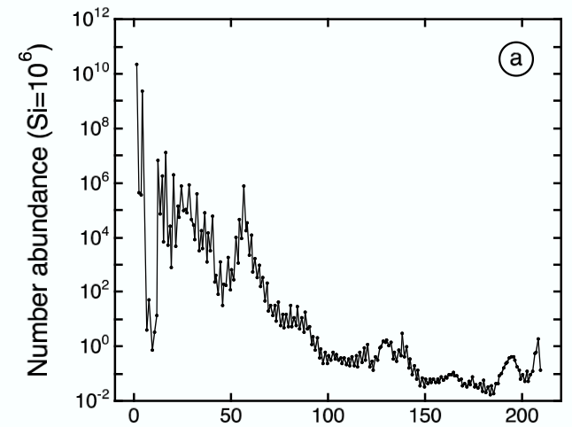
Solar system abundances
Attempts to put together table
for elements and isotopes
combining different data sources
Suess & Urey, Rev. Mod. Phys.
28, 53 (1956)
charged
particles
neutrons
Foundation of modern theory of
nuclear astrophysics:
Burbidge, Burbidge, Fowler and
Hoyle (1957)
Cameron (1957)
Nobel prize to Willy Fowler (1983)
Mass number A=N+Z
Notes:
Numero di massa Neutroni +protoni
Minimo Li-Be e B
Massimi H,He minimo, C , minimo Ca Fe Pb
Shown are the elemental abundances in the solar system, the abu. are normalized to Si at 10^6.
It is visible a landscape with a variety of hill and valley.
EXPERIMENTAL AND THEORETICAL NUCLEAR ASTROPHYSICS;
THE QUEST FOR THE ORIGIN OF THE ELEMENTS

Slide 3
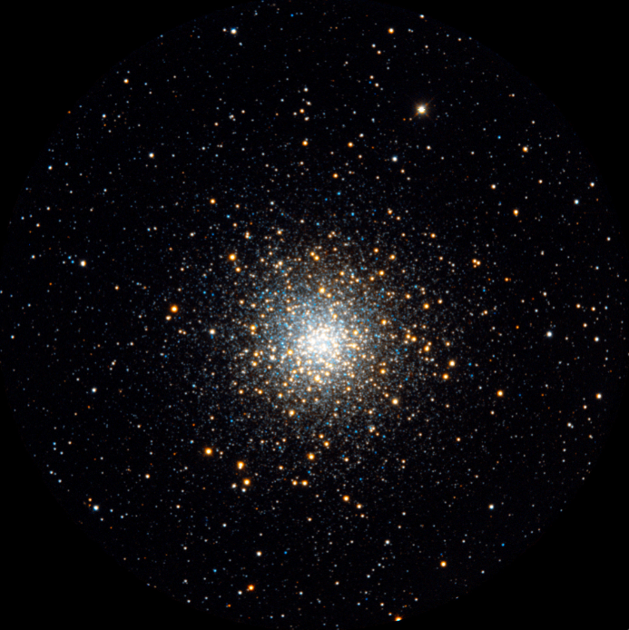
Globular cluster M 10
Red giant stars:
H→He via CNO cycles in
H shell surrounding He core
Horizontal branch stars:
He→C, O in core
H→He in shell
Main sequence stars:
H→He via pp chains in core
Accurate nuclear physics
information is crucial for
understanding of stars
How do other stars produce
energy?
How do they evolve?
Credner & Kohle, Sternwarte Bonn

Slide 4
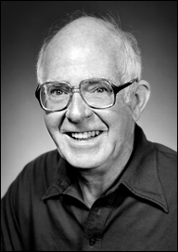

Direct evidence for stellar nucleosynthesis
(i) Solar neutrinos
first direct test of how Sun generates energy was performed by detecting
solar neutrinos [from ⁸B decay] at the Homestake gold mine, SD
disagreement of predicted and measured neutrino flux: “solar neutrino problem”
[giving later rise to discovery of neutrino oscillations]
Nobel prize to Ray Davis (2002)
Ray Davis
(1914-06)
(ii) γ-ray astronomy
radioactive (‘live”) ²⁶Al has bee observed in the Galaxy
[see image on right]
T_{1/2}(²⁶Al)=720,000 years; time scale of Galactic chemical
evolution: 10⁹ years
from photon intensity: 1-2 solar masses of ²⁶Al in Galaxy
conclusion: nucleosynthesis is ongoing
COMPTEL map
of 1.8 MeV photon
intensity

Slide 5


Birth of stars in Interstellar Clouds
Consider a region
radius R, total mass M,
mean molecular weight m,
temp.T
Clouds of low T and high r require smaller total masses
to become gravitationally unstable.
Jeans criterion
Such process could lead to the birth of individual stars.
The life of a star is composed by alternative stages of gravitational and nuclear energy generation.

Slide 6
The origin of the chemical elements
CONDENSATION
INTERSTELLAR GAS AND DUST
STAR
EJECTION, EXPLOSION
MIXING NUCLEAR REACTION
ABUNDANCE OF ELEMENTS ENERGY GENERATION, ELEMENT SYNTHESIS
Milk Way age ->15 billion years
Notes:
MATTER IS TRANSFERRED BACK AND FORTH BETWEEN STARS AND INTERSTELLAR GAS

Slide 7
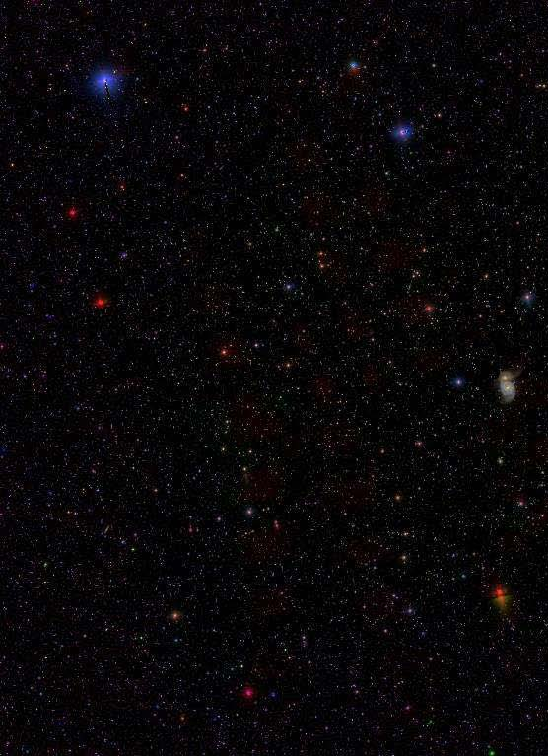
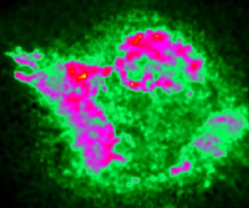
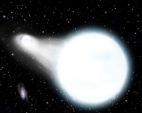
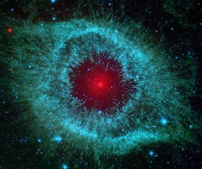
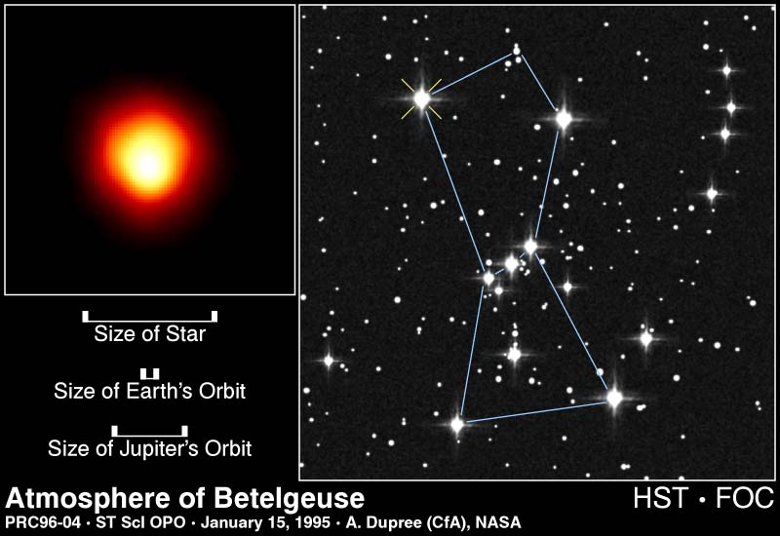
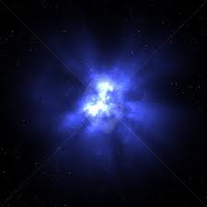
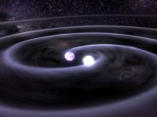
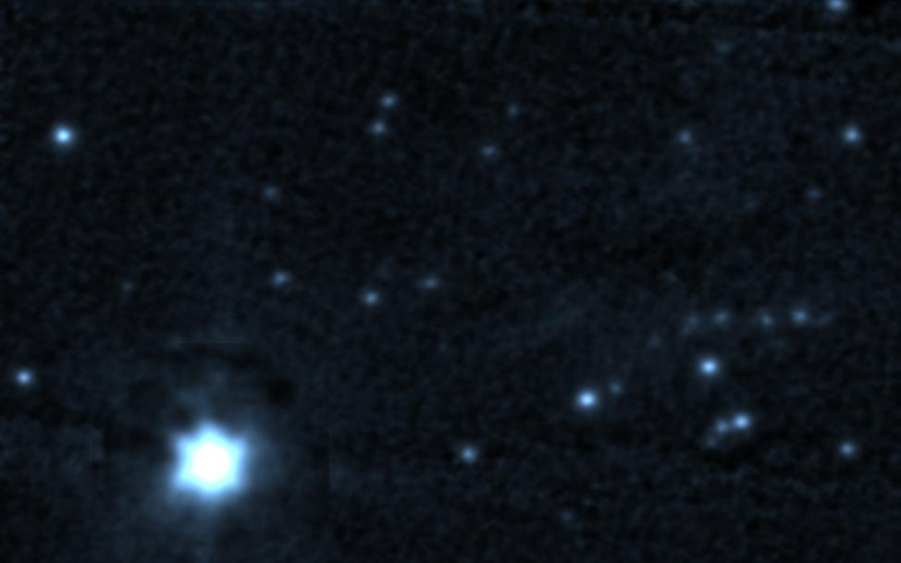
Nuclear Burning in Stars
is characterized by low energy reaction sequences at different temperature and density conditions:
pp-chains,
CNO cycles
triple alpha process
s-process
Carbon/Oxygen fusion
producing energy for maintaining stability, and provide seed for subsequent explosion in novae, supernovae, and X-ray bursts!
Measurements:
Direct measurements with background suppression techniques
(coincidence rejection, underground, inverse kinematics)
Indirect methods
(Transfer “surrogate” reactions, Trojan horse method)
10
Si-ignition
O-ignition
Ne-ignition
9
C-ignition
log (T_{c})
He-ignition
8
H-ignition
7
0
2
4
4
6
8
10
log (ρ_{c})
Notes:
reactions with smallest Coulomb barrier proceed first, stabilizing star
when nuclear fuel is consumed, star contracts gravitationally, T increases
next available nuclear fuel (ashes of previous stage) burns, stabilizing star

Slide 8
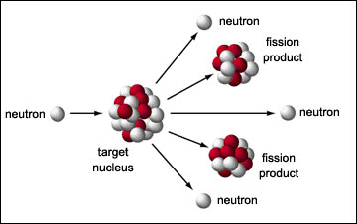
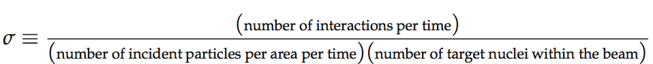
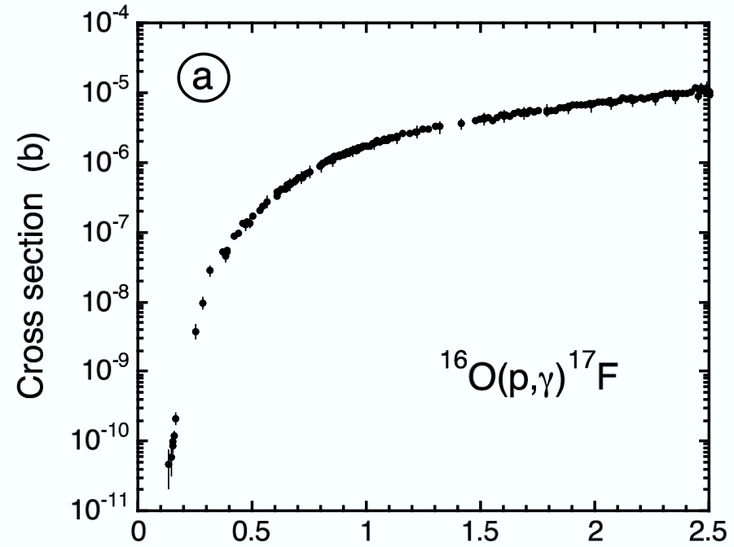
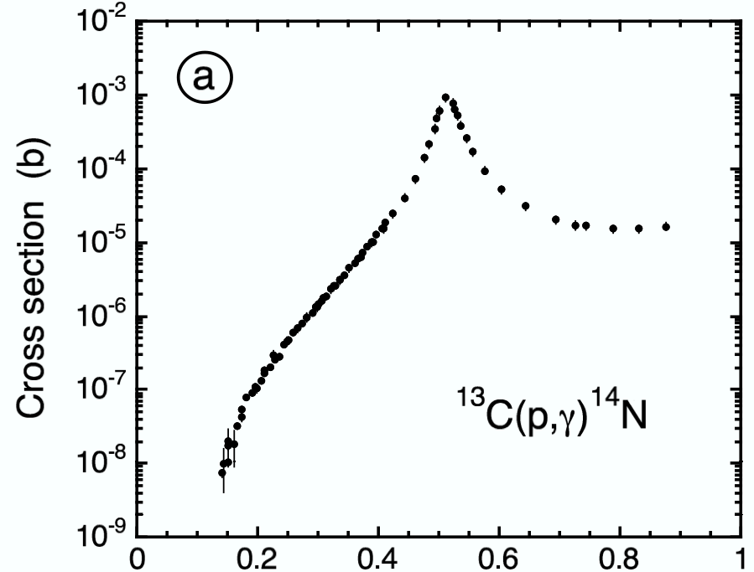
2. Nuclear Reactions
Cross sections
γ
[unit: 1 barn=10⁻²⁴ cm²]
experimental
experimental
E_{cm} (MeV)
E_{cm} (MeV)
Why does the cross section fall drastically at low energies?
Where is the peak in the cross section coming from?

Slide 9
Reaction mechanisms: I. direct (non-resonant) process
reaction mechanisms
one-step process
direct transition into a bound state
example: radiative capture A(x,γ)B
E_{cm}
γ
Q
A+x
B
H_{γ} = electromagnetic operator describing
the transition
reaction cross section proportional to single matrix element
can occur at all projectile energies
smooth energy dependence of cross section
other direct processes: stripping, pickup, charge exchange, Coulomb excitation

Slide 10
Reaction mechanisms: II. resonant process
reaction mechanisms
two-step process
example: resonant radiative capture A(x,γ)B
1. Compound nucleus formation
(in an unbound state)
2. Compound nucleus decay
(to lower excited states)
E_{cm}
E_{r}
Γ
S_{x}
γ
A+x
Q
B
B
compound decay
probability ∝ Γ_{γ}
compound formation
probability ∝ Γ_{x}
reaction cross section proportional to two matrix elements
only occurs at energies E_{cm} ~ E_{r} - Q
strong energy dependence of cross section
N. B. energy in entrance channel (Q+E_{cm}) has to match excitation energy E_{r} of resonant state,
however all excited states have a width ⇒ there is always some cross section through tails
Notes:
A mechanisms in which an excited state Er of the compound nucleus is the first formed in the entrance channel which decay to lower excite states.

Slide 11
3. Thermonuclear Reactions
stellar reaction rate
need: a) velocity distribution φ(v)
b) cross section σ(v)
a) velocity distribution
interacting nuclei in plasma are in thermal equilibrium at temperature T
also assume non-degenerate and non-relativistic plasma
Maxwell-Boltzmann velocity distribution
with
reduced mass
v = relative velocity
example: Sun T ~ 15x10⁶ K ⇒ kT ~ 1 keV
Notes:
Relative velocity between interacting nuclei
Schematically MB energy distribution of a gas characterized by the temperature T.
The distribution has a maximum at KT

Slide 12
reaction cross sections
3. Thermonuclear Reactions
b) cross section
no nuclear theory available to determine reaction cross section a priori
cross section depends sensitively on:
  the properties of the nuclei involved
  the reaction mechanism
and can vary by orders of magnitude, depending on the interaction
examples:
Reaction | Force | σ (barn) | E_{proj} (MeV)
¹⁵N(p,α)¹²C | strong | 0.5 | 2.0
³He(α,γ)⁷Be | electromagnetic | 10⁻⁶ | 2.0
p(p,e⁺ν)d | weak | 10⁻²⁰ | 2.0
1 barn = 10⁻²⁴ cm² = 100 fm²
in practice, need experiments AND theory to determine stellar reaction rates

Slide 13
Cross Section expressions for direct (non-resonant) reactions
example: direct capture
A + x → B + γ
“geometrical factor”
de Broglie wavelength
probability for barrier penetrability
depends on relative orbital angular
momentum l and energy E
matrix element
contains nuclear
properties of interaction
σ = (weak energy dependence) x (strong energy dependence)
S(E) = astrophysical factor contains nuclear physics of reaction
+ can be easily: graphed, fitted, extrapolated (if needed)
need expression for P_{l}(E)
factors affecting transmission probability:
    centrifugal barrier (both for charged particles and neutrons)
    Coulomb barrier (for charged particles only)

Slide 14
Cross Section expressions for direct (non-resonant) reactions
charge-particle reactions
charged particles
Coulomb barrier
V
Coulomb potential
energy available: from thermal motion
E_{kin} ~ kT (keV)
E_{coul} ~ Z₁Z₂ (MeV)
kT ~ 8.6 x 10⁻⁸ T[K] keV
tunnel
effect
r₀
r
nuclear well
T ~ 15x10⁶ K (e.g. our Sun) ⇒ kT ~ 1 keV
T ~ 10¹⁰ K (Big Bang) ⇒ kT ~ 2 MeV
during quiescent burnings: kT << E_{c}
reactions occur through TUNNEL EFFECT
tunneling probability P ∝ exp(-2πη)
2πη = 31.29 Z₁Z₂(μ/E)^{½}
μ in amu and E_{cm} in keV
for non-resonant reactions

Slide 15
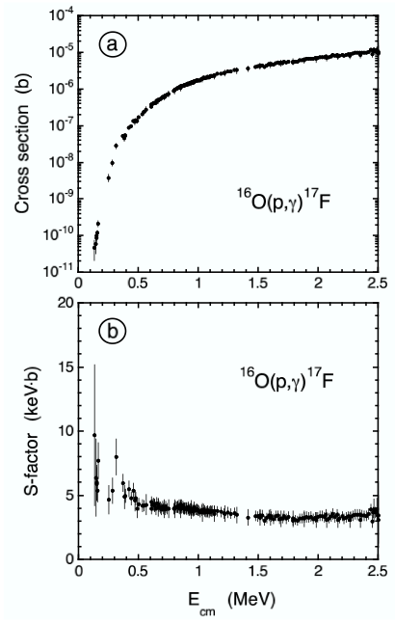
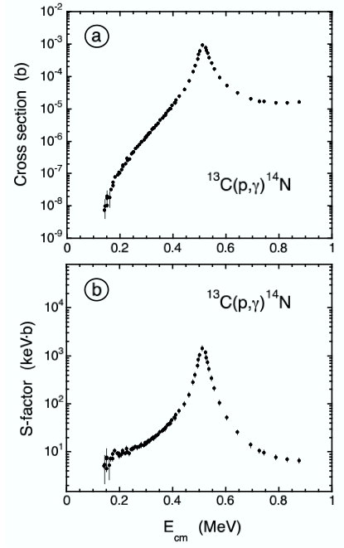
cross sections
S-factors

Slide 16

Formal reaction theory: Breit-Wigner formula
Partial widths for incoming and outgoing channel
De Broglie wavelength
spin factor
resonance
energy
total width
Used for: - for fitting data to deduce resonance properties
- for “narrow-resonance” thermonuclear reaction rates
- for extrapolating cross sections when no measurements exist
- for experimental yields when resonance cannot be resolved

Slide 17
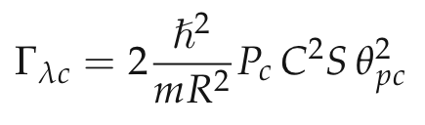
What are “partial widths”?
probability per unit time for formation or decay of a resonance (in energy units)
For protons/neutrons:
A partial width can be factored into 3 probabilities:
C²S: probability that nucleons will arrange themselves in a “residual nucleus
+ single particle” configuration [“spectroscopic factor”]
θ²: probability that single nucleon will appear on nuclear boundary
[“dimensionless reduced single particle width”; Iliadis, NPA 618, 166 (1997)]
P_{c}: probability that single nucleon will penetrate Coulomb and centripetal
barriers [“penetration factor”; strongly energy-dependent! see later]

Slide 18

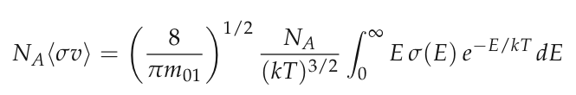

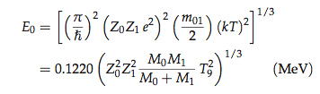

Special case #1: reaction rates for smoothly varying S-factors (“non-resonant”)
Represents the energy range over which
most nuclear reactions occur in a plasma!
“Gamow peak”
Maxwell-Boltzmann
distribution
∝ exp(-E/kT)
tunnelling through
Coulomb barrier
∝ exp(- )
Location and width of Gamow peak:
relative probability
Gamow peak
ΔE₀
kT
E₀
energy
Notes:
For a reaction 0 + 1 → 2 + 3 we find from the definition of σ (see earlier) a
“reaction rate”:

Slide 19
Gamow peak:
most effective energy region for thermonuclear reactions
E₀ ± ΔE₀/2
energy window of astrophysical interest
E₀ = f(Z₁, Z₂, T)
varies depending on reaction and/or temperature
Examples: T ~ 15x10⁶ K (T₆ = 15)
reaction | Coulomb barrier (MeV) | E₀ (keV) | area under Gamow peak ~ <σv>
p + p | 0.55 | 5.9 | 7.0x10⁻⁶
α + ¹²C | 3.43 | 56 | 5.9x10⁻⁵⁶
¹⁶O + ¹⁶O | 14.07 | 237 | 2.5x10⁻²³⁷
STRONG sensitivity
to Coulomb barrier
separate stages: H-burning
He-burning
C/O-burning …
from: M.Aliotta, Russbach lectures on Nuclear Astrophysics

Slide 20

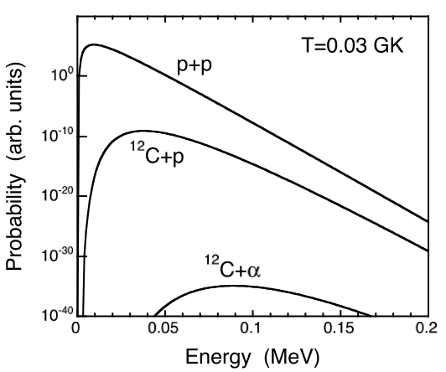
Gamow peaks
Important aspects:
(i) Gamow peak shifts to higher energy
for increasing charges Z_{p} and Z_{t}
(ii) at same time, area under Gamow
peak decreases drastically
Conclusion: for a mixture of different nuclei in a plasma, those reactions with
the smallest Coulomb barrier produce most of the energy and are
consumed most rapidly (→ stellar burning stages)
from: C.Iliadis, LNGS lectures on Nuclear Astrophysics

Slide 21

Special case #2: reaction rates for (very) “narrow resonances” (Γ_{i} constant over total Γ)
Breit-Wigner formula (energy-independent partial widths)
resonance energy needs to
be known rather precisely
[takes into account only rate
contribution at E_{r}]
“resonance strength” ωγ:
proportional to area under
narrow resonance curve
[For influence of uncertainties in E_{r} and ωγ on rate: see Thompson & Iliadis, NPA 647, 259 (1999)]

Slide 22
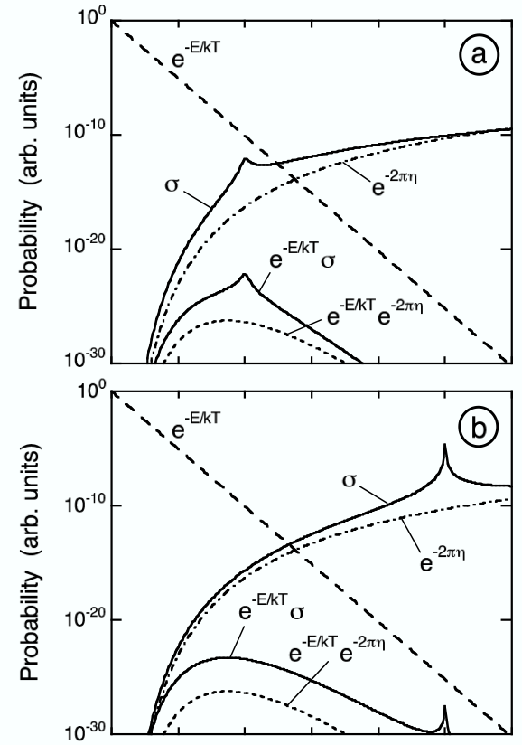

Special case #3: reaction rates for “broad resonances”
²⁴Mg(p,γ)²⁵Al at T=0.05 GK
Breit-Wigner formula (energy-dependent partial widths)
rate can be found from numerical integration
There are two contributions to the rate:
(i) from “narrow resonance” at E_{r}
(ii) from tail of broad resonance

Slide 23

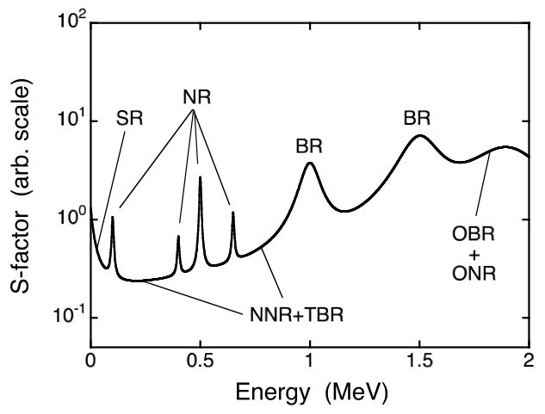
Total thermonuclear reaction rate
indirect
direct measurements
Need to consider:
non-resonant processes
narrow resonances
broad resonances
subthreshold resonances
interferences
continuum
every nuclear reaction represents a special case

Slide 24
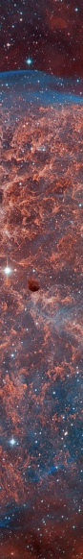
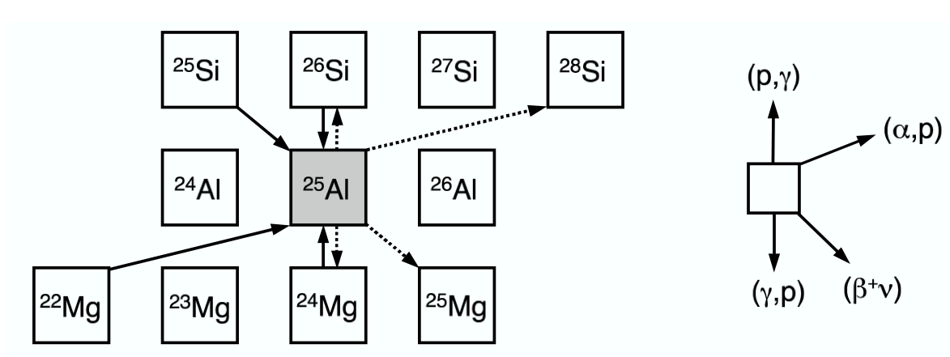
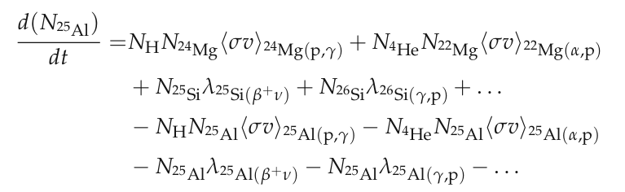
The interplay of many different nuclear reactions in a stellar plasma
production
destruction
System of coupled differential equations: “nuclear reaction network”
Solved numerically
[Arnett, “Supernovae and Nucleosynthesis”, Princeton University Press, 1996]
from: C.Iliadis, LNGS lectures on Nuclear Astrophysics

Slide 25
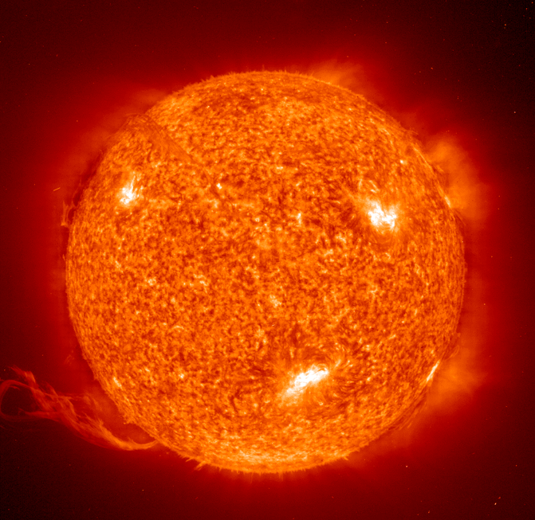
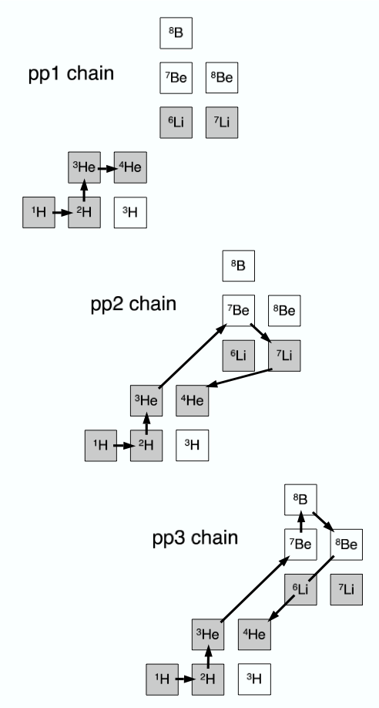
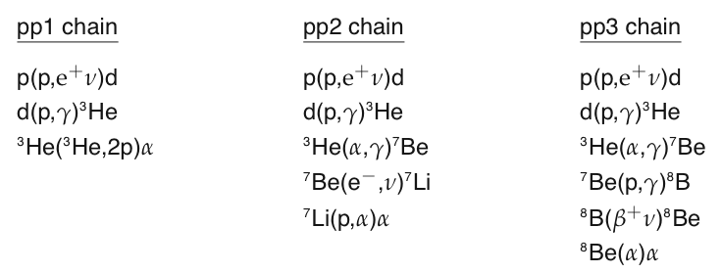
Hydrostatic Hydrogen Burning: Sun (T=15.6 MK), stellar core (T=8-55 MK),
shell of AGB stars (T=45-100 MK)
*
4H→⁴He + 2υ+2e⁺ Q_{eff} (26.7 MeV)
reactions are non-resonant at low energies
p+p has not been measured
d+p, ³He+³He, ³He+α have been measured
90% of Sun’s energy produced by pp1 chain

Slide 26
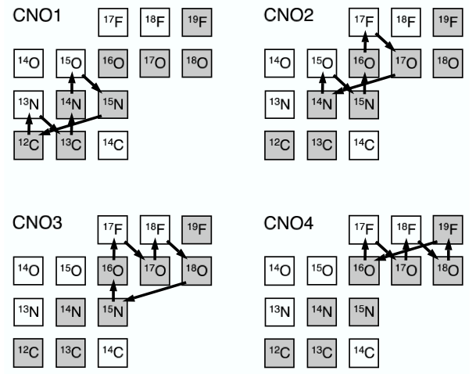
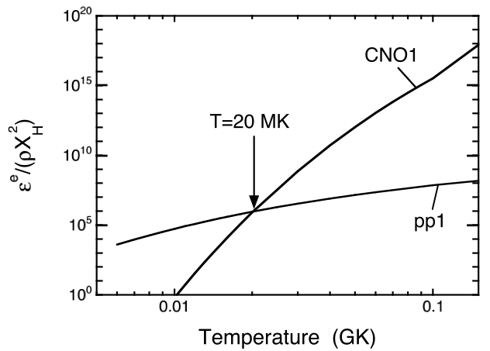
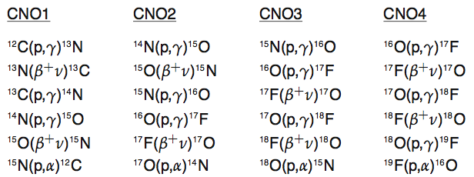
Hydrostatic Hydrogen Burning: Sun (T=15.6 MK), stellar core (T=8-55 MK),
shell of AGB stars (T=45-100 MK)
¹²C and ¹⁶O nuclei act as catalysts
branchings: (p,α) stronger than (p,γ)
¹⁴N(p,γ)¹⁵O slowest reaction in CNO1
has been measured by LUNA/LENA
solar: ¹³C/¹²C=0.01;
CNO1: ¹³C/¹²C=0.25 (“steady state”)
T>20 MK: CNO1 faster than pp1
CNO cycles in AGB stars: main source
of ¹³C and ¹⁴N in Universe

Slide 27
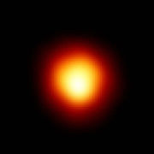
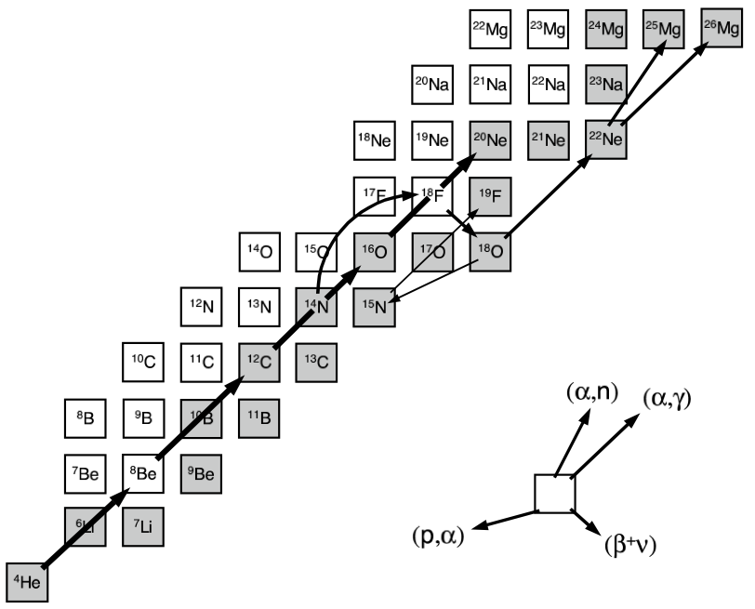
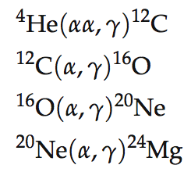
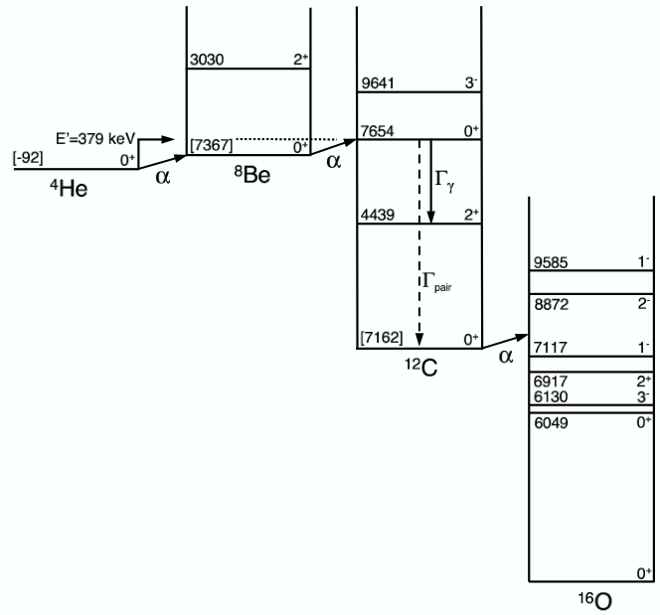
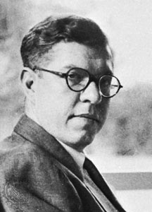
Helium Burning: Massive stars (T=100-400 MK)
Betelgeuse (α Orionis)
3α reaction cannot be measured directly (±15%)
¹²C(α,γ)¹⁶O slow (rate ±35%), determines ¹²C/¹⁶O ratio
¹⁶O(α,γ)²⁰Ne very slow
ashes: ¹²C, ¹⁶O
main source of ¹²C, ¹⁶O, ¹⁸O, ²²Ne in Universe
Fred Hoyle
(1915-2001)
neutron source for s-process

Slide 28
Nuclear astrophysics experiments: direct measurements
two nuclei with kinetic energies before reaction:
excited product nucleus after reaction:
α
γ
R_{lab}= σ·ε·I_{p}·ρ·N_{av}/A
ε ~ 10 %
I_{P} ~ mA
ρ ~ μg/cm²
What we need:
accelerated ion beams
targets
detectors
pb < σ < nb
event/month < R_{lab} < event/day

Slide 29
Gamow peak: energy window where information on nuclear processes must be obtained
BUT
kT << E₀ << E_{coul}
10⁻¹⁸ barn < σ < 10⁻⁹ barn
Major experimental difficulties
Procedure: measure σ(E) over as wide a range as possible, then extrapolate down to E₀!
CROSS SECTION
S-FACTOR
S(E)
σ(E)
resonance
extrapolation
LINEAR
SCALE
direct measurement
LOG
SCALE
low-energy tail
of broad
resonance
non-resonant
non resonant
process
direct measurements
sub-threshold
resonance
⇓
E₀
E_{coul}
-E_{r}
0
E_{r}
interaction energy E
extrapolation
needed !
Coulomb
barrier
DANGER OF EXTRAPOLATION !

Slide 30
Nuclear astrophysics experiments: direct measurements
- Quiescient burning (essentiallly p and a radiative capture):
E₀<<CB; s<pb
i. direct measurments at E=E₀
    ii. extrapolation from high energy measurements
    iii. indirect methods (Coul. break-up, delayed activity
    transfer reactions, "trojan horses")
Imply very low background (underground lab)
Imply use of efficient and selective detection apparata
Imply comparison with direct methods and model tuning
I
N
C
O
N
T
R
O
N
A
Z
I
O
N
A
L
E
F
I
S
I
C
A
N
U
C
L
E
A
R
E
L
N
S
2012
Notes:
Experimental reaction rates for understanding of
nucleosynthesis, energy production in stars,
solar neutrino problem, theories of stellar evolution

Slide 31
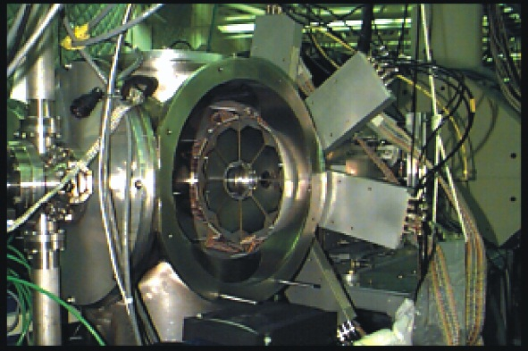
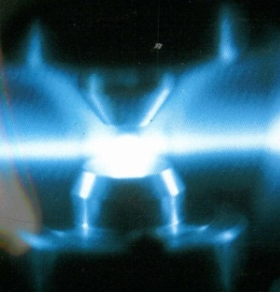
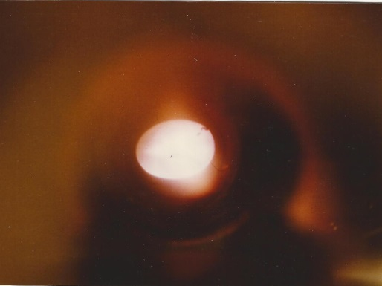
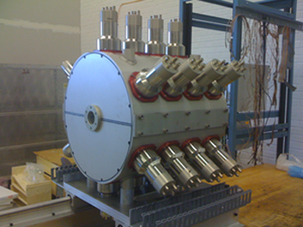
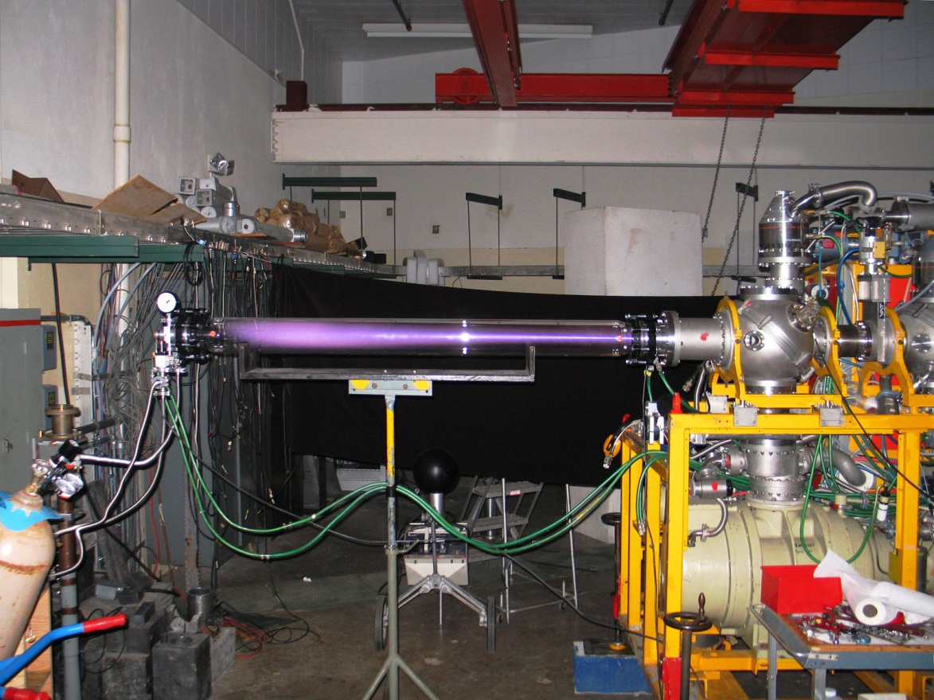
Stable beam experiments with high beam intensity
Yield measurements with particle and/or gamma detector arrangements
Notes:
Just example for typical experiment, beam on target in energy range that corresponds to stellar temperature conditions
Message: The idea was to basically introduce the way we do the measurements for simulating nuclear reactions, by beam on target. It was thought to be a generic facility, now we can use it as generic stable beam facility; what is needed high intensity accelerators, state of the art target and detection equipment to measure the extremely weak signals in strong background.
Comment: that is the first slide on stable beam techniques, maybe afterwards the questions and then the future in form of DIANA

Slide 32
Why is background a problem?
Background ﬂuctuations ∝ √t
Signal grows ∝ t
Inﬁnite measurement will always give good results
Students need to graduate → reduce background

Slide 33
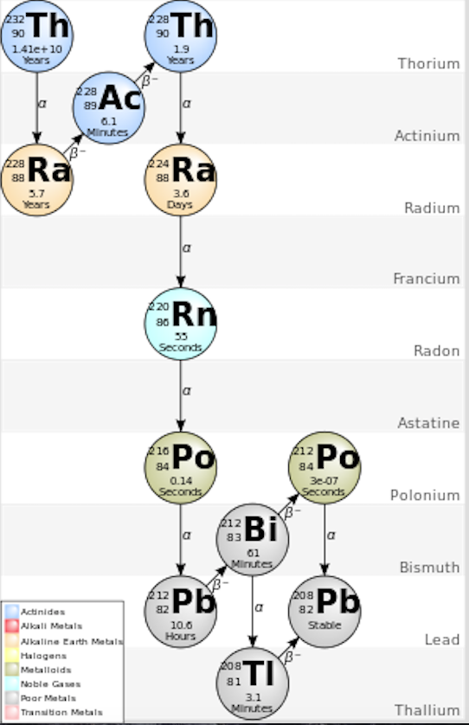
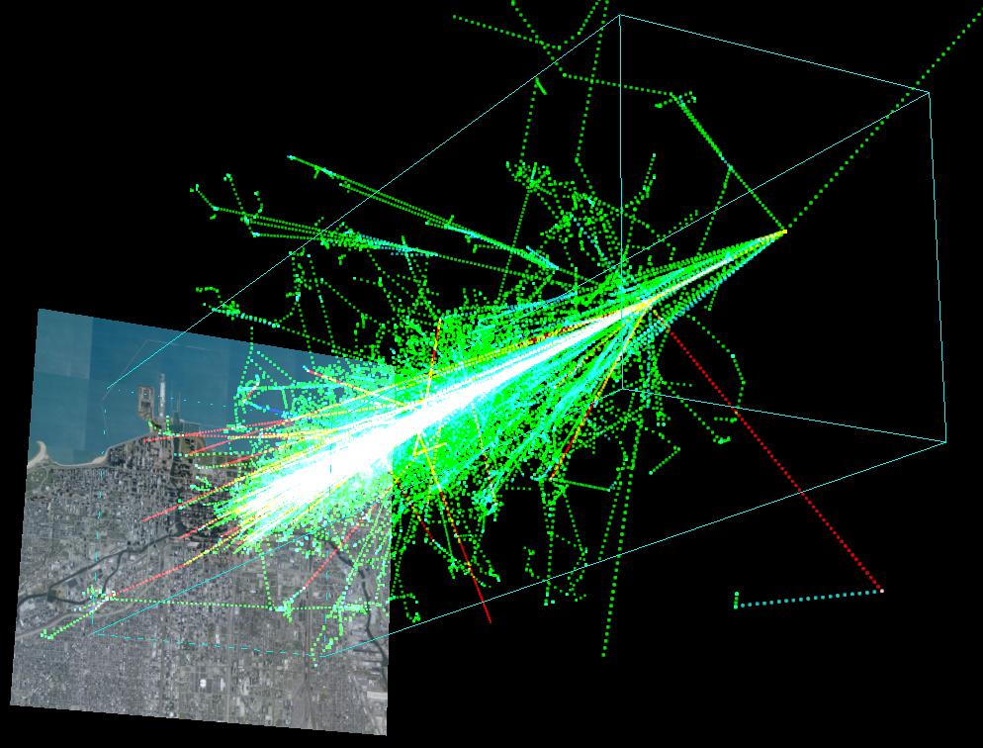
Background sources
Cosmic rays Natural radioactivity
http://astro.uchicago.edu/cosmus/projects/aires/
Primary cosmic rays: mostly protons
Create showers of secondary particles
in atmosphere
In the end muons and neutrons reach surface
Natural decay chains: Thorium, Uranium series
Potassium-40
Radon (from decay chains): gaseous
Impact mostly gamma-ray measurements

Slide 34
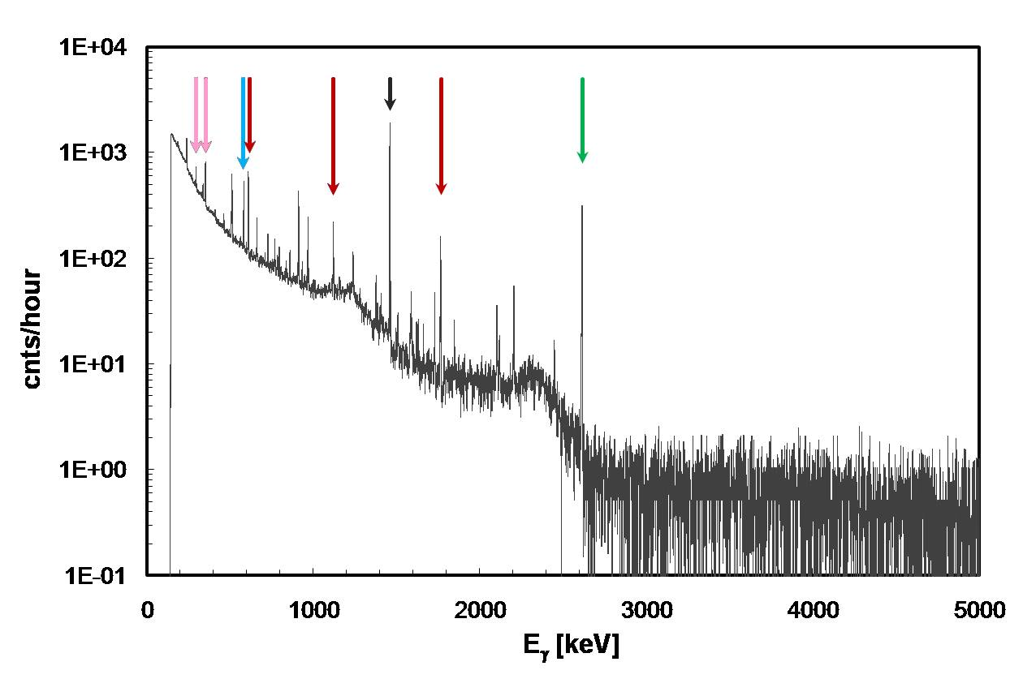
Background components
²¹⁴Pb
²⁰⁸Tl
⁴⁰K
²¹⁴Bi
²³²Th
²¹⁴Bi
Background γ-ray
Spectrum on surface
Cosmic rays
< 3.5MeV
Long-lived natural radioisotopes
Isotopes in natural radioactive decay chains
Cosmogenic and man-made radionuclides
3.5 to ∼ 7 MeV: Neutron-induced, muons Higher: muons

Slide 35

γ-ray natural background
surface
between E_{γ} =7 and 12MeV the bck
suppression factor is 100 times better
than was achieved in laboratories using
active shielding
underground
underground passive shielding
is more effective since μ flux,
that create secondary γ’s in the
shield, is suppressed
3 orders of
magnitude!
0.3 m³ Pb-Cu shield suppression
three orders of magnitude below 2MeV

Slide 36
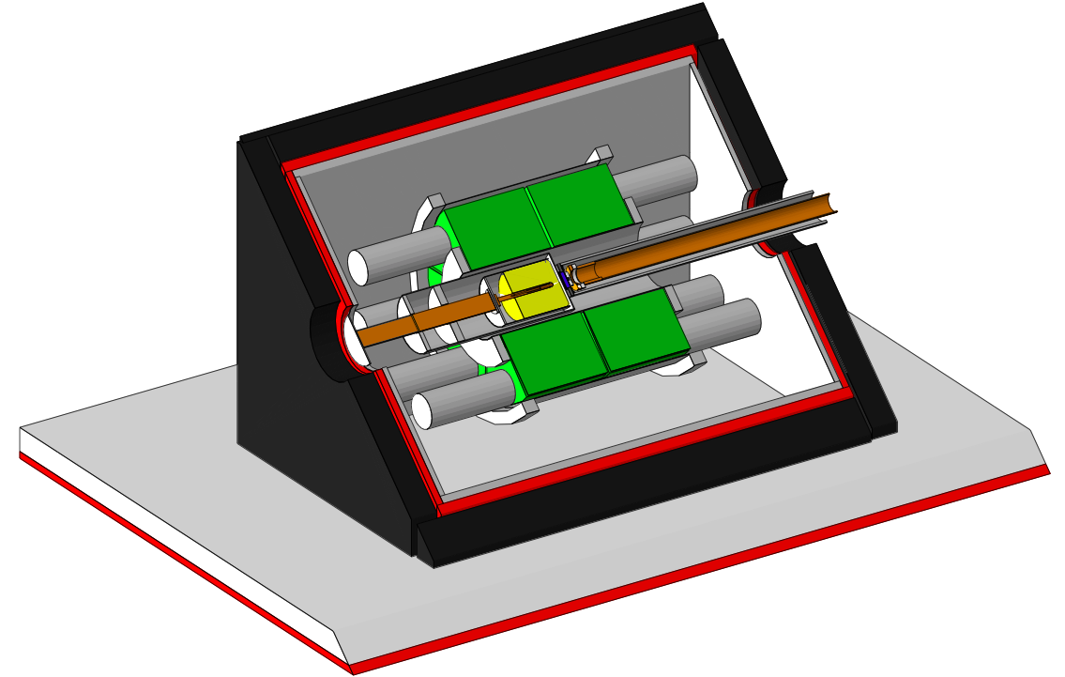
Status quo on surface
Plastic scintillators
Lead shield (2.5 cm)
NaI annulus around target +
HPGe
Muon veto + γγ coincidences
Background reduction:
< 3 MeV 1/3600
> 3 MeV 1/20
Good for low-energy part, high energies hard to actively suppress
Longland et al. 2006, Cesaratto 2011

Slide 37
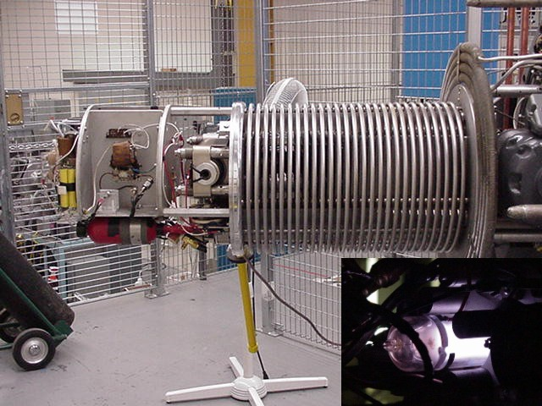
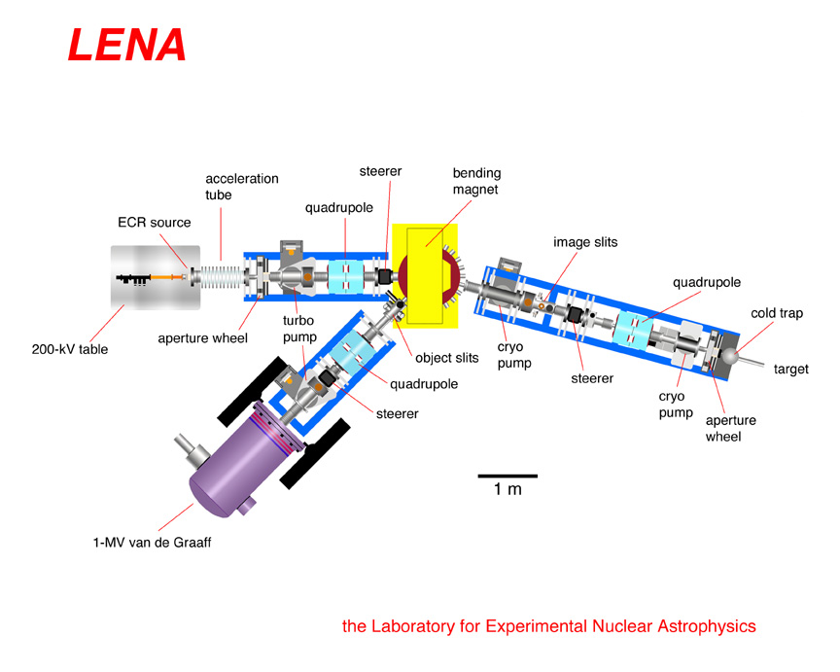
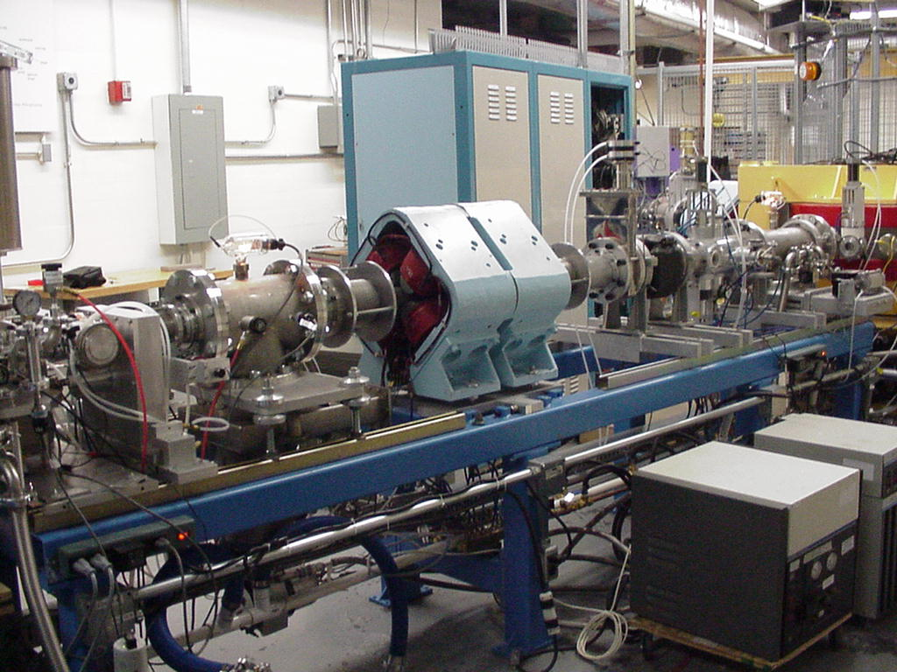
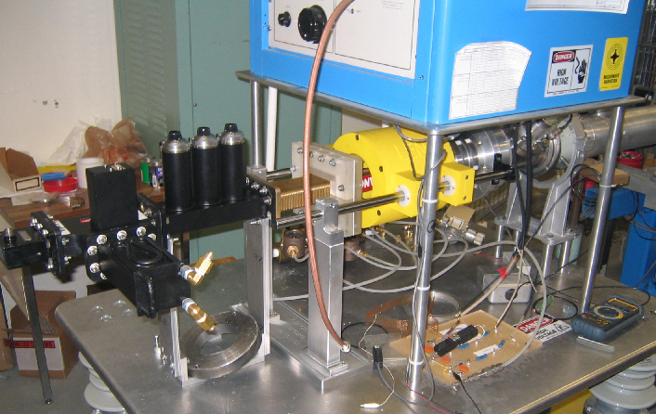
Laboratory for Experimental Nuclear Astrophysics
Cesaratto et al., Nucl. Instr. Meth. A623, 888 (2010)
Courtesy of
C.Iliadis

Slide 38




The LUNA 400KV Underground Laboratory
I
N
C
O
N
T
R
O
N
A
Z
I
O
N
A
L
E
F
I
S
I
C
A
N
U
C
L
E
A
R
E
L
N
S
2012
U_{terminal} = 50 – 400kV
I_{max} = 250A
E = 0.07keV
Allowed beams:
H⁺, ⁴He, (³He)

Slide 39
Quantity to be determined: reaction rate through cross section measurement
Number of projectiles
“beam current”
Cross section
Number of reactions
Target surface density
i.e. “target thickness”

Slide 40
Number of projectiles: gas target
thin window gas cell: charge measurement possible

Slide 41

Windowless gas target
charge exchange: charge measurement does not work
calorimetric technique: determination of current from beam power
usually must be calibrated
using charge measurement
in empty target

Slide 42
Number of projectiles: together with target thickness
On-line determination
during cross section measurement.
See later

Slide 43
Target thickness determination
Off line (before or after the c.s. meas.):
  weighing
  energy loss
  active (accelerator based) techniques
    RBS, PIXE, SIMS, ...
On line (during cross section measurement):
  scattering
  nuclear reactions
  etc...

Slide 44

Target thickness
Solid target
Target thickness and stability through nuclear
Reactions i.e. ¹⁷O(p,γ)¹⁸F reaction anodized T₂O₅
targets ~70% ¹⁷O, ~30% ¹⁸O
resonance in ¹⁸O(p,γ)¹⁹F reaction at 151 keV
Gas target
pressure and temperature measurement
no problem with target stability
beam heating effect!
A. Caciolli et al., Eur. Phys. J. A, 48, 144 (2012)
LUNA case study
³He(α,γ)⁷Be

Slide 45
Thick target yield measurement
If thin target preparation or
target thickness determination is problematic
Cross section
Number of reactions
Number of projectiles
Stopping power

Slide 46
Determination of the number of reactions
Aim: high detection efficiency
In-beam method
  particle detection (alphas, protons, neutrons)
  gamma detection
  recoil separator
  storage ring
Off-line methods
  gamma (or X-ray) detection based activation
  AMS

Slide 47

Charged particle detection (in beam)
100% intrinsic efficiency
Solid angle to be determined
Background (e.g. elastic scattering) must be avoided
  foil in front of detector
  particle identification (ΔE-E detector)
Angular distribution effect

Slide 48



Gamma-detection (in-beam)
HPGe detectors
  low efficiency
  high resolution: detailed decay scheme
Scintillator summing crystals
  high efficiency
  low resolution
  only total cross section
HPGe detector array
  high efficiency, high resolution, coincidences
  expensive

Slide 49



Coincidence-Anticoincidence Detection Apparatus LENA collaboration
resonance at 227 keV in ²⁶Mg(p,γ)²⁷Al, 1μA
singles, no
shielding
singles, shielding
Intensity
coincidences, no shielding
γ-ray energy (keV)
Rowland, Iliadis et al., Nucl. Instr. Meth. A 480, 610 (2002)
Longland, Iliadis et al., Nucl. Instr. Meth. A 566, 452 (2006)

Slide 50
γ-ray natural background
surface
between E_{γ} =7 and 12MeV the bck
suppression factor is 100 times better
than was achieved in laboratories using
active shielding
underground
underground passive shielding
is more effective since μ flux,
that create secondary γ’s in the
shield, is suppressed
3 orders of
magnitude!
0.3 m³ Pb-Cu shield suppression
three orders of magnitude below 2MeV

Slide 51



Direct detection of the recoil nuclei
B
E_{B}
x
ϑ_{recoil}
A
ϑ _{γ}
γ
x(A,γ) B reaction in the laboratory system
angle in respect to the beam
direction of the recoil
ϑ _{max} is reached when ϑ _{γ} = π/2

Slide 52
Why Recoil Separator?
Direct detection of produced nuclei
High efficiency, good particle identification
(mostly) Background free
Detecting recoils can perform: Time of Flight, Z-identification, Delayed-Activited detection, Recoil-Coincidence measurements
Technically challenging : design concept and general layout of RMS follows a velocity-rigidity-velocity filtering scheme, quite complicated, i.e. the selection and the transport of the recoils is complicated by their angular and energy spread.
Index Separator efficiency N_{p,leak}/N _{p,impinging} depends on recoil charge state, projectile ion rigidity, energy.
i.e. N_{p,leak}/N _{p,impinging} ≈ 10⁻¹⁵ - 10⁻¹⁸
⁻

Slide 53
Recoil Mass Separator : working principle
I
N
C
O
N
T
R
O
N
A
Z
I
O
N
A
L
E
F
I
S
I
C
A
N
U
C
L
E
A
R
E
L
N
S
2012
beam ions
+recoils (10⁻¹²⁻¹⁸)
accelerated beam ions
gas target
Recoil
Mass
Separator
recoils +
“leaky”
beam ions
Particle detector
γ
γ-ray
detector
gate
N_{recoils} = N_{projectiles} N_{target} σ T Φ_{qr} ε_{part}
where T Φ_{qr} trasmission and the charge state proability for the selected charge state q_{r} keys requirements of RMS

Slide 54

ERNA: Recoil Mass Separator
A+α→C+γ
A/C>10¹⁵
for ¹²C(α,γ)¹⁶O
basic principles
γ-rays
Projectiles
TARGET
FILTER
DETECTOR
LENS
Recoils
Projectiles
p_{rec} = p_{proj} momentum conservation!
coincidence
γ-rays
detector
γ-ray emission
-> recoil cone

Slide 55

Matrix ΔE/E for the ¹²C(α,γ)¹⁶ O
Run time 18h
E_{cm}=3914keV
Courtesy of Di Leva’s thesis

Slide 56

Inverse kinematics with recoil separators

Slide 57



St. George Separator
HIPPO jet gas target System (HIgh Pressure POint-like gas target)

Slide 58
¹⁴N(p,γ)¹⁵O: LUNA results
E_{CM} (keV)
E_{x} (keV)
¹⁴N + p
7540
Q = 7297
6791
6172
5180
0
¹⁵O

Slide 59

¹⁴N(p,g)¹⁵O: Age of GC
The age of the oldest Globular Clusters should be increased by about 0.7-1 Gyr.
The lower limit to the Age of the Universe is 14 ± 1 Gyr.
In good agreement with the precise detrmination of WMAP.

Slide 60


Nucleosynthesis in He burning
⁴He(2α,γ)¹²C
¹²C(α,γ)¹⁶O
¹⁶O(α,γ)²⁰Ne
Oxygen-16
The reactions determines the ¹²C/¹⁶O ratio in our universe! It also defines the late stellar evolution of massive stars, determines white dwarf matter, the ignition of supernovae type Ia, the standard candle for cosmological predictions.

Slide 61
Network for stellar Helium burning

Slide 62

¹²C(α,γ)¹⁶O, the Holy Grail of Nuclear Astrophysics
Nuclear mechanism that gave a consistent rate
with the known carbon-oxgen ratio:
Nonresonant direct-capture process
Nonresonant type of capture into tails of
nearby resonances.
Task:
which waves, s, p or d?
which J^{π}?
which transition?
Level and interference components
from various transitions are reflected in the
total cross section (S-factor) structure!
Uncertainty in low energy extrapolation is helped by a multichannel analysis of reaction ¹²C(α,γ) and scattering ¹²C(α,α)
Notes:
Look at the observed resonances above the a-threshold Erborad 400kev)= 2.42 MeV two subtreshold

Slide 63
Available textbooks
Nuclear astrophysics
C. Iliadis, Introduction to Nuclear Astrophysics,
C.E. Rolfs and W.S.Rodney, Cauldrons in the Cosmos
Particle , neutron and γ-Detector
Radiation Detection and Measurement
G.F.Knoll
Pratical Gamma-ray Spectrometry
G.R.Glimore
Available Master Thesis and PhD thesis in Nuclear Astrophysics in different INFN laboratories and univerisities:
Alba.Formicola@lngs.infn.it

Slide 64

Experimental Nuclear Astrophysics: very lively research field
stars are huge cauldrons where elements are produced and energy is generated
nuclear reactions take place under many different conditions
quiescent burning governed mainly by reactions between stable nuclei
laboratory investigations pose great challenges to experimentalists
variety of approaches and techniques must be used
stable beam experiments: New Underground facilites and Reocil Mass Separator
Notes:
explosive burning governed mainly by reactions with unstable nuclei
unstable beam experiments: new RIB facilities → more beam species and higher intensities

