Slide 1
Heavy nuclei
(variations on the theme of Density Functional Theory)
Gianluca Colò

Slide 2
Many nucleons, many problems …
One big wish is to derive the behaviour of nucleons from Quantum Chromo Dynamics (QCD). Unfortunately, this theory tells us that the strong force is not perturbative at the nuclear scale (MeV).
Even in the case of electronic systems (governed by the electromagnetic interaction) the many-body Coulomb problem is hard, or sometimes intractable, even if we know the interaction much better.
Many-particle systems have emergent properties.

Slide 3
Independent particle model (cf. previous talks)
Red = HO
M. G. Mayer, J. H. D. Jensen

Slide 4
Nuclear transparency and independent particle motion
The imaginary part of the potential that a particle feels is related to its mean free path
At low E:
the neutron mean free path
becomes larger than the nucleus
A. Bohr, B.R. Mottelson, Nuclear Structure, vol. I
Here –V and –W !

Slide 5
Nuclear saturation (I)
Described by the Bethe-Weiszäcker mass formula:
B/A is ~ 8 MeV
The volume part is ~16 MeV
How to obtain this liquid-drop
behaviour from the independent
particle motion ?
A particles in
shells

Slide 6
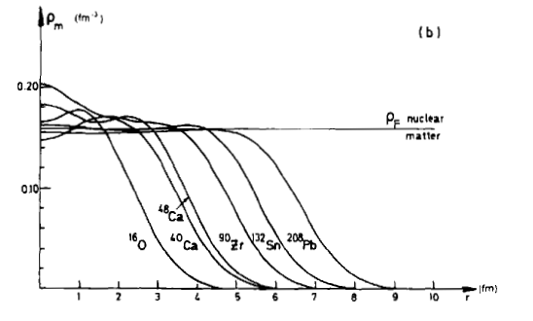
Nuclear saturation (II)
Saturation density:
M. Waroquier et al., Phys. Rep. 148, 249 (1987).
The inner part of a heavy nucleus resembles a piece of matter with N = Z, having saturation density and E/A = -16 MeV.
Keep in mind the time for a nucleon to go through the nucleus !

Slide 7
Saturation as a minimum in E/A
The empirical saturation point is a stable point for matter with N=Z .
E/A OF SYMMETRIC MATTER HAS A MINIMUM AT ϱ₀ = 0.16 fm⁻³; THE VALUE AT THE MINIMUM IS -16 MeV (E/A without mass = -B/A).
We will see that naïve mean-field does not provide saturation while Density Functional Theory (DFT) does.
G.C., Phys. Part. Nucl. 39, 557 (2008).
M. Waroquier et al., Phys. Rep. 148, 249 (1987).

Slide 8
Mean-field: Hartree-Fock
Let us consider an Hamiltonian:
Let us then assume that N particles move independently (i.e. each of them moves in the average field generated by the others):

Slide 9
Nuclear saturation with constant V: no way !
Let us assume that we wish to obtain saturation in a naïve mean-field picture with a constant V.
A two-body potential with constant matrix elements (a 𝛿-force which is a constant in k-space) would give at the Fermi energy:
The same potential would give in mean-field (Hartree-Fock):
The two equations are incompatible !
T. Nakatsukasa et al., Rev. Mod. Phys. 88, 045004 (2016)

Slide 10
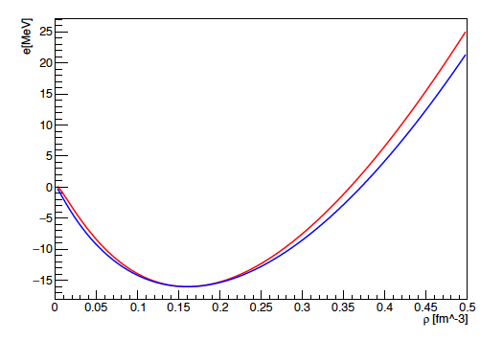
Finite-range is not enough
Due to its short-range, the Fourier transform of the nucleon-nucleon force does not have a strong k-dependence.
One must add explicit momentum dependence or exchange terms.
It has been shown that Gaussian or Yukawa interactions can produce saturation if supplemented with those terms.
(Very) wrong effective mass !
G. Accorto, R. Romano, A. Rancati, X. Roca-Maza, GC (to be published).

Slide 11
Reminder on effective mass
Here, E is the single-particle energy, NOT the total energy.
First term: E-mass
Second term: k-mass

Slide 12
Effective mass vs. levels in finite nuclei
C. Mahaux et al., Phys. Rep. 120, 1 (1985)
Experimental main peaks of transfer reactions like (d,p) can be reproduced by different Woods-Saxon potentials. Sometimes this is equivalent to a single potential if m* is introduced.
The empirical value of m*/m is between 0.7 and 1.

Slide 13
Way out: density-dependent V_{eff}
To reconcile, at least to some extent, saturation, effective mass and more, we assume V to be a function of the density.
Slater determinant
1-body density matrix
Strategies:
Start from a two-body (three-body) effective force and define H = T + V_{eff} [ϱ]. Write the expectation value on a general Slater determinant. “DFT is an exactification of Hartree-Fock” (W. Kohn).
Write directly the Energy Density Functional (EDF).

Slide 14
Nuclear Density Functional Theory (DFT)
If the only way to reconcile to some extent different properties of nuclei are density-dependent interactions, ultimately these are just “EDF generators” !
Energy density =
E is a functional
Mechanism for saturation
Flexibility (i.e., enough terms) to account for the many features of finite nuclei
Suitable for extensive computational efforts
“Guaranteed” by the Hohenberg-Kohn theorem

Slide 15
The Hohenberg-Kohn theorem
The original theorem and its proof can be found in P. Hohenberg, W. Kohn, Phys. Rev. 136, B864 (1964)¹. We have in mind a system of interacting fermions (H = T + V) in some external potential V_{ext}.
There exist a functional of the fermion density
and the part denoted by F is universal (for nuclei, it would be the only part).
b) It holds:
or, in other words, at least in principle this functional has a minimum at the exact ground-state density where it assumes the exact energy as a value.

Slide 16
Advantages of DFT (I)
The principle is relatively simple: write the energy of a system as a functional of the density and minimize !
Aims at being a theory that reconciles all observables: total energy of the nucleus, collective rotations and vibrations, single-particle states (to some extent) …
To be confronted with more accurate theories having more limited goals !
2n halo nucleus
¹⁵⁴Sm vs. ⁴⁰Ca
S_{2n}= 300 keV
¹¹Li
n
⁹Li
From: P. Flip
From: T. Nakamura
n

Slide 17
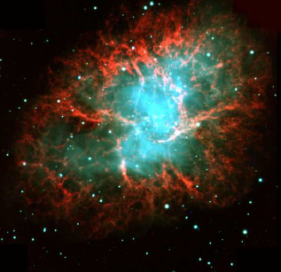
Advantages of DFT (II)
Can access a very large part of the nuclear chart, if not all
Excited states
Link with nuclear matter and compact objects like neutron stars
From: D. Vretenar

Slide 18
The good, the bad and the ugly !
The HK theorem has been generalised in (almost all) possible ways: degenerate ground-state, magnetic systems (m or spin densities), finite T, relativistic case … (the list might be not exhaustive).
In all cases one then build the energy functional E and solves:
Then, all quantities are in principle given (!).
The REAL weak point is that the various proofs of HK theorems do not give any clue on HOW to build the functional F.
Since there are many approaches to build it, the real disadvantage of DFT is that there are many realizations of such theory !
One must use the functional derivative:

Slide 19
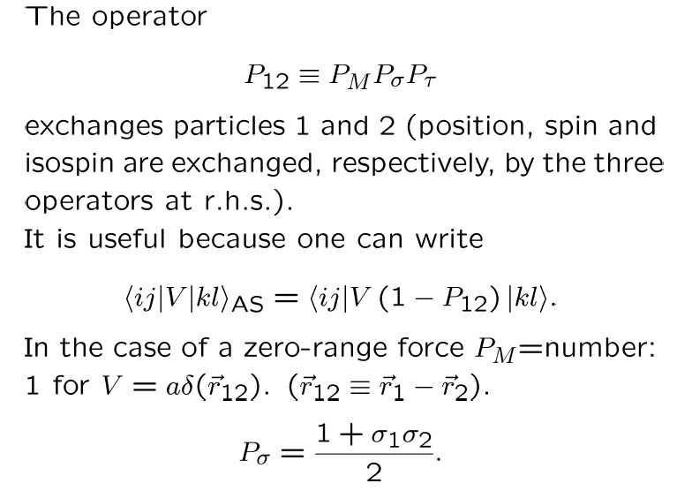
A note on exchange operators

Slide 20
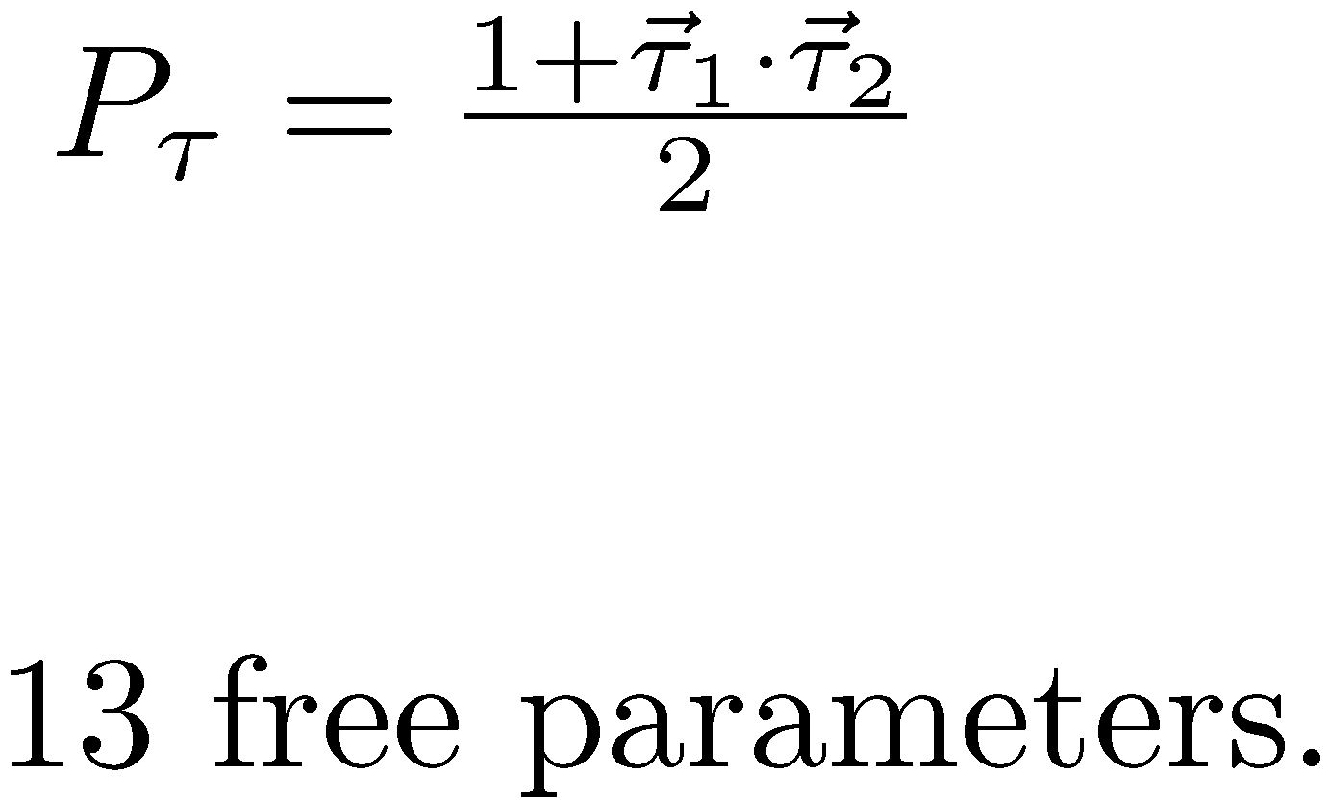
The Gogny force
There are two Gaussians with different ranges and spin/isospin dependence
The introduction of a density-dependent term seemed unavoidable. This must be zero-range.
The last term (spin-orbit) is zero-range for simplicity.
The great advantage of the Gogny force is that it seems adequate not only to enter the HF equations but to describe also nuclear superfluidity.

Slide 21

The Skyrme force
attraction
short-range repulsion
There are velocity-dependent terms which mimick the finite-range. They are related to m*.
The last term is a zero-range spin-orbit.
In total: 10 free parameters to be fitted (typically).

Slide 22
A note on the functional derivative

Slide 23
Let us see how it works in practice in a simplified case. A simple two-body force generates E ~ ϱ². NOTE: In this slide we call E only the potential energy part.
E = potential energy. The equation for s.p. states (HF/Kohn-Sham) reads:

Slide 24
The simplest model for saturation
Restricting to the case in which
One arrives at
Add kinetic energy !
If the two terms have opposite sign, one can get saturation.

Slide 25

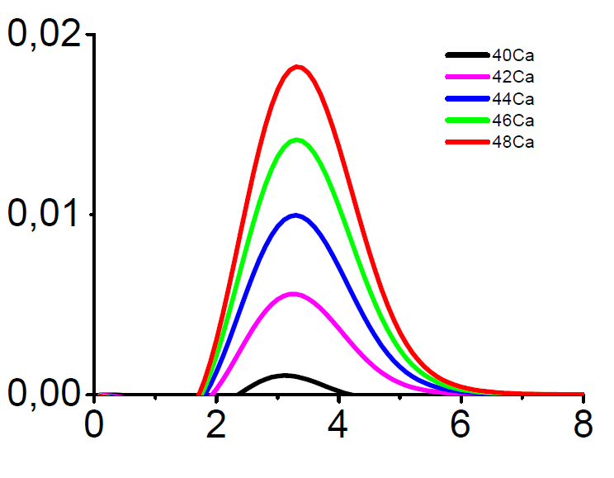
Realistic functionals
One has to consider several possible densities (including spin densities, isospin densities, gradients …).
Functionals will include all possible scalars made up with these quantities.
⁴⁸Ca
r [fm]

Slide 26
Summary of modern functionals and applications
local functionals (evolved from V_{eff} ÷ δ(r₁-r₂))
non-local from V_{eff} having Gaussian shape
covariant functionals
(Dirac nucleons exchanging effective mesons)
Skyrme (SEDF)
Gogny (GEDF)
Relativistic MF or HF
(CEDF)
Typical number of parameters ~ 10.
Error on masses of the order of 1 MeV (can go further down).
Trends of charge radii and deformations fairly well reproduced.
Good description of excitations such as giant resonances, rotational bands.
They can also be applied to β and ββ transitions.
There is current interest in large amplitude motion, reactions etc.

Slide 27
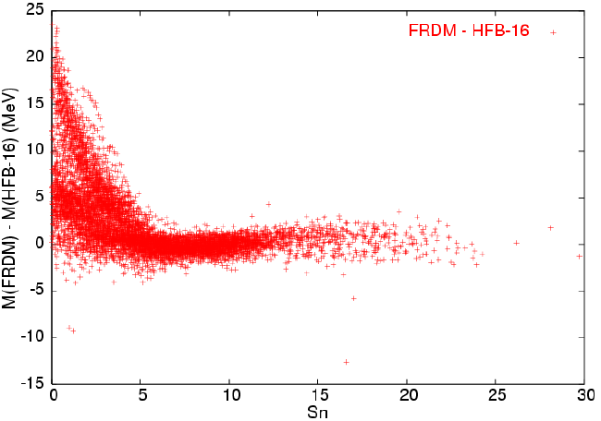
Masses/binding energies of nuclei
Typical energy density functionals have errors ≈ MeV for the masses. It means about 0.1 % to 1 % (!).
The Bruxelles-Montréal collaboration designed specific Skyrme forces for mass systematics. Quite successful at the expense of ad hoc terms.
HFB17
HFB16

Slide 28
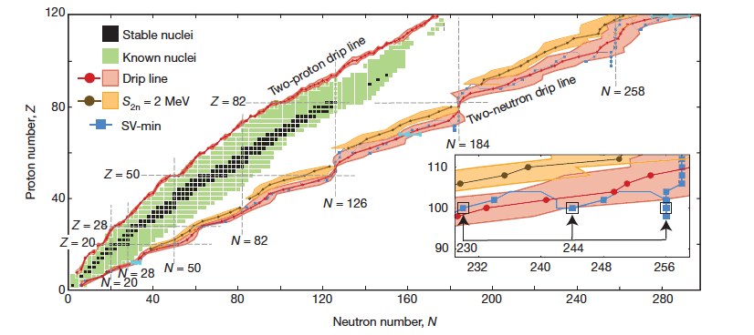
J. Erler et al., Nature 486, 509 (2012)
Statistical uncertainty around 10 mass units for large A.
Drip lines:
limits of nuclear stability with respect to the strong interaction
Figure: J. Enders, P. Van Duppen

Slide 29
Single-particle states towards the drip lines
pp and nn force is active only in T=1 channel: not so much attractive.
pn force is active also in the T=0 channel: strong attraction. This is known from the fact that the deuteron is the only bound NN system.
In a system with increasing N-Z, the neutrons become less bound with respect to the protons. This leads to β⁻ instability.
Analogous behaviour is found for neutron-deficient nuclei.

Slide 30
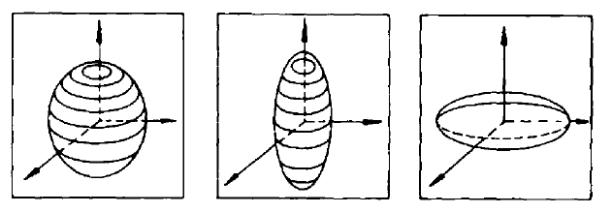
Deformation
In the case of axial quadrupole deformations:
There are non-axial deformations:
Intrinsic quadrupole moment
The overall trend of deformation is often reproduced by DFT. Specific transitional (“soft”) systems that lie between spherical and deformed shapes may be difficult to account for.
INTEREST in OCTUPOLE …
FISSION …

Slide 31
Symmetry breaking and restoration
Rotational motion restores the symmetry in the lab system.
This may happen on a time scale which is significantly larger than
𝜏_{F} ~ 10⁻²² s
From: T. Nakatsukasa

Slide 32
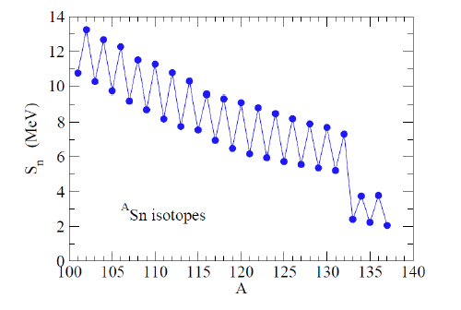
Evidences of pairing in nuclei (I)
Odd-even staggering in binding energies
Enhancement of two-particle transfer cross sections
(t,p) and (p,t) reactions:
The cross section is larger than it would be deduced from the transfer of uncorrelated neutrons.
[evidences in the literature: cf. R.A. Broglia, O. Hansen, C. Riedel, Nucl. Phys. 6, 287 (1973) and references therein].
Already known from the pairing term of the semi-empirical mass formula: it costs more energy to extract a neutron from an even-even system than from an odd system.
Nucleons → Cooper pairs ¹S₀

Slide 33
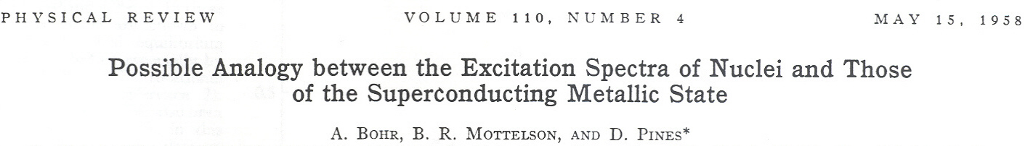
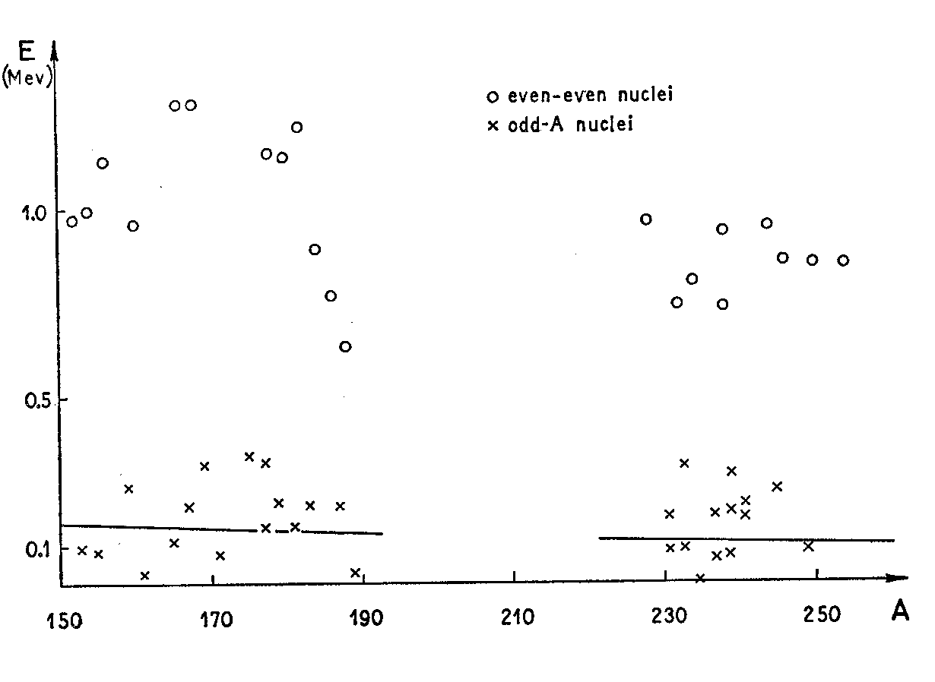
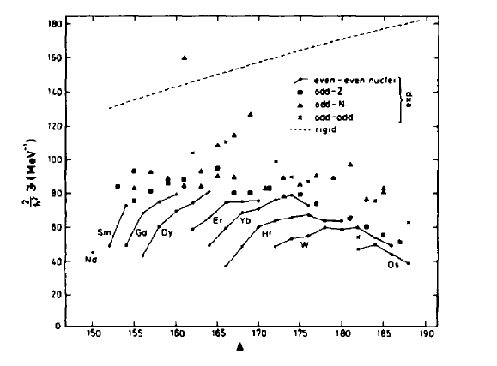
Evidences of pairing in nuclei (II)
Gap in the excitation spectrum of even-even vs. odd nuclei
Moment of inertia of deformed nuclei
ANALOGY WITH SUPERCONDUCTING METALS.

Slide 34
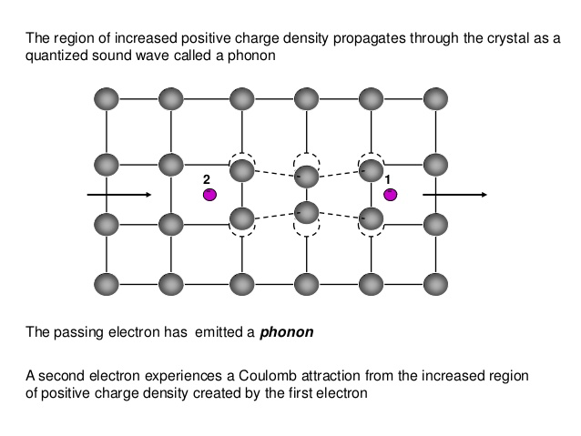
Electron-phonon interaction and superconductivity

Slide 35
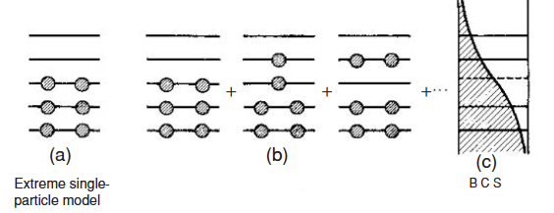
Theories for pairing: BCS or HFB
If the pairing interaction favours the Cooper pairs, the system gains energy by forming such pairs even if they are made up with nucleons on higher lying states.
BCS = Bardeen-Cooper-Schrieffer / HFB = Hartree-Fock-Bogoliubov.
Pairing can be understood as an extension of existing methods like HF or DFT.
There is debate on the origin of pairing.
A rather open question is the existence of p-n pairing.

Slide 36
Excited states: vibrations
We would like the same theory to describe both ground state and excited states.
In this lecture, we shall restrict ourselves to collective excitations of spherical nuclei (vibrations – yet in a broad sense).
DFT can be applied to excited states.

Slide 37
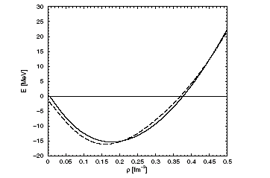
Time-dependent DFT
In practice, everybody uses so far the same functional used for the ground-state.
Density-dependent forces can be used (“TD-DFT is an exactification of time-dependent HF”).
One can solve the evolution equation for the density directly.
Often the equation for the density is linearized and solved on a basis (Random Phase Approximation or RPA).

Slide 38
Dipole oscillation
GDR (Giant Dipole Resonance): excited by e.g. a photon beam impinging on a nucleus.
E≈10-20 MeV implies that λ_{el.field} = hc / E >> R (nuclear dimension).
Consequently, the e.m. field in the nuclear region can be considered constant (dipole approximation).
From: P. Stevenson (U. Surrey)
The Fourier transform will give the energy of the mode(s).

Slide 39
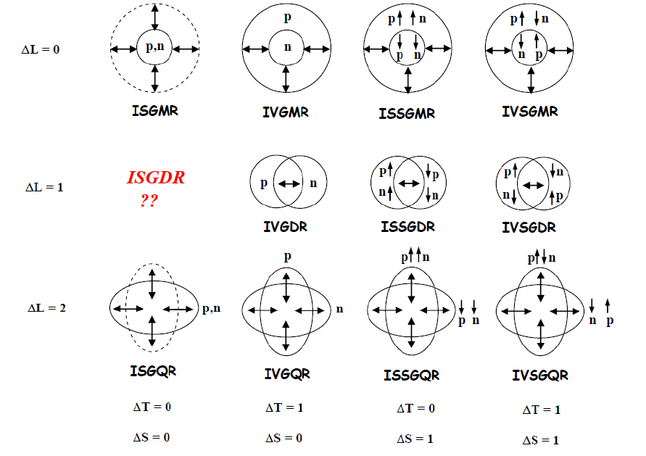
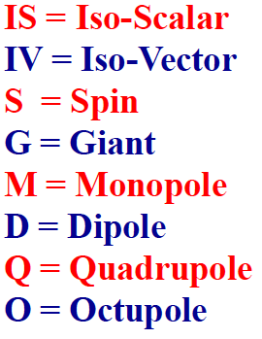
Nuclear excitations
Single-particle: one nucleon from below to above the Fermi surface.
Collective: vibrations (spherical nuclei), rotations (deformed nuclei).
Figure by M. Harakeh

Slide 40
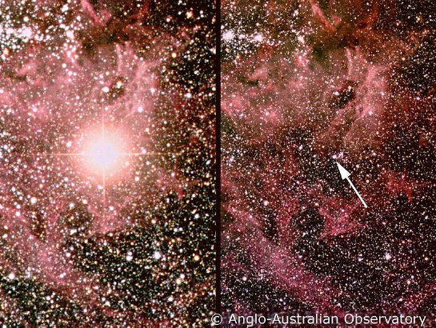
Example: Giant Monopole Resonance
Breathing mode:
This is a clear example in which the knowledge of a specific nuclear excitation may shed light on a more general property: the (in)compressibility of nuclear matter.
Supernova SN1987a

Slide 41
Charge-exchange transitions
Some transitions may be inside the allowed β-decay window.
However, most of them require external energy so that they are induced by charge-exchange reactions, like (p,n) or (³He,t).
The study of their properties can greatly improve our knowledge of the charge-changing part of the nuclear H.
At the same time the matrix elements of the transitions involved in double-β decays must be known to extract the neutrino mass.
p
n
(p,n)
(n,p)
Z+1,N-1
Z,N
Z-1,N+1

Slide 42
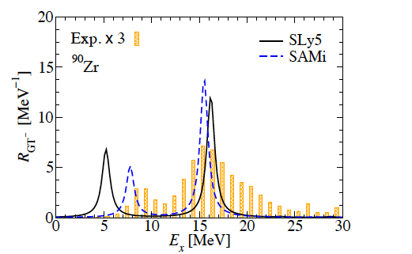
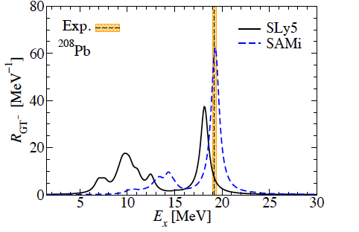
Gamow-Teller resonance
Highest and lowest particle-hole transitions in the picture
Z
N
X. Roca-Maza, G.C., H. Sagawa, PRC 86, 031306(R) (2012).
“Vibration” in spin-isospin space

Slide 43
Low-lying dipole strength vs. threshold effect
Increasing (N-Z)/A, we expect decoupling of neutron and proton excitations, and low-lying neutron strength.
Favoured in light nuclei ↔ low angular momenta.
From. T. Nakamura
After its discovery in light nuclei, low-lying dipole strength has been identified also in medium-heavy systems.
excess neutrons
A. Klimkiewicz et al., PRC 76, 051603(R) (2007).
“core”

Slide 44
Backup

Slide 45
What would we like to explain theoretically ?
Masses
Radii
Deformations
Excited states: single-particle states, vibrations, rotations.
Decays (for instance, β and ββ transitions).
Large amplitude motion (fission).
…
¹⁵⁴Sm vs. ⁴⁰Ca
From: P. Flip

Slide 46
Independent particle model (I)
Figure taken from R. Casten.
Emergence of magic numbers:
shell structure in a self-bound system !

Slide 47
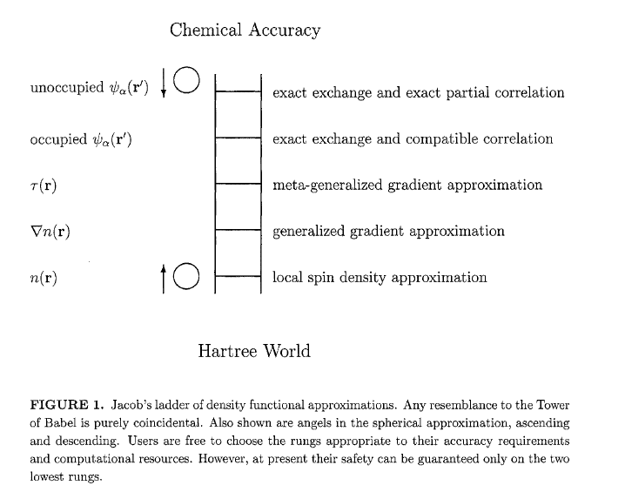
Analogies with electronic DFT
J. Perdew, K. Schmidt, AIP Conf. Proc. 577, 1 (2001).

Slide 48
Charge radii
M. Bender et al., Rev. Mod. Phys. 75, 121 (2003)
The figure shows r.m.s. radii extracted from the charge distributions (point protons distributions convoluted with the charge form factor of the proton). Symbols: direct measurement (filled), isotope shift (empty).

