Slide 1
Phenomenological Optical Potentials
(an experimentalist view)
Alessia Di Pietro
INFN-Laboratori Nazionali del Sud

Slide 2
Outline
Definition of cross-section
Elastic scattering of nuclei
Rutherford scattering
Scattering by a real nuclear potential
Scattering by a complex potential
Some basic formulas of scattering theory
The Optical Model
Woods-Saxon potential
Single and Double-Folding potential
- Saõ Paulo potential
Dynamic Polarisation potential
Threshold anomaly
Summary

Slide 3
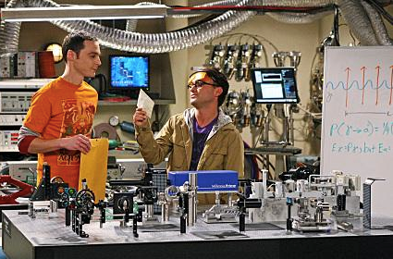
Nuclear reactions are basic tools to study nuclei i.e. their structure, the way they interact, the cross-sections for the various reaction processes…..
Nuclear Physics information are required to address some questions required by Astrophysics
Development of a theory
Laboratory experiments
Comparison of experimental results with theory to derive nuclear structure and reaction information

Slide 4
What do you need to perform a nuclear physics experiment?

Slide 5
What do we measure in a nuclear physics experiment?
Given the reaction a+A → b+B, where:
a = projectile nuclei
A = target nuclei
b,B = reaction products
N_{A}
ΔΩ [sr]
N_{a}
θ,φ
angular distribution
of all emitted particles reaches the detector
i_{a}
Total cross-section for a given process

Slide 6
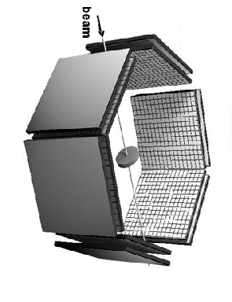
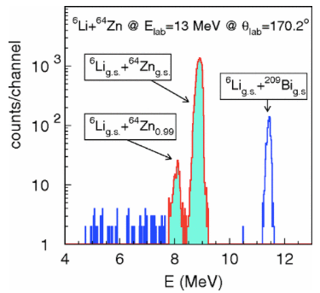
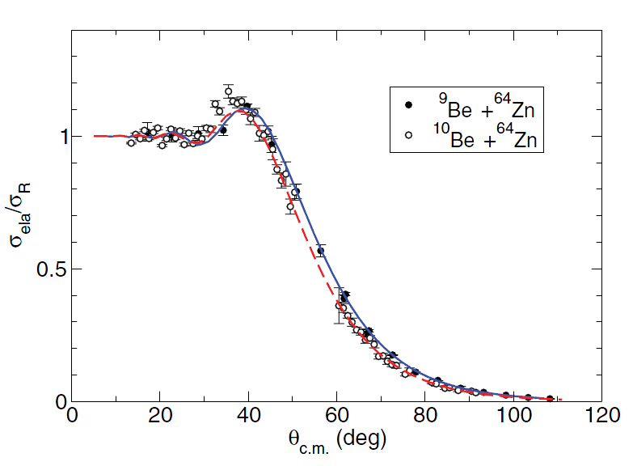
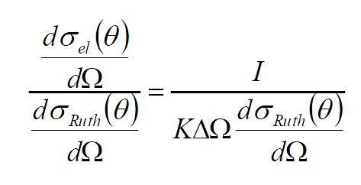
The simplest reaction process is the elastic scattering.
How to perform the measurement of its cross-section?
target
Energy spectrum
array of detectors
Number of counts in the elastic peak
Elastic / Ruth.
detector
solid angle
N_{i}×N_{t}×t=normalisation constant

Slide 7
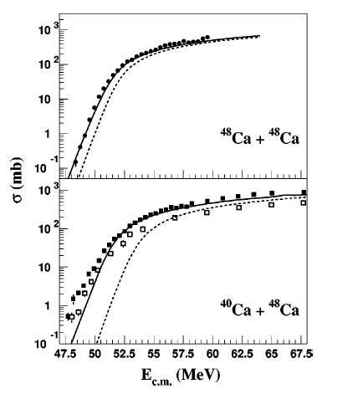
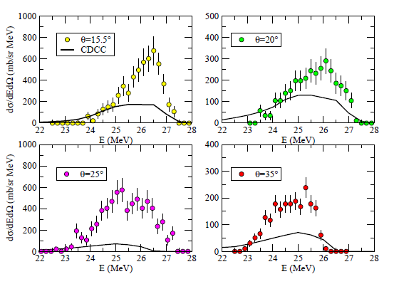
Angular distribution
θ
θ
θ
θ
Examples of cross-sections:
θ
θ
Excitation fnction σ(E)
double differential cross-section
In order to compare experiment with theory we need theoretical models

Slide 8
Elastic scattering

Slide 9
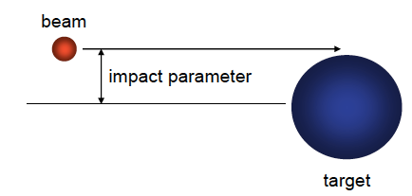
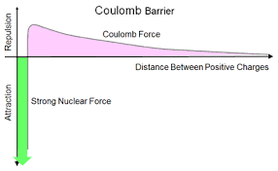
Scattering by a potential Case 1 → scattering by a Coulomb potential: the Rutherford scattering
Colliding nuclei → point-like or uniformly charged spheres
Pure Coulomb potential
1)E_{c.m.}<< V_{B} Coulomb barrier
2)No nuclear effects
Definitions:
Coulomb barrier
V_{B}
E_{c.m.}<<V_{B}
Scattering angle θ_{c.m.} related to distance of closest approach.
For each trajectory:

Slide 10
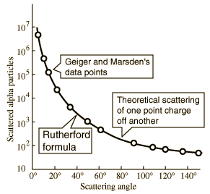
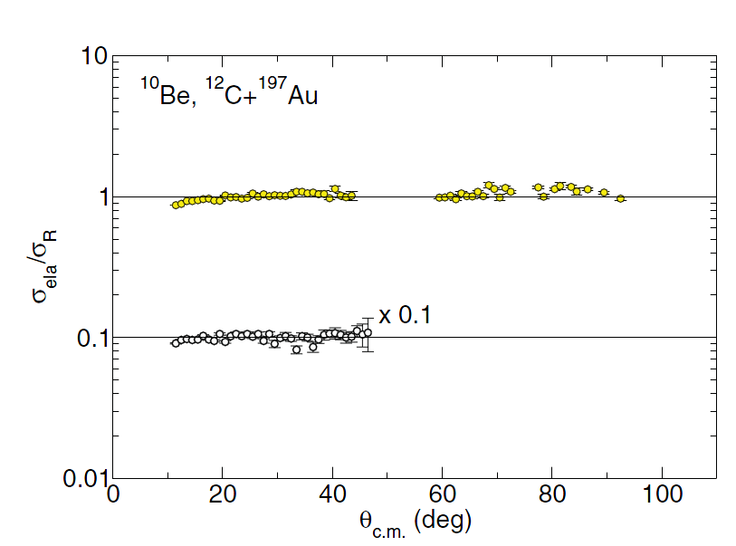
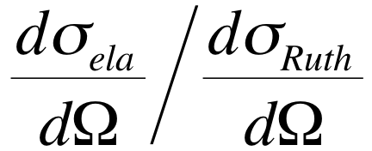
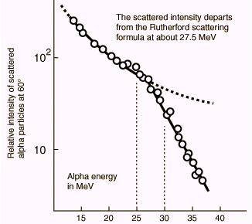
Sommerfeld parameter η>>>1
Generally σ_{elastic}/σ_{Rutherford} is plotted to see variations from the Ruth. scattering.
If η>>>1 σ_{elastic}/σ_{Rutherford} ≈ 1
θ_{c.m.} (deg)
As E_{c.m.} increases elastic cross-section starts to deviate from Rutherford at large angles

Slide 11
Case 2 → scattering by a Coulomb + Nuclear potential
Effect of repulsive Coulomb + attactive nuclear potential.
E_{cm}>V_{C} and NO ABSORPTION→V(r) real!
E_{c.m.}>V_{B}
Example of classical trajectories for real potential V(r)
orbiting
Θ
Coulomb Rainbow dΘ/dJ=0
1
2
1
θ
Grazing orbits
2
0
Glory
3
J
3
−θ
Orbiting
Trajectories 1,2 and 3 emerge with the same scattering angle.
Interference effects of these orbits
Singularities in dσ/dΩ
J=pb

Slide 12
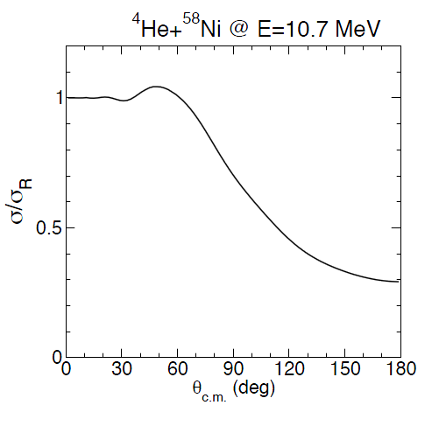
Elastic cross-section relative to Rutherford i.e.
Classical
--Rainbow - classical
Semiclassical
illuminated
shadow
Oscillations are caused by interference between contributions from the various orbits which result in the same scattering angle
As the energy increases absorption from elastic channel occurs → V(r) is imaginary

Slide 13
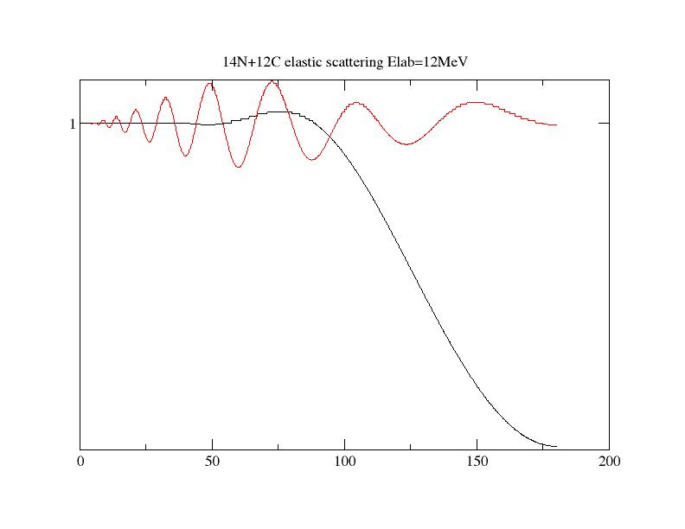
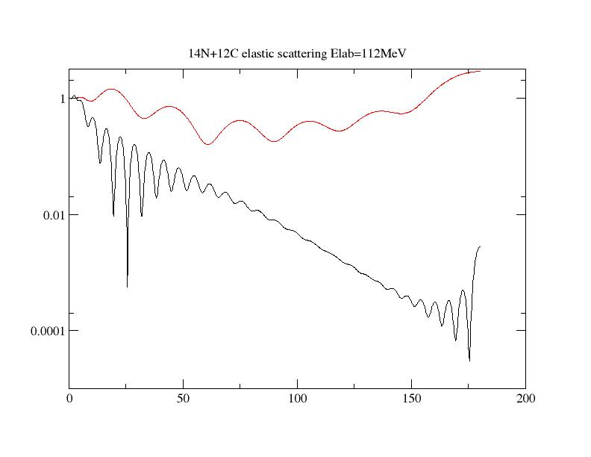
e.g. optical model calculations ¹⁴N+¹²C with and without absorption
E=12 MeV
With absorption (complex potential)
θ
Without absorption
(real potential)
E=112 MeV
θ

Slide 14
Evolution of elastic scattering with energy (V complex)
Fresnel scattering: η>>1
Strong Coulomb potential
E_{c.m.}≈ V_{B} Coulomb barrier
“Illuminated” region → interference (Coulomb-nuclear)
“Shadow region” → strong absorption
Coulomb – nuclear interference

Slide 15
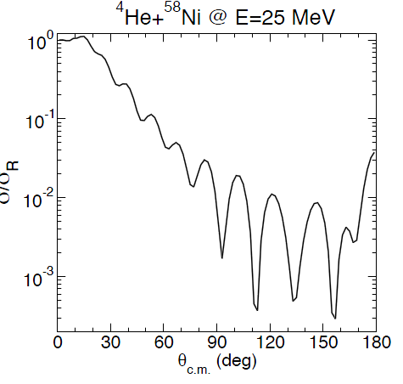
Evolution of elastic scattering with energy (V complex)
Fraunhofer scattering: η≤1
Weak Coulomb
E_{c.m.}> V_{B} Coulomb barrier
Near-side/far-side interference (diffraction)
Far-side / Near-side interference

Slide 16
The Optical Model
• The optical model is a schematic model of nuclear scattering that neglects the microscopic nuclear structure
• It is called “optical” because it treats the incident and outgoing particles as waves scattered by some “spherical” region. Sometimes those waves can be absorbed (“cloudy ball”) and we can lose flux, reducing the elastic scattering cross section
• The combined effects of many complex states are averaged into a single nucleus-nucleus effective potential called the Optical Potential
• The Optical Potential is complex. It has an imaginary term which allows to consider absorption of the incoming flux. The Optical Potential is deduced from elastic scattering data.

Slide 17
Why the optical model
A₁ nucleus
A₂ nucleus
One body problem
N-body problem
HΨ=EΨ for each nucleus
N=A₁+A₂ equations to solve
A particle of mass μ is in a potential well V(r) which replaces all interactions between the different nucleons
Optical model: All interactions are replaced by an effective central interaction V(r) between projectile and target

Slide 18
How to calculate observables that are measured experimentally
using the Optical Model?
Schrödinger equation: [H(r)-E]ψ(r) = 0
wave function ψ(r) → solution of the Schrödinger equation
Partial wave expansion of wave function:
Nucleus-nucleus Optical Potential
solution of radial equation
incoming
outgoing
Radial part of the wave function
for r→∞ (asintotic region)
A+B→A+B
α elastic channel
Norm. factor
Scattering matrix
Notes:
Sl partial wave scattering amplitudes or scattering matrix

Slide 19
a+b→a+b
1 if α=β elastic channel
α elastic channel
V(r)=0
a+b→c+d
0 if α≠β non elastic channel
β non-ela. Chan.
phase shift
V(r)≠0
The Scattering matrix gives the reflected flux i.e. the flux which goes into elastic channel for each partial wave.
|S_{l}|² probability of elastic scattering
sum extended to all channels including β=α
conservation of flux
The scattering matrix is unitary →
reciprocity theorem (time reversal)

Slide 20
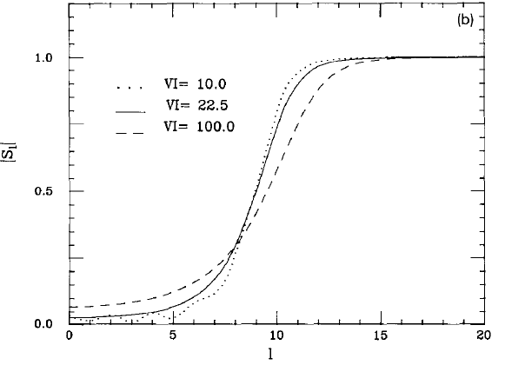
If V(r) = 0 ⇨ No scattering ⇨ S_{l} = 1 ⇨ δ_{l} = 0
V(r) real ⇨ |S_{l}| = 1 ⇨ δ_{l} real
V(r) complex ⇨ |S_{l}| < 1 ⇨ δ_{l} complex
For very large l ⇨ |S_{l}| →1

Slide 21
Incoming wave
Scattered wave
The total asyntotic wave function will be:

Slide 22
The optical potential

Slide 23
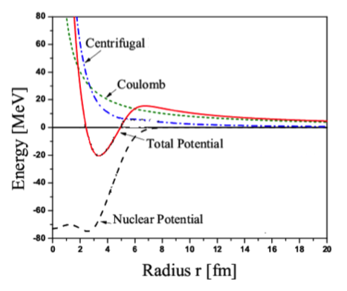
The Optical Potential: V_{tot}(r)=V_{C}(r)+V_{l}(r)+U(R)+V_{SO}(r)
V(r)+iW(r)
repulsives
attractives
Woods-Saxon potential

Slide 24
The nuclear potential can described by a Woods-Saxon shape
to mimic the density distribution in nuclei
real
imaginary
V(r)
R₀
r
a

Slide 25
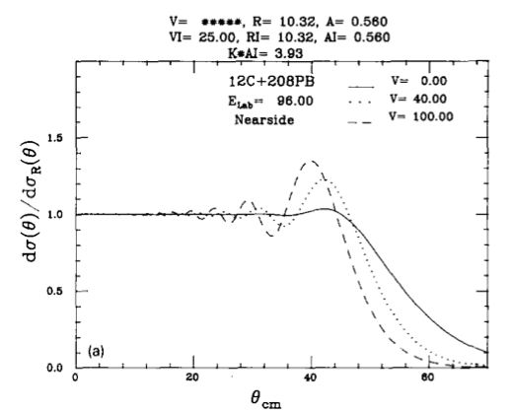
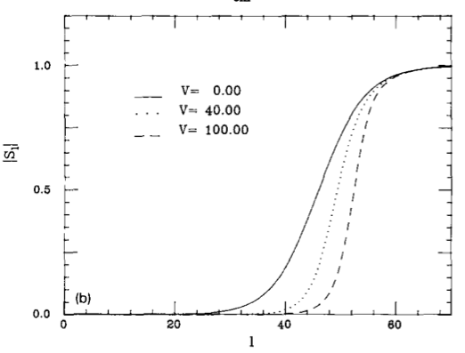
The nuclear potential is described by a Woods-Saxon shape
to mimic the density distribution in nuclei
real
imaginary
In order to reproduce the data a multiparameter fit of the experimental data needs to be performed: V₀,R₀,a,V_{i},R_{i},a_{i}
The three potentials used in the calculations differ only in the depth of the real potential.
Unexpectedly increasing the real part increases absorption since it increases f_{N}(θ) and thus the Coulomb-nuclear interference

Slide 26
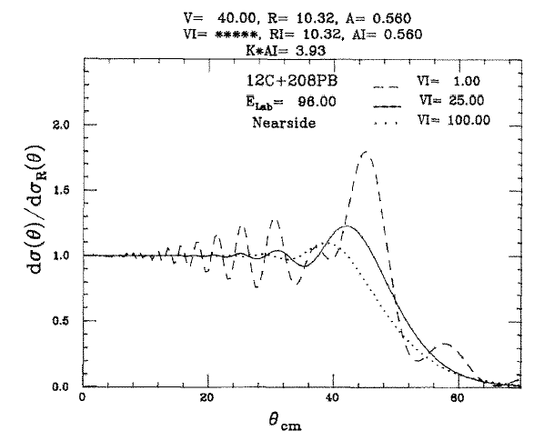
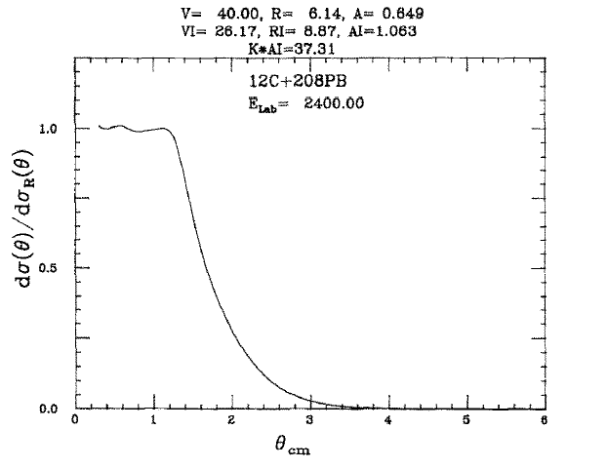
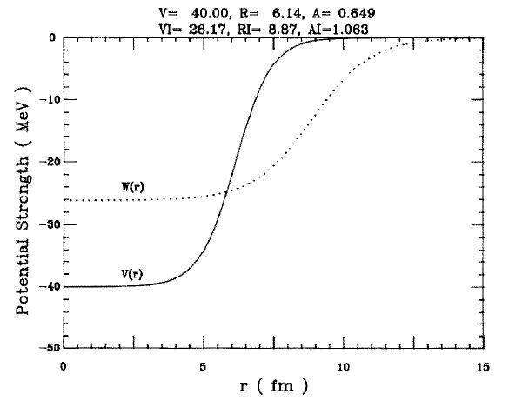
The nuclear potential is described by a Woods-Saxon shape
to mimic the density distribution in nuclei
Imaginary potential extends far outside the range of the real potential, and so strongly suppresses the nuclear amplitude relative to the Coulomb one.
The three potentials used in the calculations differ only in the depth of the imaginary potential.

Slide 27
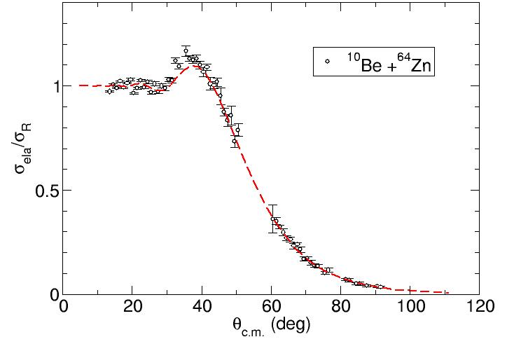
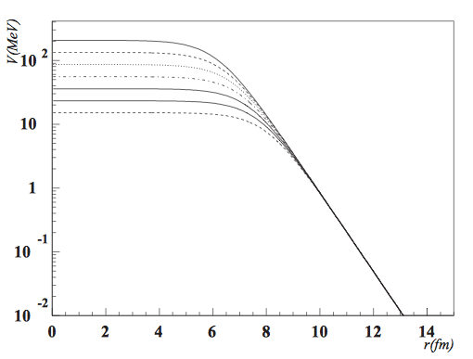
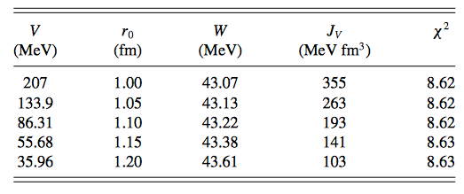
Ambiguity of optical potentials
Elastic scattering probes the nuclear surface → different potentials having the same tail give the same angular distribution. This is the so called Igo ambiguity of the optical potential
For Woods-Saxon potential the condition for equality of long range tail can be expressed as:
Igo ambiguity
G. Igo, Phys. Rev. Lett. 1, 72 (1958)

Slide 28
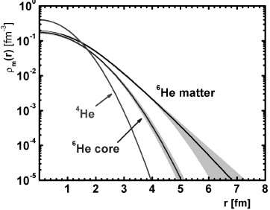
Folding potential
G.Stachler and W.G.Love Phys Rep. 55(1979)183
Within the folding model the real part of the optical potential is obtained by averaging an appropriate interaction over the matter distribution within nucleon and colliding ion (single folding) or within the two colliding ions (double folding).
Single folding potential used in nucleon-Nucleus scattering:
ν_{nN}(s)
r₂
R
nucleon (1)
Single folding potential
real
nucleon-Nucleus interaction
phenomenological derived from nucleon-Nucleus scattering
derived from realistic
nucleon-nucleon force
Target (2)
Nucleus matter density distribution

Slide 29
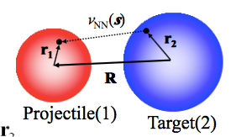
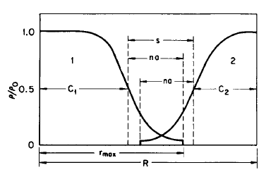
Folding potential
G.Stachler and W.G.Love Phys Rep. 55(1979)183
Within the folding model the real part of the optical potential is obtained by averaging an appropriate N-N interaction over the matter distribution within nucleon and colliding ion (single folding) or within the two colliding ions (double folding).
projectile and target densities (frozen densities assumption)
interaction
s=R+r₂-r₁
Double folding potential
real
Nuclear density distribution
The total nuclear potential is: V_{N}(R)= V_{F}(R)+iW(R)
phenomenological imaginary potential to represent absorption.
In some cases V_{F} is renormalised (NxV_{F}) to account for effects not considered in the model
Notes:
If as ν_{NN}(s) is used the the nucleon-nucleon interaction the folding models overpredict the data (NN interaction strongly repulsive at short distance).
ν_{NN}(s) is transformed into an effective interaction (G-matrix) which is based upon a realistic nucleon-nucleon force.

Slide 30
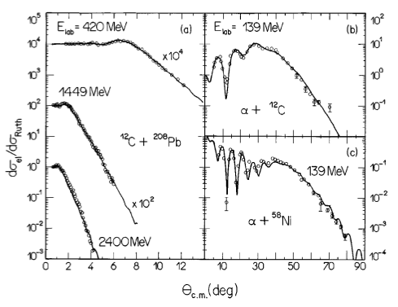
Folding potential: the Saõ Paulo Potential
L. C. Chamon, D. Pereira, and M. S. Hussein Phys. Rev. Lett. 79(1997)5218
Folding potential
Relative velocity between nuclei
Zero-range approx.
V(R)= V_{N}(R,E) +i W(R)
Imaginary part can be a W-S potential or with the same shape of V_{F}
W=N_{I}V_{F}
The real part is “parameter free”
Notes:
the range of the effective nucleon-nucleon interaction is negligible in comparison with the diffuseness of the nuclear densities: zero-range approach,

Slide 31
Are these potentials sufficient to reproduce all available data?

Slide 32
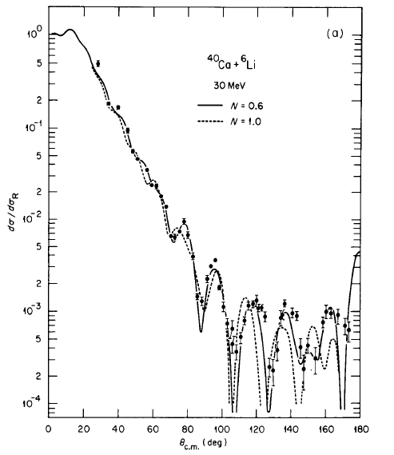
Renormalisation of Folding Potential
V_{F} works for many systems in a wide range of energies however it does not always works.
For reactions induced by weakly-bound nuclei V_{F} needs renormalisation i.e. a reduction of its strength → V=NV_{F}
⁴⁰Ca+⁶Li
V = 0.6 V_{F}
G.R. Stachler and W. Love PHYS. REP. 55 (1979) 183
Notes:
Large imaginary a is required >0.6 fm

Slide 33
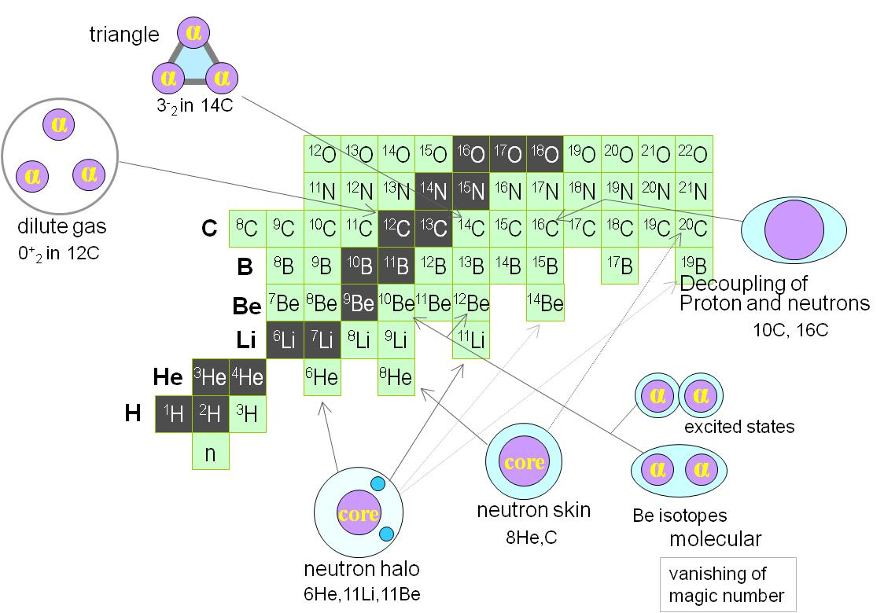
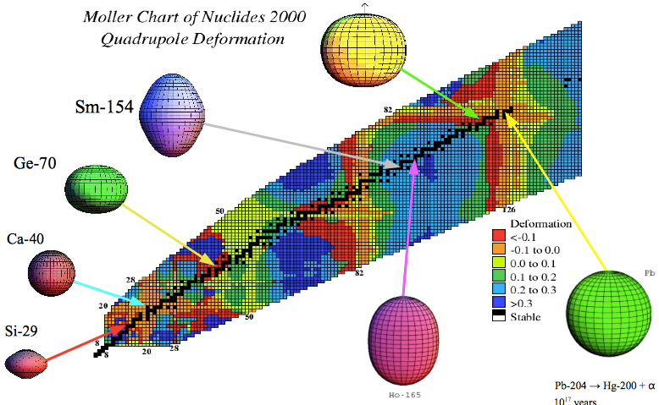
Nuclei are not marbles, they have an internal structure and this can be very “EXOTIC”
The way they interacts depends upon their structure

Slide 34
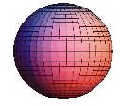
Coupling between relative motion and the internal structure or other reaction processes has to be considered
The effective Optical Potential does not take these effects into account
Channel coupling: while nuclei are moving excitation of intrinsic states may occur as well as exchanges of nucleons.
T***
T**
T*
T
g.s.
The exact solution to the problem requires solving an infinite set of coupled Schrödinger eq.

Slide 35
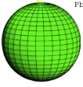
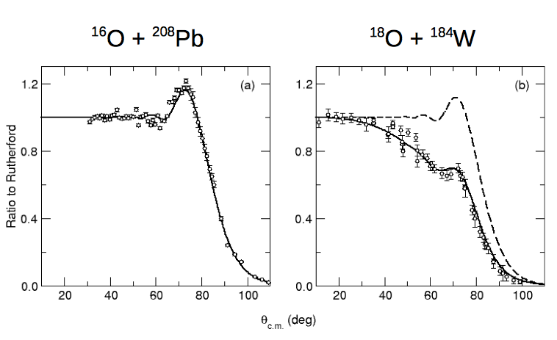
Effects of channel coupling in elastic scattering
¹⁸O+¹⁸⁴W shows reduction of elastic cross-section in the coulomb-nuclear interference region due to absorptive effects due to Coulomb excitation (long range-Coulombs field excite states in the deformed target).

Slide 36
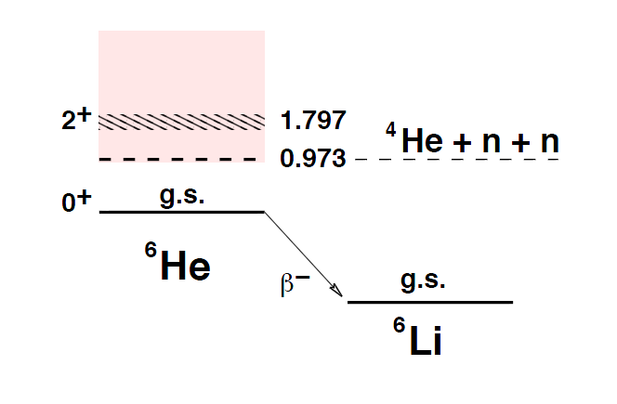
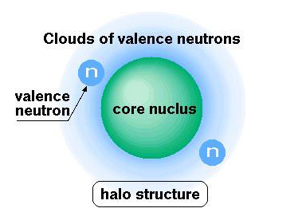
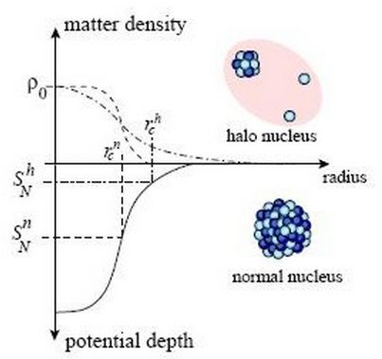
Nuclear halos
Nuclear halo is a threshold effect that may appear if the nucleus is very weakly-bound (0.1-1 MeV)
V_{p}
Halo appears if the valence nucleon(s) are in a s or p state near threshold;
Due to the low binding energy valence nucleon(s) can tunnel through and spend some time away from the core. This time is given by Heisenberg principle Δt≤ћ/2ΔE.
Halo nuclei easily break-up

Slide 37
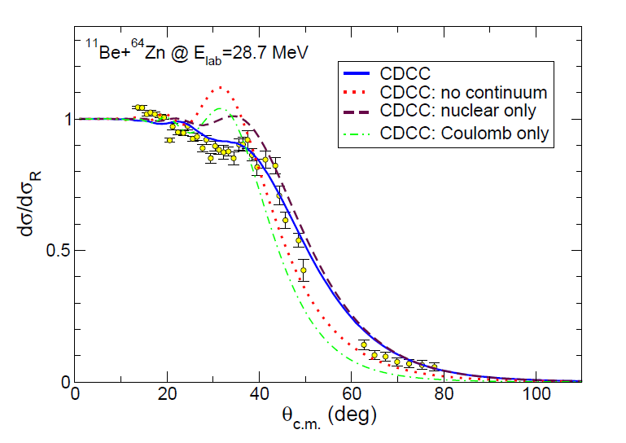
Halo vs normal nuclei
Excitation to the continuum
(break-up channel)
Effects of coupling with break-up channel
G.S.
A. Di Pietro et al. Phys. Rev. C 85, 054607 (2012)

Slide 38
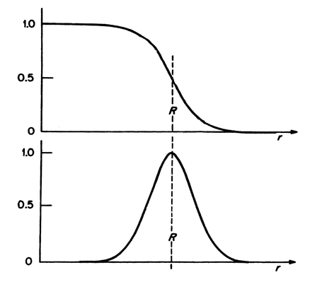
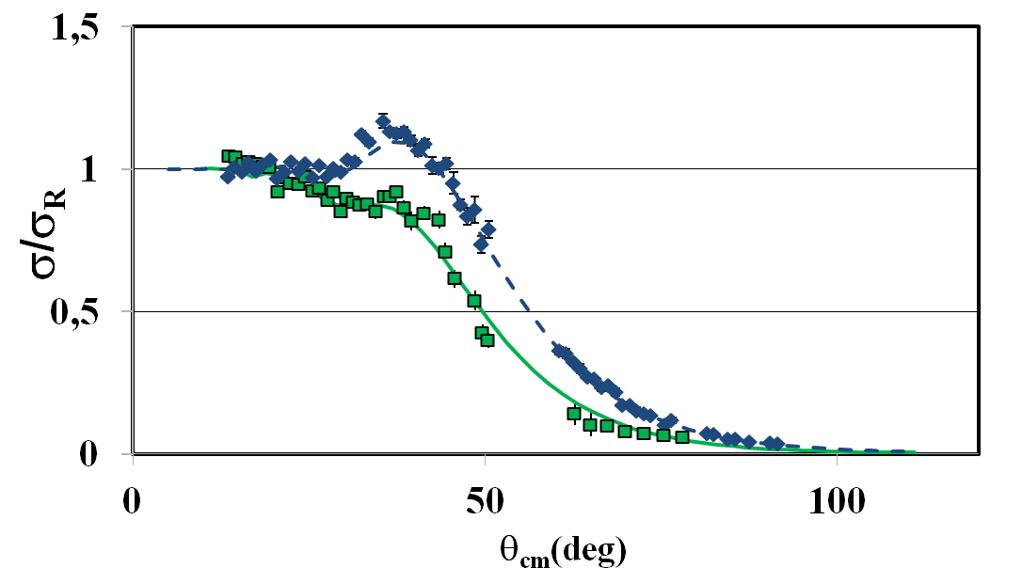
How to mimic coupling effects into Optical Model?
Dynamic Polarisation Potential ΔU_{p}(r)
U(r)=V(r)+ iW(r)+ΔU_{p}(r)
The simplest ΔU_{p}(r) is a surface potential. ΔU_{p}(r) is generally a complex potential.
Normal nucleus
Halo nucleus
¹⁰Be+⁶⁴Zn
¹¹Be+⁶⁴Zn
Surface given by a Woods-Saxon derivative
A. Di Pietro et al. Phys. Rev. Lett. 105,022701(2010)
volume potential responsible for the core-target interaction obtained from the ¹⁰Be+⁶⁴Zn elastic scattering fit of Woods-Saxon type
the surface DPP with very large diffuseness: ai= 3.5 fm responsible for halo-target interaction (similar result found in A.Bonaccrso NPA 706(2002)322)

Slide 39
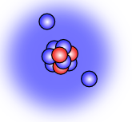
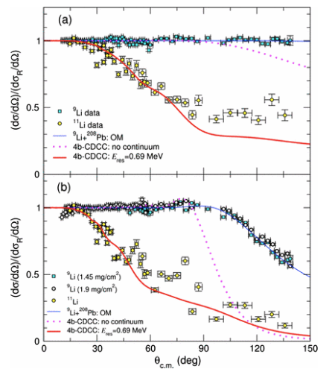
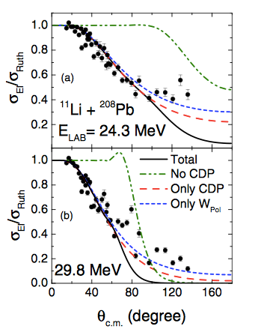
Presence of strong Coulomb-potential and intrinsic dipole strength
⁹Li+²⁰⁸Pb
¹¹Li+²⁰⁸Pb
⁴He,
Normal nucleus
Normal nucleus
Halo nucleus
Halo nucleus
L. Acosta et al PHYS. REV. C 84, 044604 (2011)
A.M.Moro lctures at Summer Triumf Institute
J.P. Fernandez-Garcia et al. Phys.Rev. C 92, 014604 (2015)
M.Cubero et al.,PRL 109, 262701 (2012)
Elastic strongly suppressed at all angles due to coupling with the break-up channel
Long range DPP due to dipole-Coulomb excitation

Slide 40
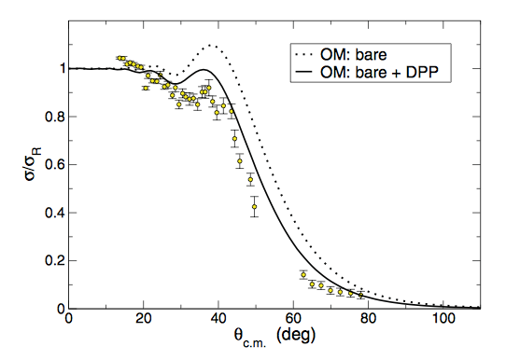
Presence weak Coulomb-potential and intrinsic dipole excitations
¹¹Be+⁶⁴Zn
Coulomb-dipole polarisation potential does not fully reproduce the data. Long-range nuclear potential important in this case.
A. Di Pietro et al. Phys. Rev. C 85, 054607(2012)

Slide 41
Energy dependence of Optical Potential

Slide 42
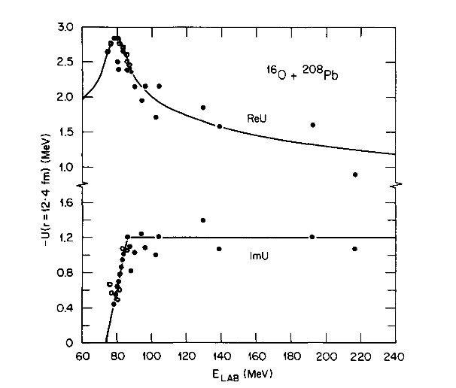
Threshold anomaly: energy dependence of Optical Potential depths
Re U
Im U
G. Satchler Phys. Rep. 199 (1991)147
There is a strong energy dependence of the Optical Potentials at E_{c.m.} near the top of Coulomb barrier (V_{B}). Need to introduce an attractive DPP which is generated by coupling effects.

Slide 43
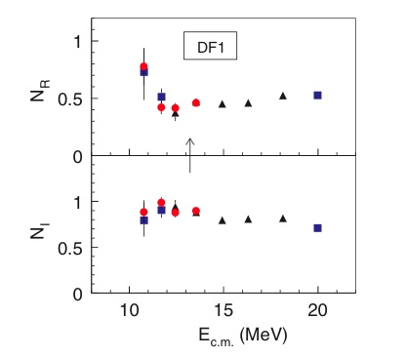
As for halo nuclei for weakly bound non-halo coupling to break-up channel important. This changes the sign of the DPP and changes the threshold anomaly effect
Energy dependence of depth of Folding potential
⁶Li+⁶⁴Zn
G.S.
M.Zadro et al.: Phys. Rev. C80,064610,(2009)
Absence of usual Threshold Anomaly in O.P. observed for many systems in collisions involving weakly bound nuclei.
Repulsive DPP due to coupling with the break-up→ break-up threshold anomaly

Slide 44
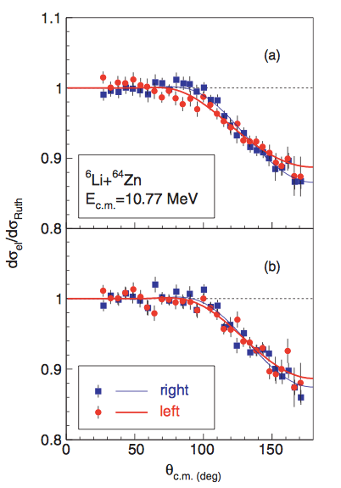
In order to deduce reliable Optical Potentials from elastic scattering around the Coulomb barrier very accurate experiments have to be performed
M.Zadro et al.: Phys. Rev. C80,064610,(2009)
Same angular distribution measured at the opposite side of the beam axis

Slide 45
There are different ways nuclei can interact:
•Elastic scattering: A+B→ A+ B
•Inelastic scattering: A+B→ A*+ B or A+B→ A+ B* or A+B→ A*+ B*
•Transfer or rearrangement reactions: A+B → C+D (nucleons are exchanged between projectile and target)
–Pickup (remove nucleon(s) from the target)
–Stripping (add nucleon(s) to the target)
–charge exchange (exchange p to n or n to p e.g. ¹¹B+¹⁸O →¹¹Be+¹⁸F)
–knock-out
•Break-up: A+B→ A+x+X or y+Y+
•Fusion reactions:
–Beam and target fuse (completely or incompletely)
–High excitation energies and angular momenta are achieved, the resulting compound nucleus “evaporate” particles and gamma rays to remove energy
Optical Model; Coupled Channel (CC)
DWBA; Coupled Reaction Channel (CRC)
DWBA transfer to continuum; CDCC
Optical Model to calculate T_{l}
To some extent to describe theoretically all these processes one needs the knowledge of the Optical potential

Slide 47
Total reaction cross-section:
Optical theorem for uncharged particles:
Optical theorem for charged particles:
for θ=0
In the presence of strong absorption:
σ_{abs}
θ

