Slide 1

Hadron Polarimetry at an EIC
Haixin Huang
E.C. Aschenauer
Electron Ion Collider - eRHIC

Slide 2
Lets learn from RHIC
RHIC the world’s only polarized hadron collider
Absolute Polarimeter (H-jet)
pC Polarimeters (2/ring)
Siberian Snakes
CEC / LEReC
e-Lens
RHIC
PHENIX
STAR
Local IR Polarimeters
Siberian Snakes
Spin Rotators
Local IR Polarimeters
Pol. Proton Source
500 μA, 400 μs
LINAC
Solenoid Snake
BOOSTER
AGS
200 MeV Polarimeter
Warm Snake
AC Dipole
pC Polarimeter
Cold
Snake

Slide 3
Concept for Hadron Polarimetry
Polarized hydrogen Jet Polarimeter (HJet)
  Source of absolute polarization (normalization of other polarimeters)
  Slow (low rates ⇒ needs looong time to get precise measurements)
Proton-Carbon Polarimeter (pC)
  Very fast and high precision ⇒ main polarization monitoring tool
  Measures polarization profile and lifetime
  Needs to be normalized to HJet
IR Local Polarimeters
  Defines spin direction and degree of rotation in experimental area
All of these systems are critical for polarization measurements and monitoring at RHIC
→ Will be critical for EIC

Slide 4
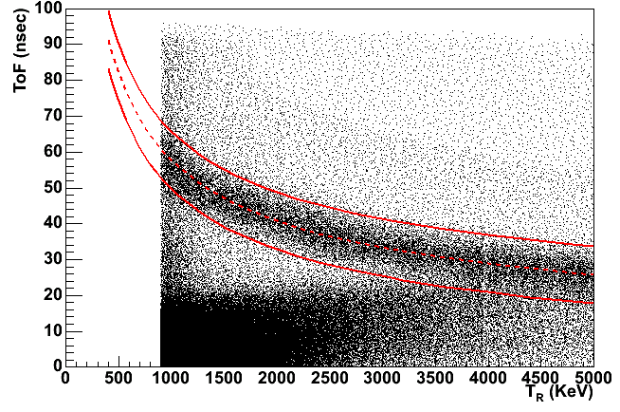
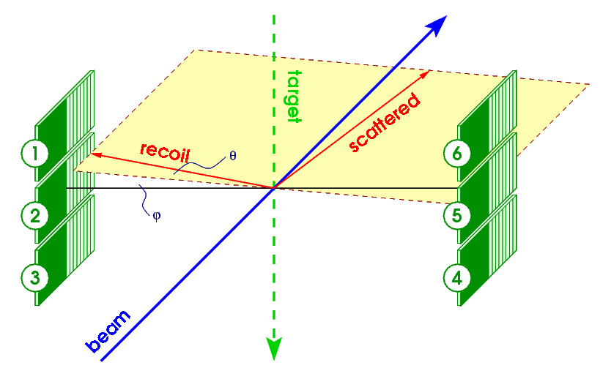
Polarized H-Jet Polarimeter
Forward scattered
proton
RHIC proton beam
H-jet target
recoil proton
Left-right asymmetry in elastic scattering due to spin-orbit interaction:
interaction between (electric or strong) field of one proton and magnetic moment associated with the spin of the other proton
Array of Si detectors measures T_{R} & ToF of recoil proton.
Channel # corresponds to recoil angle θ_{R}.
Correlations (T_{R} & ToF ) and (T_{R} & θ_{R} ) → the elastic process
Beam and target are both protons:
P_{target} from Breit Rabi Polarimeter
ToF vs. Energy

Slide 5
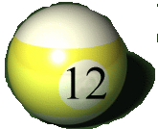
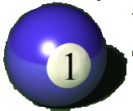
P-Carbon Polarimeter:
Left-right asymmetry in elastic scattering due to spin-orbit interaction:
interaction between (electric or strong) field of Carbon and magnetic moment associated with the spin of the proton
Carbon target
Polarized proton
Recoil carbon
6
1
Ultra thin Carbon ribbon Target
(5 mg/cm²)
Target Scan mode (20-30 sec per measurement)
Stat. precision 2-3%
Polarization profile, both vertical and horizontal
Normalized to H-Jet measurements over many fills (with precision <3%)
18cm
5
2
Si strip detectors
(TOF, E_{C})
4
3

Slide 6
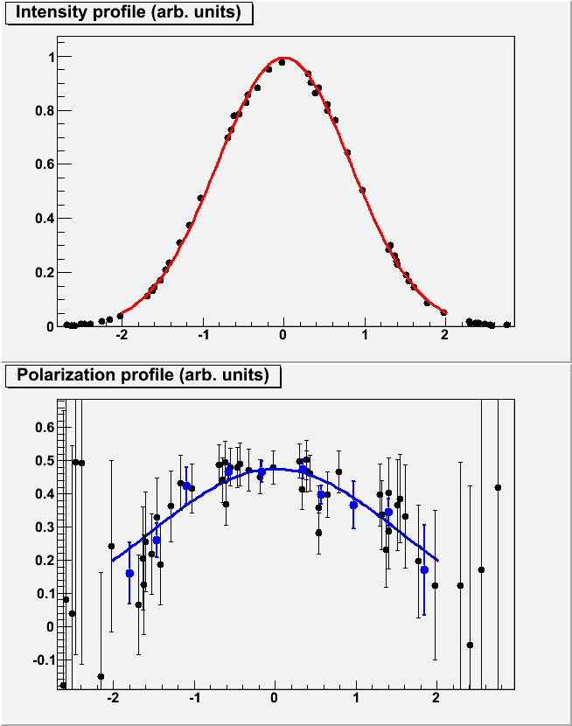
Polarization Profile
If polarization changes across the beam, the average polarization seen by Polarimeters and Experiments (in beam collision) is different
H-Jet
pC
Scan C target across the beam
in both X and Y directions
Collider
Experiments
Intensity
Polarization
~1 mm
6-7 mm
x=x₀
Target Position
P_{1,2}(x,y) – polarization profile, I_{1,2}(x,y) – intensity profile, for beam #1 and #2

Slide 7
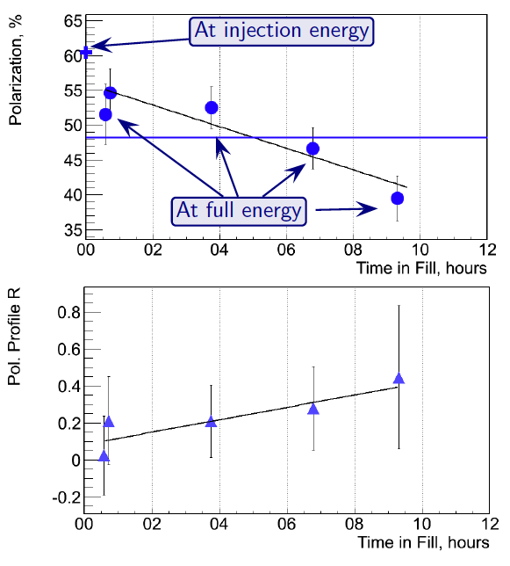
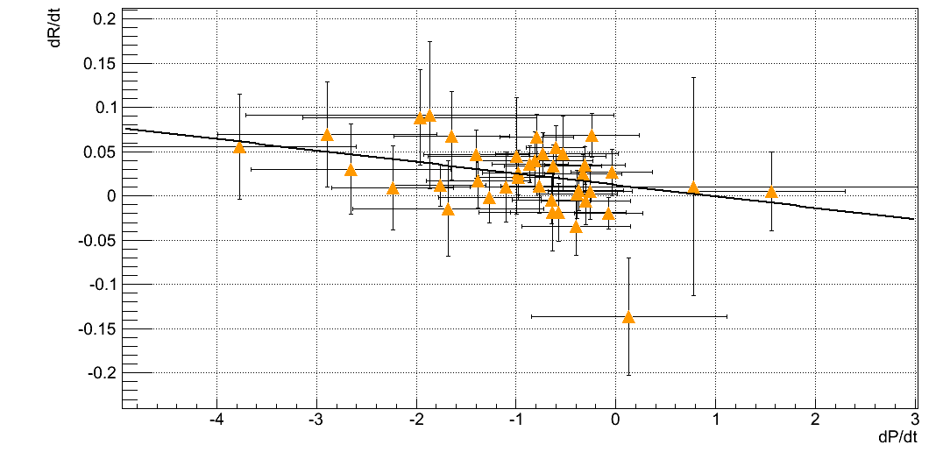
RHIC Hadron Polarisation
Account for
beam polarization decay through fill → P(t)=P₀exp(-t/τ_{p})
growth of beam polarization profile R through fill
pCarbon
polarimeter
Collider
Experiments
x=x₀
Result:
Have achieved 1.1% for Blue and 1.4% for Yellow beam for 2017
Biggest contributions
background correction for Hjet (1.0% blue / 1.3% yellow)
pC/H-Jet normalization 0.5%
correlation of
dP/dt to dR/dt
for all 2012 fills
at 250 GeV
Polarization lifetime has consequences for physics analysis
different physics triggers mix over fill
  → different <P>

Slide 8
Improvements to RHIC Hadron Polarimetry
H-Jet:
  continuously monitor molecular fraction in the H-Jet
    till 2017 dominant systematics uncertainty
      → Recent research indicates a significant reduction
pC-polarimeters
  find longer lifetime and more homogeneous target material for the pC polarimeters
    Need to account for higher peak currents in EIC → RF pickup
  can we calibrate energy scale of pC closer to E_{kin}(C) in CNI
  alternative detector technology for Si-detectors to detect C?
  norm. emittance of eRHIC hadron beam → x-y polarization profile
    RHIC: 2.5/2.5 e⁻⁶ m
    eRHIC: 3.6/1.7 μm with cooling 5.9/1.8 μm no cooling
polarized Deuterium and He-3 polarimetry will be challenging
  How does D and He-3 break up impact the polarization measurement
  would H-jet + D / H-jet + He-3 beam work as absolute polarimeter?
local polarimetry @ eRHIC
  integrate a pC-polarimeter between the spin-rotators
    Magnitude of asymmetry directly proportional to longitudinal polarization

Slide 9
Reasons why polarization / Current CAN vary from Bunch to Bunch
Polarisation:
Hadrons in a storage ring:
source instabilities
Beam-Beam effects
bunch-to-bunch emittance variation, Characteristic scale can be seen from AGS
RHIC polarization profile variation for different bunches after acceleration
leptons in a storage ring:
Beam-Beam effects
source instabilities
Current:
Hadrons & leptons in a storage ring:
Variations in transfer efficiency from pre-accelerator to main ring
→ beam-beam interaction is important, it affects the bunch lifetime during the store

Slide 10

eRHIC-h is not RHIC:
Hadron beam parameters:
→ Higher bunch frequency
eRHIC: # of bunches 330 —> bunch spacing 34.8 ns —> bunch length 5 cm with cooling (7cm without cooling)
# of bunches 1320 —> bunch spacing 8.7 ns —> bunch length 7.5 cm with cooling
beam current / bunch: eRHIC: 1.5 10¹¹ RHIC: 2.4 10¹¹
If 2 IRs, as strongly endorsed by EIC-UG
eRHIC luminosity will be shared → not all bunches collide at both IRs

Slide 11
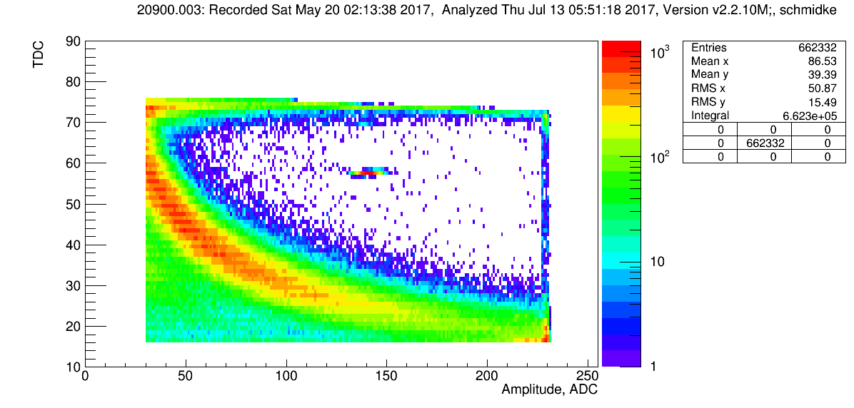
High Collision Frequency Challenge
Scattered Carbon Distribution from RHIC:
E_{kin}, MeV
0.33
0.67
1.0
1.3
1.7
ToF (ns)
65
Pulser
40
width
driven by
detector resolution
width
driven by
bunch length
Background
due to C’
from
collisions
16
Collision related background leaks under the signal “Banana”
→ background gone in empty target runs

Slide 12
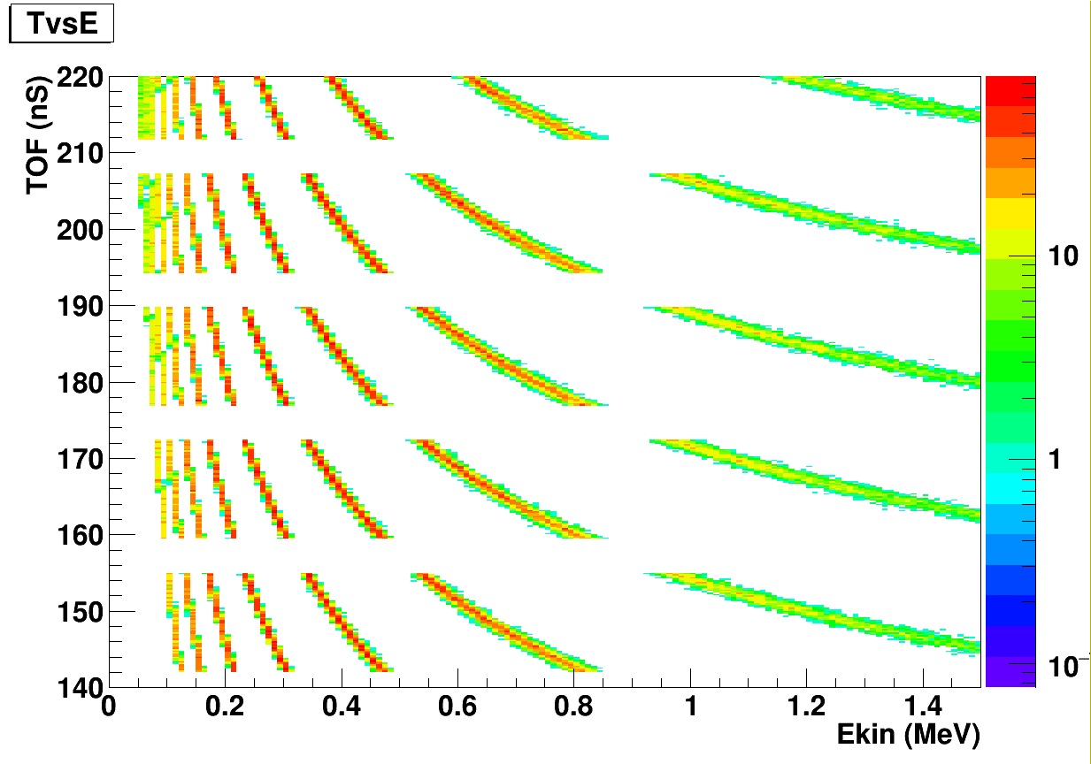
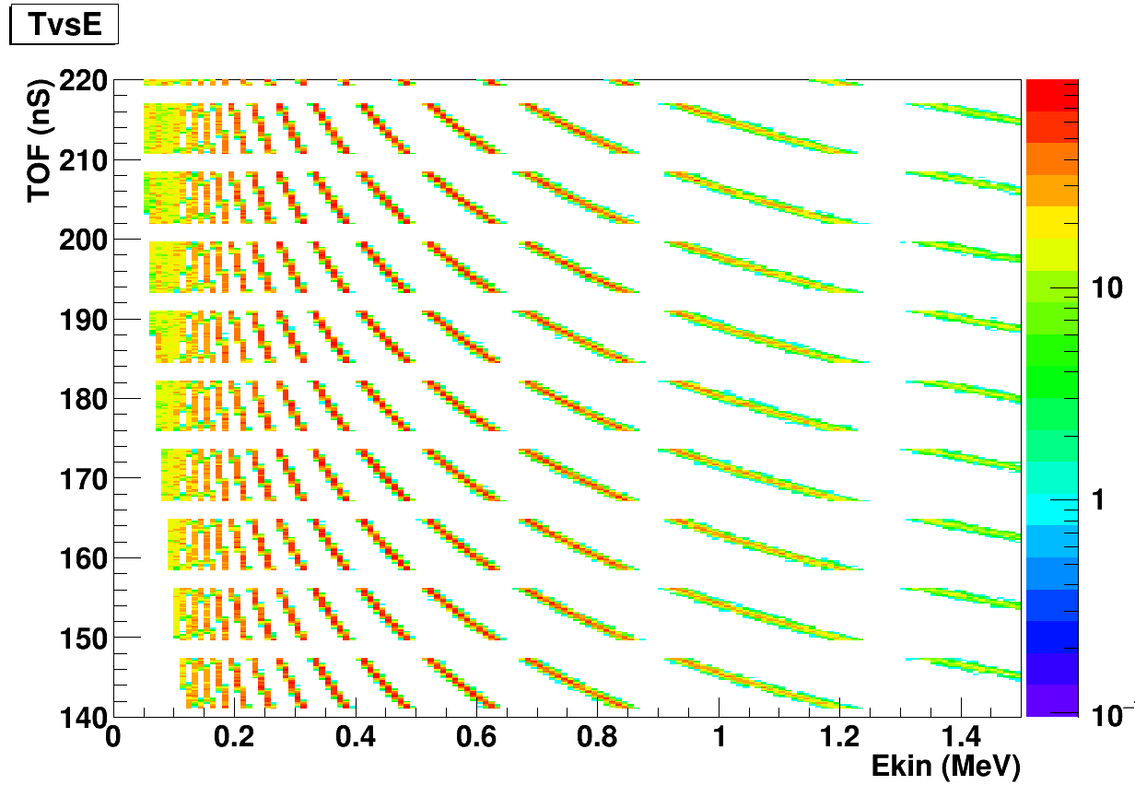
High Collision Frequency Challenge
Signal: vertical-width of ToF vs. E_{kin} will shrink as bunch length shrinks
horizontal width remains the same if the detectors and targets are similar
660 bunches —> bunch spacing 17.4 ns
—> bunch length 13.2 cm
1320 bunches —> bunch spacing 8.7 ns
—> bunch length 6.6 cm
  increased bunch number signal “bananas” overlap at low E_{kin}
  → lose data with highest statistics and high analyzing power
EIC: No background included and no smearing in horizontal due detector energy resolution and energy loss in target
  smearing need to increase lower cut on E_{kin} → lose data with high statistics & high analyzing power
  collision related C’ background
  smears from (N+1)s bunch to Ns bunch and lower → impact on measuring bunch polarization
  → Especially problematic for + / - bunch polarization transitions
  Need to work really hard to make current scheme work

Slide 13
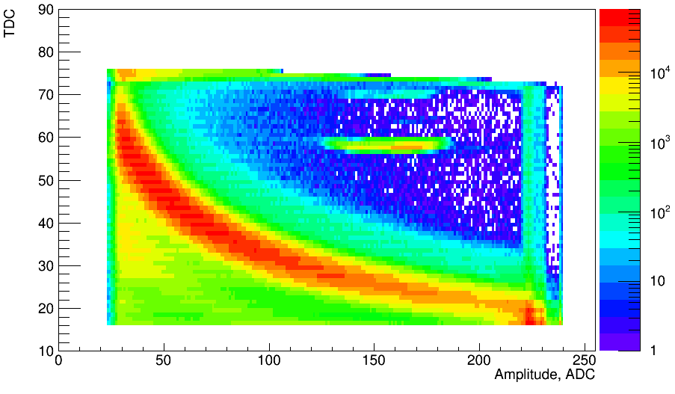
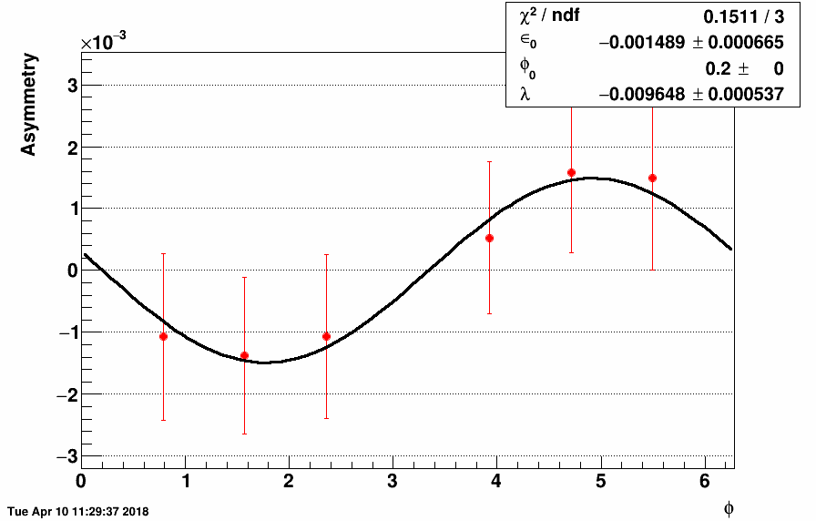
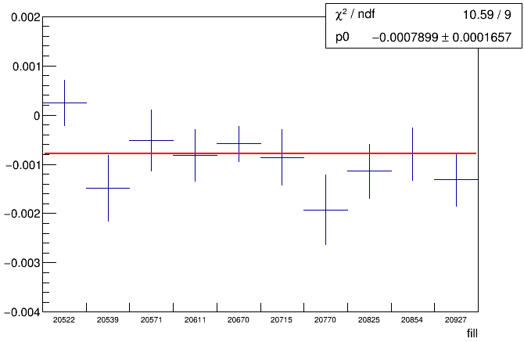
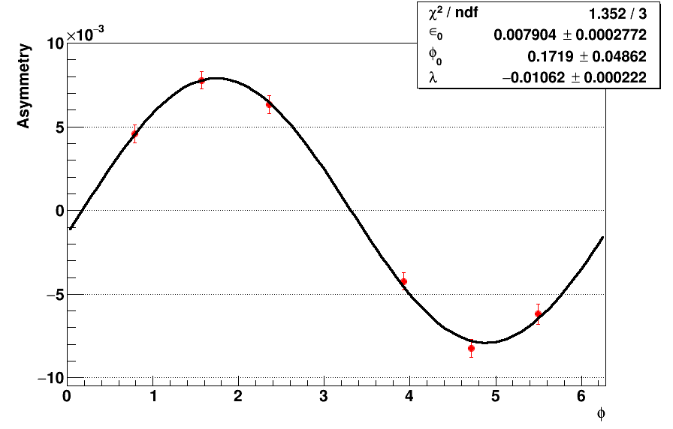
Results on Background Asymmetry
Background Asymmetry
Signal Asymmetry
Need to suppress this background

Slide 14
Next Steps / Mitigations
Need simulations to understand exact origin of collision related C’ background
  → can we reduce / eliminate this background?
    Move detectors closer → reduced ToF → mitigates merging of signal “bananas” at low E_{kin}
      loss of ToF resolution / separation
  can we change detector technology to have better energy and timing resolution
    higher timing resolution Si: 16 ps
  → can we experimentally suppress the background → PID
Can we utilize different techniques to replace pC polarimeters
  Use physics asymmetries:
    A_{N} for π^{+/-} π⁰
    A_{N} for neutrons in p↑A-scattering
    Possible Advantages
      Sometimes larger analyzing power
    Challenges
      Need HI-targets, i.e. Au
      Analyzing power as function of √s
      More spatial needs for polarimeter
      Statistical power → obtain polarization lifetime and the bunch polarization profile

Slide 15
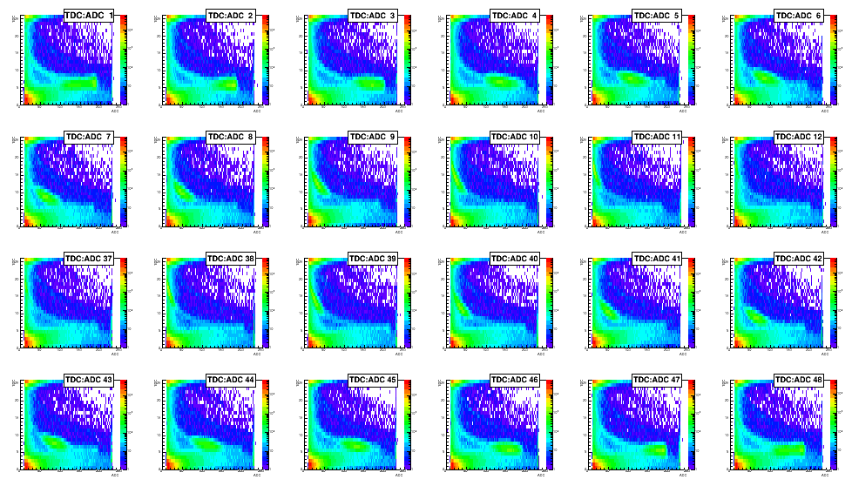
H-jet: details of Measurement from RHIC
Same issue as for pC polarimeter
Collision related background leaks under the signal “Banana”
need to follow similar mitigation strategy
BUT: no alternative absolute polarimeter
All the same problems for a polarized D and He-3 beams
PLUS
what happens if D/He-3-beam particle breaks up during scattering with target?

Slide 16

Let’s get to work

Slide 17


